Slide 1

Unit 0
Getting Started

Slide 2
Unit 0
Getting Started
Lesson 1

Slide 3
English Time Chant
English, (clap) English, (clap)
English (clap) today! (clap, clap)
English, (clap) English, (clap)
Hip, hip, (clap) hooray! (clap, clap)
Notes:
Get students ready to use the English Time chant.
Lead the class in the chant.

Slide 4

Open your books to page 2.
Notes:
Model opening your book to page two and say Open your books to page two.

Slide 5

Hello!
Notes:
Wave and say Hello to the students.
Have students repeat the word and wave at you.

Slide 6
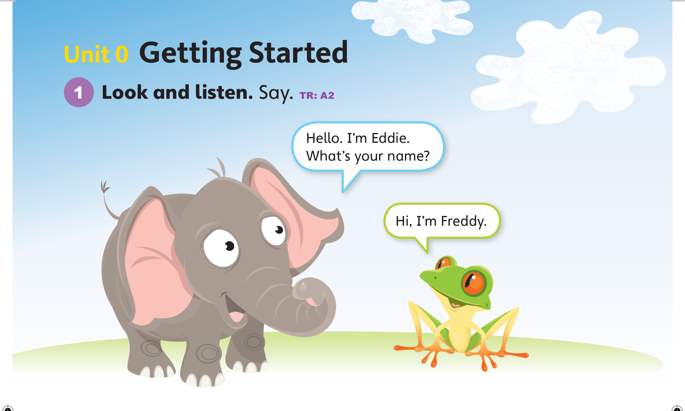

Notes:
Play TR: A2, pausing after the first two lines for students to repeat.
Model the dialogue.

Slide 7
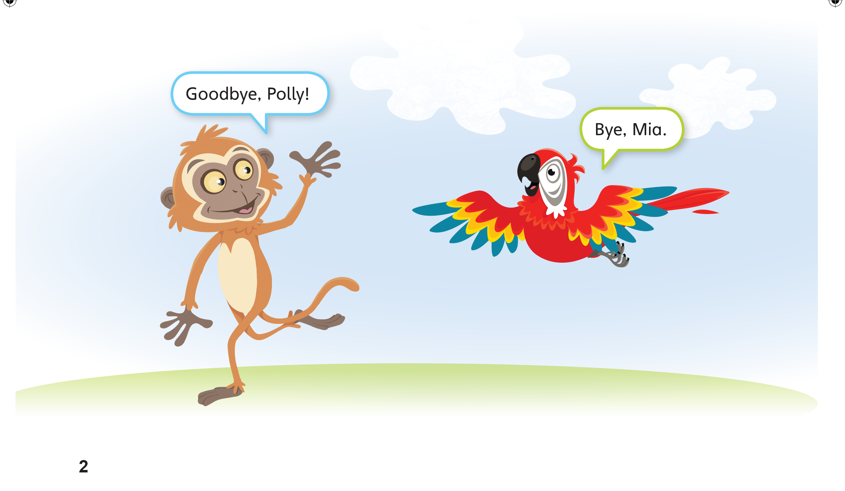
Notes:
Continue playing TR: A2.
Pretend to walk toward the door. Wave and say Goodbye, class!
Come back to the front of the room, and model the dialogue.

Slide 8

Goodbye!
Notes:
Have students repeat the word and wave at you.

Slide 9
Script
TR: A2
Unit 0
Activity 1
Look and listen. Say.
(Elephant) Hello. I’m Eddie. What’s your name?
(Frog) Hi. I’m Freddy.
(Monkey) Goodbye, Polly.
(Parriot) Bye, Mia.
Notes:
Setting the stage
Place students in pairs. Play TR: A2 again, pausing after the second line.
Have students repeat the dialogue with their partners, and then switch roles.

Slide 10
Hello. I’m ____.
What’s your name?
Hi. I’m ____.
Goodbye ____.
Bye ____.
Notes:
Divide the class into two lines. Have the students stand facing one another.
Have students move to the end of their respective lines after each dialogue, so that the next pair can speak.
Continue like this until students have greeted everyone in the other line.
Note: For larger classes, divide students into four lines instead of two.
Go around the room and greet a student with Hello, I’m [Polly]. What’s your name?
Repeat this with a few different students.

Slide 11
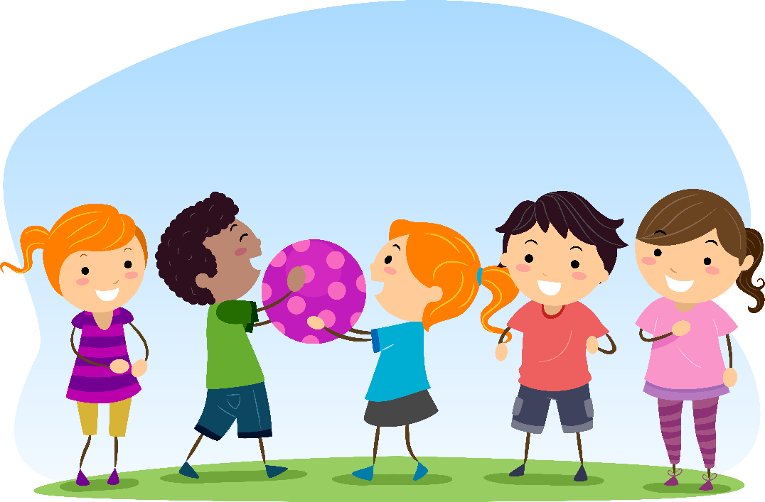
Pass the ball
Notes:
Have students stand in a circle with you.
Finish playing TR: A2.
Hold a ball in your hand, and say Goodbye, class!
Pass the ball to the student on your right, who should say Goodbye! or Bye!
Have students continue passing the ball around the circle until each one has said goodbye.

Slide 12
Goodbye Chant
Good work, class.
Hip hip, hooray!
Goodbye for now.
Have a nice day!
Notes:
Say Good job today class. Now let’s chant.
Lead the class in the Goodbye chant.

Slide 13
Let’s check!
Hello and Goodbye
Notes:
Formative Assessment
Can students greet and say goodbye to one another?
Say Hello or Goodbye to each student and have him or her respond.

Slide 14
Thank you!

Slide 15
Unit 0
Getting Started
Lesson 2

Slide 16
English Time Chant
English, (clap) English, (clap)
English (clap) today! (clap, clap)
English, (clap) English, (clap)
Hip, hip, (clap) hooray! (clap, clap)
Notes:
Get students ready to use the English Time chant.
Lead the class in the chant.

Slide 17
Open your books to page 3.
Notes:
Model opening your book to page two and say Open your books to page three.

Slide 18
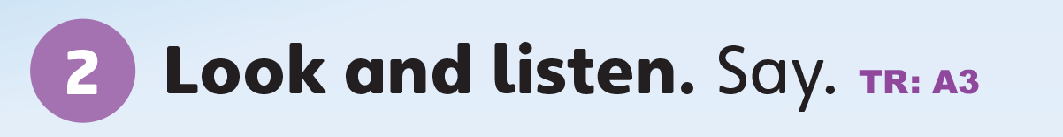
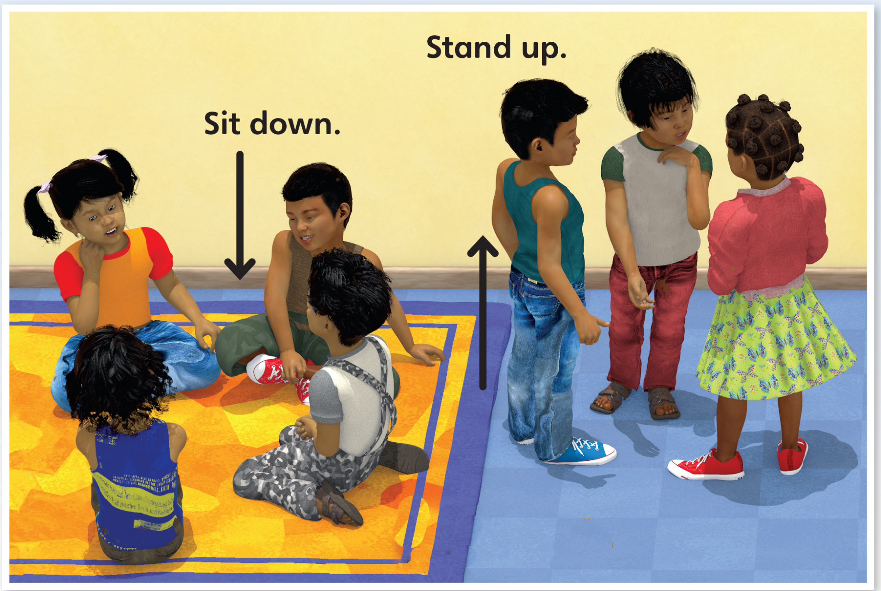
Notes:
Play TR: A3 one time, doing each action as it’s spoken.

Slide 19
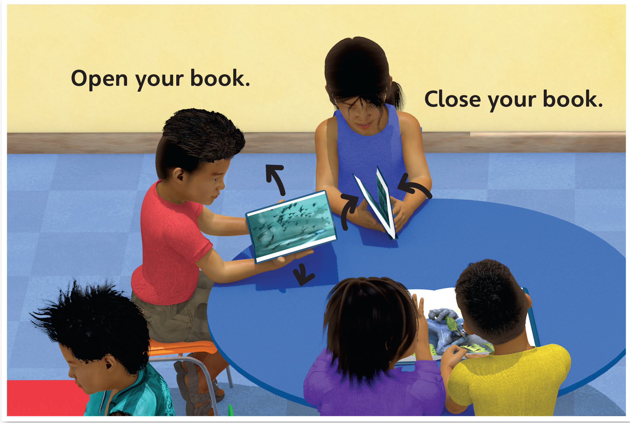
Notes:
Play TR: A3 one time, doing each action as it’s spoken.

Slide 20
Script
TR: A3
Unit 0
Activity 2
Look and listen. Say.
Sit down.
Stand up.
Open your book.
Close your book.
Notes:
Play TR: A3 again, and gesture for students to do the action with you.

Slide 21
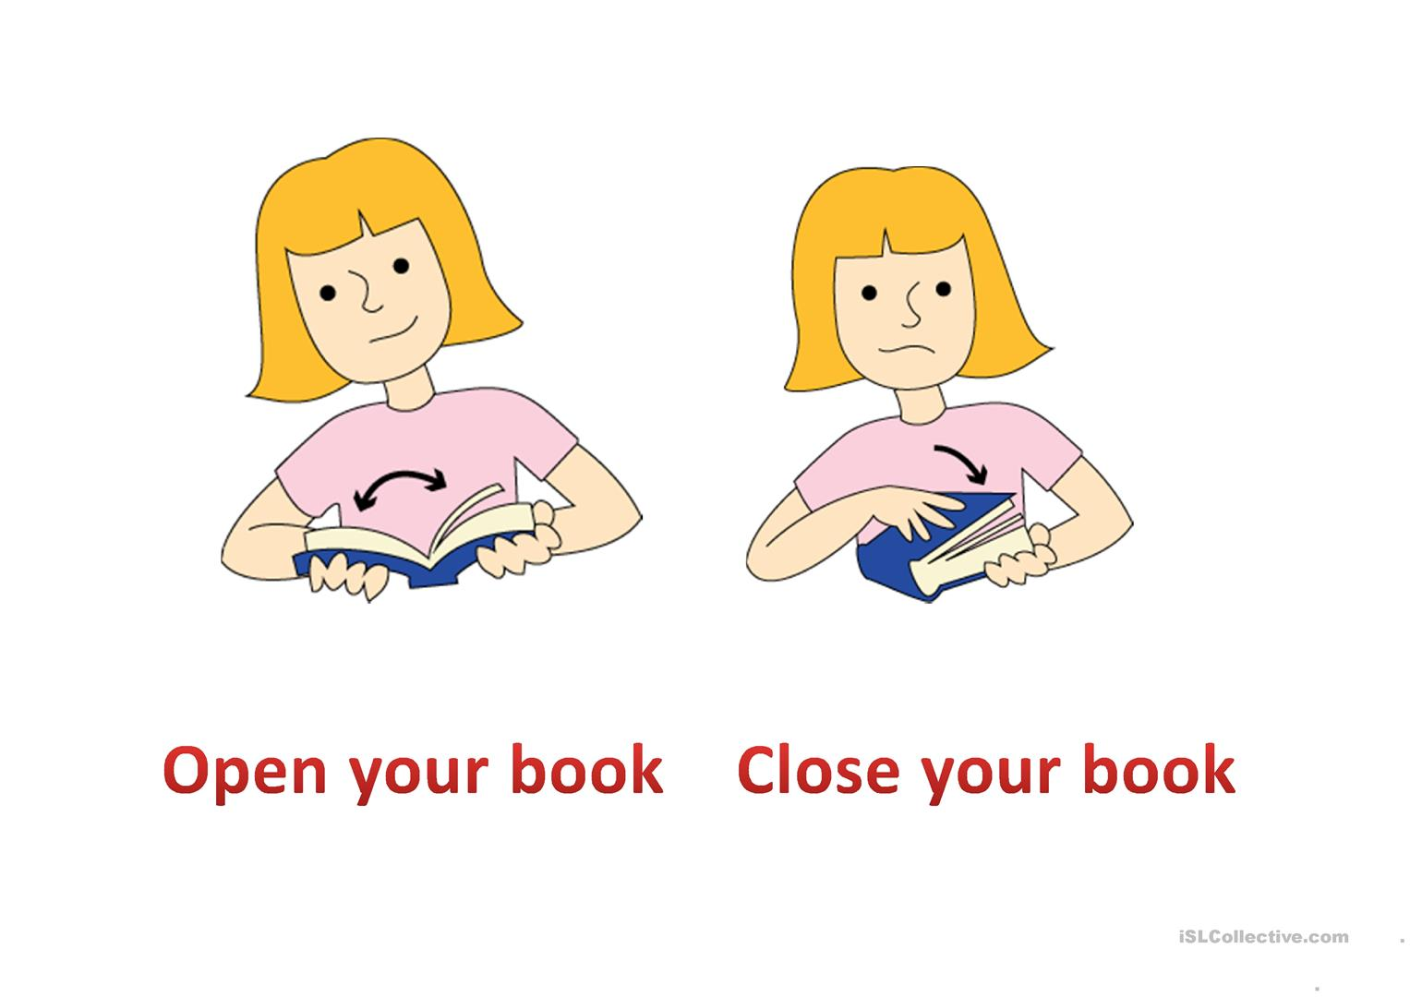
Open your book
Close your book
Notes:
Have students take out their books. Say Open your book
Have students close their books. Say Close your book

Slide 22
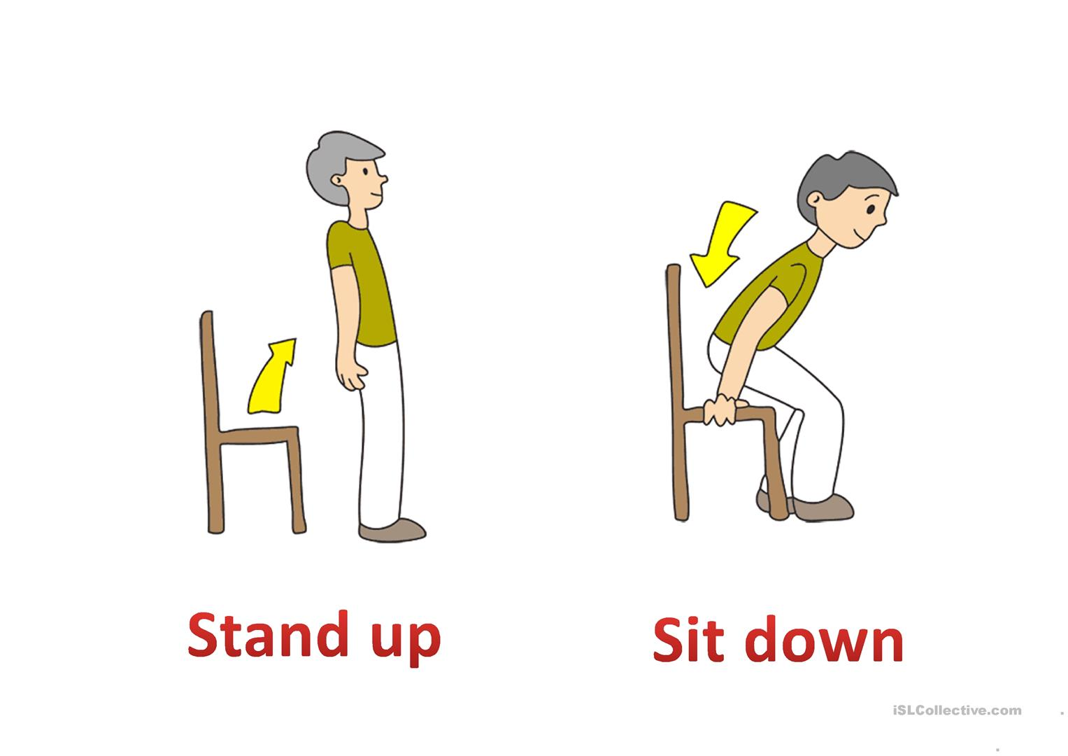
Stand up
Sit down
Notes:
Repeat this with sit down and stand up.

Slide 23
Sit down and open your book.
Notes:
Slowly give two-part directions, such as Sit down and open your book.
Walk around the room to make sure students are following your directions.

Slide 24
Close your book and stand up.
Notes:
Slowly give two-part directions, such as Sit down and open your book.
Walk around the room to make sure students are following your directions.

Slide 25

…
Teacher Says
Notes:
Listening activity
Say Let’s play “Teacher says.”
Say If you hear “Teacher says” then do as the teacher says. If you don’t hear “Teacher says” then don’t do it.
Note: Complicated instructions are difficult. This will require modeling the actions for the students.
Say Teacher says (Nod your head) stand up and stand up.
Say Sit down (Shake your head)
Say Teacher says sit down and sit down.
Do this activity with the students mixing this lesson’s vocabulary with previously learned vocabulary.
Say [Teacher says say hi.]

Slide 26
“Teacher says Stand up.” =
“Stand up.” =
Notes:
Listening activity
Say Let’s play “Teacher says.”
Say If you hear “Teacher says” then do as the teacher says. If you don’t hear “Teacher says” then don’t do it.
Note: Complicated instructions are difficult. This will require modeling the actions for the students.
Say Teacher says (Nod your head) stand up and stand up.
Say Sit down (Shake your head)
Say Teacher says sit down and sit down.
Do this activity with the students mixing this lesson’s vocabulary with previously learned vocabulary.
Say [Teacher says say hi.]

Slide 27
Goodbye Chant
Good work, class.
Hip hip, hooray!
Goodbye for now.
Have a nice day!
Notes:
Say Good job today class. Now let’s chant.
Lead the class in the Goodbye chant.

Slide 28
Let’s check!
Do the action.
Notes:
Can students listen to and respond to classroom instructions?
Say Open your book and Stand up.
Have students respond by doing each action.

Slide 29
Sit down.
Notes:
Can students listen to and respond to classroom instructions?
Say Open your book and Stand up.
Have students respond by doing each action.

Slide 30
Close your book.
Notes:
Can students listen to and respond to classroom instructions?
Say Open your book and Stand up.
Have students respond by doing each action.

Slide 31
Open your book.
Notes:
Can students listen to and respond to classroom instructions?
Say Open your book and Stand up.
Have students respond by doing each action.

Slide 32
Stand up.
Notes:
Can students listen to and respond to classroom instructions?
Say Open your book and Stand up.
Have students respond by doing each action.

Slide 33
Thank you!

Slide 34
Unit 0
Getting Started
Lesson 3

Slide 35
English Time Chant
English, (clap) English, (clap)
English (clap) today! (clap, clap)
English, (clap) English, (clap)
Hip, hip, (clap) hooray! (clap, clap)
Notes:
Get students ready to use the English Time chant.
Lead the class in the chant.

Slide 36
Open your book
Close your book
Notes:
Say Open your books.
Say Close your books.

Slide 37

This is a book.
Notes:
Hold up a book and say This is a book.

Slide 38

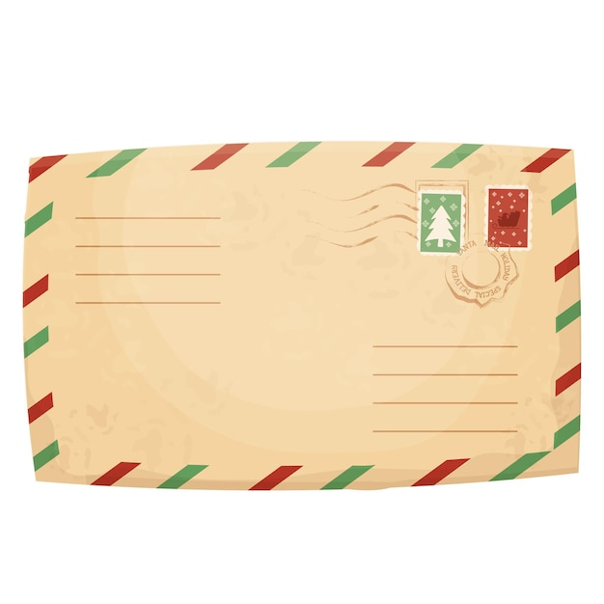
Is this a book?
Yes.
No.
No.
No.
Notes:
Hold each item up, and ask the class Is it a book?

Slide 39


Notes:
Play TR: A4. Point to each item as it is spoken in the audio.

Slide 40
Script
TR: A4
Unit 0
Activity 3
Look and listen. Say.
A book
A red book
A blue book
Notes:
Play TR: A4 again, and have students point to each of the items and say the words.

Slide 41

Is it red?
Is it blue?
No.
Notes:
Hold up a piece of green construction paper. Ask Is it red?
Ask Is it blue?

Slide 42
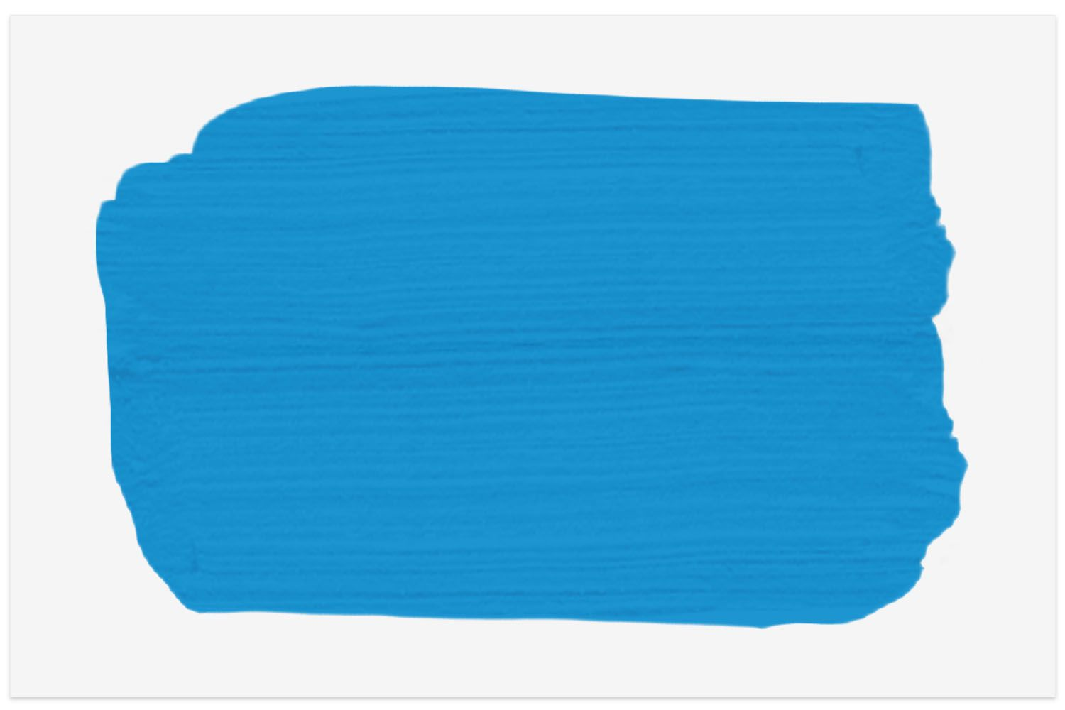
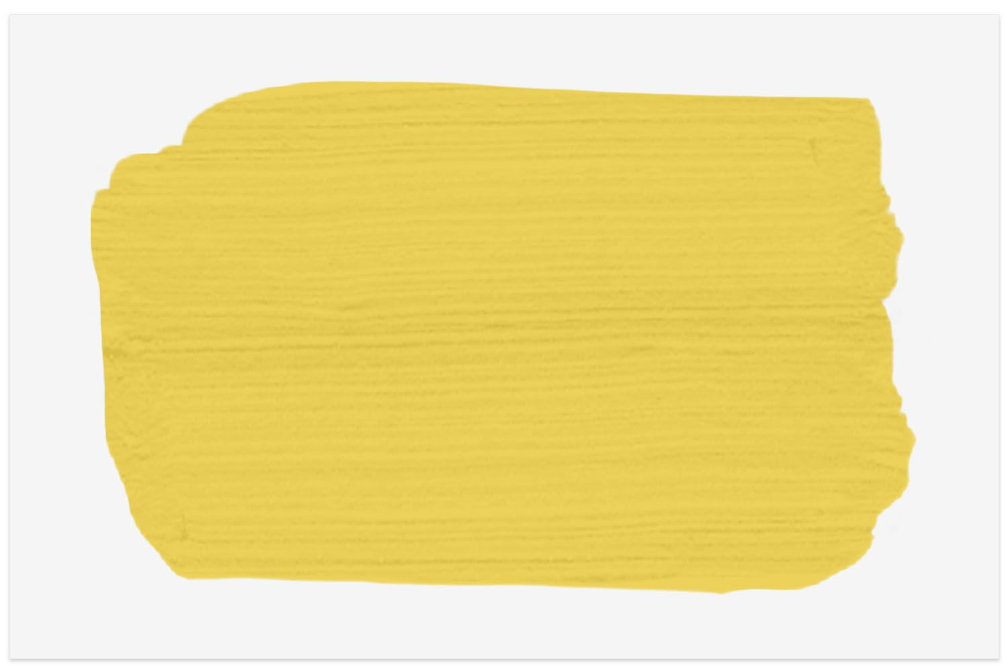
Is it red?
Is it blue?
Yes.
No.
Notes:
Hold up a piece of green construction paper. Ask Is it red?
Ask Is it blue?

Slide 43
Is it red?
Is it blue?
No.
Notes:
Hold up a piece of green construction paper. Ask Is it red?
Ask Is it blue?

Slide 44

Is it red?
Yes.
Notes:
Hold up a piece of green construction paper. Ask Is it red?
Ask Is it blue?

Slide 45
Show me red.
Notes:
Say Show me red.

Slide 46
Show me blue.
Notes:
Say Show me blue.

Slide 47


Notes:
Have them point to each book and say its color.
Once they point to and name each book, have them count the number of red books and the number of blue books.
Model by pointing to the first red book, saying One red book.
Point to the second red book and say Two red books.

Slide 48
Red dot, blue dot
Notes:
Model folding a piece of paper into four sections.
Say Look.
Model making one red dot and one blue dot on the paper.
Say Listen and have students mark their papers with dots according to the following instructions:
Point and say Section 1: One red dot, one blue dot – Section 2: One red dot, two blue dots – Section 3: Two red dots, one blue dot – Section 4: Two red dots, two blue dots

Slide 49
Goodbye Chant
Good work, class.
Hip hip, hooray!
Goodbye for now.
Have a nice day!
Notes:
Say Good job today class. Now let’s chant.
Lead the class in the Goodbye chant.

Slide 50
Let’s check!
Tell me the color.
Notes:
Can students identify and name things that are red and blue?
Point to red and blue objects. Have students name the colors they see.

Slide 51
Thank you!

Slide 52
Unit 0
Getting Started
Lesson 4

Slide 53
English Time Chant
English, (clap) English, (clap)
English (clap) today! (clap, clap)
English, (clap) English, (clap)
Hip, hip, (clap) hooray! (clap, clap)
Notes:
Get students ready to use the English Time chant.
Lead the class in the chant.

Slide 54
Open your book.
Close your book.
Notes:
Say Open your books.
Say Close your books.

Slide 55
Is this a book?
Yes, it’s a book.
No.
No.
No.
Notes:
Hold each item up, and ask the class Is it a book?

Slide 56

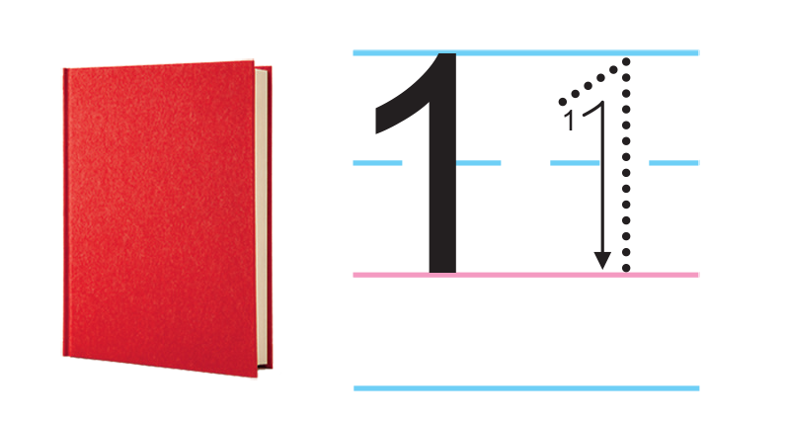
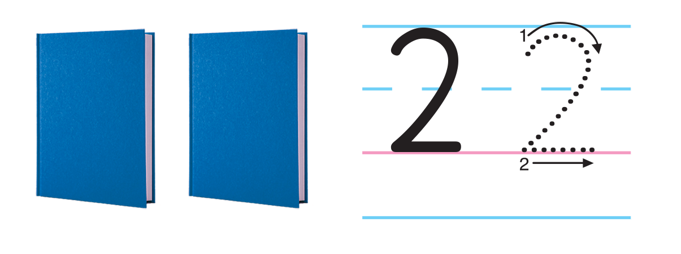
Notes:
Play TR: A5. Have students count the books as they listen, then say the number and item.
Pause the audio after number 1. Model tracing the number 1 on p. 4.
Walk around the room to make sure students are holding their pencils correctly.
Continue playing TR: A5 and have students do the same for number 2.

Slide 57
Script
TR: A5
Unit 0
Activity 5
Look and listen. Say. Trace.
One
One red book
Two
Two blue books
Notes:
Play TR: A5. Have students count the books as they listen, then say the number and item.
Pause the audio after number 1. Model tracing the number 1 on p. 4.
Walk around the room to make sure students are holding their pencils correctly.
Continue playing TR: A5 and have students do the same for number 2.

Slide 58
Guess the color
?
Notes:
Hang pieces of construction paper in the following pattern: red, blue, red, blue, red.
Point to each paper as you say One red, one blue, one red, one blue, one red
Hold up both red and blue construction paper, and ask What’s next—red or blue?

Slide 59
Guess the color
?
Notes:
Change the pattern to be blue, blue, red, blue, blue. Say Two blue, one red, two blue…What’s next—red or blue? (red)

Slide 60

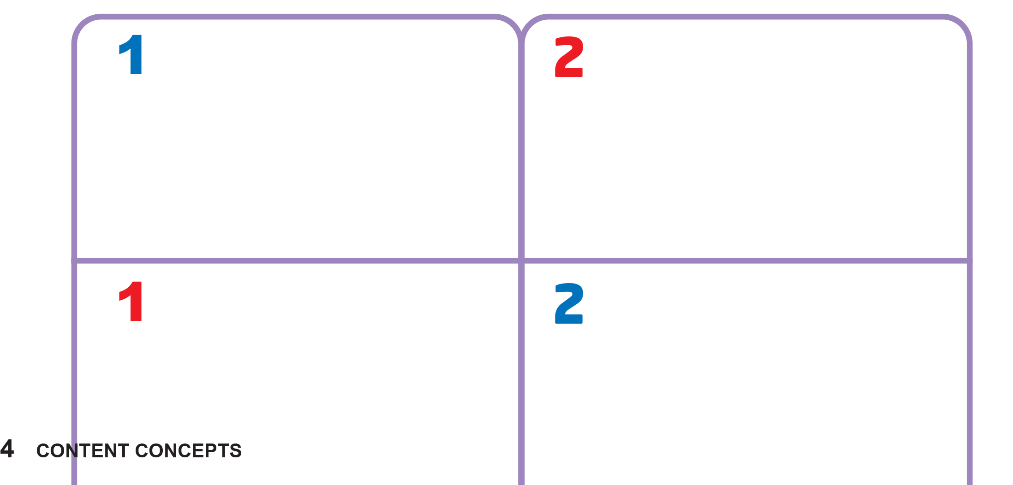
Notes:
Say Let’s do a sticker activity!
Show students the Unit 0 stickers in the back of their books. Play TR: A6 and pause after the first item.
Find the sticker of one blue book. Point to the box on the bottom left-hand side of the chart on p. 4, and ask One or two?
Ask Red or blue?
Say That’s not right!
Then, point to the box on the top left-hand side of the chart, and ask One or two?
Ask Red or blue?
Hold the sticker up to the box, and nod. Say Yes, that’s right. Place the sticker in the box.
Continue playing TR: A6, and have students complete the rest of the activity.

Slide 61
Script
TR: A6
Unit 0
Activity 6
Look and listen. Stick.
One blue book
Two red books
One red book
Two blue books
Notes:
Continue playing TR: A6, and have students complete the rest of the activity.

Slide 62
Goodbye Chant
Good work, class.
Hip hip, hooray!
Goodbye for now.
Have a nice day!
Notes:
Say Good job today class. Now let’s chant.
Lead the class in the Goodbye chant.

Slide 63
Let’s check!
How many?
Notes:
Can students count to find the quantity of items?
Hold up one book, and have students tell you the number. Repeat this with two books.

Slide 64
Thank you!

Slide 65
Unit 0
Getting Started
Lesson 5

Slide 66
English Time Chant
English, (clap) English, (clap)
English (clap) today! (clap, clap)
English, (clap) English, (clap)
Hip, hip, (clap) hooray! (clap, clap)
Notes:
Get students ready to use the English Time chant.
Lead the class in the chant.

Slide 67
Hello!
Hi!
Notes:
Set a timer or a stopwatch for two minutes.
Have students go around the room, saying Hello or Hi to as many classmates as possible before the timer goes off.

Slide 68
Stand up
Sit down
Notes:
Have students sit on the floor with a partner, back-to-back. Have them link arms. Then, say Stand up. See if students can stand up without separating their arms. Then, say Sit down and see if they can stay together while sitting down. Repeat this a few times to see if students can do it more easily with practice.

Slide 69

The sound of English
Hello!
Notes:
Say Let’s learn about some sounds of English.
Make a few sounds, such as /b/, /p/, /h/ to help students understand the phrase sounds of English.
Say H says /h/. Hello has the /h/ sound.
Say the /h/ sound again.
Ask Which has /h/—hi or book?

Slide 70

Which has the /h/ sound?
BOOK
HI
✓
Notes:
Ask Which has /h/—hi or book?

Slide 71
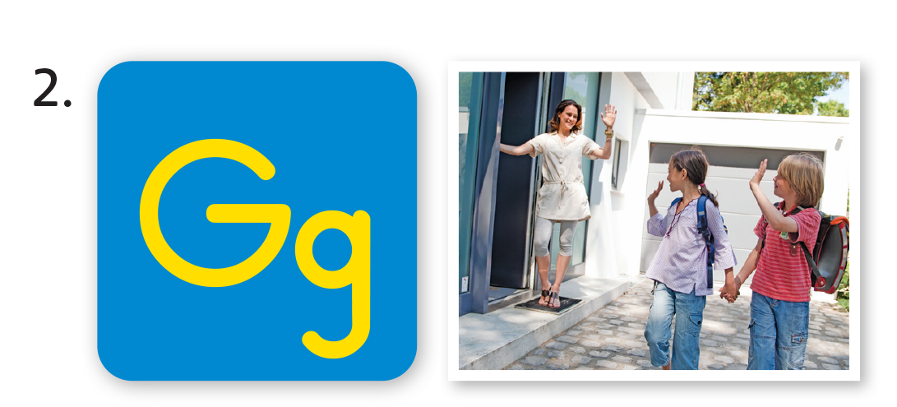
The sound of English
Goodbye!
Notes:
Say G says /g/. Goodbye has the /g/ sound.
Say the /g/ sound again.

Slide 72
Which has the /g/ sound?
TO
GO
✓
Notes:
Ask Which has /g/—to or go?

Slide 73
Notes:
Draw h in dotted outline on the board.
Say Let’s trace the letter h.
Model tracing over the outline. Then say Look at the word and picture for hello again. Listen to the sound /h/ and use your pencil to trace the letter h.
Play TR: A8 and stop after hello.
Make sure students trace h two times for hello. Then call on volunteers to say the word aloud.

Slide 74
Script
TR: A7 and A8
Unit 0
Activity 7
Look and say. Then listen again and trace.
H
/h/
Hello
Notes:
Play TR: A8 and stop after hello.
Make sure students trace h two times for hello. Then call on volunteers to say the word aloud.

Slide 75
Goodbye Chant
Good work, class.
Hip hip, hooray!
Goodbye for now.
Have a nice day!
Notes:
Say Good job today class. Now let’s chant.
Lead the class in the Goodbye chant.

Slide 76
Let’s check!
Does it have
/h/ or /g/?
Notes:
Can students identify and make the /h/ and /g/ sounds?
Make the /h/ sound. Say Hello and Goodbye.
Have students raise their hand when they hear /h/.
Make the /g/ and say the words again.

Slide 77
Thank you!

Slide 78
Unit 0
Getting Started
Lesson 5

Slide 79
English Time Chant
English, (clap) English, (clap)
English (clap) today! (clap, clap)
English, (clap) English, (clap)
Hip, hip, (clap) hooray! (clap, clap)
Notes:
Get students ready to use the English Time chant.
Lead the class in the chant.

Slide 80
Hello!
Hi!
Notes:
Set a timer or a stopwatch for two minutes.
Have students go around the room, saying Hello or Hi to as many classmates as possible before the timer goes off.

Slide 81
Stand up
Sit down
Notes:
Have students sit on the floor with a partner, back-to-back. Have them link arms. Then, say Stand up. See if students can stand up without separating their arms. Then, say Sit down and see if they can stay together while sitting down. Repeat this a few times to see if students can do it more easily with practice.

Slide 82
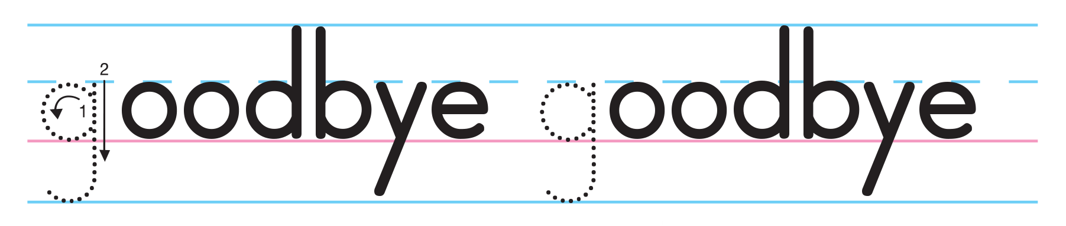
Notes:
Say Let’s learn about some sounds of English.
Play TR: A7. Pause after each word for students to repeat sound and word.
Say Goodbye has the /g/ sound.
Repeat the word, emphasizing the /g/.
Ask Which word has the /g/ sound? To or go?

Slide 83
Script
TR: A7 and A8
Unit 0
Activity 7
Look and say. Then listen again and trace.
G
/g/
Goodbye
Notes:
Play TR: A7. Pause after each word for students to repeat sound and word.

Slide 84
Which has the /g/ sound?
TO
GO
✓
Notes:
Ask Which has /g/—to or go?

Slide 85
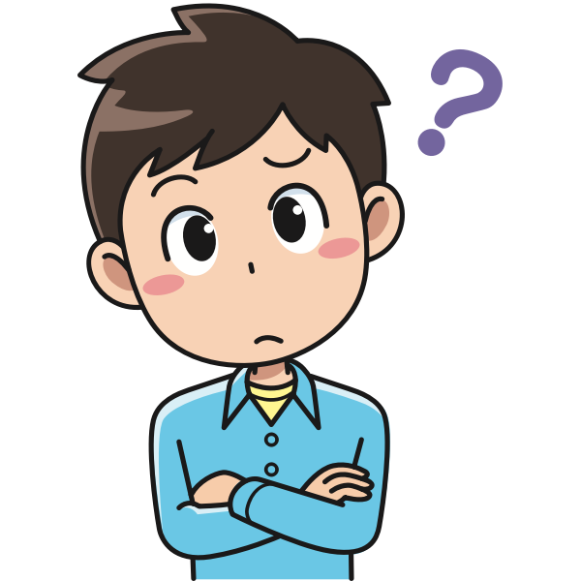
Do you have /h/ or /g/ in your name?
Notes:
Ask Which has /g/—to or go?

Slide 86
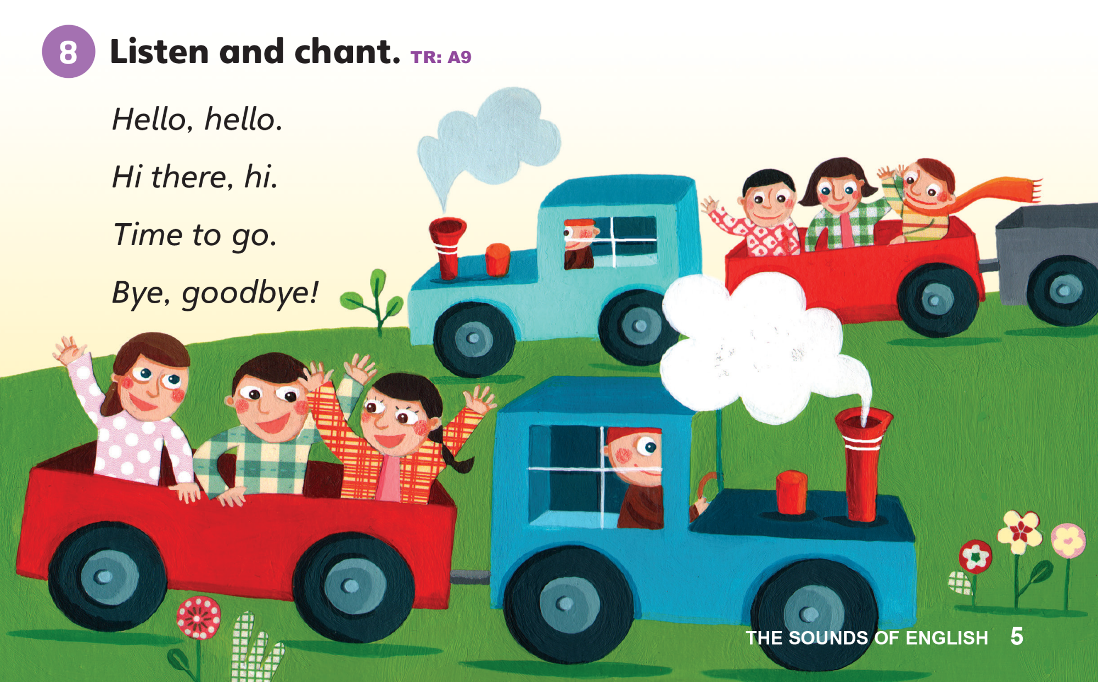
Notes:
Say Let’s listen to a chant.
Play TR: A9 two times.
Have students listen to the chant. Then, say the chant.
Walk among the class, waving hello to students for the first two lines. Then, walk back toward the front of the room, waving goodbye during the second two lines.

Slide 87
Script
TR: A9
Unit 0
Activity 8
Look and say. Then listen again and trace.
Hello, hello
Hi there, hi
Time to go
Bye, goodbye
Notes:
Play TR: A9 a third time.
This time, have students stand up next to a partner. Have them wave hello during the first two lines of the chant.
Then, have them turn away from each other and start to walk away from their partners during the last two lines.
Divide the class into two groups.
Have them say the chant as a call-and-response.
Have the first group say the first and third lines, and the second group respond.

Slide 88
Let’s check!
Does it have
/h/ or /g/?
Notes:
Can students identify and make the /h/ and /g/ sounds?
Make the /h/ sound. Say Hello and Goodbye.
Have students raise their hand when they hear /h/.
Make the /g/ and say the words again.

Slide 89
Thank you!

