Slide 1

Unit 1
My School
Bringing the world to the classroom and the classroom to life
ELTNGL.COM
A PART OF CENGAGE

Slide 2
Students in Ustupu Island, Panama

Slide 3

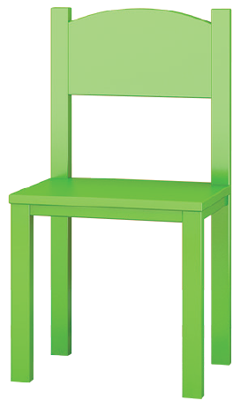
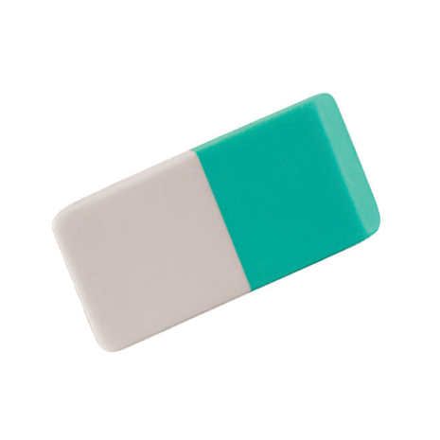

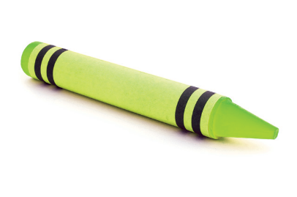
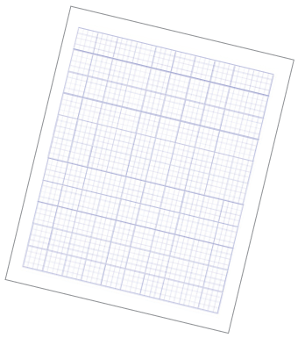


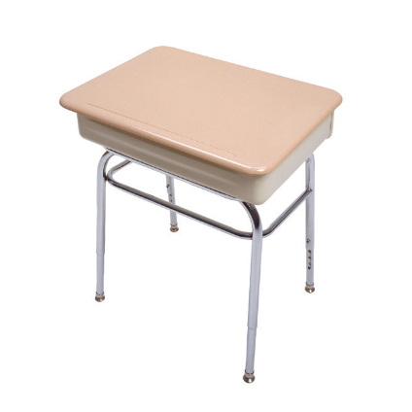
1 Listen and point.
TR: A10
2 Point and say.
a book
a chair
a crayon
an eraser
paper
a pencil
a pen
a desk
U1 pp. 8-9

Slide 4
Script
TR: A10
Unit 1
Activity 1
Listen and point.
a book a book
a chair a chair
a crayon a crayon
an eraser an eraser
paper paper
a pencil a pencil
a pen a pen
a desk a desk

Slide 5
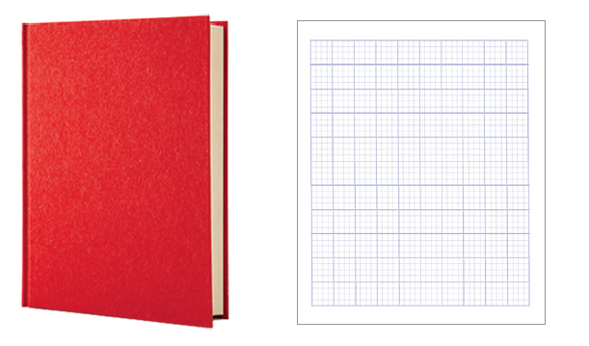

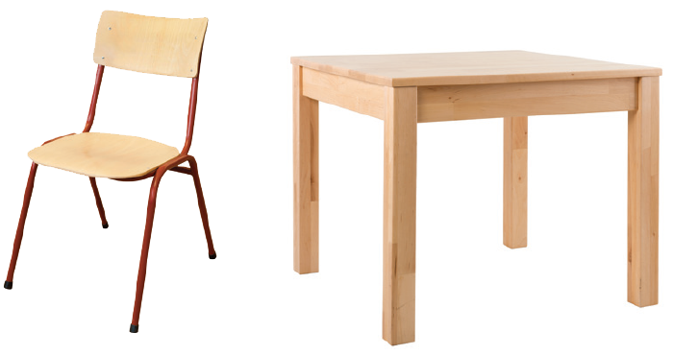
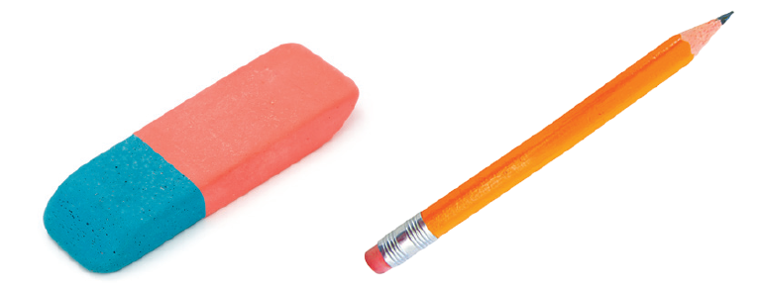
3 Listen and circle.
TR: A11
1.
2.
3.
4.
U1 p. 10

Slide 6
Script
TR: A11
Activity 3
Listen and circle.
1. paper
2. a crayon
3. a desk
4. a pencil

Slide 7
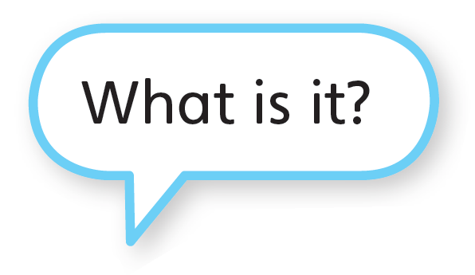


4 Listen and say. Talk.
TR: A12
U1 p. 10

Slide 8
Script
TR: A12
Activity 4
Listen and say. Talk.
(Parrot) What is it?
(Frog) It’s a chair.

Slide 9

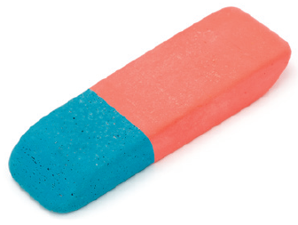
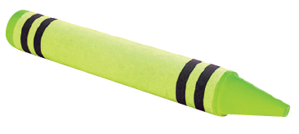
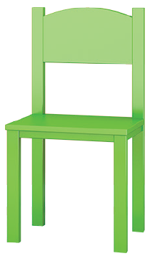

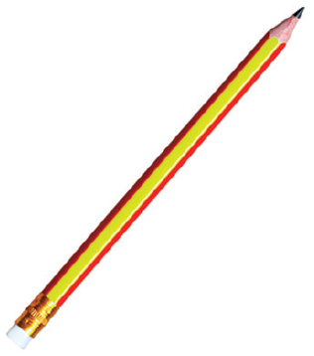
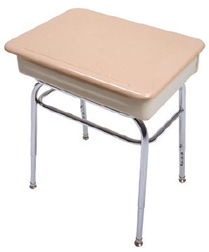
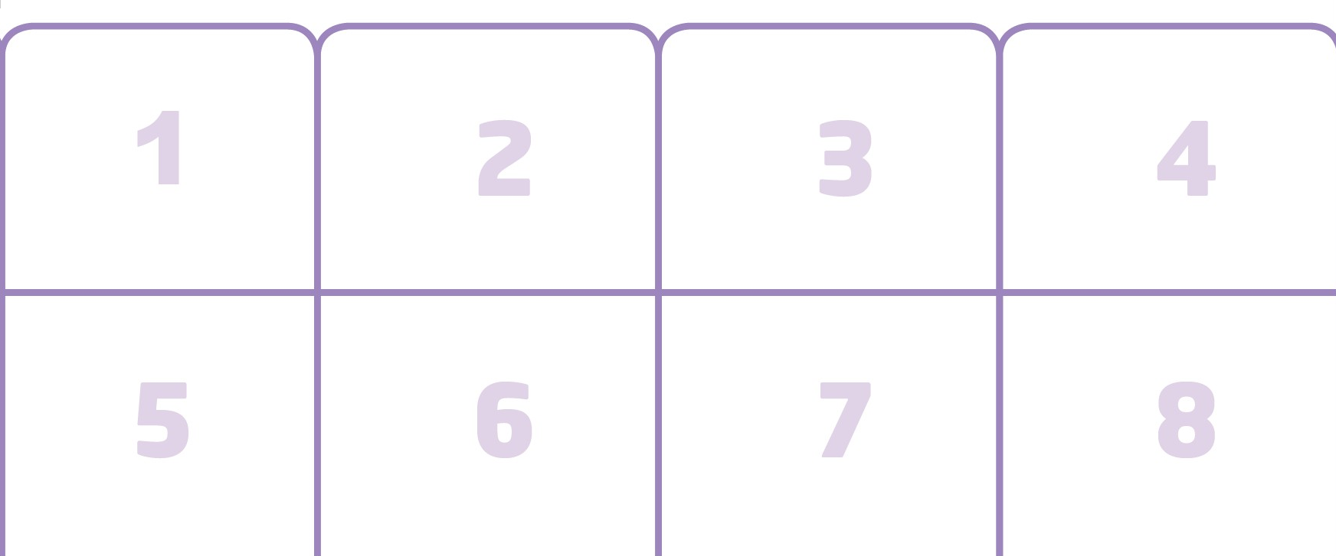
5 Stick. Ask and Answer.
U1 p. 10

Slide 10
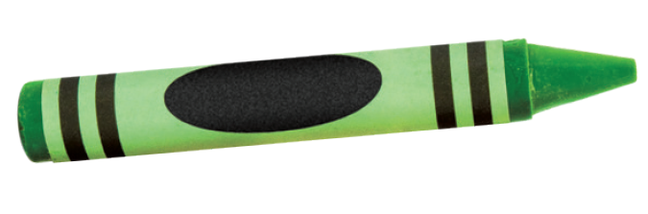
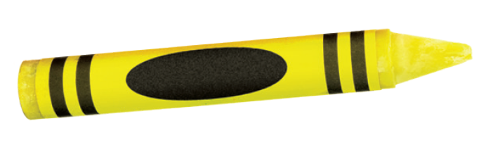
6 Listen and point. Say.
TR: A13
green
yellow
U1 p. 11

Slide 11
Script
TR: A13
Activity 6
Listen and point. Say.
green, green, a green crayon
yellow, yellow, a yellow crayon

Slide 12





7 Listen and color.
TR: A14
1.
2.
3.
4.
5.
6.
U1 p. 11

Slide 13
Script
TR: A14
Activity 7
Listen and color.
1. green crayon
2. yellow crayon
3. blue crayon
4. green crayon
5. red crayon
6. yellow crayon

Slide 14
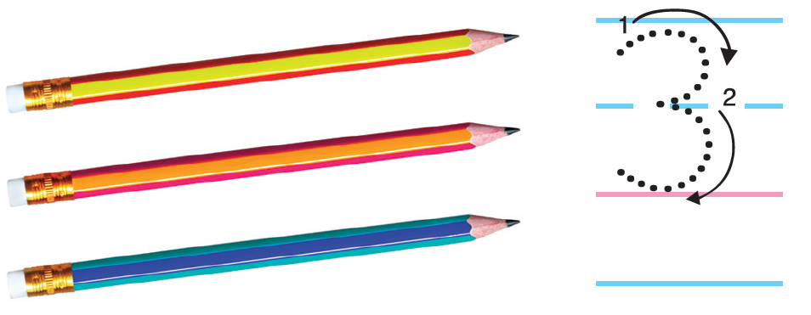
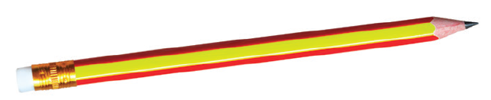
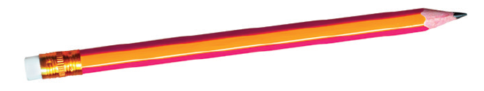
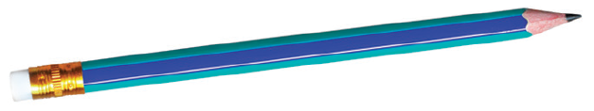
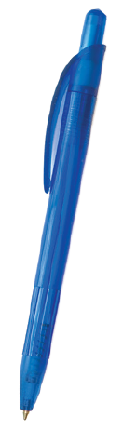
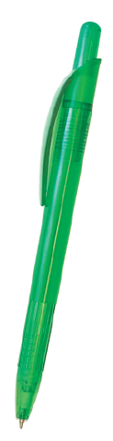
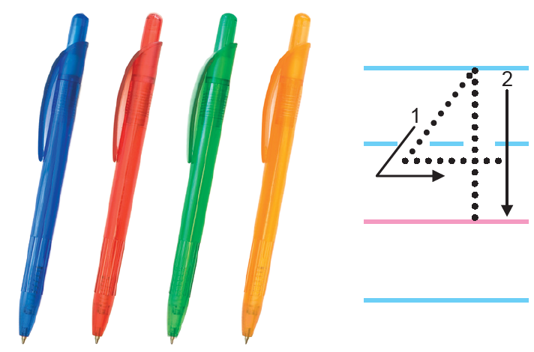
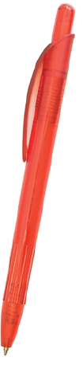
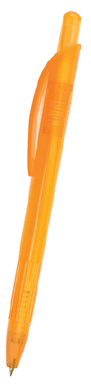
8 Listen. Count and say. Trace.
TR: A15
U1 p. 11

Slide 15
Script
TR: A15
Activity 8
Listen. Count and say. Trace.
One, two, three. Three pencils.
One, two, three, four. Four pens.

Slide 16

9 Listen. Count and say.
TR: A16
U1 p. 11

Slide 17
Script
TR: A16
Activity 9
Listen. Count and say.
How many green pencils?
How many yellow pencils?
How many red pencils?
How many blue pencils?

Slide 18

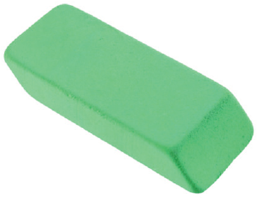

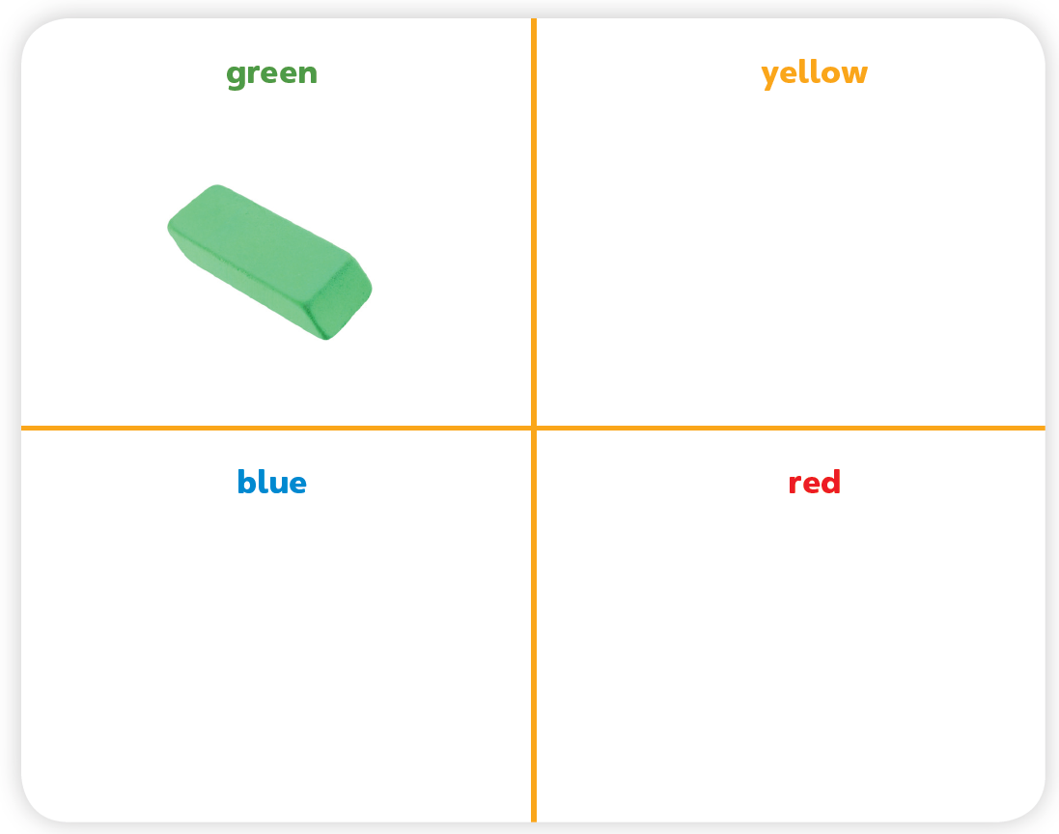


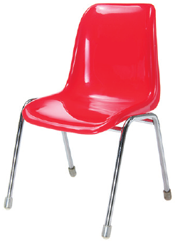

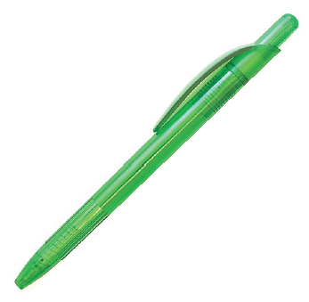



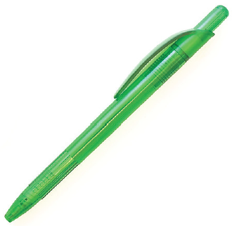


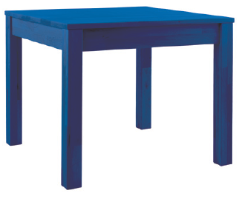
10 Listen and say. Cut out the cards for Unit 1. Listen. Put the cards in the boxes. Say.
TR: A17
U1 p. 11

Slide 19
Script
TR: A17
Activity 10
Listen and say. Cut out the cards for Unit 1. Listen. Put the cards in the boxes. Say.
a green eraser, a red book, a yellow pencil, a green
pen, a red chair, a yellow crayon, a blue desk, yellow
paper

Slide 20




11 Listen and say. Then listen again and trace.
TR: A18
TR: A19
1.
2.
U1 p. 12

Slide 21


11 Listen and say. Then listen again and trace.
TR: A18
TR: A19
3.
U1 p. 12

Slide 22
Script
Activity 11
Listen and say.
Activity 11
Listen and trace.
TR: A18
TR: A19
1. V /v/ /v/ Have Have
2. E /e/ /e/ Pen Pen
3. P /p/ /p/ Pencil Pencil
1. V /v/ /v/ Have Have
2. E /e/ /e/ Pen Pen
3. P /p/ /p/ Pencil Pencil

Slide 23

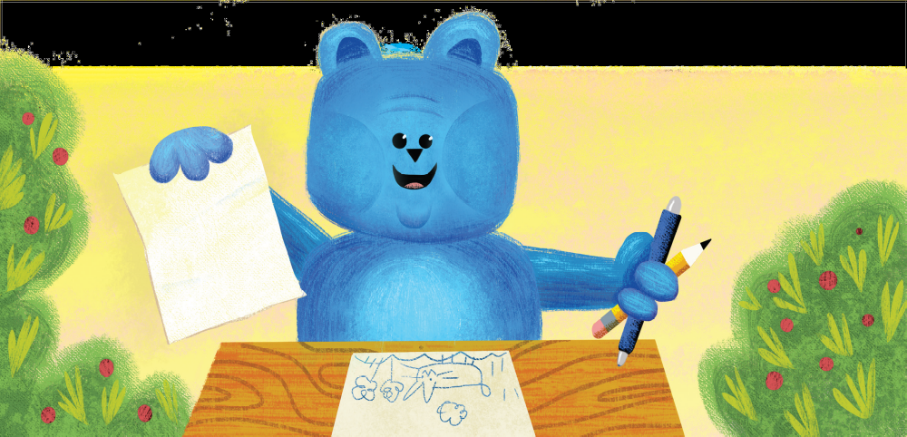
12 Listen and chant.
TR: A20
I have some paper.
I have a pen.
I have a pencil.
Let’s draw again!
U1 p. 12

Slide 24
Script
TR: A20
Activity 12
Listen and chant.
I have some paper.
I have a pen.
I have a pencil.
Let’s draw again!

Slide 25
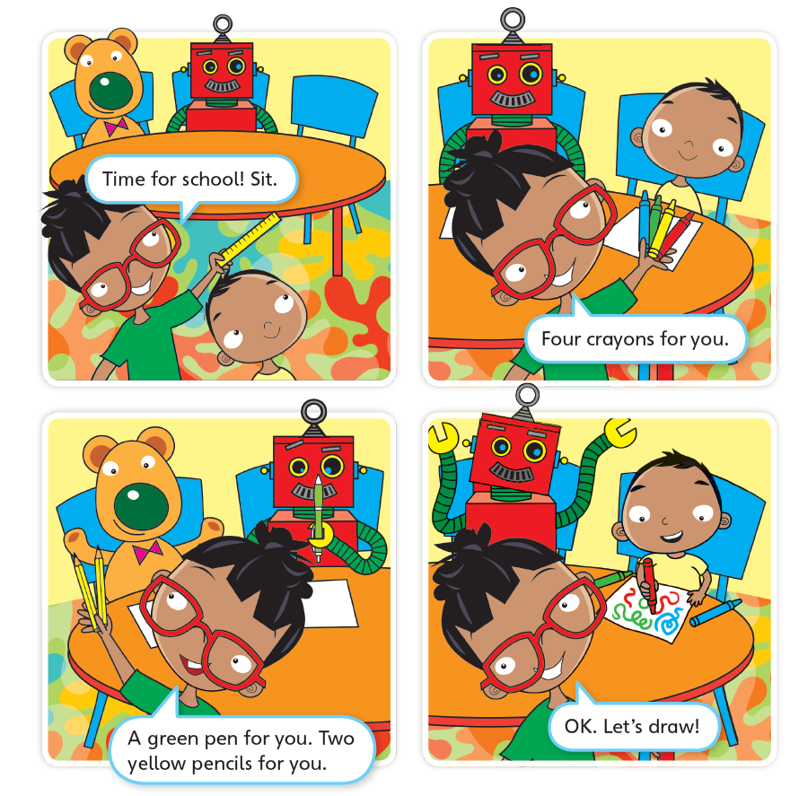
13 Listen to the story.
TR: A21
Time for School
U1 p. 13

Slide 26
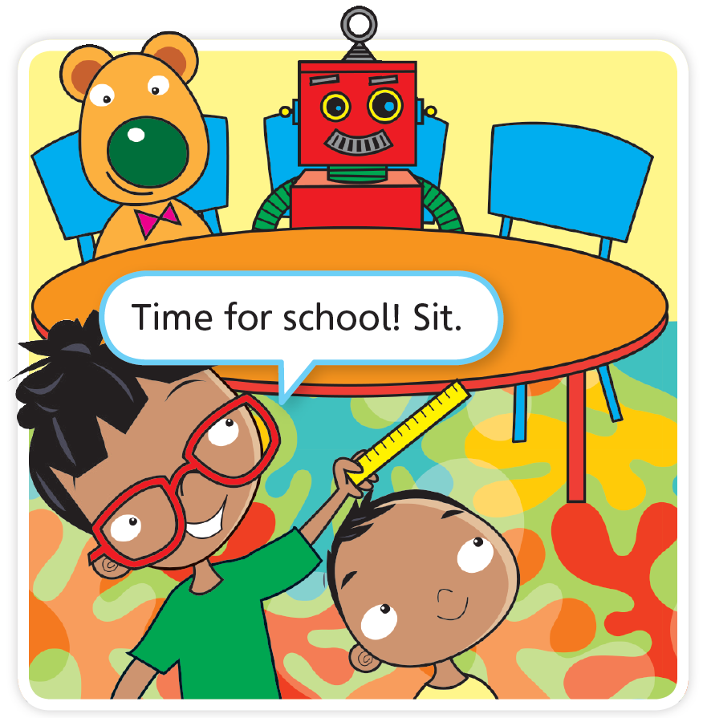
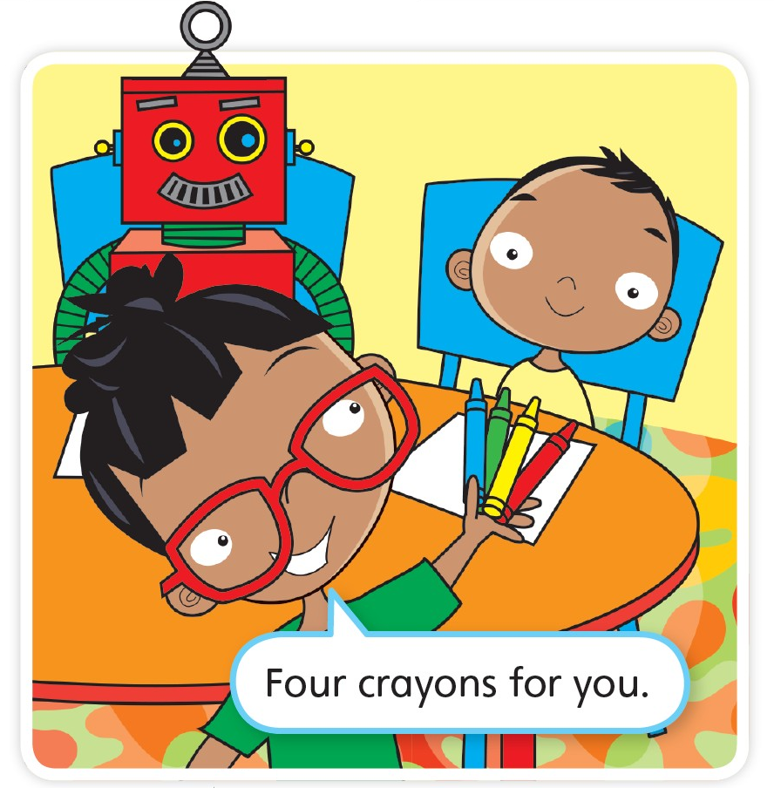


Time for School
TR: A21
U1 p. 13

Slide 27
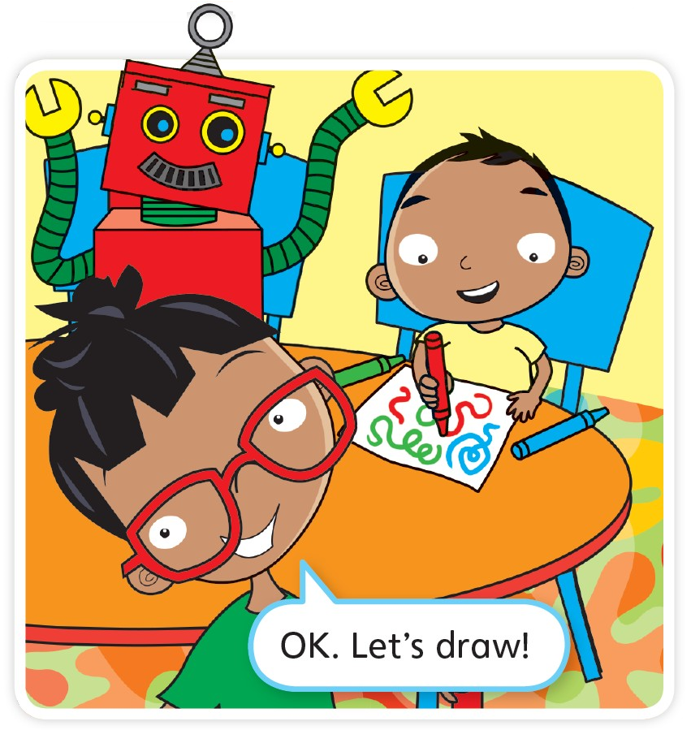
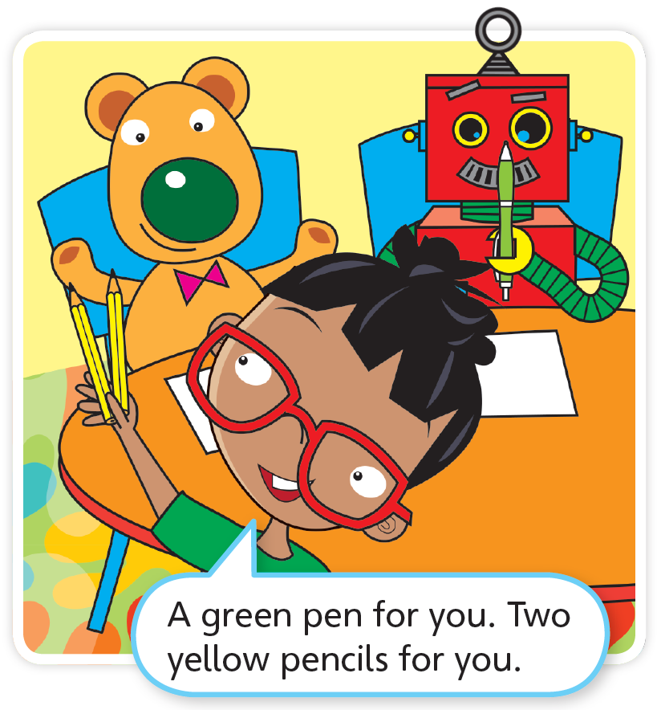

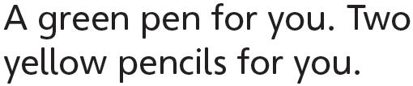
TR: A21
U1 p. 13

Slide 28
Script
TR: A21
Activity 13
Listen to the story.
Time for School
(girl pretending to be teacher) Time for school! Sit.
Four crayons for you.
A green pen for you. Two yellow pencils for you.
OK. Let’s draw!

Slide 29

14 Do you like the story? Circle.
U1 p. 13

