Slide 1


Unit 2
My Toys
Bringing the world to the classroom and the classroom to life
ELTNGL.COM
A PART OF CENGAGE

Slide 3


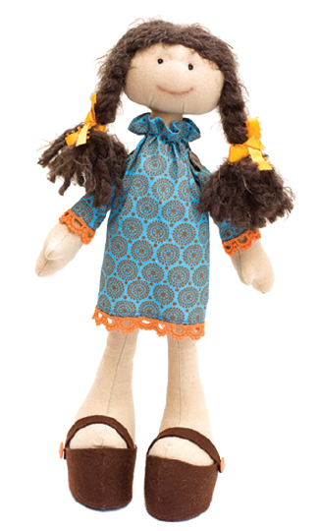
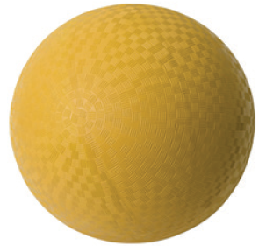
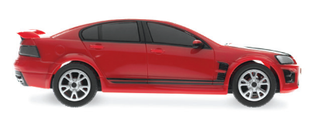
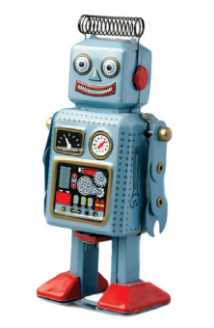
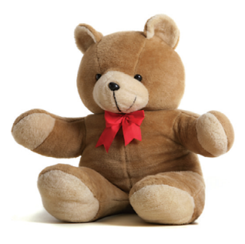

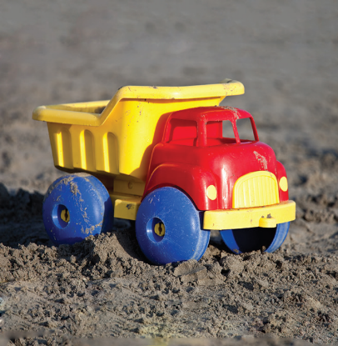
1 Listen and point.
TR: A22
2 Point and say.
a ball
a balloon
a car
a doll
a robot
a teddy bear
a kite
a truck
U2 pp. 16-17

Slide 4
Script
TR: A22
Unit 2
Activity 1
Listen and point.
a ball a ball
a balloon a balloon
a car a car
a doll a doll
a robot a robot
a teddy bear a teddy bear
a kite a kite
a truck a truck

Slide 5
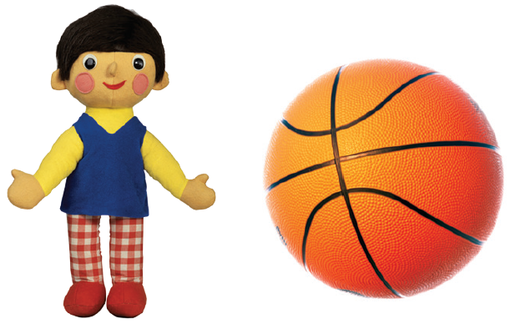
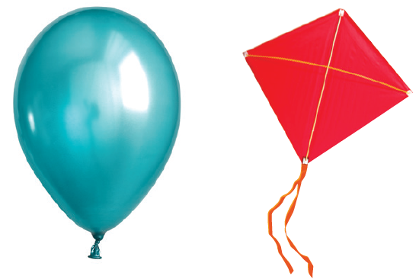
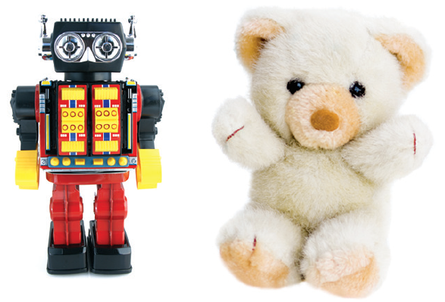
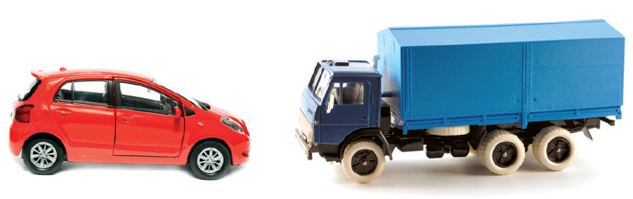
3 Listen and circle.
TR: A23
1.
2.
3.
4.
U2 p. 18

Slide 6
Script
TR: A23
Activity 3
Listen and circle.
1. a doll
2. a kite
3. a truck
4. a teddy bear

Slide 7


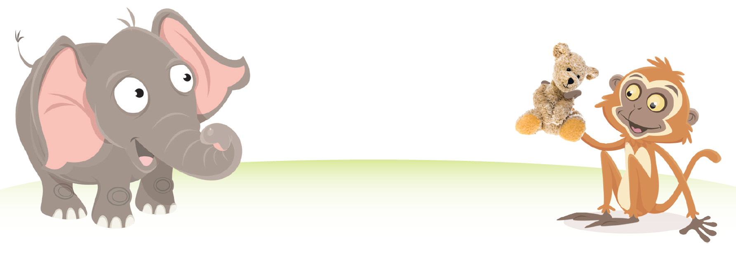


4 Listen and say. Talk.
TR: A24
U2 p. 18

Slide 8
Script
TR: A24
Activity 4
Listen and say. Talk.
(Elephant) Is it a doll?
(Monkey) No, it isn’t.
(Elephant) Is it a teddy bear?
(Monkey) Yes, it is.

Slide 9
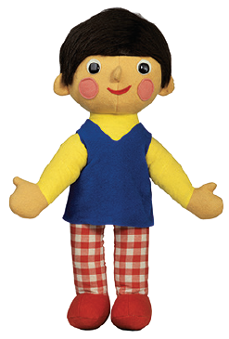
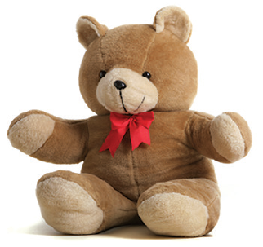

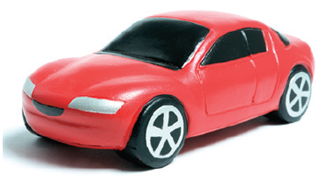

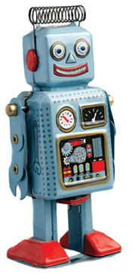
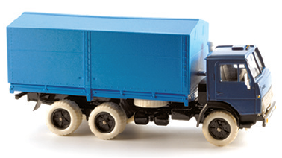
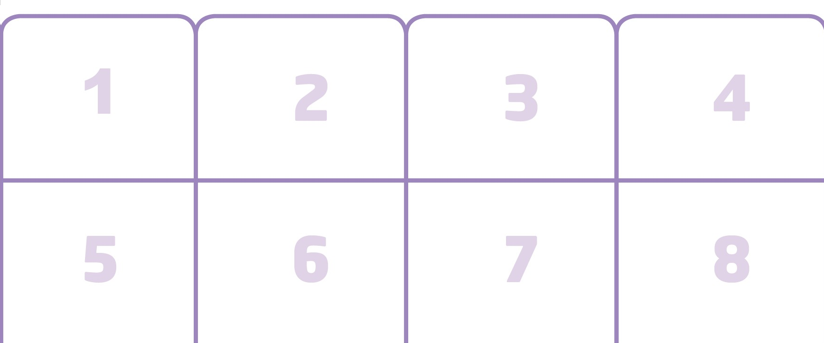
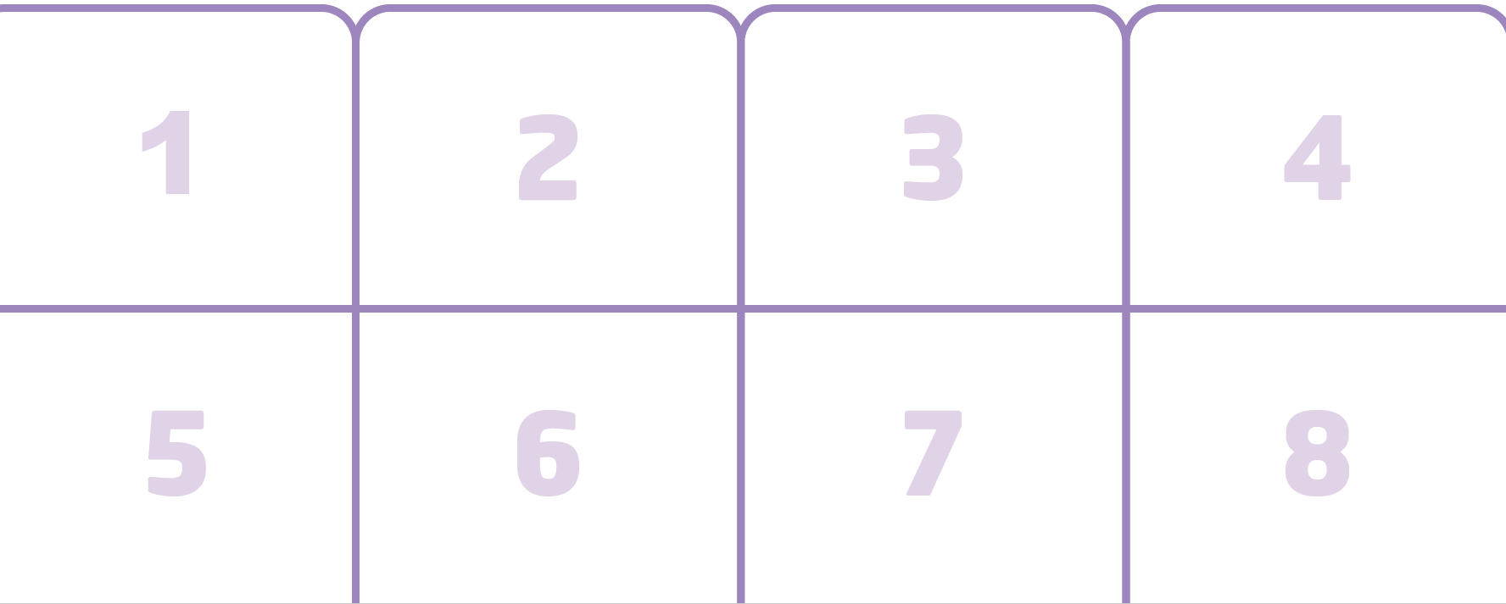
5 Listen. Stick.
TR: A25
U2 p. 18

Slide 10
Script
TR: A25
Activity 5
Listen. Stick.
1. Is it a car? No, it isn’t. It’s a teddy bear.
2. Is it a kite? Yes, it is.
3. Is it a balloon? Yes, it is.
4. Is it a teddy bear? No, it isn’t. It’s a robot.
5. Is it a ball? Yes, it is.
6. Is it a truck? No, it isn’t. It’s a car.
7. Is it a robot? No, it isn’t. It’s a truck.
8. Is it a doll? Yes, it is.

Slide 11

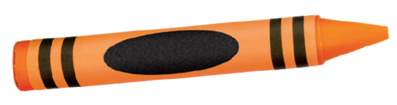
6 Listen and point. Say.
TR: A26
brown
orange
U2 p. 19

Slide 12
Script
TR: A26
Activity 6
Listen and point. Say.
brown, brown, a brown crayon
orange, orange, an orange crayon

Slide 13






7 Listen and color.
TR: A27
1.
2.
3.
4.
5.
6.
U2 p. 19

Slide 14
Script
TR: A27
Activity 7
Listen and color.
1. brown crayon
2. yellow crayon
3. orange crayon
4. green crayon
5. red crayon
6. brown crayon

Slide 15

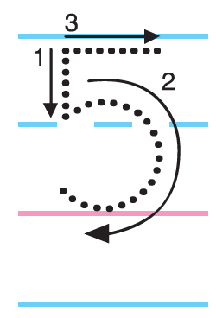


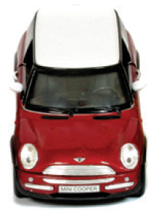
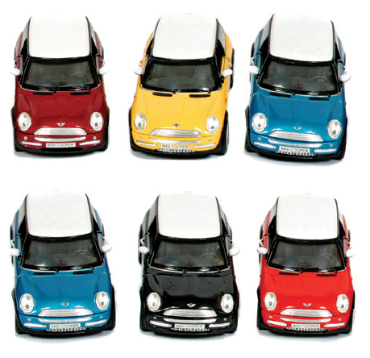
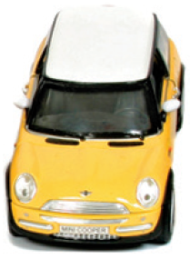
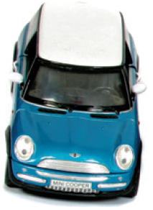
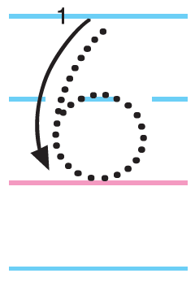
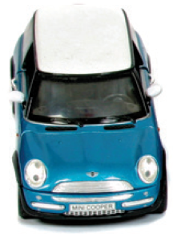
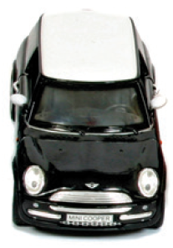
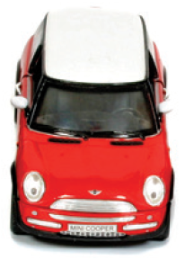
8 Listen. Count and say. Trace.
TR: A28
U2 p. 19

Slide 16
Script
TR: A28
Activity 8
Listen. Count and say. Trace.
One, two, three, four, five. Five balls.
One, two, three, four, five, six. Six cars.

Slide 17
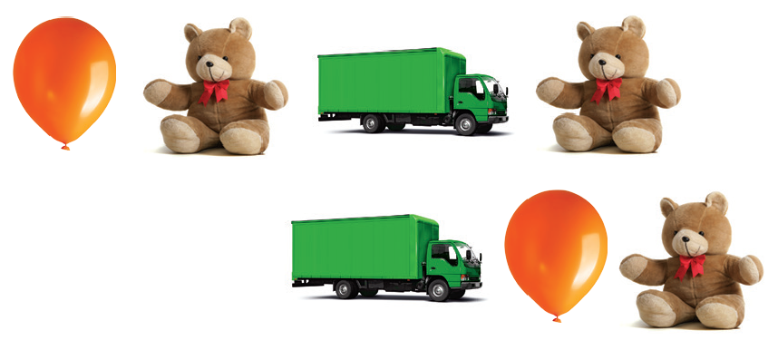
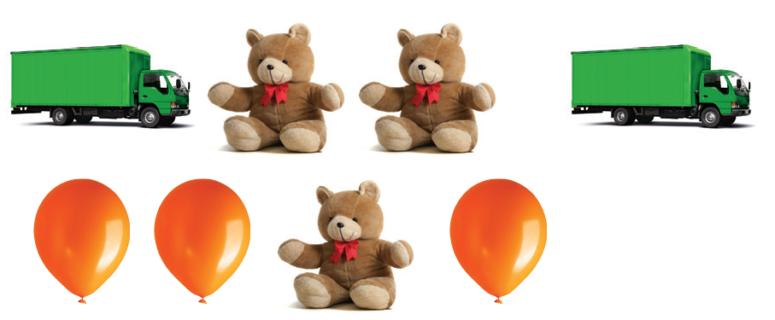
9 Listen. Count and say.
TR: A29
U2 p. 19

Slide 18
Script
TR: A29
Activity 9
Listen. Count and say.
How many orange balloons?
How many brown teddy bears?
How many green trucks?

Slide 19
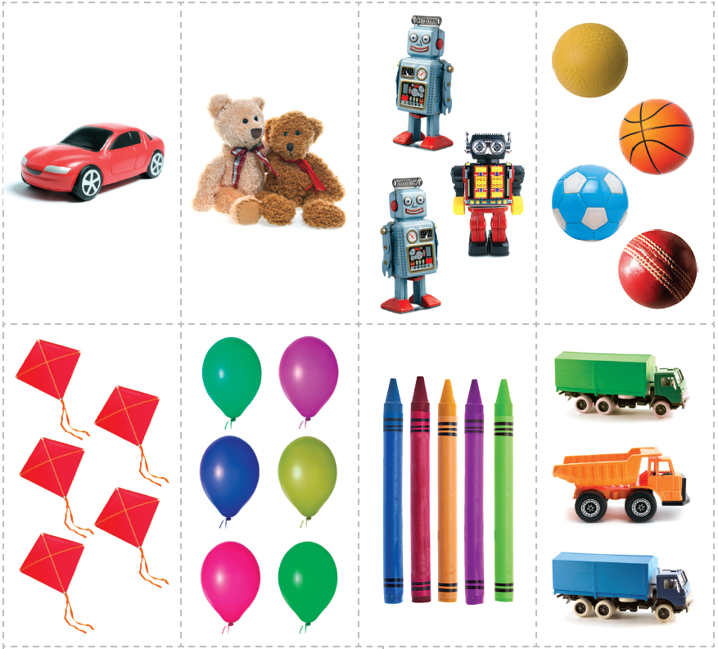

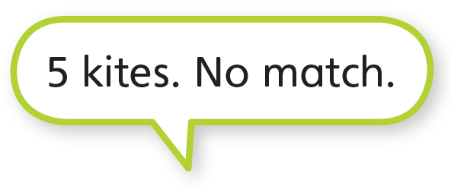
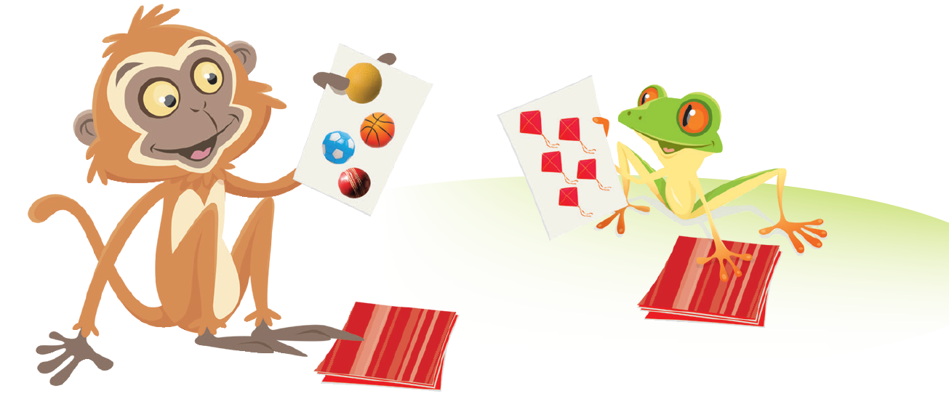
10 Listen and say. Cut out the cards for Unit 2. Play the game.
TR: A30
U2 p. 19

Slide 20
Script
TR: A30
Activity 10
Listen and say. Cut out the cards for Unit 2. Play the game.
(Monkey) Four balls.
(Frog) Five kites. No match.

Slide 21




11 Listen and say. Then listen again and trace.
TR: A31
TR: A32
1.
2.
U2 p. 20

Slide 22

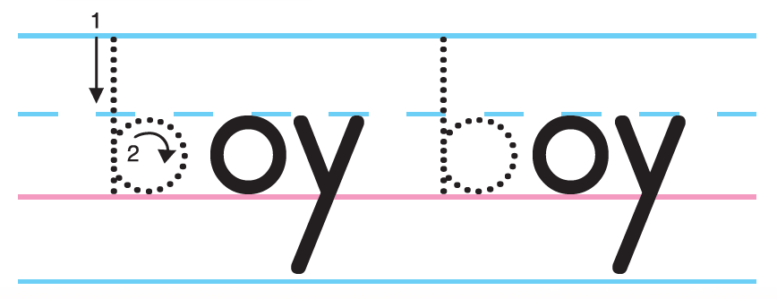
11 Listen and say. Then listen again and trace.
TR: A31
TR: A32
3.
U2 p. 20

Slide 23
Script
Activity 11
Listen and say.
Activity 11
Listen and trace.
TR: A31
TR: A32
1. O /ɑː/ /ɑː/ Doll Doll
2. T /t/ /t/ Toy Toy
3. B /b/ /b/ Boy Boy
1. O /ɑː/ /ɑː/ Doll Doll
2. T /t/ /t/ Toy Toy
3. B /b/ /b/ Boy Boy

Slide 24
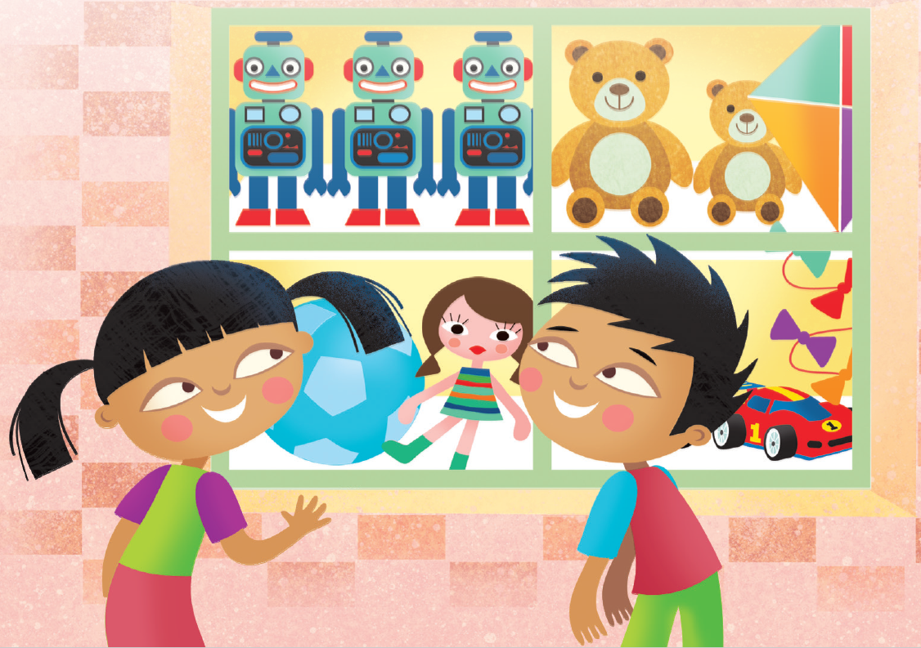
12 Listen and chant.
TR: A33
Dolls and robots
and more toys.
Balls and kites
for girls and boys!
U2 p. 20

Slide 25
Script
TR: A33
Activity 12
Listen and chant.
Dolls and robots
and more toys.
Balls and kites
for girls and boys!

Slide 26
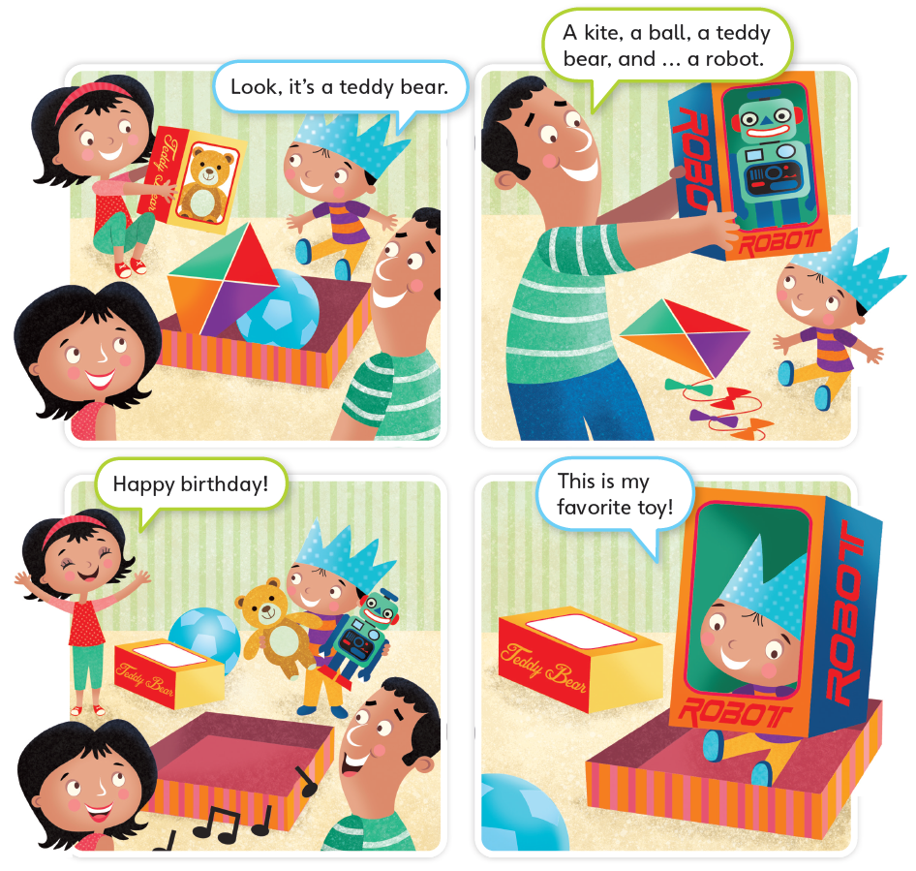
13 Listen to the story.
TR: A34
Birthday Boy
U2 p. 21

Slide 27
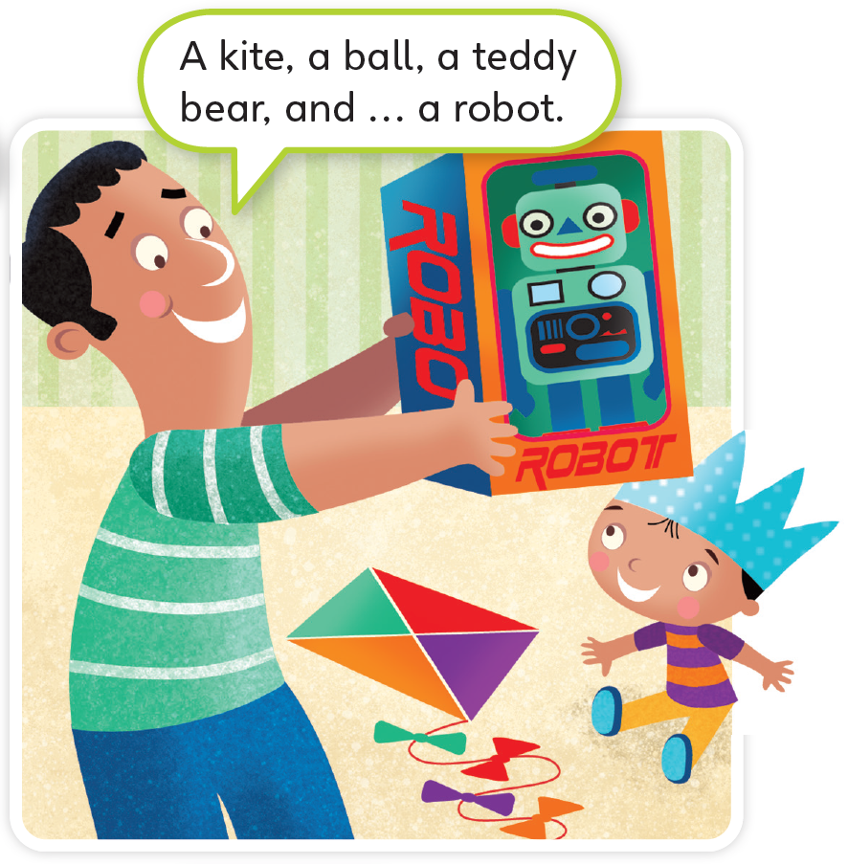

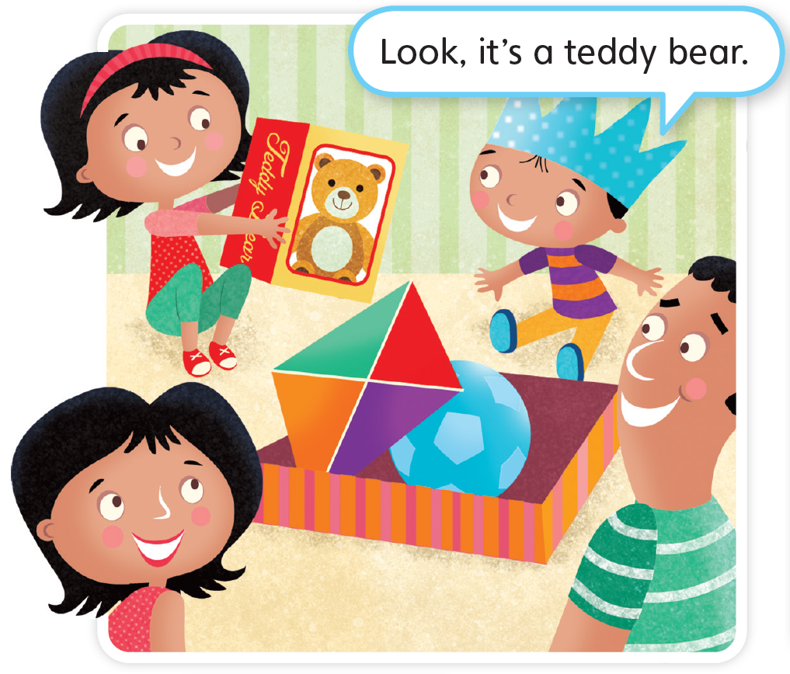

Birthday Boy
TR: A34
U2 p. 21

Slide 28
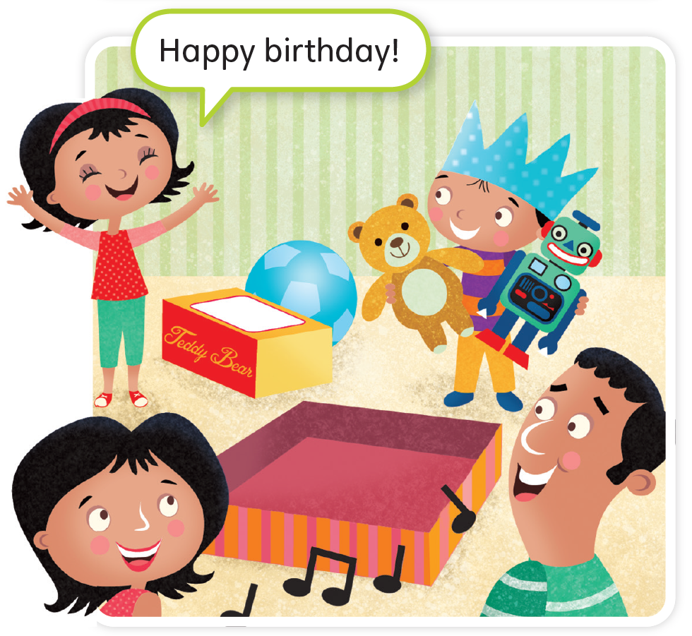
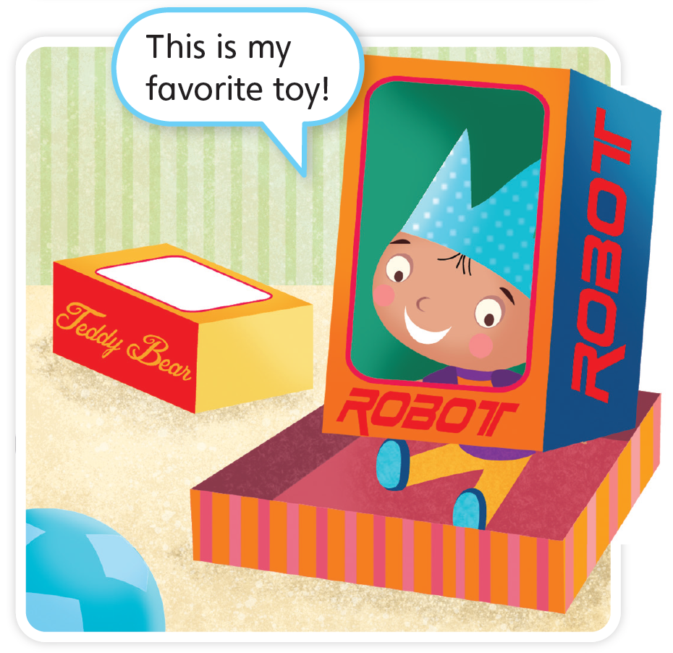

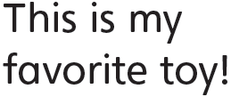
TR: A34
U2 p. 21

Slide 29
Script
TR: A34
Activity 13
Listen to the story.
Birthday Boy
(Boy) Look, it’s a teddy bear.
(Father) A kite, a ball, a teddy bear, and … a robot.
(Sister) Happy birthday!
(Boy) This is my favorite toy!

Slide 30

14 Do you like the story? Circle.
U2 p. 21

