Slide 1

Unit Review

Slide 2
Review
Units 1–2

Slide 3
English Time Chant
English, (clap) English, (clap)
English (clap) today! (clap, clap)
English, (clap) English, (clap)
Hip, hip, (clap) hooray! (clap, clap)
Notes:
Say Good morning/afternoon, class. How are you
today?
Get students ready to use the English Time chant.
Lead the class in the chant.

Slide 4

Open your books to pages 22–23
Notes:
Get ready to play Explain that students will play a game. Have
them open their books to pp. 22–23

Slide 5
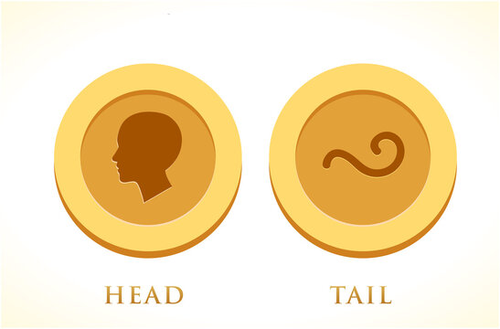
Heads and Tails
Heads
= 1 space
Tails
= 2 spaces
Notes:
Have students find the pictures of the coin on p. 23. Read the
caption aloud. Then hold up a coin for students to see. Point to
the “heads” side and say This is heads. Point to the “tails” side and
say This is tails. Walk around and show the coin to students. Have
several students try tossing it and saying heads or tails.
Direct students’ attention to the word Start on p. 22. Demonstrate
how to put a playing piece over the word to begin the game. Then
toss the coin in the air. If it lands on “heads,” demonstrate moving
the playing piece forward one space in the game. If it lands on
“tails,” demonstrate moving forward two spaces.

Slide 6
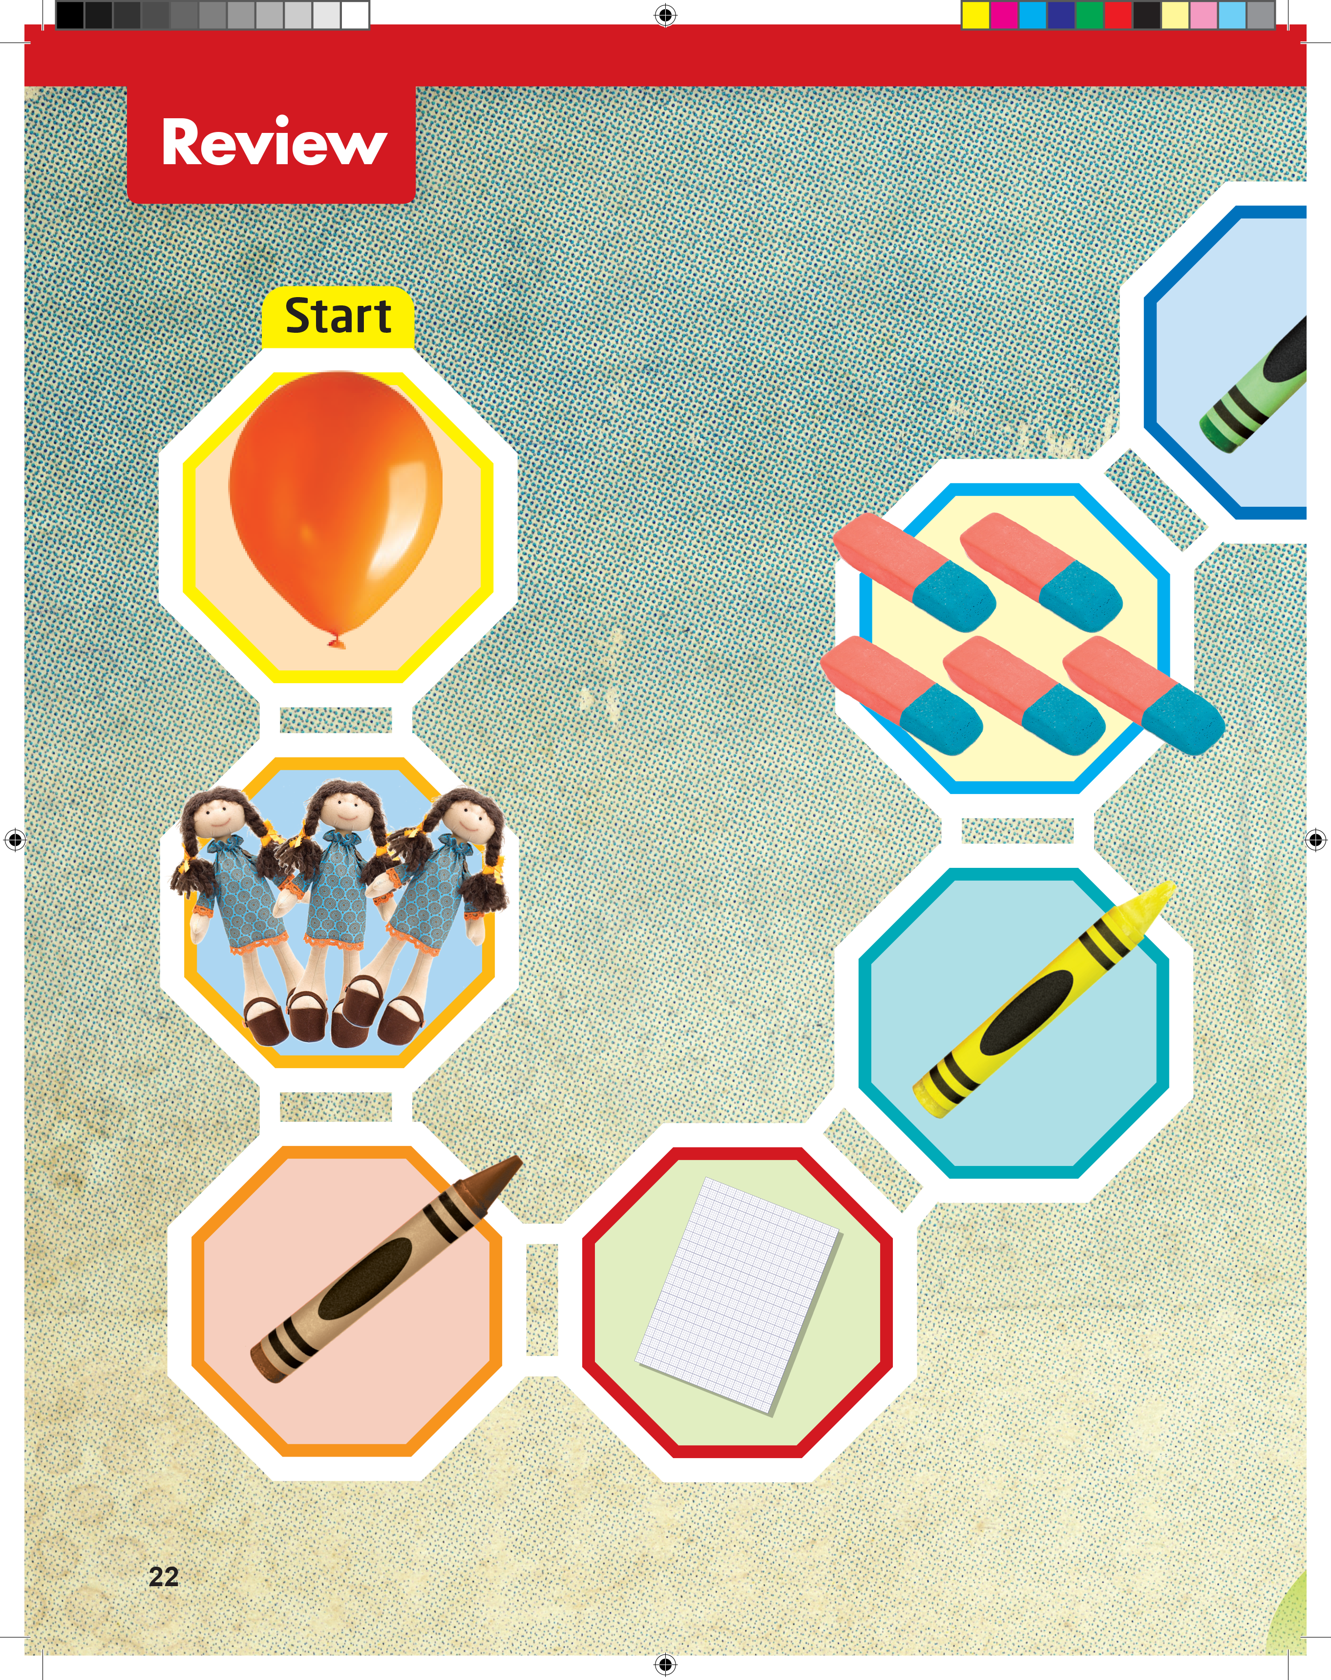
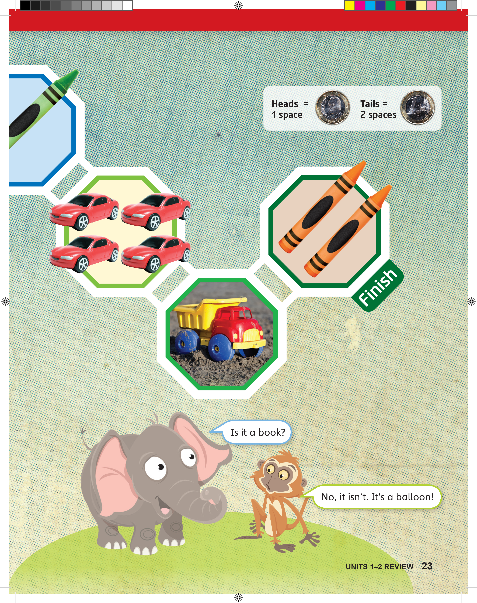
What is it?
What color is it?
How many dolls?
Notes:
Review the language Give students time to look at the images
on the two pages. Then point to the picture of the balloon. Ask
What is it? (It’s a balloon.) What color is it? (It’s orange.) Point to
the dolls. Ask How many dolls do you see? (Three.)

Slide 7
Ask and Answer
What is it? It’s __________.
What color is it? It’s __________.
Is it a _______? Yes, it is.
Is it _______? No, it isn’t.
How many __________?
Notes:
Sentence frames If students need help thinking
of questions and answers, write examples on the
board:

Slide 8
Notes:
Model playing the game. Point to a student and say
Play with me, please. Toss the coin and show heads.
Say This is heads. Move one space and ask your
partner What is it? Prompt the student to respond.
(It’s a balloon.)
• Model taking turns. Flip the coin to show tails. Have
your partner move the same playing piece forward
(two spaces.) Prompt the student to ask you the
question What is it? Say (It’s a crayon.)
• Play the game Have students read the model
dialogue on p. 23. Then say Now it’s your turn.
Play! Take turns. When it’s your turn, move one or
two spaces. Then ask a question. Have students
play the game in pairs. Give a coin and a playing
piece to each pair. Remind them to ask and answer
questions.
• Monitor students as they play the game. Accept
responses such as the following: A balloon. An
orange balloon. It’s an orange balloon. Dolls. Three
dolls. Make sure students understand that they
keep moving along the game route until they reach
the word Finish.

Slide 9
Goodbye Chant
Good work, class.
Hip hip, hooray!
Goodbye for now.
Have a nice day!
Notes:
Say Nice work today, class. Now let’s chant.
Lead the class in the Goodbye chant.

Slide 10

Let’s Check
Make a sentence with
a word from Units 1–2.
Notes:
Can students remember and use the new words
they’ve learned?
As students leave the class, ask them to make a
sentence with one word they remember from Units 1–2.

Slide 11
Thank you!

