Slide 1
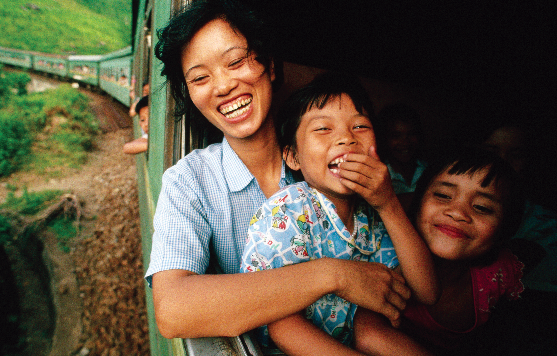

Unit 3
My Family
Bringing the world to the classroom and the classroom to life
ELTNGL.COM
A PART OF CENGAGE

Slide 2
Mother and children on a train, Vietnam

Slide 3
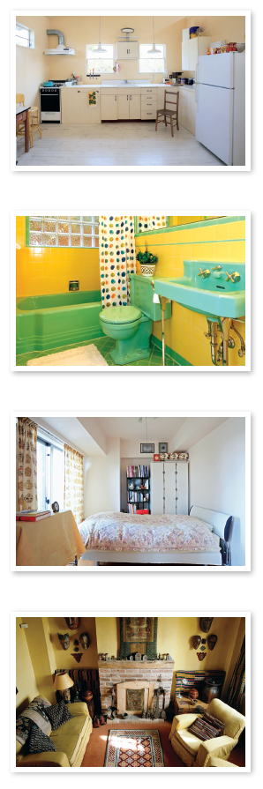

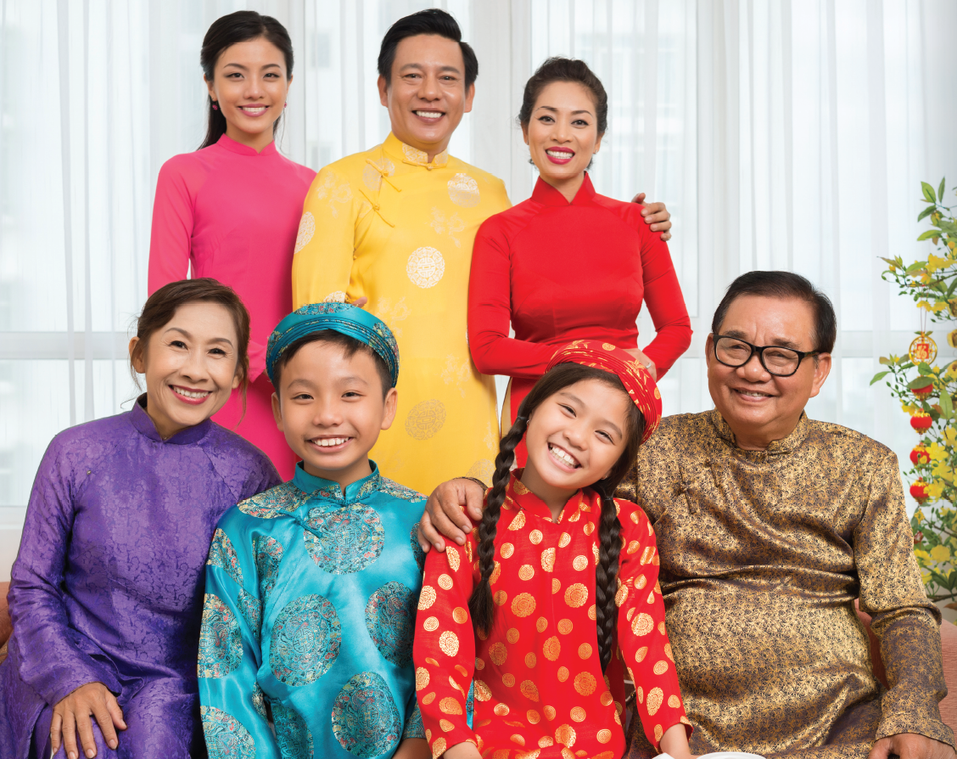
1 Listen and point.
TR: A35
2 Point and say.
a kitchen
father
sister
mother
grandpa
a bathroom
brother
grandma
me
a bedroom
a living room
U3 pp. 26-27

Slide 4
Script
TR: A35
Unit 3
Activity 1
Listen and point.
sister sister
father father
grandma grandma
brother brother
mother mother
grandpa grandpa
a kitchen a kitchen
a bathroom a bathroom
a bedroom a bedroom
a living room a living room

Slide 5
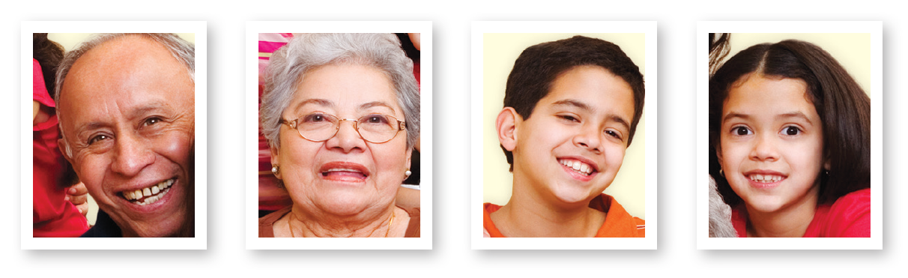

3 Listen and circle.
TR: A36
U3 p. 28

Slide 6
Script
TR: A36
Activity 3
Listen and circle.
Who’s this? It’s my grandpa.
Who’s this? It’s my mother.
Who’s this? It’s my brother.

Slide 7




4 Listen and say. Talk.
TR: A37
U3 p. 28

Slide 8
Script
TR: A37
Activity 4
Listen and say. Talk.
(Parrot) Who’s this?
(Monkey) It’s my brother.

Slide 9
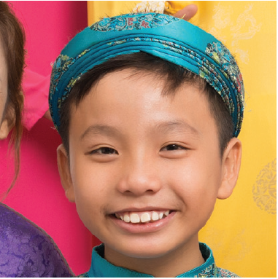
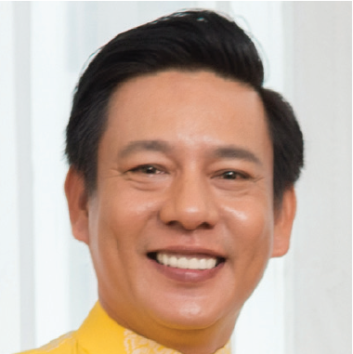



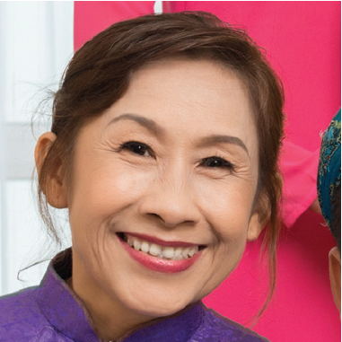
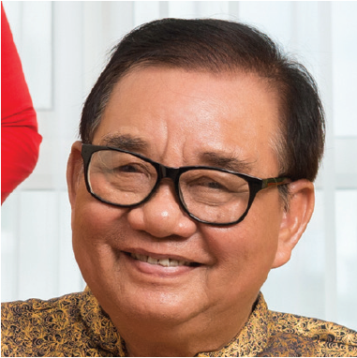


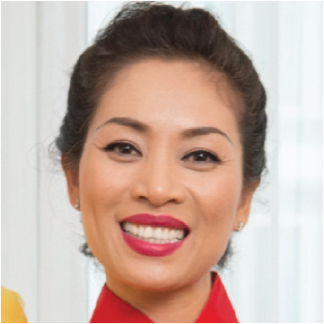
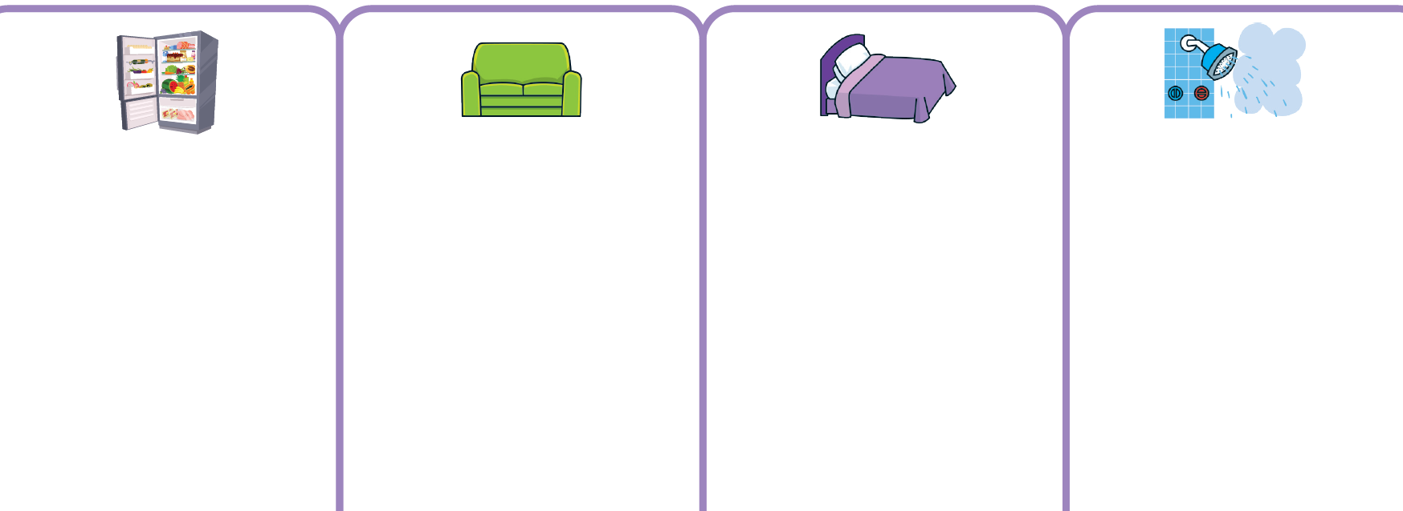





5 Listen. Look at the rooms. Stick and say.
TR: A38
U3 p. 28

Slide 10
Script
TR: A38
Activity 5
Listen. Look at the rooms. Stick and say.
(Elephant) Where’s Grandma? (Frog) In the kitchen.
(Elephant) Where’s Father? (Frog) In the living room.
(Elephant) Where’s your sister? (Frog) In the bedroom.
(Elephant) Where’s your brother? (Frog) In the bathroom.
(Elephant) Where’s Mother? (Frog) In the living room.
(Elephant) Where’s Grandpa? (Frog) In the kitchen.

Slide 11


6 Listen and point. Say.
TR: A39
black
white
U3 p. 29

Slide 12
Script
TR: A39
Activity 6
Listen and point. Say.
black, black, a black crayon;
white, white, a white crayon

Slide 13





7 Listen and color.
TR: A40
1.
2.
3.
4.
5.
6.
U3 p. 29

Slide 14
Script
TR: A40
Activity 7
Listen and color.
1. black crayon
2. green crayon
3. blue crayon
4. white crayon
5. yellow crayon
6. black crayon

Slide 15
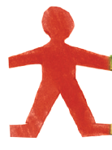



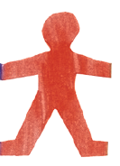
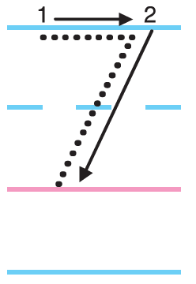






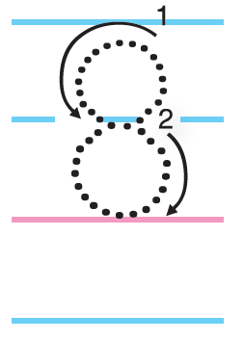
8 Listen. Count and say. Trace.
TR: A41
U3 p. 29

Slide 16
Script
TR: A41
Activity 8
Listen. Count and say. Trace.
1, 2, 3, 4, 5, 6, 7. 7 dolls.
1, 2, 3, 4, 5, 6, 7, 8. 8 books.

Slide 17
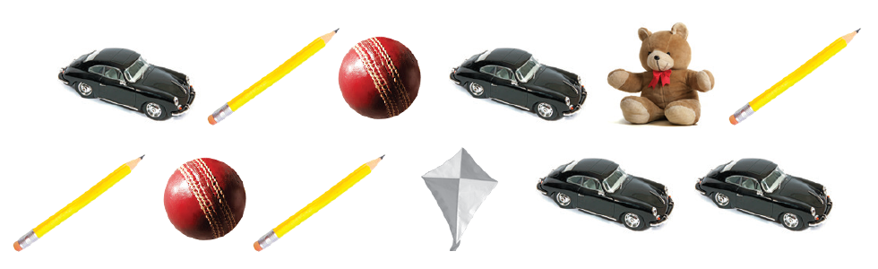
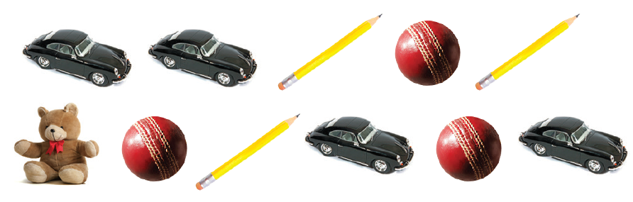
9 Listen. Count and say.
TR: A42
U3 p. 29

Slide 18
Script
TR: A42
Activity 9
Listen. Count and say.
How many red balls?
How many yellow pencils?
How many brown teddy bears?
How many black cars?
How many white kites?

Slide 19
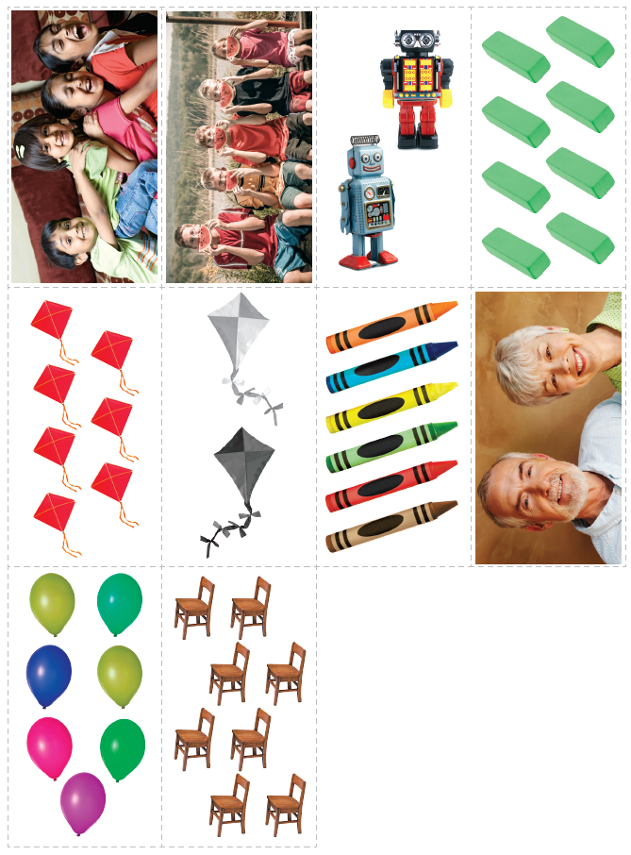
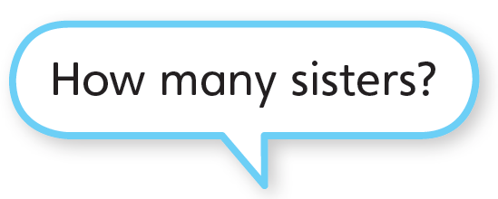



10 Listen and say. Cut out the cards for Unit 3. Ask and answer.
TR: A43
U3 p. 29

Slide 20
Script
TR: A43
Activity 10
Listen and say. Cut out the cards for Unit 3. Ask and answer.
(Elephant) How many sisters?
(Parrot) Three sisters.

Slide 21


11 Listen and say. Then listen again and trace.
TR: A44
TR: A45
1.
U3 p. 30

Slide 22




11 Listen and say. Then listen again and trace.
TR: A44
TR: A45
2.
3.
U3 p. 30

Slide 23
Script
Activity 11
Listen and say.
Activity 11
Listen and trace.
TR: A44
TR: A45
1. Y /j/ /j/ Yellow Yellow
2. A /æ/ /æ/ Apple Apple
3. I /ɪ/ /ɪ/ Sit Sit
1. Y /j/ /j/ Yellow Yellow
2. A /æ/ /æ/ Apple Apple
3. I /ɪ/ /ɪ/ Sit Sit

Slide 24
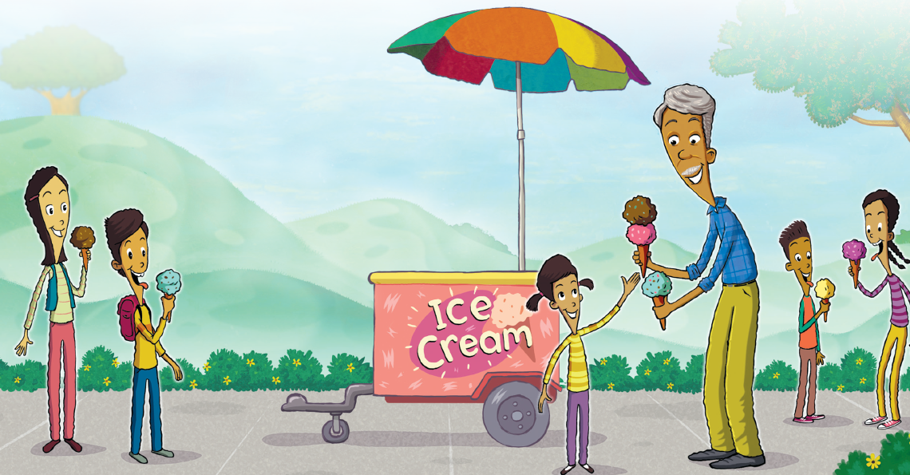
12 Listen and chant.
TR: A46
I love my grandpa!
Oh yes, I do.
My brothers and
my sisters love him, too.
U3 p. 30

Slide 25
Script
TR: A46
Activity 12
Listen and chant.
I love my grandpa!
Oh yes, I do.
My brothers and
my sisters love him, too.

Slide 26
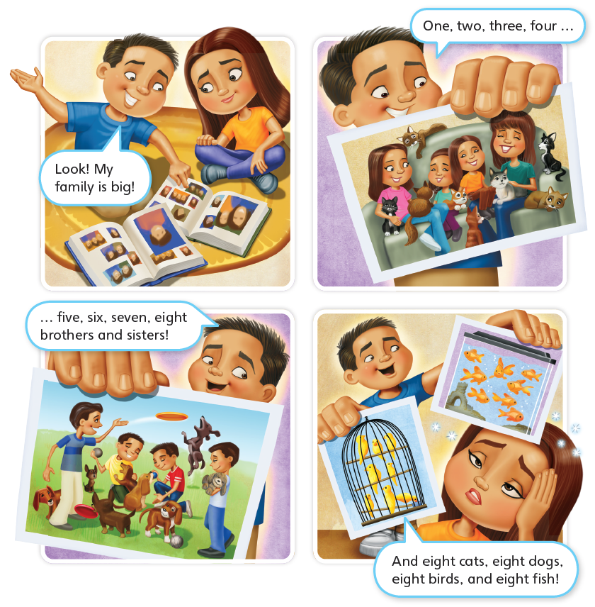
13 Listen to the story.
TR: A47
Eight is Great
U3 p. 31

Slide 27
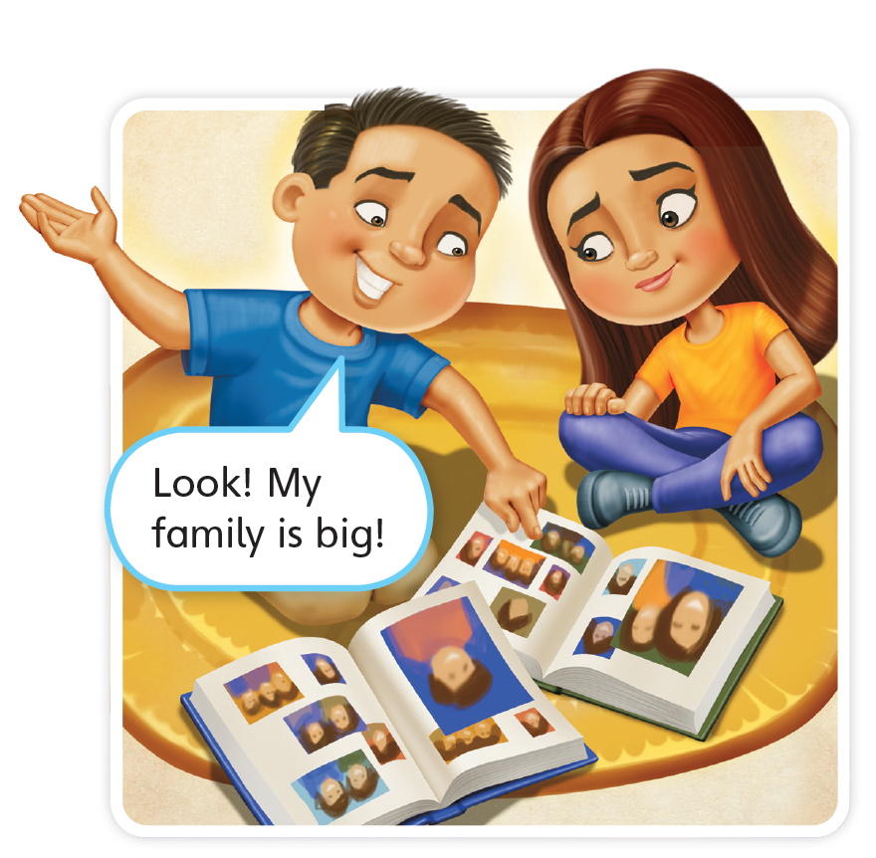
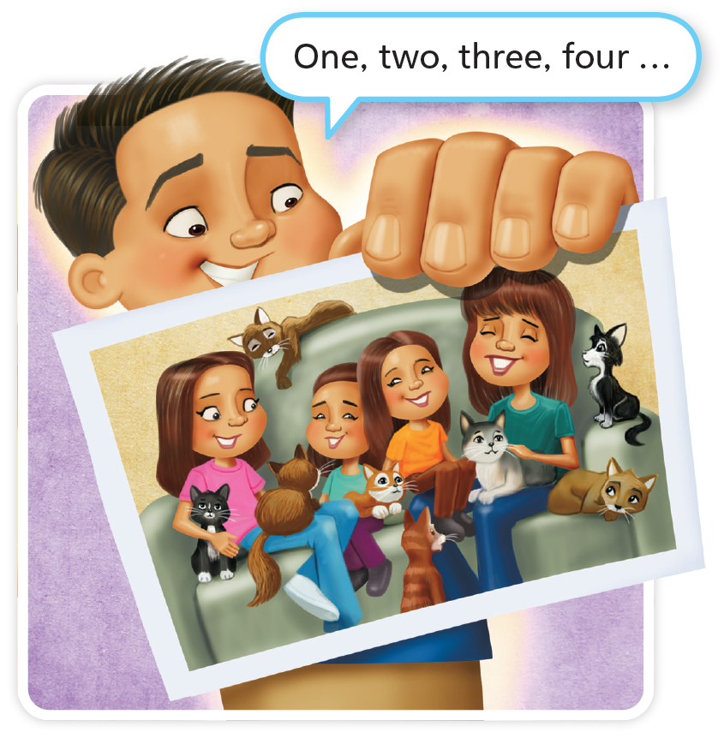


Eight is Great
TR: A47
U3 p. 31

Slide 28
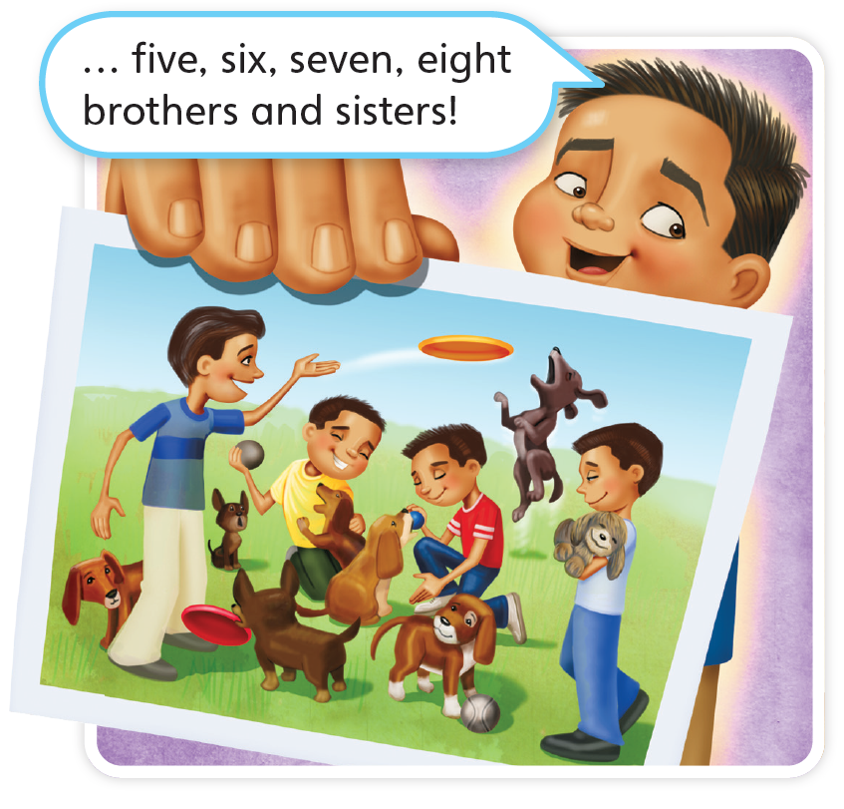
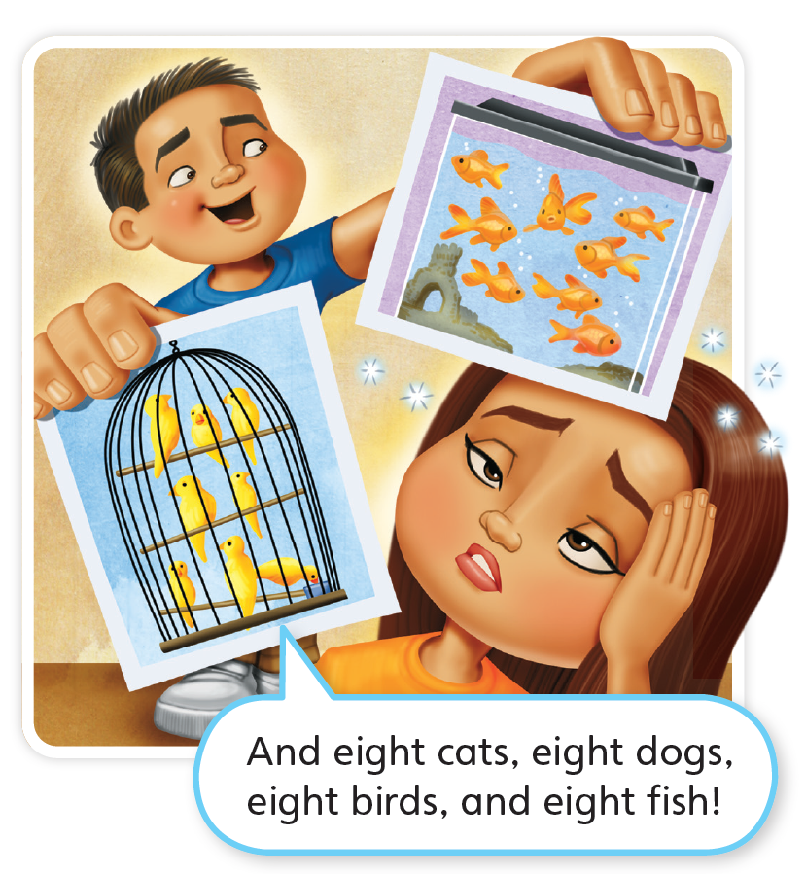


TR: A47
U3 p. 31

Slide 29
Script
TR: A47
Activity 13
Listen to the story.
Eight is Great
Look! My family is big!
One, two, three, four …
five, six, seven, eight brothers and sisters!
And eight cats, eight dogs, eight birds, and eight fish!

Slide 30

14 Do you like the story? Circle.
U3 p. 31

