Slide 1

Unit 4
My Body
Bringing the world to the classroom and the classroom to life
ELTNGL.COM
A PART OF CENGAGE

Slide 3

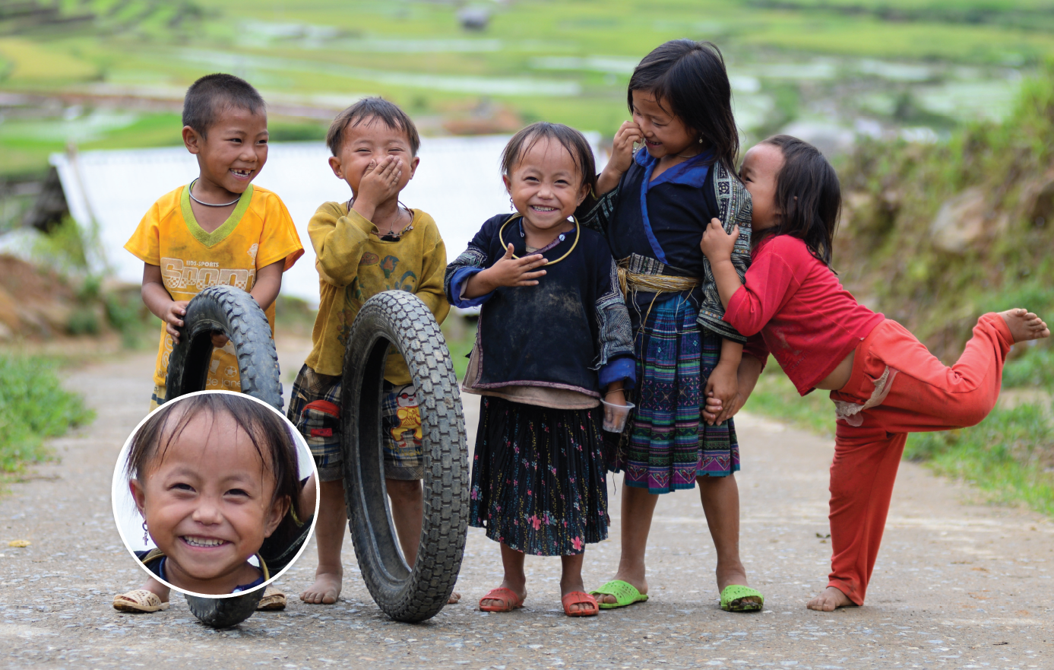
1 Listen and point.
TR: A48
2 Point and say.
ears
hair
arms
eyes
hands
a nose
a mouth
legs
feet
U4 pp. 34-35

Slide 4
Script
TR: A48
Unit 4
Activity 1
Listen and point.
ears ears
hair hair
arms arms
hands hands
eyes eyes
a nose a nose
a mouth a mouth
legs legs
feet feet

Slide 5
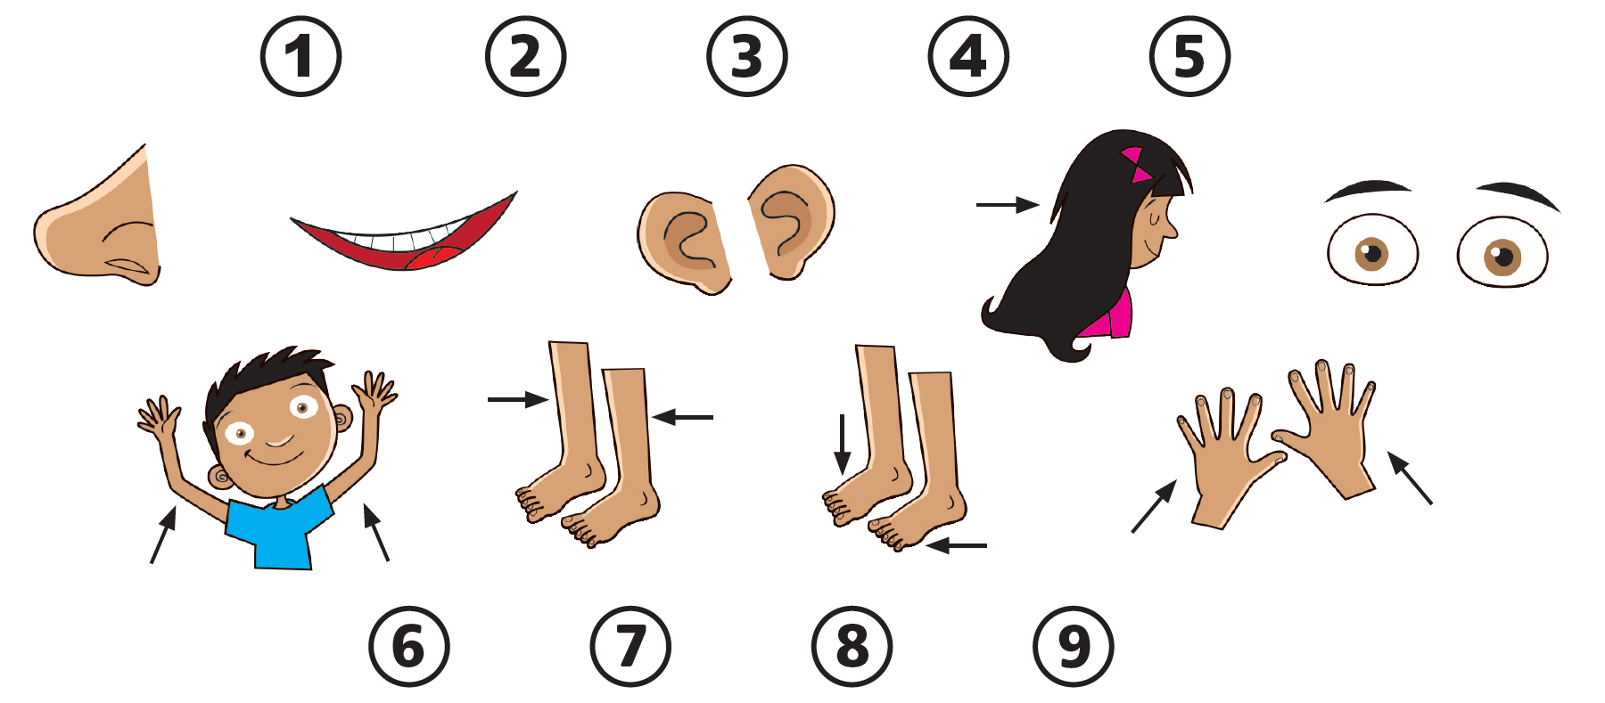
3 Listen. Draw lines.
TR: A49
U4 p. 36

Slide 6
Script
TR: A49
Activity 3
Listen. Draw lines.
1. a mouth
2. a nose
3. hair
4. ears
5. eyes
6. arms
7. hands
8. legs
9. feet

Slide 7



4 Listen and say.
TR: A50
U4 p. 36

Slide 8
Script
TR: A50
Activity 4
Listen and say.
(Monkey) I have two hands.
(Frog) She has two hands.

Slide 9

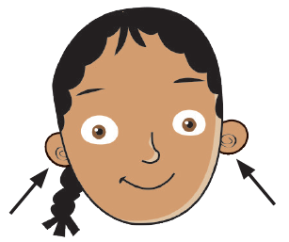
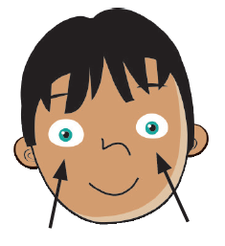
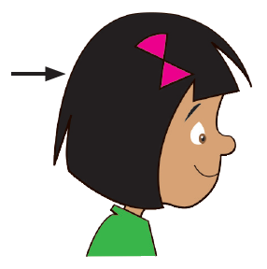

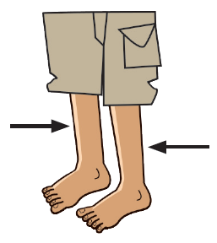
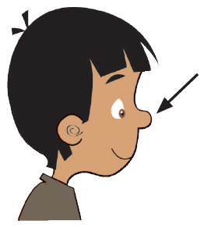
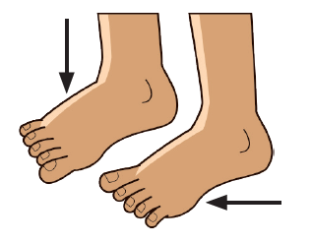


5 Listen. Stick and say.
TR: A51
U4 p. 36

Slide 10
Script
TR: A51
Activity 5
Listen. Stick and say.
I have two arms. I have two hands. I have two eyes.
I have two ears. I have two legs. I have hair.
I have two feet. I have a mouth. I have a nose.

Slide 11
6 Listen. Point to the stickers. Say.
TR: A52
U4 p. 36

Slide 12
Script
TR: A52
Activity 6
Listen. Point to the stickers. Say.
He has two eyes. He has two hands.
She has two arms. He has two feet. He has two legs.
She has two ears. She has hair.
He has a nose. She has a mouth.

Slide 13

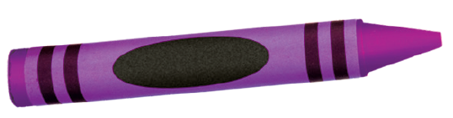
7 Listen and point. Say.
TR: A53
pink
purple
U4 p. 37

Slide 14
Script
TR: A53
Activity 7
Listen and point. Say.
pink, pink, a pink crayon
purple, purple, a purple crayon

Slide 15





8 Listen and color.
TR: A54
1.
2.
3.
4.
5.
6.
U4 p. 37

Slide 16
Script
TR: A54
Activity 8
Listen and color.
1. pink crayon
2. yellow crayon
3. purple crayon
4. white crayon
5. orange crayon
6. pink crayon

Slide 17
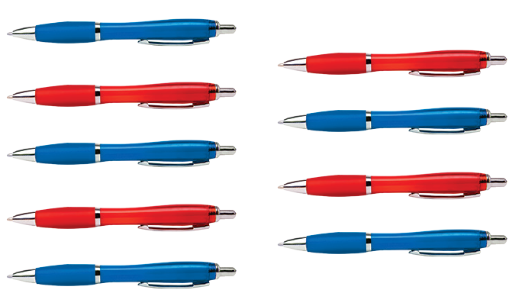
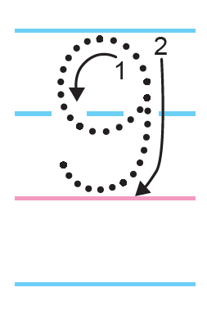


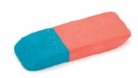
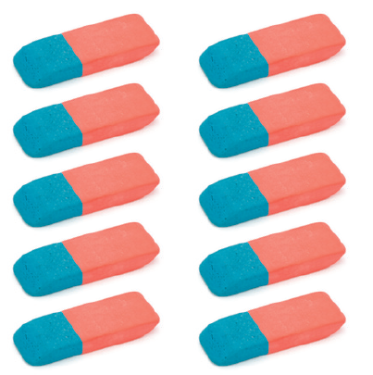
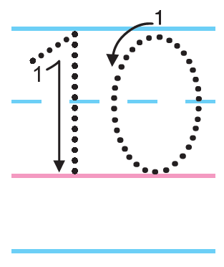
9 Listen. Count and say. Trace.
TR: A55
U4 p. 37

Slide 18
Script
TR: A55
Activity 9
Listen. Count and say. Trace.
1, 2, 3, 4, 5, 6, 7, 8, 9. 9 pens
1, 2, 3, 4, 5, 6, 7, 8, 9, 10. 10 erasers

Slide 19

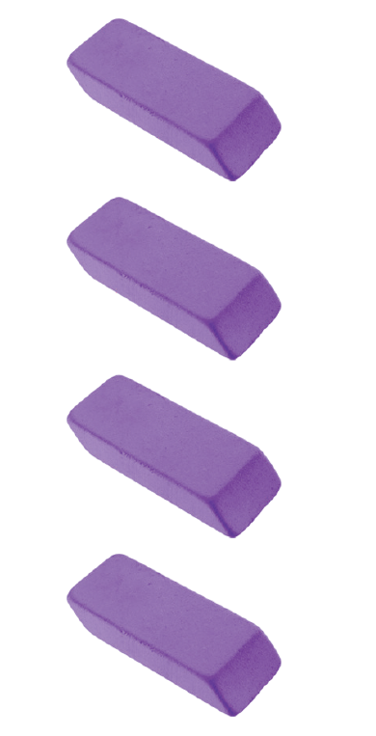


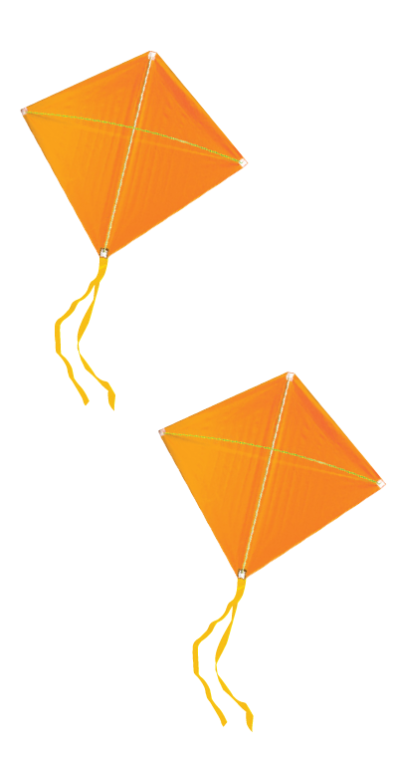


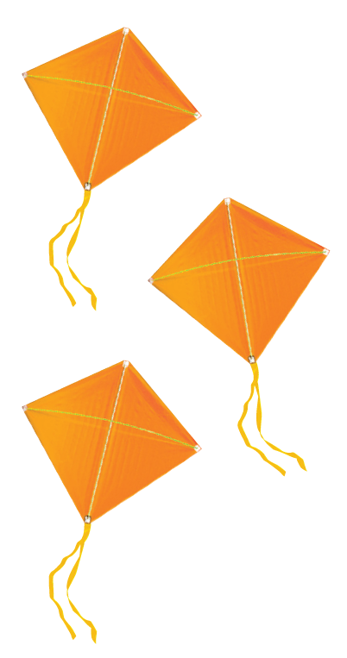
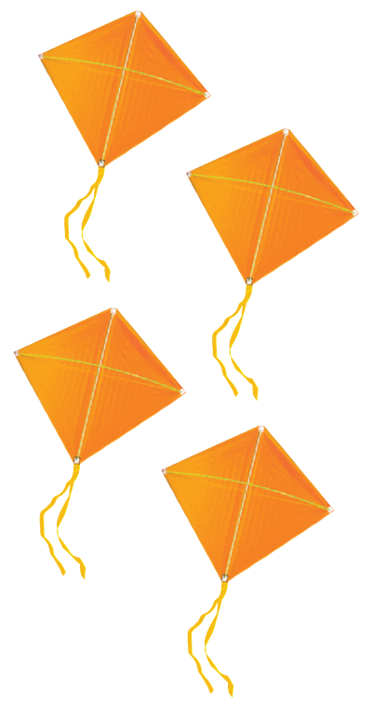
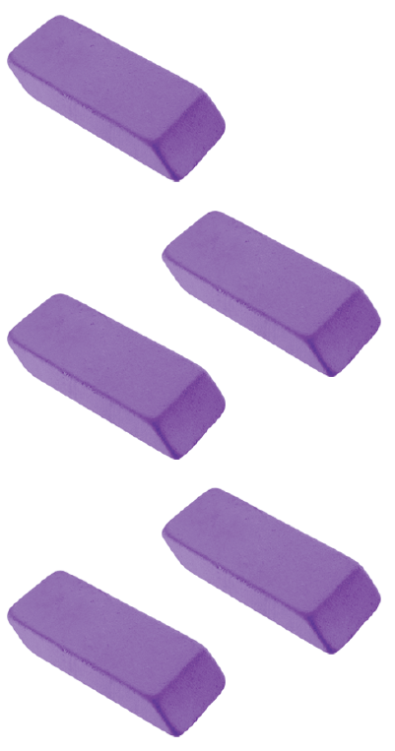

10 Cut out the cards for Unit 4. Listen. Put the cards in order. Say.
TR: A56
U4 p. 37

Slide 20
Script
TR: A56
Activity 10
Cut out the cards for Unit 4. Listen. Put the cards in order. Say.
Three pink pencils.
Four purple erasers.
Seven blue books.
Three orange kites.
One pink pencil.
How many pink pencils?
How many purple erasers?

Slide 21





11 Use the rest of the cards. Say. Put the cards in order.
U4 p. 37

Slide 22




12 Listen and say. Then listen again and trace.
TR: A57
TR: A58
1.
2.
U4 p. 38

Slide 23


12 Listen and say. Then listen again and trace.
TR: A57
TR: A58
3.
U4 p. 38

Slide 24
Script
Activity 12
Listen and say.
Activity 12
Listen and trace.
TR: A57
TR: A58
1. J /dʒ/ /dʒ/ Juice Juice
2. C /k/ /k/ Cat Cat
3. X /ks/ /ks/ Fox Fox
1. J /dʒ/ /dʒ/ Juice Juice
2. C /k/ /k/ Cat Cat
3. X /ks/ /ks/ Fox Fox

Slide 25
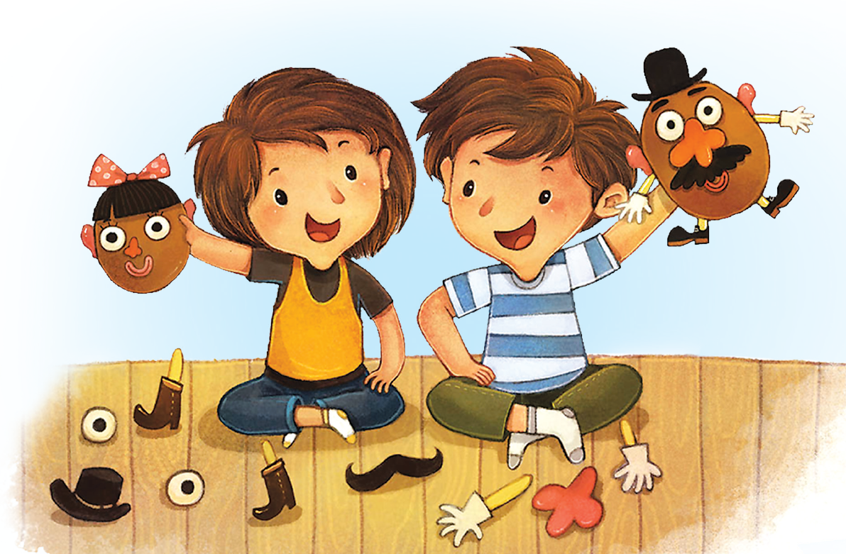
13 Listen and chant.
TR: A59
One mouth for me.
Two ears for you.
Just like the cat,
and the fox, too!
U4 p. 38

Slide 26
Script
TR: A59
Activity 13
Listen and chant.
One mouth for me.
Two ears for you.
Just like the cat,
and the fox, too!

Slide 27
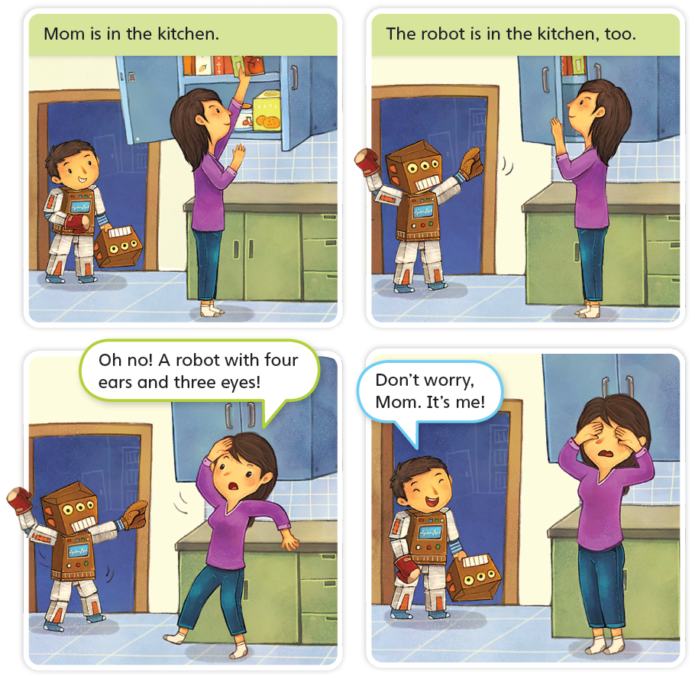
14 Listen to the story.
TR: A60
It’s Me!
U4 p. 39

Slide 28
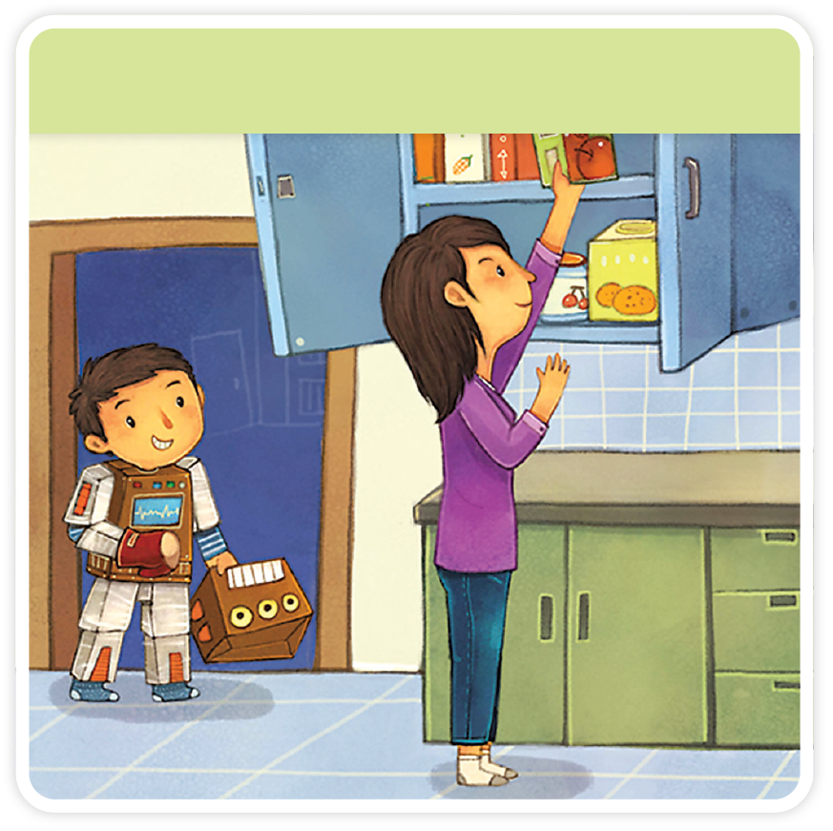
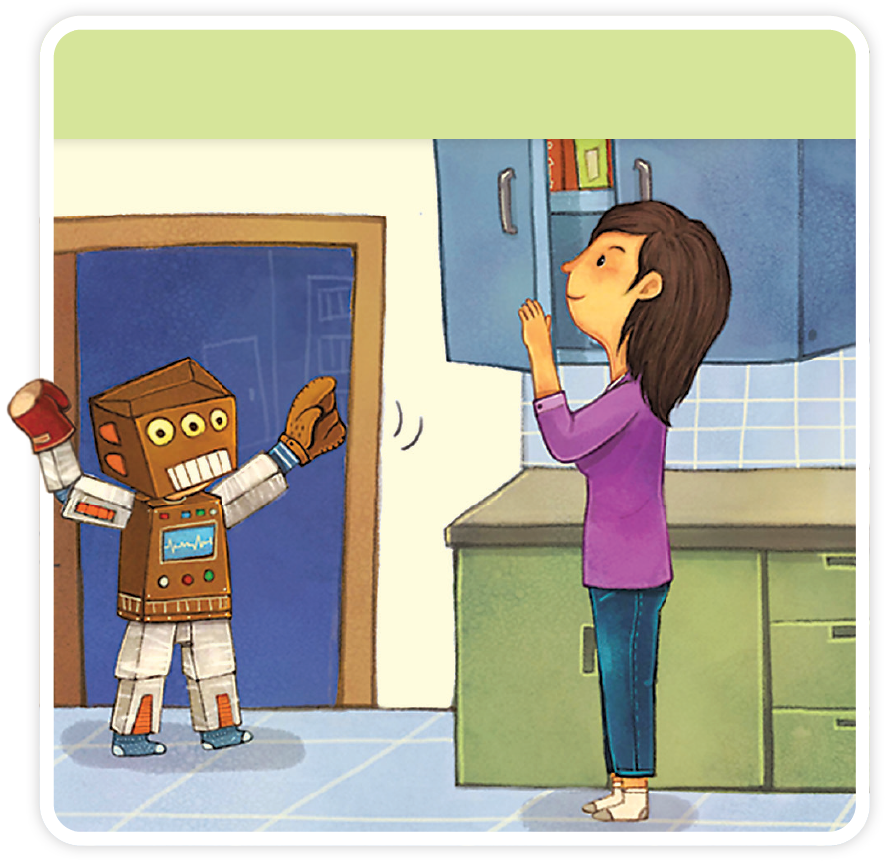

It’s Me!
TR: A60
U4 p. 39

Slide 29
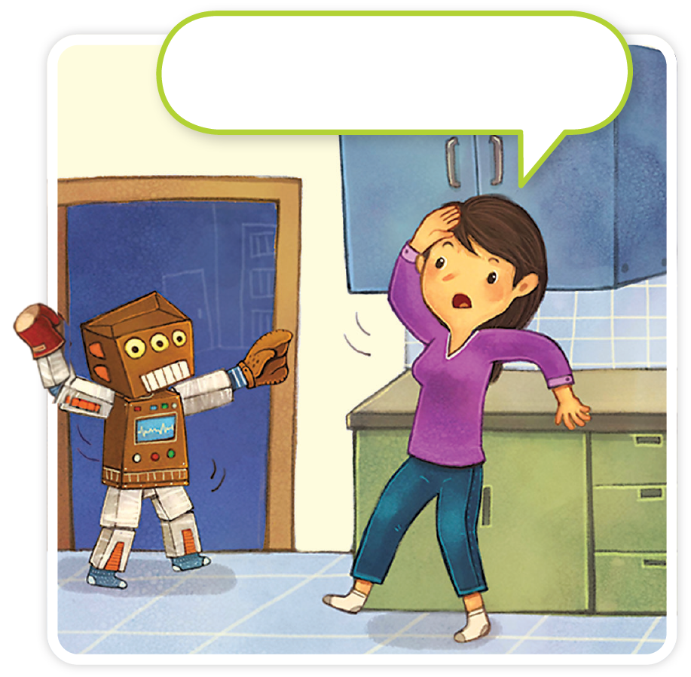
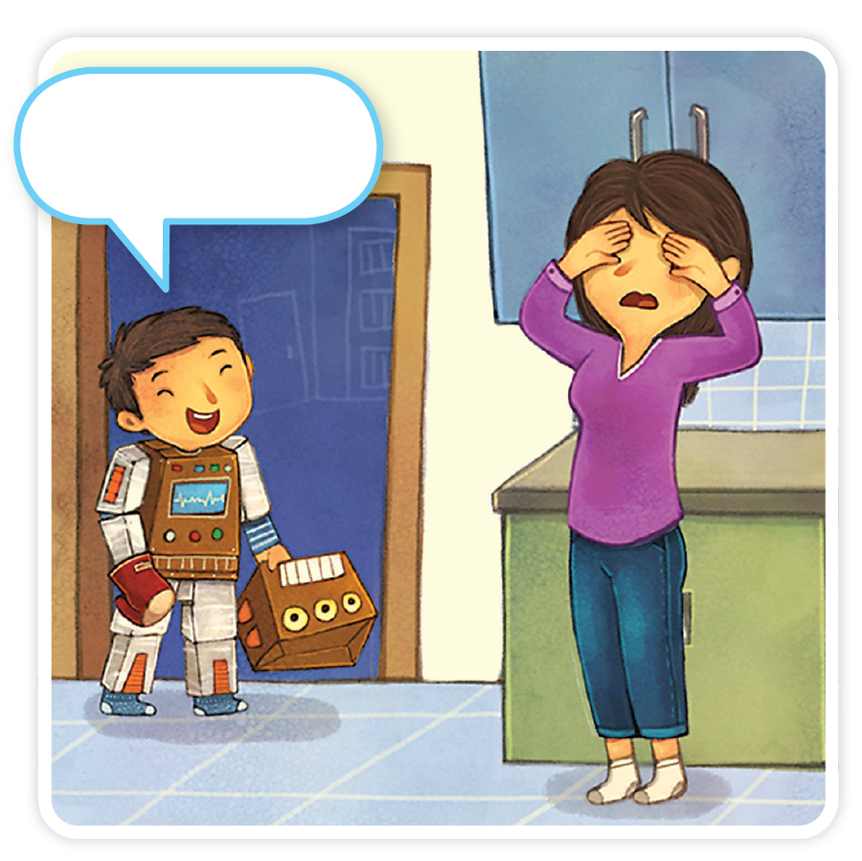
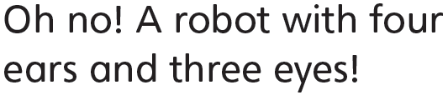
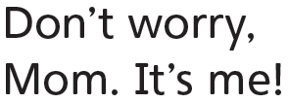
TR: A60
U4 p. 39

Slide 30
Script
TR: A60
Activity 14
Listen to the story.
It’s Me!
(Narrator) Mom is in the kitchen.
(Narrator) The robot is in the kitchen, too.
(Mother) Oh, no! A robot with four ears and three eyes!
(Boy) Don’t worry, Mom. It’s me!

Slide 31

15 Do you like the story? Circle.
U4 p. 39

