Slide 1

Unit Review

Slide 2
Review
Units 1–4

Slide 3
English Time Chant
English, (clap) English, (clap)
English (clap) today! (clap, clap)
English, (clap) English, (clap)
Hip, hip, (clap) hooray! (clap, clap)
Notes:
Say Good morning/afternoon, class. How are you
today?
Get students ready to use the English Time chant.
Lead the class in the chant.

Slide 4
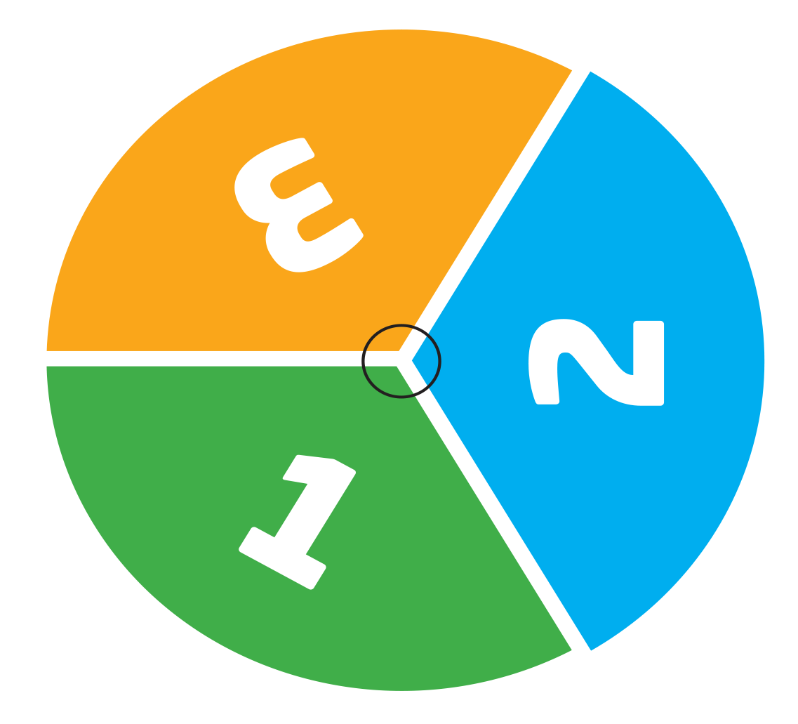
Let’s make!
Let’s make a spinner!
Notes:
Get ready to play Say Today, we are going to play a game. First, let’s make the spinner.
Have students cut out the spinner. Then, give each student a paper clip. Model using a pencil to hold the paper clip in place. Put a paper clip around the pencil point. Then, put down the pencil point in the yellow circle on the spinner. Use your pointer finger to spin the paper clip around the pencil point.

Slide 5

Open your books to page 40 - 41
Notes:
Have students open their books to pp. 40–41.

Slide 6
Spin the Spinner
1
= 1 space
2
= 2 spaces
3
= 3 spaces
Notes:
Say We are going to
use the spinner to move along the board. Spin, and say I have [2]. I move [two] spaces. Model holding up a game piece and moving
it two spaces on the board.

Slide 7
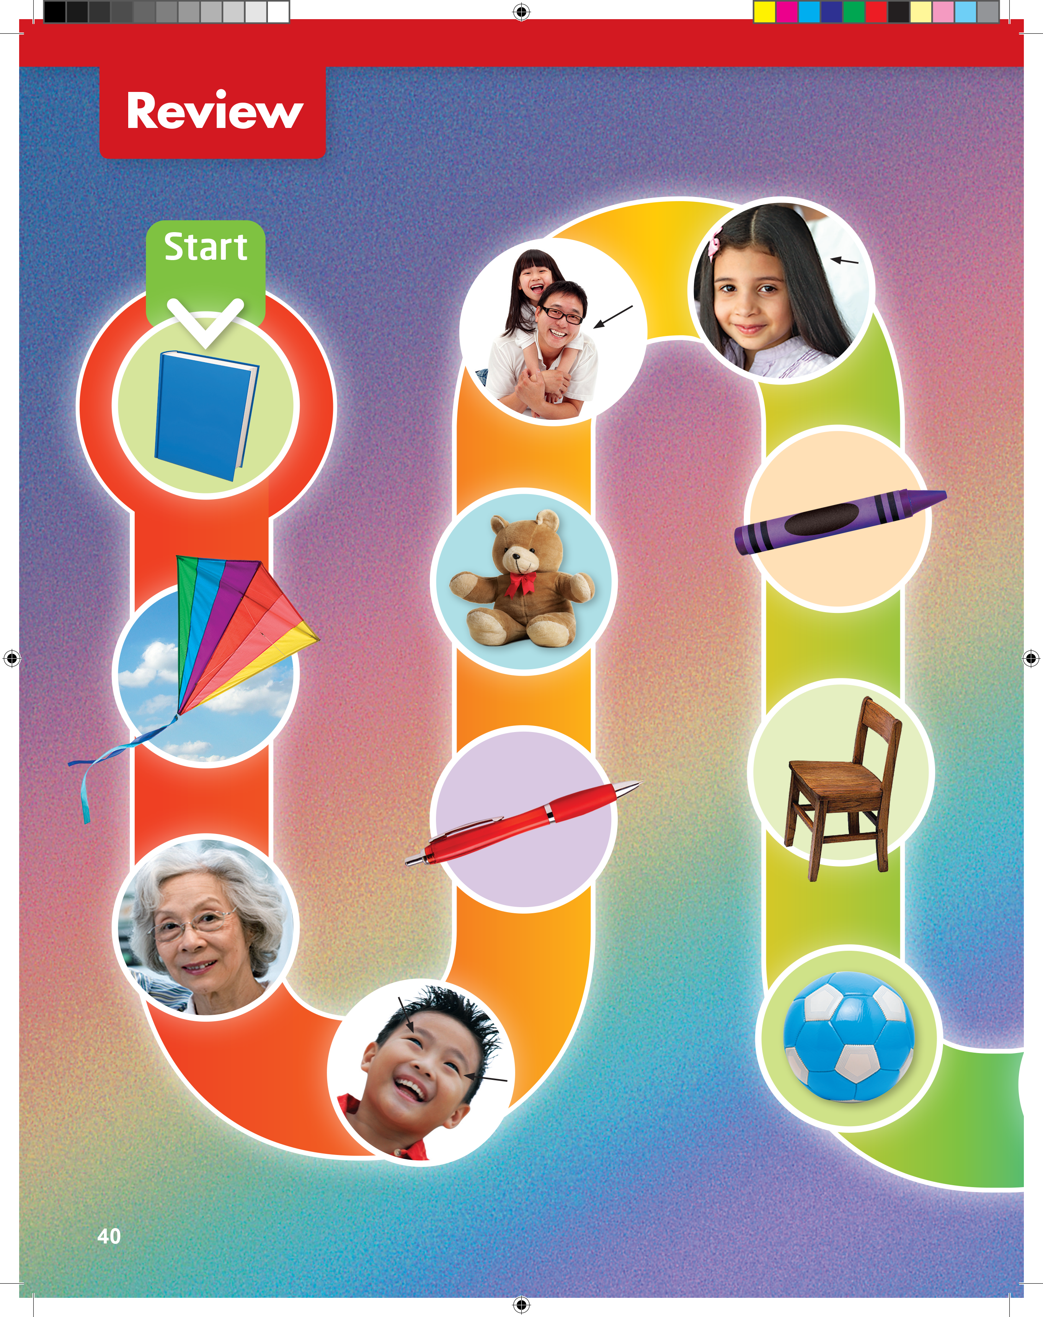
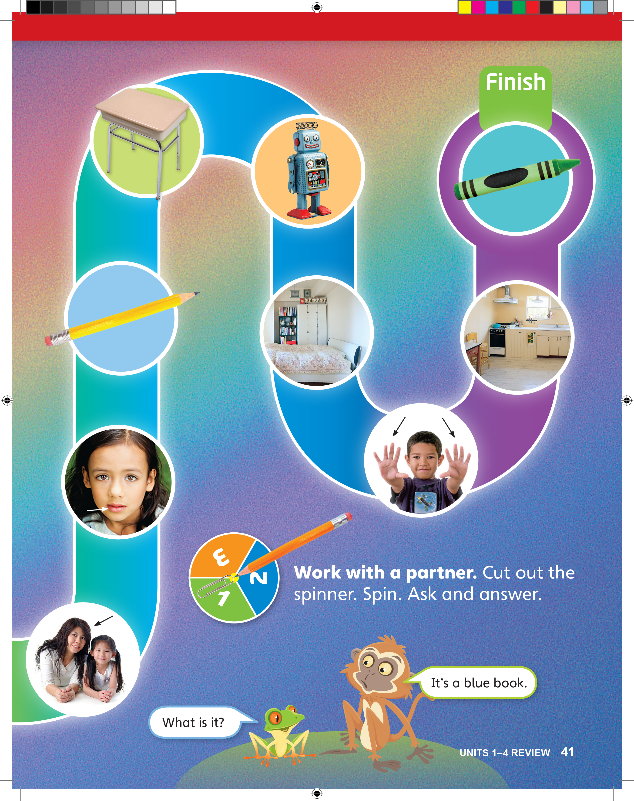
What is it?
Is it a doll?
Is it a kite?
Who is this?
How many eyes does he have?
Notes:
Have students look at the game board.
Point to the first space, and ask What is it? Have students say It’s
a blue book. Have students repeat both the question and the
answer. Point to the mascots on p. 41, and say the dialogue again.
• Point to the second space. Ask Is it a doll? (No, it isn’t.) Then ask Is
it a kite? (Yes, it is.) Have students repeat both the questions and
the answers.
Point to the third space. Ask Who’s this? Have students
respond, using the language It’s Grandma. Again,
have students repeat.
• Point to the fourth space. Ask How many eyes does
he have? Have students answer He has two eyes.
Again, have students repeat. Then, say Ask your
partner these types of questions as you play.

Slide 8
Ask and Answer
What is it? It’s __________.
Is it a _______? Yes, it is.
Is it _______? No, it isn’t.
Who is this? This is __________.
How many __________?
Notes:
Sentence frames If students need help thinking
of questions and answers, write examples on the
board:

Slide 9
Notes:
Play the game Place students in pairs. Have
students place their game pieces before the first
space. Note: Students can play in the same book.
Or, if students prefer, they can each move their
piece in their own book.
• Have students spin to decide who goes first. On a
turn, the student should spin and move. The partner
should look at the space and ask a question. For
example, if the student spins a 2 and lands on the
space with the kite, the partner asks What is it? or
Is it a kite? The first student responds in a sentence,
such as It’s a kite or Yes, it is.
• Have students take turns spinning, moving their
game piece, and answering questions about the
photos. The student who gets to the end of the path
first wins the game.
• For extra practice, encourage students to play the
game again, this time with a different partner.

Slide 10
Goodbye Chant
Good work, class.
Hip hip, hooray!
Goodbye for now.
Have a nice day!
Notes:
Say Nice work today, class. Now let’s chant.
Lead the class in the Goodbye chant.

Slide 11

Let’s Check
Make a sentence with
a word from Units 1–4.
Notes:
Can students remember and use the new words
they’ve learned?
As students leave the class, ask them to make a
sentence with one word they remember from Units 1–4.

Slide 12
Thank you!

