Slide 1

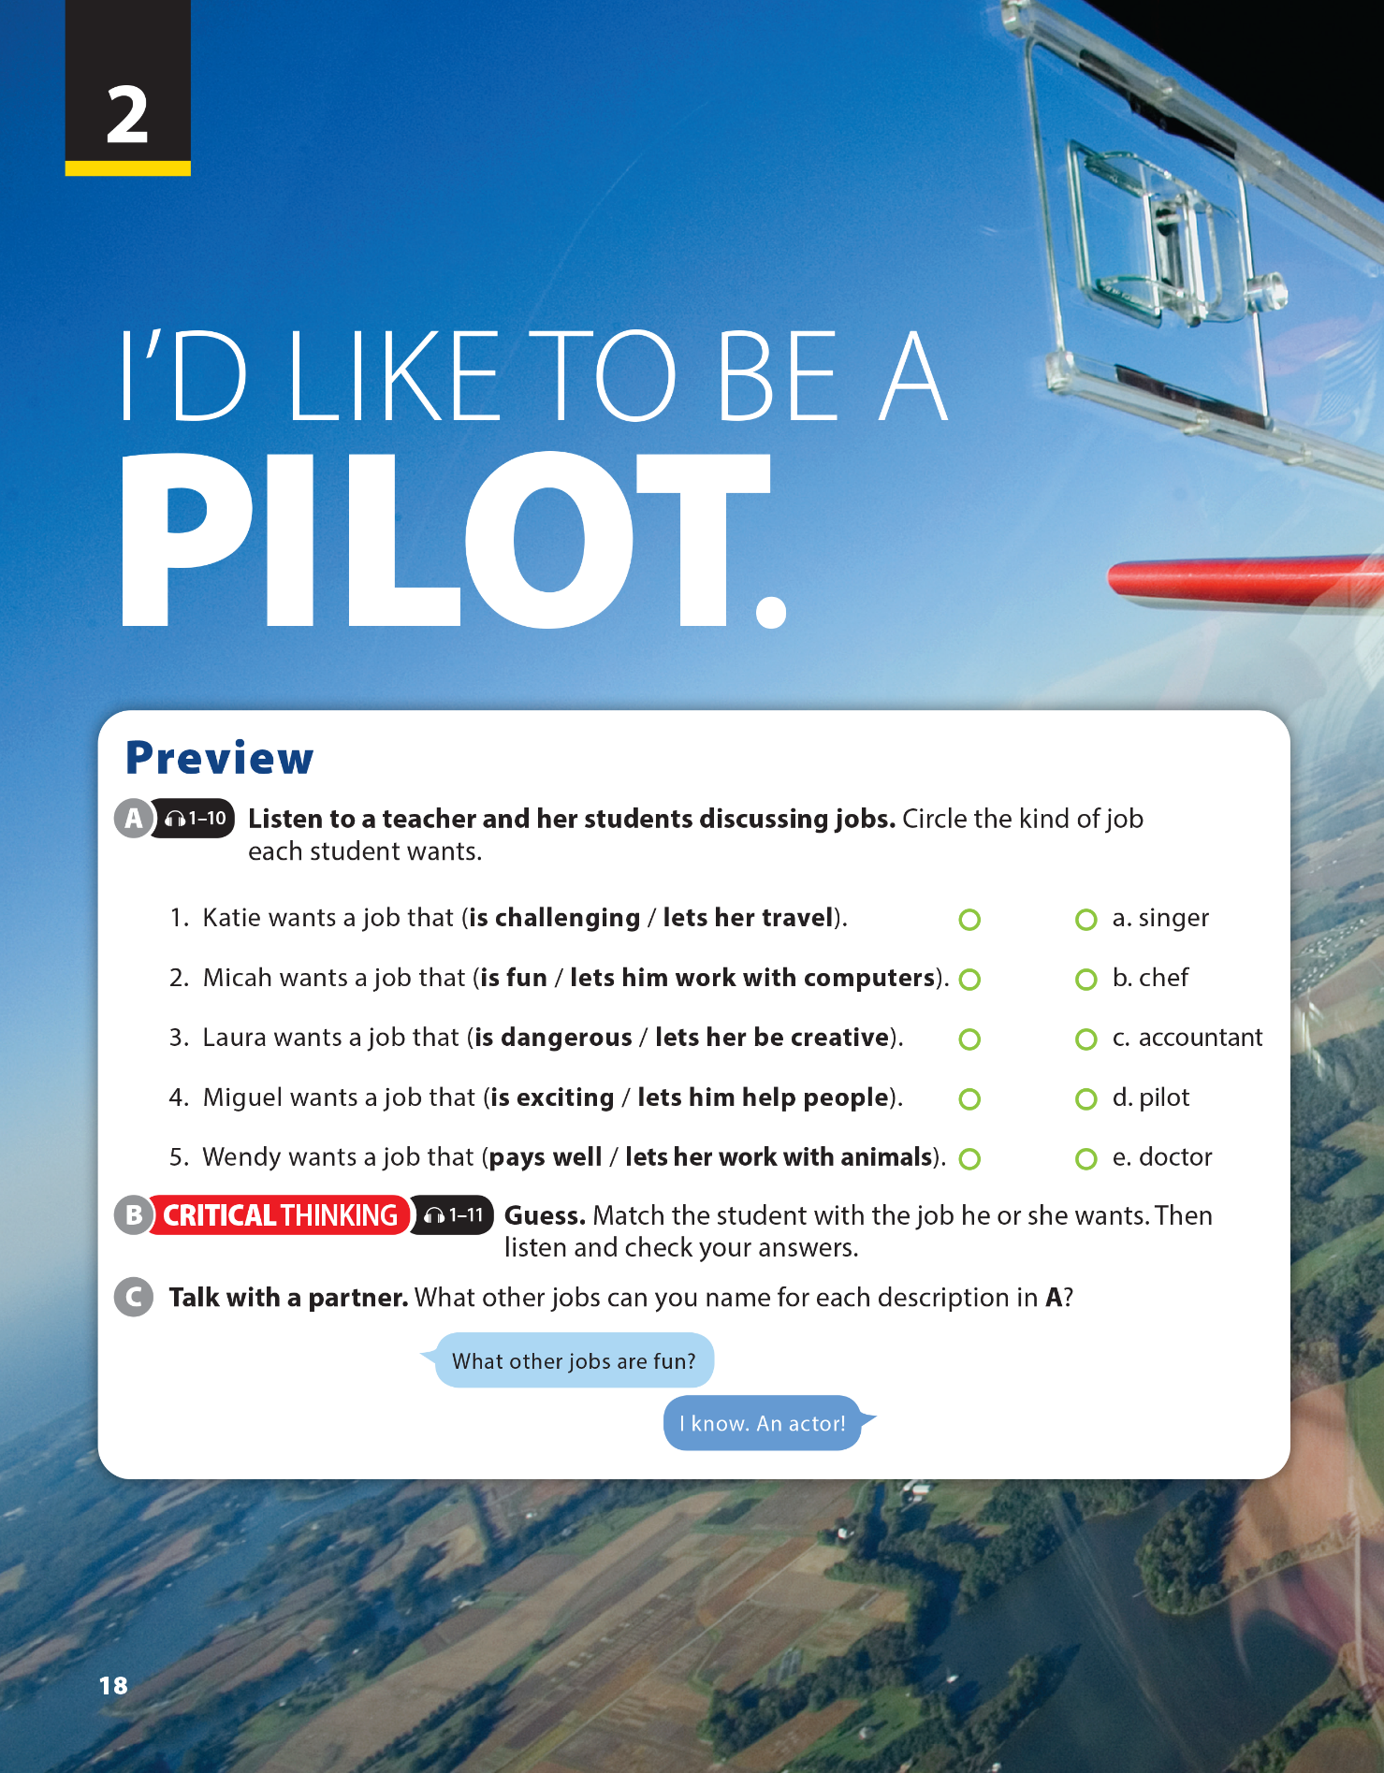
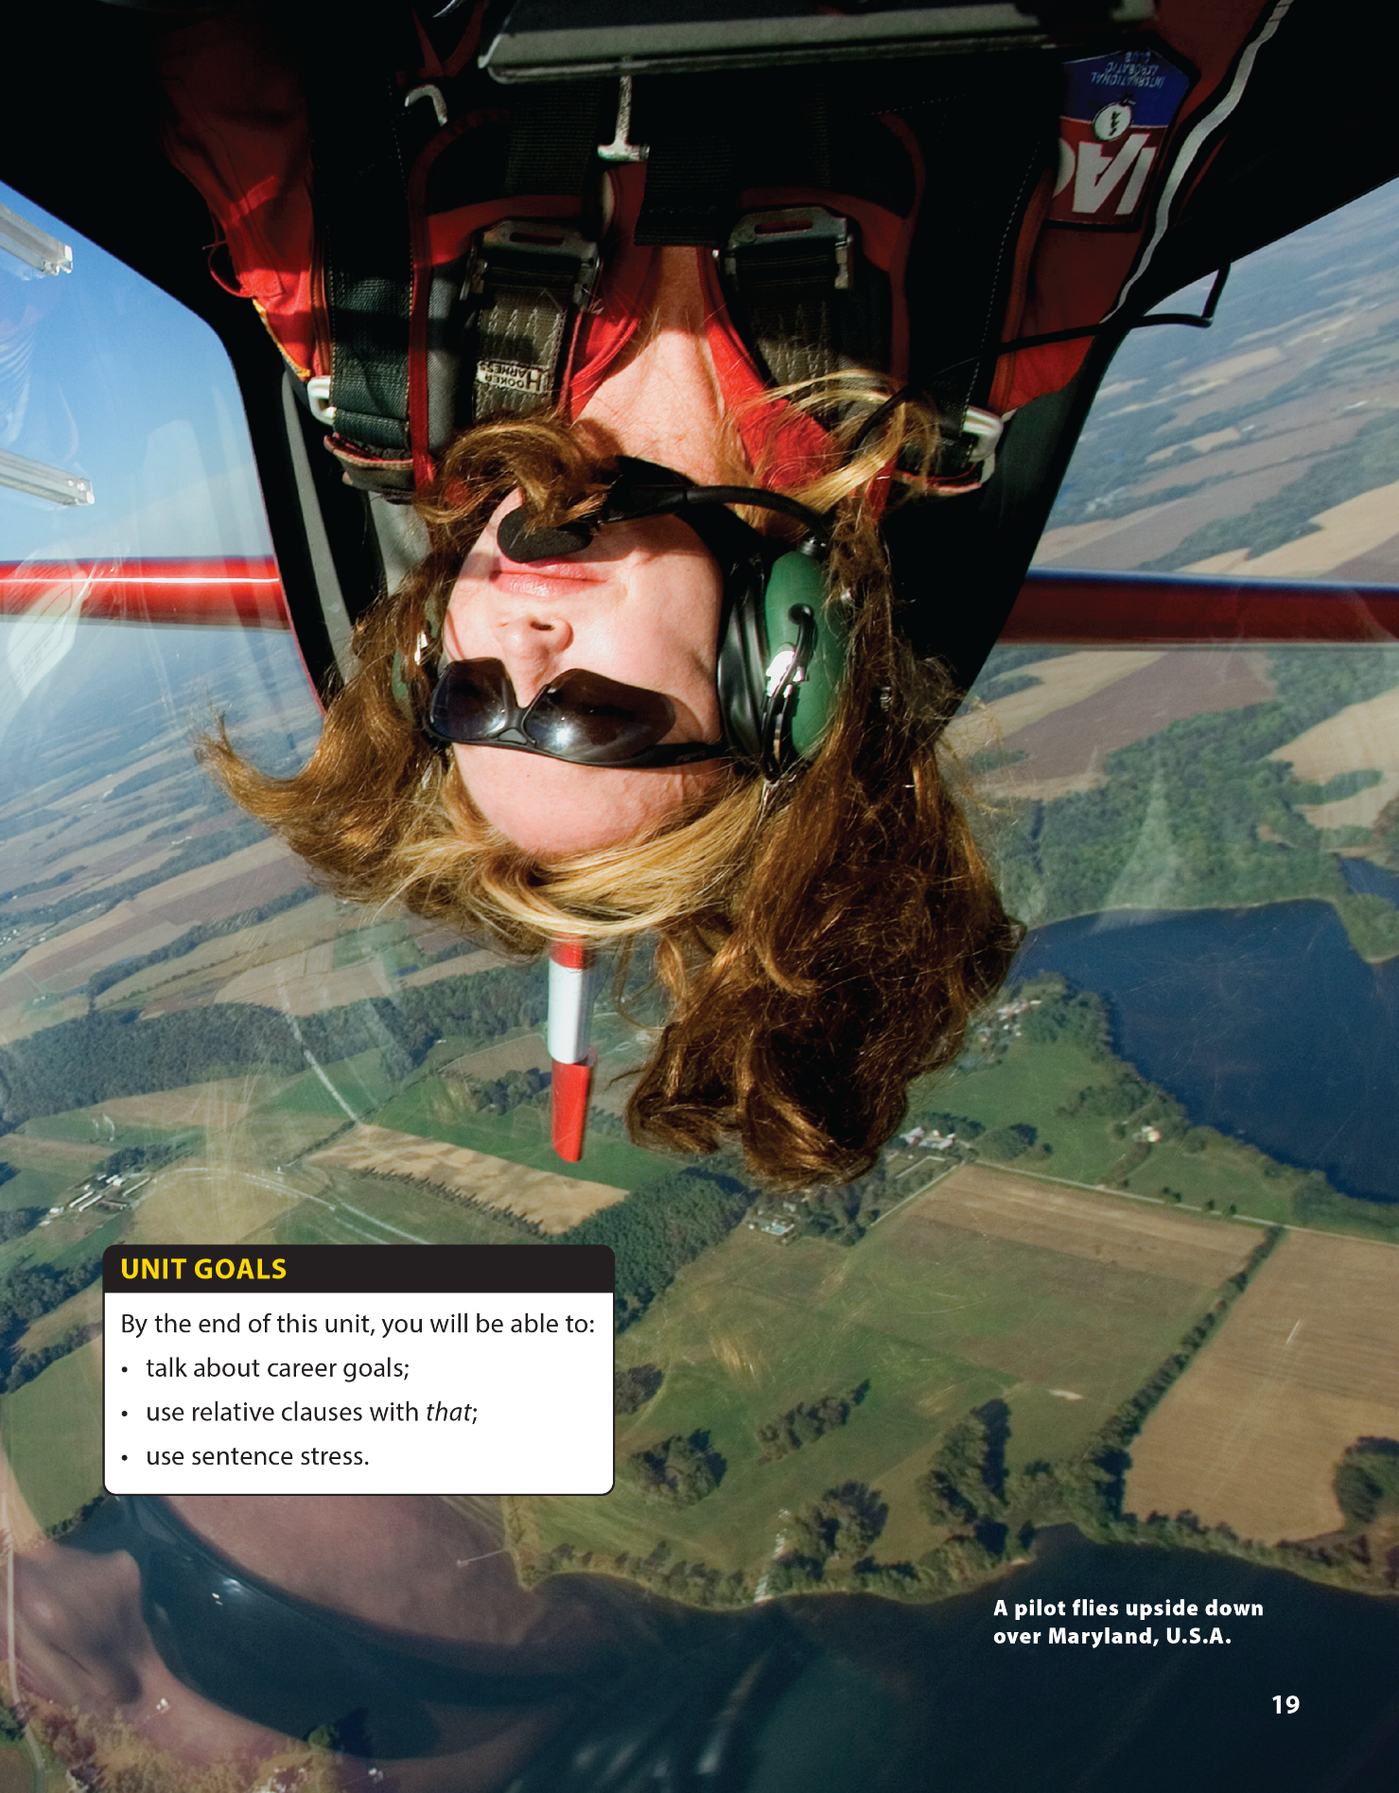

Writing and Writing Worksheet
National Geographic Learning, a Cengage Company © 2022 Cengage Learning, Inc. ALL RIGHTS RESERVED. This presentation tool is intended for teaching purposes only and may not be scanned, copied, duplicated, or posted to a publicly accessible platform in whole or in part.

Slide 2



UNIT 2
I'D LIKE TO BE A PILOT.
WARM UP
WHAT’S IN MY MIND?
Notes:
Game: “What’s in my mind?”.
Tell students they are going to play a game called “What’s in my mind?”.
Class divides into 2 groups.
Call 1 student from each group to stand up and think of a job (just in his/her mind).
Then he/she gives 1-2 sentences to describe the job (The job lets me …….).
Other group can guess after 1 clue -> get 3 stars
Other group can guess after 2 clues -> only get 1 star.
Each team has 3 turns.
Find the winner.

Slide 3



UNIT 2
I'D LIKE TO BE A PILOT.
PRESENTATION
GUIDANCE COUNSELOR
Notes:
a guidance counselor is someone who gives career advice and helps you find out which job is best for you by encouraging you to think about what you like, what you can do, and what you are good at.

Slide 4
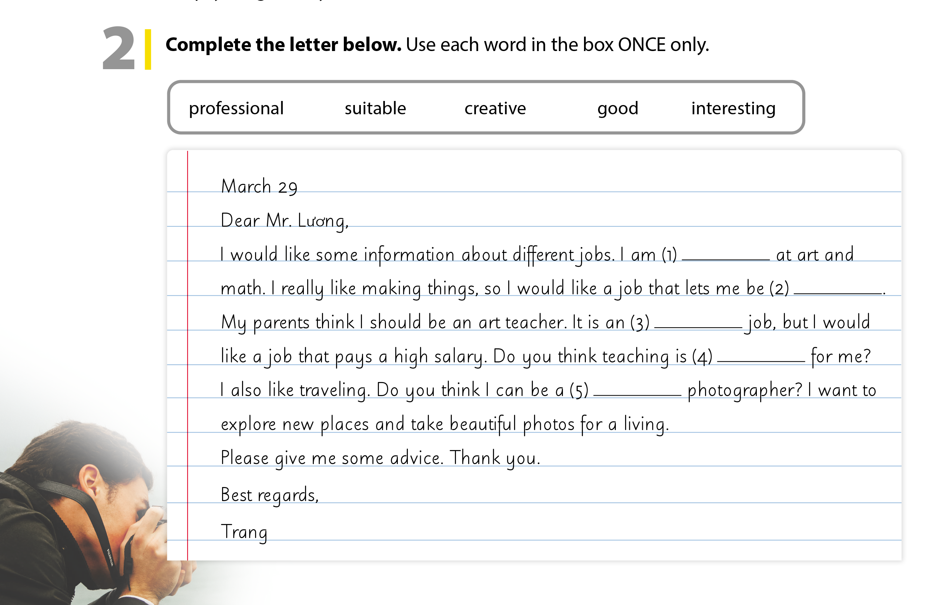
UNIT 2
I'D LIKE TO BE A PILOT.
PRESENTATION
A letter to a guidance counselor
INTRODUCTION
Date
Dear Mr/Mrs…,
BODY
Describe yourself: I’m good at…./ I’m keen on…/ I really like…….
Ask about different jobs: Do you think …?/ I want to....
Ask for some advice.
CONCLUSION
Best regards,
{Your name}

Slide 5
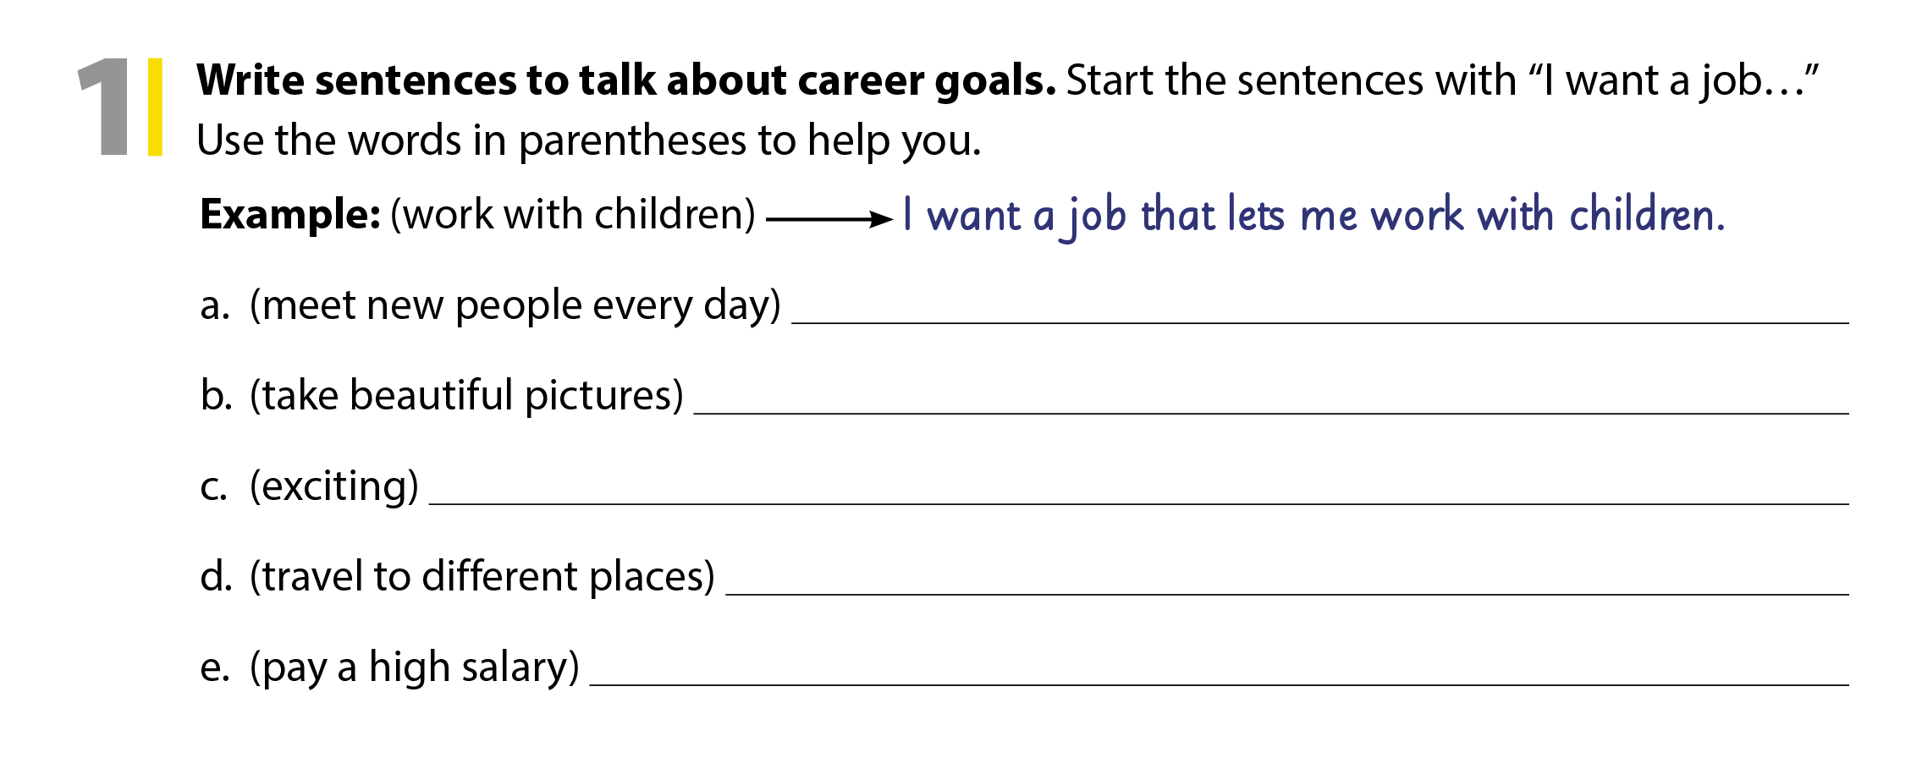
UNIT 2
I'D LIKE TO BE A PILOT.
WRITING

Slide 6
UNIT 2
I'D LIKE TO BE A PILOT.
WRITING
good
creative
interesting
suitable
professional

Slide 7

UNIT 2
I'D LIKE TO BE A PILOT.
WRITING
good
creative
interesting
suitable
professional
Notes:
Give them 10 mins for finishing the letter. Remind students that they must write 80–100 words.
Have students do the task.
Ask students to share their writing with their partners to cross-check.

Slide 8


THANK YOU!

