Slide 1

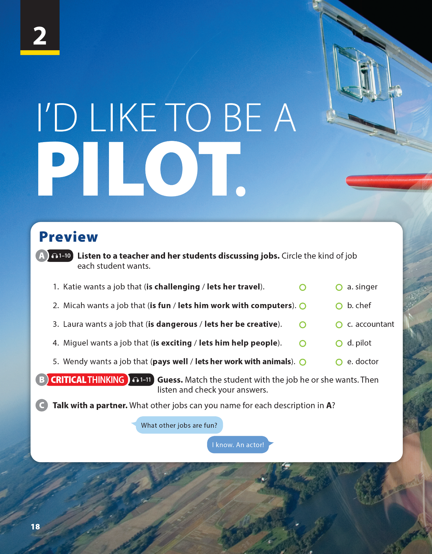
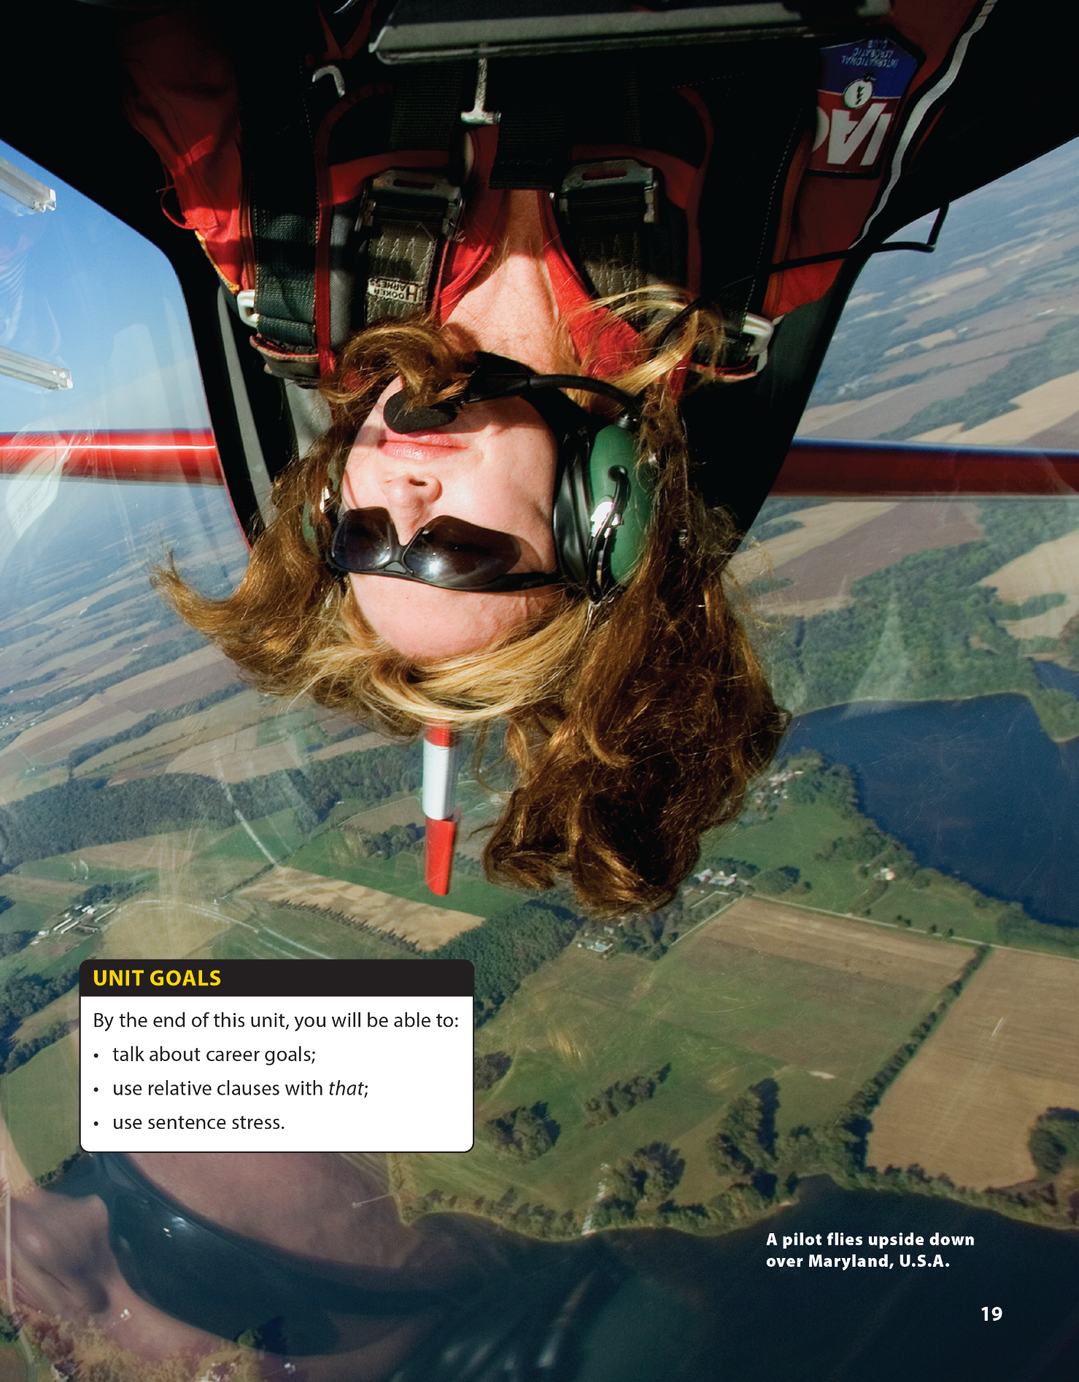

Video and Video Worksheet
National Geographic Learning, a Cengage Company © 2022 Cengage Learning, Inc. ALL RIGHTS RESERVED. This presentation tool is intended for teaching purposes only and may not be scanned, copied, duplicated, or posted to a publicly accessible platform in whole or in part.

Slide 2

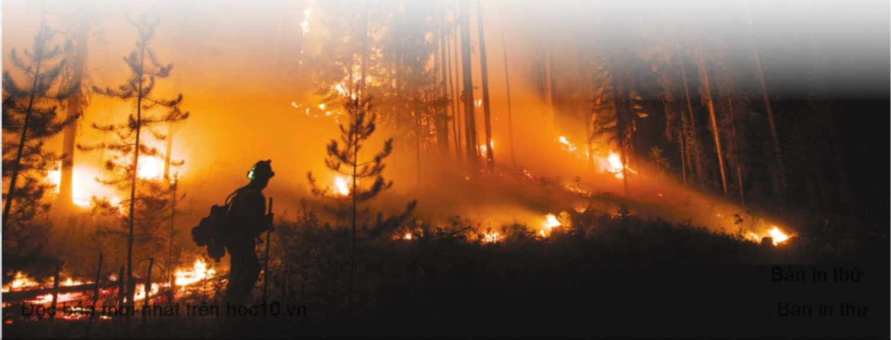
UNIT 2
I'D LIKE TO BE A PILOT.
WARM UP
Describe the picture
and guess what the video is going to be about

Slide 3
UNIT 2
I'D LIKE TO BE A PILOT.
CONTENT NOTE
WILDFIRES, MARK THIESSEN
WHERE?
HOW ?
Notes:
A wildfire occurs in forests, the wilderness, and other places with lots of plants and trees that can burn easily. The fire usually moves quickly, partially because it burns dry grass, trees, or other vegetation. The fires are difficult to control and cause widespread destruction. In contrast, when we talk about a fire, we include fires that are sometimes small and are quickly and easily extinguished. Although Mark Thiessen has been documenting wild land fires and firefighters every summer since 1996, he has also published stories on topics as varied as Peruvian mummies, Egyptian archaeologists, and James Cameron

Slide 4

UNIT 2
I'D LIKE TO BE A PILOT.
WARM UP

Slide 5
UNIT 2
I'D LIKE TO BE A PILOT.
BEFORE YOU WATCH
BEFORE YOU WATCH
Guess. What do you think it’s like to be a wildfire photographer? Circle the statements you think you will hear in the video.
It’s sometimes dangerous.
It pays well.
It has regular hours.
It lets you be creative.
It lets you work with people.
It’s challenging.

Slide 6

UNIT 2
I'D LIKE TO BE A PILOT.
BEFORE YOU WATCH
WHILE YOU WATCH
Check answers
It’s sometimes dangerous.
It pays well.
It has regular hours.
It lets you be creative.
It lets you work with people.
It’s challenging.

Slide 7
UNIT 2
I'D LIKE TO BE A PILOT.
WHILE YOU WATCH
WHILE YOU WATCH
Watch the video again. Circle the correct answer.
Thiessen usually takes photos of (wild animals / people and things).
Thiessen first wanted to become a photographer when he was (a child / a university student).
Thiessen takes photos of wildfires every (summer / fall).
Thiessen thinks the sight of trees damaged by fire can be (depressing / beautiful).

Slide 8
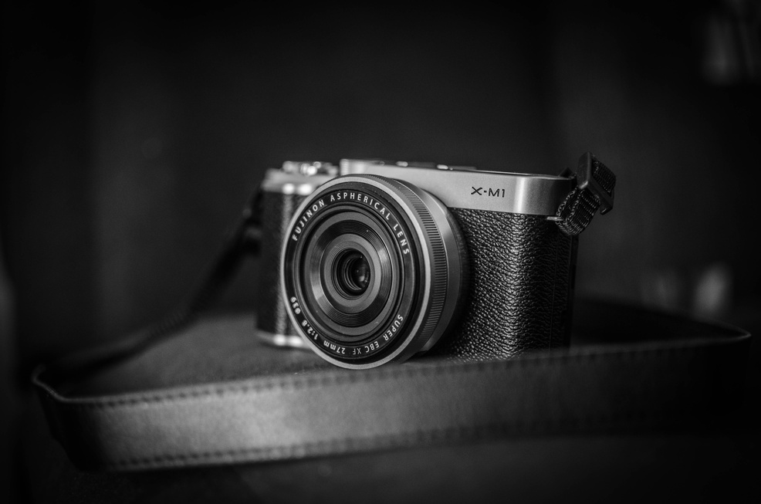
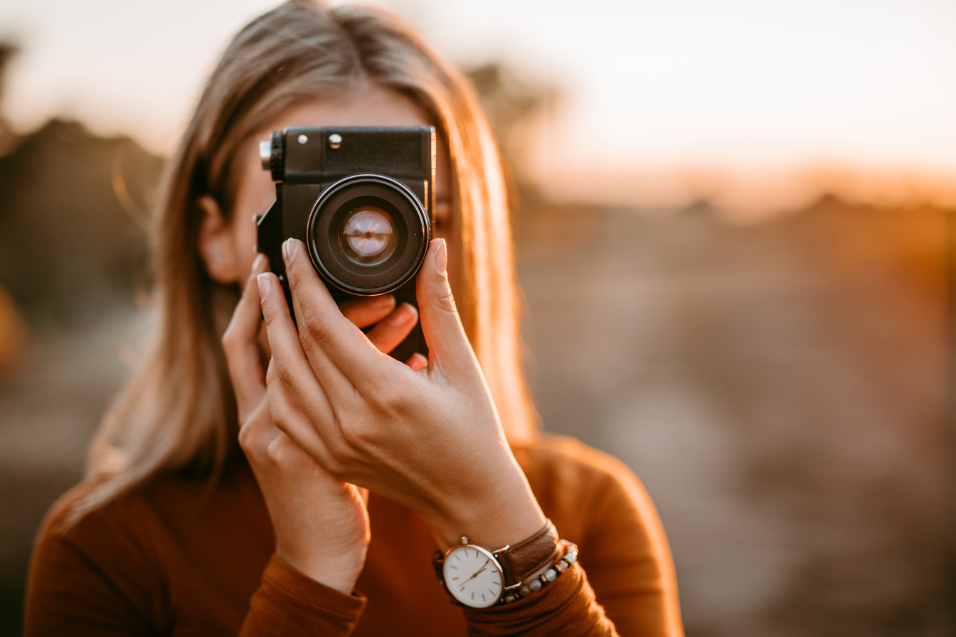
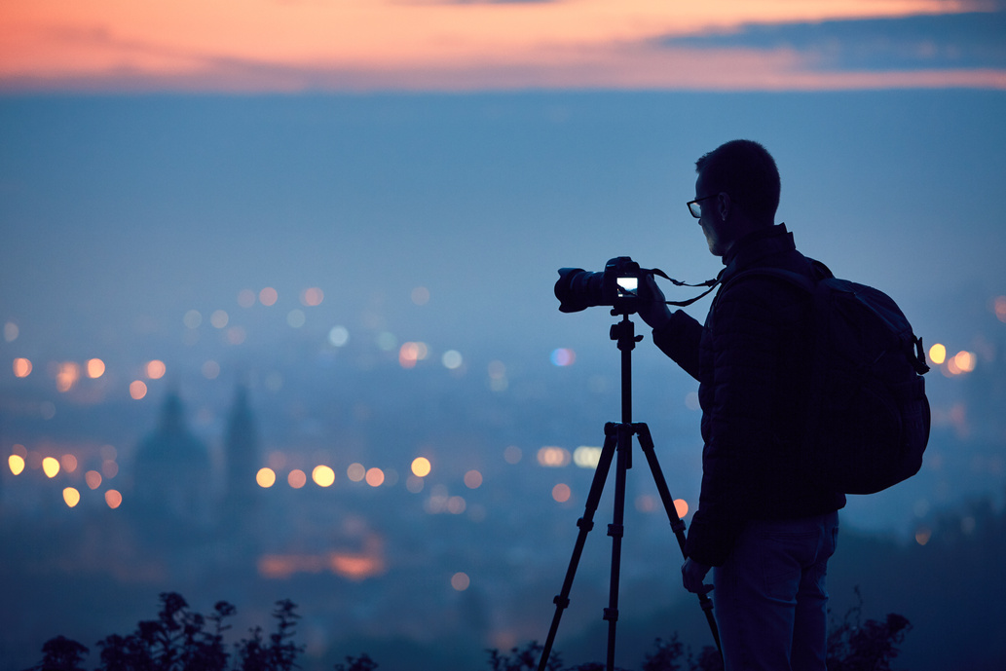
UNIT 2
I'D LIKE TO BE A PILOT.
AFTER YOU WATCH
AFTER YOU WATCH
Talk with a partner. Would you like to be a photographer? What would you like to take pictures of?

Slide 9


THANK YOU!

