Slide 1

Unit 1
My School
Bringing the world to the classroom and the classroom to life
ELTNGL.COM
A PART OF CENGAGE

Slide 2

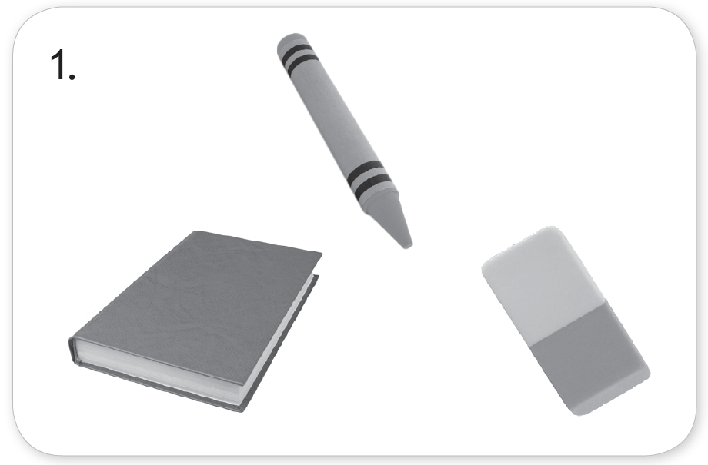
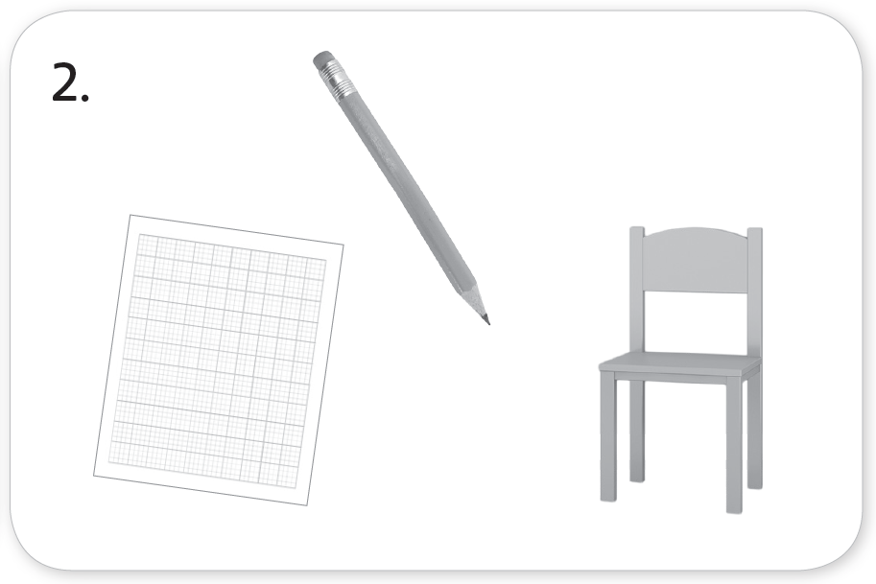
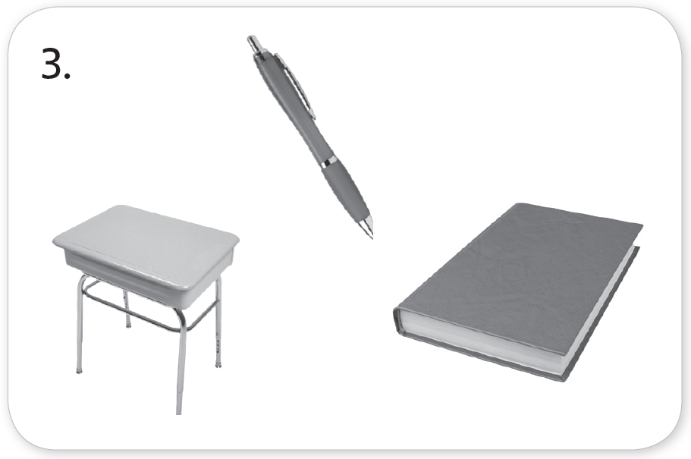
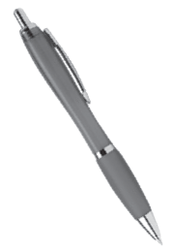
1 Listen. Look and circle.
TR: A10
U1 p. 6

Slide 3
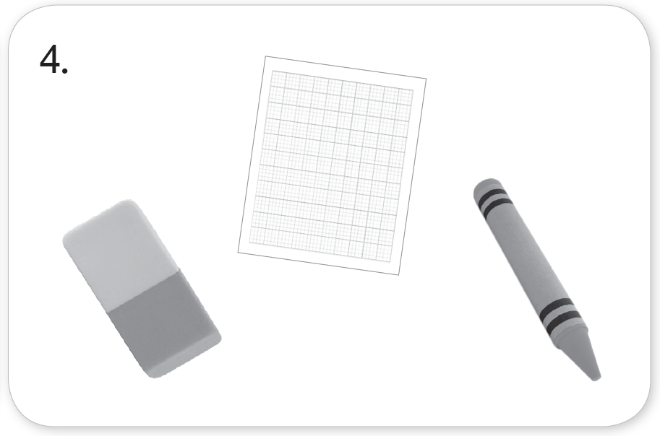
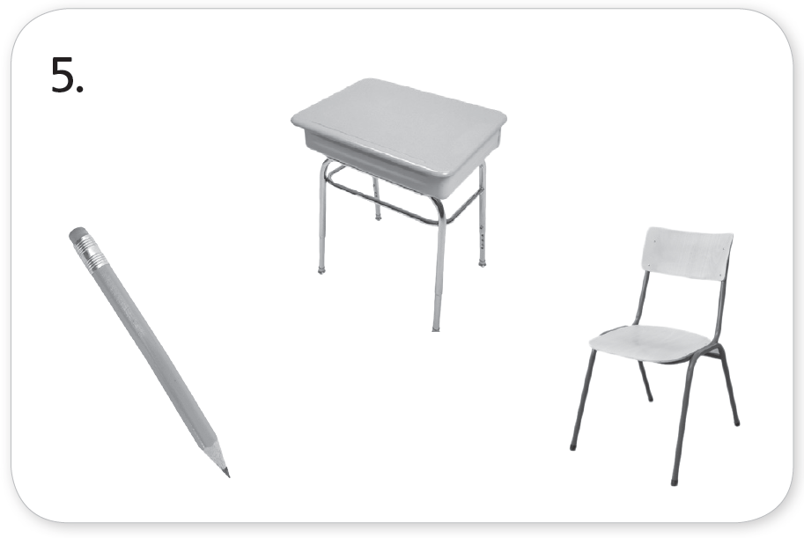
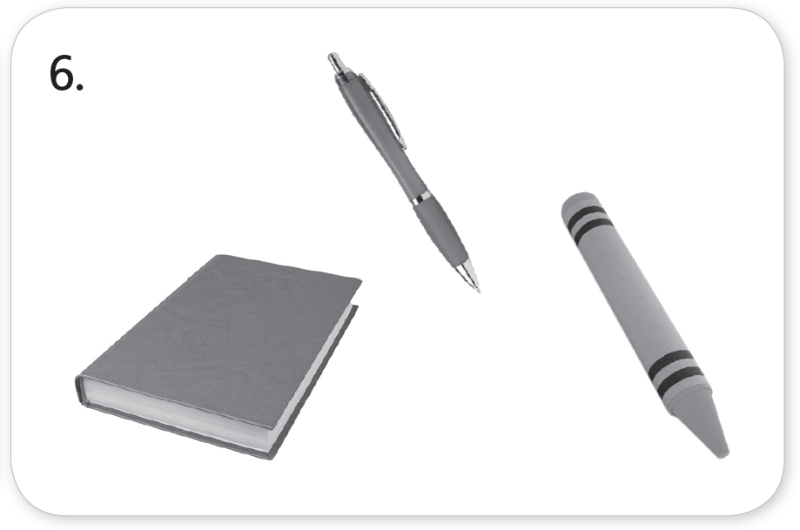
1 Listen. Look and circle.
TR: A10
U1 p. 6

Slide 4
Script
TR: A10
Unit 1
Activity 1
Listen. Look and circle.
1. a book
2. a chair
3. a pen
4. paper
5. a desk
6. a crayon

Slide 5
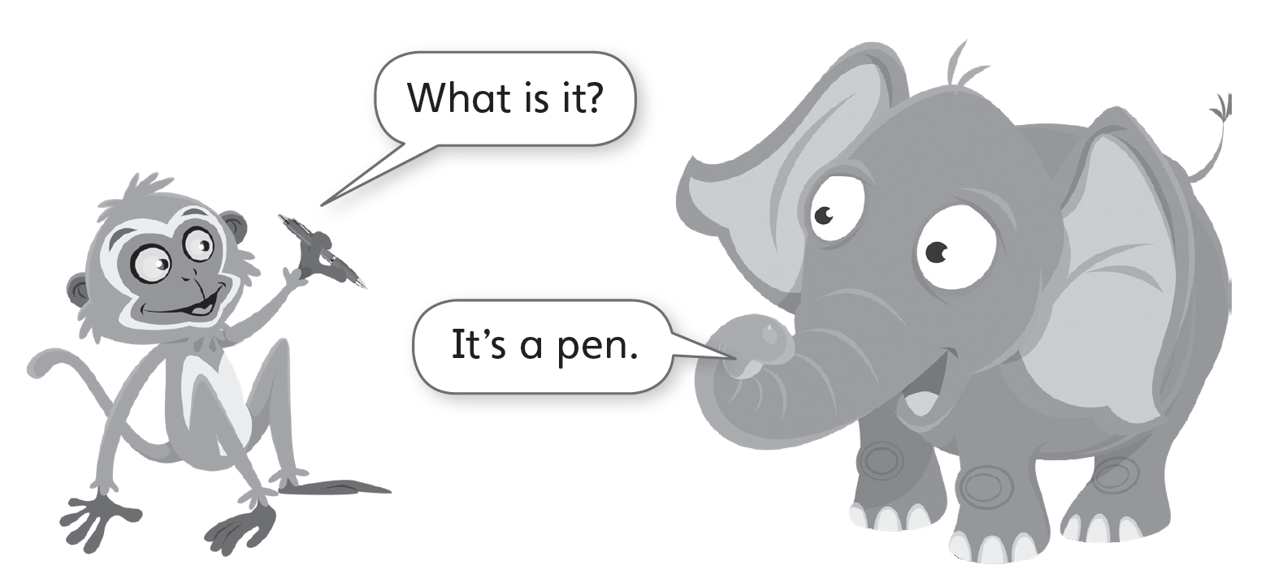
2 Listen and say.
TR: A11
U1 p. 7

Slide 6
Script
TR: A11
Activity 2
Listen and say.
(Monkey) What is it?
(Elephant) It’s a pen.

Slide 7


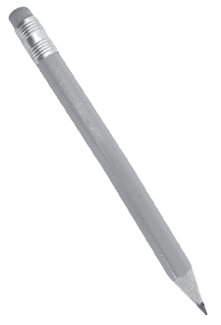
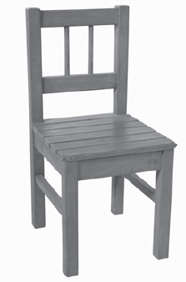


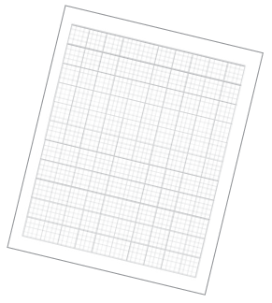
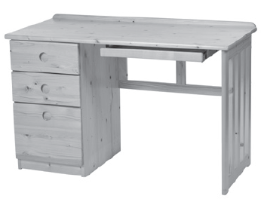

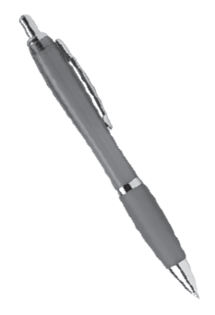
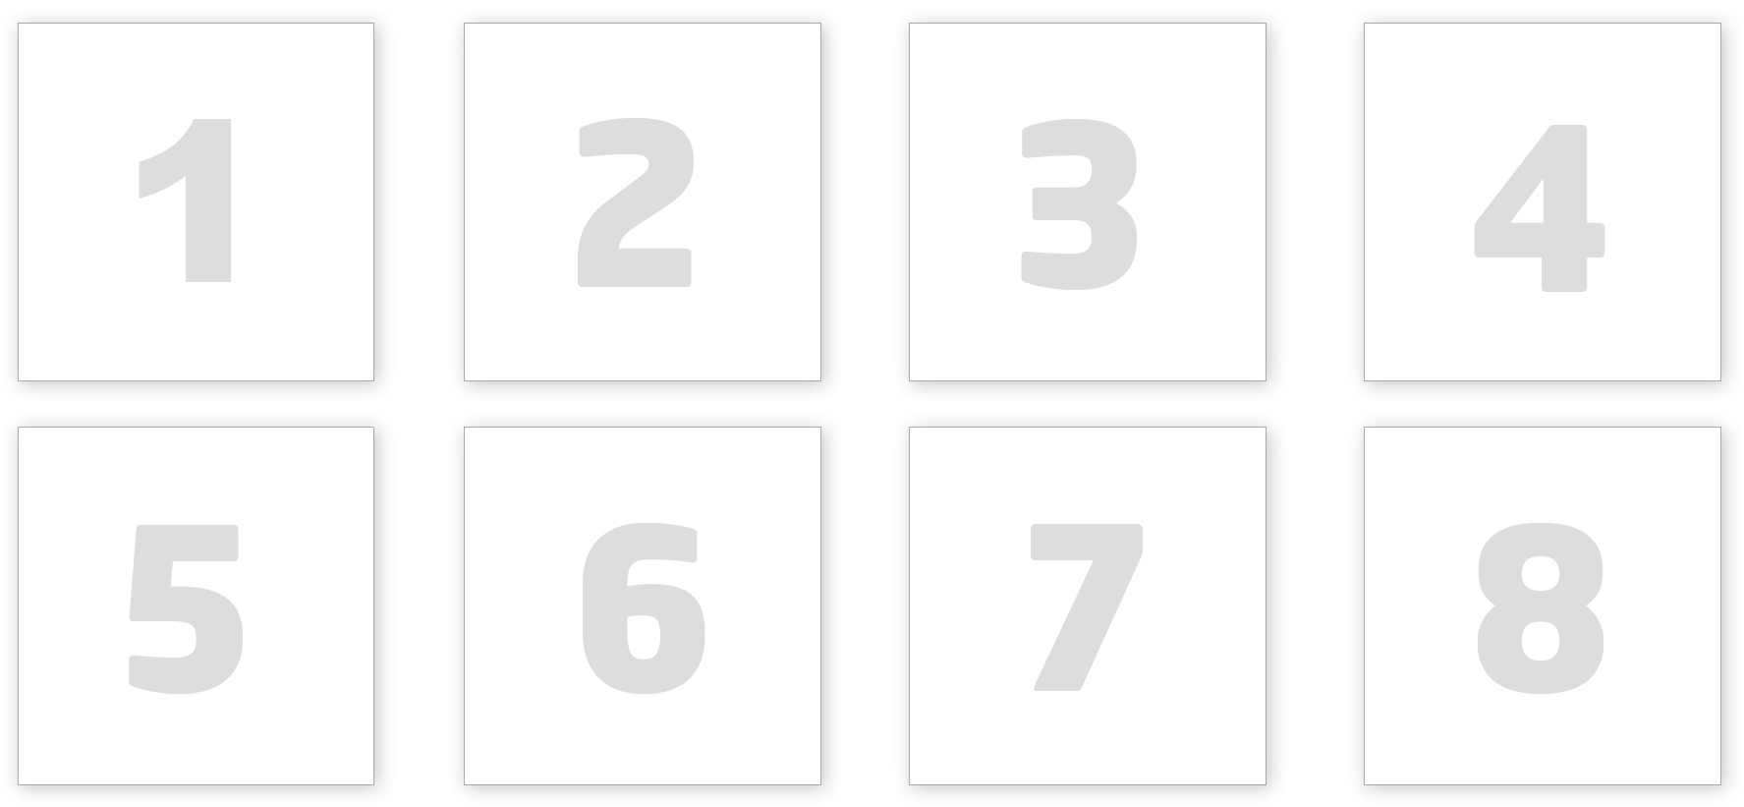

3 Cut out the cards on page 35. Listen. Glue the cards. Say.
TR: A12
U1 p. 7

Slide 8
Script
TR: A12
Activity 3
Cut out the cards on page 35. Listen. Glue the cards. Say.
1. What is it? It’s a book. 2. What is it? It’s a crayon.
3. What is it? It’s an eraser. 4. What is it? It’s a pen.
5. What is it? It’s a chair. 6. What is it? It’s paper.
7. What is it? It’s a desk. 8. What is it? It’s a pencil.

Slide 9

4 Match. Say.
U1 p. 7

Slide 10

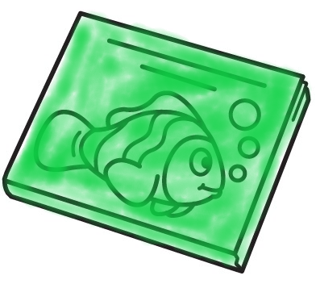
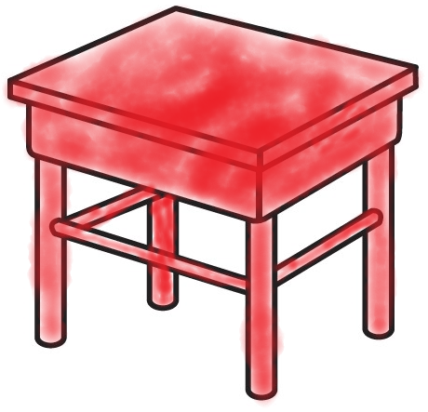
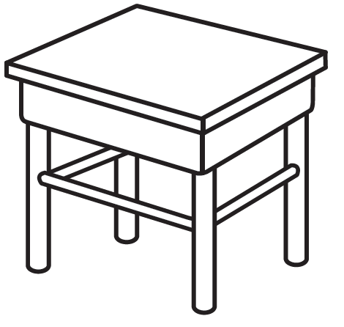




5 Listen. Color and say.
TR: A13
1.
2.
3.
4.
U1 p. 8

Slide 11
Script
TR: A13
Activity 5
Listen. Color and say.
1. a green book
2. a red desk
3. a yellow pencil
4. a blue eraser

Slide 12


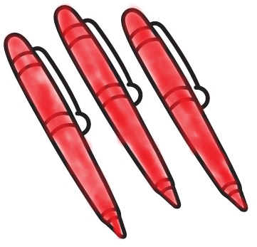
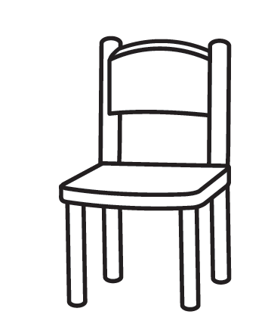
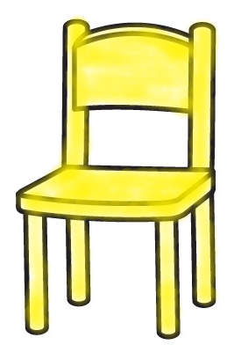


6 Listen. Color. Count and say.
TR: A14
U1 p. 8

Slide 13
Script
TR: A14
Activity 6
Listen. Color. Count and say.
three red pens
four blue books
one yellow chair
two green crayons

Slide 14
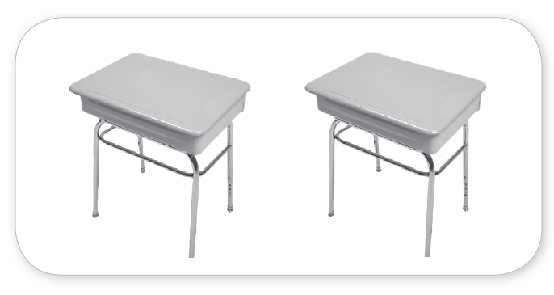
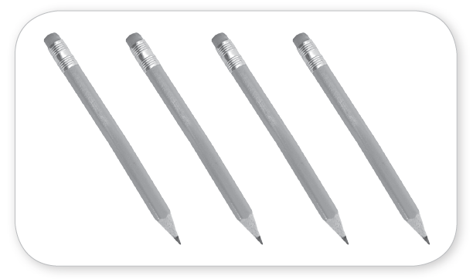

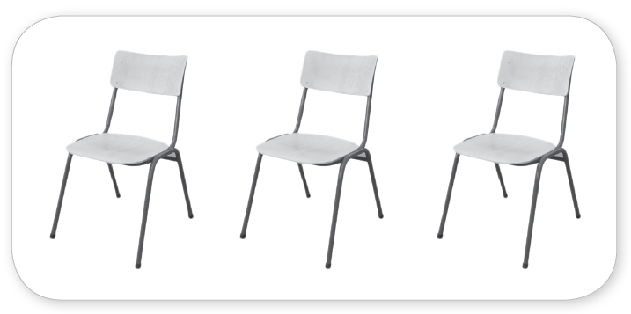
7 Listen. Count and write.
TR: A15
_______
2
_______
4
_______
_______
1
3
U1 p. 8

Slide 15
Script
TR: A15
Activity 7
Listen. Count and write.
How many desks?
How many pencils?
How many books?
How many chairs?

Slide 16
8 Listen and say.
TR: A16
Script
Activity 8
Listen and say.
1. V /v/ /v/ Have Have
2. E /e/ /e/ Pen Pen
3. P /p/ /p/ Pencil Pencil
U1 p. 9

Slide 17

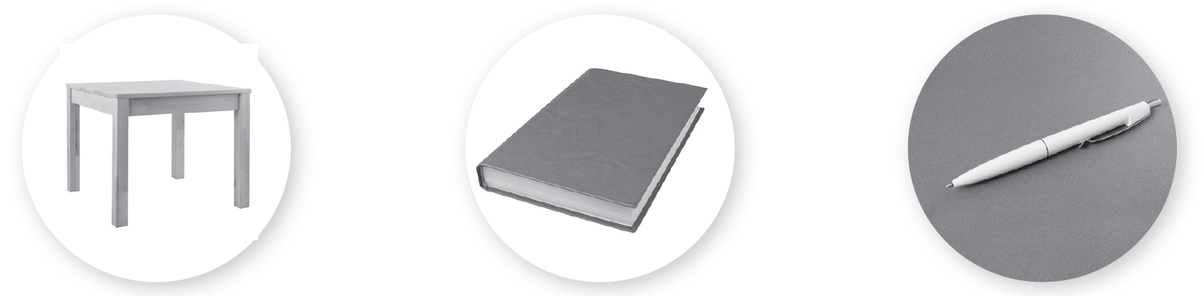

9 Listen and look. Which word is different? Circle.
TR: A17
1.
2.
3.
U1 p. 9

Slide 18
Script
TR: A17
Activity 9
Listen and look. Which word is different? Circle.
1. /v/ Have /v/ Love /v/ Chair
2. /e/ Desk /e/ Book /e/ Pen
3. /p/ Pencil /p/ Paper /p/ Crayon

Slide 19
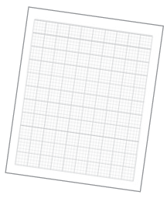

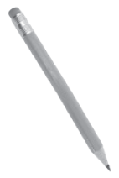
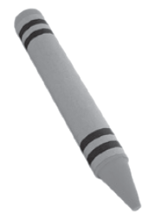
10 Listen and chant. Say a new verse.
TR: A18
I have some
I have a
I have a
Let’s draw again!
I have an
I have a
I have some
Let’s draw again!
U1 p. 9

Slide 20
Script
TR: A18
Activity 10
Listen and chant. Say a new verse.
I have some paper.
I have a pen.
I have a pencil.
Let’s draw again!
I have an eraser.
I have a pen.
I have some crayons.
Let’s draw again!

Slide 21
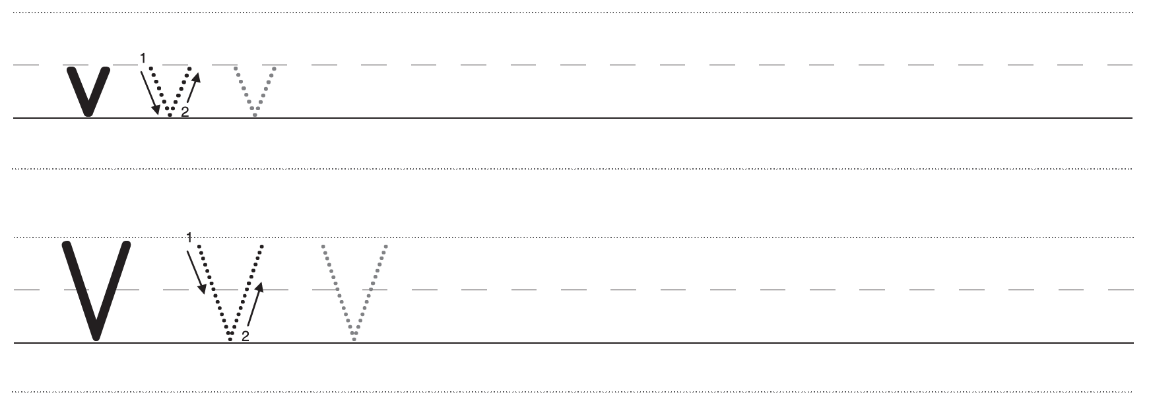
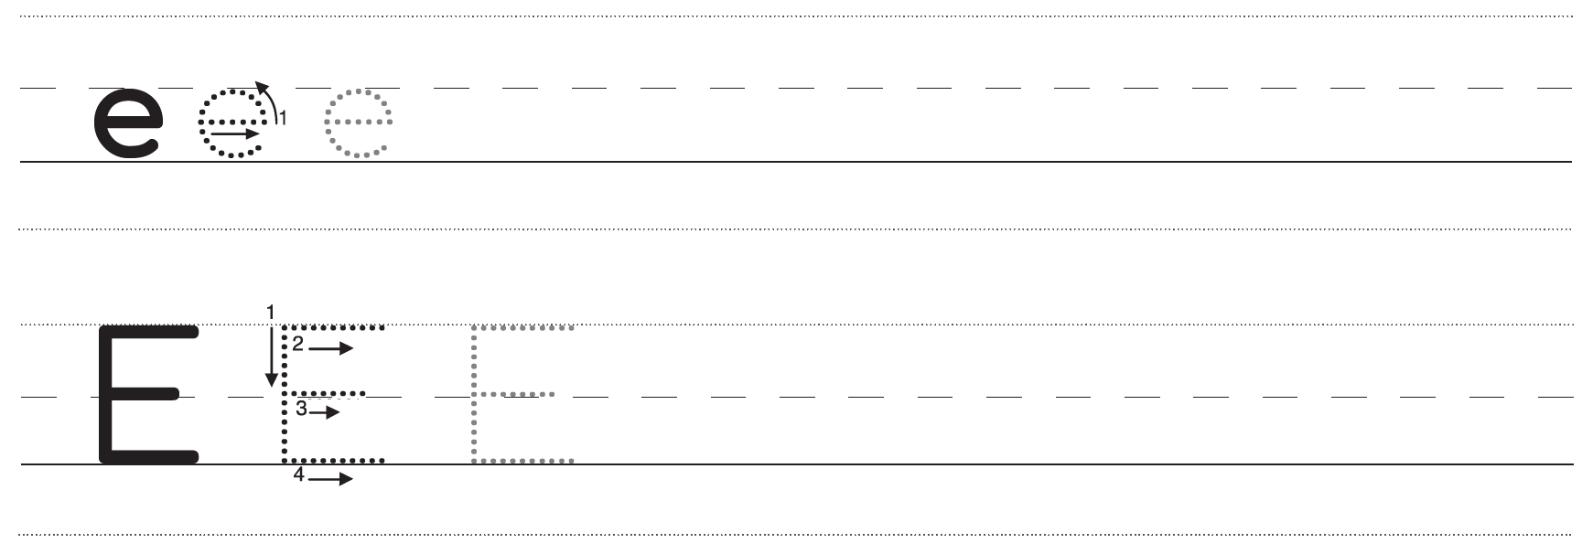
11 Trace and write.
U1 p. 10

Slide 22
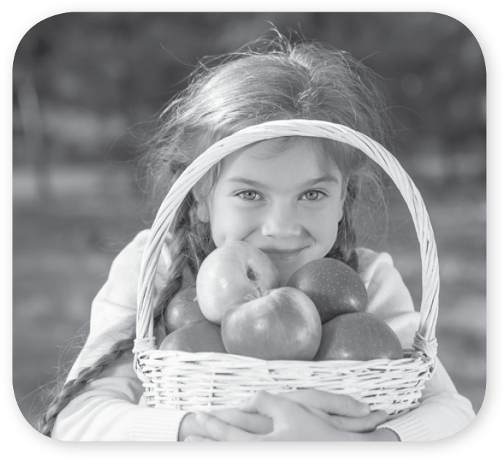
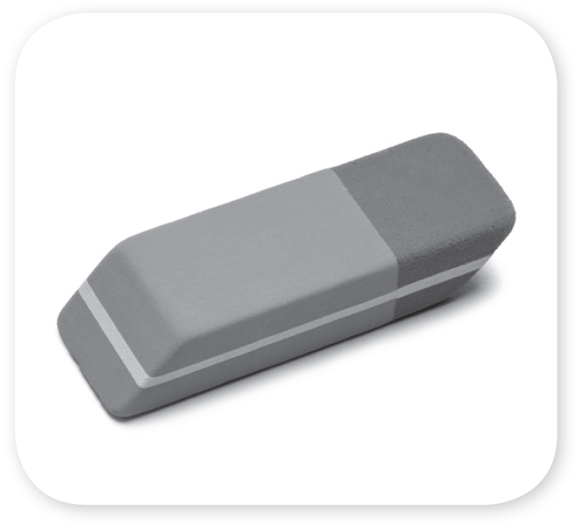
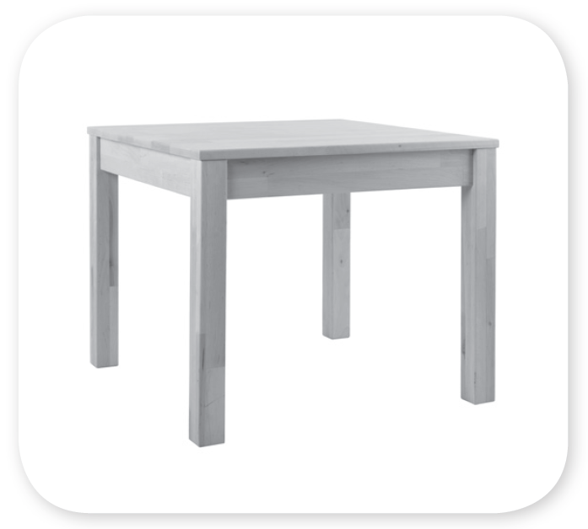



11 Trace and write.
U1 p. 10

Slide 23
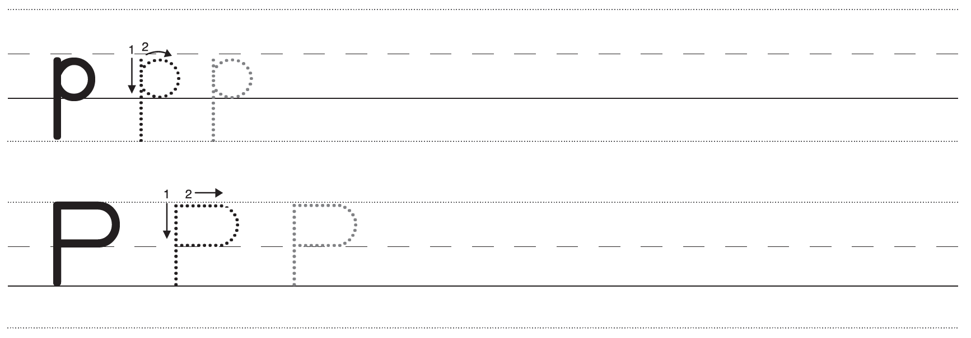
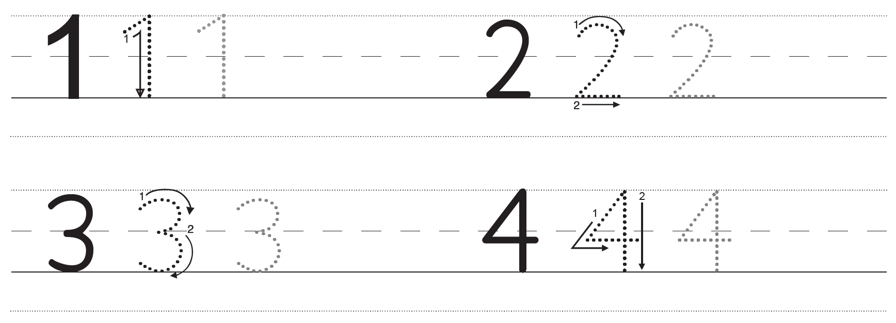
11 Trace and write.
U1 p. 11

Slide 24
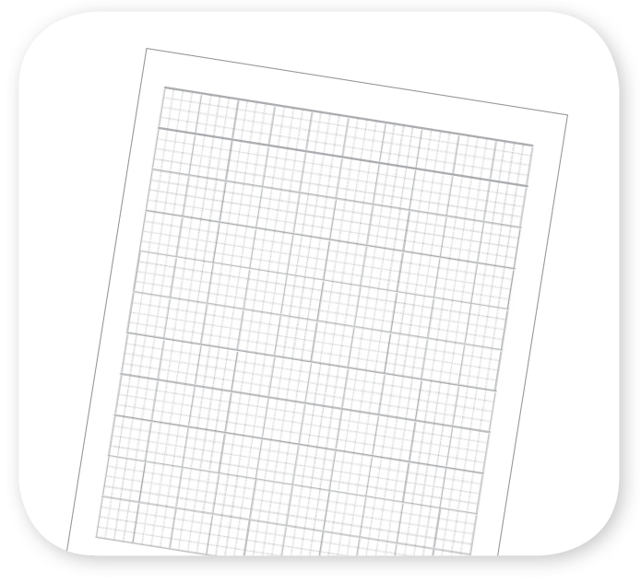
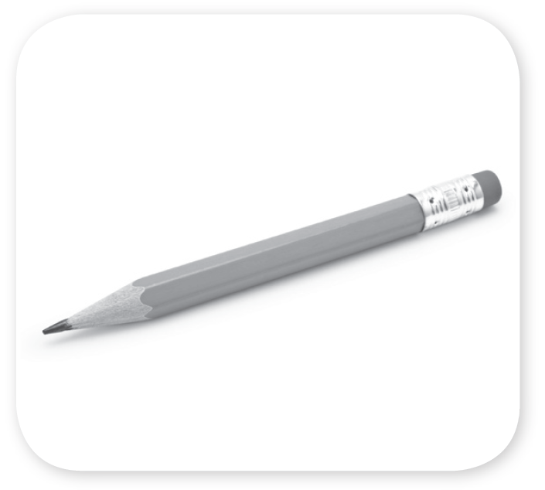




11 Trace and write.
U1 p. 11

