Slide 1

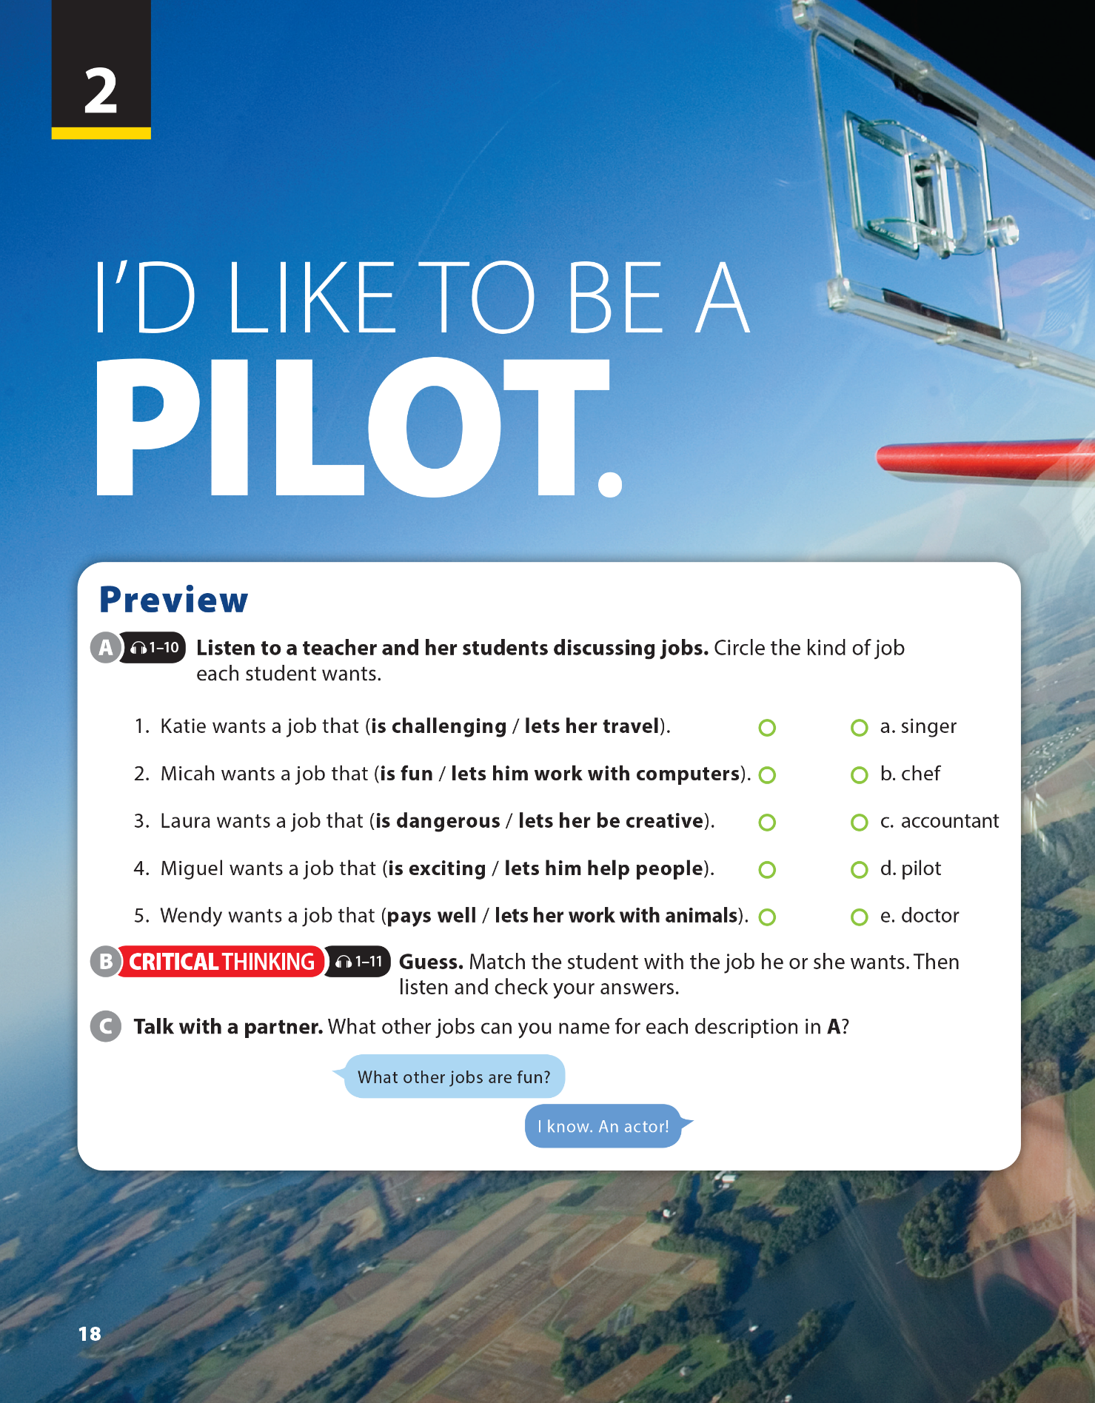


End of Unit Project
National Geographic Learning, a Cengage Company © 2022 Cengage Learning, Inc. ALL RIGHTS RESERVED. This presentation tool is intended for teaching purposes only and may not be scanned, copied, duplicated, or posted to a publicly accessible platform in whole or in part.

Slide 2

UNIT 2
I’D LIKE TO BE A PILOT.
WARM UP
I can give more
Notes:
Divide class into 2 teams, play game “I can give more”
Rule: Each team gives one name of job, one by one until they cannot give another word.
The team finish first (means that can not give another job) will be a loser.

Slide 3
UNIT 2
I'D LIKE TO BE A PILOT.
INSTRUCT A SURVEY
Instruct a survey: Write down some more questions about people’s favorite jobs
For example:
• Things people do in that occupation.
• Where those jobs tend to be.
• Usual work schedules and the work environment.
• How their interests match.
• Education level required.
• Classes they should take in high school and after.
• Average pay.
• Projected job growth.
Notes:
Remind students that they have talked about many different jobs during the unit.
Ask a few students, What do you want to do?
Have students write down some more
questions about people’s favorite jobs.
Have students get into pairs and brainstorm information that would help them decide which questions to include in their surveys.
Provide additional ideas to help students write questions for their surveys, as necessary.
For example:
• Things people do in that occupation.
• Where those jobs tend to be.
• Usual work schedules and the work
environment.
• How their interests match.
• Education level required.
• Classes they should take in high school
and after.
• Average pay.
• Projected job growth.

Slide 4


UNIT 2
I'D LIKE TO BE A PILOT..
INSTRUCT A SURVEY
SAMPLE CHART
NAME
DREAM JOB
DETAILS
WHY

Slide 5

UNIT 2
I'D LIKE TO BE A PILOT.
INSTRUCT A SURVEY
Notes:
Explain to students that they will need to find five students to interview after class
Set a time limit for students to complete their survey. If the project is assigned as homework, set a date for when they should bring their completed chart to class.
Check their surveys and give comments.

Slide 6


THANK YOU!

