Slide 1
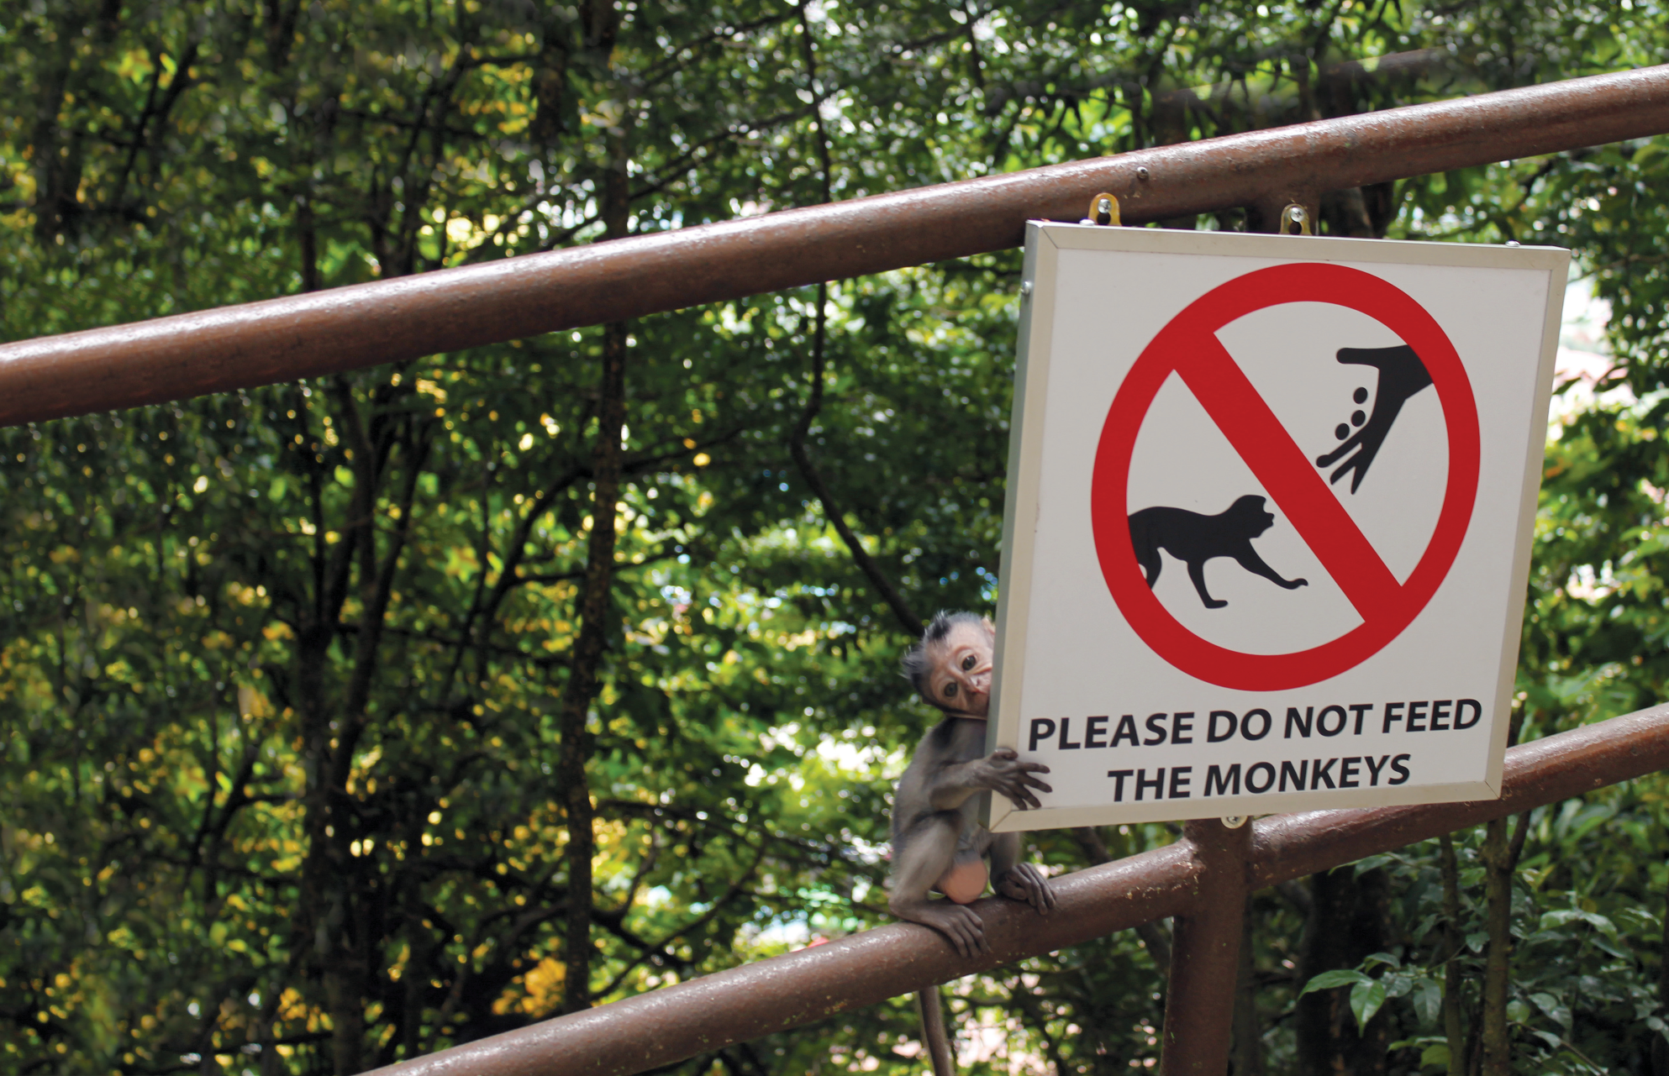
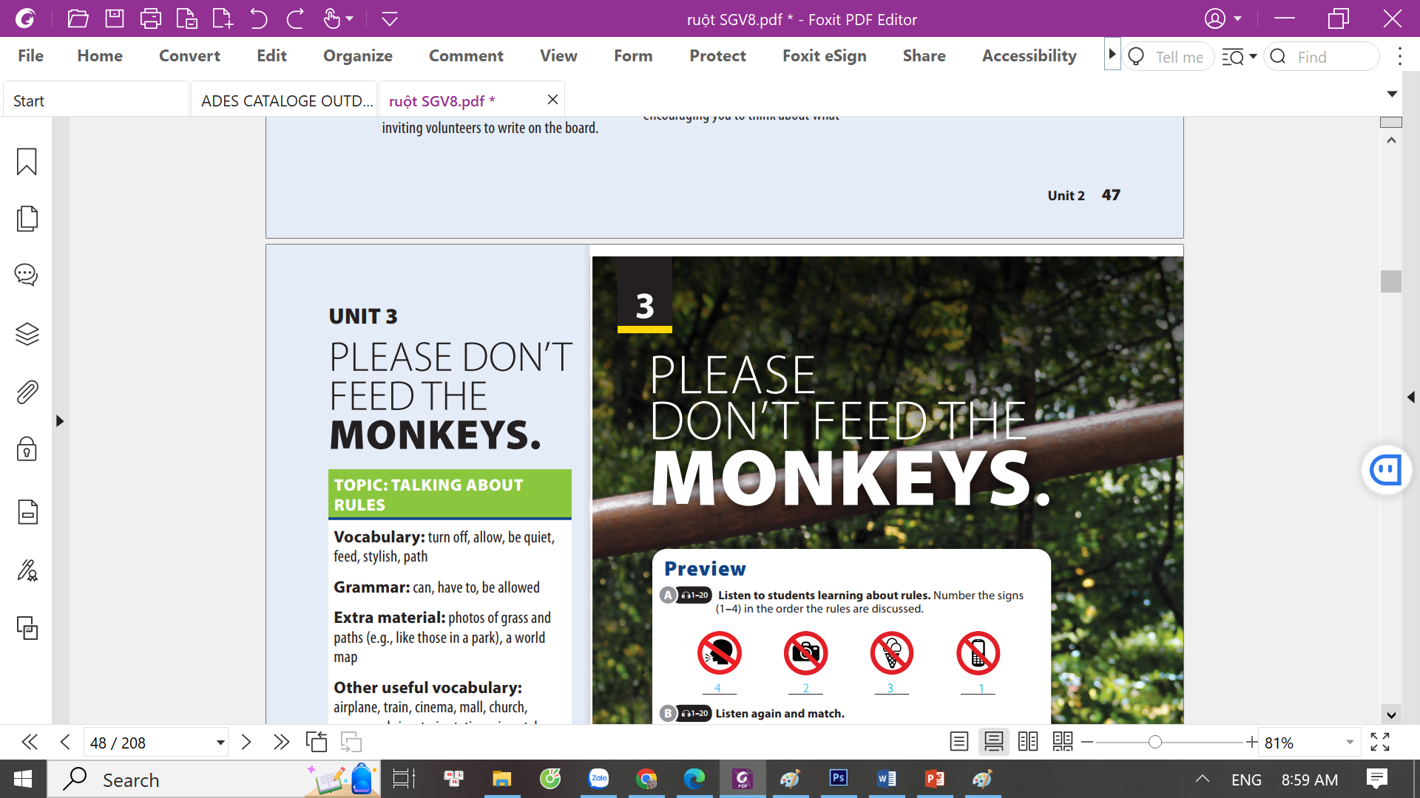
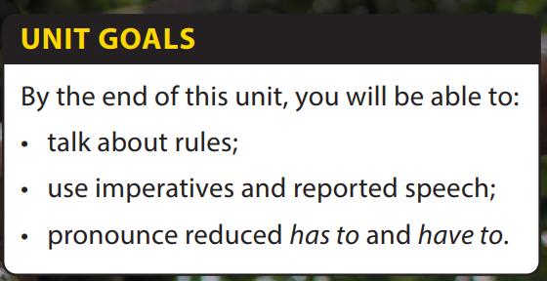
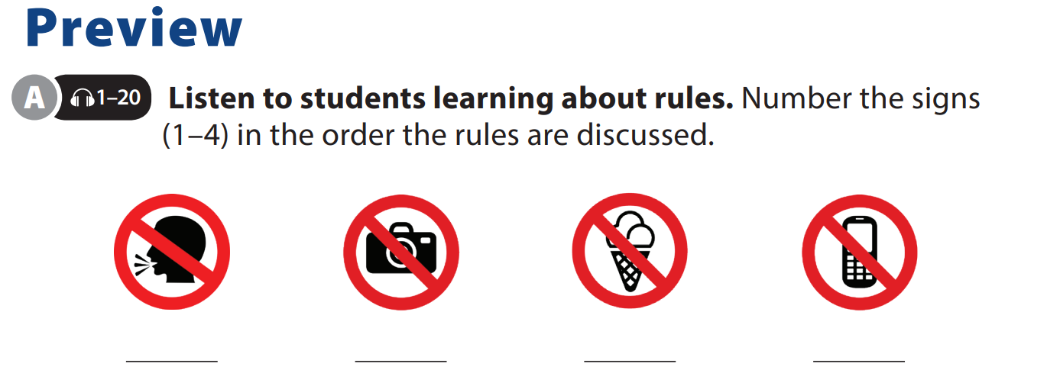
Language Focus and
The Real World

Slide 2
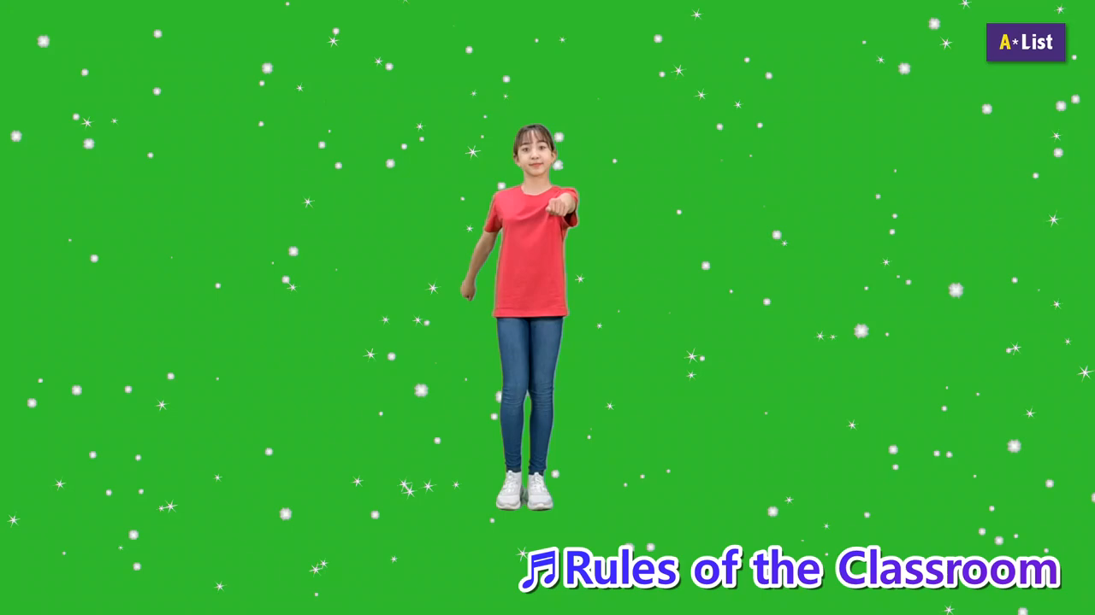
UNIT 3
PLEASE DON’T FEED THE MONKEY.
LANGUAGE FOCUS
Sing and dance “Rules of the classroom”
Notes:
Motivating and Focusing: Sing and dance “Rules of the classroom”
https://www.youtube.com/watch?v=ZmJEhpBFKEY
Ask students to stand up, follow the song and dance twice.
Discuss classroom rules: what should or shouldn’t we do?

Slide 3
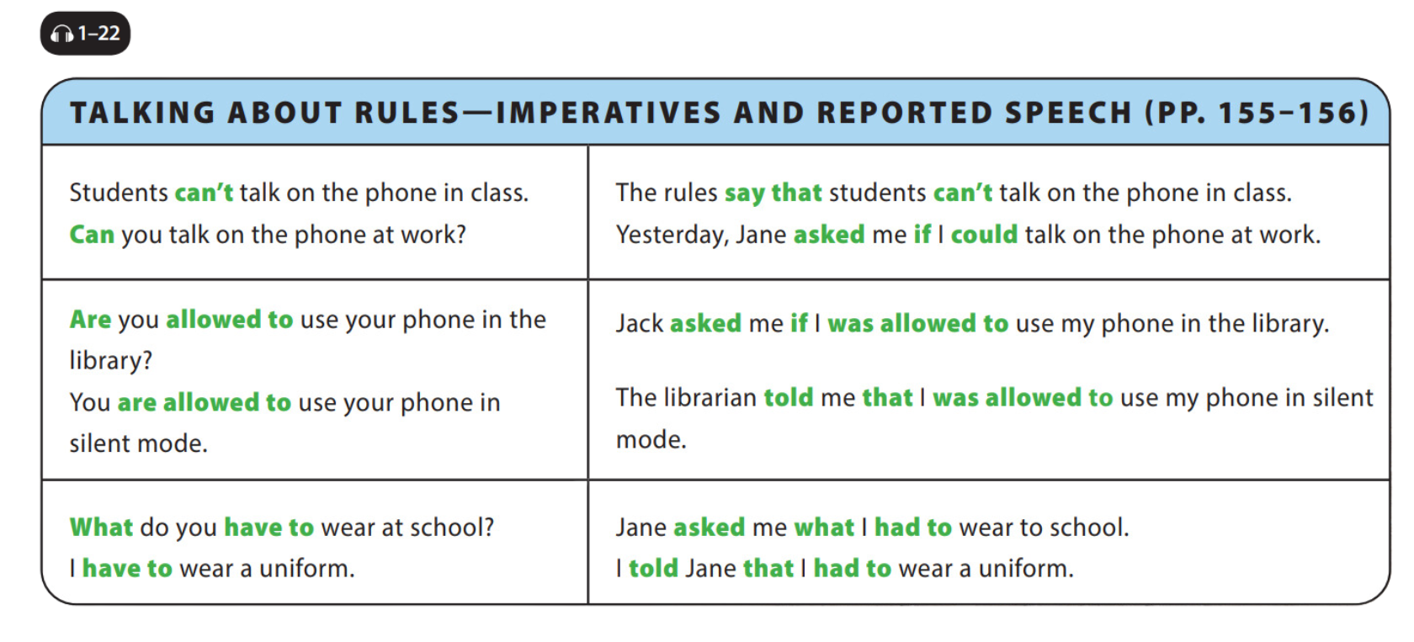

UNIT 3
PLEASE DON’T FEED THE MONKEY.
LANGUAGE FOCUS
Notes:
Read the first question and responses in the chart aloud. Explain that, in this question, can is not used to ask about ability but instead asks whether you have permission to do something. Explain to students that the statements on the right column have the reported
speech structures. They are used to ‘repeat’ or ‘report’ what someone has said.
Explain that we have to follow certain rules in changing the tenses when we use reported speech. The rules are also different when we do this for yes/no questions and wh-questions.
Introduce the rules of using reported speech to students, then give and explain the examples.

Slide 4
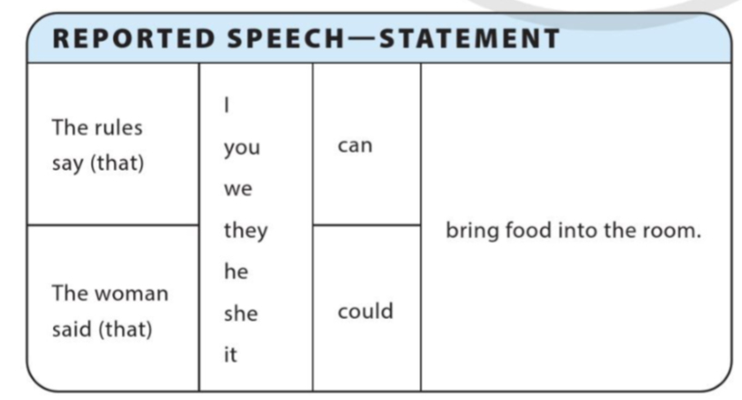
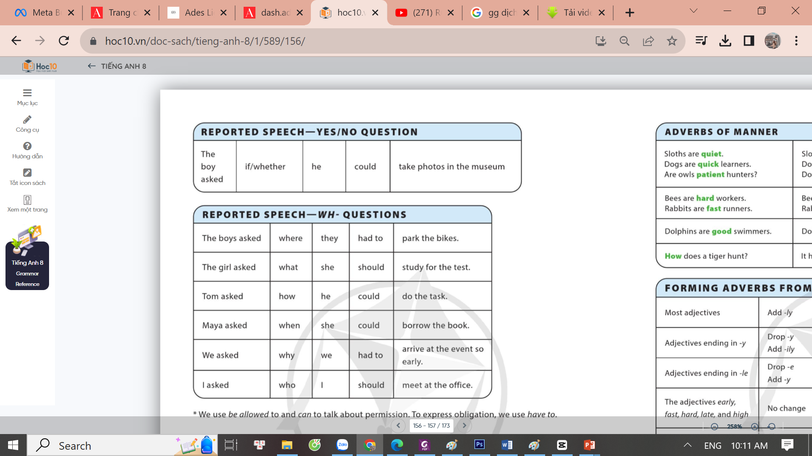
UNIT 3
PLEASE DON’T FEED THE MONKEY.
LANGUAGE FOCUS

Slide 5
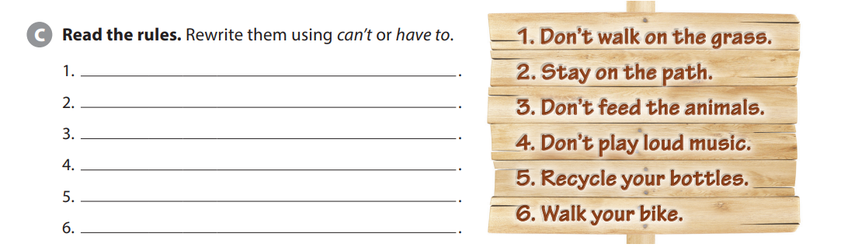
UNIT 3
PLEASE DON’T FEED THE MONKEY.
LANGUAGE FOCUS
You can’t walk on the grass.
You have to stay on the path.
            You can’t feed the animals.
You can’t play loud music.
You have to recycle your bottles.
You have to walk your bike.

Slide 6
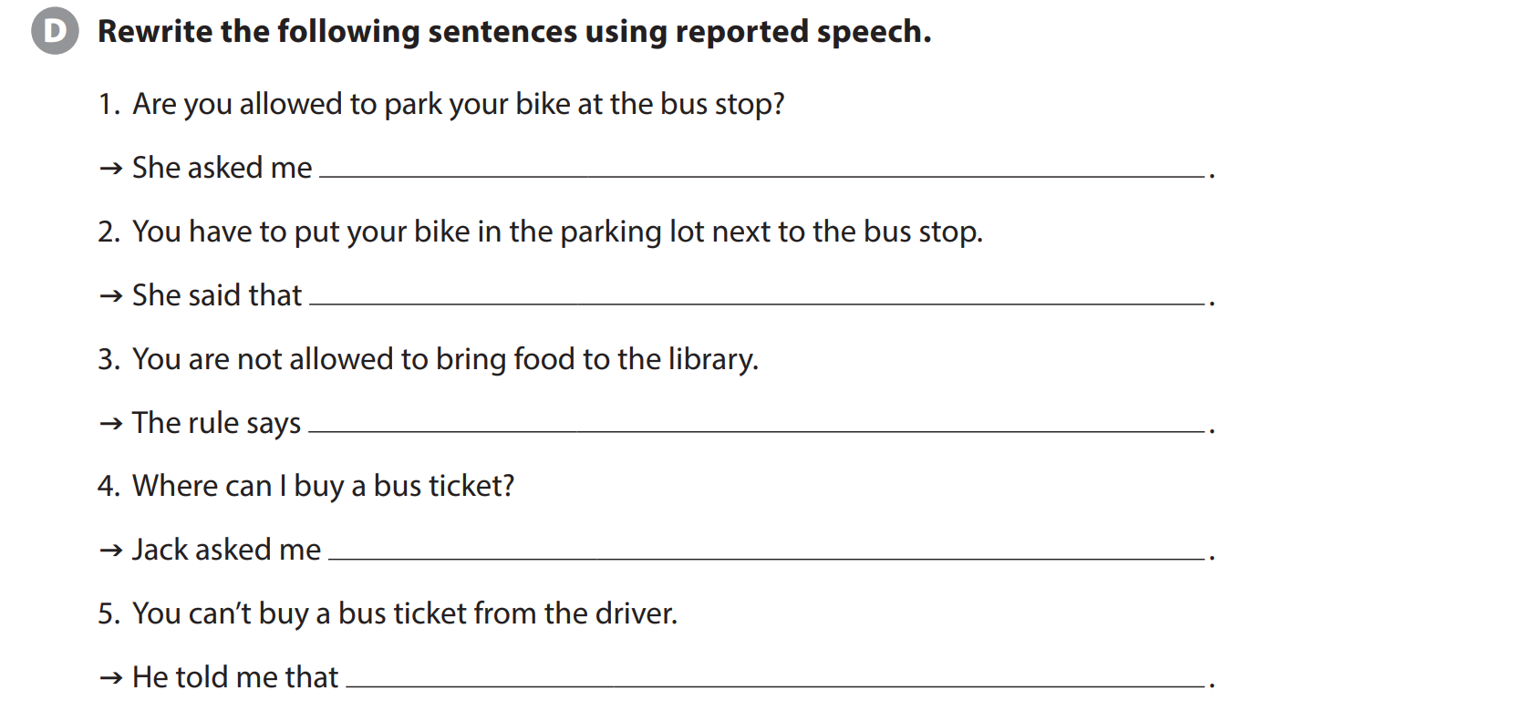
UNIT 3
PLEASE DON’T FEED THE MONKEY.
LANGUAGE FOCUS
if I was allowed to park my bike at the bus stop.
I had to put my bike in the parking lot next to the bus stop.
you are not allowed to bring food to the library.
where he could buy a bus ticket.
I couldn’t buy a bus ticket from the driver.

Slide 7
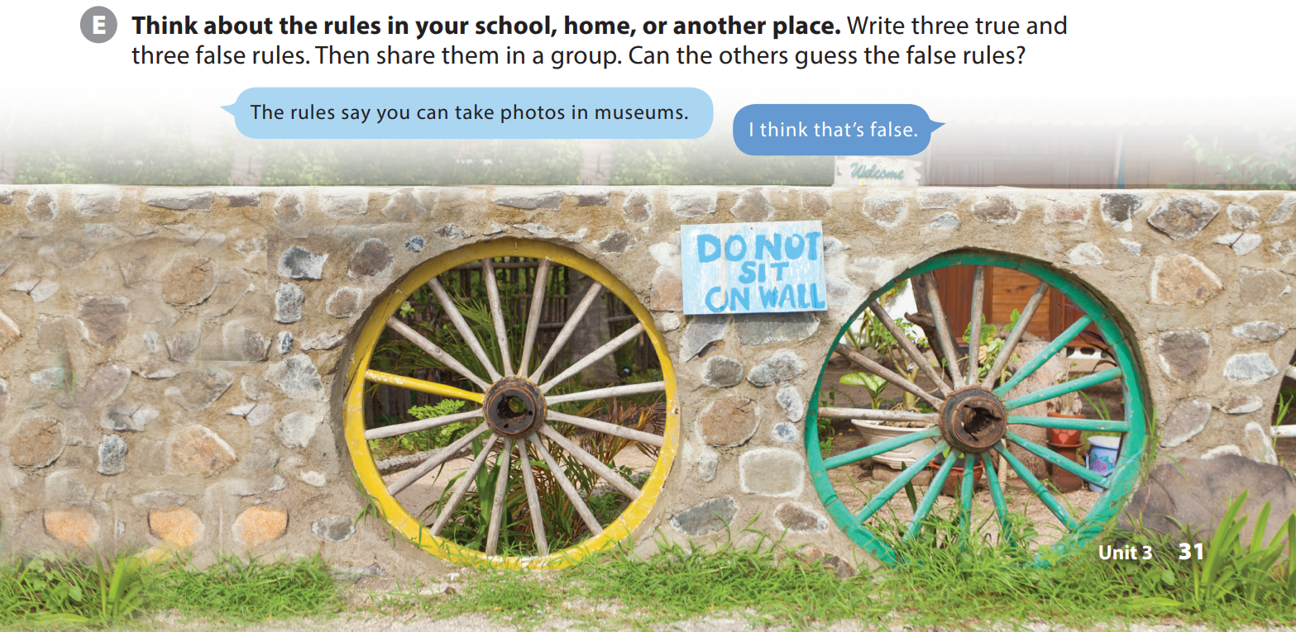
UNIT 3
PLEASE DON’T FEED THE MONKEY.
LANGUAGE FOCUS
Notes:
Tell students they will play a game to guess which rules are true and which are false.
Explain to students that they should write six rules about their school, home, or another place. Emphasize that three of them should be fake, but they should
not tell anyone which ones are real or fake.
Have students write their rules and then get into groups.
Tell students they will take turns reading their rules and the other group members must decide if the rule is real or fake.
Model the example exchange with a student.
Check understanding of how the game works.
Have students do the task.

Slide 8
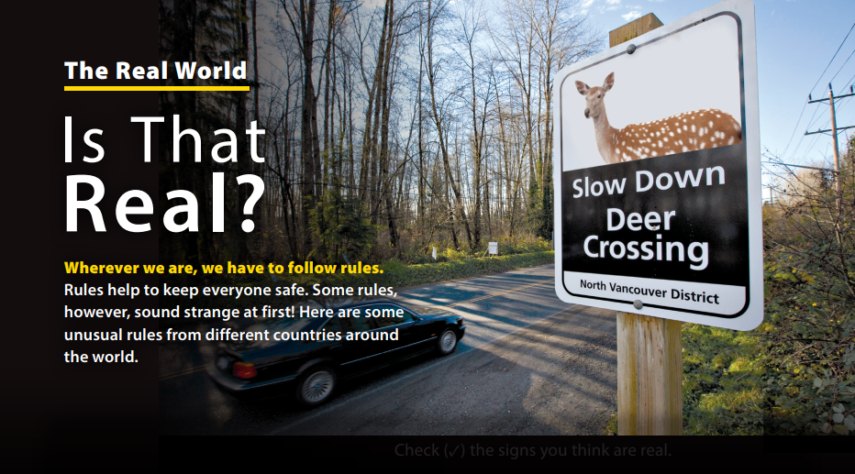
UNIT 3
PLEASE DON’T FEED THE MONKEY.
THE REAL WORLD
Notes:
real? (No. The sign has a picture of a camel, not a deer.)
As students follow along, read the title and
the short introduction aloud.

Slide 9
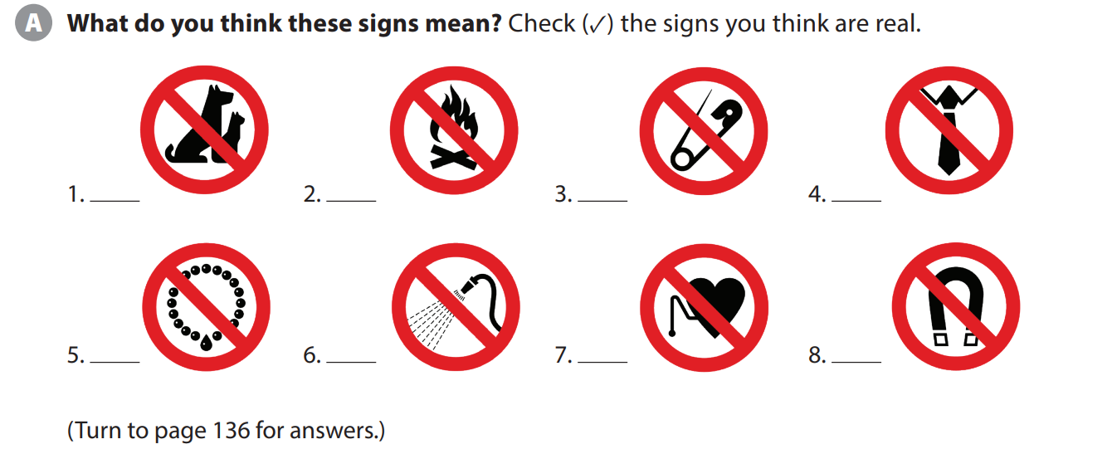
UNIT 3
PLEASE DON’T FEED THE MONKEY.
THE REAL WORLD
✓
✓
✓
Notes:
Activity A. Point out that there are eight signs. Ask
students to get into pairs and discuss what they think the signs mean.
Explain that some of the signs are real, but some are fake. Have pairs check the signs they think are real. If many students made mistakes, encourage them to use more critical thinking and introduce the concept of
visual literacy.

Slide 10
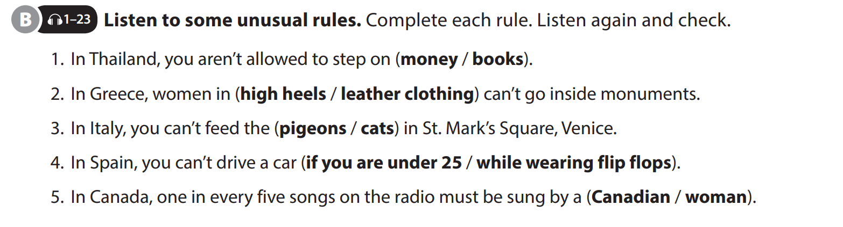
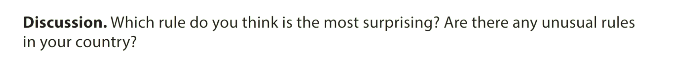
UNIT 3
PLEASE DON’T FEED THE MONKEY.
THE REAL WORLD

Slide 11


THANK YOU!

