Slide 1


Unit 2
My Toys
Bringing the world to the classroom and the classroom to life
ELTNGL.COM
A PART OF CENGAGE

Slide 2

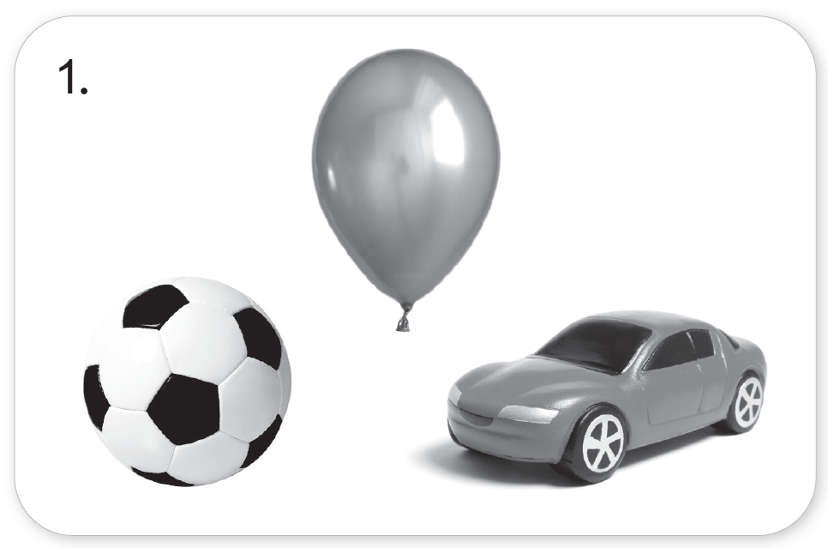
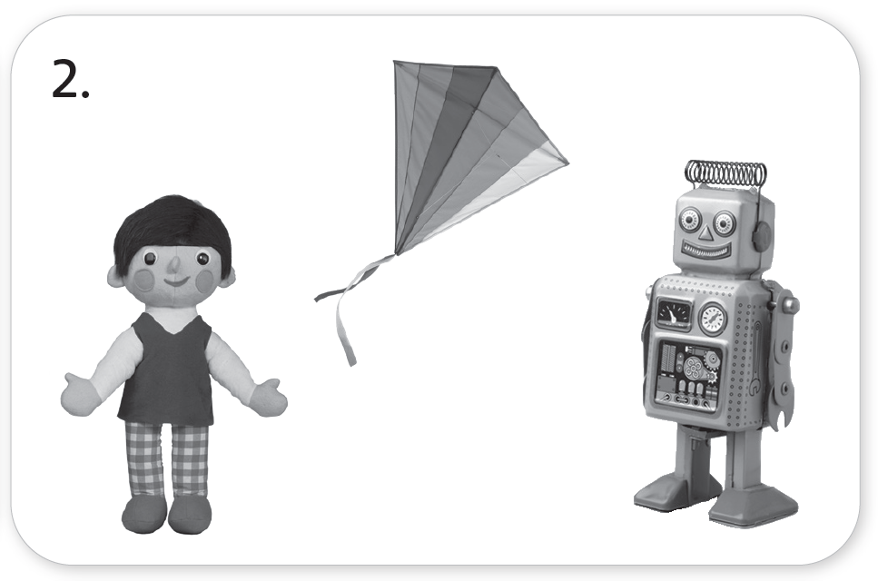
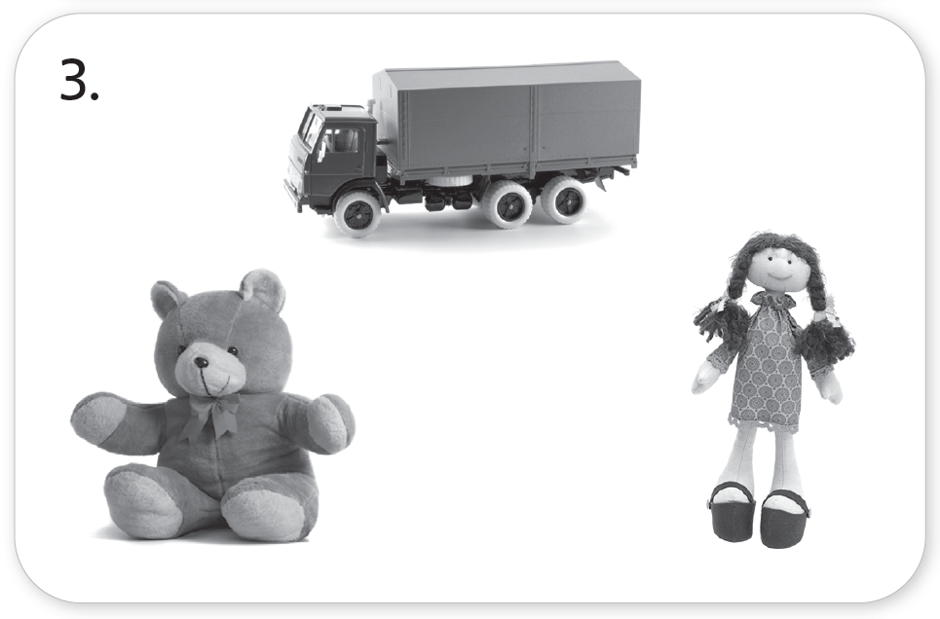
1 Listen. Look and circle.
TR: A19
U2 p. 12

Slide 3
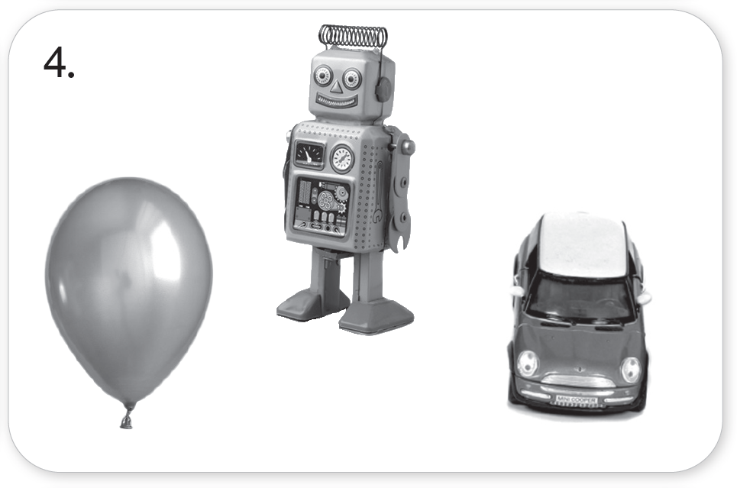
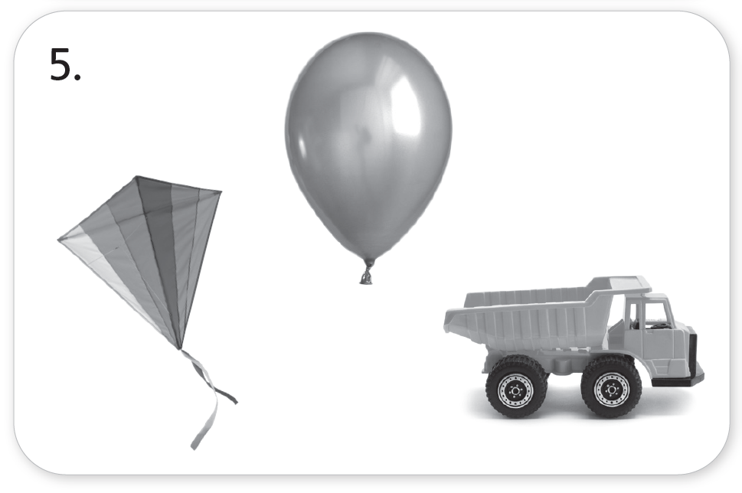
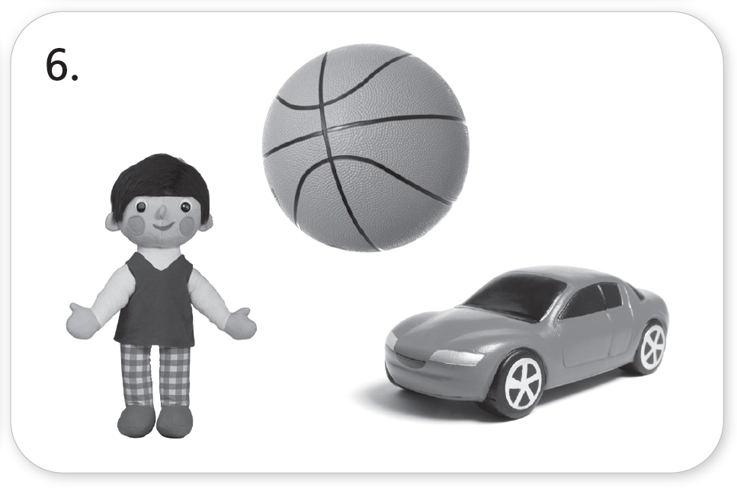
1 Listen. Look and circle.
TR: A19
U2 p. 12

Slide 4
Script
TR: A19
Unit 2
Activity 1
Listen. Look and circle.
1. a ball a ball
2. a kite a kite
3. a teddy bear a teddy bear
4. a robot a robot
5. a truck a truck
6. a doll a doll

Slide 5




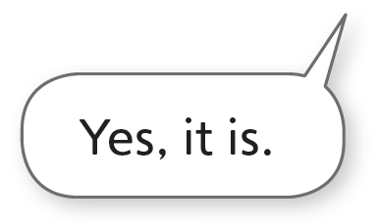
2 Listen and say.
TR: A20
U2 p. 13

Slide 6
Script
TR: A20
Activity 2
Listen and say.
(Frog) Is it a doll?
(Parrot) No, it isn’t.
(Frog) Is it a robot?
(Parrot) Yes, it is.

Slide 7



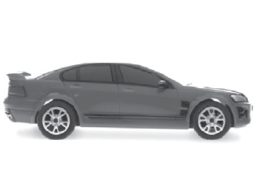
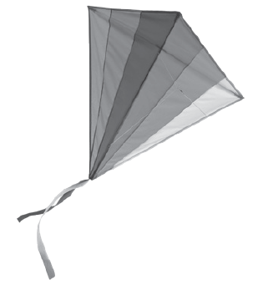
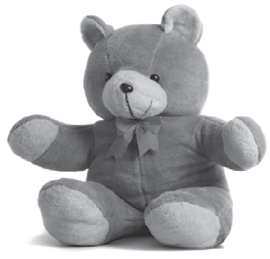
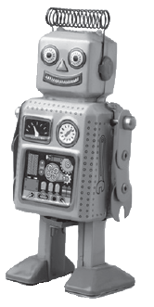
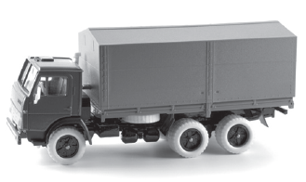

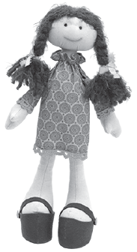


3 Cut out the cards on page 35. Listen. What is it? Glue the cards. Say.
TR: A21
U2 p. 13

Slide 8
Script
TR: A21
Activity 3
Cut out the cards on page 35. Listen. What is it? Glue the cards. Say.
1. Is it a kite? Yes, it is.
2. Is it a robot? No, it isn’t. Is it a teddy bear? Yes, it is.
3. Is it a balloon? Yes, it is.
4. Is it a truck? No, it isn’t. Is it a car? Yes, it is.
5. Is it a doll? Yes, it is.
6. Is it a balloon? No, it isn’t. Is it a truck? Yes, it is.
7. Is it a robot? Yes, it is.
8. Is it a doll? No, it isn’t. Is it a ball? Yes, it is.

Slide 9

4 Draw your favorite toy. Color. What is it? Say.
U2 p. 13

Slide 10
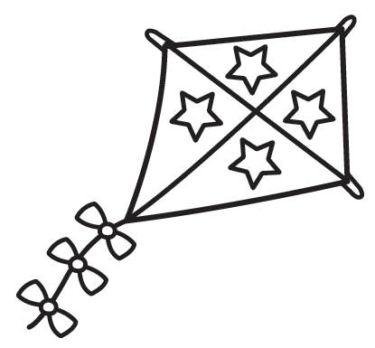

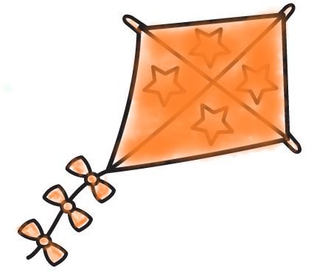
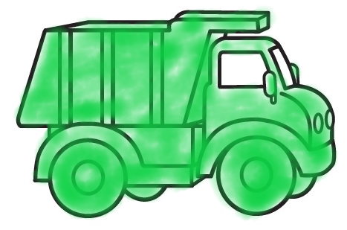

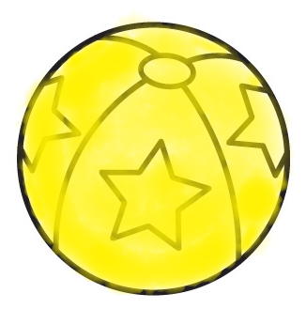


5 Listen. Color and say.
TR: A22
1.
2.
3.
4.
U2 p. 14

Slide 11
Script
TR: A22
Activity 5
Listen. Color and say.
1. an orange kite
2. a green truck
3. a brown teddy bear
4. a yellow ball

Slide 12
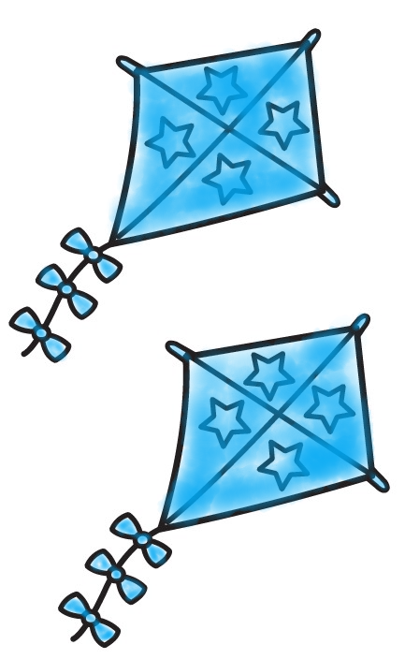
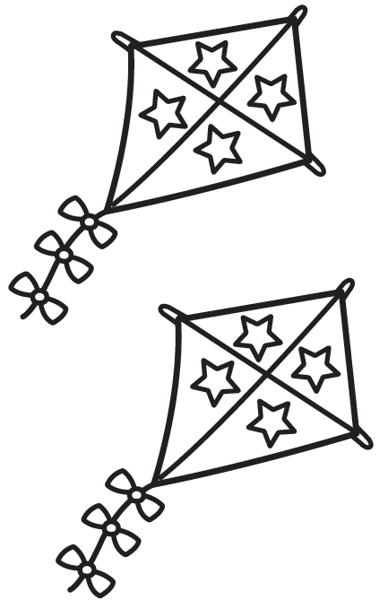
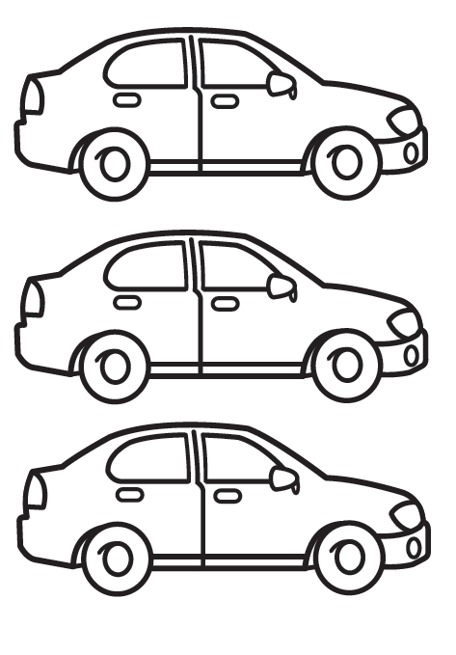

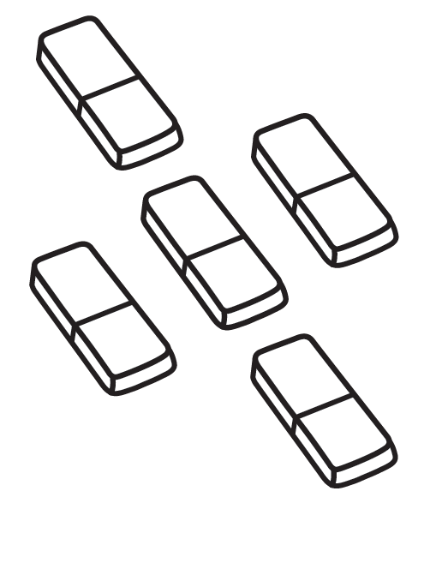
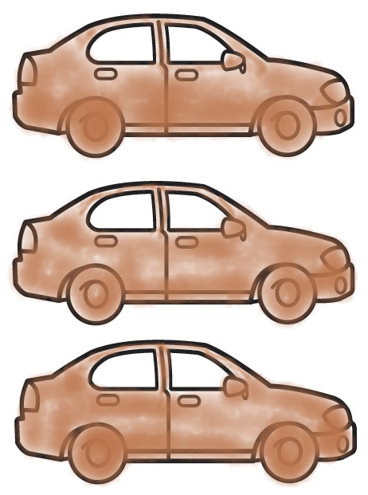
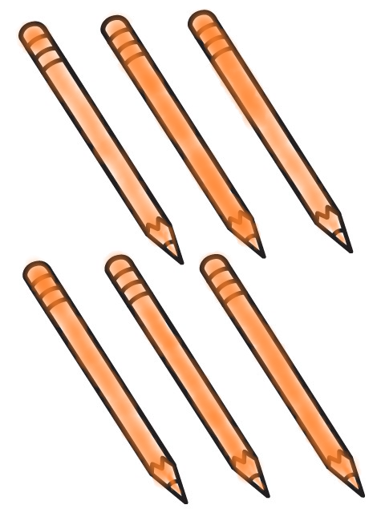
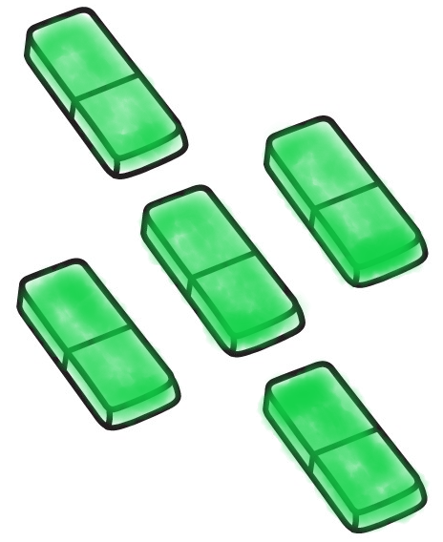
6 Listen. Color. Count and say.
TR: A23
U2 p. 14

Slide 13
Script
TR: A23
Activity 6
Listen. Color. Count and say.
1. two blue kites
2. three brown cars
3. six orange pencils
4. five green erasers

Slide 14
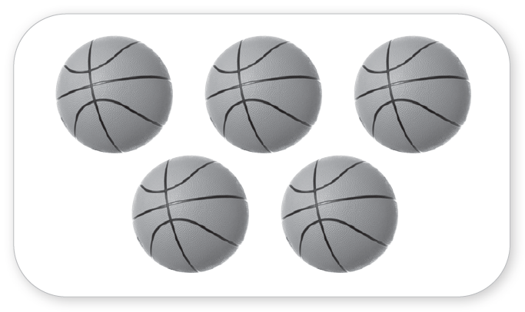
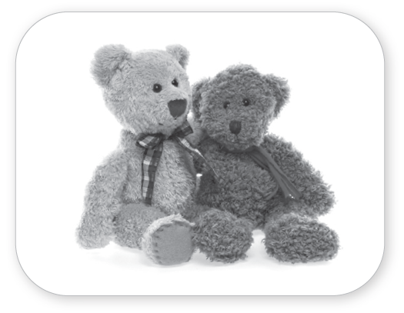
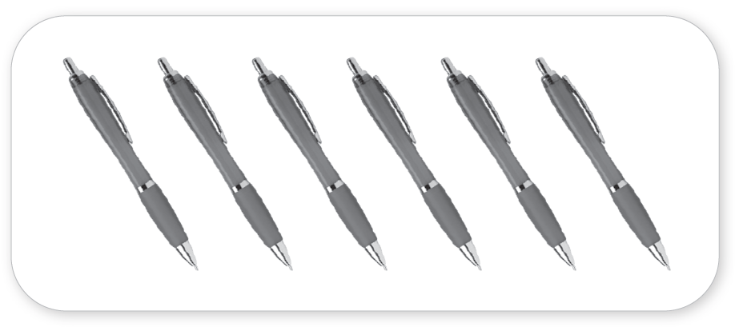
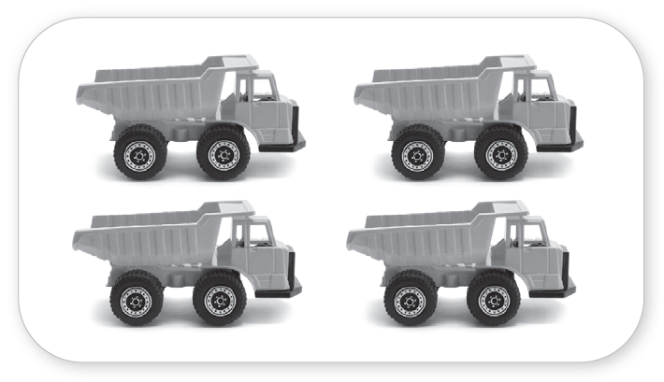
7 Listen. Count and write.
TR: A24
_______
5
_______
2
_______
_______
6
4
U2 p. 14

Slide 15
Script
TR: A24
Activity 7
Listen. Count and write.
How many balls?
How many teddy bears?
How many pens?
How many trucks?

Slide 16
8 Listen and say.
TR: A25
Script
Activity 8
Listen and say.
1. O /ɑː/ /ɑː/ Doll Doll
2. T /t/ /t/ Toy Toy
3. B /b/ /b/ Boy Boy
U2 p. 15

Slide 17

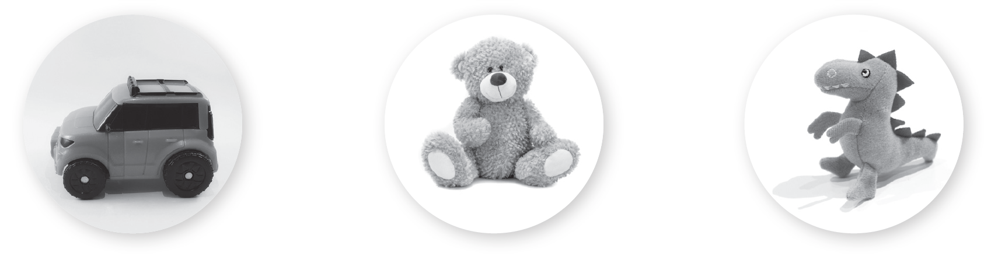

9 Listen and look. Which word is different? Circle.
TR: A26
1.
2.
3.
U2 p. 15

Slide 18
Script
TR: A26
Activity 9
Listen and look. Which word is different? Circle.
1. /ɑː/ Doll /ɑː/ Dog /ɑː/ Book
2. /t/ Car /t/ Teddy bear /t/ Toy
3. /b/ Balloon /b/ Desk /b/ Ball

Slide 19
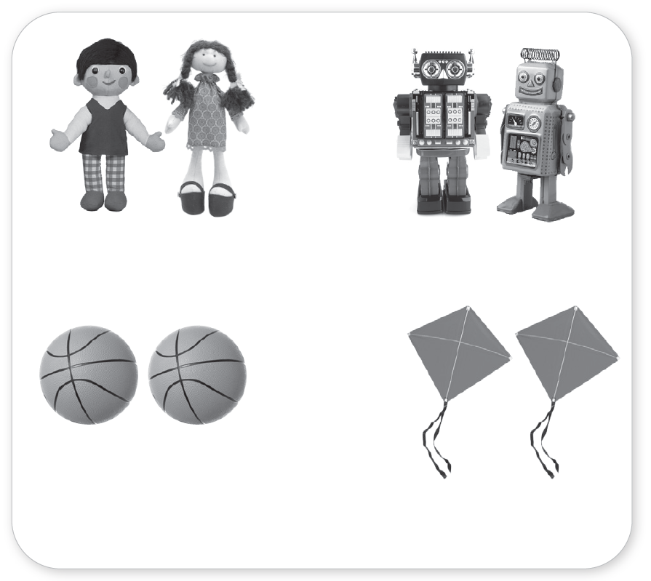
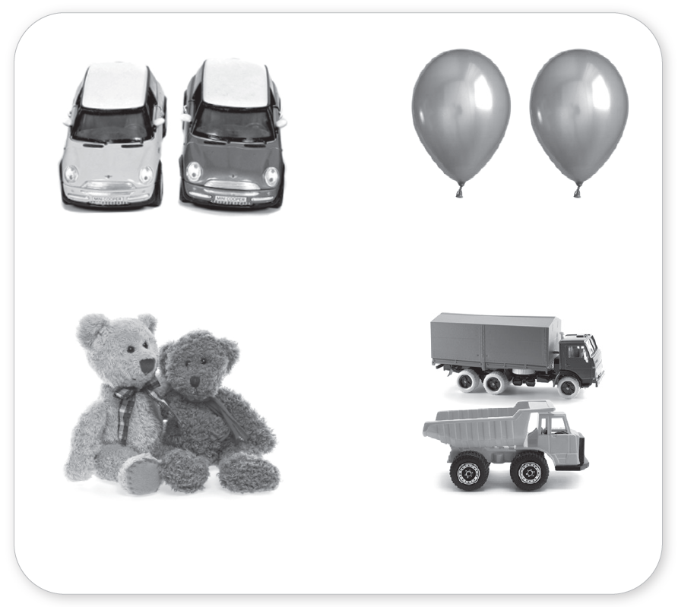
10 Listen and chant. Say a new verse.
TR: A27
and
and
and more toys.
and more toys.
and
and
for girls and boys!
for girls and boys!
U2 p. 15

Slide 20
Script
TR: A27
Activity 10
Listen and chant. Say a new verse.
Dolls and robots
and more toys.
Balls and kites
for girls and boys!
Cars and balloons
and more toys.
Bears and trucks
for girls and boys!

Slide 21
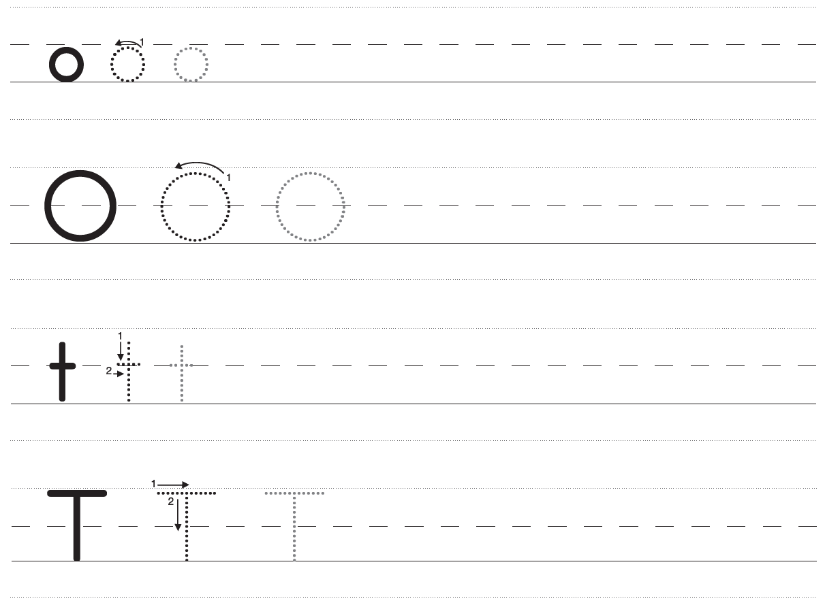
11 Trace and write.
U2 p. 16

Slide 22
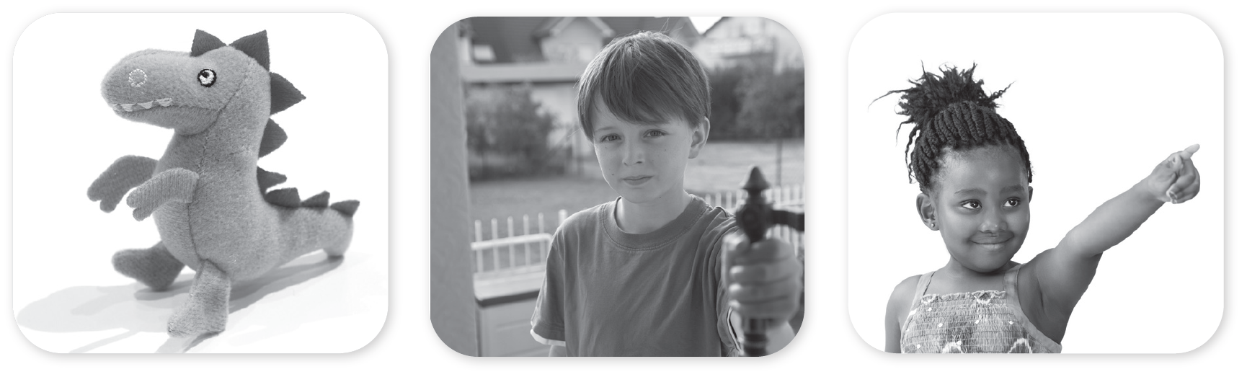



11 Trace and write.
U2 p. 16

Slide 23
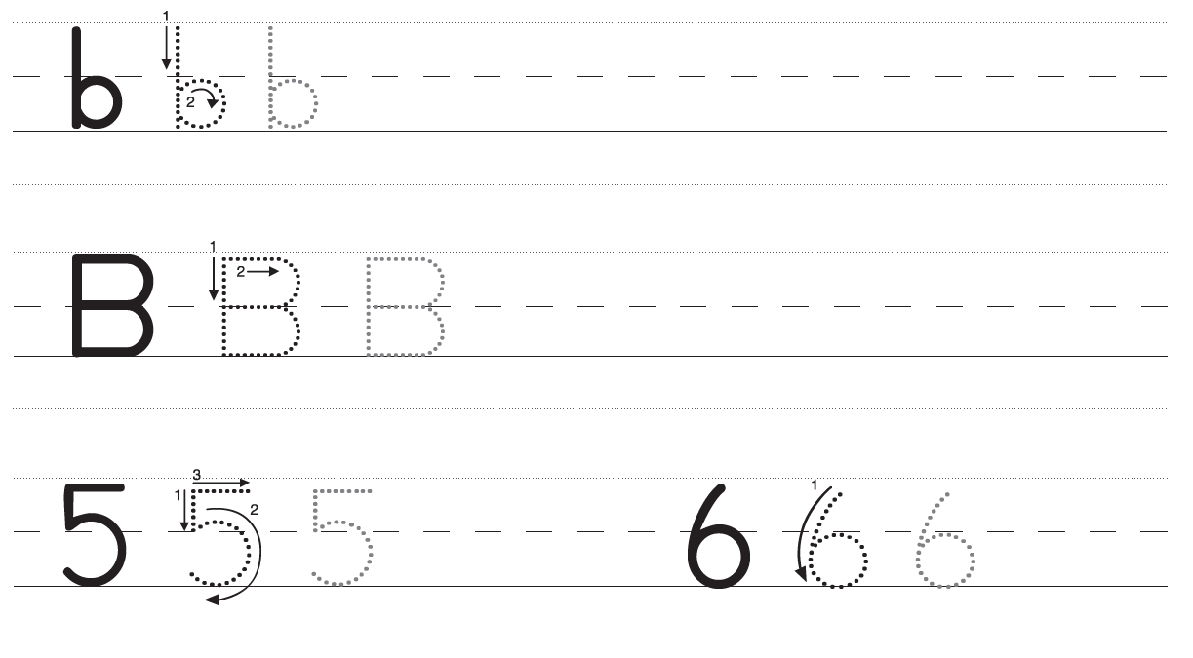
11 Trace and write.
U2 p. 17

Slide 24
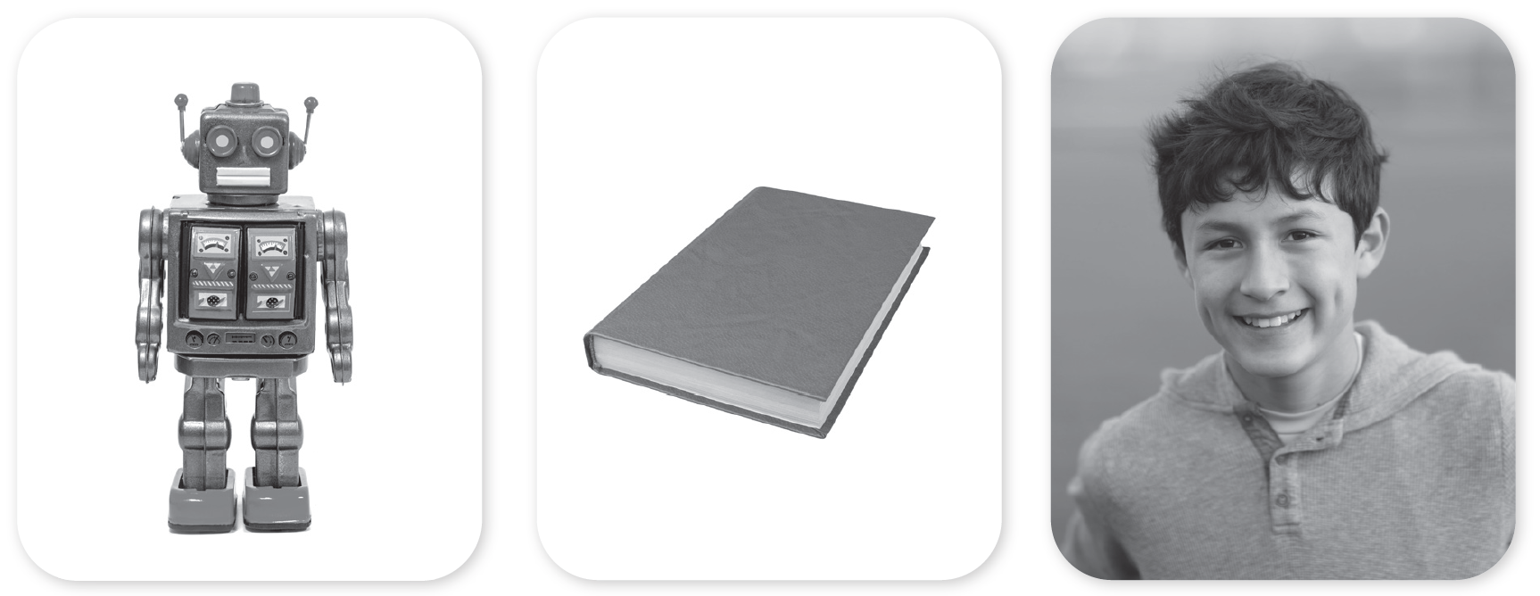



11 Trace and write.
U2 p. 17

