Slide 1
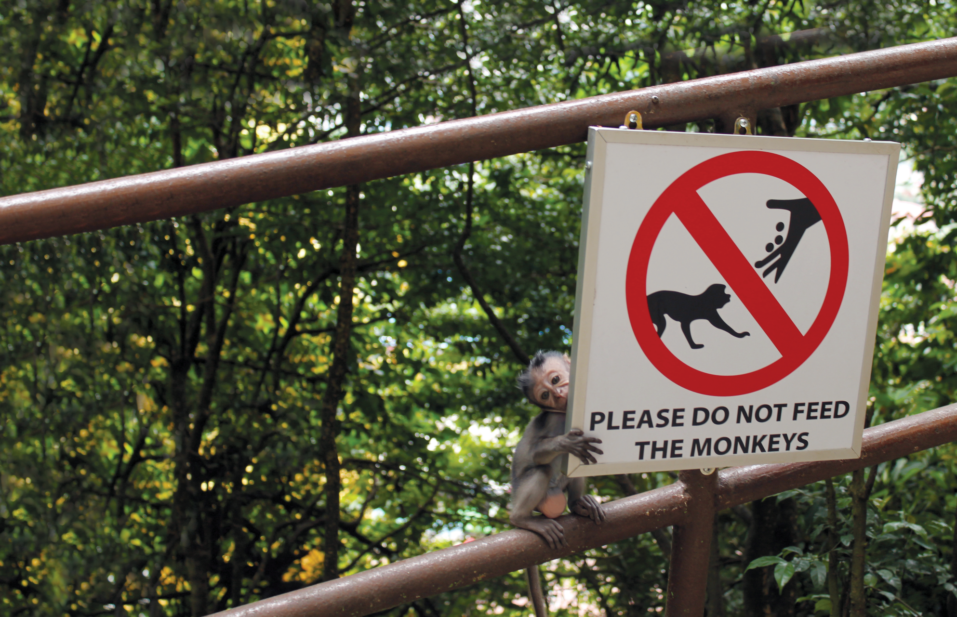
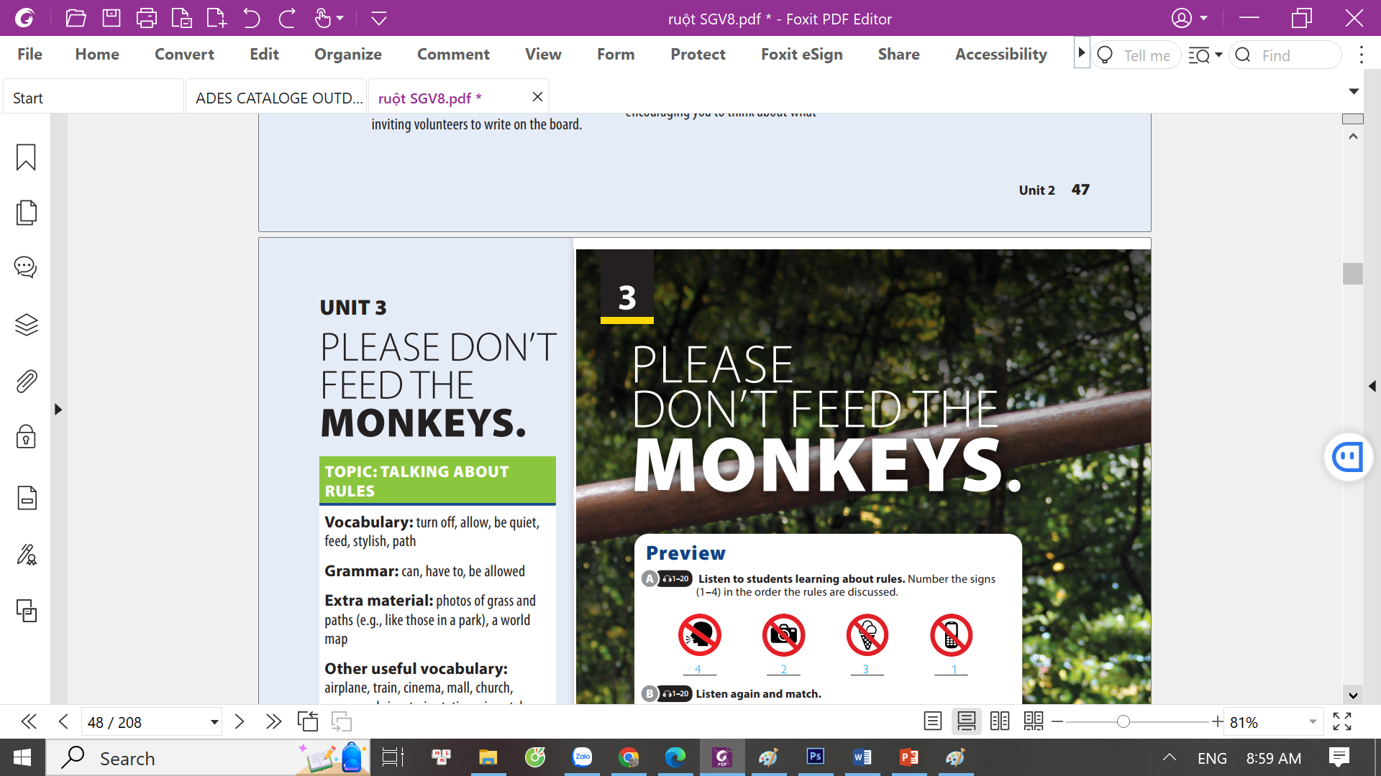
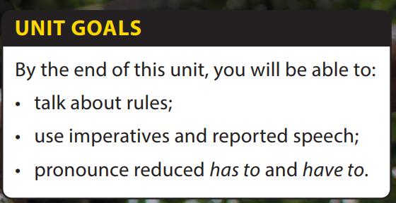
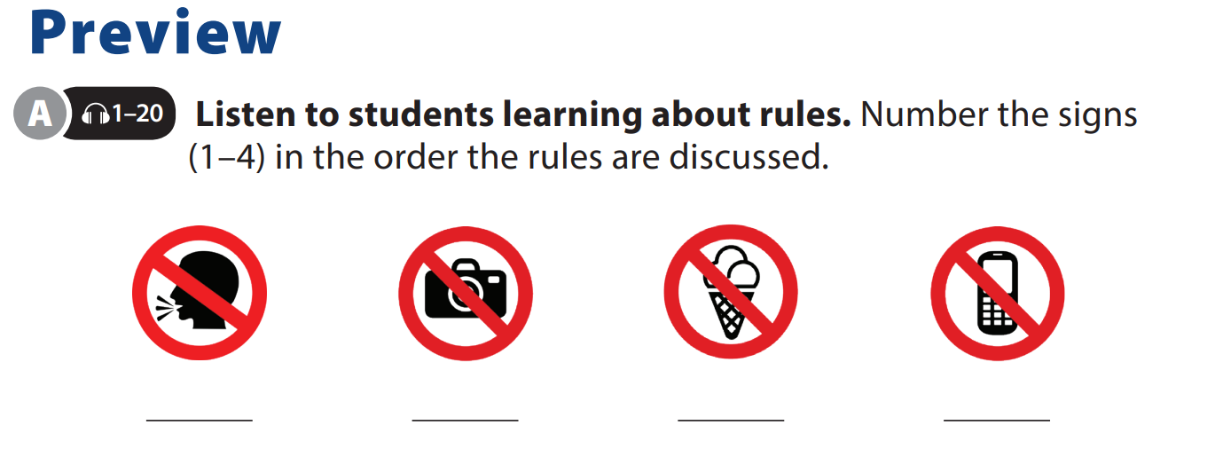
Reading
and Comprehension

Slide 2









Topic
PHOTOGRAPHY
For Kids
Notes:
Lead-in Activity.
Free talk on topic “Photography”
Ask students some questions:
Who really enjoys photography?
How can we take beautiful photos?
Let one of the non-professional photographer in class take a photo of the whole class.

Slide 3
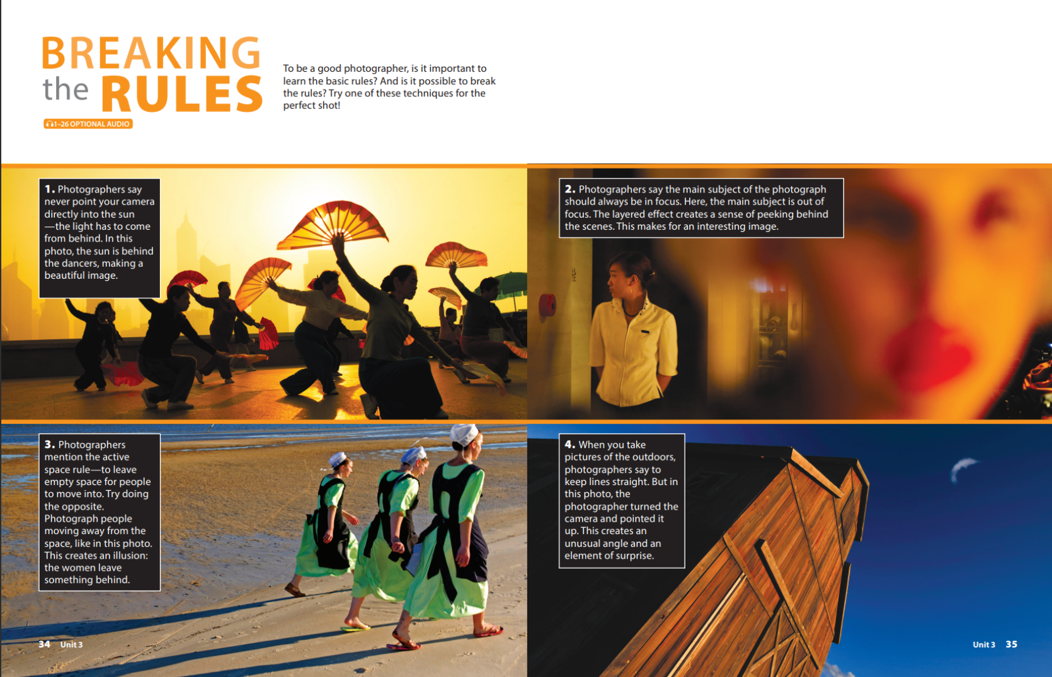
UNIT 3
PLEASE DON’T FEED THE MONKEY.
READING
Notes:
Tell students they will read about some rules they probably don’t use every day.
Ask students to look at the photos. Then, as students follow along in their books, read the title and ask students to predict what the article is about.
Ask a few students to share their
guesses.

Slide 4





)
)
)
USING CONTEXT
)
)
)
)
The author of a text often gives us clues about the meanings of words.
There are several ways to do this, including giving the opposite meaning of the idea you want to express.
Using the context to understand new vocabulary can be an effective way of understanding a passage without using a dictionary.
Using context to explain main subject (the most important thing in the picture). Sometimes, context can be used to explain secondary details (something that is less important than the main subject)
)
)
)
)
)
)
)
)
)
)
)

Slide 5

UNIT 3
PLEASE DON’T FEED THE MONKEY.
READING

Slide 6
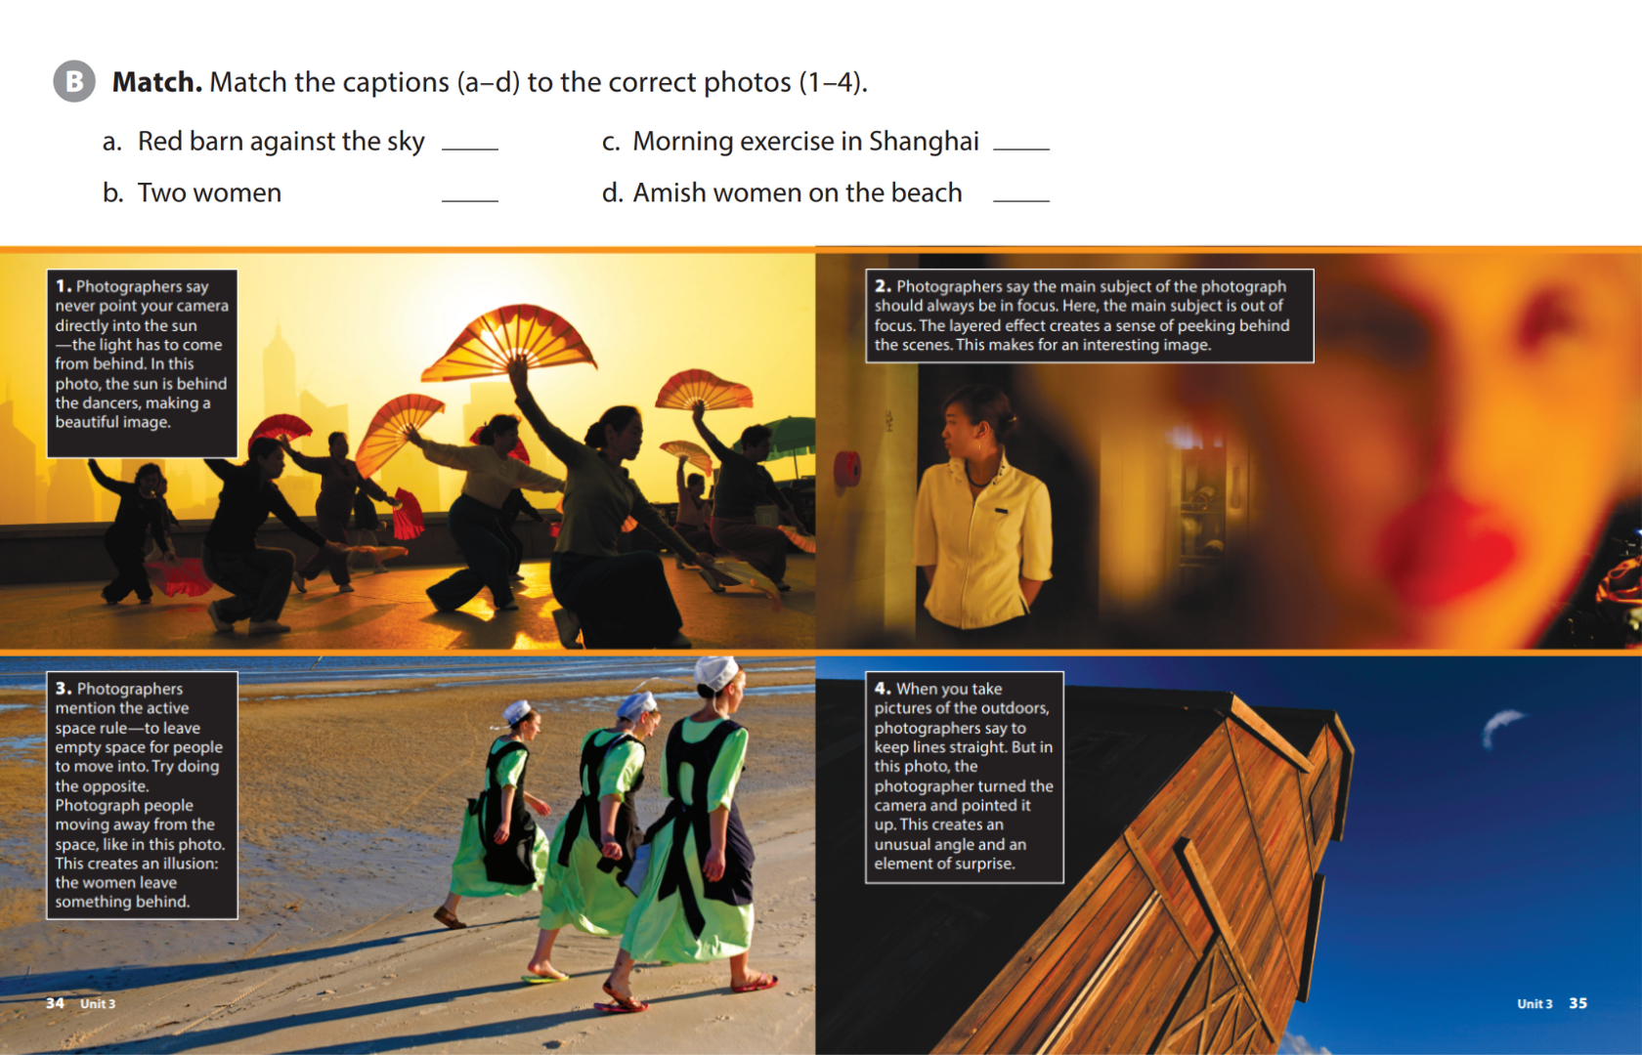
UNIT 3
PLEASE DON’T FEED THE MONKEY.
READING
4
1
2
3

Slide 7
UNIT 3
PLEASE DON’T FEED THE MONKEY.
READING

Slide 8
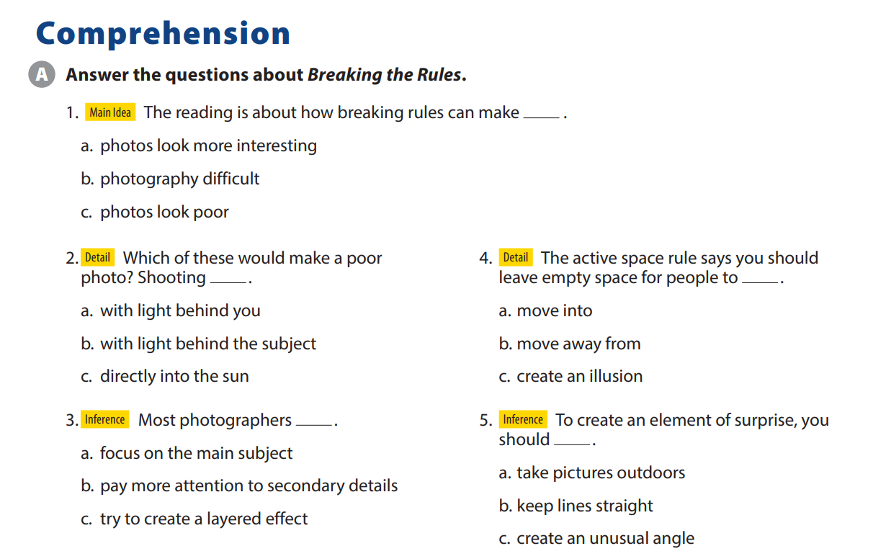
UNIT 3
PLEASE DON’T FEED THE MONKEY.
COMPREHENSION

Slide 9
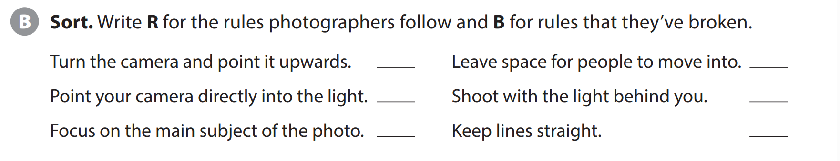
UNIT 3
PLEASE DON’T FEED THE MONKEY.
COMPREHENSION
B
R
B
R
R
R
Notes:
As students follow along, read the
explanation and question aloud. Have students get into groups and do the task.
OPTIONAL When the groups have
finished, have them share their photos and ideas with the class.

Slide 10


THANK YOU!

