Slide 1
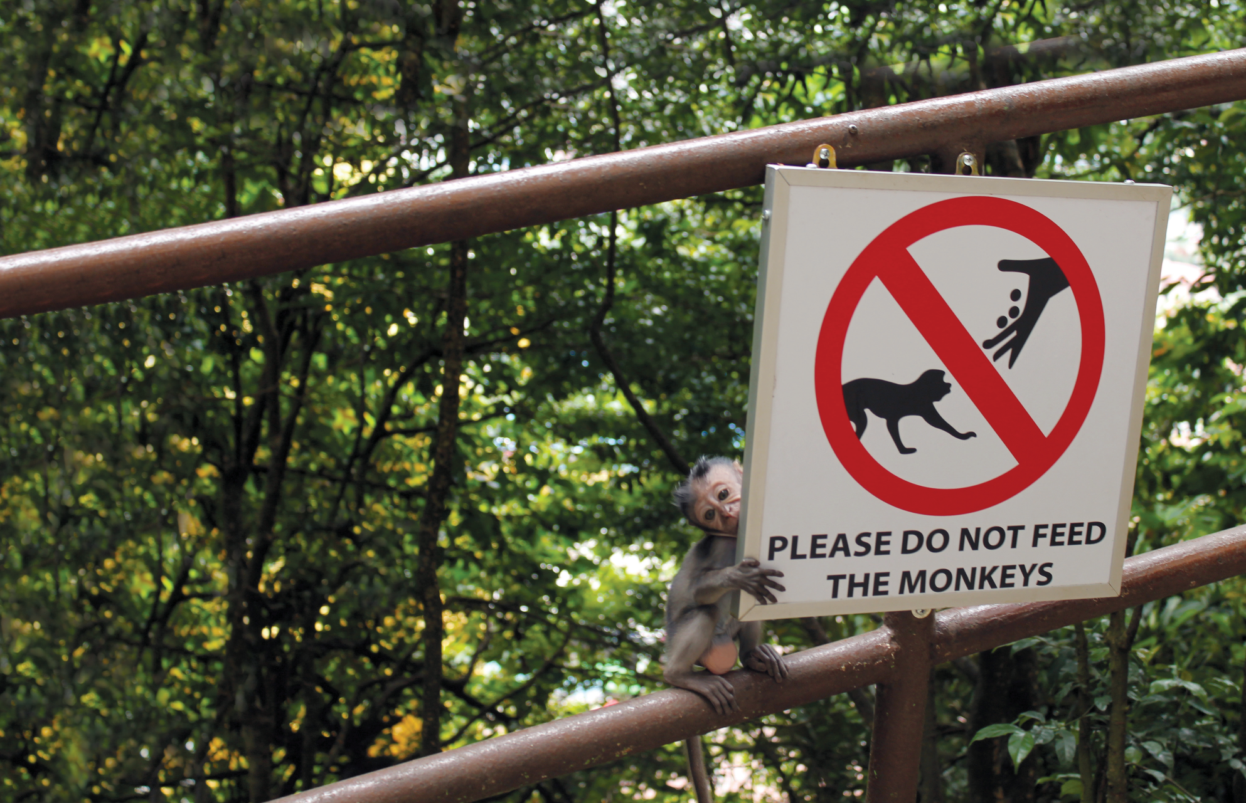
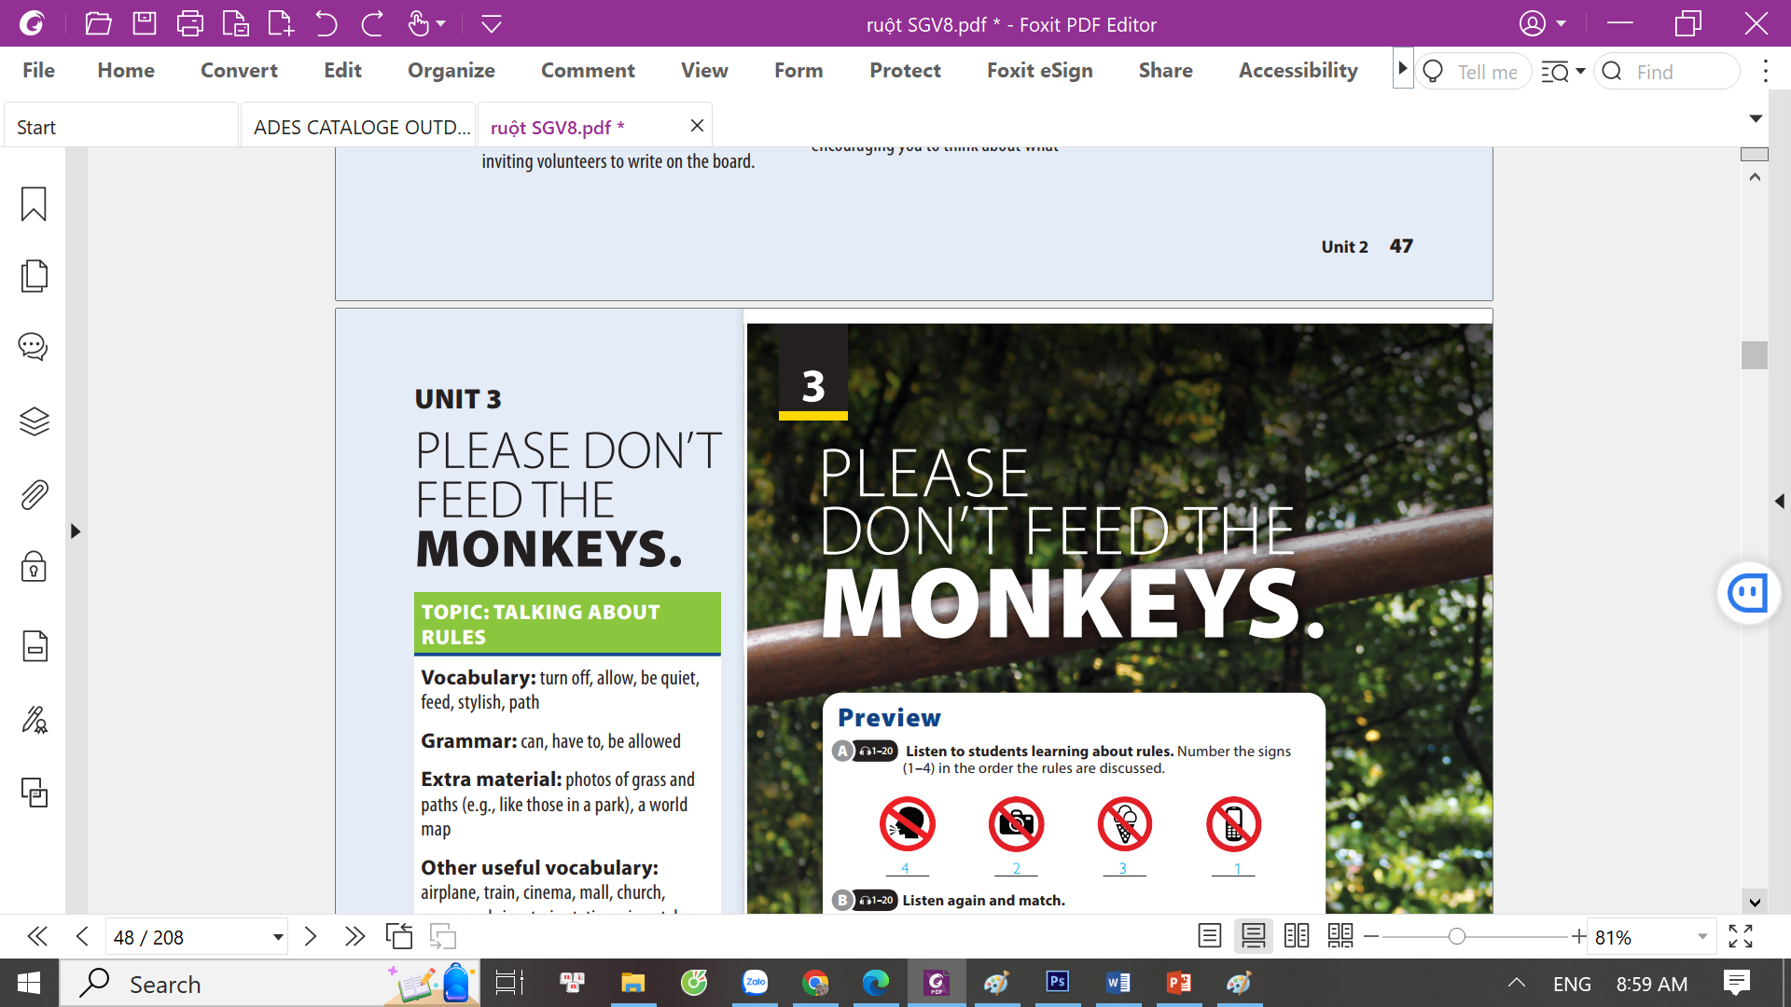
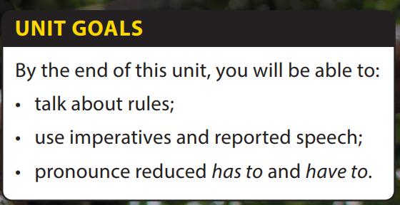
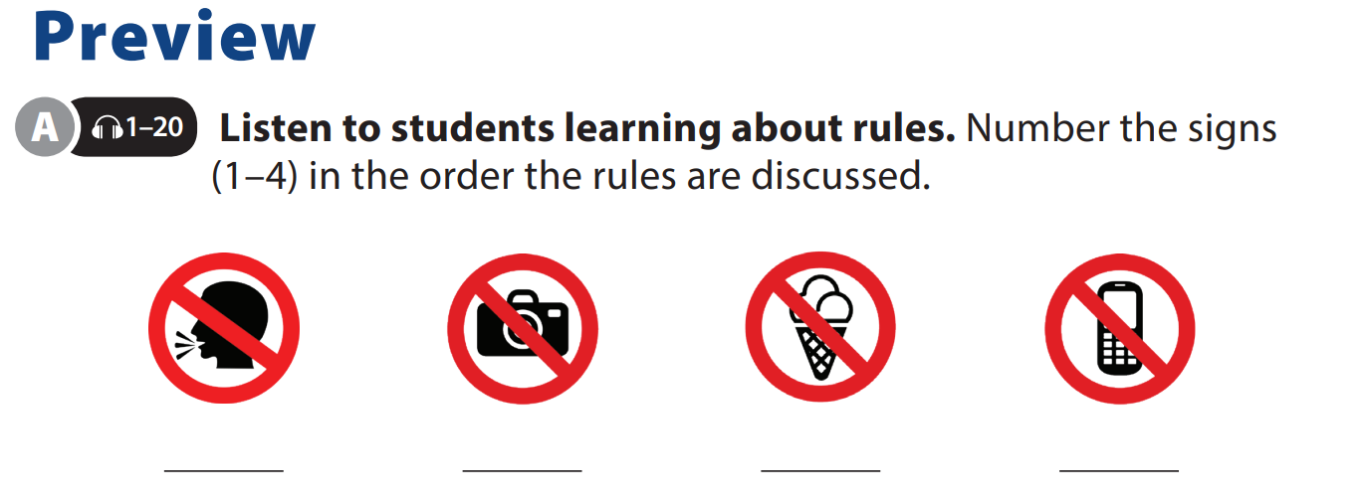
Writing and
Writing Worksheet

Slide 2







UNIT 3
PLEASE DON’T FEED THE MONKEY.
WRITING
Topic
CLASSROOM
RULES
Notes:
Free talk on classroom rules
Which rule would you most like to have? Why?
T should encourage students express their idea, don’t care much about its practicality.
Introduce new lesson.

Slide 3



UNIT 3
PLEASE DON’T FEED THE MONKEY.
WRITING
A paragraph is a short piece of writing, often 6-8 sentences long
A short paragraph includes: a topic sentence + supporting ideas + conclusion.
Short
Paragraph
Paragraph helps us:
+ Organize our idea
+ Express our ideas clearly
+ Be better communicators

Slide 4
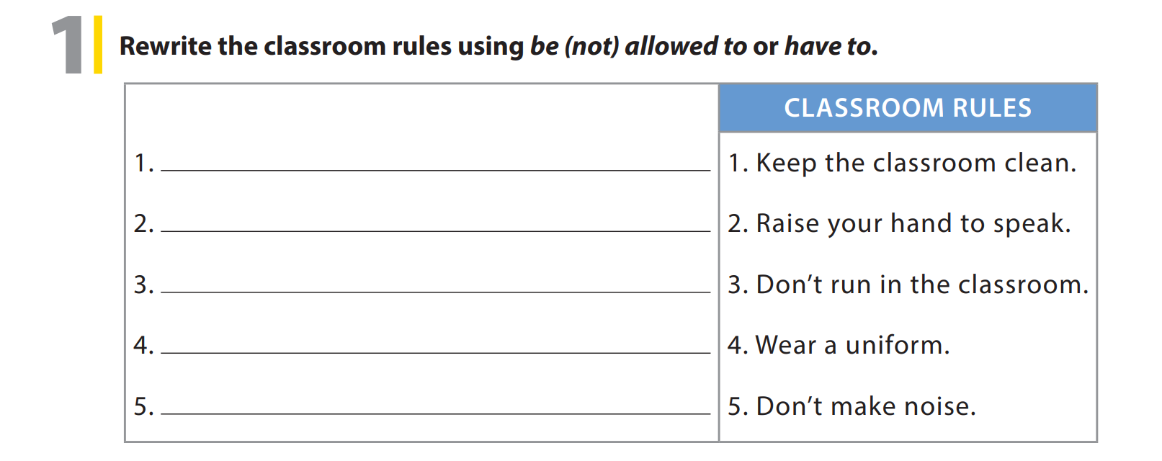
UNIT 3
PLEASE DON’T FEED THE MONKEY.
WRITING
You have to keep the classroom clean.
You have to raise your hand to speak.
You are not allowed to run in the classroom.
You have to wear a uniform.
You are not allowed to make noise.

Slide 5
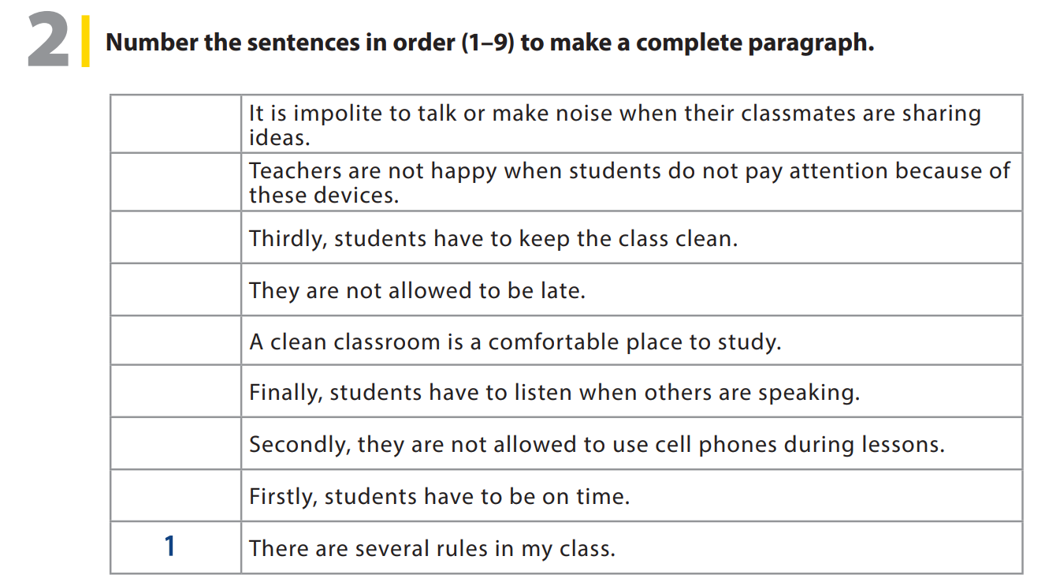
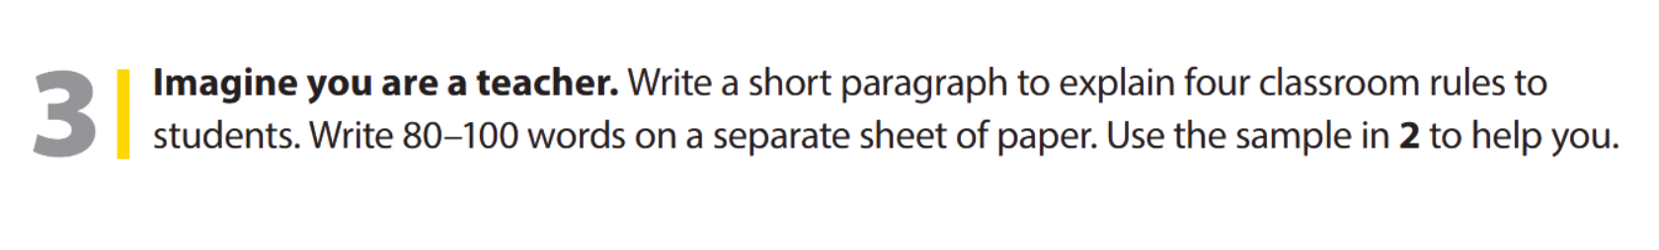
UNIT 3
PLEASE DON’T FEED THE MONKEY.
WRITING
9
5
6
3
7
8
4
2

Slide 6

UNIT 3
PLEASE DON’T FEED THE MONKEY.
WRITING
Notes:
Tell students they are going to write a short paragraph about school rules.
Explain to students that they should
imagine they are teachers and write a short paragraph explaining four rules for their class. Tell them that they must also explain why the rules are important.
Read the complete paragraph in 2 aloud, as students follow along in their books.
Point out that the paragraph is a good sample. Rephrase it to make sure it is clear, and explains the structure of the paragraph. Tell students that their paragraph should follow this pattern.
Give students about 10 minutes to finish their paragraphs, and set a minimum number of words they must write (e.g., 80 words).

Slide 7


THANK YOU!

