Slide 1
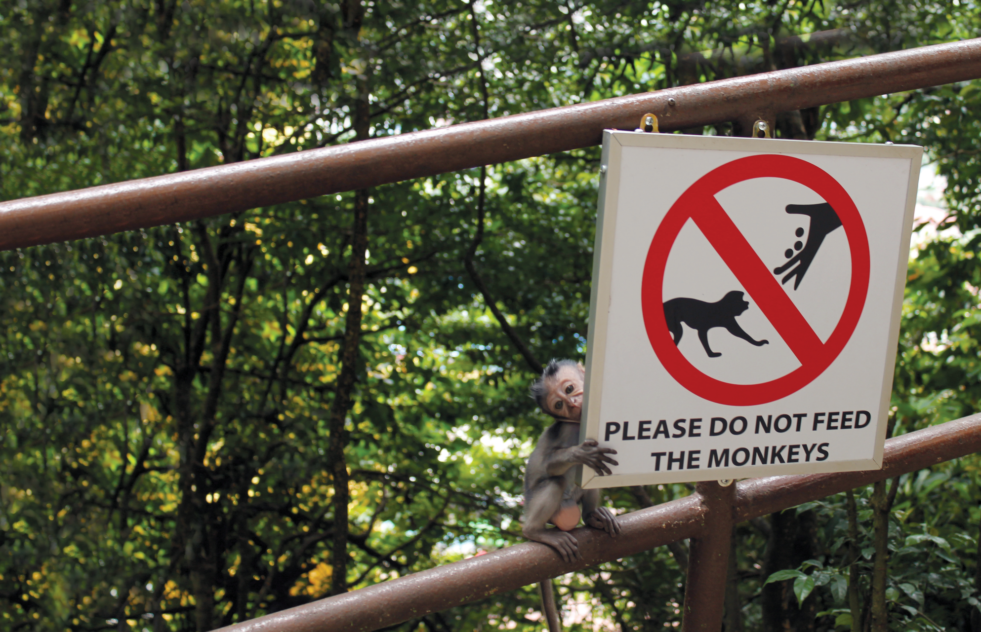
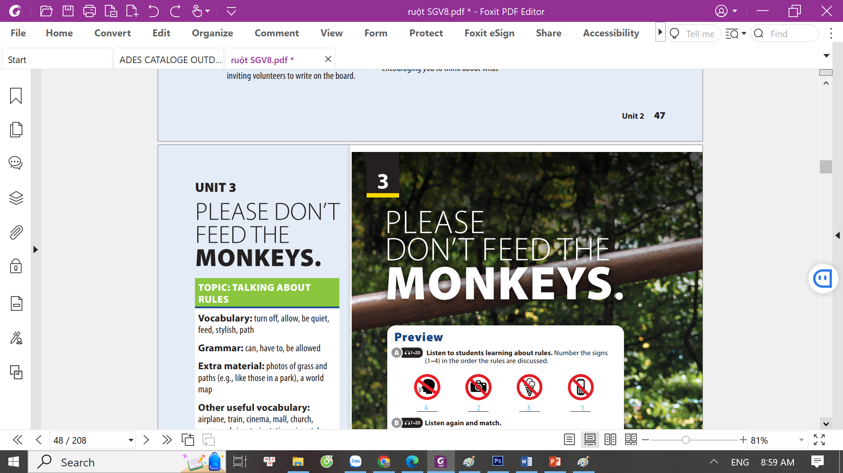
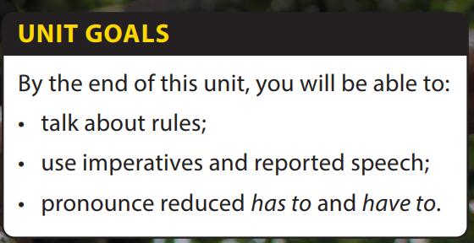
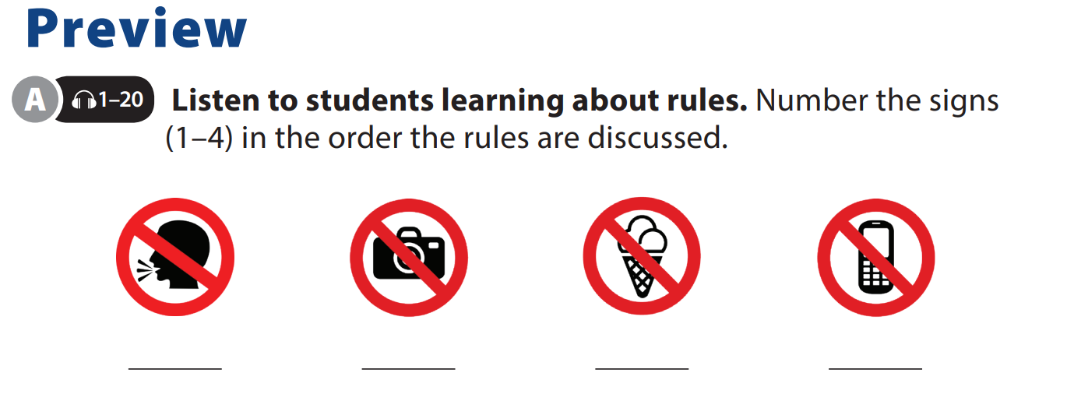
Video and
Video Worksheet

Slide 2

UNIT 3
PLEASE DON’T FEED THE MONKEY.
VIDEO

Slide 3
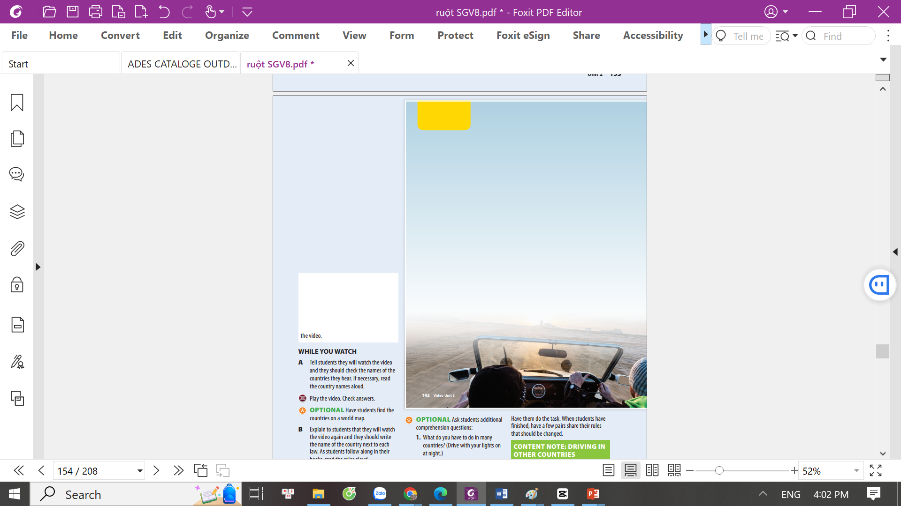
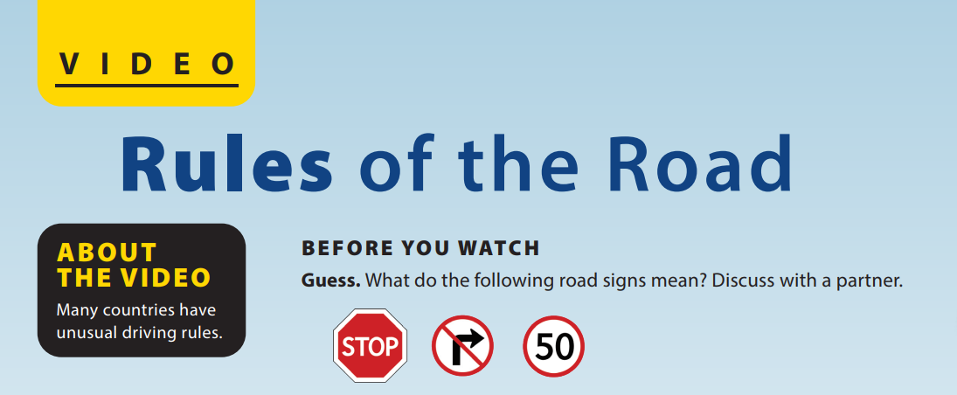
UNIT 3
PLEASE DON’T FEED THE MONKEY.
VIDEO
Notes:
Tell students they are going to watch a video. As students follow along, read the title of the video and the sentence about the video aloud. Have students describe the picture on p.142, then connect all the information together to guess what the video is going to be about.
Call on some students to share their thoughts and let the class vote on the best prediction.
Driving in other countries.
In most countries, it is against the law to drive without a valid license. Because your home
country’s license may not be recognized in other countries, some people get an International Driving Permit. This document
has the driver’s name and important information about the person, along with a photo.
Guide students on pronouncing the names of some countries in Activity A.

Slide 4
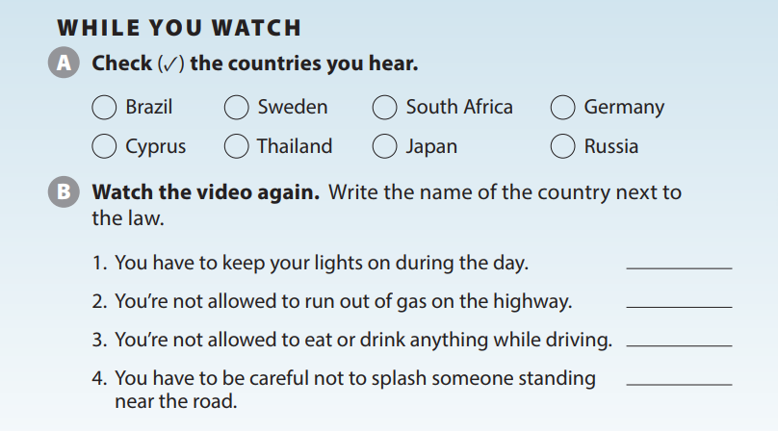
UNIT 3
PLEASE DON’T FEED THE MONKEY.
VIDEO
✓
✓
✓
✓
Sweden
Germany
Cyprus
Japan
Notes:
While You Watch
Activity A.
Tell students they will watch the video and they should check the names of the countries they hear. If necessary, read the country names aloud.
Play the video. Check answers.
OPTIONAL Have students find the
countries on a world map
Key:
Sweden/ Germany/ Cyprus/ Japan
Activity B.
Explain to students that they will watch the video again and they should write the name of the country next to each law. As students follow along in their books, read the rules aloud.
Play the video. Play it again, if necessary.
Check answers as a class.
CHALLENGE Ask students to get
into small groups and talk about the best way to learn the driving rules for other countries.
OPTIONAL Ask students additional
comprehension questions:
1. What do you have to do in many
countries? (Drive with your lights on
at night.)
2. What are you prohibited from doing in many countries? (Using your mobile phone while driving.)
Key:
1. Sweden
2. Germany
3. Cyprus
4. Japan

Slide 5
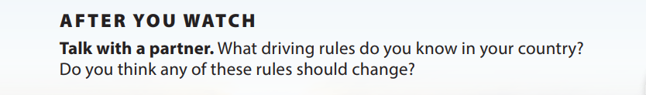
UNIT 3
PLEASE DON’T FEED THE MONKEY.
VIDEO
Notes:
Tell students they will get into pairs and talk about the video.
As students follow along in their books, read the two questions aloud.
Have them do the task. When students have finished, have a few pairs share their rules that should be changed.

Slide 6


THANK YOU!

