Slide 1
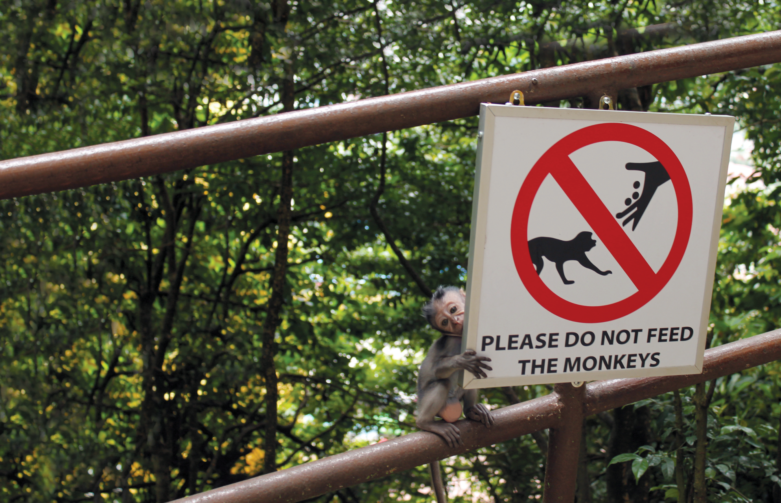
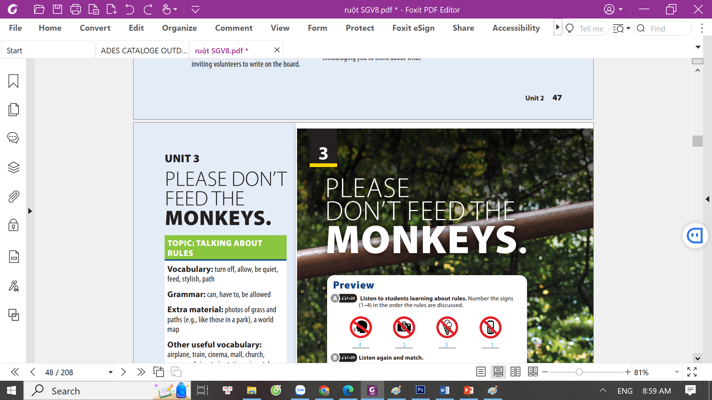
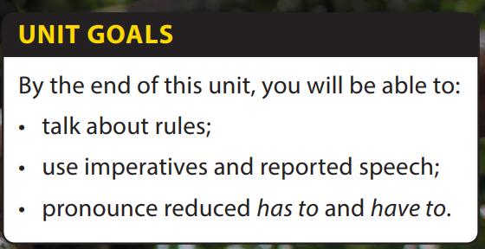
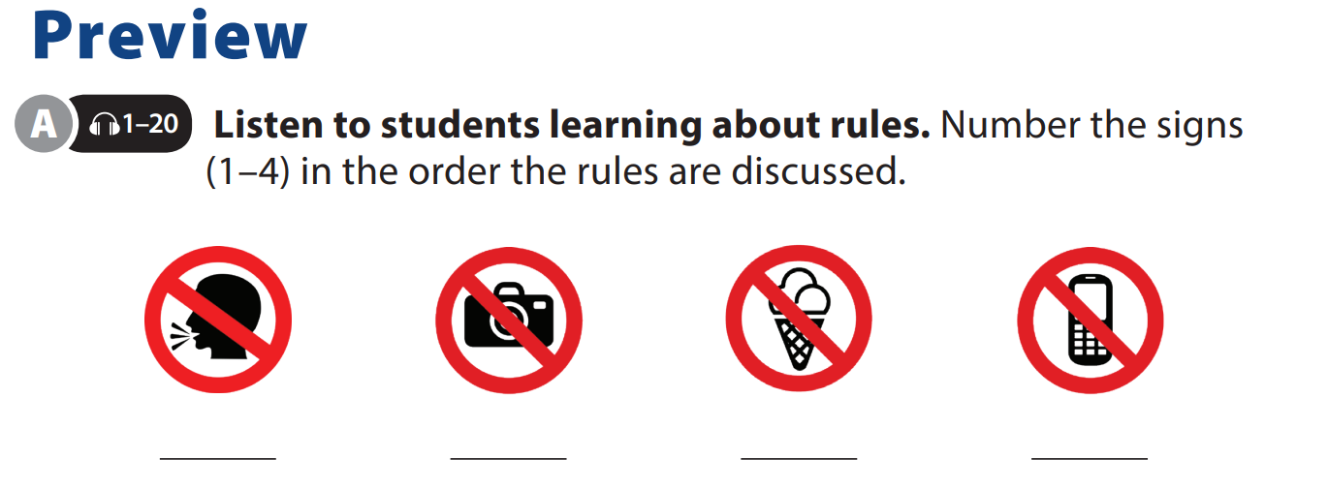
End of Unit

Slide 2




UNIT 3
PLEASE DON’T FEED THE MONKEY.
END OF UNIT
Play Game
OUR RULE
Notes:
Divide class into 2 teams, play game “Our rules”
Rule: Each team gives one classroom rule, one by one until they cannot give another word.
The team finish first (means that can not give another job) will be a loser.

Slide 3

UNIT 3
PLEASE DON’T FEED THE MONKEY.
END OF UNIT
These rules keep us safe and everything in order. For example, students are asked to wear uniforms some days a week. School uniforms help teachers and administrators identify who is a student and who isn’t, even from a distance. Also, school uniforms show a clear message of equality among students. Uniforms, as a result, reduce the chance of school bullying

Slide 4


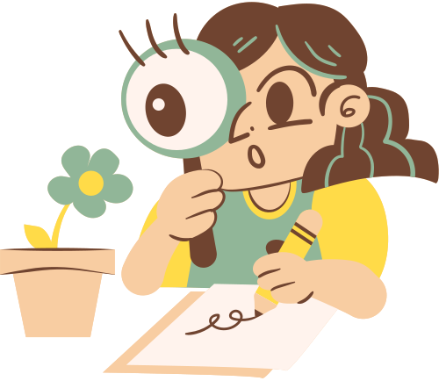
UNIT 3
PLEASE DON’T FEED THE MONKEY.
END OF UNIT
5 most important classroom rules
Fifth
Second
Second
First
Third
Notes:
Tell students they will get into groups and think of five most important classroom rules.
Explain that they must compare ideas with their group members and decide on the most important rules. They then work together to make a poster for the five classroom rules agreed and decorate it.
Emphasize that they will share the group poster with the class. Tell them that they have to explain why the rules chosen are the most important.
Have students get into groups and do the task.

Slide 5


THANK YOU!

