Slide 1
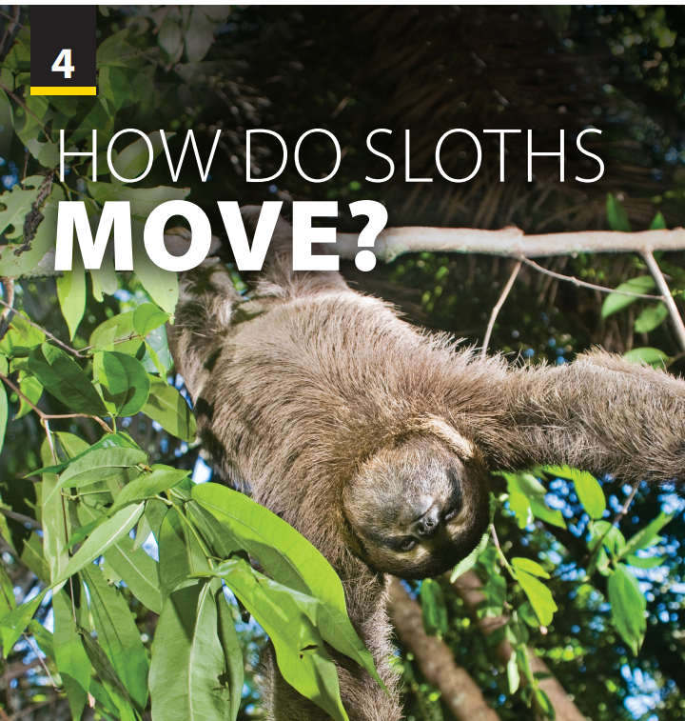
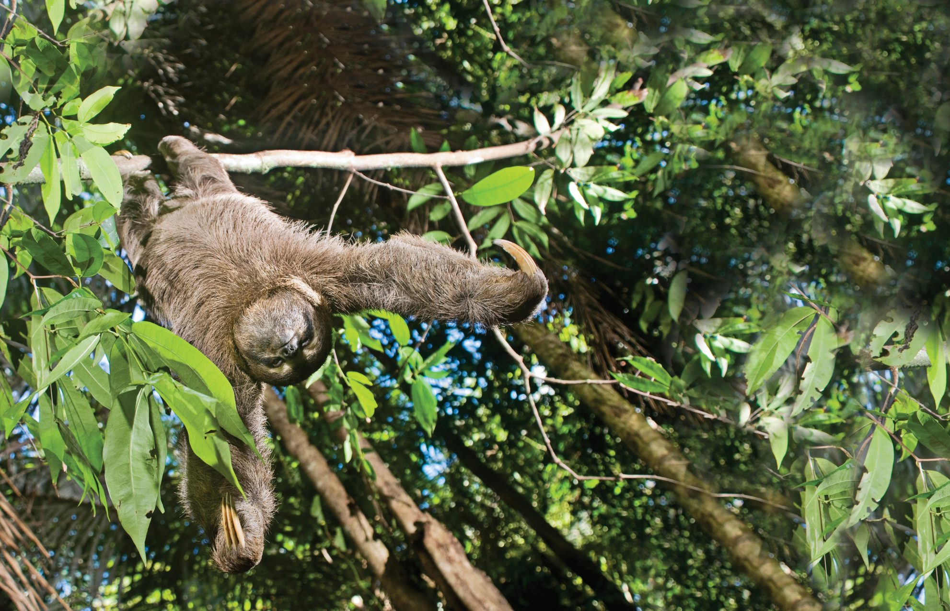
Preview and Language Focus

Slide 2

UNIT 4
HOW DO SLOTHS MOVE?
PREVIEW
Notes:
Motivating and Focusing.
Introduce the topic (job).
Have students watch a video (around 2 minutes) https://www.youtube.com/watch?v=OTp8W251aiQ
and have a discussion (based on some notes in pictures)
How does this animal move? (very slowly)
What do they spend time on? (eating and sleeping)
Describe it. (round heads, long legs, very
small ears, and short tails)
Have students read the unit title to
themselves as you read it aloud. Explain that
in this unit they will learn to talk about rules.

Slide 3
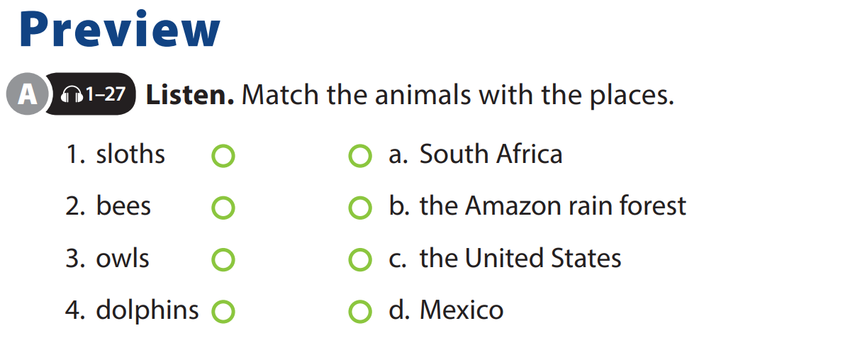

UNIT 4
HOW DO SLOTHS MOVE?
PREVIEW
Notes:
Tell students that they will hear part of a TV show about animals, and they should focus on the animals and their places so they can match them. If necessary, before playing the CD, read the animals’
names and the locations

Slide 4
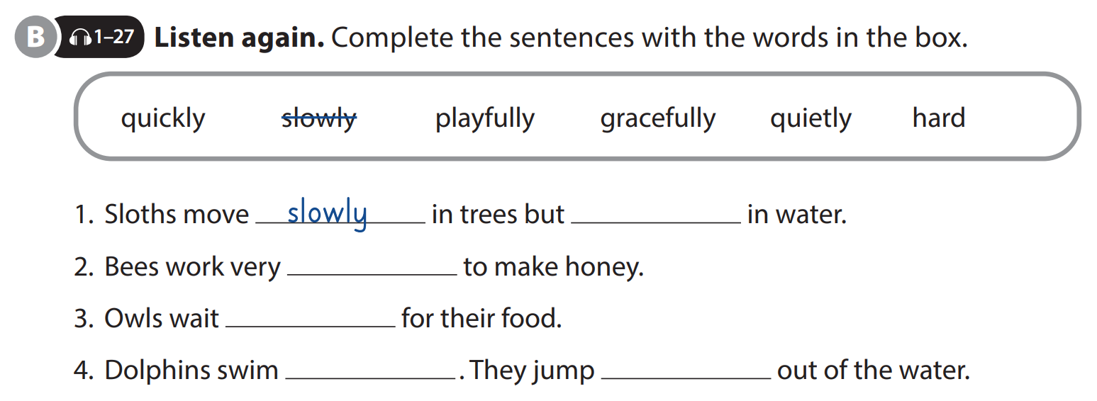
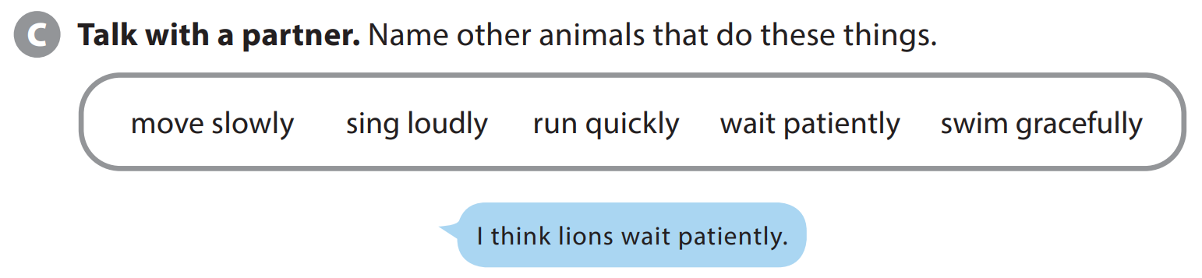
UNIT 4
HOW DO SLOTHS MOVE?
PREVIEW
quickly
hard
quitely
gracefully
playfully
Notes:
Preview - Activity B
Tell students that they will listen again and they should use the words in the box to complete the sentences. Before playing the CD, read the adverbs aloud as students follow along.
Play the CD. Play again, if necessary.
Check answers.
Keys:
Quickly
Hard
Quietly
Gracefully/ playfully
Preview - Activity C.
Tell students they are going to get into pairs and take turns talking about other animals.
As students follow along, read the expressions in the box.
Model the example.
Have students get into pairs and do the task.

Slide 5
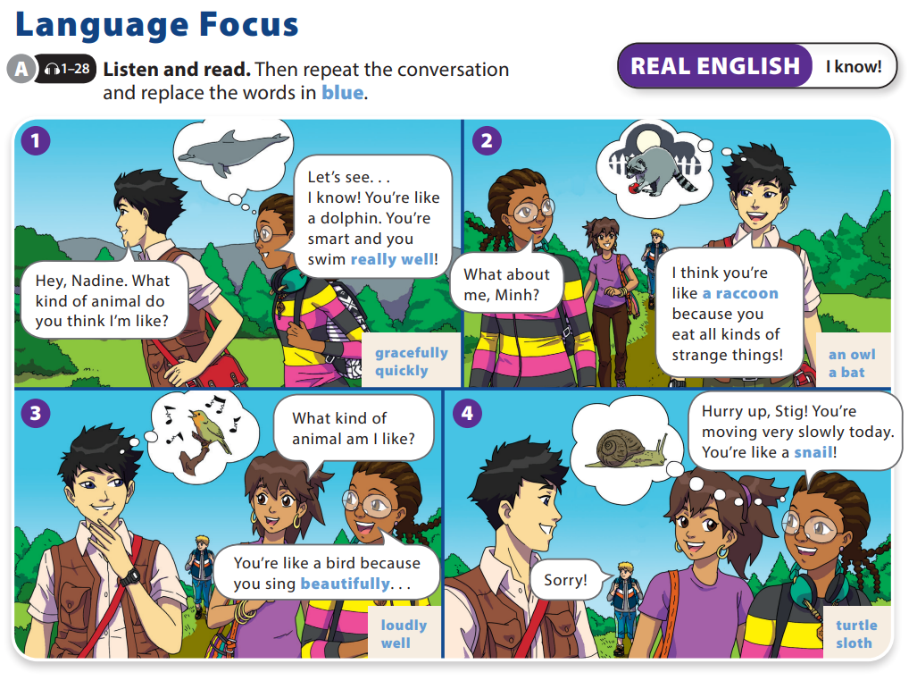
UNIT 4
HOW DO SLOTHS MOVE?
LANGUAGE FOCUS

Slide 6
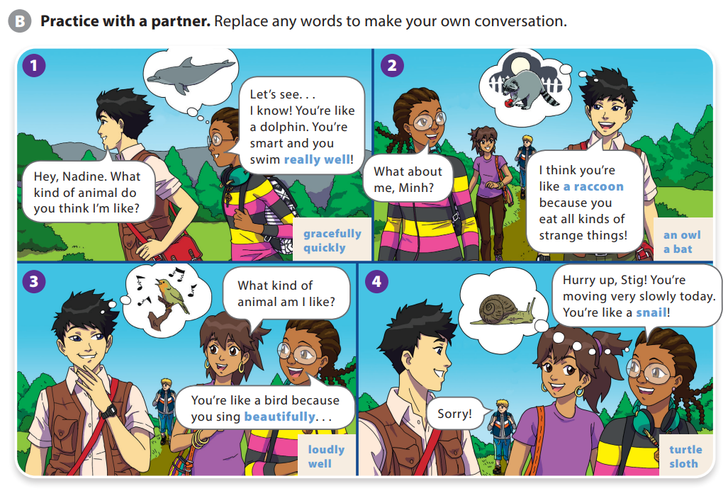
UNIT 4
HOW DO SLOTHS MOVE?
LANGUAGE FOCUS

Slide 7
UNIT 4
HOW DO SLOTHS MOVE?
LANGUAGE FOCUS
We use I know! when we suddenly think of a relevant point to make or have a new idea to share.
For example:
A: There’s nothing interesting on TV today.
B: Yeah, I’m so bored.
A: I know! Let’s go to the zoo. We haven’t
been there for ages.
B: Great idea! Let’s go!

Slide 8


THANK YOU!

