Slide 1
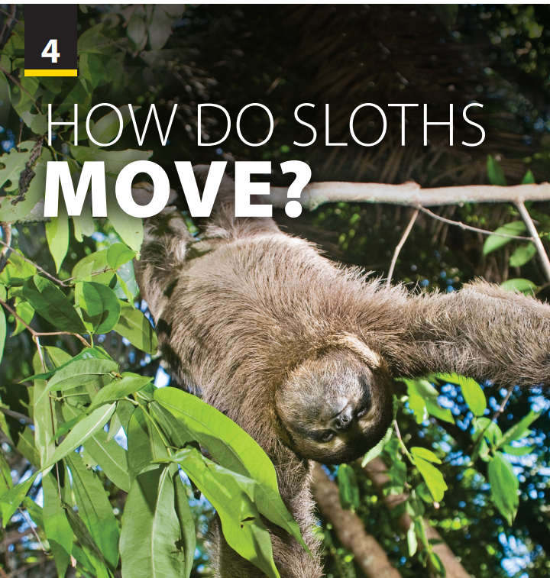
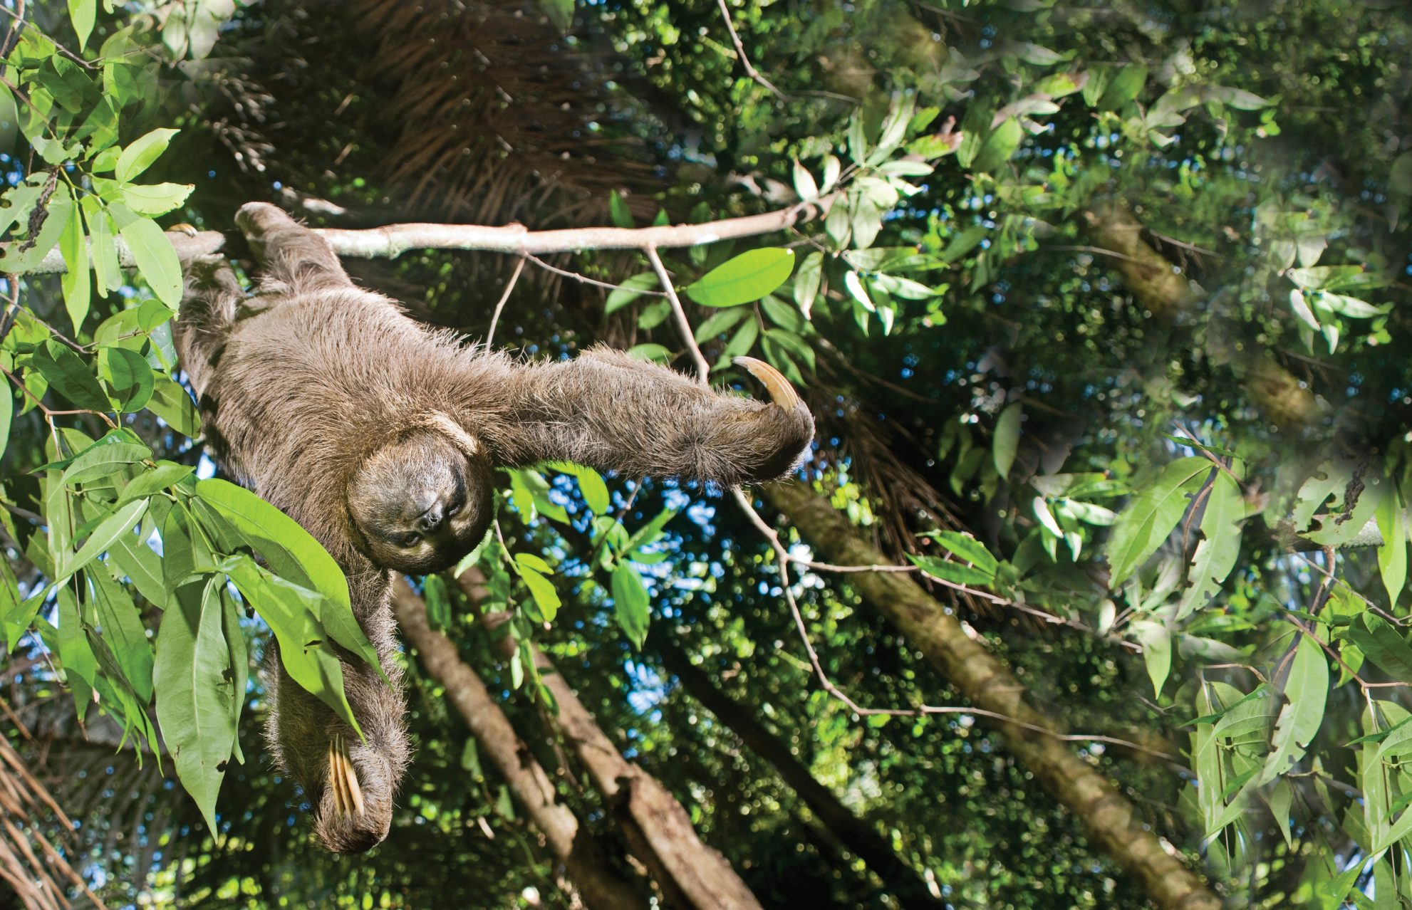
Language Focus
and
The Real World

Slide 2

UNIT 4
HOW DO SLOTHS MOVE?
LANGUAGE FOCUS
Sing and dance “It’s warm up time”
Notes:
Sing and dance

Slide 3
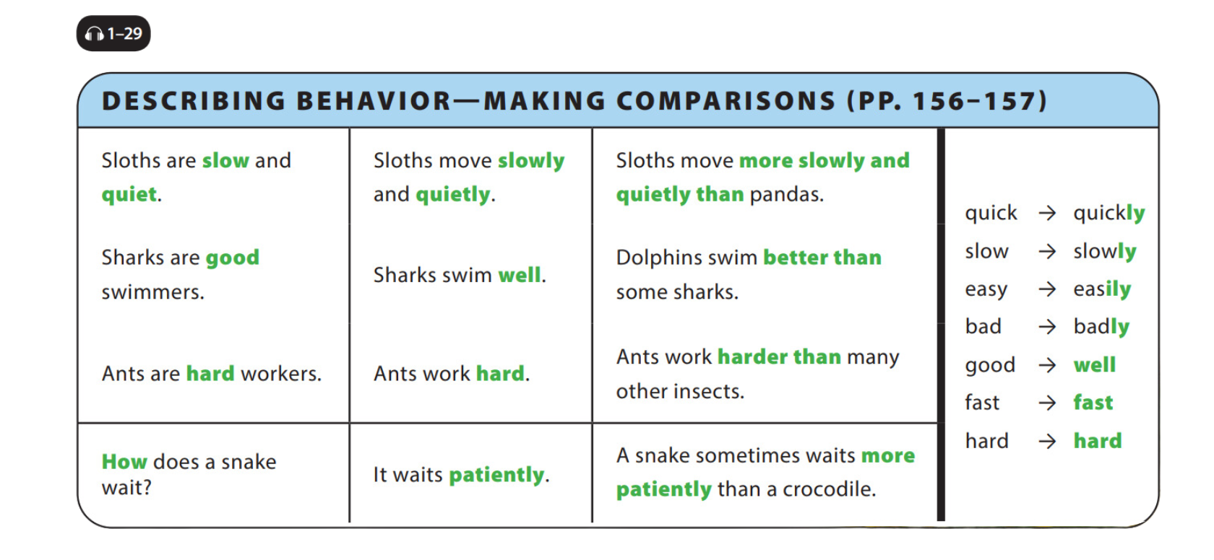

UNIT 4
HOW DO SLOTHS MOVE?
LANGUAGE FOCUS
Notes:
Point out
that the sentences describe what the
animals are like. Remind students that
when we describe a noun, the word we
use is called an adjective. Ask students
to list the adjectives in the sentences
(slow, quiet, good, hard).
Read the three sentences on the top in
the middle of the chart as students
follow along in their books. Ask students
to list the verbs in these sentences
(move, swim, work). Tell students that when we describe a verb, the word we
use is called an adverb. Ask students to
list the adverbs in these sentences
(slowly, quietly, well, hard).
Point out that for the first two words, we
simply add the letters -ly to the adjective
to change it into an adverb. Pointing to
the list on the right side of the chart,
explain that although most words follow
this pattern, a few do not. Tell them that
they need to memorize these exceptions.
Read the last sentence at the bottom
right of the chart. This sentence also uses
the verb + the adverb (wait patiently).
Tell them that a comparison between
two animals’ behaviors (that of a snake
and that of a crocodile) has been added.
Explain to students that we normally use
more + adverb + than for long adverbs
and adverb + er + than for short
adverbs. A few adverbs have irregular
comparative forms, for example, badly
-> worse, early -> earlier, much ->
more, far -> further/farther, little ->
less, and well -> better. Encourage
students to think of comparisons with
other animals if possible.
Ask students to look carefully at the
placement of the adverbs in all the
sentences in the chart, and to tell you
what they notice, giving the answer if
necessary. (The adverb always comes
after the verb.)

Slide 4
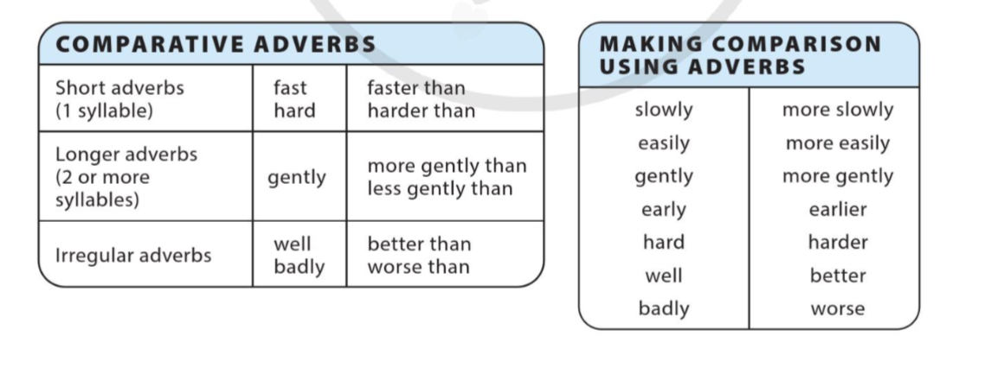
UNIT 4
HOW DO SLOTHS MOVE?
LANGUAGE FOCUS
Notes:
Guide students how to form adverbs from adjectives, let them pay more attention to irregular case.
Show them how to use adverbs of manner in comparison.
Illustrate each example to make sure students all get it.

Slide 5
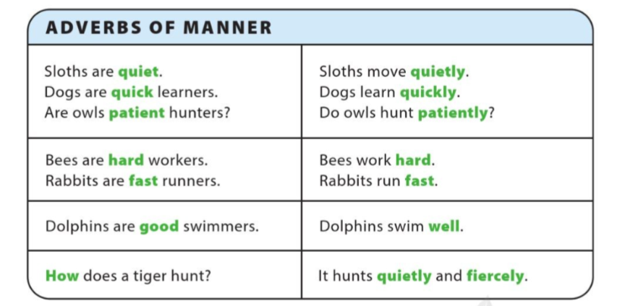
UNIT 4
HOW DO SLOTHS MOVE?
LANGUAGE FOCUS

Slide 6
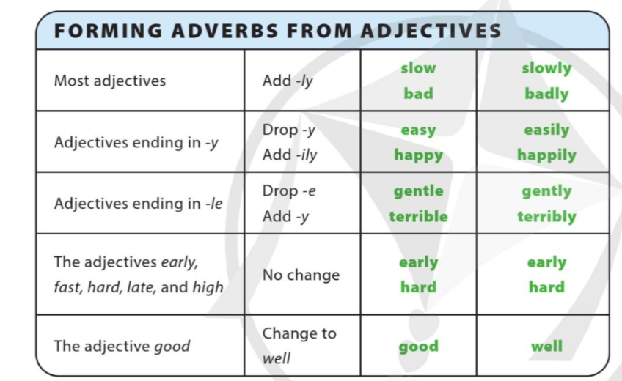
UNIT 4
HOW DO SLOTHS MOVE?
LANGUAGE FOCUS

Slide 7
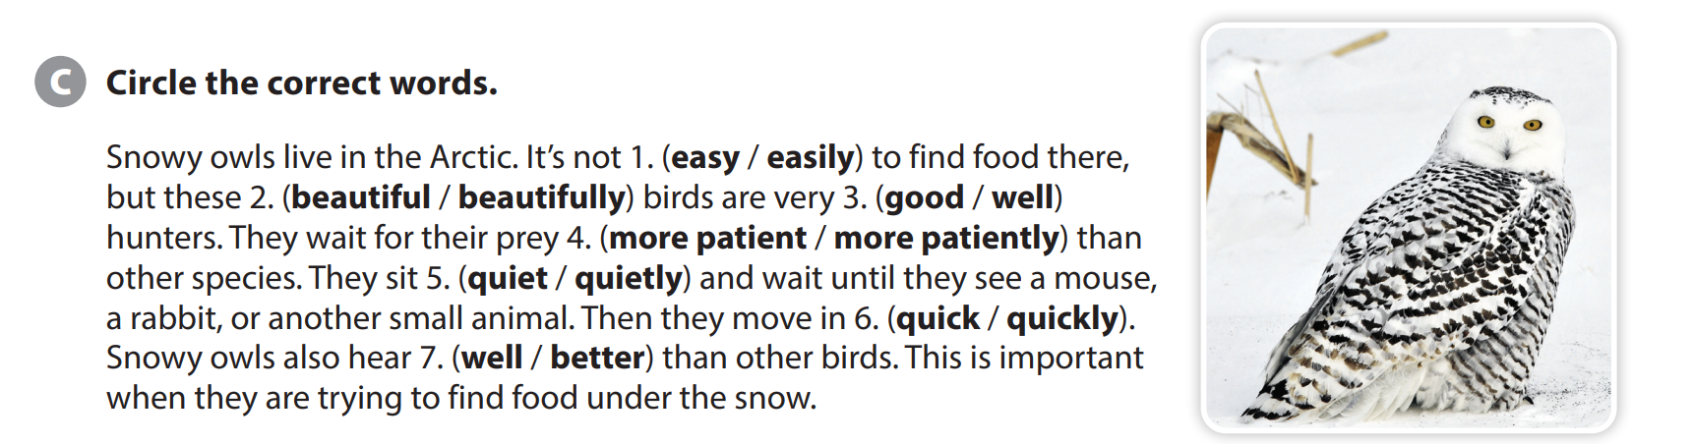
UNIT 4
HOW DO SLOTHS MOVE?
LANGUAGE FOCUS

Slide 8
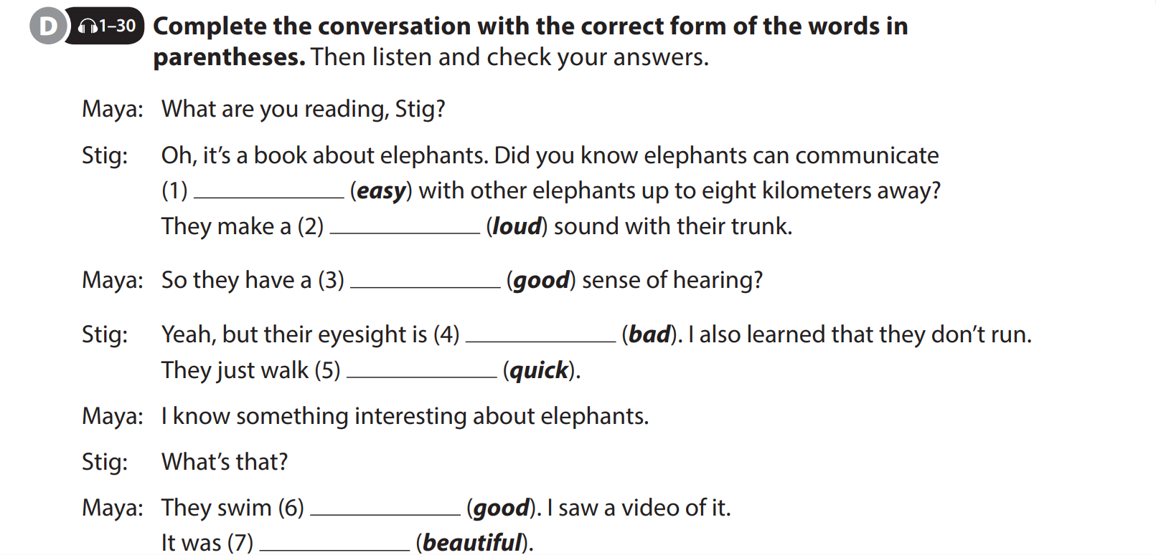
UNIT 4
HOW DO SLOTHS MOVE?
LANGUAGE FOCUS
easily
loud
good
bad
quickly
well
beautiful

Slide 9
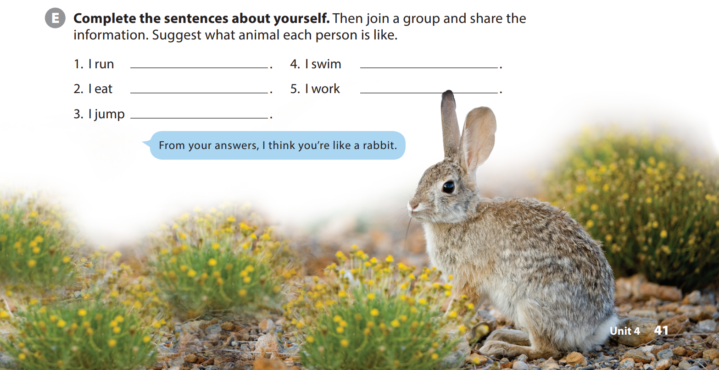
UNIT 4
HOW DO SLOTHS MOVE?
LANGUAGE FOCUS
Notes:
Remind students that Nadine said Minh
was like a dolphin because he is smart
and swims really well. Tell students they
are going to learn what kind of animal
they are like.
Have students complete the sentences
with information about themselves.
When they are finished, explain to students that they will get into groups and take turns reading their sentences.
Tell students that the other group members will suggest what kind of animal they resemble.
Model the example.

Slide 10
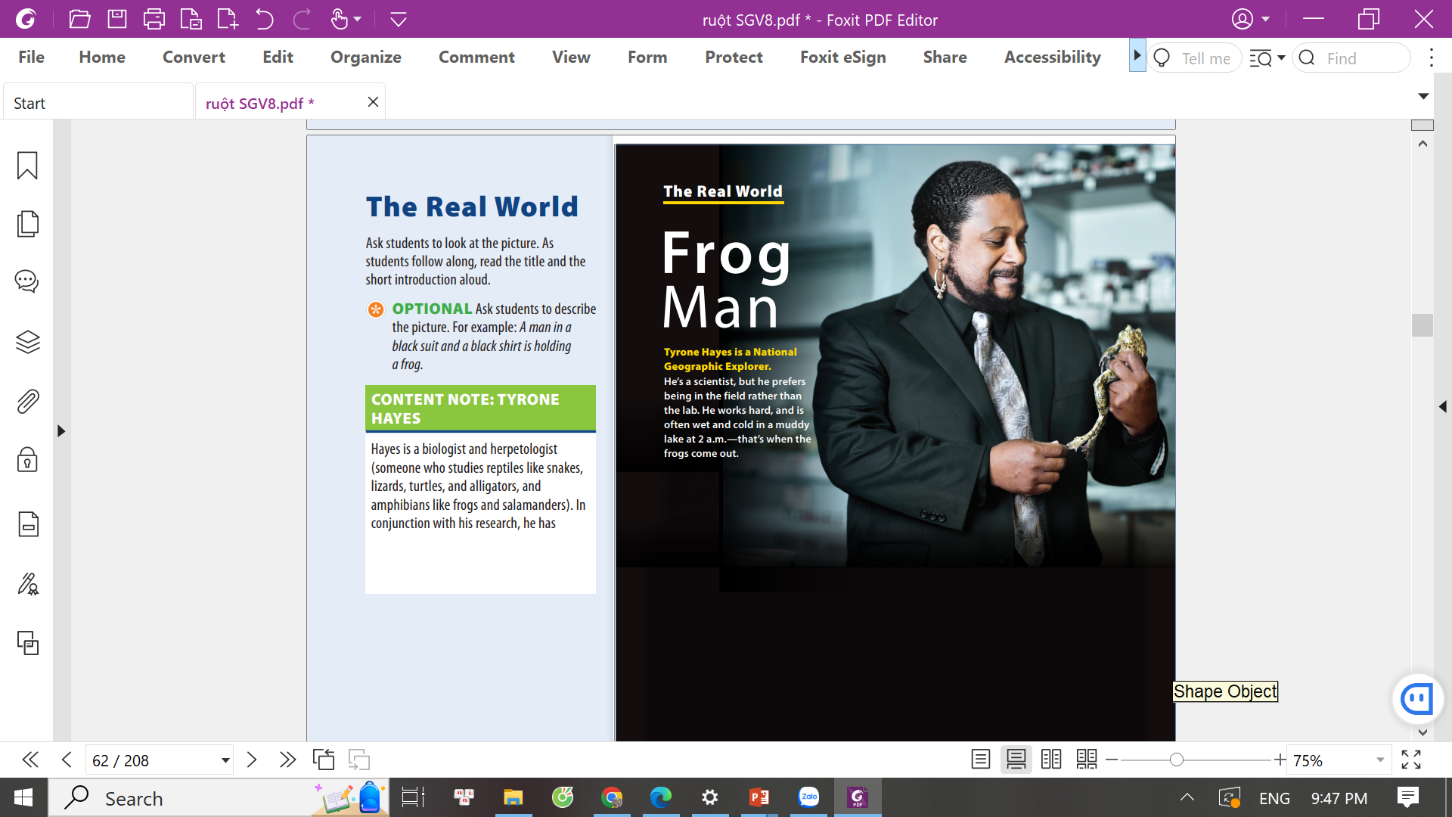
UNIT 4
HOW DO SLOTHS MOVE?
THE REAL WORLD

Slide 11
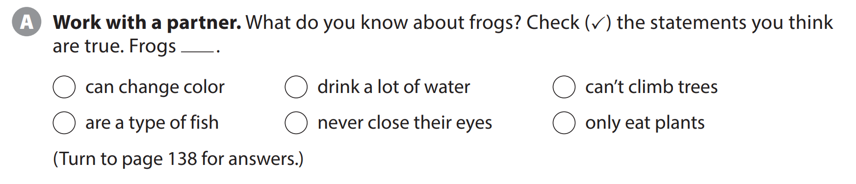
UNIT 4
HOW DO SLOTHS MOVE?
THE REAL WORLD
✓
✓
Notes:
Ask, What do you know about frogs? Tell
students they should get into pairs and
talk about what they know. Explain that
they should also check the statements that they think are true. As students follow along, read the statements.

Slide 12
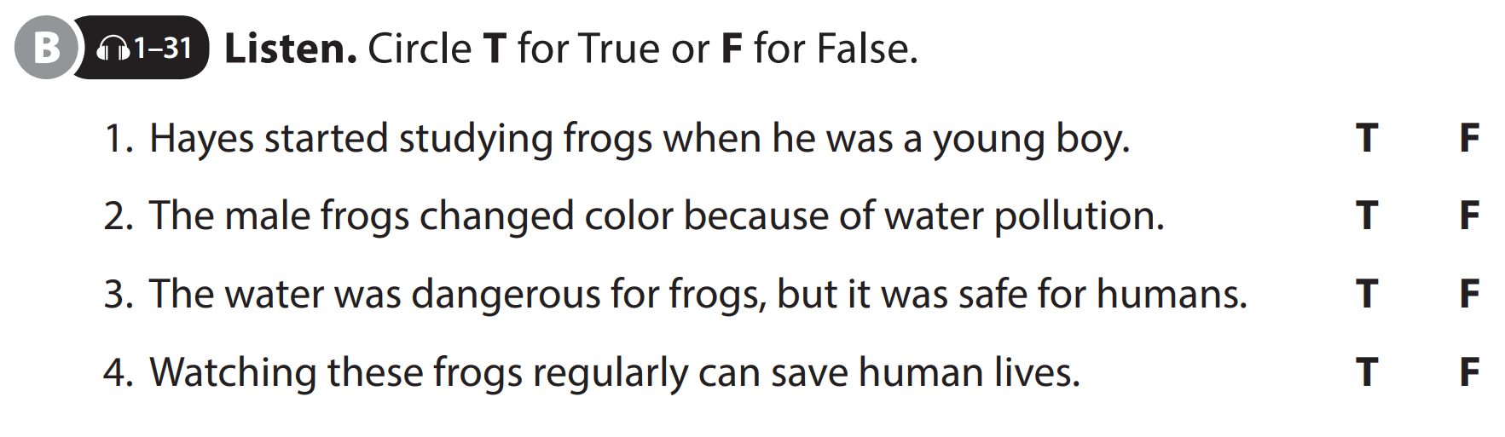
UNIT 4
HOW DO SLOTHS MOVE?
THE REAL WORLD
Notes:
Tell students they will listen to a talk about Tyrone Hayes. Explain that they should decide whether each statement is true or false, circling T or F, respectively.
As students follow along, read the sentences aloud.
Play the CD. Play it again, if necessary.

Slide 13


THANK YOU!

