Slide 1
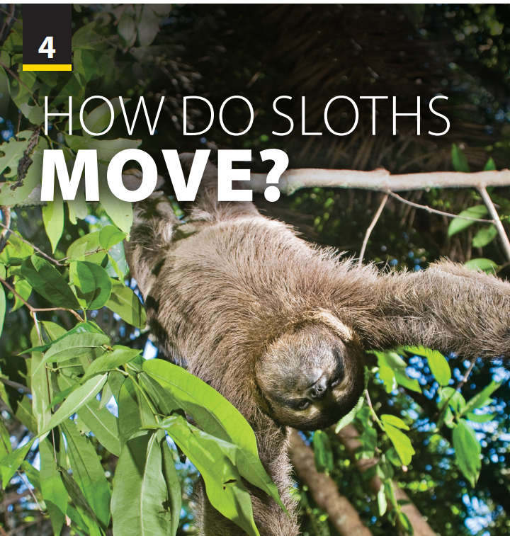
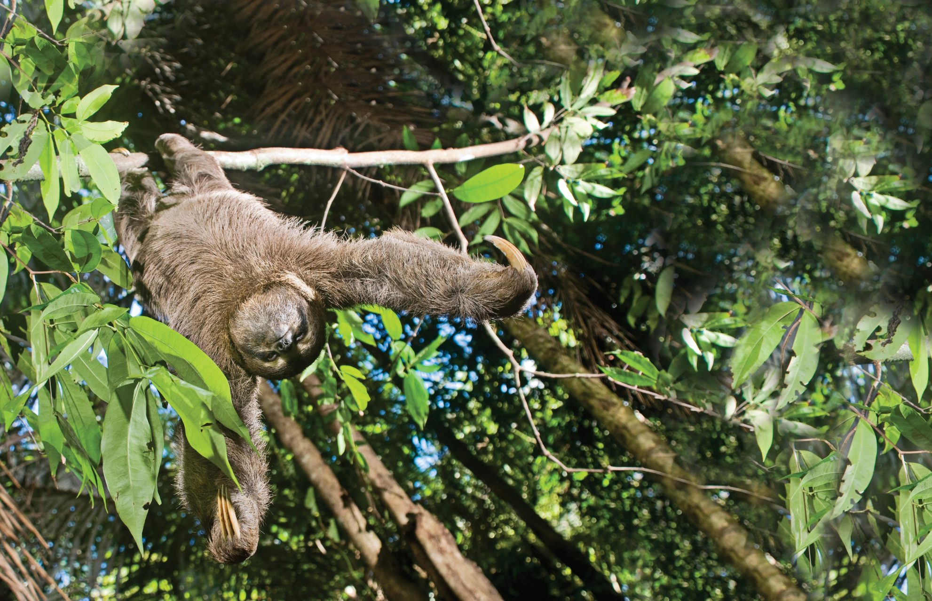
Pronunciation
and
Communication

Slide 2
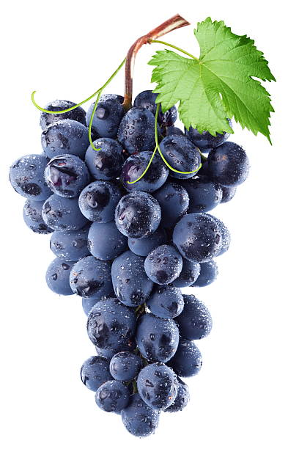
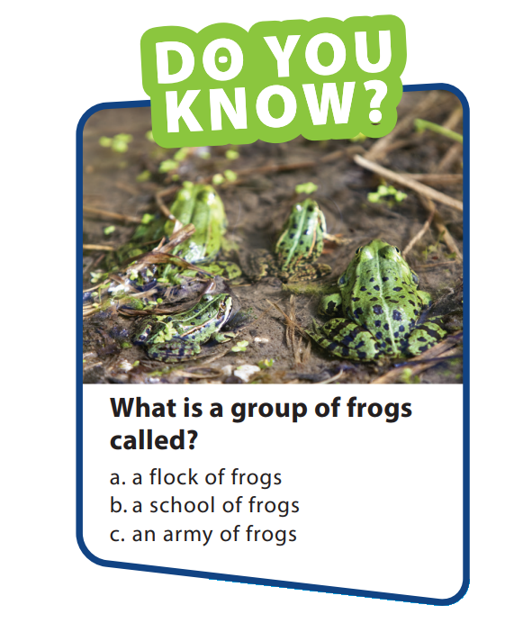
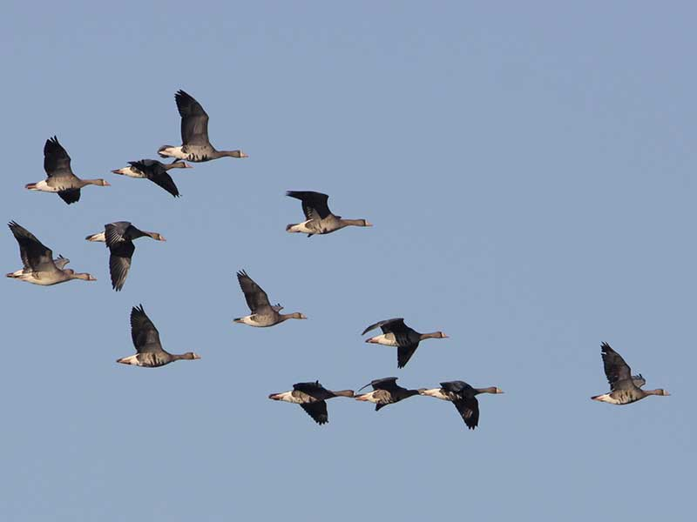
UNIT 4
HOW DO SLOTHS MOVE?
PRONUNCIATION
A group of bird => a flock
A group of grapes => a bunch
“Collective noun” means that when we refer something in a group, we put them in different collective noun

Slide 3
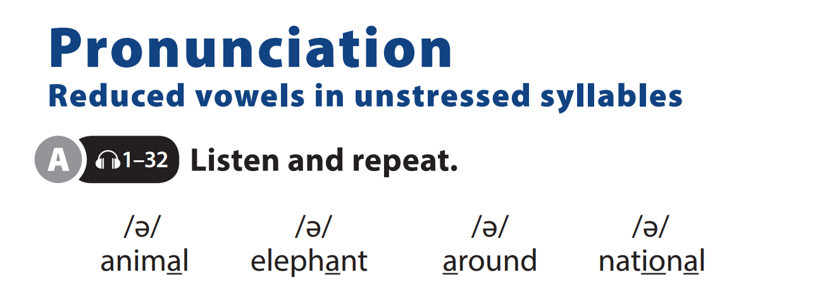

UNIT 4
HOW DO SLOTHS MOVE?
PRONUNCIATION
Notes:
Have students follow along in their
books as you explain that the symbol
that looks like an upside down e is called a schwa and is used when we say the vowel quickly. Explain that reducing the vowel allows us to place more stress on another syllable (the primary stress).
Explain that the schwa is the most often used vowel sound in English, but its pronunciation changes slightly between words.

Slide 4
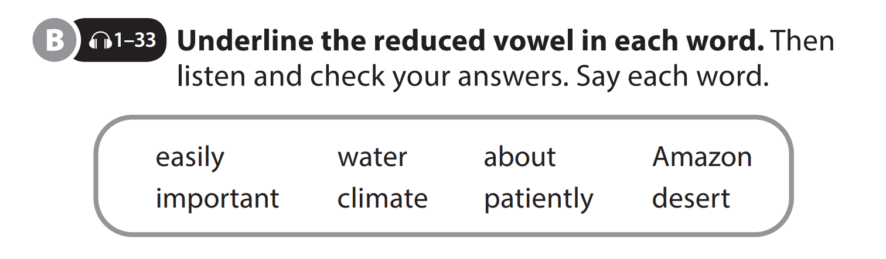
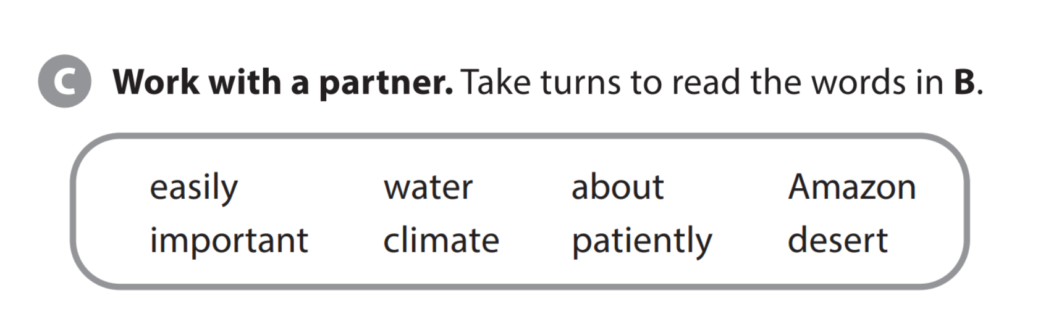
UNIT 4
HOW DO SLOTHS MOVE?
PRONUNCIATION

Slide 5
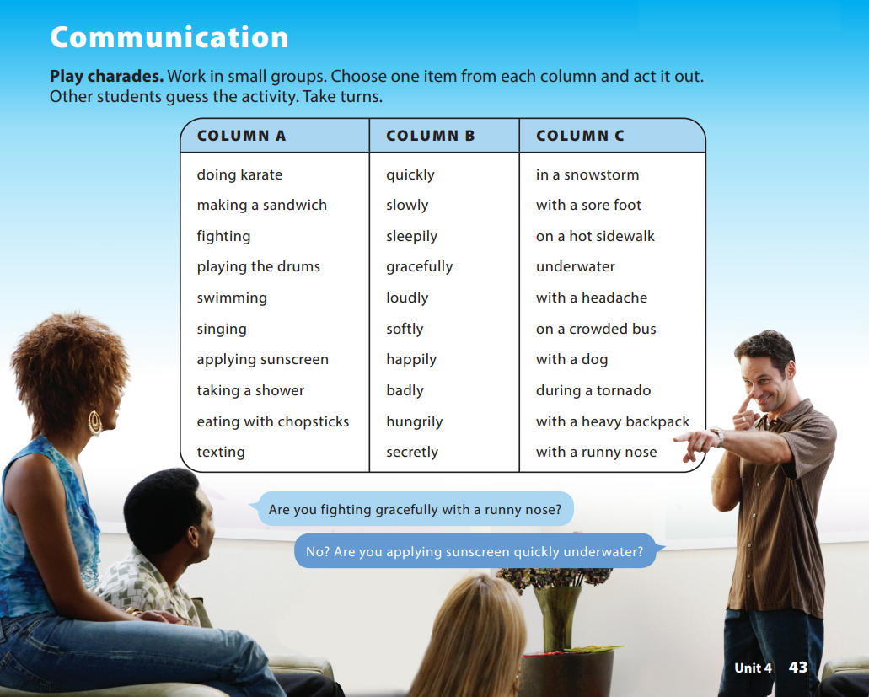
UNIT 4
HOW DO SLOTHS MOVE?
PRONUNCIATION
Notes:
Tell students they are going to get into groups and play a game of charades in which they act out an activity without using any words. Tell them that they get one point for each correct guess, and the student with the most points at the end is the winner.
Tell them that they will take turns choosing an activity from column A, an adverb from column B, and another detail from column C.
Tell them they should act out the activity until one of the other students in their group guesses correctly, and after this, the next
student will act out an activity. Explain that they can use the details in the chart more than once, mixing them as they wish, as long as their combination includes an item from
each column. Emphasize that they should have fun and can make crazy or unrealistic activities.

Slide 6


THANK YOU!

