Slide 1
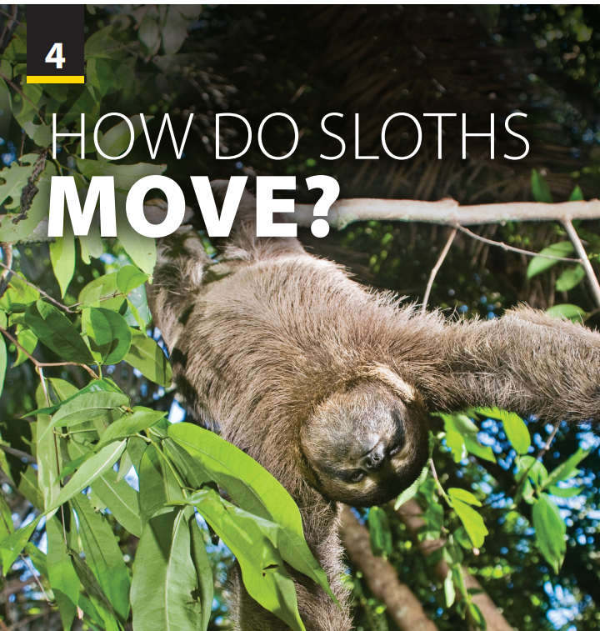
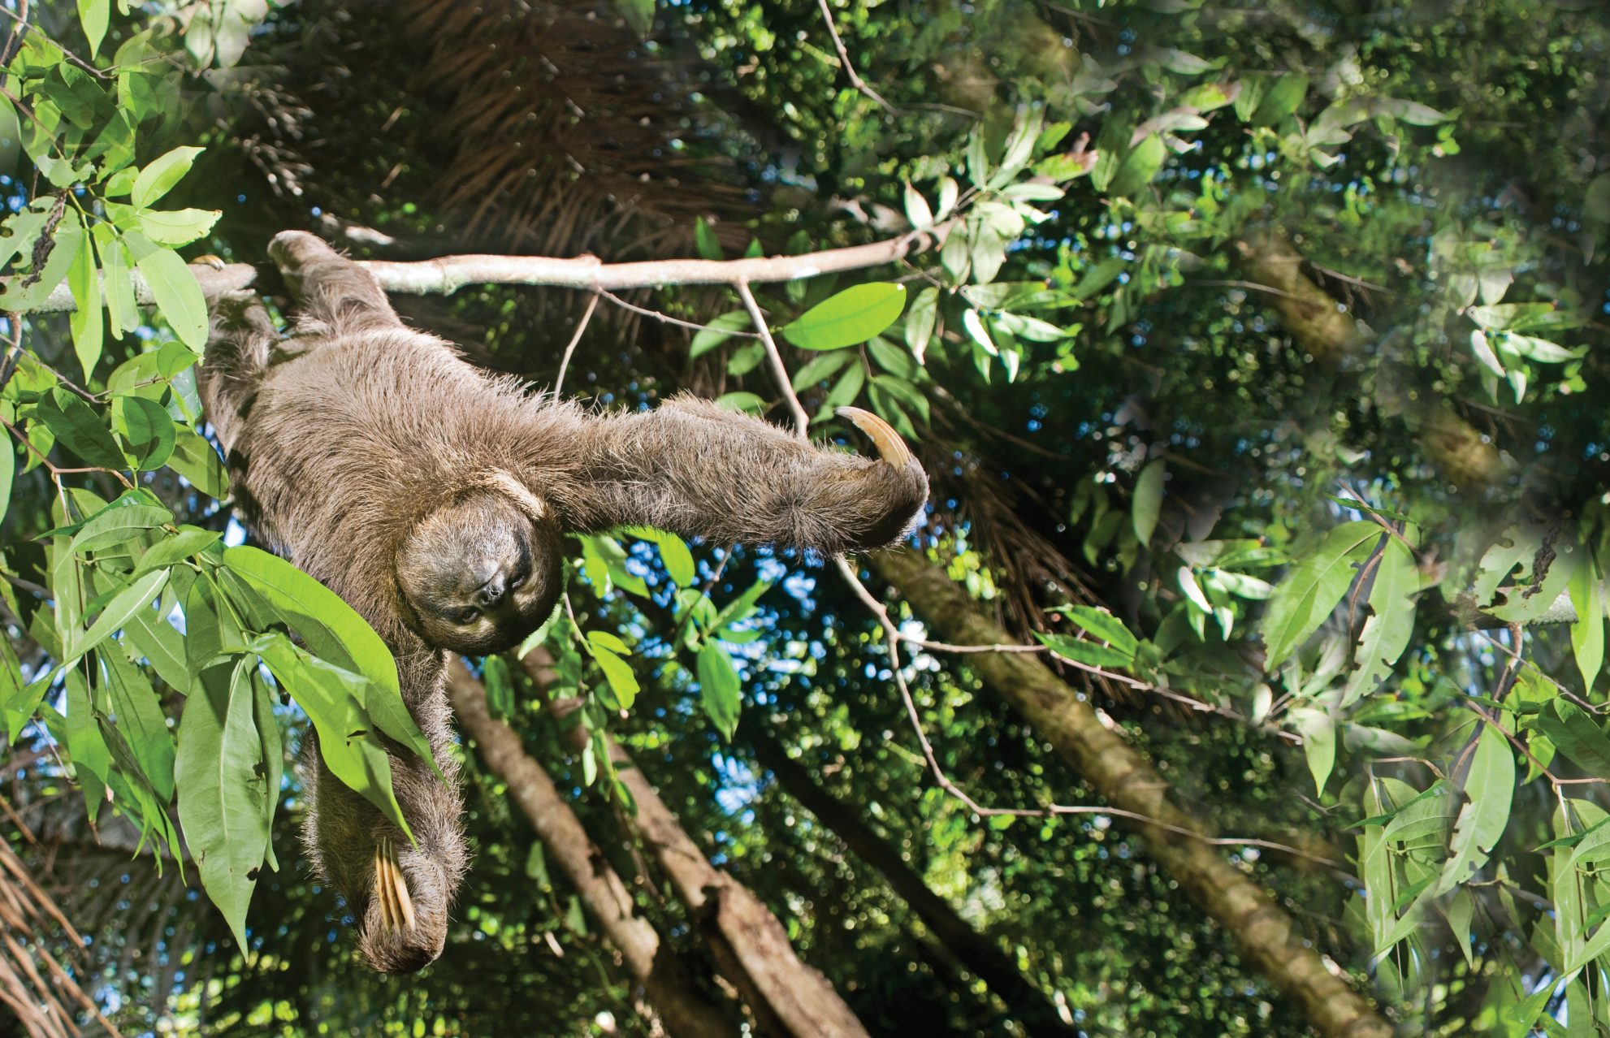
Reading
and
Comprehension
Notes:
Free talk on topic around the photo.
Ask students some questions:
What can you see? (a fox)
Have you ever been behavored nicely by an animal?

Slide 2
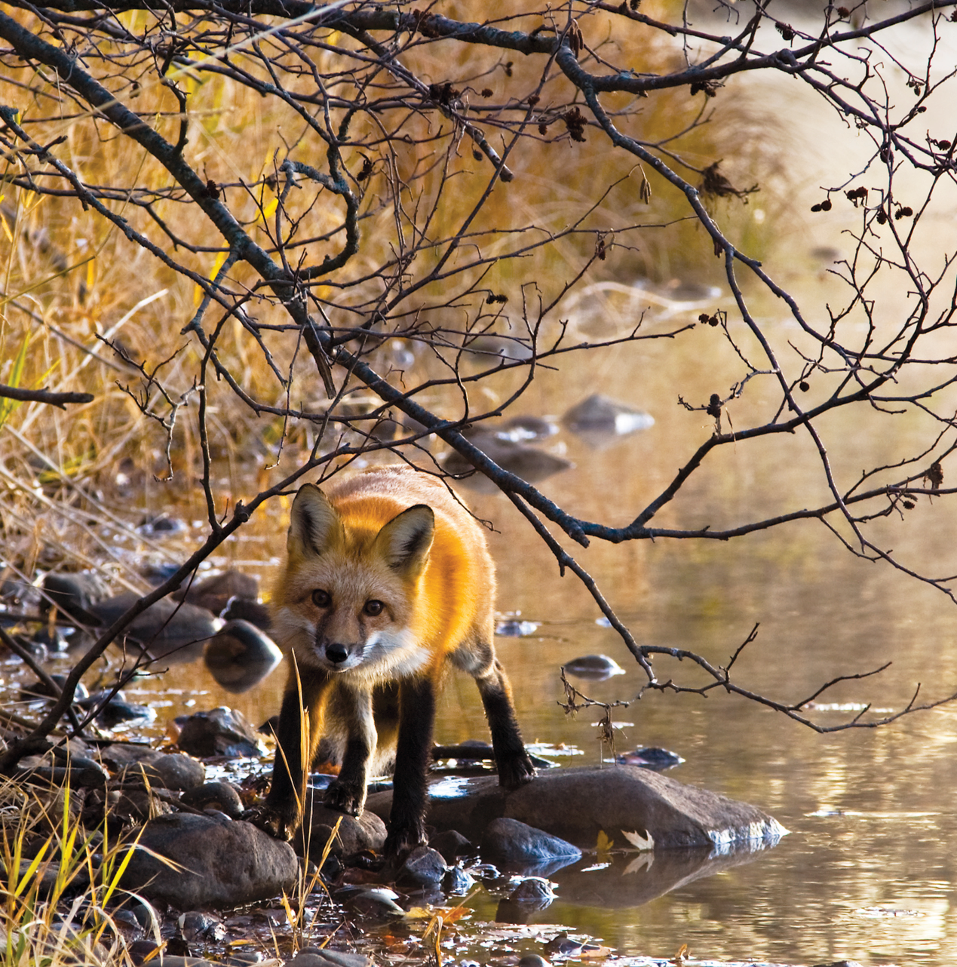
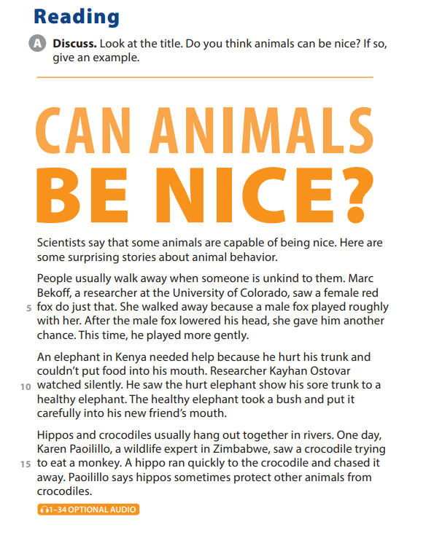
UNIT 4
HOW DO SLOTHS MOVE?
PRE-READING
Notes:
Free talk on topic around the photo.
Ask students some questions:
What can you see? (a fox)
Have you ever been behavored nicely by an animal?
Ask students to look at the photo and then follow along as you read the caption aloud.
Let them read the title and question.
Have students get into pairs and discuss it. Then randomly call on a few students to share their answers and examples.

Slide 3
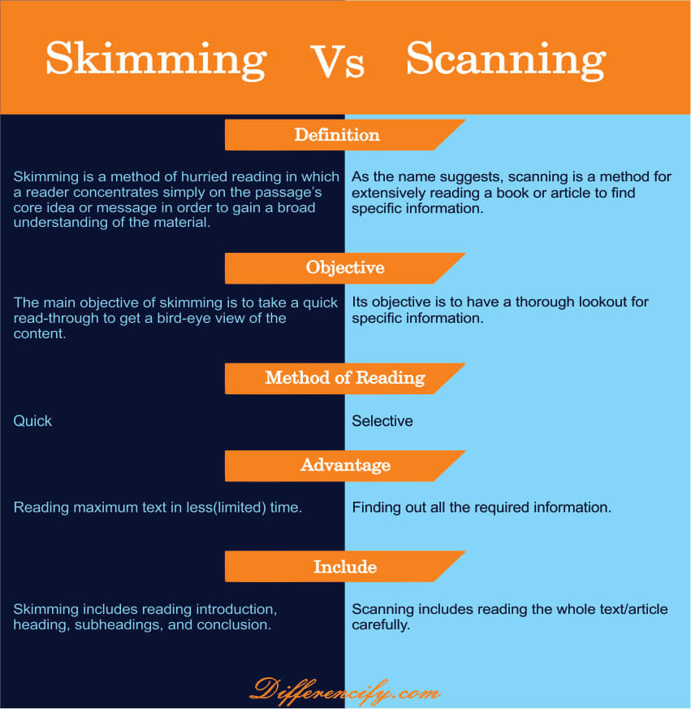
UNIT 4
HOW DO SLOTHS MOVE?
READING
Notes:
Explain technique: Differentiate skimming and scanning
Meaning – Skimming is when you read quickly, usually to get a general idea of the content. On the other hand, scanning is when you look for specific information, often using your eyes to jump from place to place.
Purpose – The purpose of skimming is to get a general overview of the text, while the purpose of scanning is to find specific information.
Speed – Skimming is done quickly, while scanning is usually done at a slower speed.
Method – When skimming, your eyes may move across the text in a zig-zag pattern; when scanning, your eyes may move back and forth or up and down the page.
Direction – When skimming, you typically read from top to bottom; when scanning, you may start anywhere on the page and move in any direction.
Attention – When skimming, you pay less attention to detail; when scanning, you try to take in as much detail as possible.
Comprehension – Skimming allows for less comprehension than scanning; however, both methods allow for some level of understanding of the text.

Slide 4
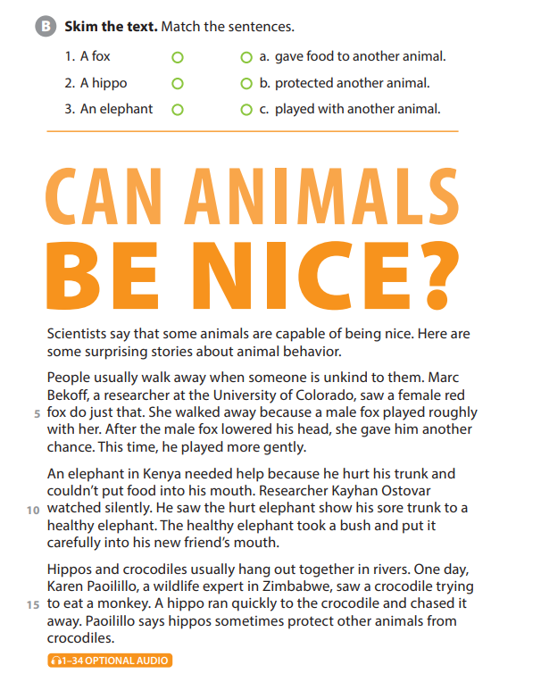
UNIT 4
HOW DO SLOTHS MOVE?
READING

Slide 5
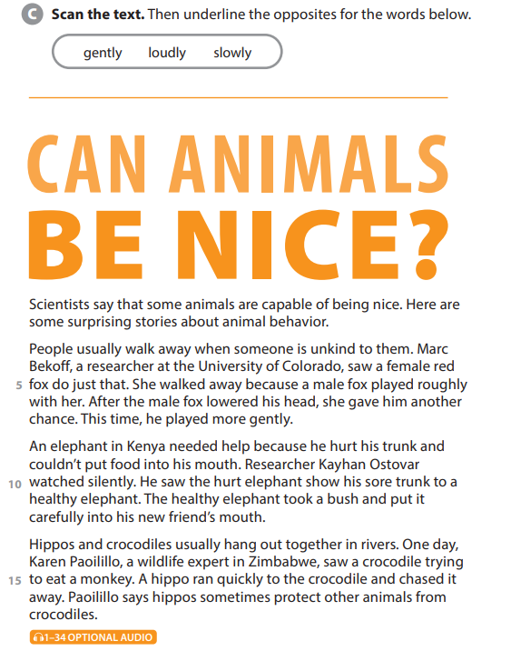
UNIT 4
HOW DO SLOTHS MOVE?
READING

Slide 6
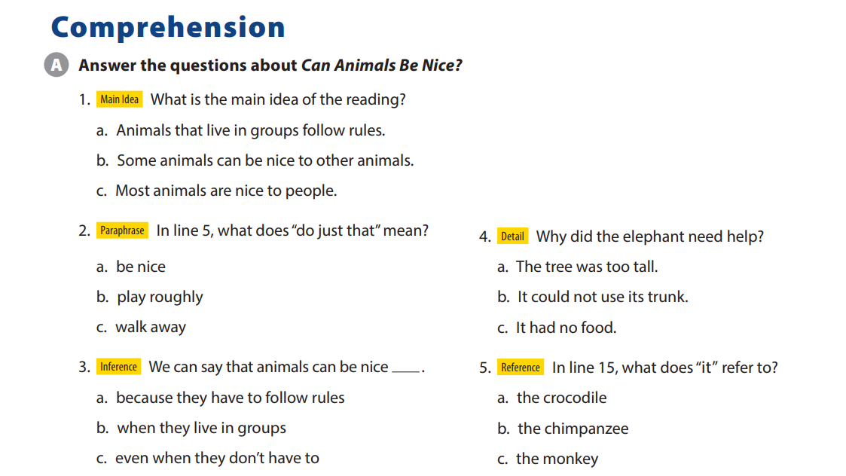
UNIT 4
HOW DO SLOTHS MOVE?
COMPREHENSION

Slide 7
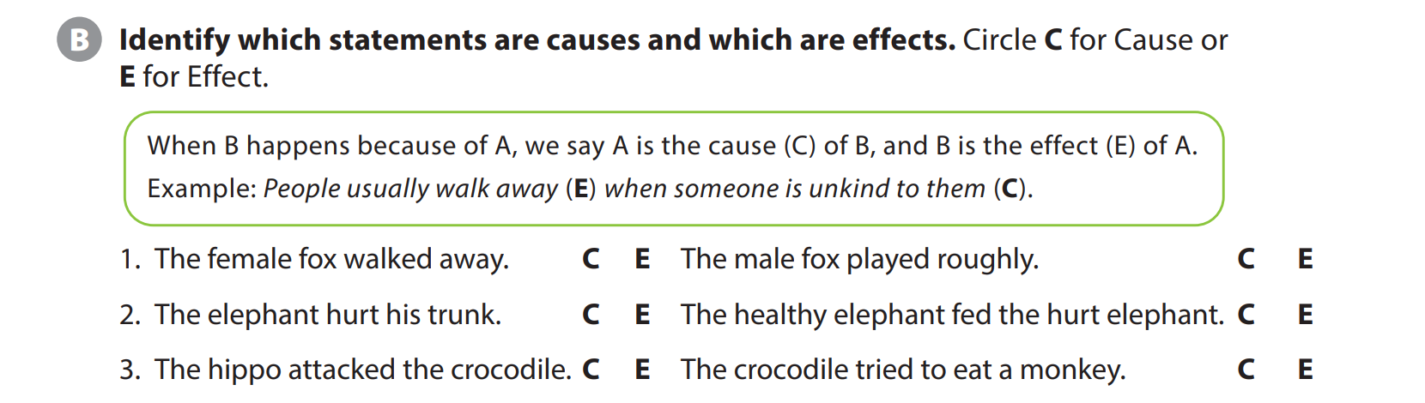
UNIT 4
HOW DO SLOTHS MOVE?
COMPREHENSION
Notes:
Activity B
Tell students that they should circleC
If the statement is a cause and E if it
Is an effect.
Explain that a cause is why
something happens, and what
happens is the effect. (the order of
the cause and effect can be reserved)
I ate four cookies because I was very
E C
hungry.

Slide 8


THANK YOU!

