Slide 1

Unit 4
My Body
Bringing the world to the classroom and the classroom to life
ELTNGL.COM
A PART OF CENGAGE

Slide 2
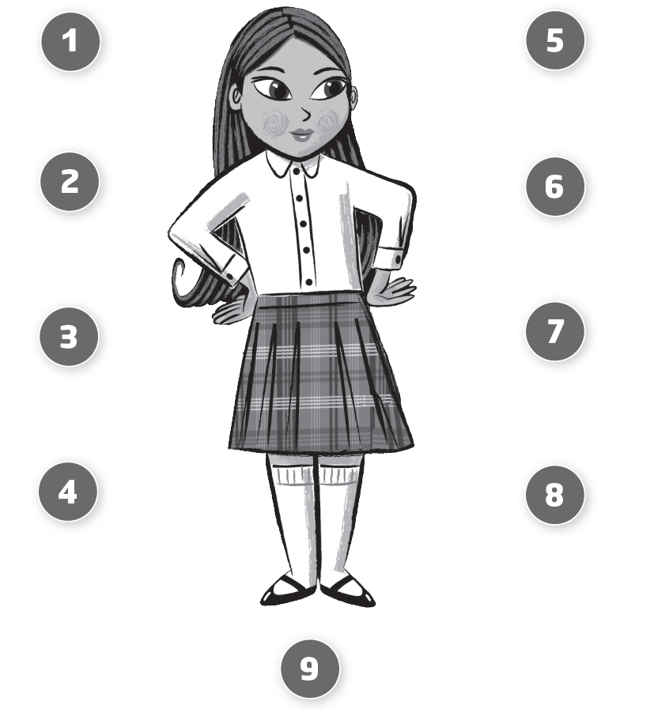

1 Listen and Look. Draw a line.
TR: A43
U4 p. 26

Slide 3
Script
TR: A43
Unit 4
Activity 1
Listen and look. Draw a line.
1. arms arms
2. ears ears
3. hands hands
4. mouth mouth
5. legs legs
6. nose nose
7. eyes eyes
8. hair hair
9. feet feet

Slide 4
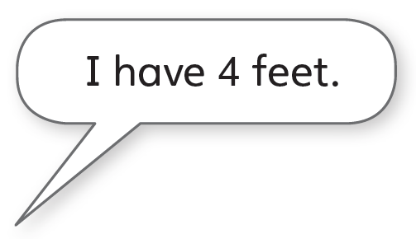


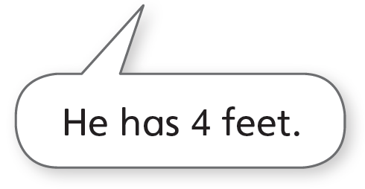
2 Listen and say.
TR: A44
U4 p. 27

Slide 5
Script
TR: A44
Activity 2
Listen and say.
(Elephant) I have four feet.
(Parrot) He has four feet.

Slide 6
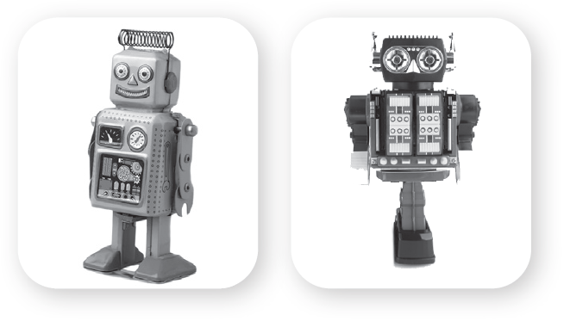
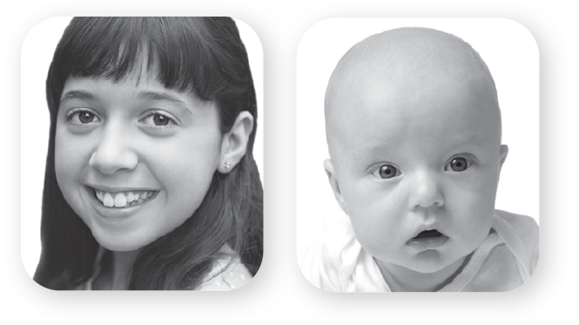
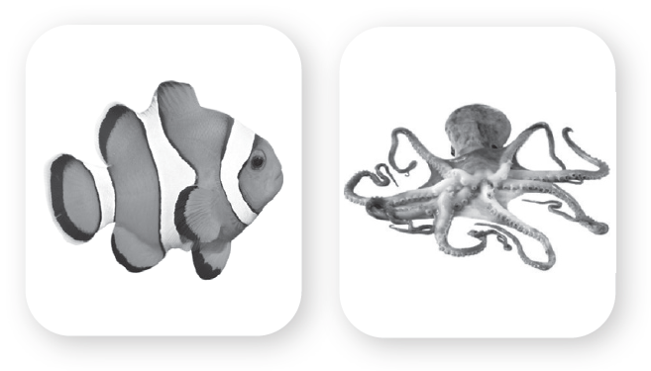
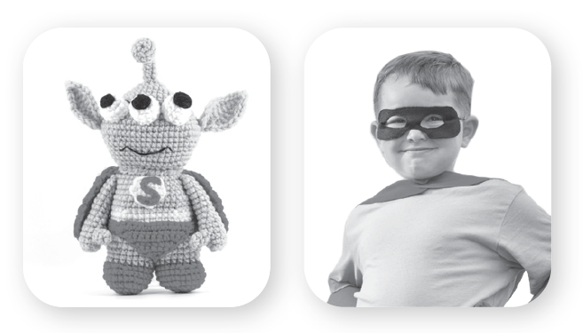
3 Listen and circle. Say.
TR: A45
1.
2.
3.
4.
U4 p. 27

Slide 7
Script
TR: A45
Activity 3
Listen and circle. Say.
1. It has one leg.
2. She has hair.
3. It has arms.
4. He has two eyes.

Slide 8

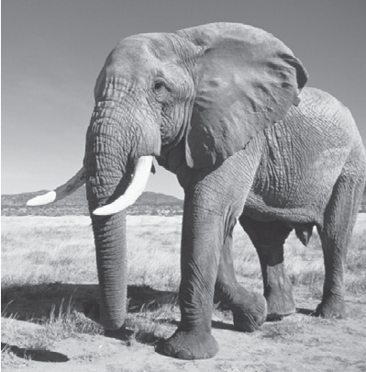
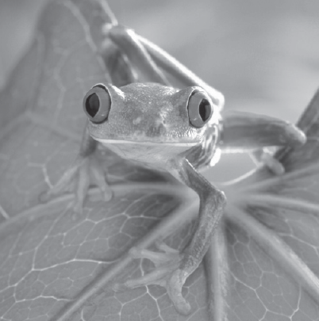
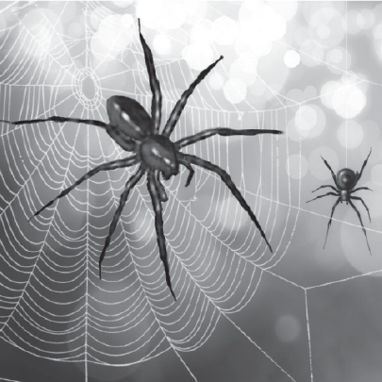
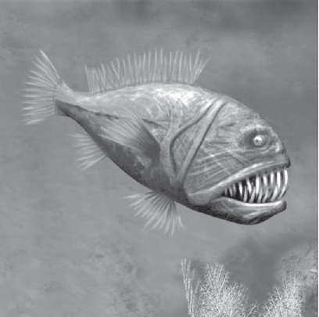

4 Cut out the cards on page 37. Listen and look. Glue the cards. Say.
TR: A46
U4 p. 27

Slide 9
Script
TR: A46
Activity 4
Cut out the cards on page 37. Listen and look. Glue the cards. Say.
1. I have two big ears. I have four legs and four feet.
2. I have a big mouth. I have no legs.
3. I have two red eyes. I have four legs and four feet.
4. I have eight eyes. I have eight legs.

Slide 10

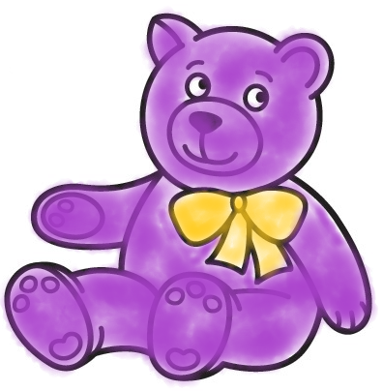

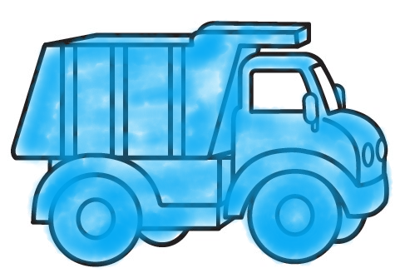

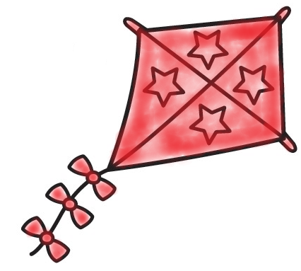

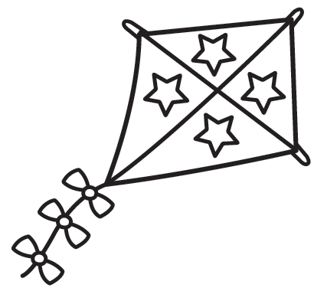
5 Listen. Color and say.
TR: A47
1.
2.
3.
4.
U4 p. 28

Slide 11
Script
TR: A47
Activity 5
Listen. Color and say.
1. a purple teddy bear
2. a blue truck
3. a pink eraser
4. a red kite

Slide 12
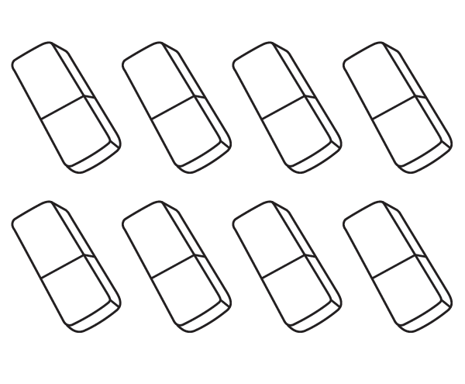
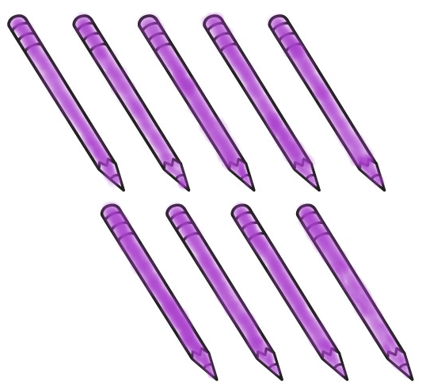
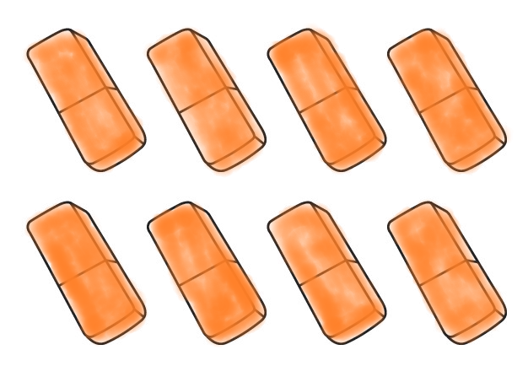



6 Listen. Color. Count and say.
TR: A48
U4 p. 28

Slide 13
Script
TR: A48
Activity 6
Listen. Color. Count and say.
9 purple pencils;
8 orange erasers;
10 pink crayons

Slide 14
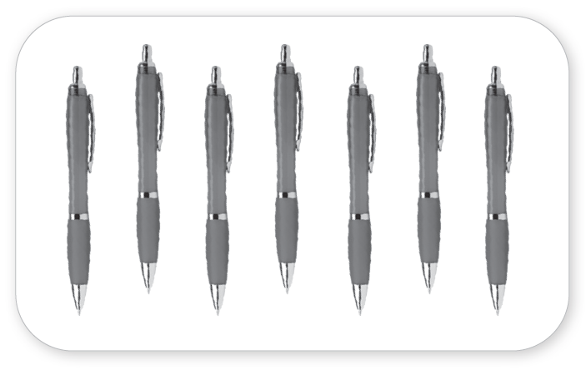
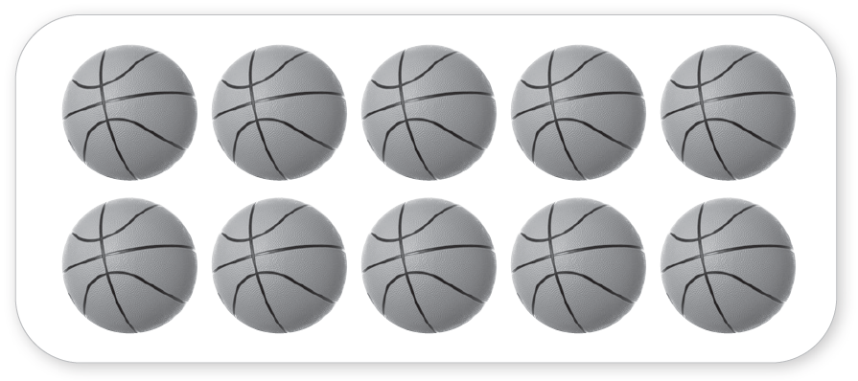
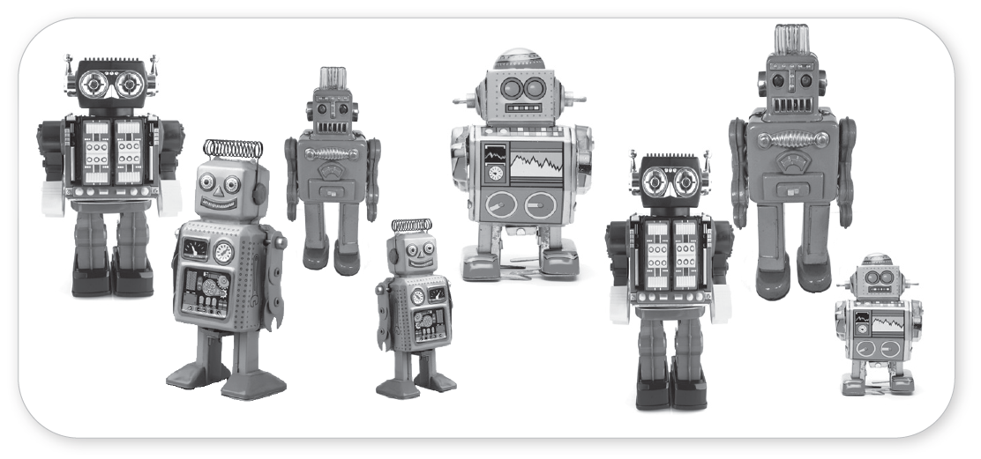
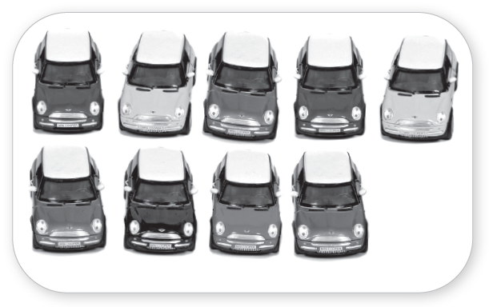
7 Listen. Count and write.
TR: A49
_______
7
_______
10
_______
_______
8
9
U4 p. 28

Slide 15
Script
TR: A49
Activity 7
Listen. Count and write.
How many pens?
How many balls?
How many robots?
How many cars?

Slide 16
8 Listen and say.
TR: A50
Script
Activity 8
Listen and say.
1. J /dʒ/ /dʒ/ Juice Juice
2. C /k/ /k/ Cat Cat
3. X /ks/ /ks/ Fox Fox
U4 p. 29

Slide 17
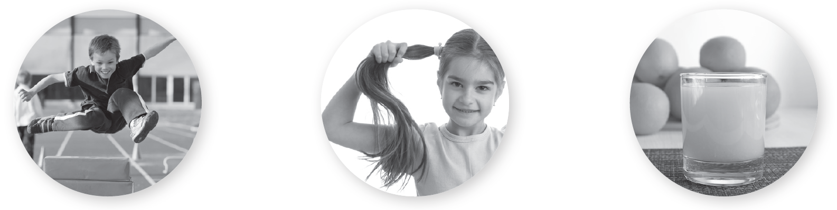
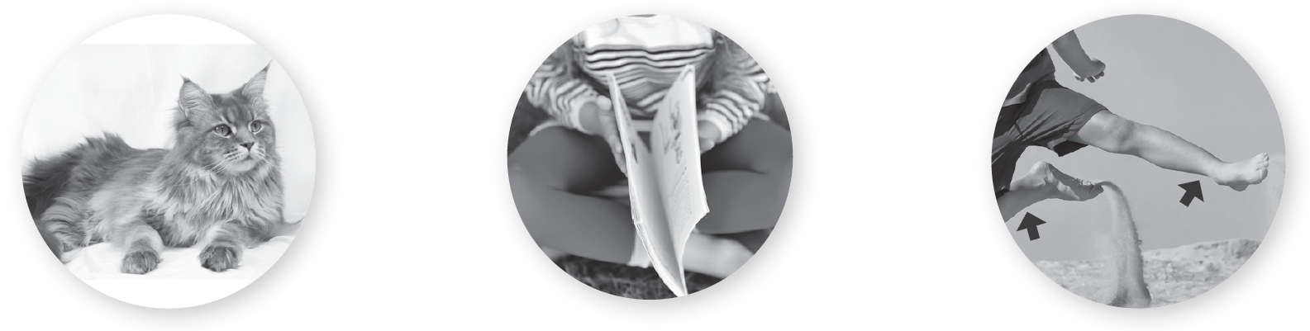
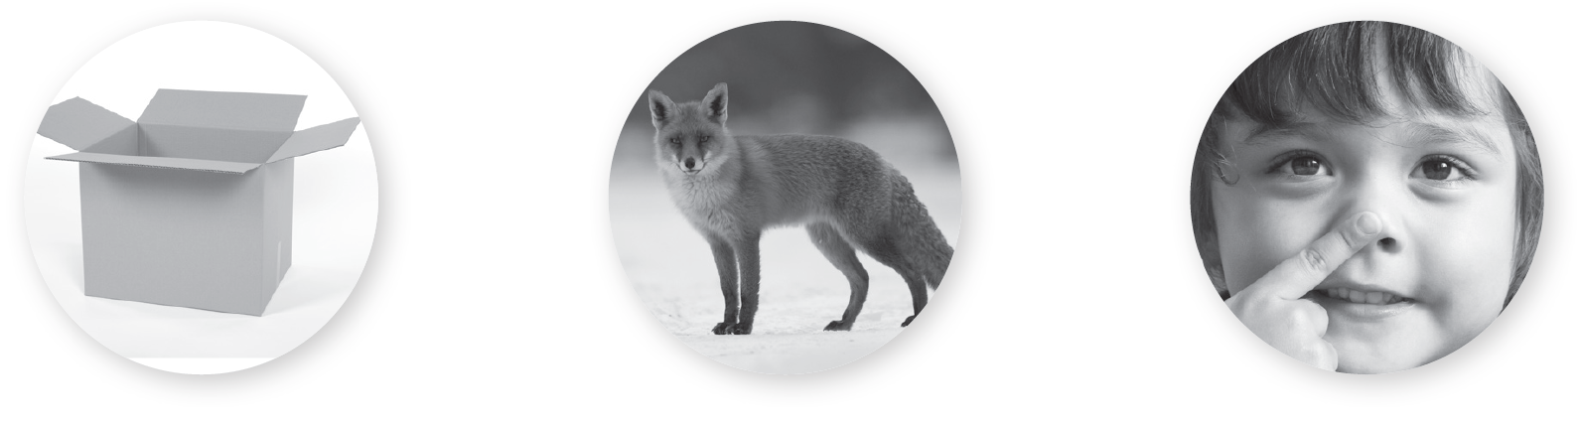
9 Listen and look. Which word is different? Circle.
TR: A51
1.
2.
3.
U4 p. 29

Slide 18
Script
TR: A51
Activity 9
Listen and look. Which word is different? Circle.
1. /dʒ/ jump /dʒ/ hair /dʒ/ juice
2. /k/ cat /k/ close /k/ legs
3. /ks/ box /ks/ fox /ks/ nose

Slide 19



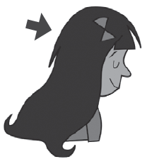

10 Listen and chant. Say a new verse.
TR: A52
One for me.
Two for you.
Just like the cat,
and the fox, too!
No for me.
Brown for you.
A for me,
and mustache, too.
U4 p. 29

Slide 20
Script
TR: A52
Activity 10
Listen and chant. Say a new verse.
One mouth for me.
Two ears for you.
Just like the cat,
and the fox, too!
No hair for me.
Brown hair for you.
A nose for me,
and mustache, too!

Slide 21
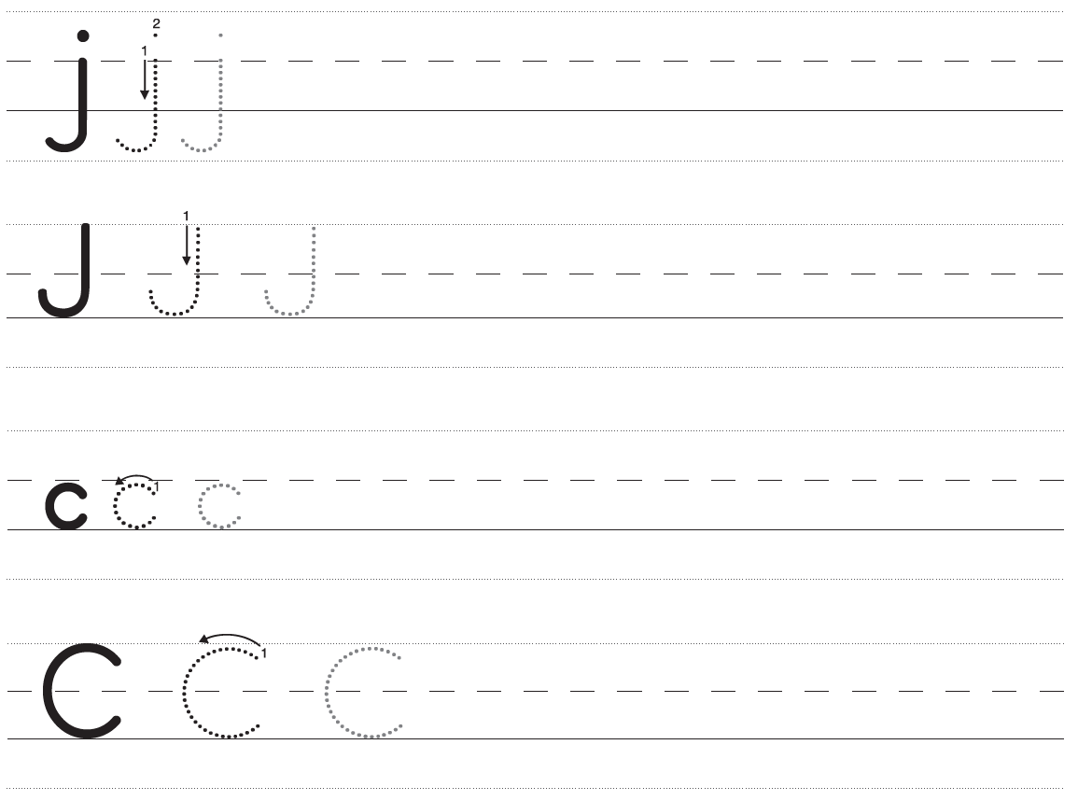
11 Trace and write.
U4 p. 30

Slide 22
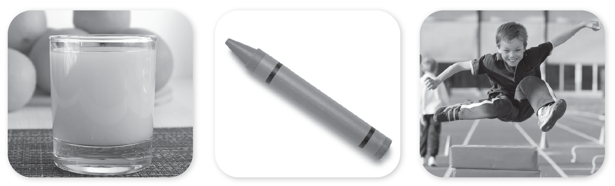



11 Trace and write.
U4 p. 30

Slide 23
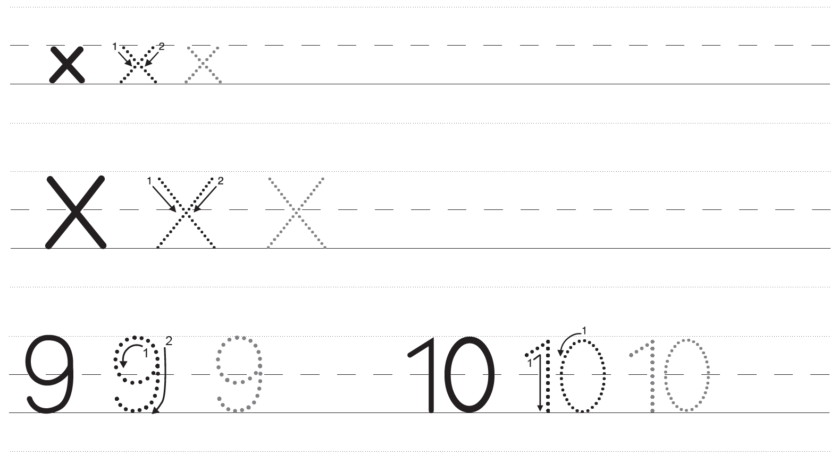
11 Trace and write.
U4 p. 31

Slide 24
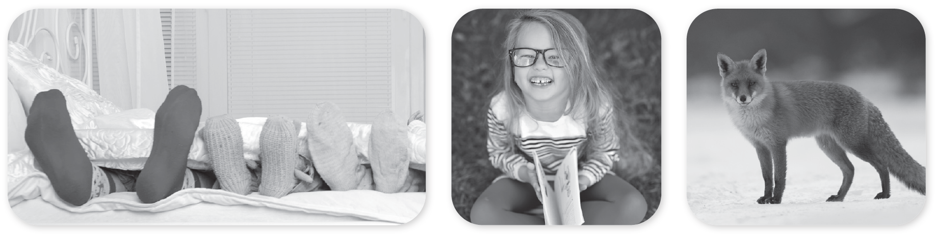



11 Trace and write.
U4 p. 31

