Slide 1
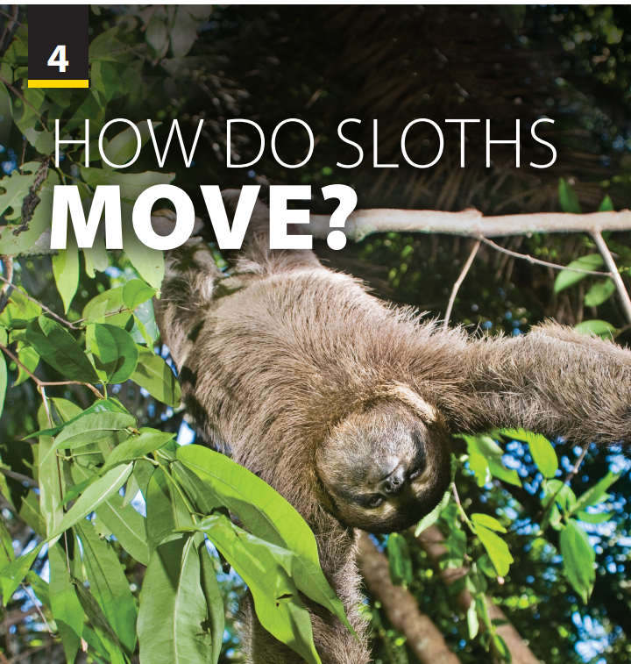
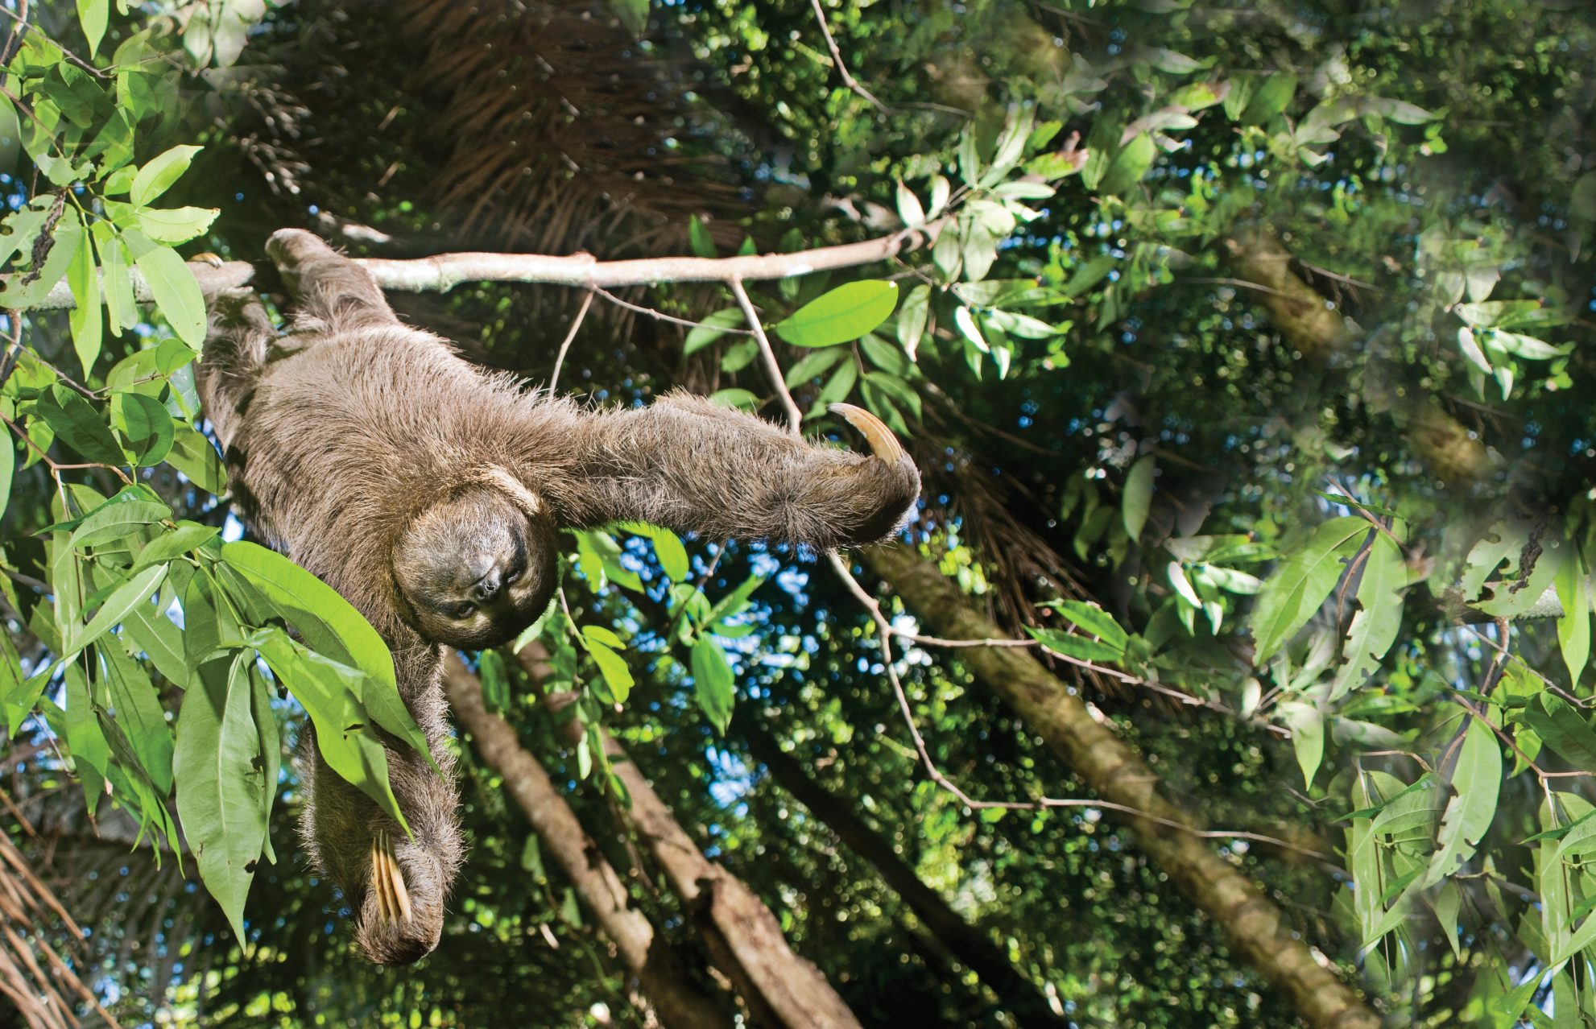
Writing
and
Writing Worksheet

Slide 2
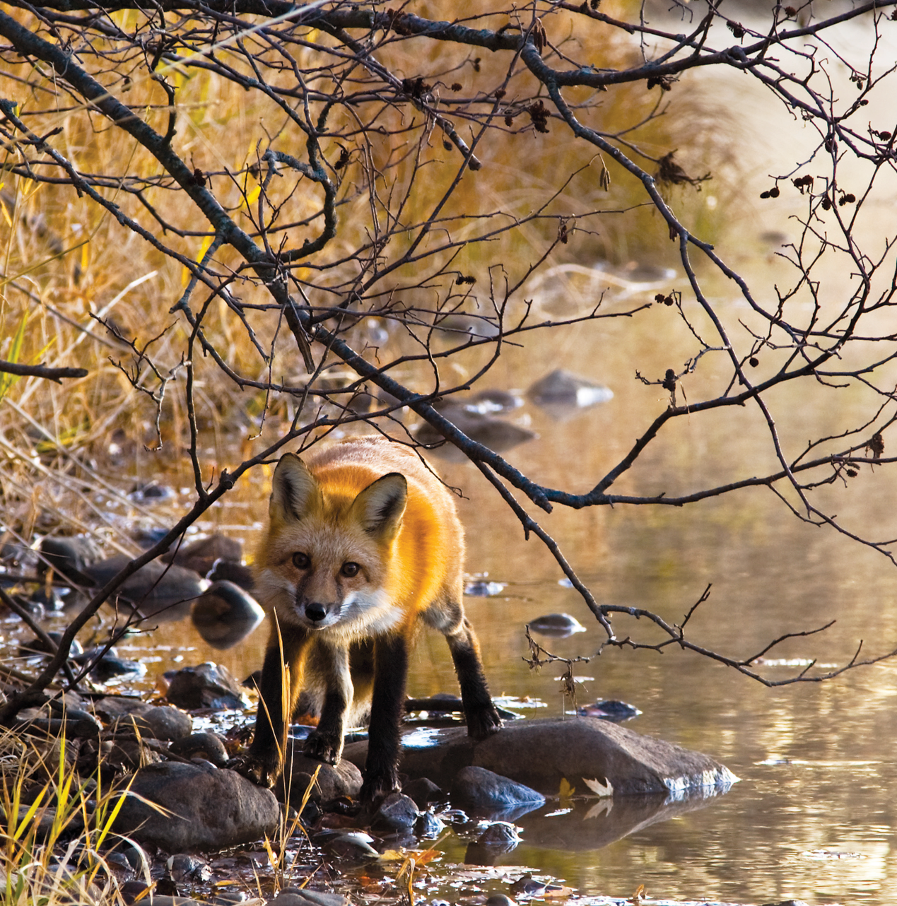
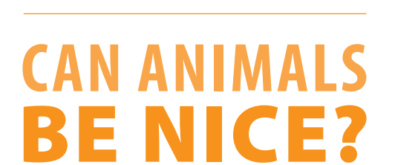
UNIT 4
HOW DO SLOTHS MOVE?
WRITING
Summarize nice behavior of a fox,
a hippo and an elephant.
Notes:
Check the last lesson
Ask students summarize nice behavior of a fox, a hippo and an elephant in Reading text page 45.
Give them 2 minutes to call on the knowledge, then 2 members from 2 groups present.
Introduce new lesson.

Slide 3





INTRODUCTION
The basic of short story
Introducing characters
Describing the setting
BODY
Introducing the conflict
Developing main characters
Telling a sequence of events
Building towards climax
CONCLUSION
Resolving the conflict
Telling the last event

Slide 4





UNIT 4
HOW DO SLOTHS MOVE?
WRITING
Before you write: Things to think about
Characters: Who is the main character? Who is the narrator?
Setting: What is the setting? How will this this affect the plot?
Mood: Is your story funny, sad, dramatic?
Organization: What happens first, second, last?
Plot: What is the problem? Why did it occur? What will solve it?

Slide 5
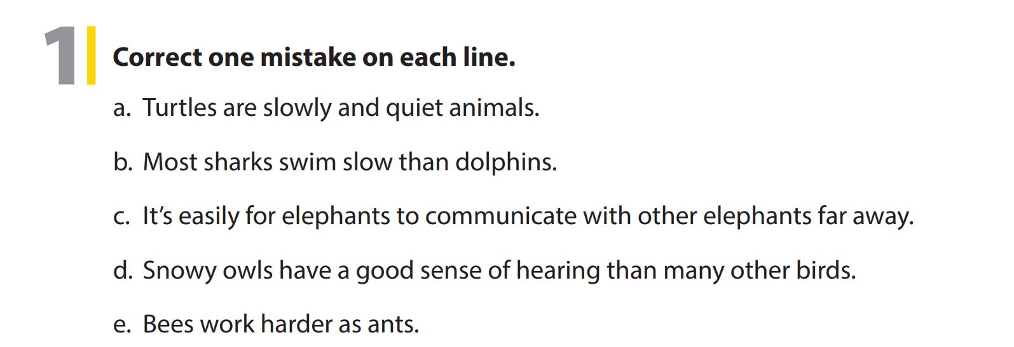
UNIT 4
HOW DO SLOTHS MOVE?
WRITING
slow
slowly
easy
better
than

Slide 6
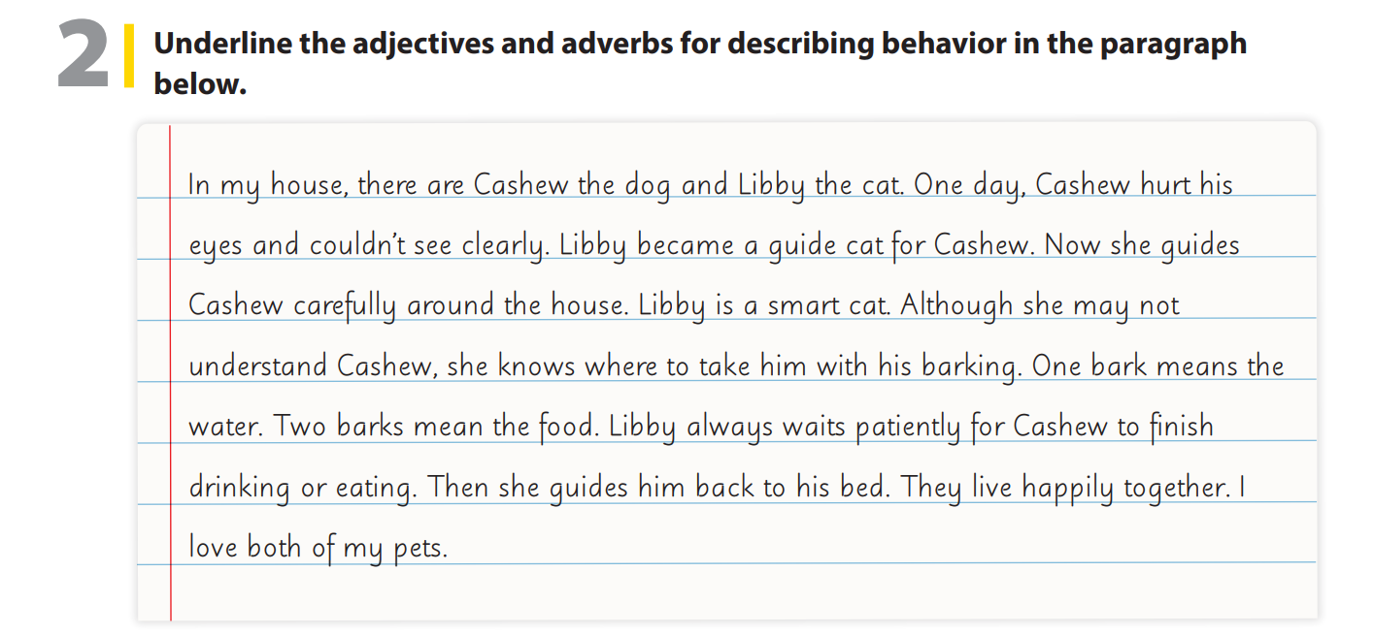
UNIT 4
HOW DO SLOTHS MOVE?
WRITING

Slide 7
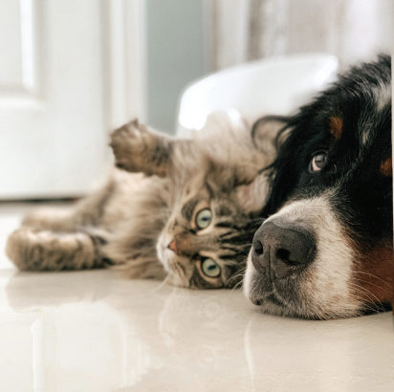

UNIT 4
HOW DO SLOTHS MOVE?
WRITING
Notes:
Tell students they are going to write a short story about an animal that was nice to another animal. Explain that if they don’t know any stories, they need to do research on the Internet.
As students follow along, read the story aloud. Have students identify the adverb the author used (carefully). Tell students that they should also include adverbs in
their story.
Point out that the story introduces the animals, their names, the problem, and how the second animal helped the first overcome it. Emphasize that the story also
includes a description of the animal’s
behavior. Tell students that their story should include all of this information.
Assign the writing for homework, and set a minimum number of words they must write (80–100 words). Have them do the task

Slide 8


THANK YOU!

