Slide 1
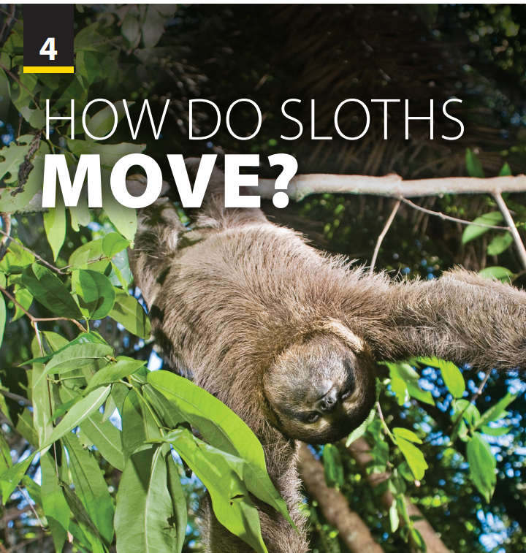
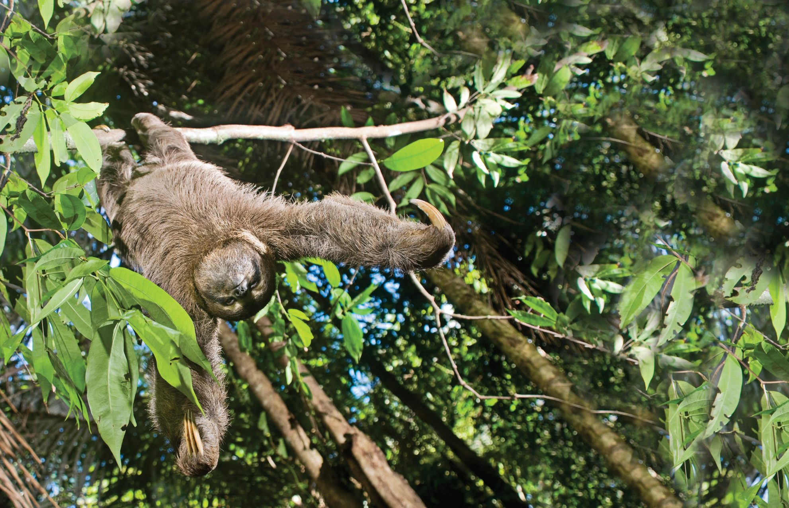
End of
Unit Project

Slide 2
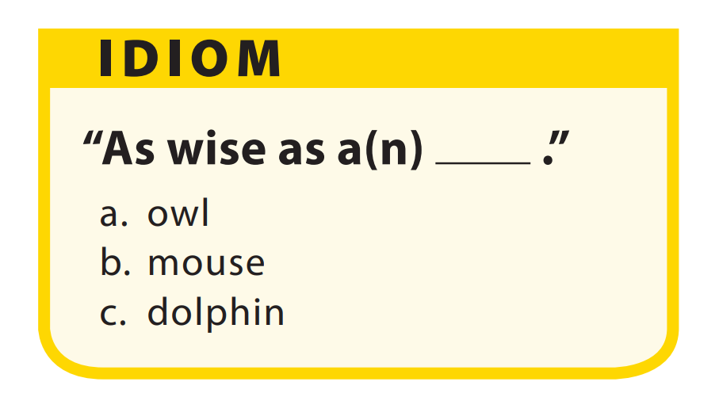


UNIT 4
HOW DO SLOTHS MOVE?
END OF PROJECT
Cat nap
=> A short sleep
Like a fish out off water
=> be uncomfortable in a situation
Raining dogs and cats
=> raining heavily
Notes:
As students follow along in their books, read the sentence and answer options aloud. Have them guess the answer before providing it. Then explain that as wise as an owl is used to describe someone who is very intelligent. Tell students that it is a compliment, saying something positive about the person.not give another job) will be a loser.
T provides some other animal idioms and let student discuss and guess their meaning.
Cat nap => a short sleep
Like a fish out off water => be uncomfortable in a situation
Raining dogs and cats => raining heavily

Slide 3
UNIT 4
HOW DO SLOTHS MOVE?
END OF PROJECT
There are many English simile about animals and they often use “like or as….as”
Using a typical or well-known quality (being wise) to describe another thing (an owl)
=> This helps us create a strong mental picture of what the writer or speaker is trying to say
Emphasize that similes use an adjective that is often associated with a specific animal.
Notes:
Tell students they will investigate whether an English animal simile represents commonly held beliefs and then present their findings to
the class.
Remind students that in the IDIOM section, they studied as wise as an owl. Tell students this is called a simile. Tell students that there are many English similes about animals, and they
often use like or as . . . as.
Point out that the simile, as wise as an owl, uses a typical or well-known quality (being wise) to describe another thing (an owl). Explain that
this helps us create a stronger mental picture of what the writer or speaker is trying to say.
Emphasize that similes use an adjective that is often associated with a specific animal.
Have students get into pairs and name at least ten animals, giving the adjectives that they associate with them.

Slide 4





UNIT 4
HOW DO SLOTHS MOVE?
END OF PROJECT
DO A RESEARCH PROJECT
1st
2nd
3rd
4th
Use the Internet to find an English simile about one of the animals
Interview a set number of people to find out what adjective they associate with the animals
Consolidate the interviewee’s answer, grouping them according to similar adjectives
Decide whether they believe the simile expresses commonly held belief

Slide 5



UNIT 4
HOW DO SLOTHS MOVE?
END OF PROJECT
RESEARCH ANIMAL
Decide on the three most important pieces of information.
Write a report about why the animal in special
Share your report.
Notes:
Tell students they will get into groups and choose an animal and research it. (Where does it live? What does it eat?
What is special about the animal?)
Compare your ideas with your partner and decide on the three most
important pieces of information.
• Write a report about why the animal is special. Find a picture of the
animal and include it in your report.
• In the next class, share your report with a group of 5–6 students

Slide 6


THANK YOU!

