Slide 1
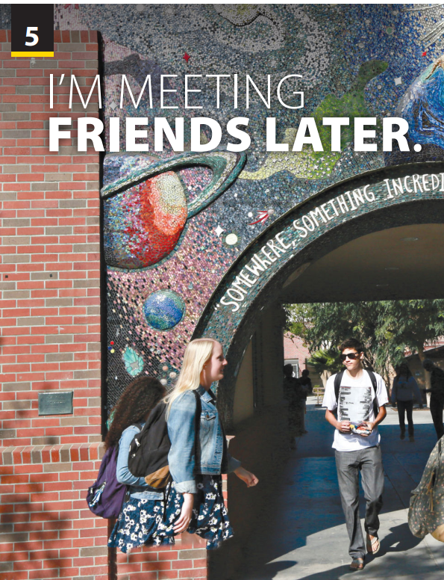
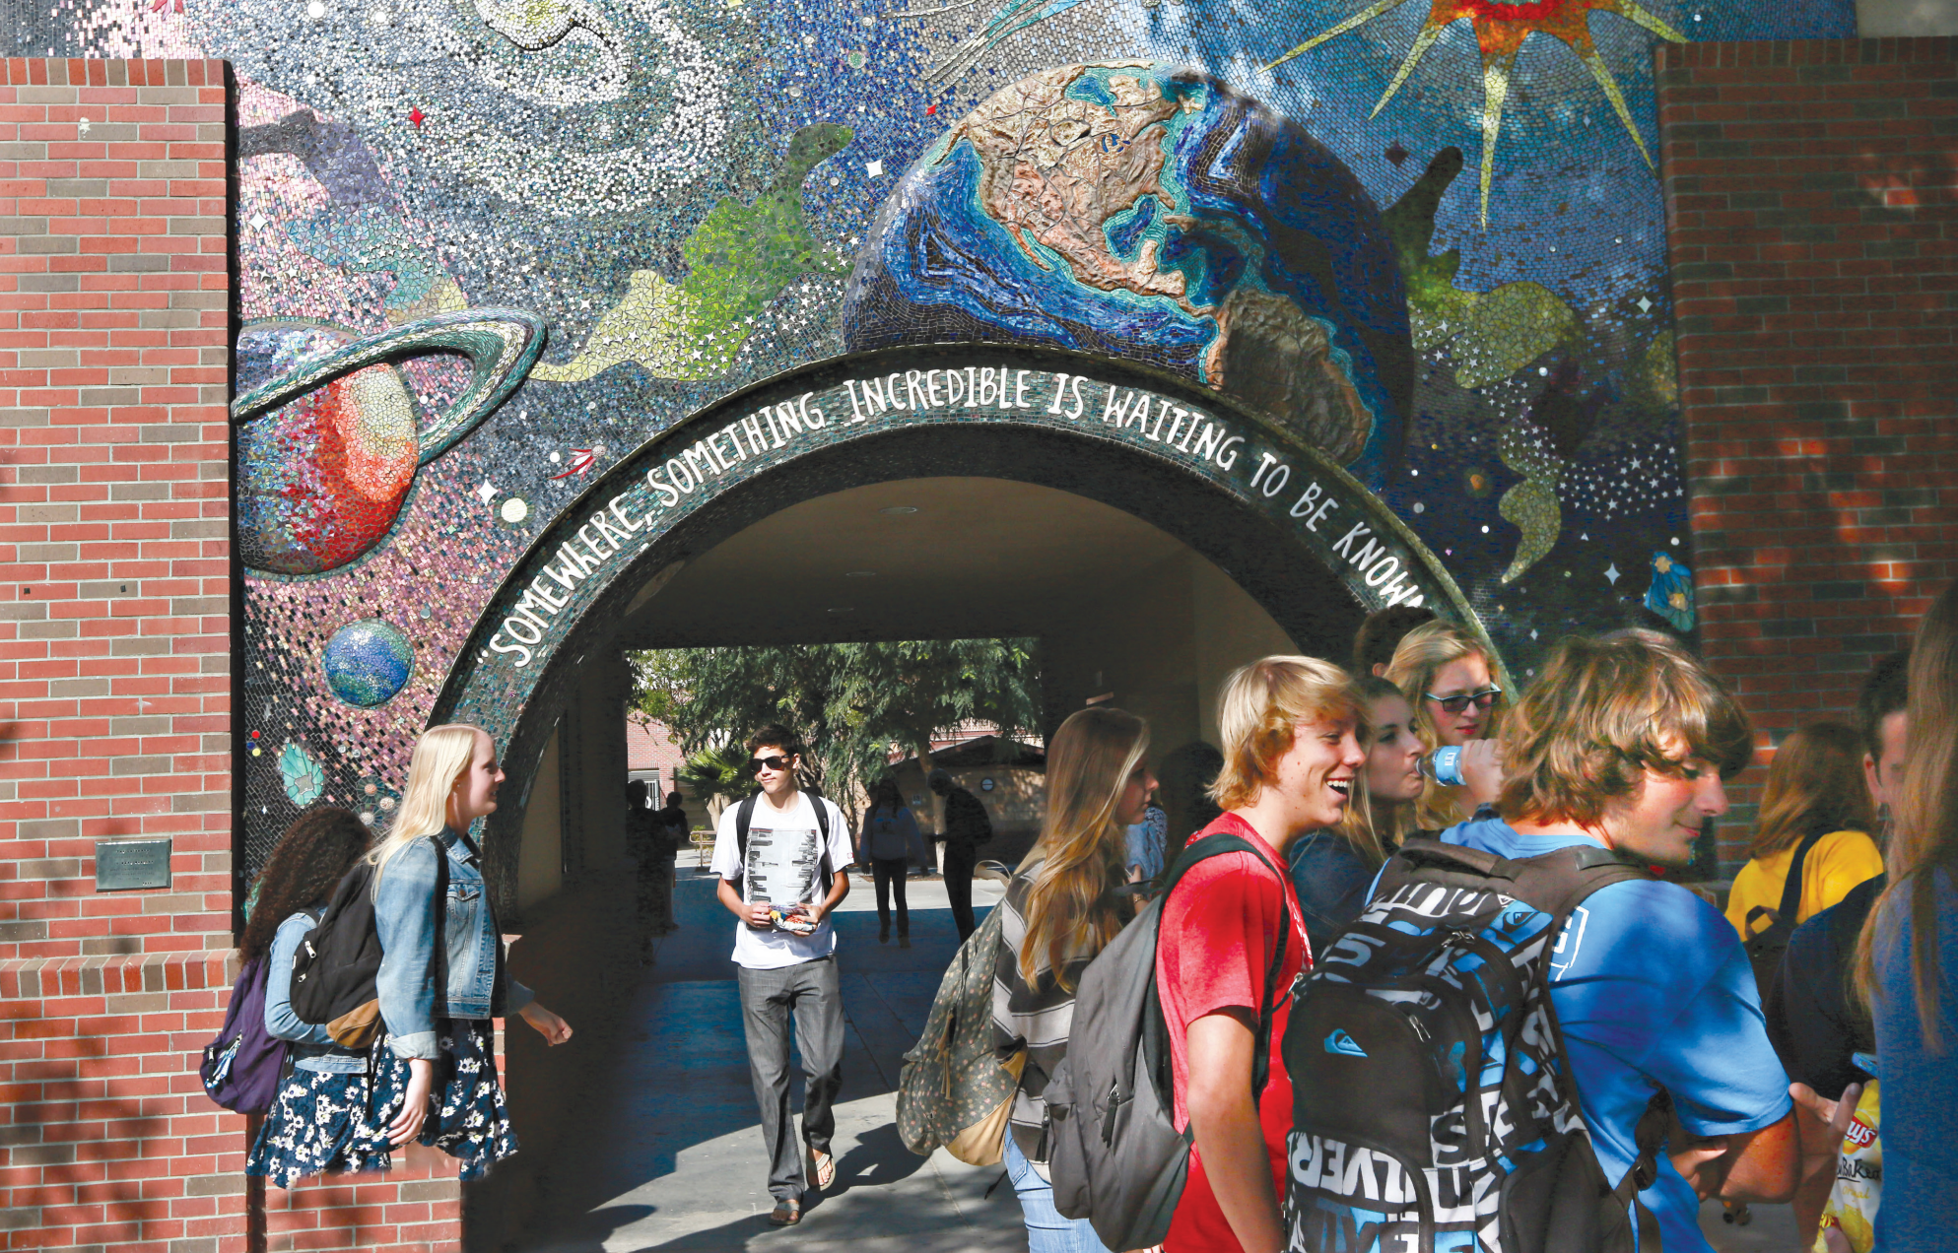
Preview and Language Focus

Slide 2
Where are they?
How do they feel?
How can you understand the quote “…, something incredible is waiting to be known”?
Describe Picture
Notes:
Motivating and Focusing.
Have students look at the big picture in page 48, 49, then describe picture based on T’s guide:
Where are they? (at school)
How do they feel? (excited/ happy/…)
How can you understand the quote “…, something incredible is waiting to be known”? (That means there are lots of interesting programs/ activities that make students curious)
Have students read the unit title to
themselves as you read it aloud. Explain that
in this unit they will learn to talk about plans
for the future.

Slide 3
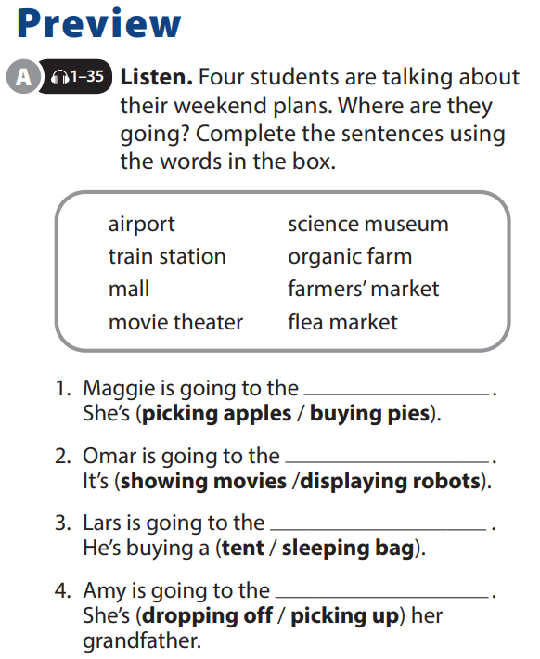

UNIT 5
I’M MEETING FRIENDS LATER.
PREVIEW
organic farm
science museum
mall
airport
Notes:
Tell students that they will hear four students talking about what they are going to do over the weekend, and they should use the places in the box to complete the sentences. As students follow along, read the locations.

Slide 4
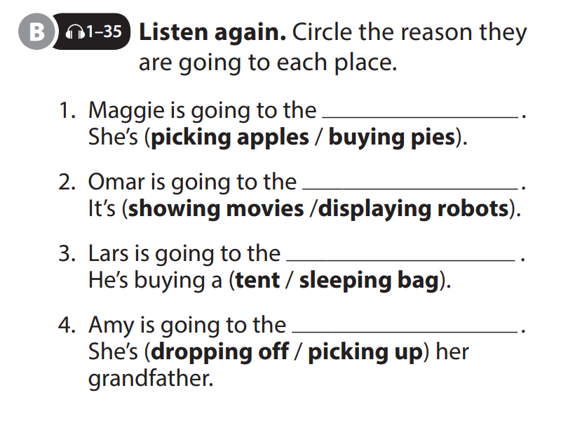
UNIT 5
I’M MEETING FRIENDS LATER.
PREVIEW
organic farm
science museum
mall
airport
Notes:
Have students explain the difference between dropping off and picking up, providing the answer if
necessary. (When we drop someone off, we start out together at place A and separate when the other person arrives at their destination. When we pick someone up, we start out at different places. One person goes to meet the other person so they can go together to the same destination.)

Slide 5
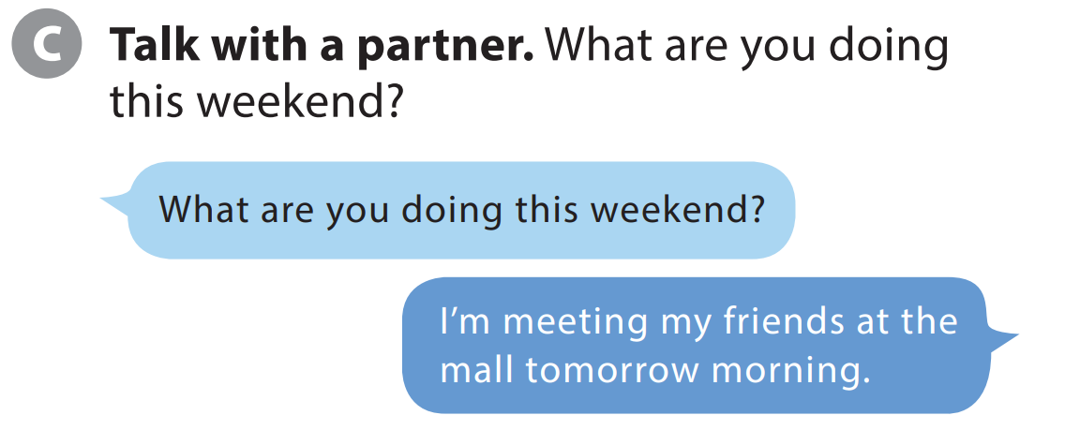
UNIT 5
I’M MEETING FRIENDS LATER.
PREVIEW
Notes:
Tell students they are going to get into pairs and take turns asking and answering questions about their plans for the weekend.
Model the conversation with a student.
Have students get into pairs and do the task.

Slide 6
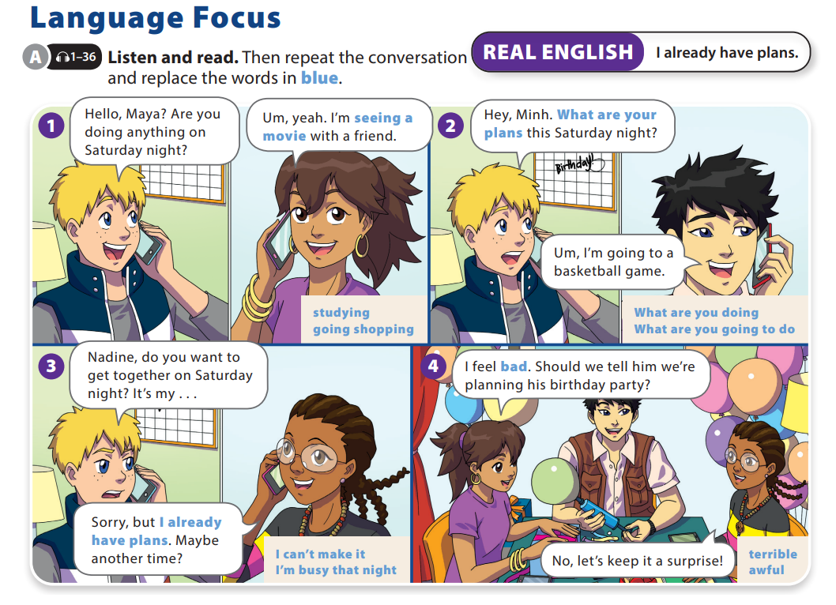
UNIT 5
I’M MEETING FRIENDS LATER.
LANGUAGE FOCUS

Slide 7
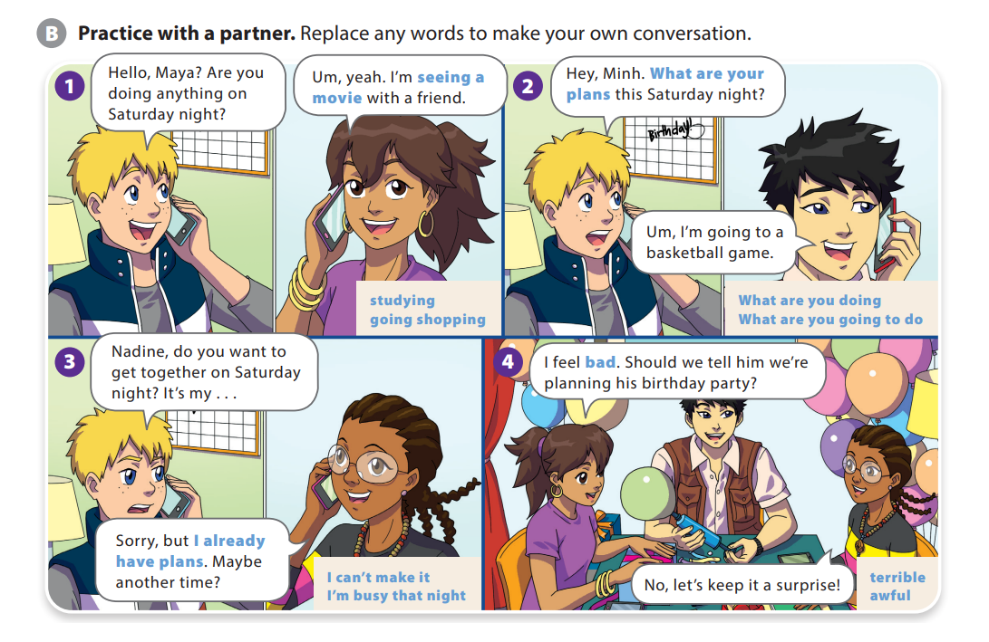
UNIT 5
I’M MEETING FRIENDS LATER.
LANGUAGE FOCUS

Slide 8
UNIT 5
I’M MEETING FRIENDS LATER.
LANGUAGE FOCUS
“I already” have plans is used when we cannot accept an invitation because we are planning to do something else.
For example:
A: Do you want to go to a movie Saturday night?
B: I’ve love to, but I already have plans

Slide 9


THANK YOU!

