Slide 1
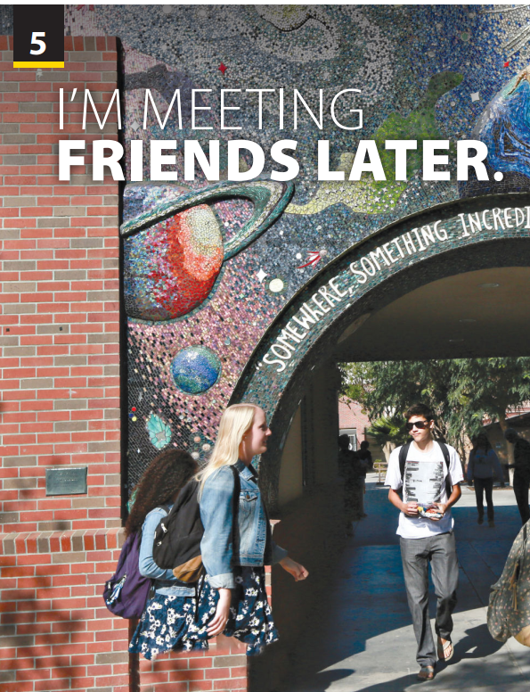
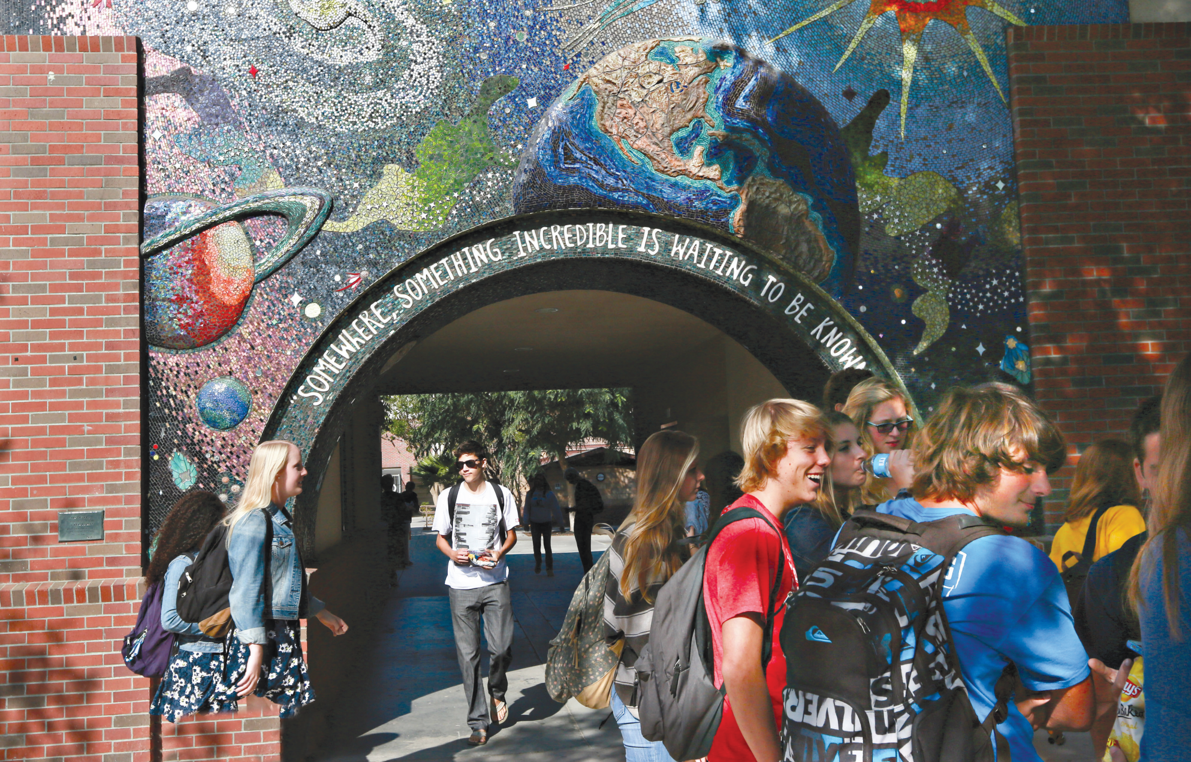
Language Focus
and
The Real World

Slide 2








What are you
going to do this
weekend?
Notes:
Free talk
Talk about students’ plan for this weekend
What are you going to do this weekend?

Slide 3

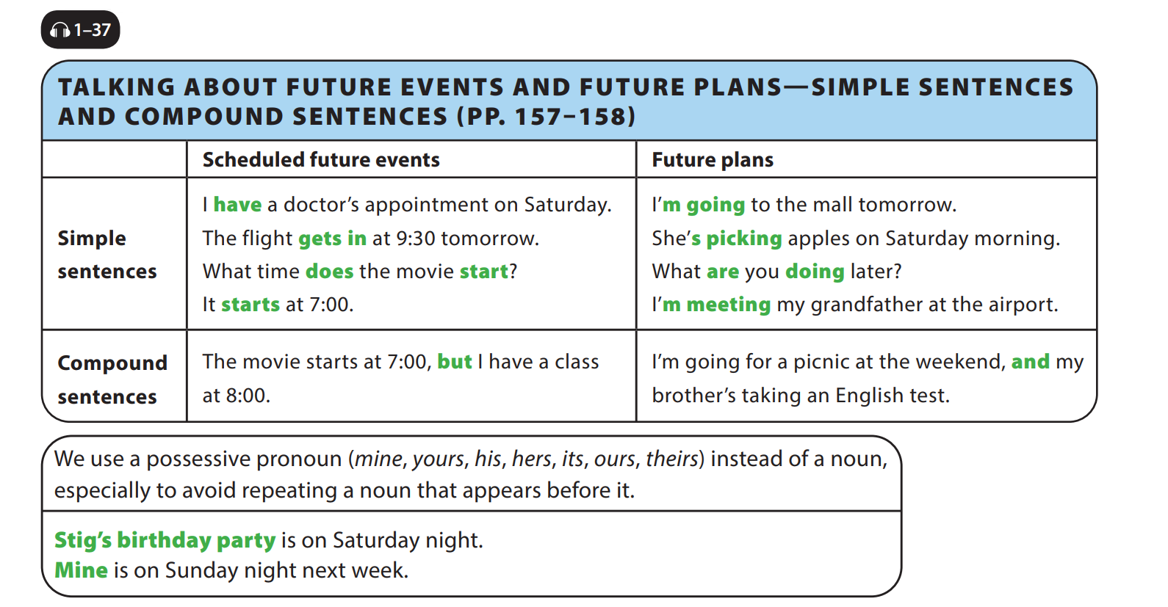
UNIT 5
I’M MEETING FRIENDS LATER.
LANGUAGE FOCUS
Notes:
Language focus chart
Ask students to look at the chart. Tell them that they will study how to talk about future events and future plans that they know are going to happen.
Have students follow along as they listen to the CD.
Read the sentences in the Scheduled future events column. Ask students what verb tense is used, providing the answer if necessary (present simple). Explain that these events have a predetermined time in the future, and that time is at least partially outside of the control of the person doing the actions.
Read the sentences in the Future plans column. Ask students what type of verb is used and its form, providing the answer if necessary (present continuous, be verb + -ing verb). Explain that these plans have been decided by the person
doing them. Emphasize that actions that we cannot control may not use the present continuous, giving one example.
It’s raining next week.
Have students identify the phrases in the Future plans sentences that refer to the future (tomorrow, Saturday morning, later).
Have students brainstorm some other phrases that can be used to discuss future plans (next week, tomorrow night).
Have students look at the second chart.
Tell them that Possessive pronouns
are pronouns that are used to indicate
the ownership (possession) of something or someone by something or someone else

Slide 4
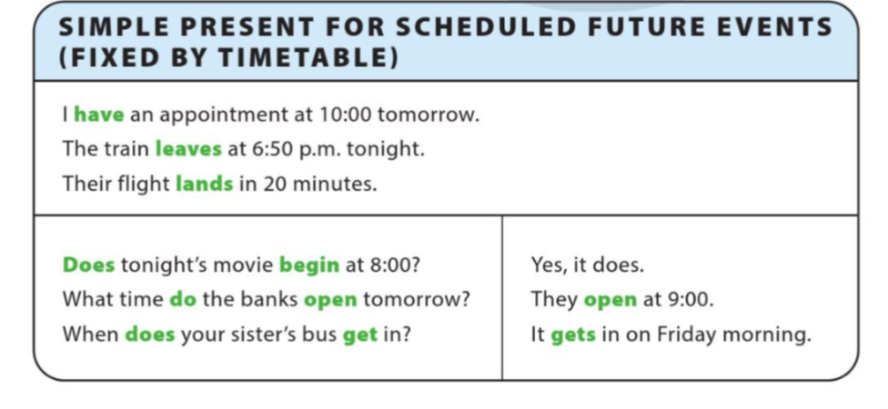
UNIT 5
I’M MEETING FRIENDS LATER.
LANGUAGE FOCUS
Notes:
Emphasize the difference of simple present (schedules future events- fixed by timetable)

Slide 5
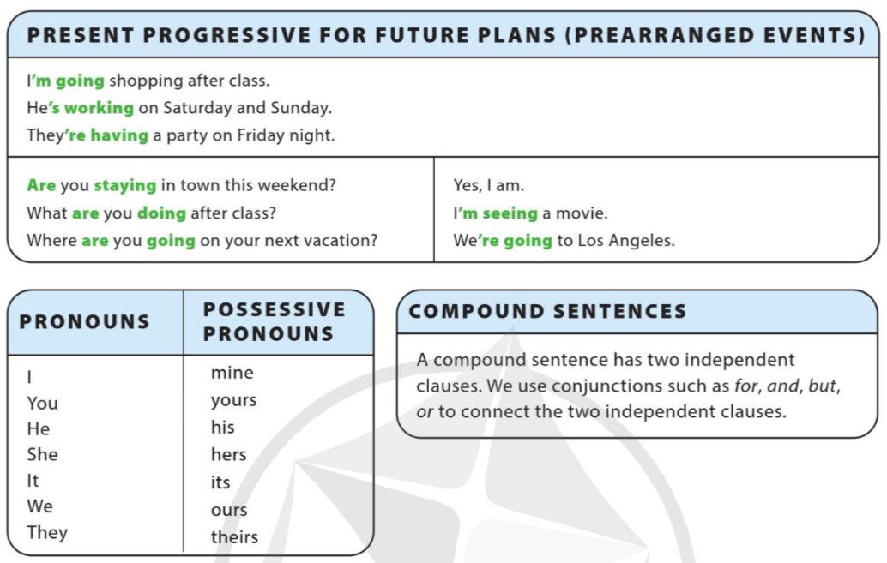
UNIT 5
I’M MEETING FRIENDS LATER.
LANGUAGE FOCUS
Notes:
present progressive for future (future plans – prearranged events). Then, illustrate each example to make sure students all get it.

Slide 6
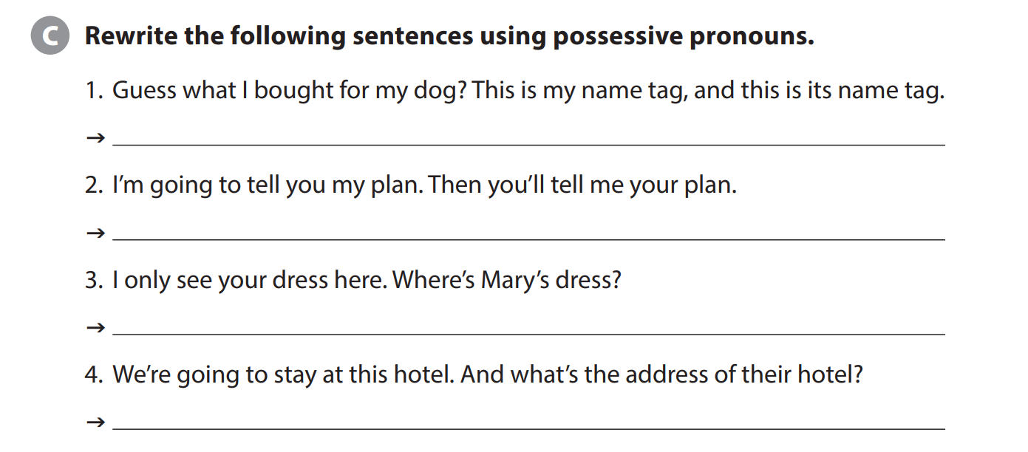
UNIT 5
I’M MEETING FRIENDS LATER.
LANGUAGE FOCUS
Guess what I bought for my dog? This is my name tag, and this is its
I’m going to tell you my plan. Then you’ll tell me yours.
I only see your dress here. Where’s hers?
We’re going to stay at this hotel. And what’s the address of theirs?

Slide 7
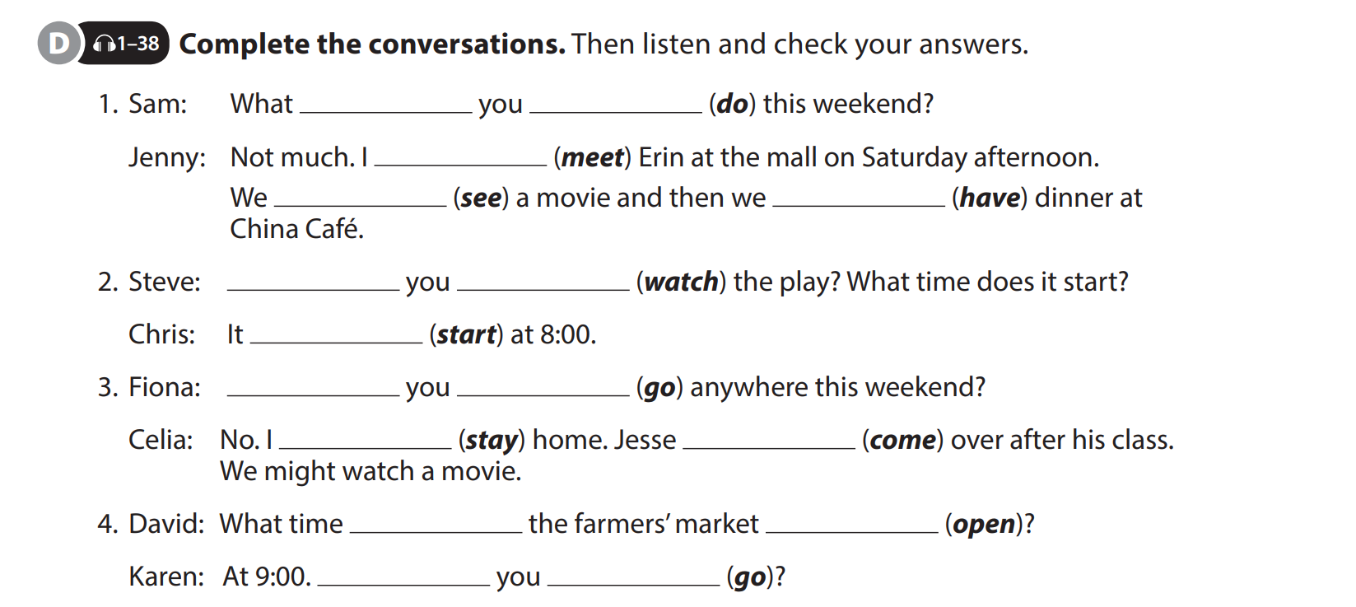
UNIT 5
I’M MEETING FRIENDS LATER.
LANGUAGE FOCUS
are
doing
‘m meeting
‘re seeing
‘re having
Are
watching
starts
Are
going
‘m staying
is coming
does
open
Are
going

Slide 8
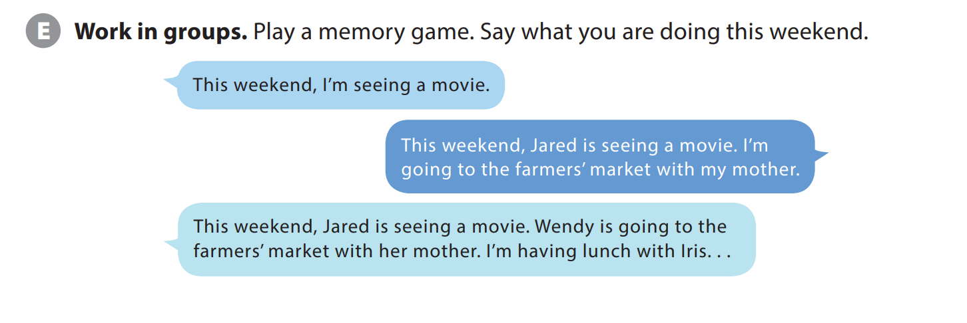
UNIT 5
I’M MEETING FRIENDS LATER.
LANGUAGE FOCUS
Notes:
Tell students they will play a game in which students take turns adding sentences to make a sentence chain. Explain that the game continues until someone makes a mistake.
Explain to students that they will get into groups and the first student will say what they are going to do this weekend.
Explain that the second student will first repeat the sentence, changing the subject fromIto the person’s name.
Explain that the second person will then add a sentence about their plans. Tell students the third student should repeat what the first two students are planning to do before adding their plans.

Slide 9
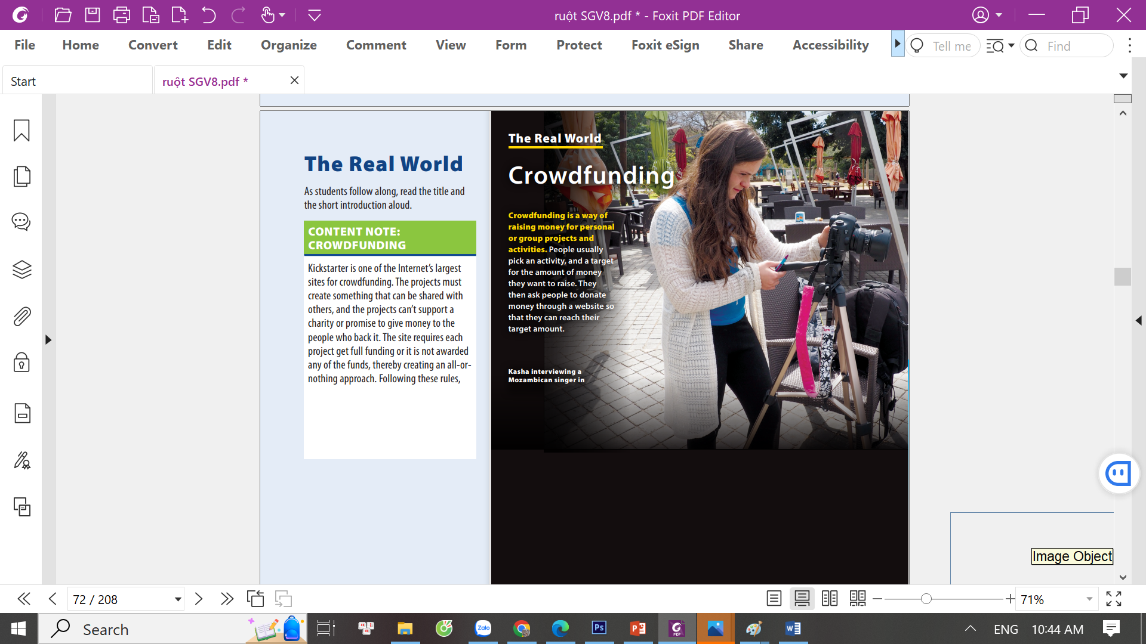
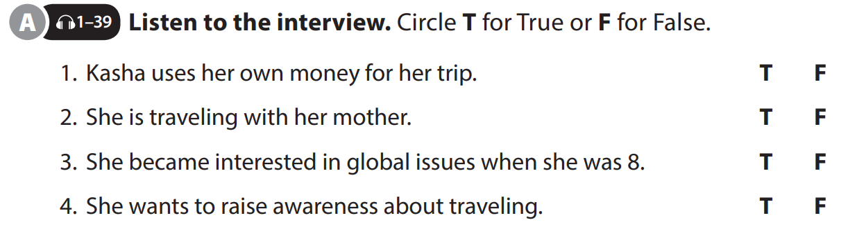
UNIT 5
I’M MEETING FRIENDS LATER.
THE REAL WORLD

Slide 10
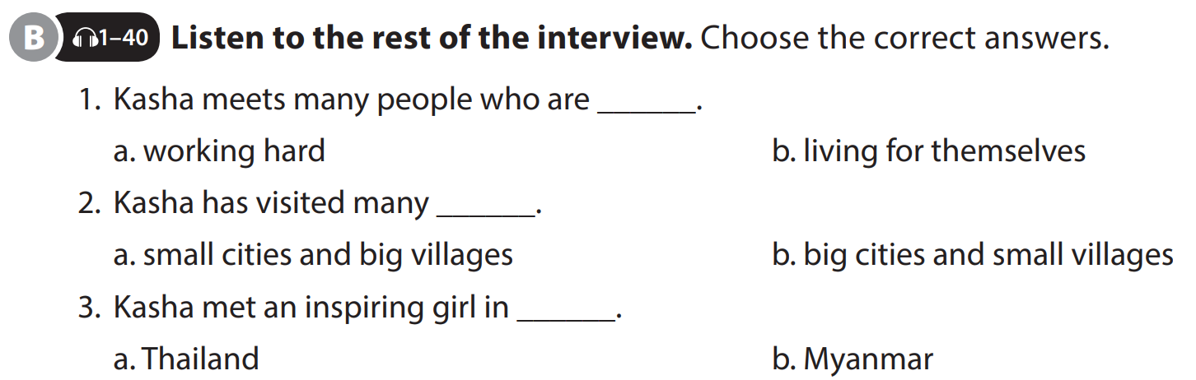
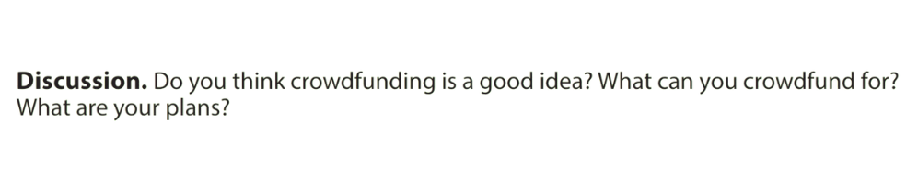
UNIT 5
I’M MEETING FRIENDS LATER.
THE REAL WORLD

Slide 11


THANK YOU!

