Slide 1
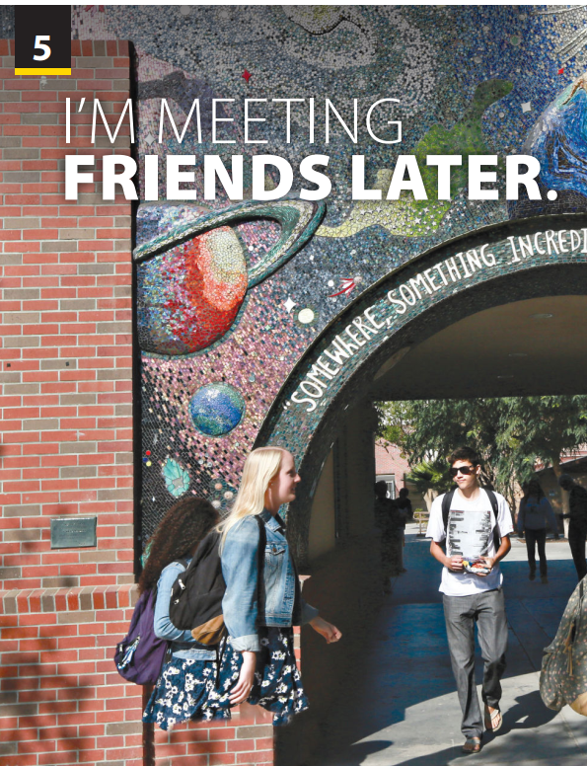
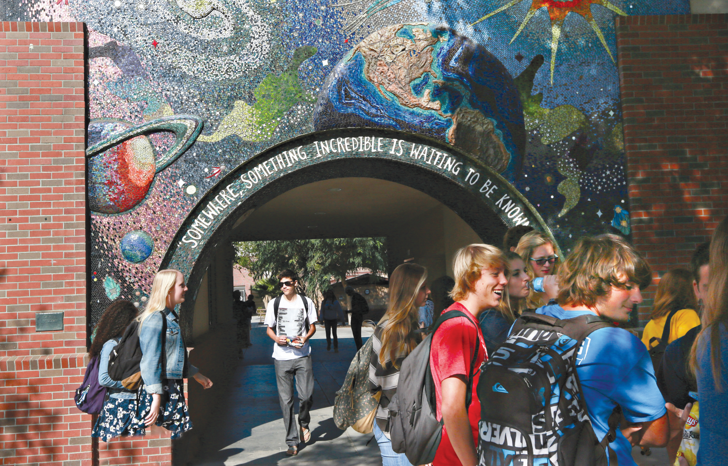
Pronunciation
and
Communication

Slide 2

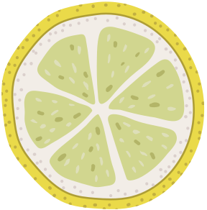




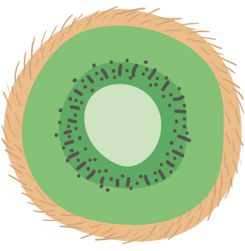




LET'S PLAY
“We can give more”
Compound noun
Notes:
Let students give example via game “We can give more”
Class is divided into 2 groups
Each group gives each compound noun.
Which group has no idea first will be loser.

Slide 3
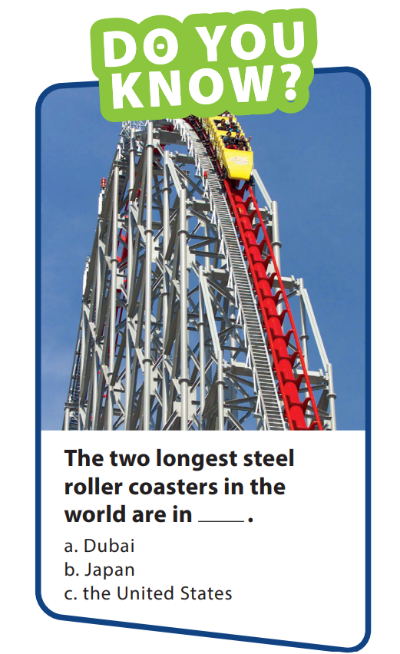
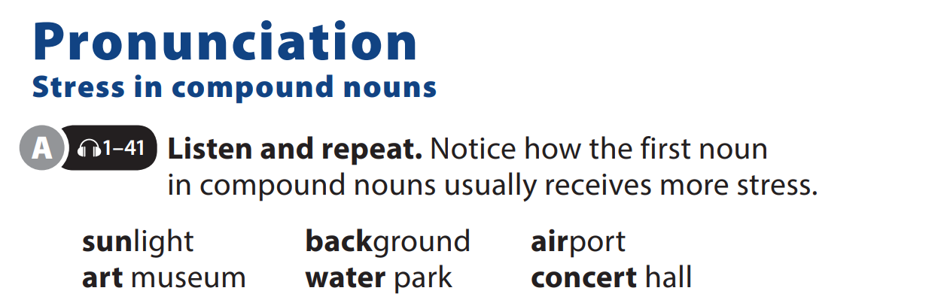

UNIT 5
I’M MEETING FRIENDS LATER.
PRONUNCIATION
Notes:
Explain that a compound noun is a noun that is formed by two or more
words. Explain that because the compound noun has a single meaning, it is important to recognize them to accurately understand them.
Let them watch video about stress in coumpound noun https://www.youtube.com/watch?v=tQAxqIqtjcU
Have students follow along in their
books as you explain that first noun in
compound nouns is usually stressed
more strongly than the second one.

Slide 4
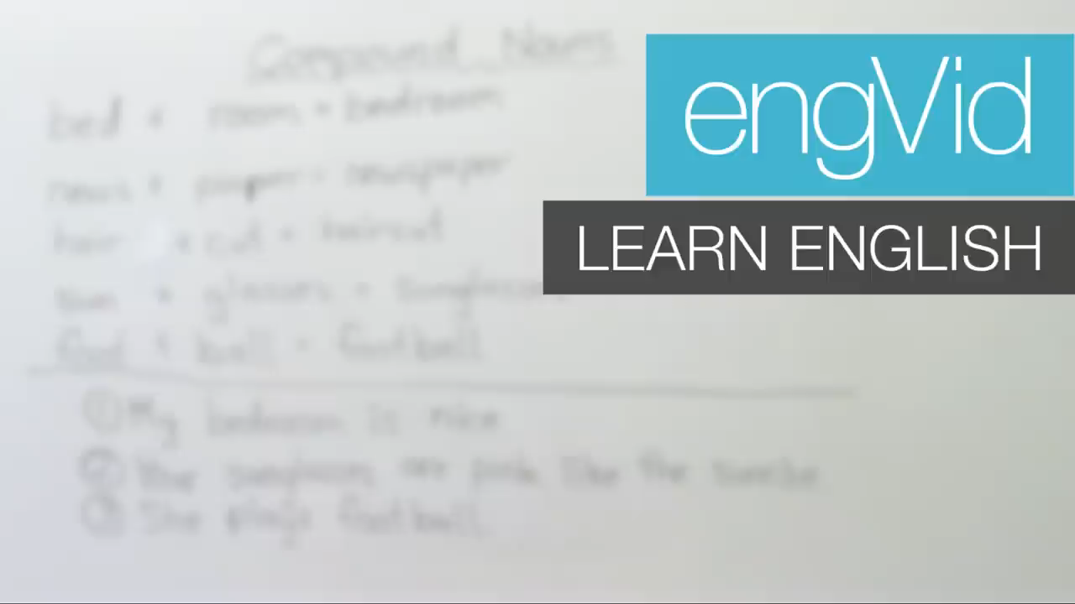
UNIT 5
I’M MEETING FRIENDS LATER.
PRONUNCIATION
Notes:
https://www.youtube.com/watch?v=tQAxqIqtjcU

Slide 5
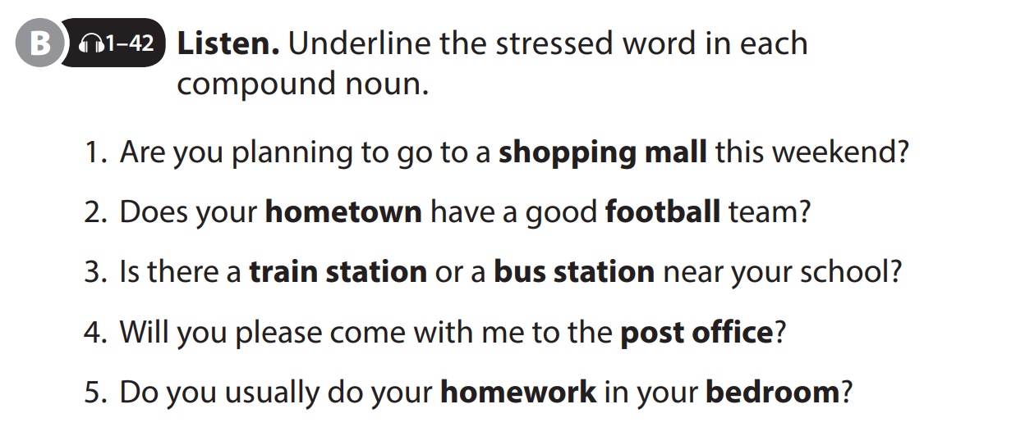
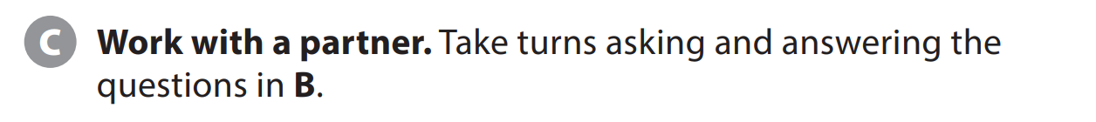
UNIT 5
I’M MEETING FRIENDS LATER.
PRONUNCIATION

Slide 6
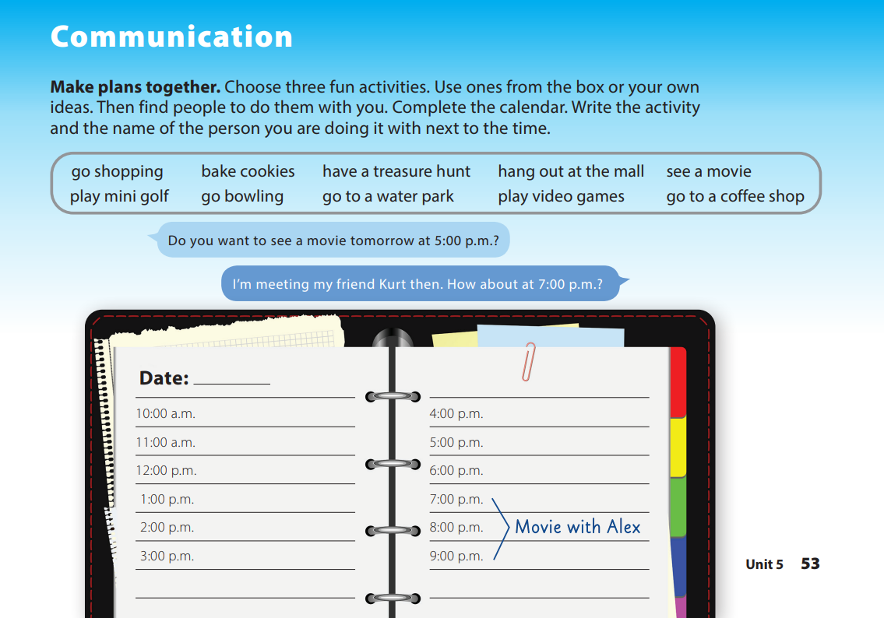
UNIT 5
I’M MEETING FRIENDS LATER.
COMMUNICATION
Notes:
Tell students they are going to make three plans with classmates and write them in their calendar.
Point to the activities in the box and have students follow along as you read them. Show students the photo of mini golf if you brought it in. Tell students that they should choose
three activities from this list, or they can use their own ideas.
Explain that they should get up, move around the room, and talk with classmates until they find people they can do the activities with.
Tell them that when they make their plans, they should write the activity and the classmate’s name in their calendar next to the time they agree on.

Slide 7


THANK YOU!

