Slide 1
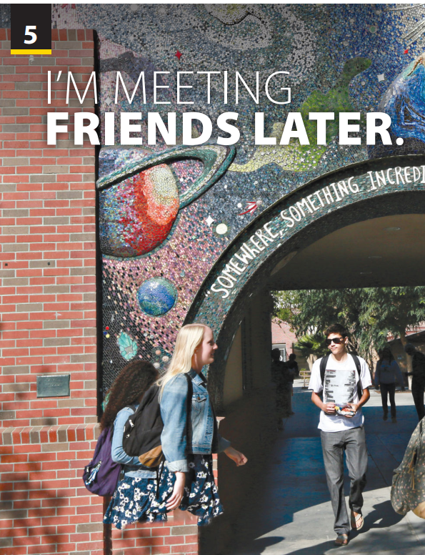
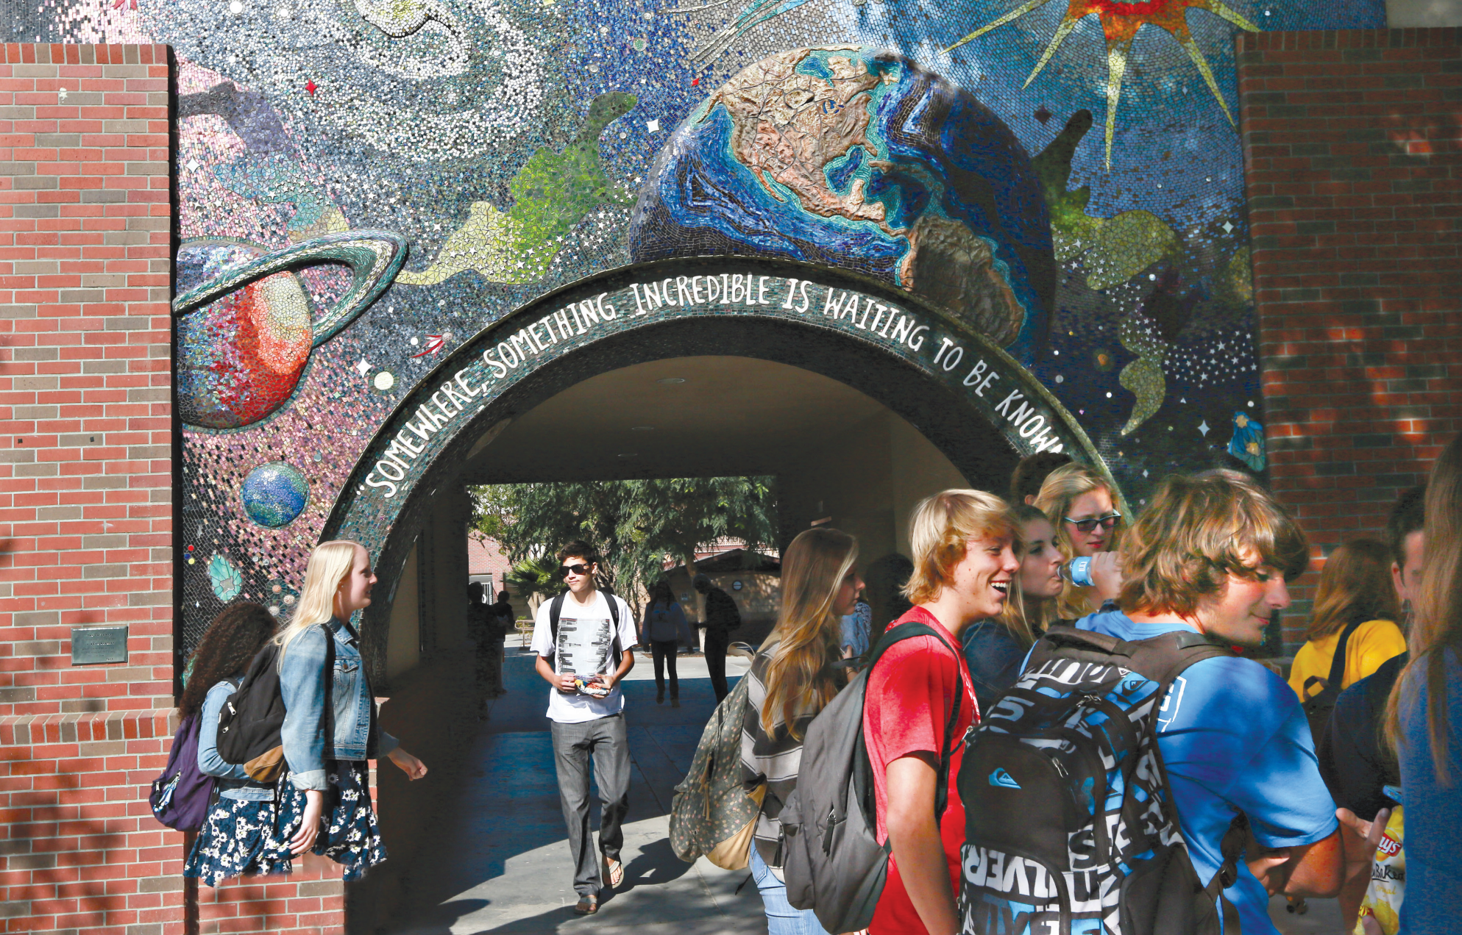
Preview and Language Focus
Notes:
Ask students to look at the photo and read the caption. Then, as students follow along in their books, read the title and ask students to predict what the article is about.
Ask a few students to share their guesses.

Slide 2
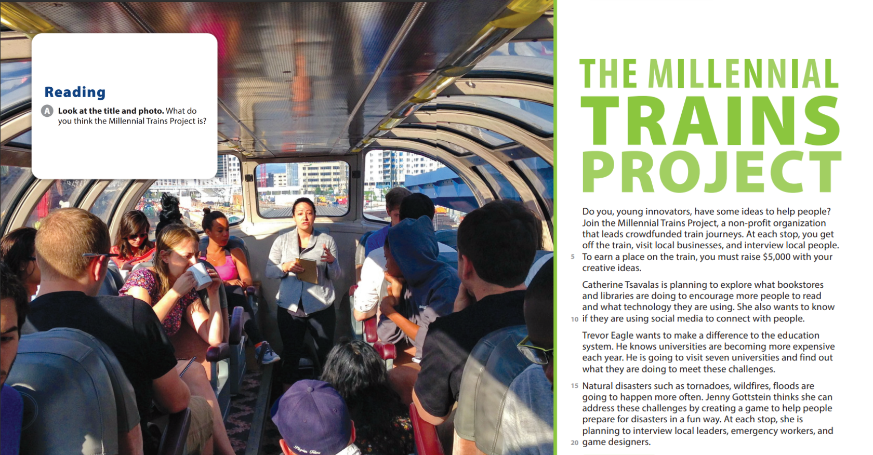
UNIT 5
I’M MEETING FRIENDS LATER
READING

Slide 3



UNIT 5
I’M MEETING FRIENDS LATER
READING
How to improve
reading fluency and speed?
Do not need to stop and look up unfamiliar words the first time they read a text.
Think about the content and guess what the meanings are, and then, if necessary, use a dictionary to check the meanings after they have finished reading the text.

Slide 4
UNIT 5
I’M MEETING FRIENDS LATER
READING
New words
Innovator: nhà cải cách
Non-profit organization: tổ chức phi lợi nhuận
Plan to V: lên kế hoạch …
Make a difference to st: tạo ra sự khác biệt
Natural disaster: thảm hoạ thiên nhiên
Address (+challenge): giải quyết thách thức

Slide 5
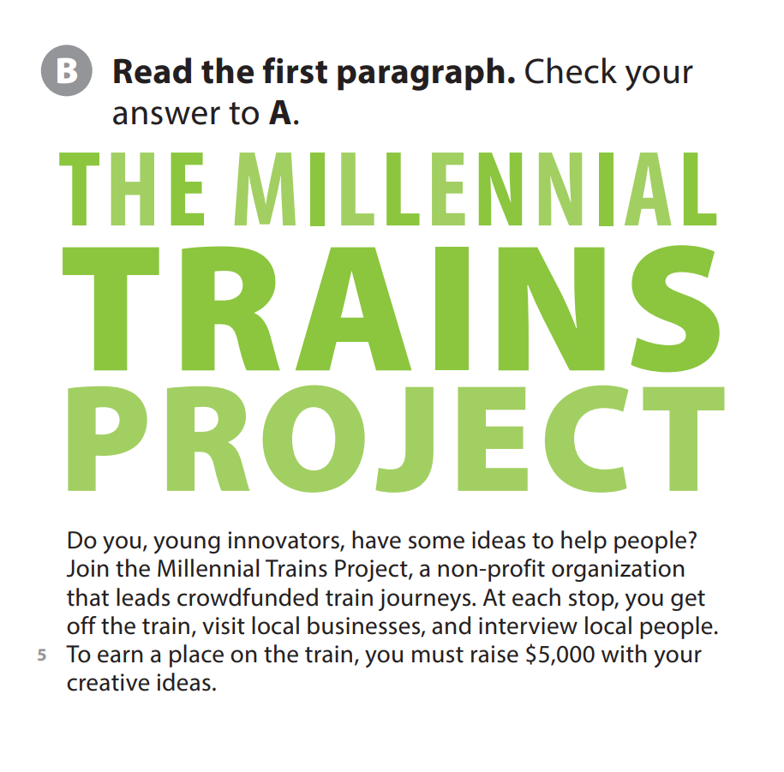
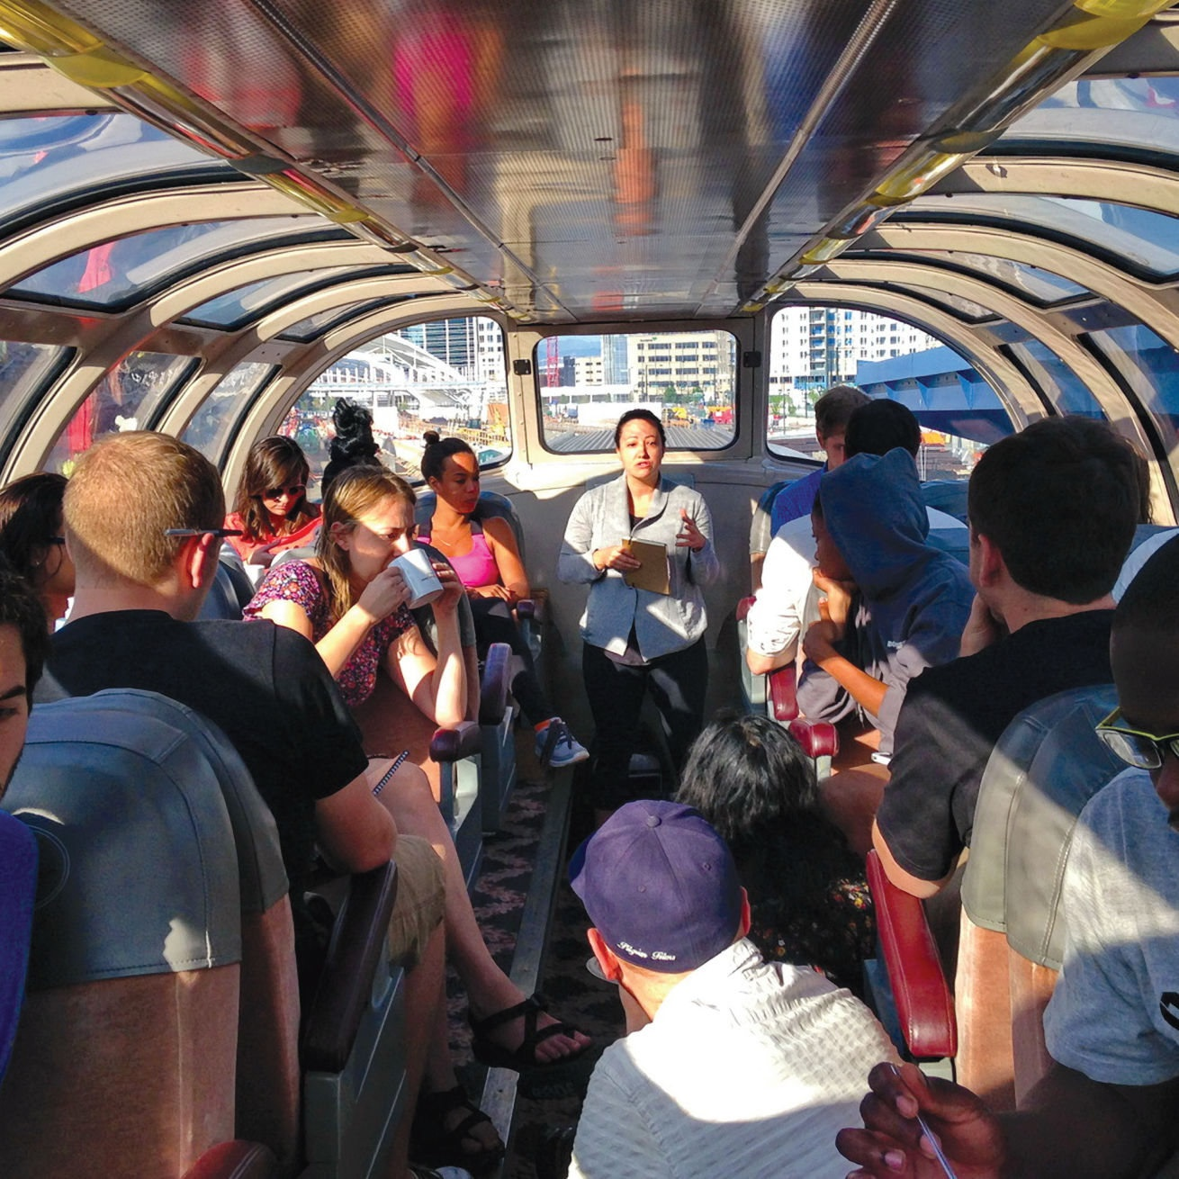
UNIT 5
I’M MEETING FRIENDS LATER
READING

Slide 6
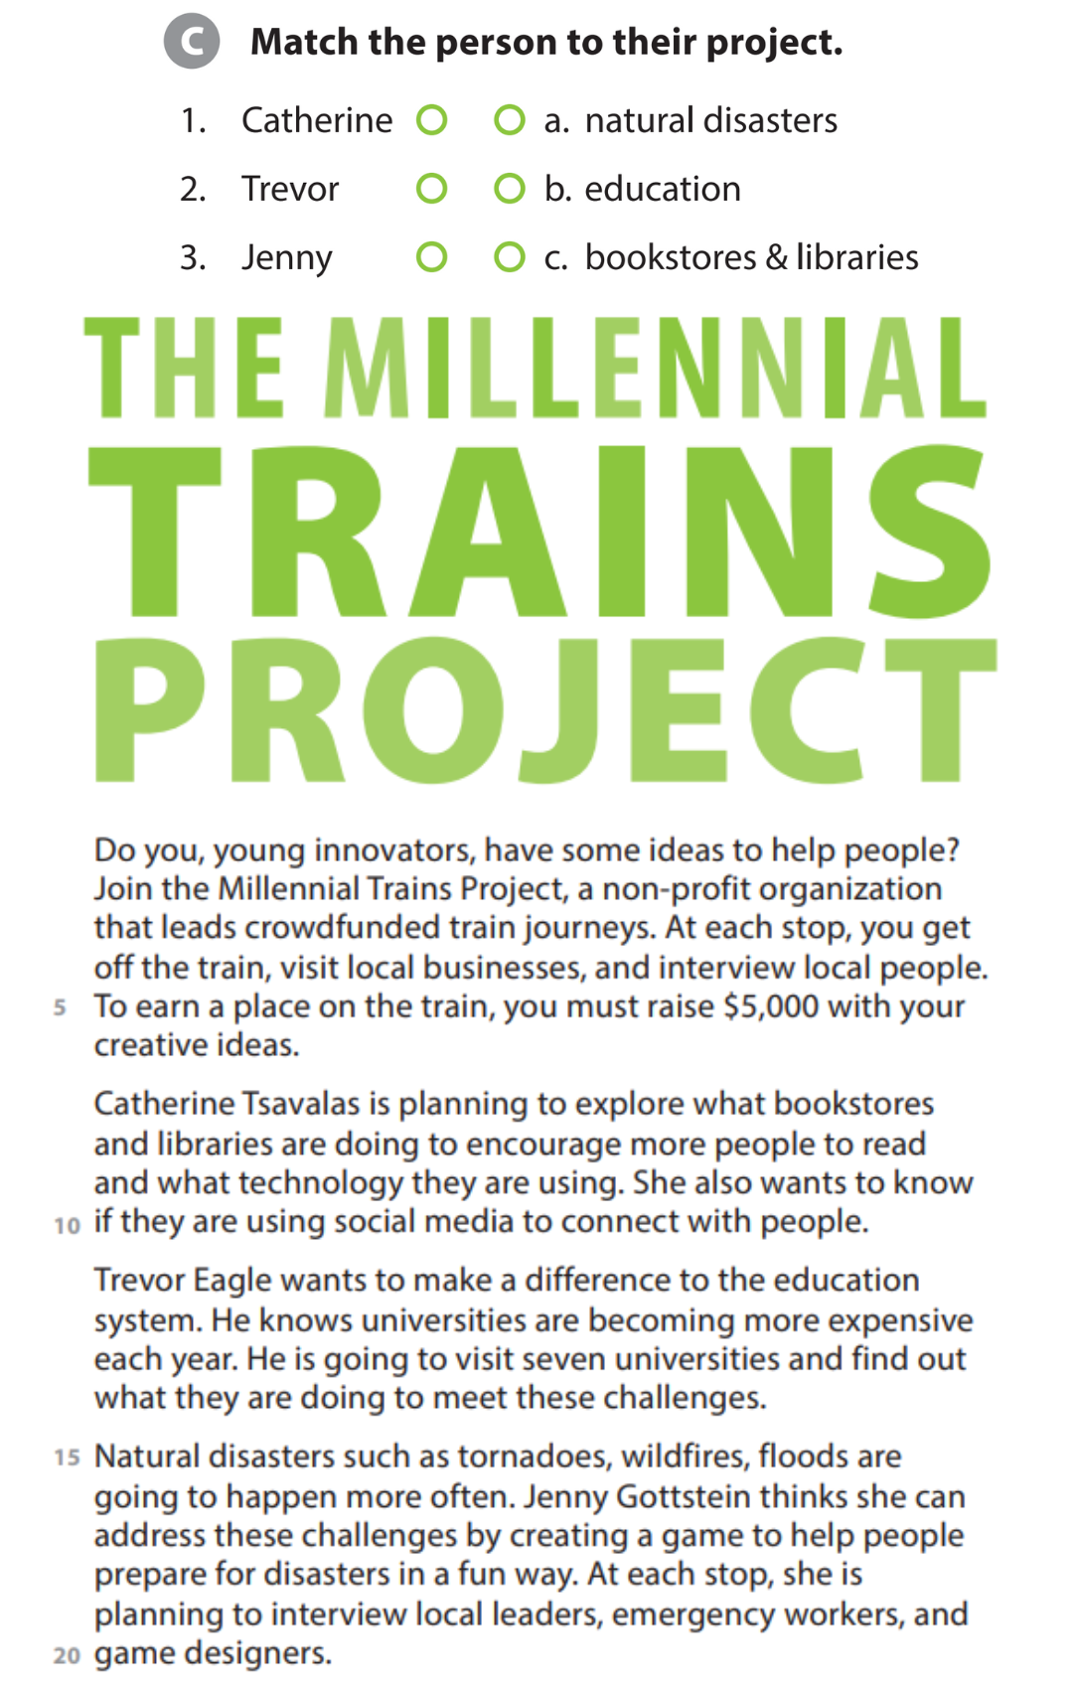
UNIT 5
I’M MEETING FRIENDS LATER
READING

Slide 7
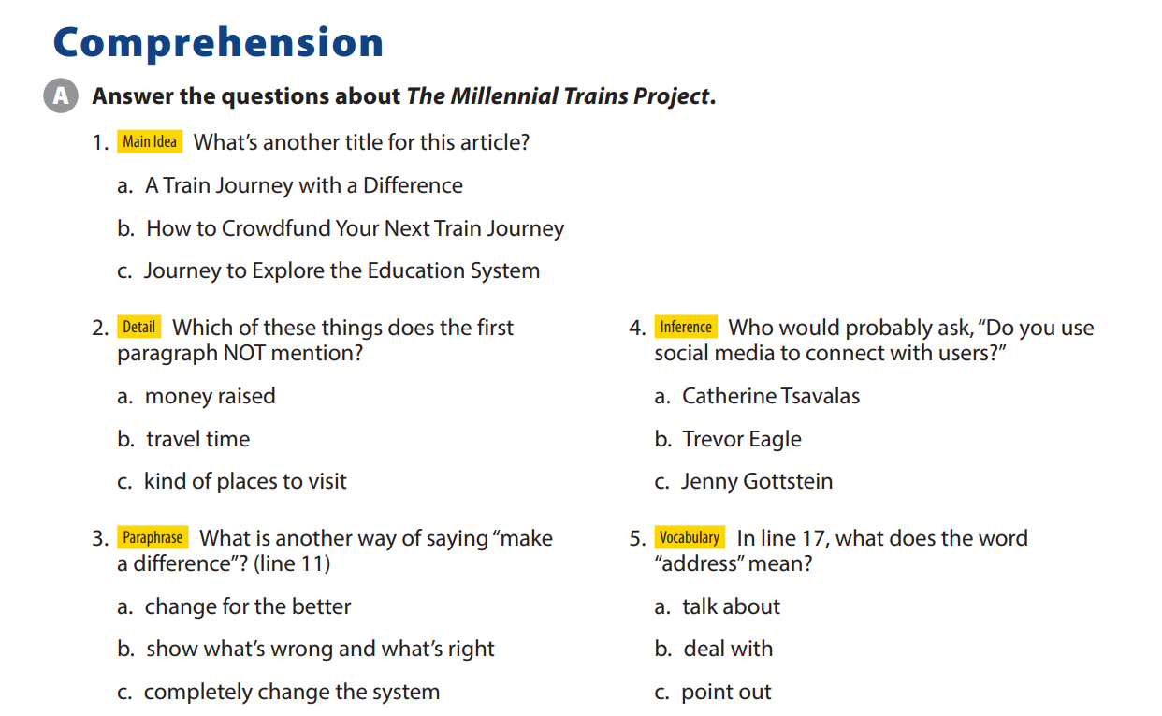
UNIT 5
I’M MEETING FRIENDS LATER
COMPREHENSION

Slide 8
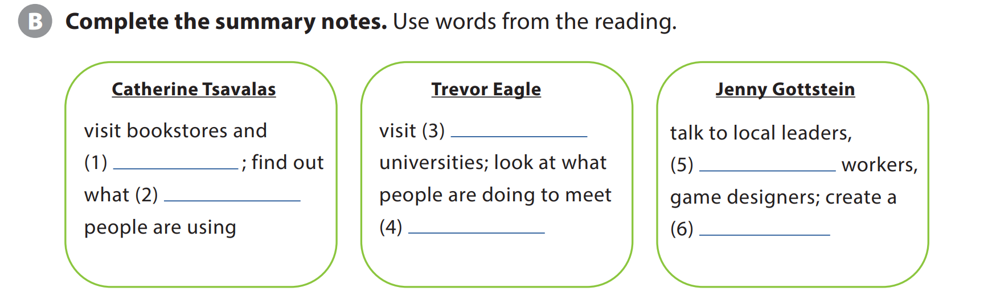
UNIT 5
I’M MEETING FRIENDS LATER
COMPREHENSION
seven
libraries
emergency
technology
challenges
game

Slide 9

UNIT 5
I’M MEETING FRIENDS LATER
IDIOM
He’s on track to win the gold at the next Olympics.
The Millennial Train Project is on track to meet their goal of four trips in four years.
Notes:
explain that on track has a positive meaning and is often when discussing long-term goals or projects, as in the following examples:

Slide 10


THANK YOU!

