Slide 1
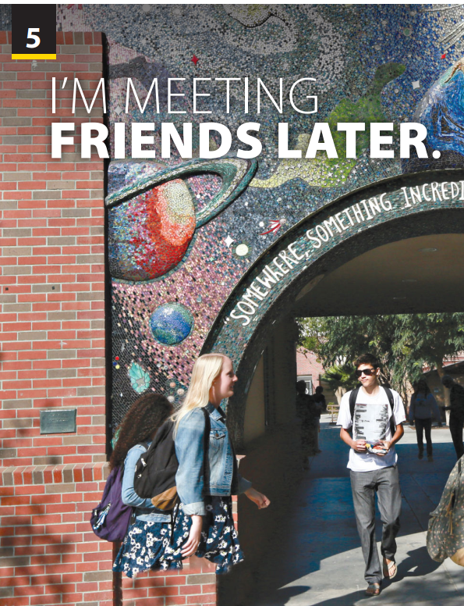
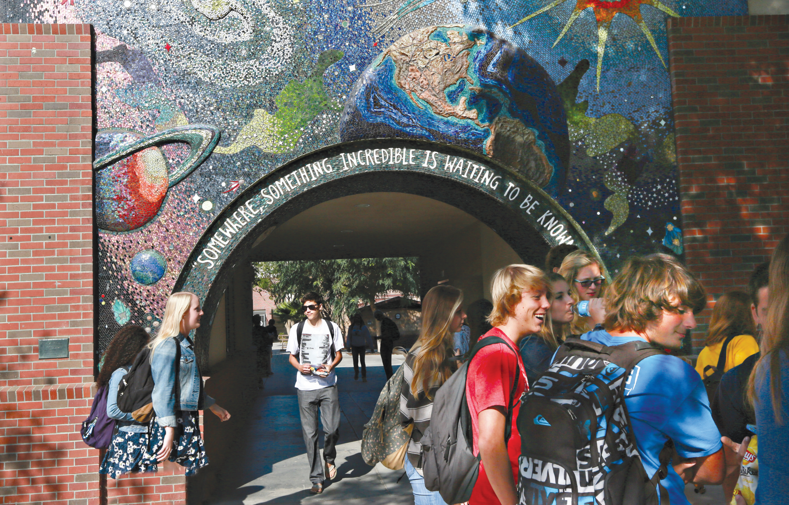
Writing and
Writing Worksheet

Slide 2

UNIT 5
I’M MEETING FRIENDS LATER.
WRITING
SING AND DANCE

Slide 3
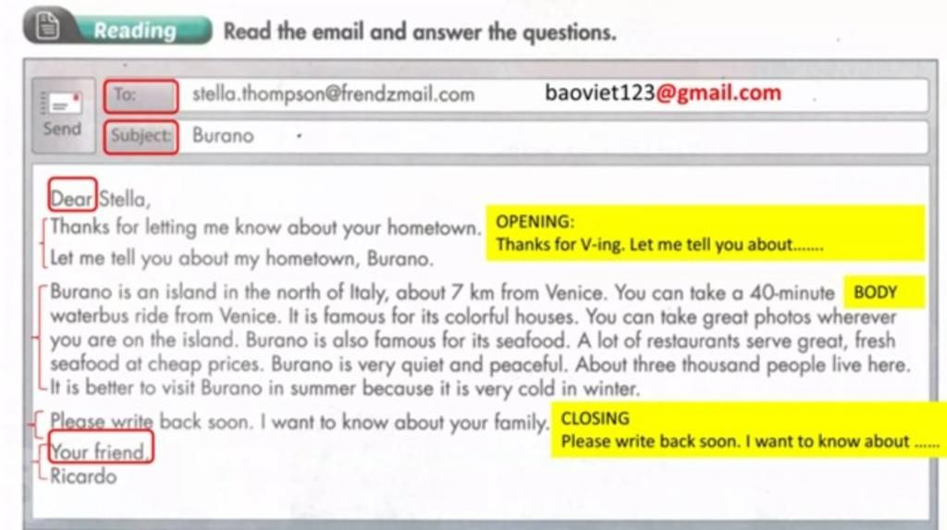
Structure of an email

Slide 4
Structure of an email
To
The receiver’s email address
Subject
The topic
Opening
Hi…/Dear…
Thank for…/Sorry…
Body
Talk about the author’s plans for the meeting
(use present continuous to give plans).
Let me know soon / Please write back soon
A friendly sign - off (Thanks / Best regard,…)
Your name
Conclusion

Slide 5
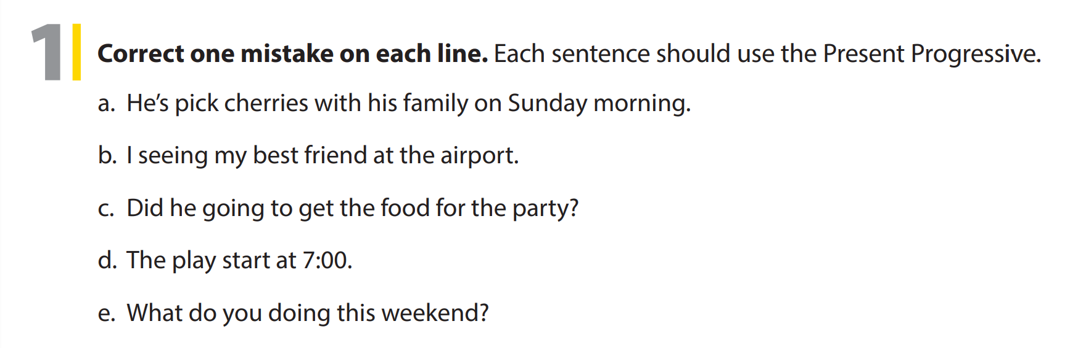
UNIT 5
I’M MEETING FRIENDS LATER.
WRITING
picking
I am/ I’m
Is
starts
are

Slide 6
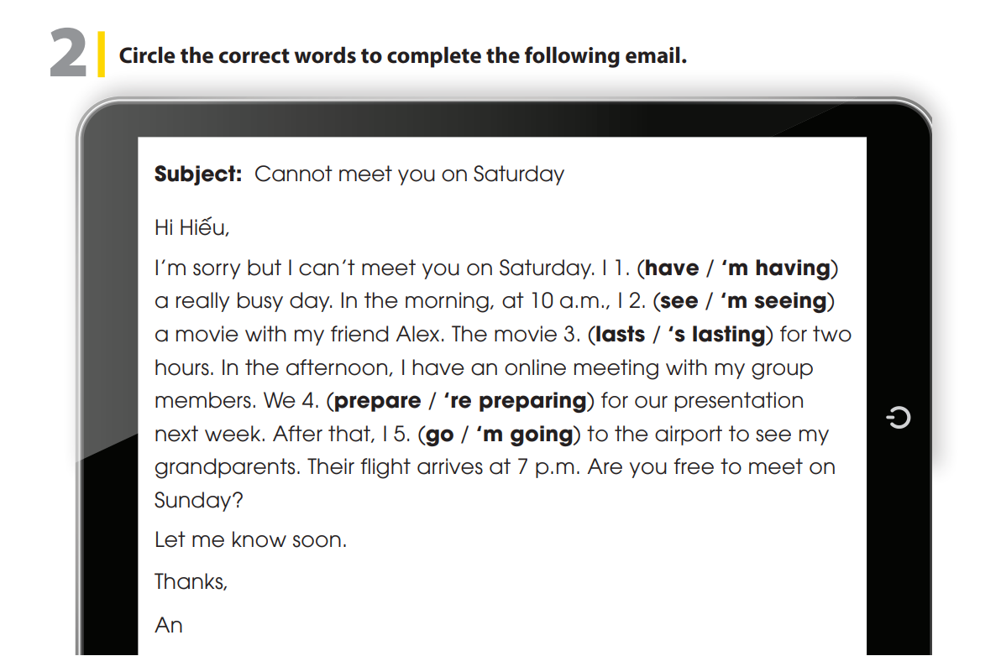
UNIT 5
I’M MEETING FRIENDS LATER.
WRITING

Slide 7

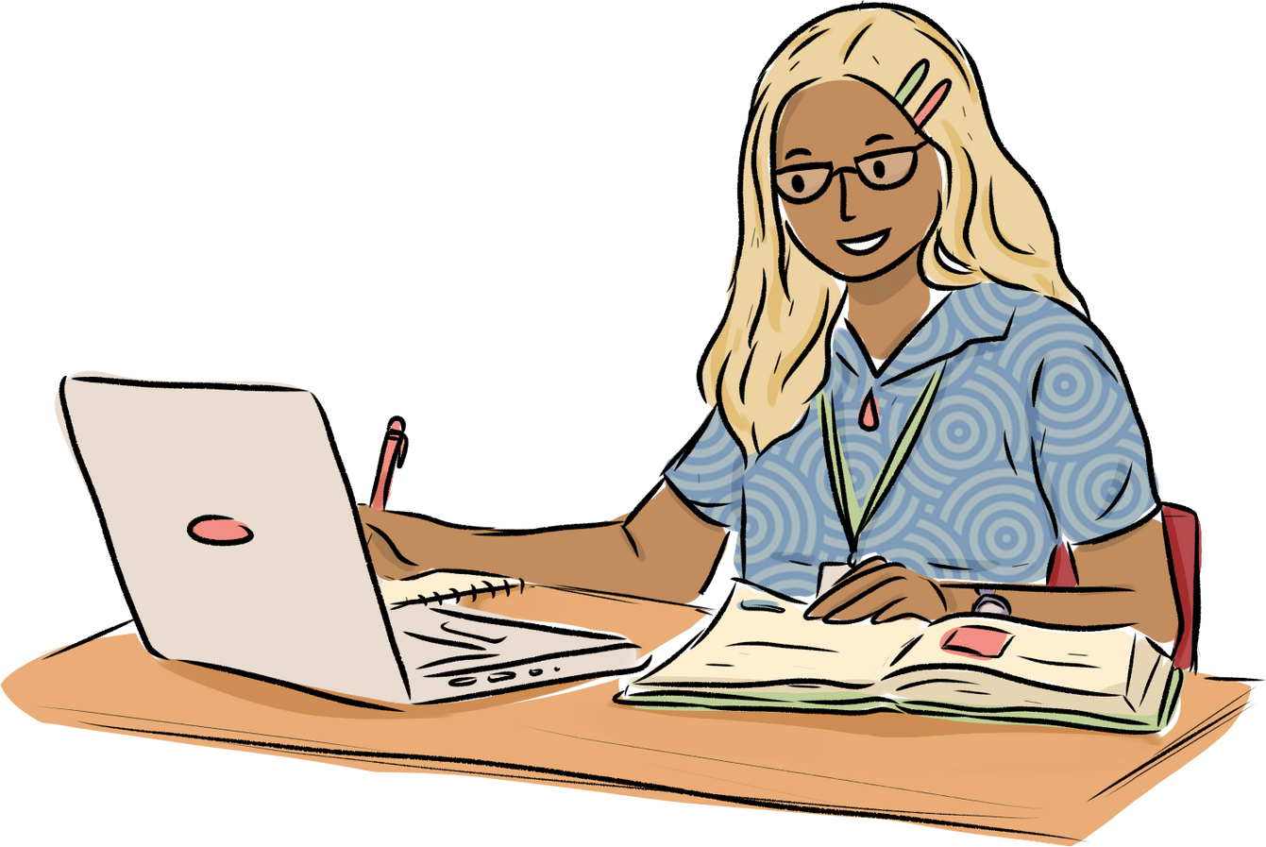
UNIT 5
I’M MEETING FRIENDS LATER.
WRITING
Notes:
Tell students they are going to write an email to a friend to talk about your plan for the coming Saturday.
Tell students that their email should follow this pattern in Activity 2.
Give students about 10 minutes to write their email, and set the number of words they must write (80-100 words).
Have them do the task.

Slide 8


THANK YOU!

