Slide 1
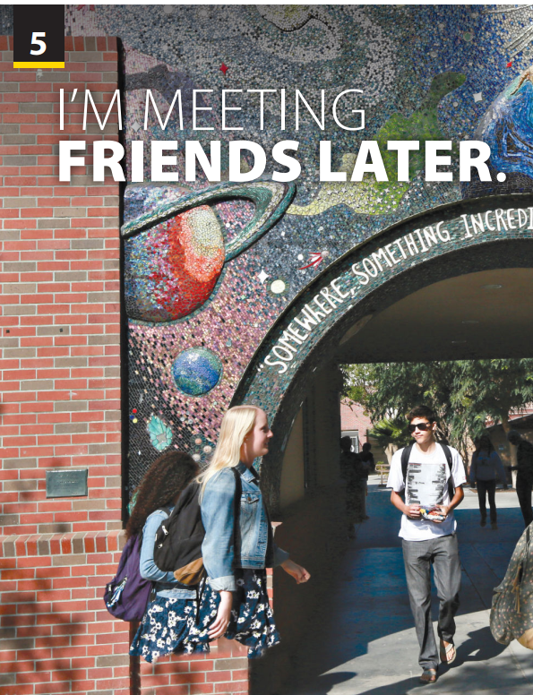
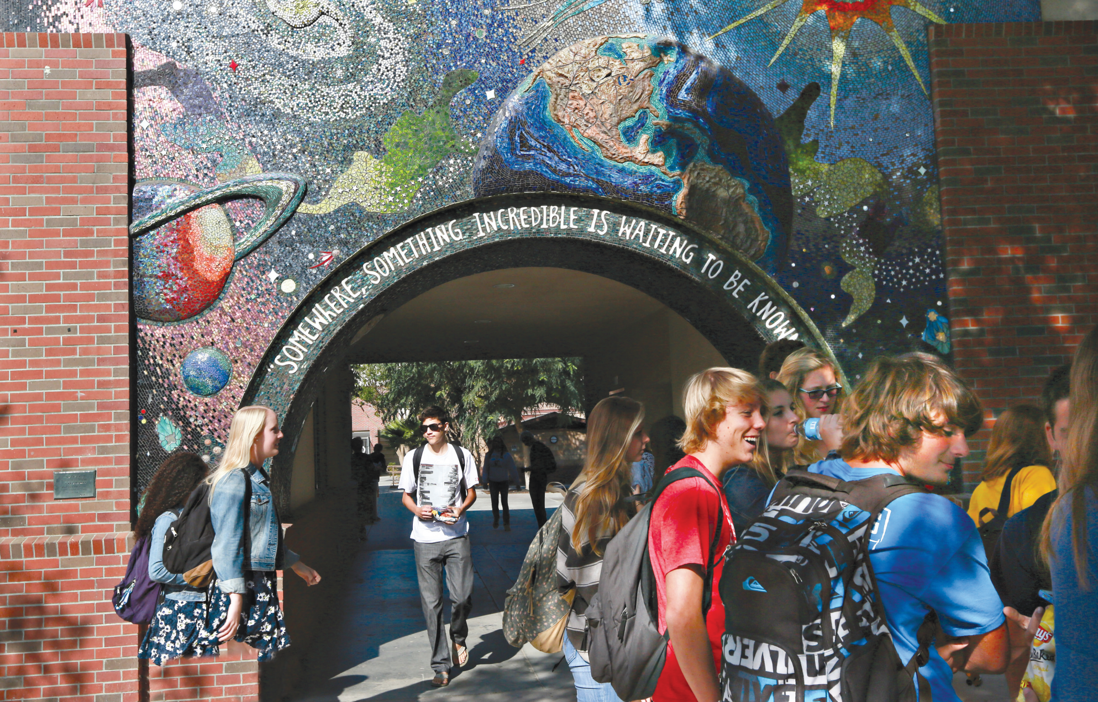
Video and
Video Worksheet

Slide 2
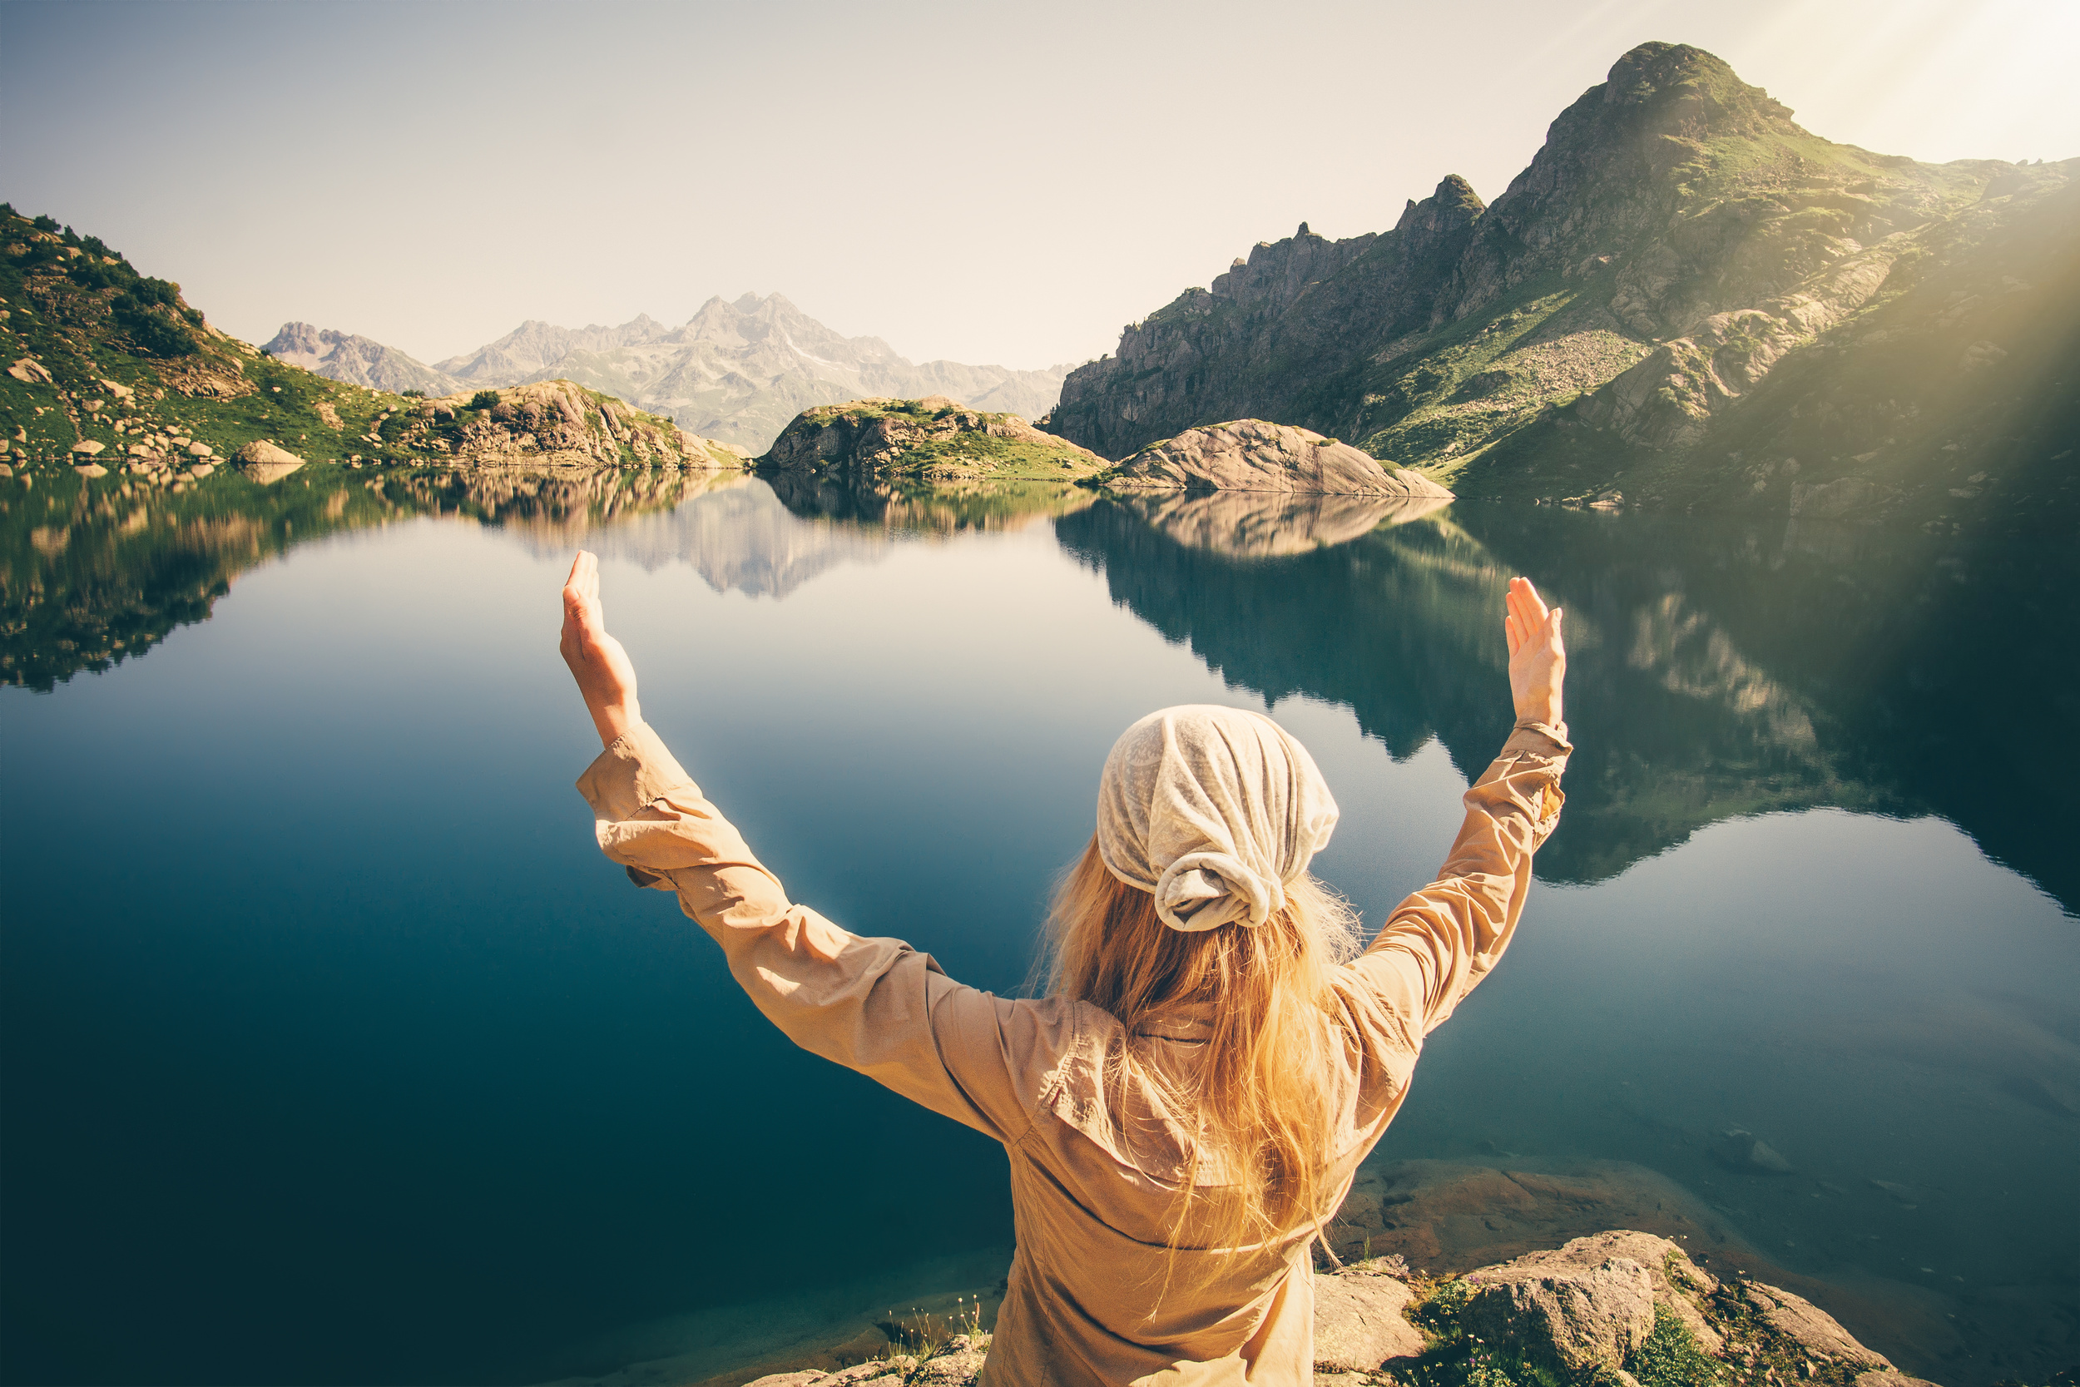


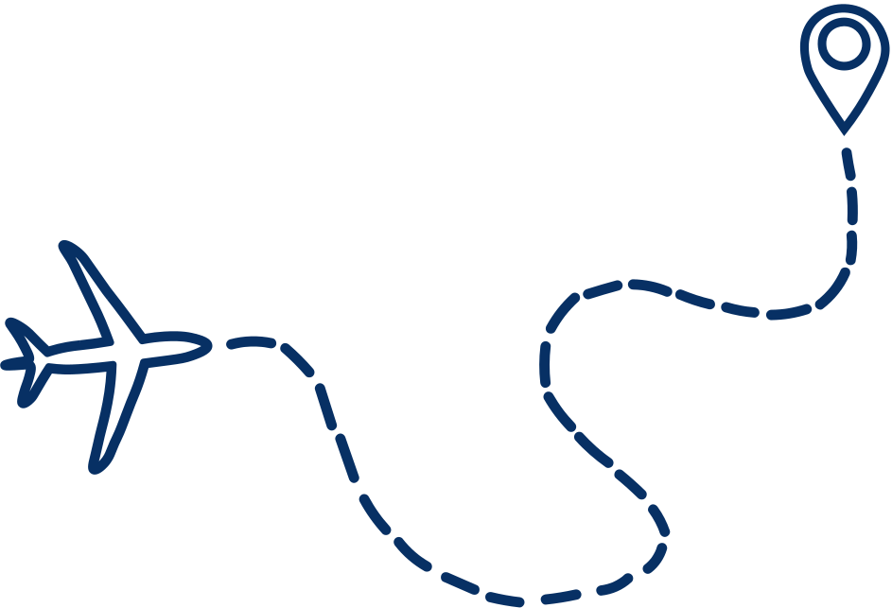


UNIT 5
I’M MEETING FRIENDS LATER.
VIDEO
FREE TALK
TRAVELING
Who like traveling?
Why do you like traveling?
Get Started
Notes:
Free talk.
Ask students some questions to get students involved in the topic
Who like travelling?
Why do you like travelling? ( your purpose when travelling)
Tell students they are going to watch a video called World Traveler. As students follow along in their books, read the sentence about the video aloud

Slide 3

UNIT 5
I’M MEETING FRIENDS LATER.
VIDEO
Notes:
Provide more information about the
Kasha Slavner.
https://www.youtube.com/watch?v=jbpcfTh2oO8
Slavner, a native of Toronto, Canada, was inspired to start her project after being a youth delegate for the 57th Commission of the Status of Women at the United Nations Headquarters in New York. She first titled her project proposal, Picture the Power of People for a Purpose, using the dual meaning of picture to mean represent and photograph.

Slide 4

UNIT 5
I’M MEETING FRIENDS LATER.
VIDEO
Notes:
Provide more information about the
Kasha Slavner.
https://www.youtube.com/watch?v=jbpcfTh2oO8
Slavner, a native of Toronto, Canada, was inspired to start her project after being a youth delegate for the 57th Commission of the Status of Women at the United Nations Headquarters in New York. She first titled her project proposal, Picture the Power of People for a Purpose, using the dual meaning of picture to mean represent and photograph.

Slide 5
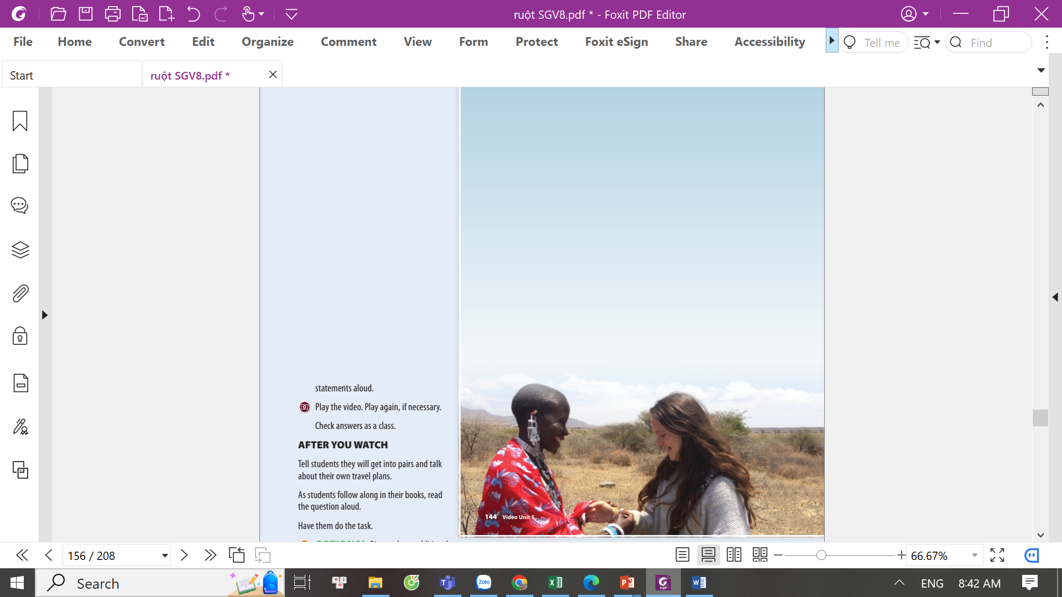
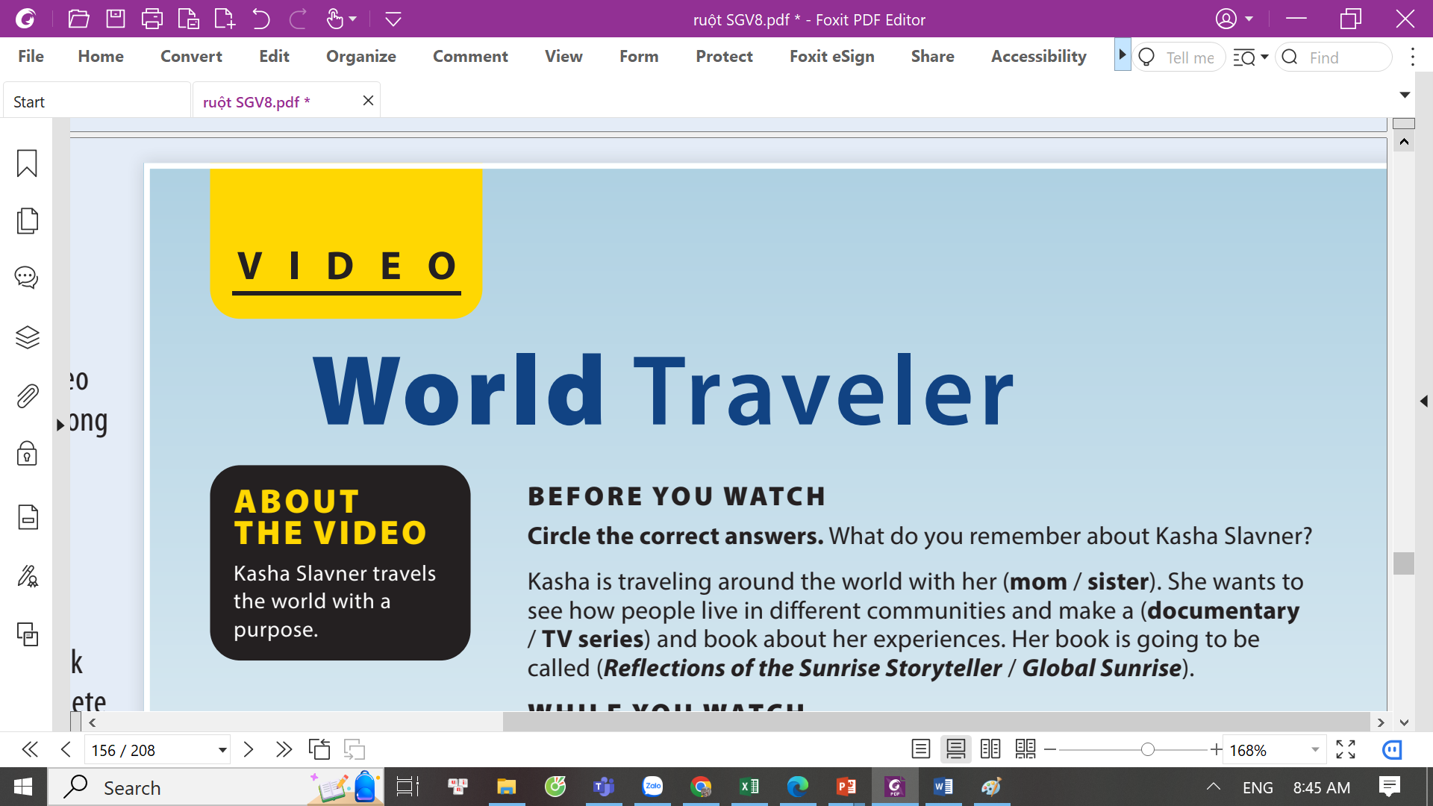
UNIT 5
I’M MEETING FRIENDS LATER.
VIDEO
Notes:
Remind students that they learned about Kasha Slavner in the Real World section. Ask them to circle the correct answers to complete
the sentences.

Slide 6
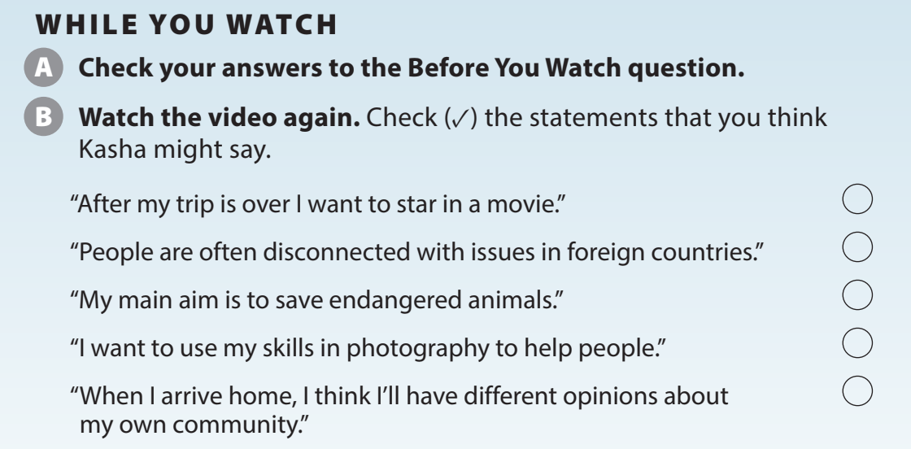
UNIT 5
I’M MEETING FRIENDS LATER.
VIDEO
✓
✓
✓

Slide 7
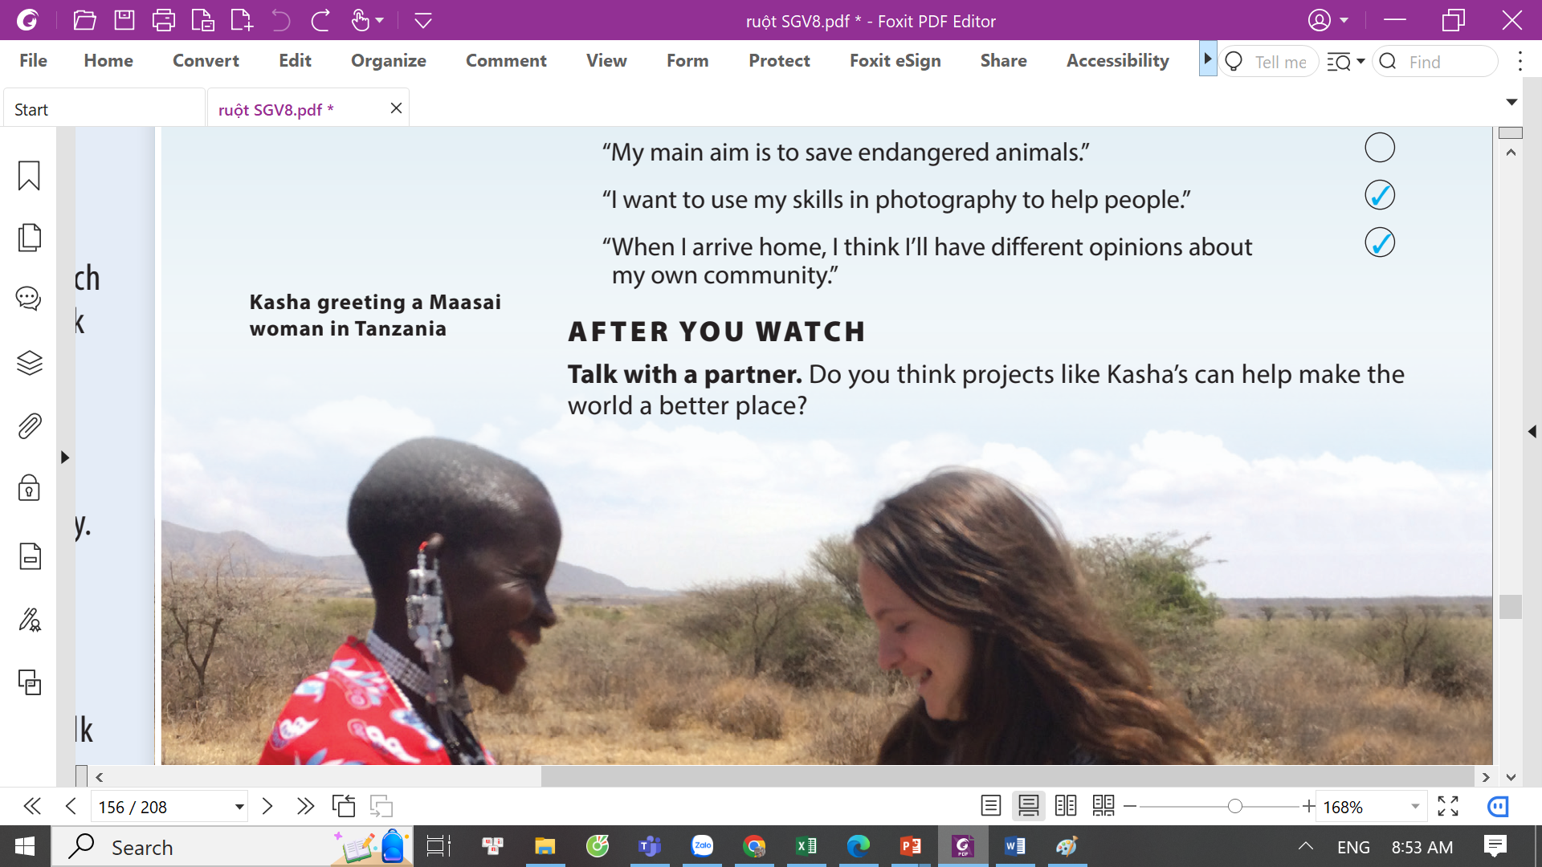
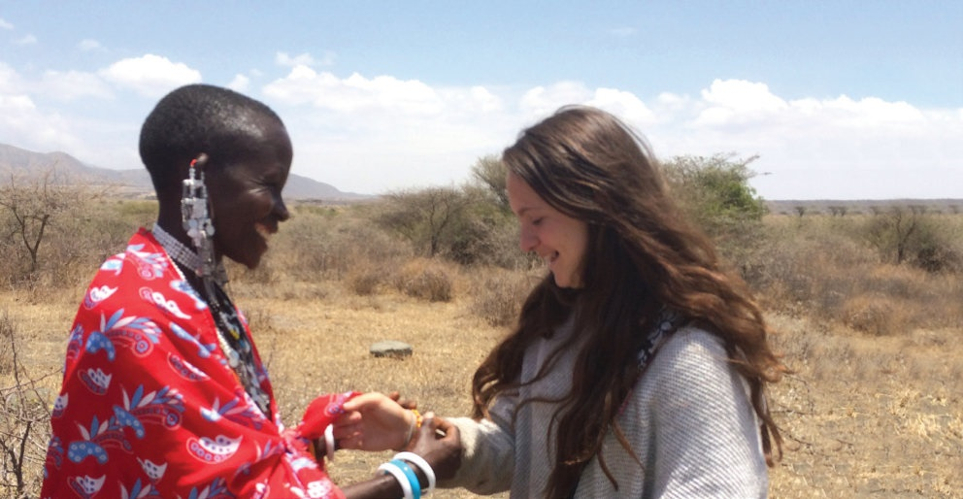
UNIT 5
I’M MEETING FRIENDS LATER.
VIDEO
Notes:
Tell students they will get into pairs and talk about their own travel plans.
As students follow along in their books, read the question aloud.
Have them do the task.

Slide 8


THANK YOU!

