Slide 1
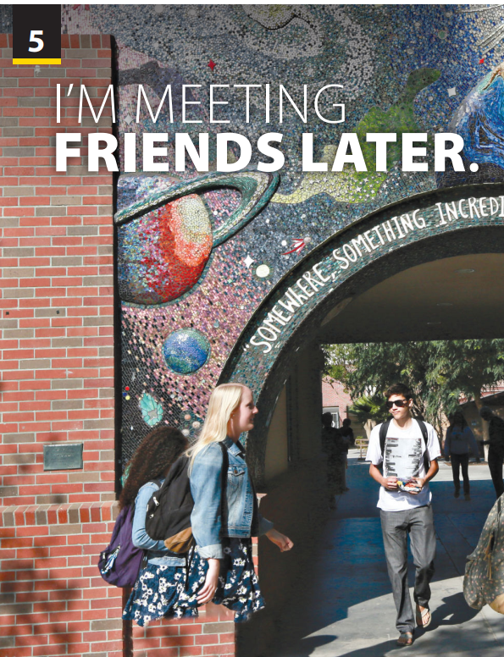
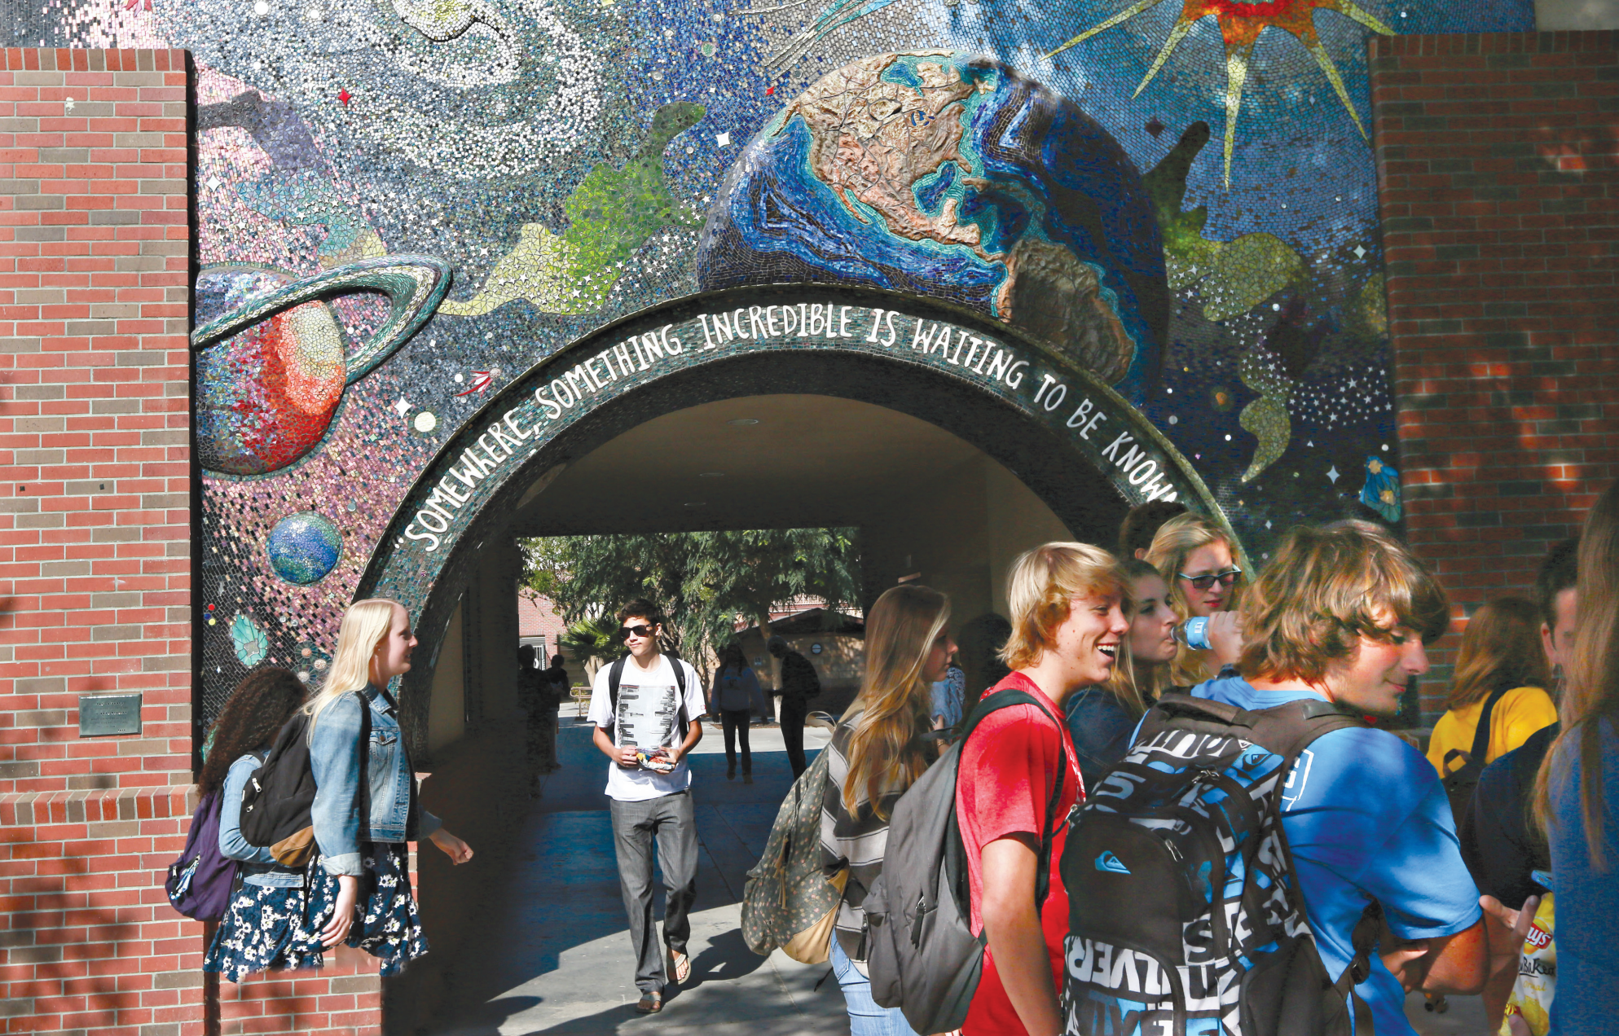
End of
Unit Project

Slide 2


UNIT 5
I’M MEETING FRIENDS LATER..
END OF UNIT
Crowdfunding
Notes:
Free talk.
Ask students some questions to get students involved in the topic
Who like travelling?
Why do you like travelling? ( your purpose when travelling)
Tell students they are going to watch a video called World Traveler. As students follow along in their books, read the sentence about the video aloud

Slide 3

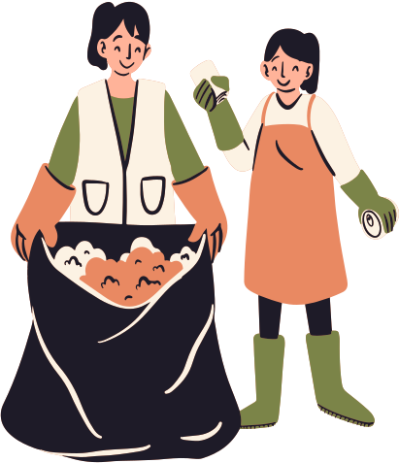



PROJECT FOR COMMUNITY
Title
Problem
Reason
Goal
Notes:
Tell the students they will get into small groups and think of a project that will make their community or the world a better place.
Remind students that Slavner took photos and made a book to show people. Explain that their project proposal has to be more than just take a trip. The project should produce something others can learn from: photos, a book, a movie, audio recordings (e.g., podcasts), art, etc.
Explain that their proposal should include:
• A project title
• A few sentences about what the
problem is and why it is important
• Why they chose the problem
• The goal of their project

Slide 4

Ready for a proposal?
Notes:
Have students get into groups, brainstorm ideas, and make their proposals.
Have students work in small groups to make a proposal for a crowdfunding project.
Explain that after they make their proposal, they will present it to the other students and the class will vote on the best three. Tell students that they need to convince the other students that their project is important enough to be chosen. Emphasize that they are only making a proposal. They don’t have to actually do the project for the class assignment.

Slide 5


THANK YOU!

