Slide 1
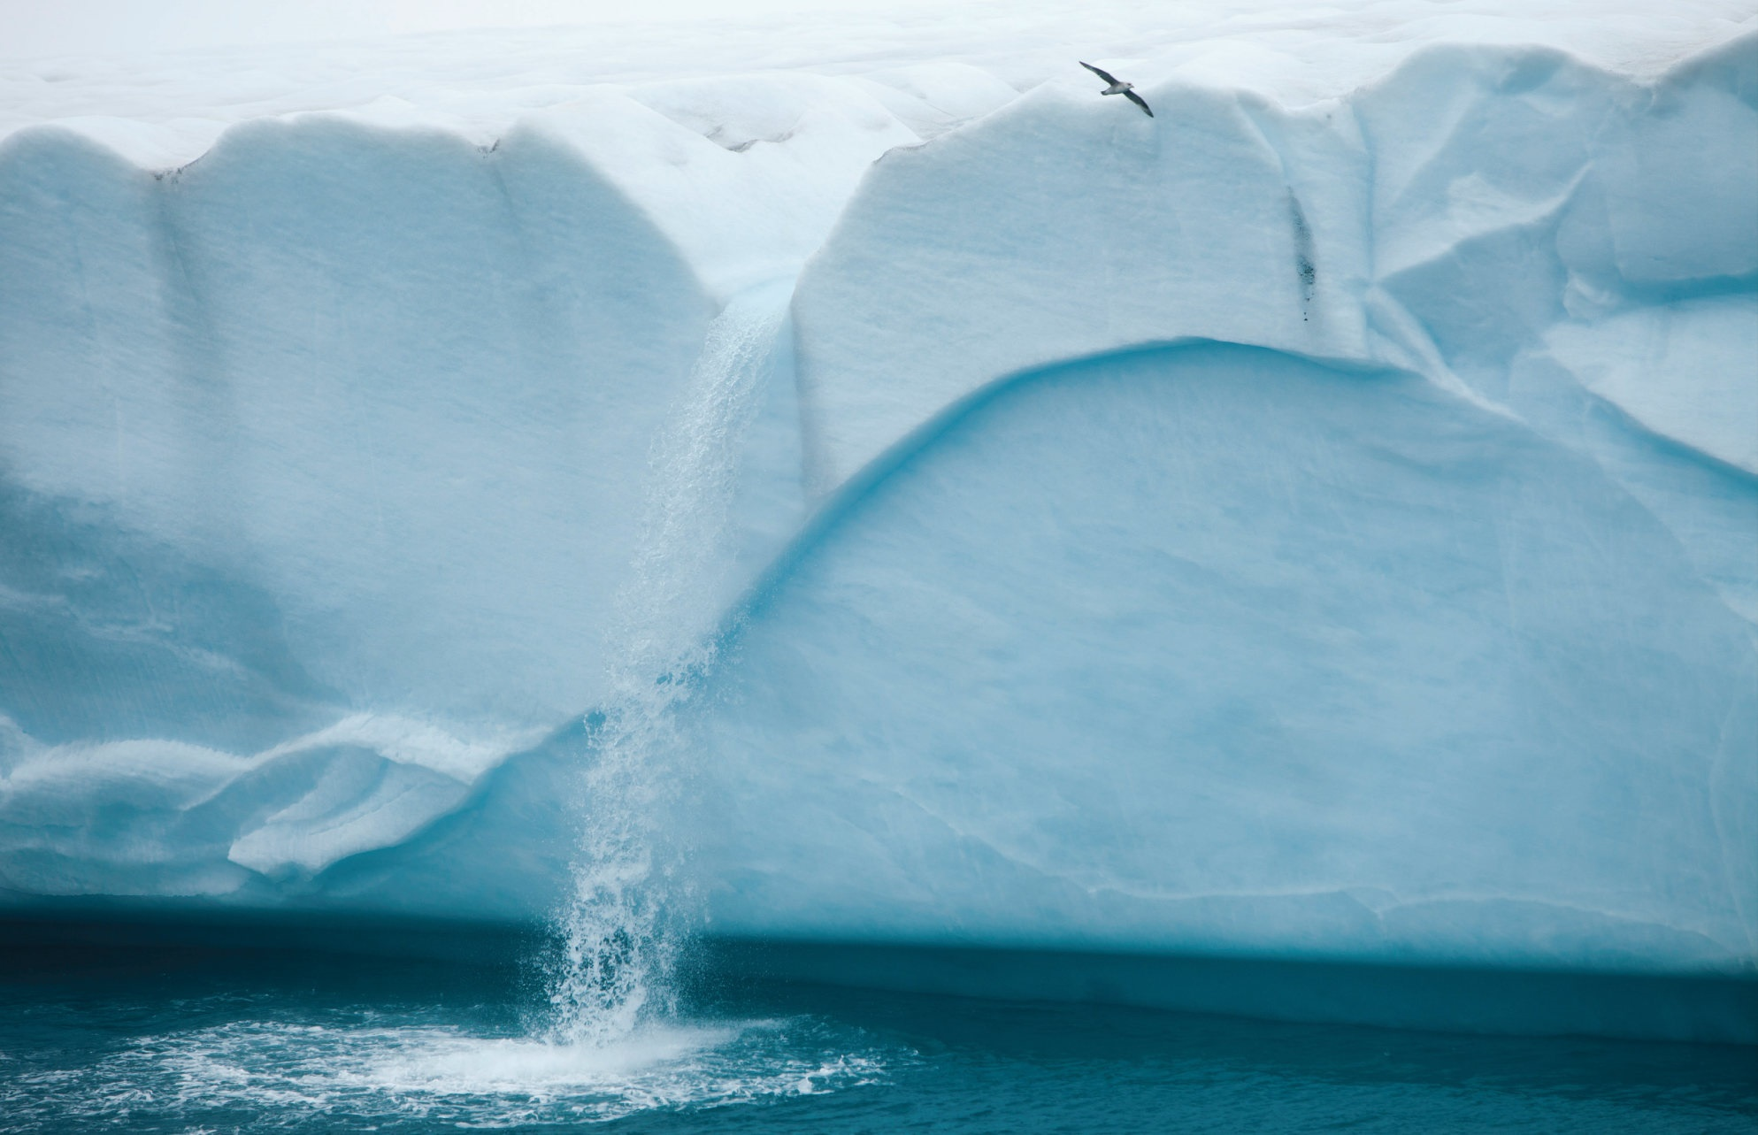
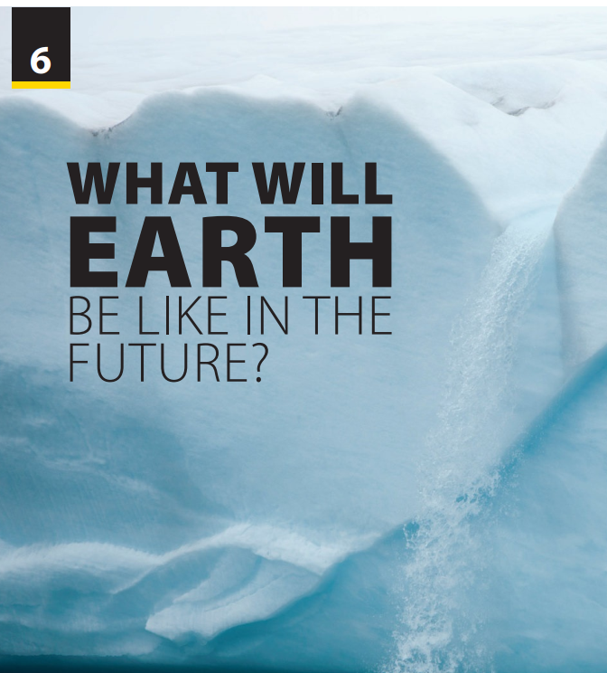
Preview and Language Focus

Slide 2
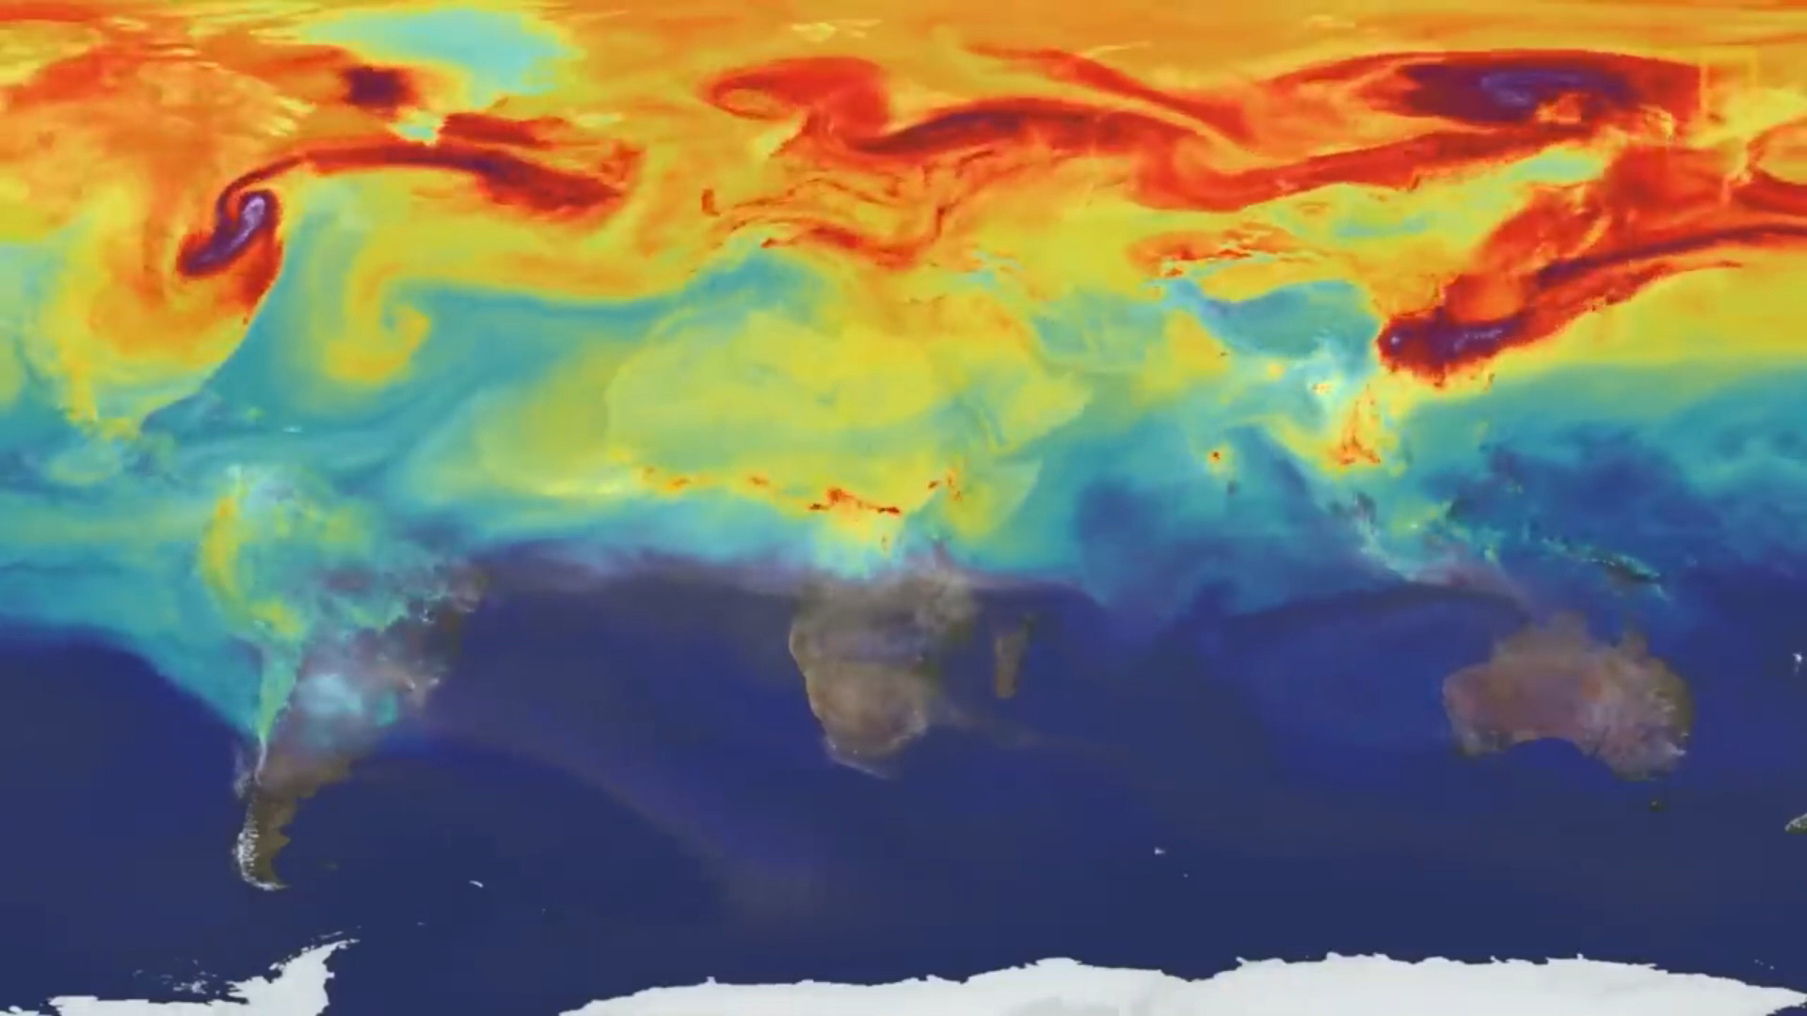
UNIT 6
WHAT WILL EARTH BE LIKE IN THE FUTURE?
PREVIEW
Melting ice
What is the reason for this disaster?
How does it affect our life?
Notes:
Have students watch a video of melting ice (from 2:39 – 3:43)
https://www.youtube.com/watch?v=WJgpDyP9ewQ
Give some questions relating to Melting ice:
What is the reason for this disaster? (global warming)
How does it affect our life? (Answers will vary)
Have students read the unit title to
themselves as you read it aloud. Explain that
in this unit they will learn to talk about things
in the future, and specifically, how the Earth
may change in the future

Slide 3
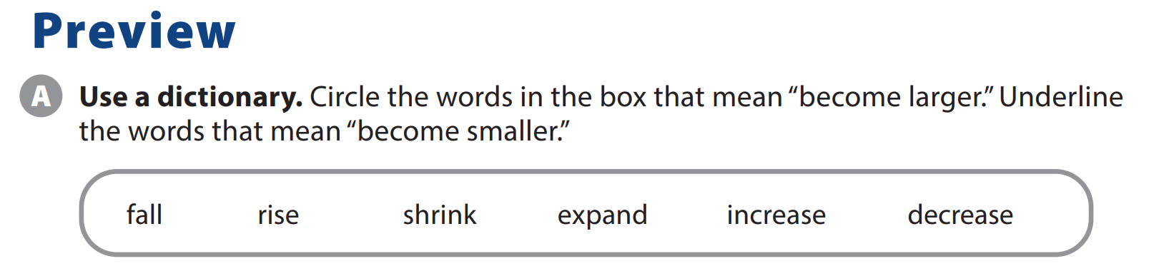
UNIT 6
WHAT WILL EARTH BE LIKE IN THE FUTURE?
PREVIEW
Notes:
Tell students they are going to study words that mean become larger and become smaller. Classifying words is a good critical thinking task, and will help students to learn new vocabulary.
Read the words in the box as students follow along. Tell students to use their dictionaries, if necessary, and circle the words that mean become larger and
underline the words that mean become smaller.

Slide 4
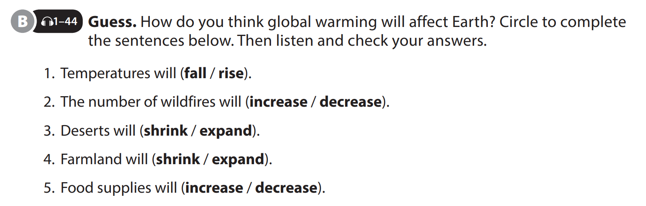

UNIT 6
WHAT WILL EARTH BE LIKE IN THE FUTURE?
PREVIEW
Notes:
Briefly explain global warming without revealing any of the content for the activity.
Human activities are the main cause of global warming.
It has resulted in higher temperatures over the past 100-200 years.
Tell students that they should guess how global warming will affect Earth and circle their predictions. As students follow along, read the sentences. Have
them do the task.

Slide 5
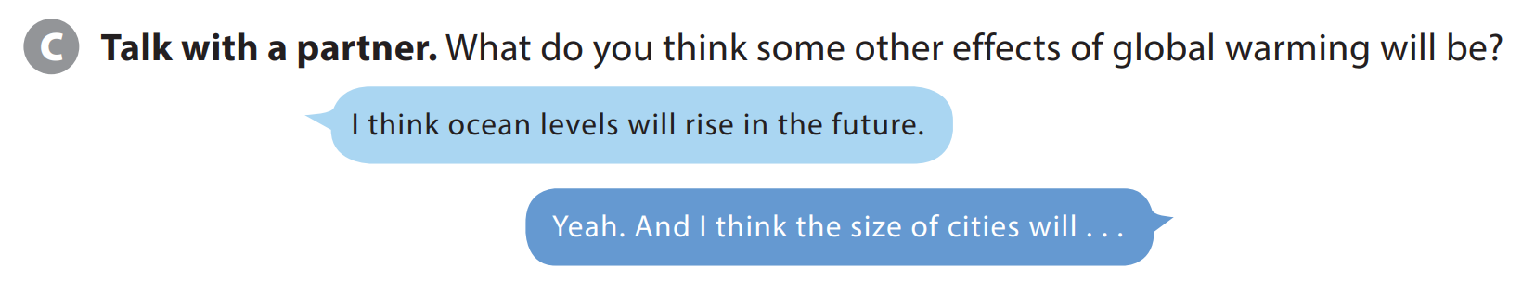
UNIT 6
WHAT WILL EARTH BE LIKE IN THE FUTURE?
PREVIEW
Notes:
Preview - Activity C.
Tell students they are going to get into pairs and take turns talking about the effects of global warming.
Model the conversation with a student.
After modeling the conversation, point out that students should use their own ideas.
Have students get into pairs and do the task.

Slide 6
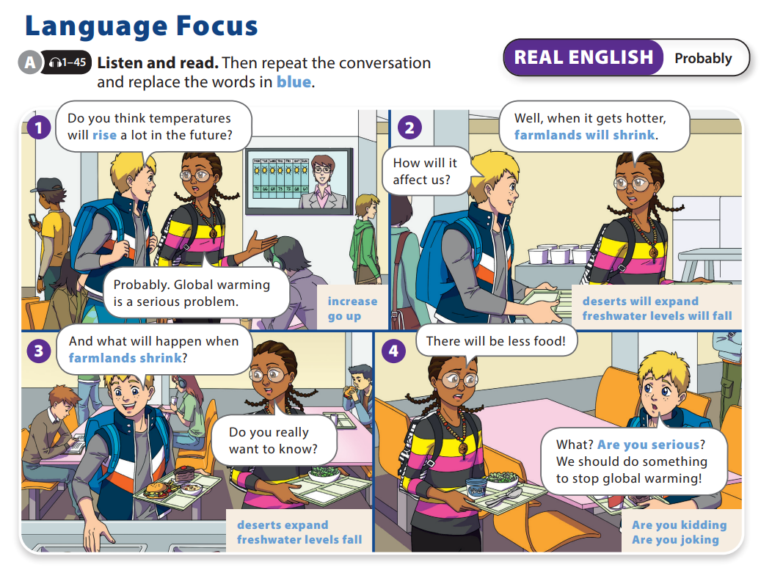
UNIT 6
WHAT WILL EARTH BE LIKE IN THE FUTURE?
LANGUAGE FOCUS

Slide 7
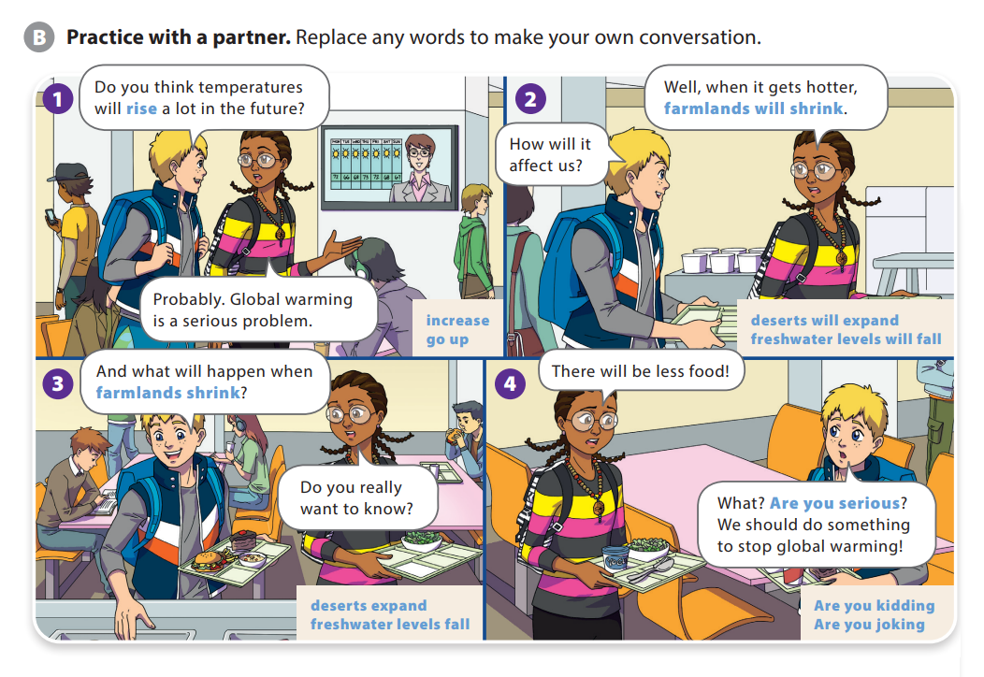
UNIT 6
WHAT WILL EARTH BE LIKE IN THE FUTURE?
LANGUAGE FOCUS

Slide 8
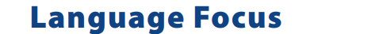
UNIT 6
WHAT WILL EARTH BE LIKE IN THE FUTURE?
LANGUAGE FOCUS
“Probably” is used when we think something is quite likely, something that we have little doubt about.
For example:
A: Do you want to go to a movie Saturday night?
B: I’ve love to, but I already have plans

Slide 9


THANK YOU!

