Slide 1
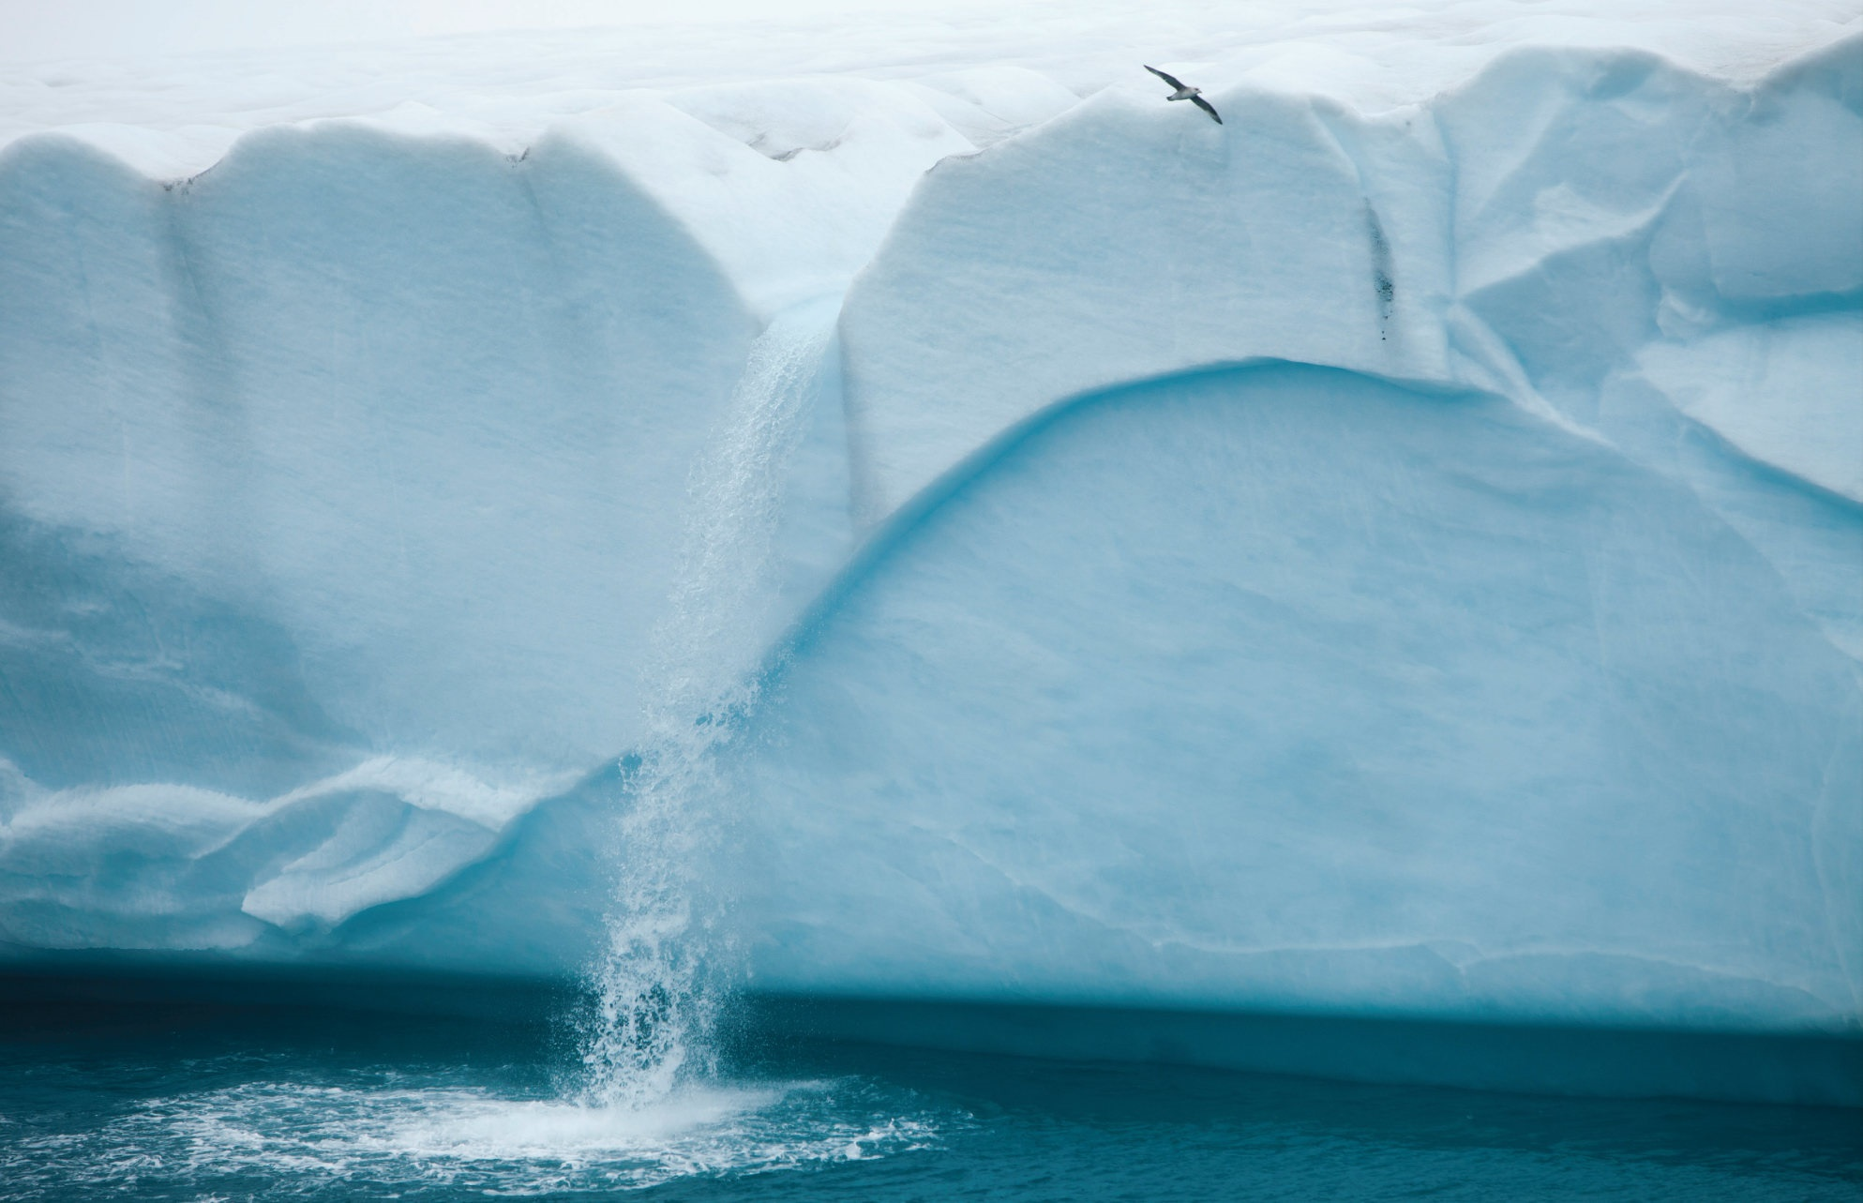
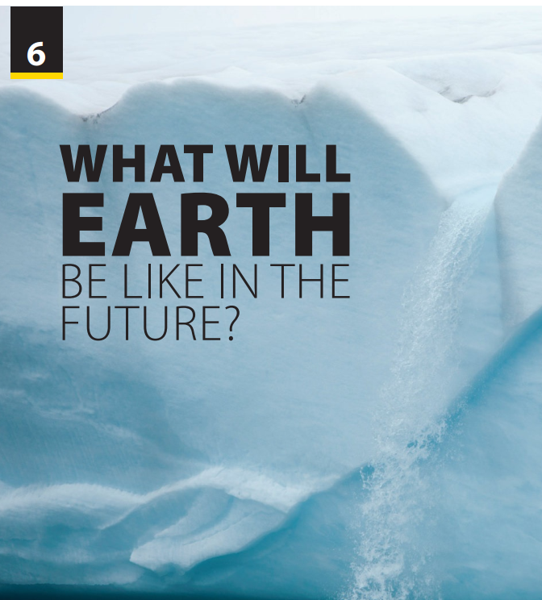
Language Focus
and
The Real World

Slide 2


UNIT 6
WHAT WILL EARTH BE LIKE IN THE FUTURE?
LANGUAGE FOCUS
What will the future like?
Free talk
Notes:
Motivating and Focusing: Free talk
What will the future be like?
Have students discuss the above question.
Teacher may suggest some factors like temperature, the number of people, developments….

Slide 3
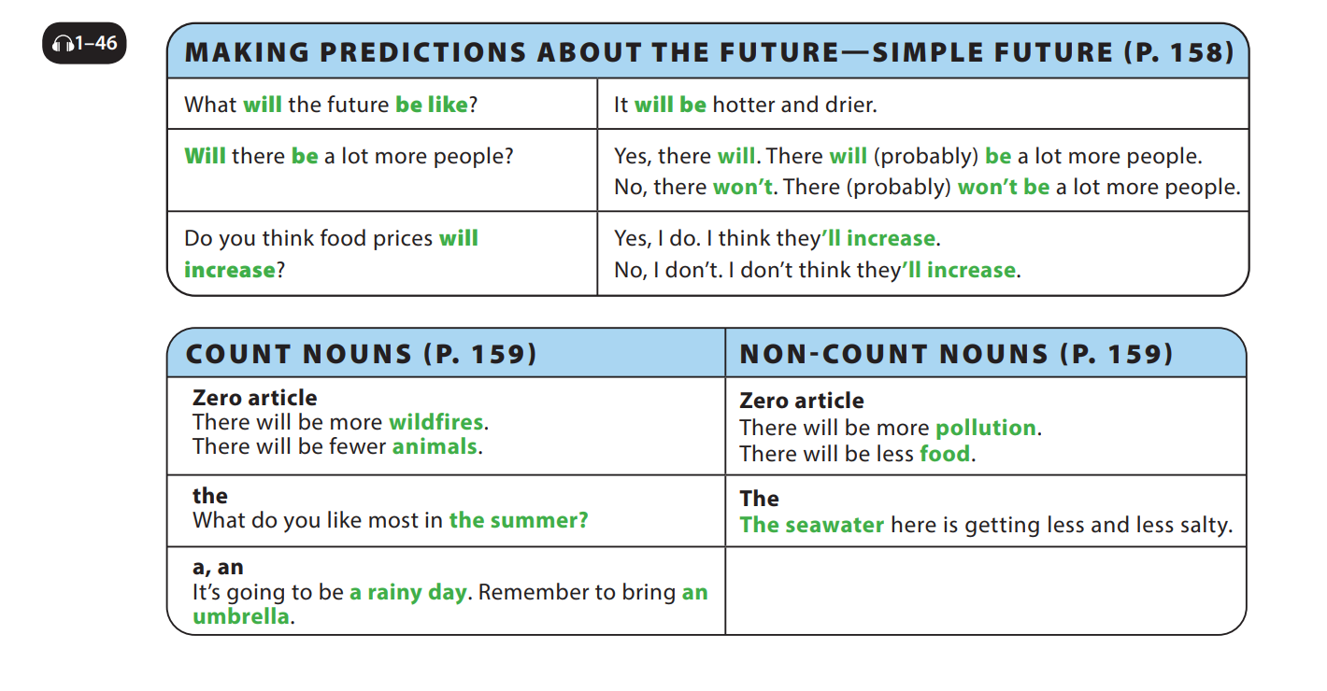

UNIT 6
WHAT WILL EARTH BE LIKE IN THE FUTURE?
LANGUAGE FOCUS
Notes:
Point out that will is repeated in the answer.
Tell students we use will to talk about the future and when we want to show intention for future acts. (For example, I will try to be earlier next time.)

Slide 4
UNIT 6
WHAT WILL EARTH BE LIKE IN THE FUTURE?
LANGUAGE FOCUS
Notes:
Tell them that they will study how to use articles with quantifiers, count nouns, and non-count nouns.
Point out that we use no article (zero article)
for quantifiers (more, few, and less).
We use the definite article (the) for any count
nouns which refer to something or someone
unique.
We use definite article (the) for any non-count
nouns which are known by the reader.
We must always use an indefinite article (a or
an) for a singular count noun.

Slide 5
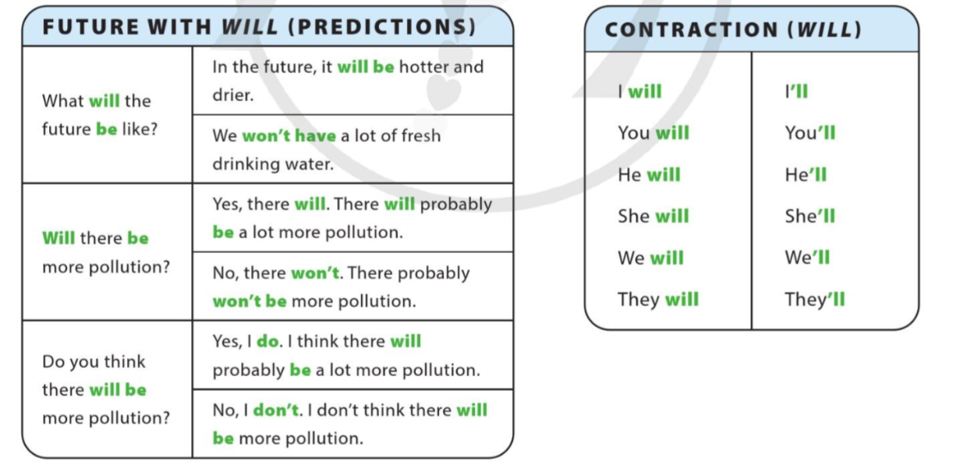
UNIT 6
WHAT WILL EARTH BE LIKE IN THE FUTURE?
LANGUAGE FOCUS
Notes:
Emphasize that Future with will is used to give predictions and its forms.

Slide 6
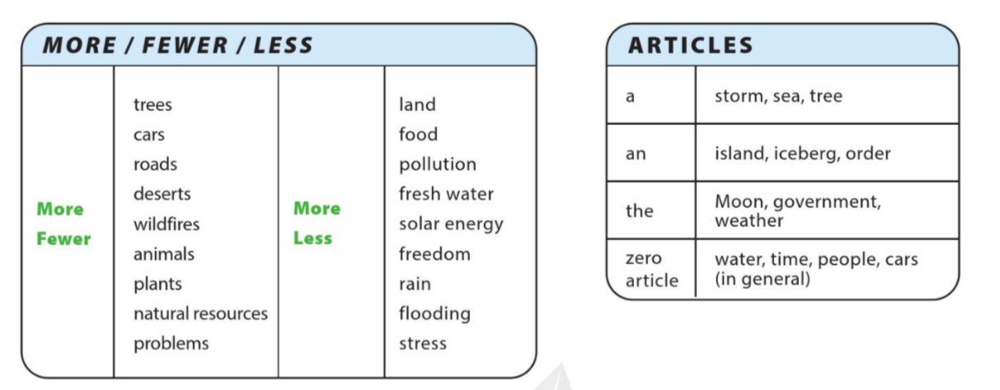
UNIT 6
WHAT WILL EARTH BE LIKE IN THE FUTURE?
LANGUAGE FOCUS
Notes:
More: uses for both plural and uncountable nouns.
Fewer: use for only plural nouns
Less: use for uncountable nouns.

Slide 7
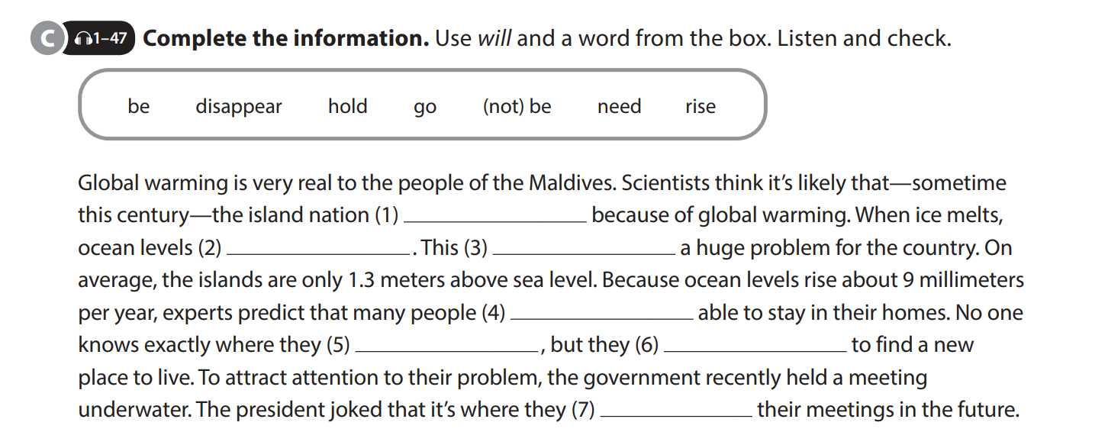
UNIT 6
WHAT WILL EARTH BE LIKE IN THE FUTURE?
LANGUAGE FOCUS
will disappear
will rise
will be
won’t be
will go
will need
will hold

Slide 8
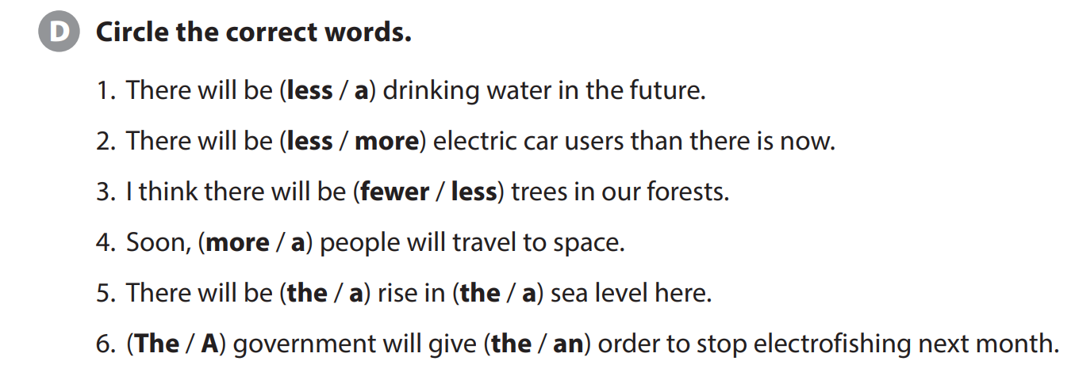
UNIT 6
WHAT WILL EARTH BE LIKE IN THE FUTURE?
LANGUAGE FOCUS

Slide 9
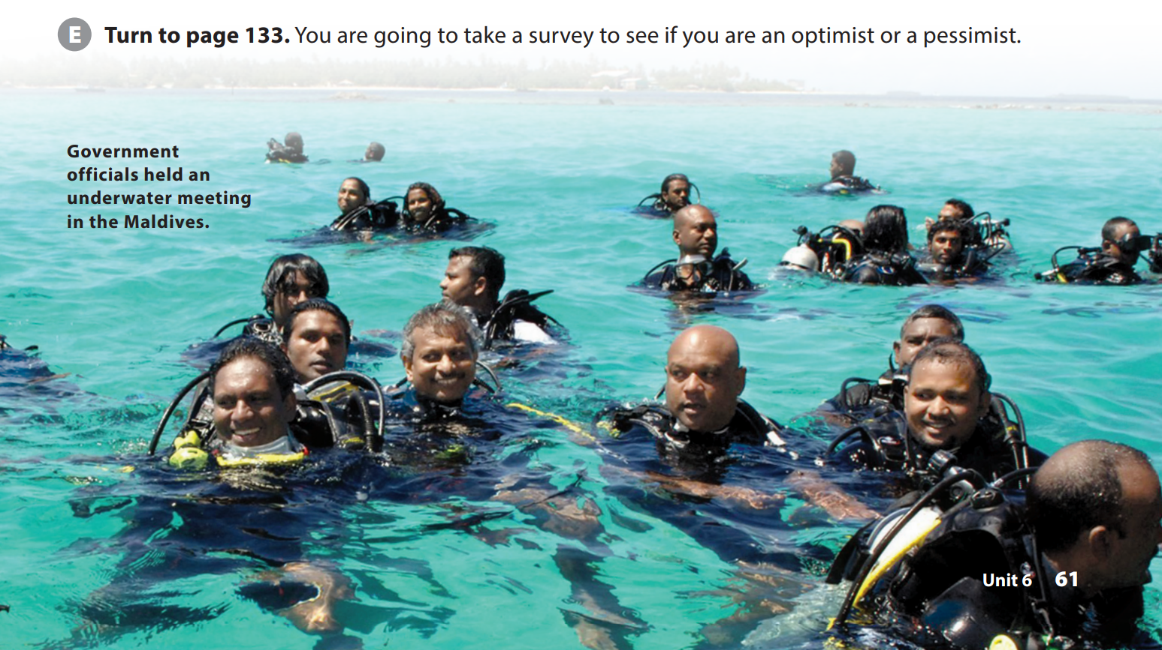
UNIT 6
WHAT WILL EARTH BE LIKE IN THE FUTURE?
LANGUAGE FOCUS
Notes:
Tell students they are going to take a survey to see if they are an optimist (someone who is usually positive and looks on the good side of things) or a pessimist (someone who is usually
negative and expects things to turn out poorly). Have students turn to page 133 and do the survey

Slide 10
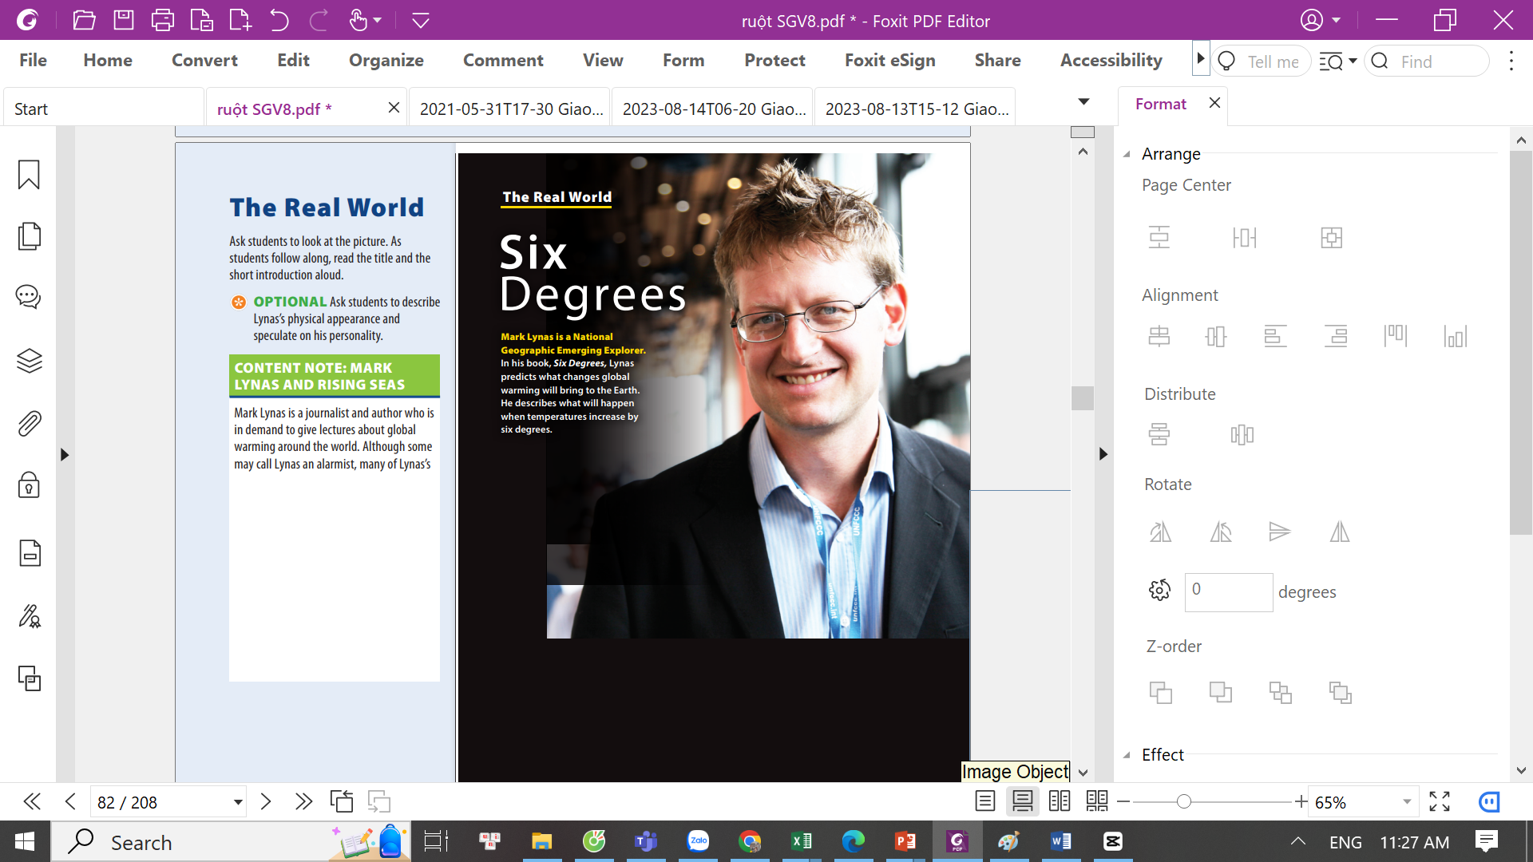
UNIT 6
WHAT WILL EARTH BE LIKE IN THE FUTURE?
THE REAL WORLD
Notes:
Ask students to look at the picture. As students follow along, read the title and the short introduction aloud.
OPTIONAL Ask students to describe Lynas’s physical appearance and speculate on his personality

Slide 11
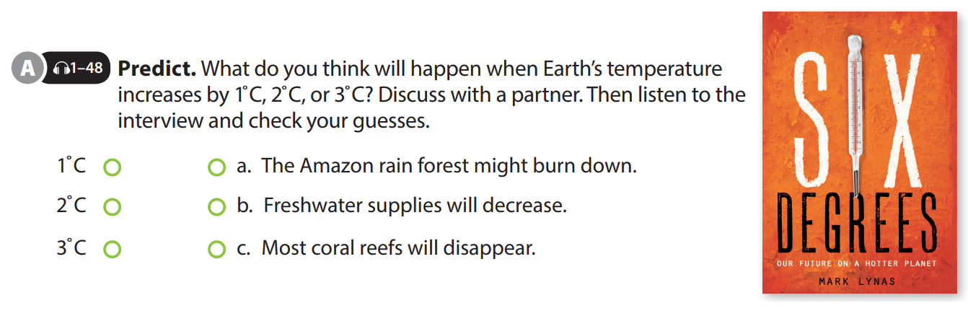
UNIT 6
WHAT WILL EARTH BE LIKE IN THE FUTURE?
THE REAL WORLD
Notes:
Tell students they should get together with a partner and predict what some scientists believe will happen when the Earth’s temperatures rise. Read the sentences aloud as students follow
along. Have students do the task.
Tell students they are going to hear an interview with Lynas and they should check their answers.

Slide 12
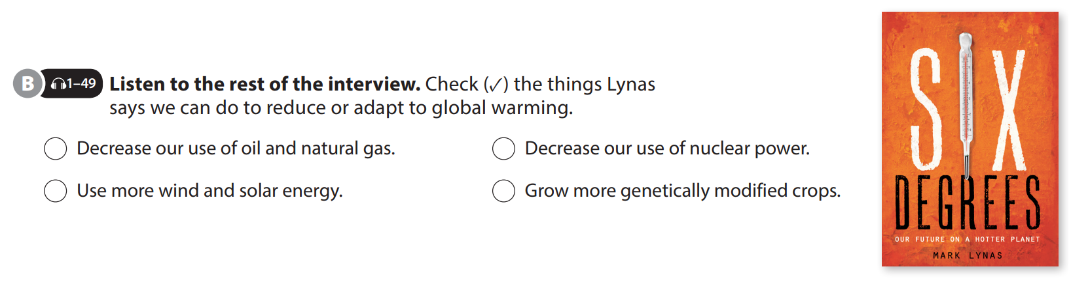
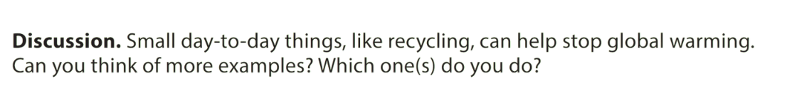
UNIT 6
WHAT WILL EARTH BE LIKE IN THE FUTURE?
THE REAL WORLD
Notes:
Tell students they will listen to the rest of the interview and they should check the things Lynas says we can do to stop or adapt to global warming.
Play the CD. Play it again, if necessary.
Check answers.
CHALLENGE Have students get into pairs and discuss whether they agree with his suggestions, giving reasons for their opinions.
Key: 1, 3, 4
Discussion
As students follow along, read the statement
and questions aloud. Having students personalize the content will make it more
meaningful. Have students get into small
groups and talk about their ideas.

Slide 13


THANK YOU!

