Slide 1
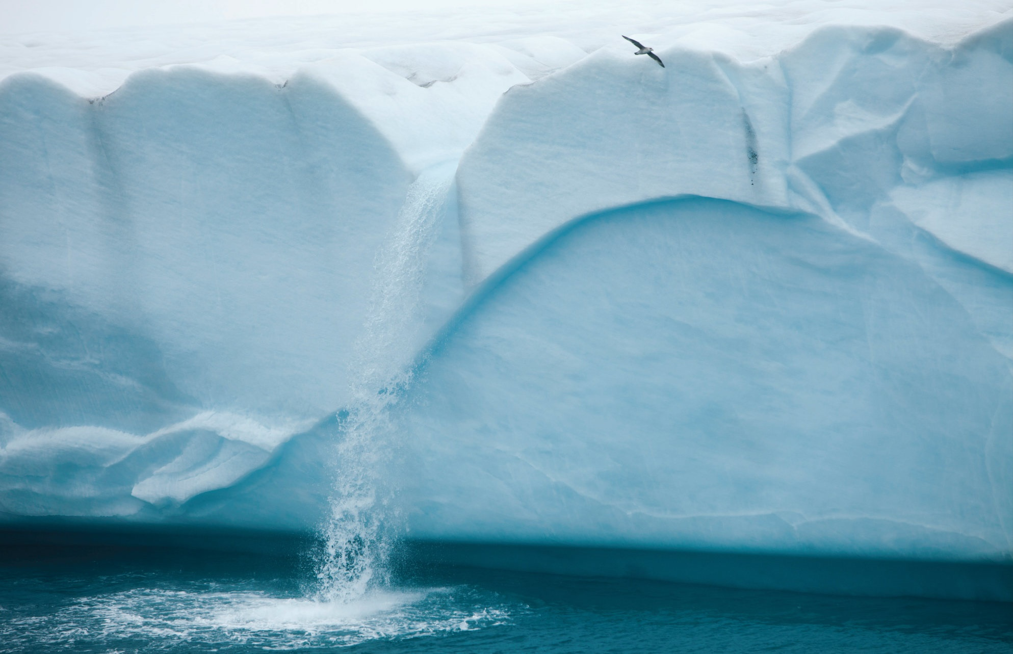
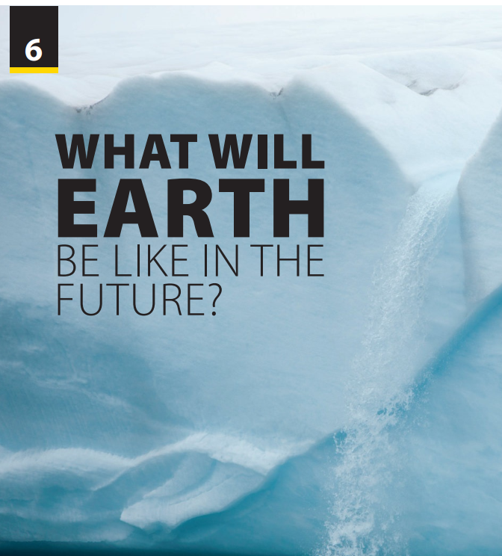
Pronunciation
and
Communication

Slide 2



Betty Botter bought some butter
But she said the butter’s bitter
If I put it in my batter, it will make my batter bitter
But a bit of better butter will make my batter better
So ‘twas better Betty Botter bought a bit of better butter
Notes:
Rouse the atmosphere.
Let students practice with this tongue twister
Betty Botter bought some butter
But she said the butter’s bitter
If I put it in my batter, it will make my batter bitter
But a bit of better butter will make my batter better
So ‘twas better Betty Botter bought a bit of better butter
T models once time, then let them practice with increasing speed

Slide 3
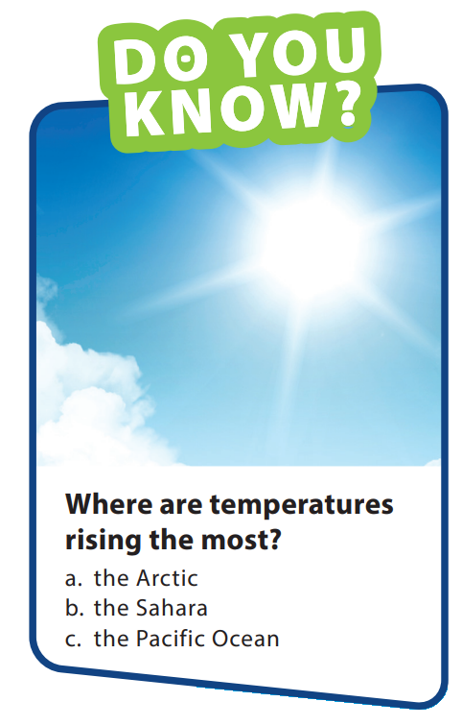
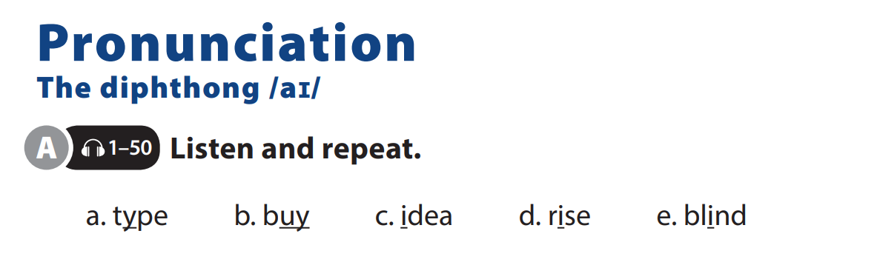

UNIT 6
WHAT WILL EARTH BE LIKE IN THE FUTURE
PRONUNCIATION
Notes:
Tell students they will practice their pronunciation of the diphthong /aɪ/.
OPTIONAL: Let student watch this video https://www.youtube.com/watch?v=rbQtAWNFy2I
Tell students they should follow along in their books and notice how the diphthong /aɪ/ is pronounced in each word.
Play the CD. Play the CD again, stopping
so students can repeat. Play the CD a
third time, if necessary

Slide 4
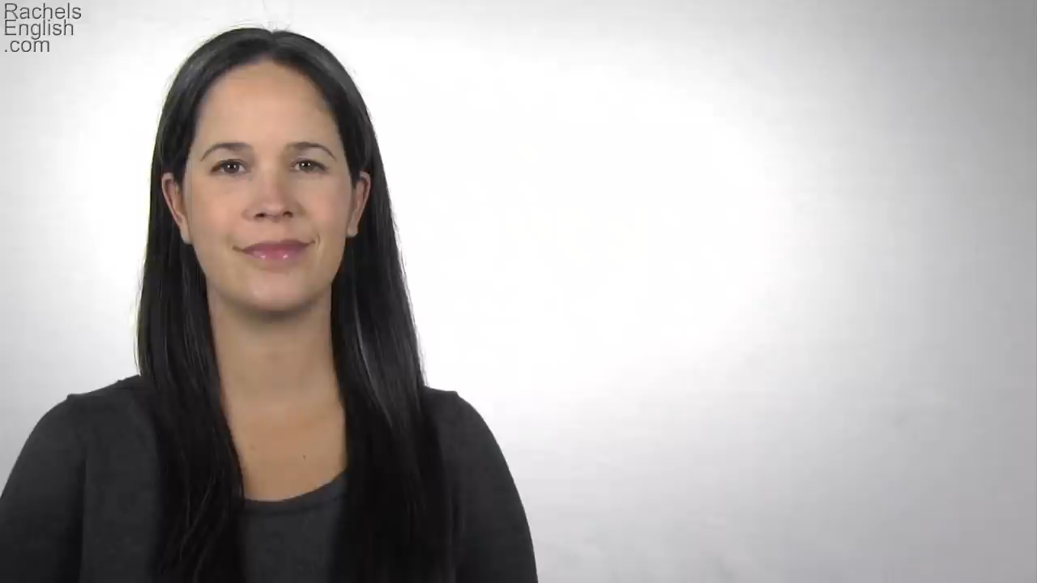
UNIT 6
WHAT WILL EARTH BE LIKE IN THE FUTURE
PRONUNCIATION
Notes:
Let student watch this video https://www.youtube.com/watch?v=rbQtAWNFy2I
Tell students they should follow along in their books and notice how the diphthong /aɪ/ is pronounced in each word.

Slide 5
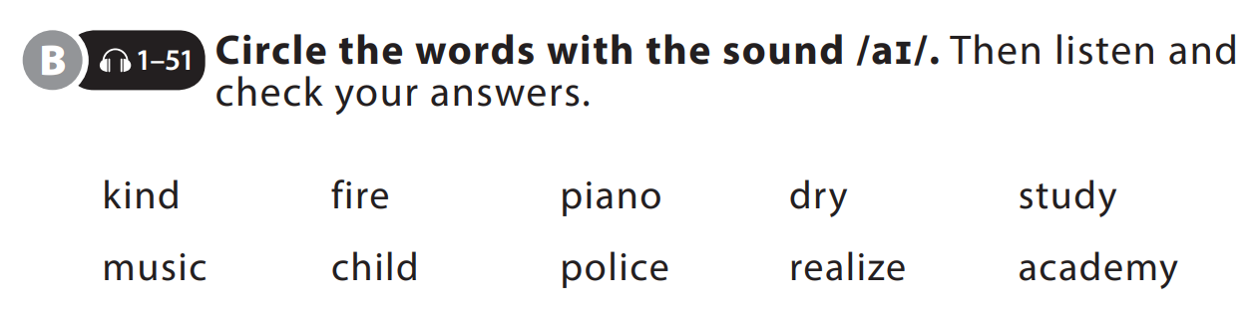
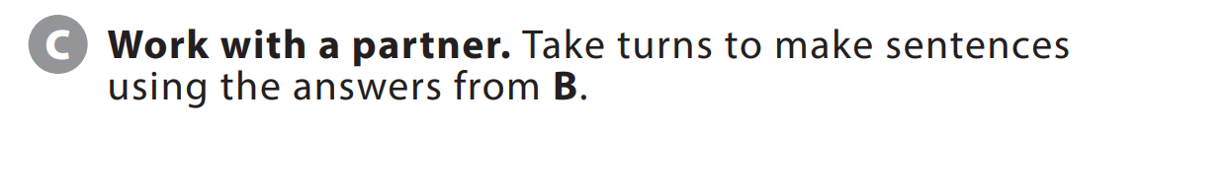
UNIT 6
WHAT WILL EARTH BE LIKE IN THE FUTURE
PRONUNCIATION

Slide 6
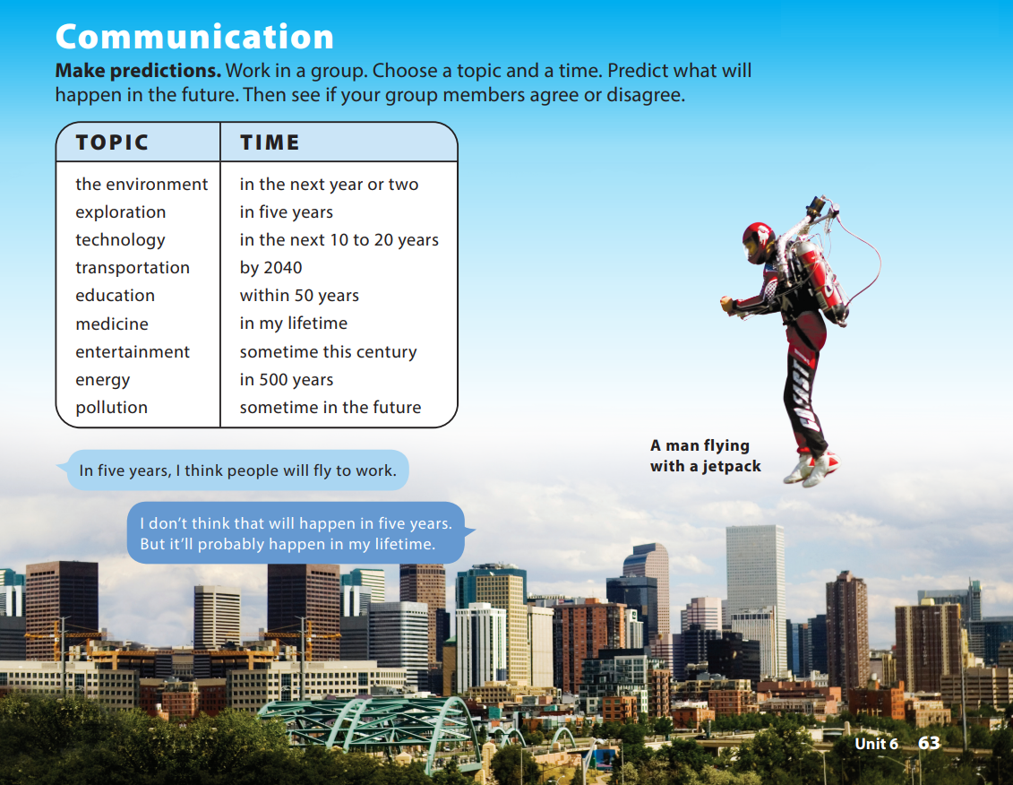
UNIT 6
WHAT WILL EARTH BE LIKE IN THE FUTURE
COMMUNICATION
Notes:
Tell students they are going to get into groups and make predictions about the future.
Tell students that they should choose a topic
and a time from the lists and make a prediction. As students follow along, read the lists aloud. Tell students that after they make their predictions, they should ask their group members if they agree.
Model the conversation with a student.
Have students do the task. Walk around the classroom, providing assistance (for example,
helping with unknown vocabulary) as necessary.
When groups have finished, have some students share their predictions.

Slide 7


THANK YOU!

