Slide 1
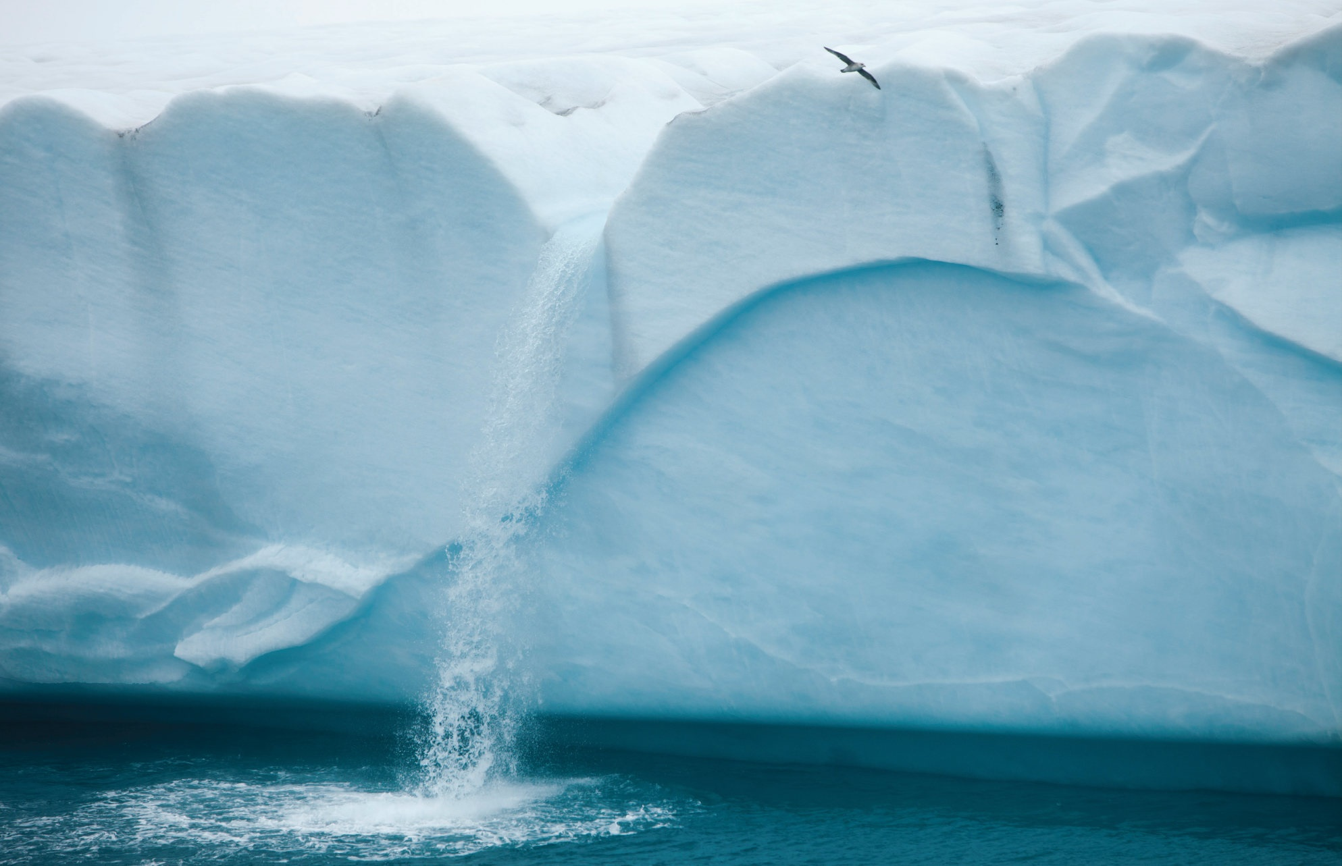
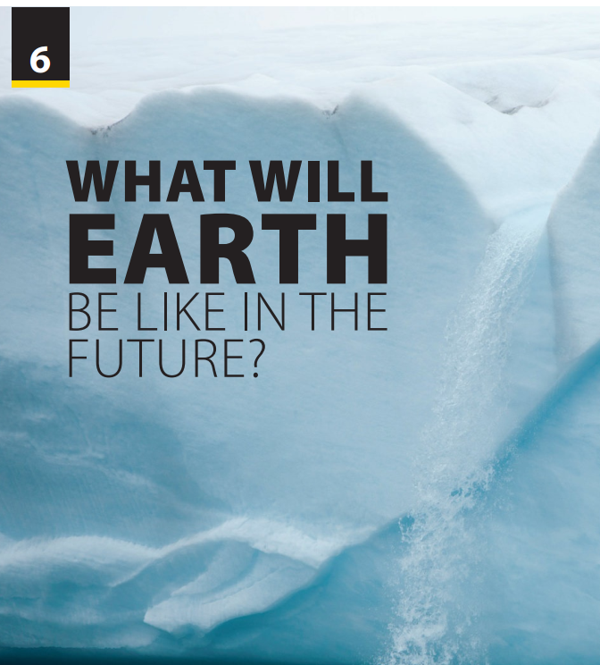
Reading
and
Comprehension

Slide 2
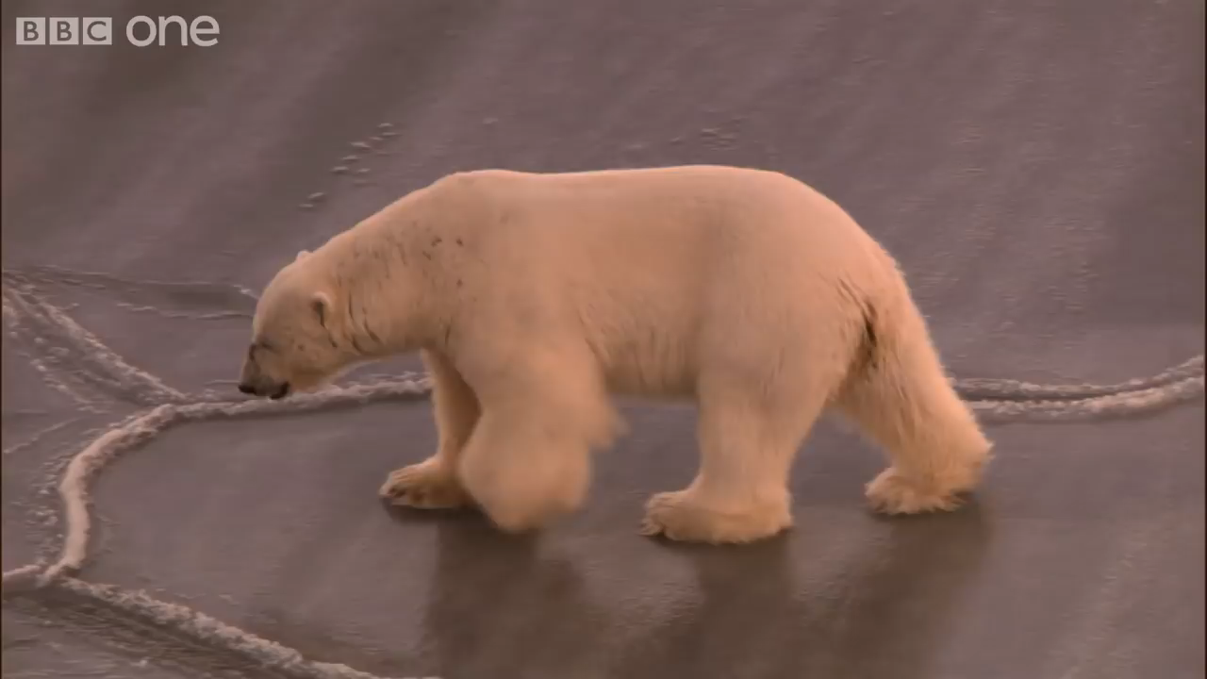
UNIT 6
WHAT WILL EARTH BE LIKE IN THE FUTURE?
READING
Notes:
Let student watch video and discuss how many challenges polar bears are changing when melting ice happens continuously
https://www.youtube.com/watch?v=Kv9v9ALV3yk
Ask students to predict what on thin
ice means.
Check answers.
Key: B

Slide 3
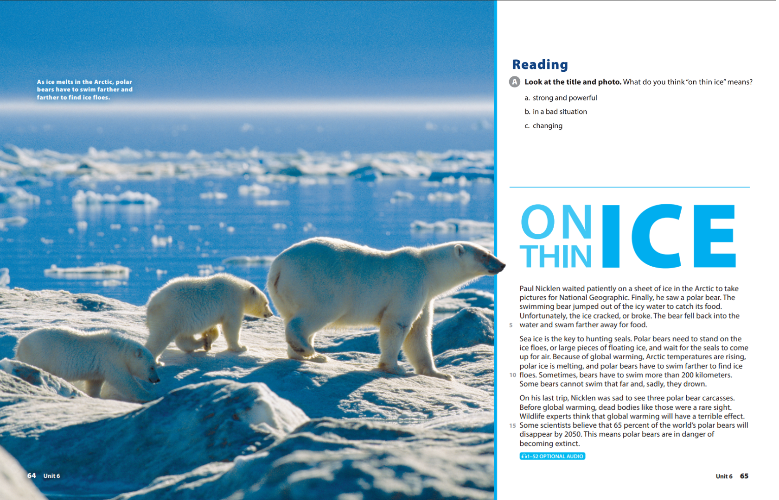
UNIT 6
WHAT WILL EARTH BE LIKE IN THE FUTURE?
READING
Notes:
Provide some information about Paul Nicklen
National Geographic photographer and biologist Paul Nicklen spent his childhood exploring the frozen lands of the Canadian Arctic. His award-winning photographs tell vivid stories of lives supported entirely by polar ice. His mission is to show us how climate change has affected these fragile ecosystems and help the world understand what the scientists are saying about global warming.
Explain some new words
Jump out of: nhảy ra khỏi
Crack: nứt
Fall back into ..: rơi xuống
Ice floe: tảng băng nổi
Carcass/ carcase: xác
Be in danger of becoming extinct: có nguy cơ tuyệt chủng

Slide 4
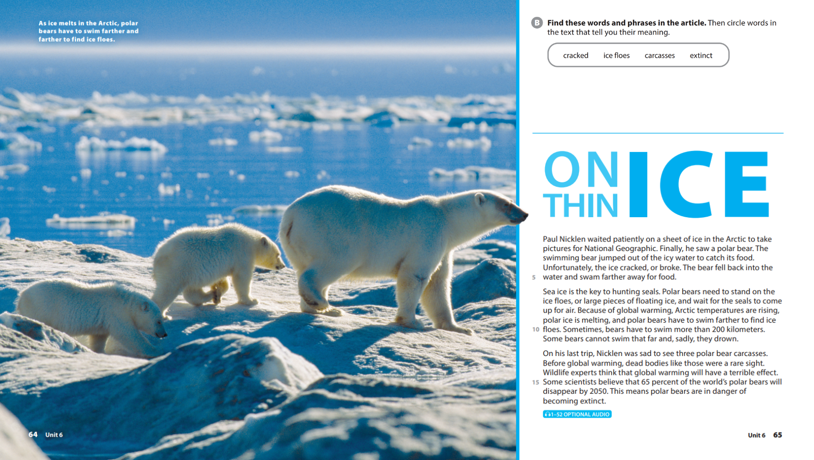
UNIT 6
WHAT WILL EARTH BE LIKE IN THE FUTURE?
READING

Slide 5
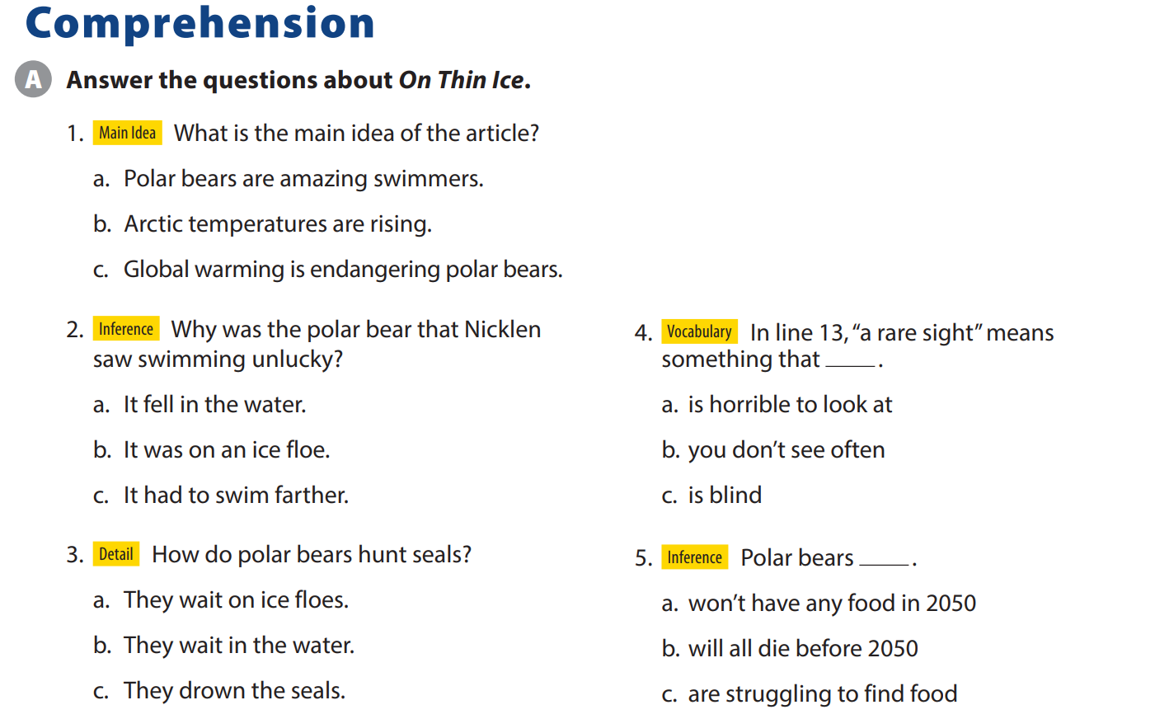
UNIT 6
WHAT WILL EARTH BE LIKE IN THE FUTURE?
COMPREHENSION

Slide 6
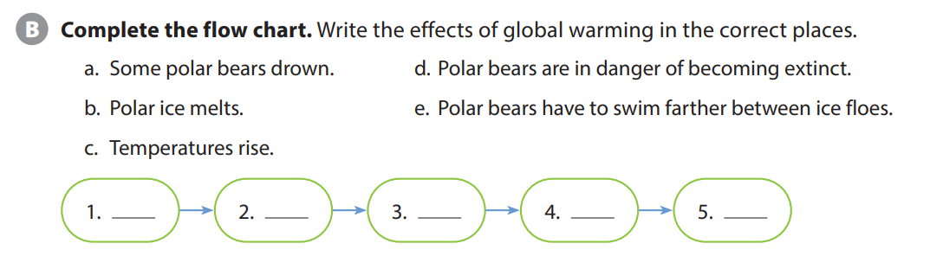
UNIT 6
WHAT WILL EARTH BE LIKE IN THE FUTURE?
COMPREHENSION
C
B
E
A
D
Notes:
Tell students a flow chart shows the order of a group of events as they occur, with the first thing numbered one and the last thing having the largest number. Explain that they should write the effects of global warming in the correct order in the
chart. If necessary, remind students that an effect is the result of an action.

Slide 7
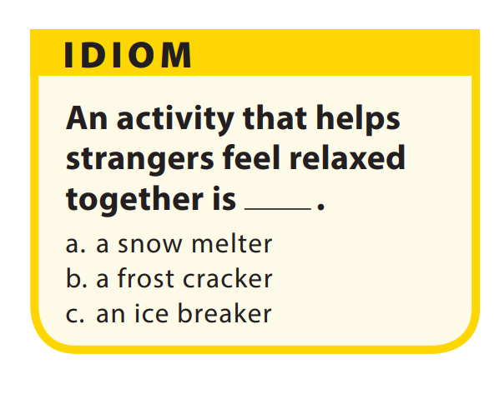
UNIT 6
WHAT WILL EARTH BE LIKE IN THE FUTURE?
COMPREHENSION
Notes:
Activity C
As students follow along, read the
questions aloud. Have students get into pairs and discuss the questions.
Idiom
As students follow along in their books, read the question and answer options aloud. Have them guess the answer before providing it (c). Then explain that we have ice breakers in classes, parties, and at events so people can get to know each other or feel comfortable in a new situation.

Slide 8


THANK YOU!

