Slide 1
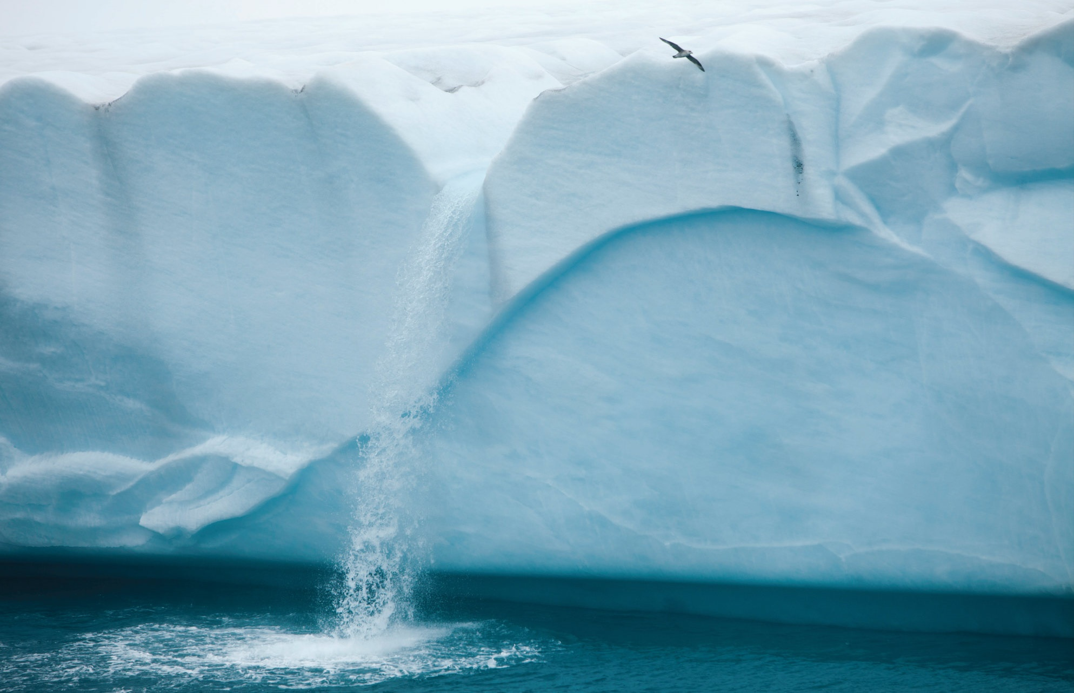
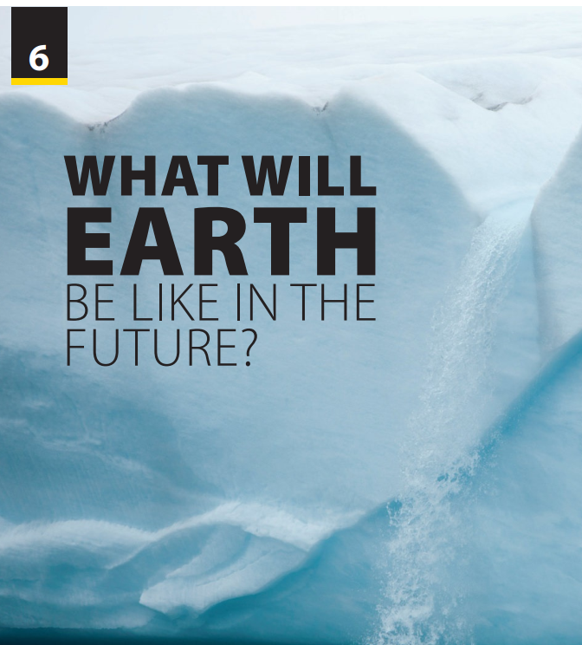
Writing
and
Writing Worksheet

Slide 2

UNIT 6
WHAT WILL EARTH BE LIKE IN THE FUTURE?
WRITING
Notes:
Rouse the atmosphere
https://www.youtube.com/watch?v=QyHp-N6-3DY
Have them stand up, sing, dance and feel the beat.
Introduce new lesson.

Slide 3
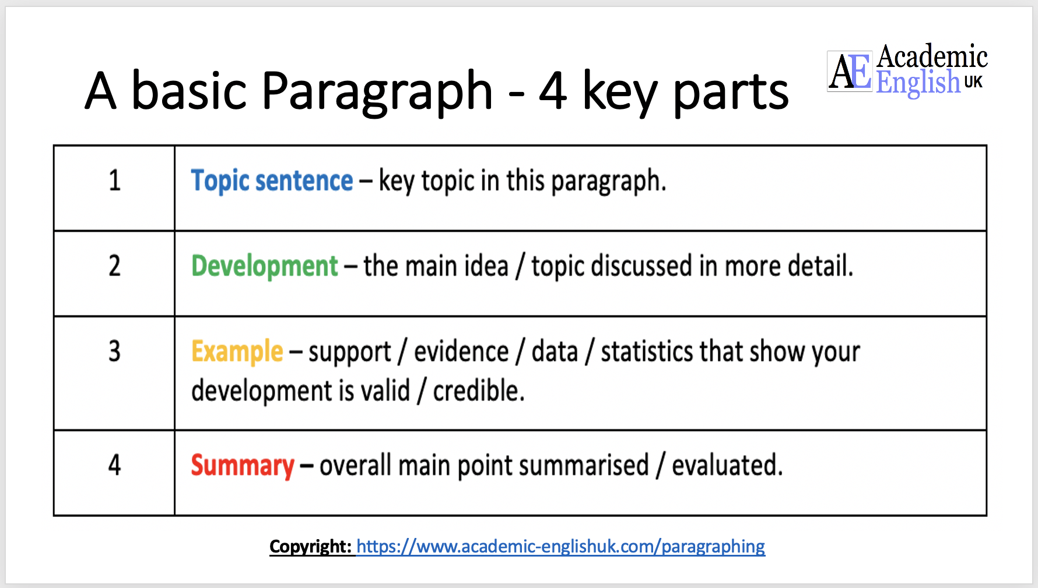
UNIT 6
WHAT WILL EARTH BE LIKE IN THE FUTURE?
WRITING
Write a short paragraph to predict what your town/ city/ country be like.

Slide 4
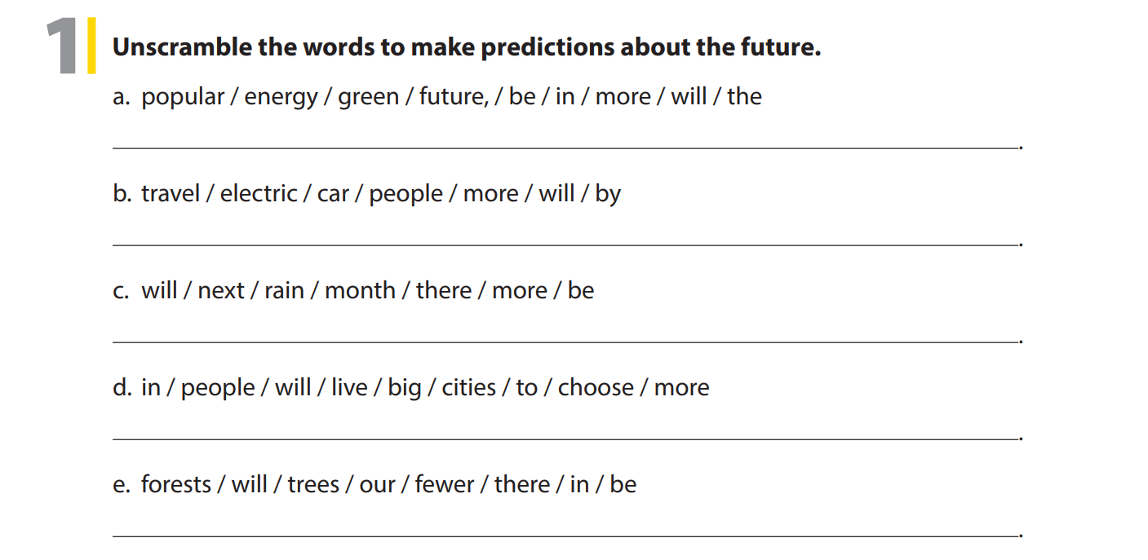
UNIT 6
WHAT WILL EARTH BE LIKE IN THE FUTURE?
WRITING
In the future, green energy will be more popular.
More people will travel by electric car.
There will be more rain next month.
More people will choose to live in big cities.
There will be fewer trees in our forests.

Slide 5
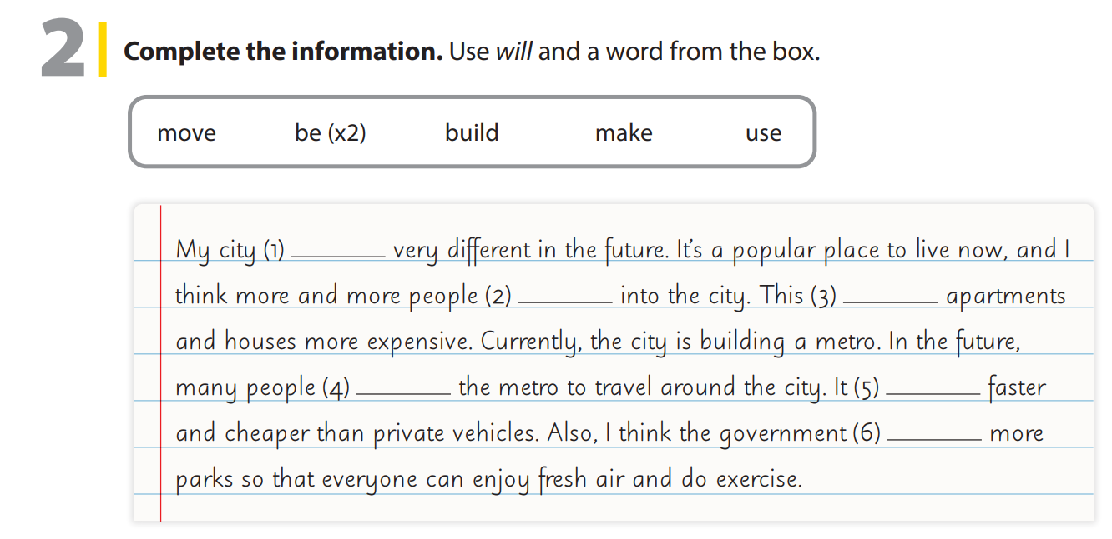
UNIT 6
WHAT WILL EARTH BE LIKE IN THE FUTURE?
WRITING
will be
will move
will make
will use
will be
will build

Slide 6
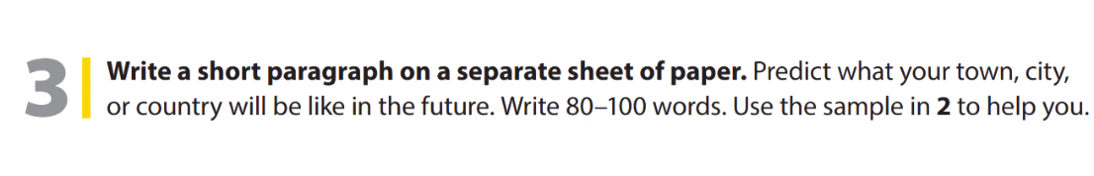

UNIT 6
WHAT WILL EARTH BE LIKE IN THE FUTURE?
WRITING
Notes:
Tell students they are going to write a
short paragraph to predict what their
town, city or country will be like in the future.
Give students about 10 minutes to write their paragraph, and set a number of words they must write (80–100 words).
Have them do the task

Slide 7


THANK YOU!

