Slide 1
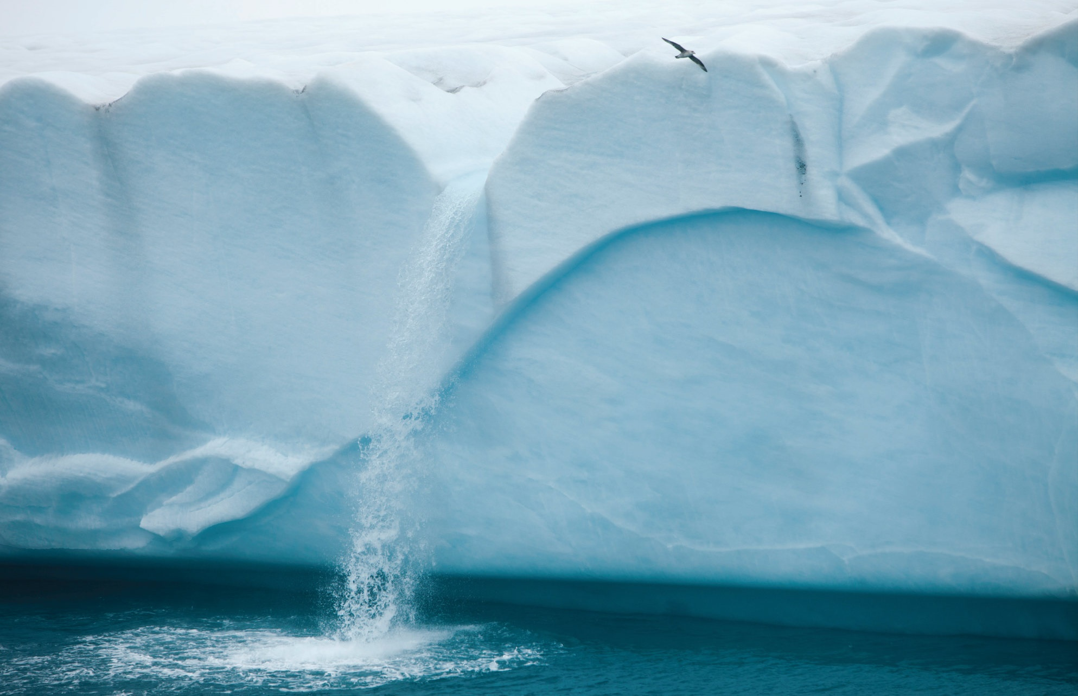
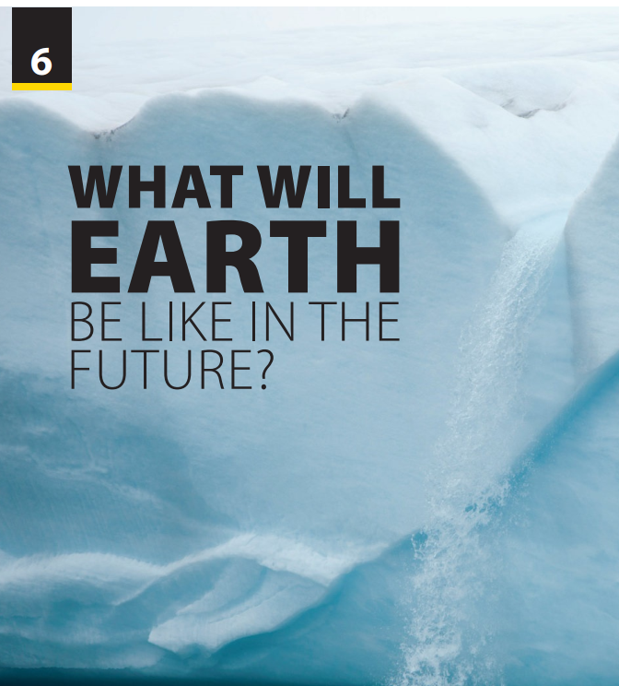
Video
and
Video Worksheet

Slide 2

UNIT 6
WHAT WILL EARTH BE LIKE IN THE FUTURE?
VIDEO
How much you know about Antarctica?
Notes:
Warm-up: How much you know about Antarctica?
https://www.youtube.com/watch?v=2m9-x3YW-JM
Have students watch the video about the general knowledge of Antarctica.
There are both questions and answers there, so T pauses before each answer.
Tell students they are going to watch a video called Polar Ice. As students follow along in their books, read the title and the sentence about the video aloud

Slide 3

UNIT 6
WHAT WILL EARTH BE LIKE IN THE FUTURE?
VIDEO

Slide 4
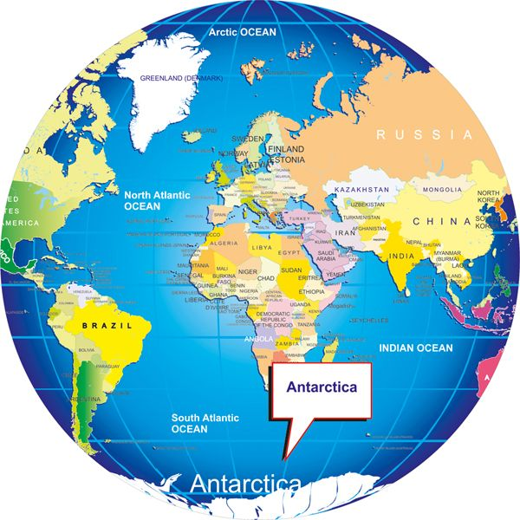
UNIT 6
WHAT WILL EARTH BE LIKE IN THE FUTURE?
VIDEO
Antarctica, meaning opposite to the Arctic, is both the southernmost continent and the coldest, with winter temperatures between -89˚C and 11˚C. Almost the entire continent is covered by a huge sheet of ice that is, on average, nearly 2.5 kilometers
think. This is about 90 percent of the world’s total continental ice sheets

Slide 5
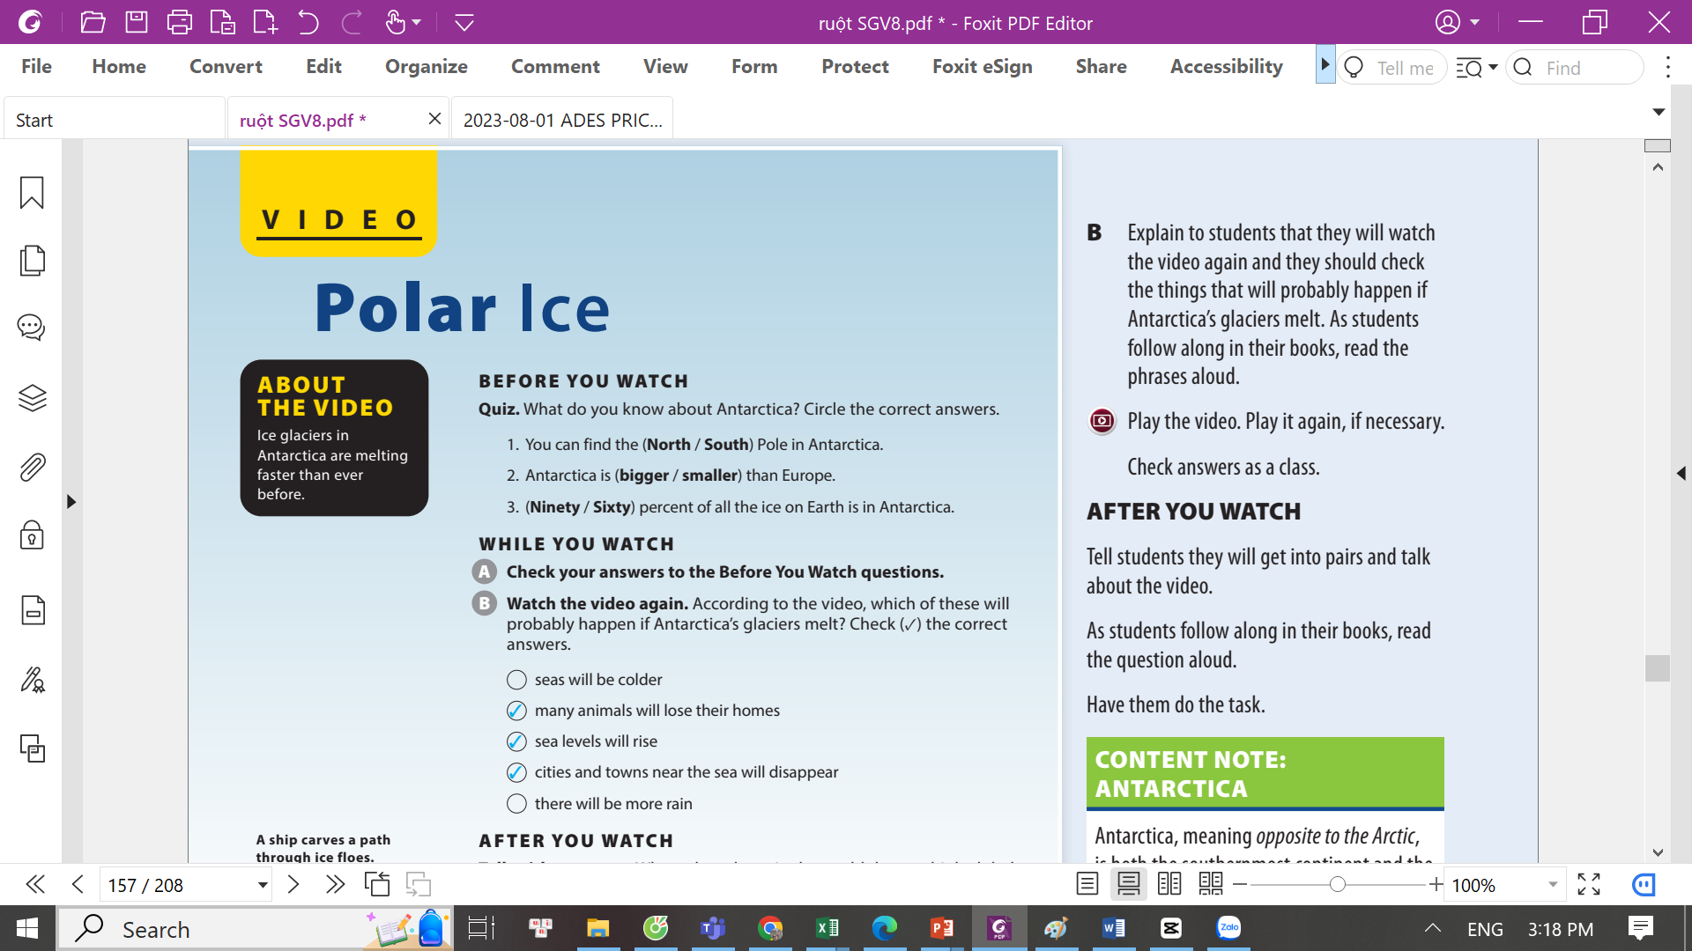
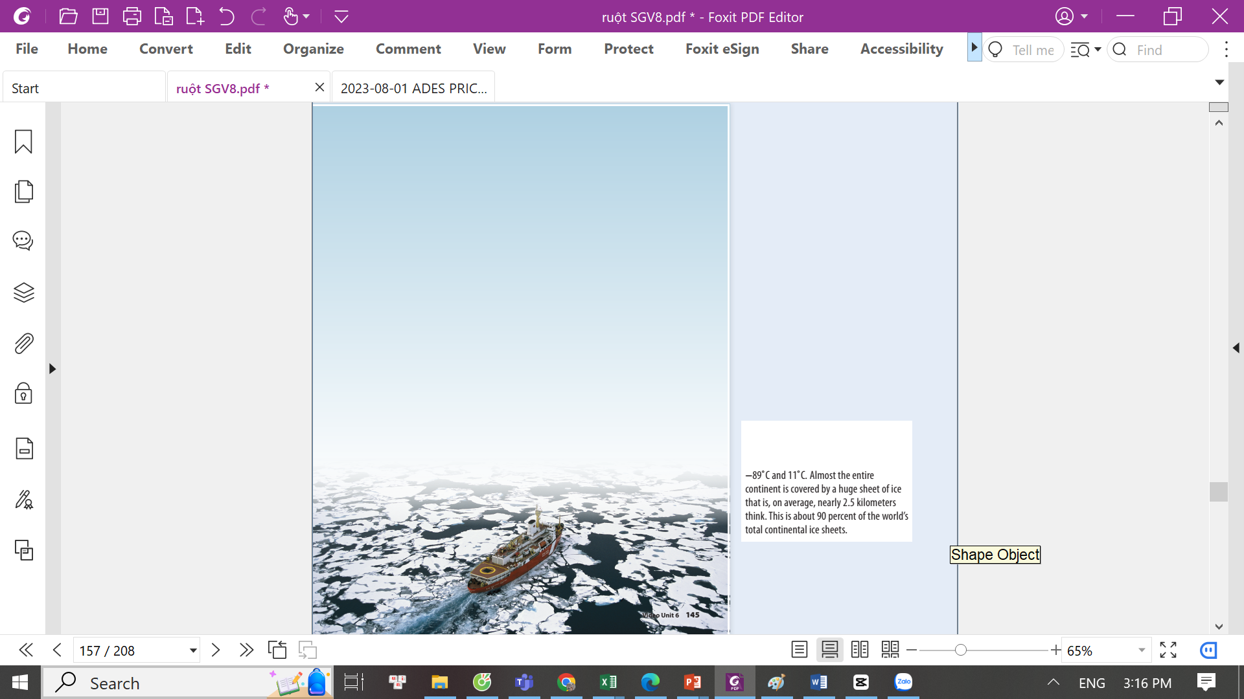
UNIT 6
WHAT WILL EARTH BE LIKE IN THE FUTURE?
VIDEO
Notes:
Tell students they will take a quiz to see how much they know about Antarctica. As
students follow along in their books, read the statements aloud. Have students circle their answers.

Slide 6

UNIT 6
WHAT WILL EARTH BE LIKE IN THE FUTURE?
VIDEO
✓
✓
✓
Notes:
While You Watch
Activity A.
Tell students they will watch the video
and they should check their answers
from BEFORE YOU WATCH.
Play the video. Check the students’
answers in BEFORE YOU WATCH.
Key:
1. South
2. bigger
3. Ninety
T
Activity B.
Explain to students that they will watch
the video again and they should check
the things that will probably happen if
Antarctica’s glaciers melt. As students
follow along in their books, read the
phrases aloud.
Play the video. Play it again, if necessary.
Check answers as a class.
Key:

Slide 7
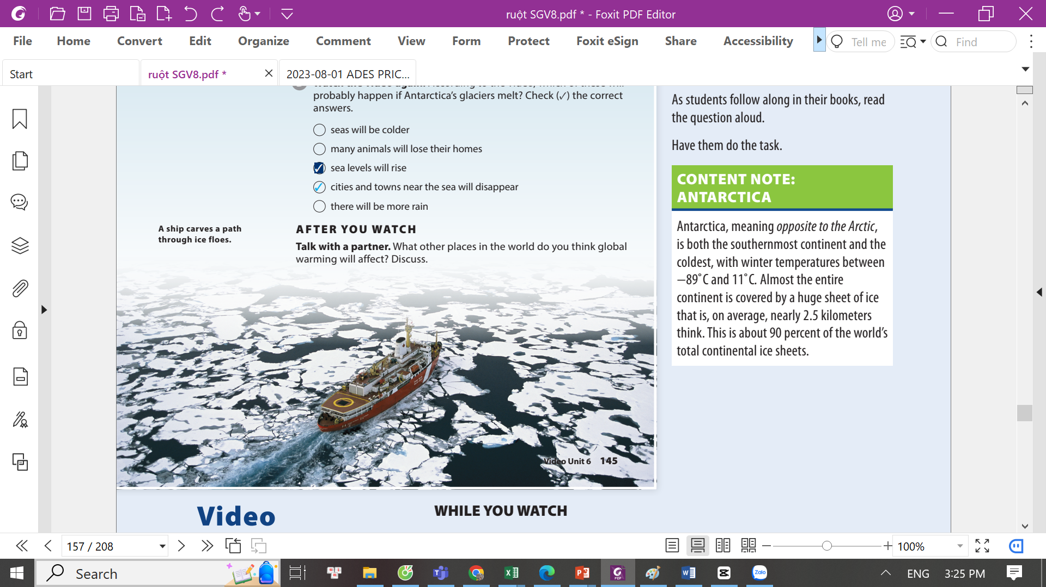
UNIT 6
WHAT WILL EARTH BE LIKE IN THE FUTURE?
VIDEO
Notes:
Tell students they will get into pairs and talk about the video.
As students follow along in their books, read the question aloud.
Have them do the task.

Slide 8


THANK YOU!

