Slide 1
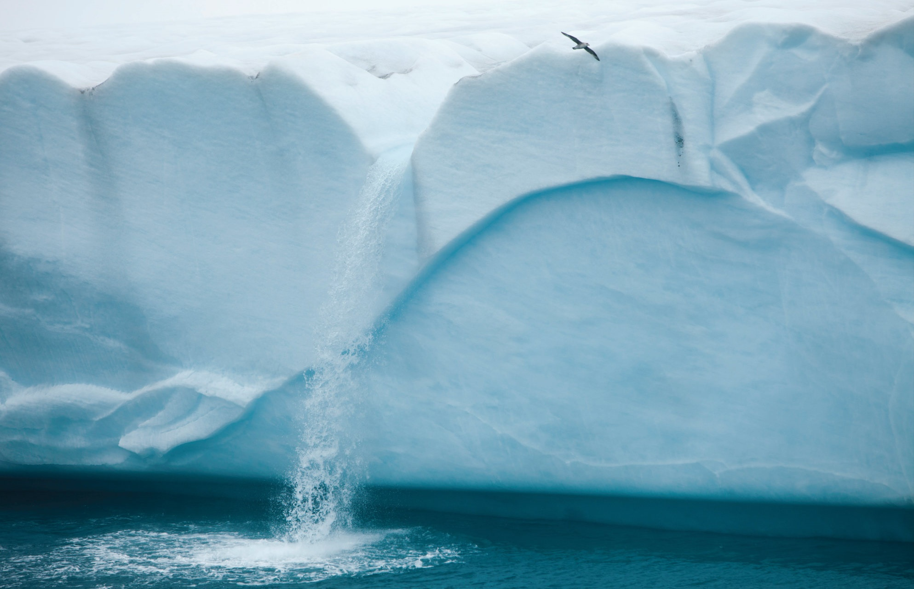
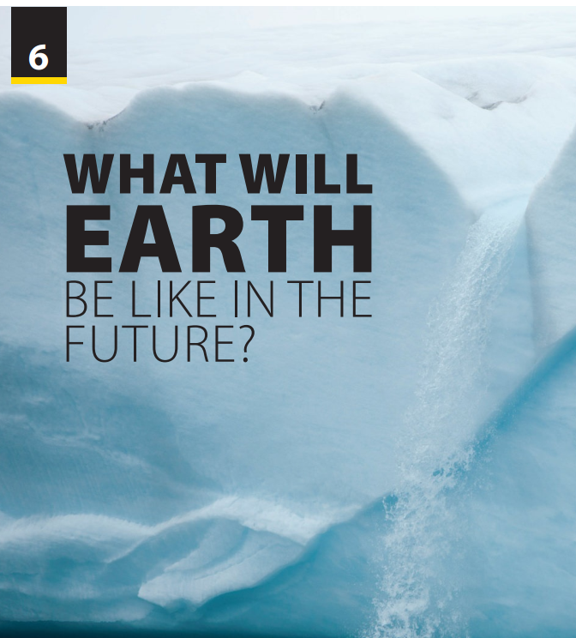
End of
Unit Project

Slide 2

UNIT 6
WHAT WILL EARTH BE LIKE IN THE FUTURE?
END OF UNIT
Notes:
Sing and dance

Slide 3
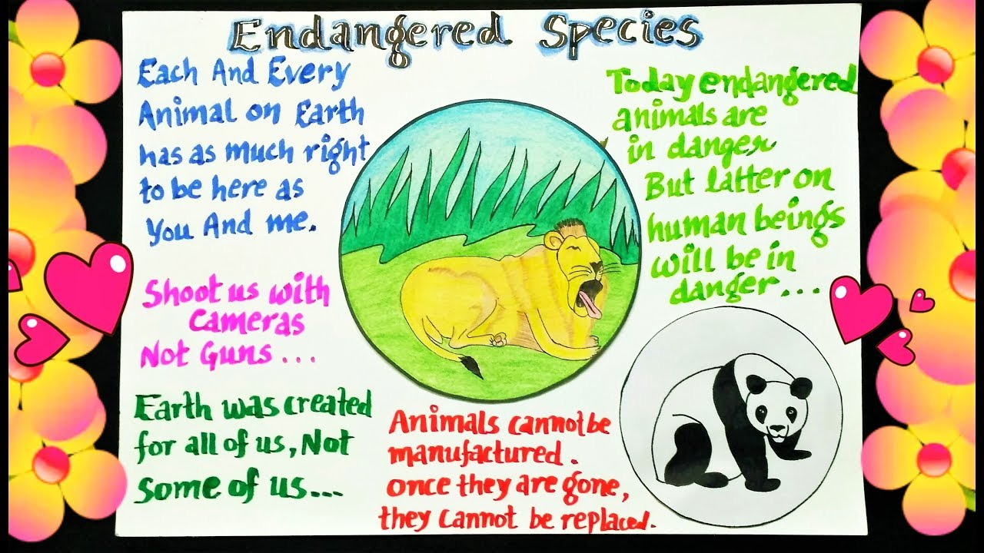
UNIT 6
WHAT WILL EARTH BE LIKE IN THE FUTURE?
END OF UNIT
The poster should have:
Where the animal lives and information about the animal’s lifestyle
What is causing them to disappear
A photo of the animal

Slide 4

MAKE YOUR POSTER
Walruses live in the Arctic. Because of global warming, Arctic temperatures are rising. Polar ice is also melting. Walruses need ice. They rest on the ice. Female walruses have their babies, called pups, on ice floes. Ice is very important for the pups because they can’t swim well.
When their mothers hunt for food, walrus pups wait on the ice.
Arctic ice floes are melting, so in the future, mothers and pups won’t have places to rest. Without Arctic ice, the walrus is in danger of becoming extinct.
Notes:
Have students get into groups, brainstorm ideas, and make their poster.
Tell them their poster should have at least 10 sentences.
Give students the following example if necessary:
Walruses live in the Arctic. Because of global warming, Arctic temperatures are rising. Polar ice is also melting. Walruses need ice. They rest on the ice. Female walruses have their babies, called pups, on ice floes. Ice is very important for the pups because they can’t swim well.
When their mothers hunt for food, walrus pups wait on the ice.
Arctic ice floes are melting, so in the future, mothers and pups won’t have places to rest. Without Arctic ice, the walrus is in danger of becoming extinct.
Have students do the task

Slide 5

Notes:
Have students put their posters up and then walk around the room, reading them.
When students have finished, have them locate where each animal lives on a world map.
Two important critical thinking skills are
determining causes and effects and
summarizing. As a class, discuss the causes
(from the posters) of the potential

Slide 6


THANK YOU!

