Slide 1



Unit 1:
PEOPLE
_______________________________________________________________________________________________________________________________________________________________________________________________________________________
National Geographic Learning, a Cengage Company. © 2022 Cengage Learning, Inc. ALL RIGHTS RESERVED. This presentation tool is for teaching purpose only. May not be scanned, copied or duplicated, or posted to a publicly accessible website, in whole or in part.

Slide 2



Slide 3
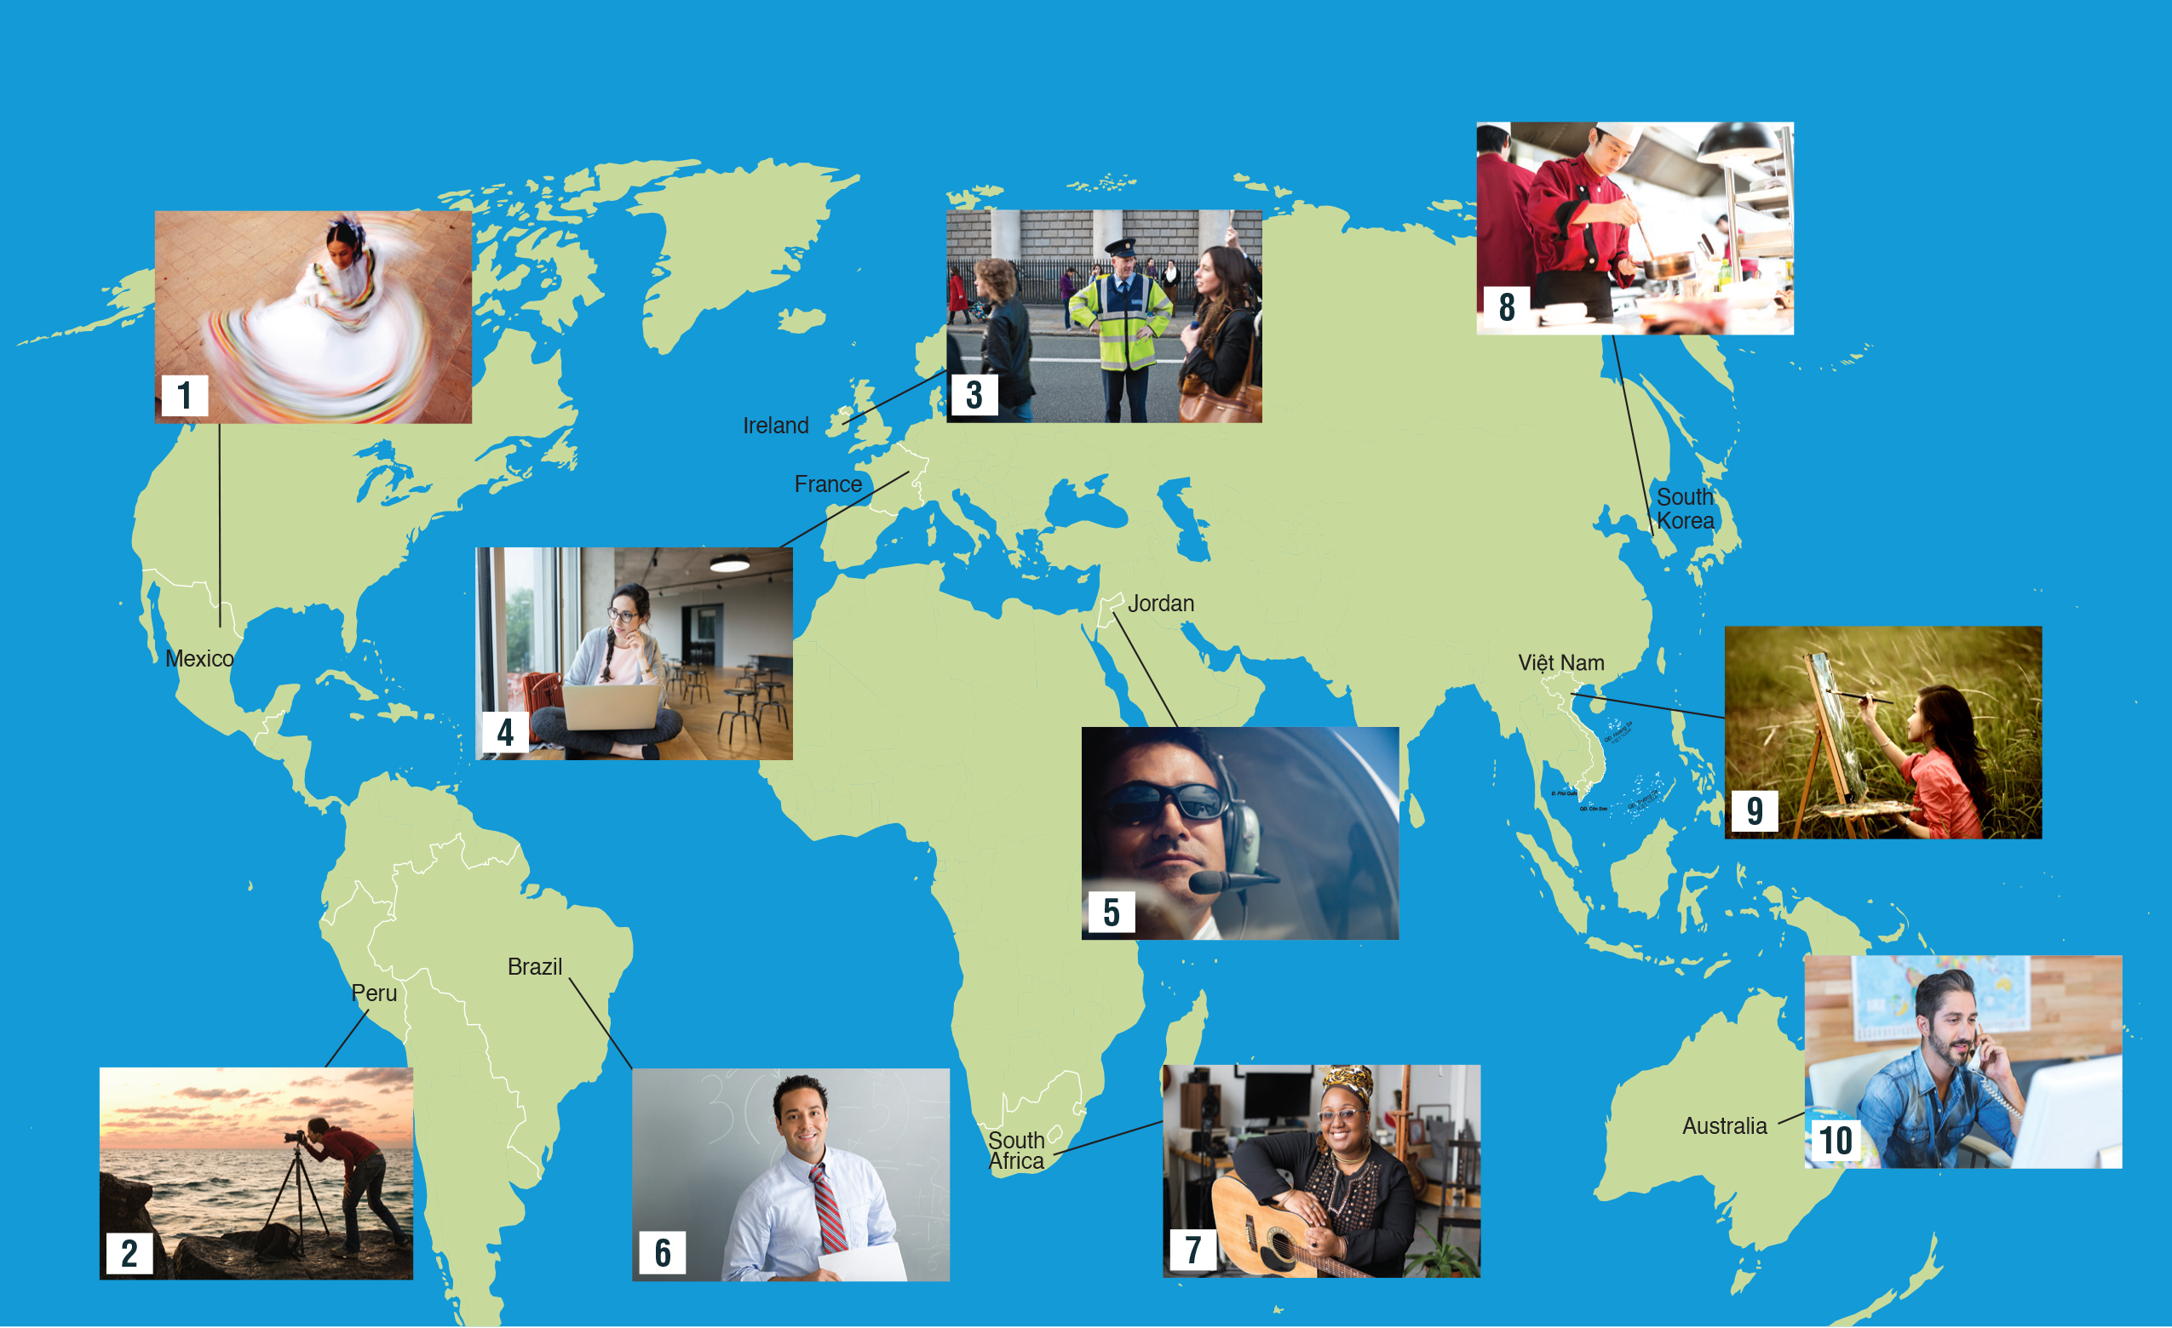

UNIT 1
PEOPLE
VOCABULARY
_______________________________________________________________________________________________________________________________________________________________________________________________________________________
National Geographic Learning, a Cengage Company. © 2022 Cengage Learning, Inc. ALL RIGHTS RESERVED. This presentation tool is for teaching purpose only. May not be scanned, copied or duplicated, or posted to a publicly accessible website, in whole or in part.

Slide 4
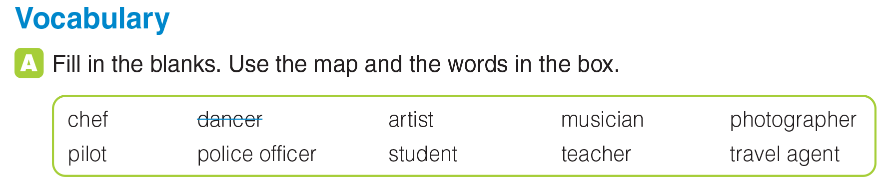
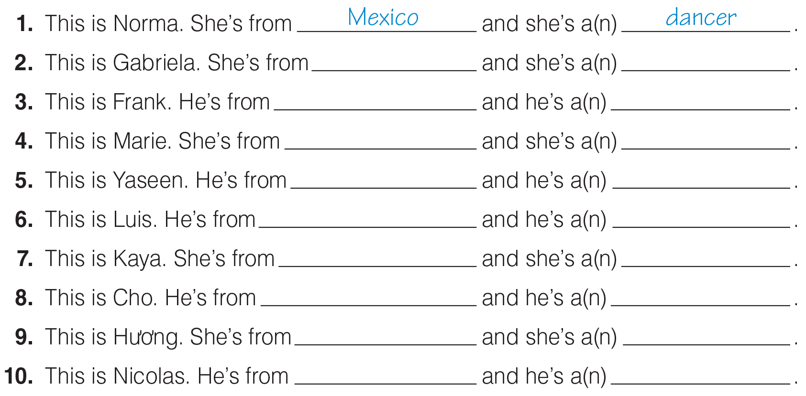
UNIT 1
PEOPLE
VOCABULARY
Peru
photographer
Ireland
police officer
France
student
Jordan
pilot
Brazil
teacher
South Africa
musician
South Korea
chef
Việt Nam
artist
Australia
travel agent
_______________________________________________________________________________________________________________________________________________________________________________________________________________________
National Geographic Learning, a Cengage Company. © 2022 Cengage Learning, Inc. ALL RIGHTS RESERVED. This presentation tool is for teaching purpose only. May not be scanned, copied or duplicated, or posted to a publicly accessible website, in whole or in part.

Slide 5




UNIT 1
PEOPLE
VOCABULARY
_______________________________________________________________________________________________________________________________________________________________________________________________________________________
National Geographic Learning, a Cengage Company. © 2022 Cengage Learning, Inc. ALL RIGHTS RESERVED. This presentation tool is for teaching purpose only. May not be scanned, copied or duplicated, or posted to a publicly accessible website, in whole or in part.

Slide 6
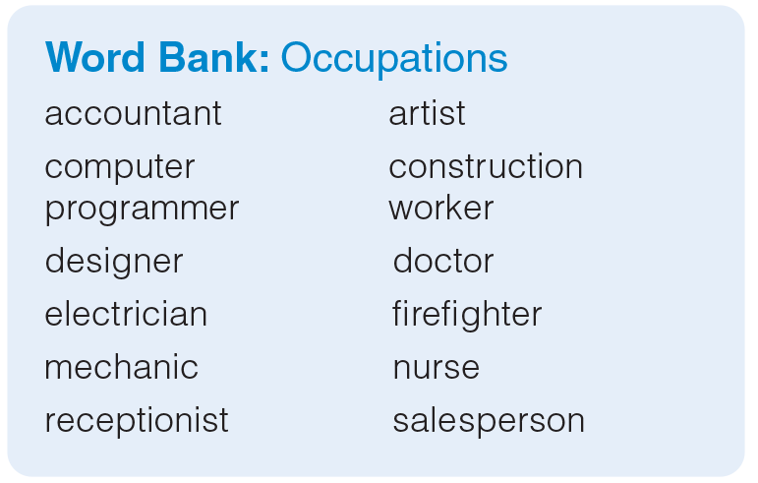
UNIT 1
PEOPLE
VOCABULARY
_______________________________________________________________________________________________________________________________________________________________________________________________________________________
National Geographic Learning, a Cengage Company. © 2022 Cengage Learning, Inc. ALL RIGHTS RESERVED. This presentation tool is for teaching purpose only. May not be scanned, copied or duplicated, or posted to a publicly accessible website, in whole or in part.

Slide 7
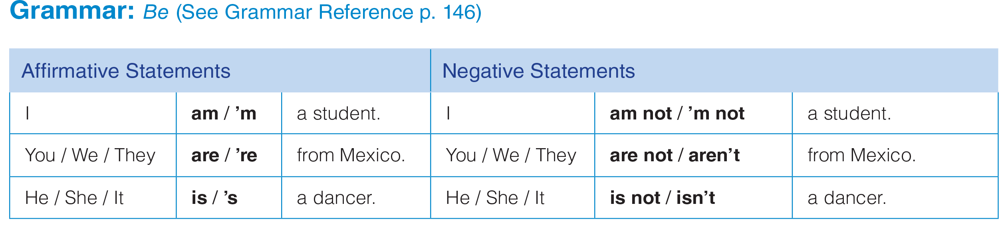

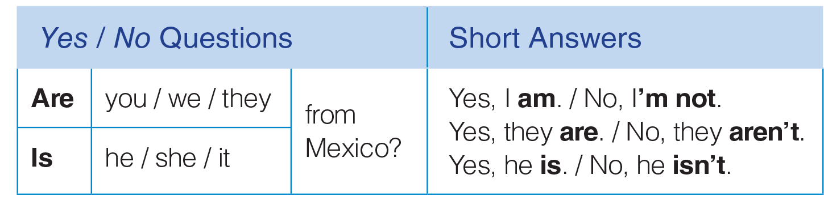
UNIT 1
PEOPLE
GRAMMAR
_______________________________________________________________________________________________________________________________________________________________________________________________________________________
National Geographic Learning, a Cengage Company. © 2022 Cengage Learning, Inc. ALL RIGHTS RESERVED. This presentation tool is for teaching purpose only. May not be scanned, copied or duplicated, or posted to a publicly accessible website, in whole or in part.

Slide 8
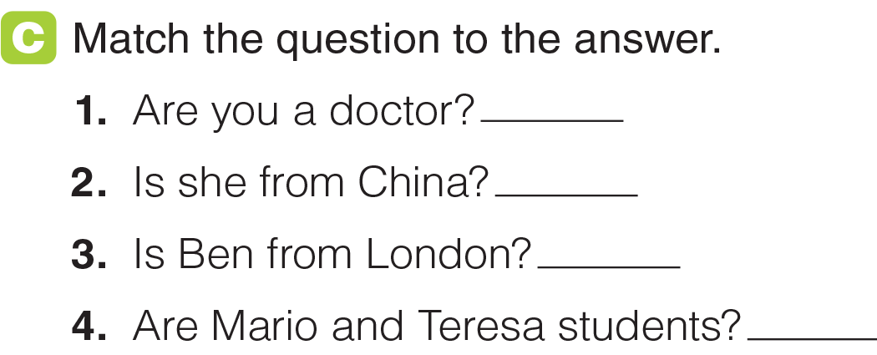

UNIT 1
PEOPLE
GRAMMAR
d
b
a
c
_______________________________________________________________________________________________________________________________________________________________________________________________________________________
National Geographic Learning, a Cengage Company. © 2022 Cengage Learning, Inc. ALL RIGHTS RESERVED. This presentation tool is for teaching purpose only. May not be scanned, copied or duplicated, or posted to a publicly accessible website, in whole or in part.

Slide 9
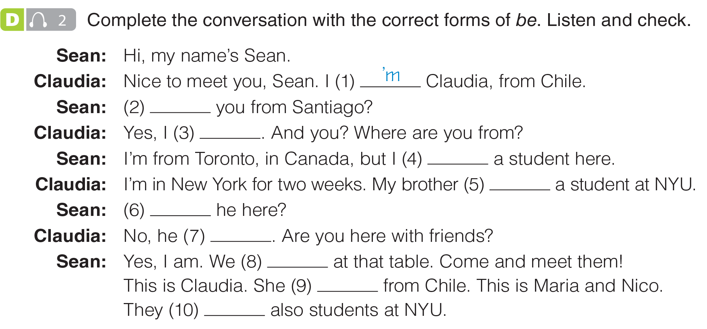

UNIT 1
PEOPLE
GRAMMAR
Are
am
‘m
is
Is
isn’t
‘re
‘s
‘re
_______________________________________________________________________________________________________________________________________________________________________________________________________________________
National Geographic Learning, a Cengage Company. © 2022 Cengage Learning, Inc. ALL RIGHTS RESERVED. This presentation tool is for teaching purpose only. May not be scanned, copied or duplicated, or posted to a publicly accessible website, in whole or in part.

Slide 10
UNIT 1
PEOPLE
GRAMMAR
Are
am
‘m
is
Is
isn’t
‘re
‘s
‘re
_______________________________________________________________________________________________________________________________________________________________________________________________________________________
National Geographic Learning, a Cengage Company. © 2022 Cengage Learning, Inc. ALL RIGHTS RESERVED. This presentation tool is for teaching purpose only. May not be scanned, copied or duplicated, or posted to a publicly accessible website, in whole or in part.

Slide 11

UNIT 1
PEOPLE
GRAMMAR
_______________________________________________________________________________________________________________________________________________________________________________________________________________________
National Geographic Learning, a Cengage Company. © 2022 Cengage Learning, Inc. ALL RIGHTS RESERVED. This presentation tool is for teaching purpose only. May not be scanned, copied or duplicated, or posted to a publicly accessible website, in whole or in part.

Slide 12
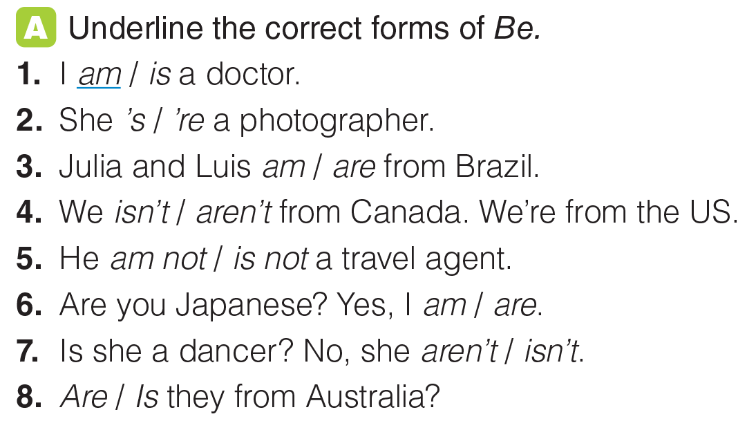
UNIT 1
PEOPLE
GRAMMAR
_______________________________________________________________________________________________________________________________________________________________________________________________________________________
National Geographic Learning, a Cengage Company. © 2022 Cengage Learning, Inc. ALL RIGHTS RESERVED. This presentation tool is for teaching purpose only. May not be scanned, copied or duplicated, or posted to a publicly accessible website, in whole or in part.

Slide 13
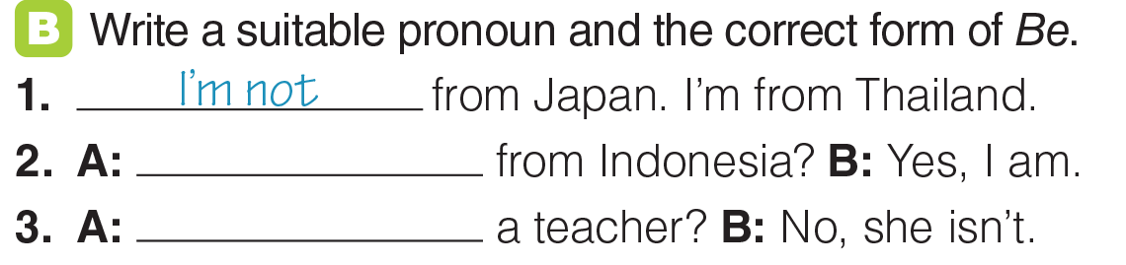
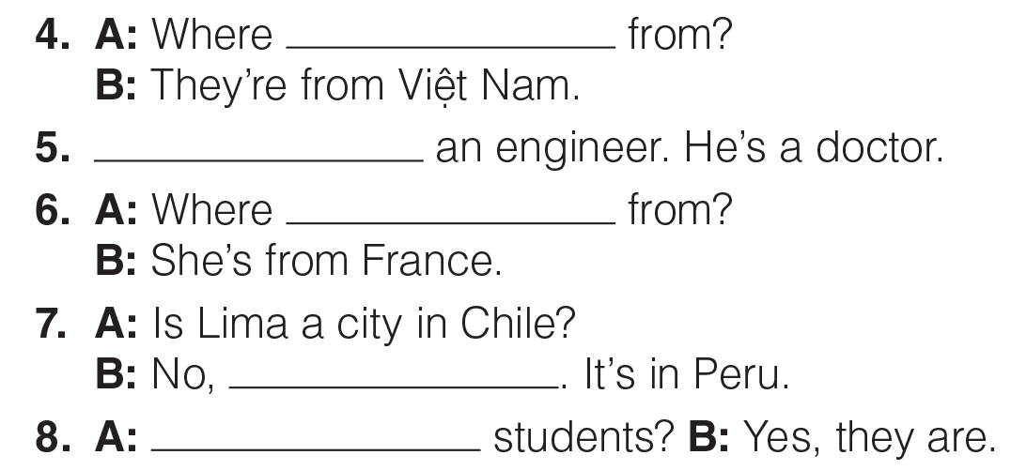
UNIT 1
PEOPLE
GRAMMAR
Are you
Is she
are they
He is not
is she
it isn’t
Are they
_______________________________________________________________________________________________________________________________________________________________________________________________________________________
National Geographic Learning, a Cengage Company. © 2022 Cengage Learning, Inc. ALL RIGHTS RESERVED. This presentation tool is for teaching purpose only. May not be scanned, copied or duplicated, or posted to a publicly accessible website, in whole or in part.

Slide 14
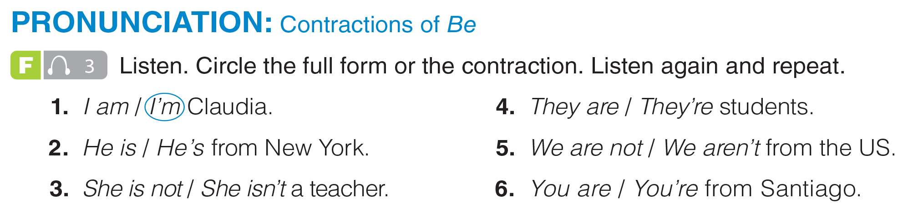
UNIT 1
PEOPLE
PRONUNCIATION
_______________________________________________________________________________________________________________________________________________________________________________________________________________________
National Geographic Learning, a Cengage Company. © 2022 Cengage Learning, Inc. ALL RIGHTS RESERVED. This presentation tool is for teaching purpose only. May not be scanned, copied or duplicated, or posted to a publicly accessible website, in whole or in part.

Slide 15
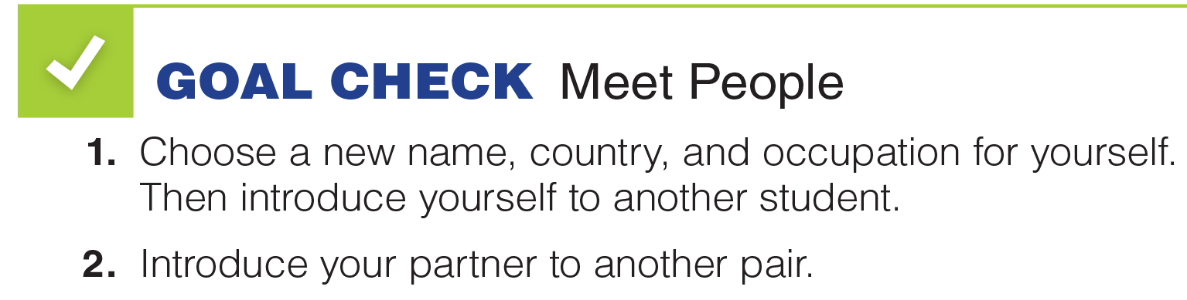

UNIT 1
PEOPLE
GOAL CHECK
_______________________________________________________________________________________________________________________________________________________________________________________________________________________
National Geographic Learning, a Cengage Company. © 2022 Cengage Learning, Inc. ALL RIGHTS RESERVED. This presentation tool is for teaching purpose only. May not be scanned, copied or duplicated, or posted to a publicly accessible website, in whole or in part.

Slide 16
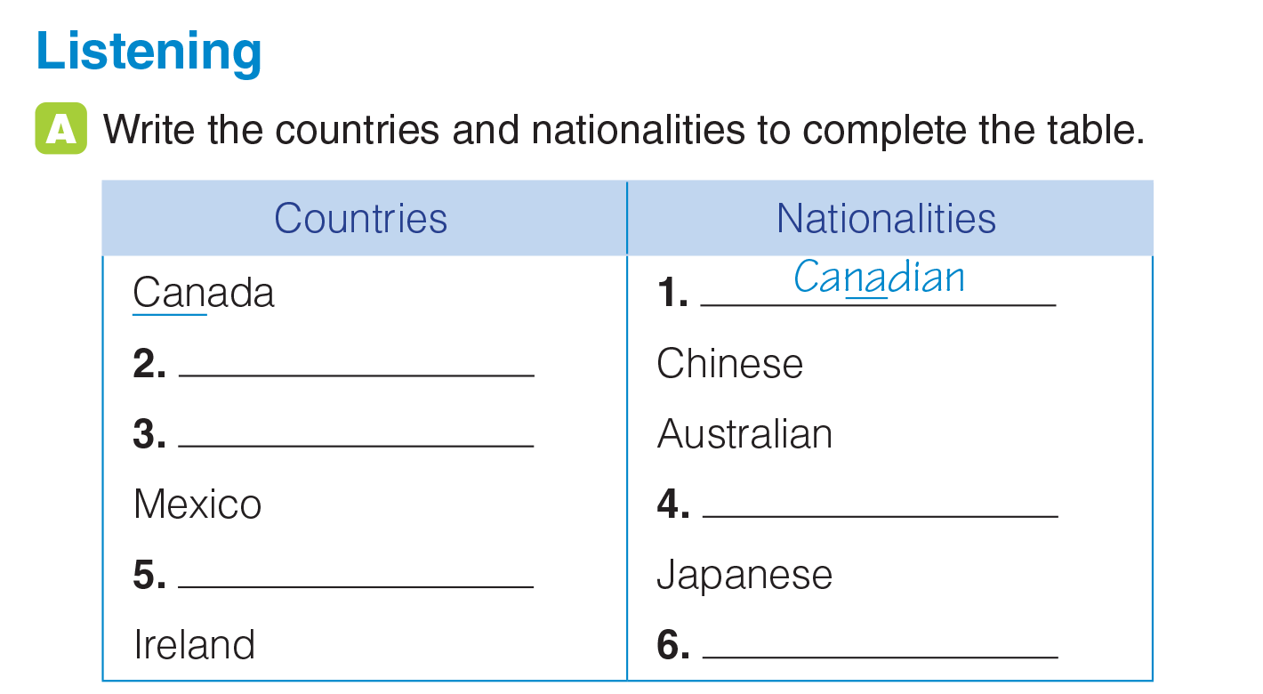
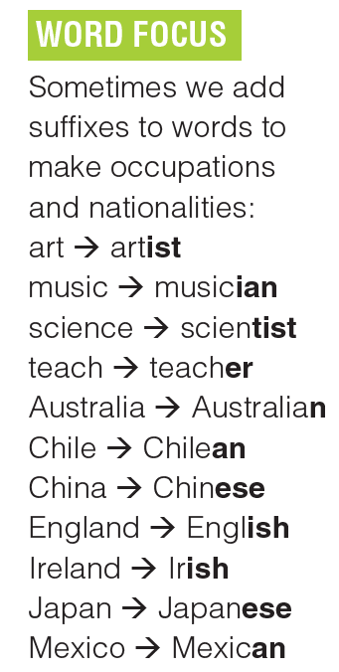
UNIT 1
PEOPLE
LISTENING
China
Australia
Mexican
Japan
Irish
_______________________________________________________________________________________________________________________________________________________________________________________________________________________
National Geographic Learning, a Cengage Company. © 2022 Cengage Learning, Inc. ALL RIGHTS RESERVED. This presentation tool is for teaching purpose only. May not be scanned, copied or duplicated, or posted to a publicly accessible website, in whole or in part.

Slide 17
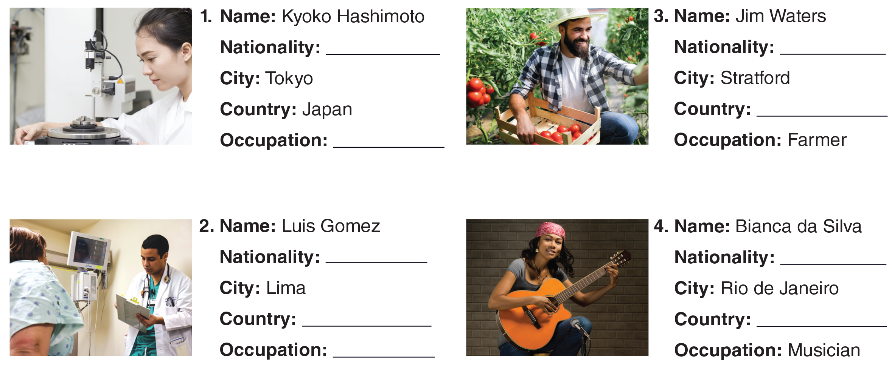
UNIT 1
PEOPLE
LISTENING
_______________________________________________________________________________________________________________________________________________________________________________________________________________________
National Geographic Learning, a Cengage Company. © 2022 Cengage Learning, Inc. ALL RIGHTS RESERVED. This presentation tool is for teaching purpose only. May not be scanned, copied or duplicated, or posted to a publicly accessible website, in whole or in part.

Slide 18
UNIT 1
PEOPLE
LISTENING
Japanese
Canadian
Canada
Engineer
Peruvian
Brazilian
Peru
Brazil
Doctor
_______________________________________________________________________________________________________________________________________________________________________________________________________________________
National Geographic Learning, a Cengage Company. © 2022 Cengage Learning, Inc. ALL RIGHTS RESERVED. This presentation tool is for teaching purpose only. May not be scanned, copied or duplicated, or posted to a publicly accessible website, in whole or in part.

Slide 19

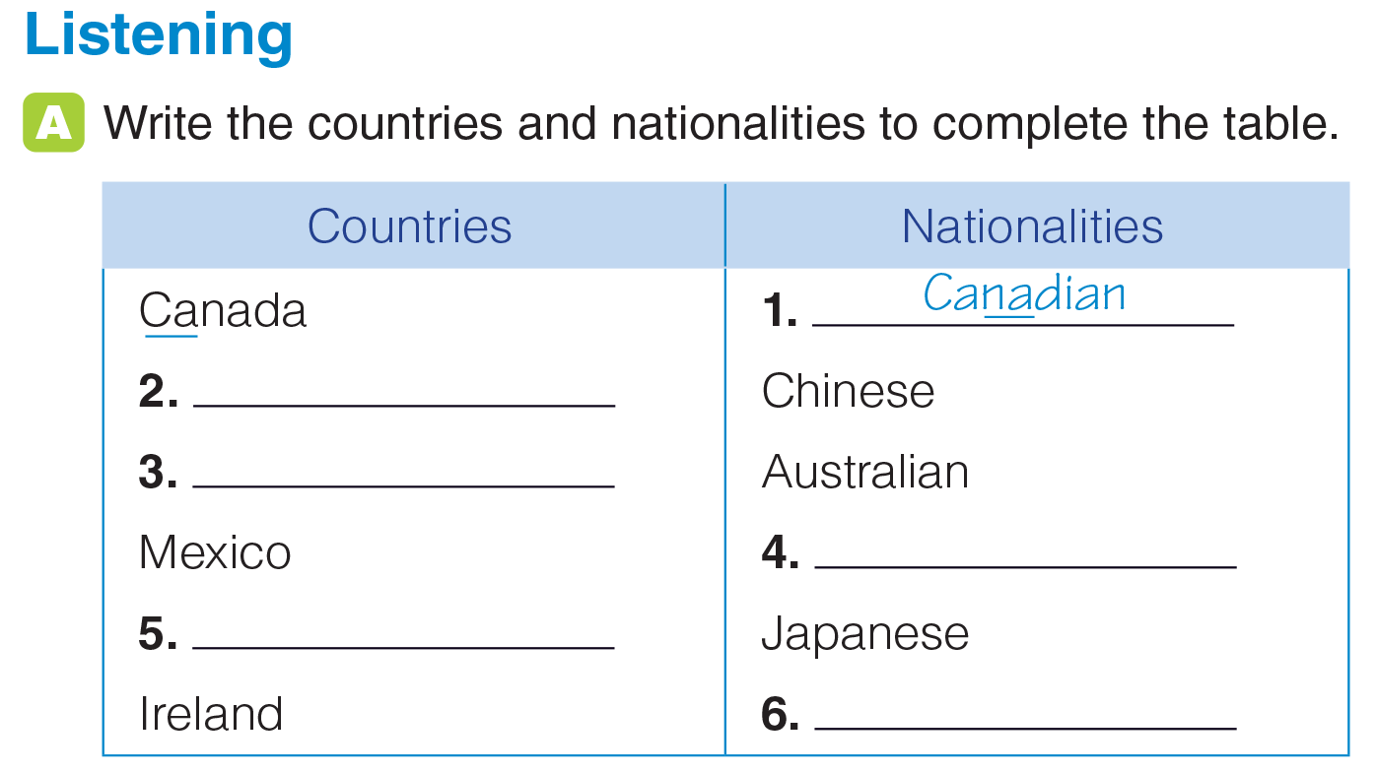
UNIT 1
PEOPLE
PRONUNCIATION
China
Australia
Mexican
Japan
Irish
_______________________________________________________________________________________________________________________________________________________________________________________________________________________
National Geographic Learning, a Cengage Company. © 2022 Cengage Learning, Inc. ALL RIGHTS RESERVED. This presentation tool is for teaching purpose only. May not be scanned, copied or duplicated, or posted to a publicly accessible website, in whole or in part.

Slide 20

UNIT 1
PEOPLE
PRONUNCIATION
_______________________________________________________________________________________________________________________________________________________________________________________________________________________
National Geographic Learning, a Cengage Company. © 2022 Cengage Learning, Inc. ALL RIGHTS RESERVED. This presentation tool is for teaching purpose only. May not be scanned, copied or duplicated, or posted to a publicly accessible website, in whole or in part.

Slide 21
UNIT 1
PEOPLE
PRONUNCIATION
_______________________________________________________________________________________________________________________________________________________________________________________________________________________
National Geographic Learning, a Cengage Company. © 2022 Cengage Learning, Inc. ALL RIGHTS RESERVED. This presentation tool is for teaching purpose only. May not be scanned, copied or duplicated, or posted to a publicly accessible website, in whole or in part.

Slide 22
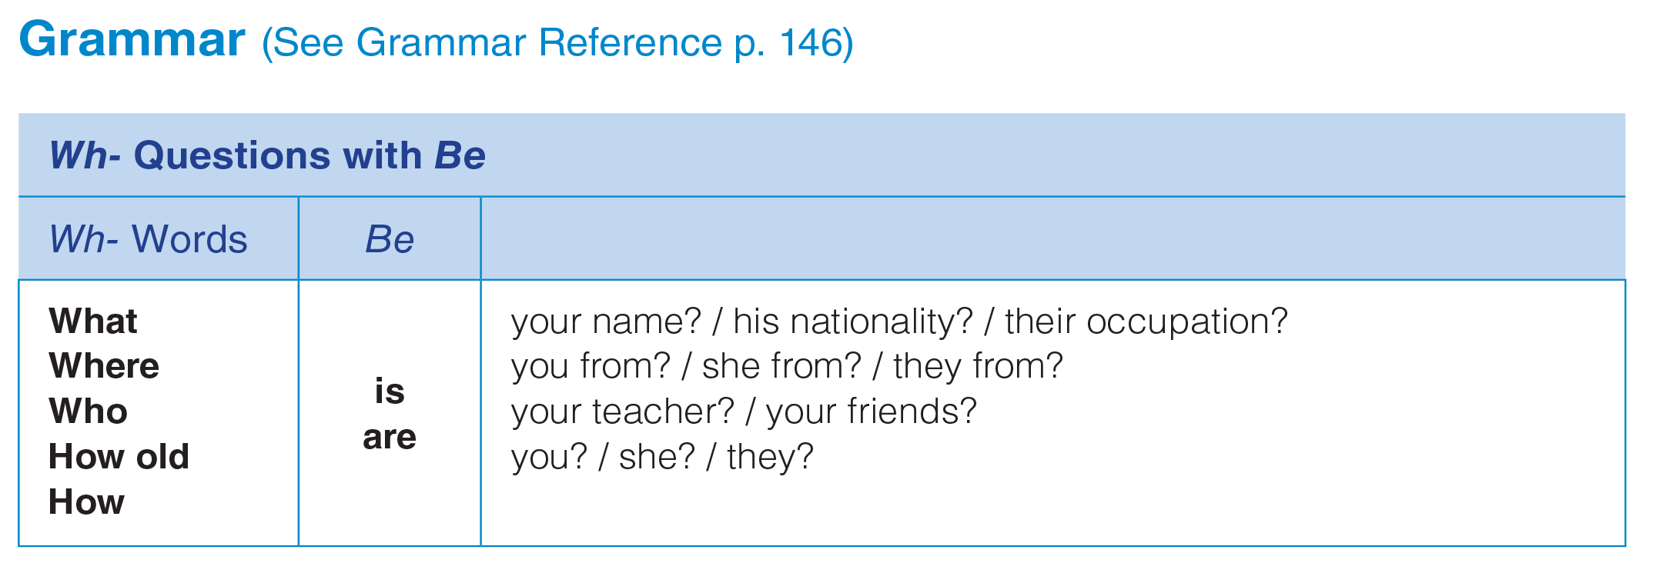
UNIT 1
PEOPLE
GRAMMAR
_______________________________________________________________________________________________________________________________________________________________________________________________________________________
National Geographic Learning, a Cengage Company. © 2022 Cengage Learning, Inc. ALL RIGHTS RESERVED. This presentation tool is for teaching purpose only. May not be scanned, copied or duplicated, or posted to a publicly accessible website, in whole or in part.

Slide 23

UNIT 1
PEOPLE
GRAMMAR
Who are your English teachers?
What is her name?
How old is she?
Where are they from? / What is their nationality?
How is the doctor?
_______________________________________________________________________________________________________________________________________________________________________________________________________________________
National Geographic Learning, a Cengage Company. © 2022 Cengage Learning, Inc. ALL RIGHTS RESERVED. This presentation tool is for teaching purpose only. May not be scanned, copied or duplicated, or posted to a publicly accessible website, in whole or in part.

Slide 24
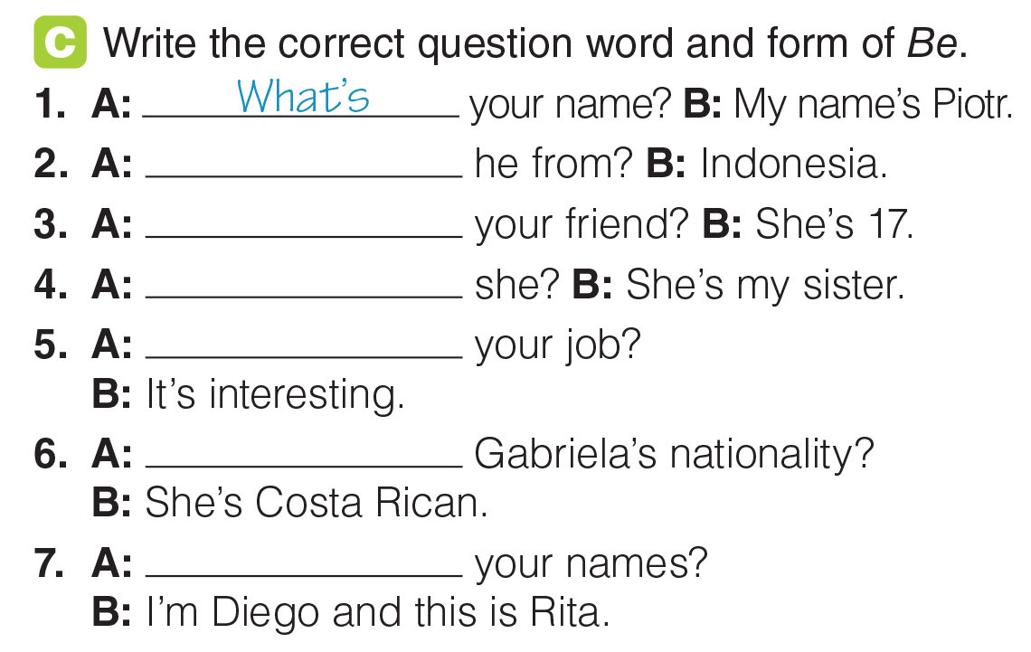
UNIT 1
PEOPLE
GRAMMAR
Where’s
How old is
Who is
How’s
What’s
What are
_______________________________________________________________________________________________________________________________________________________________________________________________________________________
National Geographic Learning, a Cengage Company. © 2022 Cengage Learning, Inc. ALL RIGHTS RESERVED. This presentation tool is for teaching purpose only. May not be scanned, copied or duplicated, or posted to a publicly accessible website, in whole or in part.

Slide 25
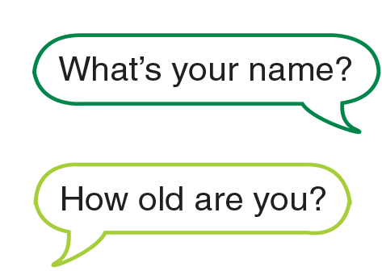
UNIT 1
PEOPLE
GRAMMAR
_______________________________________________________________________________________________________________________________________________________________________________________________________________________
National Geographic Learning, a Cengage Company. © 2022 Cengage Learning, Inc. ALL RIGHTS RESERVED. This presentation tool is for teaching purpose only. May not be scanned, copied or duplicated, or posted to a publicly accessible website, in whole or in part.

Slide 26
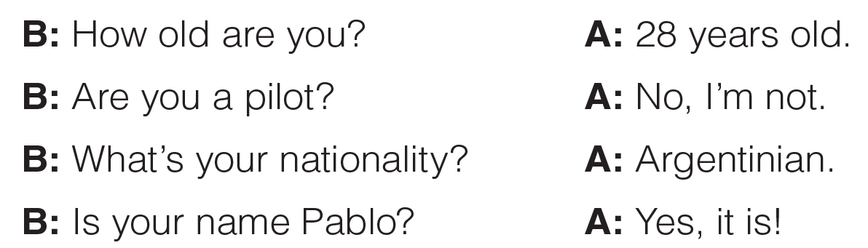
UNIT 1
PEOPLE
GRAMMAR
_______________________________________________________________________________________________________________________________________________________________________________________________________________________
National Geographic Learning, a Cengage Company. © 2022 Cengage Learning, Inc. ALL RIGHTS RESERVED. This presentation tool is for teaching purpose only. May not be scanned, copied or duplicated, or posted to a publicly accessible website, in whole or in part.

Slide 27
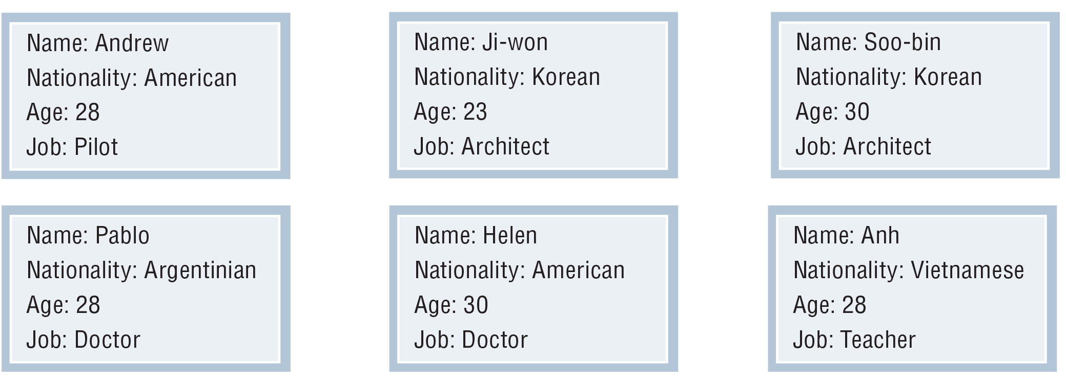
UNIT 1
PEOPLE
GRAMMAR
_______________________________________________________________________________________________________________________________________________________________________________________________________________________
National Geographic Learning, a Cengage Company. © 2022 Cengage Learning, Inc. ALL RIGHTS RESERVED. This presentation tool is for teaching purpose only. May not be scanned, copied or duplicated, or posted to a publicly accessible website, in whole or in part.

Slide 28
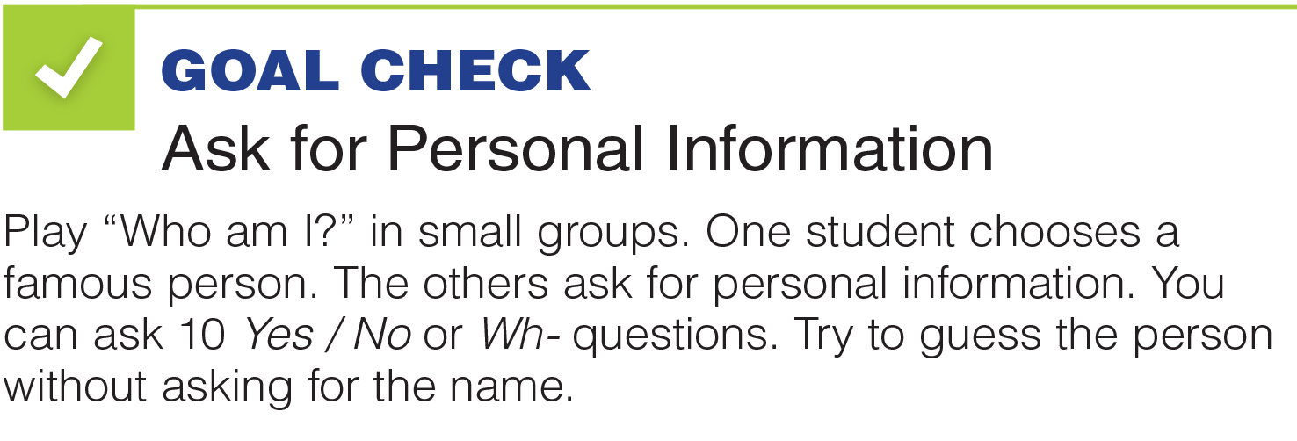




UNIT 1
PEOPLE
GOAL CHECK
_______________________________________________________________________________________________________________________________________________________________________________________________________________________
National Geographic Learning, a Cengage Company. © 2022 Cengage Learning, Inc. ALL RIGHTS RESERVED. This presentation tool is for teaching purpose only. May not be scanned, copied or duplicated, or posted to a publicly accessible website, in whole or in part.

Slide 29

UNIT 1
PEOPLE
LANGUAGE EXPANSION
_______________________________________________________________________________________________________________________________________________________________________________________________________________________
National Geographic Learning, a Cengage Company. © 2022 Cengage Learning, Inc. ALL RIGHTS RESERVED. This presentation tool is for teaching purpose only. May not be scanned, copied or duplicated, or posted to a publicly accessible website, in whole or in part.

Slide 30
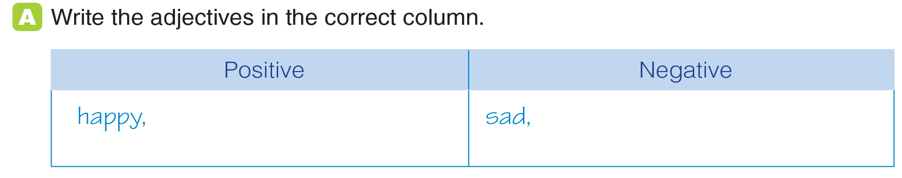
UNIT 1
PEOPLE
LANGUAGE EXPANSION
interesting, easy, rich, safe
boring, difficult, poor, dangerous
_______________________________________________________________________________________________________________________________________________________________________________________________________________________
National Geographic Learning, a Cengage Company. © 2022 Cengage Learning, Inc. ALL RIGHTS RESERVED. This presentation tool is for teaching purpose only. May not be scanned, copied or duplicated, or posted to a publicly accessible website, in whole or in part.

Slide 31
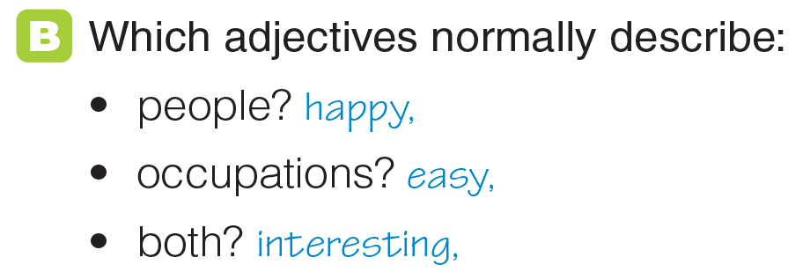
UNIT 1
PEOPLE
LANGUAGE EXPANSION
sad, rich, poor
difficult, safe
boring, dangerous
_______________________________________________________________________________________________________________________________________________________________________________________________________________________
National Geographic Learning, a Cengage Company. © 2022 Cengage Learning, Inc. ALL RIGHTS RESERVED. This presentation tool is for teaching purpose only. May not be scanned, copied or duplicated, or posted to a publicly accessible website, in whole or in part.

Slide 32
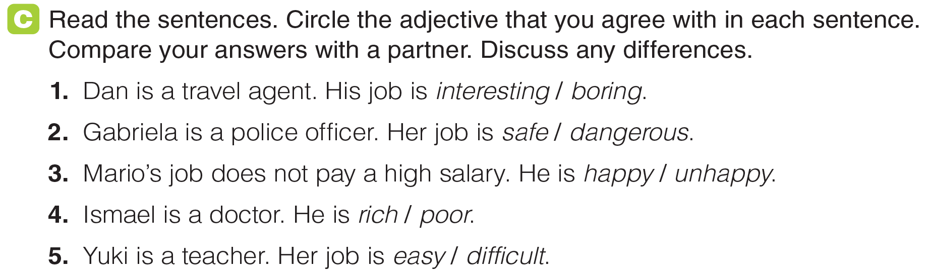
UNIT 1
PEOPLE
LANGUAGE EXPANSION
_______________________________________________________________________________________________________________________________________________________________________________________________________________________
National Geographic Learning, a Cengage Company. © 2022 Cengage Learning, Inc. ALL RIGHTS RESERVED. This presentation tool is for teaching purpose only. May not be scanned, copied or duplicated, or posted to a publicly accessible website, in whole or in part.

Slide 33
UNIT 1
PEOPLE
LANGUAGE EXPANSION
_______________________________________________________________________________________________________________________________________________________________________________________________________________________
National Geographic Learning, a Cengage Company. © 2022 Cengage Learning, Inc. ALL RIGHTS RESERVED. This presentation tool is for teaching purpose only. May not be scanned, copied or duplicated, or posted to a publicly accessible website, in whole or in part.

Slide 34
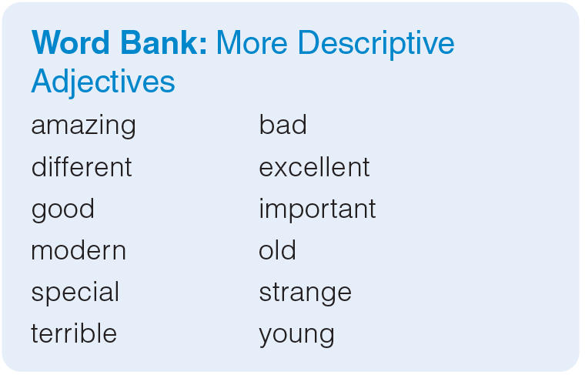
UNIT 1
PEOPLE
GRAMMAR
_______________________________________________________________________________________________________________________________________________________________________________________________________________________
National Geographic Learning, a Cengage Company. © 2022 Cengage Learning, Inc. ALL RIGHTS RESERVED. This presentation tool is for teaching purpose only. May not be scanned, copied or duplicated, or posted to a publicly accessible website, in whole or in part.

Slide 35
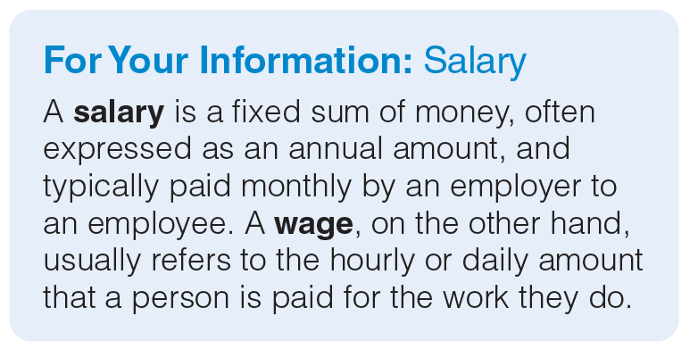

UNIT 1
PEOPLE
LANGUAGE EXPANSION
_______________________________________________________________________________________________________________________________________________________________________________________________________________________
National Geographic Learning, a Cengage Company. © 2022 Cengage Learning, Inc. ALL RIGHTS RESERVED. This presentation tool is for teaching purpose only. May not be scanned, copied or duplicated, or posted to a publicly accessible website, in whole or in part.

Slide 36
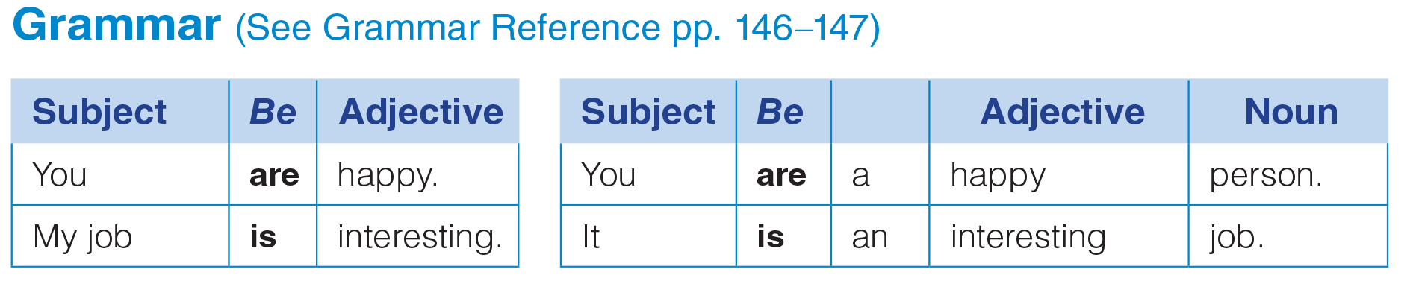
UNIT 1
PEOPLE
GRAMMAR
_______________________________________________________________________________________________________________________________________________________________________________________________________________________
National Geographic Learning, a Cengage Company. © 2022 Cengage Learning, Inc. ALL RIGHTS RESERVED. This presentation tool is for teaching purpose only. May not be scanned, copied or duplicated, or posted to a publicly accessible website, in whole or in part.

Slide 37
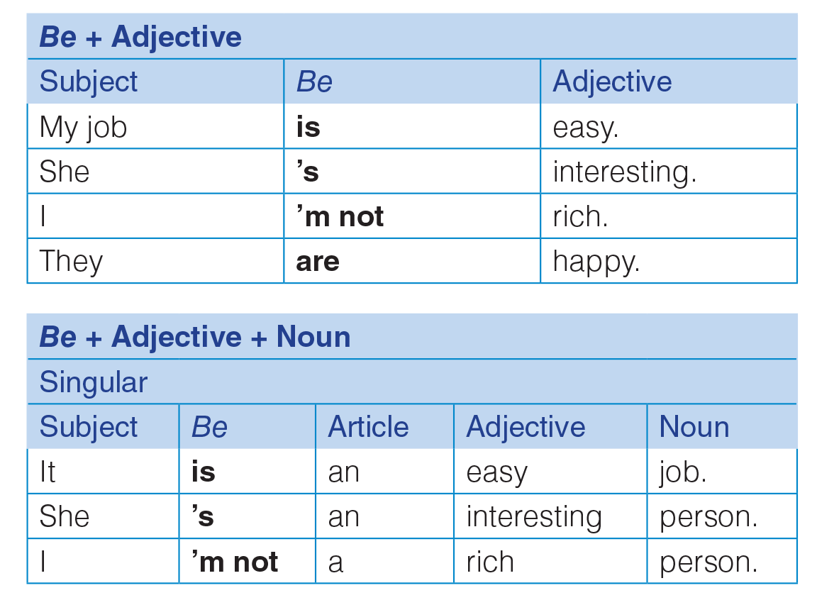
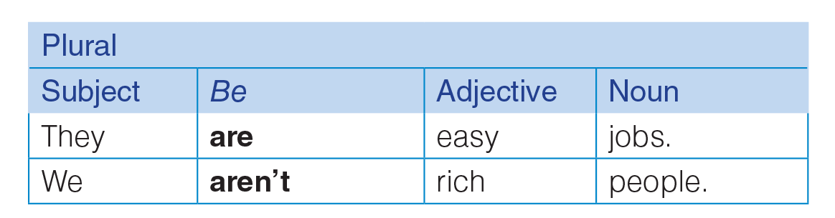
UNIT 1
PEOPLE
GRAMMAR
_______________________________________________________________________________________________________________________________________________________________________________________________________________________
National Geographic Learning, a Cengage Company. © 2022 Cengage Learning, Inc. ALL RIGHTS RESERVED. This presentation tool is for teaching purpose only. May not be scanned, copied or duplicated, or posted to a publicly accessible website, in whole or in part.

Slide 38
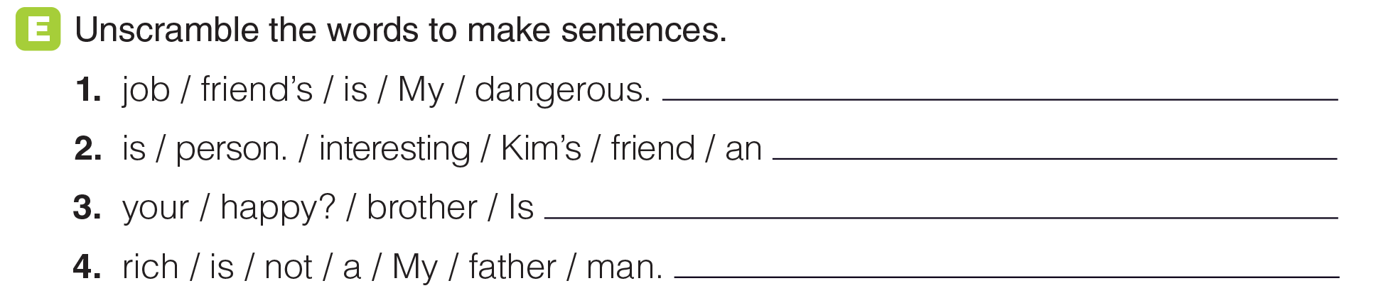
UNIT 1
PEOPLE
GRAMMAR
My friend’s job is dangerous.
Kim’s friend is an interesting person.
Is your brother happy?
My father is not a rich man.
_______________________________________________________________________________________________________________________________________________________________________________________________________________________
National Geographic Learning, a Cengage Company. © 2022 Cengage Learning, Inc. ALL RIGHTS RESERVED. This presentation tool is for teaching purpose only. May not be scanned, copied or duplicated, or posted to a publicly accessible website, in whole or in part.

Slide 39
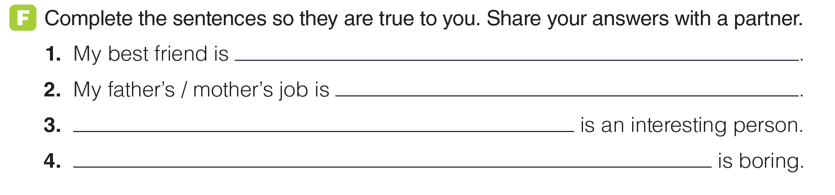
UNIT 1
PEOPLE
GRAMMAR
_______________________________________________________________________________________________________________________________________________________________________________________________________________________
National Geographic Learning, a Cengage Company. © 2022 Cengage Learning, Inc. ALL RIGHTS RESERVED. This presentation tool is for teaching purpose only. May not be scanned, copied or duplicated, or posted to a publicly accessible website, in whole or in part.

Slide 40
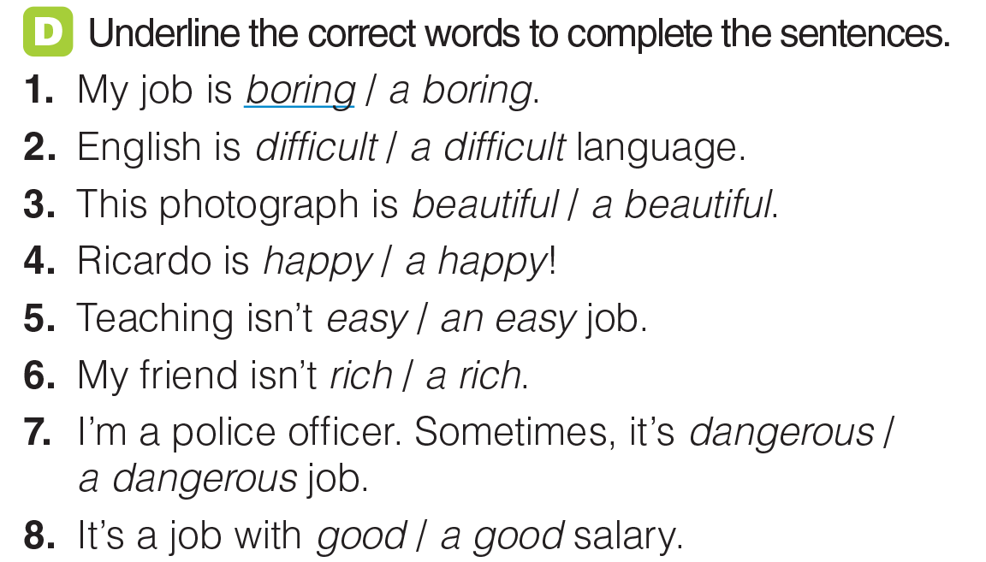
UNIT 1
PEOPLE
GRAMMAR
_______________________________________________________________________________________________________________________________________________________________________________________________________________________
National Geographic Learning, a Cengage Company. © 2022 Cengage Learning, Inc. ALL RIGHTS RESERVED. This presentation tool is for teaching purpose only. May not be scanned, copied or duplicated, or posted to a publicly accessible website, in whole or in part.

Slide 41
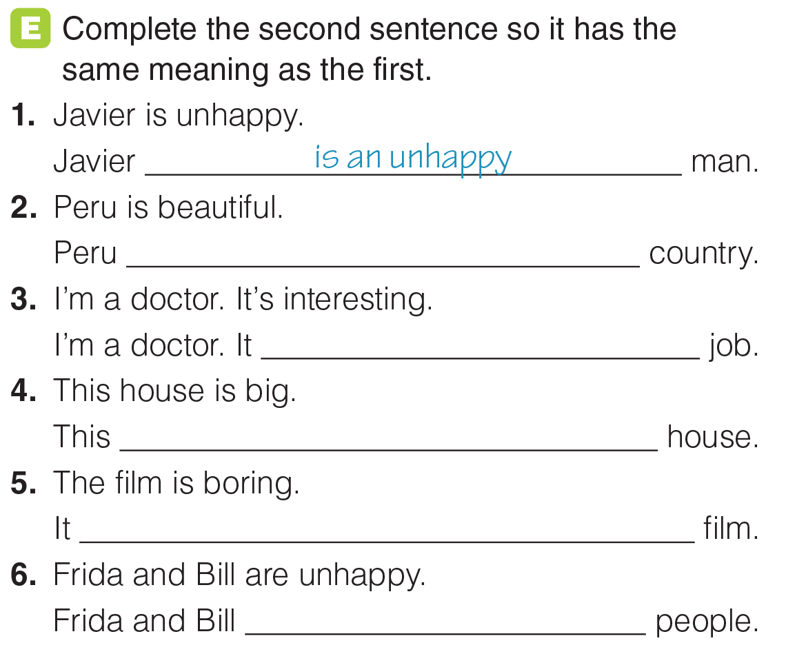
UNIT 1
PEOPLE
GRAMMAR
is a beautiful
‘s an interesting
is a big
’s a boring
are unhappy
_______________________________________________________________________________________________________________________________________________________________________________________________________________________
National Geographic Learning, a Cengage Company. © 2022 Cengage Learning, Inc. ALL RIGHTS RESERVED. This presentation tool is for teaching purpose only. May not be scanned, copied or duplicated, or posted to a publicly accessible website, in whole or in part.

Slide 42
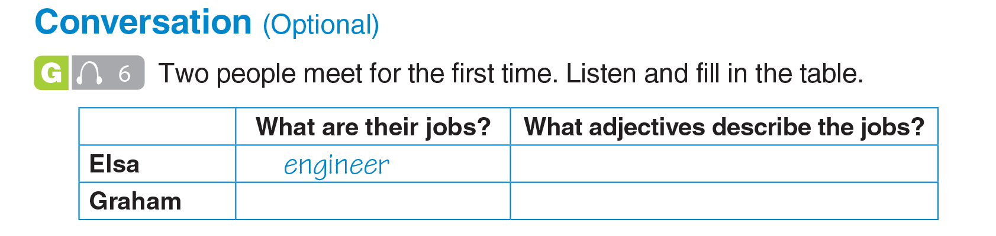

UNIT 1
PEOPLE
CONVERSATION
interesting, difficult
forest ranger
exciting, boring
_______________________________________________________________________________________________________________________________________________________________________________________________________________________
National Geographic Learning, a Cengage Company. © 2022 Cengage Learning, Inc. ALL RIGHTS RESERVED. This presentation tool is for teaching purpose only. May not be scanned, copied or duplicated, or posted to a publicly accessible website, in whole or in part.

Slide 43
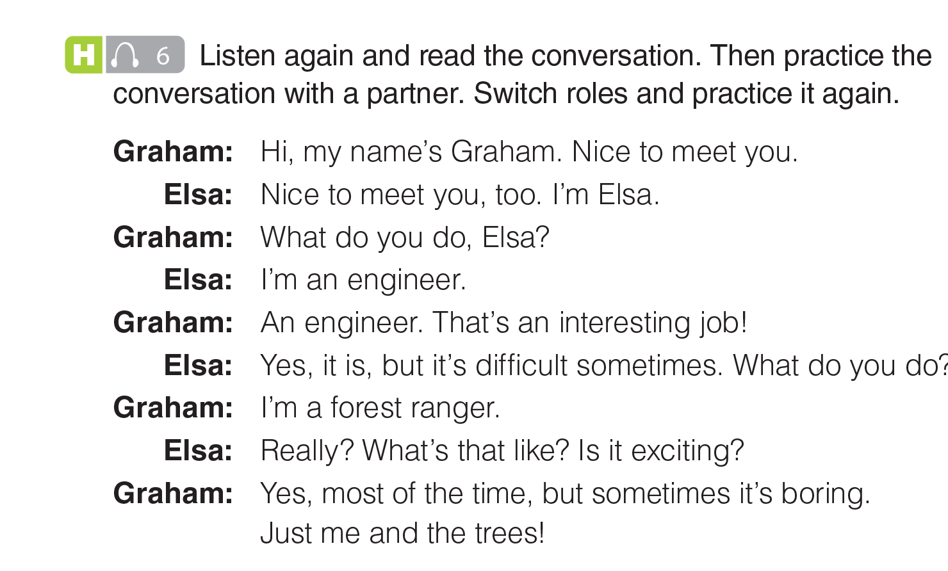
UNIT 1
PEOPLE
CONVERSATION
_______________________________________________________________________________________________________________________________________________________________________________________________________________________
National Geographic Learning, a Cengage Company. © 2022 Cengage Learning, Inc. ALL RIGHTS RESERVED. This presentation tool is for teaching purpose only. May not be scanned, copied or duplicated, or posted to a publicly accessible website, in whole or in part.

Slide 44

UNIT 1
PEOPLE
GOAL CHECK
_______________________________________________________________________________________________________________________________________________________________________________________________________________________
National Geographic Learning, a Cengage Company. © 2022 Cengage Learning, Inc. ALL RIGHTS RESERVED. This presentation tool is for teaching purpose only. May not be scanned, copied or duplicated, or posted to a publicly accessible website, in whole or in part.

Slide 45

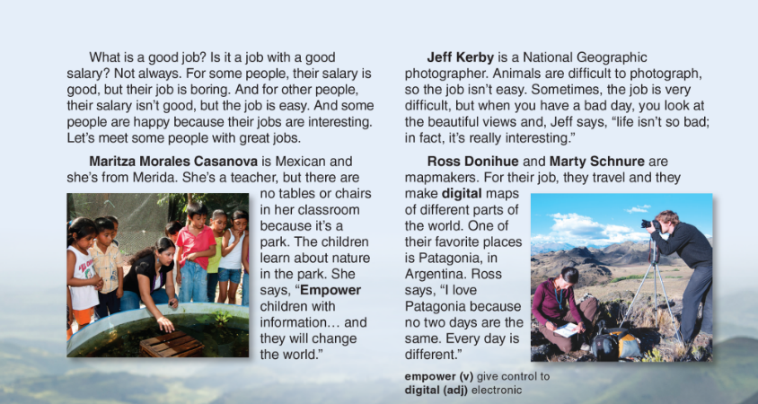
UNIT 1
PEOPLE
READING
_______________________________________________________________________________________________________________________________________________________________________________________________________________________
National Geographic Learning, a Cengage Company. © 2022 Cengage Learning, Inc. ALL RIGHTS RESERVED. This presentation tool is for teaching purpose only. May not be scanned, copied or duplicated, or posted to a publicly accessible website, in whole or in part.

Slide 46
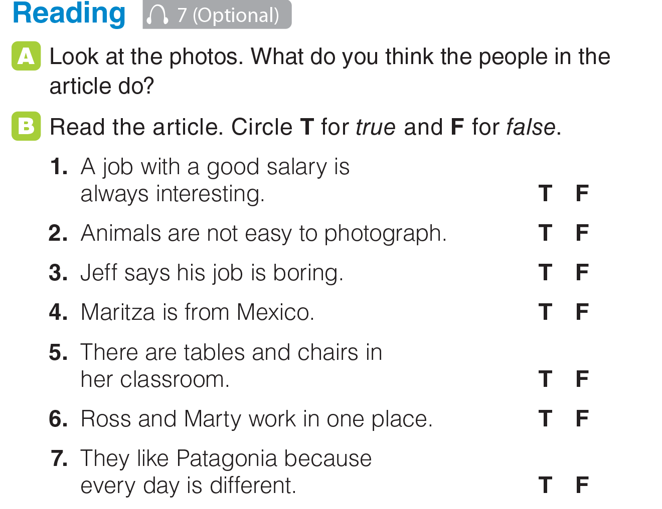
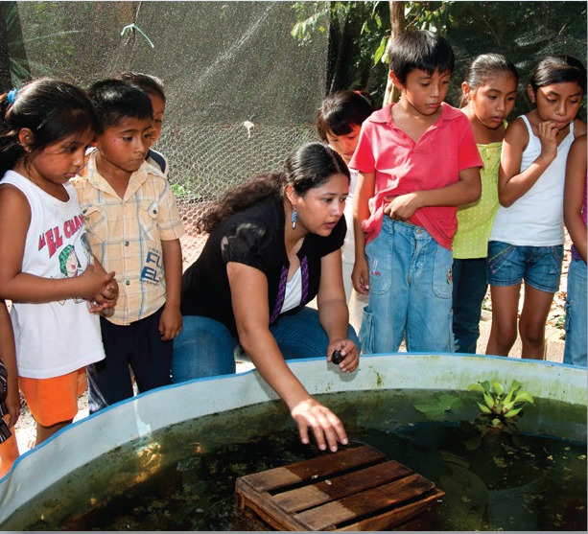
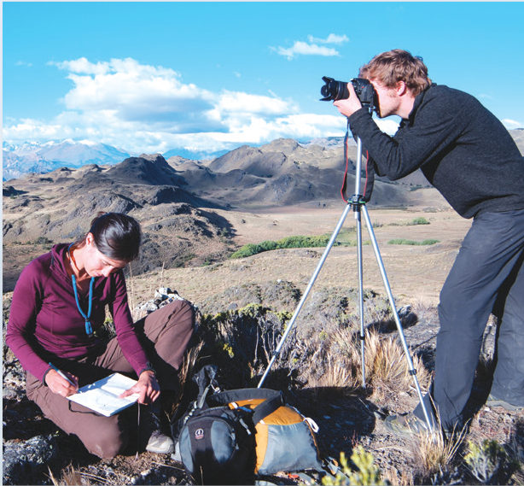
UNIT 1
PEOPLE
READING
_______________________________________________________________________________________________________________________________________________________________________________________________________________________
National Geographic Learning, a Cengage Company. © 2022 Cengage Learning, Inc. ALL RIGHTS RESERVED. This presentation tool is for teaching purpose only. May not be scanned, copied or duplicated, or posted to a publicly accessible website, in whole or in part.

Slide 47
UNIT 1
PEOPLE
READING
_______________________________________________________________________________________________________________________________________________________________________________________________________________________
National Geographic Learning, a Cengage Company. © 2022 Cengage Learning, Inc. ALL RIGHTS RESERVED. This presentation tool is for teaching purpose only. May not be scanned, copied or duplicated, or posted to a publicly accessible website, in whole or in part.

Slide 48
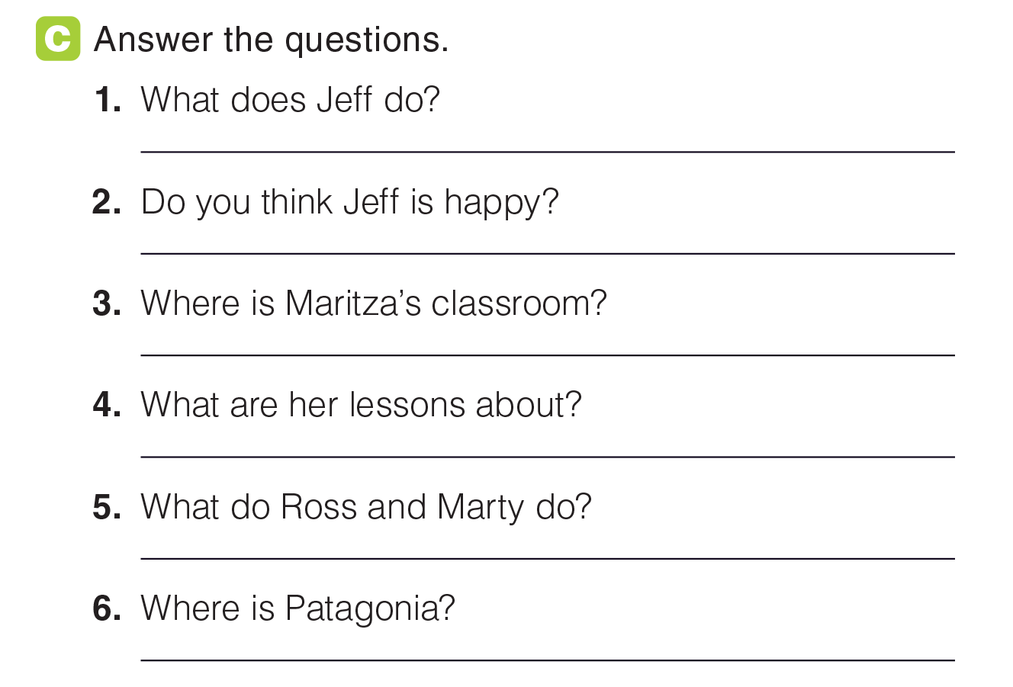
UNIT 1
PEOPLE
READING
He’s a photographer.
Yes.
Her classroom is in a park.
Her lessons are about nature.
They are mapmakers.
In Argentina.
_______________________________________________________________________________________________________________________________________________________________________________________________________________________
National Geographic Learning, a Cengage Company. © 2022 Cengage Learning, Inc. ALL RIGHTS RESERVED. This presentation tool is for teaching purpose only. May not be scanned, copied or duplicated, or posted to a publicly accessible website, in whole or in part.

Slide 49
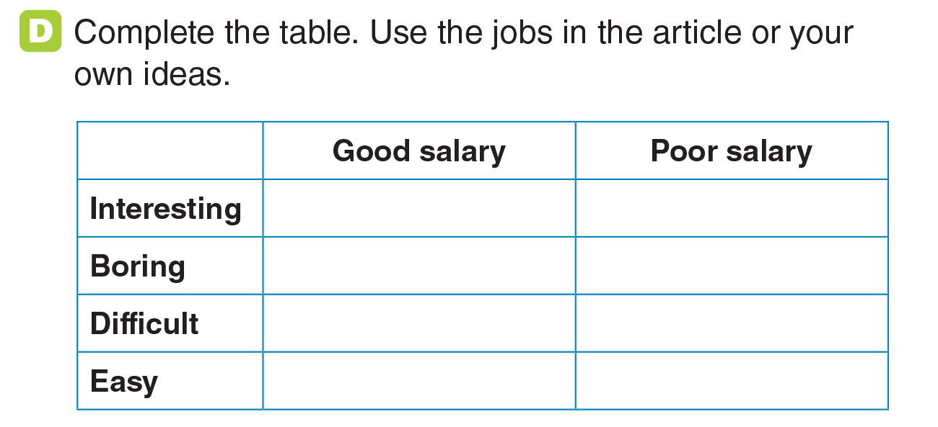
UNIT 1
PEOPLE
READING
_______________________________________________________________________________________________________________________________________________________________________________________________________________________
National Geographic Learning, a Cengage Company. © 2022 Cengage Learning, Inc. ALL RIGHTS RESERVED. This presentation tool is for teaching purpose only. May not be scanned, copied or duplicated, or posted to a publicly accessible website, in whole or in part.

Slide 50
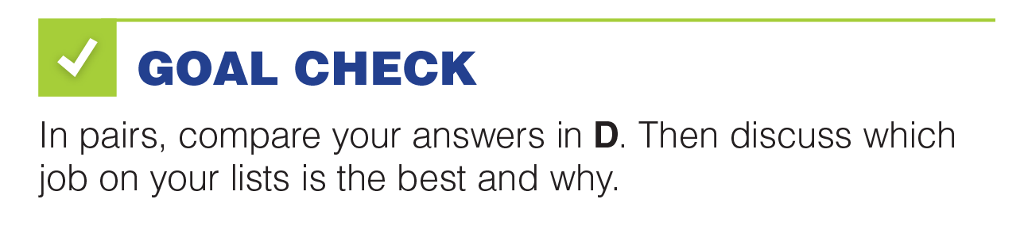
UNIT 1
PEOPLE
GOAL CHECK
_______________________________________________________________________________________________________________________________________________________________________________________________________________________
National Geographic Learning, a Cengage Company. © 2022 Cengage Learning, Inc. ALL RIGHTS RESERVED. This presentation tool is for teaching purpose only. May not be scanned, copied or duplicated, or posted to a publicly accessible website, in whole or in part.

Slide 51
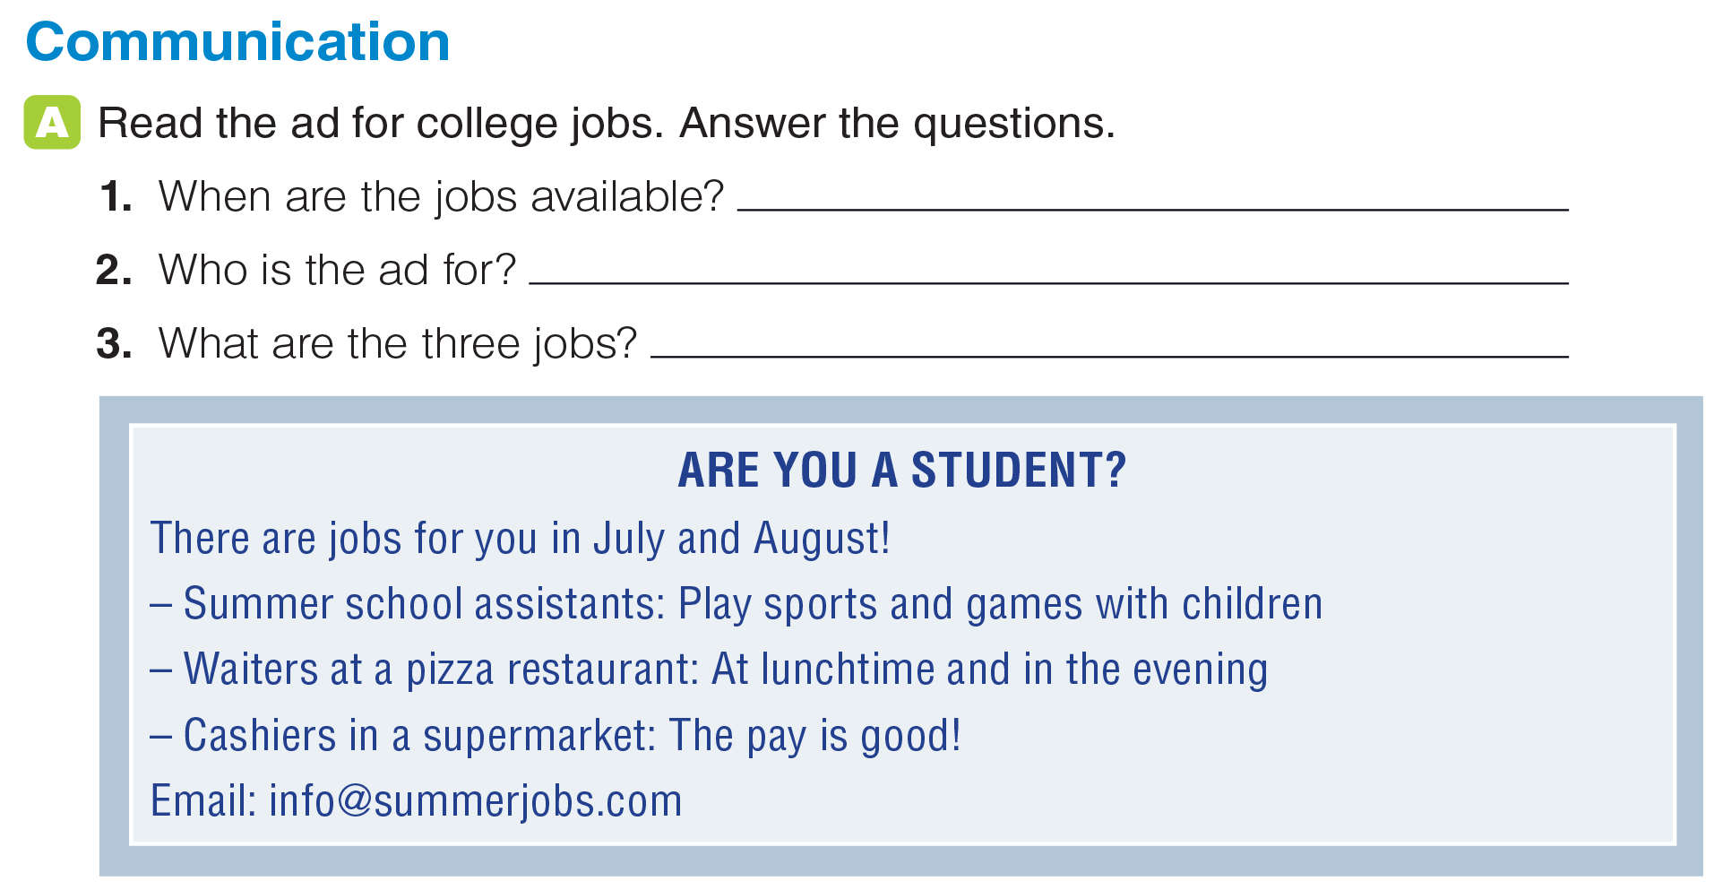
UNIT 1
PEOPLE
COMMUNICATION
July and August
students
summer school assistants, waiters, cashier
_______________________________________________________________________________________________________________________________________________________________________________________________________________________
National Geographic Learning, a Cengage Company. © 2022 Cengage Learning, Inc. ALL RIGHTS RESERVED. This presentation tool is for teaching purpose only. May not be scanned, copied or duplicated, or posted to a publicly accessible website, in whole or in part.

Slide 52
UNIT 1
PEOPLE
COMMUNICATION
summer school assistants
waiters
cashier
_______________________________________________________________________________________________________________________________________________________________________________________________________________________
National Geographic Learning, a Cengage Company. © 2022 Cengage Learning, Inc. ALL RIGHTS RESERVED. This presentation tool is for teaching purpose only. May not be scanned, copied or duplicated, or posted to a publicly accessible website, in whole or in part.

Slide 53


UNIT 1
PEOPLE
COMMUNICATION
_______________________________________________________________________________________________________________________________________________________________________________________________________________________
National Geographic Learning, a Cengage Company. © 2022 Cengage Learning, Inc. ALL RIGHTS RESERVED. This presentation tool is for teaching purpose only. May not be scanned, copied or duplicated, or posted to a publicly accessible website, in whole or in part.

Slide 54
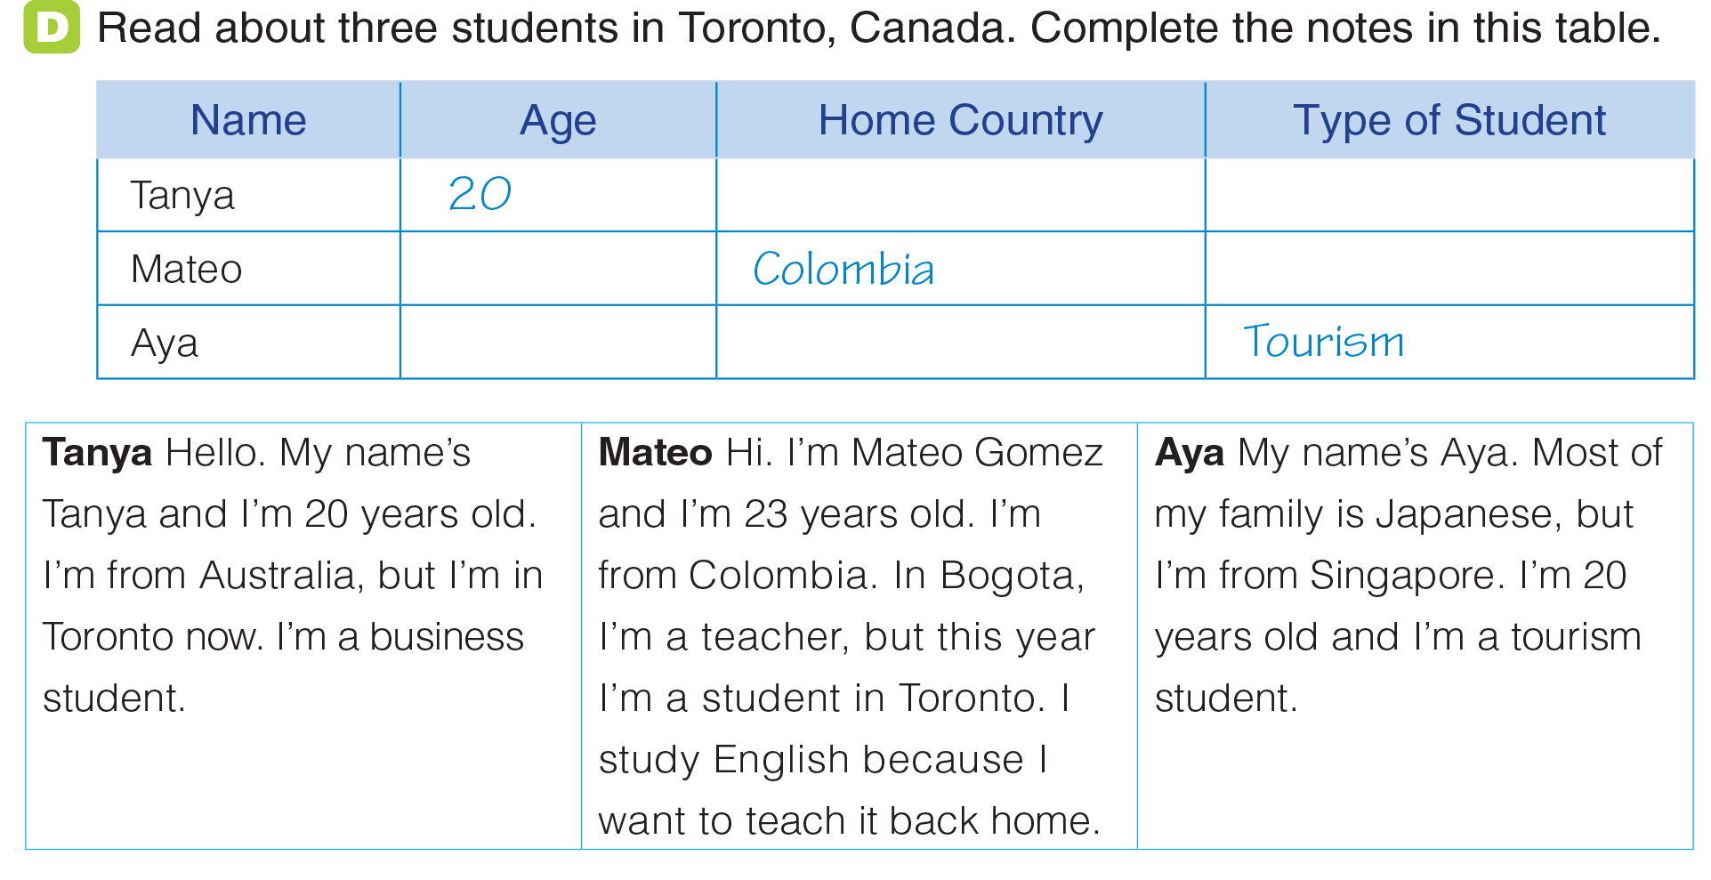
UNIT 1
PEOPLE
COMMUNICATION
Australia
Business
23
English
20
Singapore
_______________________________________________________________________________________________________________________________________________________________________________________________________________________
National Geographic Learning, a Cengage Company. © 2022 Cengage Learning, Inc. ALL RIGHTS RESERVED. This presentation tool is for teaching purpose only. May not be scanned, copied or duplicated, or posted to a publicly accessible website, in whole or in part.

Slide 55

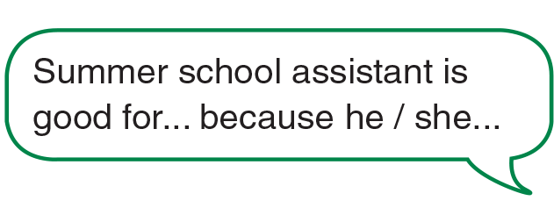
UNIT 1
PEOPLE
COMMUNICATION
summer school assistants
waiters
cashier
_______________________________________________________________________________________________________________________________________________________________________________________________________________________
National Geographic Learning, a Cengage Company. © 2022 Cengage Learning, Inc. ALL RIGHTS RESERVED. This presentation tool is for teaching purpose only. May not be scanned, copied or duplicated, or posted to a publicly accessible website, in whole or in part.

Slide 56
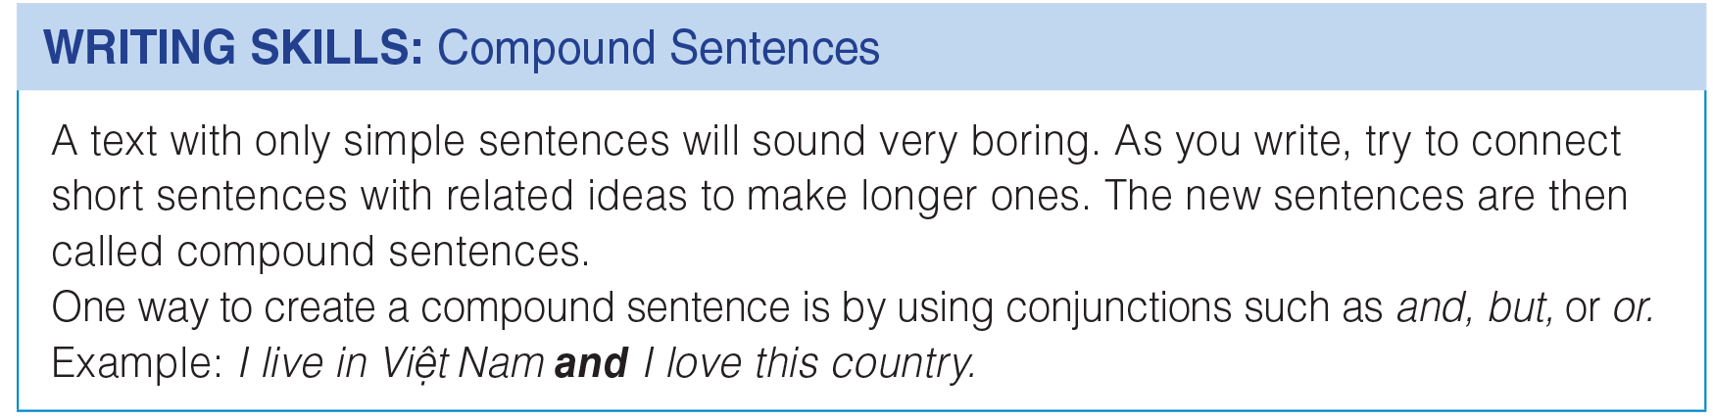
UNIT 1
PEOPLE
WRITING
_______________________________________________________________________________________________________________________________________________________________________________________________________________________
National Geographic Learning, a Cengage Company. © 2022 Cengage Learning, Inc. ALL RIGHTS RESERVED. This presentation tool is for teaching purpose only. May not be scanned, copied or duplicated, or posted to a publicly accessible website, in whole or in part.

Slide 57
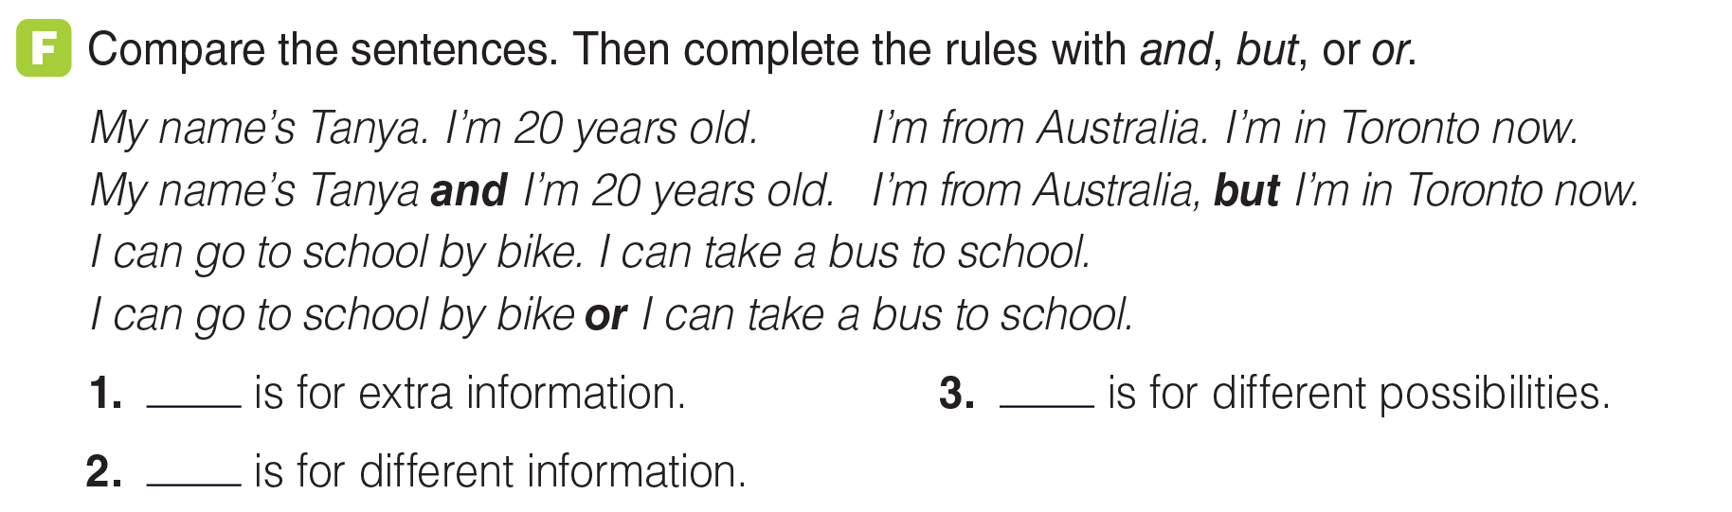
UNIT 1
PEOPLE
WRITING
And
Or
But
_______________________________________________________________________________________________________________________________________________________________________________________________________________________
National Geographic Learning, a Cengage Company. © 2022 Cengage Learning, Inc. ALL RIGHTS RESERVED. This presentation tool is for teaching purpose only. May not be scanned, copied or duplicated, or posted to a publicly accessible website, in whole or in part.

Slide 58
UNIT 1
PEOPLE
WRITING
_______________________________________________________________________________________________________________________________________________________________________________________________________________________
National Geographic Learning, a Cengage Company. © 2022 Cengage Learning, Inc. ALL RIGHTS RESERVED. This presentation tool is for teaching purpose only. May not be scanned, copied or duplicated, or posted to a publicly accessible website, in whole or in part.

Slide 59
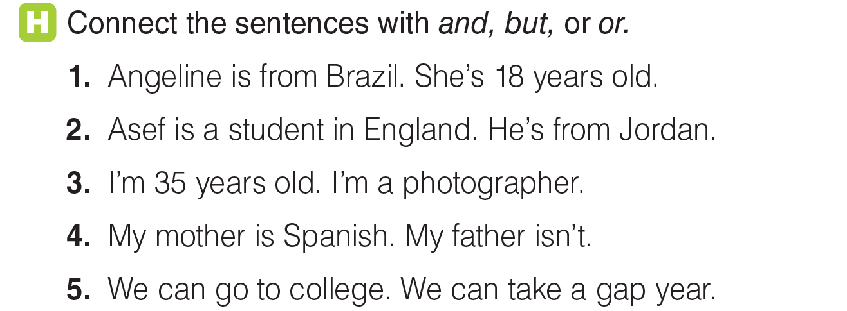
UNIT 1
PEOPLE
WRITING
1. Angeline is from Brazil and she’s 18 years old.
2. Asef is a student in England, but he’s from Jordan.
3. I’m 35 years old and I’m a photographer.
4. My mother is Spanish, but my father isn’t.
5. We can go to college, or we can take a gap year.
_______________________________________________________________________________________________________________________________________________________________________________________________________________________
National Geographic Learning, a Cengage Company. © 2022 Cengage Learning, Inc. ALL RIGHTS RESERVED. This presentation tool is for teaching purpose only. May not be scanned, copied or duplicated, or posted to a publicly accessible website, in whole or in part.

Slide 60

UNIT 1
PEOPLE
GOAL CHECK
_______________________________________________________________________________________________________________________________________________________________________________________________________________________
National Geographic Learning, a Cengage Company. © 2022 Cengage Learning, Inc. ALL RIGHTS RESERVED. This presentation tool is for teaching purpose only. May not be scanned, copied or duplicated, or posted to a publicly accessible website, in whole or in part.

