Slide 1


Unit 1
Stories

Slide 2
Unit 1:
Stories
Lesson 1

Slide 3
UNIT 1
STORIES
English Time Chant
English, (clap) English, (clap)
English (clap) today! (clap, clap)
English, (clap) English, (clap)
Hip, hip, (clap) hooray! (clap, clap)

Slide 4
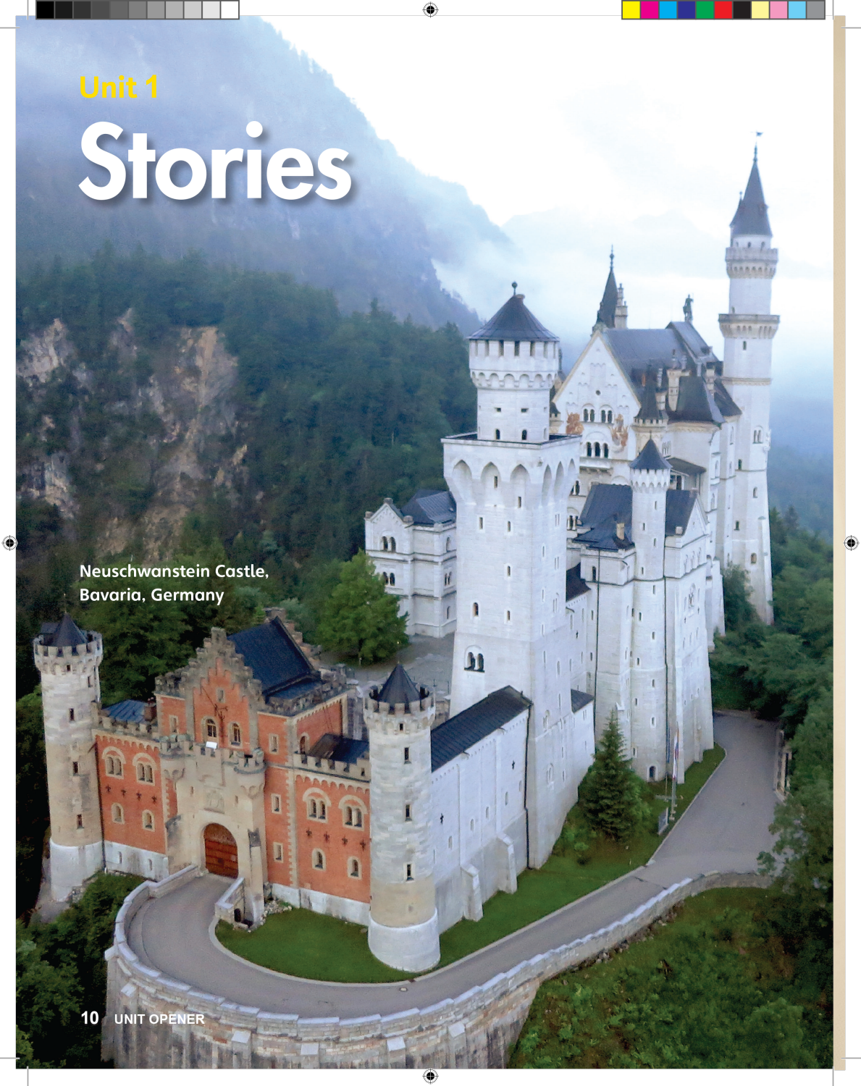
UNIT 1
STORIES
What stories do you know?
Time for School
Eight is Great
Notes:
Show students p. 10. Point to the unit title and say Stories.
Hold up several picture books and say These books have stories.
One at a time, go through the pages of these books, and say Look at the stories.
Write this question on the board and ask What stories do you know?
Students should say [Eight is Great].
Note
If they mention a fairy tale, come back to it in the next part.
Have students name familiar stories that they know from English (such as the stories from Grade 1) or in their native language.

Slide 5
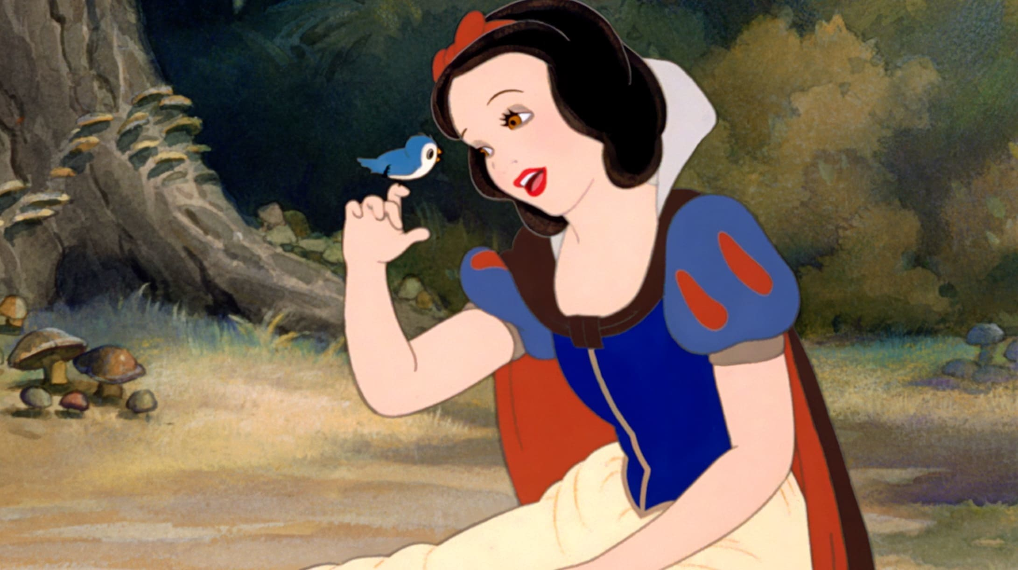
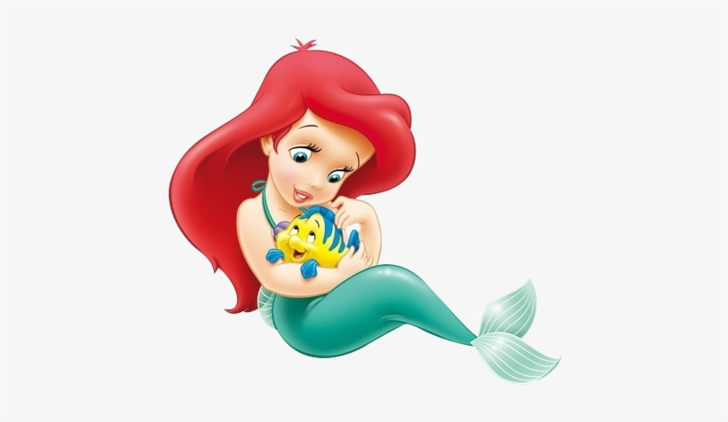
UNIT 1
STORIES
Do you know any more stories?
Snow White
The Little Mermaid
Notes:
Draw a rectangle on the board and divide it into three parts using dotted lines.
Get students to name a story, such as a familiar fairy tale.
Ask Do you know of any more stories?
Students should say [Snow White].
Make a story board for the story. In a story board, you make drawings to tell the story. Include three parts in your story—the introduction, the action, and the ending.
Give each student a piece of paper. Show students how to fold the paper to create three parts. Have them draw a story board for a familiar story
Note
If the students have trouble, coming up with any stories, guide them by asking about famous movies/princesses they may have seen e.g., Snow White
Note
If students cannot think of a story, provide the names of stories that they may be familiar with.

Slide 6
UNIT 1
STORIES
Let’s draw!
Introduction | Action | Ending
Notes:
Draw a rectangle on the board and divide it into three parts using dotted lines.
Get students to name a story, such as a familiar fairy tale.
Ask Do you know of any more stories?
Students should say [Snow White].
Make a story board for the story. In a story board, you make drawings to tell the story. Include three parts in your story—the introduction, the action, and the ending.
Give each student a piece of paper. Show students how to fold the paper to create three parts. Have them draw a story board for a familiar story
Note
If the students have trouble, coming up with any stories, guide them by asking about famous movies/princesses they may have seen e.g., Snow White
Note
If students cannot think of a story, provide the names of stories that they may be familiar with.

Slide 7

UNIT 1
STORIES
What story is this?
Notes:
When students finish, walk around the room to collect their story boards.
Ask each student to tell you what story is represented.
Students should say The story is [Cinderella].
Write the story’s name on the back of the paper.
Once you have all the story boards, hold them up, one by one.
Ask the class What story is this?
Students should say It’s [Cinderella].
Note
If students have trouble identifying the story from the drawing, give them a choice between two stories.
For example, in English, you might ask Cinderella or Pinocchio? Use titles in students’ native language, if necessary.
Say This unit is about stories.
If students have drawn any of the Unit 1 vocabulary words in their story boards, point to the pictures for the class to see, and name the words.
Say Some stories have [kings and queens].
Note
If students haven’t included target words in their drawings, hold up the story books you showed students, or p. 11 in the Student Book, as you point to and name people and things in a story.

Slide 8
UNIT 1
STORIES
Goodbye Chant
Good work, class.
Hip hip, hooray!
Goodbye for now.
Have a nice day!
Notes:
Say Good job today class. Now let’s chant.
Lead the class in the Goodbye chant.

Slide 9

UNIT 1
STORIES
Let’s check!
Tell the story
Notes:
Can students use the simple present tense to answer simple questions about stories?
Can students identify and give examples of stories, and recognize things/characters in stories?

Slide 10
UNIT 1
STORIES
Thank you!

Slide 11
Unit 1:
Stories
Lesson 2

Slide 12
UNIT 1
STORIES
English Time Chant
English, (clap) English, (clap)
English (clap) today! (clap, clap)
English, (clap) English, (clap)
Hip, hip, (clap) hooray! (clap, clap)

Slide 13
UNIT 1
STORIES
This is a castle.
Do you live in a castle?
Who lives in a castle?
Notes:
Help students open their books to p. 10.
Point to the castle. Say This is a castle.
Ask Do you live in a castle?
Students should say No.
Say King and queens live in castles.
Say Princes and princesses live in castles, too.
Say These are people in stories. Let’s learn about stories.

Slide 14
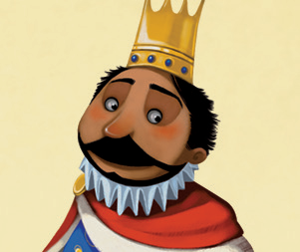
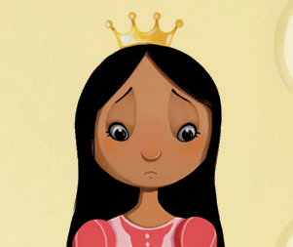
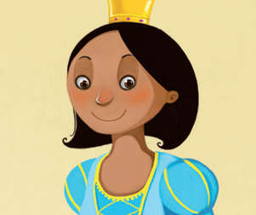

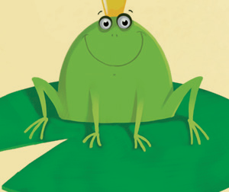
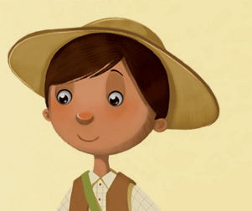
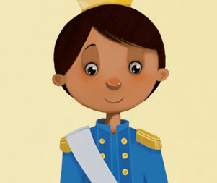
UNIT 1
STORIES
Repeat after me
crown
a king
a princess
a queen
happy
a frog
a friend
a prince
sad
Notes:
Help students open their books to p. 11.
Point to the picture for each word and say the word aloud. Students should repeat after you.

Slide 15
UNIT 1
STORIES
Tell me
Give me another word that you think of.
brother
sister
mother
father
open
close
Notes:
Say I say a word. Give me another word that you think of. Listen: I say brother and you say sister.
Say the following words: [mother, grandpa, open].
Students should say [father, grandma, close].

Slide 16
UNIT 1
STORIES
Repeat after me
crown
a king
a princess
a queen
happy
a frog
a friend
a prince
sad
Notes:
Point to p. 11.
Point to the king and say King.
Point to the queen and say Queen. Say King and queen.
Point to the prince and say Prince.
Ask Prince and?
Students should say Princess.
Note
If students don’t guess princess, ask Prince and friend, or prince and princess?
Point to the happy face and say Happy.
Point to the sad face and say Sad.
Say Happy and sad are both feelings.

Slide 17

UNIT 1
STORIES
1
Listen and point. TR: B22
a king
a princess
a queen
happy
a frog
a friend
a prince
sad
Notes:
Point to each of the Unit 1 pictures I random order.
Ask What’s this? or Who’s this?
Students should say [It’s a princess].
Once students answer correctly, say That’s right! It’s a [princess]! Repeat this for each of the Unit 1 pictures.

Slide 18
UNIT 1
STORIES
What is this? Who is it?
Notes:
Help students open their books to p. 11.
Point to the picture for each word and say the word aloud. Students should repeat after you.

Slide 19
UNIT 1
STORIES
Goodbye Chant
Good work, class.
Hip hip, hooray!
Goodbye for now.
Have a nice day!
Notes:
Say Good job today class. Now let’s chant.
Lead the class in the Goodbye chant.

Slide 20
UNIT 1
STORIES
Let’s check!
Is it a _____?
Notes:
Can students identify and name people and things in a story?
Hold up p. 11. Point to each picture, and ask Is it [a frog] or a [crown]?

Slide 21
UNIT 1
STORIES
It’s _________.
a crown
a king
a princess
a queen
happy
a frog
a friend
a prince
sad
Notes:
(Click the picture to show the word)

Slide 22
UNIT 1
STORIES
Thank you!

Slide 23
Unit 1:
Stories
Lesson 3

Slide 24
UNIT 1
STORIES
English Time Chant
English, (clap) English, (clap)
English (clap) today! (clap, clap)
English, (clap) English, (clap)
Hip, hip, (clap) hooray! (clap, clap)

Slide 25
UNIT 1
STORIES
What is this? Who is it?
Notes:
Review the last lesson’s vocabulary.
Say What’s this?
Students should say It’s [a crown].
Note
Students may find it easy to remember new vocabulary when it is presented with a related term. Present and practice related words two at a time, instead of focusing on an individual word. For example, if you are presenting words for people, present the male and female words together, such as mother/father, brother/sister, and king/queen. Present words that are opposites together, such as open/close or happy/sad.

Slide 26
UNIT 1
STORIES
What is it?
king
queen
prince
princess
happy
sad
Notes:
Draw a T-chart organizer on the board.
Say Look!
Write king in the left-hand column. Point to the word and ask What is it?
Students should say King.
Point to the pictures for friend and queen. Ask Which one goes with the king?
Students should say Queen.
Write queen into the right-hand column, next to king.
Then, repeat this with prince/princess and happy/sad.
Say Look at the words, and practice saying them together.

Slide 27
UNIT 1
STORIES
2
Who is happy/sad?
Point and say.
a king
a princess
a queen
happy
a frog
a friend
a prince
sad
Notes:
Point to each of the Unit 1 pictures I random order. 2 Place students in pairs. Have them take turns pointing to a picture for a word on p. 11 for their partner to say.
After they finish, ask Who’s happy?
Students should say The queen, the prince, the frog.
Ask Who’s sad?
Students should say The princess.
Note
Students may need more explanation on when to use a, an, and the. Explain to them that a and an are used when we talk about people, animals, or things, for the first time, but we can use the after that.
Ask What’s this? or Who’s this?
Students should say [It’s a princess].
Once students answer correctly, say That’s right! It’s a [princess]! Repeat this for each of the Unit 1 pictures.

Slide 28

UNIT 1
STORIES
Let’s make a crown
I’m a king!
Notes:
Have students make their own crowns. Give each student a strip of poster board.
One at a time, measure each student’s head. Cut the poster board to form a crown that fits the student’s head.
Have students use crayons, stickers, buttons, beads, or glitter to decorate their crowns. Staple the crowns. Once the students finish their crowns, have them wear them. Encourage students to get up and show their crowns to one another.
Students should walk around and introduce themselves.
They should say I’m a [king/queen/prince/princess].
You may want to have students vote on the best crown in the class.

Slide 29
UNIT 1
STORIES
Goodbye Chant
Good work, class.
Hip hip, hooray!
Goodbye for now.
Have a nice day!
Notes:
Say Good job today class. Now let’s chant.
Lead the class in the Goodbye chant.

Slide 30
UNIT 1
STORIES
Let’s check!
Is it a _____?
Notes:
Can students identify and name people and things in a story? Can they identify feelings of happiness and sadness?
Hold up p. 11. Point to each picture, and ask Is it [a frog] or a [crown]? Is [the king] happy or sad?

Slide 31
UNIT 1
STORIES
It’s _________.
a crown
a king
a princess
a queen
happy
a frog
a friend
a prince
sad
Notes:
(Click the picture to show the word)

Slide 32
UNIT 1
STORIES
Thank you!

Slide 33
Unit 1:
Stories
Lesson 4

Slide 34
UNIT 1
STORIES
English Time Chant
English, (clap) English, (clap)
English (clap) today! (clap, clap)
English, (clap) English, (clap)
Hip, hip, (clap) hooray! (clap, clap)

Slide 35

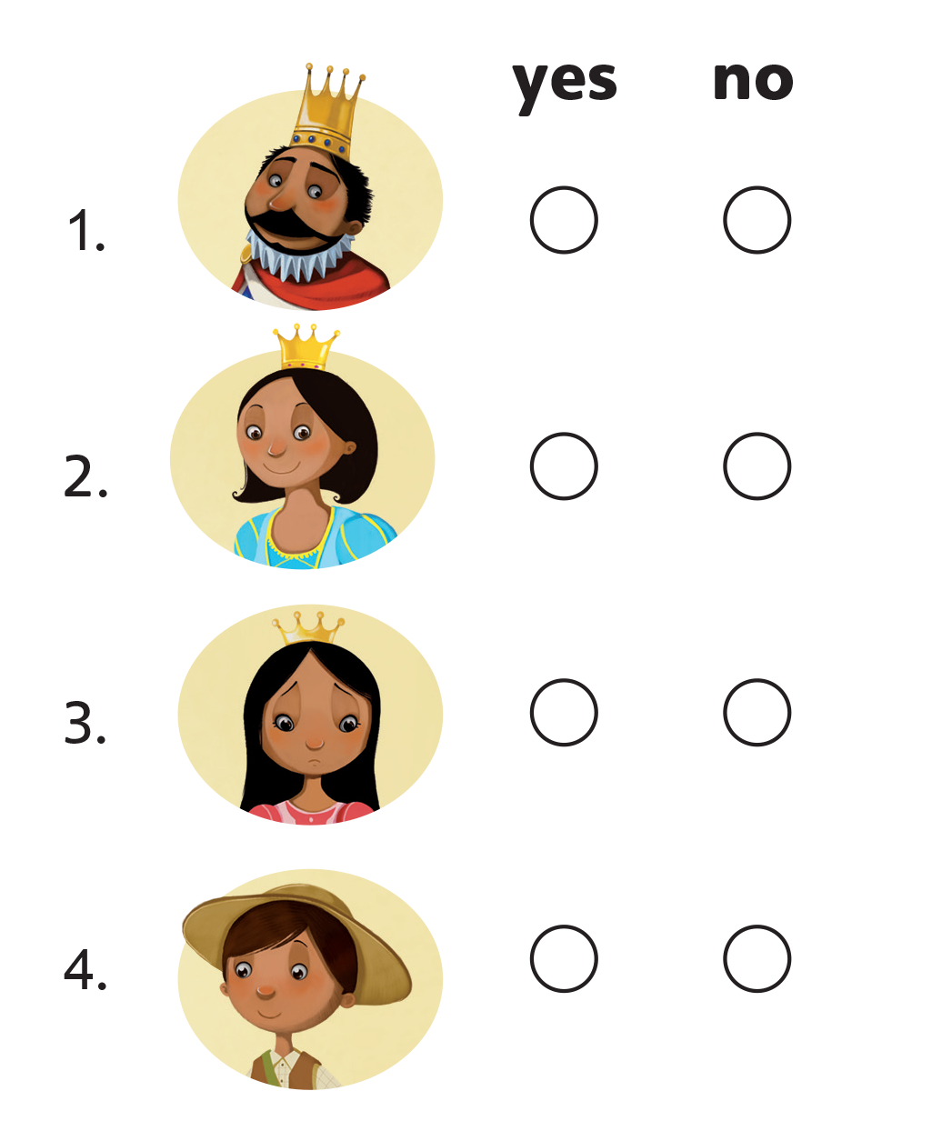
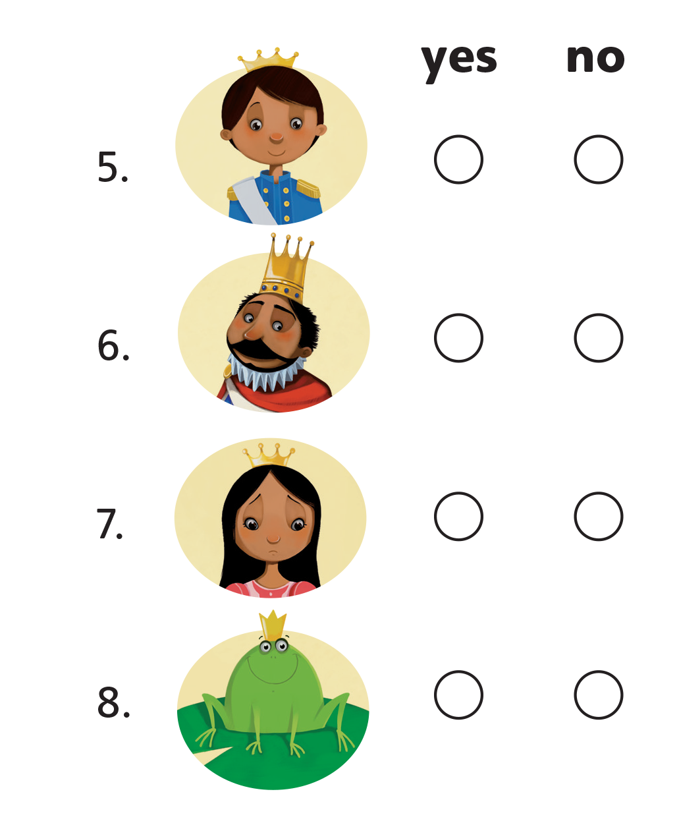
UNIT 1
STORIES
✓
✓
✓
✓
✓
✓
✓
✓
Notes:
3 Have students open their books to p. 12. Point to the number 1, and ask Who’s this?
Students should say A king.
Play TR: B23. Pause after item 1 and ask a student to repeat the sentence.
Ask Is this right?
Students should say Yes, he’s the king.
Say Yes, that’s right. He’s the king. Let’s put a check under yes.
Point to the word yes and say it aloud.
Model putting a check under yes for number 1. Do number 2 with students, too.
Be sure to point to the word no in the column, and say it aloud, as you model putting a check for no.

Slide 36
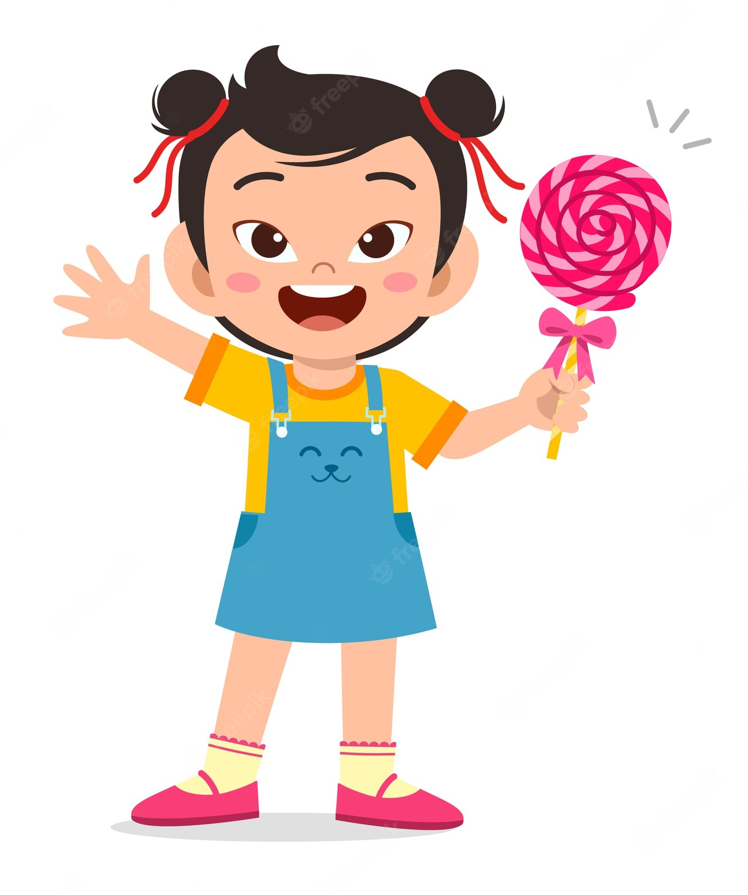
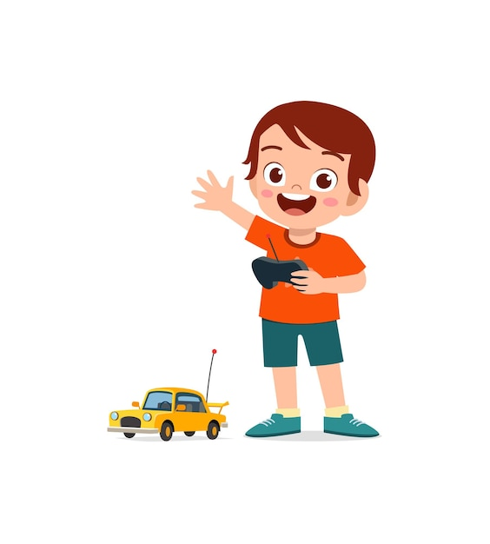
UNIT 1
STORIES
I want candy.
I want a car.
Notes:
4 Hold up a piece of candy, rub your stomach with your other hand, and say Mm. I want candy.
Hold up a picture of a new car and say I want a new car.
Say the following sentences aloud, and have students raise their hands when it’s true for them:
– I want new toys.
– I want candy.
– I want a crown.
– I want a good book.
– I want crayons.

Slide 37
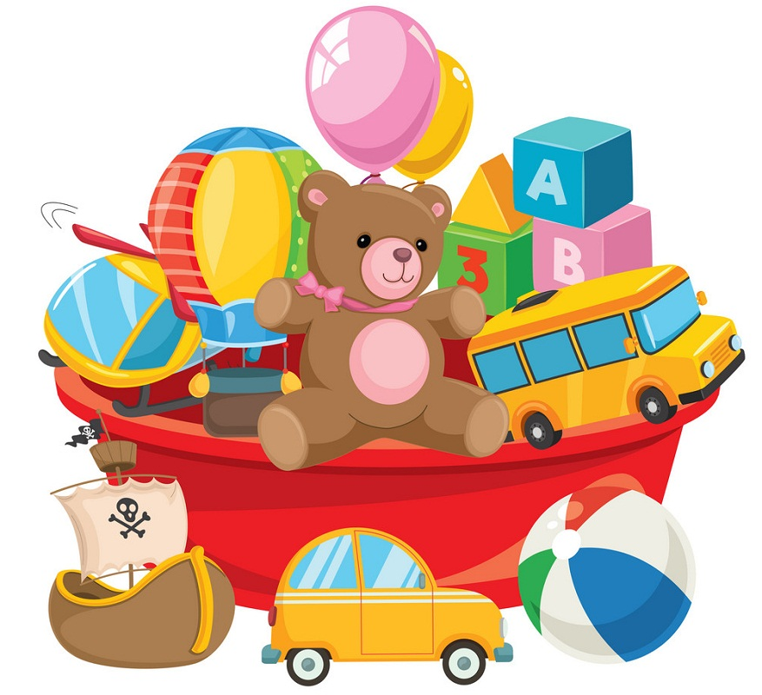
UNIT 1
STORIES
Raise your hand
I want new toys.
Notes:
4 Hold up a piece of candy, rub your stomach with your other hand, and say Mm. I want candy.
Hold up a picture of a new car and say I want a new car.
Say the following sentences aloud, and have students raise their hands when it’s true for them:
– I want new toys.
– I want candy.
– I want a crown.
– I want a good book.
– I want crayons.

Slide 38
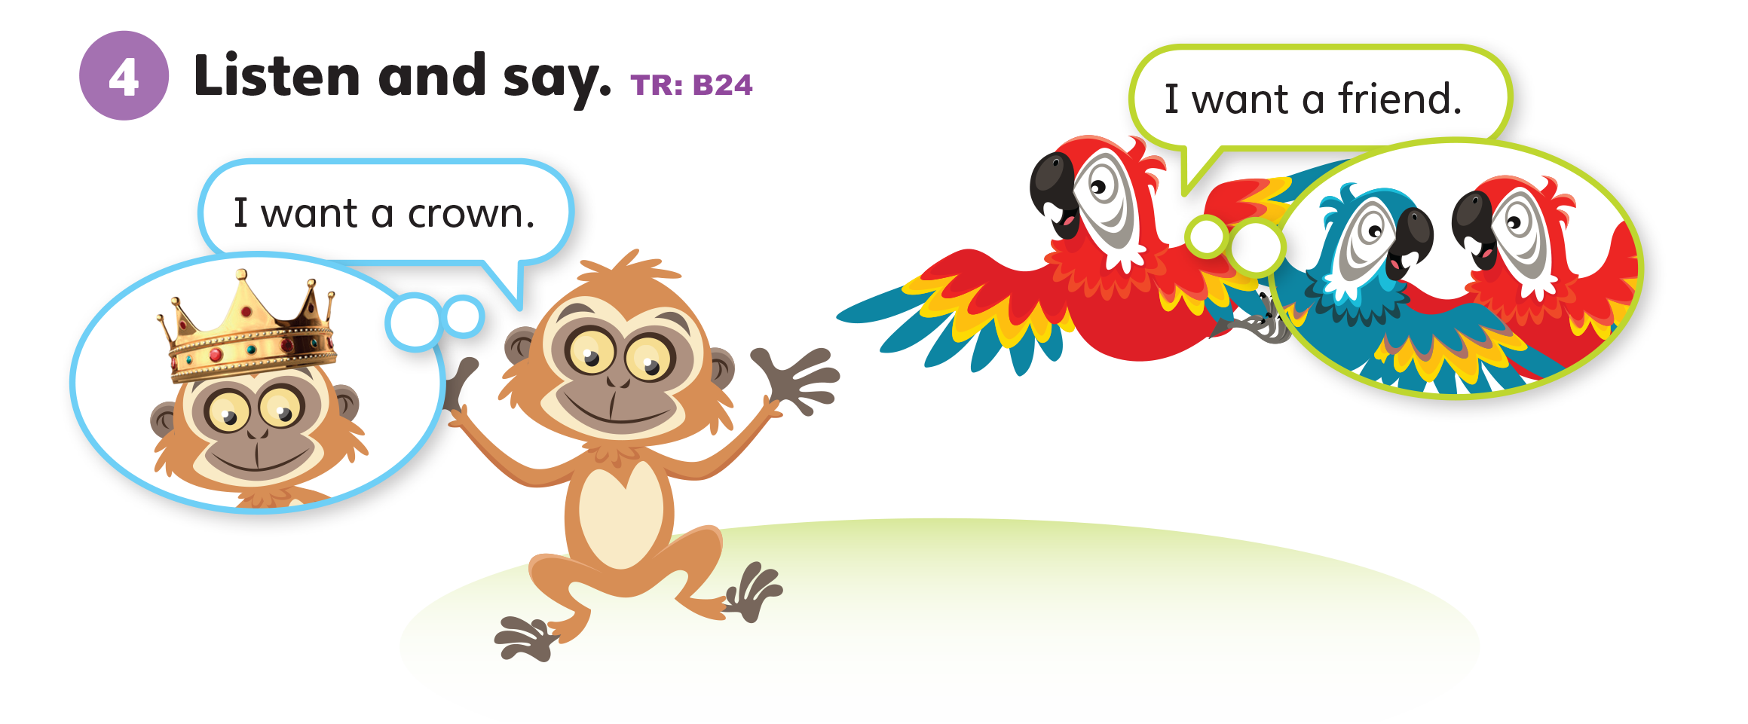
UNIT 1
STORIES
Notes:
Point to the mascots on p. 12 as you say Let’s listen.
Play TR: B24 two times. Each time, pause the audio for students to repeat the sentences.

Slide 39
UNIT 1
STORIES
He/She wants _____.
I want ____, too.
a king
a princess
a queen
a frog
a friend
a prince
Notes:
Have students look at p. 11 again. Point to the king.
Say He’s the king. He wants a castle. And you? Do you want a castle?
Gesture for students to raise their hands if they want a castle. Then, call on each student with a raised hand.
Students should say I want a castle.
If time allows, do the following too:
Point to the princess, and say She is sad. She wants a friend. And you?
Students who raise their hands should say I want a friend.
Point to the queen, and say She is the queen. She wants a crown. And you?
Students should say I want a crown.

Slide 40

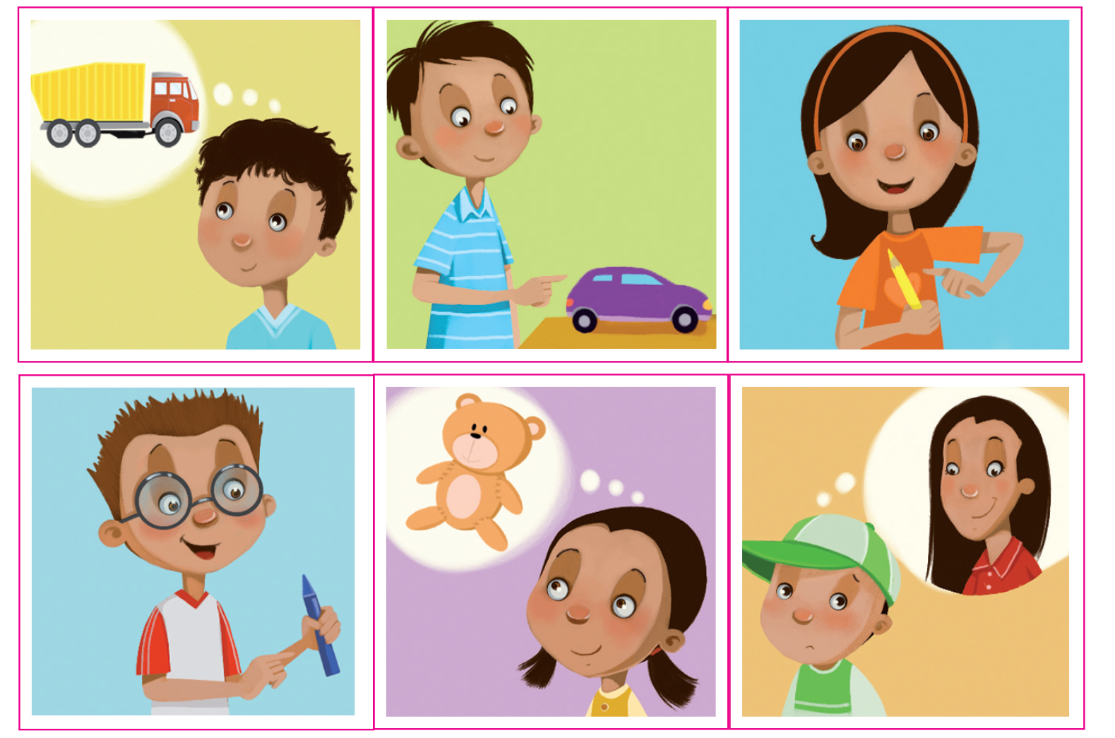
UNIT 1
STORIES
Notes:
5 Say Let’s do a sticker activity!
Show students the Unit 1 stickers in the back of the book.
Say Listen. Play TR: B25. Pause after the first item.
Then ask Is it a boy or a girl?
Students should say A boy.
Say Yes, it’s a boy. What does he want?
Students should say A truck.
Model finding and placing the correct sticker in the first space on p. 12. Continue playing TR: B25. Have students place the correct sticker after each item.

Slide 41

UNIT 1
STORIES
Notes:
5 Say Let’s do a sticker activity!
Show students the Unit 1 stickers in the back of the book.
Say Listen. Play TR: B25. Pause after the first item.
Then ask Is it a boy or a girl?
Students should say A boy.
Say Yes, it’s a boy. What does he want?
Students should say A truck.
Model finding and placing the correct sticker in the first space on p. 12. Continue playing TR: B25. Have students place the correct sticker after each item.

Slide 42
UNIT 1
STORIES
What does he/she want?
He wants a car.
She wants a yellow crayon.
Notes:
Have students look at the stickers that are left after Activity 5. Hold up the sticker of the boy and the car, and ask What does he say?
Students should say I want a car.
Repeat for the last sticker.
Students should say I want a yellow crayon.

Slide 43

UNIT 1
STORIES
What do you want?
I want ______.
Notes:
Have students work in pairs. Have one student say that he or she wants something in the room.
Students should say I want [a red book].
The student’s partner should look around the room, find the item being described, and bring it to the student who wants it. Then, have students switch roles.
Continue this until each student has three items.

Slide 44
UNIT 1
STORIES
Goodbye Chant
Good work, class.
Hip hip, hooray!
Goodbye for now.
Have a nice day!
Notes:
Say Good job today class. Now let’s chant.
Lead the class in the Goodbye chant.

Slide 45

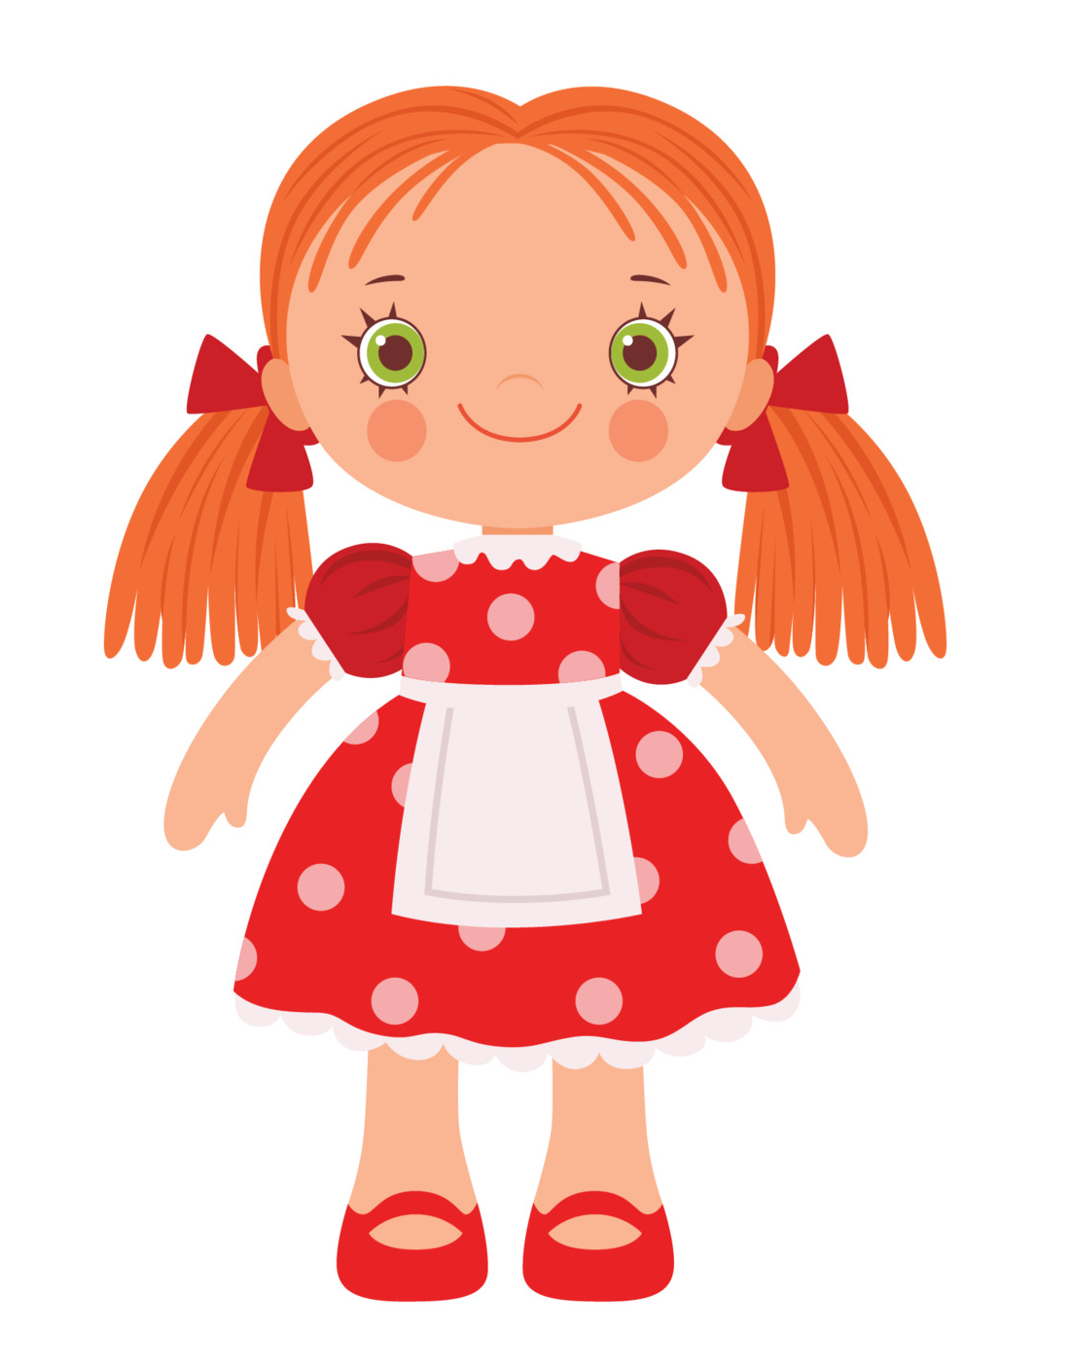

UNIT 1
STORIES
Let’s check!
What do you want?
I want ______.
Notes:
Can students use the simple present tense to talk
about classroom objects?
Point to different classroom objects and ask the students What is it? as they leave the class.

Slide 46
UNIT 1
STORIES
Thank you!

Slide 47
Unit 1:
Stories
Lesson 5

Slide 48
UNIT 1
STORIES
English Time Chant
English, (clap) English, (clap)
English (clap) today! (clap, clap)
English, (clap) English, (clap)
Hip, hip, (clap) hooray! (clap, clap)

Slide 49
UNIT 1
STORIES
Write a color letter!
A
G
Red A
Green G
Notes:
Give each student a red, blue, green, yellow, orange, brown, pink, purple, and black crayon and a sheet of paper. Say Let’s review colors and letter.
Have students write letters H, G, V, E, P, O, T, B, Y, A, I, J, C, and X, using different colors.
For example, say Write a red A. Write a green G.
Walk around the room to check students’ work.

Slide 50
UNIT 1
STORIES
Write a color letter!
H
V
Blue H
Black V
Notes:
Give each student a red, blue, green, yellow, orange, brown, pink, purple, and black crayon and a sheet of paper. Say Let’s review colors and letter.
Have students write letters H, G, V, E, P, O, T, B, Y, A, I, J, C, and X, using different colors.
For example, say Write a red A. Write a green G.
Walk around the room to check students’ work.

Slide 51
UNIT 1
STORIES
Write a color letter!
E
B
Orange E
Brown B
Notes:
Give each student a red, blue, green, yellow, orange, brown, pink, purple, and black crayon and a sheet of paper. Say Let’s review colors and letter.
Have students write letters H, G, V, E, P, O, T, B, Y, A, I, J, C, and X, using different colors.
For example, say Write a red A. Write a green G.
Walk around the room to check students’ work.

Slide 52
UNIT 1
STORIES
Write a color letter!
P
O
Yellow P
Purple O
Notes:
Give each student a red, blue, green, yellow, orange, brown, pink, purple, and black crayon and a sheet of paper. Say Let’s review colors and letter.
Have students write letters H, G, V, E, P, O, T, B, Y, A, I, J, C, and X, using different colors.
For example, say Write a red A. Write a green G.
Walk around the room to check students’ work.

Slide 53
UNIT 1
STORIES
Write a color letter!
T
Y
Brown T
Pink Y
Notes:
Give each student a red, blue, green, yellow, orange, brown, pink, purple, and black crayon and a sheet of paper. Say Let’s review colors and letter.
Have students write letters H, G, V, E, P, O, T, B, Y, A, I, J, C, and X, using different colors.
For example, say Write a red A. Write a green G.
Walk around the room to check students’ work.

Slide 54
UNIT 1
STORIES
Write a color letter!
I
J
Black I
Red J
Notes:
Give each student a red, blue, green, yellow, orange, brown, pink, purple, and black crayon and a sheet of paper. Say Let’s review colors and letter.
Have students write letters H, G, V, E, P, O, T, B, Y, A, I, J, C, and X, using different colors.
For example, say Write a red A. Write a green G.
Walk around the room to check students’ work.

Slide 55
UNIT 1
STORIES
Write a color letter!
C
X
Green C
Purple X
Notes:
Give each student a red, blue, green, yellow, orange, brown, pink, purple, and black crayon and a sheet of paper. Say Let’s review colors and letter.
Have students write letters H, G, V, E, P, O, T, B, Y, A, I, J, C, and X, using different colors.
For example, say Write a red A. Write a green G.
Walk around the room to check students’ work.

Slide 56
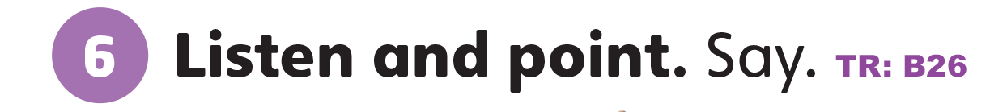

UNIT 1
STORIES
Find a gold or silver thing.
Notes:
6 Play TR: B26. Have students point to each color as they hear it. Then, have students name each of the colors.
Point to the gold picture, and ask Gold or silver?
Students should say Gold.
Repeat, using the silver picture.
Students should say Silver.
If you are wearing any jewelry that is gold or silver, point to it and ask Gold or silver?
If possible, find other gold- or silver-colored items in your classroom, and have students say their colors.
Have students name any other gold or silver objects they have come across.

Slide 57
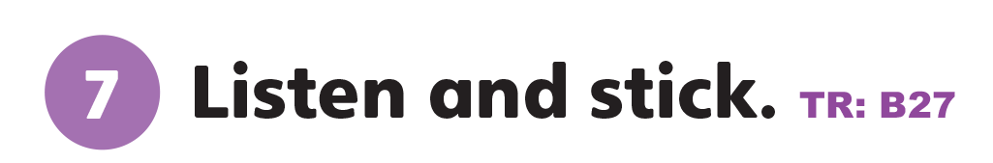
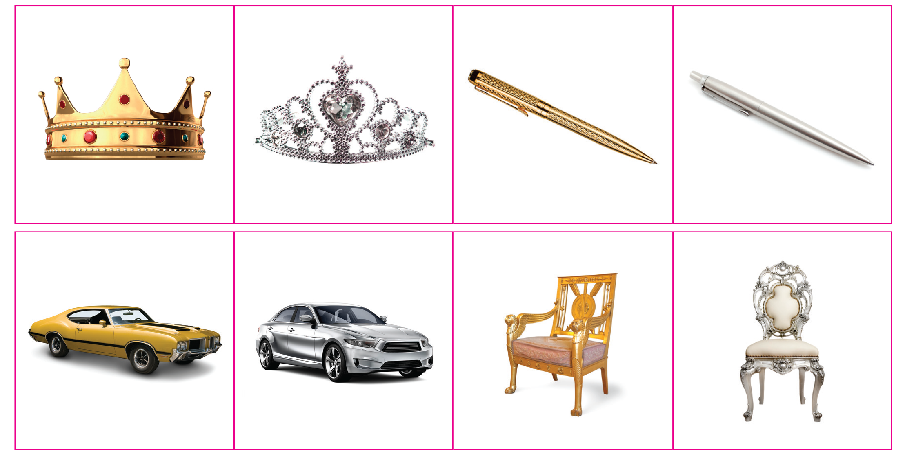
UNIT 1
STORIES
Notes:
7 Say Let’s do a sticker activity.
Show students the second set of Unit 1 stickers in the back of their book. Play TR: B27.
Pause after item 1, and ask What is it?
Students should say A silver car.
Continue playing TR: B27 and have students place the other stickers.

Slide 58

UNIT 1
STORIES
Notes:
7 Say Let’s do a sticker activity.
Show students the second set of Unit 1 stickers in the back of their book. Play TR: B27.
Pause after item 1, and ask What is it?
Students should say A silver car.
Continue playing TR: B27 and have students place the other stickers.

Slide 59
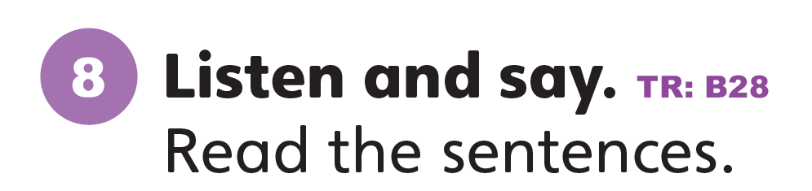

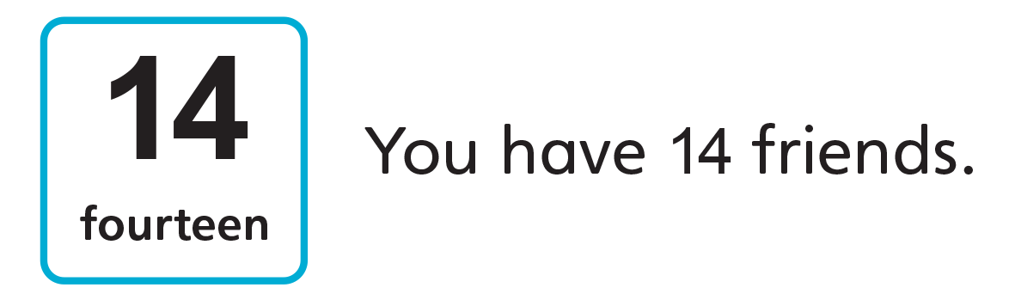
UNIT 1
STORIES
Notes:
8 Have students look at Activity 8. Say Let’s listen. Repeat the numbers you hear.
Play TR: BR28 and have students listen and repeat what they hear.
Students should say Thirteen. Fourteen.
Ask students to number off from 1 to 14. Call a random number from 1 to 14 and have the student(s) with the number read the sentences aloud.
Students should say I want 13 crowns. / You have 14 friends.

Slide 60


UNIT 1
STORIES
Let’s decorate
I want ______.
Notes:
Give each student half a sheet of construction paper and a bottle of glue or a glue stick.
If students are able, have them write the first letter of their first name using the glue. If they cannot yet write the letter, have students make a simple design.
Walk around the room with a container of gold glitter and a container of silver glitter.
Have students say I want gold or I want silver.
Students should say I want [gold].
Sprinkle the color of glitter they want over the glue on their paper.

Slide 61
UNIT 1
STORIES
Goodbye Chant
Good work, class.
Hip hip, hooray!
Goodbye for now.
Have a nice day!
Notes:
Say Good job today class. Now let’s chant.
Lead the class in the Goodbye chant.

Slide 62
UNIT 1
STORIES
Let’s check!
What color is it?
Notes:
Can students identify and name things that are gold and silver?
Point to the gold and silver pictures, and have students name each color.

Slide 63


UNIT 1
STORIES
What color is it?
It’s ________.
Notes:
Can students identify and name things that are gold and silver?
Point to the gold and silver pictures, and have students name each color.

Slide 64
UNIT 1
STORIES
Thank you!

Slide 65
Unit 1:
Stories
Lesson 6

Slide 66
UNIT 1
STORIES
English Time Chant
English, (clap) English, (clap)
English (clap) today! (clap, clap)
English, (clap) English, (clap)
Hip, hip, (clap) hooray! (clap, clap)

Slide 67
UNIT 1
STORIES
Let’s review
Notes:
Play TR: B26. Have students point to each color as they hear it. Then, have students name each of the colors.

Slide 68
UNIT 1
STORIES
What numbers come after 10, 11 and 12?
Notes:
Have students open their books to p. 13. Point to the numbers 13 and 14.
Ask What numbers come after 10, 11 and 12?
Students should say Thirteen. Fourteen.

Slide 69
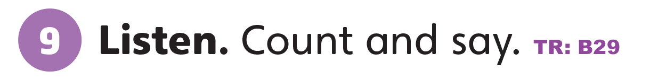
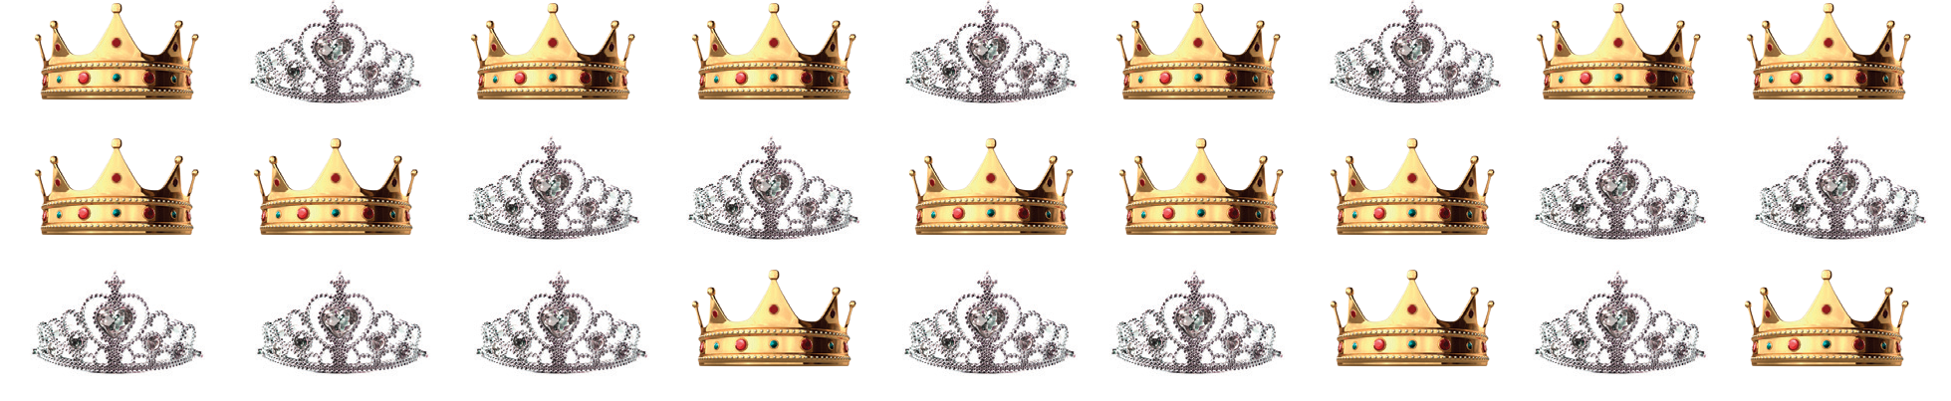
UNIT 1
STORIES
How many ______?
14 golden crowns
13 silver crowns
Notes:
9 Have students count the crowns and write the number on a paper. Then, say Now, let’s listen.
Play TR: B29 and pause after the first item.
Say There are 14 gold crowns. Do you have the right answer?
Students should raise their hand if they counted 14 gold crowns.
Continue playing TR: B29, pausing after each item to have students count and answer the questions.

Slide 70

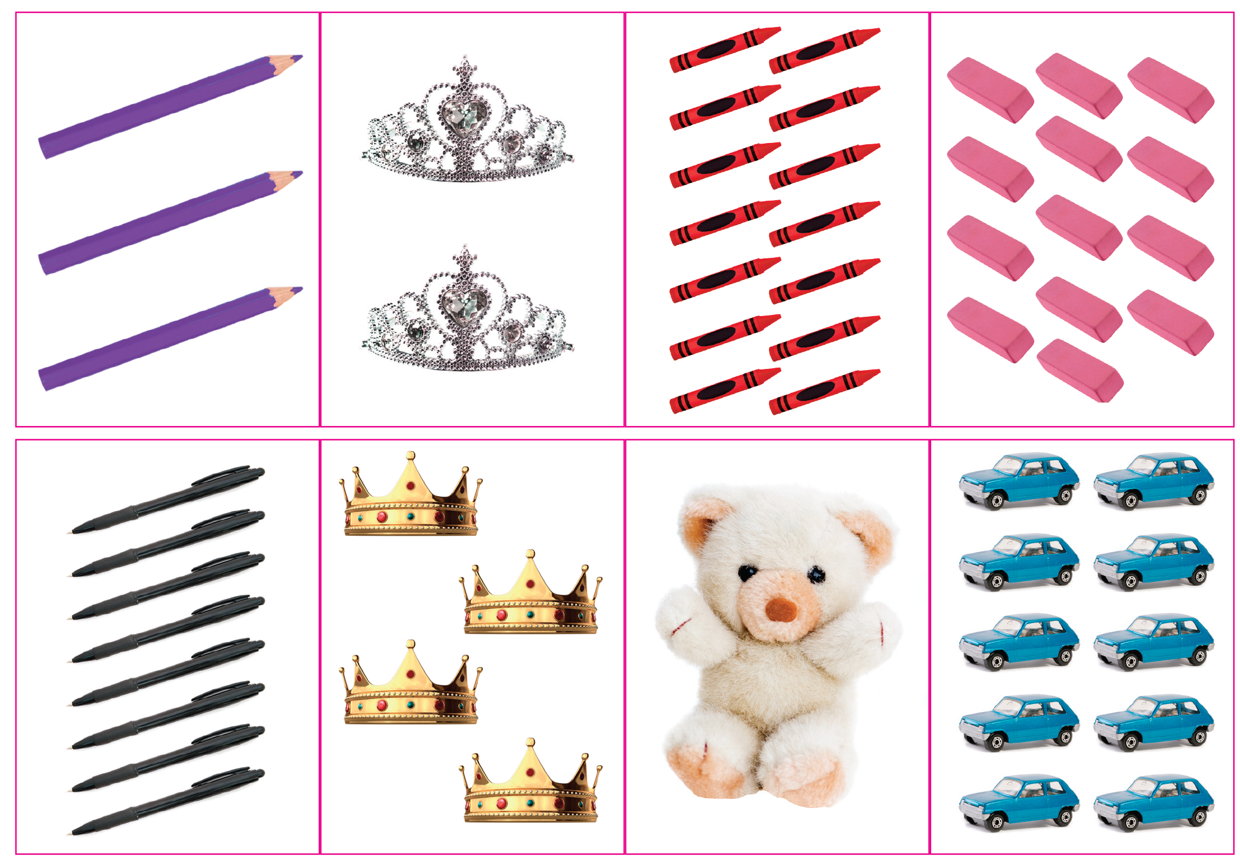
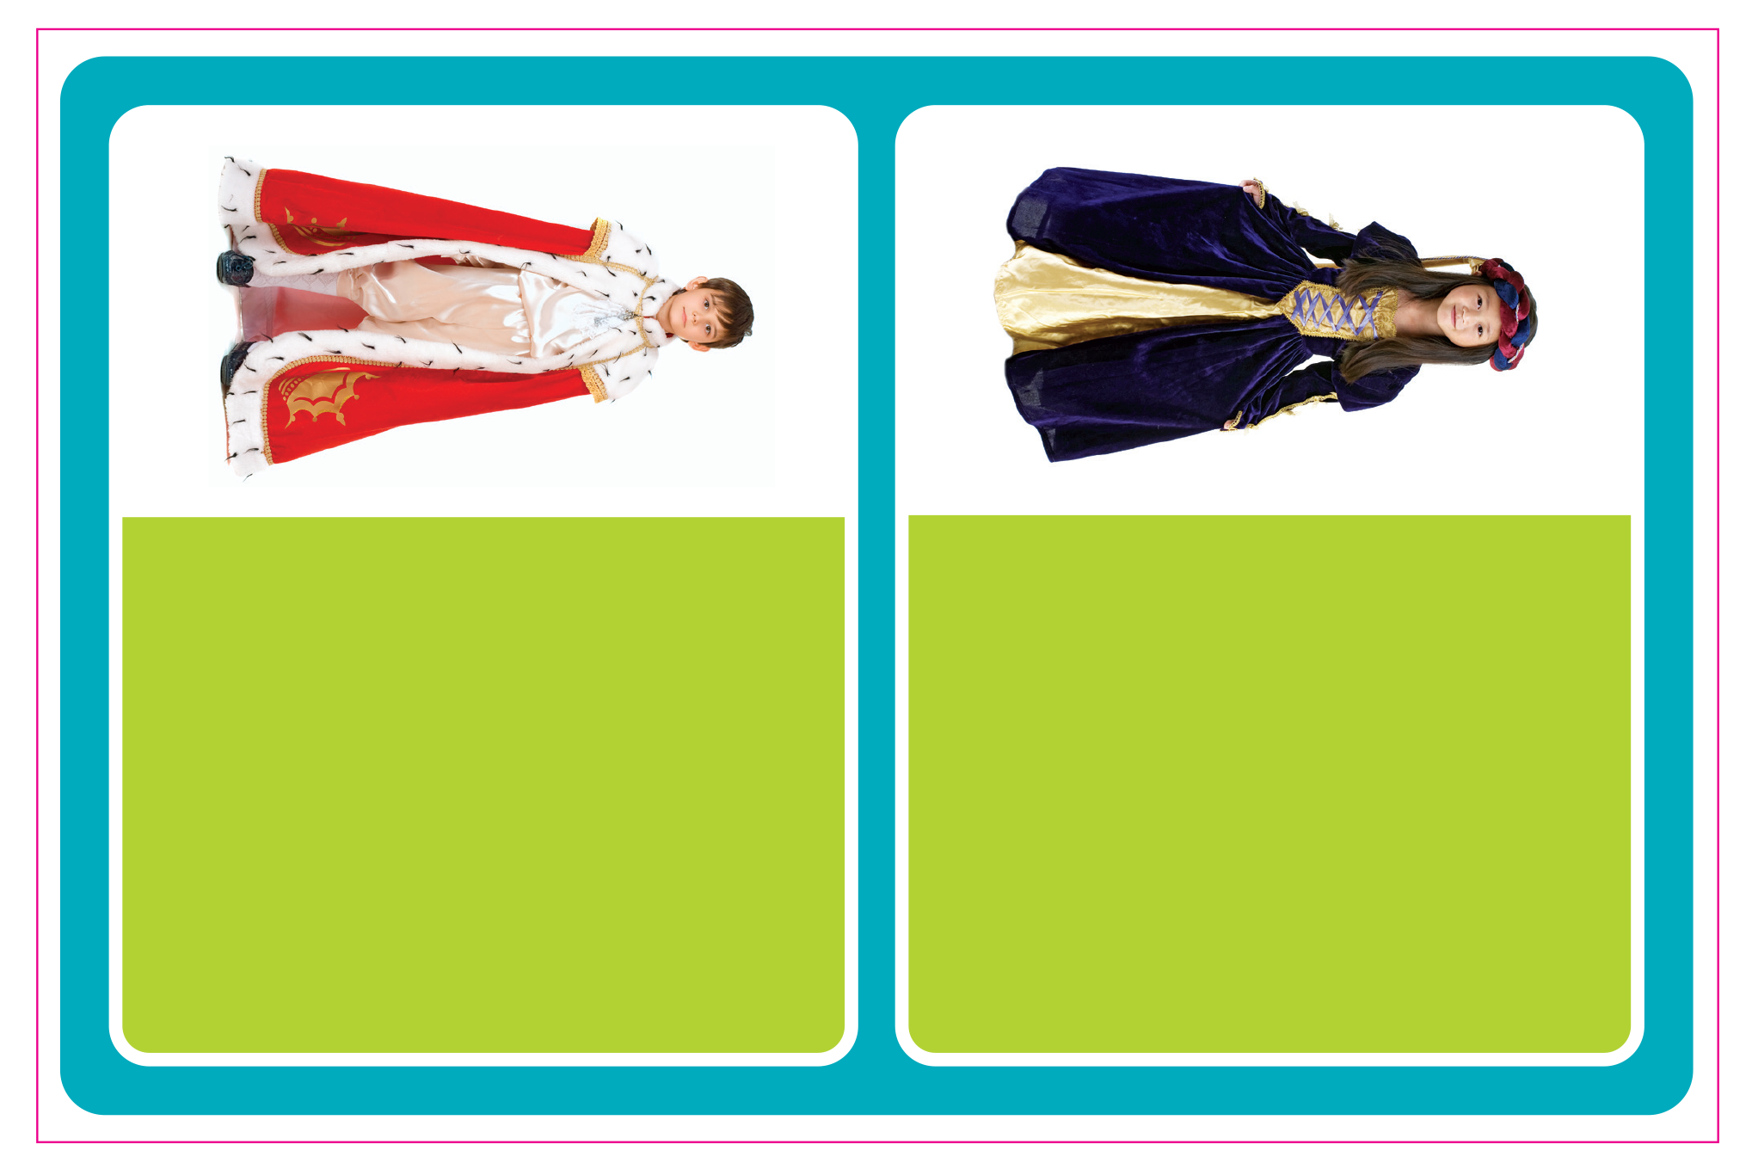
UNIT 1
STORIES
Notes:
10 Say Let’s do a sticker activity.
Play TR: B30 and pause after the directions.
Give students scissors and poster board to make the cards and the game board. Hold up the game board, point to the girl, and ask Who’s this?
Students should say A princess.
Repeat for the boy.
Students should say A prince.
Continue playing TR: B30. Pause after the first item, and ask Who’s talking?
Students should say The prince.
Model finding the correct card and placing it next to the prince.
Continue playing the TR: B30.
Pause after each item, to give students time to find and place the correct card.
When students finish, place them in pairs.
Have one student play the role of the prince, and the other play the role of the princess.
Have them take turns holding up the cards in their piles and saying what they want.
Students should say I want [two silver crowns].

Slide 71
UNIT 1
STORIES
Notes:
10 Say Let’s do a sticker activity.
Play TR: B30 and pause after the directions.
Give students scissors and poster board to make the cards and the game board. Hold up the game board, point to the girl, and ask Who’s this?
Students should say A princess.
Repeat for the boy.
Students should say A prince.
Continue playing TR: B30. Pause after the first item, and ask Who’s talking?
Students should say The prince.
Model finding the correct card and placing it next to the prince.
Continue playing the TR: B30.
Pause after each item, to give students time to find and place the correct card.
When students finish, place them in pairs.
Have one student play the role of the prince, and the other play the role of the princess.
Have them take turns holding up the cards in their piles and saying what they want.
Students should say I want [two silver crowns].

Slide 72

UNIT 1
STORIES
Let’s make medals
Notes:
Create gold medals for half of your class using gold crayons, markers, or glitter on circles cut from poster board.
Create silver medals for the other half, using silver crayons, markers, or glitter, or aluminum foil, around circles.

Slide 73
UNIT 1
STORIES
English Olympics
Notes:
Hold an “English Olympics” in your class.
Divide students into two teams. Have one member at a time from each team come to the front. Point to pictures for any of the words from this unit or Grade 1 for students to name.
Award a point to the team with the student who identifies the word first.
After each picture has been reviewed, count the points and announce the winner.
Give the gold medals to the winning team, and silver medals to the second-place team.

Slide 74
UNIT 1
STORIES
Goodbye Chant
Good work, class.
Hip hip, hooray!
Goodbye for now.
Have a nice day!
Notes:
Say Good job today class. Now let’s chant.
Lead the class in the Goodbye chant.

Slide 75
UNIT 1
STORIES
Let’s check!
What color is it?
Notes:
Can students identify and name things that are gold and silver?
Point to the gold and silver pictures, and have students name each color.

Slide 76
UNIT 1
STORIES
What color is it?
It’s ________.
Notes:
Can students identify and name things that are gold and silver?
Point to the gold and silver pictures, and have students name each color.

Slide 77
UNIT 1
STORIES
Thank you!

Slide 78
Unit 1:
Stories
Lesson 7

Slide 79
UNIT 1
STORIES
English Time Chant
English, (clap) English, (clap)
English (clap) today! (clap, clap)
English, (clap) English, (clap)
Hip, hip, (clap) hooray! (clap, clap)

Slide 80
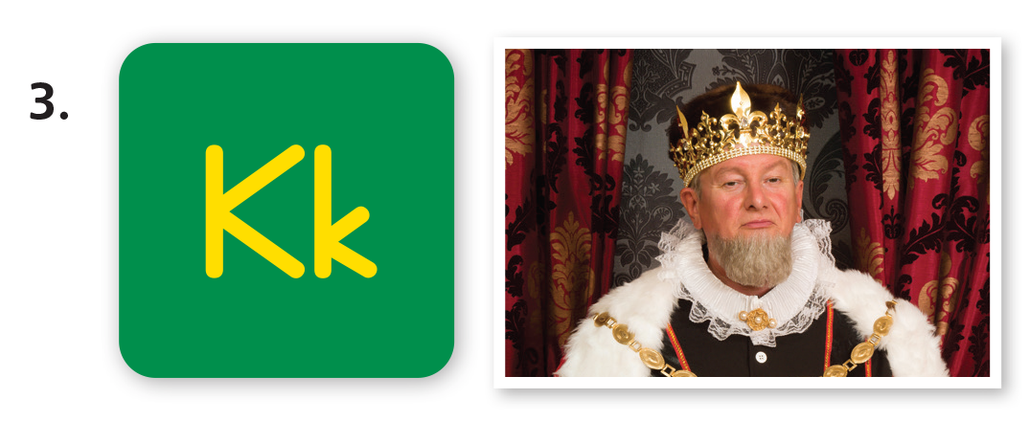
UNIT 1
STORIES
A King
The King sits.
Notes:
Point to the picture of the king on p. 14 and ask students to name what they see.
Students should say A king.
Then make the /s/ sound. Say Sit. The king sits. Ask What other words starts with /s/?
Students should say [Stand, stories].
Make the /ʌ/ sound, and ask What words have /ʌ/?
Students should say [Up].

Slide 81

UNIT 1
STORIES
What other words starts with /s/?
Stand
Stories
Notes:
Point to the picture of the king on p. 14 and ask students to name what they see.
Students should say A king.
Then make the /s/ sound. Say Sit. The king sits. Ask What other words starts with /s/?
Students should say [Stand, stories].
Make the /ʌ/ sound, and ask What words have /ʌ/?
Students should say [Up].

Slide 82
UNIT 1
STORIES
What words have /ʌ/?
Up
Notes:
Point to the picture of the king on p. 14 and ask students to name what they see.
Students should say A king.
Then make the /s/ sound. Say Sit. The king sits. Ask What other words starts with /s/?
Students should say [Stand, stories].
Make the /ʌ/ sound, and ask What words have /ʌ/?
Students should say [Up].

Slide 83
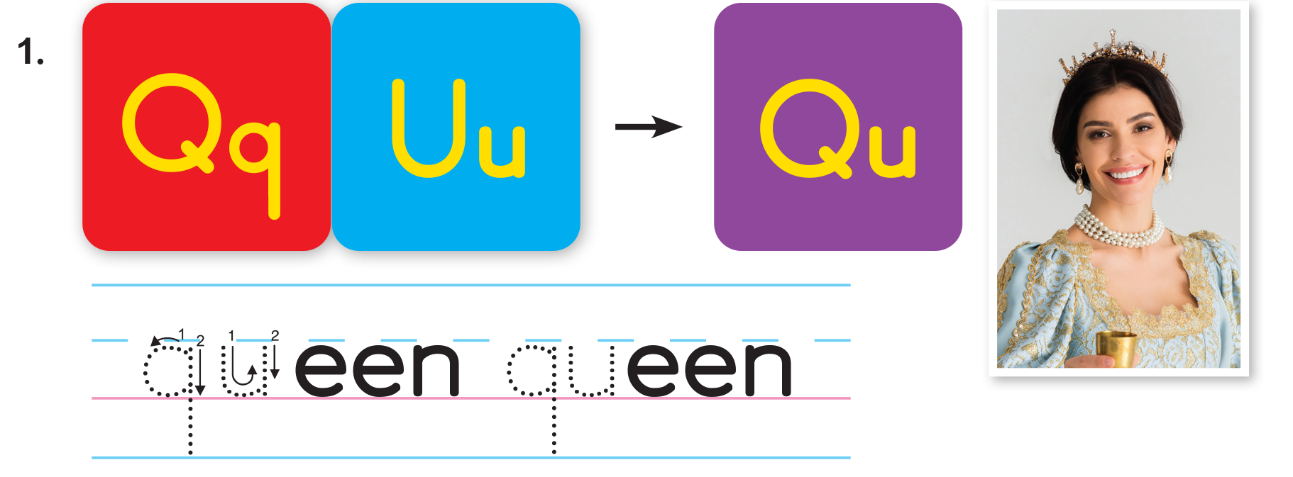
UNIT 1
STORIES
The sound of English
Notes:
Say Let’s listen to new sounds. Play TR: B31. Ask students to repeat each sound or word they hear.
Say Queen has the /kw/ sound. Have students repeat the sound and the word.
Then, say the following words, and have students raise their hands when they hear /kw/: hello, goodbye, queen, frog, quiet, crown.
Students should raise their hands when they hear queen and quiet.

Slide 84
UNIT 1
STORIES
Which has the /kw/ sound?
✓
HELLO
GOODBYE
QUEEN
FROG
QUITE
CROWN
✓
Notes:
Say Queen has the /kw/ sound. Have students repeat the sound and the word.
Then, say the following words, and have students raise their hands when they hear /kw/: hello, goodbye, queen, frog, quiet, crown.
Students should raise their hands when they hear queen and quiet.

Slide 85
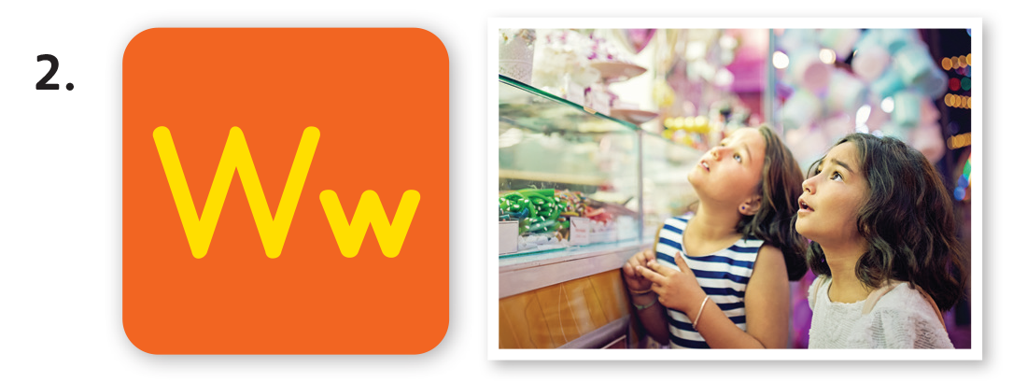
UNIT 1
STORIES
The sound of English
Notes:
Say Let’s listen to new sounds. Play TR: B31. Ask students to repeat each sound or word they hear.
Say Queen has the /kw/ sound. Have students repeat the sound and the word.
Then, say the following words, and have students raise their hands when they hear /kw/: hello, goodbye, queen, frog, quiet, crown.
Students should raise their hands when they hear queen and quiet.

Slide 86
UNIT 1
STORIES
Which has the /w/ sound?
✓
✓
RED
WANT
GREEN
WHITE
WATER
ARM
FEET
✓
Notes:
Say Want has the /w/ sound. Have students repeat the sound and the word. Then, say the following words, and have students raise their hands when they hear /w/: red, want, green, water, arm, feet, white.
Students should raise their hands when they hear want, water, white.

Slide 87
UNIT 1
STORIES
The sound of English
Notes:
Say Let’s listen to new sounds. Play TR: B31. Ask students to repeat each sound or word they hear.
Say Queen has the /kw/ sound. Have students repeat the sound and the word.
Then, say the following words, and have students raise their hands when they hear /kw/: hello, goodbye, queen, frog, quiet, crown.
Students should raise their hands when they hear queen and quiet.

Slide 88
UNIT 1
STORIES
Which has the /k/ sound?
✓
✓
KITE
KING
PEN
SIT
BOOK
✓
Notes:
Say King has the /k/ sound. Have students repeat the sound and the word. Then, say the following words, and have students raise their hands when they hear /k/. Remind students that the sound can appear in the middle or at the end of a word: kite, king, pen, sit, book.
Students should raise their hands when they hear kite, king, book.

Slide 89
UNIT 1
STORIES
Do you have /kw/, /w/, or /k/ in your name?
Notes:
If there are students in your class with /kw/, /w/, or /k/ in their names, point them out. For example, say Wanda. What sounds do you hear in Wanda’s name?
Students should say /w/.

Slide 90
UNIT 1
STORIES
Notes:
11 Write Qq on the board. Ask What letter is this?
Students should say Q.
Then write Uu on the board. Ask What letter is this?
Students should say U.
Then say The letter q together with the letter u makes the sound /kw/. Have students make the /kw/ sound.
Students should say /kw/.
Ask students to open their books to p. 14. Then say Let’s learn to pronounce /kw/. Listen and repeat what you hear.
Play TR: B31.
Have students follow along with the track by looking at the Activity 11 and pointing to the letters and words. Play the track again and have students repeat the sounds.

Slide 91
UNIT 1
STORIES
Let’s Say
QUEEN
Notes:
11 Write Qq on the board. Ask What letter is this?
Students should say Q.
Then write Uu on the board. Ask What letter is this?
Students should say U.
Then say The letter q together with the letter u makes the sound /kw/. Have students make the /kw/ sound.
Students should say /kw/.
Ask students to open their books to p. 14. Then say Let’s learn to pronounce /kw/. Listen and repeat what you hear.
Play TR: B31.
Have students follow along with the track by looking at the Activity 11 and pointing to the letters and words. Play the track again and have students repeat the sounds.

Slide 92

UNIT 1
STORIES
Notes:
Say Let’s listen to new sounds. Play TR: B31. Ask students to repeat each sound or word they hear.
Say Queen has the /kw/ sound. Have students repeat the sound and the word.
Then, say the following words, and have students raise their hands when they hear /kw/: hello, goodbye, queen, frog, quiet, crown.
Students should raise their hands when they hear queen and quiet.

Slide 93
UNIT 1
STORIES
Let’s Say
WANT
Notes:
11 Write Qq on the board. Ask What letter is this?
Students should say Q.
Then write Uu on the board. Ask What letter is this?
Students should say U.
Then say The letter q together with the letter u makes the sound /kw/. Have students make the /kw/ sound.
Students should say /kw/.
Ask students to open their books to p. 14. Then say Let’s learn to pronounce /kw/. Listen and repeat what you hear.
Play TR: B31.
Have students follow along with the track by looking at the Activity 11 and pointing to the letters and words. Play the track again and have students repeat the sounds.

Slide 94
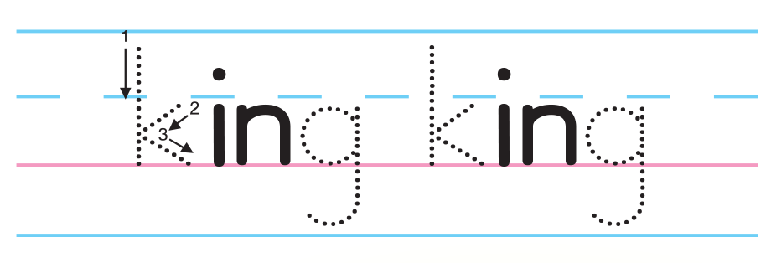
UNIT 1
STORIES
Notes:
Say Let’s listen to new sounds. Play TR: B31. Ask students to repeat each sound or word they hear.
Say Queen has the /kw/ sound. Have students repeat the sound and the word.
Then, say the following words, and have students raise their hands when they hear /kw/: hello, goodbye, queen, frog, quiet, crown.
Students should raise their hands when they hear queen and quiet.

Slide 95
UNIT 1
STORIES
Let’s Say
KING
Notes:
11 Write Qq on the board. Ask What letter is this?
Students should say Q.
Then write Uu on the board. Ask What letter is this?
Students should say U.
Then say The letter q together with the letter u makes the sound /kw/. Have students make the /kw/ sound.
Students should say /kw/.
Ask students to open their books to p. 14. Then say Let’s learn to pronounce /kw/. Listen and repeat what you hear.
Play TR: B31.
Have students follow along with the track by looking at the Activity 11 and pointing to the letters and words. Play the track again and have students repeat the sounds.

Slide 96
UNIT 1
STORIES
Let’s Trace
Notes:
Draw Qu and qu in dotted outline on the board. Say Let’s trace the letters qu. Model tracing over the outline. Then say Look at the word and picture for queen again. Listen to the sound /kw/ and use your pencil to trace the letters qu.
Play TR: B32 and stop after queen. Make sure students trace qu two times for queen.
Call on volunteers to say the word aloud.
Students should say Queen.
Repeat the activity for w and k and play the rest of TR: B32.

Slide 97
UNIT 1
STORIES
Let’s Trace
Notes:
Draw Qu and qu in dotted outline on the board. Say Let’s trace the letters qu. Model tracing over the outline. Then say Look at the word and picture for queen again. Listen to the sound /kw/ and use your pencil to trace the letters qu.
Play TR: B32 and stop after queen. Make sure students trace qu two times for queen.
Call on volunteers to say the word aloud.
Students should say Queen.
Repeat the activity for w and k and play the rest of TR: B32.

Slide 98
UNIT 1
STORIES
Let’s Trace
Notes:
Draw Qu and qu in dotted outline on the board. Say Let’s trace the letters qu. Model tracing over the outline. Then say Look at the word and picture for queen again. Listen to the sound /kw/ and use your pencil to trace the letters qu.
Play TR: B32 and stop after queen. Make sure students trace qu two times for queen.
Call on volunteers to say the word aloud.
Students should say Queen.
Repeat the activity for w and k and play the rest of TR: B32.

Slide 99
UNIT 1
STORIES
Goodbye Chant
Good work, class.
Hip hip, hooray!
Goodbye for now.
Have a nice day!
Notes:
Say Good job today class. Now let’s chant.
Lead the class in the Goodbye chant.

Slide 100
UNIT 1
STORIES
Let’s check!
Let’s Say
Notes:
Can students identify and make the /kw/, /w/ and /k/ sounds?
Display the pictures for queen, want, and king.
Make a target sound, and have students point to the picture and say the word that has the sound they hear.

Slide 101
UNIT 1
STORIES
Thank you!

Slide 102
Unit 1:
Stories
Lesson 8

Slide 103
UNIT 1
STORIES
English Time Chant
English, (clap) English, (clap)
English (clap) today! (clap, clap)
English, (clap) English, (clap)
Hip, hip, (clap) hooray! (clap, clap)

Slide 104
UNIT 1
STORIES
The Sound of English
Notes:
Say Let’s listen to new sounds. Play TR: B31. Pause after each word for students to repeat the sound and the word.
Say Queen has the /kw/ sound. Have students repeat the sound and the word.
Then, say the following words, and have students raise their hands when they hear /kw/: hello, goodbye, queen, frog, quiet, crown.
Students should raise their hands when they hear queen and quiet.
Repeat for the other sounds.

Slide 105
UNIT 1
STORIES
Which has the /kw/ sound?
✓
HELLO
GOODBYE
QUEEN
FROG
QUITE
CROWN
✓
Notes:
Say Let’s listen to new sounds. Play TR: B31. Pause after each word for students to repeat the sound and the word.
Say Queen has the /kw/ sound. Have students repeat the sound and the word.
Then, say the following words, and have students raise their hands when they hear /kw/: hello, goodbye, queen, frog, quiet, crown.
Students should raise their hands when they hear queen and quiet.
Repeat for the other sounds.

Slide 106
UNIT 1
STORIES
The Sound of English
Notes:
Say Let’s listen to new sounds. Play TR: B31. Pause after each word for students to repeat the sound and the word.
Say Queen has the /kw/ sound. Have students repeat the sound and the word.
Then, say the following words, and have students raise their hands when they hear /kw/: hello, goodbye, queen, frog, quiet, crown.
Students should raise their hands when they hear queen and quiet.
Repeat for the other sounds.

Slide 107
UNIT 1
STORIES
Which has the /w/ sound?
✓
✓
RED
WANT
GREEN
WHITE
WATER
ARM
FEET
✓
Notes:
Say Let’s listen to new sounds. Play TR: B31. Pause after each word for students to repeat the sound and the word.
Say Queen has the /kw/ sound. Have students repeat the sound and the word.
Then, say the following words, and have students raise their hands when they hear /kw/: hello, goodbye, queen, frog, quiet, crown.
Students should raise their hands when they hear queen and quiet.
Repeat for the other sounds.

Slide 108
UNIT 1
STORIES
The sound of English
Notes:
Say Let’s listen to new sounds. Play TR: B31. Pause after each word for students to repeat the sound and the word.
Say Queen has the /kw/ sound. Have students repeat the sound and the word.
Then, say the following words, and have students raise their hands when they hear /kw/: hello, goodbye, queen, frog, quiet, crown.
Students should raise their hands when they hear queen and quiet.
Repeat for the other sounds.

Slide 109
UNIT 1
STORIES
Which has the /k/ sound?
✓
✓
KITE
KING
PEN
SIT
BOOK
✓
Notes:
Say Let’s listen to new sounds. Play TR: B31. Pause after each word for students to repeat the sound and the word.
Say Queen has the /kw/ sound. Have students repeat the sound and the word.
Then, say the following words, and have students raise their hands when they hear /kw/: hello, goodbye, queen, frog, quiet, crown.
Students should raise their hands when they hear queen and quiet.
Repeat for the other sounds.

Slide 110
UNIT 1
STORIES
Do you have /kw/, /w/, or /k/ in your name?
Notes:
If there are students in your class with /kw/, /w/, or /k/ in their names, point them out. For example, say Kanga. What sounds do you hear in Kanga’s name?
Students should say /k/.

Slide 111
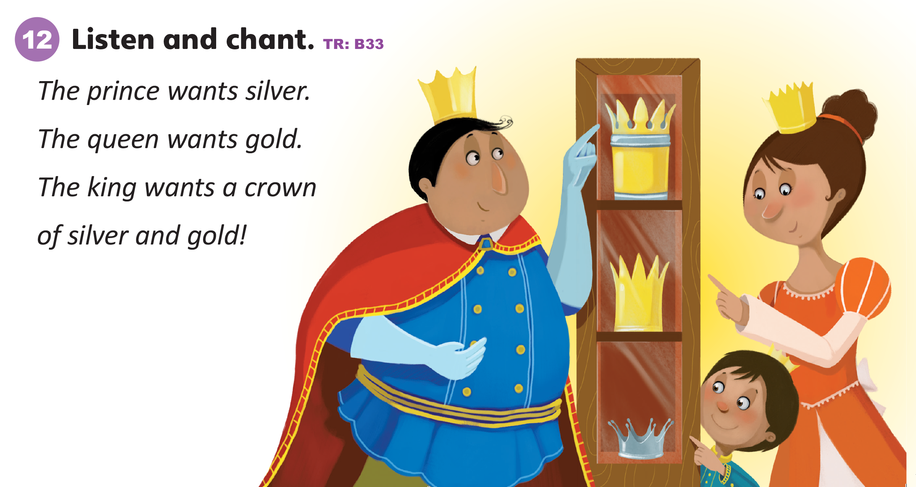
UNIT 1
STORIES
Notes:
12 Say Let’s listen to a chant.
Play TR: B33 two times. Have students listen to the chant.
Play TR: B33 a third time and pause after each line. Have students try to say the entire chant.
Put students in pairs. Have them look at pictures for frog, prince, princess, queen, king, and friend on p. 11.
This time, have students replace the words prince, queen, and king with the words for the pictures that they chose.
Students should take turns repeating the chant.

Slide 112
UNIT 1
STORIES
Let’s play
STOP
GO
Notes:
Have students play Red Light, Green Light.
Have students line up on one side of the room.
Hold up a piece of green paper to show go.
Have students say the chant as they walk across the room. Every few seconds, hold up a piece of red paper, and have students stop.
Continue having students walk and chant until they have crossed the room a few times.

Slide 113
UNIT 1
STORIES
Let’s Play
Can you find it?
Notes:
Hide pictures or picture cards for queen, want, and king in the room. Say I’m looking for something with /k/.
Call on a student.
Ask [Meilyn], can you help me?
Have that student look for the picture of the king. Once he or she finds it, have the student say the word and then sit back down. Repeat for the other two sounds.

Slide 114
UNIT 1
STORIES
Goodbye Chant
Good work, class.
Hip hip, hooray!
Goodbye for now.
Have a nice day!
Notes:
Say Good job today class. Now let’s chant.
Lead the class in the Goodbye chant.

Slide 115
UNIT 1
STORIES
Let’s check!
Let’s Say
Notes:
Can students identify and make the /kw/, /w/, and /k/ sounds?
Display the pictures for queen, want, and king.
Make a target sound, and have students point to the picture and say the word that has the sound they hear.

Slide 116
UNIT 1
STORIES
Thank you!

Slide 117
Unit 1:
Stories
Lesson 9

Slide 118
UNIT 1
STORIES
English Time Chant
English, (clap) English, (clap)
English (clap) today! (clap, clap)
English, (clap) English, (clap)
Hip, hip, (clap) hooray! (clap, clap)

Slide 119
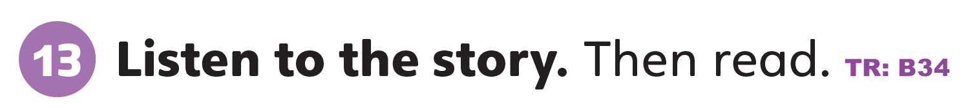
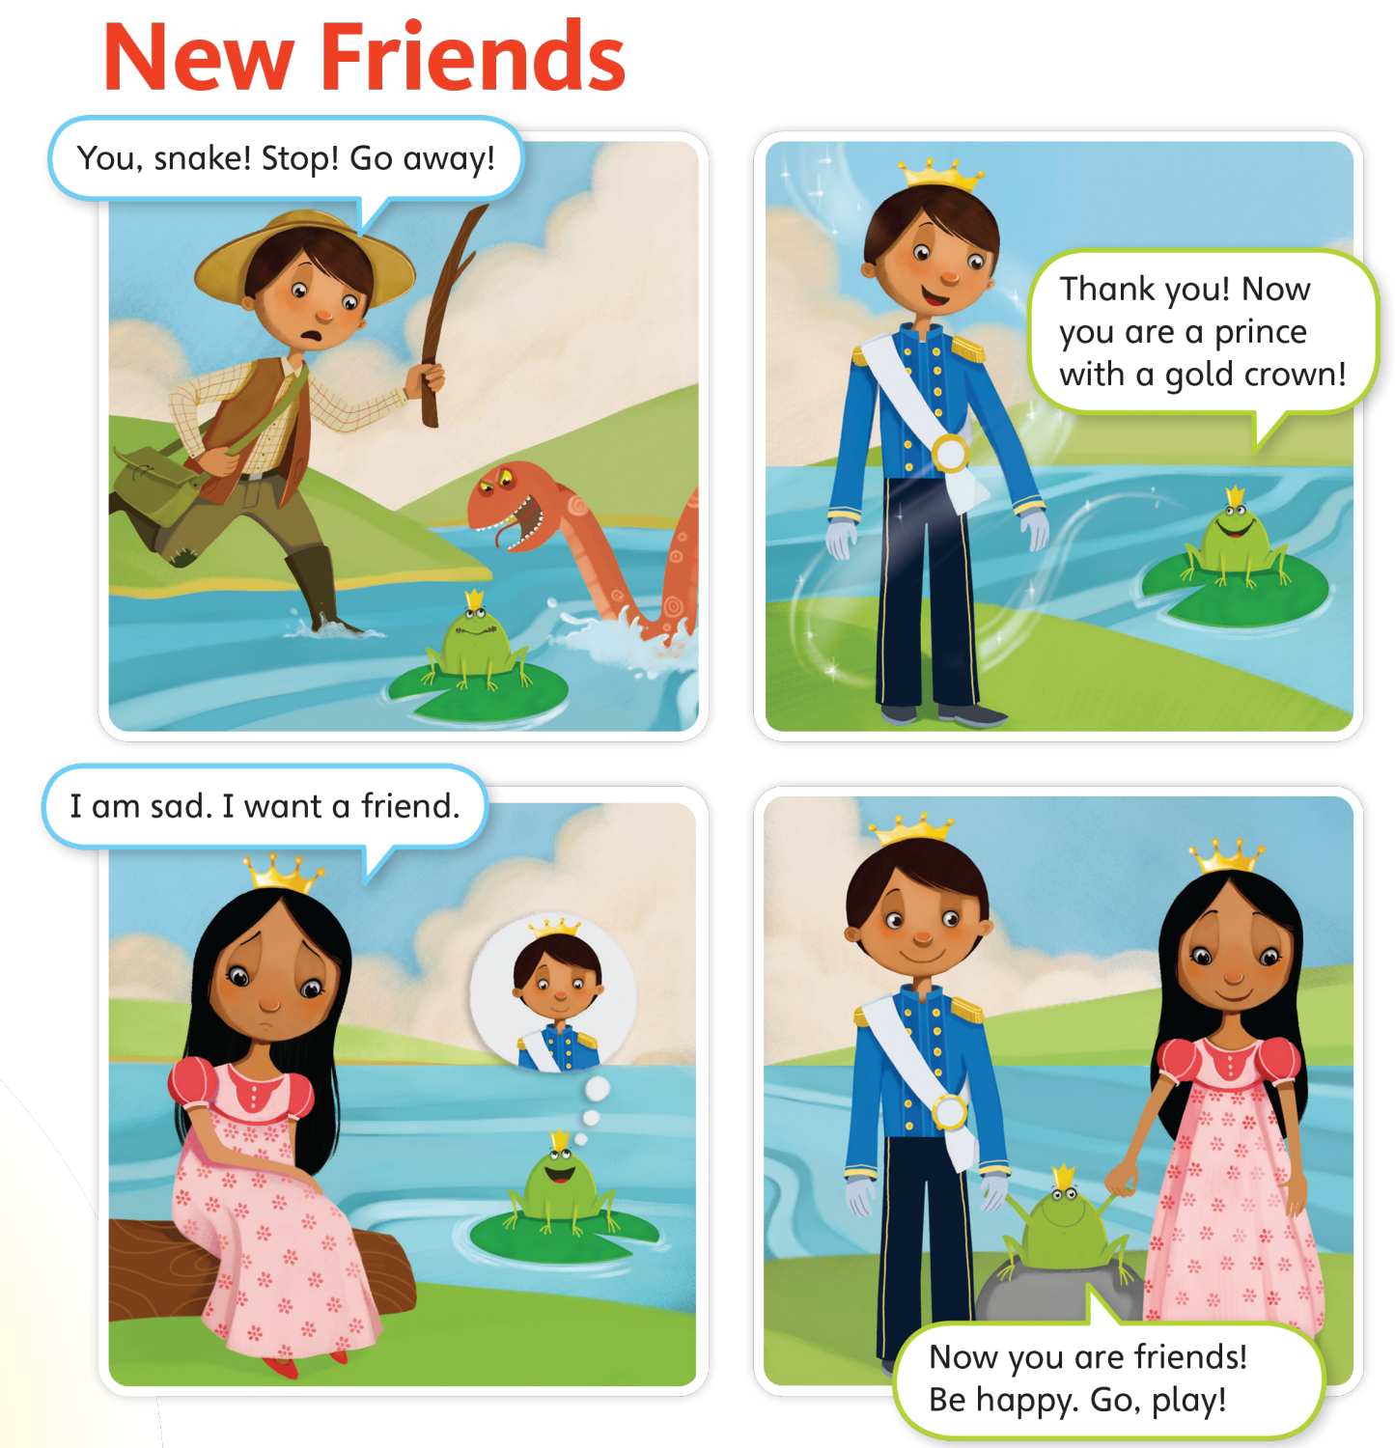
UNIT 1
STORIES
Who has a crown?
The frog, the prince, the princess
Notes:
Have students look at the story on p. 15.
Ask students the following questions:
Who has a crown?
Students should say The frog, the prince, the princess.
Is the frog happy or sad?
Students should say Happy.
Who is sad?
Students should say The princess.

Slide 120
UNIT 1
STORIES
Is the frog happy or sad?
Happy
Notes:
Have students look at the story on p. 15.
Ask students the following questions:
Who has a crown?
Students should say The frog, the prince, the princess.
Is the frog happy or sad?
Students should say Happy.
Who is sad?
Students should say The princess.

Slide 121
UNIT 1
STORIES
Who is sad?
The princess
Notes:
Have students look at the story on p. 15.
Ask students the following questions:
Who has a crown?
Students should say The frog, the prince, the princess.
Is the frog happy or sad?
Students should say Happy.
Who is sad?
Students should say The princess.

Slide 122
UNIT 1
STORIES
Who does the friend help—the frog or the snake?
The frog
Notes:
13 Give students two strips of paper each, and have them cover the story, except for the first panel.
Point to the first panel of the story and say Look! A snake! Point to the frog, and say Oh, no! The snake will get the frog! Point to the boy and say Look! A friend!
Read aloud the boy’s line from the first panel. Then, ask students Who does the fried help—the frog or the snake?
Students should say The frog.
Let students uncover the second panel of the story. Read the text, and ask Are you right? Does the friend help the frog?
Students should say Yes.
Say Now the friend is a prince!

Slide 123
UNIT 1
STORIES
Yes
Are you right? Does the friend help the frog?
Now the friend is a prince.
Notes:
13 Give students two strips of paper each, and have them cover the story, except for the first panel.
Point to the first panel of the story and say Look! A snake! Point to the frog, and say Oh, no! The snake will get the frog! Point to the boy and say Look! A friend!
Read aloud the boy’s line from the first panel. Then, ask students Who does the fried help—the frog or the snake?
Students should say The frog.
Let students uncover the second panel of the story. Read the text, and ask Are you right? Does the friend help the frog?
Students should say Yes.
Say Now the friend is a prince!

Slide 124
UNIT 1
STORIES
Who is it?
The princess
How does she feel?
Sad
Notes:
Have students look at the third panel as you read it aloud. Then, ask the following questions:
Who is it?
Students should say The princess.
How does she feel?
Students should say Sad.
What does she want?
Students should say A friend.
Who will be the friend—the frog or the prince?
Students should say The prince.
Have students uncover the fourth panel and read the story. Have them confirm their predictions.

Slide 125
UNIT 1
STORIES
What does she want?
A friend
Who will be the friend—the frog or the prince?
The prince
Notes:
Have students look at the third panel as you read it aloud. Then, ask the following questions:
Who is it?
Students should say The princess.
How does she feel?
Students should say Sad.
What does she want?
Students should say A friend.
Who will be the friend—the frog or the prince?
Students should say The prince.
Have students uncover the fourth panel and read the story. Have them confirm their predictions.

Slide 126
UNIT 1
STORIES
Are you right?
Notes:
Have students look at the third panel as you read it aloud. Then, ask the following questions:
Who is it?
Students should say The princess.
How does she feel?
Students should say Sad.
What does she want?
Students should say A friend.
Who will be the friend—the frog or the prince?
Students should say The prince.
Have students uncover the fourth panel and read the story. Have them confirm their predictions.
Remember to consider students’ learning styles when doing reading activities and vary the lesson accordingly. Read the story aloud to aural learners and encourage them to read it aloud to themselves. Since kinesthetic learners learn best by doing, encourage them to act out the story.

Slide 127
UNIT 1
STORIES
Notes:
Say Let’s read about new friends.
Play TR: B34. As the story plays, point to each panel.
Play TR: B34 a second time. This time, have students point to each panel as they hear the story.
Divide students into four groups. Have each group read the text from each panel. If time permits, rotate the reading so that all groups get to read the text from all four panels. Alternatively, have volunteers act out the story.

Slide 128
UNIT 1
STORIES
Notes:
14 Say I like the story!
Hold up your book and point to the happy face.
Say I like the story. I circle the happy face.
Model circling the happy face. Then, gesture toward the students, and ask Do you like the story?
Students should choose a face and circle it to show how they feel about the story.
Have students decide which response is the most popular by counting the number of marks next to each face.

Slide 129

UNIT 1
STORIES
Let’s draw
What is next?
Notes:
Give each student a piece of paper and some crayons or markers.
Have them draw a picture to show what happens next in the story. For example, they might draw a picture of the prince and the princess going off to a castle or playing together.
Allow students a few moments to draw. Collect students’ pictures, and hold them up, one at a time.
For each one, ask What happens next? Have students say what happens in each picture.
Provide support whenever necessary, if students do not have the language to describe the scene. Then, have the class vote on their favorite ending.

Slide 130
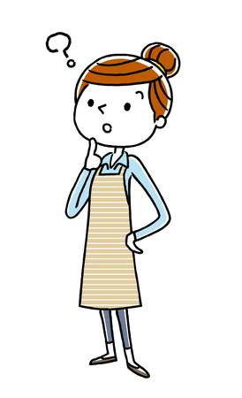
UNIT 1
STORIES
Let’s remember
What color are the prince’s clothes?
Black and Blue
Notes:
Have students close their books.
Then ask them the following questions to test their memory:
What color are the prince’s clothes?
Students should say Blue and black.
What color is the princess’s hair?
Students should say Black.
Does the frog have a crown?
Students should say Yes.
Is it gold or silver?
Students should say Gold.
Who is holding hands at the end of the story?
Students should say The prince, the frog, and the princess.
Listen to students’ answers. Then, have them open their book and check to see which answer were correct.

Slide 131
UNIT 1
STORIES
Let’s remember
What color is the princess’s hair?
Black
Notes:
Have students close their books.
Then ask them the following questions to test their memory:
What color are the prince’s clothes?
Students should say Blue and black.
What color is the princess’s hair?
Students should say Black.
Does the frog have a crown?
Students should say Yes.
Is it gold or silver?
Students should say Gold.
Who is holding hands at the end of the story?
Students should say The prince, the frog, and the princess.
Listen to students’ answers. Then, have them open their book and check to see which answer were correct.

Slide 132
UNIT 1
STORIES
Let’s remember
Does the frog have a crown?
Yes
Notes:
Have students close their books.
Then ask them the following questions to test their memory:
What color are the prince’s clothes?
Students should say Blue and black.
What color is the princess’s hair?
Students should say Black.
Does the frog have a crown?
Students should say Yes.
Is it gold or silver?
Students should say Gold.
Who is holding hands at the end of the story?
Students should say The prince, the frog, and the princess.
Listen to students’ answers. Then, have them open their book and check to see which answer were correct.

Slide 133
UNIT 1
STORIES
Let’s remember
Is it gold or silver?
Gold
Notes:
Have students close their books.
Then ask them the following questions to test their memory:
What color are the prince’s clothes?
Students should say Blue and black.
What color is the princess’s hair?
Students should say Black.
Does the frog have a crown?
Students should say Yes.
Is it gold or silver?
Students should say Gold.
Who is holding hands at the end of the story?
Students should say The prince, the frog, and the princess.
Listen to students’ answers. Then, have them open their book and check to see which answer were correct.

Slide 134
UNIT 1
STORIES
Let’s remember
Who is holding hands at the end of the story?
The prince, the frog, and the princess.
Notes:
Have students close their books.
Then ask them the following questions to test their memory:
What color are the prince’s clothes?
Students should say Blue and black.
What color is the princess’s hair?
Students should say Black.
Does the frog have a crown?
Students should say Yes.
Is it gold or silver?
Students should say Gold.
Who is holding hands at the end of the story?
Students should say The prince, the frog, and the princess.
Listen to students’ answers. Then, have them open their book and check to see which answer were correct.

Slide 135
UNIT 1
STORIES
Goodbye Chant
Good work, class.
Hip hip, hooray!
Goodbye for now.
Have a nice day!
Notes:
Say Good job today class. Now let’s chant.
Lead the class in the Goodbye chant.

Slide 136
UNIT 1
STORIES
Let’s check!
Let’s review
Notes:
Can students listen to and understand a story?
Read New Friends. Then ask students Who became friends?
Can students recognize target vocabulary in context?
Slowly say each of the Unit 1 vocabulary words, and have students raise their hands when they hear a word that was included in the story.

Slide 137
UNIT 1
STORIES
Thank you!

