Slide 1
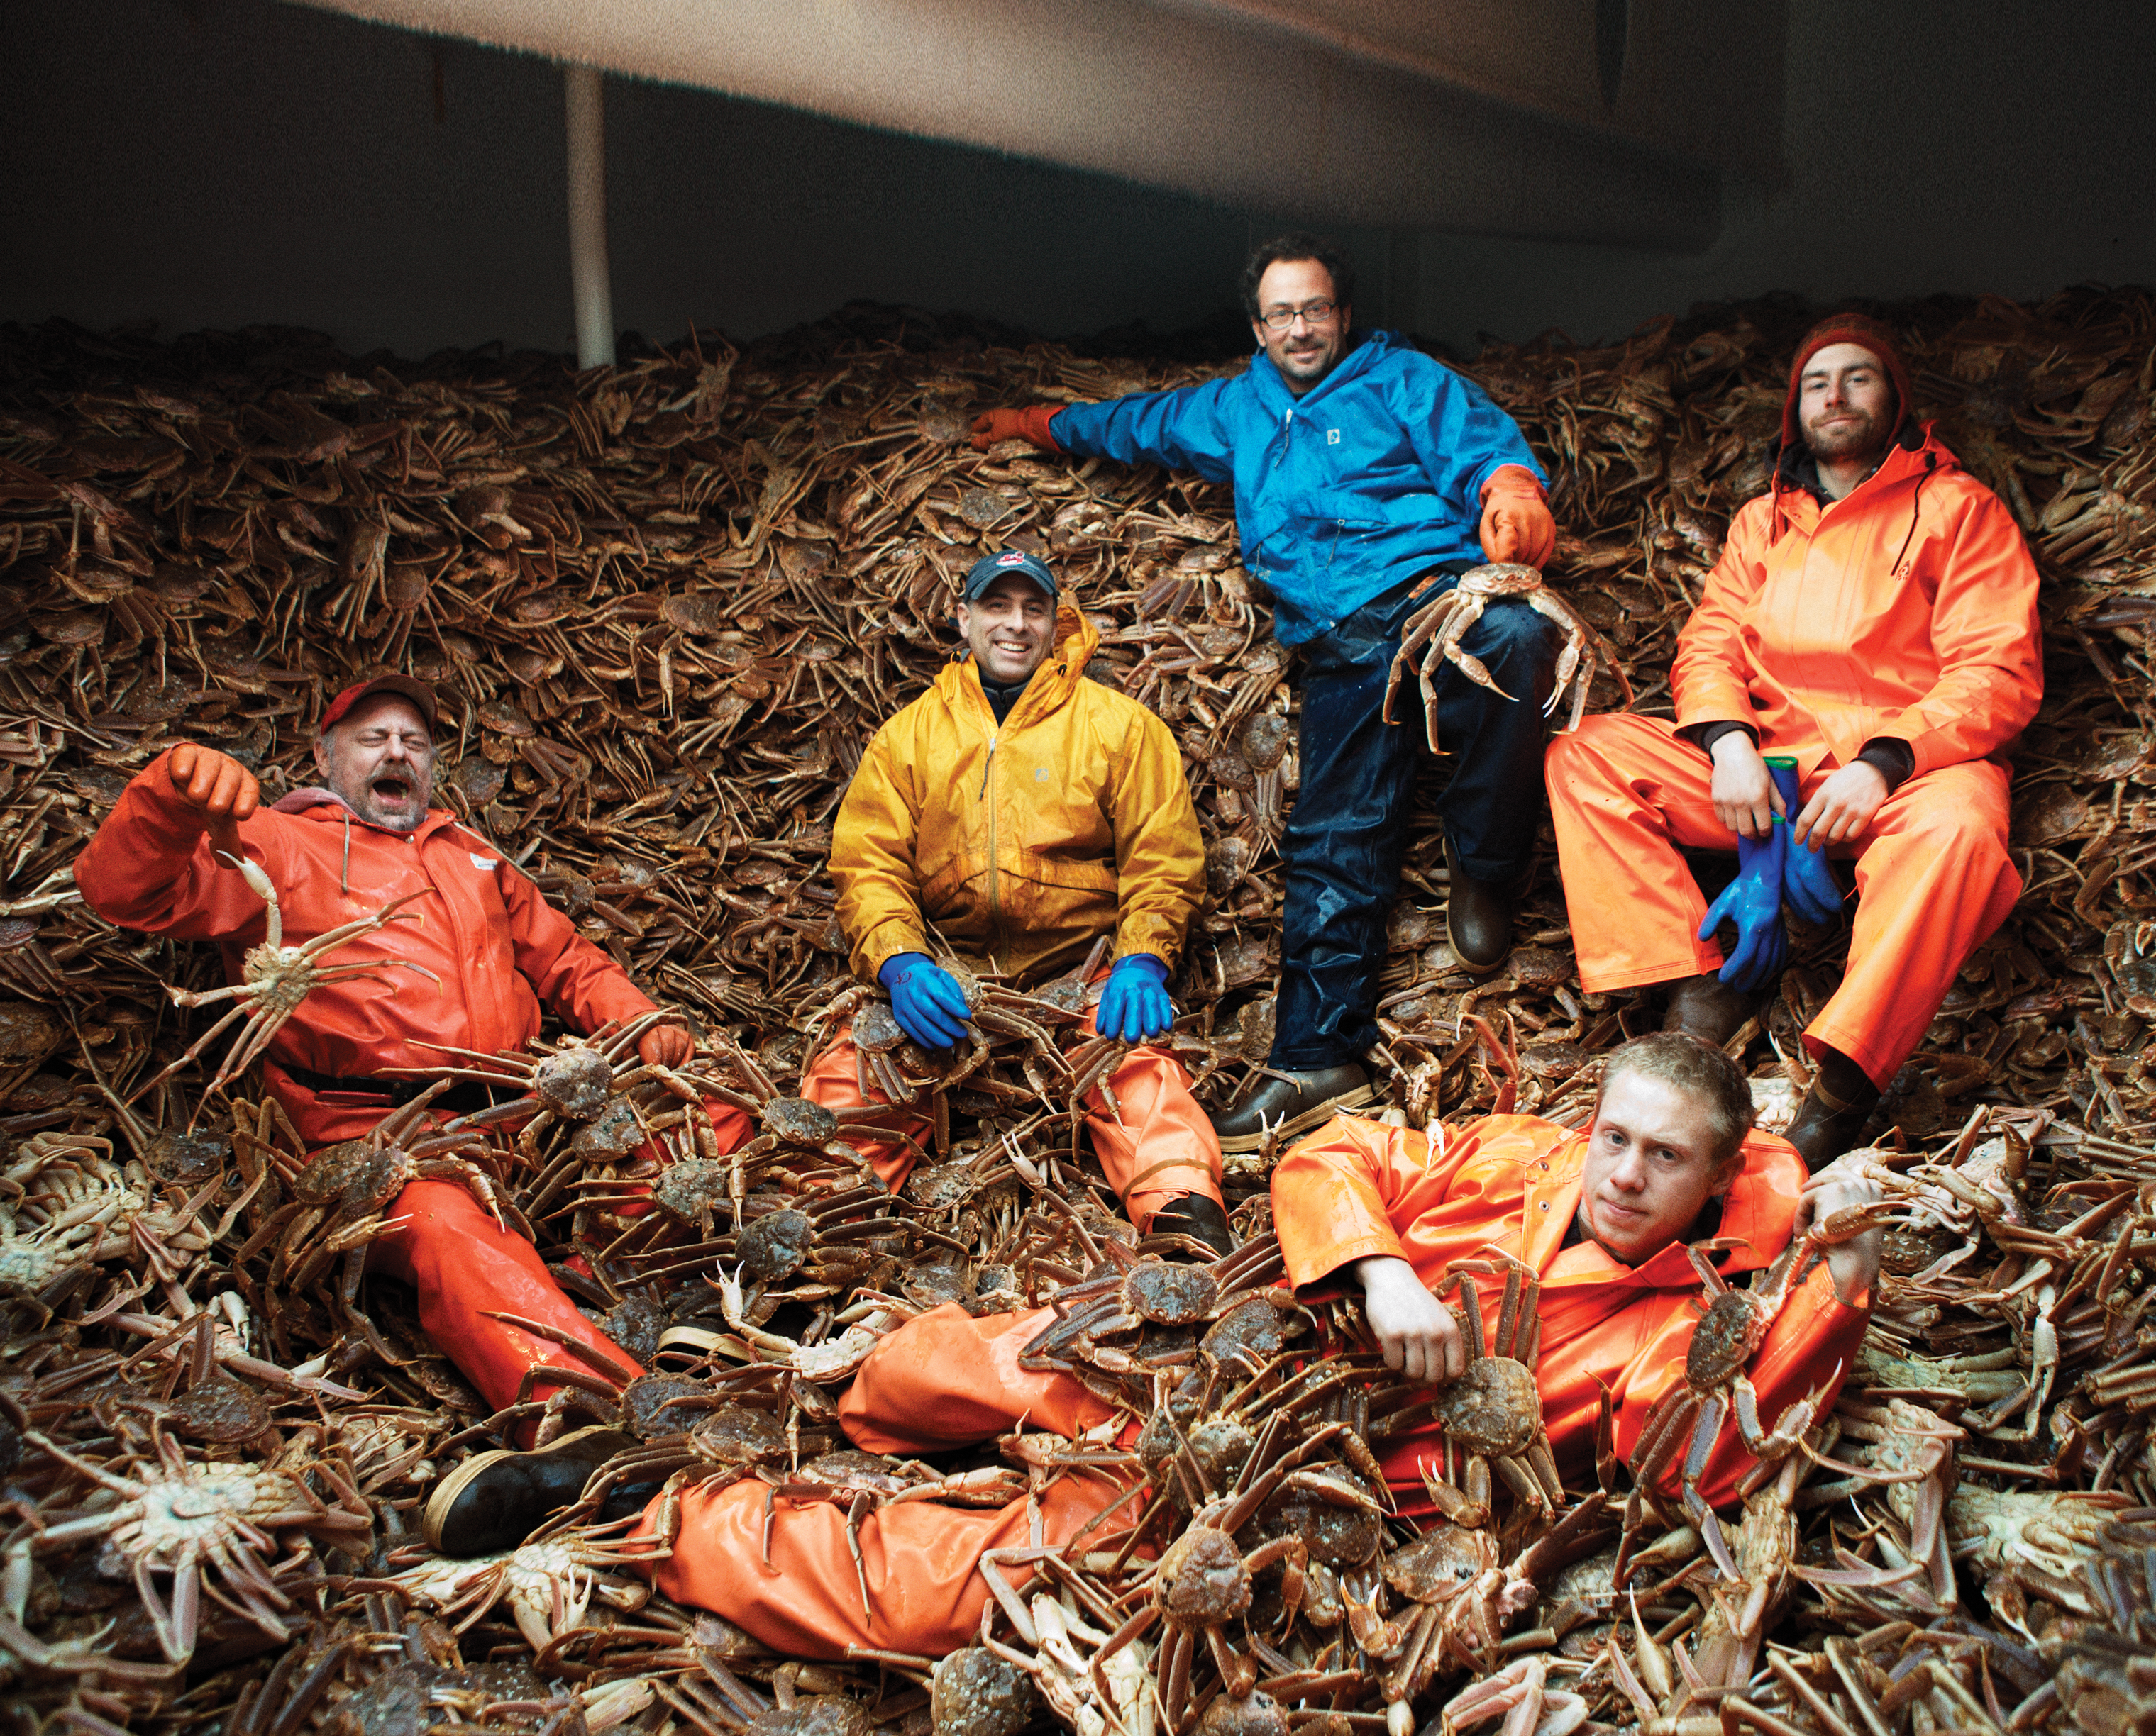


Unit 2:
A DAY
IN THE LIFE
_______________________________________________________________________________________________________________________________________________________________________________________________________________________
National Geographic Learning, a Cengage Company. © 2022 Cengage Learning, Inc. ALL RIGHTS RESERVED. This presentation tool is for teaching purpose only. May not be scanned, copied or duplicated, or posted to a publicly accessible website, in whole or in part.

Slide 2
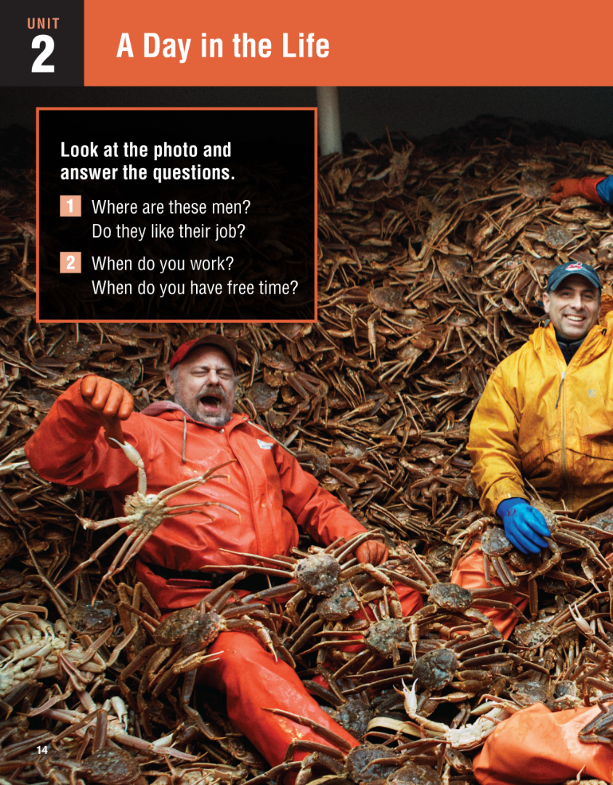
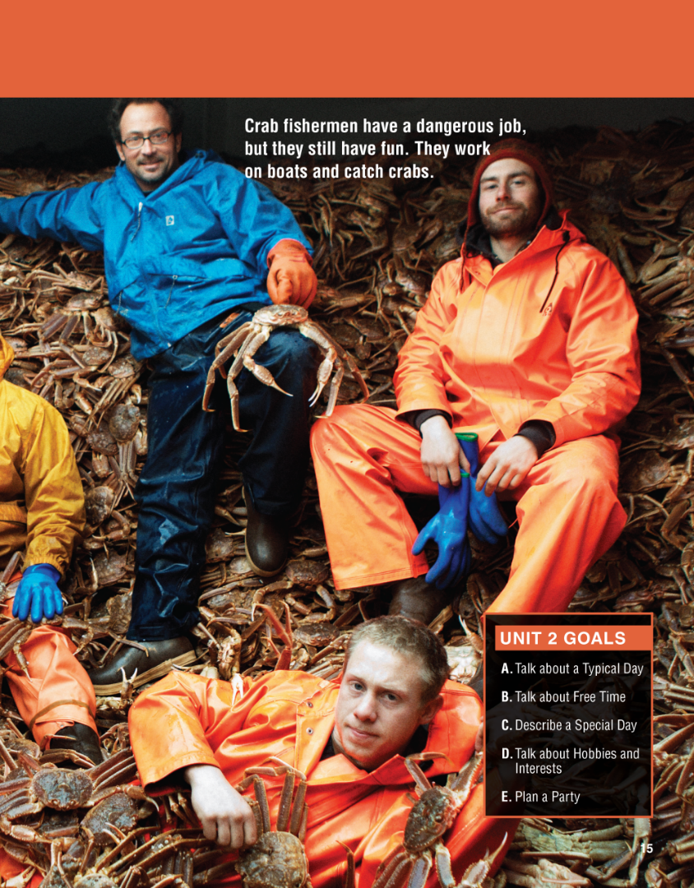

Slide 3
UNIT 12
DECISIONS
OVERVIEW
Do you know?
Crab fishing is done all over the world. There are almost 7,000 species, and they vary in size from tiny to enormous.
Worldwide, we eat over a million tons of crab every year.
_______________________________________________________________________________________________________________________________________________________________________________________________________________________
National Geographic Learning, a Cengage Company. © 2022 Cengage Learning, Inc. ALL RIGHTS RESERVED. This presentation tool is for teaching purpose only. May not be scanned, copied or duplicated, or posted to a publicly accessible website, in whole or in part.

Slide 4
UNIT 2
A DAY IN LIFE
VOCABULARY
What things do you do every day?
brush your teeth
eat breakfast
go to class
start work
take a shower
_______________________________________________________________________________________________________________________________________________________________________________________________________________________
National Geographic Learning, a Cengage Company. © 2022 Cengage Learning, Inc. ALL RIGHTS RESERVED. This presentation tool is for teaching purpose only. May not be scanned, copied or duplicated, or posted to a publicly accessible website, in whole or in part.

Slide 5
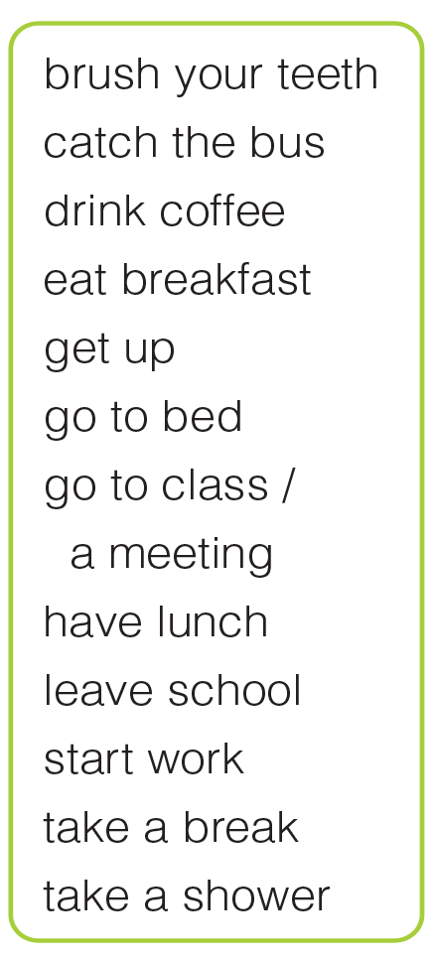
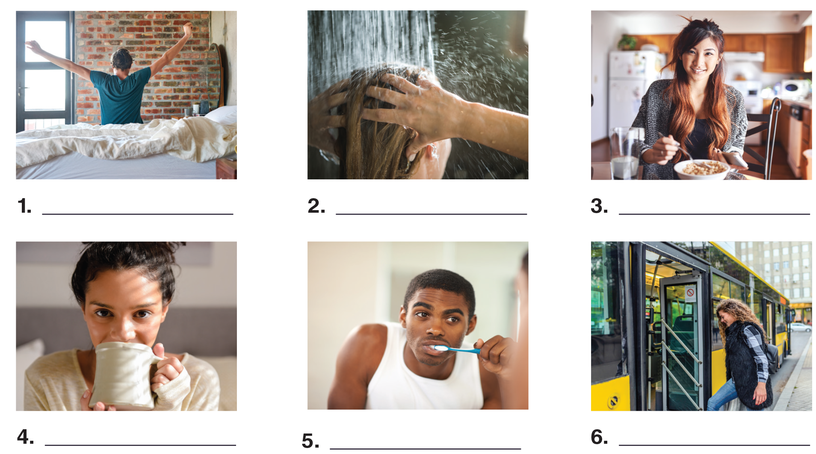
UNIT 2
A DAY IN LIFE
VOCABULARY
get up
take a shower
eat breakfast
drink coffee
brush your teeth
catch the bus
_______________________________________________________________________________________________________________________________________________________________________________________________________________________
National Geographic Learning, a Cengage Company. © 2022 Cengage Learning, Inc. ALL RIGHTS RESERVED. This presentation tool is for teaching purpose only. May not be scanned, copied or duplicated, or posted to a publicly accessible website, in whole or in part.

Slide 6
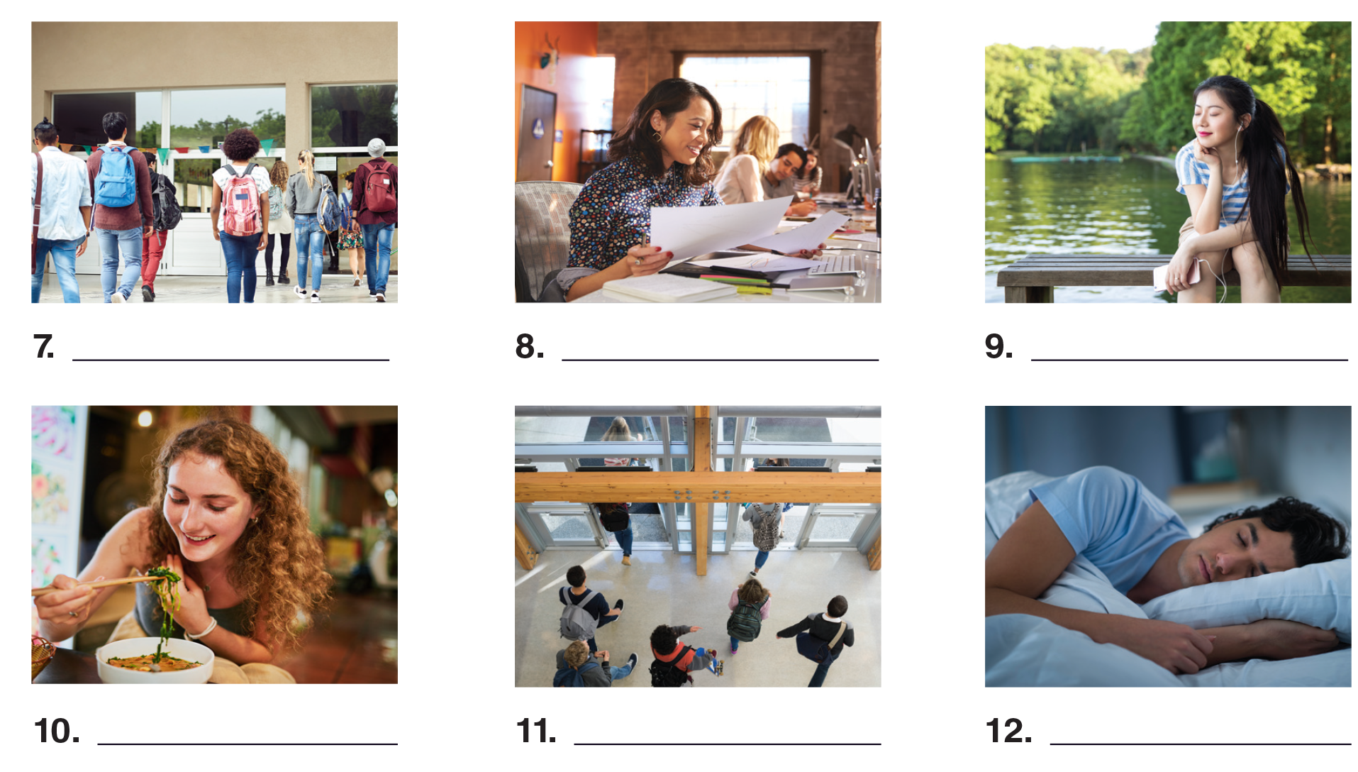
UNIT 2
A DAY IN LIFE
VOCABULARY
go to class
start work
take a break
have lunch
leave school
go to bed
_______________________________________________________________________________________________________________________________________________________________________________________________________________________
National Geographic Learning, a Cengage Company. © 2022 Cengage Learning, Inc. ALL RIGHTS RESERVED. This presentation tool is for teaching purpose only. May not be scanned, copied or duplicated, or posted to a publicly accessible website, in whole or in part.

Slide 7
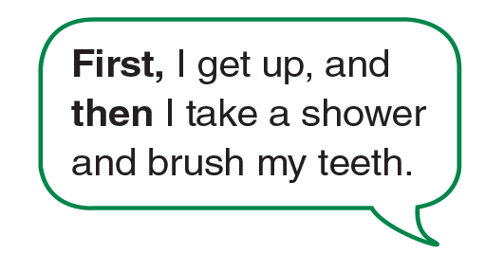
UNIT 2
A DAY IN LIFE
VOCABULARY
_______________________________________________________________________________________________________________________________________________________________________________________________________________________
National Geographic Learning, a Cengage Company. © 2022 Cengage Learning, Inc. ALL RIGHTS RESERVED. This presentation tool is for teaching purpose only. May not be scanned, copied or duplicated, or posted to a publicly accessible website, in whole or in part.

Slide 8
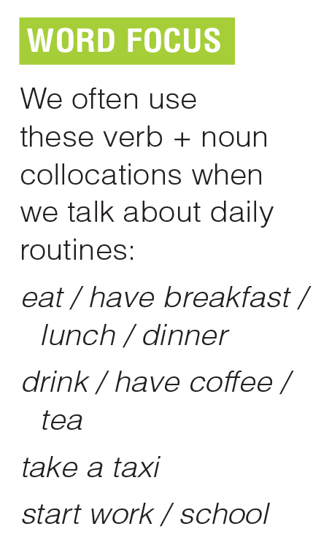
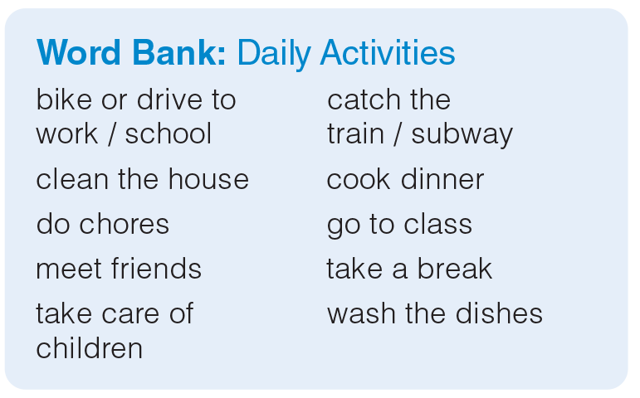
UNIT 2
A DAY IN LIFE
VOCABULARY
_______________________________________________________________________________________________________________________________________________________________________________________________________________________
National Geographic Learning, a Cengage Company. © 2022 Cengage Learning, Inc. ALL RIGHTS RESERVED. This presentation tool is for teaching purpose only. May not be scanned, copied or duplicated, or posted to a publicly accessible website, in whole or in part.

Slide 9
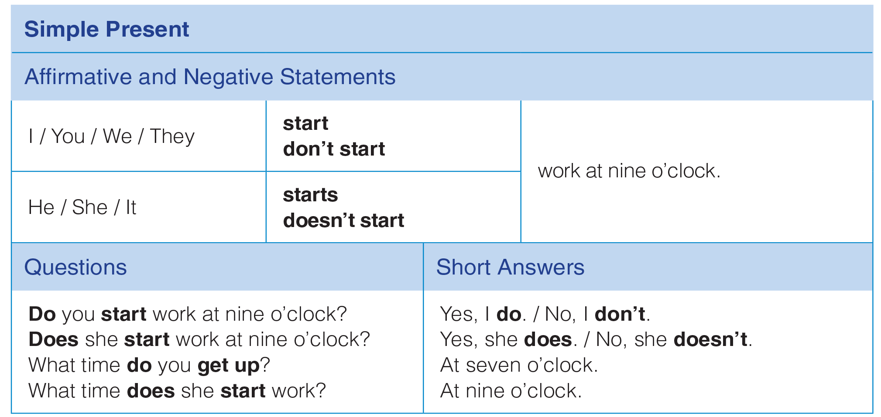
UNIT 2
A DAY IN LIFE
GRAMMAR
_______________________________________________________________________________________________________________________________________________________________________________________________________________________
National Geographic Learning, a Cengage Company. © 2022 Cengage Learning, Inc. ALL RIGHTS RESERVED. This presentation tool is for teaching purpose only. May not be scanned, copied or duplicated, or posted to a publicly accessible website, in whole or in part.

Slide 10
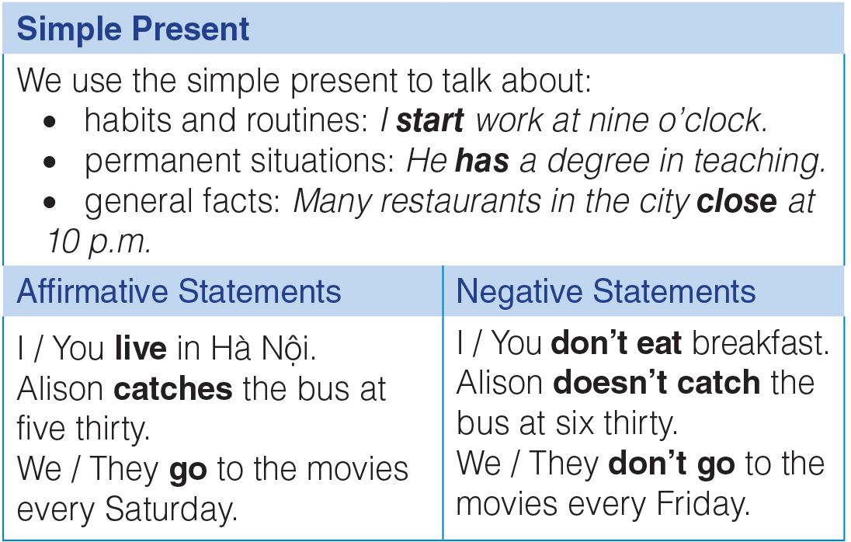
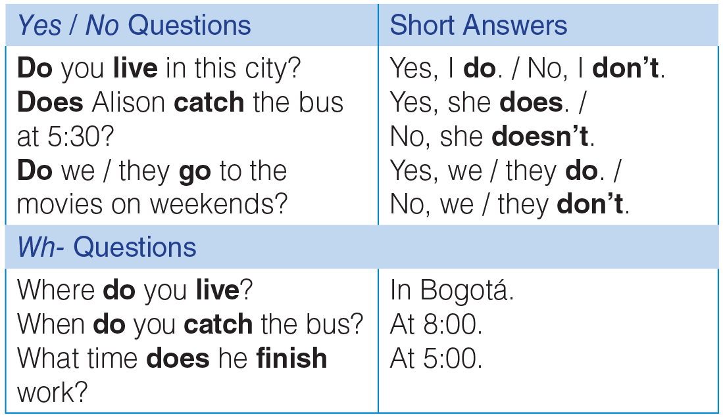
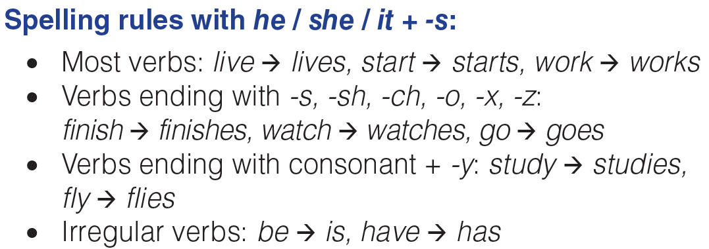
UNIT 2
A DAY IN LIFE
GRAMMAR
_______________________________________________________________________________________________________________________________________________________________________________________________________________________
National Geographic Learning, a Cengage Company. © 2022 Cengage Learning, Inc. ALL RIGHTS RESERVED. This presentation tool is for teaching purpose only. May not be scanned, copied or duplicated, or posted to a publicly accessible website, in whole or in part.

Slide 11
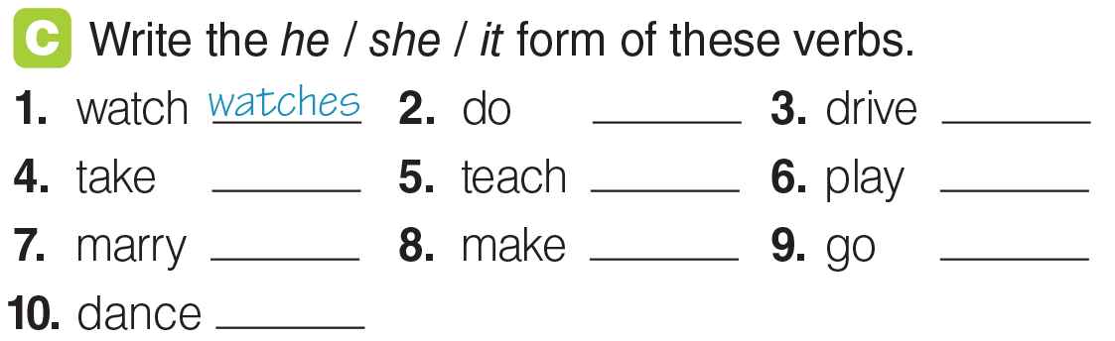
UNIT 2
A DAY IN LIFE
GRAMMAR
does
drives
takes
teaches
plays
marries
makes
goes
dances
_______________________________________________________________________________________________________________________________________________________________________________________________________________________
National Geographic Learning, a Cengage Company. © 2022 Cengage Learning, Inc. ALL RIGHTS RESERVED. This presentation tool is for teaching purpose only. May not be scanned, copied or duplicated, or posted to a publicly accessible website, in whole or in part.

Slide 12
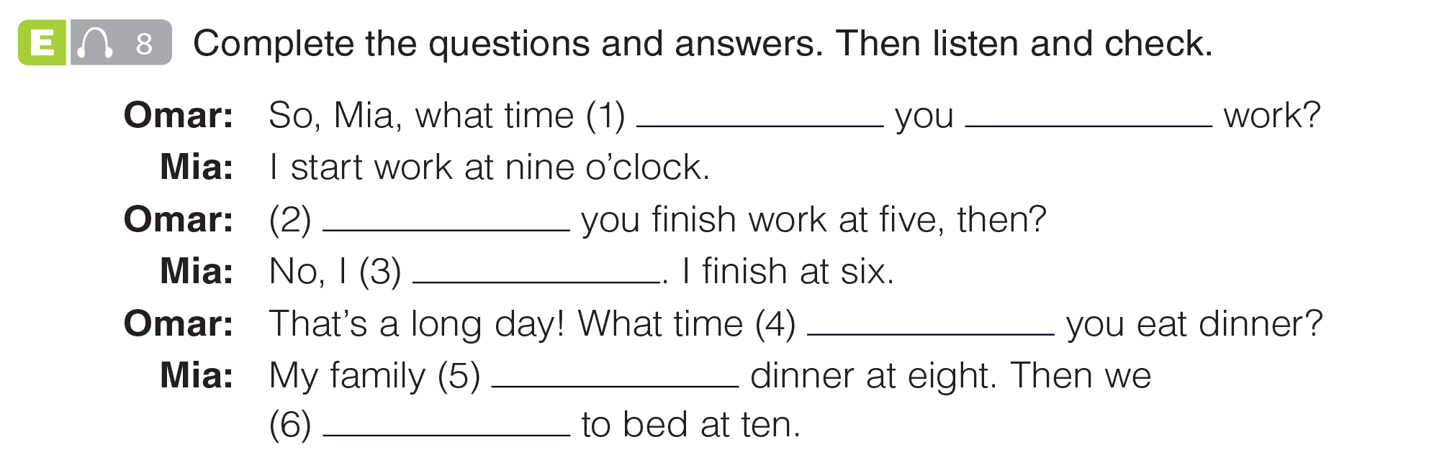

UNIT 2
A DAY IN LIFE
GRAMMAR
do
start
Do
don’t
do
eats
go
_______________________________________________________________________________________________________________________________________________________________________________________________________________________
National Geographic Learning, a Cengage Company. © 2022 Cengage Learning, Inc. ALL RIGHTS RESERVED. This presentation tool is for teaching purpose only. May not be scanned, copied or duplicated, or posted to a publicly accessible website, in whole or in part.

Slide 13
UNIT 2
A DAY IN LIFE
GRAMMAR
do
start
Do
don’t
do
eats
go
_______________________________________________________________________________________________________________________________________________________________________________________________________________________
National Geographic Learning, a Cengage Company. © 2022 Cengage Learning, Inc. ALL RIGHTS RESERVED. This presentation tool is for teaching purpose only. May not be scanned, copied or duplicated, or posted to a publicly accessible website, in whole or in part.

Slide 14
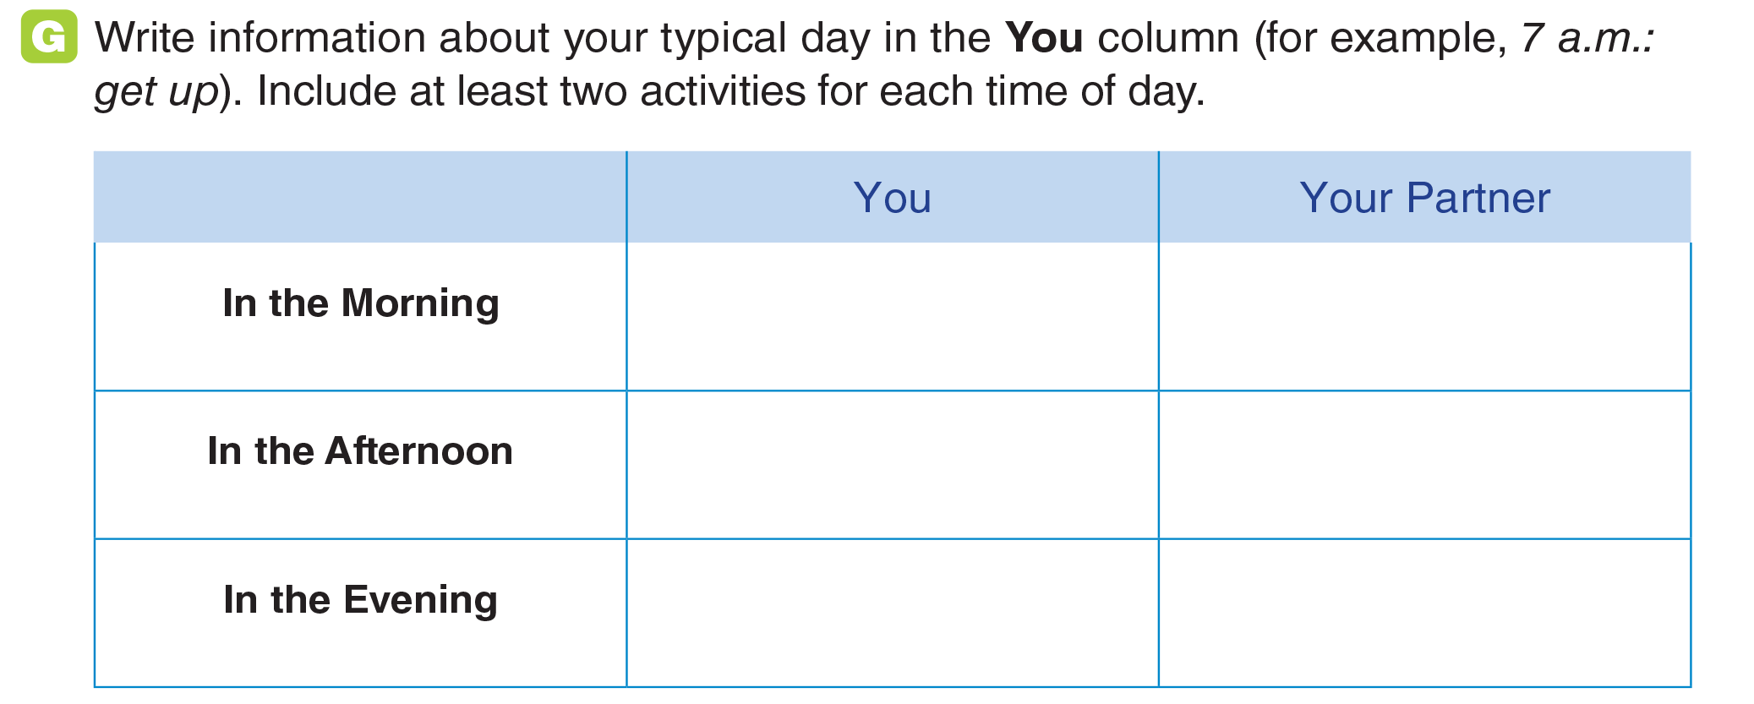
UNIT 2
A DAY IN LIFE
GRAMMAR
_______________________________________________________________________________________________________________________________________________________________________________________________________________________
National Geographic Learning, a Cengage Company. © 2022 Cengage Learning, Inc. ALL RIGHTS RESERVED. This presentation tool is for teaching purpose only. May not be scanned, copied or duplicated, or posted to a publicly accessible website, in whole or in part.

Slide 15
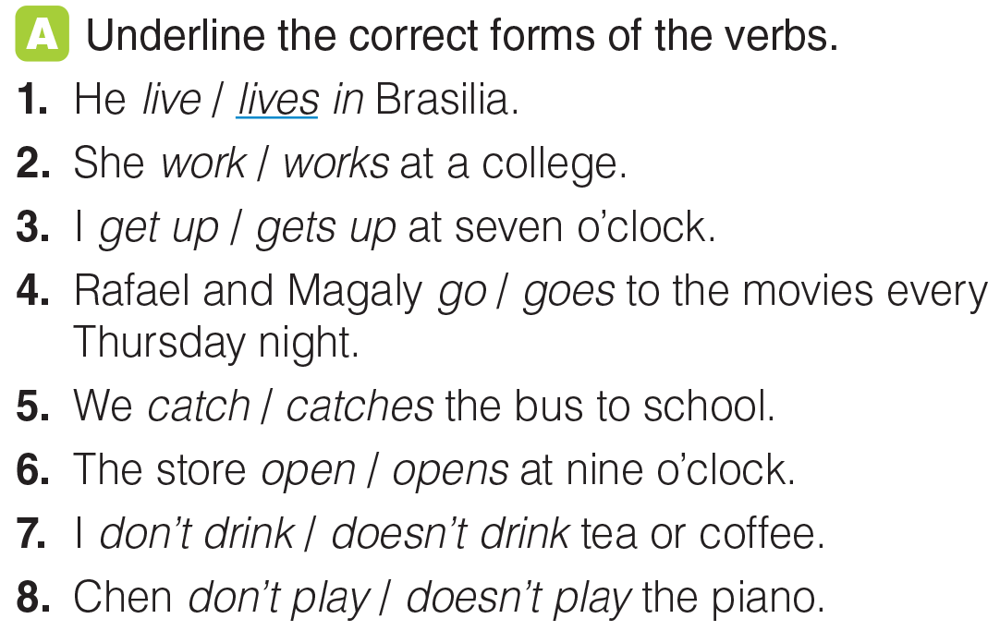
UNIT 2
A DAY IN LIFE
GRAMMAR
_______________________________________________________________________________________________________________________________________________________________________________________________________________________
National Geographic Learning, a Cengage Company. © 2022 Cengage Learning, Inc. ALL RIGHTS RESERVED. This presentation tool is for teaching purpose only. May not be scanned, copied or duplicated, or posted to a publicly accessible website, in whole or in part.

Slide 16
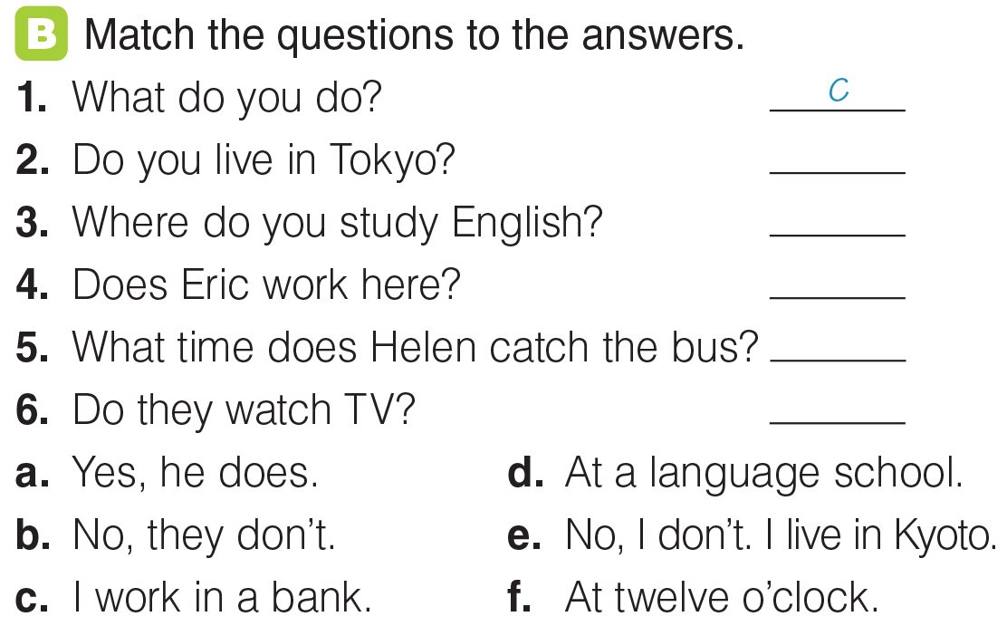
UNIT 2
A DAY IN LIFE
GRAMMAR
e
d
a
f
b
_______________________________________________________________________________________________________________________________________________________________________________________________________________________
National Geographic Learning, a Cengage Company. © 2022 Cengage Learning, Inc. ALL RIGHTS RESERVED. This presentation tool is for teaching purpose only. May not be scanned, copied or duplicated, or posted to a publicly accessible website, in whole or in part.

Slide 17

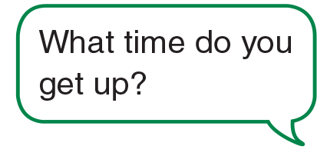
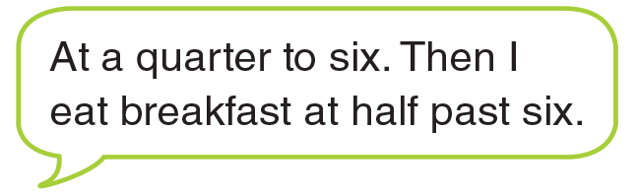
UNIT 2
A DAY IN LIFE
GOAL CHECK
_______________________________________________________________________________________________________________________________________________________________________________________________________________________
National Geographic Learning, a Cengage Company. © 2022 Cengage Learning, Inc. ALL RIGHTS RESERVED. This presentation tool is for teaching purpose only. May not be scanned, copied or duplicated, or posted to a publicly accessible website, in whole or in part.

Slide 18
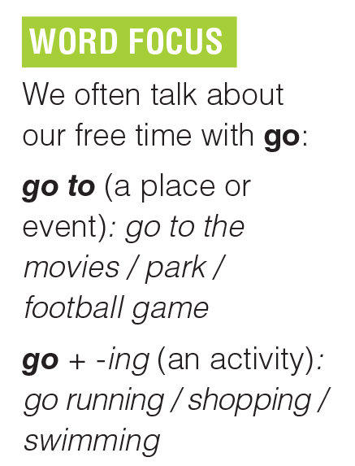
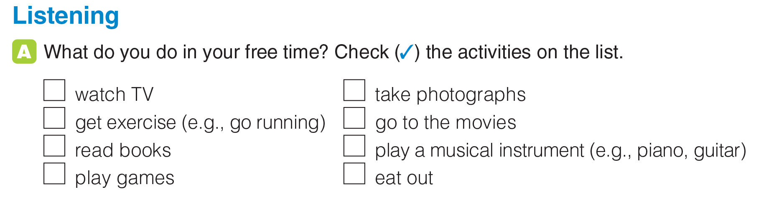
UNIT 2
A DAY IN LIFE
LISTENING
_______________________________________________________________________________________________________________________________________________________________________________________________________________________
National Geographic Learning, a Cengage Company. © 2022 Cengage Learning, Inc. ALL RIGHTS RESERVED. This presentation tool is for teaching purpose only. May not be scanned, copied or duplicated, or posted to a publicly accessible website, in whole or in part.

Slide 19
UNIT 2
A DAY IN LIFE
LISTENING
×
×
×
_______________________________________________________________________________________________________________________________________________________________________________________________________________________
National Geographic Learning, a Cengage Company. © 2022 Cengage Learning, Inc. ALL RIGHTS RESERVED. This presentation tool is for teaching purpose only. May not be scanned, copied or duplicated, or posted to a publicly accessible website, in whole or in part.

Slide 20
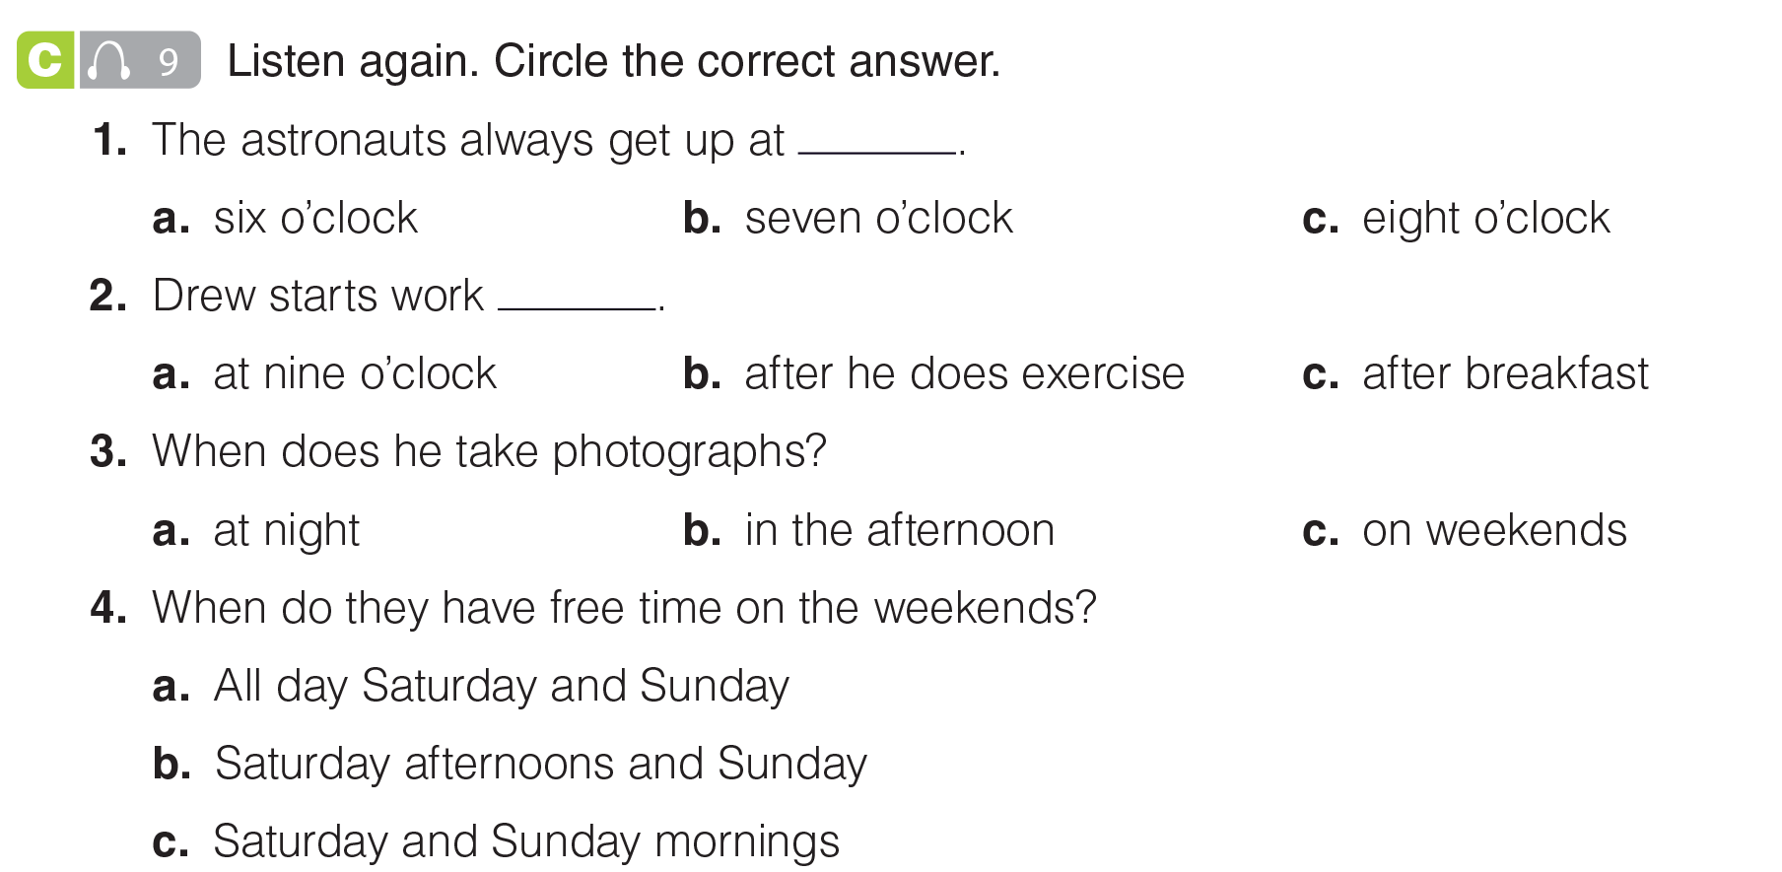
UNIT 2
A DAY IN LIFE
LISTENING
_______________________________________________________________________________________________________________________________________________________________________________________________________________________
National Geographic Learning, a Cengage Company. © 2022 Cengage Learning, Inc. ALL RIGHTS RESERVED. This presentation tool is for teaching purpose only. May not be scanned, copied or duplicated, or posted to a publicly accessible website, in whole or in part.

Slide 21
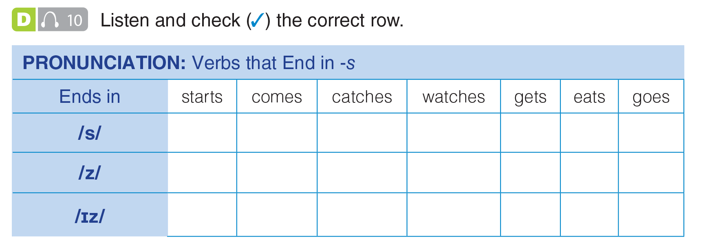
UNIT 2
A DAY IN LIFE
PRONUNCIATION
✓
✓
✓
✓
✓
✓
✓
_______________________________________________________________________________________________________________________________________________________________________________________________________________________
National Geographic Learning, a Cengage Company. © 2022 Cengage Learning, Inc. ALL RIGHTS RESERVED. This presentation tool is for teaching purpose only. May not be scanned, copied or duplicated, or posted to a publicly accessible website, in whole or in part.

Slide 22
UNIT 2
A DAY IN LIFE
PRONUNCIATION
✓
✓
✓
✓
✓
✓
✓
_______________________________________________________________________________________________________________________________________________________________________________________________________________________
National Geographic Learning, a Cengage Company. © 2022 Cengage Learning, Inc. ALL RIGHTS RESERVED. This presentation tool is for teaching purpose only. May not be scanned, copied or duplicated, or posted to a publicly accessible website, in whole or in part.

Slide 23
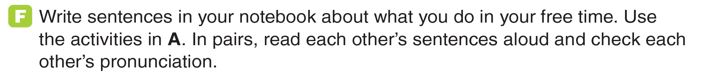
UNIT 2
A DAY IN LIFE
PRONUNCIATION
_______________________________________________________________________________________________________________________________________________________________________________________________________________________
National Geographic Learning, a Cengage Company. © 2022 Cengage Learning, Inc. ALL RIGHTS RESERVED. This presentation tool is for teaching purpose only. May not be scanned, copied or duplicated, or posted to a publicly accessible website, in whole or in part.

Slide 24
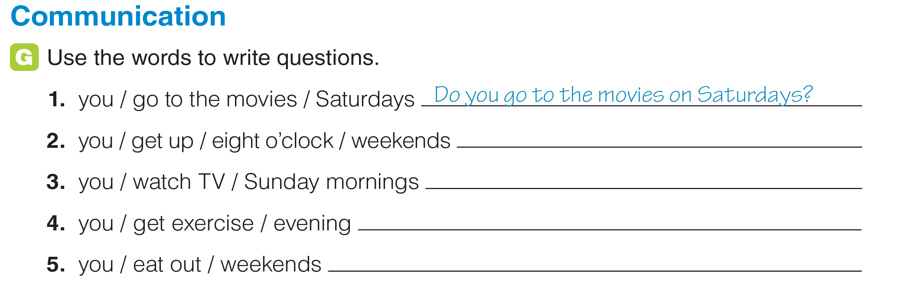
UNIT 2
A DAY IN LIFE
COMMUNICATION
Do you get up at eight o’clock on weekends?
Do you watch TV on Sunday mornings?
Do you get exercise in the evening?
Do you eat out on weekends?
_______________________________________________________________________________________________________________________________________________________________________________________________________________________
National Geographic Learning, a Cengage Company. © 2022 Cengage Learning, Inc. ALL RIGHTS RESERVED. This presentation tool is for teaching purpose only. May not be scanned, copied or duplicated, or posted to a publicly accessible website, in whole or in part.

Slide 25
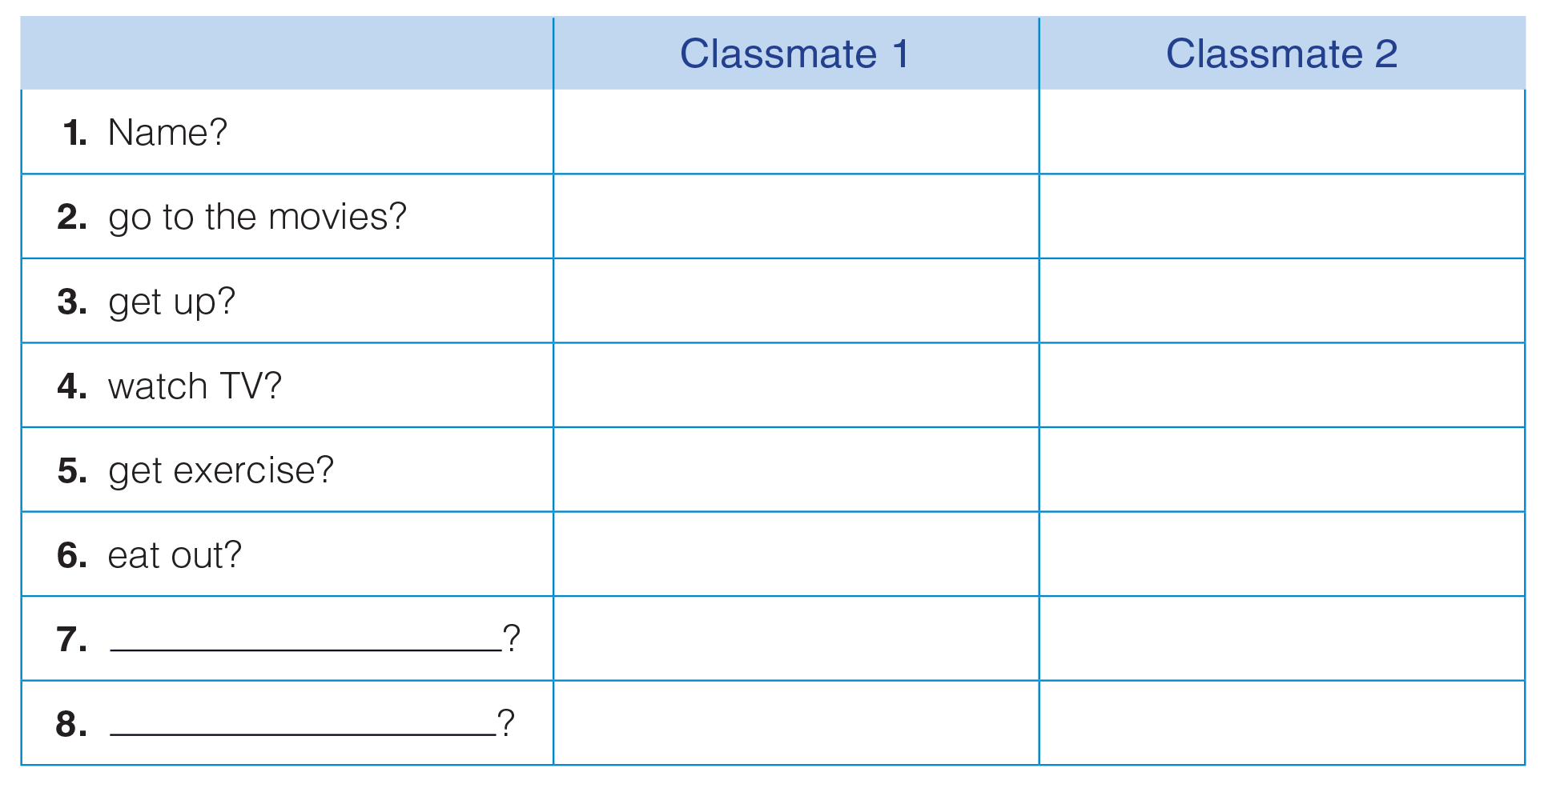
UNIT 2
A DAY IN LIFE
COMMUNICATION
_______________________________________________________________________________________________________________________________________________________________________________________________________________________
National Geographic Learning, a Cengage Company. © 2022 Cengage Learning, Inc. ALL RIGHTS RESERVED. This presentation tool is for teaching purpose only. May not be scanned, copied or duplicated, or posted to a publicly accessible website, in whole or in part.

Slide 26

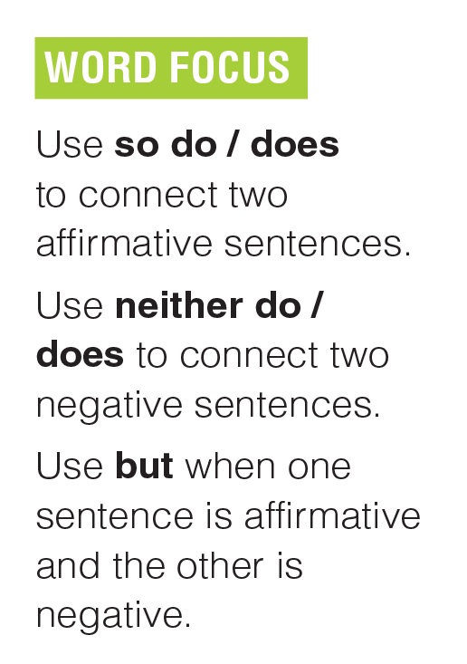
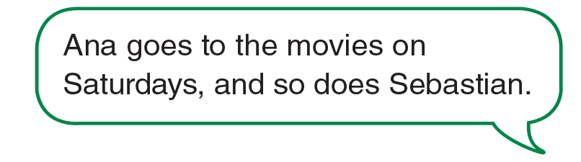
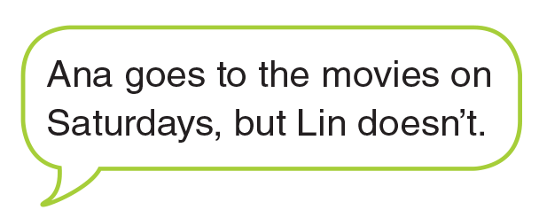
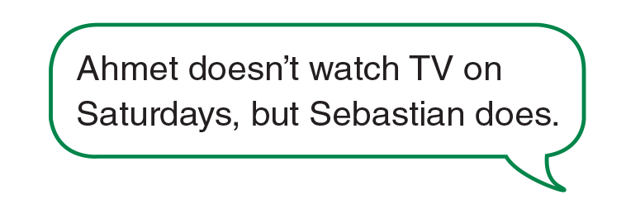
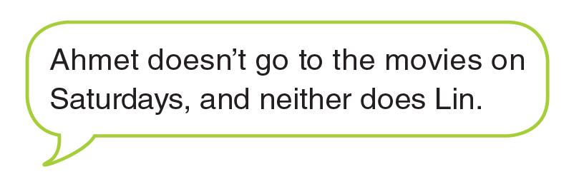
UNIT 2
A DAY IN LIFE
GOAL CHECK
_______________________________________________________________________________________________________________________________________________________________________________________________________________________
National Geographic Learning, a Cengage Company. © 2022 Cengage Learning, Inc. ALL RIGHTS RESERVED. This presentation tool is for teaching purpose only. May not be scanned, copied or duplicated, or posted to a publicly accessible website, in whole or in part.

Slide 27
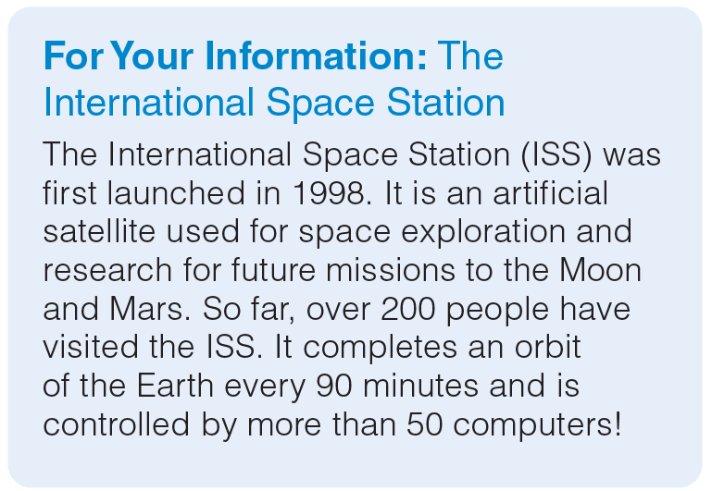
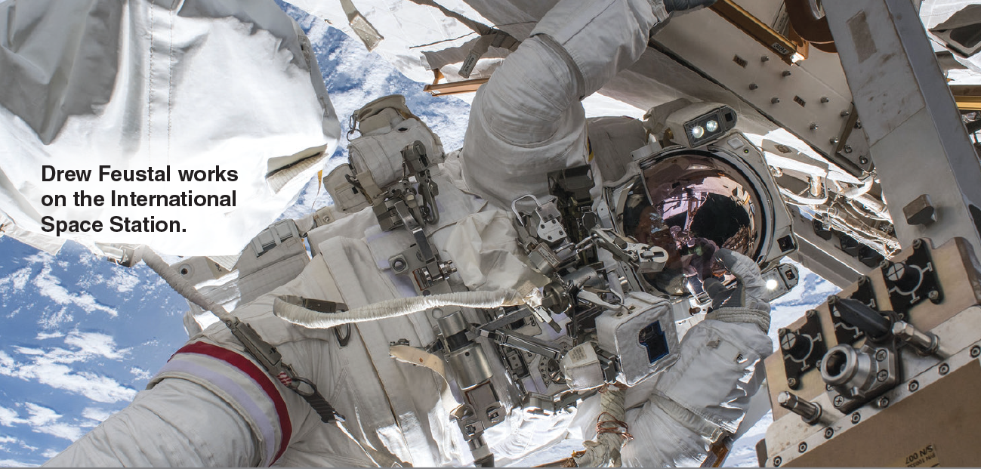
UNIT 2
A DAY IN LIFE
GOAL CHECK
_______________________________________________________________________________________________________________________________________________________________________________________________________________________
National Geographic Learning, a Cengage Company. © 2022 Cengage Learning, Inc. ALL RIGHTS RESERVED. This presentation tool is for teaching purpose only. May not be scanned, copied or duplicated, or posted to a publicly accessible website, in whole or in part.

Slide 28
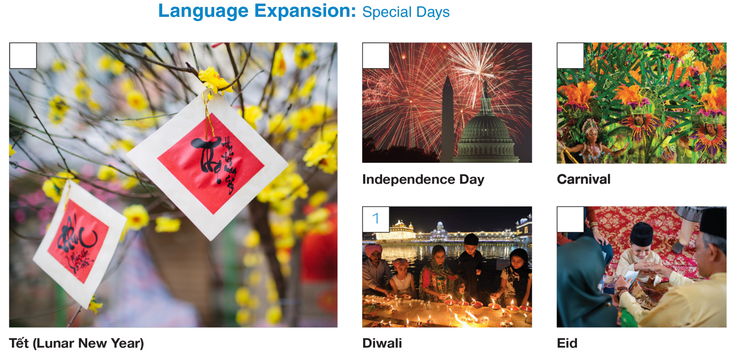
UNIT 2
A DAY IN LIFE
LANGUAGE EXPANSION
_______________________________________________________________________________________________________________________________________________________________________________________________________________________
National Geographic Learning, a Cengage Company. © 2022 Cengage Learning, Inc. ALL RIGHTS RESERVED. This presentation tool is for teaching purpose only. May not be scanned, copied or duplicated, or posted to a publicly accessible website, in whole or in part.

Slide 29
UNIT 2
A DAY IN LIFE
LANGUAGE EXPANSION
Washington, D.C.
Brazil
Việt Nam
India
the Middle East
_______________________________________________________________________________________________________________________________________________________________________________________________________________________
National Geographic Learning, a Cengage Company. © 2022 Cengage Learning, Inc. ALL RIGHTS RESERVED. This presentation tool is for teaching purpose only. May not be scanned, copied or duplicated, or posted to a publicly accessible website, in whole or in part.

Slide 30
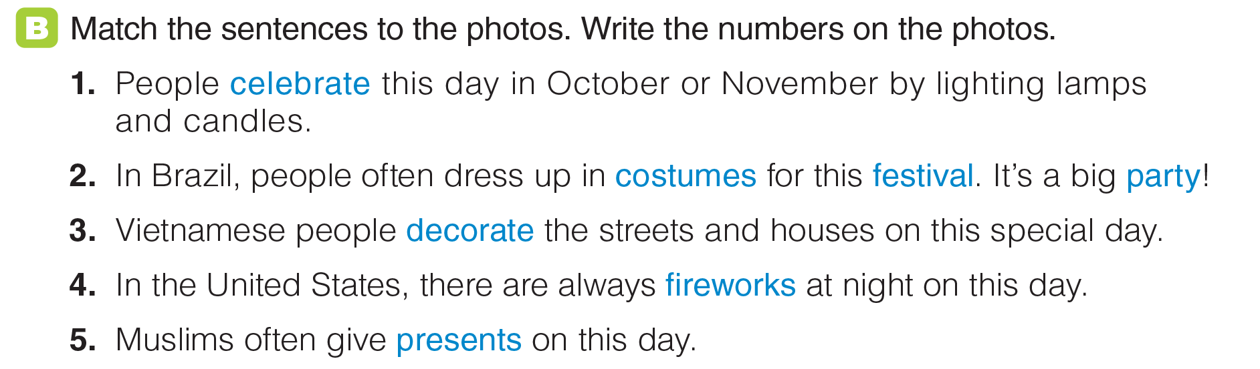
UNIT 2
A DAY IN LIFE
LANGUAGE EXPANSION
_______________________________________________________________________________________________________________________________________________________________________________________________________________________
National Geographic Learning, a Cengage Company. © 2022 Cengage Learning, Inc. ALL RIGHTS RESERVED. This presentation tool is for teaching purpose only. May not be scanned, copied or duplicated, or posted to a publicly accessible website, in whole or in part.

Slide 31
UNIT 2
A DAY IN LIFE
LANGUAGE EXPANSION
3
4
2
5
_______________________________________________________________________________________________________________________________________________________________________________________________________________________
National Geographic Learning, a Cengage Company. © 2022 Cengage Learning, Inc. ALL RIGHTS RESERVED. This presentation tool is for teaching purpose only. May not be scanned, copied or duplicated, or posted to a publicly accessible website, in whole or in part.

Slide 32
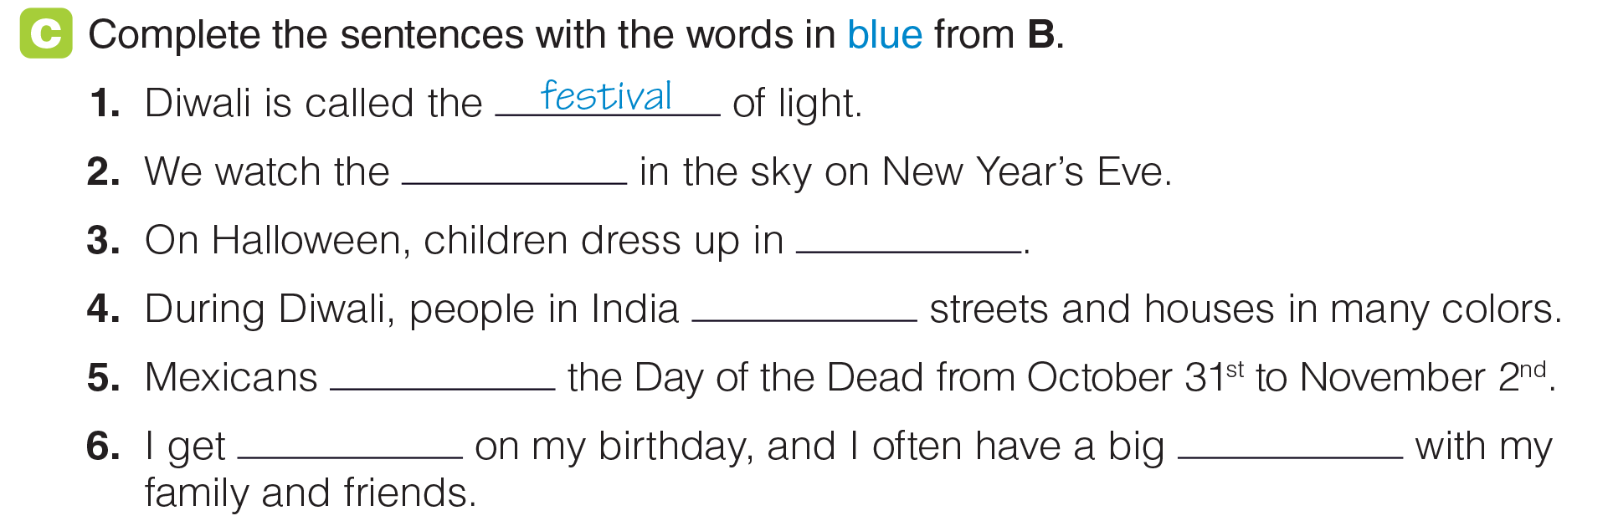
UNIT 2
A DAY IN LIFE
LANGUAGE EXPANSION
fireworks
costumes
decorate
celebrate
presents
party
_______________________________________________________________________________________________________________________________________________________________________________________________________________________
National Geographic Learning, a Cengage Company. © 2022 Cengage Learning, Inc. ALL RIGHTS RESERVED. This presentation tool is for teaching purpose only. May not be scanned, copied or duplicated, or posted to a publicly accessible website, in whole or in part.

Slide 33
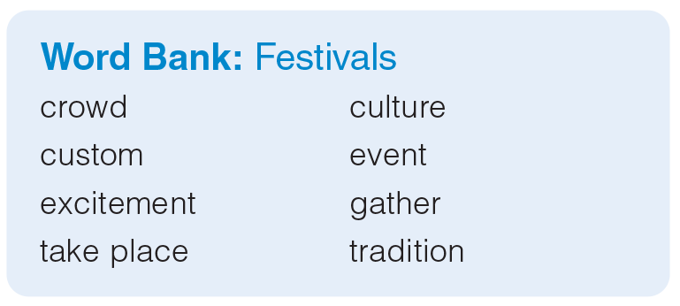
UNIT 2
A DAY IN LIFE
LANGUAGE EXPANSION
_______________________________________________________________________________________________________________________________________________________________________________________________________________________
National Geographic Learning, a Cengage Company. © 2022 Cengage Learning, Inc. ALL RIGHTS RESERVED. This presentation tool is for teaching purpose only. May not be scanned, copied or duplicated, or posted to a publicly accessible website, in whole or in part.

Slide 34
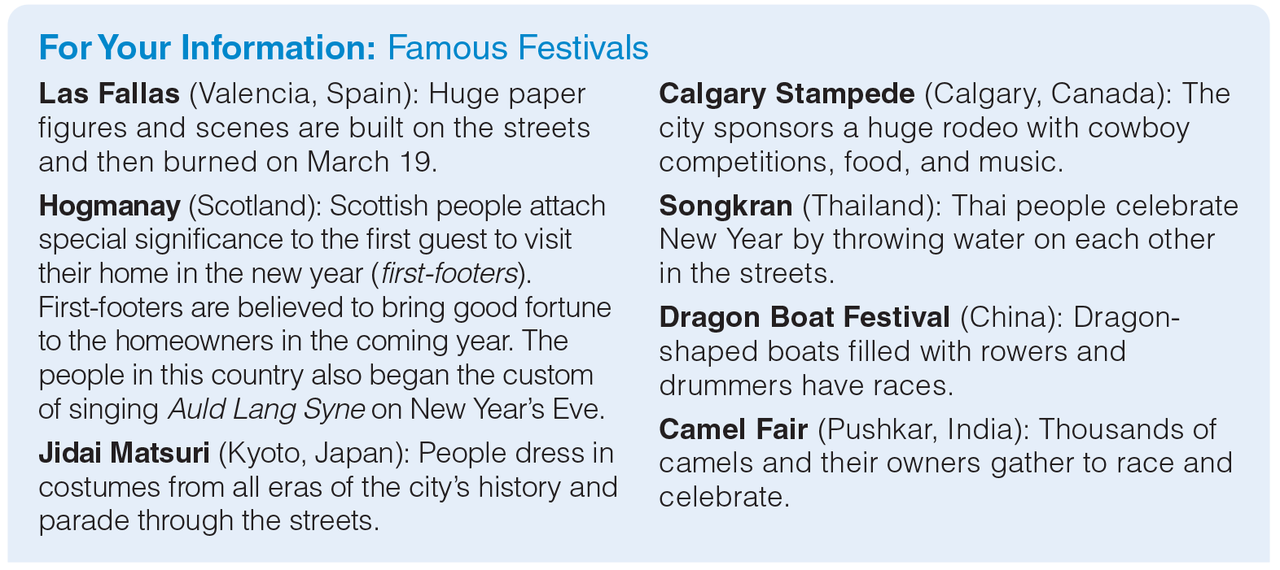
UNIT 2
A DAY IN LIFE
LANGUAGE EXPANSION
_______________________________________________________________________________________________________________________________________________________________________________________________________________________
National Geographic Learning, a Cengage Company. © 2022 Cengage Learning, Inc. ALL RIGHTS RESERVED. This presentation tool is for teaching purpose only. May not be scanned, copied or duplicated, or posted to a publicly accessible website, in whole or in part.

Slide 35
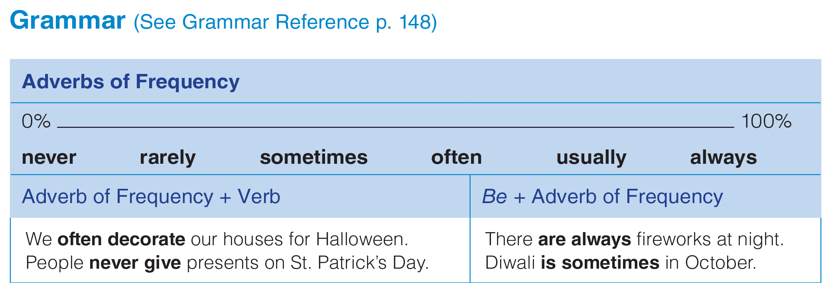
UNIT 2
A DAY IN LIFE
GRAMMAR
_______________________________________________________________________________________________________________________________________________________________________________________________________________________
National Geographic Learning, a Cengage Company. © 2022 Cengage Learning, Inc. ALL RIGHTS RESERVED. This presentation tool is for teaching purpose only. May not be scanned, copied or duplicated, or posted to a publicly accessible website, in whole or in part.

Slide 36
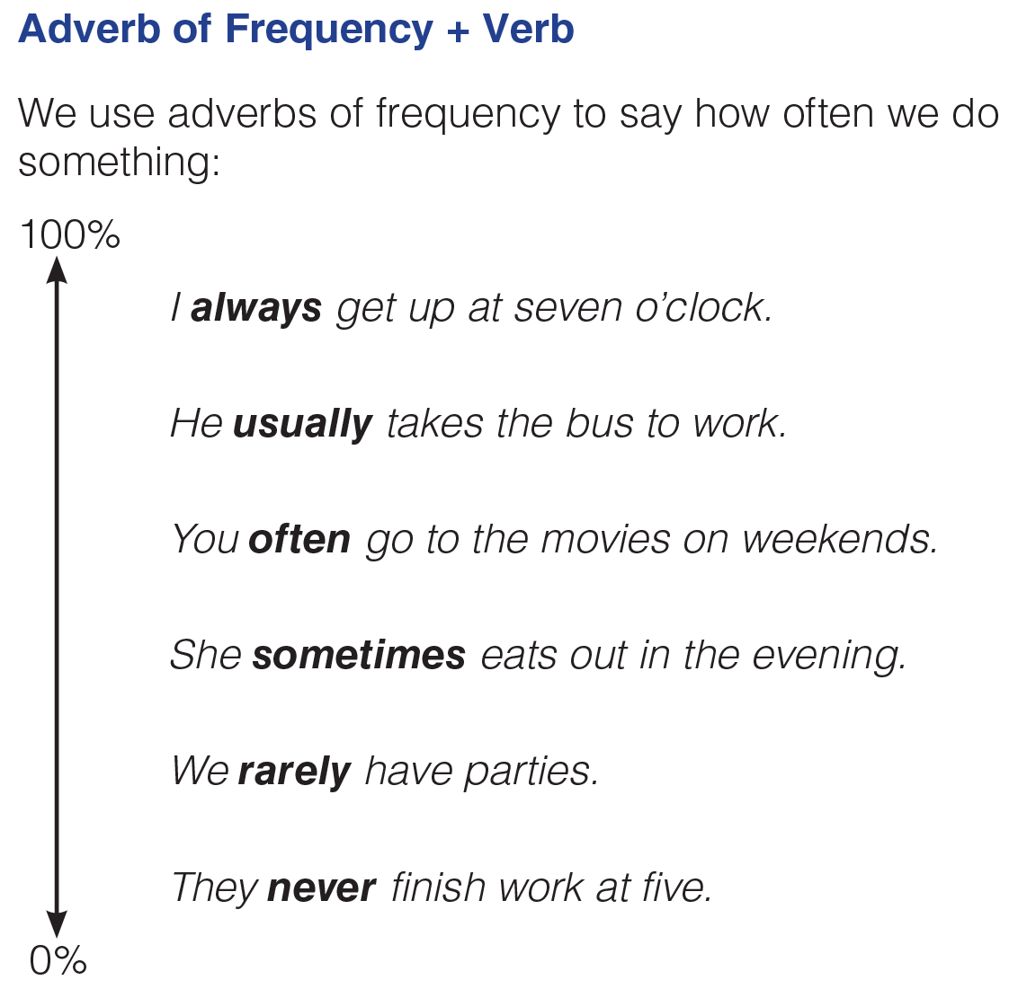
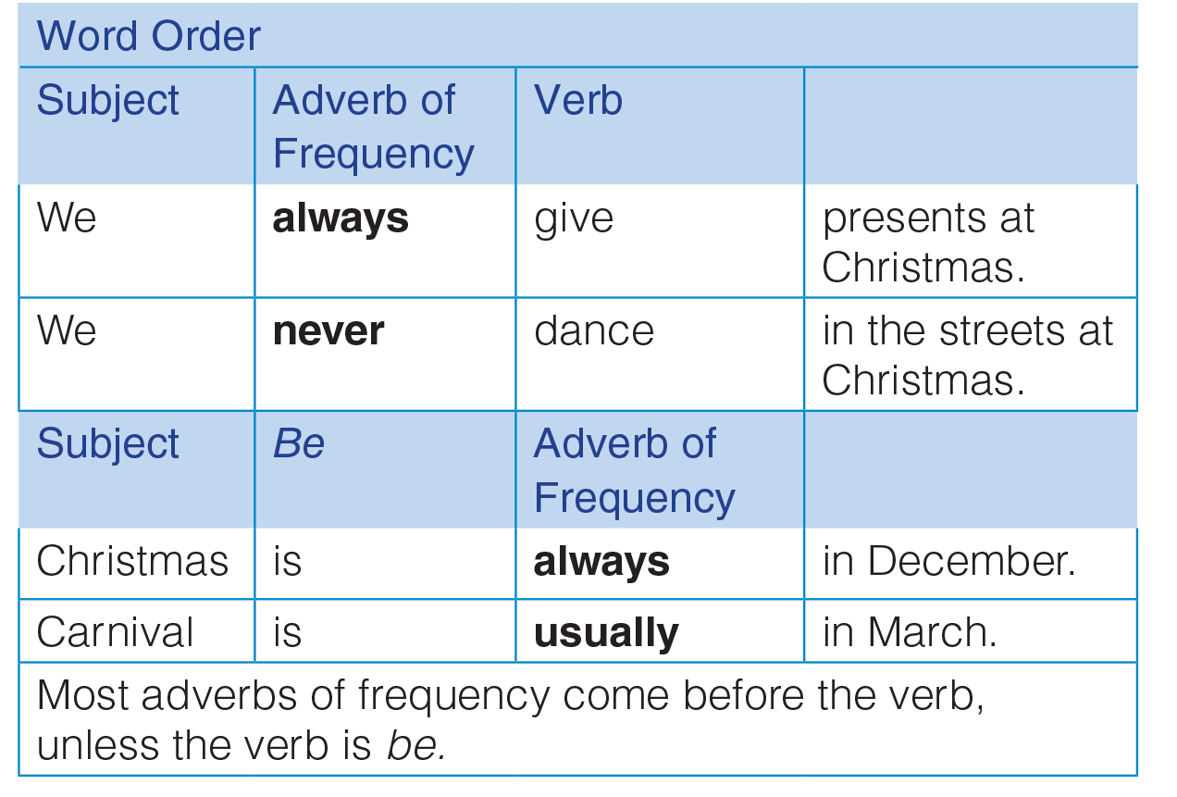
UNIT 2
A DAY IN LIFE
GRAMMAR
_______________________________________________________________________________________________________________________________________________________________________________________________________________________
National Geographic Learning, a Cengage Company. © 2022 Cengage Learning, Inc. ALL RIGHTS RESERVED. This presentation tool is for teaching purpose only. May not be scanned, copied or duplicated, or posted to a publicly accessible website, in whole or in part.

Slide 37
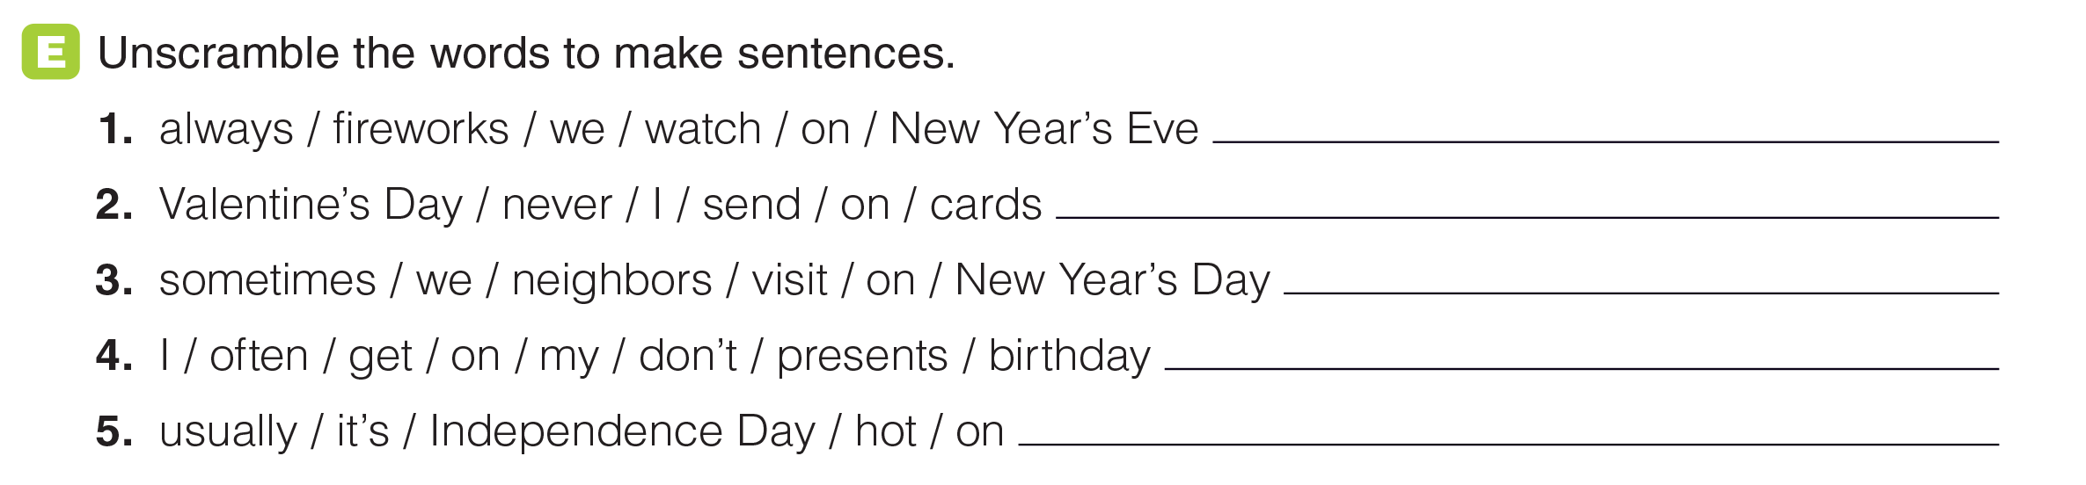
UNIT 2
A DAY IN LIFE
GRAMMAR
We always have fireworks on New Year’s Eve.
I never send cards on Valentine’s Day.
We sometimes / Sometimes, we visit neighbors on New Year’s Day.
I don’t often get presents on my birthday.
It’s usually / Usually, it’s hot on Independence Day.
_______________________________________________________________________________________________________________________________________________________________________________________________________________________
National Geographic Learning, a Cengage Company. © 2022 Cengage Learning, Inc. ALL RIGHTS RESERVED. This presentation tool is for teaching purpose only. May not be scanned, copied or duplicated, or posted to a publicly accessible website, in whole or in part.

Slide 38
UNIT 2
A DAY IN LIFE
GRAMMAR
We always have fireworks on New Year’s Eve.
I never send cards on Valentine’s Day.
We sometimes / Sometimes, we visit neighbors on New Year’s Day.
I don’t often get presents on my birthday.
It’s usually / Usually, it’s hot on Independence Day.
_______________________________________________________________________________________________________________________________________________________________________________________________________________________
National Geographic Learning, a Cengage Company. © 2022 Cengage Learning, Inc. ALL RIGHTS RESERVED. This presentation tool is for teaching purpose only. May not be scanned, copied or duplicated, or posted to a publicly accessible website, in whole or in part.

Slide 39
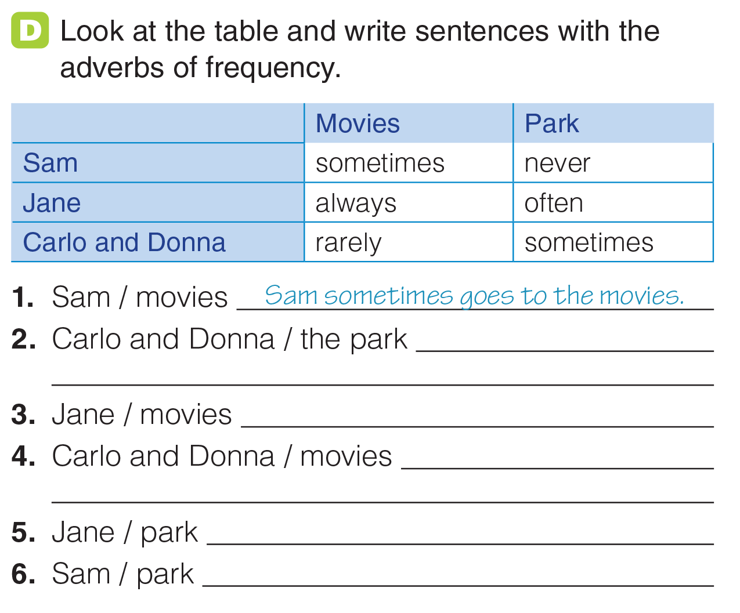
UNIT 2
A DAY IN LIFE
GRAMMAR
Carlo and Donna sometimes go to the park.
Jane always goes to the movies.
Carlo and Donna don’t often go to the movies.
Jane often goes to the park.
Sam never goes to the park.
_______________________________________________________________________________________________________________________________________________________________________________________________________________________
National Geographic Learning, a Cengage Company. © 2022 Cengage Learning, Inc. ALL RIGHTS RESERVED. This presentation tool is for teaching purpose only. May not be scanned, copied or duplicated, or posted to a publicly accessible website, in whole or in part.

Slide 40
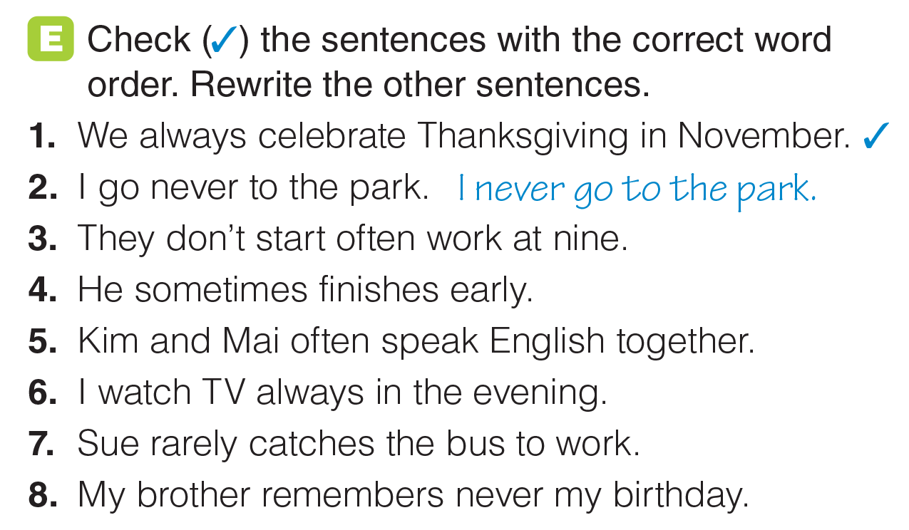
UNIT 2
A DAY IN LIFE
GRAMMAR
They don’t often start work at nine.
✓
✓
I always watch TV in the evening.
✓
My brother never remembers my birthday.
_______________________________________________________________________________________________________________________________________________________________________________________________________________________
National Geographic Learning, a Cengage Company. © 2022 Cengage Learning, Inc. ALL RIGHTS RESERVED. This presentation tool is for teaching purpose only. May not be scanned, copied or duplicated, or posted to a publicly accessible website, in whole or in part.

Slide 41
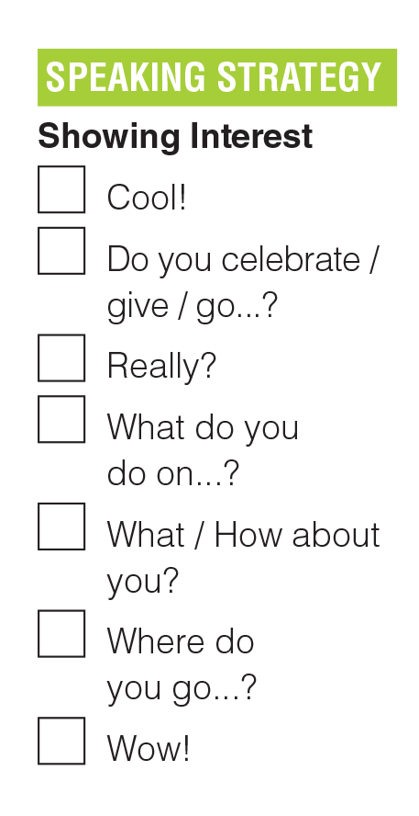
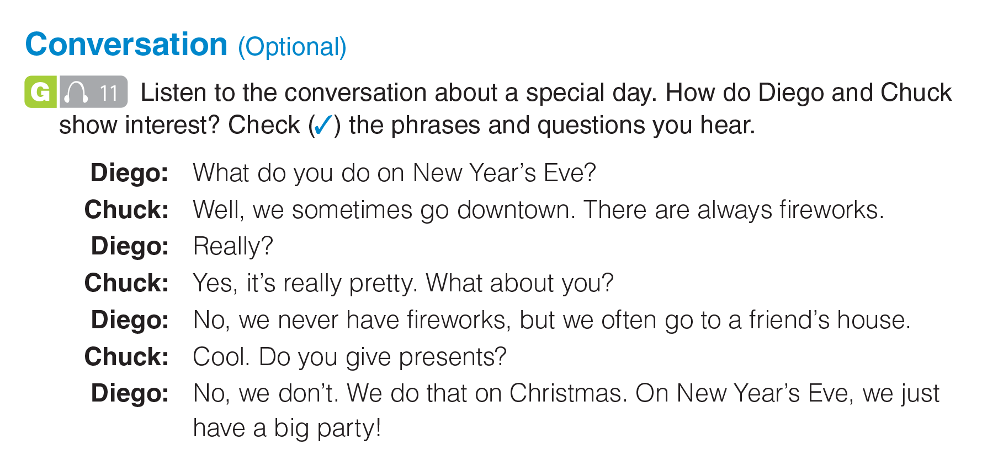

UNIT 2
A DAY IN LIFE
CONVERSATION
✓
✓
✓
✓
✓
_______________________________________________________________________________________________________________________________________________________________________________________________________________________
National Geographic Learning, a Cengage Company. © 2022 Cengage Learning, Inc. ALL RIGHTS RESERVED. This presentation tool is for teaching purpose only. May not be scanned, copied or duplicated, or posted to a publicly accessible website, in whole or in part.

Slide 42
UNIT 2
A DAY IN LIFE
CONVERSATION
_______________________________________________________________________________________________________________________________________________________________________________________________________________________
National Geographic Learning, a Cengage Company. © 2022 Cengage Learning, Inc. ALL RIGHTS RESERVED. This presentation tool is for teaching purpose only. May not be scanned, copied or duplicated, or posted to a publicly accessible website, in whole or in part.

Slide 43
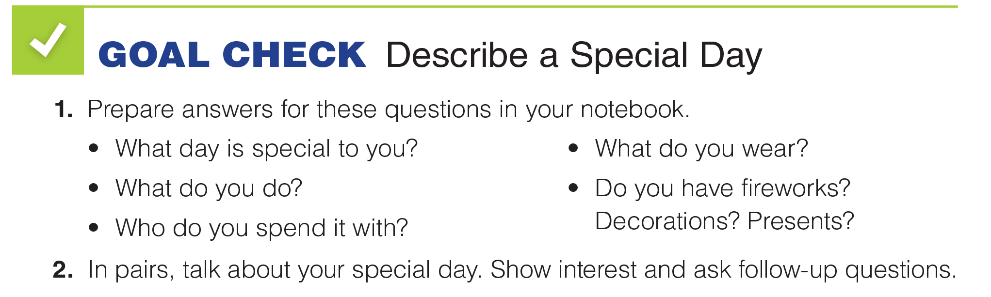
UNIT 2
A DAY IN LIFE
GOAL CHECK
_______________________________________________________________________________________________________________________________________________________________________________________________________________________
National Geographic Learning, a Cengage Company. © 2022 Cengage Learning, Inc. ALL RIGHTS RESERVED. This presentation tool is for teaching purpose only. May not be scanned, copied or duplicated, or posted to a publicly accessible website, in whole or in part.

Slide 44

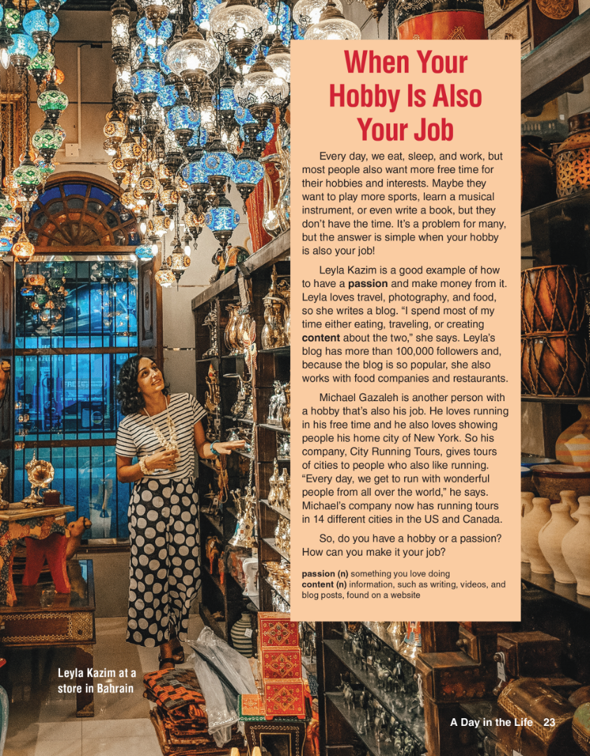
UNIT 2
A DAY IN LIFE
READING

Slide 45
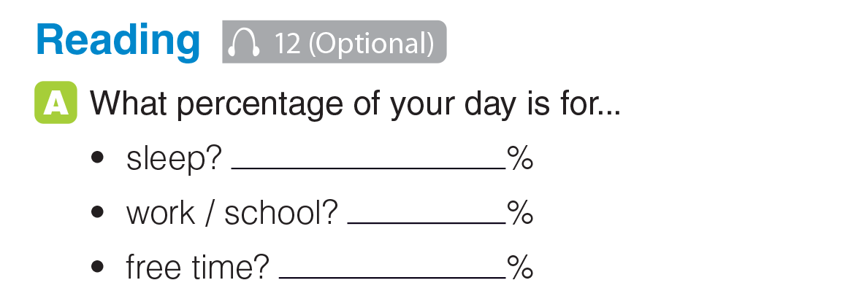
UNIT 2
A DAY IN LIFE
READING
_______________________________________________________________________________________________________________________________________________________________________________________________________________________
National Geographic Learning, a Cengage Company. © 2022 Cengage Learning, Inc. ALL RIGHTS RESERVED. This presentation tool is for teaching purpose only. May not be scanned, copied or duplicated, or posted to a publicly accessible website, in whole or in part.

Slide 46

UNIT 2
A DAY IN LIFE
READING
_______________________________________________________________________________________________________________________________________________________________________________________________________________________
National Geographic Learning, a Cengage Company. © 2022 Cengage Learning, Inc. ALL RIGHTS RESERVED. This presentation tool is for teaching purpose only. May not be scanned, copied or duplicated, or posted to a publicly accessible website, in whole or in part.

Slide 47

UNIT 2
A DAY IN LIFE
READING
_______________________________________________________________________________________________________________________________________________________________________________________________________________________
National Geographic Learning, a Cengage Company. © 2022 Cengage Learning, Inc. ALL RIGHTS RESERVED. This presentation tool is for teaching purpose only. May not be scanned, copied or duplicated, or posted to a publicly accessible website, in whole or in part.

Slide 48

UNIT 2
A DAY IN LIFE
READING
for their hobbies and interests
travel and food
more than 100,000
running and showing people his home city
visitors to the city and
“wonderful people from all over the world”
in 14 cities in the US and Canada
_______________________________________________________________________________________________________________________________________________________________________________________________________________________
National Geographic Learning, a Cengage Company. © 2022 Cengage Learning, Inc. ALL RIGHTS RESERVED. This presentation tool is for teaching purpose only. May not be scanned, copied or duplicated, or posted to a publicly accessible website, in whole or in part.

Slide 49

UNIT 2
A DAY IN LIFE
GOAL CHECK
_______________________________________________________________________________________________________________________________________________________________________________________________________________________
National Geographic Learning, a Cengage Company. © 2022 Cengage Learning, Inc. ALL RIGHTS RESERVED. This presentation tool is for teaching purpose only. May not be scanned, copied or duplicated, or posted to a publicly accessible website, in whole or in part.

Slide 50

UNIT 2
A DAY IN LIFE
COMMUNICATION
Do you know?
There is a career called party planner. People hire professional party planners to organize their events, from special family celebrations to very large corporate events.
_______________________________________________________________________________________________________________________________________________________________________________________________________________________
National Geographic Learning, a Cengage Company. © 2022 Cengage Learning, Inc. ALL RIGHTS RESERVED. This presentation tool is for teaching purpose only. May not be scanned, copied or duplicated, or posted to a publicly accessible website, in whole or in part.

Slide 51




UNIT 2
A DAY IN LIFE
COMMUNICATION
_______________________________________________________________________________________________________________________________________________________________________________________________________________________
National Geographic Learning, a Cengage Company. © 2022 Cengage Learning, Inc. ALL RIGHTS RESERVED. This presentation tool is for teaching purpose only. May not be scanned, copied or duplicated, or posted to a publicly accessible website, in whole or in part.

Slide 52



UNIT 2
A DAY IN LIFE
WRITING
_______________________________________________________________________________________________________________________________________________________________________________________________________________________
National Geographic Learning, a Cengage Company. © 2022 Cengage Learning, Inc. ALL RIGHTS RESERVED. This presentation tool is for teaching purpose only. May not be scanned, copied or duplicated, or posted to a publicly accessible website, in whole or in part.

Slide 53

UNIT 2
A DAY IN LIFE
WRITING
Can you help?
Can you buy...?
What time...?
Do you know...?
Let’s meet at...
See you later.
Best,
_______________________________________________________________________________________________________________________________________________________________________________________________________________________
National Geographic Learning, a Cengage Company. © 2022 Cengage Learning, Inc. ALL RIGHTS RESERVED. This presentation tool is for teaching purpose only. May not be scanned, copied or duplicated, or posted to a publicly accessible website, in whole or in part.

Slide 54

UNIT 2
A DAY IN LIFE
GOAL CHECK
_______________________________________________________________________________________________________________________________________________________________________________________________________________________
National Geographic Learning, a Cengage Company. © 2022 Cengage Learning, Inc. ALL RIGHTS RESERVED. This presentation tool is for teaching purpose only. May not be scanned, copied or duplicated, or posted to a publicly accessible website, in whole or in part.

