Slide 1
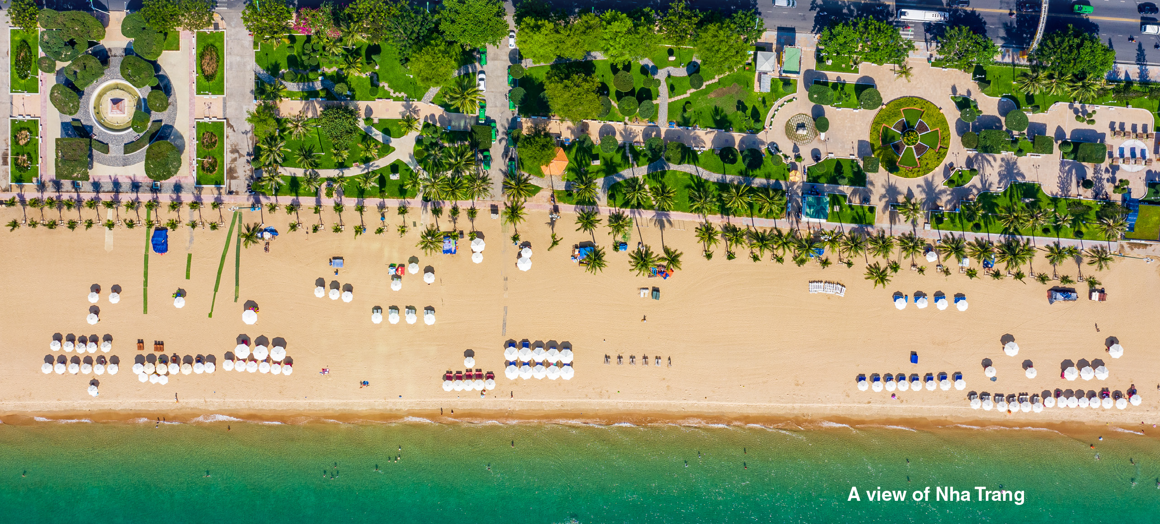


Unit 3:
GOING PLACES
_______________________________________________________________________________________________________________________________________________________________________________________________________________________
National Geographic Learning, a Cengage Company. © 2022 Cengage Learning, Inc. ALL RIGHTS RESERVED. This presentation tool is for teaching purpose only. May not be scanned, copied or duplicated, or posted to a publicly accessible website, in whole or in part.

Slide 2
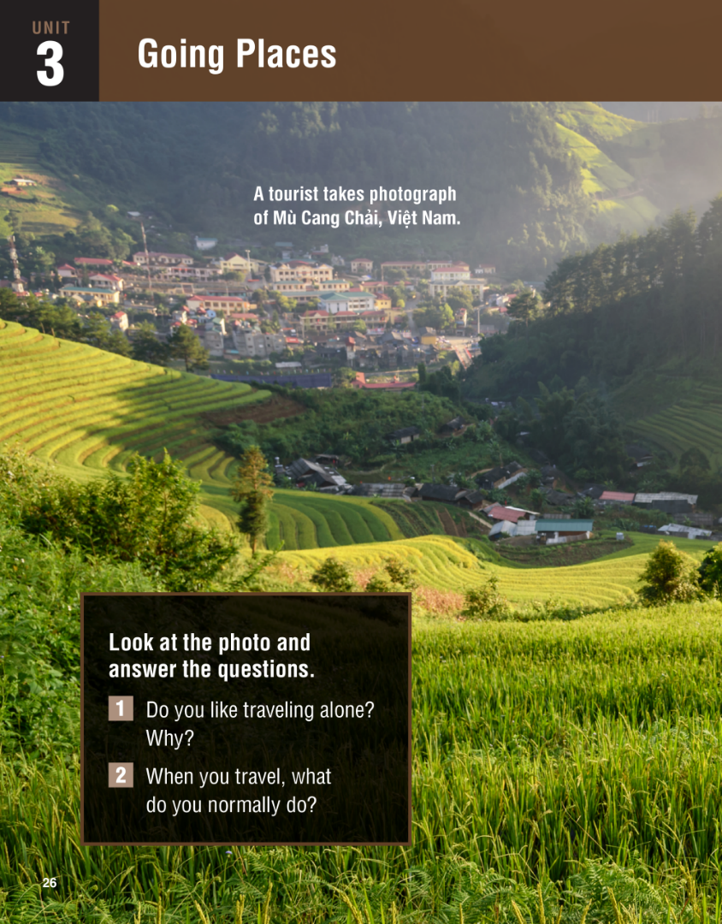


Slide 3
UNIT 3
GOING PLACES
OVERVIEW
Do you know?
One of the world’s largest industries is travel and tourism. It gets revenue from transportation, accommodation, food, entertainment, sightseeing, and so on.
_______________________________________________________________________________________________________________________________________________________________________________________________________________________
National Geographic Learning, a Cengage Company. © 2022 Cengage Learning, Inc. ALL RIGHTS RESERVED. This presentation tool is for teaching purpose only. May not be scanned, copied or duplicated, or posted to a publicly accessible website, in whole or in part.

Slide 4
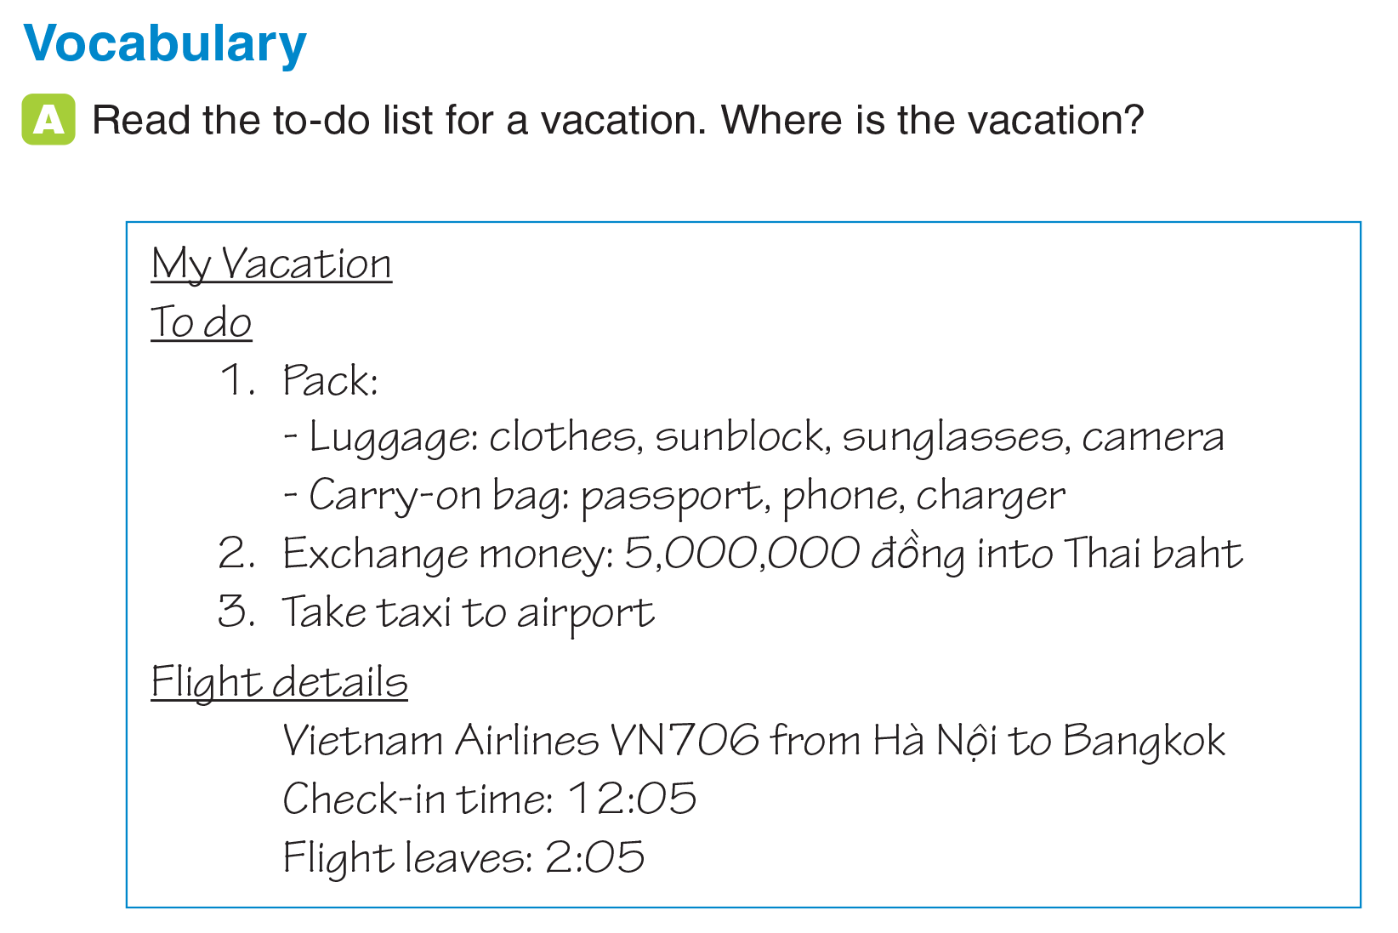
UNIT 3
GOING PLACES
VOCABULARY
In Thailand
_______________________________________________________________________________________________________________________________________________________________________________________________________________________
National Geographic Learning, a Cengage Company. © 2022 Cengage Learning, Inc. ALL RIGHTS RESERVED. This presentation tool is for teaching purpose only. May not be scanned, copied or duplicated, or posted to a publicly accessible website, in whole or in part.

Slide 5
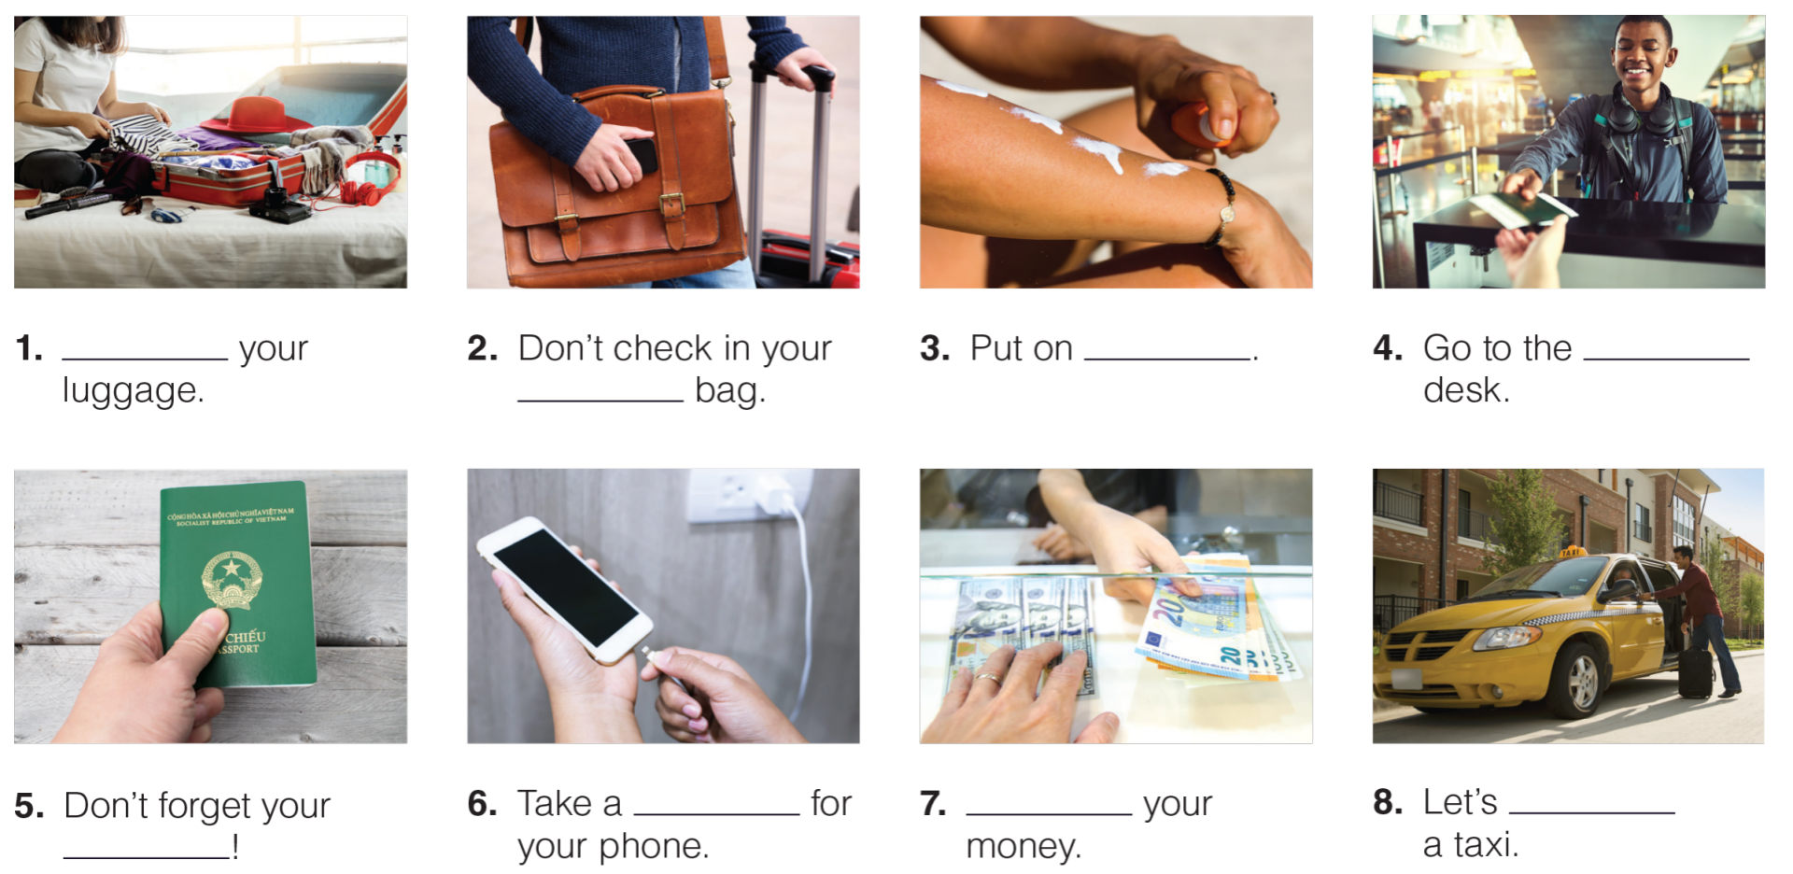
UNIT 3
GOING PLACES
VOCABULARY
Pack
sunblock
check-in
carry-on
charger
Exchange
take
passport
_______________________________________________________________________________________________________________________________________________________________________________________________________________________
National Geographic Learning, a Cengage Company. © 2022 Cengage Learning, Inc. ALL RIGHTS RESERVED. This presentation tool is for teaching purpose only. May not be scanned, copied or duplicated, or posted to a publicly accessible website, in whole or in part.

Slide 6
UNIT 3
GOING PLACE
VOCABULARY
_______________________________________________________________________________________________________________________________________________________________________________________________________________________
National Geographic Learning, a Cengage Company. © 2022 Cengage Learning, Inc. ALL RIGHTS RESERVED. This presentation tool is for teaching purpose only. May not be scanned, copied or duplicated, or posted to a publicly accessible website, in whole or in part.

Slide 7
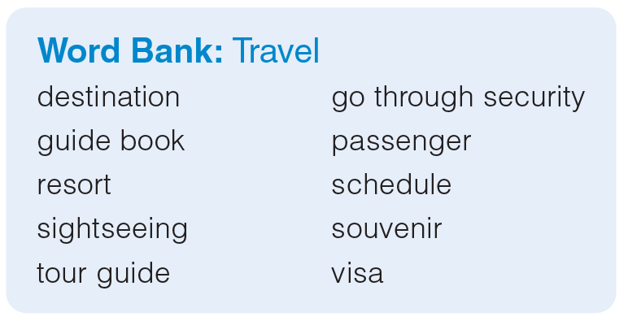
UNIT 3
GOING PLACES
VOCABULARY
_______________________________________________________________________________________________________________________________________________________________________________________________________________________
National Geographic Learning, a Cengage Company. © 2022 Cengage Learning, Inc. ALL RIGHTS RESERVED. This presentation tool is for teaching purpose only. May not be scanned, copied or duplicated, or posted to a publicly accessible website, in whole or in part.

Slide 8
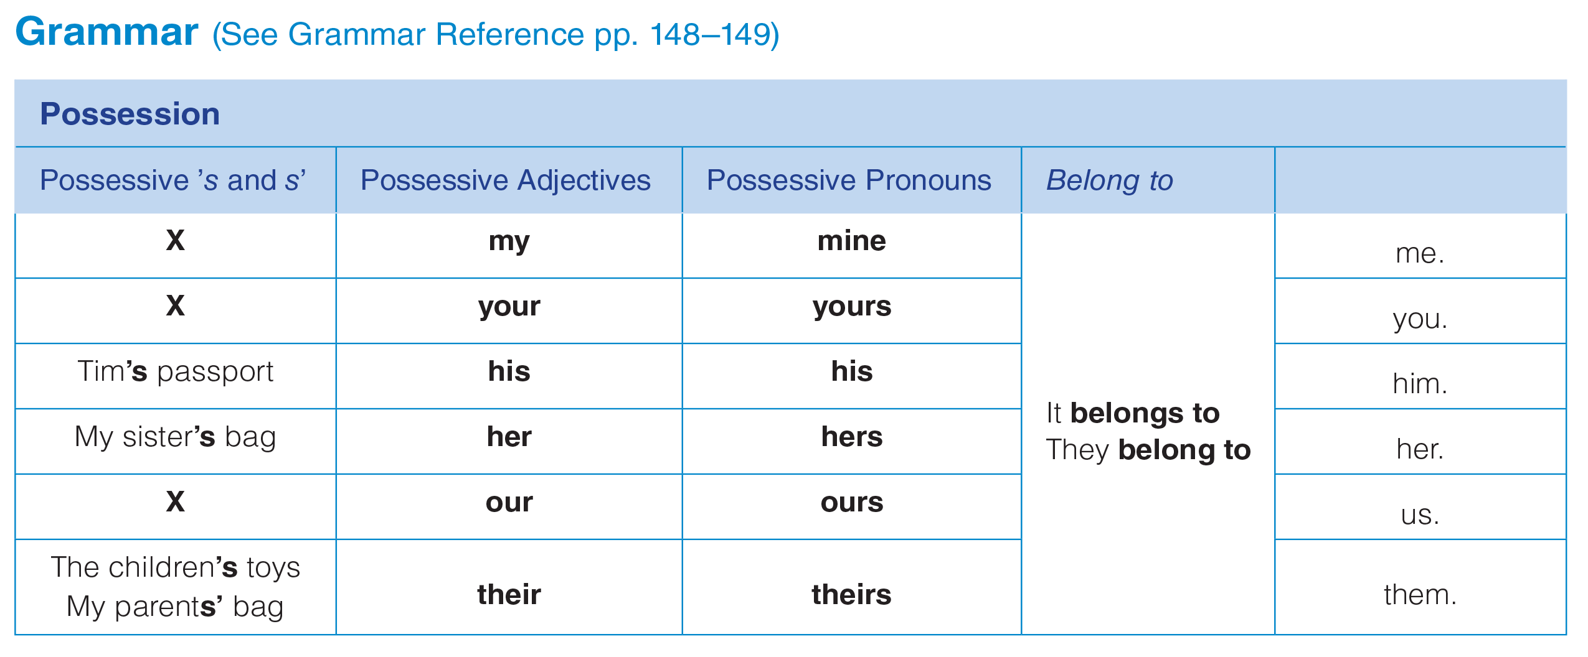
UNIT 3
GOING PLACE
GRAMMAR
_______________________________________________________________________________________________________________________________________________________________________________________________________________________
National Geographic Learning, a Cengage Company. © 2022 Cengage Learning, Inc. ALL RIGHTS RESERVED. This presentation tool is for teaching purpose only. May not be scanned, copied or duplicated, or posted to a publicly accessible website, in whole or in part.

Slide 9
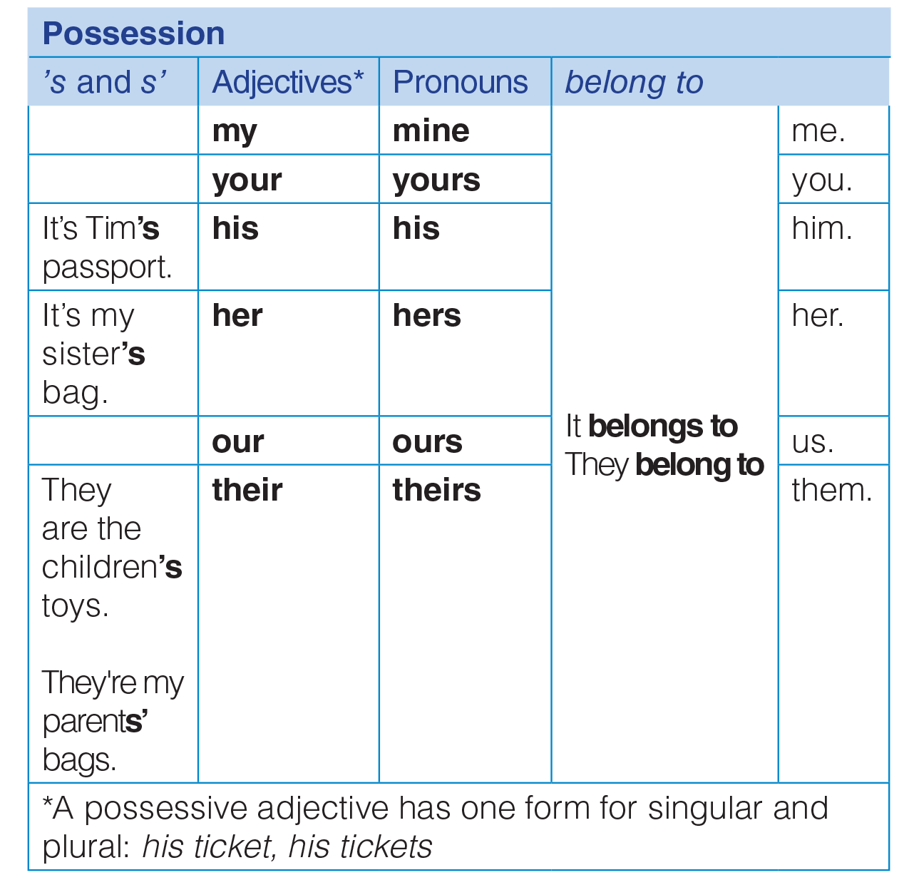
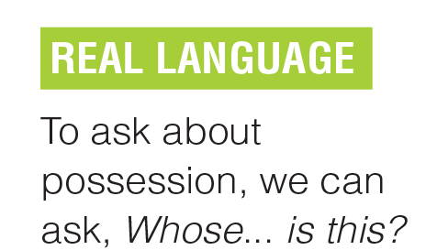
UNIT 3
GOING PLACES
GRAMMAR
_______________________________________________________________________________________________________________________________________________________________________________________________________________________
National Geographic Learning, a Cengage Company. © 2022 Cengage Learning, Inc. ALL RIGHTS RESERVED. This presentation tool is for teaching purpose only. May not be scanned, copied or duplicated, or posted to a publicly accessible website, in whole or in part.

Slide 10
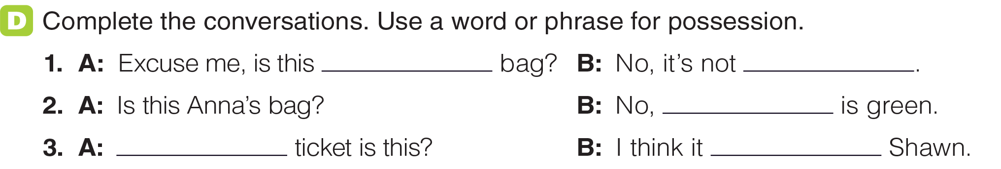
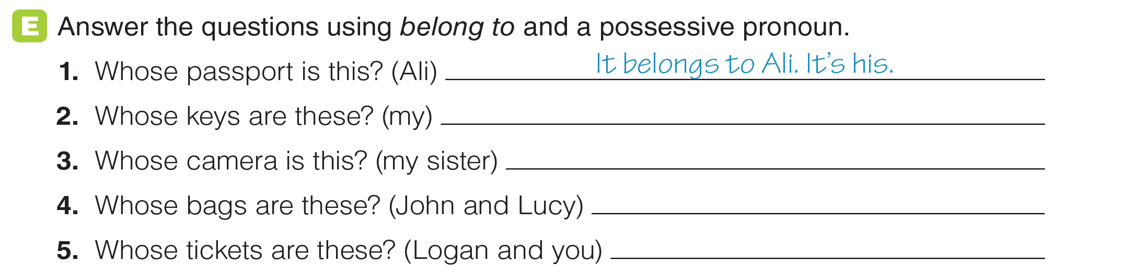
UNIT 3
GOING PLACES
GRAMMAR
your
mine
hers
Whose
belongs to
They belong to me. They’re mine.
It belongs to my sister. It’s hers.
They belong to John and Lucy. They’re theirs.
They belong to Logan and you. They're yours.
_______________________________________________________________________________________________________________________________________________________________________________________________________________________
National Geographic Learning, a Cengage Company. © 2022 Cengage Learning, Inc. ALL RIGHTS RESERVED. This presentation tool is for teaching purpose only. May not be scanned, copied or duplicated, or posted to a publicly accessible website, in whole or in part.

Slide 11
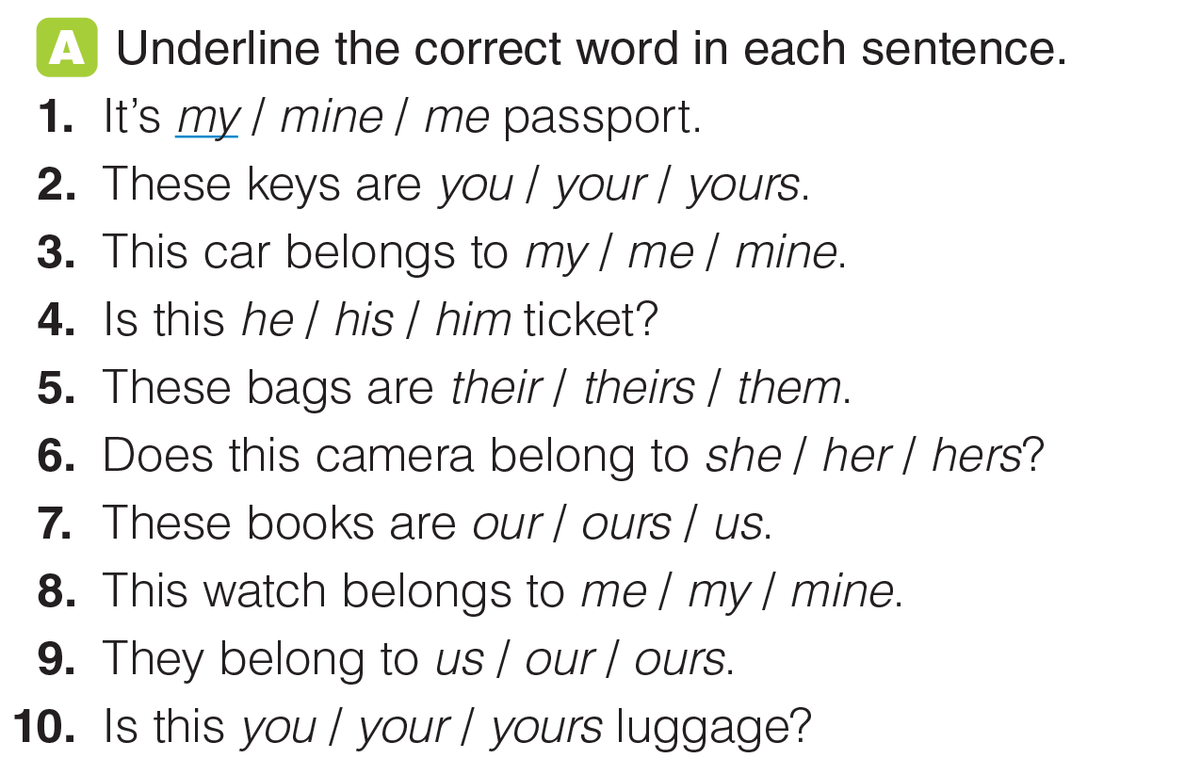
UNIT 3
GOING PLACES
GRAMMAR
_______________________________________________________________________________________________________________________________________________________________________________________________________________________
National Geographic Learning, a Cengage Company. © 2022 Cengage Learning, Inc. ALL RIGHTS RESERVED. This presentation tool is for teaching purpose only. May not be scanned, copied or duplicated, or posted to a publicly accessible website, in whole or in part.

Slide 12
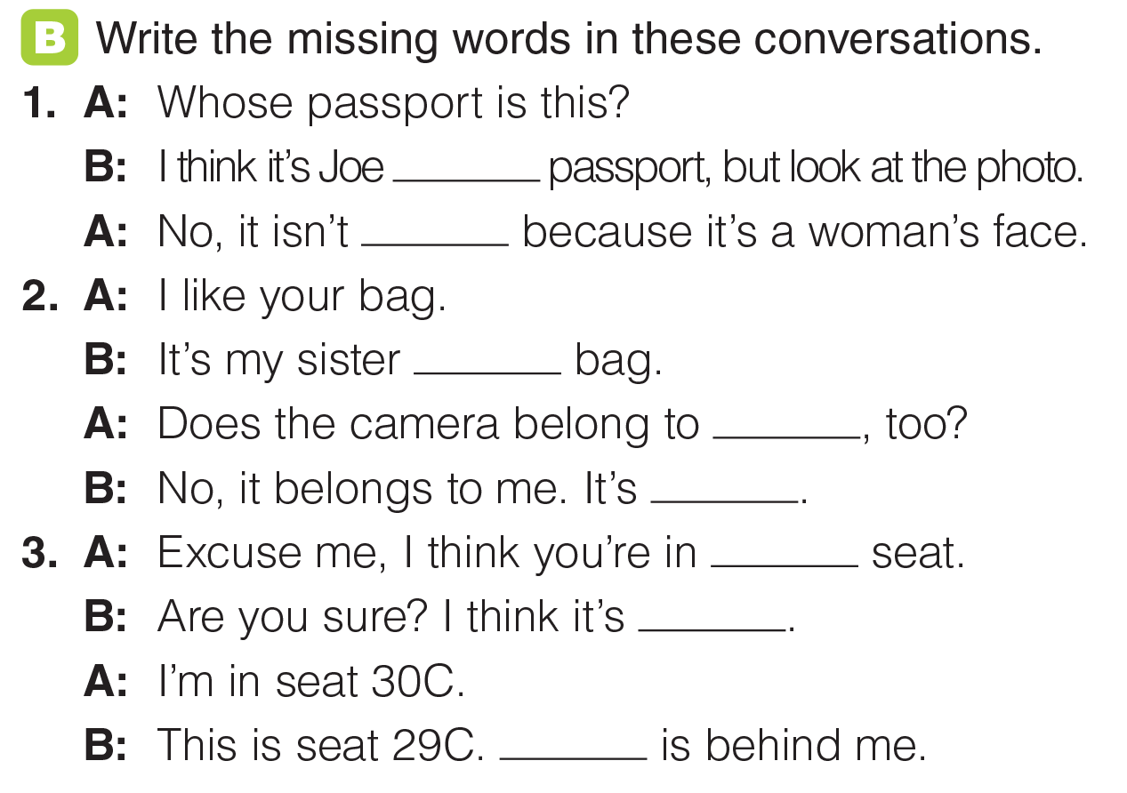
UNIT 3
GOING PLACES
GRAMMAR
‘s
his
‘s
her
mine
my
mine
Yours

Slide 13
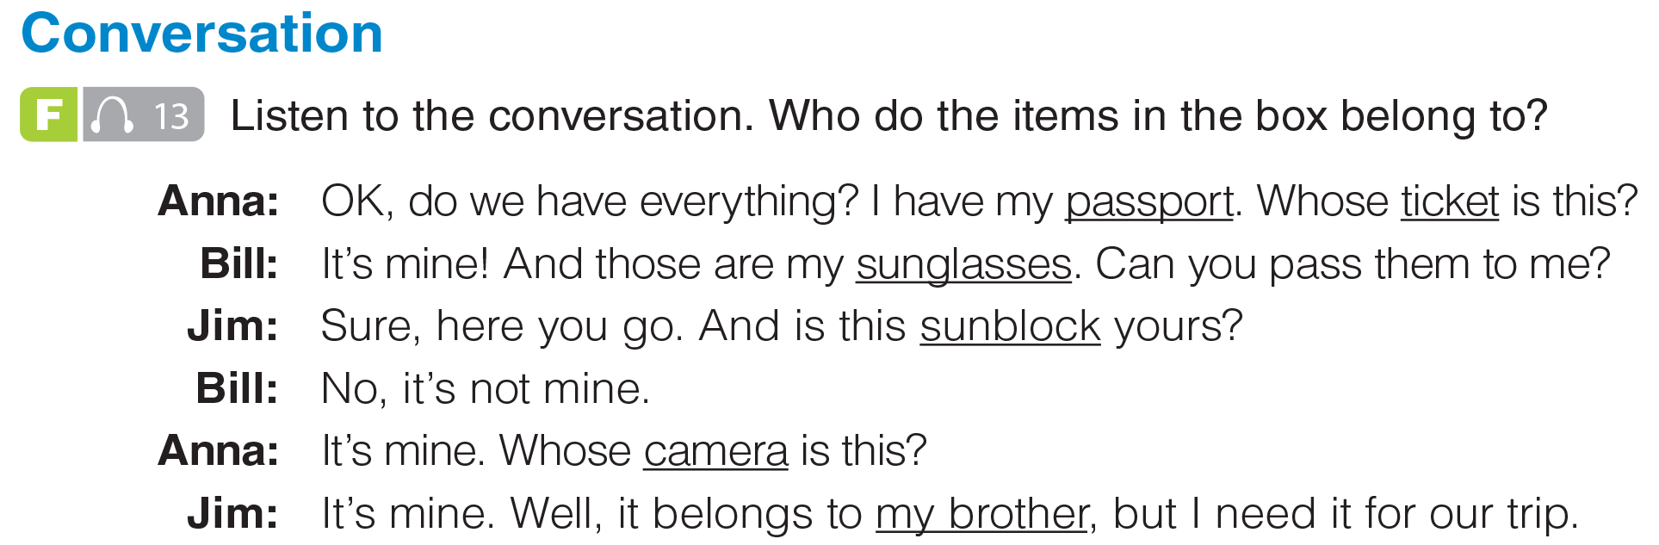


UNIT 3
GOING PLACES
CONVERSATION
Jim/Jim’s brother
Anna
Anna
Bill
Bill
_______________________________________________________________________________________________________________________________________________________________________________________________________________________
National Geographic Learning, a Cengage Company. © 2022 Cengage Learning, Inc. ALL RIGHTS RESERVED. This presentation tool is for teaching purpose only. May not be scanned, copied or duplicated, or posted to a publicly accessible website, in whole or in part.

Slide 14
UNIT 3
GOING PLACES
CONVERSATION
_______________________________________________________________________________________________________________________________________________________________________________________________________________________
National Geographic Learning, a Cengage Company. © 2022 Cengage Learning, Inc. ALL RIGHTS RESERVED. This presentation tool is for teaching purpose only. May not be scanned, copied or duplicated, or posted to a publicly accessible website, in whole or in part.

Slide 15


UNIT 3
GOING PLACES
GOAL CHECK
_______________________________________________________________________________________________________________________________________________________________________________________________________________________
National Geographic Learning, a Cengage Company. © 2022 Cengage Learning, Inc. ALL RIGHTS RESERVED. This presentation tool is for teaching purpose only. May not be scanned, copied or duplicated, or posted to a publicly accessible website, in whole or in part.

Slide 16
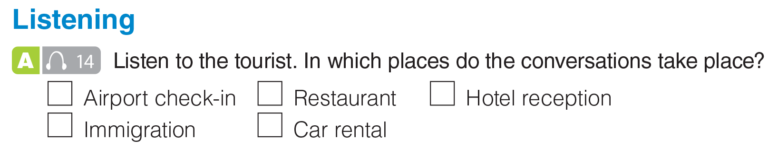

UNIT 3
GOING PLACES
LISTENING
✓
✓
_______________________________________________________________________________________________________________________________________________________________________________________________________________________
National Geographic Learning, a Cengage Company. © 2022 Cengage Learning, Inc. ALL RIGHTS RESERVED. This presentation tool is for teaching purpose only. May not be scanned, copied or duplicated, or posted to a publicly accessible website, in whole or in part.

Slide 17
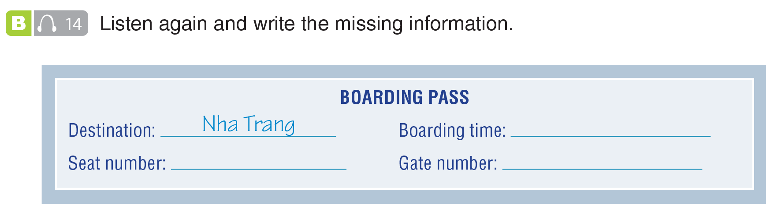
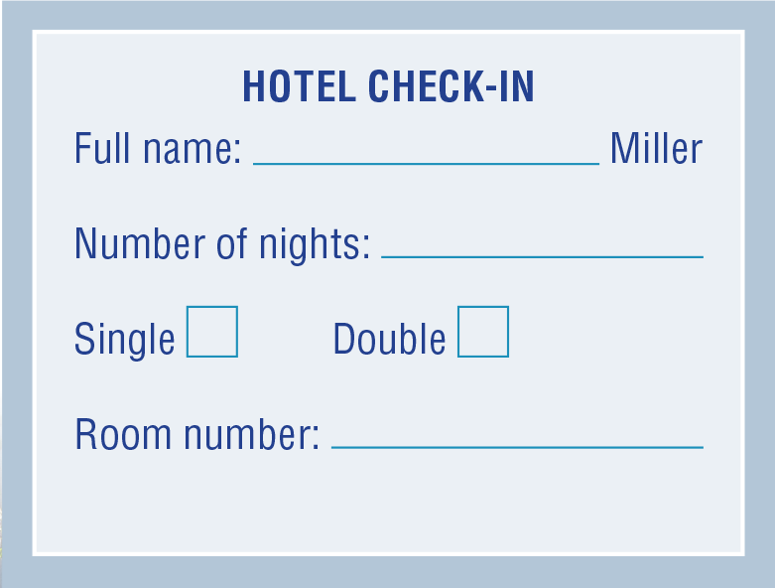
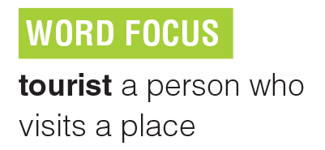
UNIT 3
GOING PLACES
LISTENING
10:00
18A
5
Steven
1
✓
303
_______________________________________________________________________________________________________________________________________________________________________________________________________________________
National Geographic Learning, a Cengage Company. © 2022 Cengage Learning, Inc. ALL RIGHTS RESERVED. This presentation tool is for teaching purpose only. May not be scanned, copied or duplicated, or posted to a publicly accessible website, in whole or in part.

Slide 18
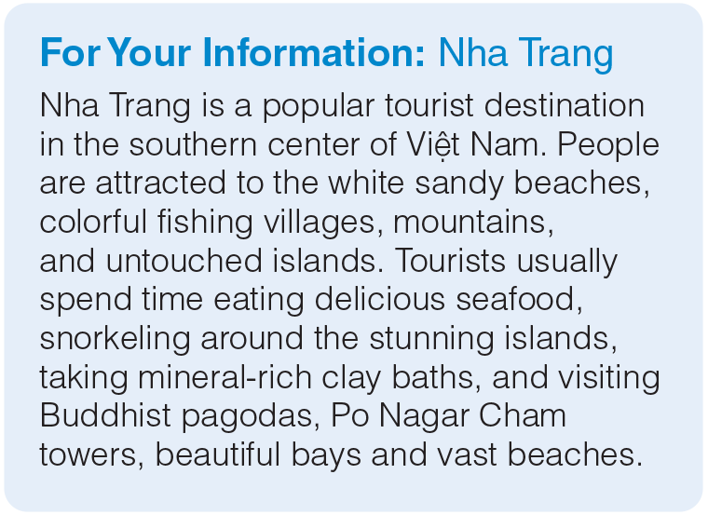
UNIT 3
GOING PLACES
LISTENING
_______________________________________________________________________________________________________________________________________________________________________________________________________________________
National Geographic Learning, a Cengage Company. © 2022 Cengage Learning, Inc. ALL RIGHTS RESERVED. This presentation tool is for teaching purpose only. May not be scanned, copied or duplicated, or posted to a publicly accessible website, in whole or in part.

Slide 19
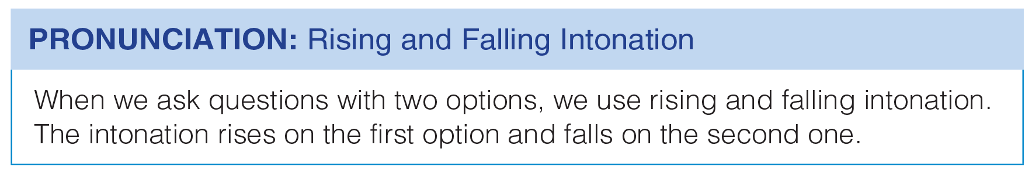
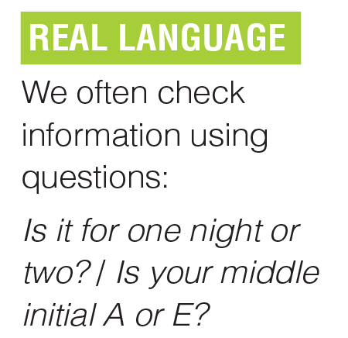
UNIT 3
GOING PLACES
PRONUNCIATION

Slide 20
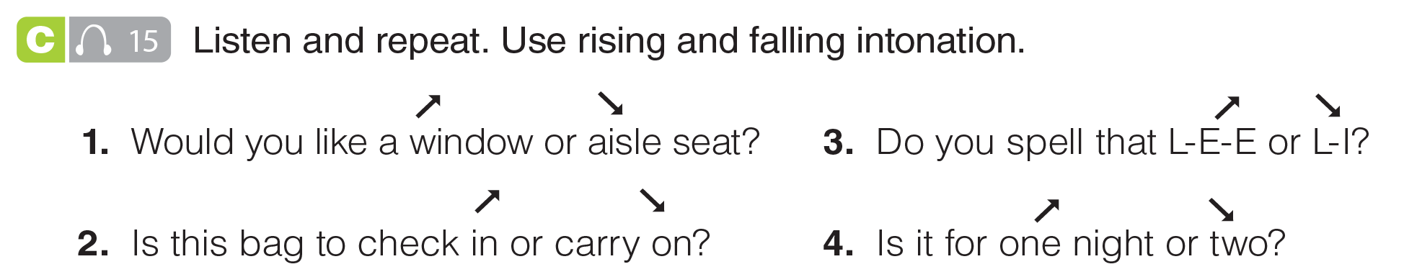
UNIT 3
GOING PLACES
PRONUNCIATION
_______________________________________________________________________________________________________________________________________________________________________________________________________________________
National Geographic Learning, a Cengage Company. © 2022 Cengage Learning, Inc. ALL RIGHTS RESERVED. This presentation tool is for teaching purpose only. May not be scanned, copied or duplicated, or posted to a publicly accessible website, in whole or in part.

Slide 21
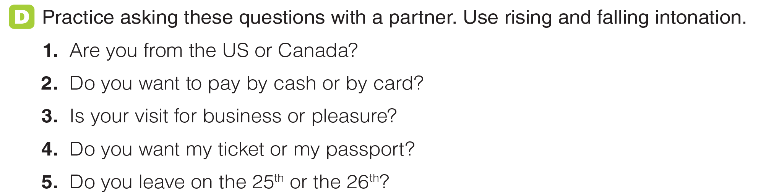
UNIT 3
GOING PLACES
PRONUNCIATION
_______________________________________________________________________________________________________________________________________________________________________________________________________________________
National Geographic Learning, a Cengage Company. © 2022 Cengage Learning, Inc. ALL RIGHTS RESERVED. This presentation tool is for teaching purpose only. May not be scanned, copied or duplicated, or posted to a publicly accessible website, in whole or in part.

Slide 22
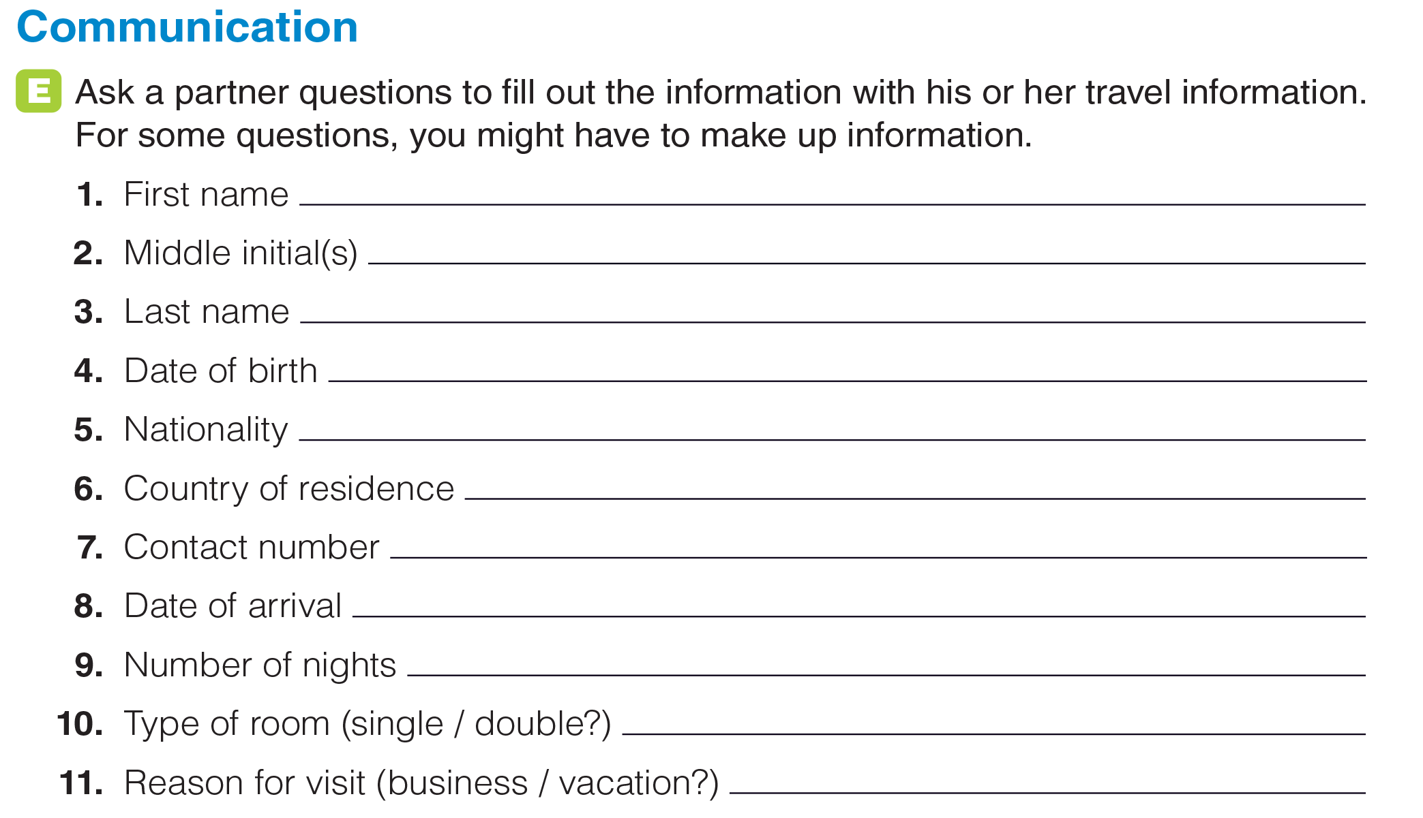
UNIT 3
GOING PLACES
COMMUNICATION
_______________________________________________________________________________________________________________________________________________________________________________________________________________________
National Geographic Learning, a Cengage Company. © 2022 Cengage Learning, Inc. ALL RIGHTS RESERVED. This presentation tool is for teaching purpose only. May not be scanned, copied or duplicated, or posted to a publicly accessible website, in whole or in part.

Slide 23

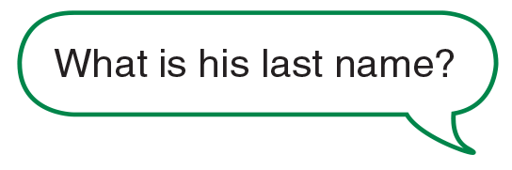



UNIT 3
GOING PLACES
GOAL CHECK
_______________________________________________________________________________________________________________________________________________________________________________________________________________________
National Geographic Learning, a Cengage Company. © 2022 Cengage Learning, Inc. ALL RIGHTS RESERVED. This presentation tool is for teaching purpose only. May not be scanned, copied or duplicated, or posted to a publicly accessible website, in whole or in part.

Slide 24
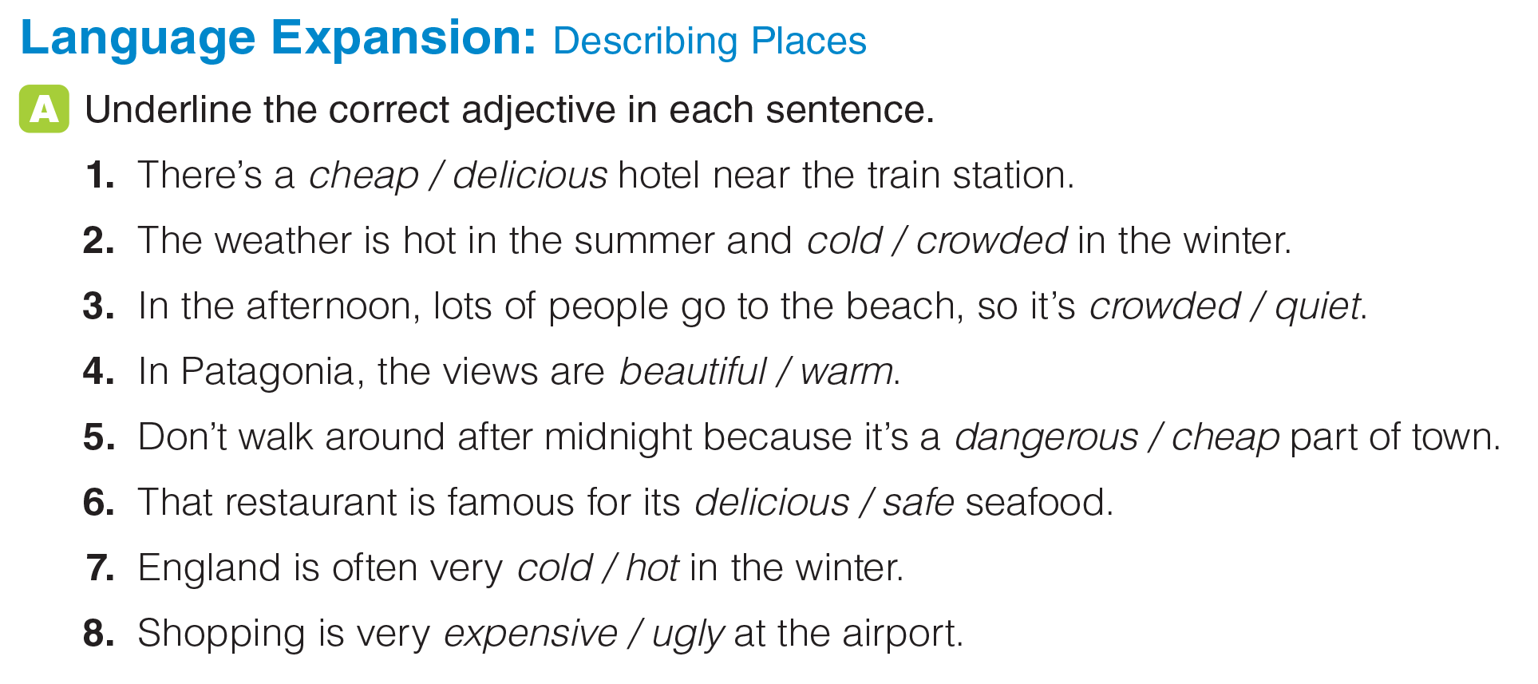
UNIT 3
GOING PLACES
LANGUAGE EXPANSION
_______________________________________________________________________________________________________________________________________________________________________________________________________________________
National Geographic Learning, a Cengage Company. © 2022 Cengage Learning, Inc. ALL RIGHTS RESERVED. This presentation tool is for teaching purpose only. May not be scanned, copied or duplicated, or posted to a publicly accessible website, in whole or in part.

Slide 25
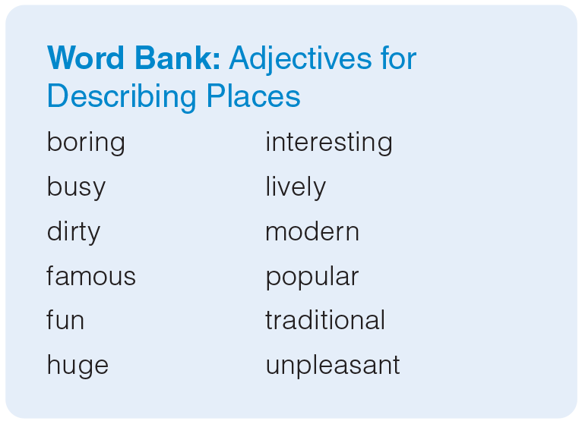
UNIT 3
GOING PLACES
LANGUAGE EXPANSION
_______________________________________________________________________________________________________________________________________________________________________________________________________________________
National Geographic Learning, a Cengage Company. © 2022 Cengage Learning, Inc. ALL RIGHTS RESERVED. This presentation tool is for teaching purpose only. May not be scanned, copied or duplicated, or posted to a publicly accessible website, in whole or in part.

Slide 26
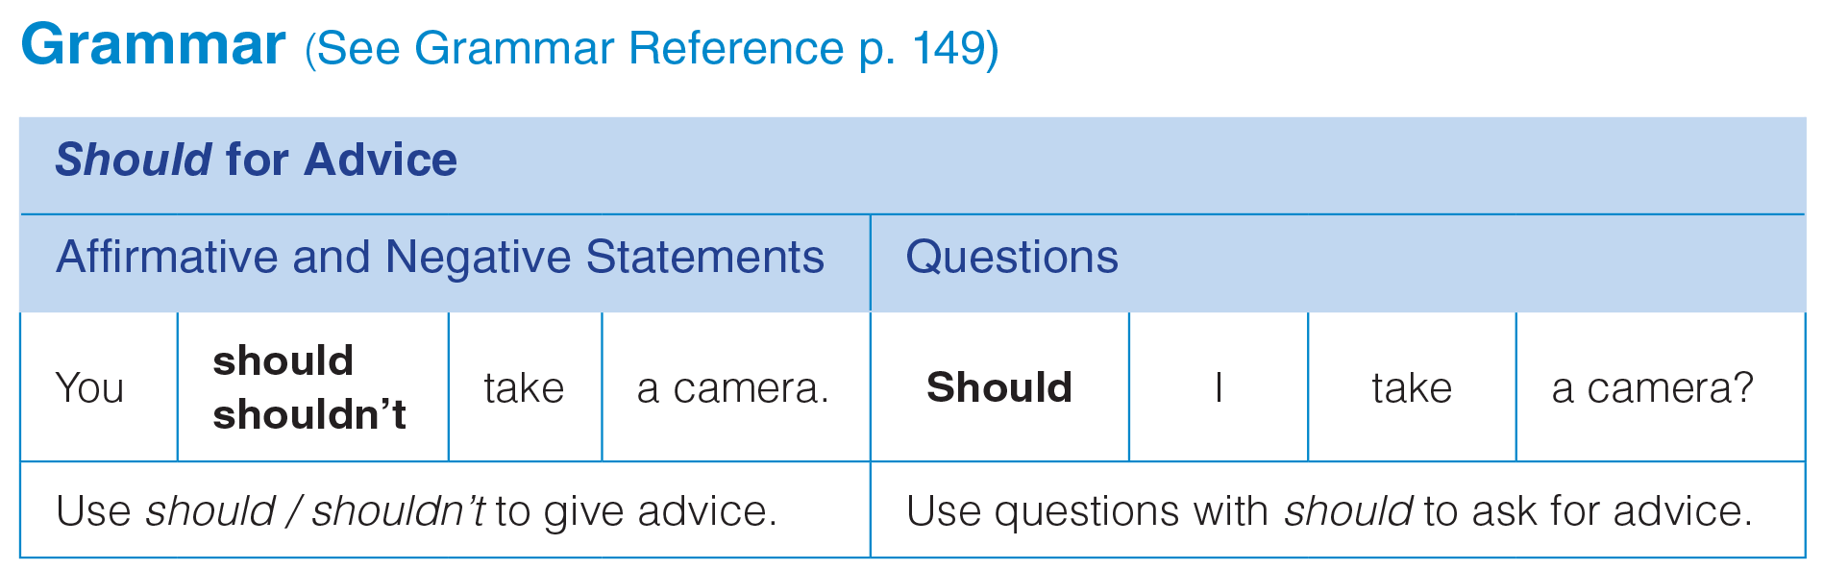
UNIT 3
GOING PLACES
GRAMMAR
_______________________________________________________________________________________________________________________________________________________________________________________________________________________
National Geographic Learning, a Cengage Company. © 2022 Cengage Learning, Inc. ALL RIGHTS RESERVED. This presentation tool is for teaching purpose only. May not be scanned, copied or duplicated, or posted to a publicly accessible website, in whole or in part.

Slide 27
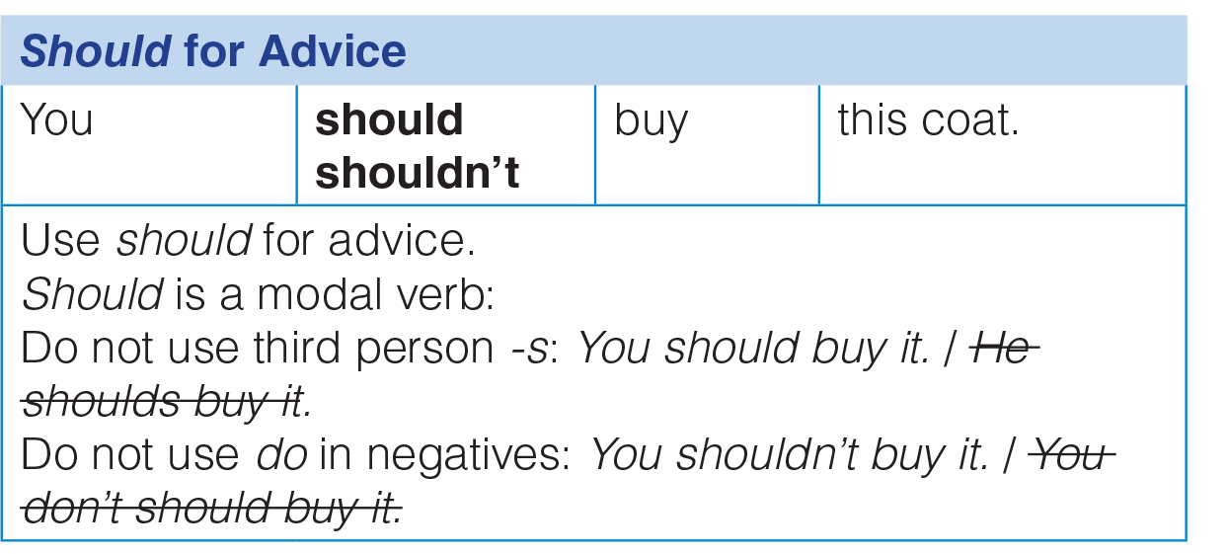
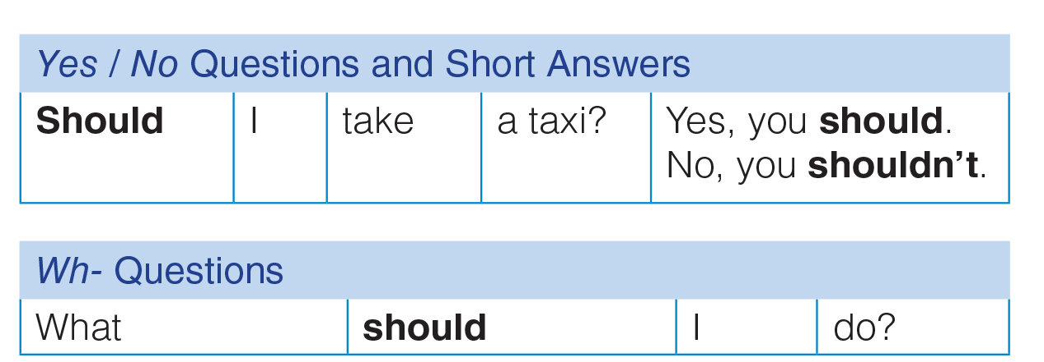
UNIT 3
GOING PLACES
GRAMMAR
_______________________________________________________________________________________________________________________________________________________________________________________________________________________
National Geographic Learning, a Cengage Company. © 2022 Cengage Learning, Inc. ALL RIGHTS RESERVED. This presentation tool is for teaching purpose only. May not be scanned, copied or duplicated, or posted to a publicly accessible website, in whole or in part.

Slide 28
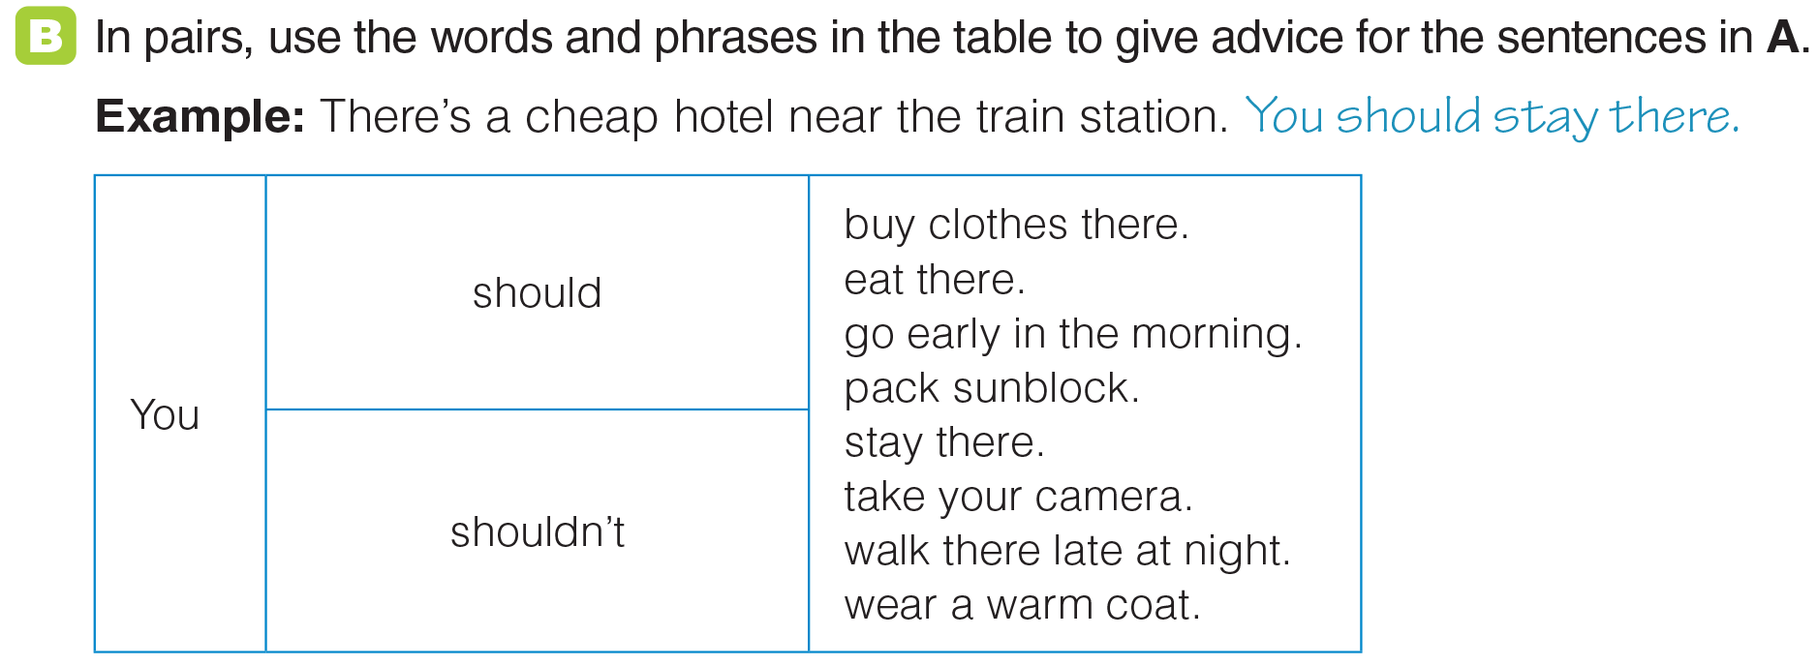
UNIT 3
GOING PLACES
GRAMMAR
_______________________________________________________________________________________________________________________________________________________________________________________________________________________
National Geographic Learning, a Cengage Company. © 2022 Cengage Learning, Inc. ALL RIGHTS RESERVED. This presentation tool is for teaching purpose only. May not be scanned, copied or duplicated, or posted to a publicly accessible website, in whole or in part.

Slide 29
UNIT 3
GOING PLACES
GRAMMAR
_______________________________________________________________________________________________________________________________________________________________________________________________________________________
National Geographic Learning, a Cengage Company. © 2022 Cengage Learning, Inc. ALL RIGHTS RESERVED. This presentation tool is for teaching purpose only. May not be scanned, copied or duplicated, or posted to a publicly accessible website, in whole or in part.

Slide 30
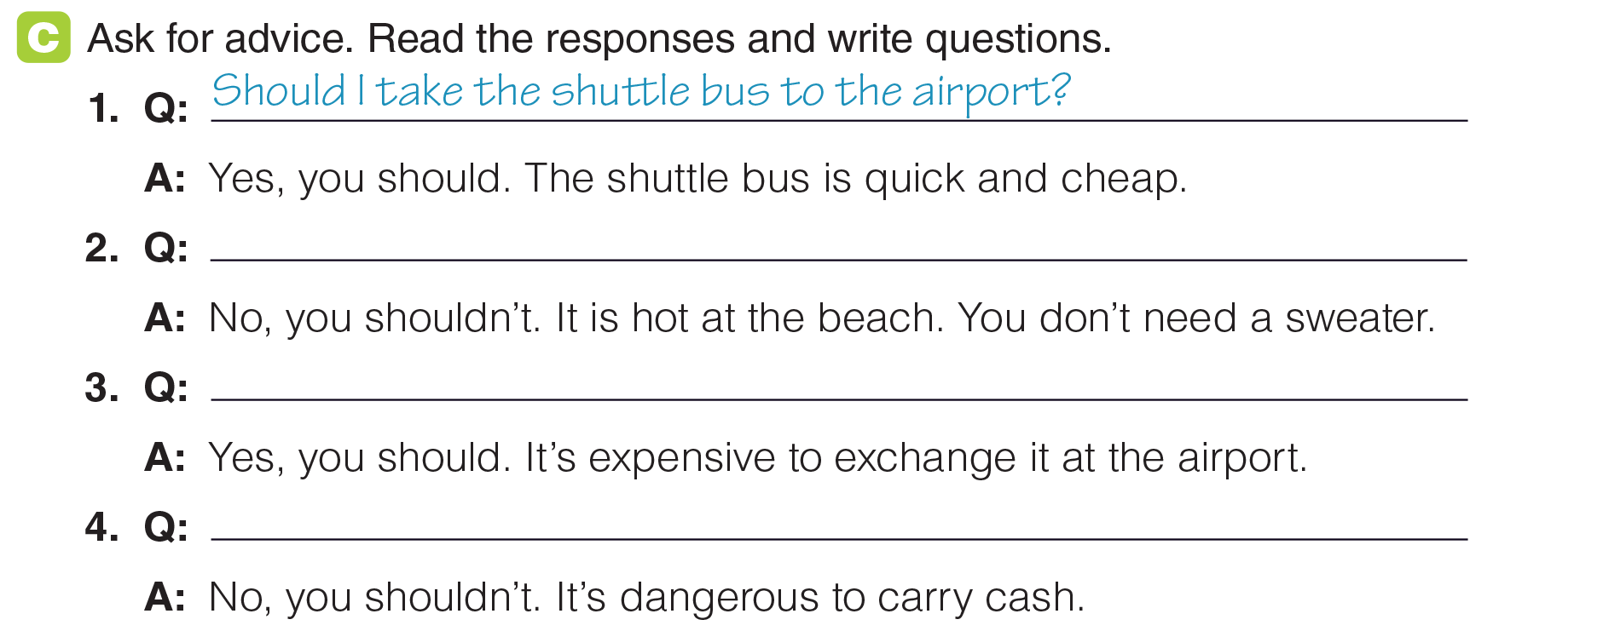
UNIT 3
GOING PLACES
GRAMMAR
Should I bring a sweater?
Should I exchange money at the bank?
Should I bring a lot of cash?
_______________________________________________________________________________________________________________________________________________________________________________________________________________________
National Geographic Learning, a Cengage Company. © 2022 Cengage Learning, Inc. ALL RIGHTS RESERVED. This presentation tool is for teaching purpose only. May not be scanned, copied or duplicated, or posted to a publicly accessible website, in whole or in part.

Slide 31
UNIT 3
GOING PLACES
GRAMMAR
Should I bring a sweater?
Should I exchange money at the bank?
Should I bring a lot of cash?
_______________________________________________________________________________________________________________________________________________________________________________________________________________________
National Geographic Learning, a Cengage Company. © 2022 Cengage Learning, Inc. ALL RIGHTS RESERVED. This presentation tool is for teaching purpose only. May not be scanned, copied or duplicated, or posted to a publicly accessible website, in whole or in part.

Slide 32
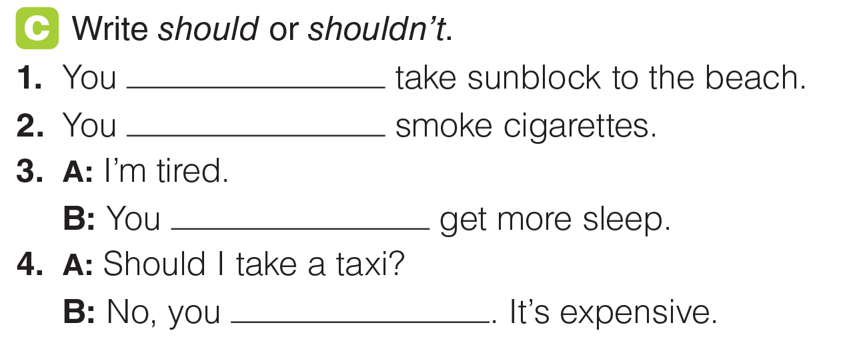
UNIT 3
GOING PLACES
GRAMMAR
should
shouldn’t
should
shouldn’t
_______________________________________________________________________________________________________________________________________________________________________________________________________________________
National Geographic Learning, a Cengage Company. © 2022 Cengage Learning, Inc. ALL RIGHTS RESERVED. This presentation tool is for teaching purpose only. May not be scanned, copied or duplicated, or posted to a publicly accessible website, in whole or in part.

Slide 33
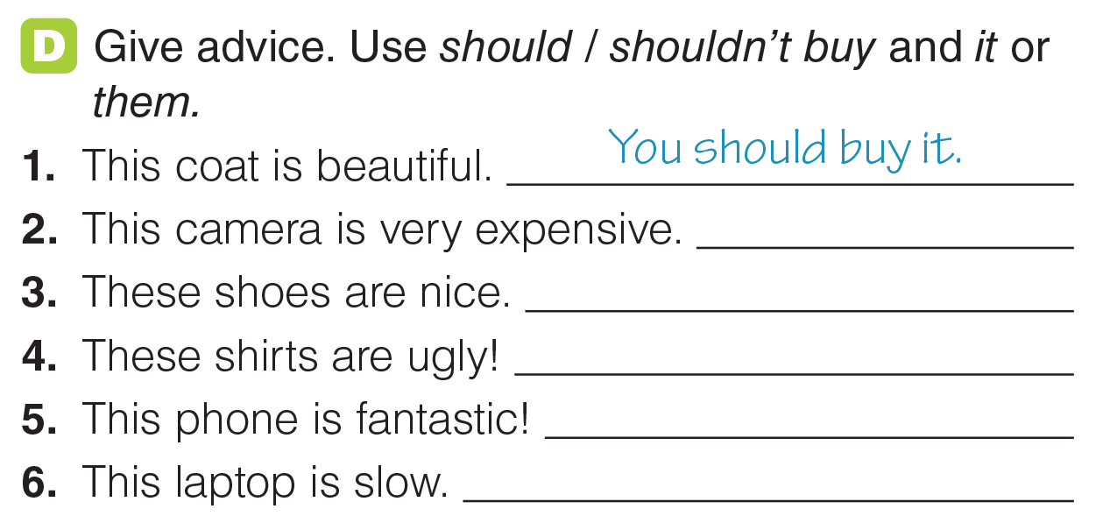
UNIT 3
GOING PLACES
GRAMMAR
You shouldn’t buy it.
You should buy them.
You shouldn’t buy it.
You should buy it.
You shouldn’t buy it.
_______________________________________________________________________________________________________________________________________________________________________________________________________________________
National Geographic Learning, a Cengage Company. © 2022 Cengage Learning, Inc. ALL RIGHTS RESERVED. This presentation tool is for teaching purpose only. May not be scanned, copied or duplicated, or posted to a publicly accessible website, in whole or in part.

Slide 34
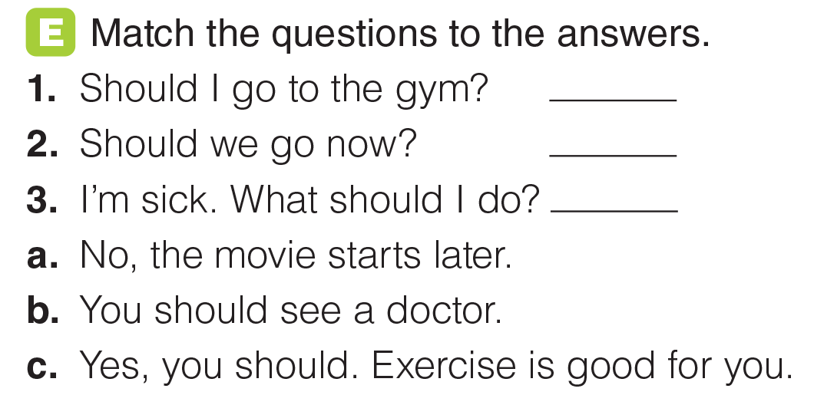
UNIT 3
GOING PLACES
GRAMMAR
c
a
b
_______________________________________________________________________________________________________________________________________________________________________________________________________________________
National Geographic Learning, a Cengage Company. © 2022 Cengage Learning, Inc. ALL RIGHTS RESERVED. This presentation tool is for teaching purpose only. May not be scanned, copied or duplicated, or posted to a publicly accessible website, in whole or in part.

Slide 35
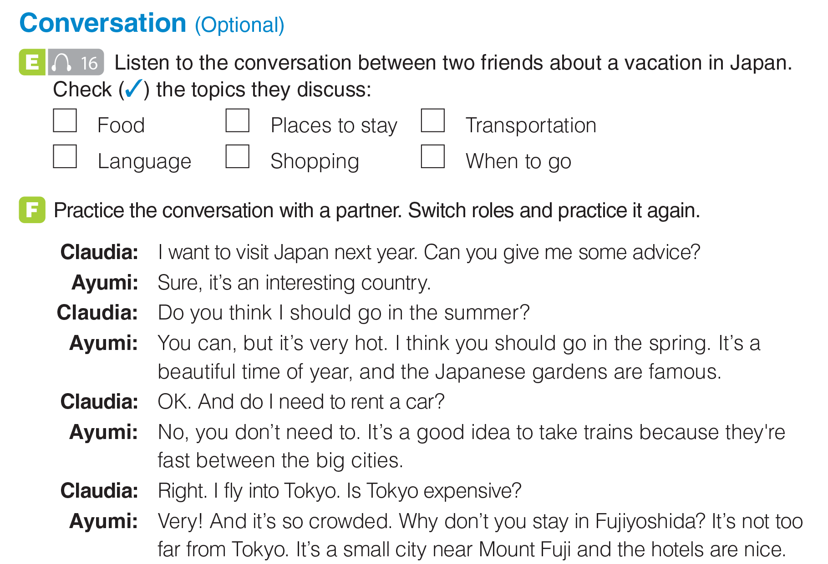
UNIT 3
GOING PLACES
CONVERSATION
✓
✓
✓
_______________________________________________________________________________________________________________________________________________________________________________________________________________________
National Geographic Learning, a Cengage Company. © 2022 Cengage Learning, Inc. ALL RIGHTS RESERVED. This presentation tool is for teaching purpose only. May not be scanned, copied or duplicated, or posted to a publicly accessible website, in whole or in part.

Slide 36
UNIT 3
GOING PLACES
CONVERSATION
_______________________________________________________________________________________________________________________________________________________________________________________________________________________
National Geographic Learning, a Cengage Company. © 2022 Cengage Learning, Inc. ALL RIGHTS RESERVED. This presentation tool is for teaching purpose only. May not be scanned, copied or duplicated, or posted to a publicly accessible website, in whole or in part.

Slide 37
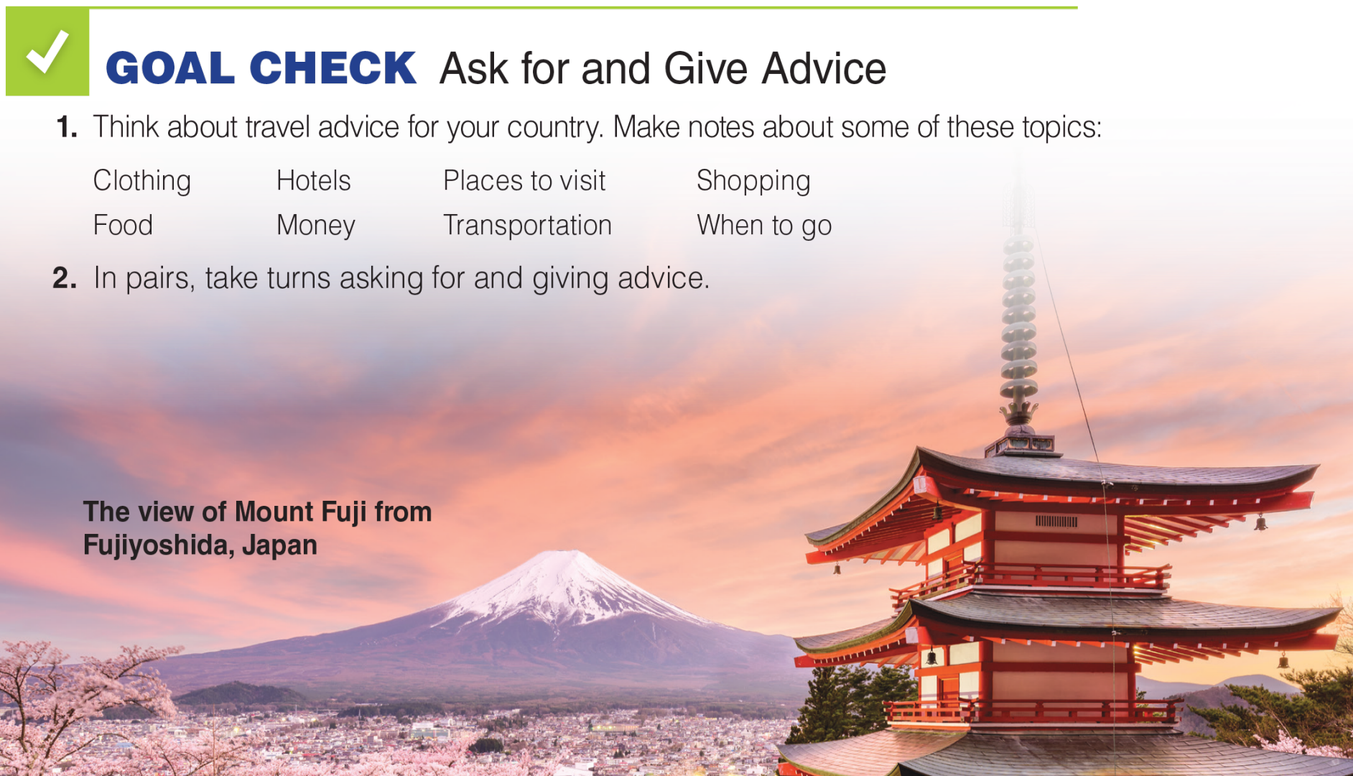
UNIT 3
GOING PLACES
GOAL CHECK
_______________________________________________________________________________________________________________________________________________________________________________________________________________________
National Geographic Learning, a Cengage Company. © 2022 Cengage Learning, Inc. ALL RIGHTS RESERVED. This presentation tool is for teaching purpose only. May not be scanned, copied or duplicated, or posted to a publicly accessible website, in whole or in part.

Slide 38
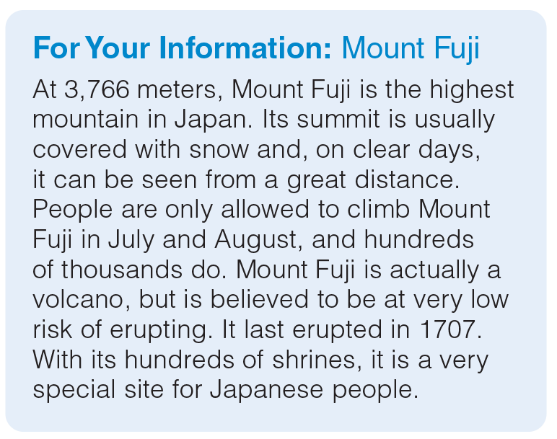
UNIT 3
GOING PLACES
GOAL CHECK
_______________________________________________________________________________________________________________________________________________________________________________________________________________________
National Geographic Learning, a Cengage Company. © 2022 Cengage Learning, Inc. ALL RIGHTS RESERVED. This presentation tool is for teaching purpose only. May not be scanned, copied or duplicated, or posted to a publicly accessible website, in whole or in part.

Slide 39

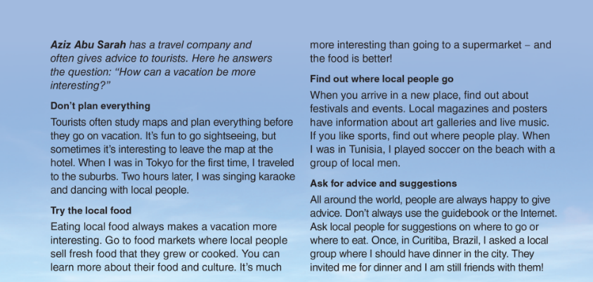
UNIT 3
GOING PLACES
READING
_______________________________________________________________________________________________________________________________________________________________________________________________________________________
National Geographic Learning, a Cengage Company. © 2022 Cengage Learning, Inc. ALL RIGHTS RESERVED. This presentation tool is for teaching purpose only. May not be scanned, copied or duplicated, or posted to a publicly accessible website, in whole or in part.

Slide 40
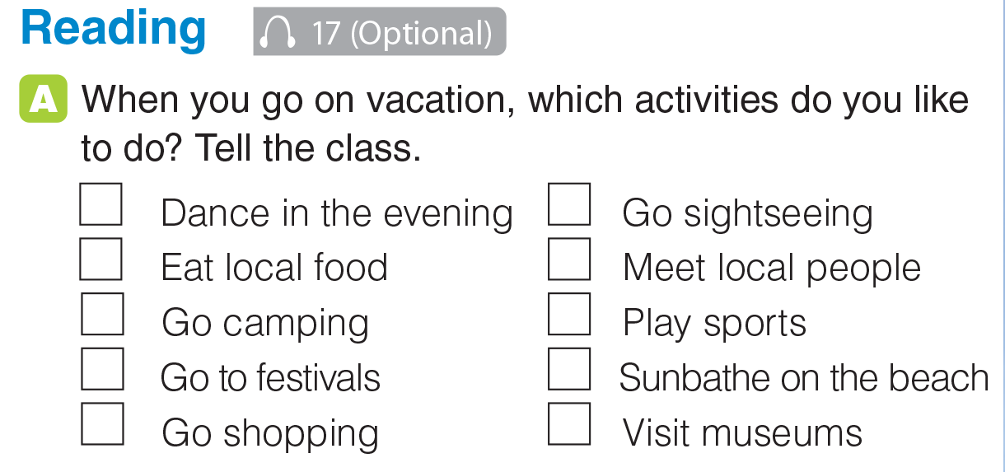
UNIT 3
GOING PLACES
READING
_______________________________________________________________________________________________________________________________________________________________________________________________________________________
National Geographic Learning, a Cengage Company. © 2022 Cengage Learning, Inc. ALL RIGHTS RESERVED. This presentation tool is for teaching purpose only. May not be scanned, copied or duplicated, or posted to a publicly accessible website, in whole or in part.

Slide 41
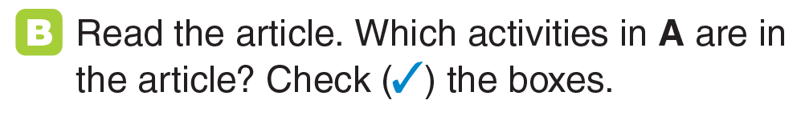
UNIT 3
GOING PLACES
READING
✓
✓
✓
✓
✓
✓
_______________________________________________________________________________________________________________________________________________________________________________________________________________________
National Geographic Learning, a Cengage Company. © 2022 Cengage Learning, Inc. ALL RIGHTS RESERVED. This presentation tool is for teaching purpose only. May not be scanned, copied or duplicated, or posted to a publicly accessible website, in whole or in part.

Slide 42
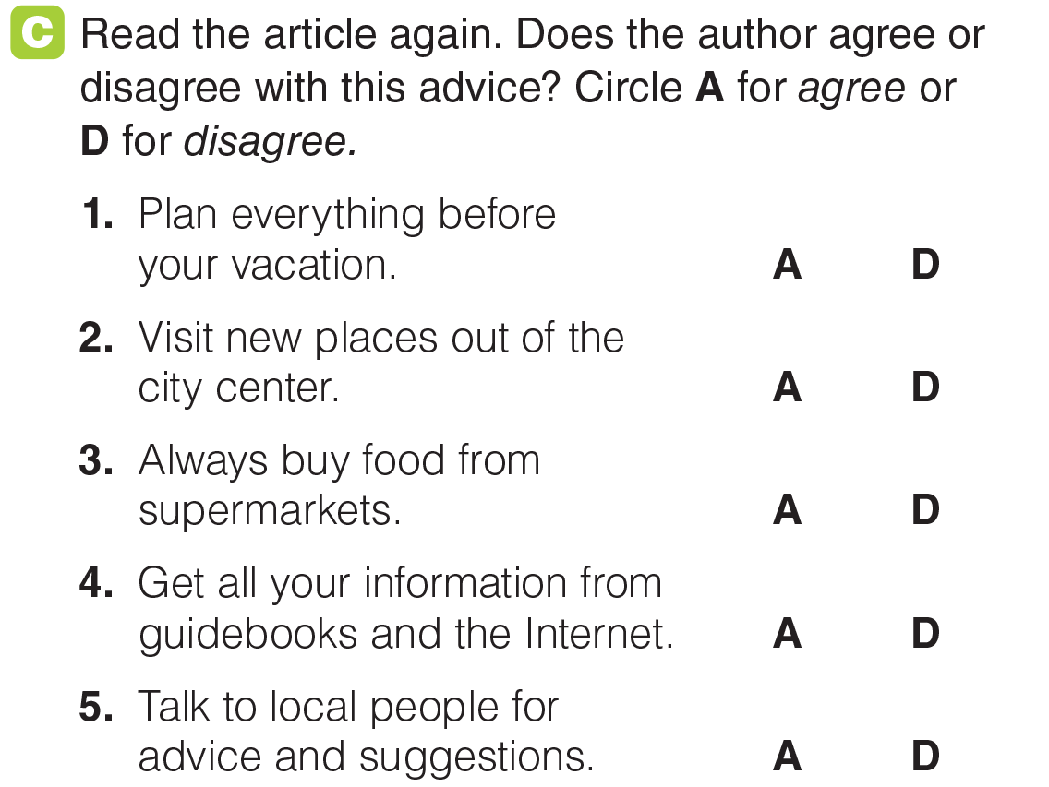
UNIT 3
GOING PLACES
READING
_______________________________________________________________________________________________________________________________________________________________________________________________________________________
National Geographic Learning, a Cengage Company. © 2022 Cengage Learning, Inc. ALL RIGHTS RESERVED. This presentation tool is for teaching purpose only. May not be scanned, copied or duplicated, or posted to a publicly accessible website, in whole or in part.

Slide 43

UNIT 3
GOING PLACES
READING
_______________________________________________________________________________________________________________________________________________________________________________________________________________________
National Geographic Learning, a Cengage Company. © 2022 Cengage Learning, Inc. ALL RIGHTS RESERVED. This presentation tool is for teaching purpose only. May not be scanned, copied or duplicated, or posted to a publicly accessible website, in whole or in part.

Slide 44
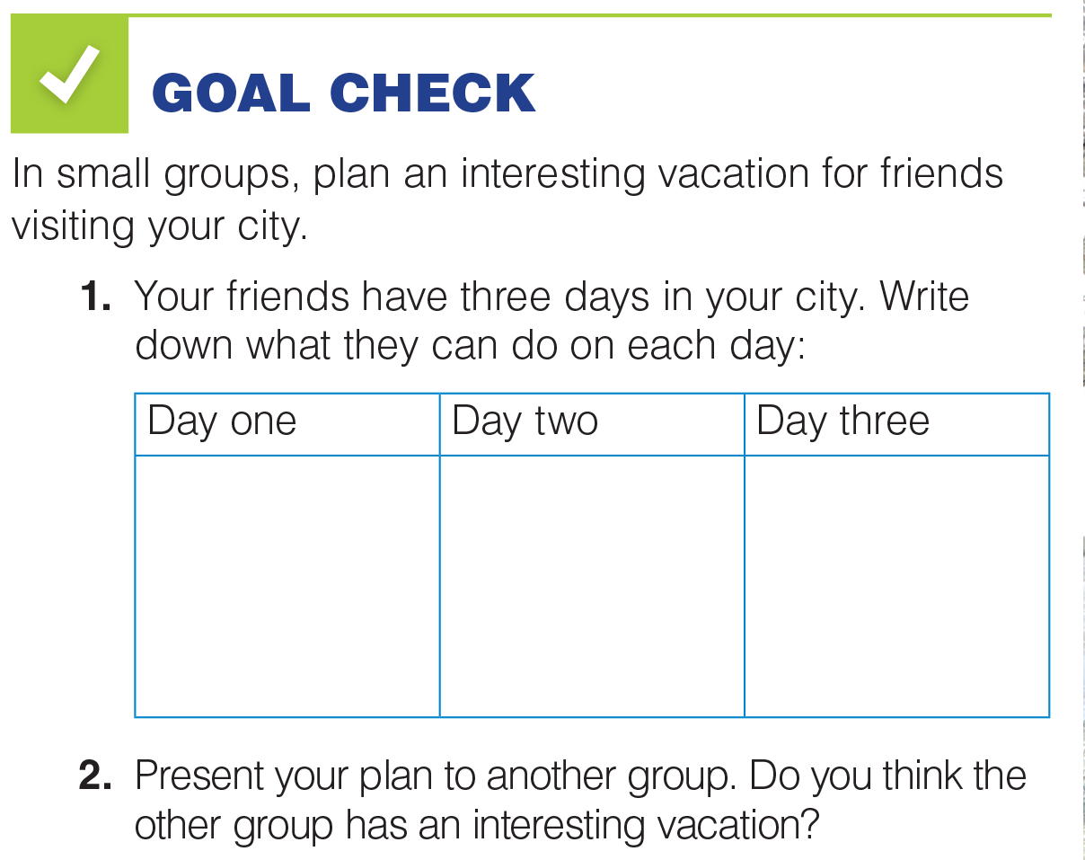
UNIT 3
GOING PLACES
GOAL CHECK
_______________________________________________________________________________________________________________________________________________________________________________________________________________________
National Geographic Learning, a Cengage Company. © 2022 Cengage Learning, Inc. ALL RIGHTS RESERVED. This presentation tool is for teaching purpose only. May not be scanned, copied or duplicated, or posted to a publicly accessible website, in whole or in part.

Slide 45


UNIT 3
GOING PLACES
COMMUNICATION
_______________________________________________________________________________________________________________________________________________________________________________________________________________________
National Geographic Learning, a Cengage Company. © 2022 Cengage Learning, Inc. ALL RIGHTS RESERVED. This presentation tool is for teaching purpose only. May not be scanned, copied or duplicated, or posted to a publicly accessible website, in whole or in part.

Slide 46
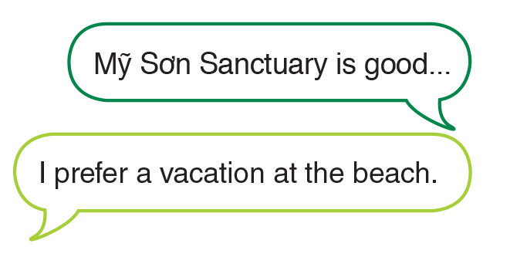
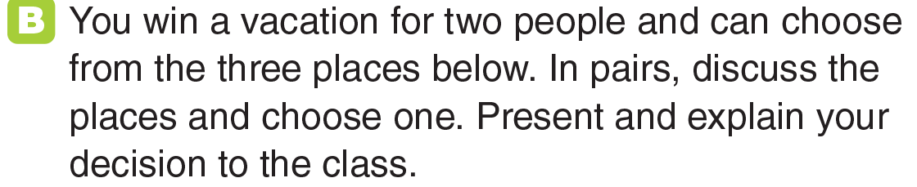
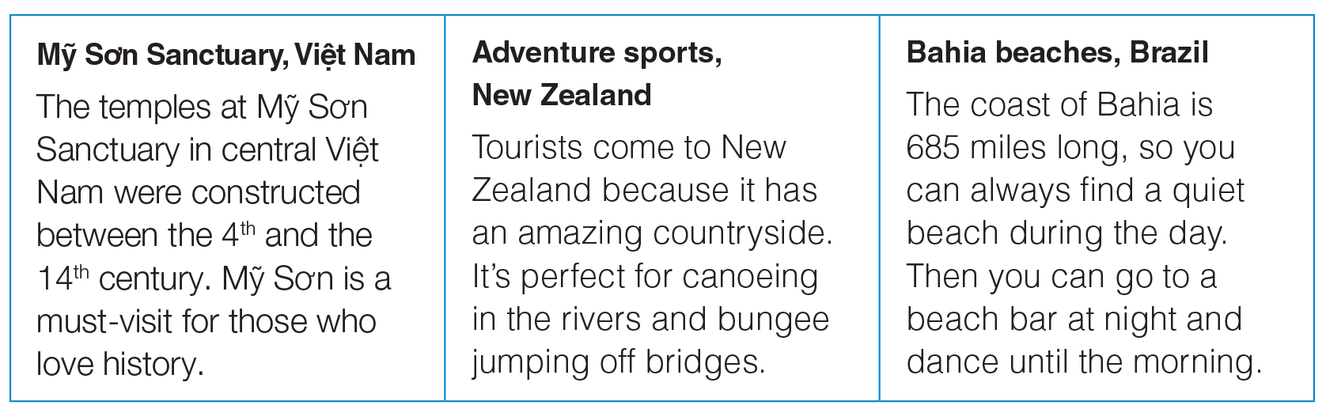
UNIT 3
GOING PLACES
COMMUNICATION
_______________________________________________________________________________________________________________________________________________________________________________________________________________________
National Geographic Learning, a Cengage Company. © 2022 Cengage Learning, Inc. ALL RIGHTS RESERVED. This presentation tool is for teaching purpose only. May not be scanned, copied or duplicated, or posted to a publicly accessible website, in whole or in part.

Slide 47
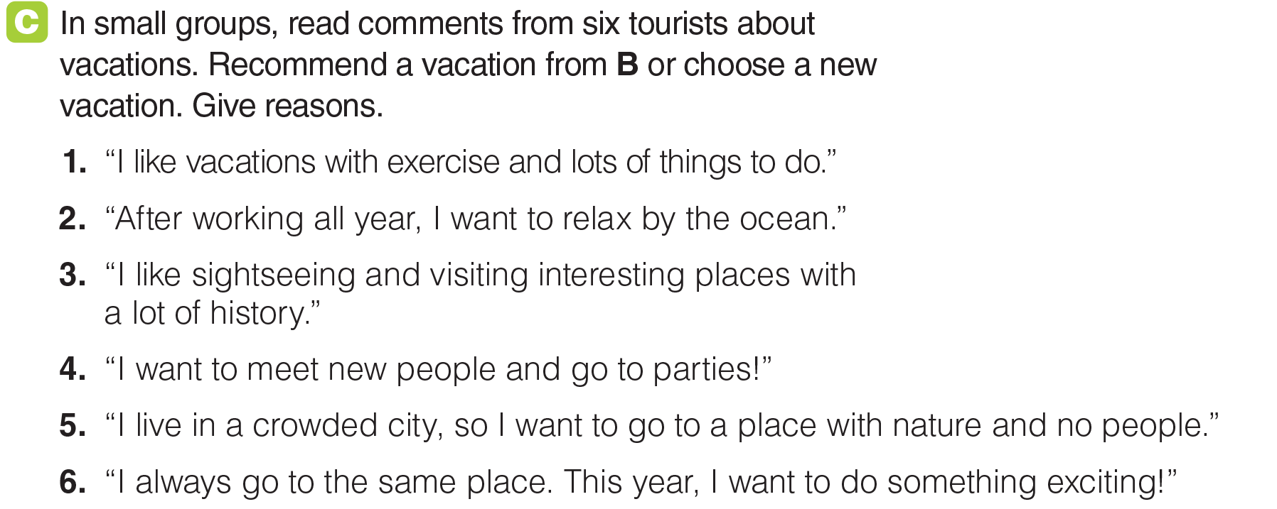
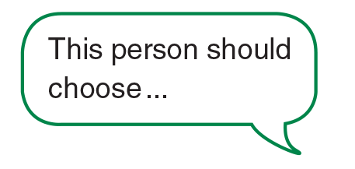


UNIT 3
GOING PLACES
COMMUNICATION
_______________________________________________________________________________________________________________________________________________________________________________________________________________________
National Geographic Learning, a Cengage Company. © 2022 Cengage Learning, Inc. ALL RIGHTS RESERVED. This presentation tool is for teaching purpose only. May not be scanned, copied or duplicated, or posted to a publicly accessible website, in whole or in part.

Slide 48
UNIT 3
GOING PLACES
COMMUNICATION
_______________________________________________________________________________________________________________________________________________________________________________________________________________________
National Geographic Learning, a Cengage Company. © 2022 Cengage Learning, Inc. ALL RIGHTS RESERVED. This presentation tool is for teaching purpose only. May not be scanned, copied or duplicated, or posted to a publicly accessible website, in whole or in part.

Slide 49
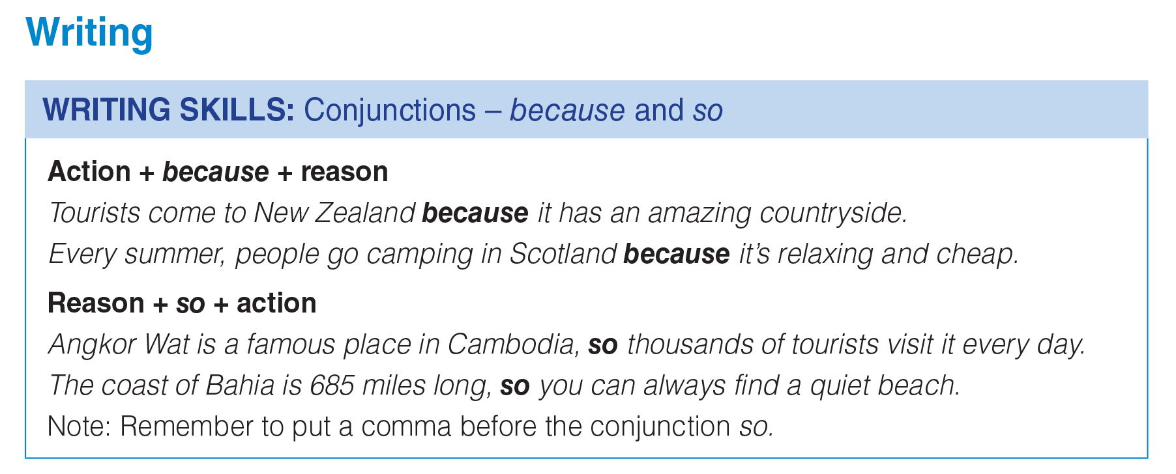
UNIT 3
GOING PLACES
WRITING
_______________________________________________________________________________________________________________________________________________________________________________________________________________________
National Geographic Learning, a Cengage Company. © 2022 Cengage Learning, Inc. ALL RIGHTS RESERVED. This presentation tool is for teaching purpose only. May not be scanned, copied or duplicated, or posted to a publicly accessible website, in whole or in part.

Slide 50
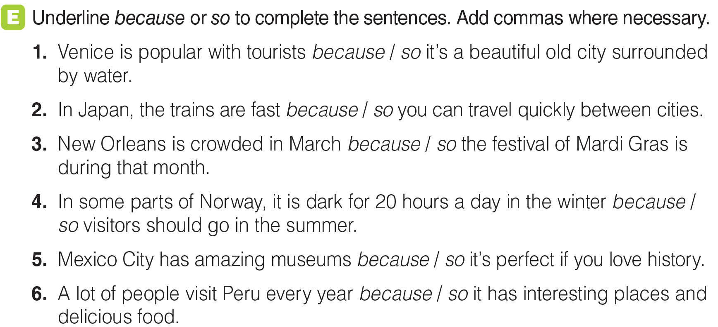
UNIT 3
GOING PLACES
WRITING
,
,
,
_______________________________________________________________________________________________________________________________________________________________________________________________________________________
National Geographic Learning, a Cengage Company. © 2022 Cengage Learning, Inc. ALL RIGHTS RESERVED. This presentation tool is for teaching purpose only. May not be scanned, copied or duplicated, or posted to a publicly accessible website, in whole or in part.

Slide 51
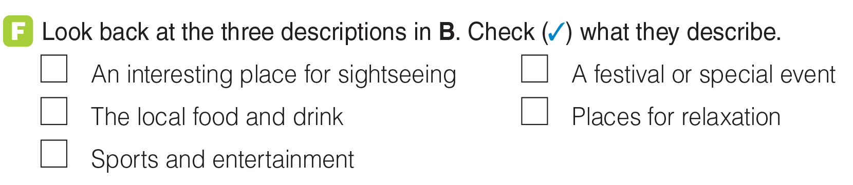
UNIT 3
GOING PLACES
WRITING
✓
✓
✓
_______________________________________________________________________________________________________________________________________________________________________________________________________________________
National Geographic Learning, a Cengage Company. © 2022 Cengage Learning, Inc. ALL RIGHTS RESERVED. This presentation tool is for teaching purpose only. May not be scanned, copied or duplicated, or posted to a publicly accessible website, in whole or in part.

Slide 52


UNIT 3
GOING PLACES
GOAL CHECK
_______________________________________________________________________________________________________________________________________________________________________________________________________________________
National Geographic Learning, a Cengage Company. © 2022 Cengage Learning, Inc. ALL RIGHTS RESERVED. This presentation tool is for teaching purpose only. May not be scanned, copied or duplicated, or posted to a publicly accessible website, in whole or in part.

