Slide 1
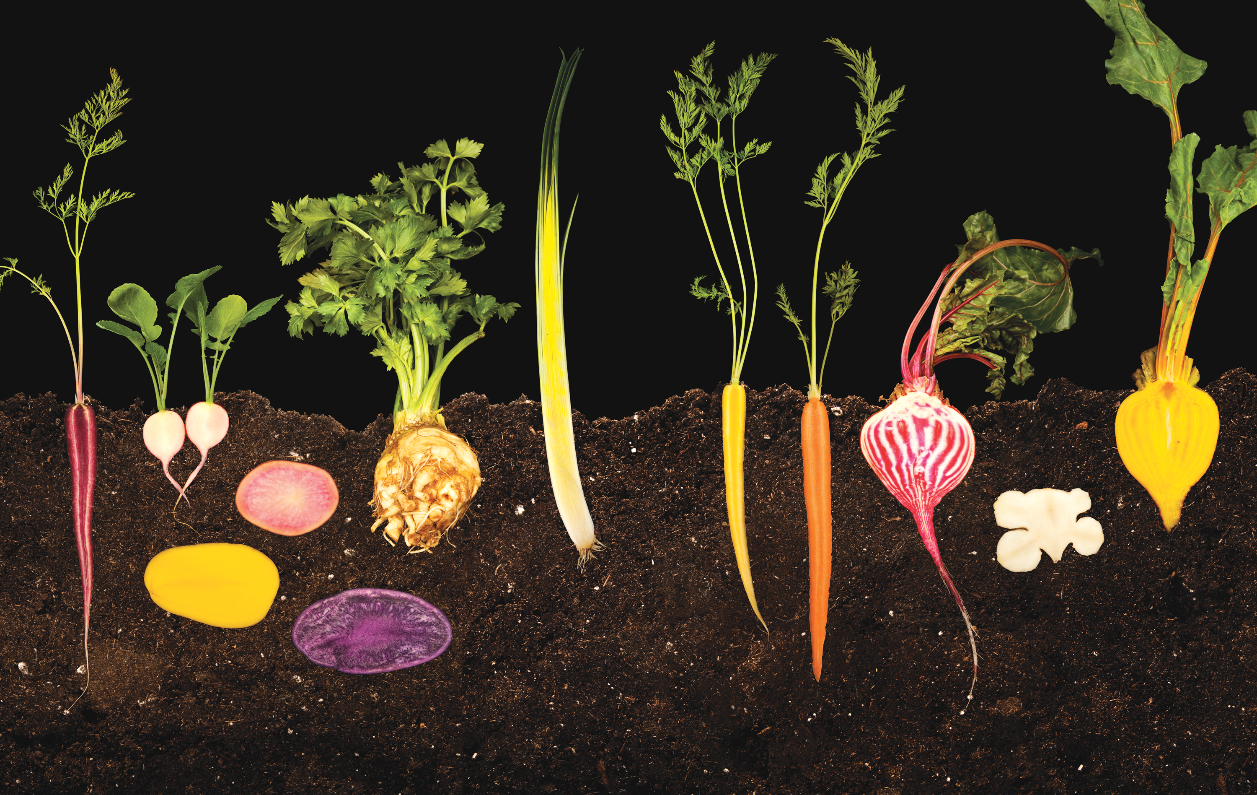


Unit 4:
FOOD
_______________________________________________________________________________________________________________________________________________________________________________________________________________________
National Geographic Learning, a Cengage Company. © 2022 Cengage Learning, Inc. ALL RIGHTS RESERVED. This presentation tool is for teaching purpose only. May not be scanned, copied or duplicated, or posted to a publicly accessible website, in whole or in part.

Slide 2
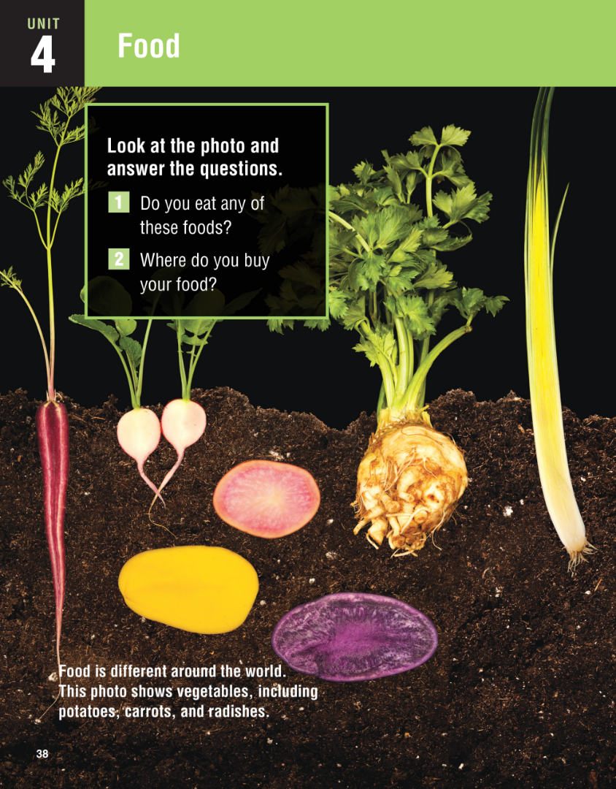


Slide 3
UNIT 4
FOOD
OVERVIEW
Do you know?
Food is a complex and interesting topic, with cultural, social, health, and even moral aspects. Our food preferences are shaped not only by personal taste, but also by custom, habit, and our physical environment.
_______________________________________________________________________________________________________________________________________________________________________________________________________________________
National Geographic Learning, a Cengage Company. © 2022 Cengage Learning, Inc. ALL RIGHTS RESERVED. This presentation tool is for teaching purpose only. May not be scanned, copied or duplicated, or posted to a publicly accessible website, in whole or in part.

Slide 4
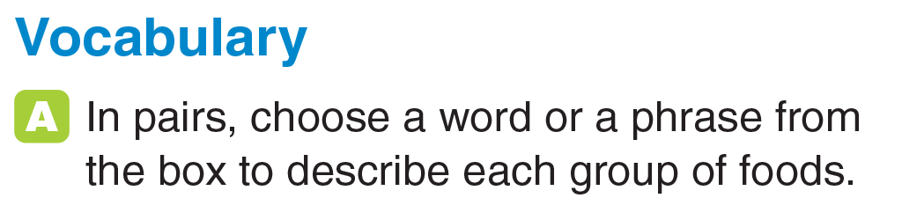
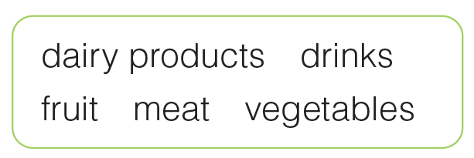
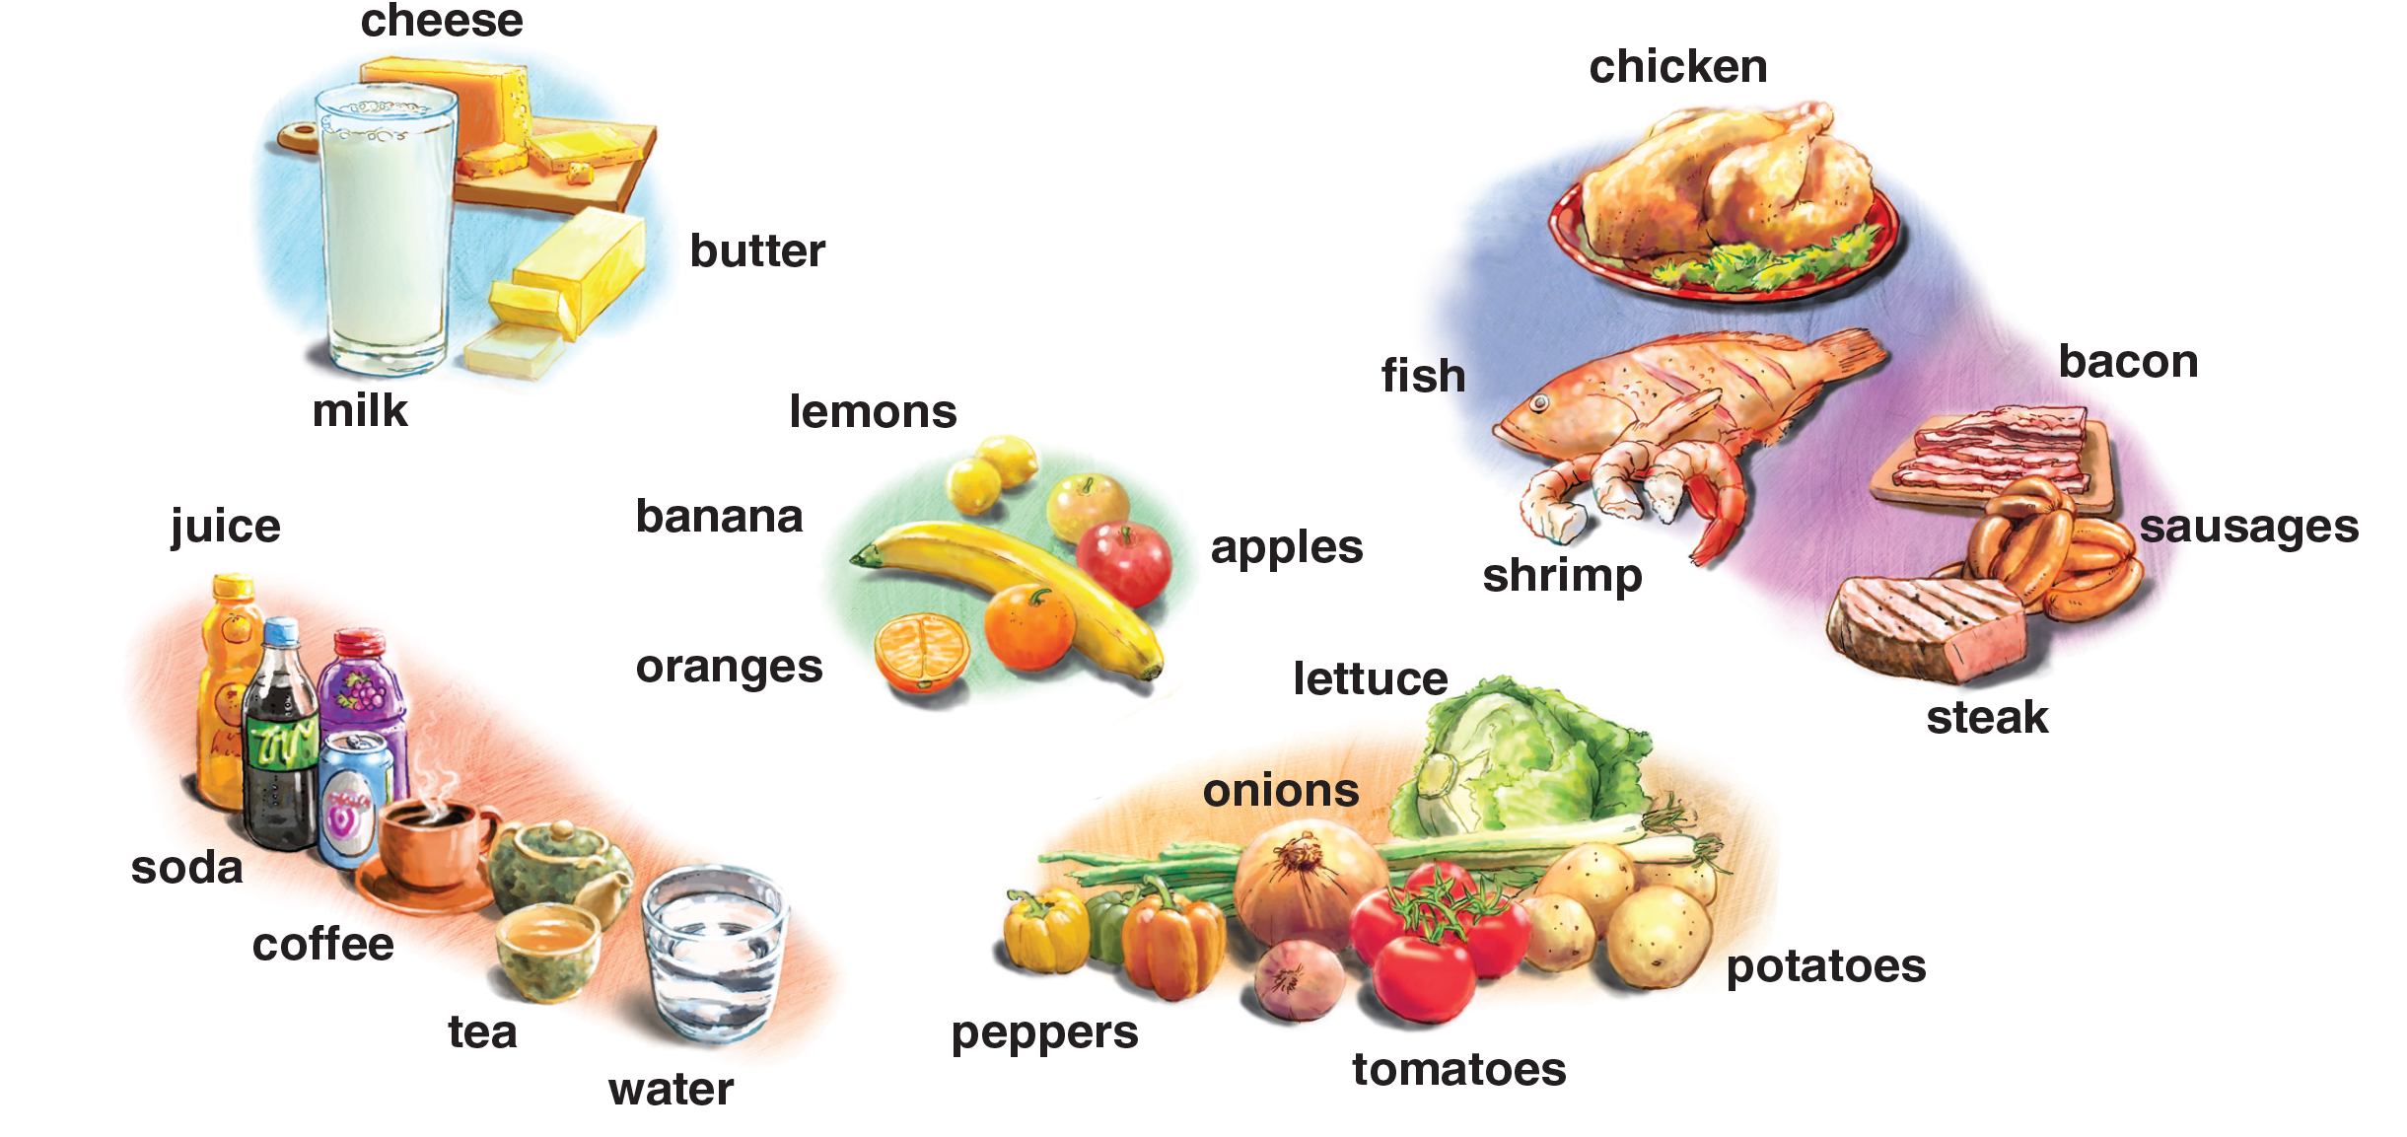
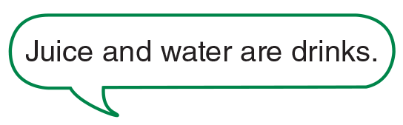
UNIT 4
FOOD
VOCABULARY
dairy
products
meat
fruit
vegetables
drinks
_______________________________________________________________________________________________________________________________________________________________________________________________________________________
National Geographic Learning, a Cengage Company. © 2022 Cengage Learning, Inc. ALL RIGHTS RESERVED. This presentation tool is for teaching purpose only. May not be scanned, copied or duplicated, or posted to a publicly accessible website, in whole or in part.

Slide 5
UNIT 4
FOOD
VOCABULARY
dairy products | drinks | fruit | meat | vegetables
_______________________________________________________________________________________________________________________________________________________________________________________________________________________
National Geographic Learning, a Cengage Company. © 2022 Cengage Learning, Inc. ALL RIGHTS RESERVED. This presentation tool is for teaching purpose only. May not be scanned, copied or duplicated, or posted to a publicly accessible website, in whole or in part.

Slide 6
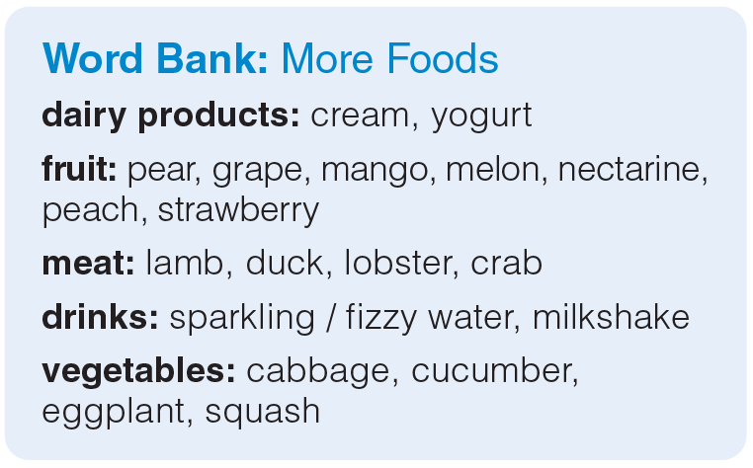
UNIT 4
FOOD
VOCABULARY
_______________________________________________________________________________________________________________________________________________________________________________________________________________________
National Geographic Learning, a Cengage Company. © 2022 Cengage Learning, Inc. ALL RIGHTS RESERVED. This presentation tool is for teaching purpose only. May not be scanned, copied or duplicated, or posted to a publicly accessible website, in whole or in part.

Slide 7
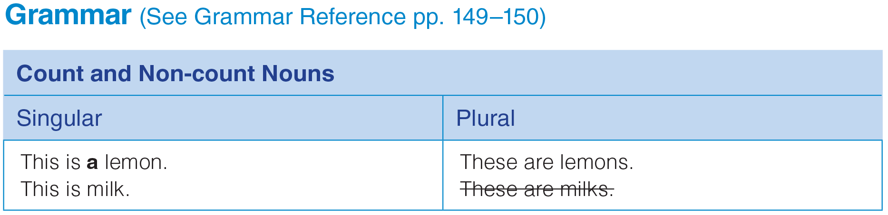
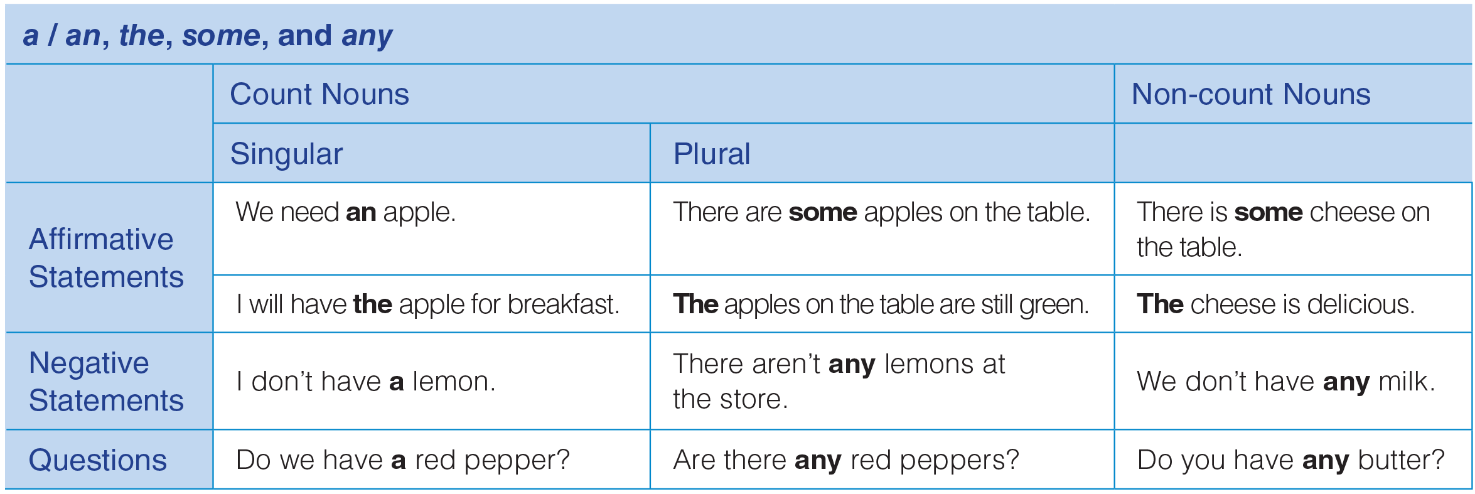
UNIT 4
FOOD
GRAMMAR
_______________________________________________________________________________________________________________________________________________________________________________________________________________________
National Geographic Learning, a Cengage Company. © 2022 Cengage Learning, Inc. ALL RIGHTS RESERVED. This presentation tool is for teaching purpose only. May not be scanned, copied or duplicated, or posted to a publicly accessible website, in whole or in part.

Slide 8
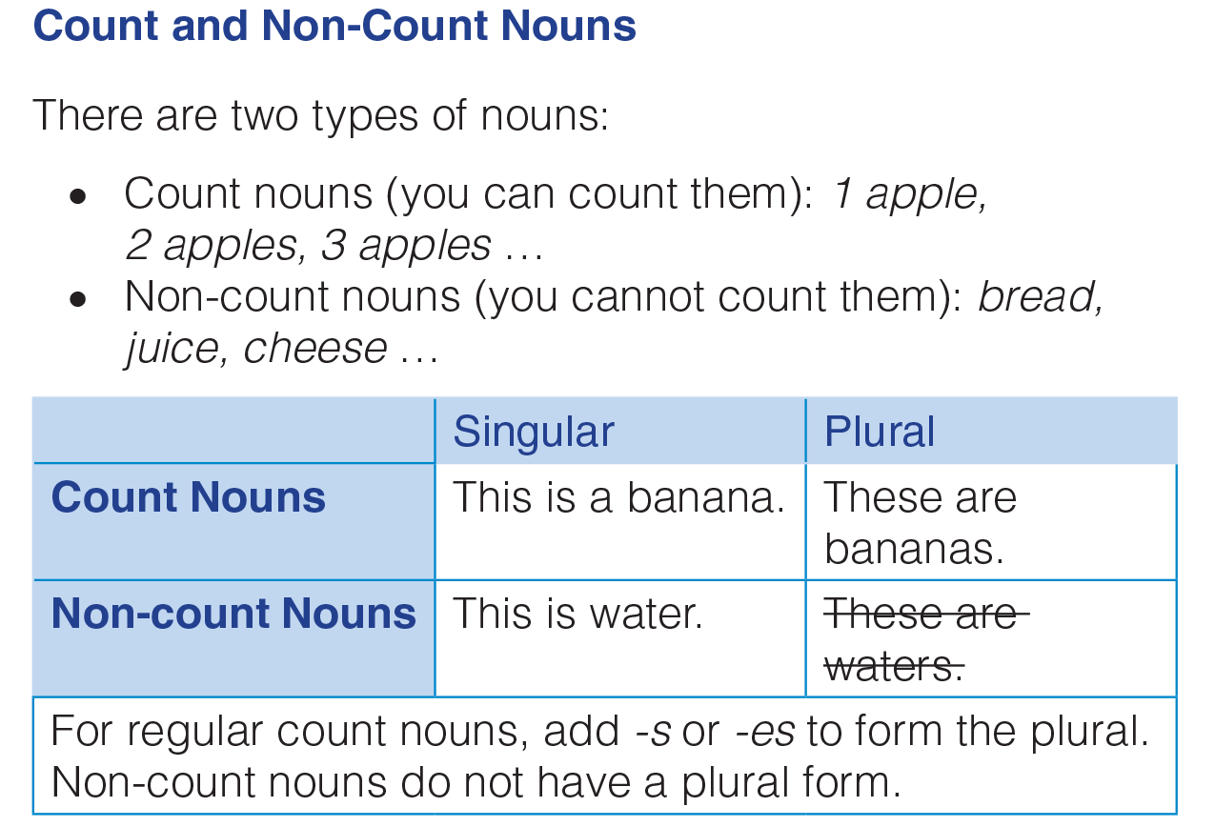
UNIT 4
FOOD
GRAMMAR
_______________________________________________________________________________________________________________________________________________________________________________________________________________________
National Geographic Learning, a Cengage Company. © 2022 Cengage Learning, Inc. ALL RIGHTS RESERVED. This presentation tool is for teaching purpose only. May not be scanned, copied or duplicated, or posted to a publicly accessible website, in whole or in part.

Slide 9
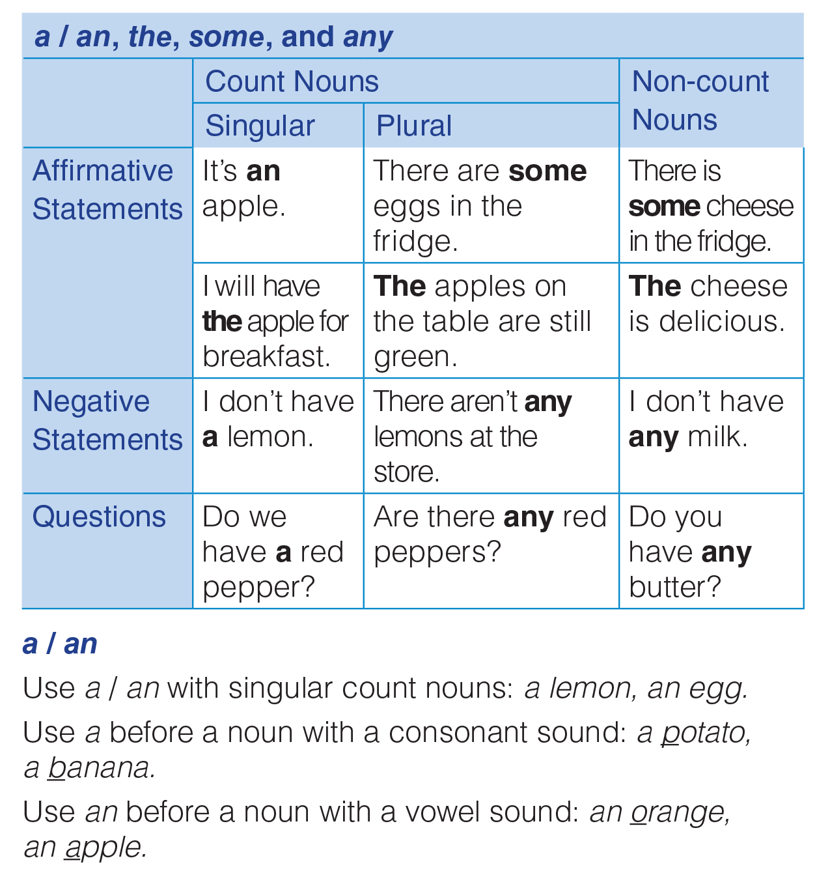
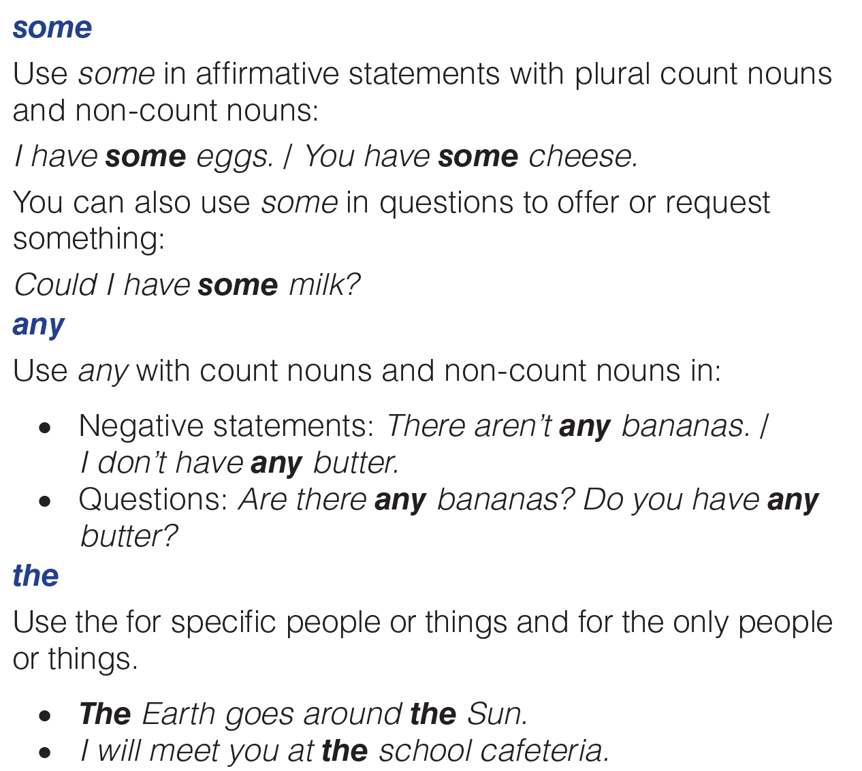
UNIT 4
FOOD
GRAMMAR
_______________________________________________________________________________________________________________________________________________________________________________________________________________________
National Geographic Learning, a Cengage Company. © 2022 Cengage Learning, Inc. ALL RIGHTS RESERVED. This presentation tool is for teaching purpose only. May not be scanned, copied or duplicated, or posted to a publicly accessible website, in whole or in part.

Slide 10
UNIT 4
FOOD
GRAMMAR
_______________________________________________________________________________________________________________________________________________________________________________________________________________________
National Geographic Learning, a Cengage Company. © 2022 Cengage Learning, Inc. ALL RIGHTS RESERVED. This presentation tool is for teaching purpose only. May not be scanned, copied or duplicated, or posted to a publicly accessible website, in whole or in part.

Slide 11
UNIT 4
FOOD
GRAMMAR
COUNT NOUNS | NON-COUNT NOUNS
lemon, orange, apple, banana, sausage, shrimp, pepper, onion, potato, tomato
cheese, butter, milk, chicken, fish, steak, bacon, juice, soda, coffee, tea, water, lettuce
_______________________________________________________________________________________________________________________________________________________________________________________________________________________
National Geographic Learning, a Cengage Company. © 2022 Cengage Learning, Inc. ALL RIGHTS RESERVED. This presentation tool is for teaching purpose only. May not be scanned, copied or duplicated, or posted to a publicly accessible website, in whole or in part.

Slide 12
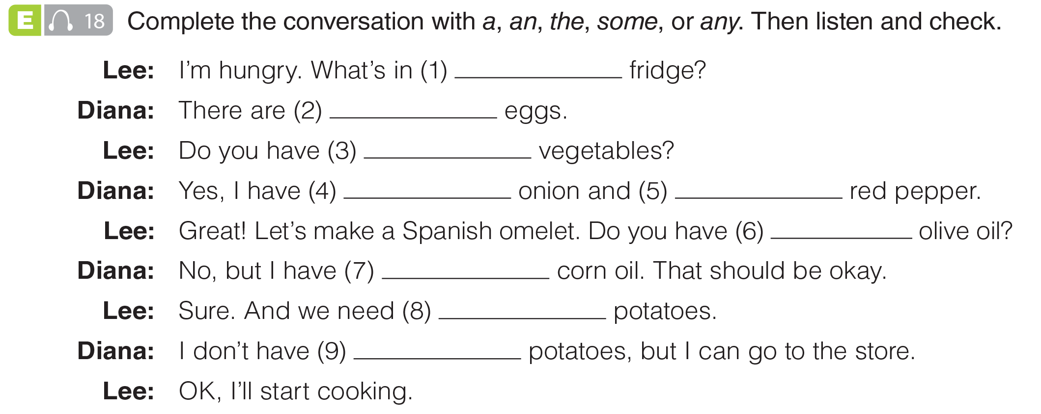

UNIT 4
FOOD
GRAMMAR
the
some
any
an
a
any
some
some
any
_______________________________________________________________________________________________________________________________________________________________________________________________________________________
National Geographic Learning, a Cengage Company. © 2022 Cengage Learning, Inc. ALL RIGHTS RESERVED. This presentation tool is for teaching purpose only. May not be scanned, copied or duplicated, or posted to a publicly accessible website, in whole or in part.

Slide 13
UNIT 4
FOOD
GRAMMAR
the
some
any
an
a
any
some
some
any
_______________________________________________________________________________________________________________________________________________________________________________________________________________________
National Geographic Learning, a Cengage Company. © 2022 Cengage Learning, Inc. ALL RIGHTS RESERVED. This presentation tool is for teaching purpose only. May not be scanned, copied or duplicated, or posted to a publicly accessible website, in whole or in part.

Slide 14
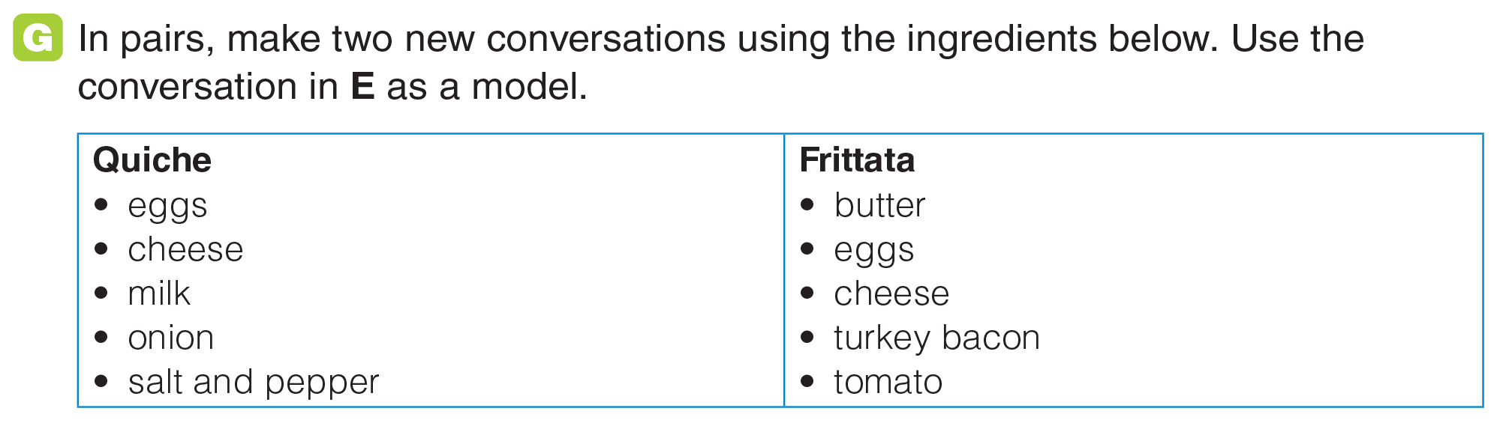
UNIT 4
FOOD
GRAMMAR
_______________________________________________________________________________________________________________________________________________________________________________________________________________________
National Geographic Learning, a Cengage Company. © 2022 Cengage Learning, Inc. ALL RIGHTS RESERVED. This presentation tool is for teaching purpose only. May not be scanned, copied or duplicated, or posted to a publicly accessible website, in whole or in part.

Slide 15
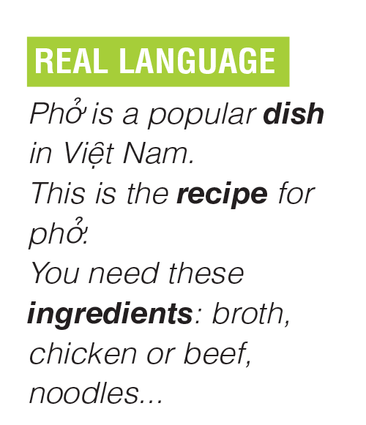
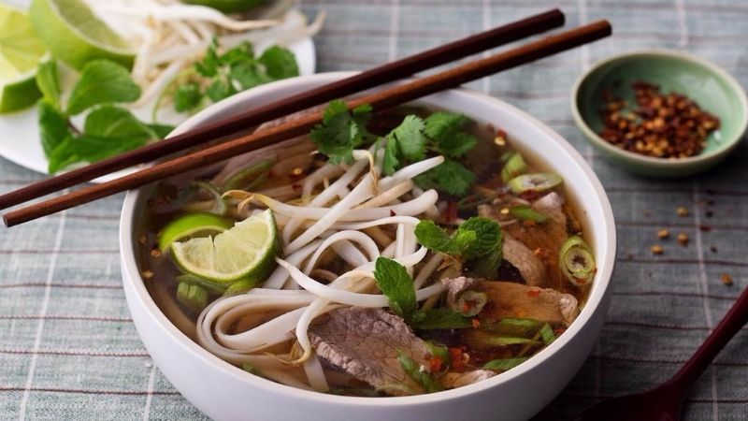
UNIT 4
FOOD
GRAMMAR
_______________________________________________________________________________________________________________________________________________________________________________________________________________________
National Geographic Learning, a Cengage Company. © 2022 Cengage Learning, Inc. ALL RIGHTS RESERVED. This presentation tool is for teaching purpose only. May not be scanned, copied or duplicated, or posted to a publicly accessible website, in whole or in part.

Slide 16
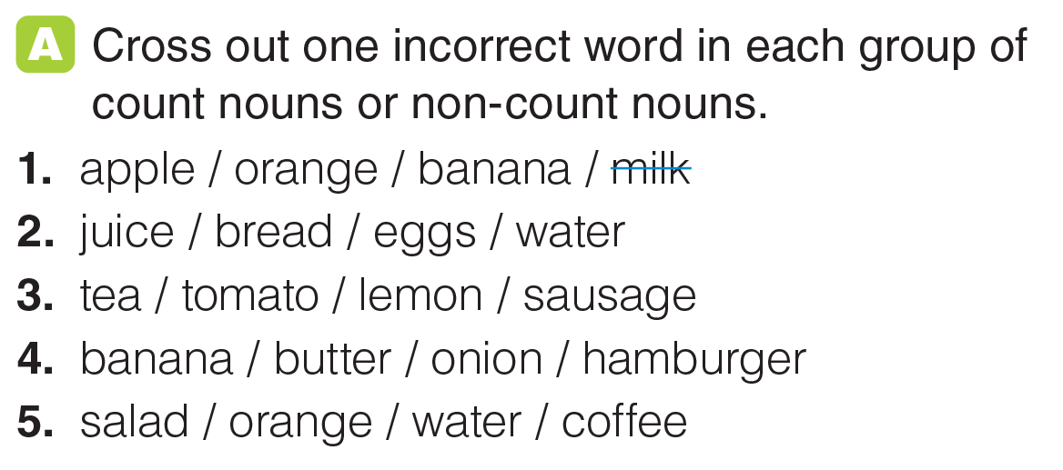
UNIT 4
FOOD
GRAMMAR
_______________________________________________________________________________________________________________________________________________________________________________________________________________________
National Geographic Learning, a Cengage Company. © 2022 Cengage Learning, Inc. ALL RIGHTS RESERVED. This presentation tool is for teaching purpose only. May not be scanned, copied or duplicated, or posted to a publicly accessible website, in whole or in part.

Slide 17
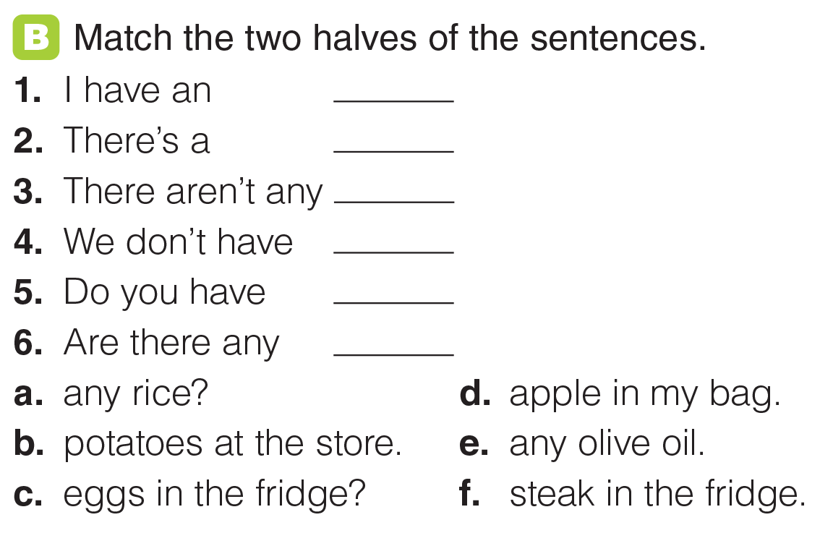
UNIT 4
FOOD
GRAMMAR
d
f
b
e
a
c
_______________________________________________________________________________________________________________________________________________________________________________________________________________________
National Geographic Learning, a Cengage Company. © 2022 Cengage Learning, Inc. ALL RIGHTS RESERVED. This presentation tool is for teaching purpose only. May not be scanned, copied or duplicated, or posted to a publicly accessible website, in whole or in part.

Slide 18
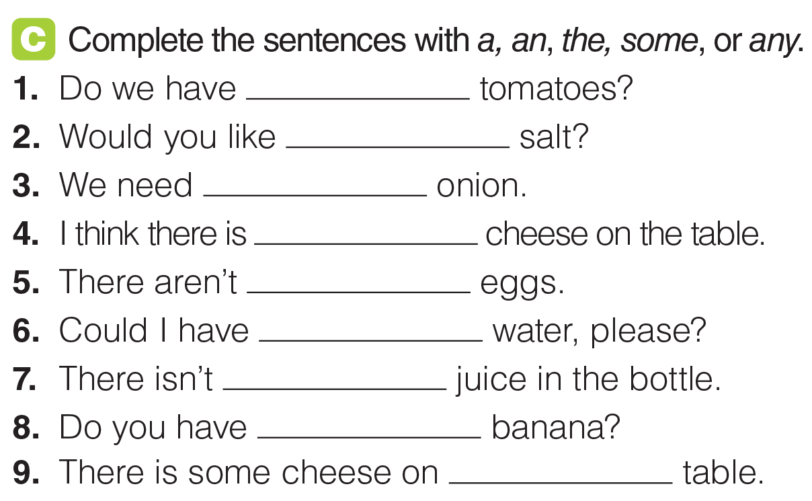
UNIT 4
FOOD
GRAMMAR
any
some
an
some
any
some
any
a
the
_______________________________________________________________________________________________________________________________________________________________________________________________________________________
National Geographic Learning, a Cengage Company. © 2022 Cengage Learning, Inc. ALL RIGHTS RESERVED. This presentation tool is for teaching purpose only. May not be scanned, copied or duplicated, or posted to a publicly accessible website, in whole or in part.

Slide 19
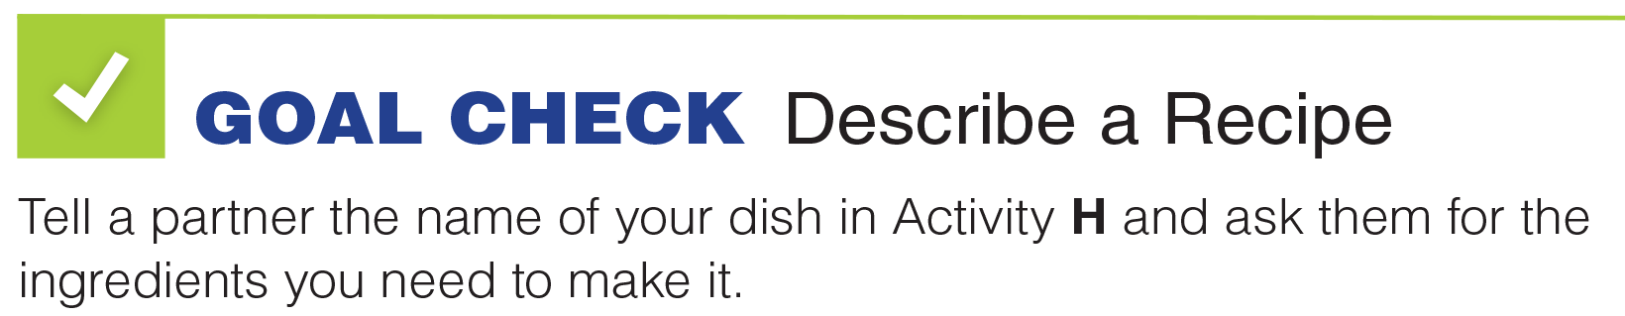




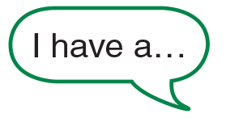
UNIT 4
FOOD
GOAL CHECK
_______________________________________________________________________________________________________________________________________________________________________________________________________________________
National Geographic Learning, a Cengage Company. © 2022 Cengage Learning, Inc. ALL RIGHTS RESERVED. This presentation tool is for teaching purpose only. May not be scanned, copied or duplicated, or posted to a publicly accessible website, in whole or in part.

Slide 20
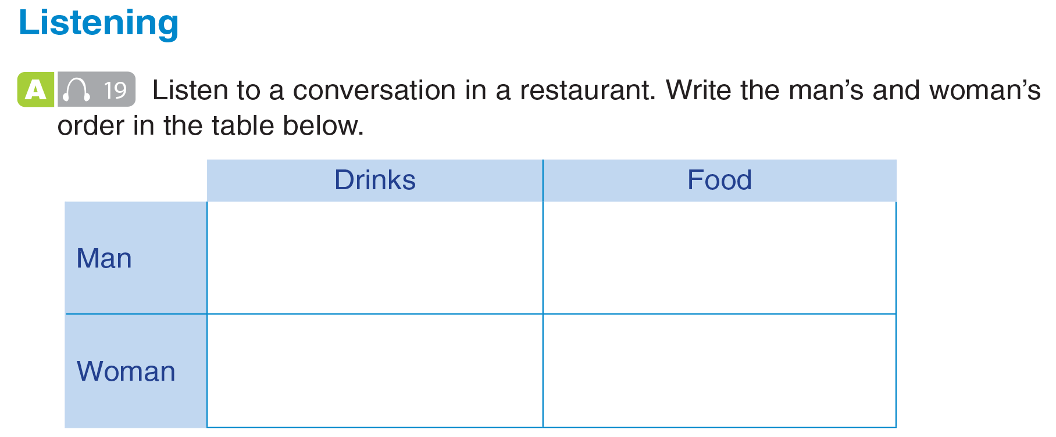
UNIT 4
FOOD
LISTENING
steak with french fries and salad
iced tea
sparkling mineral water
(butter-baked)
chicken
_______________________________________________________________________________________________________________________________________________________________________________________________________________________
National Geographic Learning, a Cengage Company. © 2022 Cengage Learning, Inc. ALL RIGHTS RESERVED. This presentation tool is for teaching purpose only. May not be scanned, copied or duplicated, or posted to a publicly accessible website, in whole or in part.

Slide 21
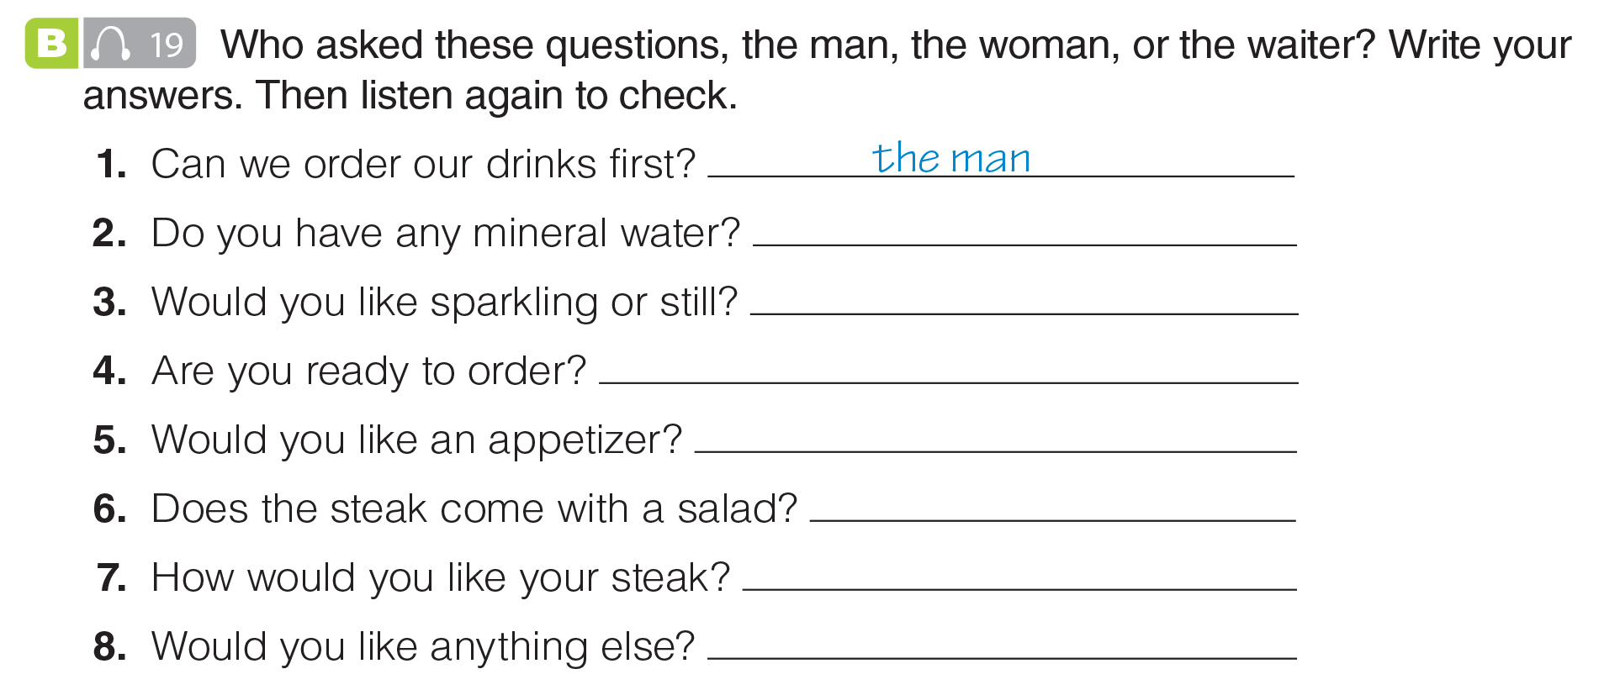
UNIT 4
FOOD
LISTENING
the woman
the waiter
the waiter
the waiter
the man
the waiter
the waiter
_______________________________________________________________________________________________________________________________________________________________________________________________________________________
National Geographic Learning, a Cengage Company. © 2022 Cengage Learning, Inc. ALL RIGHTS RESERVED. This presentation tool is for teaching purpose only. May not be scanned, copied or duplicated, or posted to a publicly accessible website, in whole or in part.

Slide 22
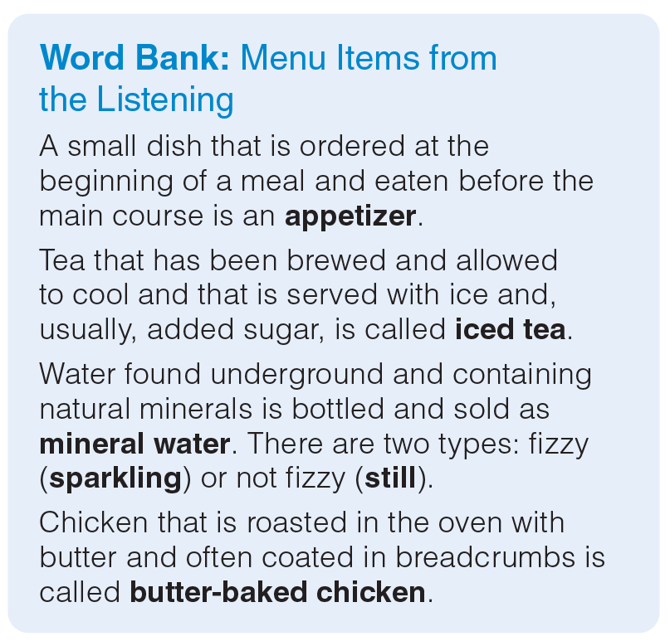
UNIT 4
FOOD
LISTENING
_______________________________________________________________________________________________________________________________________________________________________________________________________________________
National Geographic Learning, a Cengage Company. © 2022 Cengage Learning, Inc. ALL RIGHTS RESERVED. This presentation tool is for teaching purpose only. May not be scanned, copied or duplicated, or posted to a publicly accessible website, in whole or in part.

Slide 23
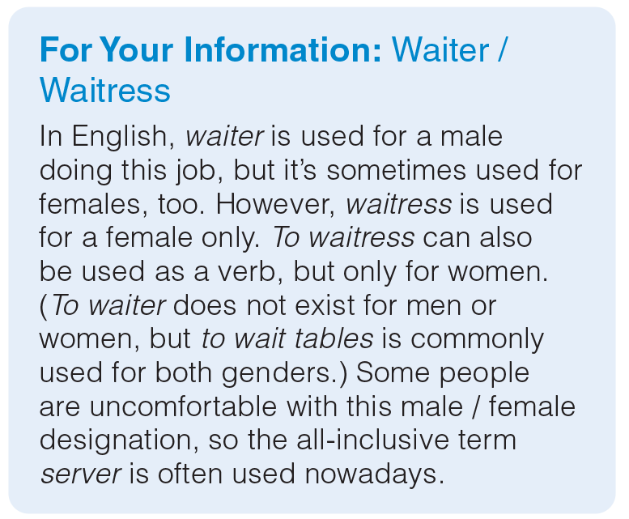
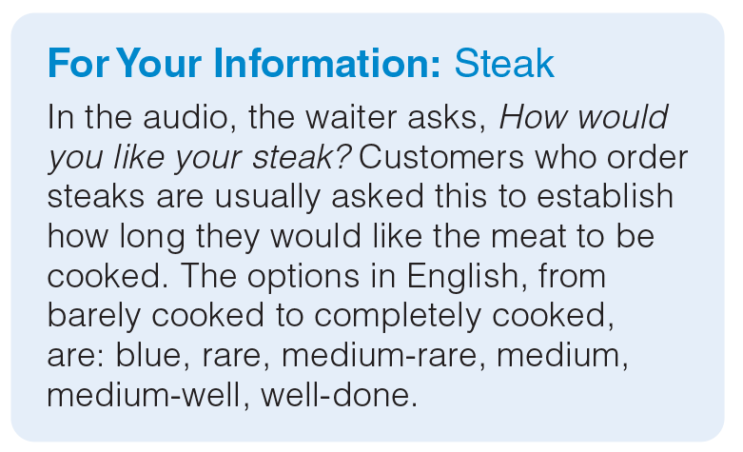
UNIT 4
FOOD
LISTENING
_______________________________________________________________________________________________________________________________________________________________________________________________________________________
National Geographic Learning, a Cengage Company. © 2022 Cengage Learning, Inc. ALL RIGHTS RESERVED. This presentation tool is for teaching purpose only. May not be scanned, copied or duplicated, or posted to a publicly accessible website, in whole or in part.

Slide 24
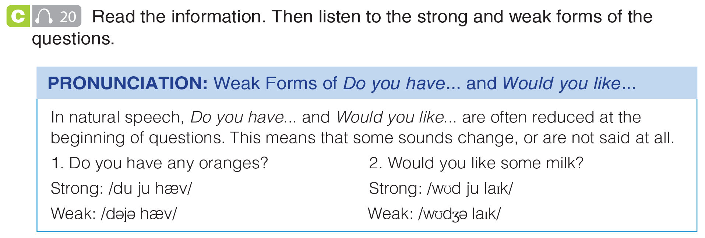
UNIT 4
FOOD
PRONUNCIATION
_______________________________________________________________________________________________________________________________________________________________________________________________________________________
National Geographic Learning, a Cengage Company. © 2022 Cengage Learning, Inc. ALL RIGHTS RESERVED. This presentation tool is for teaching purpose only. May not be scanned, copied or duplicated, or posted to a publicly accessible website, in whole or in part.

Slide 25
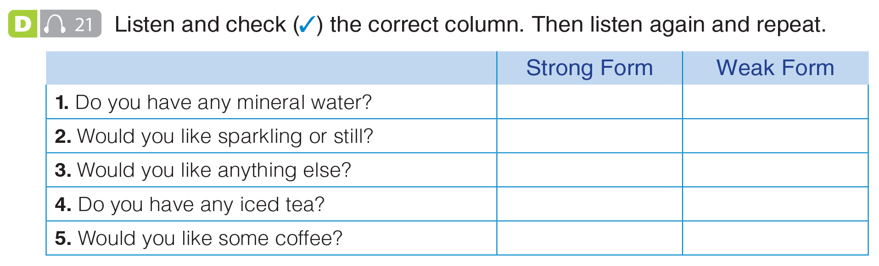
UNIT 4
FOOD
PRONUNCIATION
✓
✓
✓
✓
✓
_______________________________________________________________________________________________________________________________________________________________________________________________________________________
National Geographic Learning, a Cengage Company. © 2022 Cengage Learning, Inc. ALL RIGHTS RESERVED. This presentation tool is for teaching purpose only. May not be scanned, copied or duplicated, or posted to a publicly accessible website, in whole or in part.

Slide 26
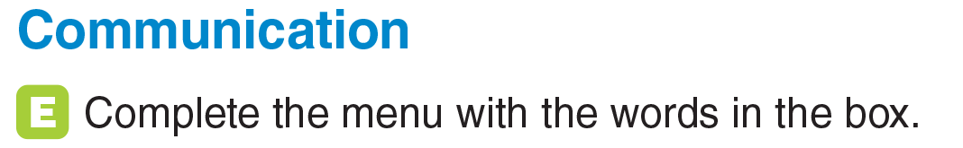
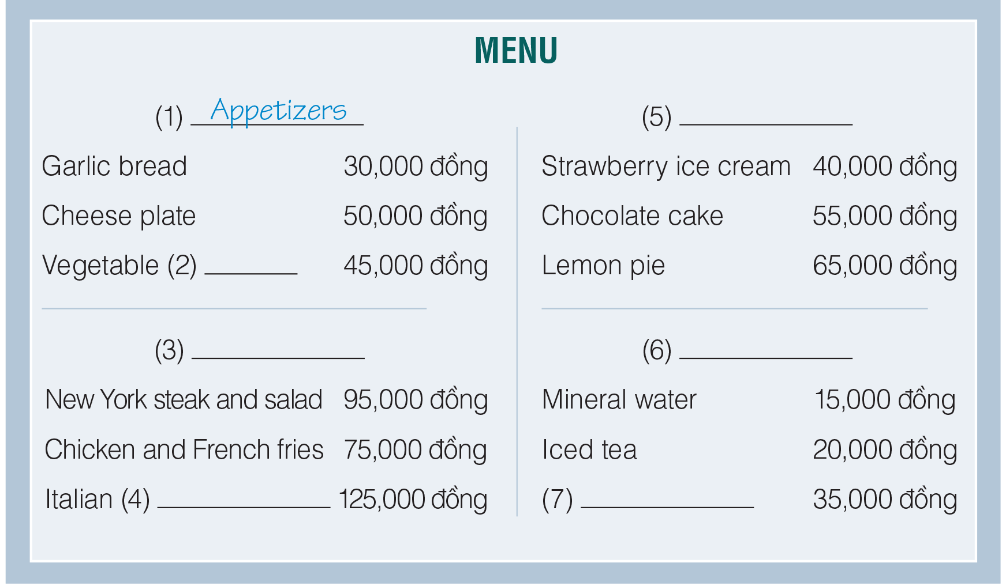
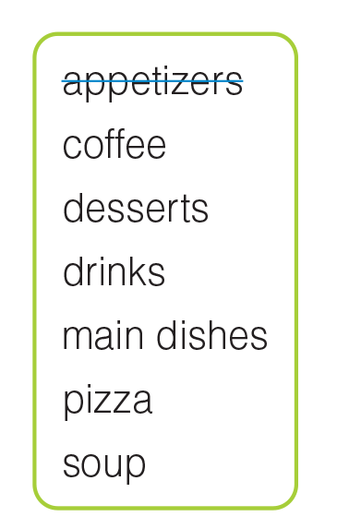
UNIT 4
FOOD
COMMUNICATION
Desserts
soup
Main dishes
Drinks
pizza
Coffee
_______________________________________________________________________________________________________________________________________________________________________________________________________________________
National Geographic Learning, a Cengage Company. © 2022 Cengage Learning, Inc. ALL RIGHTS RESERVED. This presentation tool is for teaching purpose only. May not be scanned, copied or duplicated, or posted to a publicly accessible website, in whole or in part.

Slide 27
UNIT 4
FOOD
COMMUNICATION
Desserts
soup
Main dishes
Drinks
pizza
Coffee
_______________________________________________________________________________________________________________________________________________________________________________________________________________________
National Geographic Learning, a Cengage Company. © 2022 Cengage Learning, Inc. ALL RIGHTS RESERVED. This presentation tool is for teaching purpose only. May not be scanned, copied or duplicated, or posted to a publicly accessible website, in whole or in part.

Slide 28
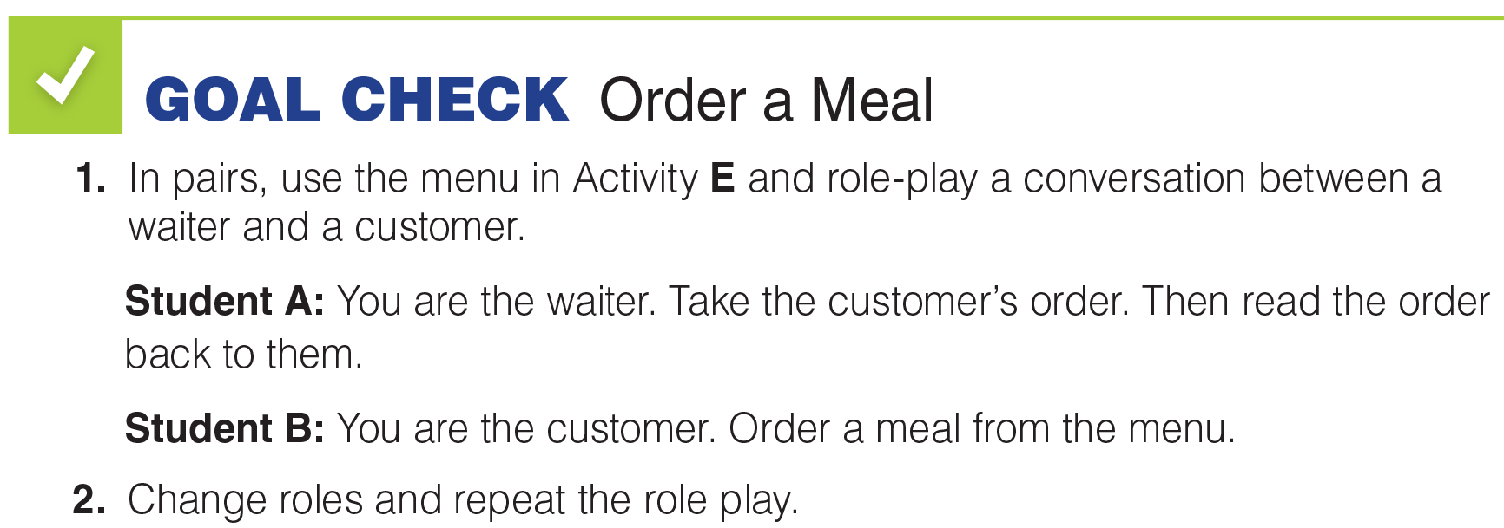




UNIT 4
FOOD
GOAL CHECK
_______________________________________________________________________________________________________________________________________________________________________________________________________________________
National Geographic Learning, a Cengage Company. © 2022 Cengage Learning, Inc. ALL RIGHTS RESERVED. This presentation tool is for teaching purpose only. May not be scanned, copied or duplicated, or posted to a publicly accessible website, in whole or in part.

Slide 29
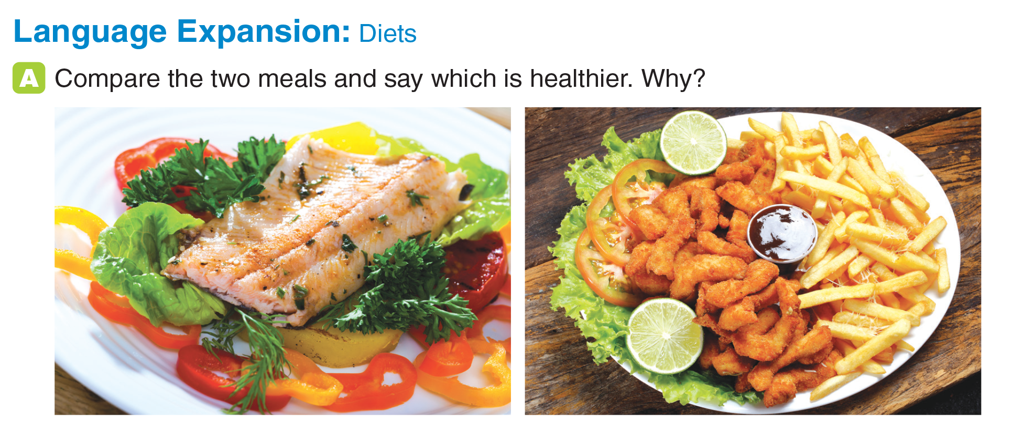
UNIT 4
FOOD
LANGUAGE EXPANSION
_______________________________________________________________________________________________________________________________________________________________________________________________________________________
National Geographic Learning, a Cengage Company. © 2022 Cengage Learning, Inc. ALL RIGHTS RESERVED. This presentation tool is for teaching purpose only. May not be scanned, copied or duplicated, or posted to a publicly accessible website, in whole or in part.

Slide 30
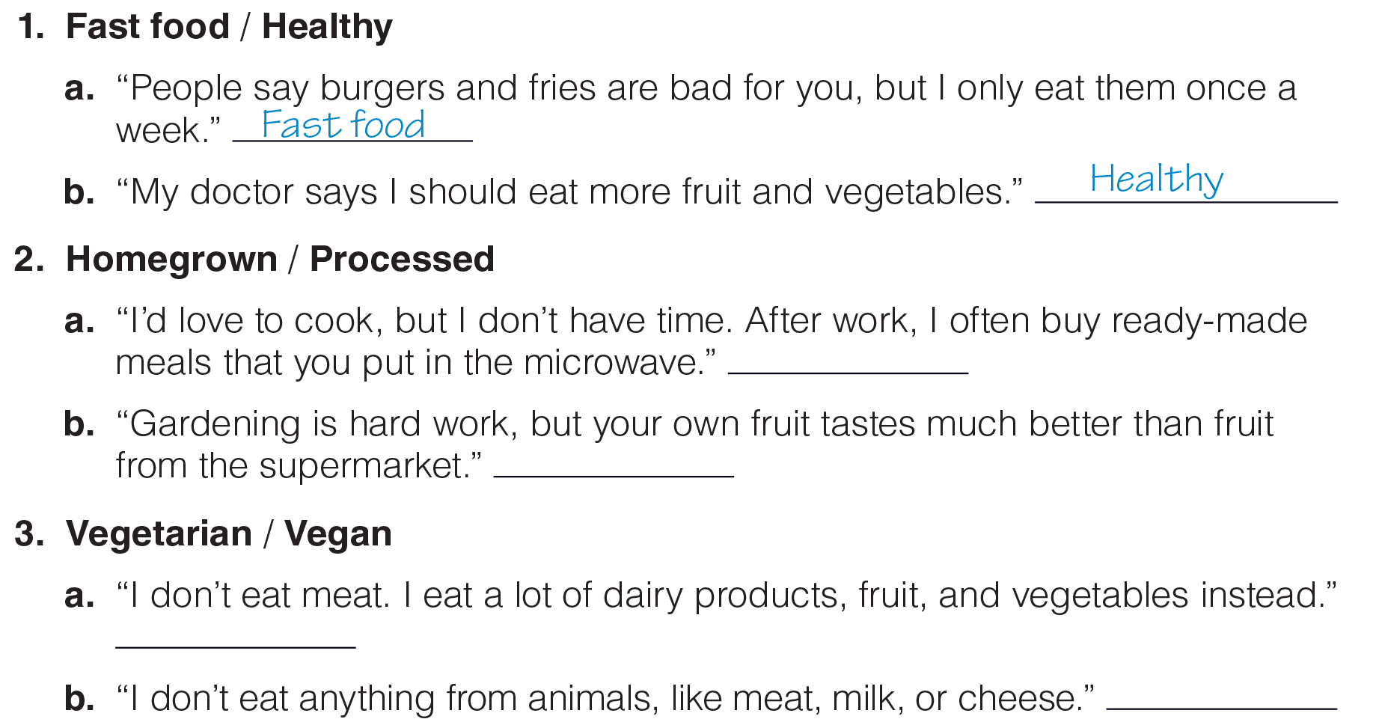
UNIT 4
FOOD
LANGUAGE EXPANSION
Processed
Homegrown
Vegetarian
Vegan
_______________________________________________________________________________________________________________________________________________________________________________________________________________________
National Geographic Learning, a Cengage Company. © 2022 Cengage Learning, Inc. ALL RIGHTS RESERVED. This presentation tool is for teaching purpose only. May not be scanned, copied or duplicated, or posted to a publicly accessible website, in whole or in part.

Slide 31
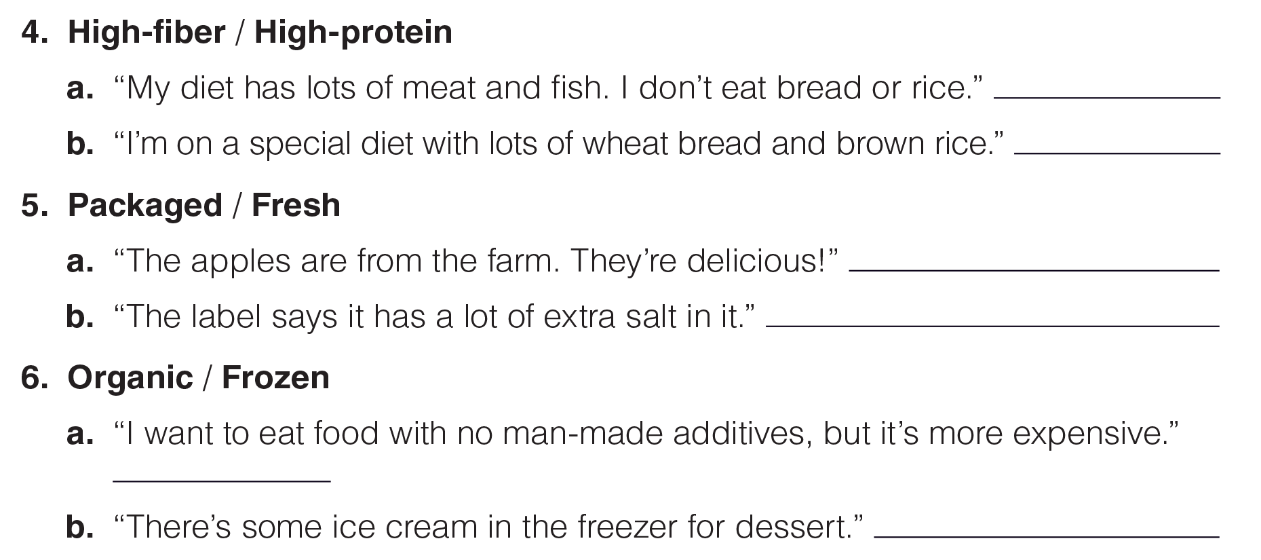
UNIT 4
FOOD
LANGUAGE EXPANSION
High-protein
High-fiber
Fresh
Packaged
Organic
Frozen
_______________________________________________________________________________________________________________________________________________________________________________________________________________________
National Geographic Learning, a Cengage Company. © 2022 Cengage Learning, Inc. ALL RIGHTS RESERVED. This presentation tool is for teaching purpose only. May not be scanned, copied or duplicated, or posted to a publicly accessible website, in whole or in part.

Slide 32
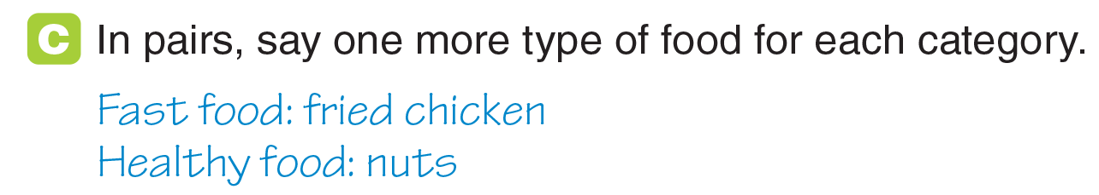
UNIT 4
FOOD
LANGUAGE EXPANSION
_______________________________________________________________________________________________________________________________________________________________________________________________________________________
National Geographic Learning, a Cengage Company. © 2022 Cengage Learning, Inc. ALL RIGHTS RESERVED. This presentation tool is for teaching purpose only. May not be scanned, copied or duplicated, or posted to a publicly accessible website, in whole or in part.

Slide 33
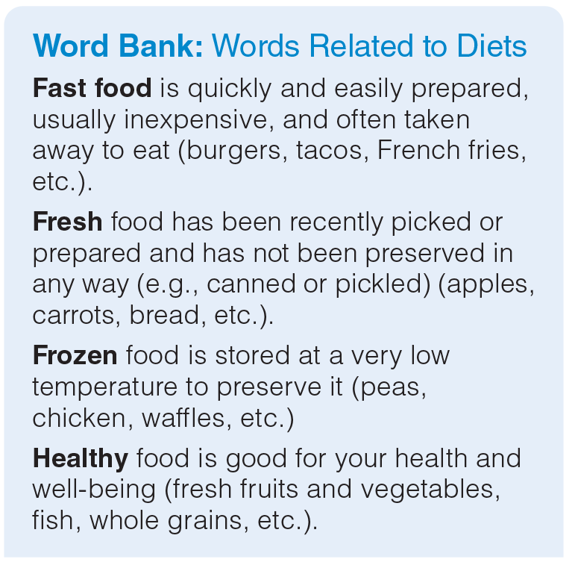
UNIT 4
FOOD
LANGUAGE EXPANSION
_______________________________________________________________________________________________________________________________________________________________________________________________________________________
National Geographic Learning, a Cengage Company. © 2022 Cengage Learning, Inc. ALL RIGHTS RESERVED. This presentation tool is for teaching purpose only. May not be scanned, copied or duplicated, or posted to a publicly accessible website, in whole or in part.

Slide 34
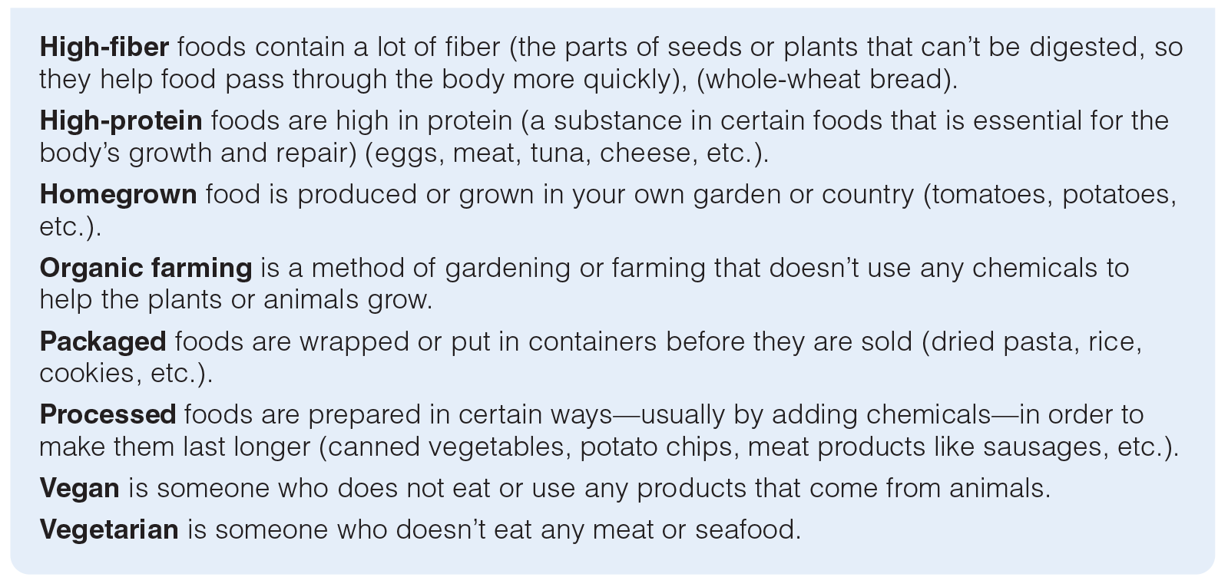
UNIT 4
FOOD
LANGUAGE EXPANSION
_______________________________________________________________________________________________________________________________________________________________________________________________________________________
National Geographic Learning, a Cengage Company. © 2022 Cengage Learning, Inc. ALL RIGHTS RESERVED. This presentation tool is for teaching purpose only. May not be scanned, copied or duplicated, or posted to a publicly accessible website, in whole or in part.

Slide 35
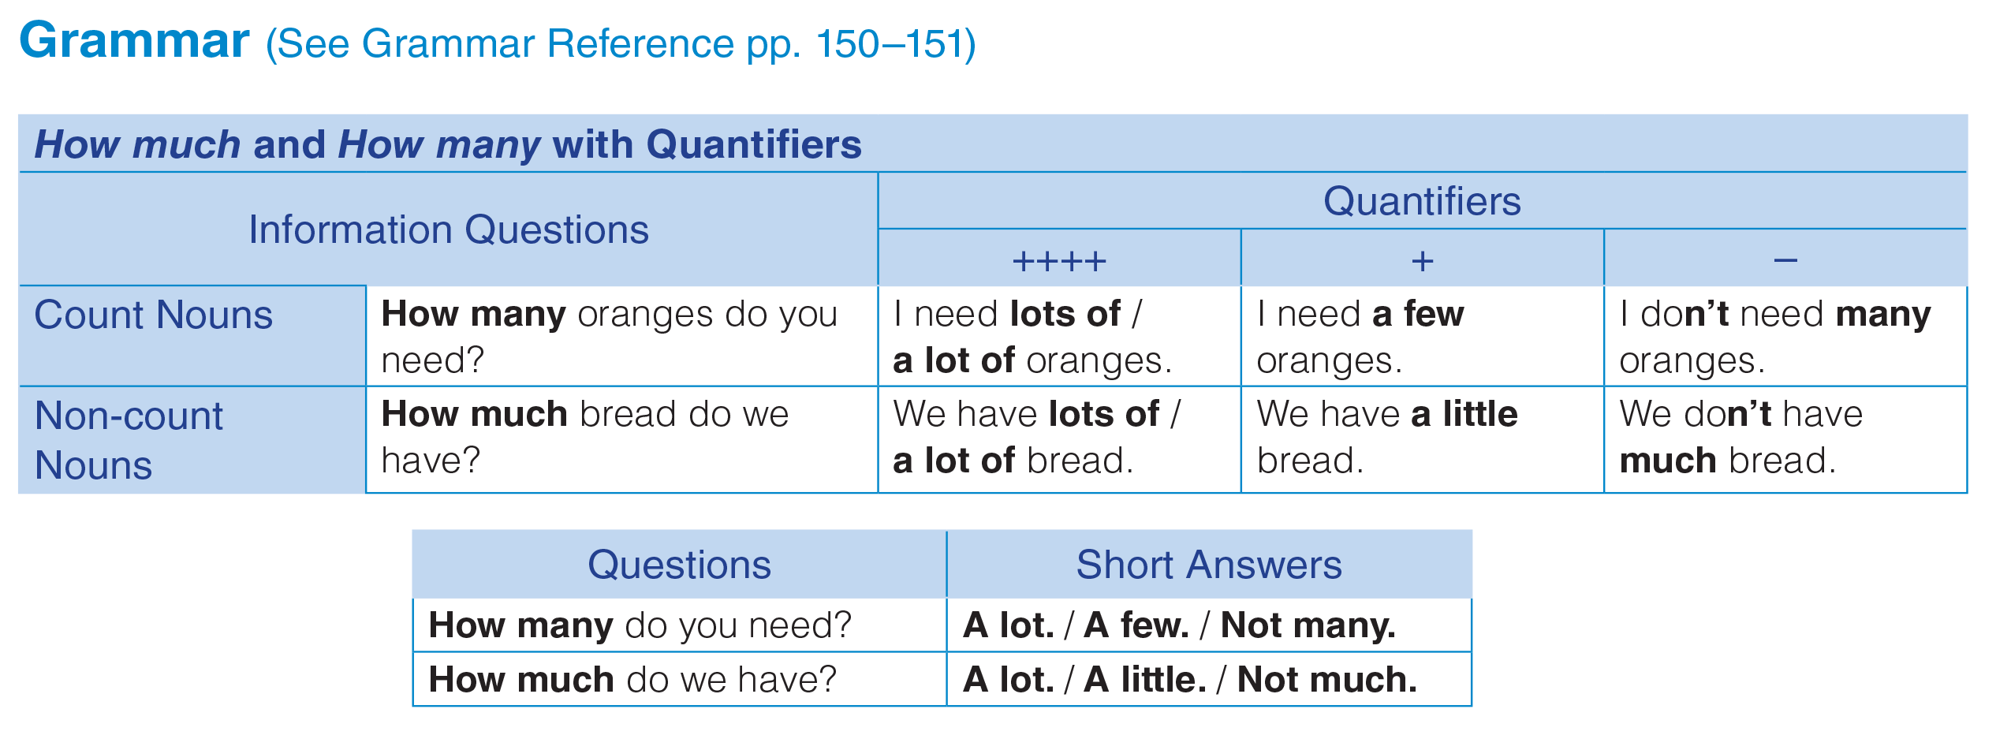
UNIT 4
FOOD
GRAMMAR
_______________________________________________________________________________________________________________________________________________________________________________________________________________________
National Geographic Learning, a Cengage Company. © 2022 Cengage Learning, Inc. ALL RIGHTS RESERVED. This presentation tool is for teaching purpose only. May not be scanned, copied or duplicated, or posted to a publicly accessible website, in whole or in part.

Slide 36
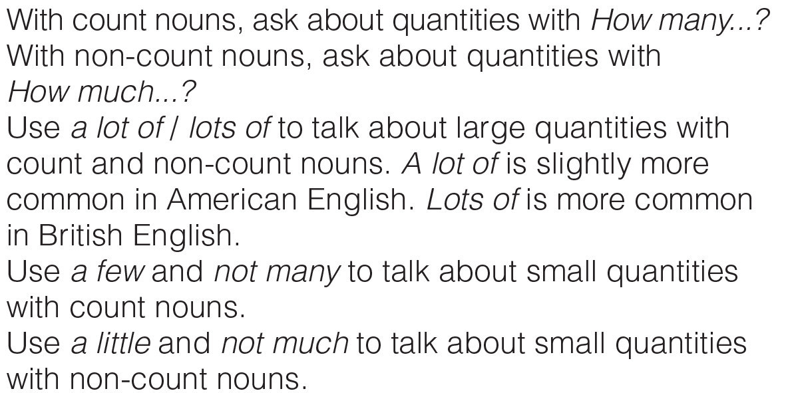
UNIT 4
FOOD
GRAMMAR
_______________________________________________________________________________________________________________________________________________________________________________________________________________________
National Geographic Learning, a Cengage Company. © 2022 Cengage Learning, Inc. ALL RIGHTS RESERVED. This presentation tool is for teaching purpose only. May not be scanned, copied or duplicated, or posted to a publicly accessible website, in whole or in part.

Slide 37
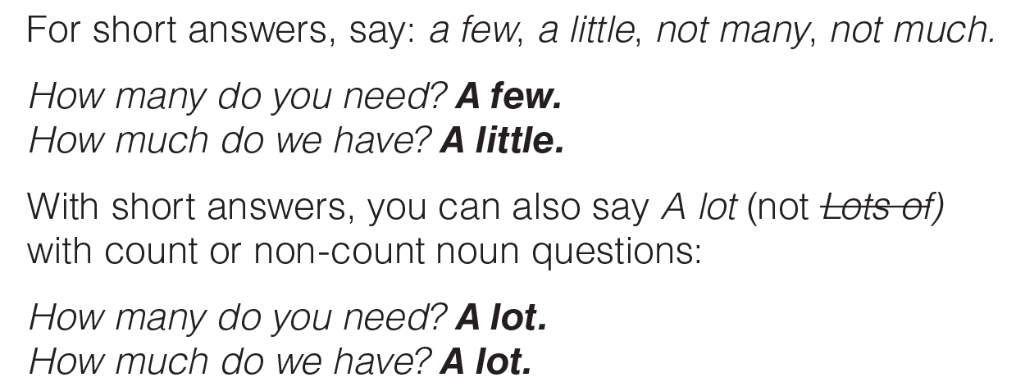
UNIT 4
FOOD
GRAMMAR
_______________________________________________________________________________________________________________________________________________________________________________________________________________________
National Geographic Learning, a Cengage Company. © 2022 Cengage Learning, Inc. ALL RIGHTS RESERVED. This presentation tool is for teaching purpose only. May not be scanned, copied or duplicated, or posted to a publicly accessible website, in whole or in part.

Slide 38
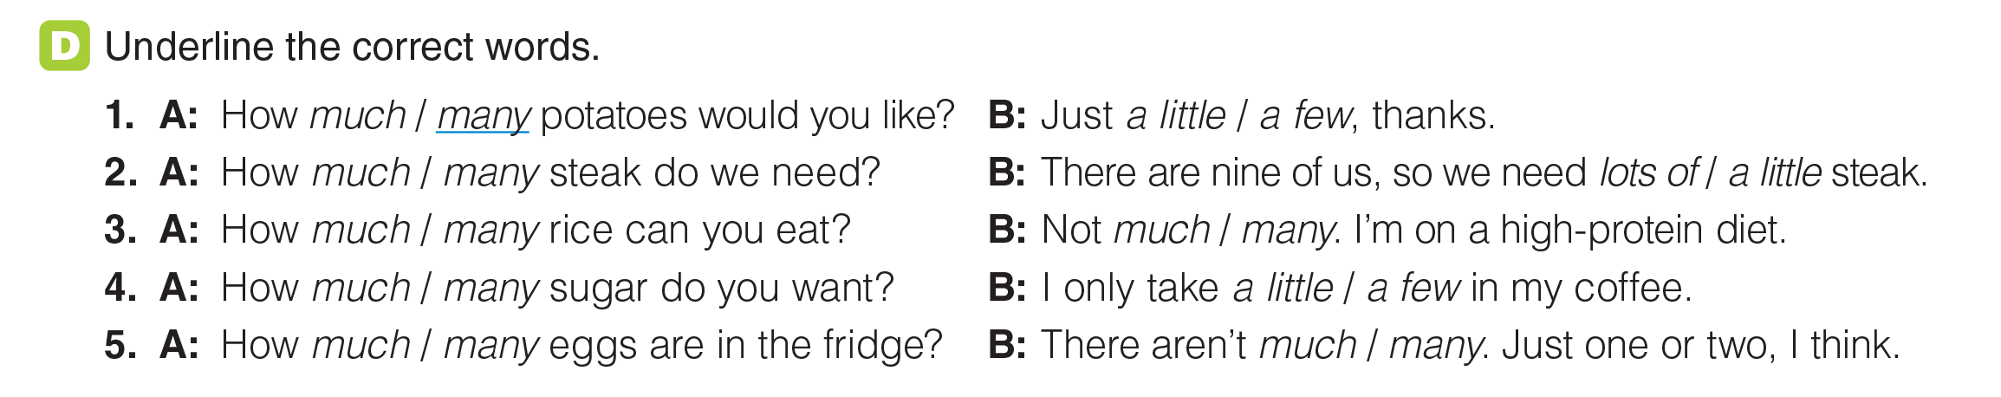
UNIT 4
FOOD
GRAMMAR
_______________________________________________________________________________________________________________________________________________________________________________________________________________________
National Geographic Learning, a Cengage Company. © 2022 Cengage Learning, Inc. ALL RIGHTS RESERVED. This presentation tool is for teaching purpose only. May not be scanned, copied or duplicated, or posted to a publicly accessible website, in whole or in part.

Slide 39
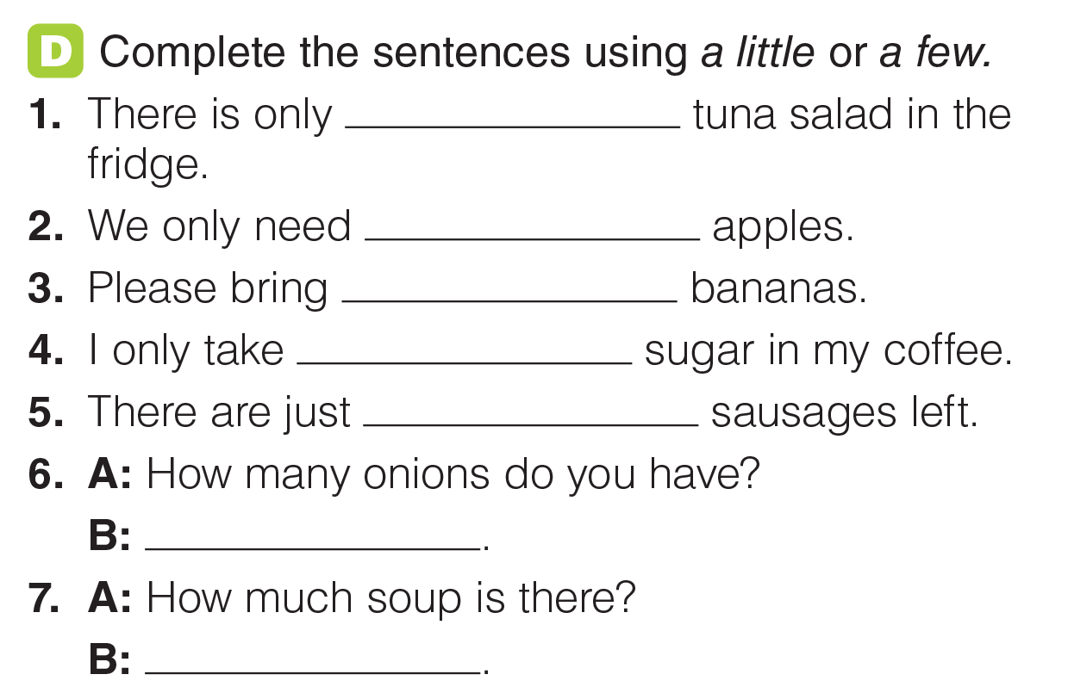
UNIT 4
FOOD
GRAMMAR
a little
a few
a few
a little
a few
A few
A little
_______________________________________________________________________________________________________________________________________________________________________________________________________________________
National Geographic Learning, a Cengage Company. © 2022 Cengage Learning, Inc. ALL RIGHTS RESERVED. This presentation tool is for teaching purpose only. May not be scanned, copied or duplicated, or posted to a publicly accessible website, in whole or in part.

Slide 40
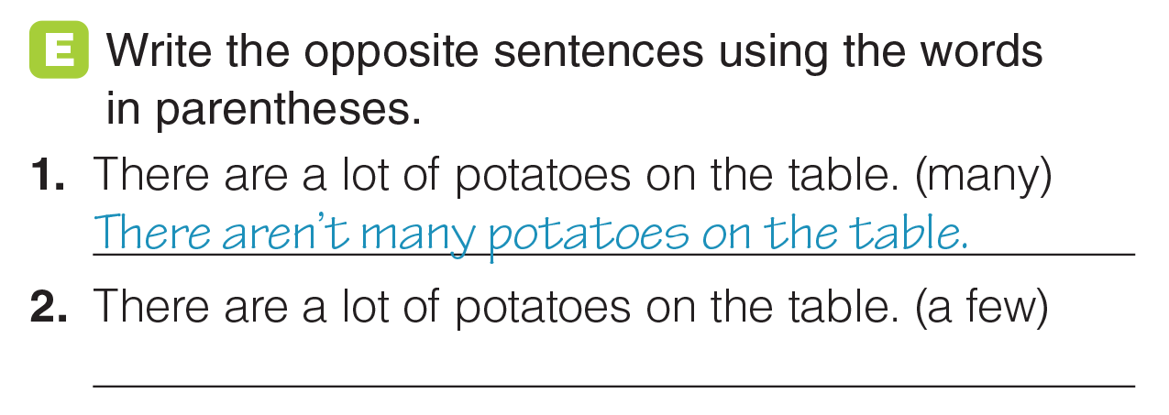
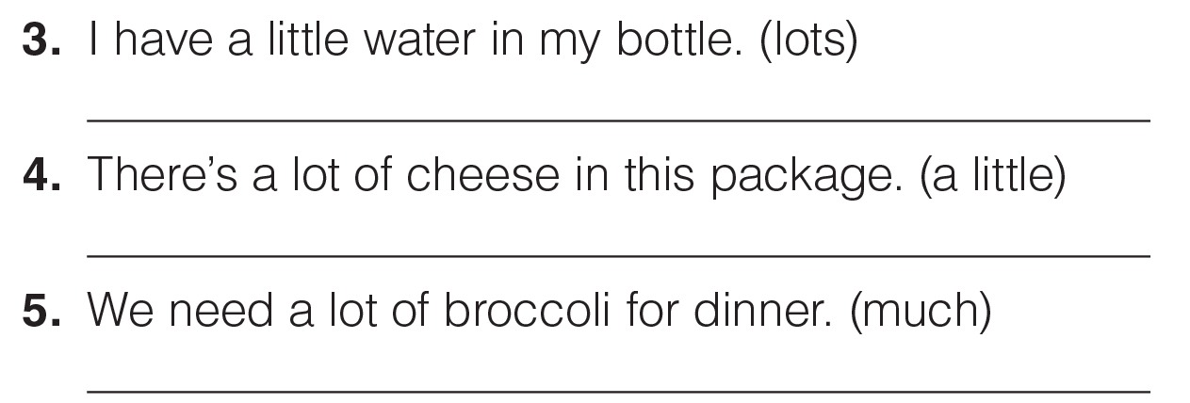
UNIT 4
FOOD
GRAMMAR
There are a few potatoes on the table.
I have lots of water in my bottle.
There’s a little cheese in this package.
We don’t need much broccoli for dinner.
_______________________________________________________________________________________________________________________________________________________________________________________________________________________
National Geographic Learning, a Cengage Company. © 2022 Cengage Learning, Inc. ALL RIGHTS RESERVED. This presentation tool is for teaching purpose only. May not be scanned, copied or duplicated, or posted to a publicly accessible website, in whole or in part.

Slide 41
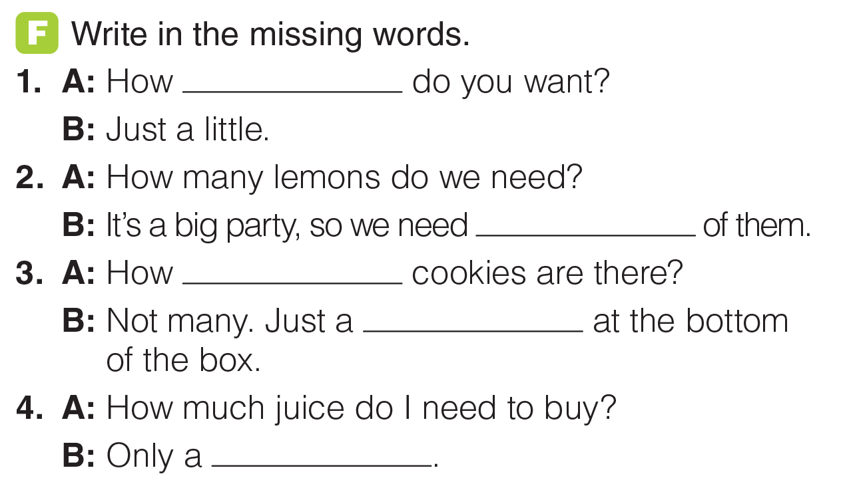
UNIT 4
FOOD
GRAMMAR
much
lots / a lot
many
few
few
_______________________________________________________________________________________________________________________________________________________________________________________________________________________
National Geographic Learning, a Cengage Company. © 2022 Cengage Learning, Inc. ALL RIGHTS RESERVED. This presentation tool is for teaching purpose only. May not be scanned, copied or duplicated, or posted to a publicly accessible website, in whole or in part.

Slide 42
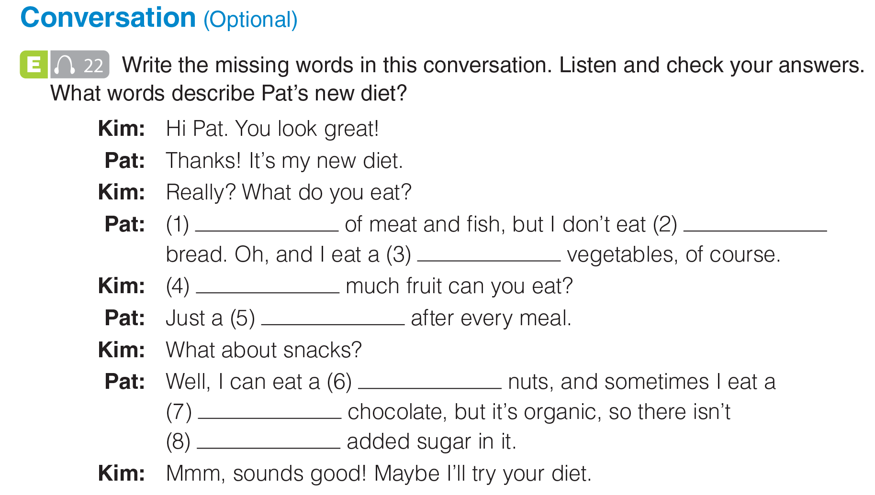

UNIT 4
FOOD
CONVERSATION
A lot
much
few
How
little
few
little
much
_______________________________________________________________________________________________________________________________________________________________________________________________________________________
National Geographic Learning, a Cengage Company. © 2022 Cengage Learning, Inc. ALL RIGHTS RESERVED. This presentation tool is for teaching purpose only. May not be scanned, copied or duplicated, or posted to a publicly accessible website, in whole or in part.

Slide 43
UNIT 4
FOOD
CONVERSATION
A lot
much
few
How
little
few
little
much
_______________________________________________________________________________________________________________________________________________________________________________________________________________________
National Geographic Learning, a Cengage Company. © 2022 Cengage Learning, Inc. ALL RIGHTS RESERVED. This presentation tool is for teaching purpose only. May not be scanned, copied or duplicated, or posted to a publicly accessible website, in whole or in part.

Slide 44
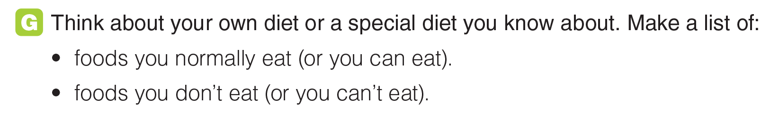
UNIT 4
FOOD
CONVERSATION
_______________________________________________________________________________________________________________________________________________________________________________________________________________________
National Geographic Learning, a Cengage Company. © 2022 Cengage Learning, Inc. ALL RIGHTS RESERVED. This presentation tool is for teaching purpose only. May not be scanned, copied or duplicated, or posted to a publicly accessible website, in whole or in part.

Slide 45

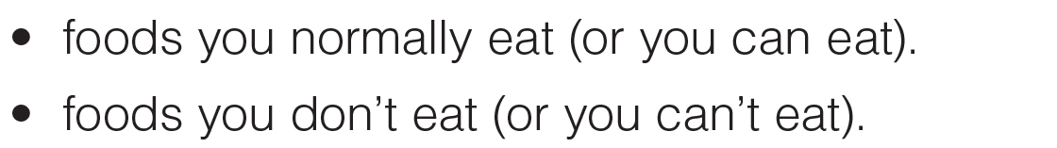
UNIT 4
FOOD
GOAL CHECK
_______________________________________________________________________________________________________________________________________________________________________________________________________________________
National Geographic Learning, a Cengage Company. © 2022 Cengage Learning, Inc. ALL RIGHTS RESERVED. This presentation tool is for teaching purpose only. May not be scanned, copied or duplicated, or posted to a publicly accessible website, in whole or in part.

Slide 46

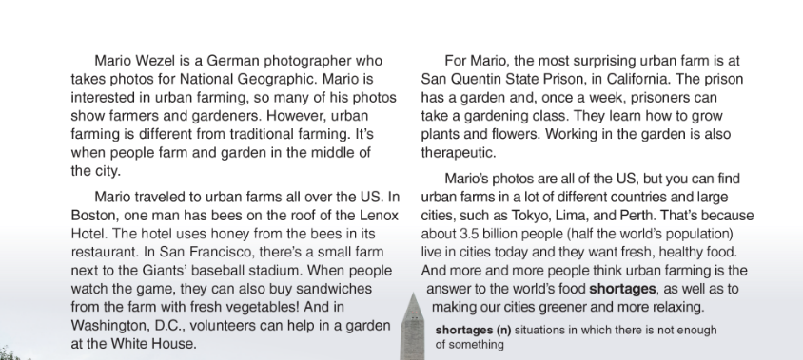
UNIT 4
FOOD
READING
_______________________________________________________________________________________________________________________________________________________________________________________________________________________
National Geographic Learning, a Cengage Company. © 2022 Cengage Learning, Inc. ALL RIGHTS RESERVED. This presentation tool is for teaching purpose only. May not be scanned, copied or duplicated, or posted to a publicly accessible website, in whole or in part.

Slide 47

UNIT 4
FOOD
READING
Mario Weze
farmers and gardeners
At the Giants’ baseball stadium in San Francisco
Prisoners at San Quentin State prison
About 3.5 billion
_______________________________________________________________________________________________________________________________________________________________________________________________________________________
National Geographic Learning, a Cengage Company. © 2022 Cengage Learning, Inc. ALL RIGHTS RESERVED. This presentation tool is for teaching purpose only. May not be scanned, copied or duplicated, or posted to a publicly accessible website, in whole or in part.

Slide 48

UNIT 4
FOOD
READING
a
c
b
g
e
d
_______________________________________________________________________________________________________________________________________________________________________________________________________________________
National Geographic Learning, a Cengage Company. © 2022 Cengage Learning, Inc. ALL RIGHTS RESERVED. This presentation tool is for teaching purpose only. May not be scanned, copied or duplicated, or posted to a publicly accessible website, in whole or in part.

Slide 49

UNIT 4
FOOD
READING
_______________________________________________________________________________________________________________________________________________________________________________________________________________________
National Geographic Learning, a Cengage Company. © 2022 Cengage Learning, Inc. ALL RIGHTS RESERVED. This presentation tool is for teaching purpose only. May not be scanned, copied or duplicated, or posted to a publicly accessible website, in whole or in part.

Slide 50

UNIT 4
FOOD
READING
_______________________________________________________________________________________________________________________________________________________________________________________________________________________
National Geographic Learning, a Cengage Company. © 2022 Cengage Learning, Inc. ALL RIGHTS RESERVED. This presentation tool is for teaching purpose only. May not be scanned, copied or duplicated, or posted to a publicly accessible website, in whole or in part.

Slide 51

UNIT 4
FOOD
GOAL CHECK
_______________________________________________________________________________________________________________________________________________________________________________________________________________________
National Geographic Learning, a Cengage Company. © 2022 Cengage Learning, Inc. ALL RIGHTS RESERVED. This presentation tool is for teaching purpose only. May not be scanned, copied or duplicated, or posted to a publicly accessible website, in whole or in part.

Slide 52

UNIT 4
FOOD
COMMUNICATION
_______________________________________________________________________________________________________________________________________________________________________________________________________________________
National Geographic Learning, a Cengage Company. © 2022 Cengage Learning, Inc. ALL RIGHTS RESERVED. This presentation tool is for teaching purpose only. May not be scanned, copied or duplicated, or posted to a publicly accessible website, in whole or in part.

Slide 53

UNIT 4
FOOD
COMMUNICATION
_______________________________________________________________________________________________________________________________________________________________________________________________________________________
National Geographic Learning, a Cengage Company. © 2022 Cengage Learning, Inc. ALL RIGHTS RESERVED. This presentation tool is for teaching purpose only. May not be scanned, copied or duplicated, or posted to a publicly accessible website, in whole or in part.

Slide 54

UNIT 4
FOOD
COMMUNICATION
_______________________________________________________________________________________________________________________________________________________________________________________________________________________
National Geographic Learning, a Cengage Company. © 2022 Cengage Learning, Inc. ALL RIGHTS RESERVED. This presentation tool is for teaching purpose only. May not be scanned, copied or duplicated, or posted to a publicly accessible website, in whole or in part.

Slide 55

UNIT 4
FOOD
WRITING
_______________________________________________________________________________________________________________________________________________________________________________________________________________________
National Geographic Learning, a Cengage Company. © 2022 Cengage Learning, Inc. ALL RIGHTS RESERVED. This presentation tool is for teaching purpose only. May not be scanned, copied or duplicated, or posted to a publicly accessible website, in whole or in part.

Slide 56
UNIT 4
FOOD
WRITING
_______________________________________________________________________________________________________________________________________________________________________________________________________________________
National Geographic Learning, a Cengage Company. © 2022 Cengage Learning, Inc. ALL RIGHTS RESERVED. This presentation tool is for teaching purpose only. May not be scanned, copied or duplicated, or posted to a publicly accessible website, in whole or in part.

Slide 57

UNIT 4
FOOD
WRITING
4
6
3
1
5
2
_______________________________________________________________________________________________________________________________________________________________________________________________________________________
National Geographic Learning, a Cengage Company. © 2022 Cengage Learning, Inc. ALL RIGHTS RESERVED. This presentation tool is for teaching purpose only. May not be scanned, copied or duplicated, or posted to a publicly accessible website, in whole or in part.

Slide 58

UNIT 4
FOOD
WRITING
irst
hen
fter
hat
inally
_______________________________________________________________________________________________________________________________________________________________________________________________________________________
National Geographic Learning, a Cengage Company. © 2022 Cengage Learning, Inc. ALL RIGHTS RESERVED. This presentation tool is for teaching purpose only. May not be scanned, copied or duplicated, or posted to a publicly accessible website, in whole or in part.

Slide 59

UNIT 4
FOOD
GOAL CHECK
_______________________________________________________________________________________________________________________________________________________________________________________________________________________
National Geographic Learning, a Cengage Company. © 2022 Cengage Learning, Inc. ALL RIGHTS RESERVED. This presentation tool is for teaching purpose only. May not be scanned, copied or duplicated, or posted to a publicly accessible website, in whole or in part.

