Slide 1
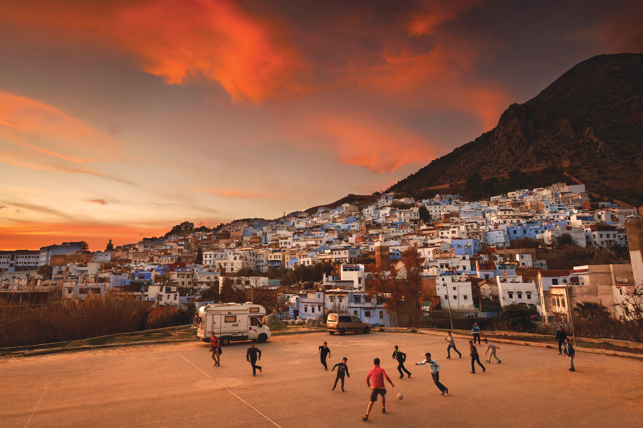


Unit 5:
SPORTS
_______________________________________________________________________________________________________________________________________________________________________________________________________________________
National Geographic Learning, a Cengage Company. © 2022 Cengage Learning, Inc. ALL RIGHTS RESERVED. This presentation tool is for teaching purpose only. May not be scanned, copied or duplicated, or posted to a publicly accessible website, in whole or in part.

Slide 2
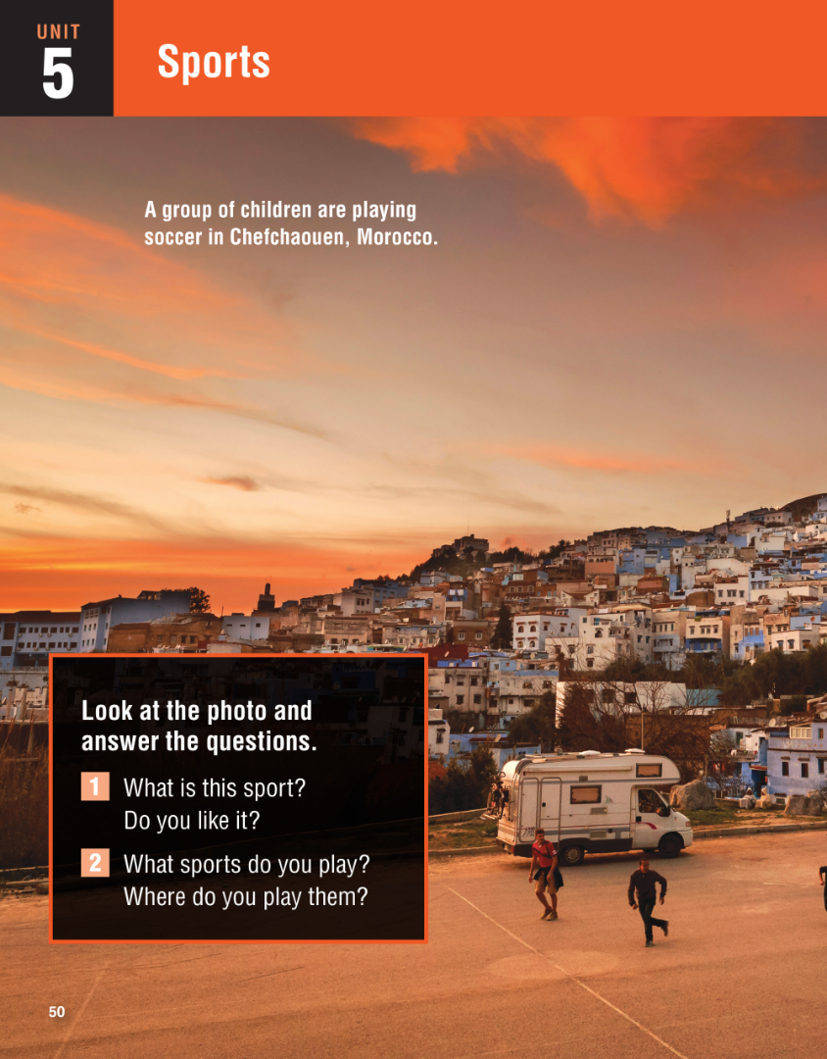


Slide 3
UNIT 5
SPORTS
OVERVIEW
Do you know?
The term soccer is only really used in the United States. In the rest of the world, this sport is simply called football. Americans use the term soccer to distinguish this sport from their own national sport of American football.
_______________________________________________________________________________________________________________________________________________________________________________________________________________________
National Geographic Learning, a Cengage Company. © 2022 Cengage Learning, Inc. ALL RIGHTS RESERVED. This presentation tool is for teaching purpose only. May not be scanned, copied or duplicated, or posted to a publicly accessible website, in whole or in part.

Slide 4
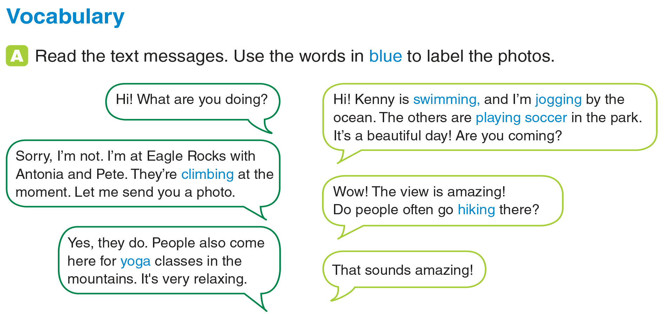
UNIT 5
SPORTS
VOCABULARY
_______________________________________________________________________________________________________________________________________________________________________________________________________________________
National Geographic Learning, a Cengage Company. © 2022 Cengage Learning, Inc. ALL RIGHTS RESERVED. This presentation tool is for teaching purpose only. May not be scanned, copied or duplicated, or posted to a publicly accessible website, in whole or in part.

Slide 5
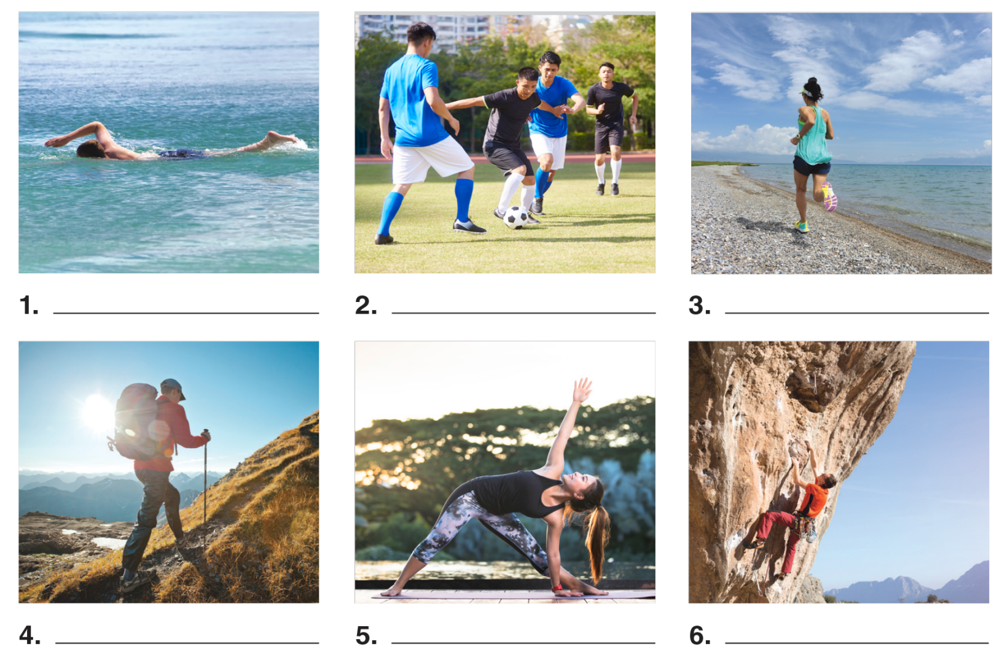
UNIT 5
SPORTS
VOCABULARY
swimming
playing soccer
jogging
hiking
yoga
climbing
_______________________________________________________________________________________________________________________________________________________________________________________________________________________
National Geographic Learning, a Cengage Company. © 2022 Cengage Learning, Inc. ALL RIGHTS RESERVED. This presentation tool is for teaching purpose only. May not be scanned, copied or duplicated, or posted to a publicly accessible website, in whole or in part.

Slide 6
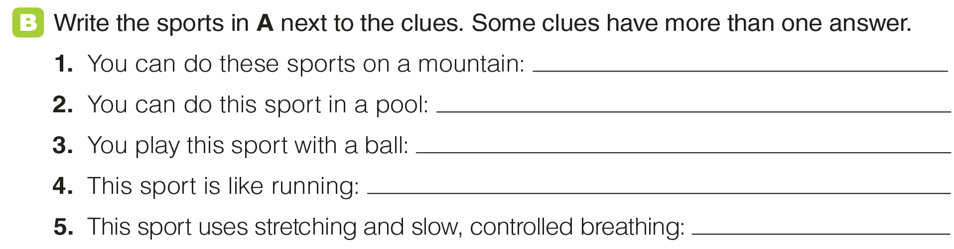
UNIT 5
SPORTS
VOCABULARY
climbing, hiking, yoga, jogging
swimming
soccer
jogging
yoga
_______________________________________________________________________________________________________________________________________________________________________________________________________________________
National Geographic Learning, a Cengage Company. © 2022 Cengage Learning, Inc. ALL RIGHTS RESERVED. This presentation tool is for teaching purpose only. May not be scanned, copied or duplicated, or posted to a publicly accessible website, in whole or in part.

Slide 7
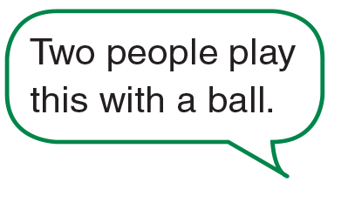
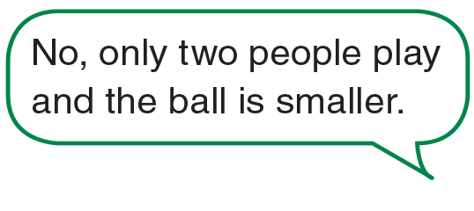



UNIT 5
SPORTS
VOCABULARY
_______________________________________________________________________________________________________________________________________________________________________________________________________________________
National Geographic Learning, a Cengage Company. © 2022 Cengage Learning, Inc. ALL RIGHTS RESERVED. This presentation tool is for teaching purpose only. May not be scanned, copied or duplicated, or posted to a publicly accessible website, in whole or in part.

Slide 8
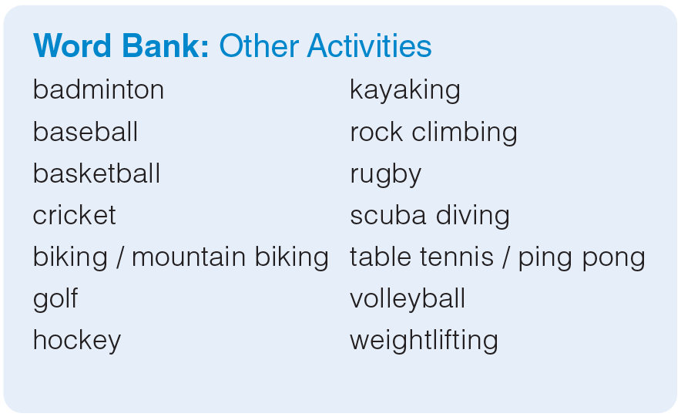
UNIT 5
SPORTS
VOCABULARY
_______________________________________________________________________________________________________________________________________________________________________________________________________________________
National Geographic Learning, a Cengage Company. © 2022 Cengage Learning, Inc. ALL RIGHTS RESERVED. This presentation tool is for teaching purpose only. May not be scanned, copied or duplicated, or posted to a publicly accessible website, in whole or in part.

Slide 9
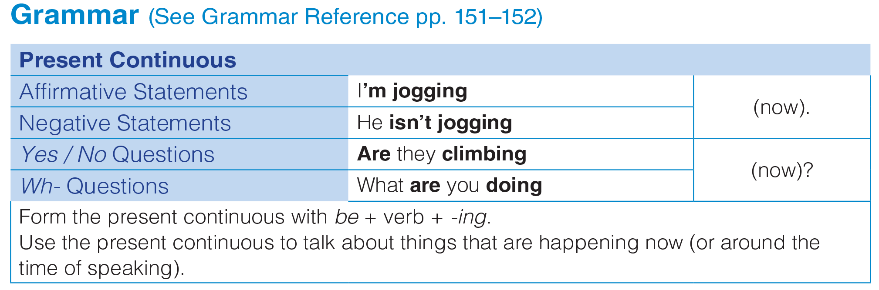
UNIT 5
SPORTS
GRAMMAR
_______________________________________________________________________________________________________________________________________________________________________________________________________________________
National Geographic Learning, a Cengage Company. © 2022 Cengage Learning, Inc. ALL RIGHTS RESERVED. This presentation tool is for teaching purpose only. May not be scanned, copied or duplicated, or posted to a publicly accessible website, in whole or in part.

Slide 10
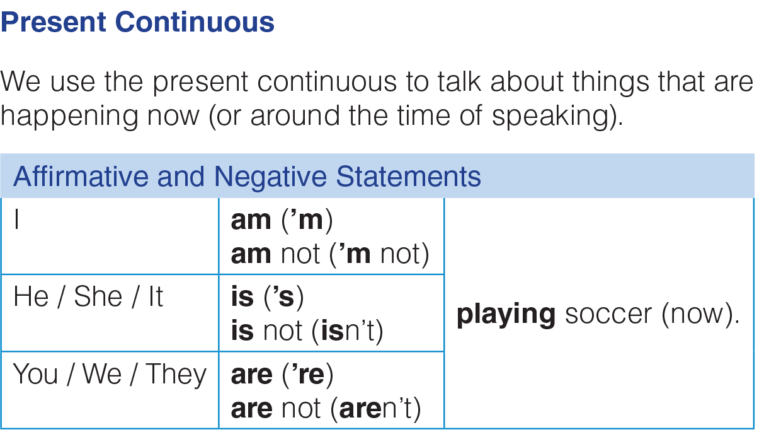
UNIT 5
SPORTS
GRAMMAR
_______________________________________________________________________________________________________________________________________________________________________________________________________________________
National Geographic Learning, a Cengage Company. © 2022 Cengage Learning, Inc. ALL RIGHTS RESERVED. This presentation tool is for teaching purpose only. May not be scanned, copied or duplicated, or posted to a publicly accessible website, in whole or in part.

Slide 11
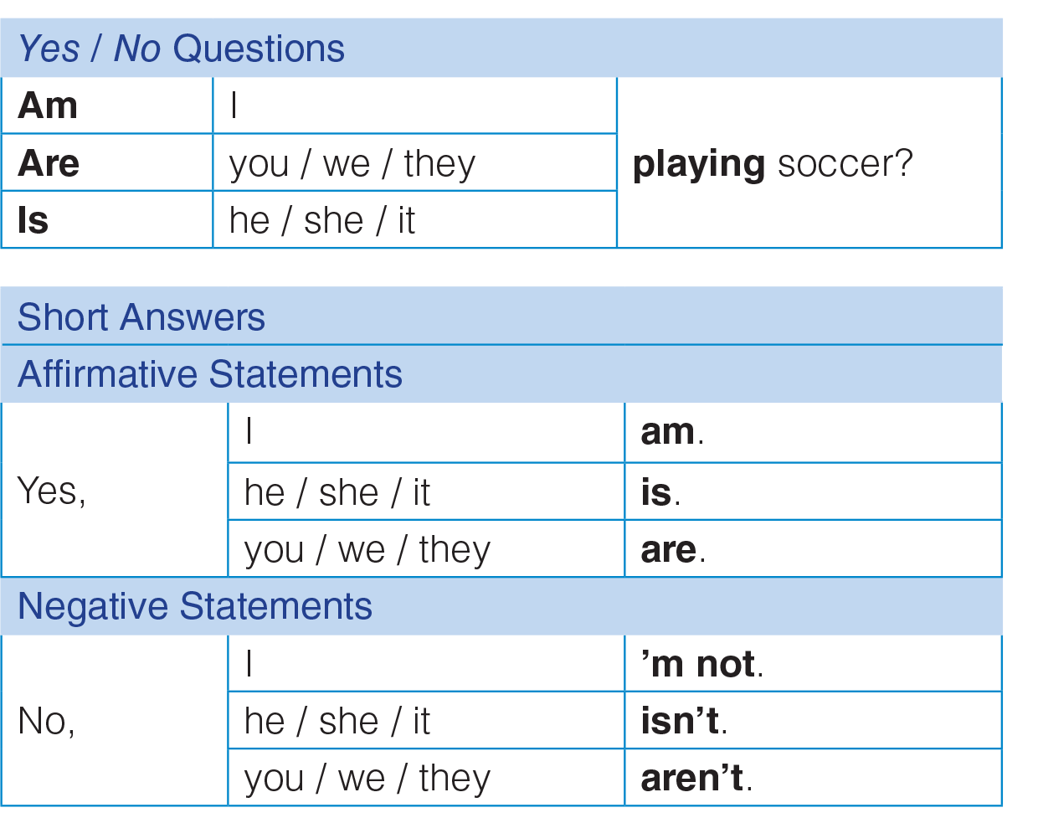
UNIT 5
SPORTS
GRAMMAR
_______________________________________________________________________________________________________________________________________________________________________________________________________________________
National Geographic Learning, a Cengage Company. © 2022 Cengage Learning, Inc. ALL RIGHTS RESERVED. This presentation tool is for teaching purpose only. May not be scanned, copied or duplicated, or posted to a publicly accessible website, in whole or in part.

Slide 12
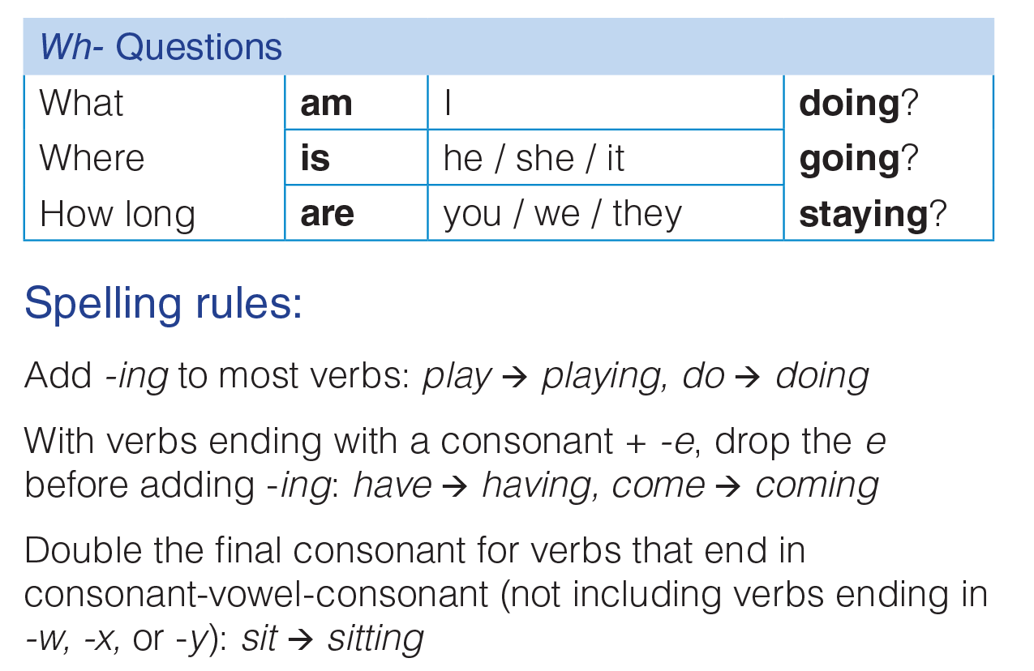
UNIT 5
SPORTS
GRAMMAR
_______________________________________________________________________________________________________________________________________________________________________________________________________________________
National Geographic Learning, a Cengage Company. © 2022 Cengage Learning, Inc. ALL RIGHTS RESERVED. This presentation tool is for teaching purpose only. May not be scanned, copied or duplicated, or posted to a publicly accessible website, in whole or in part.

Slide 13
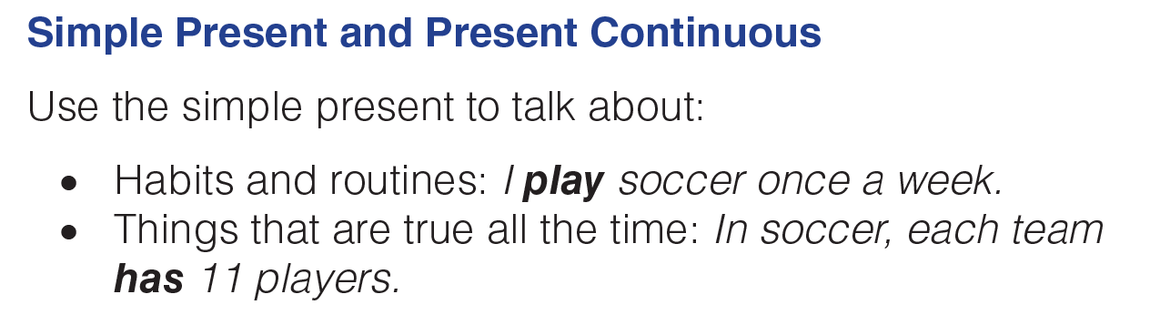
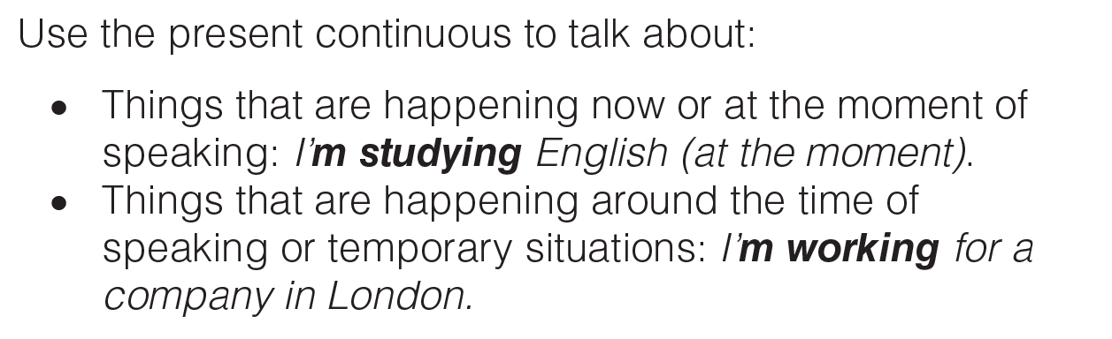
UNIT 5
SPORTS
GRAMMAR
_______________________________________________________________________________________________________________________________________________________________________________________________________________________
National Geographic Learning, a Cengage Company. © 2022 Cengage Learning, Inc. ALL RIGHTS RESERVED. This presentation tool is for teaching purpose only. May not be scanned, copied or duplicated, or posted to a publicly accessible website, in whole or in part.

Slide 14
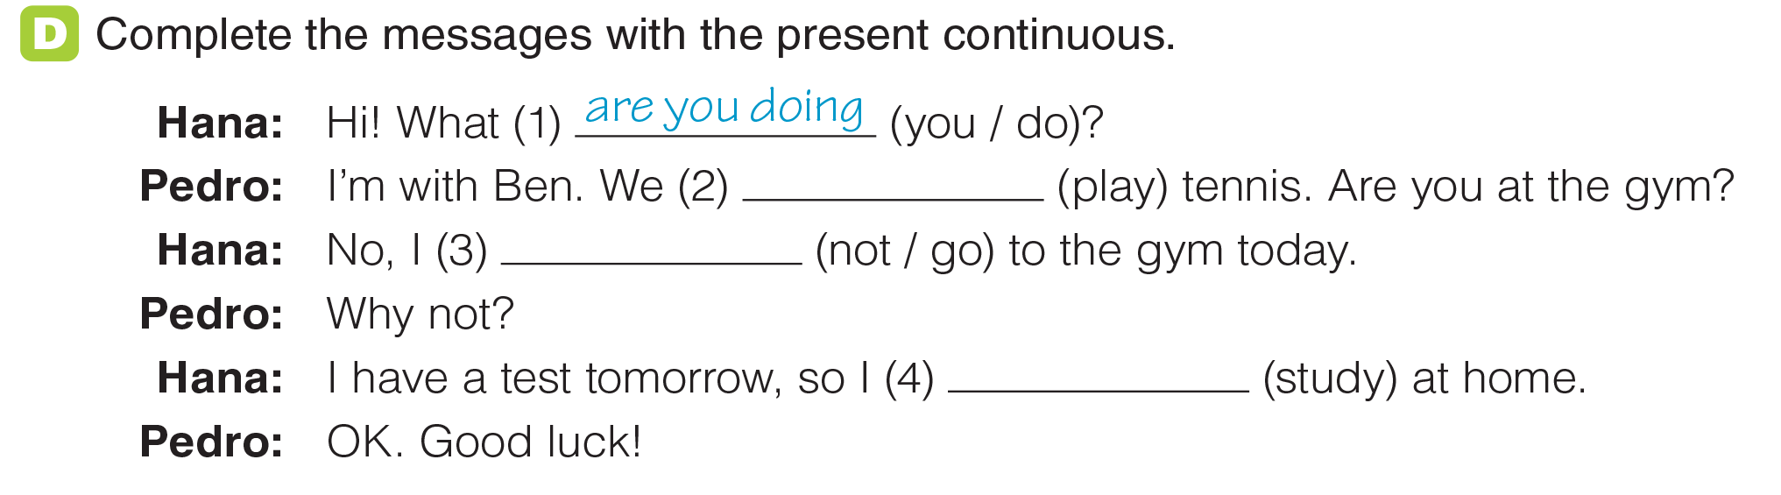
UNIT 5
SPORTS
GRAMMAR
‘re playing
‘m not going
‘m studying
_______________________________________________________________________________________________________________________________________________________________________________________________________________________
National Geographic Learning, a Cengage Company. © 2022 Cengage Learning, Inc. ALL RIGHTS RESERVED. This presentation tool is for teaching purpose only. May not be scanned, copied or duplicated, or posted to a publicly accessible website, in whole or in part.

Slide 15
UNIT 5
SPORTS
GRAMMAR
‘re playing
‘m not going
‘m studying
_______________________________________________________________________________________________________________________________________________________________________________________________________________________
National Geographic Learning, a Cengage Company. © 2022 Cengage Learning, Inc. ALL RIGHTS RESERVED. This presentation tool is for teaching purpose only. May not be scanned, copied or duplicated, or posted to a publicly accessible website, in whole or in part.

Slide 16



UNIT 5
SPORTS
GRAMMAR
_______________________________________________________________________________________________________________________________________________________________________________________________________________________
National Geographic Learning, a Cengage Company. © 2022 Cengage Learning, Inc. ALL RIGHTS RESERVED. This presentation tool is for teaching purpose only. May not be scanned, copied or duplicated, or posted to a publicly accessible website, in whole or in part.

Slide 17
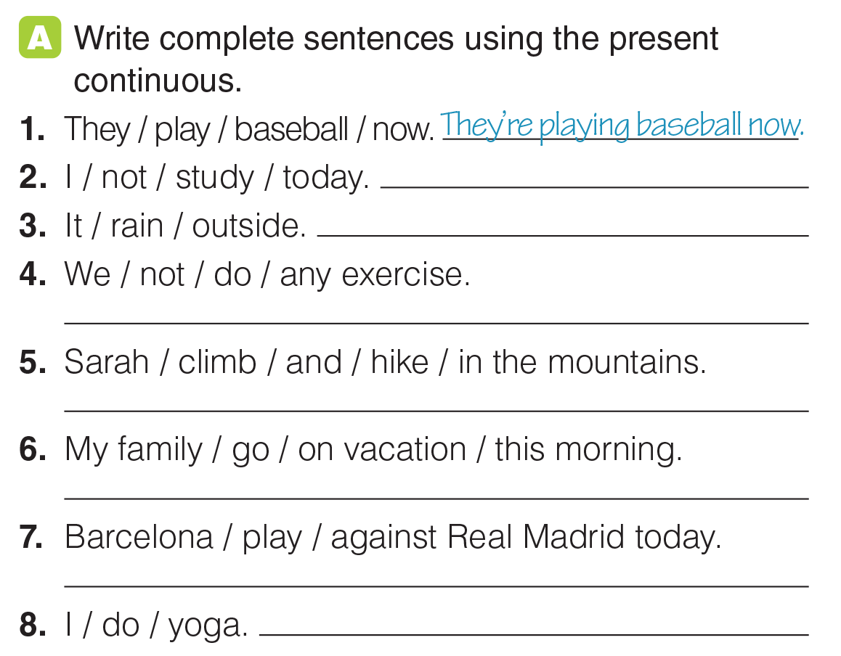
UNIT 5
SPORTS
GRAMMAR
I’m not studying today.
It’s raining outside.
We aren’t doing any exercise.
Sarah’s climbing and hiking in the mountains.
My family’s going on vacation this morning.
Barcelona’s playing against Real Madrid today.
I’m doing yoga.
_______________________________________________________________________________________________________________________________________________________________________________________________________________________
National Geographic Learning, a Cengage Company. © 2022 Cengage Learning, Inc. ALL RIGHTS RESERVED. This presentation tool is for teaching purpose only. May not be scanned, copied or duplicated, or posted to a publicly accessible website, in whole or in part.

Slide 18
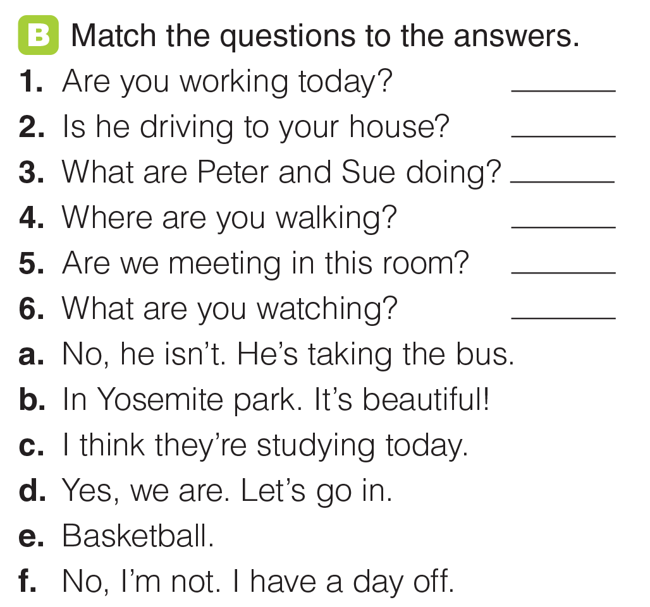
UNIT 5
SPORTS
GRAMMAR
f
a
c
b
d
e
_______________________________________________________________________________________________________________________________________________________________________________________________________________________
National Geographic Learning, a Cengage Company. © 2022 Cengage Learning, Inc. ALL RIGHTS RESERVED. This presentation tool is for teaching purpose only. May not be scanned, copied or duplicated, or posted to a publicly accessible website, in whole or in part.

Slide 19
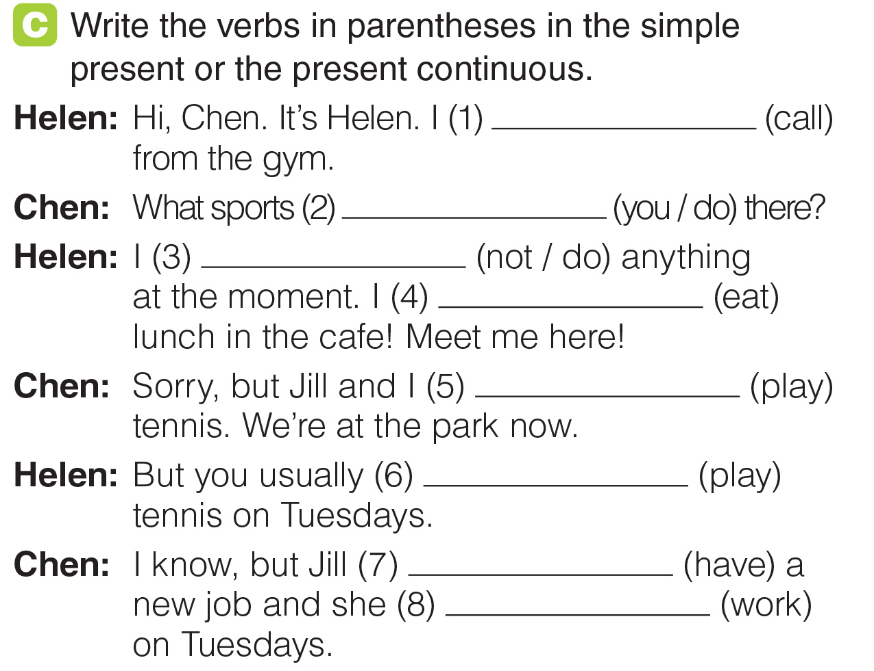
UNIT 5
SPORTS
GRAMMAR
‘m calling
are you doing
‘m not doing
‘m eating
are playing
play
has
work
_______________________________________________________________________________________________________________________________________________________________________________________________________________________
National Geographic Learning, a Cengage Company. © 2022 Cengage Learning, Inc. ALL RIGHTS RESERVED. This presentation tool is for teaching purpose only. May not be scanned, copied or duplicated, or posted to a publicly accessible website, in whole or in part.

Slide 20




UNIT 5
SPORTS
GOAL CHECK
_______________________________________________________________________________________________________________________________________________________________________________________________________________________
National Geographic Learning, a Cengage Company. © 2022 Cengage Learning, Inc. ALL RIGHTS RESERVED. This presentation tool is for teaching purpose only. May not be scanned, copied or duplicated, or posted to a publicly accessible website, in whole or in part.

Slide 21

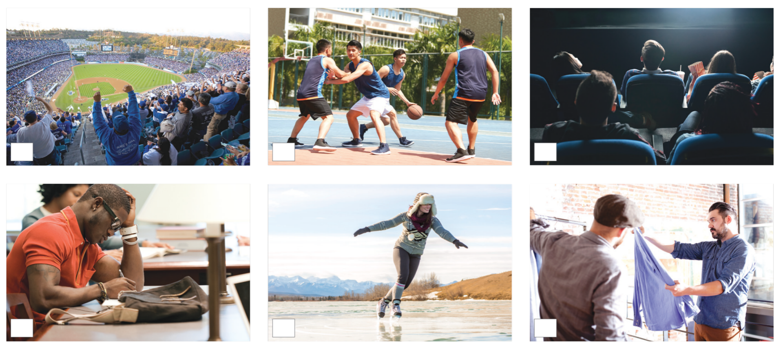
UNIT 5
SPORTS
LISTENING
_______________________________________________________________________________________________________________________________________________________________________________________________________________________
National Geographic Learning, a Cengage Company. © 2022 Cengage Learning, Inc. ALL RIGHTS RESERVED. This presentation tool is for teaching purpose only. May not be scanned, copied or duplicated, or posted to a publicly accessible website, in whole or in part.

Slide 22

UNIT 5
SPORTS
LISTENING
3
2
1
2
1
3
_______________________________________________________________________________________________________________________________________________________________________________________________________________________
National Geographic Learning, a Cengage Company. © 2022 Cengage Learning, Inc. ALL RIGHTS RESERVED. This presentation tool is for teaching purpose only. May not be scanned, copied or duplicated, or posted to a publicly accessible website, in whole or in part.

Slide 23
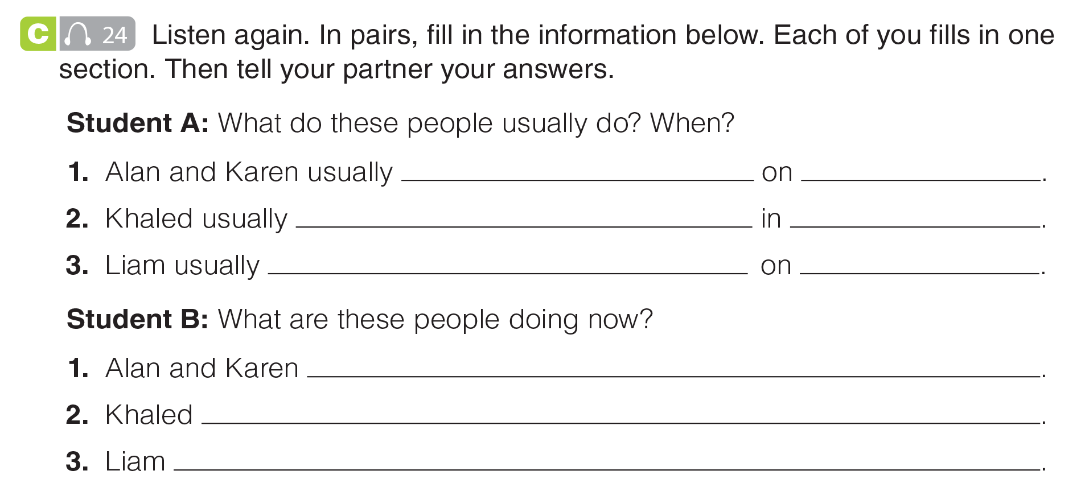
UNIT 5
SPORTS
LISTENING
go to the movies
Fridays
studies
the evening
goes to the ball game
Saturdays
are ice skating
isn’t studying / is playing basketball
is shopping for clothes
_______________________________________________________________________________________________________________________________________________________________________________________________________________________
National Geographic Learning, a Cengage Company. © 2022 Cengage Learning, Inc. ALL RIGHTS RESERVED. This presentation tool is for teaching purpose only. May not be scanned, copied or duplicated, or posted to a publicly accessible website, in whole or in part.

Slide 24
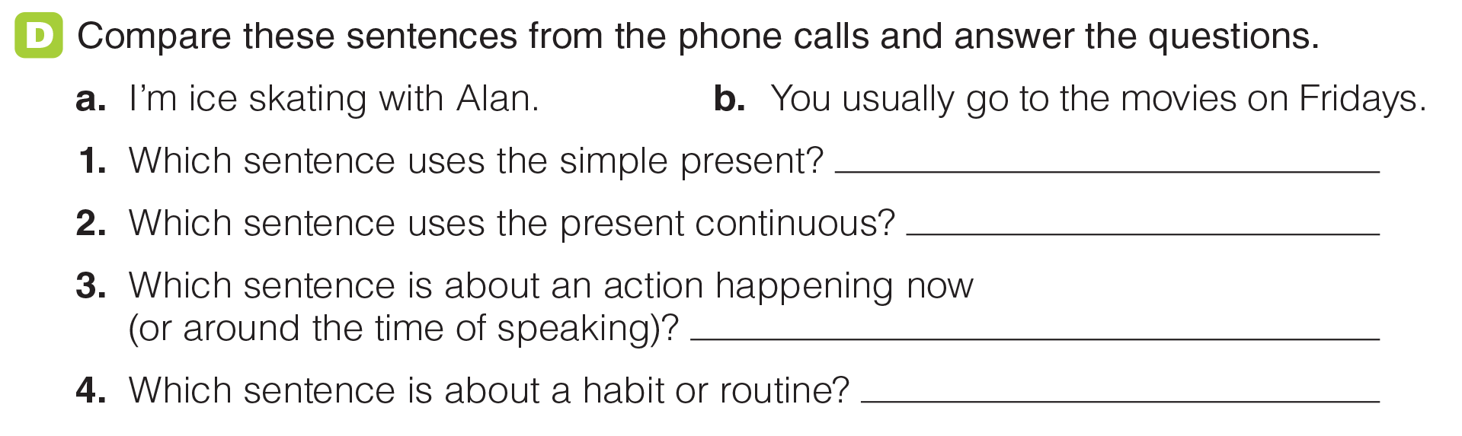
UNIT 5
SPORTS
LISTENING
b
a
a
b
_______________________________________________________________________________________________________________________________________________________________________________________________________________________
National Geographic Learning, a Cengage Company. © 2022 Cengage Learning, Inc. ALL RIGHTS RESERVED. This presentation tool is for teaching purpose only. May not be scanned, copied or duplicated, or posted to a publicly accessible website, in whole or in part.

Slide 25
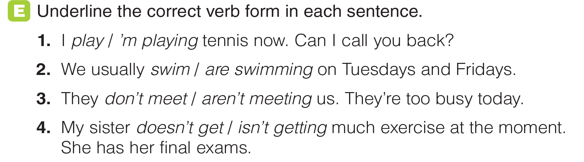
UNIT 5
SPORTS
LISTENING
_______________________________________________________________________________________________________________________________________________________________________________________________________________________
National Geographic Learning, a Cengage Company. © 2022 Cengage Learning, Inc. ALL RIGHTS RESERVED. This presentation tool is for teaching purpose only. May not be scanned, copied or duplicated, or posted to a publicly accessible website, in whole or in part.

Slide 26
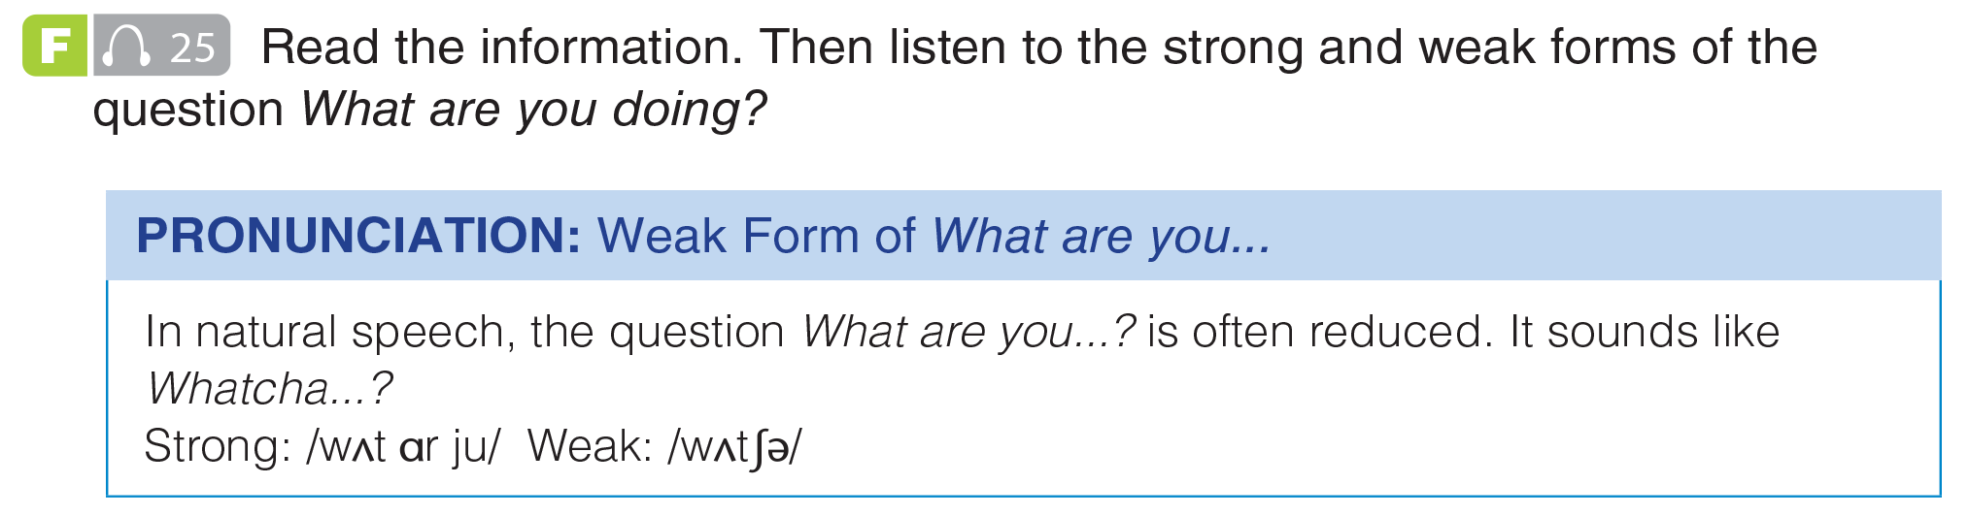
UNIT 5
SPORTS
PRONUNCIATION
_______________________________________________________________________________________________________________________________________________________________________________________________________________________
National Geographic Learning, a Cengage Company. © 2022 Cengage Learning, Inc. ALL RIGHTS RESERVED. This presentation tool is for teaching purpose only. May not be scanned, copied or duplicated, or posted to a publicly accessible website, in whole or in part.

Slide 27
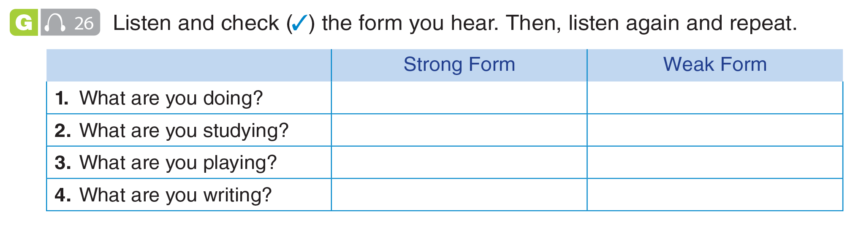
UNIT 5
SPORTS
PRONUNCIATION
✓
✓
✓
✓
_______________________________________________________________________________________________________________________________________________________________________________________________________________________
National Geographic Learning, a Cengage Company. © 2022 Cengage Learning, Inc. ALL RIGHTS RESERVED. This presentation tool is for teaching purpose only. May not be scanned, copied or duplicated, or posted to a publicly accessible website, in whole or in part.

Slide 28
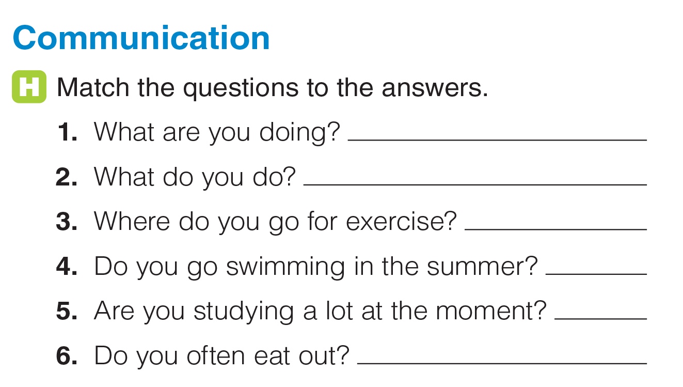
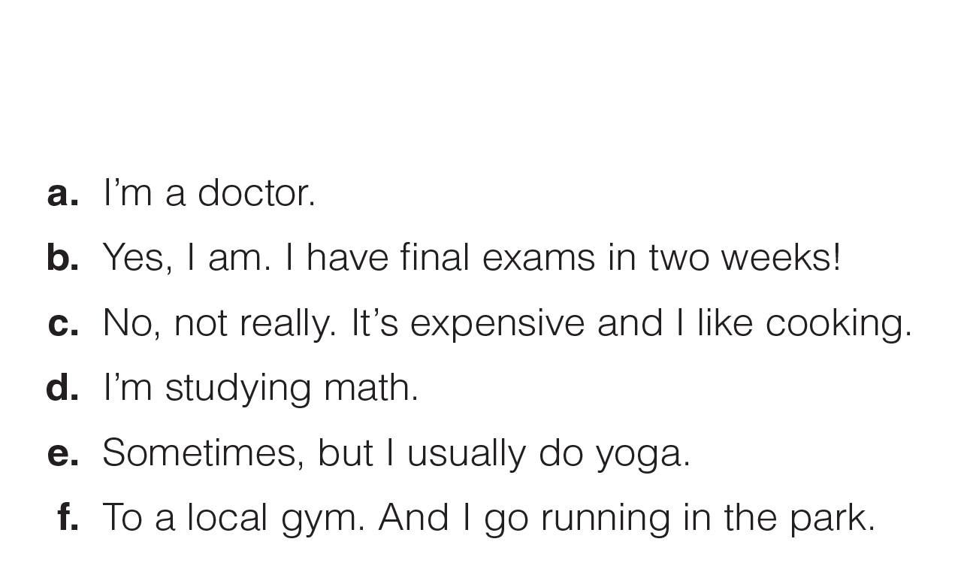
UNIT 5
SPORTS
COMMUNICATION
d
a
f
e
b
c
_______________________________________________________________________________________________________________________________________________________________________________________________________________________
National Geographic Learning, a Cengage Company. © 2022 Cengage Learning, Inc. ALL RIGHTS RESERVED. This presentation tool is for teaching purpose only. May not be scanned, copied or duplicated, or posted to a publicly accessible website, in whole or in part.

Slide 29
UNIT 5
SPORTS
COMMUNICATION
d
a
f
e
b
c
_______________________________________________________________________________________________________________________________________________________________________________________________________________________
National Geographic Learning, a Cengage Company. © 2022 Cengage Learning, Inc. ALL RIGHTS RESERVED. This presentation tool is for teaching purpose only. May not be scanned, copied or duplicated, or posted to a publicly accessible website, in whole or in part.

Slide 30
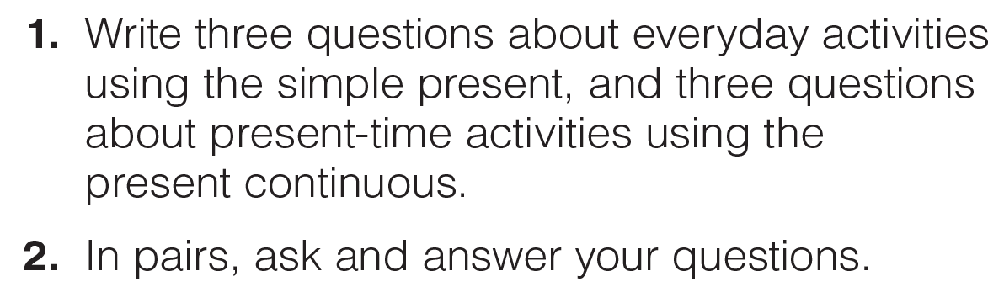




UNIT 5
SPORTS
GOAL CHECK
_______________________________________________________________________________________________________________________________________________________________________________________________________________________
National Geographic Learning, a Cengage Company. © 2022 Cengage Learning, Inc. ALL RIGHTS RESERVED. This presentation tool is for teaching purpose only. May not be scanned, copied or duplicated, or posted to a publicly accessible website, in whole or in part.

Slide 31
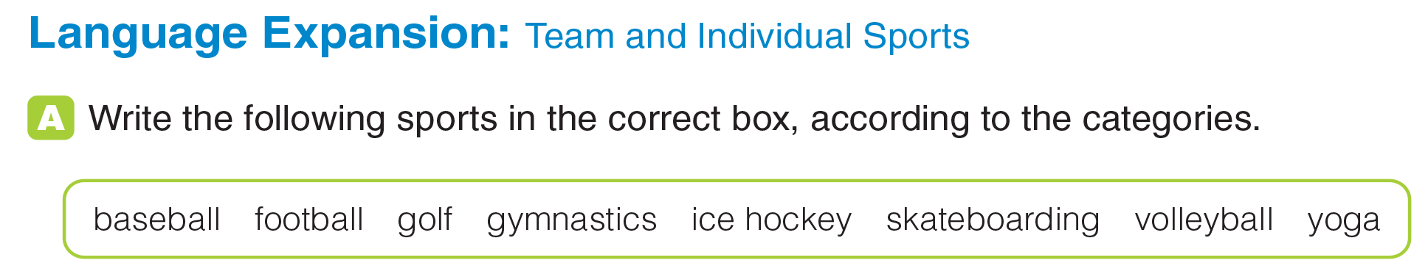
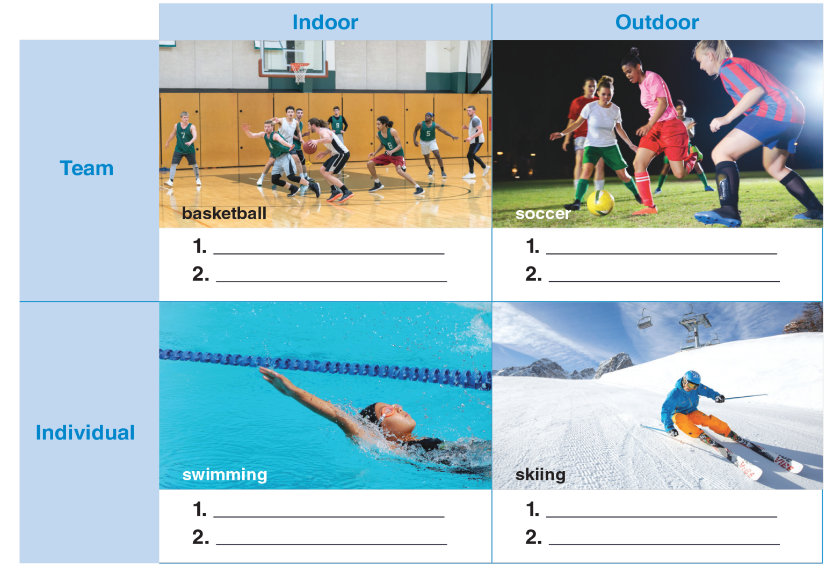
UNIT 5
SPORTS
LANGUAGE EXPANSION
_______________________________________________________________________________________________________________________________________________________________________________________________________________________
National Geographic Learning, a Cengage Company. © 2022 Cengage Learning, Inc. ALL RIGHTS RESERVED. This presentation tool is for teaching purpose only. May not be scanned, copied or duplicated, or posted to a publicly accessible website, in whole or in part.

Slide 32
UNIT 5
SPORTS
LANGUAGE EXPANSION
volleyball
baseball
ice hockey
football
gymnastics
skateboarding
yoga
golf
_______________________________________________________________________________________________________________________________________________________________________________________________________________________
National Geographic Learning, a Cengage Company. © 2022 Cengage Learning, Inc. ALL RIGHTS RESERVED. This presentation tool is for teaching purpose only. May not be scanned, copied or duplicated, or posted to a publicly accessible website, in whole or in part.

Slide 33
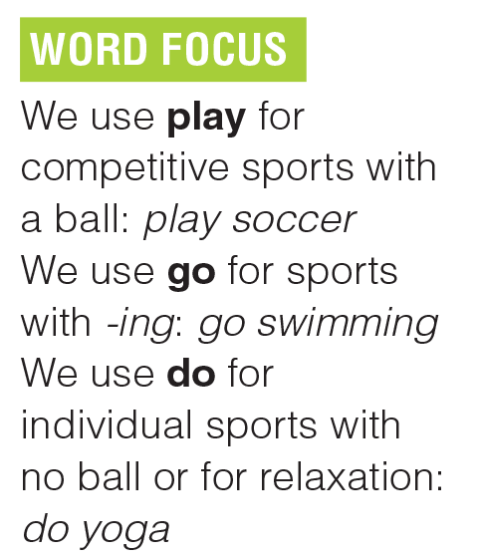
UNIT 5
SPORTS
LANGUAGE EXPANSION
_______________________________________________________________________________________________________________________________________________________________________________________________________________________
National Geographic Learning, a Cengage Company. © 2022 Cengage Learning, Inc. ALL RIGHTS RESERVED. This presentation tool is for teaching purpose only. May not be scanned, copied or duplicated, or posted to a publicly accessible website, in whole or in part.

Slide 34
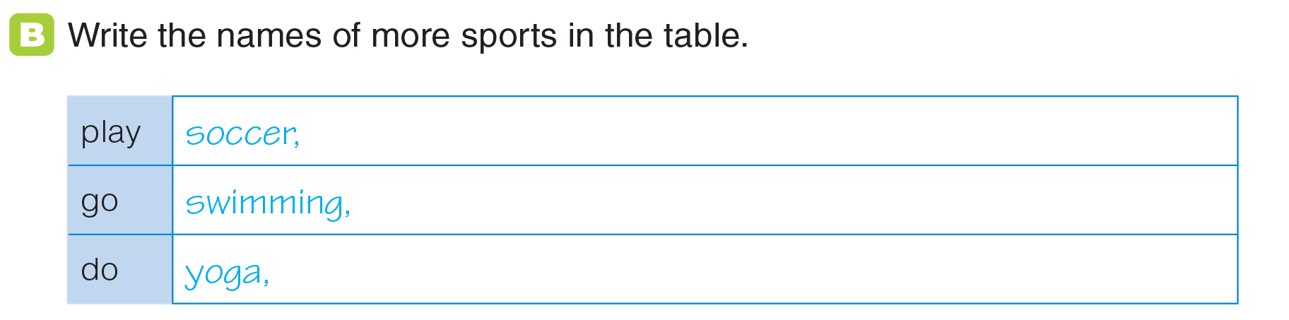
UNIT 5
SPORTS
LANGUAGE EXPANSION
baseball, volleyball, ice hockey, golf
skateboarding, skiing, snowboarding, hiking, climbing
gymnastics
_______________________________________________________________________________________________________________________________________________________________________________________________________________________
National Geographic Learning, a Cengage Company. © 2022 Cengage Learning, Inc. ALL RIGHTS RESERVED. This presentation tool is for teaching purpose only. May not be scanned, copied or duplicated, or posted to a publicly accessible website, in whole or in part.

Slide 35
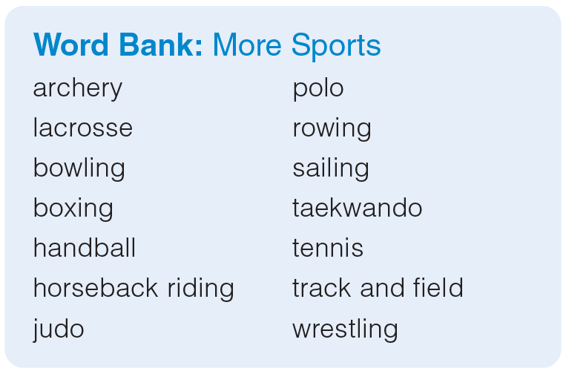
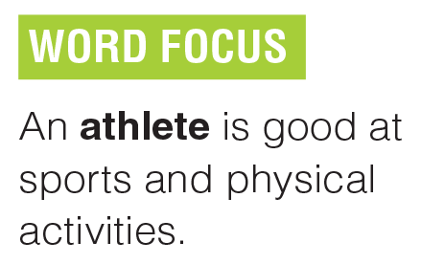
UNIT 5
SPORTS
LANGUAGE EXPANSION
_______________________________________________________________________________________________________________________________________________________________________________________________________________________
National Geographic Learning, a Cengage Company. © 2022 Cengage Learning, Inc. ALL RIGHTS RESERVED. This presentation tool is for teaching purpose only. May not be scanned, copied or duplicated, or posted to a publicly accessible website, in whole or in part.

Slide 36
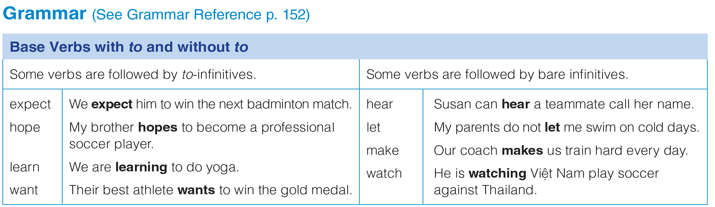
UNIT 5
SPORTS
GRAMMAR
_______________________________________________________________________________________________________________________________________________________________________________________________________________________
National Geographic Learning, a Cengage Company. © 2022 Cengage Learning, Inc. ALL RIGHTS RESERVED. This presentation tool is for teaching purpose only. May not be scanned, copied or duplicated, or posted to a publicly accessible website, in whole or in part.

Slide 37
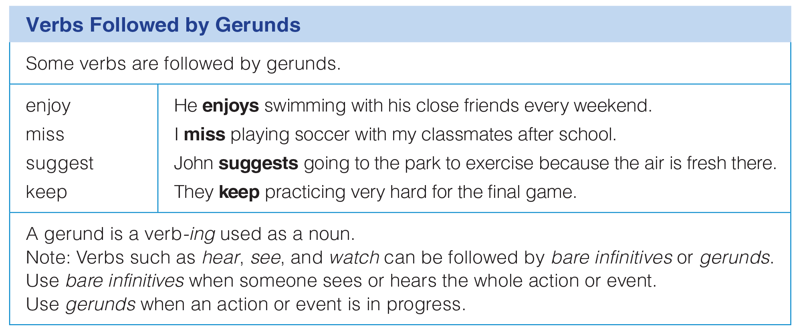
UNIT 5
SPORTS
GRAMMAR
_______________________________________________________________________________________________________________________________________________________________________________________________________________________
National Geographic Learning, a Cengage Company. © 2022 Cengage Learning, Inc. ALL RIGHTS RESERVED. This presentation tool is for teaching purpose only. May not be scanned, copied or duplicated, or posted to a publicly accessible website, in whole or in part.

Slide 38
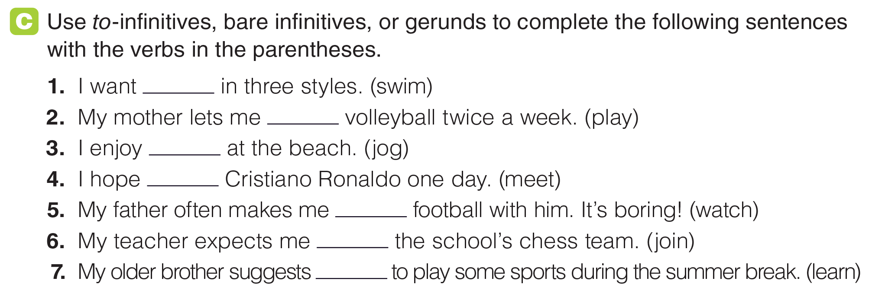
UNIT 5
SPORTS
GRAMMAR
to swim
play
jogging
to meet
watch
to join
learning
_______________________________________________________________________________________________________________________________________________________________________________________________________________________
National Geographic Learning, a Cengage Company. © 2022 Cengage Learning, Inc. ALL RIGHTS RESERVED. This presentation tool is for teaching purpose only. May not be scanned, copied or duplicated, or posted to a publicly accessible website, in whole or in part.

Slide 39
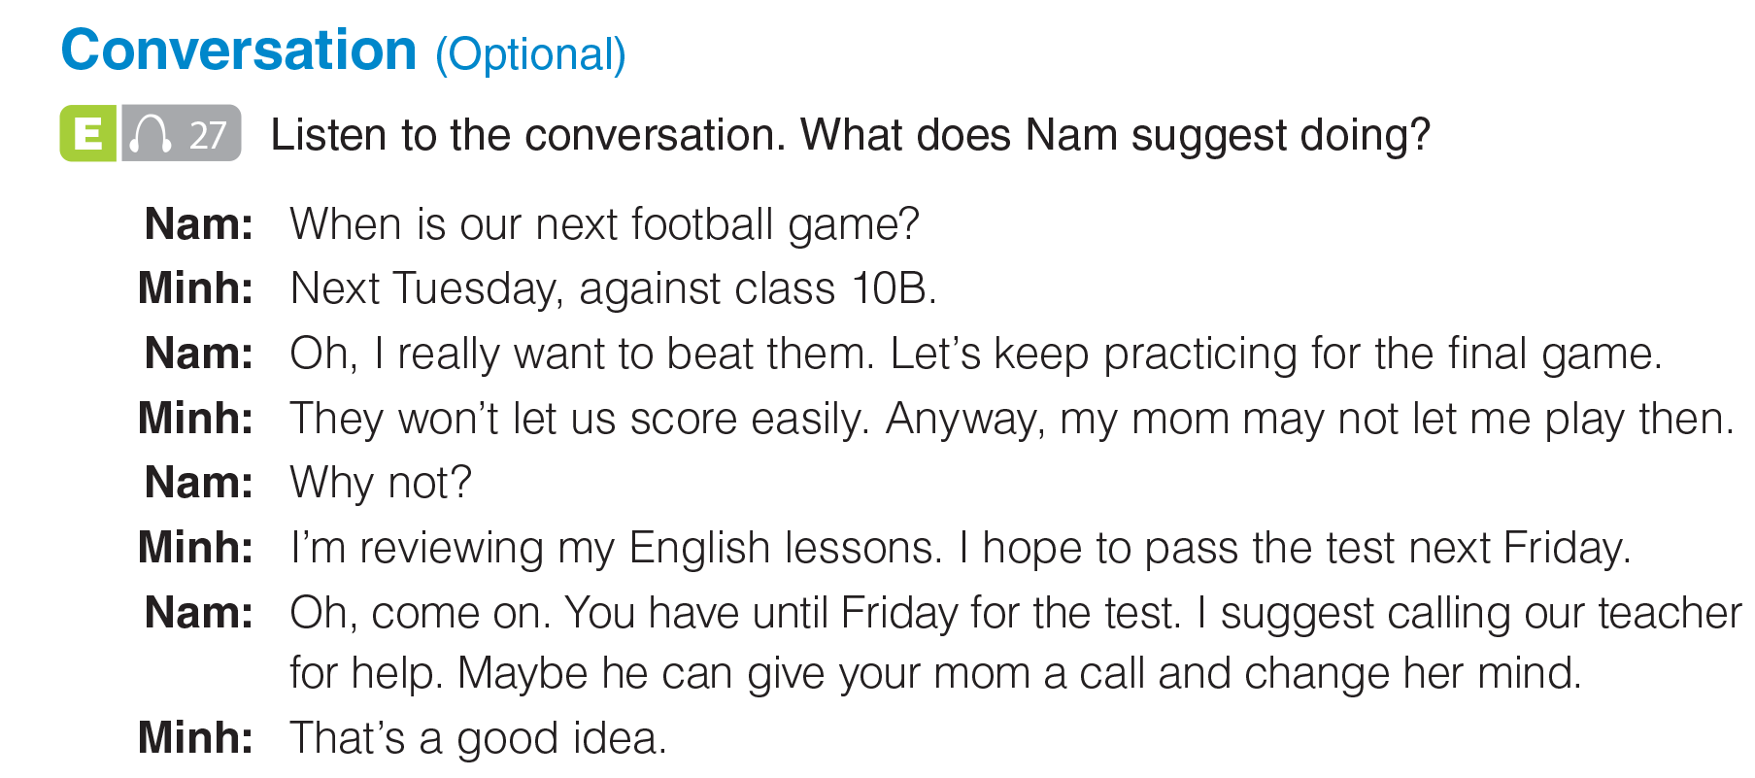

UNIT 5
SPORTS
CONVERSATION
He suggests calling their teacher to help.
_______________________________________________________________________________________________________________________________________________________________________________________________________________________
National Geographic Learning, a Cengage Company. © 2022 Cengage Learning, Inc. ALL RIGHTS RESERVED. This presentation tool is for teaching purpose only. May not be scanned, copied or duplicated, or posted to a publicly accessible website, in whole or in part.

Slide 40
UNIT 5
SPORTS
CONVERSATION
_______________________________________________________________________________________________________________________________________________________________________________________________________________________
National Geographic Learning, a Cengage Company. © 2022 Cengage Learning, Inc. ALL RIGHTS RESERVED. This presentation tool is for teaching purpose only. May not be scanned, copied or duplicated, or posted to a publicly accessible website, in whole or in part.

Slide 41
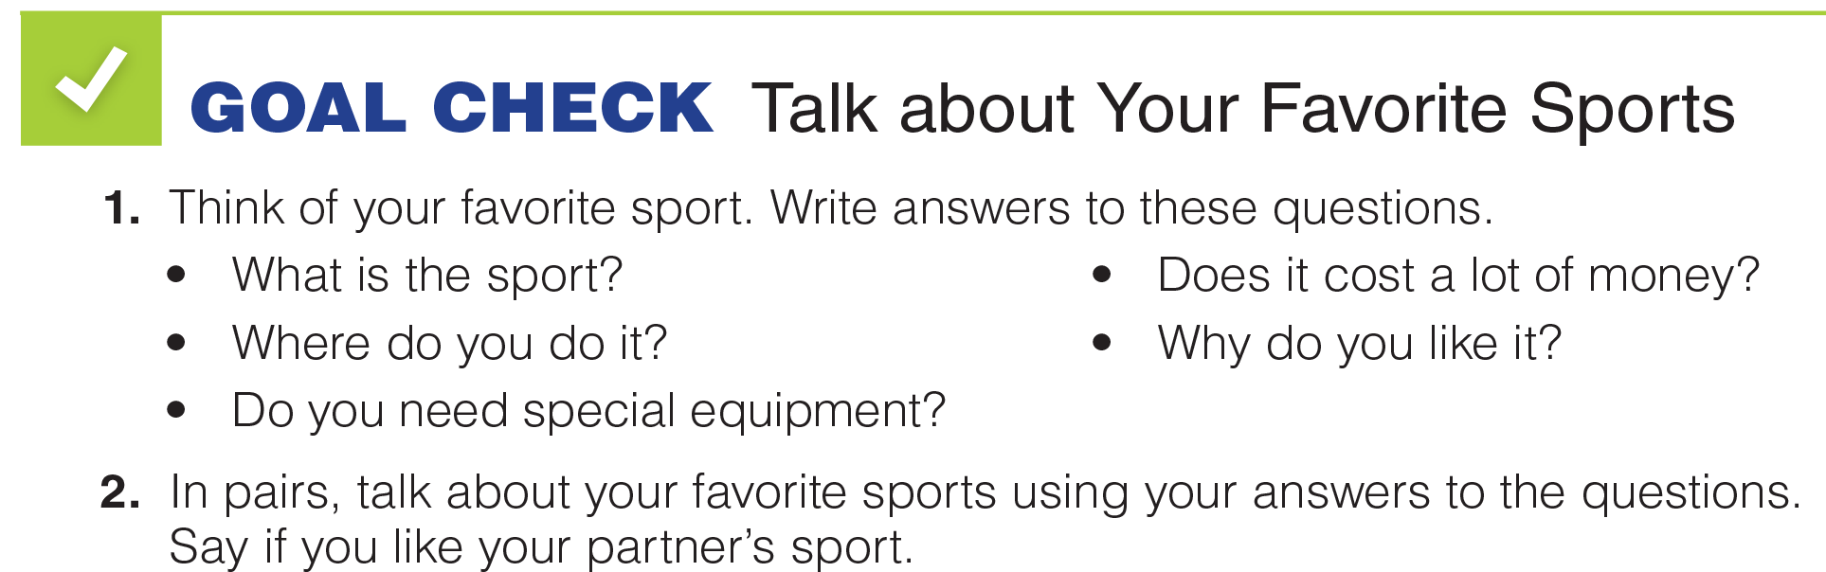
UNIT 5
SPORTS
GOAL CHECK
_______________________________________________________________________________________________________________________________________________________________________________________________________________________
National Geographic Learning, a Cengage Company. © 2022 Cengage Learning, Inc. ALL RIGHTS RESERVED. This presentation tool is for teaching purpose only. May not be scanned, copied or duplicated, or posted to a publicly accessible website, in whole or in part.

Slide 42
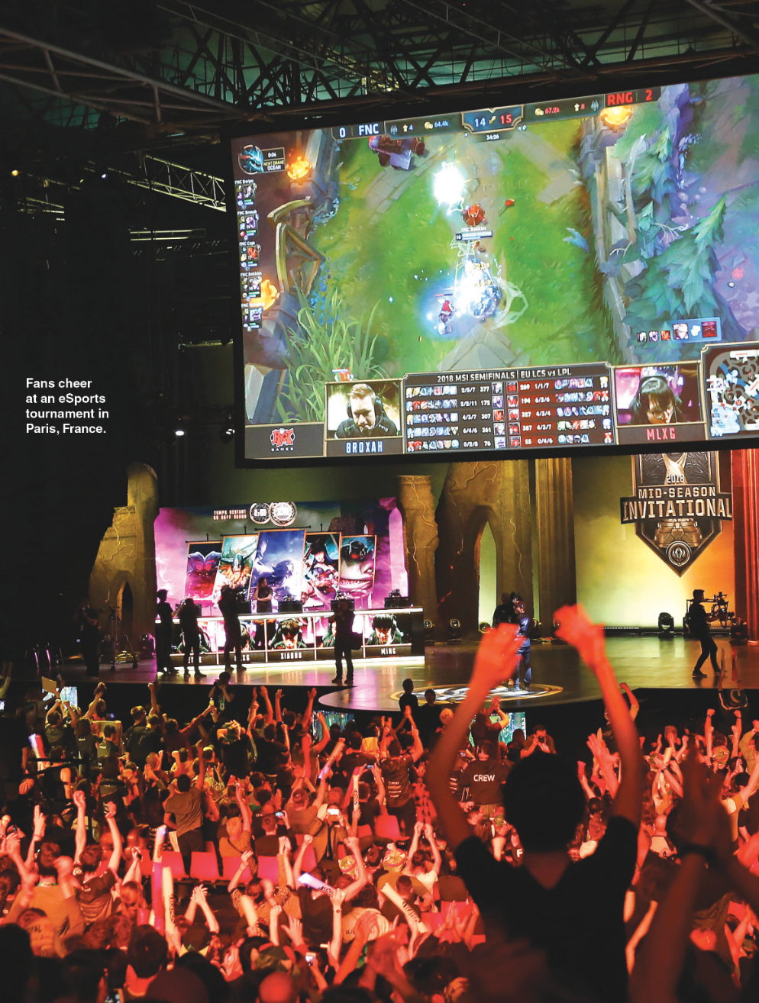
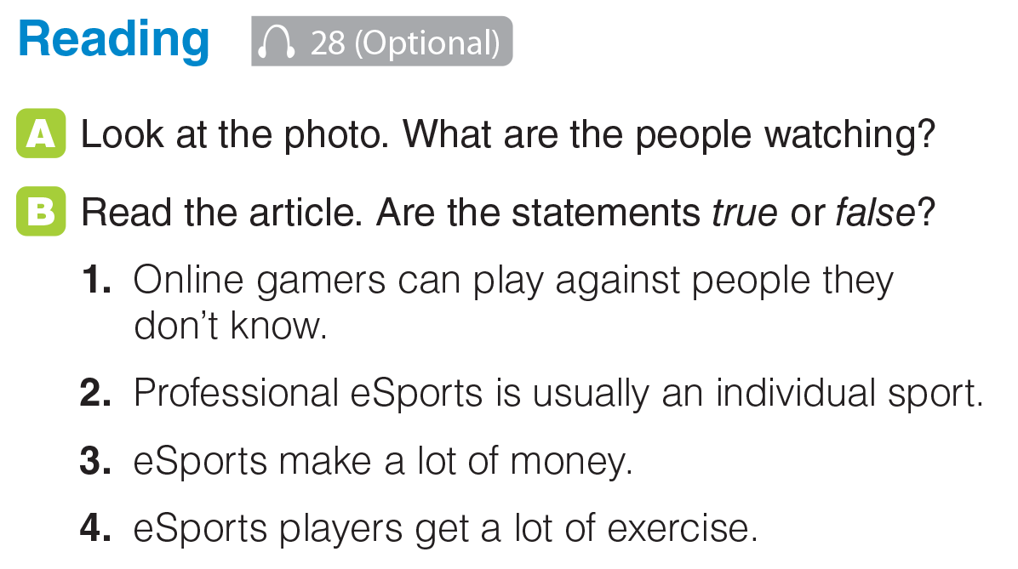
UNIT 5
SPORTS
READING
_______________________________________________________________________________________________________________________________________________________________________________________________________________________
National Geographic Learning, a Cengage Company. © 2022 Cengage Learning, Inc. ALL RIGHTS RESERVED. This presentation tool is for teaching purpose only. May not be scanned, copied or duplicated, or posted to a publicly accessible website, in whole or in part.

Slide 43
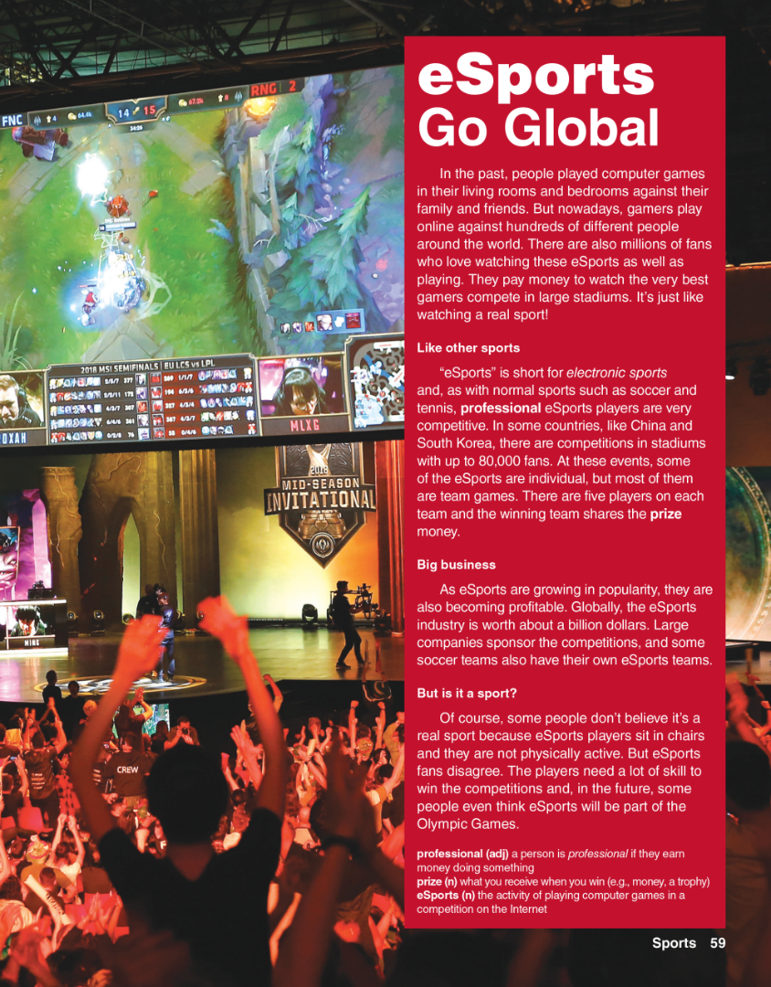
UNIT 5
SPORTS
READING
_______________________________________________________________________________________________________________________________________________________________________________________________________________________
National Geographic Learning, a Cengage Company. © 2022 Cengage Learning, Inc. ALL RIGHTS RESERVED. This presentation tool is for teaching purpose only. May not be scanned, copied or duplicated, or posted to a publicly accessible website, in whole or in part.

Slide 44

UNIT 5
SPORTS
READING
_______________________________________________________________________________________________________________________________________________________________________________________________________________________
National Geographic Learning, a Cengage Company. © 2022 Cengage Learning, Inc. ALL RIGHTS RESERVED. This presentation tool is for teaching purpose only. May not be scanned, copied or duplicated, or posted to a publicly accessible website, in whole or in part.

Slide 45
UNIT 5
SPORTS
READING
true
false
true
false
_______________________________________________________________________________________________________________________________________________________________________________________________________________________
National Geographic Learning, a Cengage Company. © 2022 Cengage Learning, Inc. ALL RIGHTS RESERVED. This presentation tool is for teaching purpose only. May not be scanned, copied or duplicated, or posted to a publicly accessible website, in whole or in part.

Slide 46


UNIT 5
SPORTS
READING
_______________________________________________________________________________________________________________________________________________________________________________________________________________________
National Geographic Learning, a Cengage Company. © 2022 Cengage Learning, Inc. ALL RIGHTS RESERVED. This presentation tool is for teaching purpose only. May not be scanned, copied or duplicated, or posted to a publicly accessible website, in whole or in part.

Slide 47
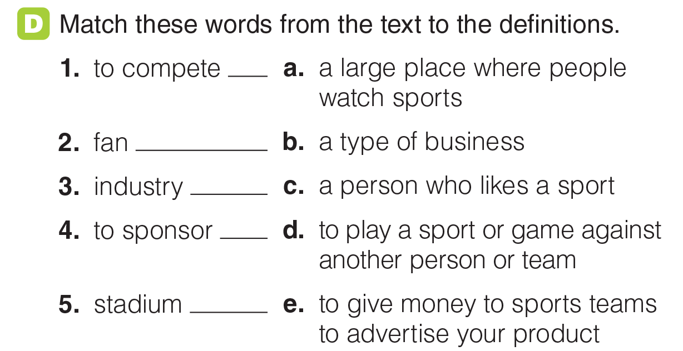
UNIT 5
SPORTS
READING
d
c
b
e
a
_______________________________________________________________________________________________________________________________________________________________________________________________________________________
National Geographic Learning, a Cengage Company. © 2022 Cengage Learning, Inc. ALL RIGHTS RESERVED. This presentation tool is for teaching purpose only. May not be scanned, copied or duplicated, or posted to a publicly accessible website, in whole or in part.

Slide 48

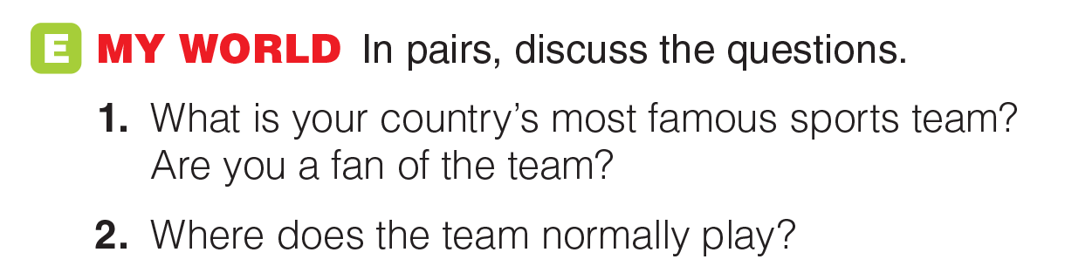
UNIT 5
SPORTS
READING
_______________________________________________________________________________________________________________________________________________________________________________________________________________________
National Geographic Learning, a Cengage Company. © 2022 Cengage Learning, Inc. ALL RIGHTS RESERVED. This presentation tool is for teaching purpose only. May not be scanned, copied or duplicated, or posted to a publicly accessible website, in whole or in part.

Slide 49
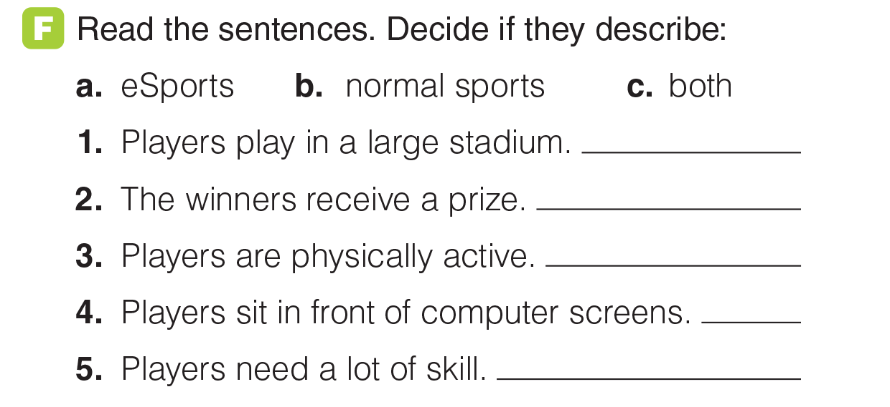
UNIT 5
SPORTS
READING
c
c
b
a
c
_______________________________________________________________________________________________________________________________________________________________________________________________________________________
National Geographic Learning, a Cengage Company. © 2022 Cengage Learning, Inc. ALL RIGHTS RESERVED. This presentation tool is for teaching purpose only. May not be scanned, copied or duplicated, or posted to a publicly accessible website, in whole or in part.

Slide 50
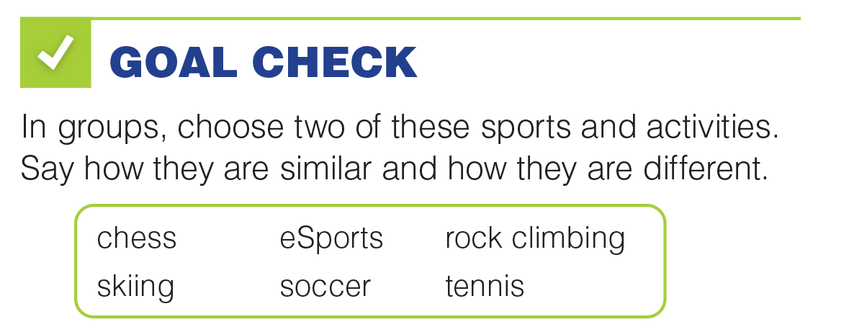
UNIT 5
SPORTS
GOAL CHECK
_______________________________________________________________________________________________________________________________________________________________________________________________________________________
National Geographic Learning, a Cengage Company. © 2022 Cengage Learning, Inc. ALL RIGHTS RESERVED. This presentation tool is for teaching purpose only. May not be scanned, copied or duplicated, or posted to a publicly accessible website, in whole or in part.

Slide 51
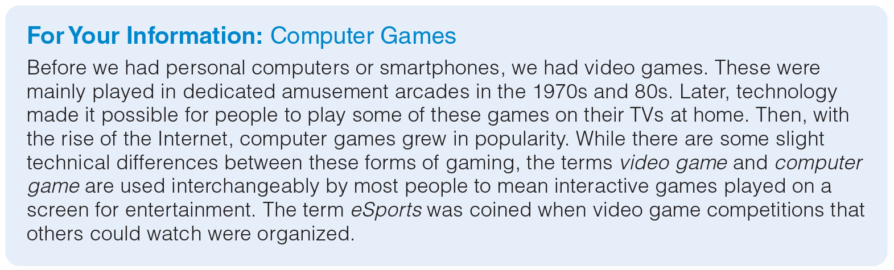
UNIT 5
SPORTS
GOAL CHECK
_______________________________________________________________________________________________________________________________________________________________________________________________________________________
National Geographic Learning, a Cengage Company. © 2022 Cengage Learning, Inc. ALL RIGHTS RESERVED. This presentation tool is for teaching purpose only. May not be scanned, copied or duplicated, or posted to a publicly accessible website, in whole or in part.

Slide 52
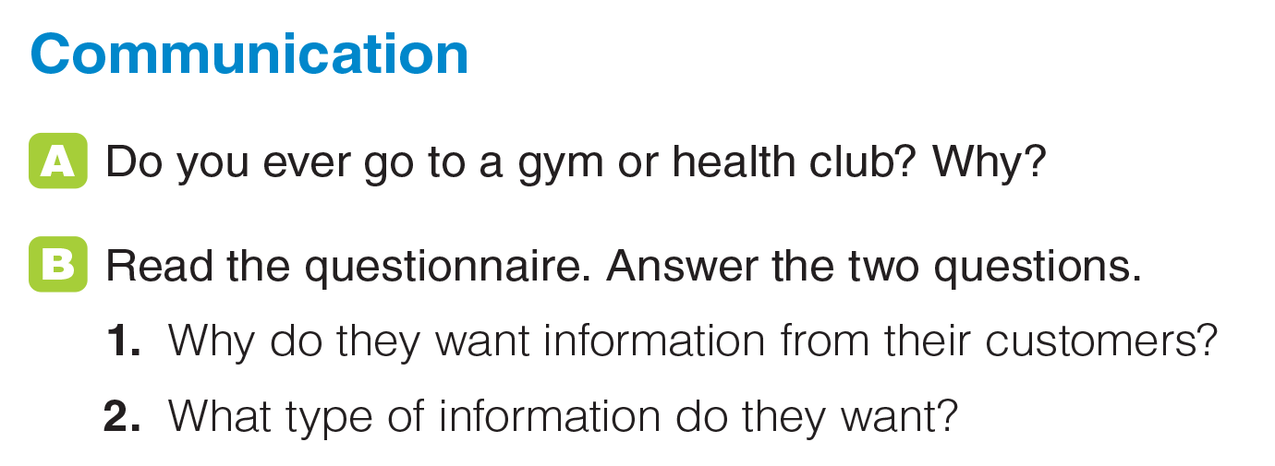
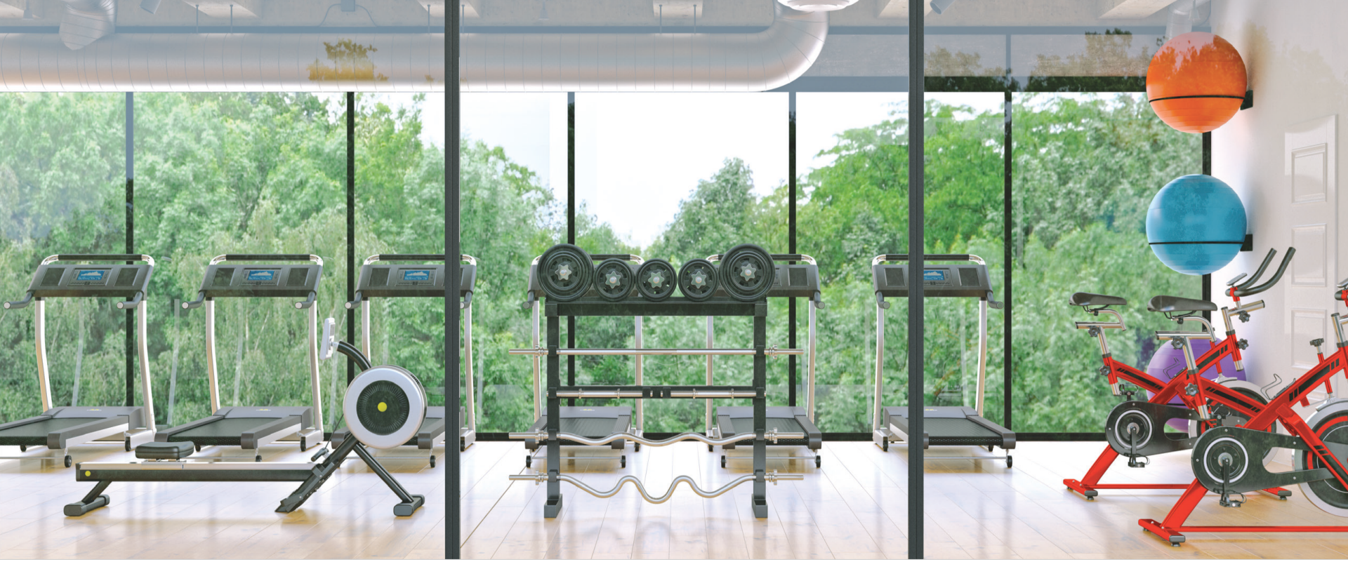
UNIT 5
SPORTS
COMMUNICATION
_______________________________________________________________________________________________________________________________________________________________________________________________________________________
National Geographic Learning, a Cengage Company. © 2022 Cengage Learning, Inc. ALL RIGHTS RESERVED. This presentation tool is for teaching purpose only. May not be scanned, copied or duplicated, or posted to a publicly accessible website, in whole or in part.

Slide 53
UNIT 5
SPORTS
COMMUNICATION
_______________________________________________________________________________________________________________________________________________________________________________________________________________________
National Geographic Learning, a Cengage Company. © 2022 Cengage Learning, Inc. ALL RIGHTS RESERVED. This presentation tool is for teaching purpose only. May not be scanned, copied or duplicated, or posted to a publicly accessible website, in whole or in part.

Slide 54
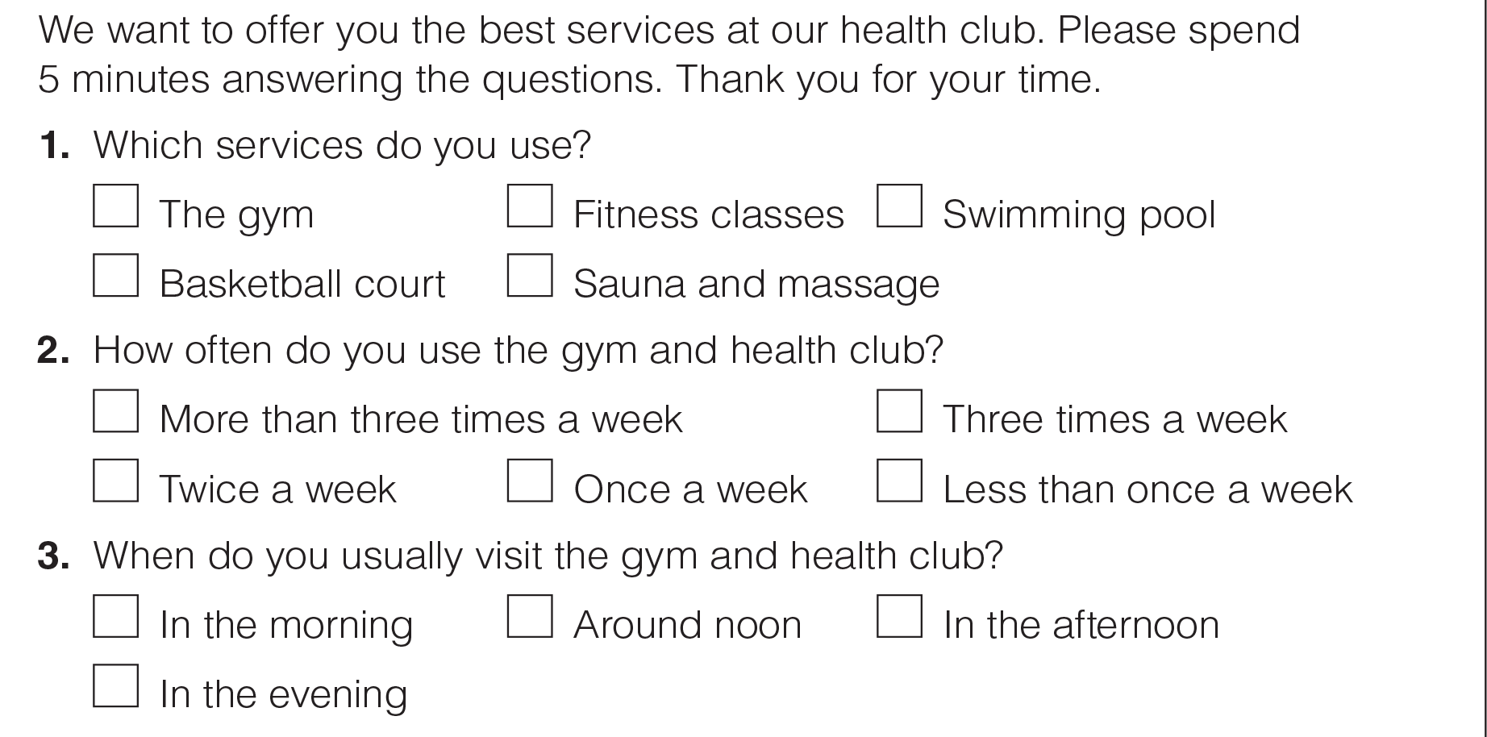
UNIT 5
SPORTS
COMMUNICATION
_______________________________________________________________________________________________________________________________________________________________________________________________________________________
National Geographic Learning, a Cengage Company. © 2022 Cengage Learning, Inc. ALL RIGHTS RESERVED. This presentation tool is for teaching purpose only. May not be scanned, copied or duplicated, or posted to a publicly accessible website, in whole or in part.

Slide 55
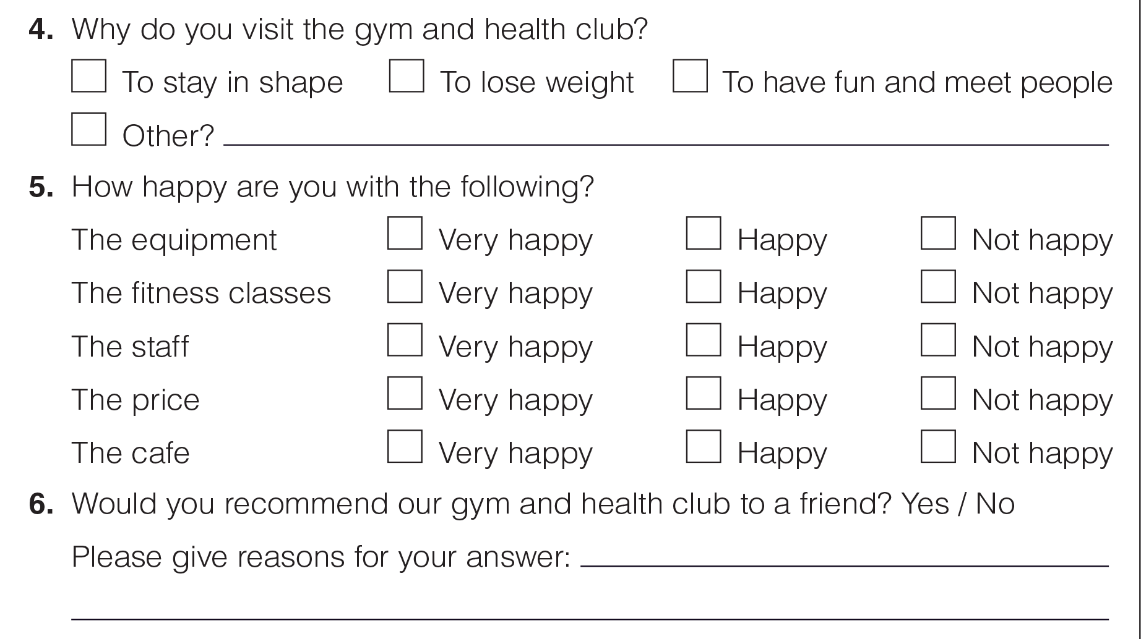
UNIT 5
SPORTS
COMMUNICATION
_______________________________________________________________________________________________________________________________________________________________________________________________________________________
National Geographic Learning, a Cengage Company. © 2022 Cengage Learning, Inc. ALL RIGHTS RESERVED. This presentation tool is for teaching purpose only. May not be scanned, copied or duplicated, or posted to a publicly accessible website, in whole or in part.

Slide 56
UNIT 5
SPORTS
COMMUNICATION
1. They want to offer them the best services.
2. They want to know what services customers use, when they use them, and why they use the club. They also want customers’ opinions on the club and to know if they would recommend them.
_______________________________________________________________________________________________________________________________________________________________________________________________________________________
National Geographic Learning, a Cengage Company. © 2022 Cengage Learning, Inc. ALL RIGHTS RESERVED. This presentation tool is for teaching purpose only. May not be scanned, copied or duplicated, or posted to a publicly accessible website, in whole or in part.

Slide 57

UNIT 5
SPORTS
COMMUNICATION
_______________________________________________________________________________________________________________________________________________________________________________________________________________________
National Geographic Learning, a Cengage Company. © 2022 Cengage Learning, Inc. ALL RIGHTS RESERVED. This presentation tool is for teaching purpose only. May not be scanned, copied or duplicated, or posted to a publicly accessible website, in whole or in part.

Slide 58

UNIT 5
SPORTS
WRITING
_______________________________________________________________________________________________________________________________________________________________________________________________________________________
National Geographic Learning, a Cengage Company. © 2022 Cengage Learning, Inc. ALL RIGHTS RESERVED. This presentation tool is for teaching purpose only. May not be scanned, copied or duplicated, or posted to a publicly accessible website, in whole or in part.

Slide 59
UNIT 5
SPORTS
WRITING
6
1, 2, 3, 4, 5
_______________________________________________________________________________________________________________________________________________________________________________________________________________________
National Geographic Learning, a Cengage Company. © 2022 Cengage Learning, Inc. ALL RIGHTS RESERVED. This presentation tool is for teaching purpose only. May not be scanned, copied or duplicated, or posted to a publicly accessible website, in whole or in part.

Slide 60

UNIT 5
SPORTS
WRITING
What
When / What time
Why
How often
How happy
Would
recommend
_______________________________________________________________________________________________________________________________________________________________________________________________________________________
National Geographic Learning, a Cengage Company. © 2022 Cengage Learning, Inc. ALL RIGHTS RESERVED. This presentation tool is for teaching purpose only. May not be scanned, copied or duplicated, or posted to a publicly accessible website, in whole or in part.

Slide 61

UNIT 5
SPORTS
GOAL CHECK
_______________________________________________________________________________________________________________________________________________________________________________________________________________________
National Geographic Learning, a Cengage Company. © 2022 Cengage Learning, Inc. ALL RIGHTS RESERVED. This presentation tool is for teaching purpose only. May not be scanned, copied or duplicated, or posted to a publicly accessible website, in whole or in part.

