Slide 1



Unit 6:
DESTINATIONS
_______________________________________________________________________________________________________________________________________________________________________________________________________________________
National Geographic Learning, a Cengage Company. © 2022 Cengage Learning, Inc. ALL RIGHTS RESERVED. This presentation tool is for teaching purpose only. May not be scanned, copied or duplicated, or posted to a publicly accessible website, in whole or in part.

Slide 2
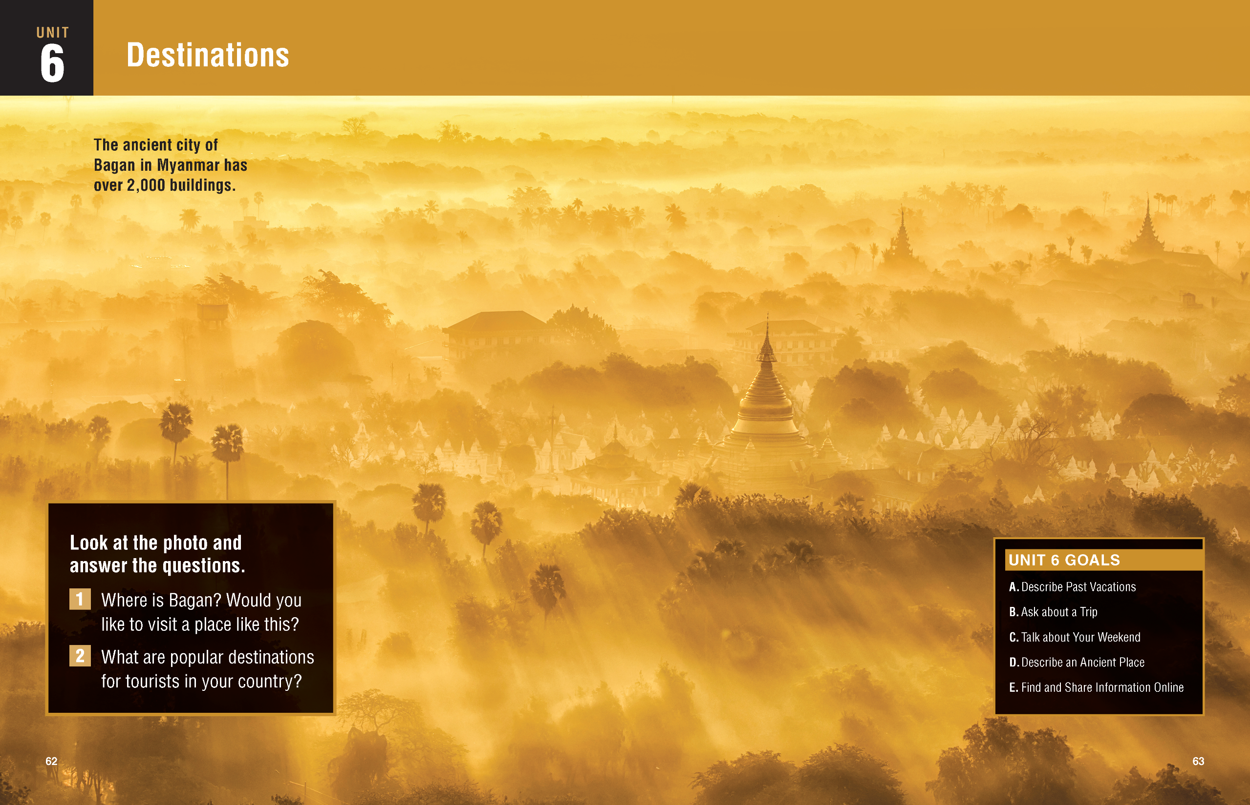

Slide 3
UNIT 6
DESTINATIONS
OVERVIEW
Do you know?
The World Travel Organization compiles reports on the countries most visited by international travelers. Among the top ten, we usually find France, the United States, Mexico, China, and Thailand.
_______________________________________________________________________________________________________________________________________________________________________________________________________________________
National Geographic Learning, a Cengage Company. © 2022 Cengage Learning, Inc. ALL RIGHTS RESERVED. This presentation tool is for teaching purpose only. May not be scanned, copied or duplicated, or posted to a publicly accessible website, in whole or in part.

Slide 4
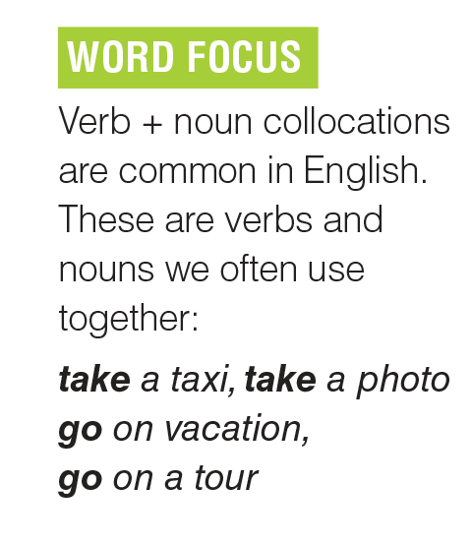
UNIT 6
DESTINATIONS
VOCABULARY
_______________________________________________________________________________________________________________________________________________________________________________________________________________________
National Geographic Learning, a Cengage Company. © 2022 Cengage Learning, Inc. ALL RIGHTS RESERVED. This presentation tool is for teaching purpose only. May not be scanned, copied or duplicated, or posted to a publicly accessible website, in whole or in part.

Slide 5
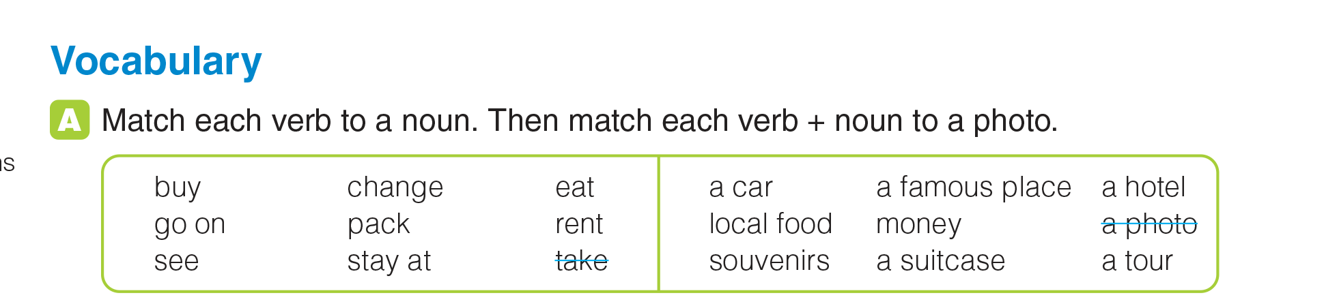
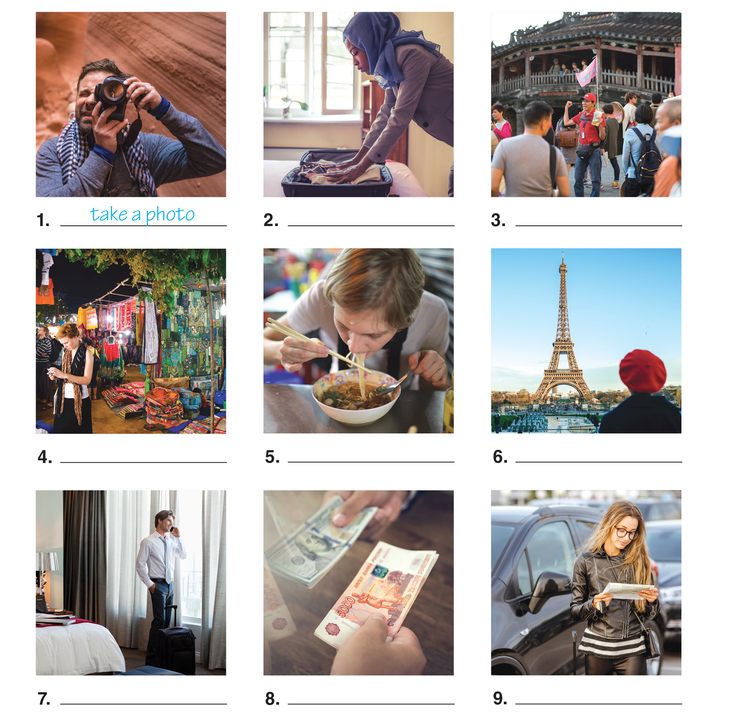
UNIT 6
DESTINATIONS
VOCABULARY
pack a suitcase
go on a tour
buy souvenirs
eat local food
see a famous place
stay at a hotel
change money
rent a car
_______________________________________________________________________________________________________________________________________________________________________________________________________________________
National Geographic Learning, a Cengage Company. © 2022 Cengage Learning, Inc. ALL RIGHTS RESERVED. This presentation tool is for teaching purpose only. May not be scanned, copied or duplicated, or posted to a publicly accessible website, in whole or in part.

Slide 6
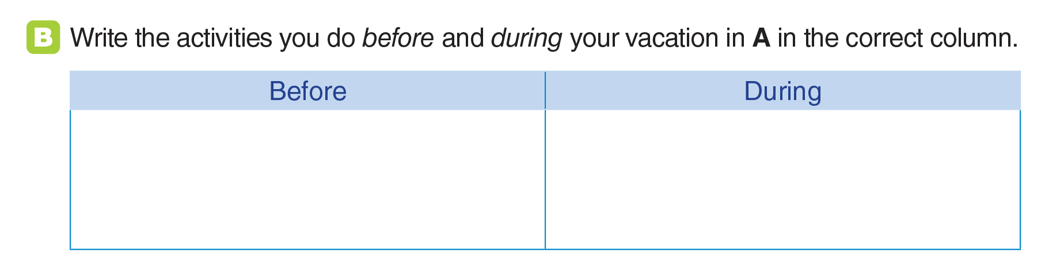
UNIT 6
DESTINATIONS
VOCABULARY
pack a suitcase
go on a tour
buy souvenirs
eat local food
see a famous place
stay at a hotel
change money
rent a car
take a photo
pack a suitcase
stay at a hotel
take a photo
rent a car
go on a tour
eat local food
change money
see a famous place
buy souvenirs
_______________________________________________________________________________________________________________________________________________________________________________________________________________________
National Geographic Learning, a Cengage Company. © 2022 Cengage Learning, Inc. ALL RIGHTS RESERVED. This presentation tool is for teaching purpose only. May not be scanned, copied or duplicated, or posted to a publicly accessible website, in whole or in part.

Slide 7
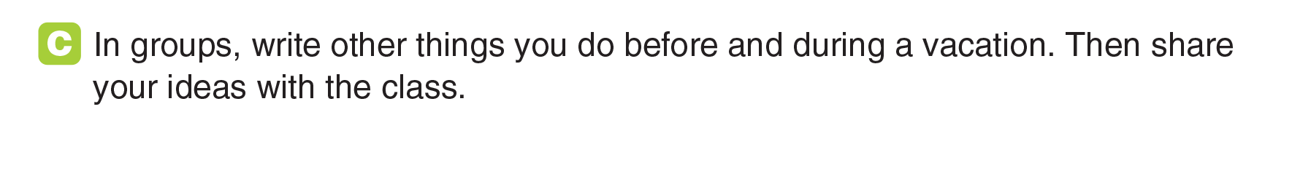
UNIT 6
DESTINATIONS
VOCABULARY
_______________________________________________________________________________________________________________________________________________________________________________________________________________________
National Geographic Learning, a Cengage Company. © 2022 Cengage Learning, Inc. ALL RIGHTS RESERVED. This presentation tool is for teaching purpose only. May not be scanned, copied or duplicated, or posted to a publicly accessible website, in whole or in part.

Slide 8
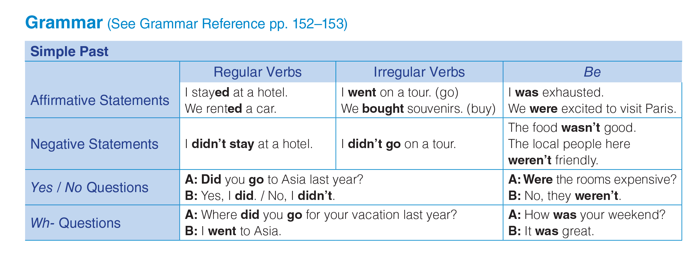
UNIT 6
DESTINATIONS
GRAMMAR
_______________________________________________________________________________________________________________________________________________________________________________________________________________________
National Geographic Learning, a Cengage Company. © 2022 Cengage Learning, Inc. ALL RIGHTS RESERVED. This presentation tool is for teaching purpose only. May not be scanned, copied or duplicated, or posted to a publicly accessible website, in whole or in part.

Slide 9
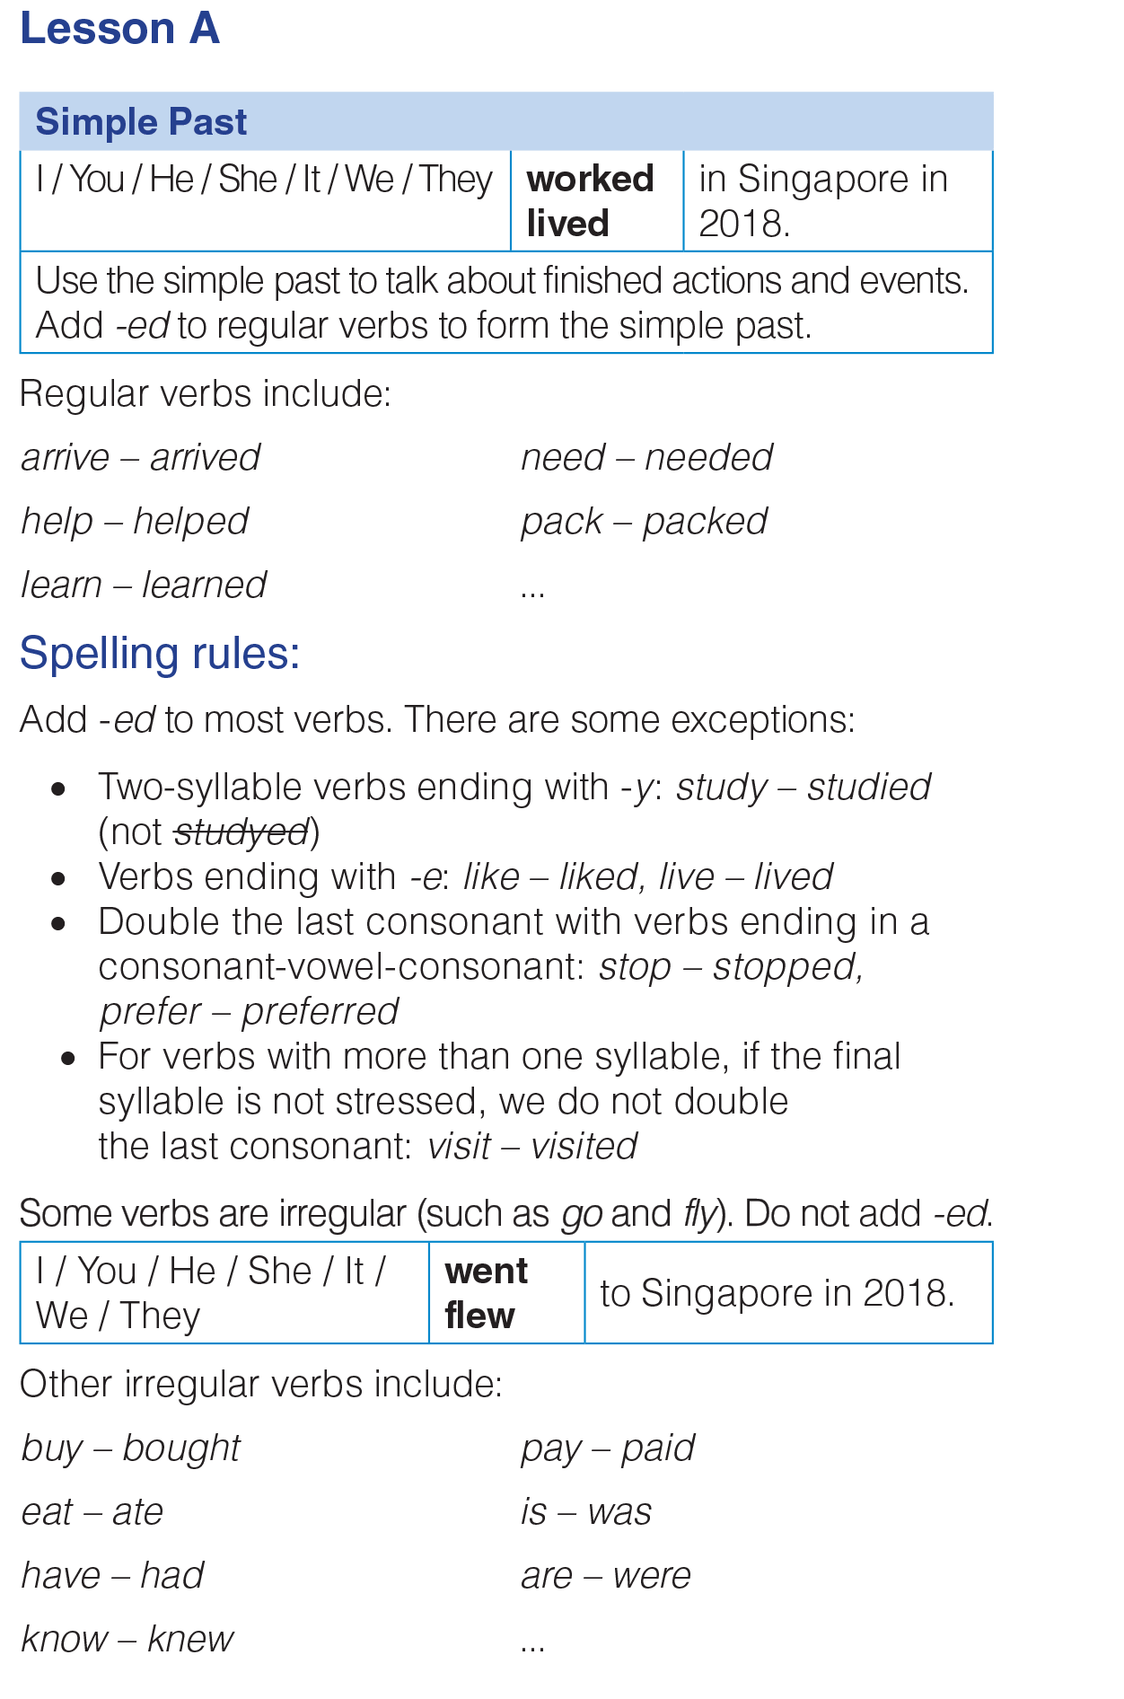
UNIT 6
DESTINATIONS
GRAMMAR
_______________________________________________________________________________________________________________________________________________________________________________________________________________________
National Geographic Learning, a Cengage Company. © 2022 Cengage Learning, Inc. ALL RIGHTS RESERVED. This presentation tool is for teaching purpose only. May not be scanned, copied or duplicated, or posted to a publicly accessible website, in whole or in part.

Slide 10
UNIT 6
DESTINATIONS
GRAMMAR
_______________________________________________________________________________________________________________________________________________________________________________________________________________________
National Geographic Learning, a Cengage Company. © 2022 Cengage Learning, Inc. ALL RIGHTS RESERVED. This presentation tool is for teaching purpose only. May not be scanned, copied or duplicated, or posted to a publicly accessible website, in whole or in part.

Slide 11
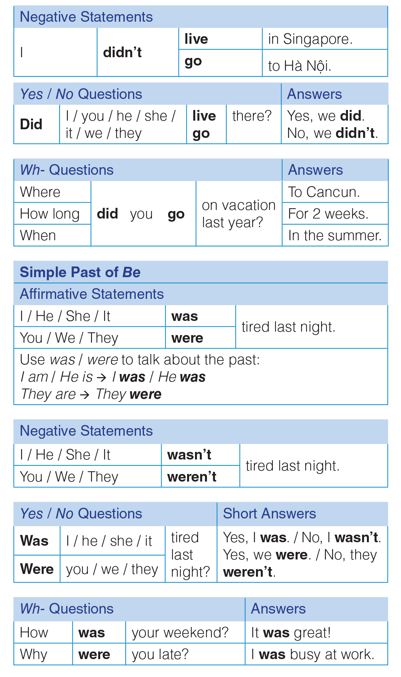
UNIT 6
DESTINATIONS
GRAMMAR
_______________________________________________________________________________________________________________________________________________________________________________________________________________________
National Geographic Learning, a Cengage Company. © 2022 Cengage Learning, Inc. ALL RIGHTS RESERVED. This presentation tool is for teaching purpose only. May not be scanned, copied or duplicated, or posted to a publicly accessible website, in whole or in part.

Slide 12
UNIT 6
DESTINATIONS
GRAMMAR
_______________________________________________________________________________________________________________________________________________________________________________________________________________________
National Geographic Learning, a Cengage Company. © 2022 Cengage Learning, Inc. ALL RIGHTS RESERVED. This presentation tool is for teaching purpose only. May not be scanned, copied or duplicated, or posted to a publicly accessible website, in whole or in part.

Slide 13
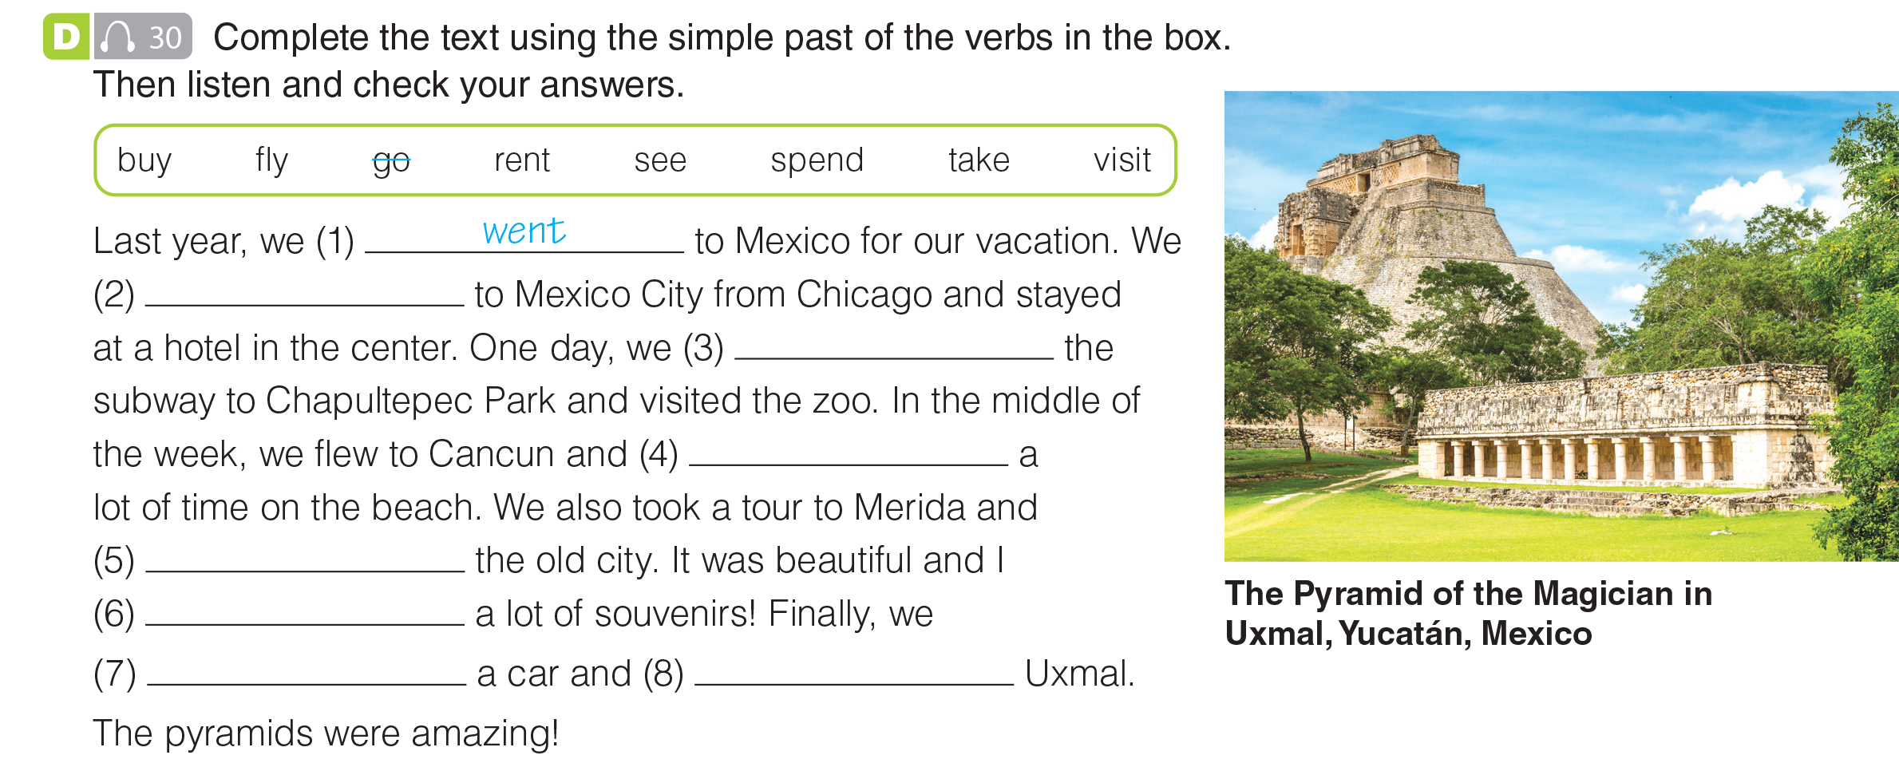

UNIT 6
DESTINATIONS
GRAMMAR
flew
took
spent
saw
bought
rented
visited
_______________________________________________________________________________________________________________________________________________________________________________________________________________________
National Geographic Learning, a Cengage Company. © 2022 Cengage Learning, Inc. ALL RIGHTS RESERVED. This presentation tool is for teaching purpose only. May not be scanned, copied or duplicated, or posted to a publicly accessible website, in whole or in part.

Slide 14
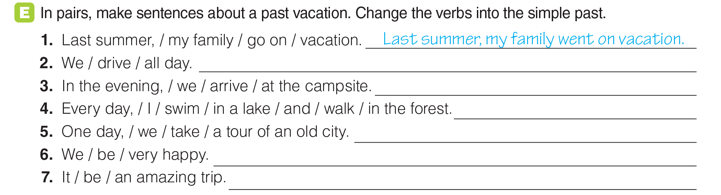
UNIT 6
DESTINATIONS
GRAMMAR
We drove all day.
In the evening, we arrived at the campsite.
Every day, I swam in a lake and walked in the forest.
One day, we took a tour of an old city.
We were very happy.
It was an amazing trip.
_______________________________________________________________________________________________________________________________________________________________________________________________________________________
National Geographic Learning, a Cengage Company. © 2022 Cengage Learning, Inc. ALL RIGHTS RESERVED. This presentation tool is for teaching purpose only. May not be scanned, copied or duplicated, or posted to a publicly accessible website, in whole or in part.

Slide 15
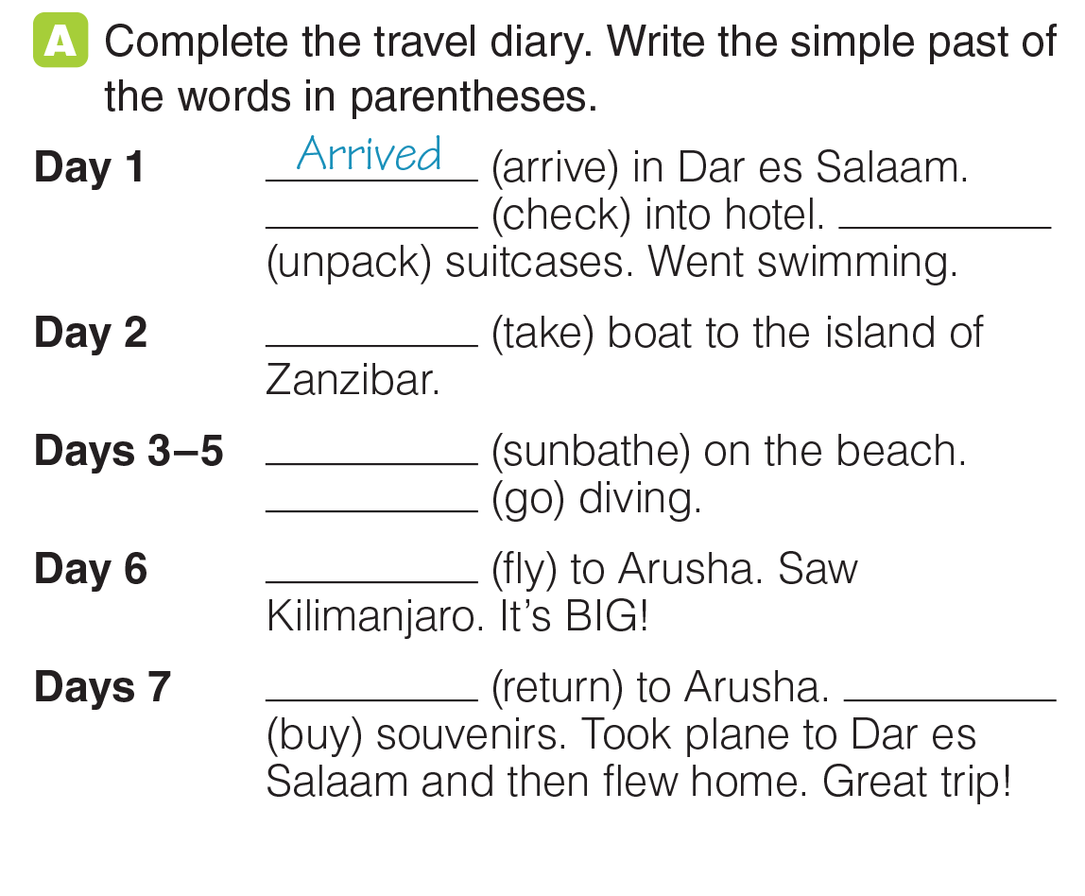
UNIT 6
DESTINATIONS
GRAMMAR
checked
Unpacked
Took
Sunbathed
Went
Flew
Returned
Bought
_______________________________________________________________________________________________________________________________________________________________________________________________________________________
National Geographic Learning, a Cengage Company. © 2022 Cengage Learning, Inc. ALL RIGHTS RESERVED. This presentation tool is for teaching purpose only. May not be scanned, copied or duplicated, or posted to a publicly accessible website, in whole or in part.

Slide 16
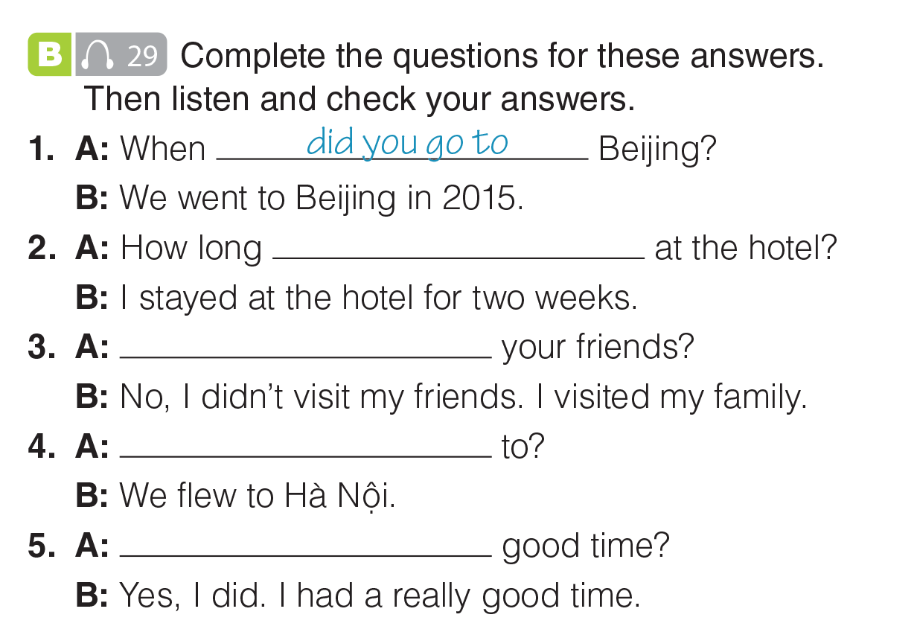
UNIT 6
DESTINATIONS
GRAMMAR
did you stay
Did you visit
Where did you fly
Did you have a
_______________________________________________________________________________________________________________________________________________________________________________________________________________________
National Geographic Learning, a Cengage Company. © 2022 Cengage Learning, Inc. ALL RIGHTS RESERVED. This presentation tool is for teaching purpose only. May not be scanned, copied or duplicated, or posted to a publicly accessible website, in whole or in part.

Slide 17
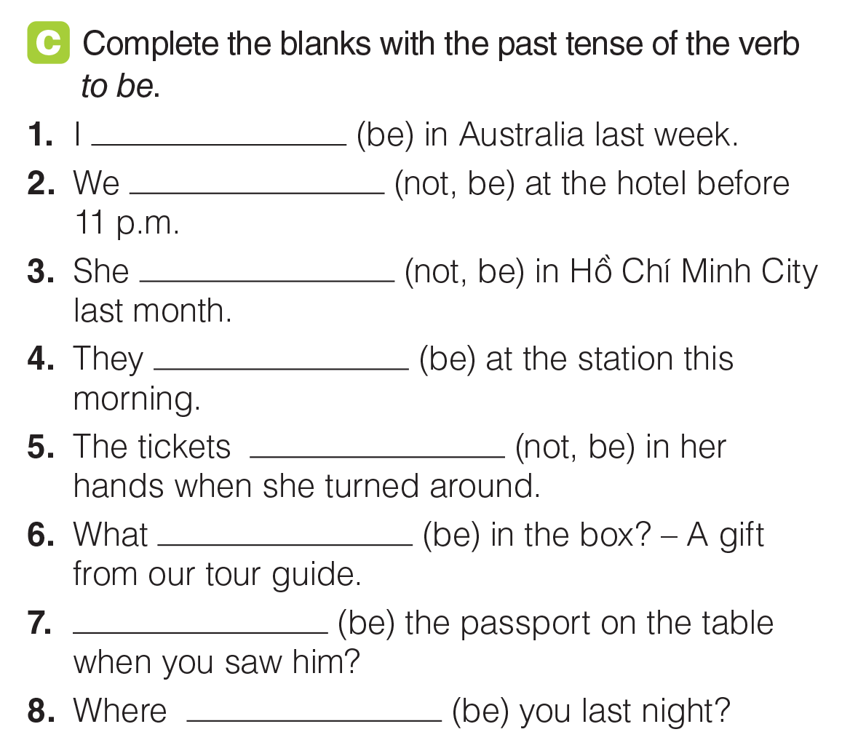
UNIT 6
DESTINATIONS
GRAMMAR
was
weren’t
wasn’t
were
weren’t
was
Was
were
_______________________________________________________________________________________________________________________________________________________________________________________________________________________
National Geographic Learning, a Cengage Company. © 2022 Cengage Learning, Inc. ALL RIGHTS RESERVED. This presentation tool is for teaching purpose only. May not be scanned, copied or duplicated, or posted to a publicly accessible website, in whole or in part.

Slide 18
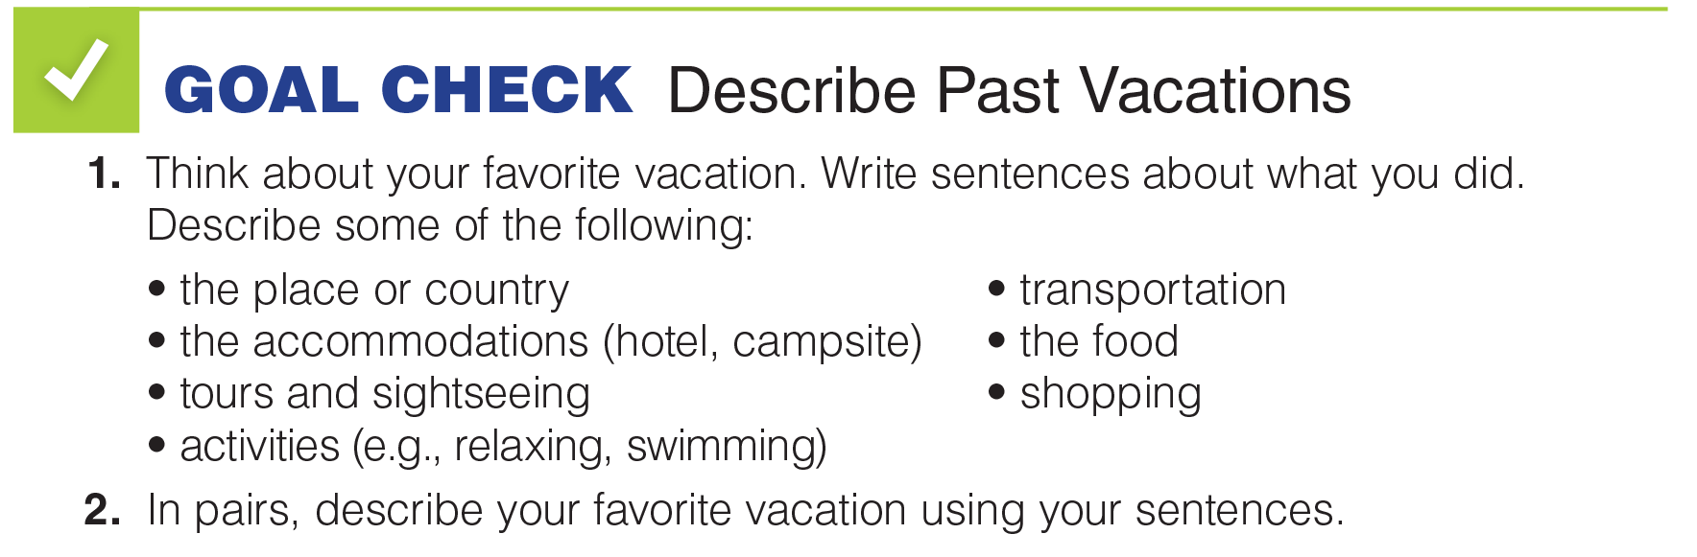
UNIT 6
DESTINATIONS
GOAL CHECK
_______________________________________________________________________________________________________________________________________________________________________________________________________________________
National Geographic Learning, a Cengage Company. © 2022 Cengage Learning, Inc. ALL RIGHTS RESERVED. This presentation tool is for teaching purpose only. May not be scanned, copied or duplicated, or posted to a publicly accessible website, in whole or in part.

Slide 19
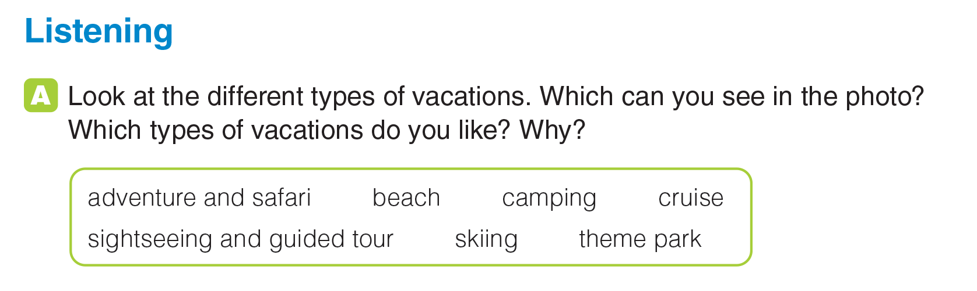
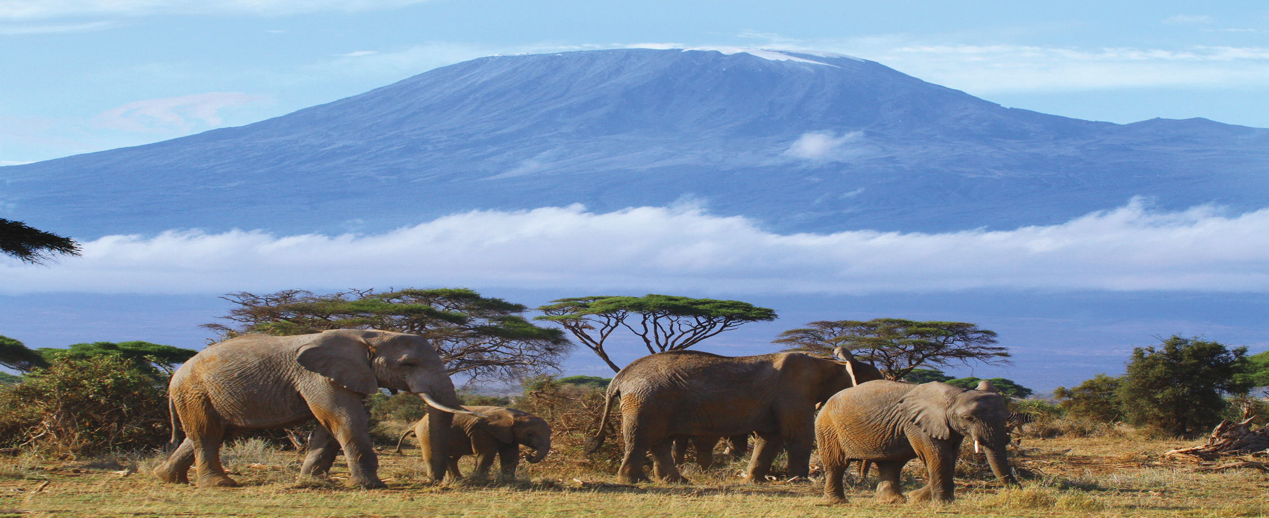
UNIT 6
DESTINATIONS
LISTENING
The photo shows an adventure and safari vacation.
_______________________________________________________________________________________________________________________________________________________________________________________________________________________
National Geographic Learning, a Cengage Company. © 2022 Cengage Learning, Inc. ALL RIGHTS RESERVED. This presentation tool is for teaching purpose only. May not be scanned, copied or duplicated, or posted to a publicly accessible website, in whole or in part.

Slide 20
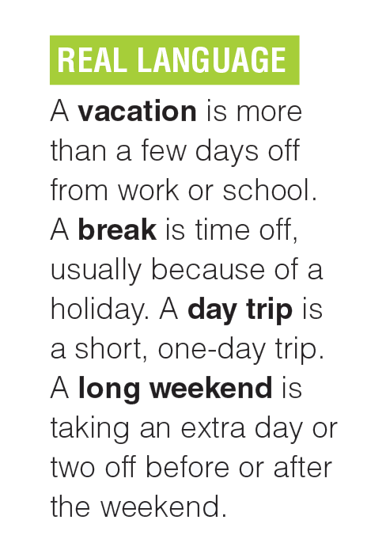
UNIT 6
DESTINATIONS
LISTENING
_______________________________________________________________________________________________________________________________________________________________________________________________________________________
National Geographic Learning, a Cengage Company. © 2022 Cengage Learning, Inc. ALL RIGHTS RESERVED. This presentation tool is for teaching purpose only. May not be scanned, copied or duplicated, or posted to a publicly accessible website, in whole or in part.

Slide 21

UNIT 6
DESTINATIONS
LISTENING
adventure and safari
theme park
_______________________________________________________________________________________________________________________________________________________________________________________________________________________
National Geographic Learning, a Cengage Company. © 2022 Cengage Learning, Inc. ALL RIGHTS RESERVED. This presentation tool is for teaching purpose only. May not be scanned, copied or duplicated, or posted to a publicly accessible website, in whole or in part.

Slide 22
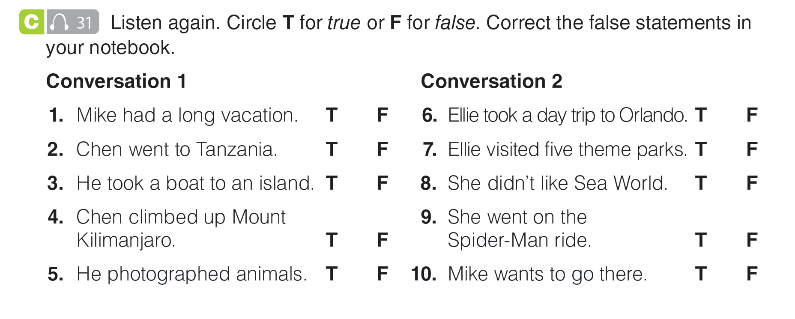
UNIT 6
DESTINATIONS
LISTENING
Chen had a long vacation.
She took a long weekend to Orlando.
She visited three theme parks.
He saw Mount Kilimanjaro.
She didn’t go on the Spider-Man ride.
_______________________________________________________________________________________________________________________________________________________________________________________________________________________
National Geographic Learning, a Cengage Company. © 2022 Cengage Learning, Inc. ALL RIGHTS RESERVED. This presentation tool is for teaching purpose only. May not be scanned, copied or duplicated, or posted to a publicly accessible website, in whole or in part.

Slide 23
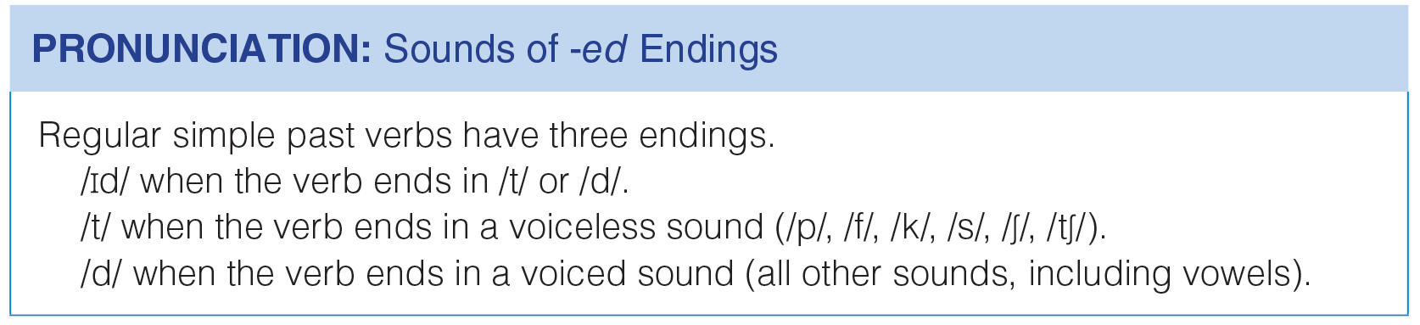
UNIT 6
DESTINATIONS
PRONUNCIATION
_______________________________________________________________________________________________________________________________________________________________________________________________________________________
National Geographic Learning, a Cengage Company. © 2022 Cengage Learning, Inc. ALL RIGHTS RESERVED. This presentation tool is for teaching purpose only. May not be scanned, copied or duplicated, or posted to a publicly accessible website, in whole or in part.

Slide 24
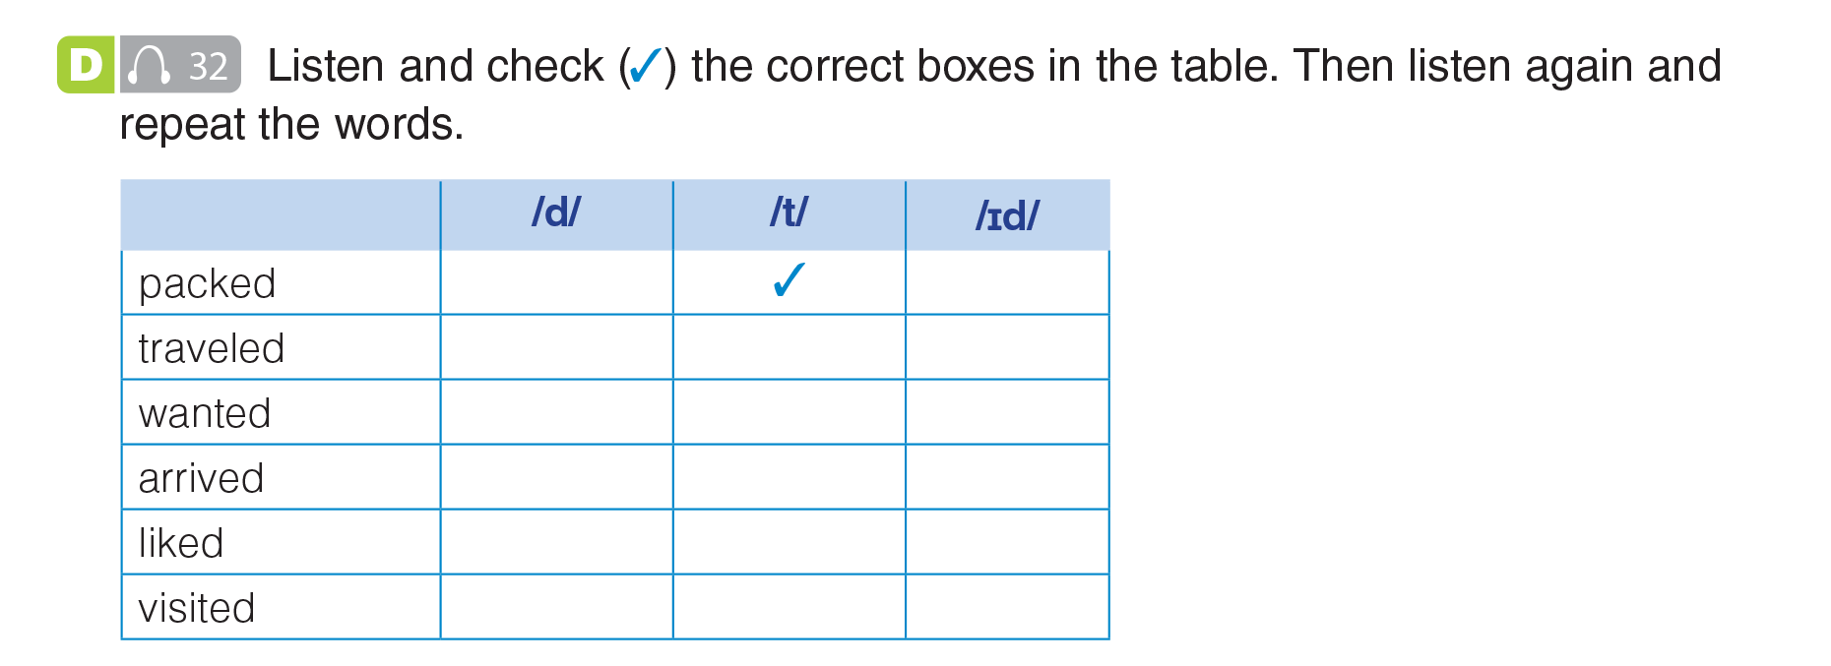
UNIT 6
DESTINATIONS
PRONUNCIATION
✓
✓
✓
✓
✓
_______________________________________________________________________________________________________________________________________________________________________________________________________________________
National Geographic Learning, a Cengage Company. © 2022 Cengage Learning, Inc. ALL RIGHTS RESERVED. This presentation tool is for teaching purpose only. May not be scanned, copied or duplicated, or posted to a publicly accessible website, in whole or in part.

Slide 25
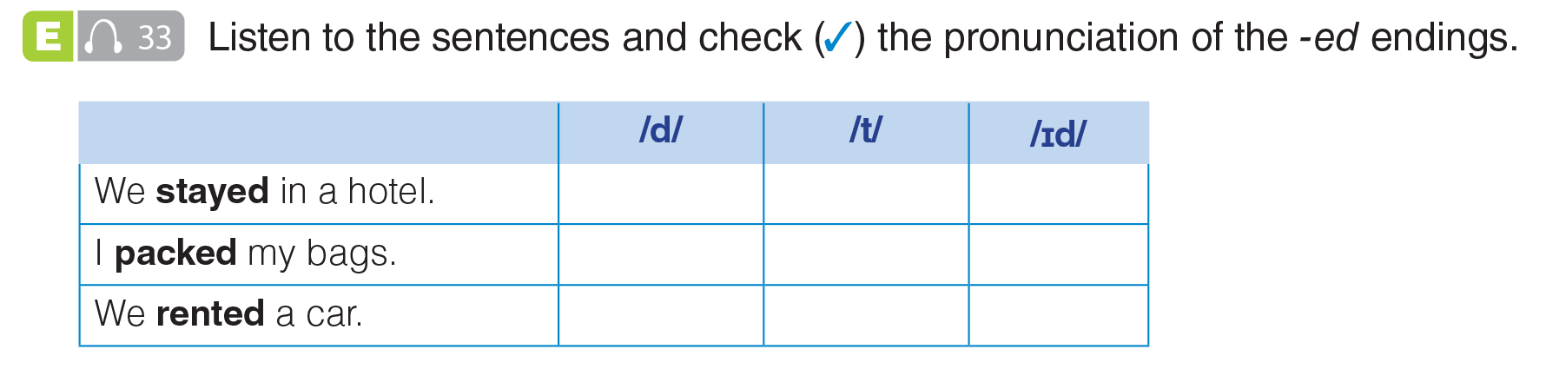
UNIT 6
DESTINATIONS
PRONUNCIATION
✓
✓
✓
_______________________________________________________________________________________________________________________________________________________________________________________________________________________
National Geographic Learning, a Cengage Company. © 2022 Cengage Learning, Inc. ALL RIGHTS RESERVED. This presentation tool is for teaching purpose only. May not be scanned, copied or duplicated, or posted to a publicly accessible website, in whole or in part.

Slide 26
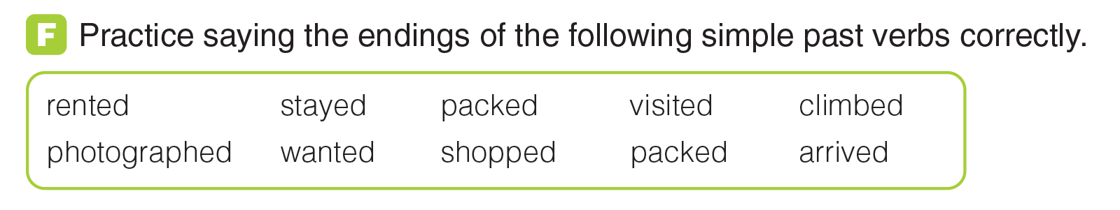
UNIT 6
DESTINATIONS
PRONUNCIATION
_______________________________________________________________________________________________________________________________________________________________________________________________________________________
National Geographic Learning, a Cengage Company. © 2022 Cengage Learning, Inc. ALL RIGHTS RESERVED. This presentation tool is for teaching purpose only. May not be scanned, copied or duplicated, or posted to a publicly accessible website, in whole or in part.

Slide 27
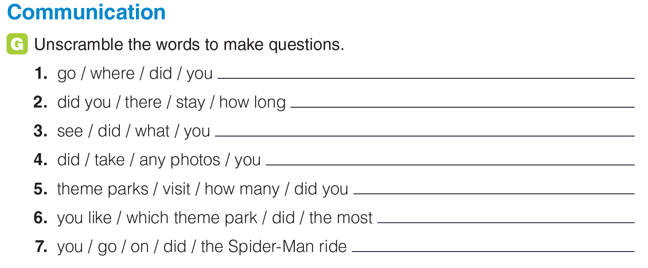
UNIT 6
DESTINATIONS
COMMUNICATION
Where did you go?
How long did you stay there?
What did you see?
Did you take any photos?
How many theme parks did you visit?
Which theme park did you like the most?
Did you go on the Spider-Man ride?
_______________________________________________________________________________________________________________________________________________________________________________________________________________________
National Geographic Learning, a Cengage Company. © 2022 Cengage Learning, Inc. ALL RIGHTS RESERVED. This presentation tool is for teaching purpose only. May not be scanned, copied or duplicated, or posted to a publicly accessible website, in whole or in part.

Slide 28
UNIT 6
DESTINATIONS
COMMUNICATION
Where did you go?
How long did you stay there?
What did you see?
Did you take any photos?
How many theme parks did you visit?
Which theme park did you like the most?
Did you go on the Spider-Man ride?
_______________________________________________________________________________________________________________________________________________________________________________________________________________________
National Geographic Learning, a Cengage Company. © 2022 Cengage Learning, Inc. ALL RIGHTS RESERVED. This presentation tool is for teaching purpose only. May not be scanned, copied or duplicated, or posted to a publicly accessible website, in whole or in part.

Slide 29
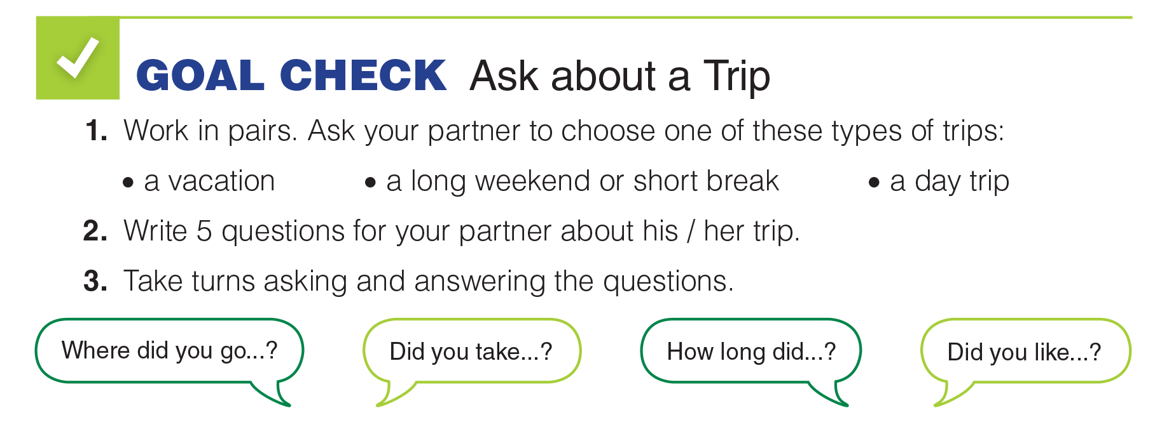
UNIT 6
DESTINATIONS
GOAL CHECK
_______________________________________________________________________________________________________________________________________________________________________________________________________________________
National Geographic Learning, a Cengage Company. © 2022 Cengage Learning, Inc. ALL RIGHTS RESERVED. This presentation tool is for teaching purpose only. May not be scanned, copied or duplicated, or posted to a publicly accessible website, in whole or in part.

Slide 30
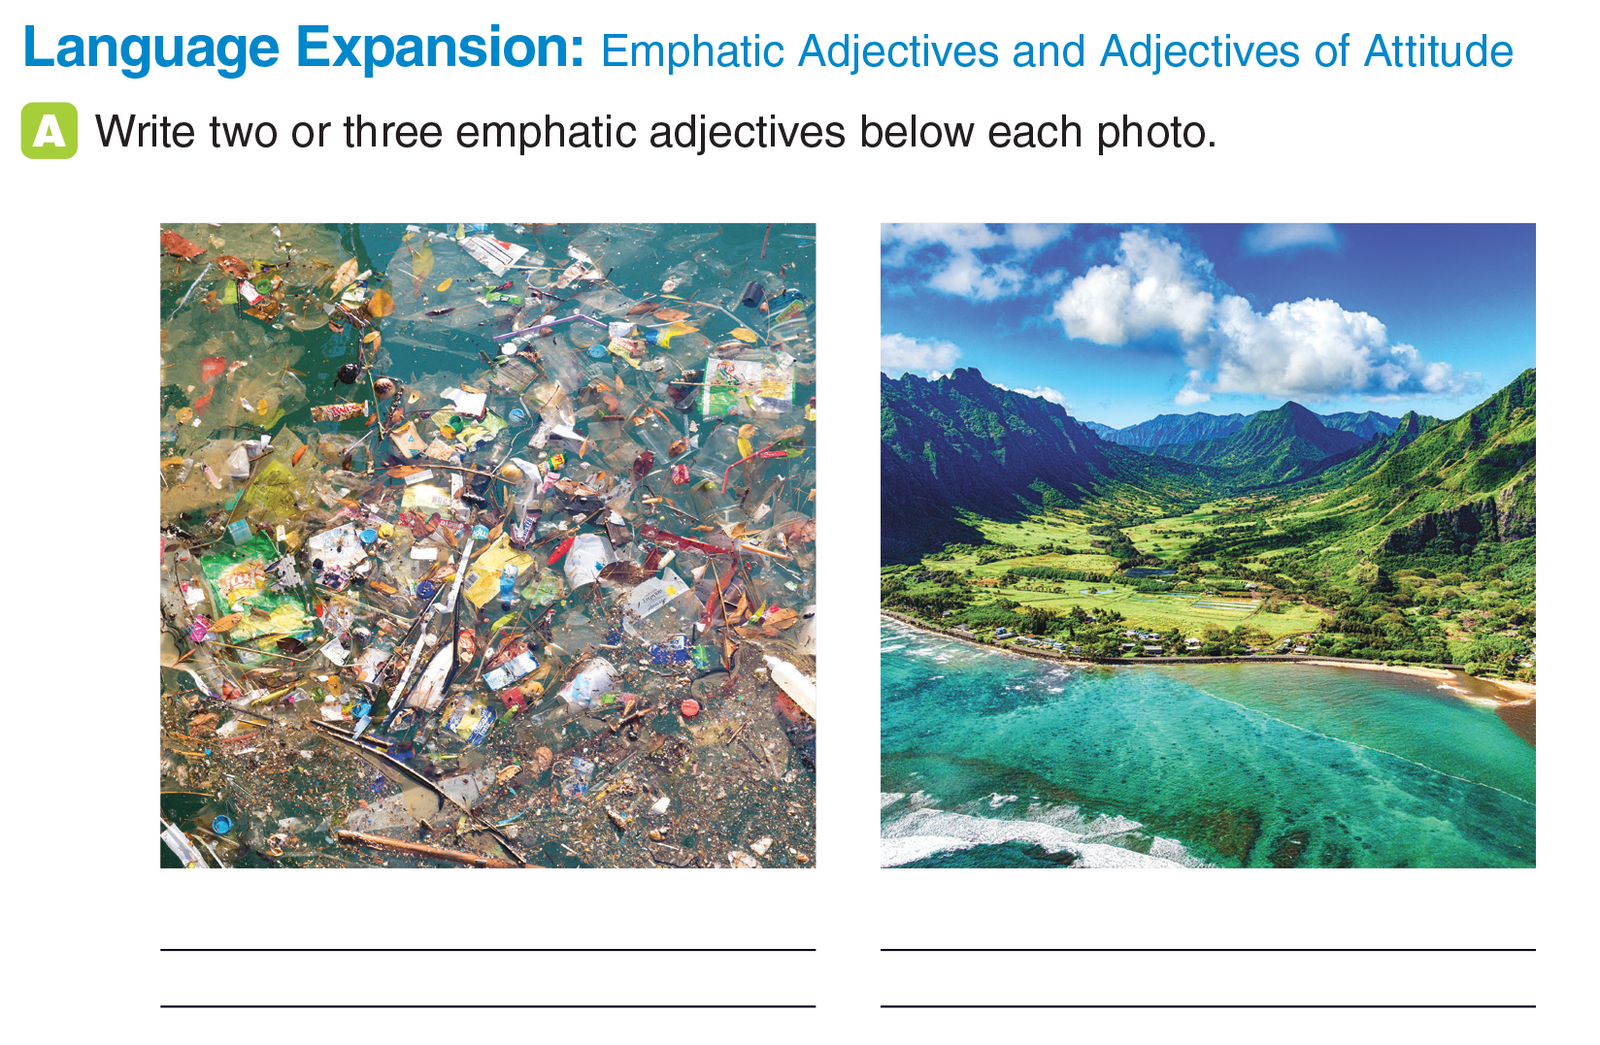
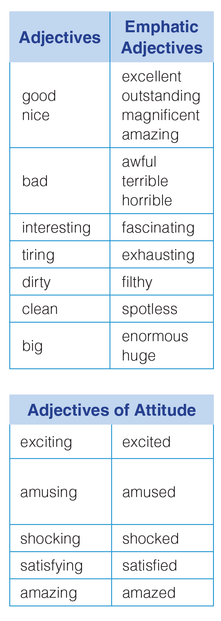
UNIT 6
DESTINATIONS
LANGUAGE EXPANSION
_______________________________________________________________________________________________________________________________________________________________________________________________________________________
National Geographic Learning, a Cengage Company. © 2022 Cengage Learning, Inc. ALL RIGHTS RESERVED. This presentation tool is for teaching purpose only. May not be scanned, copied or duplicated, or posted to a publicly accessible website, in whole or in part.

Slide 31
UNIT 6
DESTINATIONS
LANGUAGE EXPANSION
filthy, shocking, awful
(Answers will vary)
spotless, amazing, magnificent (Answers will vary)
_______________________________________________________________________________________________________________________________________________________________________________________________________________________
National Geographic Learning, a Cengage Company. © 2022 Cengage Learning, Inc. ALL RIGHTS RESERVED. This presentation tool is for teaching purpose only. May not be scanned, copied or duplicated, or posted to a publicly accessible website, in whole or in part.

Slide 32
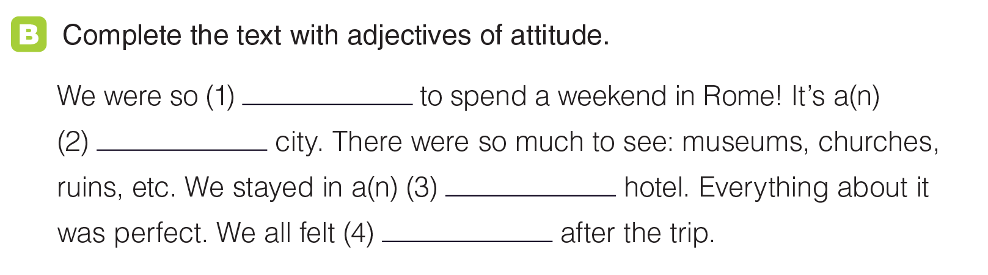
UNIT 6
DESTINATIONS
LANGUAGE EXPANSION
(Answers will vary)
excited
exciting
amazing
satisfied
_______________________________________________________________________________________________________________________________________________________________________________________________________________________
National Geographic Learning, a Cengage Company. © 2022 Cengage Learning, Inc. ALL RIGHTS RESERVED. This presentation tool is for teaching purpose only. May not be scanned, copied or duplicated, or posted to a publicly accessible website, in whole or in part.

Slide 33
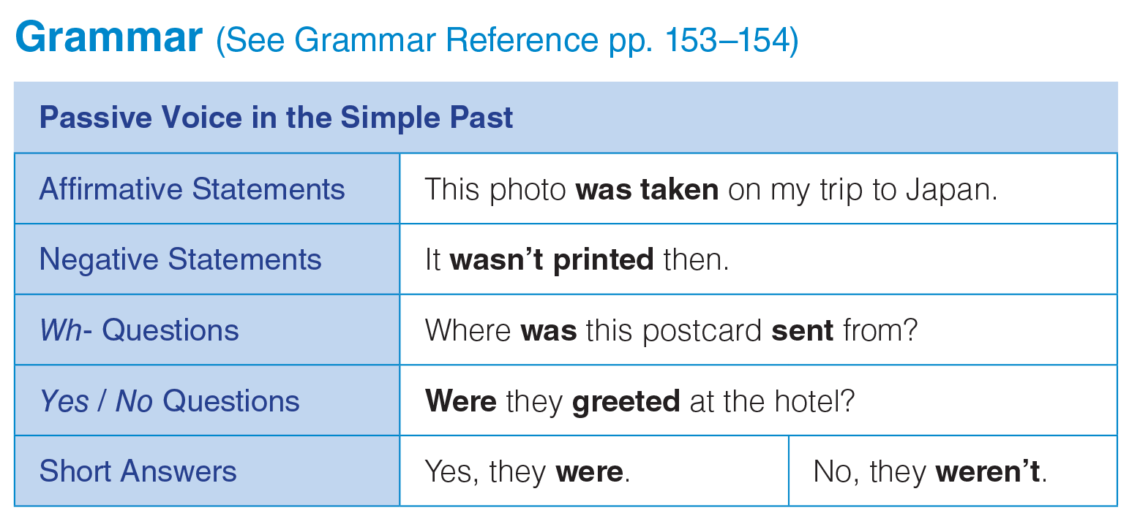
UNIT 6
DESTINATIONS
GRAMMAR
_______________________________________________________________________________________________________________________________________________________________________________________________________________________
National Geographic Learning, a Cengage Company. © 2022 Cengage Learning, Inc. ALL RIGHTS RESERVED. This presentation tool is for teaching purpose only. May not be scanned, copied or duplicated, or posted to a publicly accessible website, in whole or in part.

Slide 34
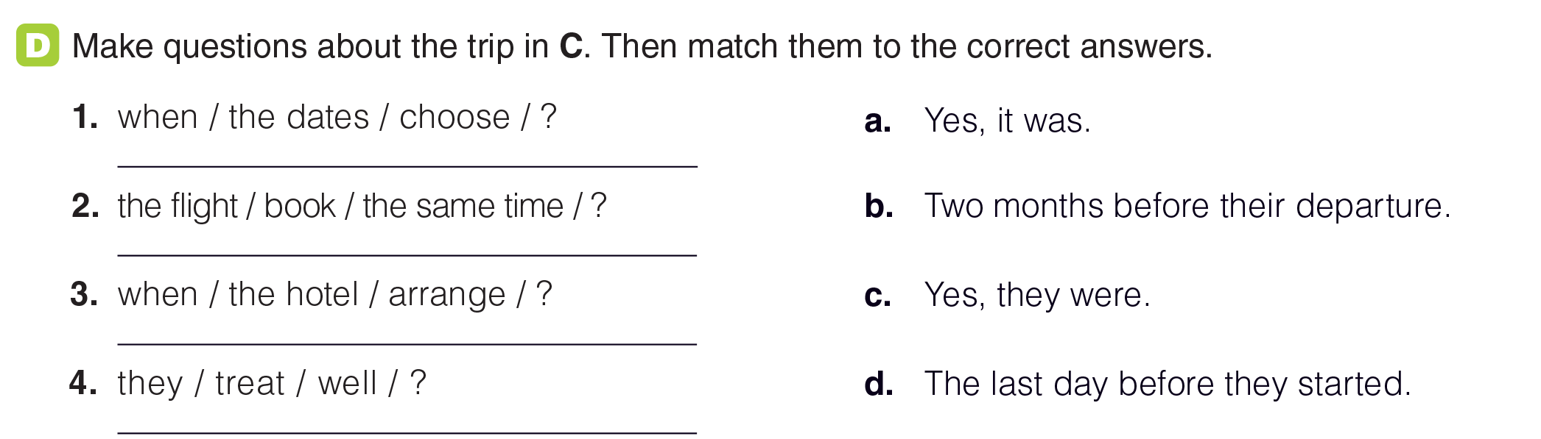
UNIT 6
DESTINATIONS
GRAMMAR
When were the dates chosen?
b
Was the flight booked at the same time?
a
When was the hotel arranged?
d
Were they treated well?
c
_______________________________________________________________________________________________________________________________________________________________________________________________________________________
National Geographic Learning, a Cengage Company. © 2022 Cengage Learning, Inc. ALL RIGHTS RESERVED. This presentation tool is for teaching purpose only. May not be scanned, copied or duplicated, or posted to a publicly accessible website, in whole or in part.

Slide 35
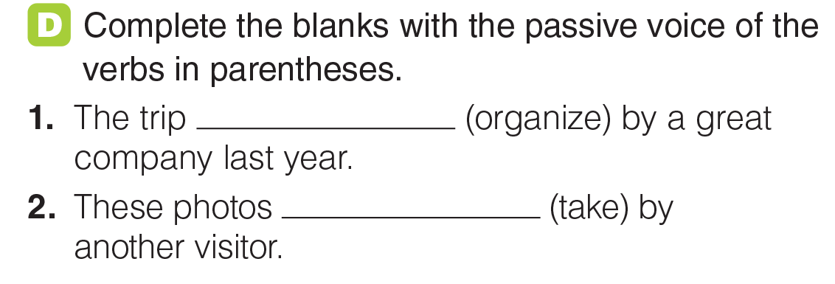
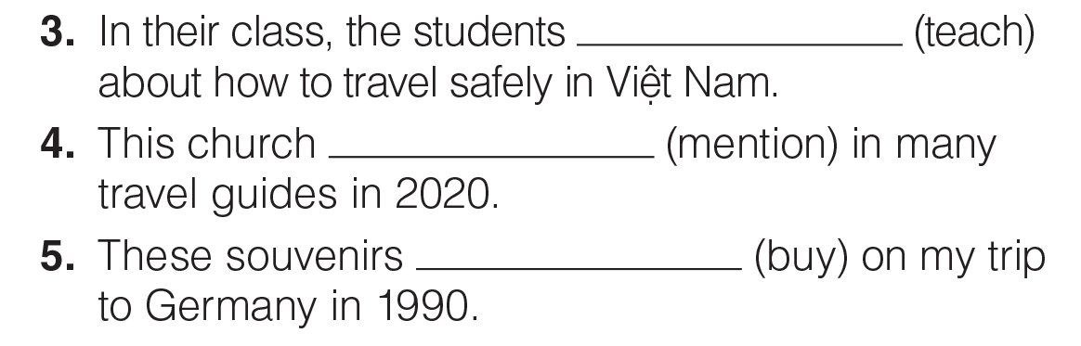
UNIT 6
DESTINATIONS
GRAMMAR
was organized
were taken
were taught
was mentioned
were bought
_______________________________________________________________________________________________________________________________________________________________________________________________________________________
National Geographic Learning, a Cengage Company. © 2022 Cengage Learning, Inc. ALL RIGHTS RESERVED. This presentation tool is for teaching purpose only. May not be scanned, copied or duplicated, or posted to a publicly accessible website, in whole or in part.

Slide 36
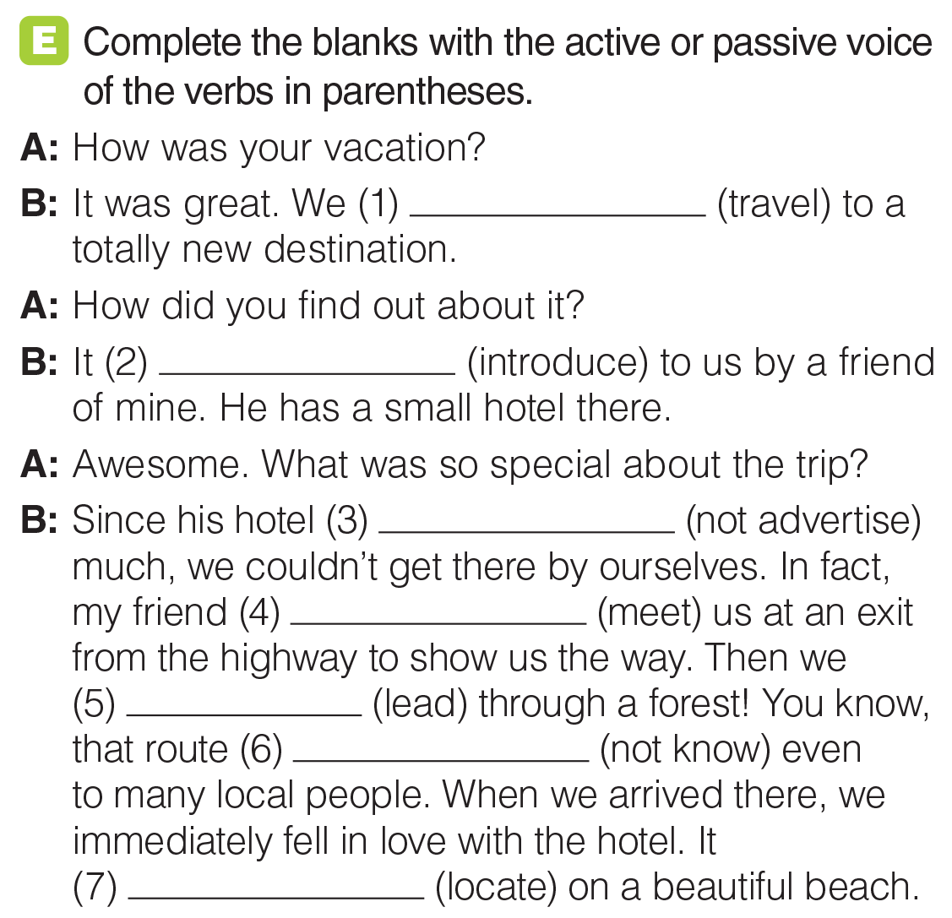
UNIT 6
DESTINATIONS
GRAMMAR
wasn’t advertised
traveled
met
were led
was introduced
wasn’t known
was located
_______________________________________________________________________________________________________________________________________________________________________________________________________________________
National Geographic Learning, a Cengage Company. © 2022 Cengage Learning, Inc. ALL RIGHTS RESERVED. This presentation tool is for teaching purpose only. May not be scanned, copied or duplicated, or posted to a publicly accessible website, in whole or in part.

Slide 37
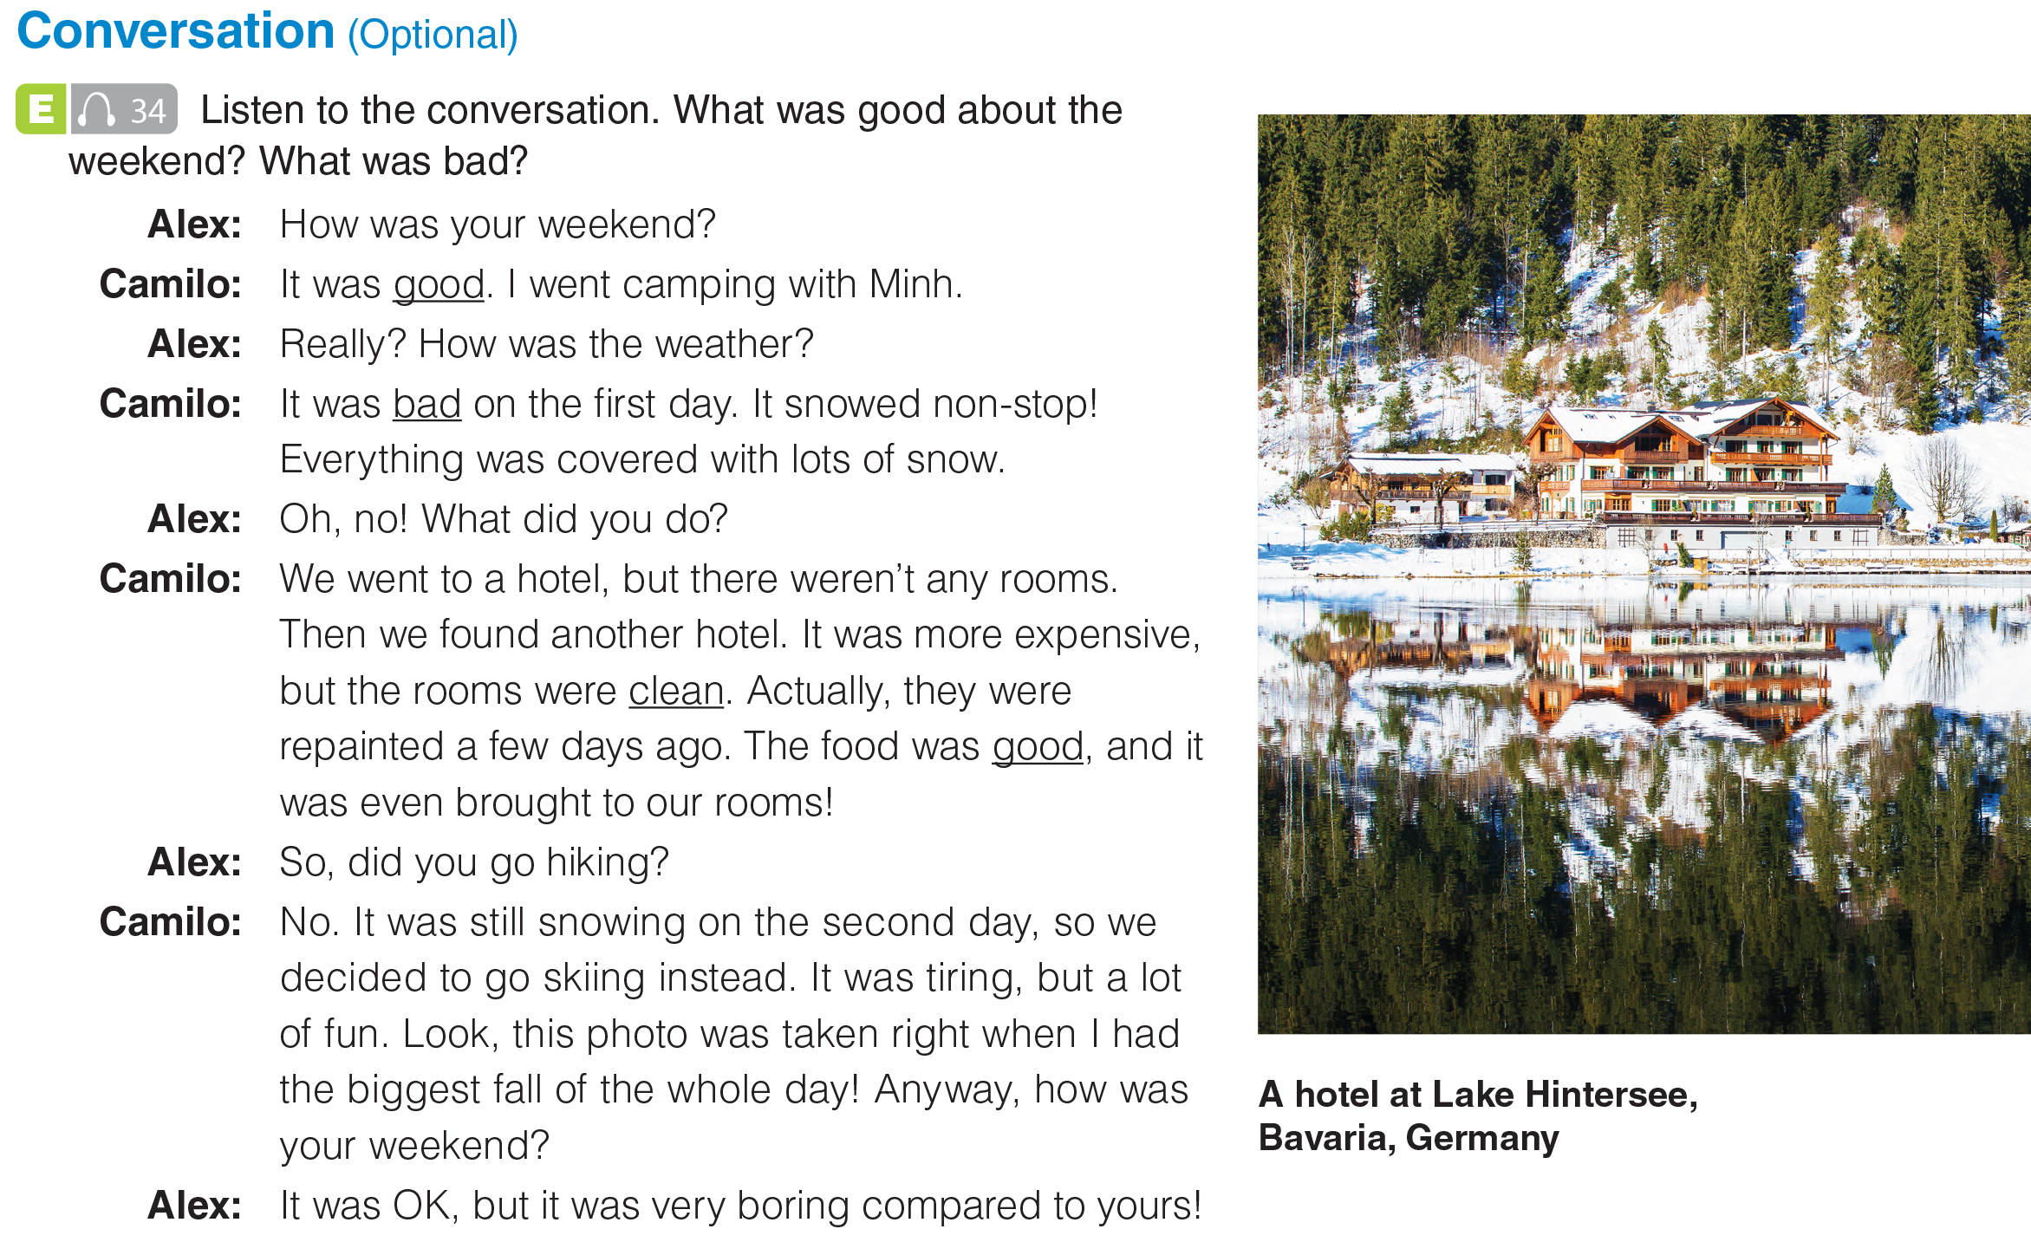
UNIT 6
DESTINATIONS
CONVERSATION
Good: the second hotel, food, skiing;
Bad: weather on first day, no rooms
at the first hotel
_______________________________________________________________________________________________________________________________________________________________________________________________________________________
National Geographic Learning, a Cengage Company. © 2022 Cengage Learning, Inc. ALL RIGHTS RESERVED. This presentation tool is for teaching purpose only. May not be scanned, copied or duplicated, or posted to a publicly accessible website, in whole or in part.

Slide 38
UNIT 6
DESTINATIONS
CONVERSATION
_______________________________________________________________________________________________________________________________________________________________________________________________________________________
National Geographic Learning, a Cengage Company. © 2022 Cengage Learning, Inc. ALL RIGHTS RESERVED. This presentation tool is for teaching purpose only. May not be scanned, copied or duplicated, or posted to a publicly accessible website, in whole or in part.

Slide 39
UNIT 6
DESTINATIONS
CONVERSATION
_______________________________________________________________________________________________________________________________________________________________________________________________________________________
National Geographic Learning, a Cengage Company. © 2022 Cengage Learning, Inc. ALL RIGHTS RESERVED. This presentation tool is for teaching purpose only. May not be scanned, copied or duplicated, or posted to a publicly accessible website, in whole or in part.

Slide 40
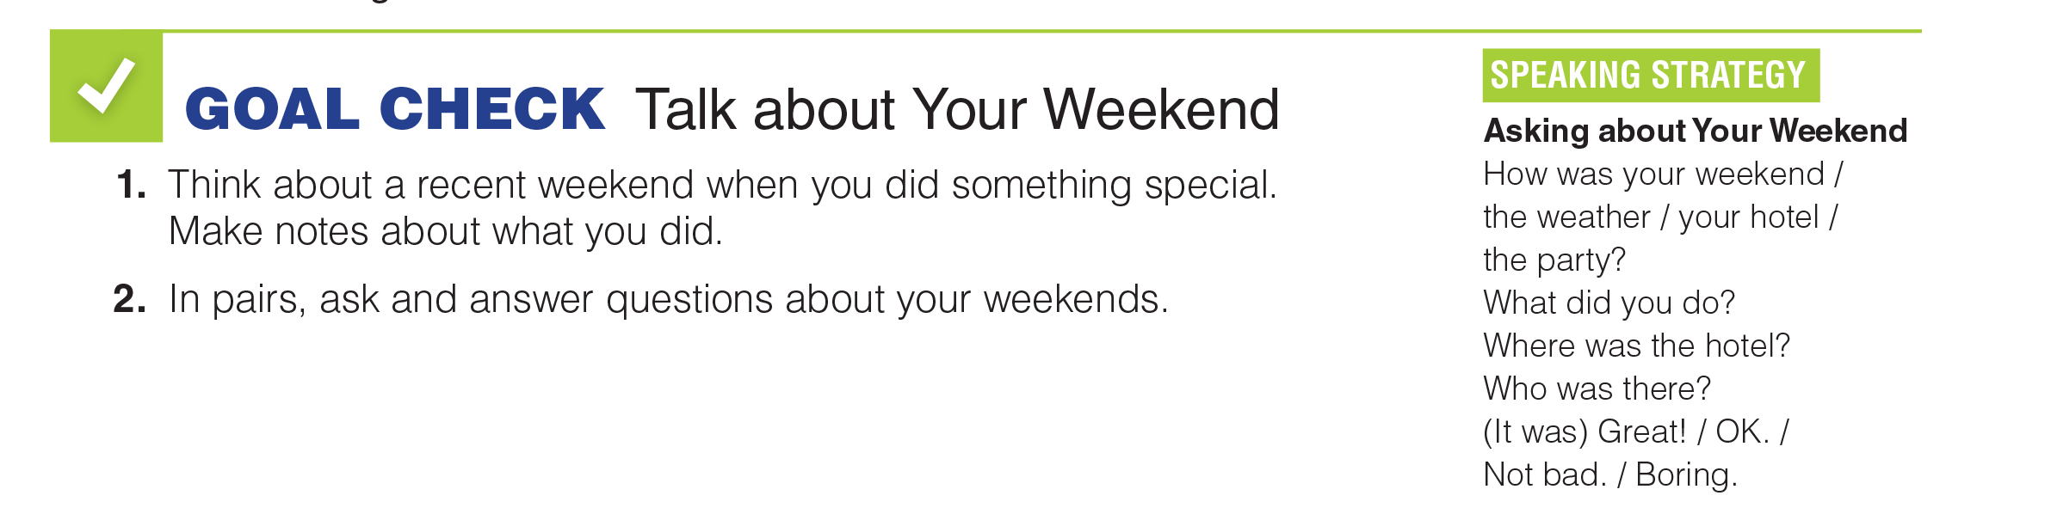
UNIT 6
DESTINATIONS
GOAL CHECK
_______________________________________________________________________________________________________________________________________________________________________________________________________________________
National Geographic Learning, a Cengage Company. © 2022 Cengage Learning, Inc. ALL RIGHTS RESERVED. This presentation tool is for teaching purpose only. May not be scanned, copied or duplicated, or posted to a publicly accessible website, in whole or in part.

Slide 41
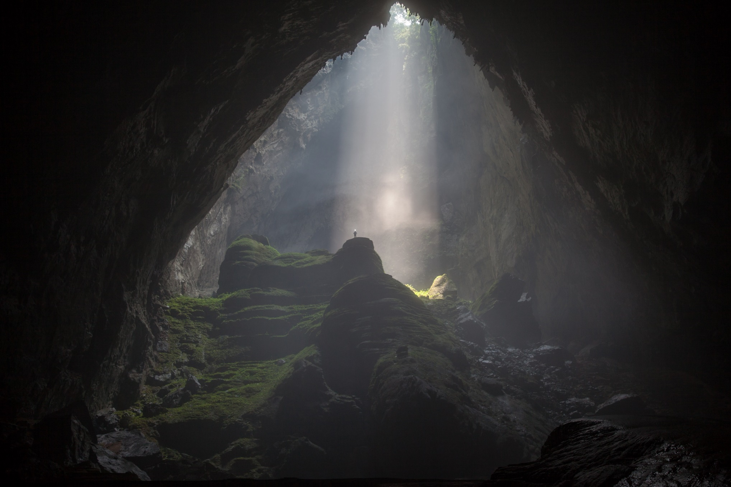
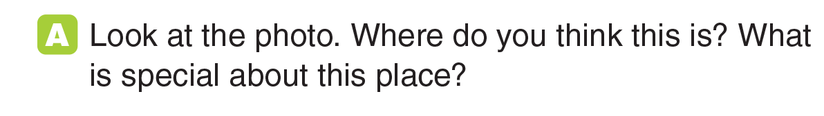
UNIT 6
DESTINATIONS
READING
Phong Nha–Kẻ Bàng National Park
_______________________________________________________________________________________________________________________________________________________________________________________________________________________
National Geographic Learning, a Cengage Company. © 2022 Cengage Learning, Inc. ALL RIGHTS RESERVED. This presentation tool is for teaching purpose only. May not be scanned, copied or duplicated, or posted to a publicly accessible website, in whole or in part.

Slide 42

UNIT 6
DESTINATIONS
READING
_______________________________________________________________________________________________________________________________________________________________________________________________________________________
National Geographic Learning, a Cengage Company. © 2022 Cengage Learning, Inc. ALL RIGHTS RESERVED. This presentation tool is for teaching purpose only. May not be scanned, copied or duplicated, or posted to a publicly accessible website, in whole or in part.

Slide 43
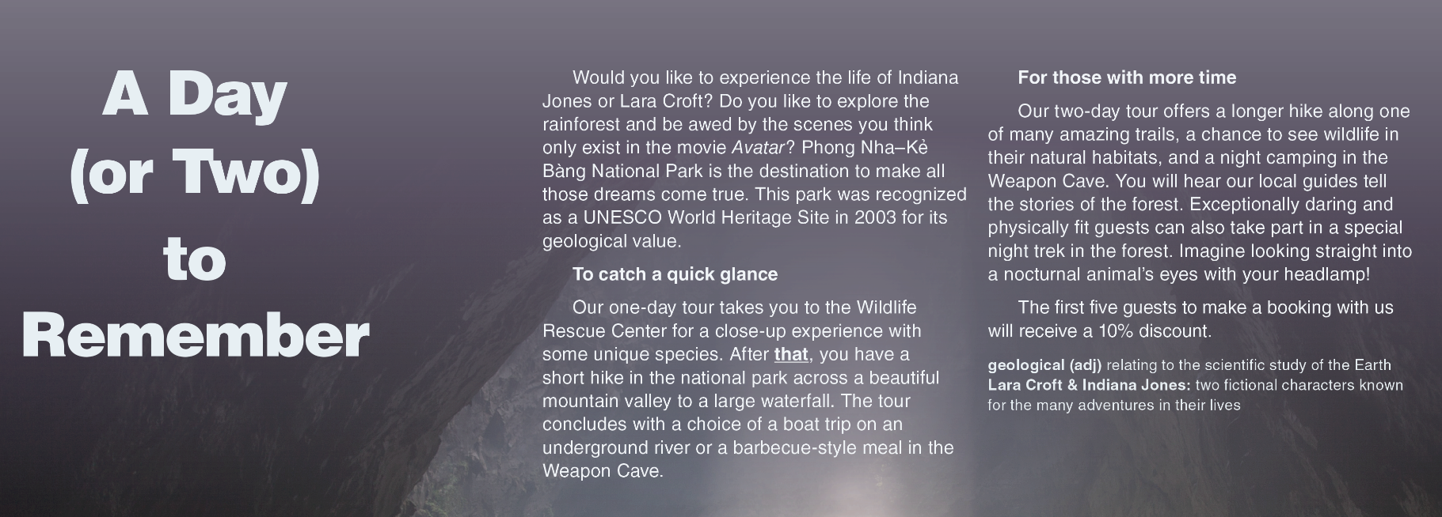
UNIT 6
DESTINATIONS
READING
_______________________________________________________________________________________________________________________________________________________________________________________________________________________
National Geographic Learning, a Cengage Company. © 2022 Cengage Learning, Inc. ALL RIGHTS RESERVED. This presentation tool is for teaching purpose only. May not be scanned, copied or duplicated, or posted to a publicly accessible website, in whole or in part.

Slide 44
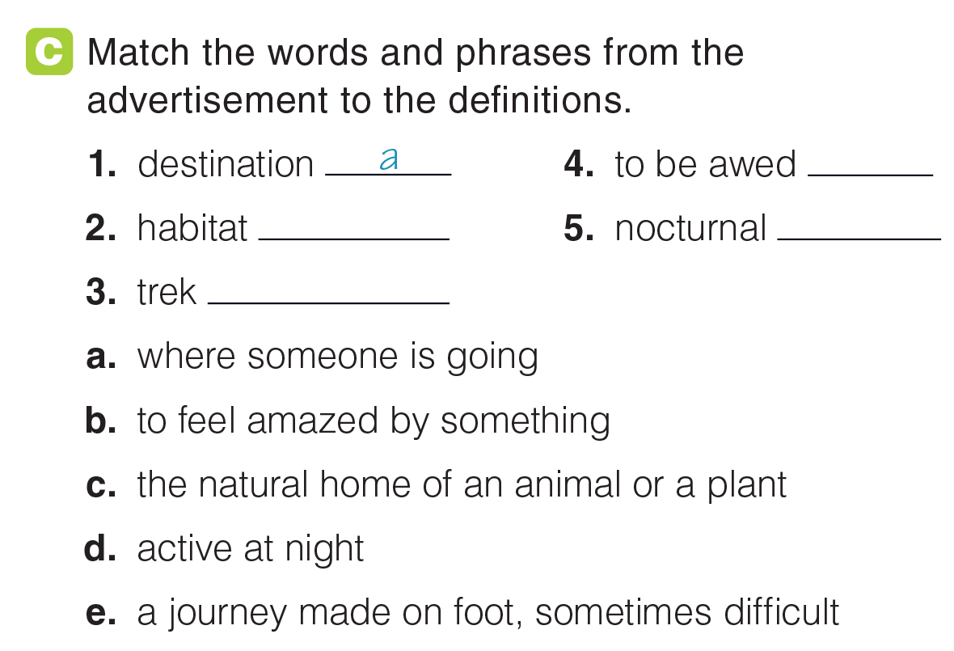
UNIT 6
DESTINATIONS
READING
b
c
d
e
_______________________________________________________________________________________________________________________________________________________________________________________________________________________
National Geographic Learning, a Cengage Company. © 2022 Cengage Learning, Inc. ALL RIGHTS RESERVED. This presentation tool is for teaching purpose only. May not be scanned, copied or duplicated, or posted to a publicly accessible website, in whole or in part.

Slide 45
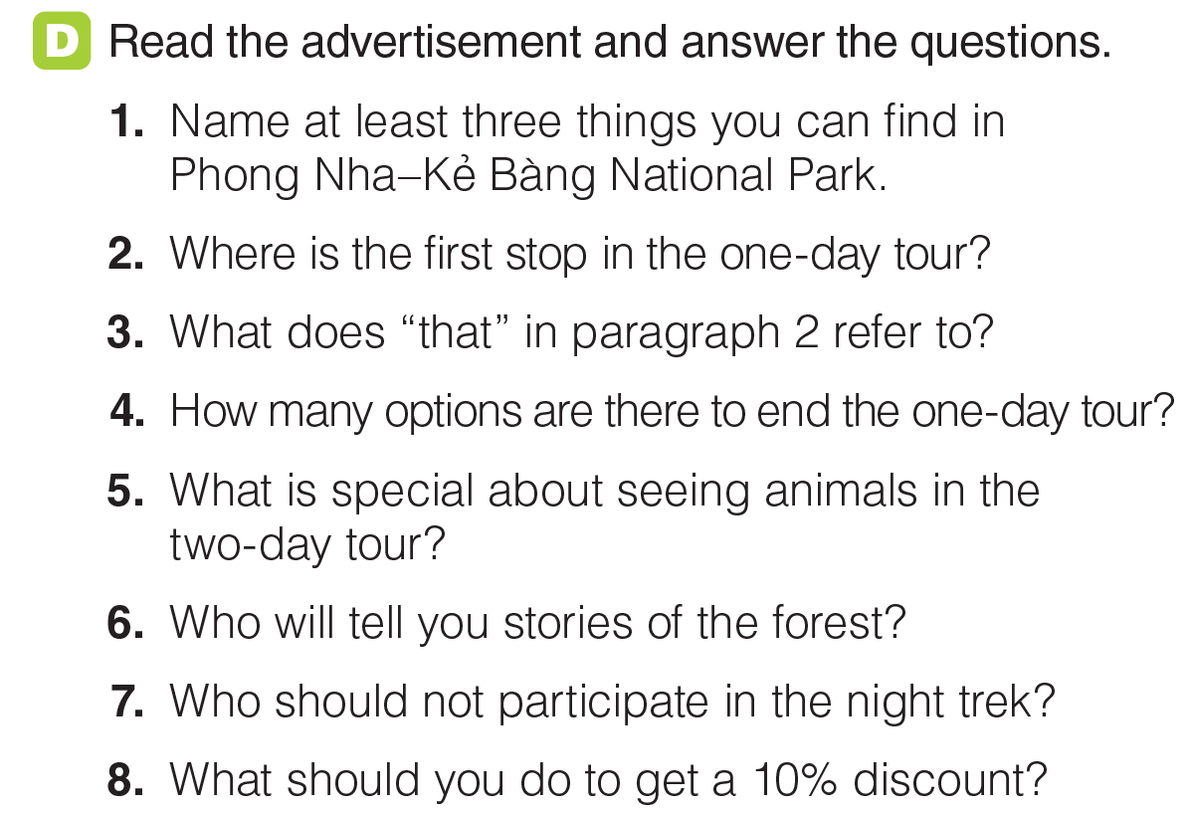
UNIT 6
DESTINATIONS
READING
(Answers may vary) Unique species, valley, waterfall, underground river, cave, nocturnal animals, trails, forest.
The Wildlife Rescue Center.
A stop at the Wildlife Rescue Center./ A close-up experience with some unique species.
Two.
You will see them in their natural habitats./ Animals are nocturnal
Local guides.
Guests who are physically unfit or not daring.
You should be among the first five guests.
_______________________________________________________________________________________________________________________________________________________________________________________________________________________
National Geographic Learning, a Cengage Company. © 2022 Cengage Learning, Inc. ALL RIGHTS RESERVED. This presentation tool is for teaching purpose only. May not be scanned, copied or duplicated, or posted to a publicly accessible website, in whole or in part.

Slide 46
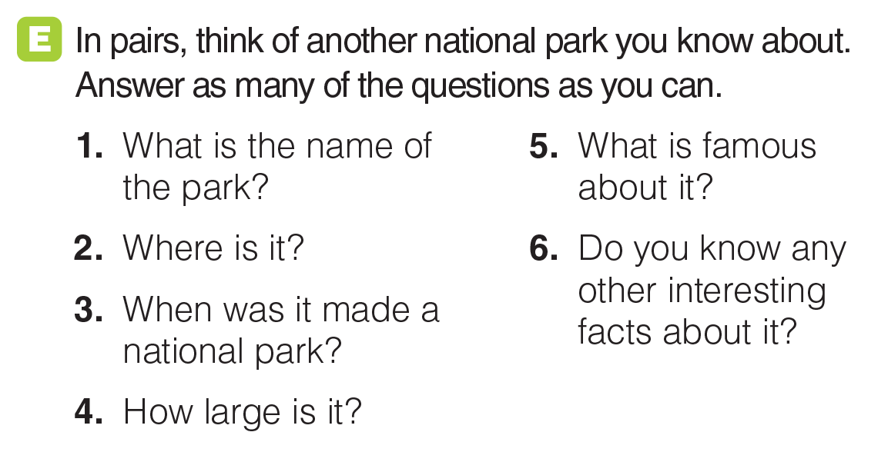
UNIT 6
DESTINATIONS
READING
_______________________________________________________________________________________________________________________________________________________________________________________________________________________
National Geographic Learning, a Cengage Company. © 2022 Cengage Learning, Inc. ALL RIGHTS RESERVED. This presentation tool is for teaching purpose only. May not be scanned, copied or duplicated, or posted to a publicly accessible website, in whole or in part.

Slide 47
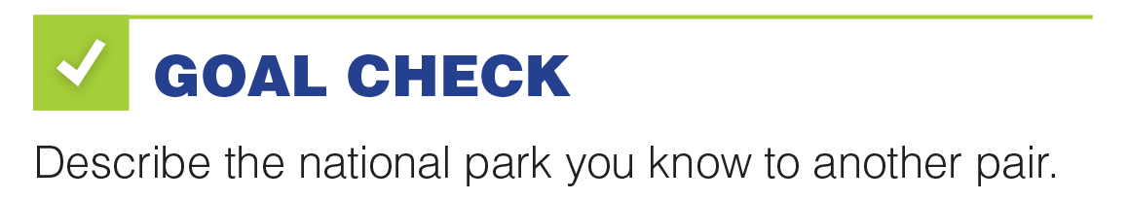
UNIT 6
DESTINATIONS
READING
_______________________________________________________________________________________________________________________________________________________________________________________________________________________
National Geographic Learning, a Cengage Company. © 2022 Cengage Learning, Inc. ALL RIGHTS RESERVED. This presentation tool is for teaching purpose only. May not be scanned, copied or duplicated, or posted to a publicly accessible website, in whole or in part.

Slide 48
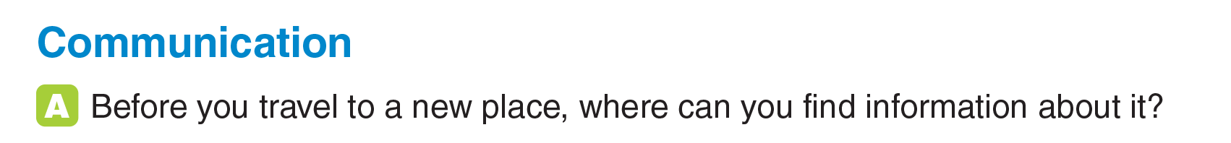
UNIT 6
DESTINATIONS
COMMUNICATION
_______________________________________________________________________________________________________________________________________________________________________________________________________________________
National Geographic Learning, a Cengage Company. © 2022 Cengage Learning, Inc. ALL RIGHTS RESERVED. This presentation tool is for teaching purpose only. May not be scanned, copied or duplicated, or posted to a publicly accessible website, in whole or in part.

Slide 49
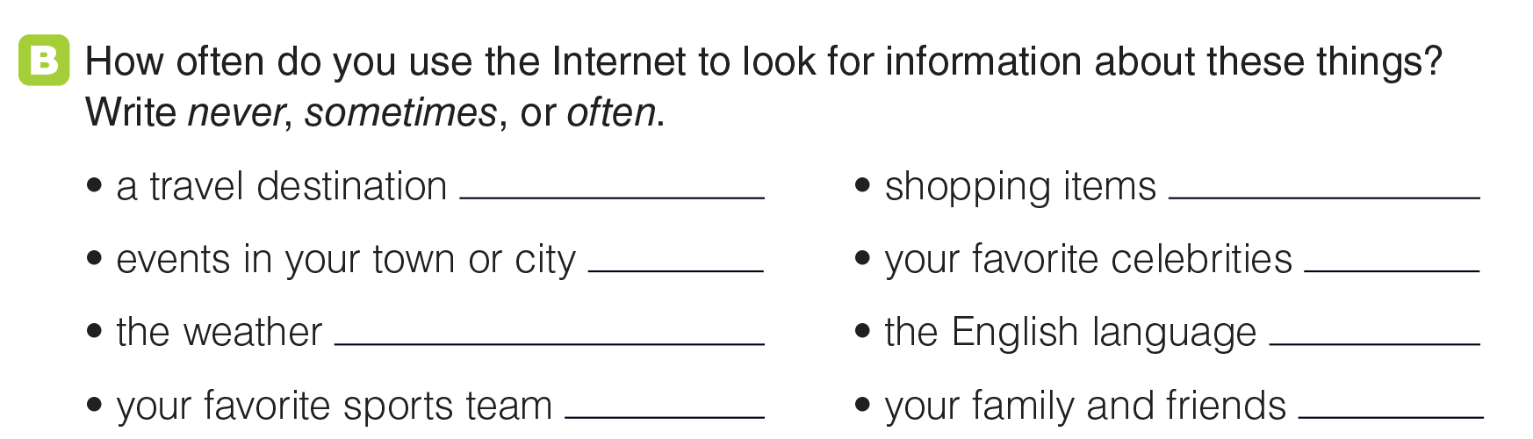
UNIT 6
DESTINATIONS
COMMUNICATION
_______________________________________________________________________________________________________________________________________________________________________________________________________________________
National Geographic Learning, a Cengage Company. © 2022 Cengage Learning, Inc. ALL RIGHTS RESERVED. This presentation tool is for teaching purpose only. May not be scanned, copied or duplicated, or posted to a publicly accessible website, in whole or in part.

Slide 50
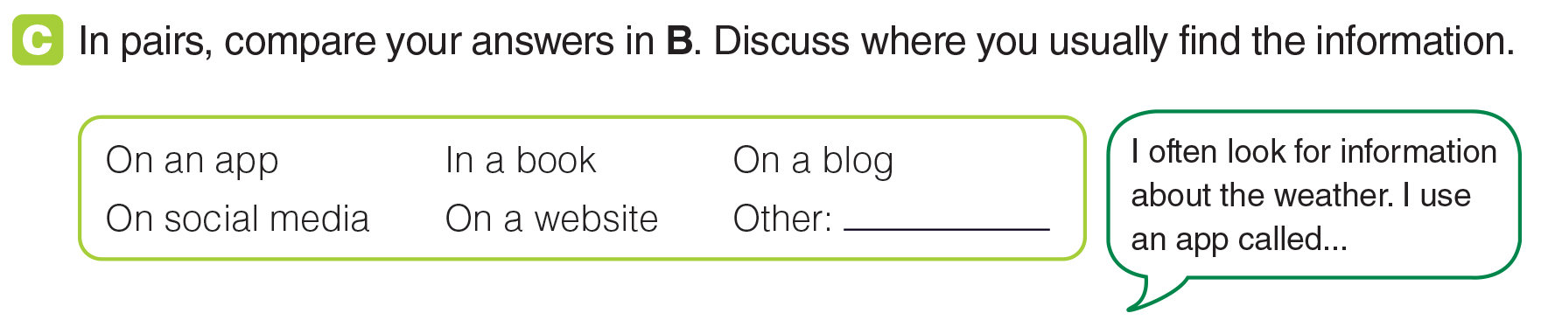
UNIT 6
DESTINATIONS
COMMUNICATION
_______________________________________________________________________________________________________________________________________________________________________________________________________________________
National Geographic Learning, a Cengage Company. © 2022 Cengage Learning, Inc. ALL RIGHTS RESERVED. This presentation tool is for teaching purpose only. May not be scanned, copied or duplicated, or posted to a publicly accessible website, in whole or in part.

Slide 51
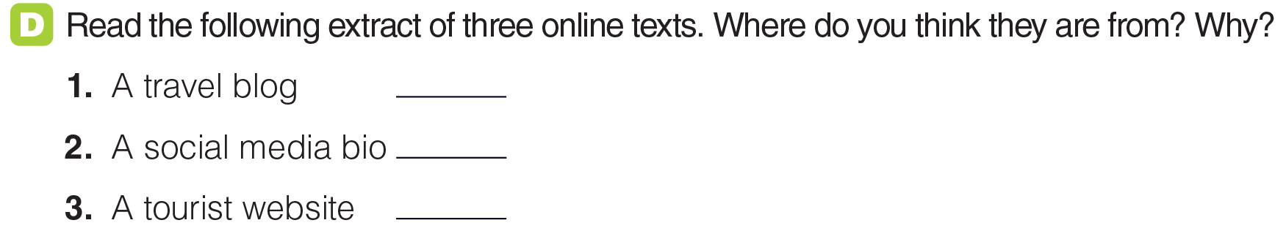
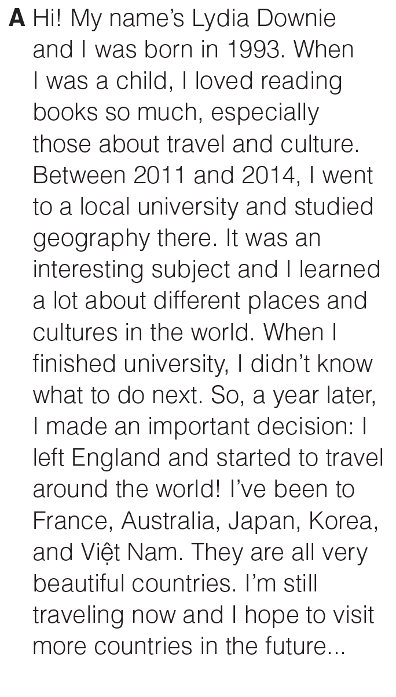
UNIT 6
DESTINATIONS
COMMUNICATION
A
_______________________________________________________________________________________________________________________________________________________________________________________________________________________
National Geographic Learning, a Cengage Company. © 2022 Cengage Learning, Inc. ALL RIGHTS RESERVED. This presentation tool is for teaching purpose only. May not be scanned, copied or duplicated, or posted to a publicly accessible website, in whole or in part.

Slide 52
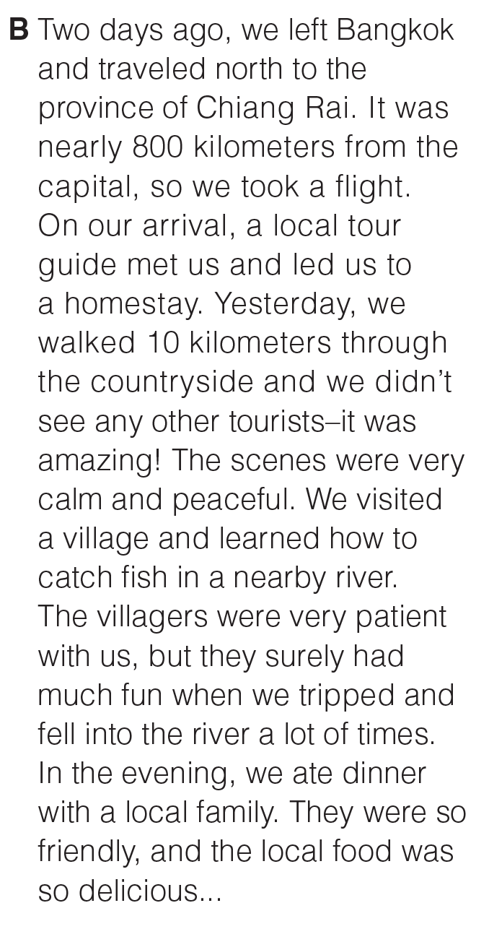
UNIT 6
DESTINATIONS
COMMUNICATION
B
_______________________________________________________________________________________________________________________________________________________________________________________________________________________
National Geographic Learning, a Cengage Company. © 2022 Cengage Learning, Inc. ALL RIGHTS RESERVED. This presentation tool is for teaching purpose only. May not be scanned, copied or duplicated, or posted to a publicly accessible website, in whole or in part.

Slide 53
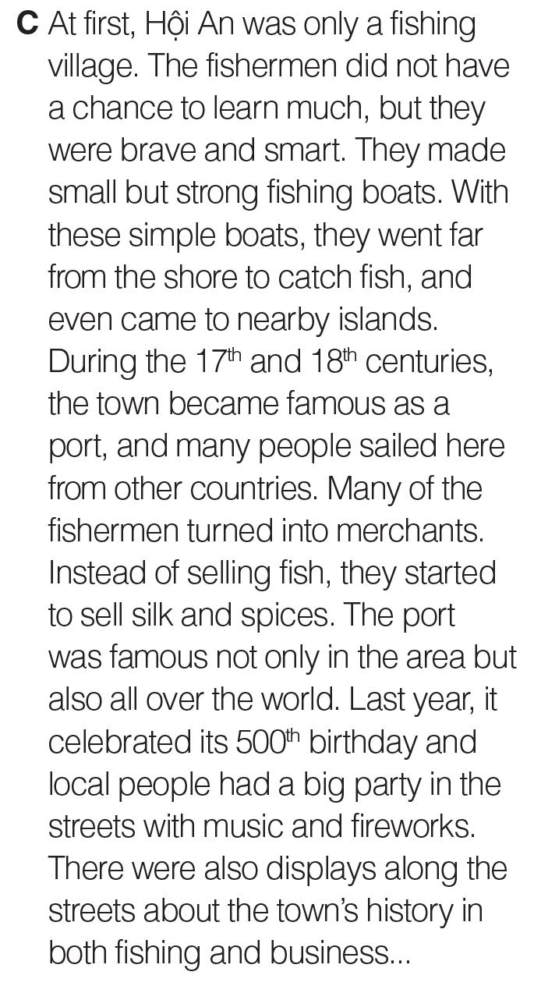
UNIT 6
DESTINATIONS
UNIT 6
DESTINATIONS
COMMUNICATION
C
_______________________________________________________________________________________________________________________________________________________________________________________________________________________
National Geographic Learning, a Cengage Company. © 2022 Cengage Learning, Inc. ALL RIGHTS RESERVED. This presentation tool is for teaching purpose only. May not be scanned, copied or duplicated, or posted to a publicly accessible website, in whole or in part.

Slide 54
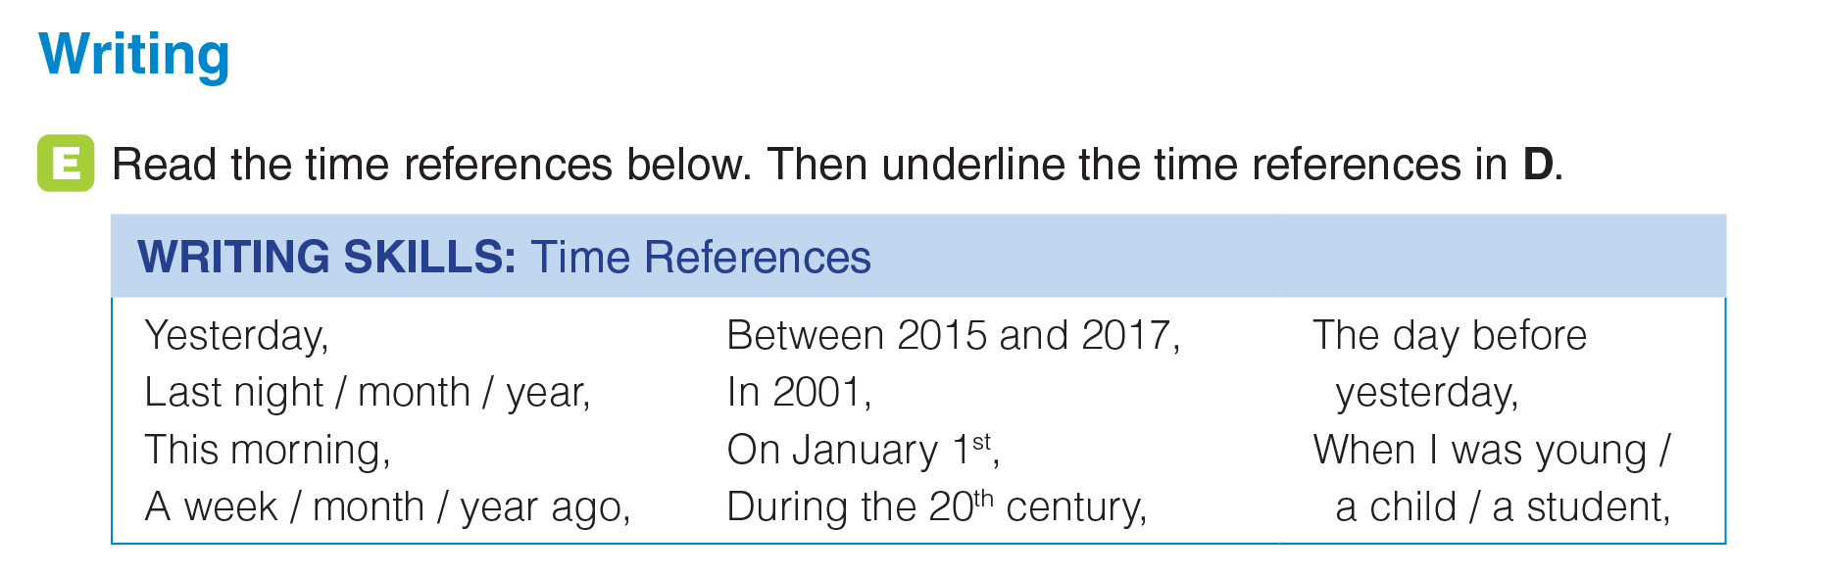
UNIT 6
DESTINATIONS
_______________________________________________________________________________________________________________________________________________________________________________________________________________________
National Geographic Learning, a Cengage Company. © 2022 Cengage Learning, Inc. ALL RIGHTS RESERVED. This presentation tool is for teaching purpose only. May not be scanned, copied or duplicated, or posted to a publicly accessible website, in whole or in part.

Slide 55
UNIT 6
DESTINATIONS
_______________________________________________________________________________________________________________________________________________________________________________________________________________________
National Geographic Learning, a Cengage Company. © 2022 Cengage Learning, Inc. ALL RIGHTS RESERVED. This presentation tool is for teaching purpose only. May not be scanned, copied or duplicated, or posted to a publicly accessible website, in whole or in part.

Slide 56
UNIT 6
DESTINATIONS
WRITING
_______________________________________________________________________________________________________________________________________________________________________________________________________________________
National Geographic Learning, a Cengage Company. © 2022 Cengage Learning, Inc. ALL RIGHTS RESERVED. This presentation tool is for teaching purpose only. May not be scanned, copied or duplicated, or posted to a publicly accessible website, in whole or in part.

Slide 57

UNIT 6
DESTINATIONS
WRITING
_______________________________________________________________________________________________________________________________________________________________________________________________________________________
National Geographic Learning, a Cengage Company. © 2022 Cengage Learning, Inc. ALL RIGHTS RESERVED. This presentation tool is for teaching purpose only. May not be scanned, copied or duplicated, or posted to a publicly accessible website, in whole or in part.

Slide 58

UNIT 6
DESTINATIONS
WRITING
_______________________________________________________________________________________________________________________________________________________________________________________________________________________
National Geographic Learning, a Cengage Company. © 2022 Cengage Learning, Inc. ALL RIGHTS RESERVED. This presentation tool is for teaching purpose only. May not be scanned, copied or duplicated, or posted to a publicly accessible website, in whole or in part.

