Slide 1



Unit 7:
COMMUNICATION
_______________________________________________________________________________________________________________________________________________________________________________________________________________________
National Geographic Learning, a Cengage Company. © 2022 Cengage Learning, Inc. ALL RIGHTS RESERVED. This presentation tool is for teaching purpose only. May not be scanned, copied or duplicated, or posted to a publicly accessible website, in whole or in part.

Slide 2



Slide 3
UNIT 7
COMMUNICATION
OVERVIEW
Do you know?
Communication is the field of human activity that has changed and developed the most in recent years. Today, the Internet—particularly social media—and smartphones have changed how we communicate in daily life.
_______________________________________________________________________________________________________________________________________________________________________________________________________________________
National Geographic Learning, a Cengage Company. © 2022 Cengage Learning, Inc. ALL RIGHTS RESERVED. This presentation tool is for teaching purpose only. May not be scanned, copied or duplicated, or posted to a publicly accessible website, in whole or in part.

Slide 4
UNIT 7
COMMUNICATION
OVERVIEW
About the photo
The Maori, the indigenous people of New Zealand, arrived there from Polynesia in the 13th century. They developed their own language, culture, and traditions, one of which is the haka, a special dance and chant, as shown in this photo.
_______________________________________________________________________________________________________________________________________________________________________________________________________________________
National Geographic Learning, a Cengage Company. © 2022 Cengage Learning, Inc. ALL RIGHTS RESERVED. This presentation tool is for teaching purpose only. May not be scanned, copied or duplicated, or posted to a publicly accessible website, in whole or in part.

Slide 5
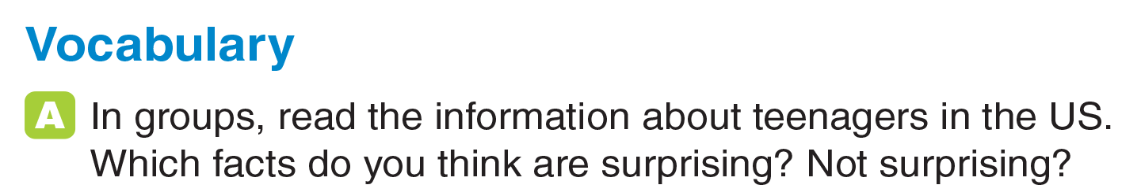
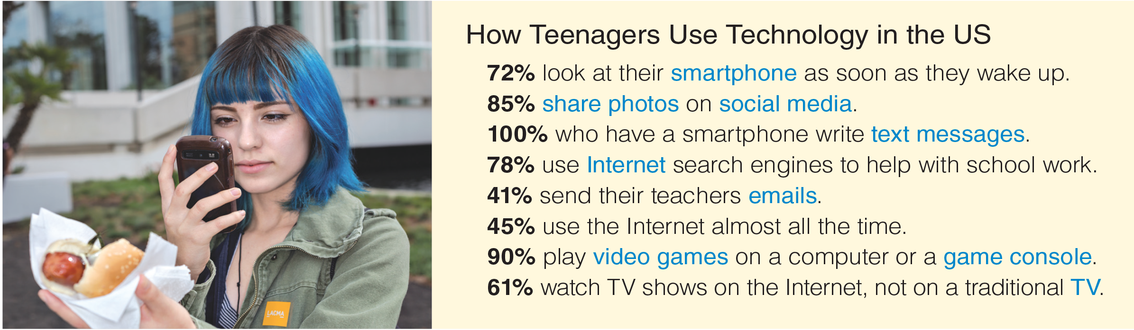
UNIT 7
COMMUNICATION
VOCABULARY
_______________________________________________________________________________________________________________________________________________________________________________________________________________________
National Geographic Learning, a Cengage Company. © 2022 Cengage Learning, Inc. ALL RIGHTS RESERVED. This presentation tool is for teaching purpose only. May not be scanned, copied or duplicated, or posted to a publicly accessible website, in whole or in part.

Slide 6

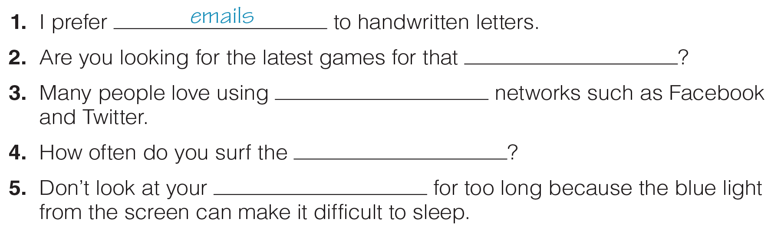
UNIT 7
COMMUNICATION
VOCABULARY
game console
social media
Internet
smartphone
_______________________________________________________________________________________________________________________________________________________________________________________________________________________
National Geographic Learning, a Cengage Company. © 2022 Cengage Learning, Inc. ALL RIGHTS RESERVED. This presentation tool is for teaching purpose only. May not be scanned, copied or duplicated, or posted to a publicly accessible website, in whole or in part.

Slide 7
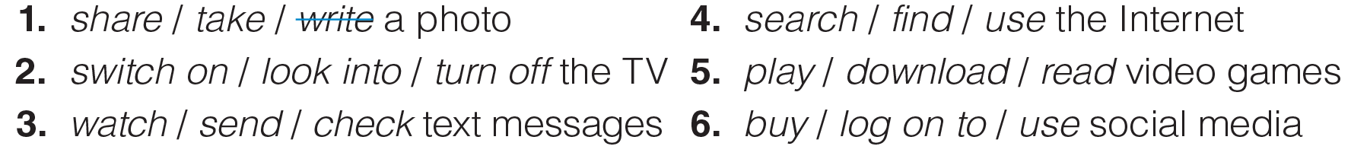
UNIT 7
COMMUNICATION
VOCABULARY
_______________________________________________________________________________________________________________________________________________________________________________________________________________________
National Geographic Learning, a Cengage Company. © 2022 Cengage Learning, Inc. ALL RIGHTS RESERVED. This presentation tool is for teaching purpose only. May not be scanned, copied or duplicated, or posted to a publicly accessible website, in whole or in part.

Slide 8
UNIT 7
COMMUNICATION
VOCABULARY
_______________________________________________________________________________________________________________________________________________________________________________________________________________________
National Geographic Learning, a Cengage Company. © 2022 Cengage Learning, Inc. ALL RIGHTS RESERVED. This presentation tool is for teaching purpose only. May not be scanned, copied or duplicated, or posted to a publicly accessible website, in whole or in part.

Slide 9
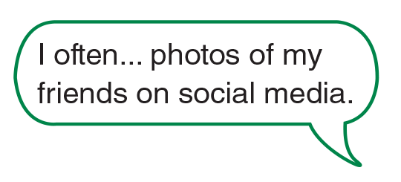


UNIT 7
COMMUNICATION
VOCABULARY
_______________________________________________________________________________________________________________________________________________________________________________________________________________________
National Geographic Learning, a Cengage Company. © 2022 Cengage Learning, Inc. ALL RIGHTS RESERVED. This presentation tool is for teaching purpose only. May not be scanned, copied or duplicated, or posted to a publicly accessible website, in whole or in part.

Slide 10
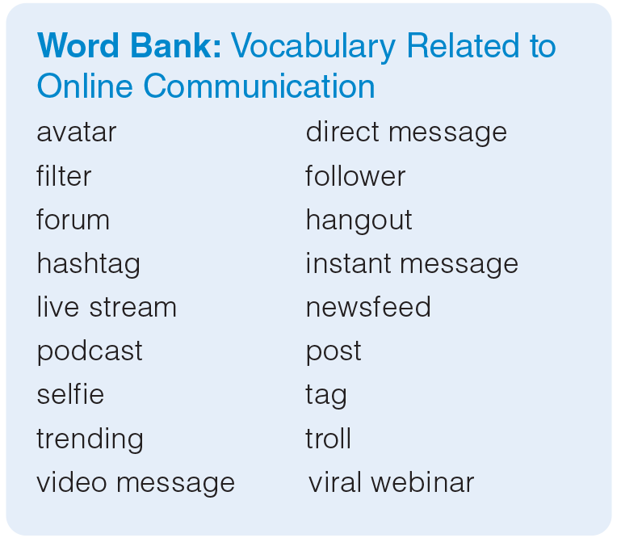
UNIT 7
COMMUNICATION
VOCABULARY
_______________________________________________________________________________________________________________________________________________________________________________________________________________________
National Geographic Learning, a Cengage Company. © 2022 Cengage Learning, Inc. ALL RIGHTS RESERVED. This presentation tool is for teaching purpose only. May not be scanned, copied or duplicated, or posted to a publicly accessible website, in whole or in part.

Slide 11
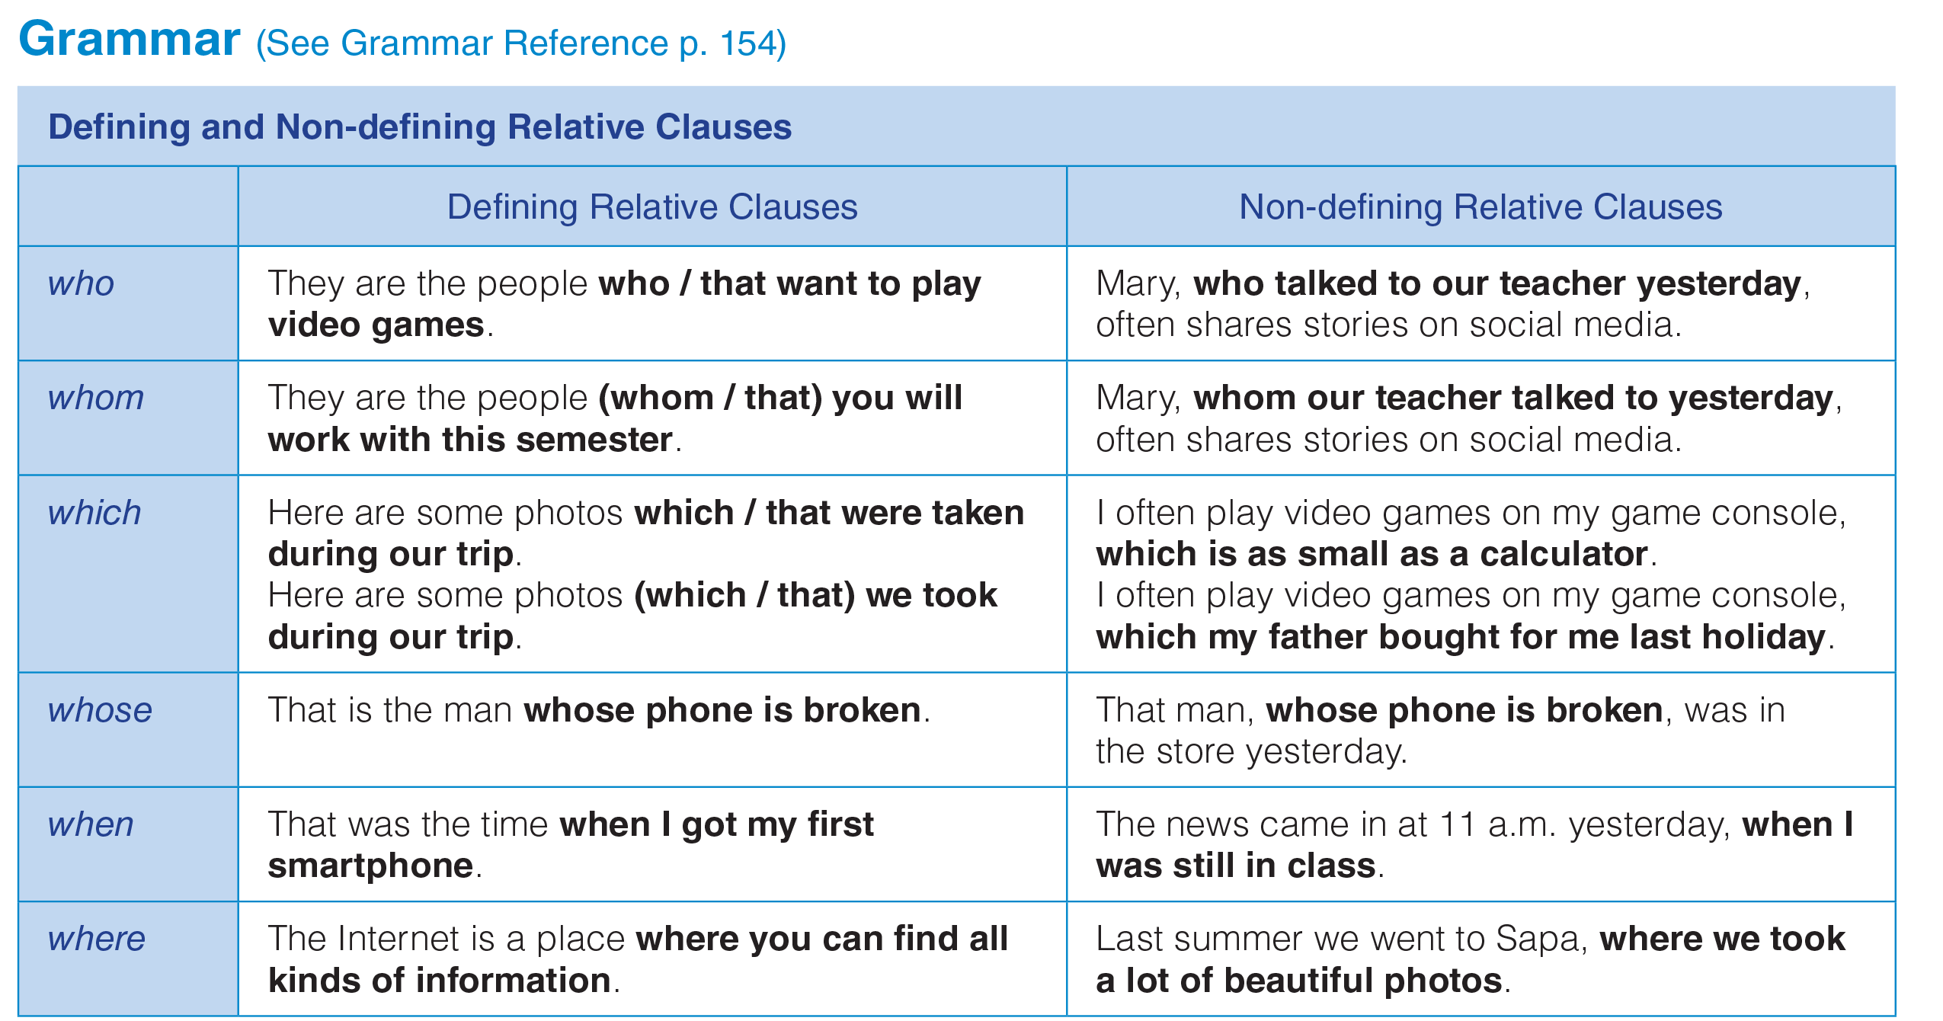
UNIT 7
COMMUNICATION
GRAMMAR
_______________________________________________________________________________________________________________________________________________________________________________________________________________________
National Geographic Learning, a Cengage Company. © 2022 Cengage Learning, Inc. ALL RIGHTS RESERVED. This presentation tool is for teaching purpose only. May not be scanned, copied or duplicated, or posted to a publicly accessible website, in whole or in part.

Slide 12
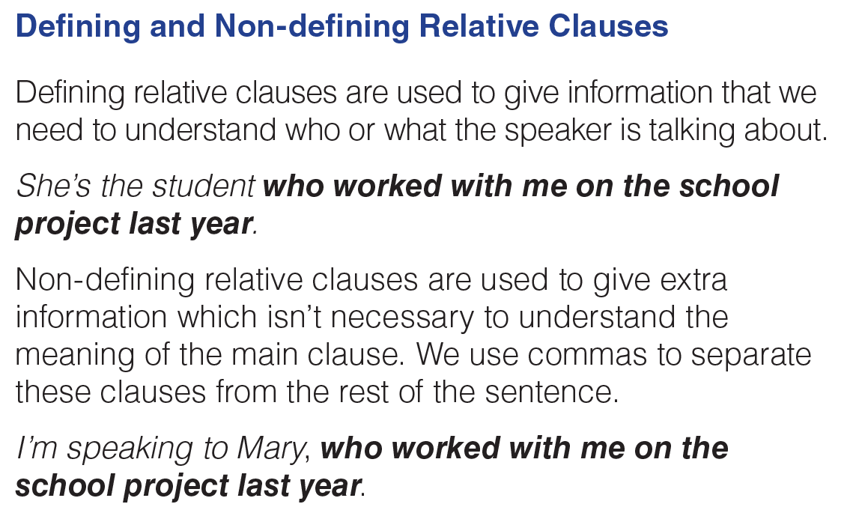
UNIT 7
COMMUNICATION
GRAMMAR
_______________________________________________________________________________________________________________________________________________________________________________________________________________________
National Geographic Learning, a Cengage Company. © 2022 Cengage Learning, Inc. ALL RIGHTS RESERVED. This presentation tool is for teaching purpose only. May not be scanned, copied or duplicated, or posted to a publicly accessible website, in whole or in part.

Slide 13
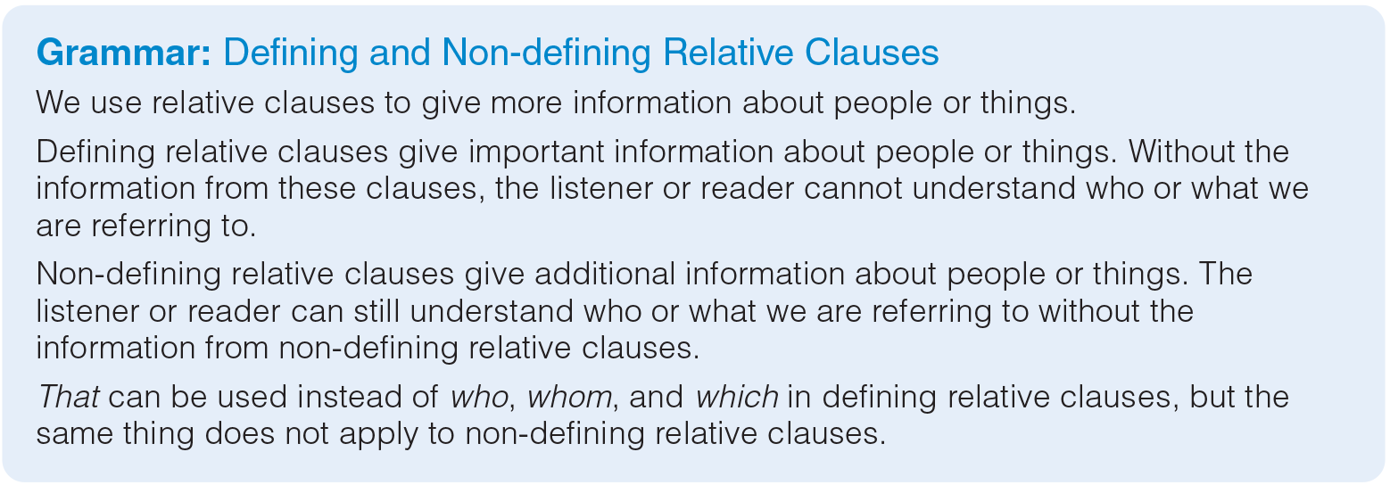
UNIT 7
COMMUNICATION
GRAMMAR
_______________________________________________________________________________________________________________________________________________________________________________________________________________________
National Geographic Learning, a Cengage Company. © 2022 Cengage Learning, Inc. ALL RIGHTS RESERVED. This presentation tool is for teaching purpose only. May not be scanned, copied or duplicated, or posted to a publicly accessible website, in whole or in part.

Slide 14
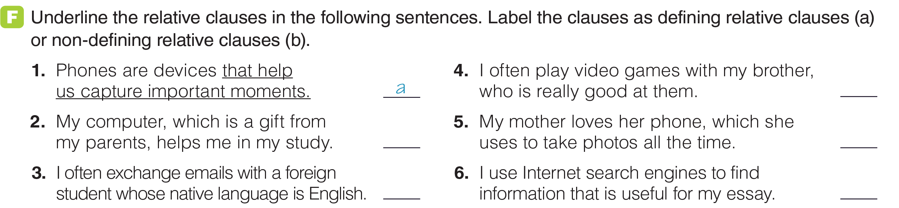
UNIT 7
COMMUNICATION
GRAMMAR
b
a
b
b
a
_______________________________________________________________________________________________________________________________________________________________________________________________________________________
National Geographic Learning, a Cengage Company. © 2022 Cengage Learning, Inc. ALL RIGHTS RESERVED. This presentation tool is for teaching purpose only. May not be scanned, copied or duplicated, or posted to a publicly accessible website, in whole or in part.

Slide 15
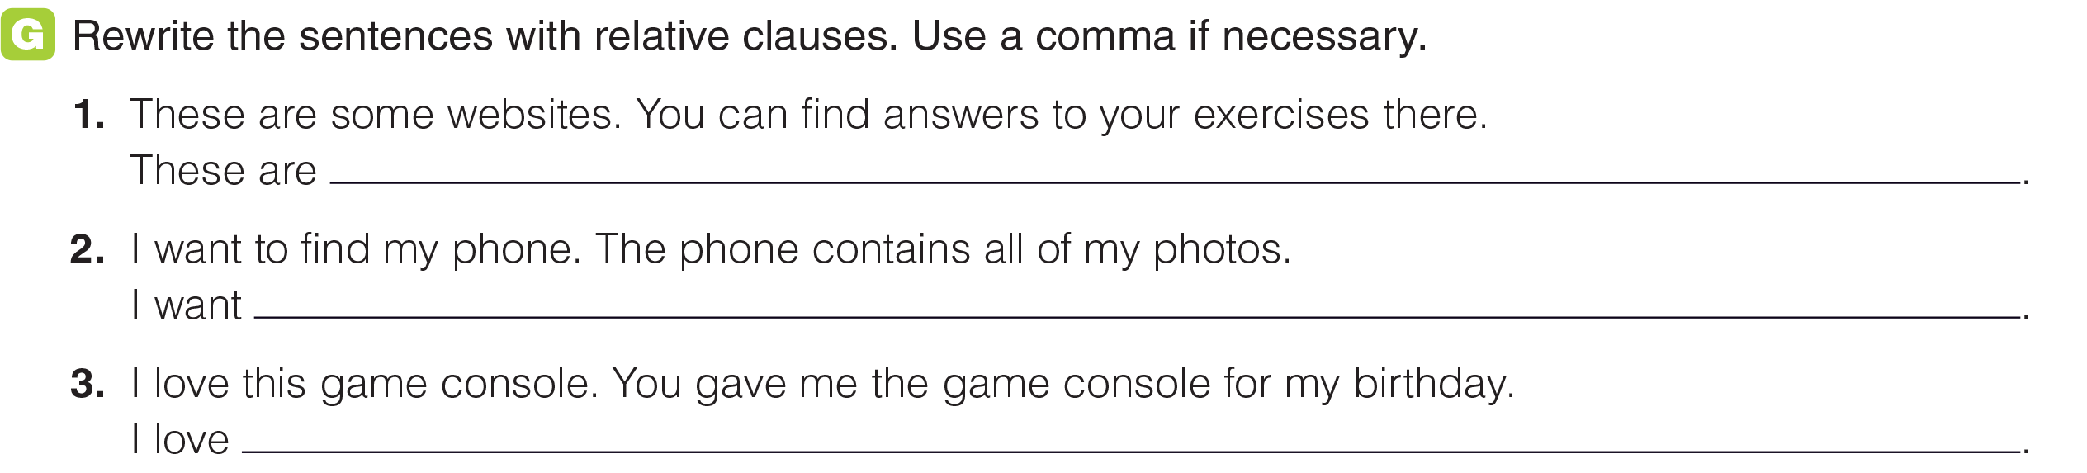
UNIT 7
COMMUNICATION
GRAMMAR
some websites where you can find answers to your exercises.
to find my phone, which contains all of my photos.
the game console that you gave me for my birthday.
_______________________________________________________________________________________________________________________________________________________________________________________________________________________
National Geographic Learning, a Cengage Company. © 2022 Cengage Learning, Inc. ALL RIGHTS RESERVED. This presentation tool is for teaching purpose only. May not be scanned, copied or duplicated, or posted to a publicly accessible website, in whole or in part.

Slide 16
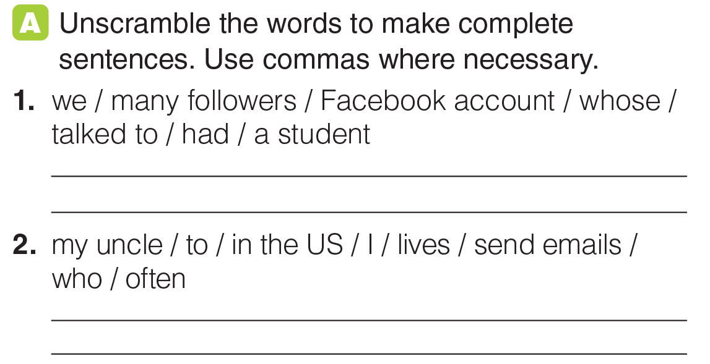
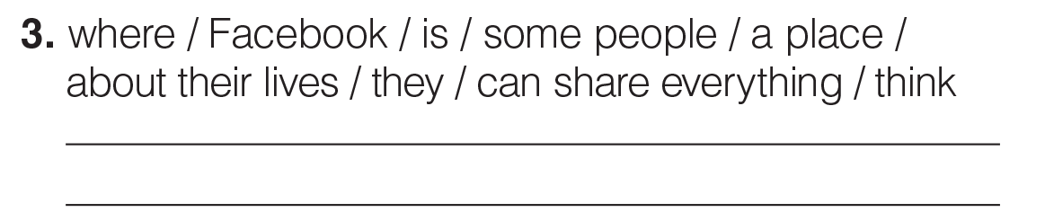
UNIT 7
COMMUNICATION
GRAMMAR
We talked to a student whose Facebook account had many followers.
I often send emails to my uncle, who lives in the US.
Some people think Facebook is a place where they can share everything about their life.
_______________________________________________________________________________________________________________________________________________________________________________________________________________________
National Geographic Learning, a Cengage Company. © 2022 Cengage Learning, Inc. ALL RIGHTS RESERVED. This presentation tool is for teaching purpose only. May not be scanned, copied or duplicated, or posted to a publicly accessible website, in whole or in part.

Slide 17
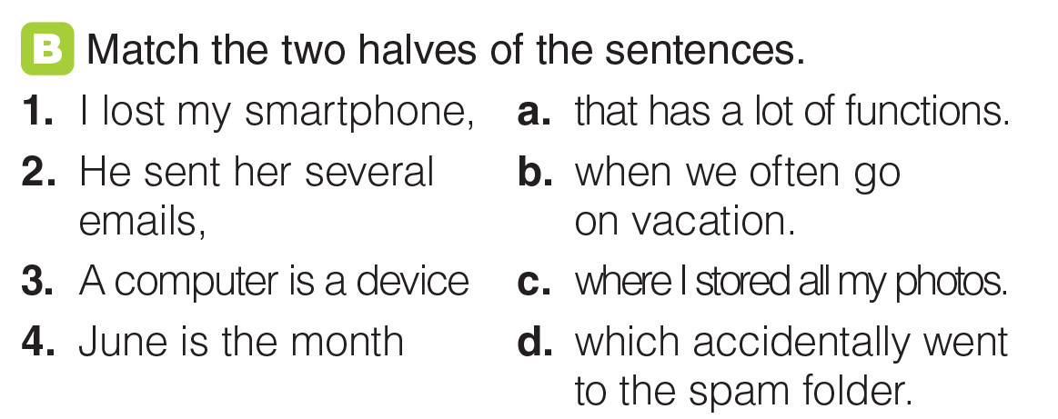
UNIT 7
COMMUNICATION
GRAMMAR
c
d
a
b
_______________________________________________________________________________________________________________________________________________________________________________________________________________________
National Geographic Learning, a Cengage Company. © 2022 Cengage Learning, Inc. ALL RIGHTS RESERVED. This presentation tool is for teaching purpose only. May not be scanned, copied or duplicated, or posted to a publicly accessible website, in whole or in part.

Slide 18

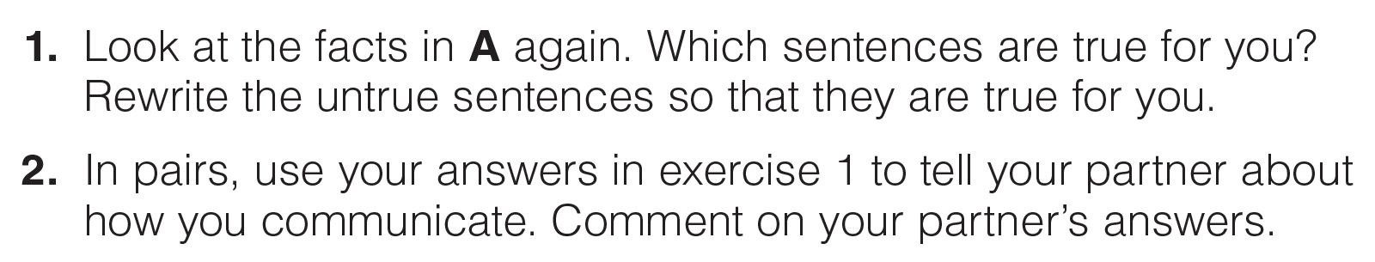

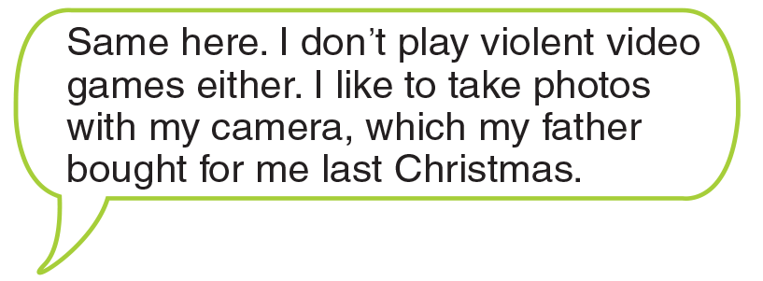
UNIT 7
COMMUNICATION
GOAL CHECK
_______________________________________________________________________________________________________________________________________________________________________________________________________________________
National Geographic Learning, a Cengage Company. © 2022 Cengage Learning, Inc. ALL RIGHTS RESERVED. This presentation tool is for teaching purpose only. May not be scanned, copied or duplicated, or posted to a publicly accessible website, in whole or in part.

Slide 19
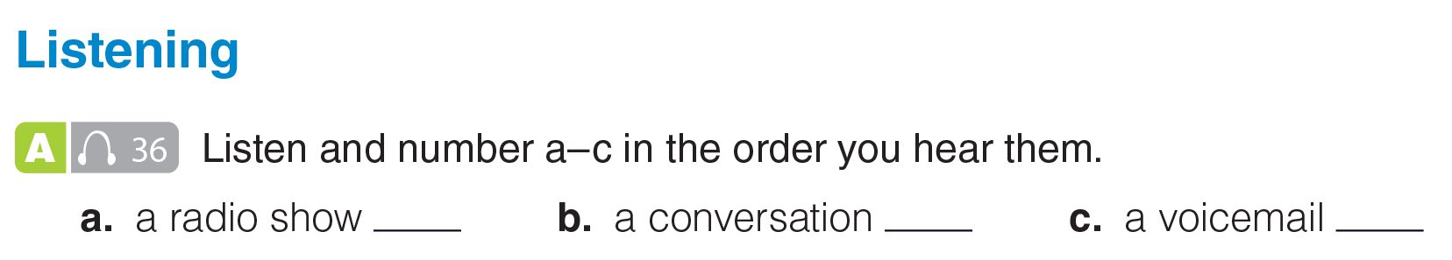

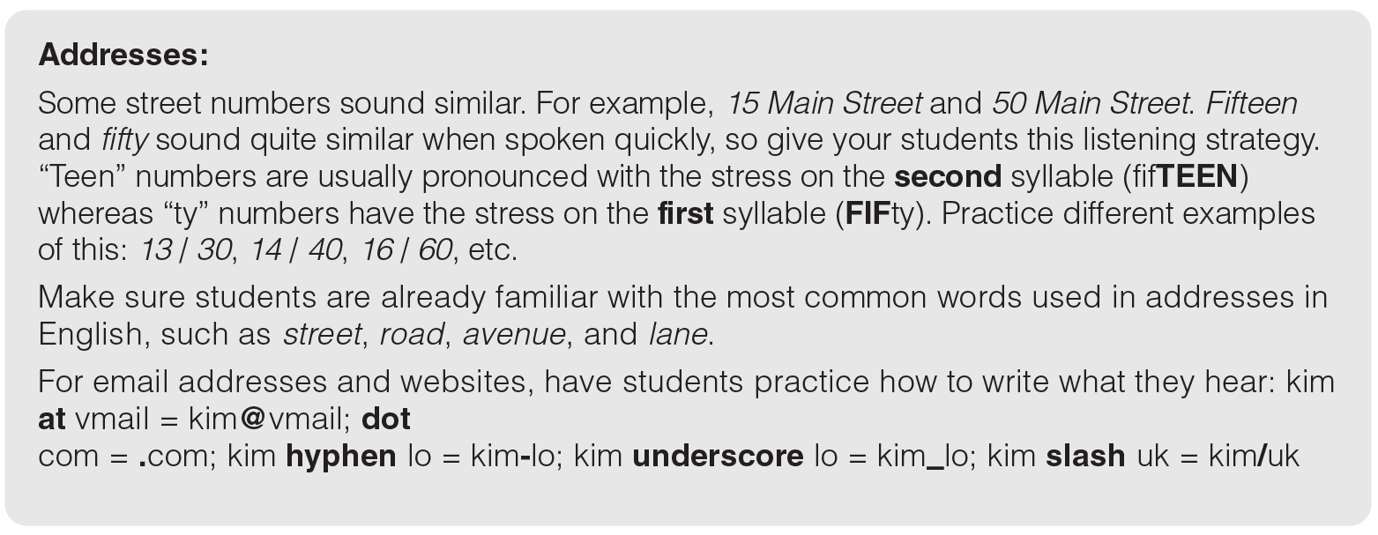
UNIT 7
COMMUNICATION
LISTENING
2
3
1
_______________________________________________________________________________________________________________________________________________________________________________________________________________________
National Geographic Learning, a Cengage Company. © 2022 Cengage Learning, Inc. ALL RIGHTS RESERVED. This presentation tool is for teaching purpose only. May not be scanned, copied or duplicated, or posted to a publicly accessible website, in whole or in part.

Slide 20
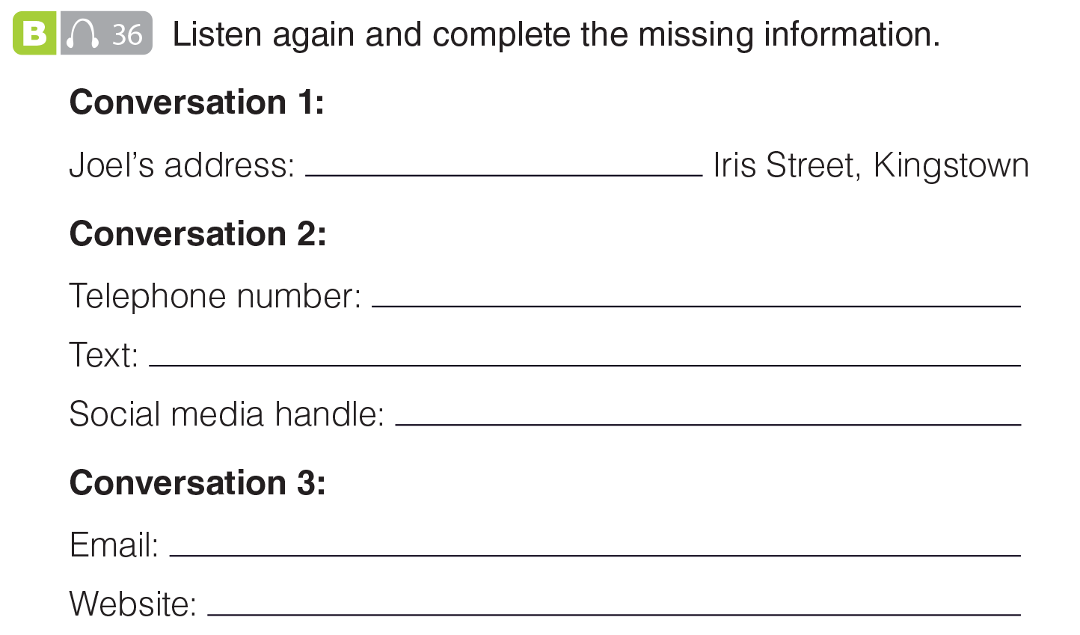
UNIT 7
COMMUNICATION
LISTENING
15a
43-33-629-1834
43-33-317-3476
@kingstownradio1
info@englang.com
www.englang.com/info_courses
_______________________________________________________________________________________________________________________________________________________________________________________________________________________
National Geographic Learning, a Cengage Company. © 2022 Cengage Learning, Inc. ALL RIGHTS RESERVED. This presentation tool is for teaching purpose only. May not be scanned, copied or duplicated, or posted to a publicly accessible website, in whole or in part.

Slide 21
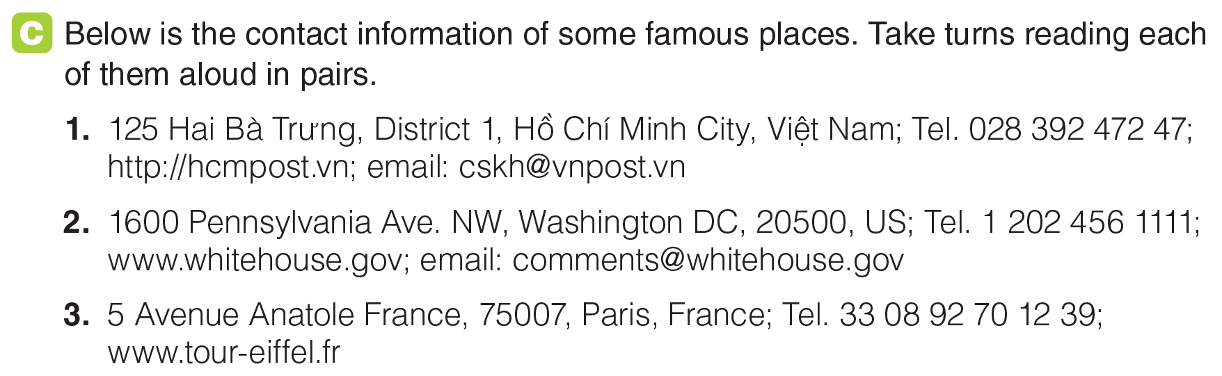
UNIT 7
COMMUNICATION
LISTENING
_______________________________________________________________________________________________________________________________________________________________________________________________________________________
National Geographic Learning, a Cengage Company. © 2022 Cengage Learning, Inc. ALL RIGHTS RESERVED. This presentation tool is for teaching purpose only. May not be scanned, copied or duplicated, or posted to a publicly accessible website, in whole or in part.

Slide 22
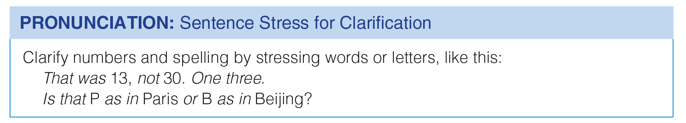
UNIT 7
COMMUNICATION
LISTENING
_______________________________________________________________________________________________________________________________________________________________________________________________________________________
National Geographic Learning, a Cengage Company. © 2022 Cengage Learning, Inc. ALL RIGHTS RESERVED. This presentation tool is for teaching purpose only. May not be scanned, copied or duplicated, or posted to a publicly accessible website, in whole or in part.

Slide 23
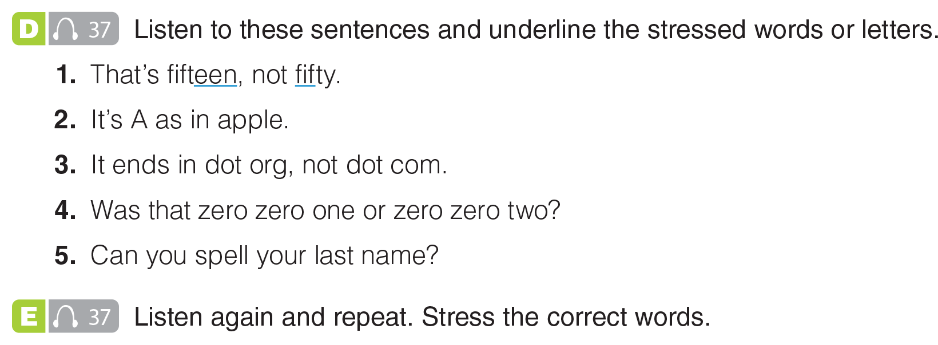
UNIT 7
COMMUNICATION
LISTENING
_______________________________________________________________________________________________________________________________________________________________________________________________________________________
National Geographic Learning, a Cengage Company. © 2022 Cengage Learning, Inc. ALL RIGHTS RESERVED. This presentation tool is for teaching purpose only. May not be scanned, copied or duplicated, or posted to a publicly accessible website, in whole or in part.

Slide 24
UNIT 7
COMMUNICATION
LISTENING
_______________________________________________________________________________________________________________________________________________________________________________________________________________________
National Geographic Learning, a Cengage Company. © 2022 Cengage Learning, Inc. ALL RIGHTS RESERVED. This presentation tool is for teaching purpose only. May not be scanned, copied or duplicated, or posted to a publicly accessible website, in whole or in part.

Slide 25
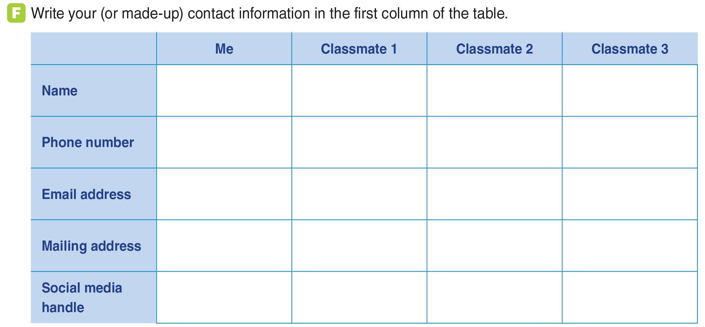
UNIT 7
COMMUNICATION
LISTENING
_______________________________________________________________________________________________________________________________________________________________________________________________________________________
National Geographic Learning, a Cengage Company. © 2022 Cengage Learning, Inc. ALL RIGHTS RESERVED. This presentation tool is for teaching purpose only. May not be scanned, copied or duplicated, or posted to a publicly accessible website, in whole or in part.

Slide 26




UNIT 7
COMMUNICATION
GOAL CHECK
_______________________________________________________________________________________________________________________________________________________________________________________________________________________
National Geographic Learning, a Cengage Company. © 2022 Cengage Learning, Inc. ALL RIGHTS RESERVED. This presentation tool is for teaching purpose only. May not be scanned, copied or duplicated, or posted to a publicly accessible website, in whole or in part.

Slide 27

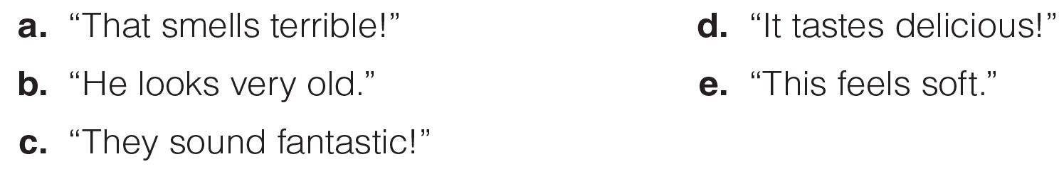
UNIT 7
COMMUNICATION
LANGUAGE EXPANSION
_______________________________________________________________________________________________________________________________________________________________________________________________________________________
National Geographic Learning, a Cengage Company. © 2022 Cengage Learning, Inc. ALL RIGHTS RESERVED. This presentation tool is for teaching purpose only. May not be scanned, copied or duplicated, or posted to a publicly accessible website, in whole or in part.

Slide 28
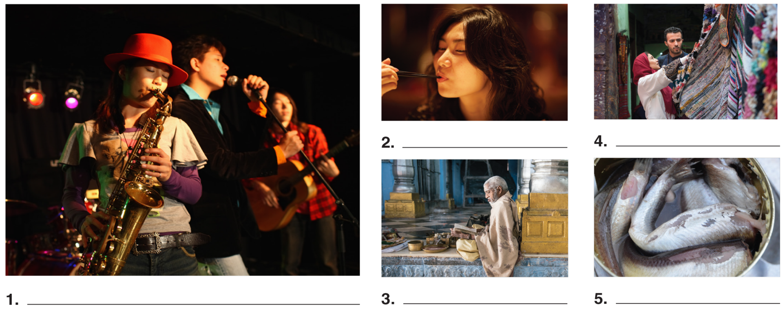
UNIT 7
COMMUNICATION
LANGUAGE EXPANSION
d. “It tastes delicious!”
e. “This feels soft.”
c. “They sound fantastic!”
b. “He looks very old.”
a. “That smells terrible!”
_______________________________________________________________________________________________________________________________________________________________________________________________________________________
National Geographic Learning, a Cengage Company. © 2022 Cengage Learning, Inc. ALL RIGHTS RESERVED. This presentation tool is for teaching purpose only. May not be scanned, copied or duplicated, or posted to a publicly accessible website, in whole or in part.

Slide 29
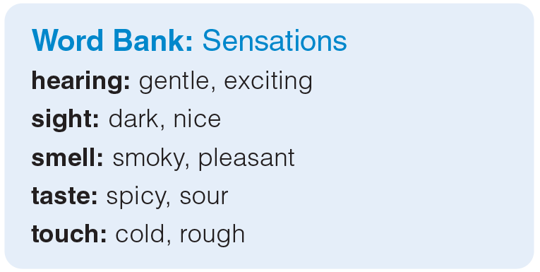
UNIT 7
COMMUNICATION
LANGUAGE EXPANSION
_______________________________________________________________________________________________________________________________________________________________________________________________________________________
National Geographic Learning, a Cengage Company. © 2022 Cengage Learning, Inc. ALL RIGHTS RESERVED. This presentation tool is for teaching purpose only. May not be scanned, copied or duplicated, or posted to a publicly accessible website, in whole or in part.

Slide 30
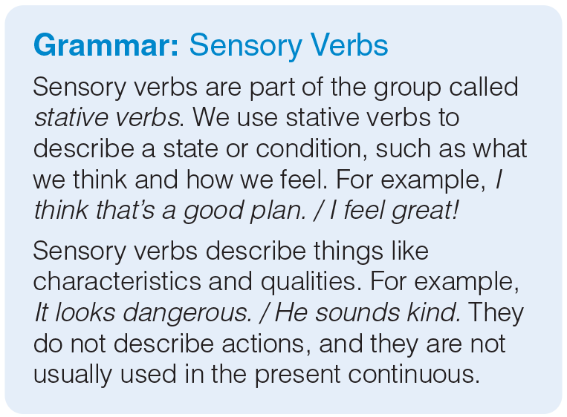
UNIT 7
COMMUNICATION
GRAMMAR
_______________________________________________________________________________________________________________________________________________________________________________________________________________________
National Geographic Learning, a Cengage Company. © 2022 Cengage Learning, Inc. ALL RIGHTS RESERVED. This presentation tool is for teaching purpose only. May not be scanned, copied or duplicated, or posted to a publicly accessible website, in whole or in part.

Slide 31
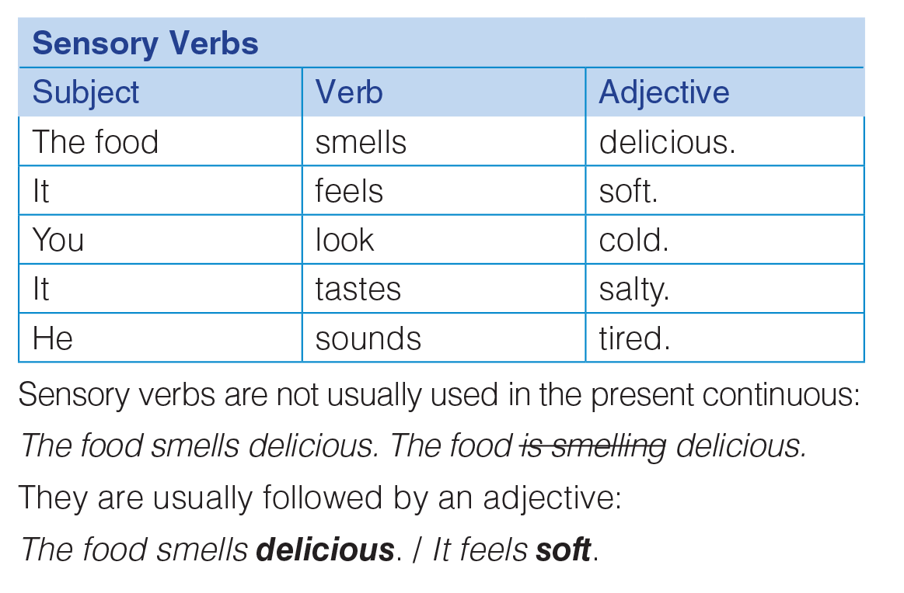
UNIT 7
COMMUNICATION
GRAMMAR
_______________________________________________________________________________________________________________________________________________________________________________________________________________________
National Geographic Learning, a Cengage Company. © 2022 Cengage Learning, Inc. ALL RIGHTS RESERVED. This presentation tool is for teaching purpose only. May not be scanned, copied or duplicated, or posted to a publicly accessible website, in whole or in part.

Slide 32
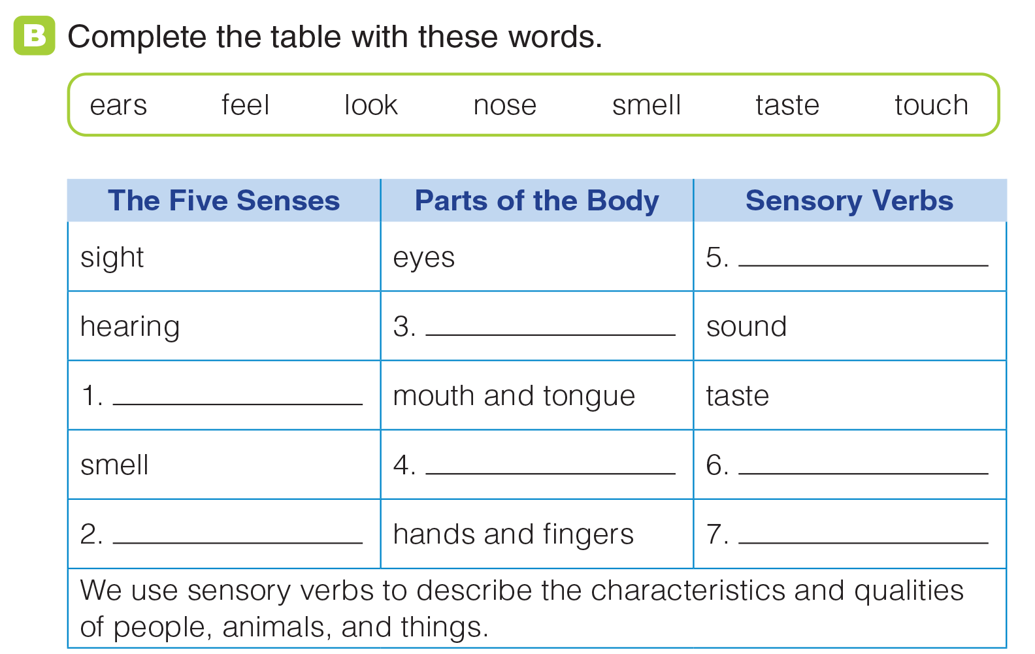
UNIT 7
COMMUNICATION
GRAMMAR
look
ears
taste
nose
smell
touch
feel
_______________________________________________________________________________________________________________________________________________________________________________________________________________________
National Geographic Learning, a Cengage Company. © 2022 Cengage Learning, Inc. ALL RIGHTS RESERVED. This presentation tool is for teaching purpose only. May not be scanned, copied or duplicated, or posted to a publicly accessible website, in whole or in part.

Slide 33
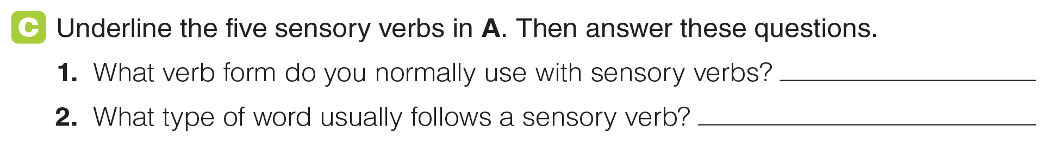
UNIT 7
COMMUNICATION
GRAMMAR
the simple present
an adjective
_______________________________________________________________________________________________________________________________________________________________________________________________________________________
National Geographic Learning, a Cengage Company. © 2022 Cengage Learning, Inc. ALL RIGHTS RESERVED. This presentation tool is for teaching purpose only. May not be scanned, copied or duplicated, or posted to a publicly accessible website, in whole or in part.

Slide 34
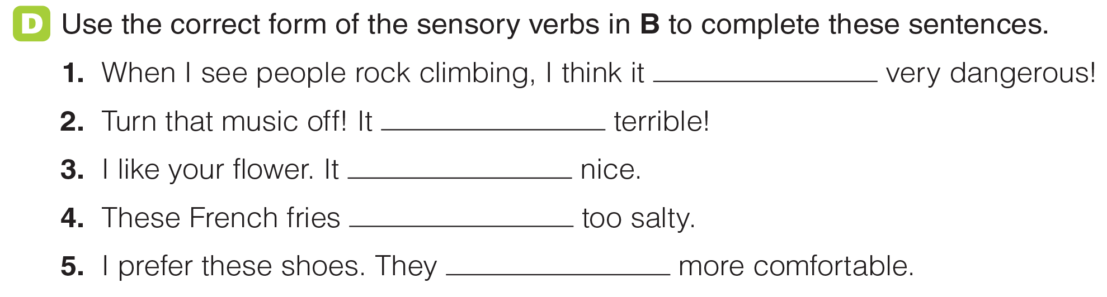
UNIT 7
COMMUNICATION
GRAMMAR
looks
sounds
smells
taste
feel
_______________________________________________________________________________________________________________________________________________________________________________________________________________________
National Geographic Learning, a Cengage Company. © 2022 Cengage Learning, Inc. ALL RIGHTS RESERVED. This presentation tool is for teaching purpose only. May not be scanned, copied or duplicated, or posted to a publicly accessible website, in whole or in part.

Slide 35
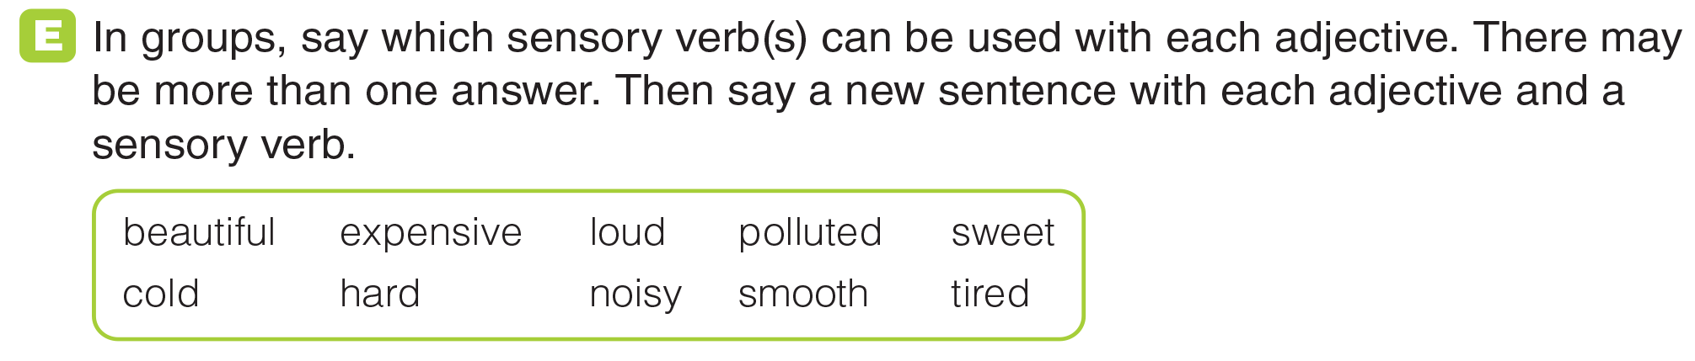
UNIT 7
COMMUNICATION
GRAMMAR
_______________________________________________________________________________________________________________________________________________________________________________________________________________________
National Geographic Learning, a Cengage Company. © 2022 Cengage Learning, Inc. ALL RIGHTS RESERVED. This presentation tool is for teaching purpose only. May not be scanned, copied or duplicated, or posted to a publicly accessible website, in whole or in part.

Slide 36

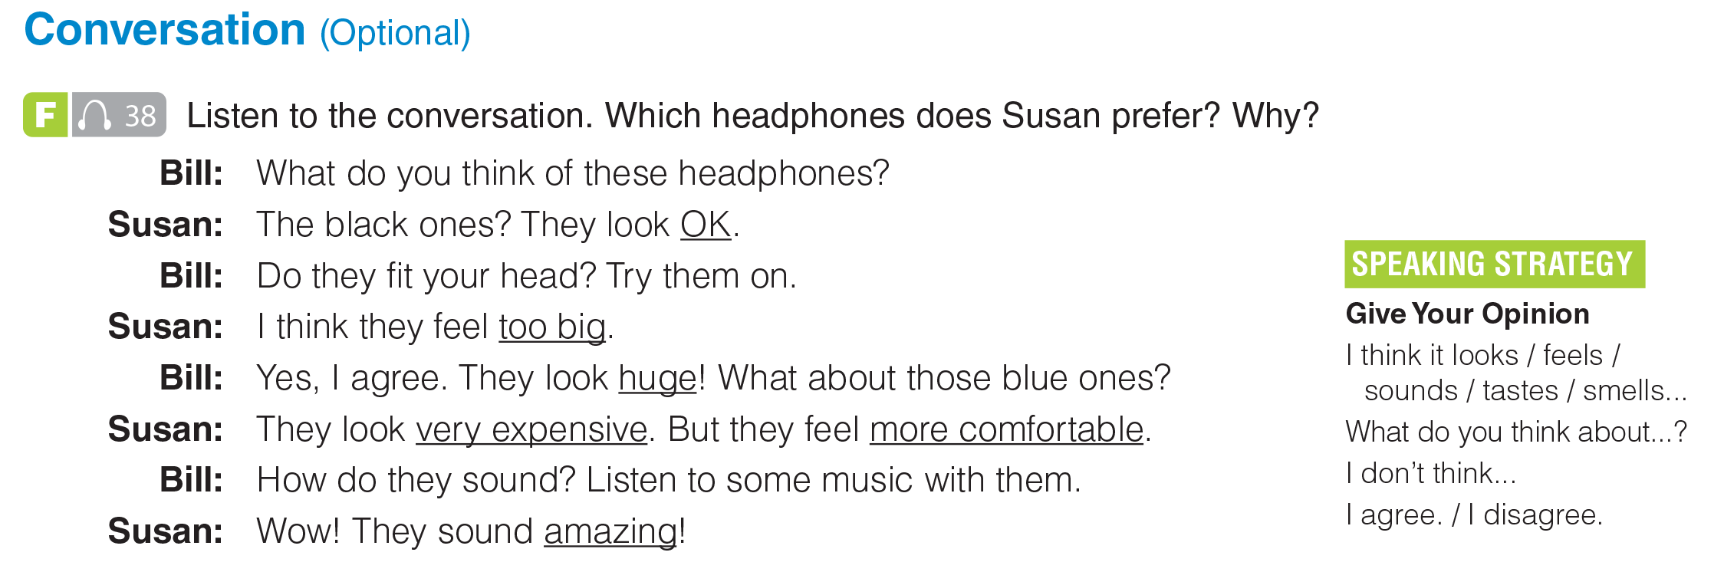
UNIT 7
COMMUNICATION
CONVERSATION
Susan prefers the blue headphones because they feel more comfortable and they sound amazing.
_______________________________________________________________________________________________________________________________________________________________________________________________________________________
National Geographic Learning, a Cengage Company. © 2022 Cengage Learning, Inc. ALL RIGHTS RESERVED. This presentation tool is for teaching purpose only. May not be scanned, copied or duplicated, or posted to a publicly accessible website, in whole or in part.

Slide 37
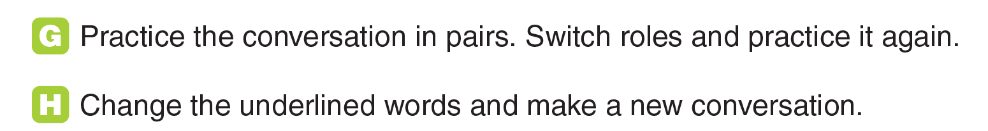
UNIT 7
COMMUNICATION
CONVERSATION
_______________________________________________________________________________________________________________________________________________________________________________________________________________________
National Geographic Learning, a Cengage Company. © 2022 Cengage Learning, Inc. ALL RIGHTS RESERVED. This presentation tool is for teaching purpose only. May not be scanned, copied or duplicated, or posted to a publicly accessible website, in whole or in part.

Slide 38
UNIT 7
COMMUNICATION
CONVERSATION
_______________________________________________________________________________________________________________________________________________________________________________________________________________________
National Geographic Learning, a Cengage Company. © 2022 Cengage Learning, Inc. ALL RIGHTS RESERVED. This presentation tool is for teaching purpose only. May not be scanned, copied or duplicated, or posted to a publicly accessible website, in whole or in part.

Slide 39
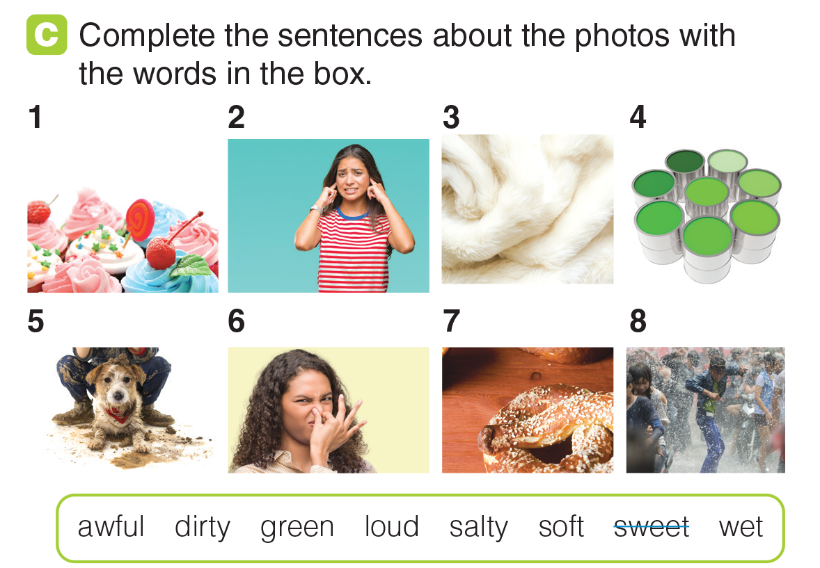
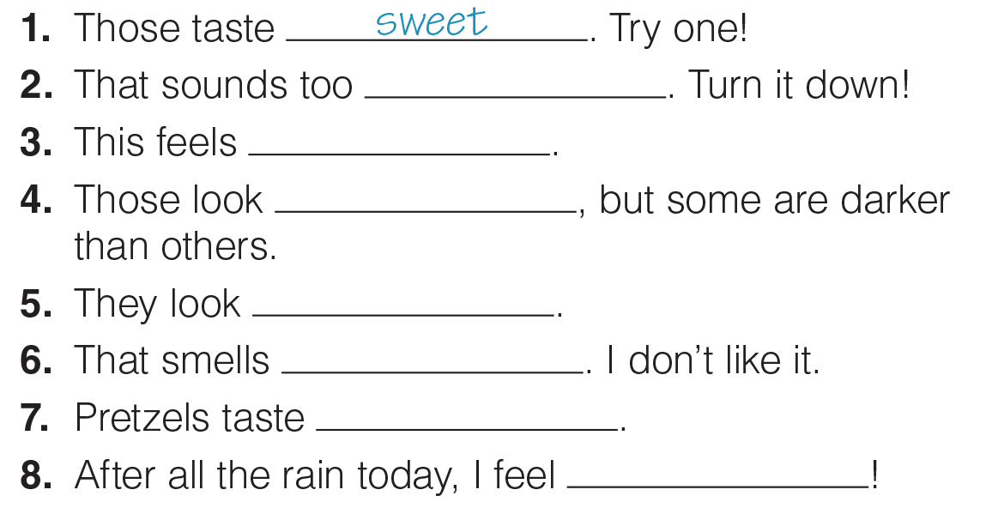
UNIT 7
COMMUNICATION
GRAMMAR
loud
soft
green
dirty
awful
salty
wet
_______________________________________________________________________________________________________________________________________________________________________________________________________________________
National Geographic Learning, a Cengage Company. © 2022 Cengage Learning, Inc. ALL RIGHTS RESERVED. This presentation tool is for teaching purpose only. May not be scanned, copied or duplicated, or posted to a publicly accessible website, in whole or in part.

Slide 40
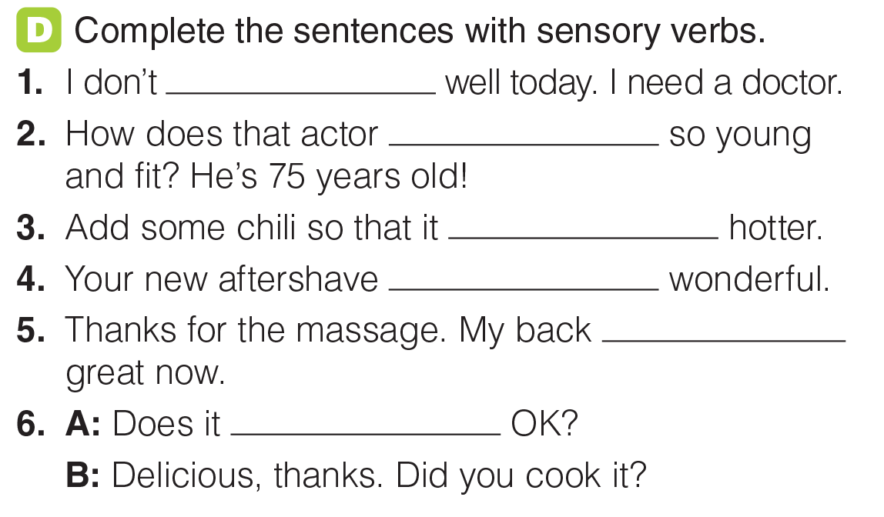
UNIT 7
COMMUNICATION
GRAMMAR
feel
look
tastes
smells
feels
taste
_______________________________________________________________________________________________________________________________________________________________________________________________________________________
National Geographic Learning, a Cengage Company. © 2022 Cengage Learning, Inc. ALL RIGHTS RESERVED. This presentation tool is for teaching purpose only. May not be scanned, copied or duplicated, or posted to a publicly accessible website, in whole or in part.

Slide 41

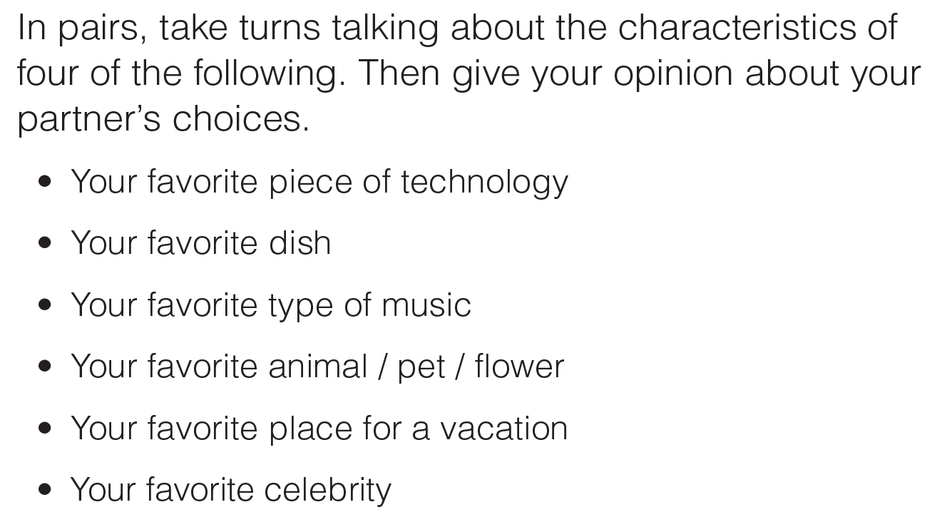

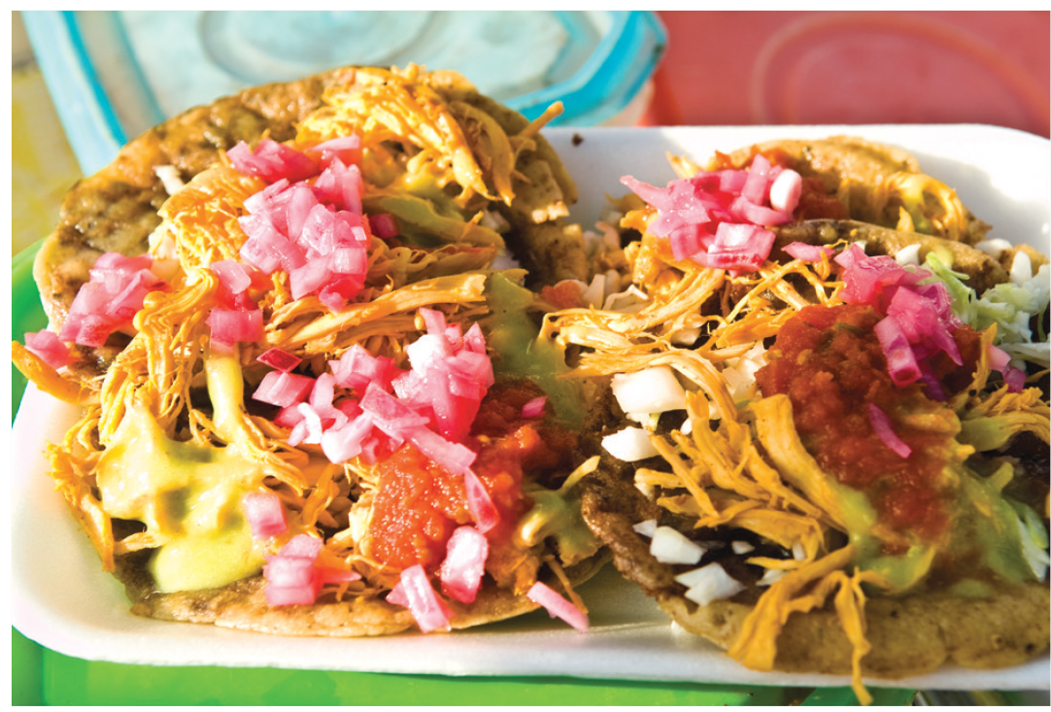
UNIT 7
COMMUNICATION
GRAMMAR
_______________________________________________________________________________________________________________________________________________________________________________________________________________________
National Geographic Learning, a Cengage Company. © 2022 Cengage Learning, Inc. ALL RIGHTS RESERVED. This presentation tool is for teaching purpose only. May not be scanned, copied or duplicated, or posted to a publicly accessible website, in whole or in part.

Slide 42

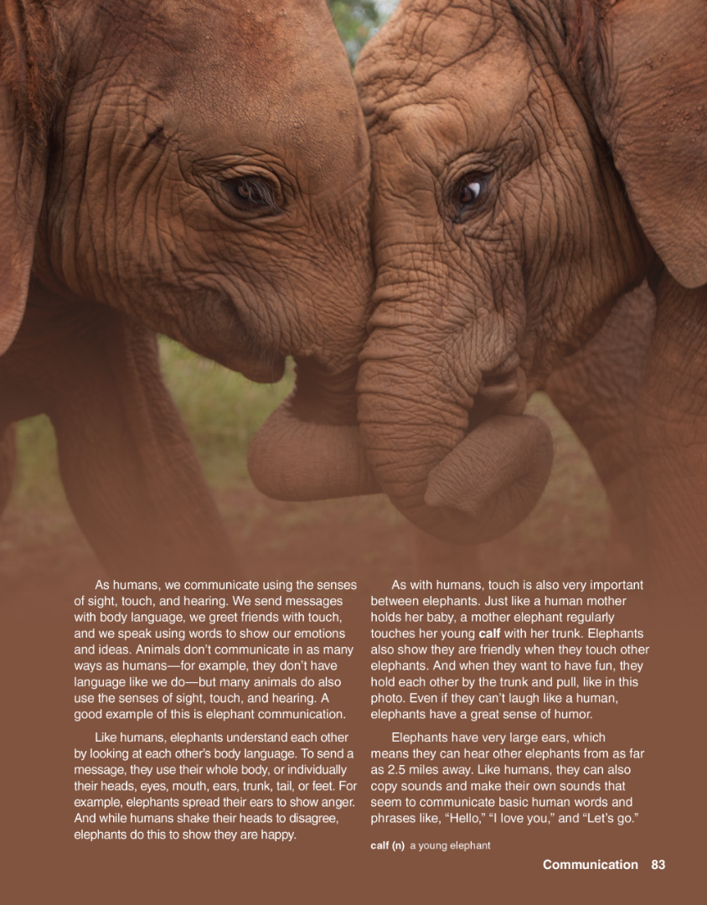
UNIT 7
COMMUNICATION
READING
_______________________________________________________________________________________________________________________________________________________________________________________________________________________
National Geographic Learning, a Cengage Company. © 2022 Cengage Learning, Inc. ALL RIGHTS RESERVED. This presentation tool is for teaching purpose only. May not be scanned, copied or duplicated, or posted to a publicly accessible website, in whole or in part.

Slide 43
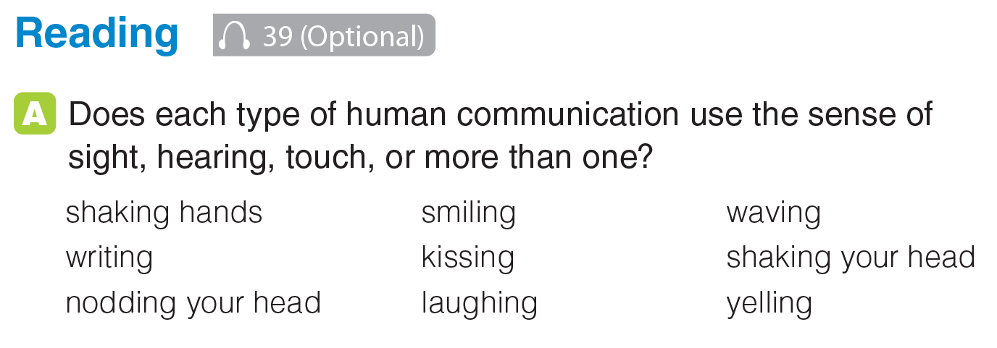
UNIT 7
COMMUNICATION
READING
touch
sight
sight
sight, touch
touch
sight
sight
sight/hearing
hearing
_______________________________________________________________________________________________________________________________________________________________________________________________________________________
National Geographic Learning, a Cengage Company. © 2022 Cengage Learning, Inc. ALL RIGHTS RESERVED. This presentation tool is for teaching purpose only. May not be scanned, copied or duplicated, or posted to a publicly accessible website, in whole or in part.

Slide 44
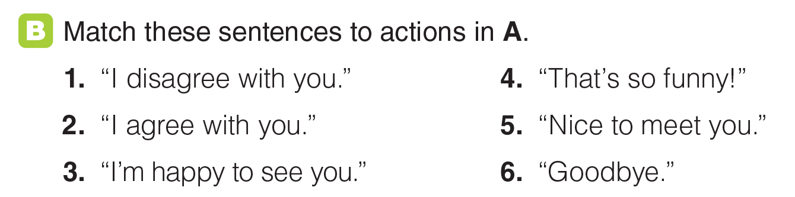
UNIT 7
COMMUNICATION
READING
shaking your head
laughing
nodding your head
shaking hands
smiling
waving
_______________________________________________________________________________________________________________________________________________________________________________________________________________________
National Geographic Learning, a Cengage Company. © 2022 Cengage Learning, Inc. ALL RIGHTS RESERVED. This presentation tool is for teaching purpose only. May not be scanned, copied or duplicated, or posted to a publicly accessible website, in whole or in part.

Slide 45

UNIT 7
COMMUNICATION
READING
_______________________________________________________________________________________________________________________________________________________________________________________________________________________
National Geographic Learning, a Cengage Company. © 2022 Cengage Learning, Inc. ALL RIGHTS RESERVED. This presentation tool is for teaching purpose only. May not be scanned, copied or duplicated, or posted to a publicly accessible website, in whole or in part.

Slide 46
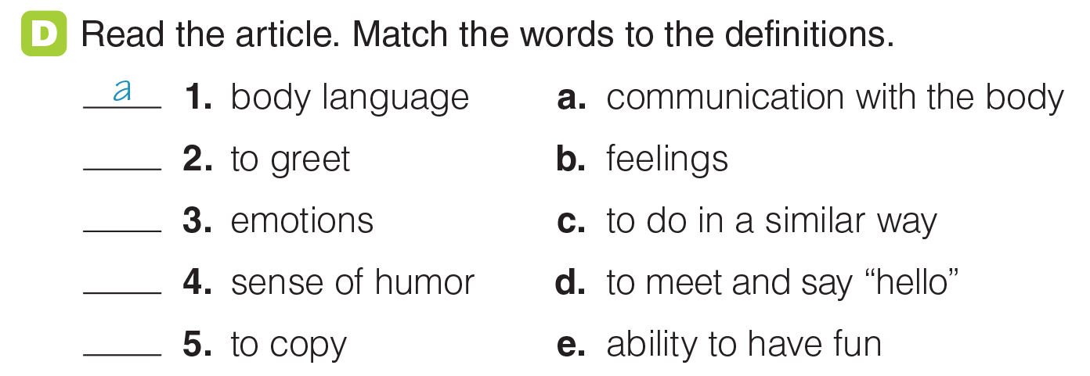
UNIT 7
COMMUNICATION
READING
d
b
e
c
_______________________________________________________________________________________________________________________________________________________________________________________________________________________
National Geographic Learning, a Cengage Company. © 2022 Cengage Learning, Inc. ALL RIGHTS RESERVED. This presentation tool is for teaching purpose only. May not be scanned, copied or duplicated, or posted to a publicly accessible website, in whole or in part.

Slide 47
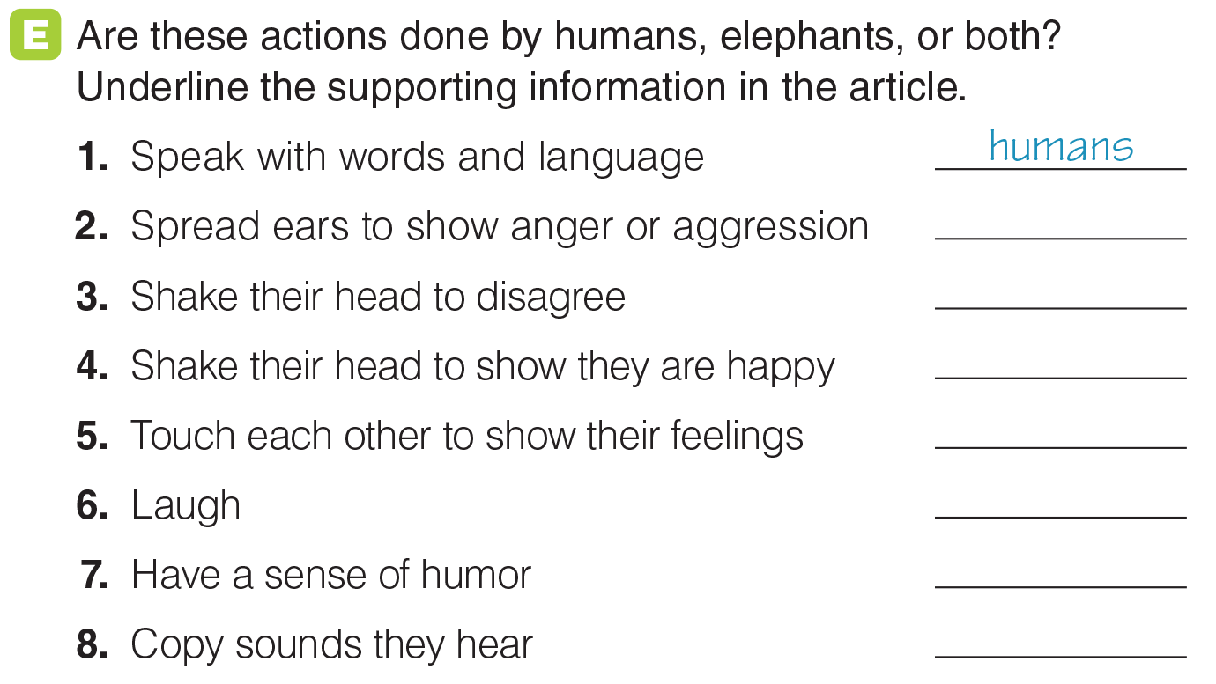
UNIT 7
COMMUNICATION
READING
elephants
humans
elephants
both
humans
both
both
_______________________________________________________________________________________________________________________________________________________________________________________________________________________
National Geographic Learning, a Cengage Company. © 2022 Cengage Learning, Inc. ALL RIGHTS RESERVED. This presentation tool is for teaching purpose only. May not be scanned, copied or duplicated, or posted to a publicly accessible website, in whole or in part.

Slide 48
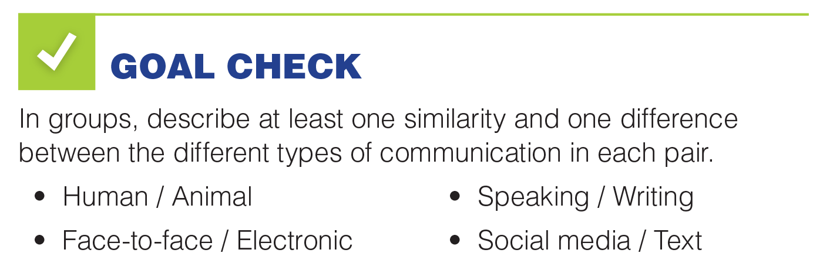
UNIT 7
COMMUNICATION
GOAL CHECK
_______________________________________________________________________________________________________________________________________________________________________________________________________________________
National Geographic Learning, a Cengage Company. © 2022 Cengage Learning, Inc. ALL RIGHTS RESERVED. This presentation tool is for teaching purpose only. May not be scanned, copied or duplicated, or posted to a publicly accessible website, in whole or in part.

Slide 49
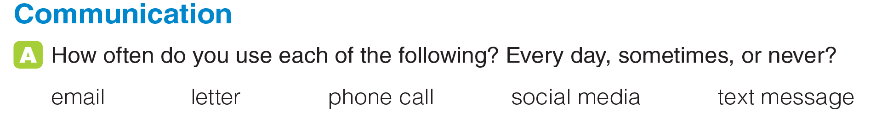
UNIT 7
COMMUNICATION
COMMUNICATION
_______________________________________________________________________________________________________________________________________________________________________________________________________________________
National Geographic Learning, a Cengage Company. © 2022 Cengage Learning, Inc. ALL RIGHTS RESERVED. This presentation tool is for teaching purpose only. May not be scanned, copied or duplicated, or posted to a publicly accessible website, in whole or in part.

Slide 50
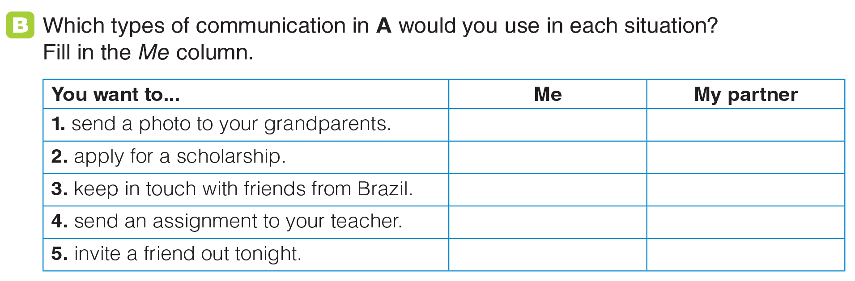
UNIT 7
COMMUNICATION
COMMUNICATION
_______________________________________________________________________________________________________________________________________________________________________________________________________________________
National Geographic Learning, a Cengage Company. © 2022 Cengage Learning, Inc. ALL RIGHTS RESERVED. This presentation tool is for teaching purpose only. May not be scanned, copied or duplicated, or posted to a publicly accessible website, in whole or in part.

Slide 51
UNIT 7
COMMUNICATION
COMMUNICATION
_______________________________________________________________________________________________________________________________________________________________________________________________________________________
National Geographic Learning, a Cengage Company. © 2022 Cengage Learning, Inc. ALL RIGHTS RESERVED. This presentation tool is for teaching purpose only. May not be scanned, copied or duplicated, or posted to a publicly accessible website, in whole or in part.

Slide 52
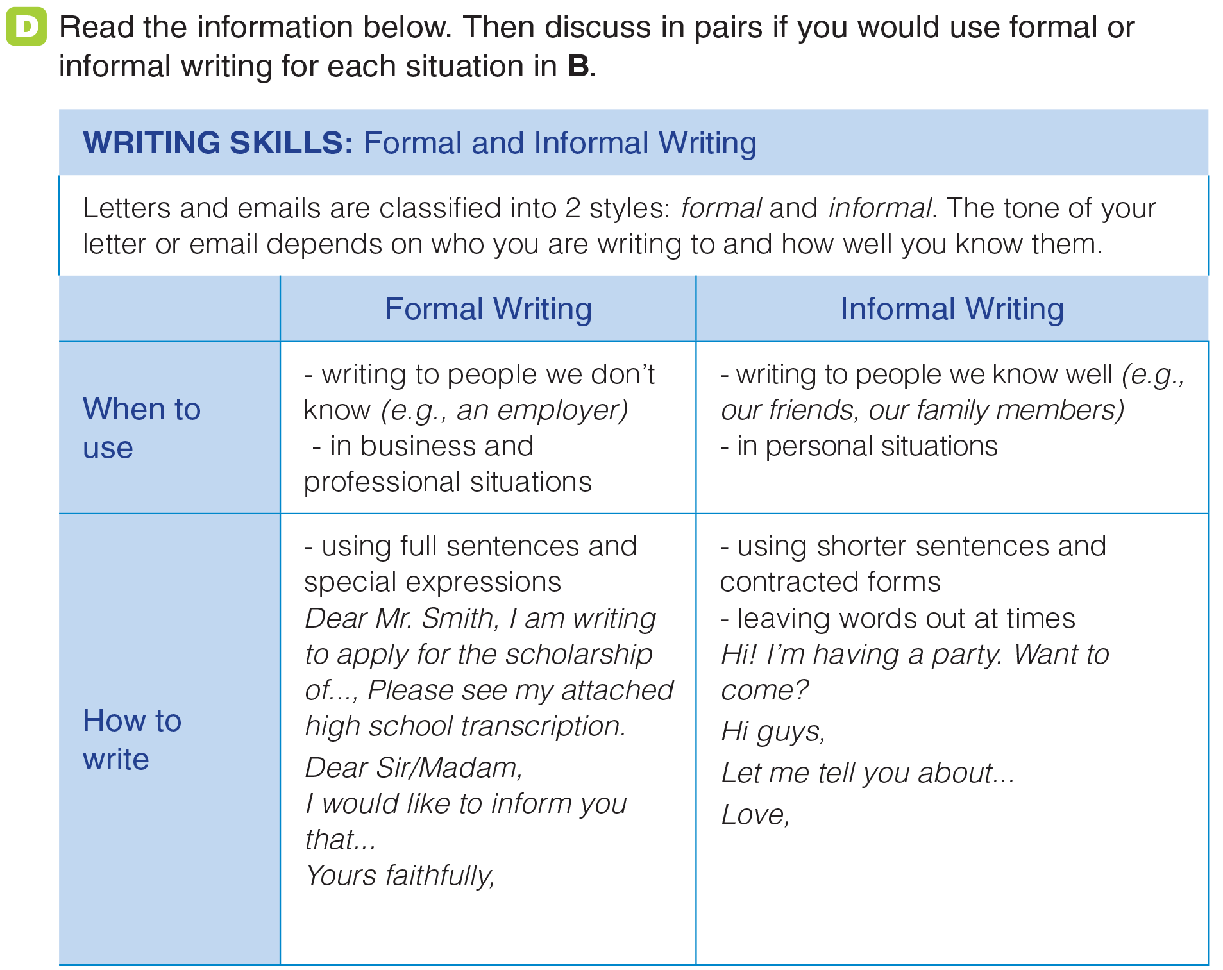
UNIT 7
COMMUNICATION
WRITING
_______________________________________________________________________________________________________________________________________________________________________________________________________________________
National Geographic Learning, a Cengage Company. © 2022 Cengage Learning, Inc. ALL RIGHTS RESERVED. This presentation tool is for teaching purpose only. May not be scanned, copied or duplicated, or posted to a publicly accessible website, in whole or in part.

Slide 53
UNIT 7
COMMUNICATION
WRITING
informal
formal
informal
formal
informal
_______________________________________________________________________________________________________________________________________________________________________________________________________________________
National Geographic Learning, a Cengage Company. © 2022 Cengage Learning, Inc. ALL RIGHTS RESERVED. This presentation tool is for teaching purpose only. May not be scanned, copied or duplicated, or posted to a publicly accessible website, in whole or in part.

Slide 54
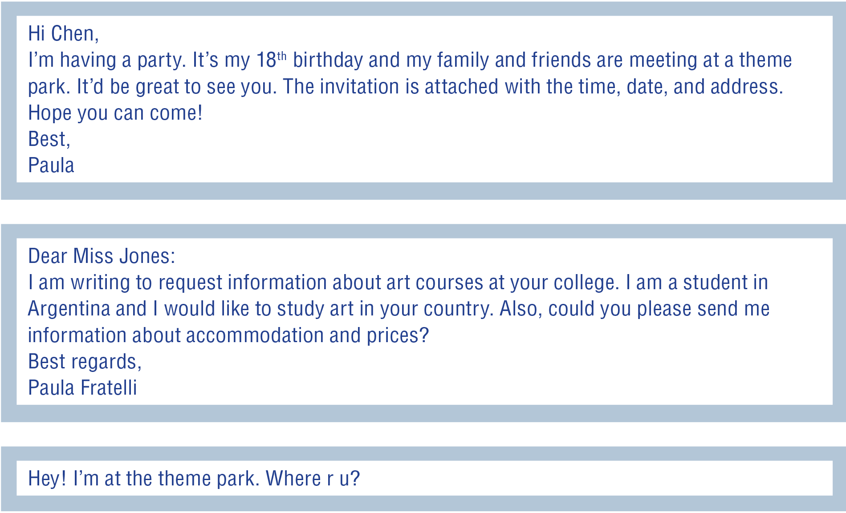
UNIT 7
COMMUNICATION
WRITING
2
1
3
_______________________________________________________________________________________________________________________________________________________________________________________________________________________
National Geographic Learning, a Cengage Company. © 2022 Cengage Learning, Inc. ALL RIGHTS RESERVED. This presentation tool is for teaching purpose only. May not be scanned, copied or duplicated, or posted to a publicly accessible website, in whole or in part.

Slide 55
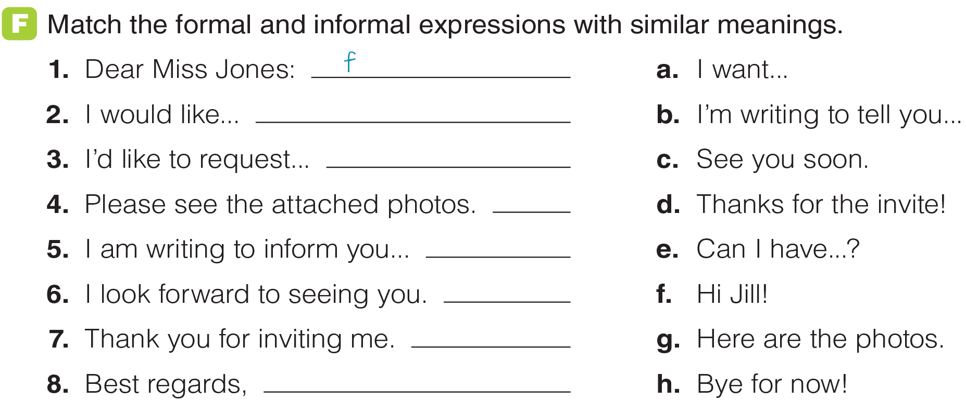
UNIT 7
COMMUNICATION
WRITING
a
e
g
b
c
d
h
_______________________________________________________________________________________________________________________________________________________________________________________________________________________
National Geographic Learning, a Cengage Company. © 2022 Cengage Learning, Inc. ALL RIGHTS RESERVED. This presentation tool is for teaching purpose only. May not be scanned, copied or duplicated, or posted to a publicly accessible website, in whole or in part.

Slide 56

UNIT 7
COMMUNICATION
GOAL CHECK
_______________________________________________________________________________________________________________________________________________________________________________________________________________________
National Geographic Learning, a Cengage Company. © 2022 Cengage Learning, Inc. ALL RIGHTS RESERVED. This presentation tool is for teaching purpose only. May not be scanned, copied or duplicated, or posted to a publicly accessible website, in whole or in part.

