Slide 1



Unit 8:
MAKING PLANS
_______________________________________________________________________________________________________________________________________________________________________________________________________________________
National Geographic Learning, a Cengage Company. © 2022 Cengage Learning, Inc. ALL RIGHTS RESERVED. This presentation tool is for teaching purpose only. May not be scanned, copied or duplicated, or posted to a publicly accessible website, in whole or in part.

Slide 2

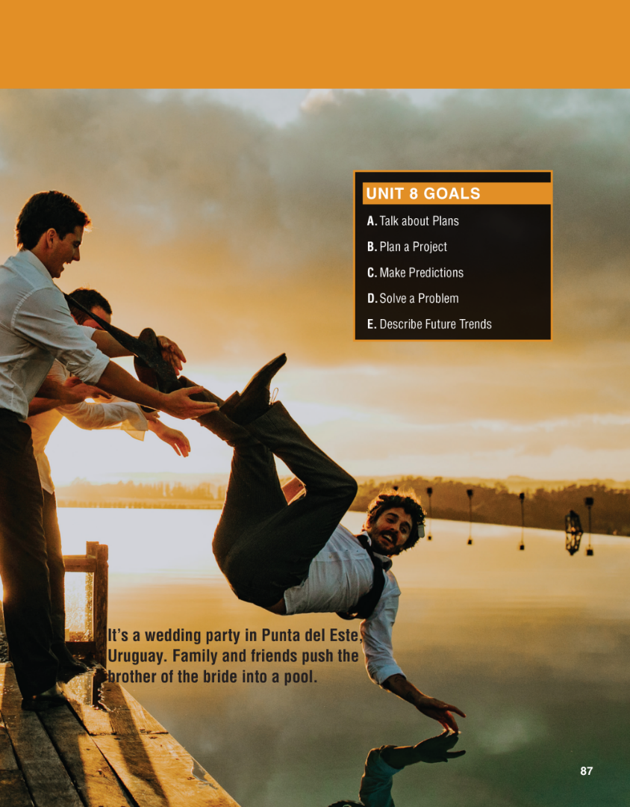

Slide 3
UNIT 8
MAKING PLANS
OVERVIEW
Do you know?
Why do people make plans? Plans and the future are inseparable because every plan we make is for a time in the future, whether that is five minutes from now or five years from now.
_______________________________________________________________________________________________________________________________________________________________________________________________________________________
National Geographic Learning, a Cengage Company. © 2022 Cengage Learning, Inc. ALL RIGHTS RESERVED. This presentation tool is for teaching purpose only. May not be scanned, copied or duplicated, or posted to a publicly accessible website, in whole or in part.

Slide 4
UNIT 8
MAKING PLANS
OVERVIEW
About the photo
This photo of a wedding was taken by Mateo Boffano from Uruguay. Mateo has explained that, when the wedding party
finished, some of the guests decided to play a practical joke on the brother of the bride by throwing him into the water.
This prank is a joyous moment of shared fun at a wedding—a special occasion when family and friends come together to celebrate.
_______________________________________________________________________________________________________________________________________________________________________________________________________________________
National Geographic Learning, a Cengage Company. © 2022 Cengage Learning, Inc. ALL RIGHTS RESERVED. This presentation tool is for teaching purpose only. May not be scanned, copied or duplicated, or posted to a publicly accessible website, in whole or in part.

Slide 5
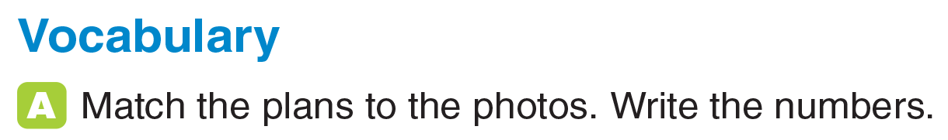
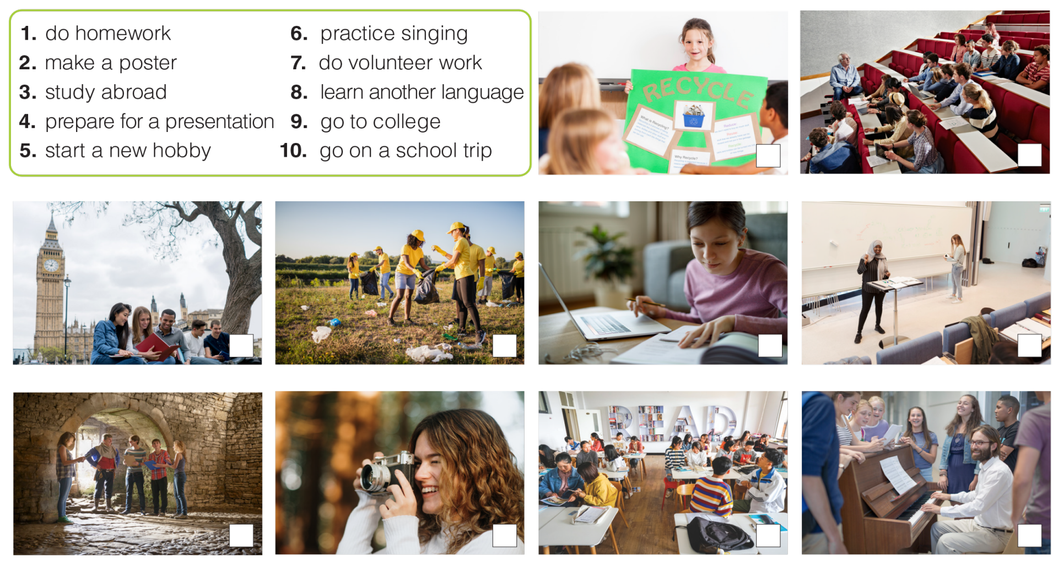
UNIT 8
MAKING PLANS
VOCABULARY
2
9
3
7
1
4
10
5
8
6
_______________________________________________________________________________________________________________________________________________________________________________________________________________________
National Geographic Learning, a Cengage Company. © 2022 Cengage Learning, Inc. ALL RIGHTS RESERVED. This presentation tool is for teaching purpose only. May not be scanned, copied or duplicated, or posted to a publicly accessible website, in whole or in part.

Slide 6
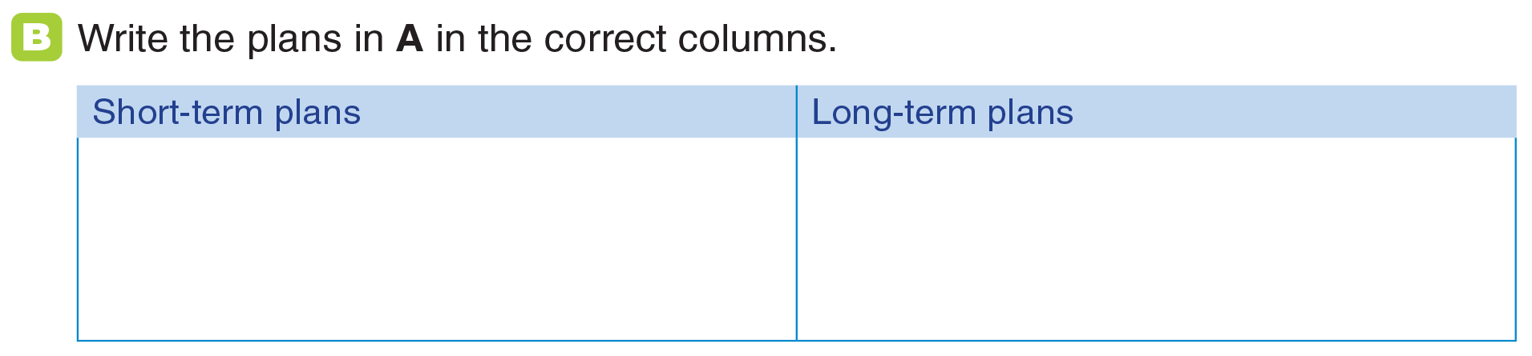
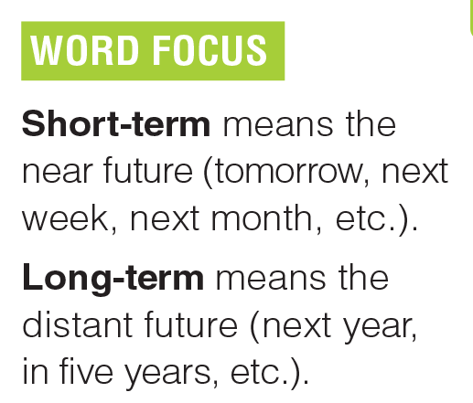
UNIT 8
MAKING PLANS
VOCABULARY
make a poster
go to college
do homework
prepare for a presentation
do volunteer work
go on a school trip
study abroad
speak English fluently
practice singing
start a new hobby
_______________________________________________________________________________________________________________________________________________________________________________________________________________________
National Geographic Learning, a Cengage Company. © 2022 Cengage Learning, Inc. ALL RIGHTS RESERVED. This presentation tool is for teaching purpose only. May not be scanned, copied or duplicated, or posted to a publicly accessible website, in whole or in part.

Slide 7
UNIT 8
MAKING PLANS
VOCABULARY
make a poster
go to college
do homework
prepare for a presentation
do volunteer work
go on a school trip
study abroad
speak English fluently
practice singing
start a new hobby
_______________________________________________________________________________________________________________________________________________________________________________________________________________________
National Geographic Learning, a Cengage Company. © 2022 Cengage Learning, Inc. ALL RIGHTS RESERVED. This presentation tool is for teaching purpose only. May not be scanned, copied or duplicated, or posted to a publicly accessible website, in whole or in part.

Slide 8
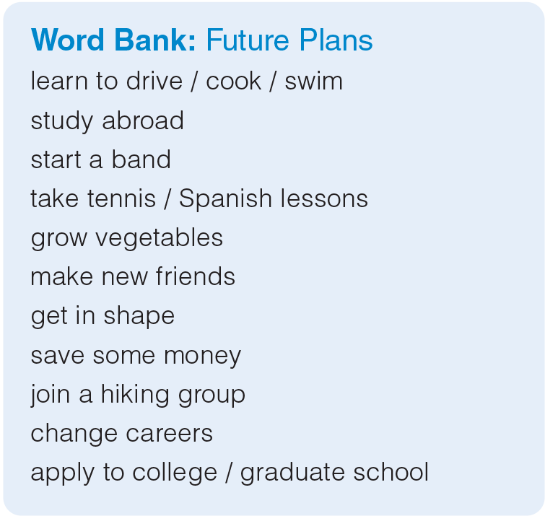
UNIT 8
MAKING PLANS
VOCABULARY
_______________________________________________________________________________________________________________________________________________________________________________________________________________________
National Geographic Learning, a Cengage Company. © 2022 Cengage Learning, Inc. ALL RIGHTS RESERVED. This presentation tool is for teaching purpose only. May not be scanned, copied or duplicated, or posted to a publicly accessible website, in whole or in part.

Slide 9
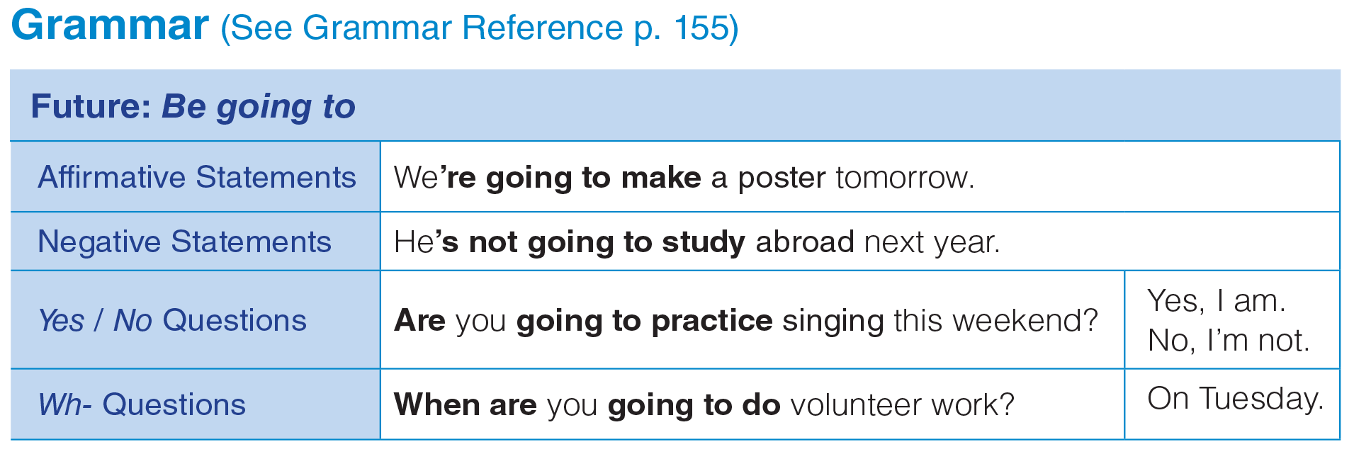
UNIT 8
MAKING PLANS
GRAMMAR
_______________________________________________________________________________________________________________________________________________________________________________________________________________________
National Geographic Learning, a Cengage Company. © 2022 Cengage Learning, Inc. ALL RIGHTS RESERVED. This presentation tool is for teaching purpose only. May not be scanned, copied or duplicated, or posted to a publicly accessible website, in whole or in part.

Slide 10
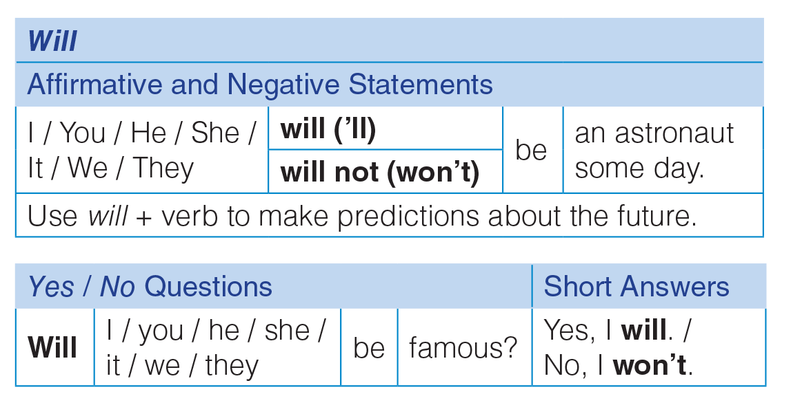
UNIT 8
MAKING PLANS
GRAMMAR
_______________________________________________________________________________________________________________________________________________________________________________________________________________________
National Geographic Learning, a Cengage Company. © 2022 Cengage Learning, Inc. ALL RIGHTS RESERVED. This presentation tool is for teaching purpose only. May not be scanned, copied or duplicated, or posted to a publicly accessible website, in whole or in part.

Slide 11
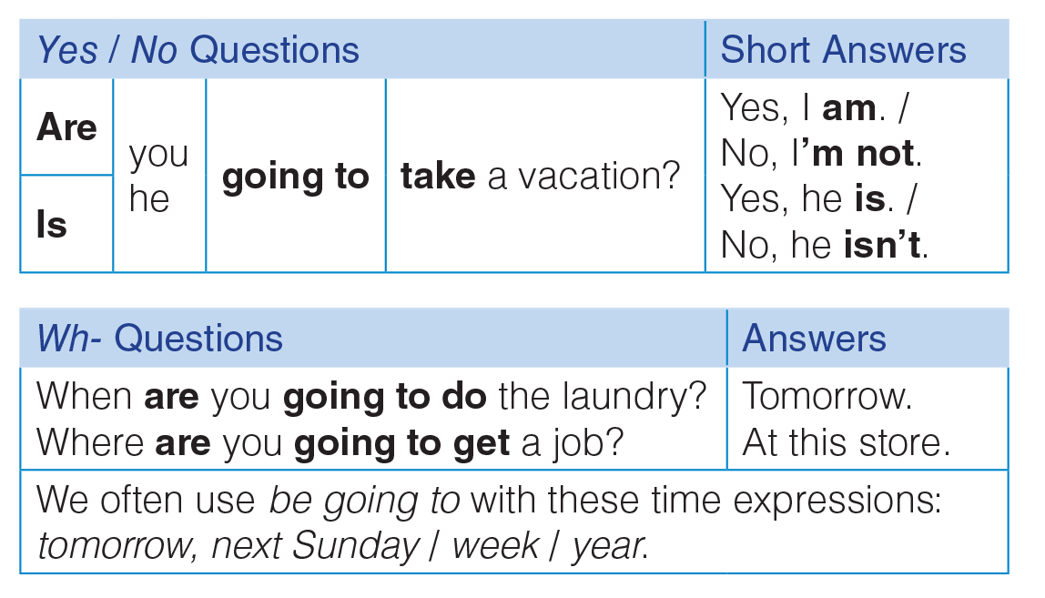
UNIT 8
MAKING PLANS
GRAMMAR
_______________________________________________________________________________________________________________________________________________________________________________________________________________________
National Geographic Learning, a Cengage Company. © 2022 Cengage Learning, Inc. ALL RIGHTS RESERVED. This presentation tool is for teaching purpose only. May not be scanned, copied or duplicated, or posted to a publicly accessible website, in whole or in part.

Slide 12
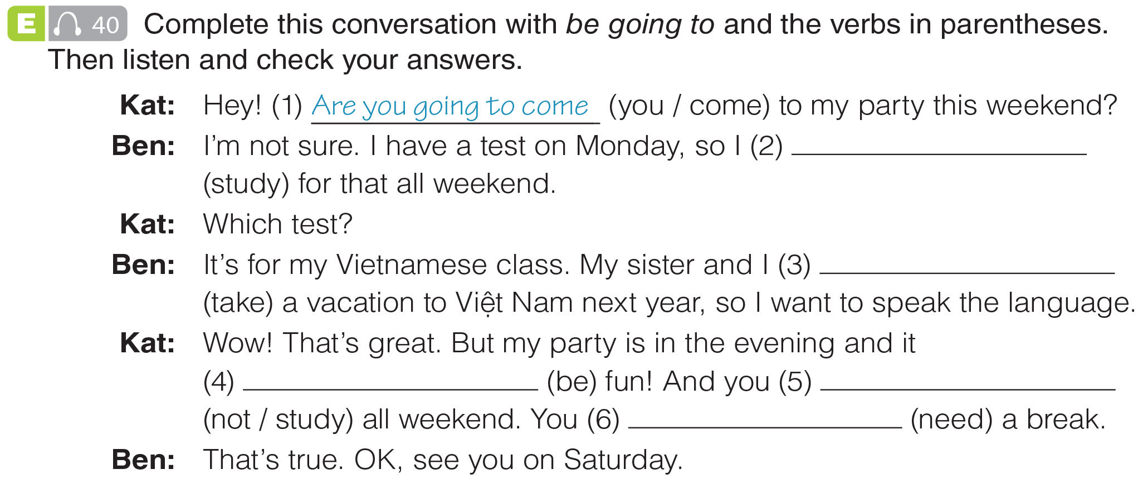

UNIT 8
MAKING PLANS
GRAMMAR
‘m going to study
are going to take
‘s going to be
aren’t going to study
‘re going to need
_______________________________________________________________________________________________________________________________________________________________________________________________________________________
National Geographic Learning, a Cengage Company. © 2022 Cengage Learning, Inc. ALL RIGHTS RESERVED. This presentation tool is for teaching purpose only. May not be scanned, copied or duplicated, or posted to a publicly accessible website, in whole or in part.

Slide 13
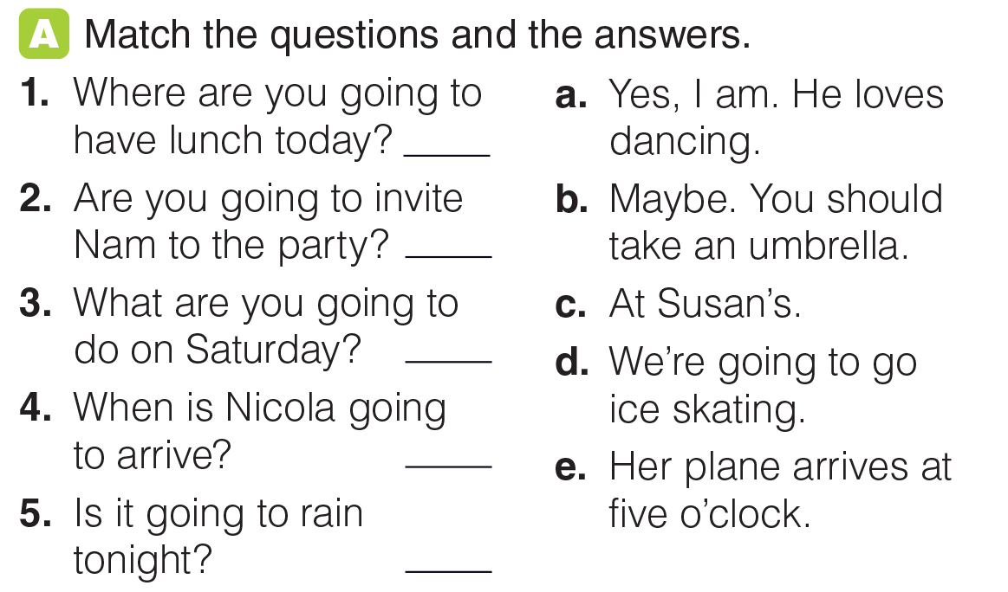
UNIT 8
MAKING PLANS
GRAMMAR
c
a
d
e
b
_______________________________________________________________________________________________________________________________________________________________________________________________________________________
National Geographic Learning, a Cengage Company. © 2022 Cengage Learning, Inc. ALL RIGHTS RESERVED. This presentation tool is for teaching purpose only. May not be scanned, copied or duplicated, or posted to a publicly accessible website, in whole or in part.

Slide 14
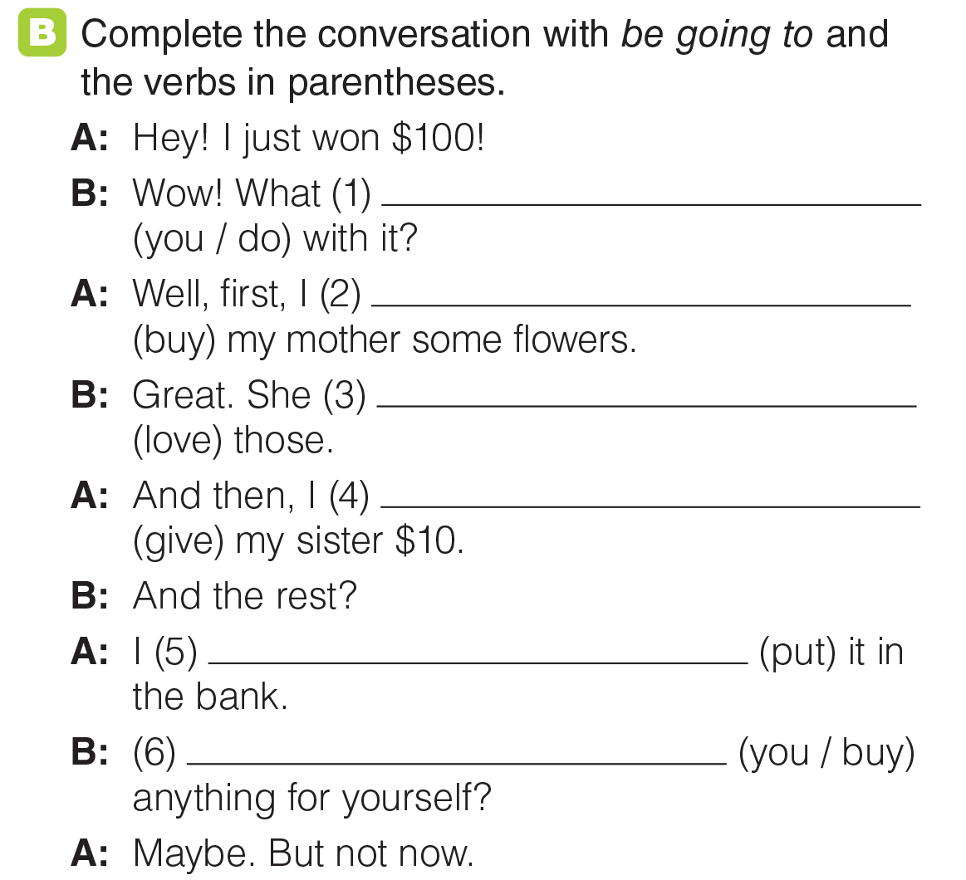
UNIT 8
MAKING PLANS
GRAMMAR
are you going to do
’m / am going to buy
’s / is going to love
’m / am going to give
’m / am going to put
Are you going to buy
_______________________________________________________________________________________________________________________________________________________________________________________________________________________
National Geographic Learning, a Cengage Company. © 2022 Cengage Learning, Inc. ALL RIGHTS RESERVED. This presentation tool is for teaching purpose only. May not be scanned, copied or duplicated, or posted to a publicly accessible website, in whole or in part.

Slide 15
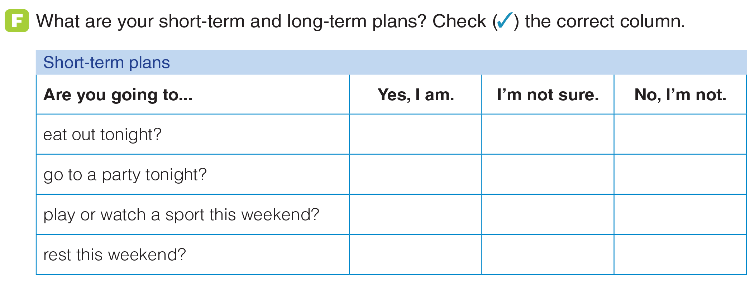
UNIT 8
MAKING PLANS
GRAMMAR
_______________________________________________________________________________________________________________________________________________________________________________________________________________________
National Geographic Learning, a Cengage Company. © 2022 Cengage Learning, Inc. ALL RIGHTS RESERVED. This presentation tool is for teaching purpose only. May not be scanned, copied or duplicated, or posted to a publicly accessible website, in whole or in part.

Slide 16
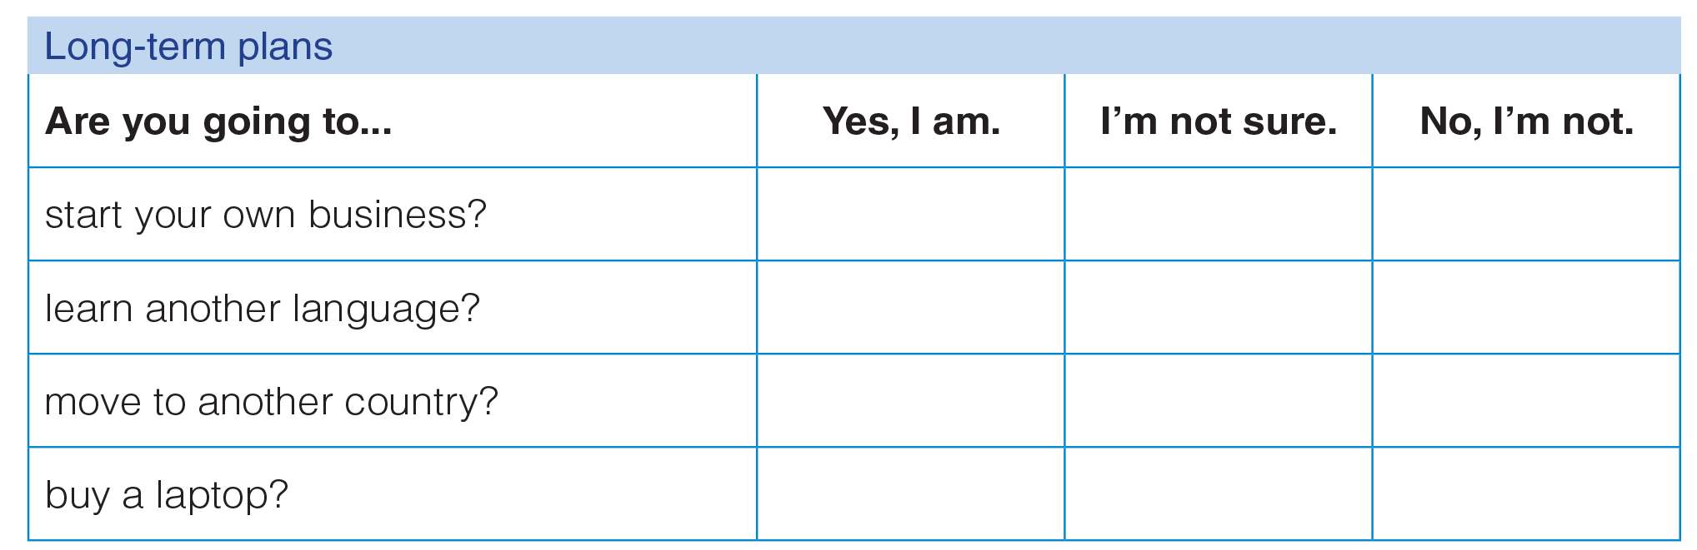
UNIT 8
MAKING PLANS
GRAMMAR
_______________________________________________________________________________________________________________________________________________________________________________________________________________________
National Geographic Learning, a Cengage Company. © 2022 Cengage Learning, Inc. ALL RIGHTS RESERVED. This presentation tool is for teaching purpose only. May not be scanned, copied or duplicated, or posted to a publicly accessible website, in whole or in part.

Slide 17
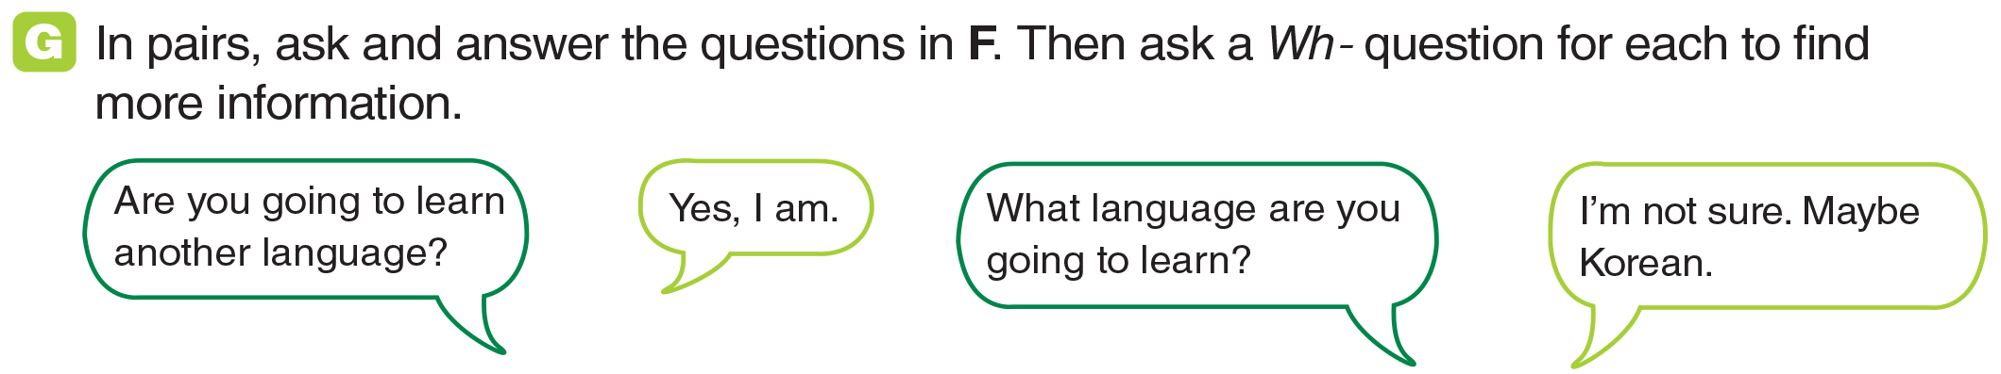
UNIT 8
MAKING PLANS
GRAMMAR
_______________________________________________________________________________________________________________________________________________________________________________________________________________________
National Geographic Learning, a Cengage Company. © 2022 Cengage Learning, Inc. ALL RIGHTS RESERVED. This presentation tool is for teaching purpose only. May not be scanned, copied or duplicated, or posted to a publicly accessible website, in whole or in part.

Slide 18
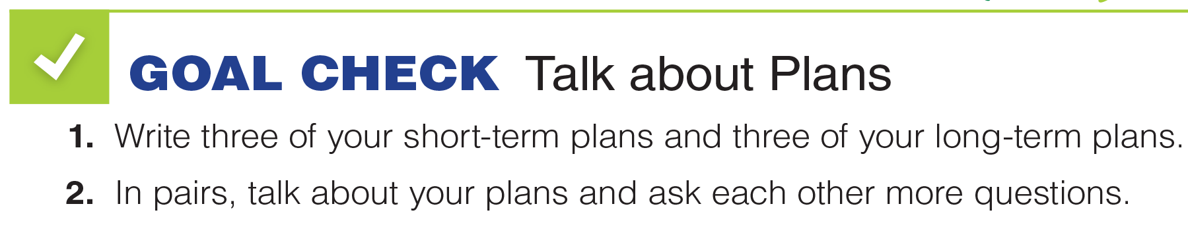
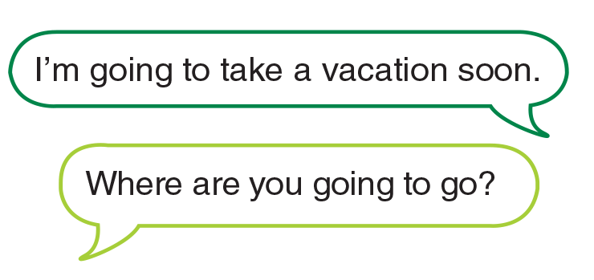
UNIT 8
MAKING PLANS
GOAL CHECK
_______________________________________________________________________________________________________________________________________________________________________________________________________________________
National Geographic Learning, a Cengage Company. © 2022 Cengage Learning, Inc. ALL RIGHTS RESERVED. This presentation tool is for teaching purpose only. May not be scanned, copied or duplicated, or posted to a publicly accessible website, in whole or in part.

Slide 19
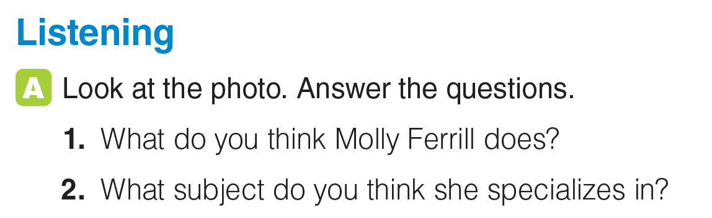
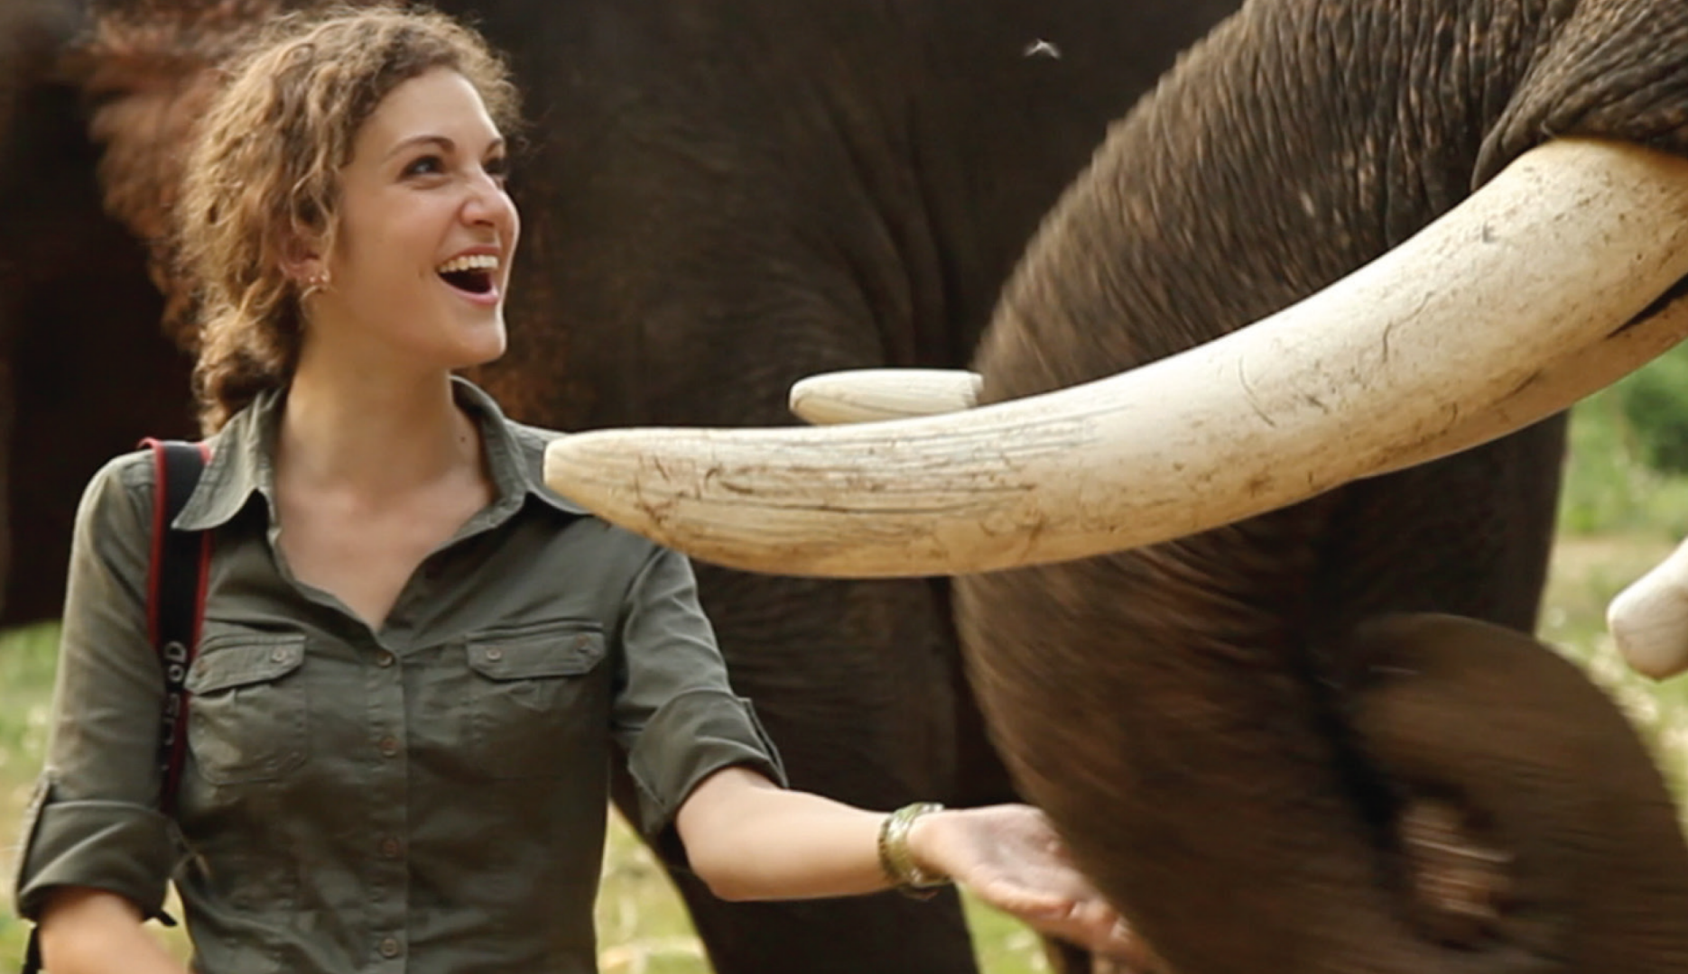
UNIT 8
MAKING PLANS
LISTENING
_______________________________________________________________________________________________________________________________________________________________________________________________________________________
National Geographic Learning, a Cengage Company. © 2022 Cengage Learning, Inc. ALL RIGHTS RESERVED. This presentation tool is for teaching purpose only. May not be scanned, copied or duplicated, or posted to a publicly accessible website, in whole or in part.

Slide 20

UNIT 8
MAKING PLANS
LISTENING
She is a photographer, writer, and filmmaker.
the environment
_______________________________________________________________________________________________________________________________________________________________________________________________________________________
National Geographic Learning, a Cengage Company. © 2022 Cengage Learning, Inc. ALL RIGHTS RESERVED. This presentation tool is for teaching purpose only. May not be scanned, copied or duplicated, or posted to a publicly accessible website, in whole or in part.

Slide 21
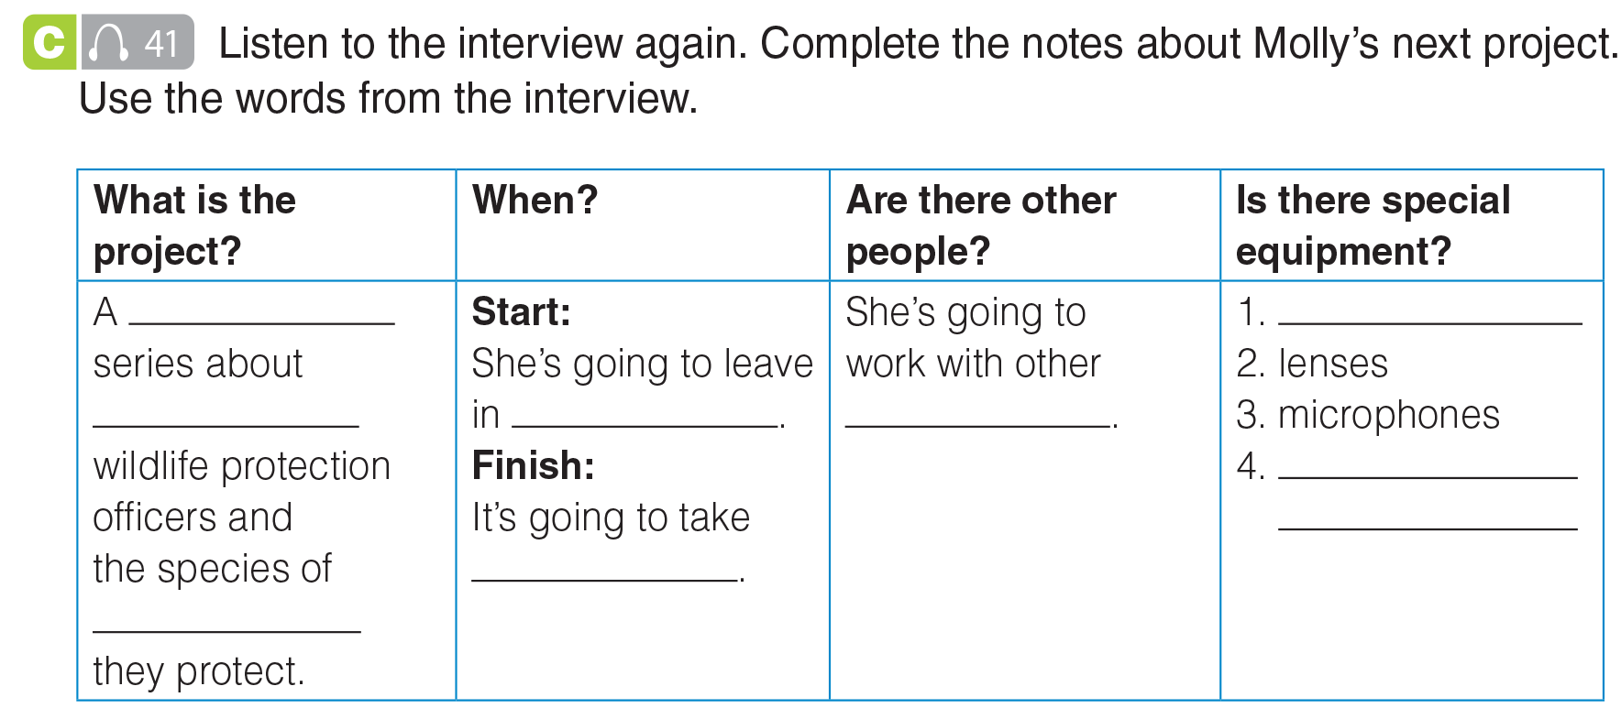
UNIT 8
MAKING PLANS
LISTENING
video
cameras
female
two months
filmmakers
different types
of clothing
about a year
animal
_______________________________________________________________________________________________________________________________________________________________________________________________________________________
National Geographic Learning, a Cengage Company. © 2022 Cengage Learning, Inc. ALL RIGHTS RESERVED. This presentation tool is for teaching purpose only. May not be scanned, copied or duplicated, or posted to a publicly accessible website, in whole or in part.

Slide 22
UNIT 8
MAKING PLANS
LISTENING
video
cameras
female
two months
filmmakers
different types
of clothing
about a year
animal
_______________________________________________________________________________________________________________________________________________________________________________________________________________________
National Geographic Learning, a Cengage Company. © 2022 Cengage Learning, Inc. ALL RIGHTS RESERVED. This presentation tool is for teaching purpose only. May not be scanned, copied or duplicated, or posted to a publicly accessible website, in whole or in part.

Slide 23
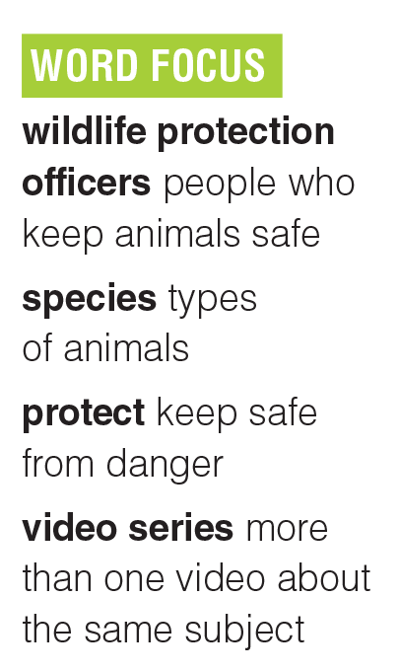
UNIT 8
MAKING PLANS
LISTENING
_______________________________________________________________________________________________________________________________________________________________________________________________________________________
National Geographic Learning, a Cengage Company. © 2022 Cengage Learning, Inc. ALL RIGHTS RESERVED. This presentation tool is for teaching purpose only. May not be scanned, copied or duplicated, or posted to a publicly accessible website, in whole or in part.

Slide 24
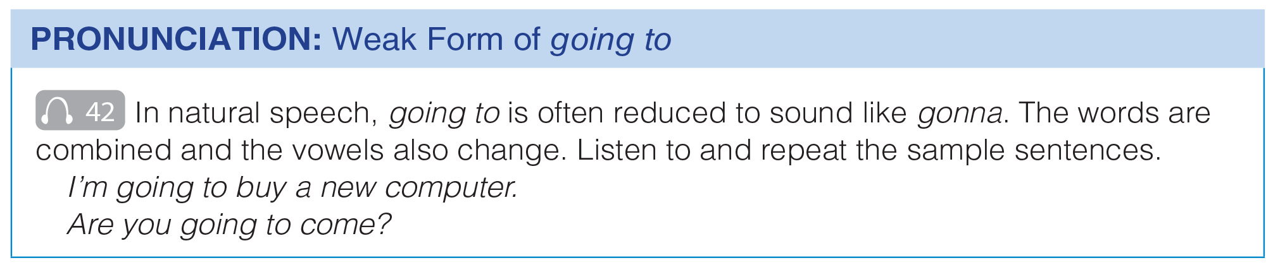
UNIT 8
MAKING PLANS
PRONUNCIATION
_______________________________________________________________________________________________________________________________________________________________________________________________________________________
National Geographic Learning, a Cengage Company. © 2022 Cengage Learning, Inc. ALL RIGHTS RESERVED. This presentation tool is for teaching purpose only. May not be scanned, copied or duplicated, or posted to a publicly accessible website, in whole or in part.

Slide 25
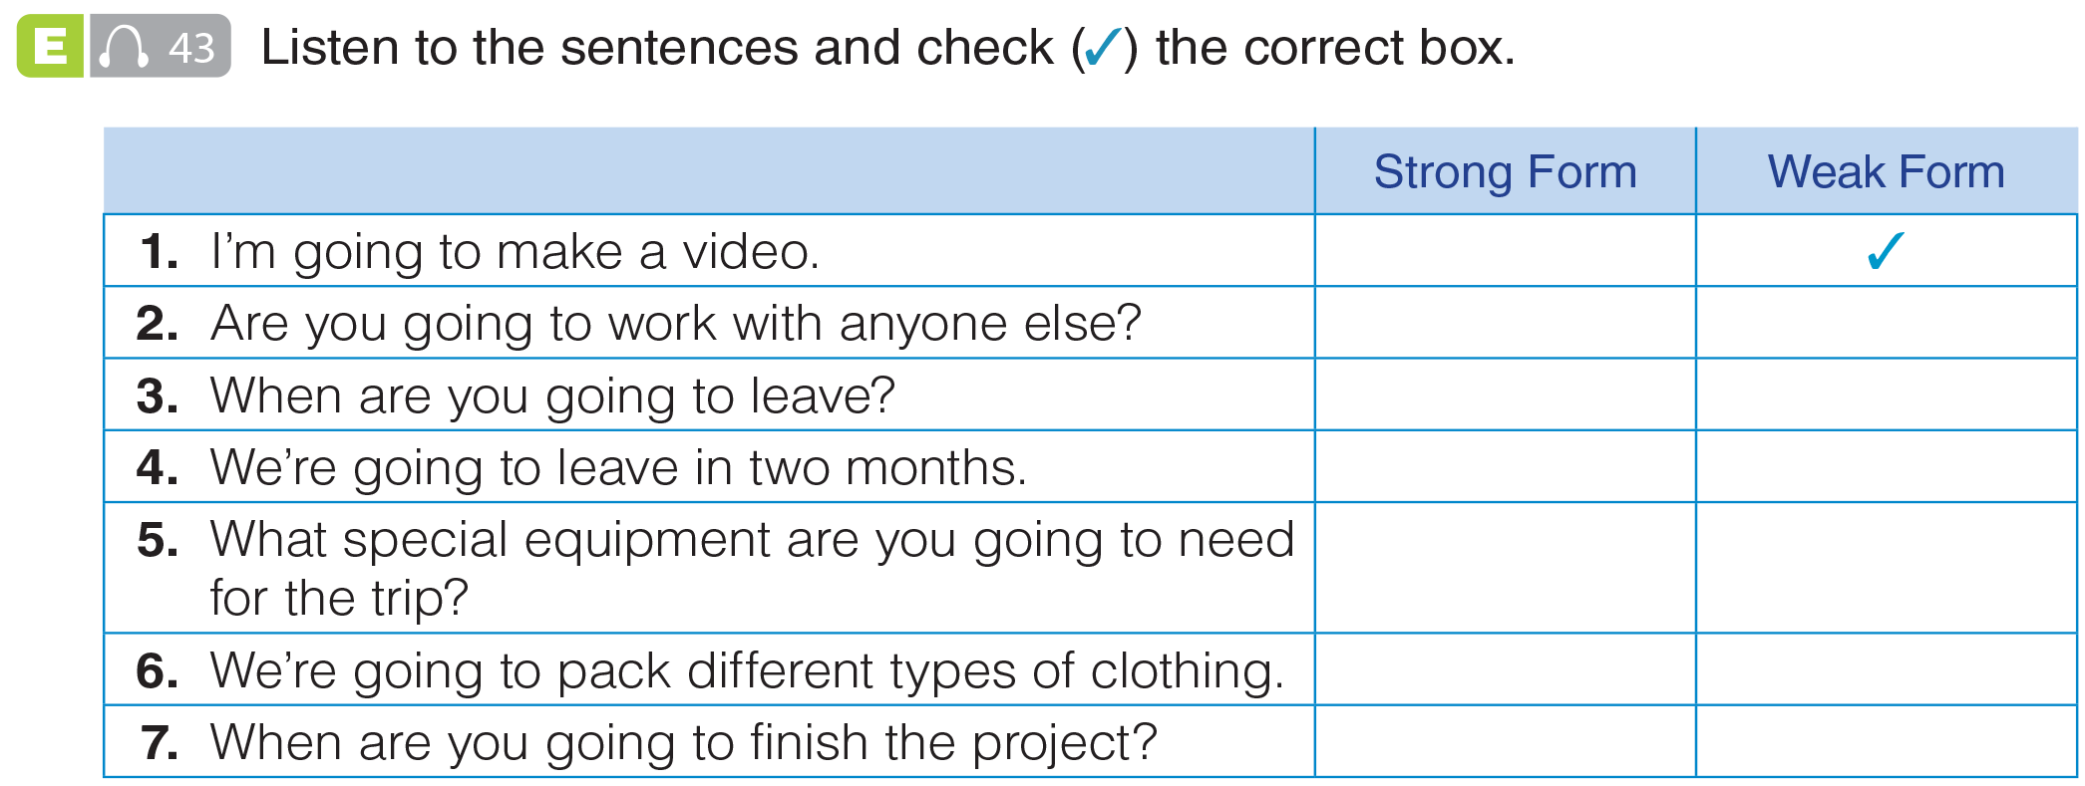
UNIT 8
MAKING PLANS
PRONUNCIATION
✓
✓
✓
✓
✓
✓
_______________________________________________________________________________________________________________________________________________________________________________________________________________________
National Geographic Learning, a Cengage Company. © 2022 Cengage Learning, Inc. ALL RIGHTS RESERVED. This presentation tool is for teaching purpose only. May not be scanned, copied or duplicated, or posted to a publicly accessible website, in whole or in part.

Slide 26
UNIT 8
MAKING PLANS
PRONUNCIATION
✓
✓
✓
✓
✓
✓
_______________________________________________________________________________________________________________________________________________________________________________________________________________________
National Geographic Learning, a Cengage Company. © 2022 Cengage Learning, Inc. ALL RIGHTS RESERVED. This presentation tool is for teaching purpose only. May not be scanned, copied or duplicated, or posted to a publicly accessible website, in whole or in part.

Slide 27
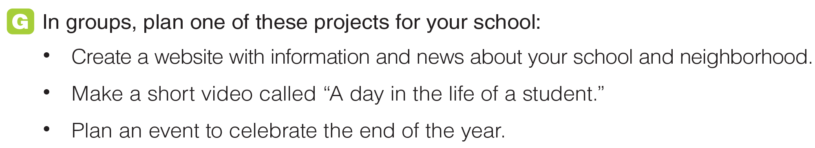
UNIT 8
MAKING PLANS
PRONUNCIATION
_______________________________________________________________________________________________________________________________________________________________________________________________________________________
National Geographic Learning, a Cengage Company. © 2022 Cengage Learning, Inc. ALL RIGHTS RESERVED. This presentation tool is for teaching purpose only. May not be scanned, copied or duplicated, or posted to a publicly accessible website, in whole or in part.

Slide 28

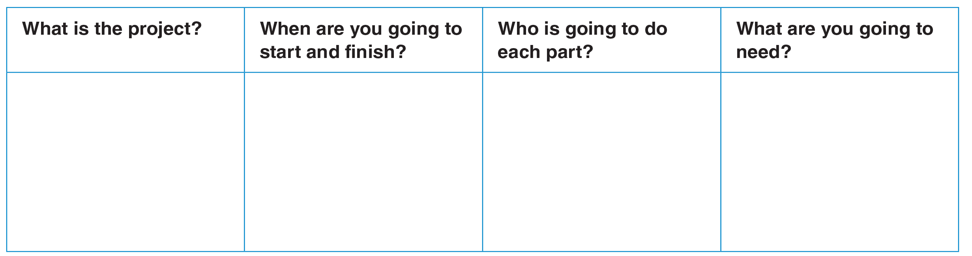
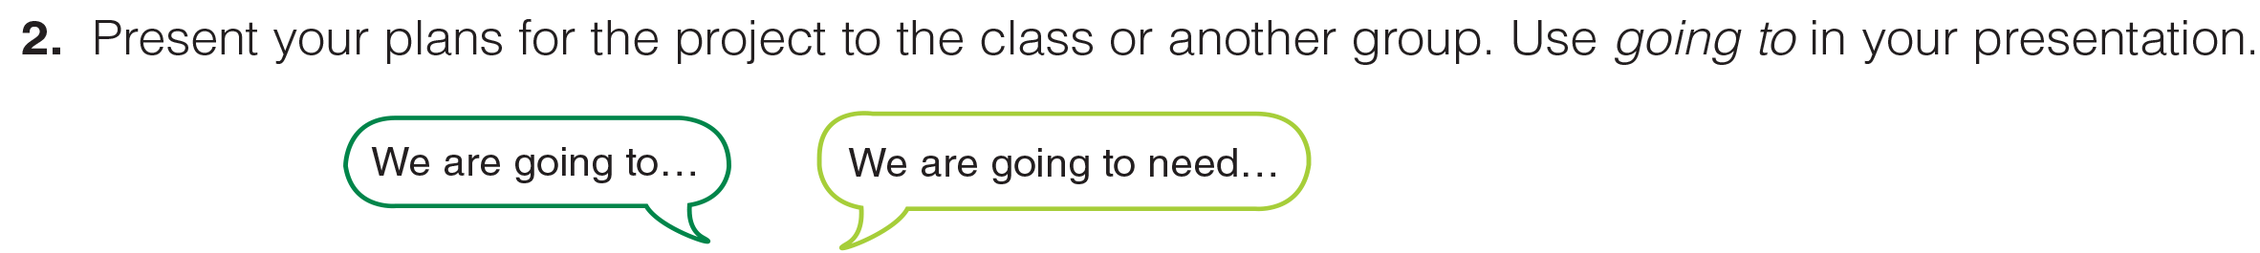
UNIT 8
MAKING PLANS
GOAL CHECK
_______________________________________________________________________________________________________________________________________________________________________________________________________________________
National Geographic Learning, a Cengage Company. © 2022 Cengage Learning, Inc. ALL RIGHTS RESERVED. This presentation tool is for teaching purpose only. May not be scanned, copied or duplicated, or posted to a publicly accessible website, in whole or in part.

Slide 29
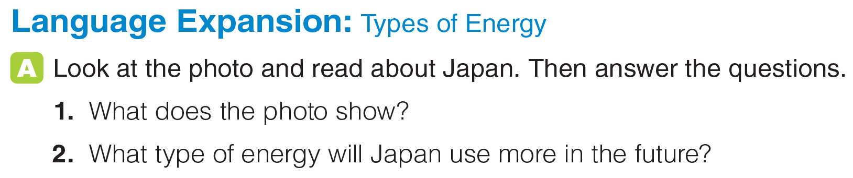

UNIT 8
MAKING PLANS
LANGUAGE EXPANSION
_______________________________________________________________________________________________________________________________________________________________________________________________________________________
National Geographic Learning, a Cengage Company. © 2022 Cengage Learning, Inc. ALL RIGHTS RESERVED. This presentation tool is for teaching purpose only. May not be scanned, copied or duplicated, or posted to a publicly accessible website, in whole or in part.

Slide 30
UNIT 8
MAKING PLANS
LANGUAGE EXPANSION
1. Solar panels on the top of a building in Tokyo
2. Renewable energy
_______________________________________________________________________________________________________________________________________________________________________________________________________________________
National Geographic Learning, a Cengage Company. © 2022 Cengage Learning, Inc. ALL RIGHTS RESERVED. This presentation tool is for teaching purpose only. May not be scanned, copied or duplicated, or posted to a publicly accessible website, in whole or in part.

Slide 31
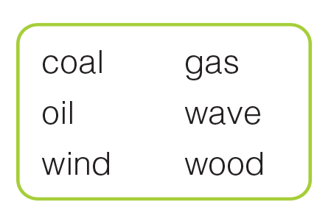
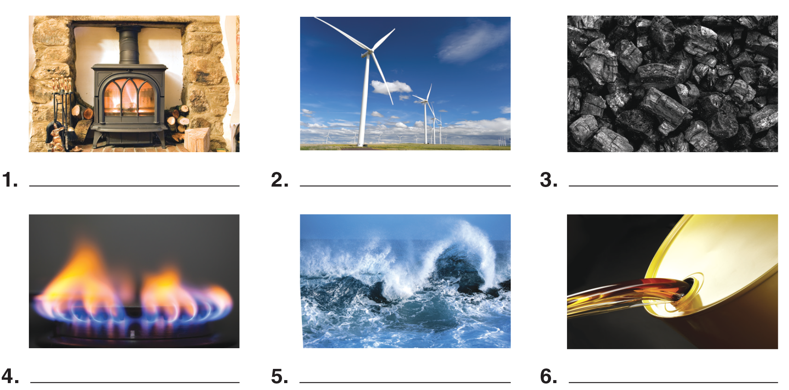
UNIT 8
MAKING PLANS
LANGUAGE EXPANSION
wood
wind
coal
gas
wave
oil
_______________________________________________________________________________________________________________________________________________________________________________________________________________________
National Geographic Learning, a Cengage Company. © 2022 Cengage Learning, Inc. ALL RIGHTS RESERVED. This presentation tool is for teaching purpose only. May not be scanned, copied or duplicated, or posted to a publicly accessible website, in whole or in part.

Slide 32
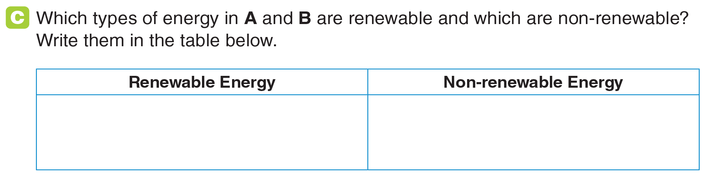
UNIT 8
MAKING PLANS
LANGUAGE EXPANSION
solar, wind, wave
wood, coal, gas, oil
_______________________________________________________________________________________________________________________________________________________________________________________________________________________
National Geographic Learning, a Cengage Company. © 2022 Cengage Learning, Inc. ALL RIGHTS RESERVED. This presentation tool is for teaching purpose only. May not be scanned, copied or duplicated, or posted to a publicly accessible website, in whole or in part.

Slide 33
UNIT 8
MAKING PLANS
LANGUAGE EXPANSION
_______________________________________________________________________________________________________________________________________________________________________________________________________________________
National Geographic Learning, a Cengage Company. © 2022 Cengage Learning, Inc. ALL RIGHTS RESERVED. This presentation tool is for teaching purpose only. May not be scanned, copied or duplicated, or posted to a publicly accessible website, in whole or in part.

Slide 34
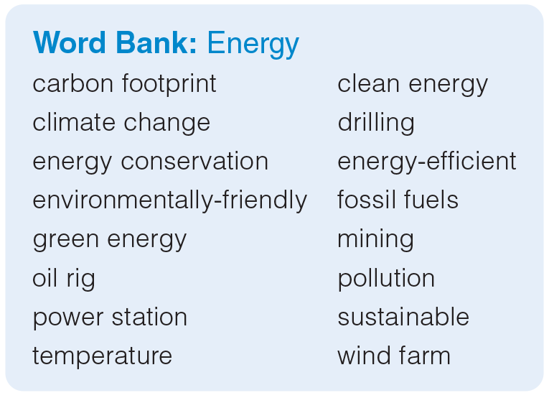
UNIT 8
MAKING PLANS
LANGUAGE EXPANSION
_______________________________________________________________________________________________________________________________________________________________________________________________________________________
National Geographic Learning, a Cengage Company. © 2022 Cengage Learning, Inc. ALL RIGHTS RESERVED. This presentation tool is for teaching purpose only. May not be scanned, copied or duplicated, or posted to a publicly accessible website, in whole or in part.

Slide 35
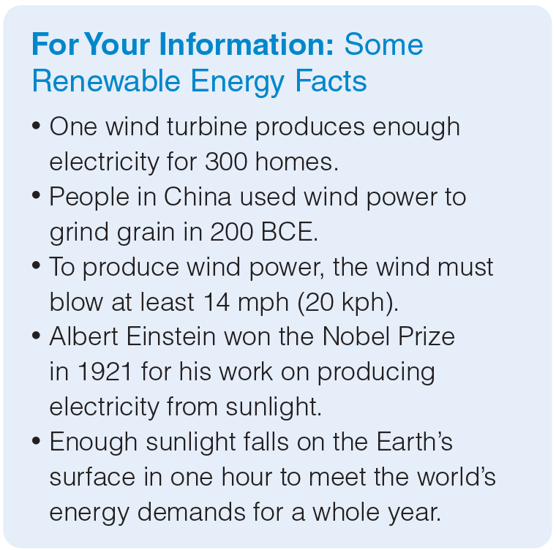
UNIT 8
MAKING PLANS
LANGUAGE EXPANSION
_______________________________________________________________________________________________________________________________________________________________________________________________________________________
National Geographic Learning, a Cengage Company. © 2022 Cengage Learning, Inc. ALL RIGHTS RESERVED. This presentation tool is for teaching purpose only. May not be scanned, copied or duplicated, or posted to a publicly accessible website, in whole or in part.

Slide 36
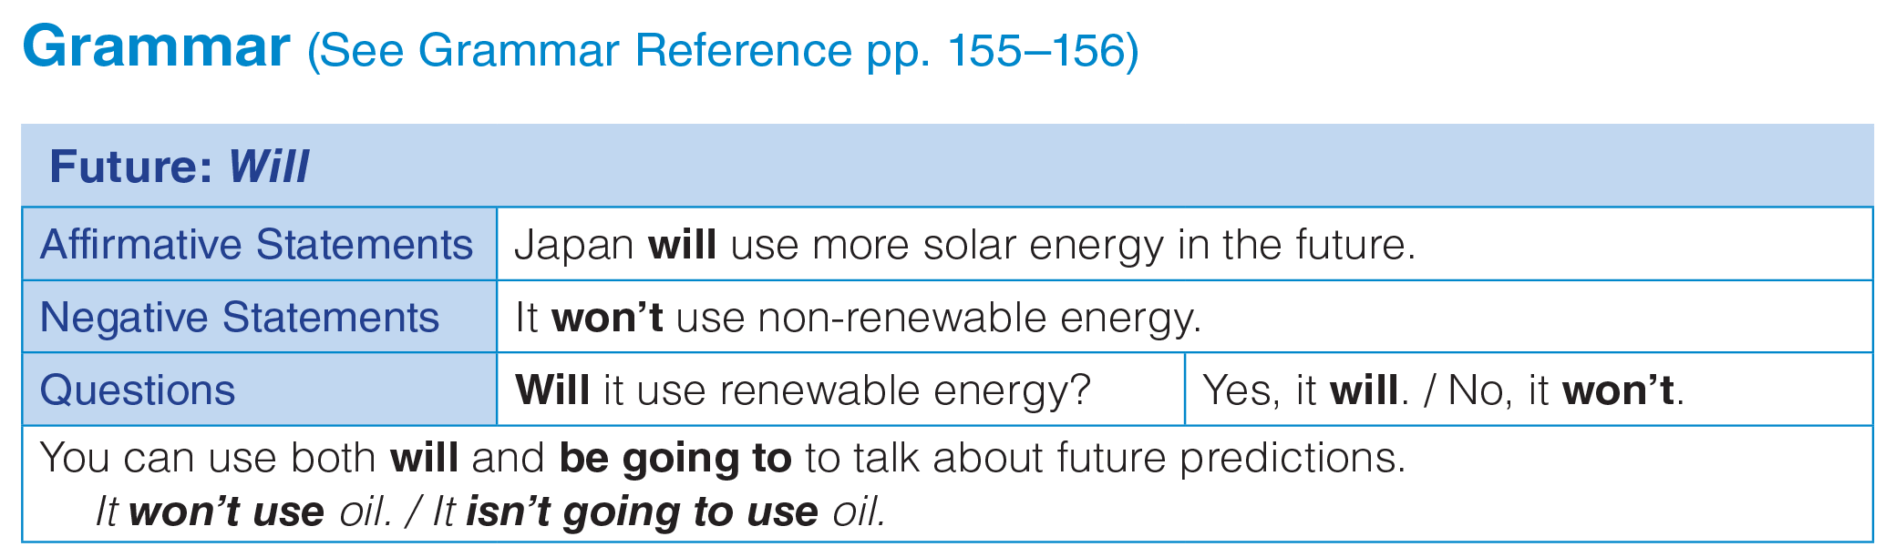
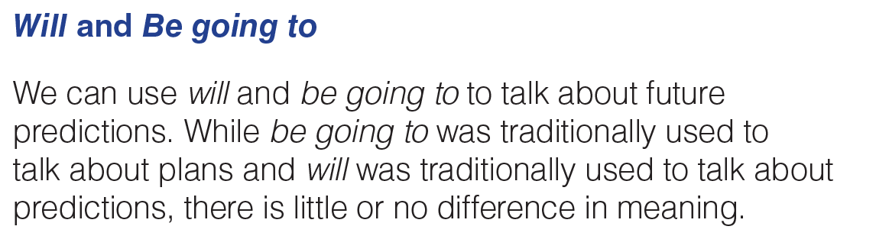
UNIT 8
MAKING PLANS
GRAMMAR
_______________________________________________________________________________________________________________________________________________________________________________________________________________________
National Geographic Learning, a Cengage Company. © 2022 Cengage Learning, Inc. ALL RIGHTS RESERVED. This presentation tool is for teaching purpose only. May not be scanned, copied or duplicated, or posted to a publicly accessible website, in whole or in part.

Slide 37
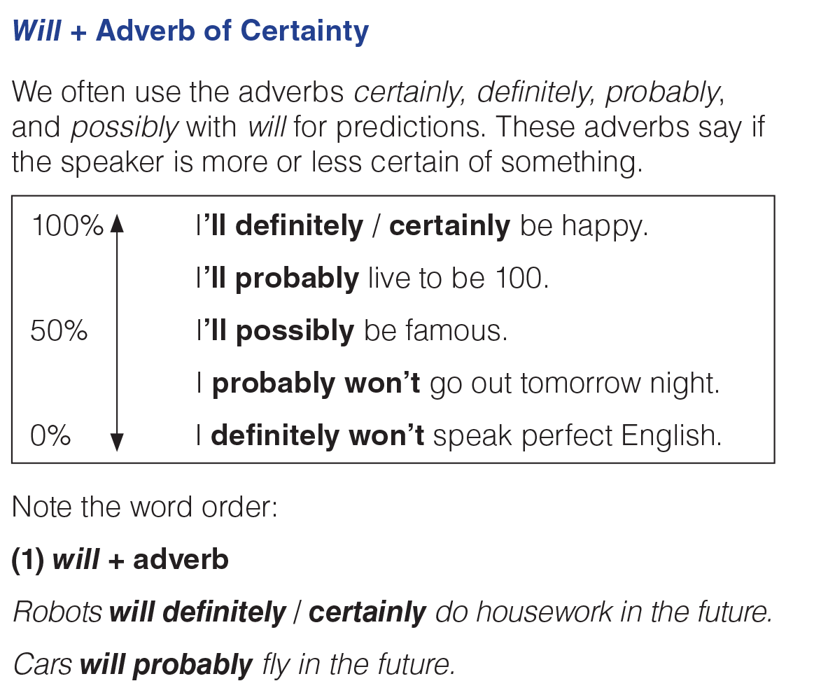
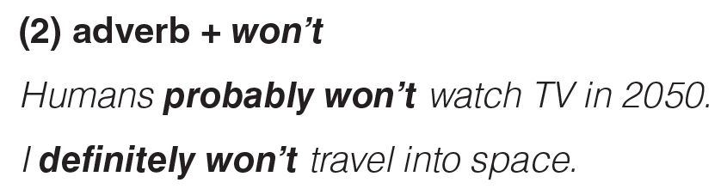
UNIT 8
MAKING PLANS
GRAMMAR
_______________________________________________________________________________________________________________________________________________________________________________________________________________________
National Geographic Learning, a Cengage Company. © 2022 Cengage Learning, Inc. ALL RIGHTS RESERVED. This presentation tool is for teaching purpose only. May not be scanned, copied or duplicated, or posted to a publicly accessible website, in whole or in part.

Slide 38
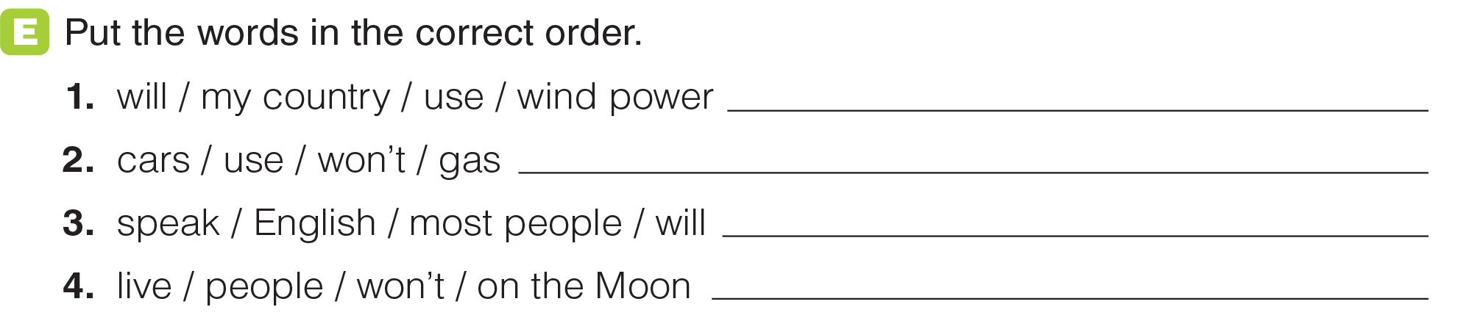
UNIT 8
MAKING PLANS
GRAMMAR
My country will use wind power.
Cars won’t use gas.
Most people will speak English.
People won’t live on the Moon.
_______________________________________________________________________________________________________________________________________________________________________________________________________________________
National Geographic Learning, a Cengage Company. © 2022 Cengage Learning, Inc. ALL RIGHTS RESERVED. This presentation tool is for teaching purpose only. May not be scanned, copied or duplicated, or posted to a publicly accessible website, in whole or in part.

Slide 39
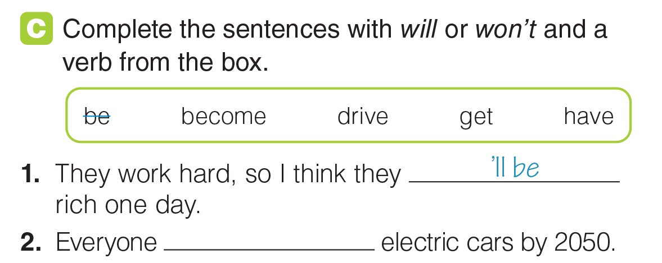
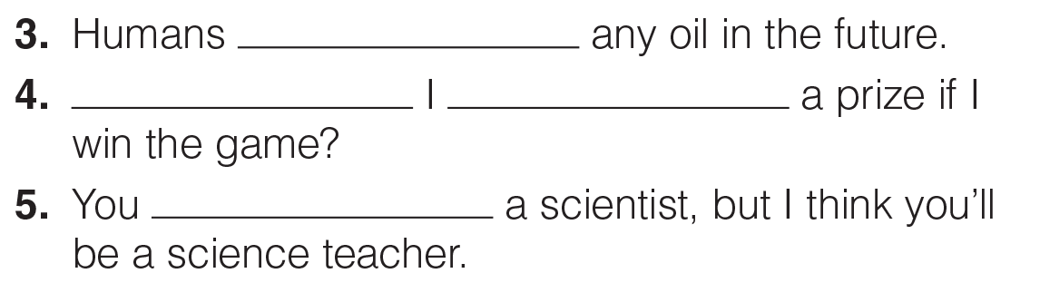
UNIT 8
MAKING PLANS
GRAMMAR
will drive
won’t have
Will
get
won’t become
_______________________________________________________________________________________________________________________________________________________________________________________________________________________
National Geographic Learning, a Cengage Company. © 2022 Cengage Learning, Inc. ALL RIGHTS RESERVED. This presentation tool is for teaching purpose only. May not be scanned, copied or duplicated, or posted to a publicly accessible website, in whole or in part.

Slide 40
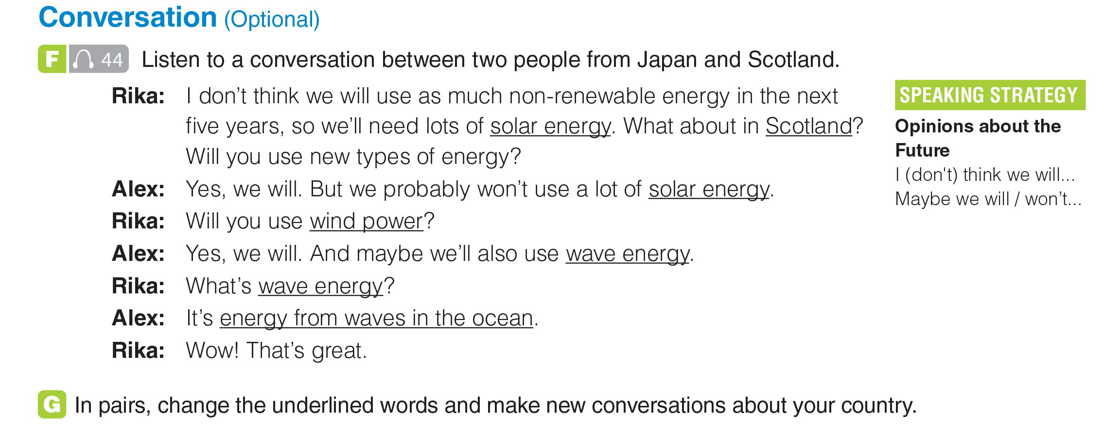
UNIT 8
MAKING PLANS
CONVERSATION
_______________________________________________________________________________________________________________________________________________________________________________________________________________________
National Geographic Learning, a Cengage Company. © 2022 Cengage Learning, Inc. ALL RIGHTS RESERVED. This presentation tool is for teaching purpose only. May not be scanned, copied or duplicated, or posted to a publicly accessible website, in whole or in part.

Slide 41
UNIT 8
MAKING PLANS
CONVERSATION
_______________________________________________________________________________________________________________________________________________________________________________________________________________________
National Geographic Learning, a Cengage Company. © 2022 Cengage Learning, Inc. ALL RIGHTS RESERVED. This presentation tool is for teaching purpose only. May not be scanned, copied or duplicated, or posted to a publicly accessible website, in whole or in part.

Slide 42
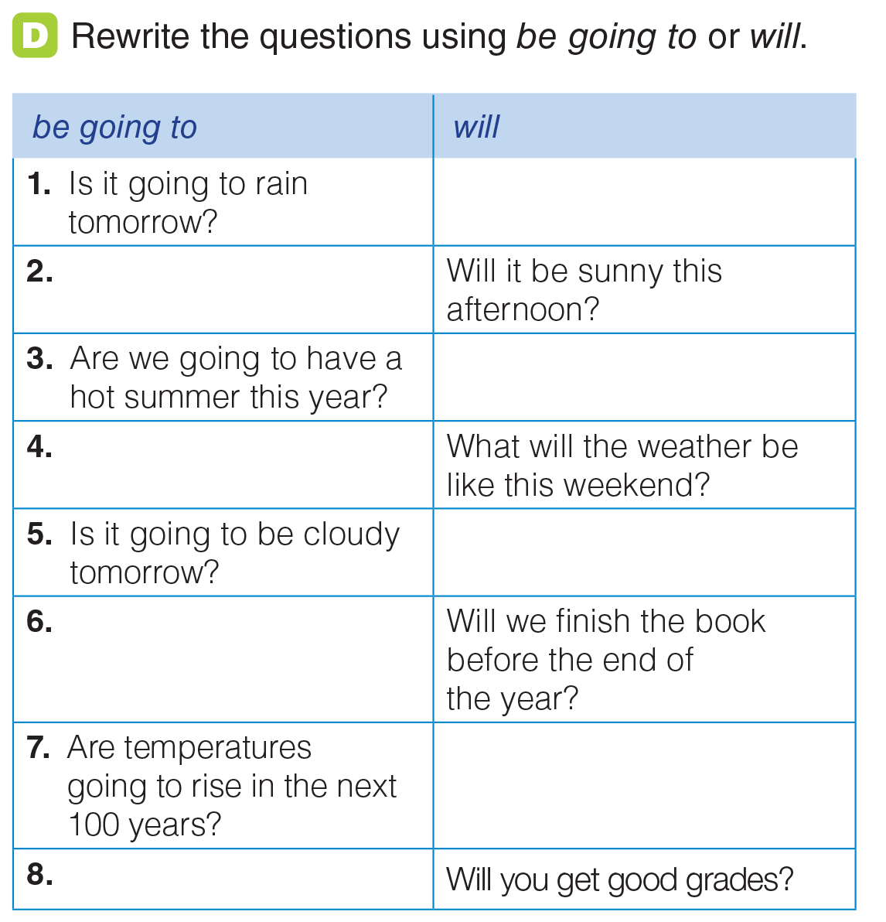
UNIT 8
MAKING PLANS
GRAMMAR
Will it rain tomorrow?
Is it going to be sunny this afternoon?
Will we have a hot summer this year?
What is the weather going
to be like this weekend?
Will it be cloudy tomorrow?
Are we going to finish the book before the end of the year?
Will temperatures rise in the next 100 years?
Are you going to get good grades?
_______________________________________________________________________________________________________________________________________________________________________________________________________________________
National Geographic Learning, a Cengage Company. © 2022 Cengage Learning, Inc. ALL RIGHTS RESERVED. This presentation tool is for teaching purpose only. May not be scanned, copied or duplicated, or posted to a publicly accessible website, in whole or in part.

Slide 43
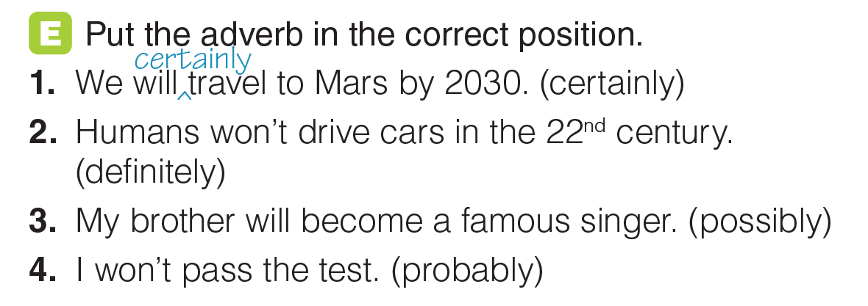
UNIT 8
MAKING PLANS
GRAMMAR
definitely
^
possibly
^
probably
^
_______________________________________________________________________________________________________________________________________________________________________________________________________________________
National Geographic Learning, a Cengage Company. © 2022 Cengage Learning, Inc. ALL RIGHTS RESERVED. This presentation tool is for teaching purpose only. May not be scanned, copied or duplicated, or posted to a publicly accessible website, in whole or in part.

Slide 44
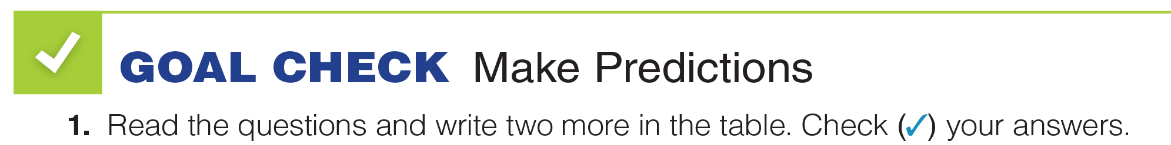
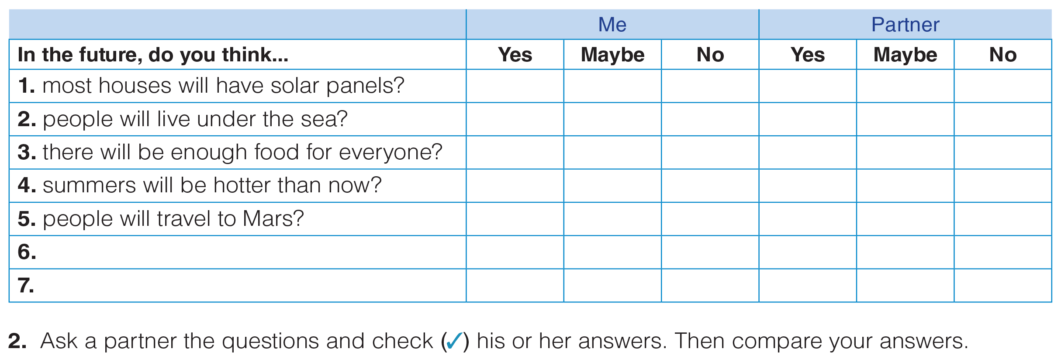
UNIT 8
MAKING PLANS
GOAL CHECK
_______________________________________________________________________________________________________________________________________________________________________________________________________________________
National Geographic Learning, a Cengage Company. © 2022 Cengage Learning, Inc. ALL RIGHTS RESERVED. This presentation tool is for teaching purpose only. May not be scanned, copied or duplicated, or posted to a publicly accessible website, in whole or in part.

Slide 45

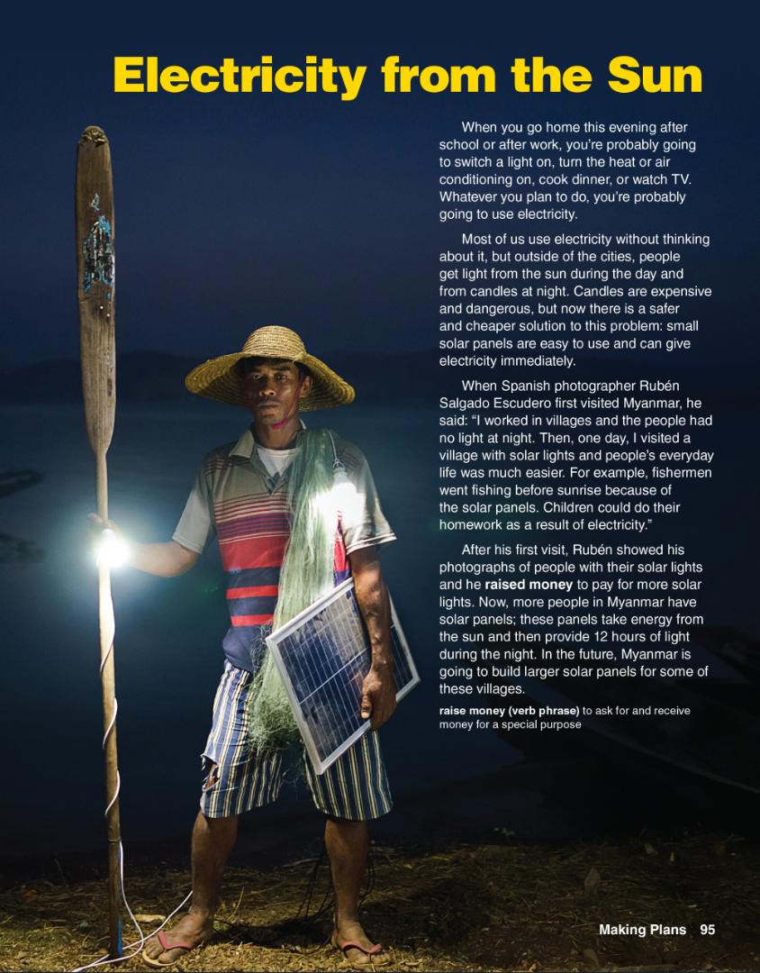
UNIT 8
MAKING PLANS
READING
_______________________________________________________________________________________________________________________________________________________________________________________________________________________
National Geographic Learning, a Cengage Company. © 2022 Cengage Learning, Inc. ALL RIGHTS RESERVED. This presentation tool is for teaching purpose only. May not be scanned, copied or duplicated, or posted to a publicly accessible website, in whole or in part.

Slide 46
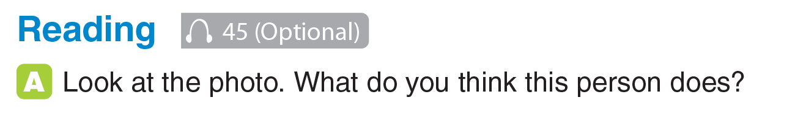
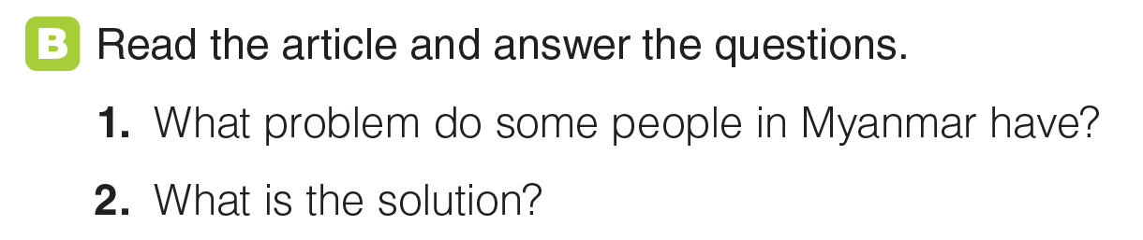
UNIT 8
MAKING PLANS
READING
They don’t have electricity. At night, they use candles.
Solar panels that can provide electricity and light.
_______________________________________________________________________________________________________________________________________________________________________________________________________________________
National Geographic Learning, a Cengage Company. © 2022 Cengage Learning, Inc. ALL RIGHTS RESERVED. This presentation tool is for teaching purpose only. May not be scanned, copied or duplicated, or posted to a publicly accessible website, in whole or in part.

Slide 47
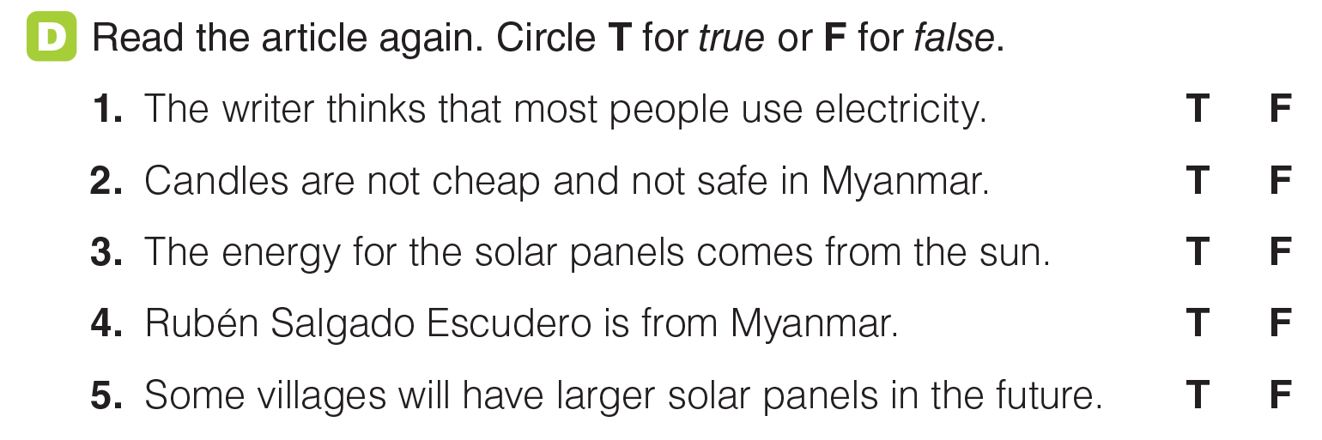
UNIT 8
MAKING PLANS
READING
_______________________________________________________________________________________________________________________________________________________________________________________________________________________
National Geographic Learning, a Cengage Company. © 2022 Cengage Learning, Inc. ALL RIGHTS RESERVED. This presentation tool is for teaching purpose only. May not be scanned, copied or duplicated, or posted to a publicly accessible website, in whole or in part.

Slide 48
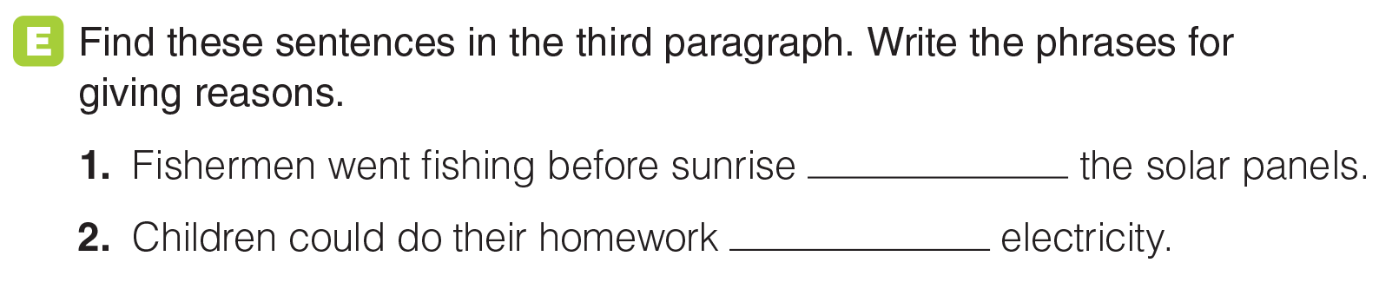
UNIT 8
MAKING PLANS
READING
because of
as a result of
_______________________________________________________________________________________________________________________________________________________________________________________________________________________
National Geographic Learning, a Cengage Company. © 2022 Cengage Learning, Inc. ALL RIGHTS RESERVED. This presentation tool is for teaching purpose only. May not be scanned, copied or duplicated, or posted to a publicly accessible website, in whole or in part.

Slide 49
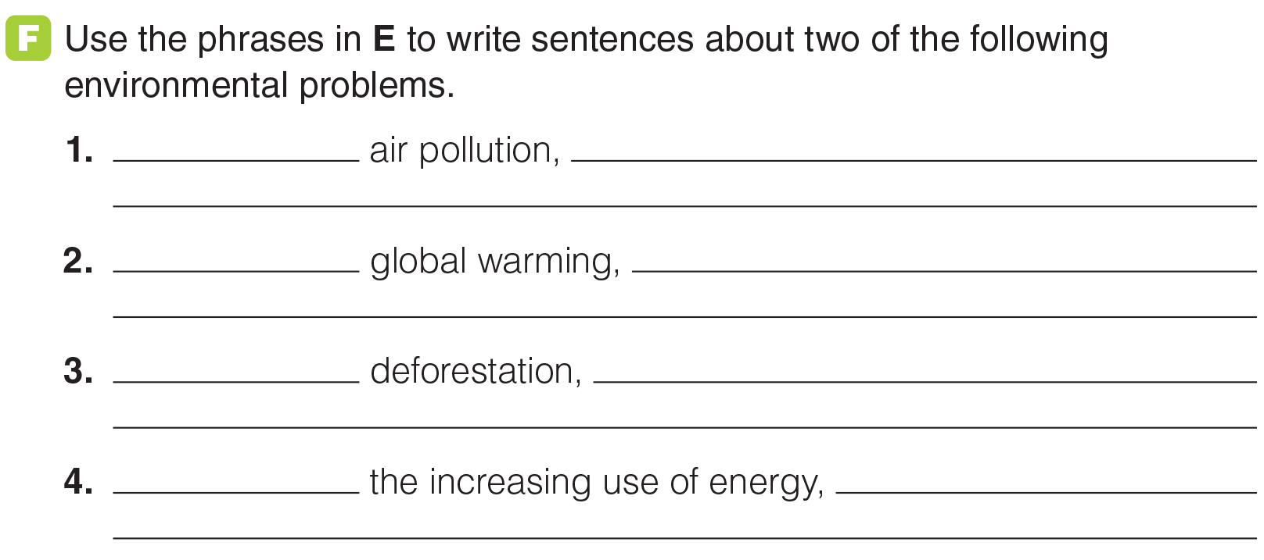
UNIT 8
MAKING PLANS
READING
_______________________________________________________________________________________________________________________________________________________________________________________________________________________
National Geographic Learning, a Cengage Company. © 2022 Cengage Learning, Inc. ALL RIGHTS RESERVED. This presentation tool is for teaching purpose only. May not be scanned, copied or duplicated, or posted to a publicly accessible website, in whole or in part.

Slide 50



UNIT 8
MAKING PLANS
GOAL CHECK
_______________________________________________________________________________________________________________________________________________________________________________________________________________________
National Geographic Learning, a Cengage Company. © 2022 Cengage Learning, Inc. ALL RIGHTS RESERVED. This presentation tool is for teaching purpose only. May not be scanned, copied or duplicated, or posted to a publicly accessible website, in whole or in part.

Slide 51

UNIT 8
MAKING PLANS
COMMUNICATION
_______________________________________________________________________________________________________________________________________________________________________________________________________________________
National Geographic Learning, a Cengage Company. © 2022 Cengage Learning, Inc. ALL RIGHTS RESERVED. This presentation tool is for teaching purpose only. May not be scanned, copied or duplicated, or posted to a publicly accessible website, in whole or in part.

Slide 52

UNIT 8
MAKING PLANS
COMMUNICATION
_______________________________________________________________________________________________________________________________________________________________________________________________________________________
National Geographic Learning, a Cengage Company. © 2022 Cengage Learning, Inc. ALL RIGHTS RESERVED. This presentation tool is for teaching purpose only. May not be scanned, copied or duplicated, or posted to a publicly accessible website, in whole or in part.

Slide 53

UNIT 8
MAKING PLANS
COMMUNICATION
1. Will you have a healthy and happy life?
2. Will you live to be 100 years old?
3. Will you have your dream job someday?
4. Will you speak perfect English one day?
_______________________________________________________________________________________________________________________________________________________________________________________________________________________
National Geographic Learning, a Cengage Company. © 2022 Cengage Learning, Inc. ALL RIGHTS RESERVED. This presentation tool is for teaching purpose only. May not be scanned, copied or duplicated, or posted to a publicly accessible website, in whole or in part.

Slide 54

UNIT 8
MAKING PLANS
COMMUNICATION
_______________________________________________________________________________________________________________________________________________________________________________________________________________________
National Geographic Learning, a Cengage Company. © 2022 Cengage Learning, Inc. ALL RIGHTS RESERVED. This presentation tool is for teaching purpose only. May not be scanned, copied or duplicated, or posted to a publicly accessible website, in whole or in part.

Slide 55


UNIT 8
MAKING PLANS
WRITING
increase: population (very certain), number of people living in cities (quite certain)
decrease: number of people living in the countryside (quite certain)
_______________________________________________________________________________________________________________________________________________________________________________________________________________________
National Geographic Learning, a Cengage Company. © 2022 Cengage Learning, Inc. ALL RIGHTS RESERVED. This presentation tool is for teaching purpose only. May not be scanned, copied or duplicated, or posted to a publicly accessible website, in whole or in part.

Slide 56

UNIT 8
MAKING PLANS
WRITING
30
55
45
70
_______________________________________________________________________________________________________________________________________________________________________________________________________________________
National Geographic Learning, a Cengage Company. © 2022 Cengage Learning, Inc. ALL RIGHTS RESERVED. This presentation tool is for teaching purpose only. May not be scanned, copied or duplicated, or posted to a publicly accessible website, in whole or in part.

Slide 57

UNIT 8
MAKING PLANS
WRITING
_______________________________________________________________________________________________________________________________________________________________________________________________________________________
National Geographic Learning, a Cengage Company. © 2022 Cengage Learning, Inc. ALL RIGHTS RESERVED. This presentation tool is for teaching purpose only. May not be scanned, copied or duplicated, or posted to a publicly accessible website, in whole or in part.

Slide 58

UNIT 8
MAKING PLANS
WRITING
_______________________________________________________________________________________________________________________________________________________________________________________________________________________
National Geographic Learning, a Cengage Company. © 2022 Cengage Learning, Inc. ALL RIGHTS RESERVED. This presentation tool is for teaching purpose only. May not be scanned, copied or duplicated, or posted to a publicly accessible website, in whole or in part.

Slide 59


UNIT 8
MAKING PLANS
WRITING
At the moment
go down to
By 2046
decreasing
probably
_______________________________________________________________________________________________________________________________________________________________________________________________________________________
National Geographic Learning, a Cengage Company. © 2022 Cengage Learning, Inc. ALL RIGHTS RESERVED. This presentation tool is for teaching purpose only. May not be scanned, copied or duplicated, or posted to a publicly accessible website, in whole or in part.

Slide 60


UNIT 8
MAKING PLANS
GOAL CHECK
_______________________________________________________________________________________________________________________________________________________________________________________________________________________
National Geographic Learning, a Cengage Company. © 2022 Cengage Learning, Inc. ALL RIGHTS RESERVED. This presentation tool is for teaching purpose only. May not be scanned, copied or duplicated, or posted to a publicly accessible website, in whole or in part.

