Slide 1
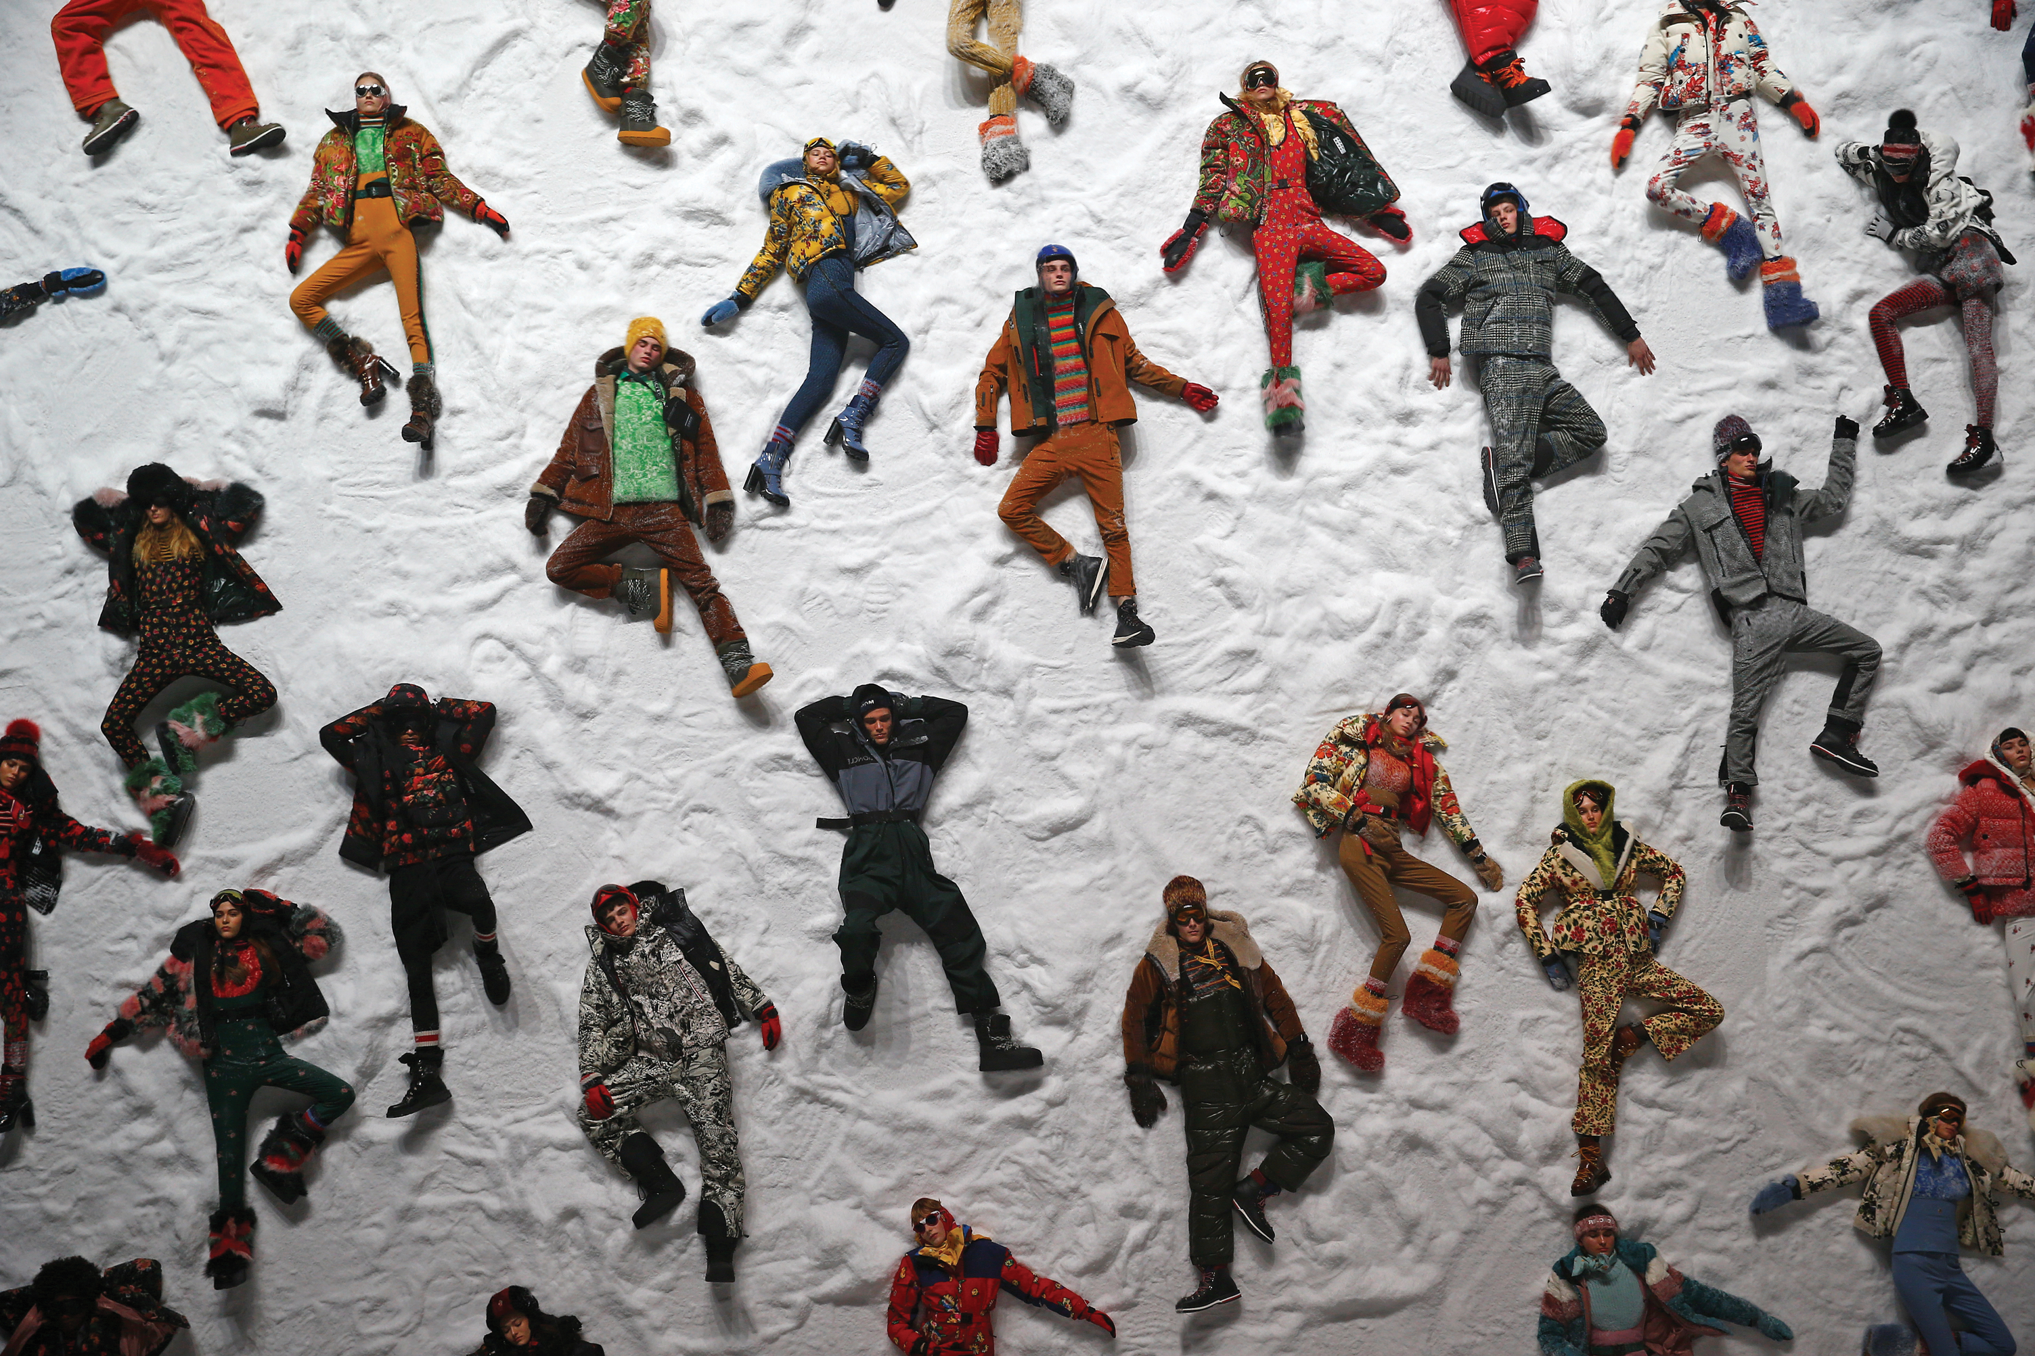


Unit 9:
TYPES OF CLOTHING
_______________________________________________________________________________________________________________________________________________________________________________________________________________________
National Geographic Learning, a Cengage Company. © 2022 Cengage Learning, Inc. ALL RIGHTS RESERVED. This presentation tool is for teaching purpose only. May not be scanned, copied or duplicated, or posted to a publicly accessible website, in whole or in part.

Slide 2
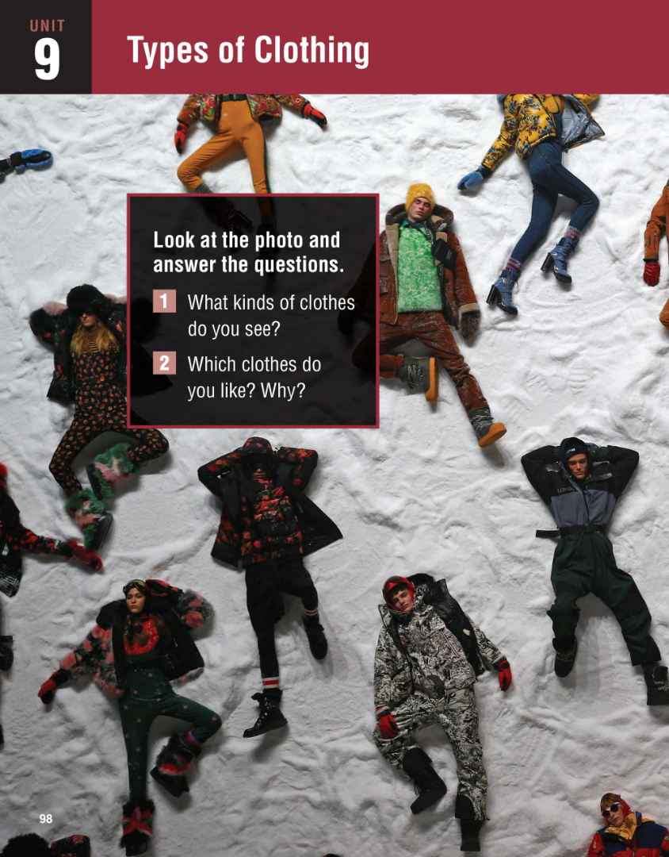
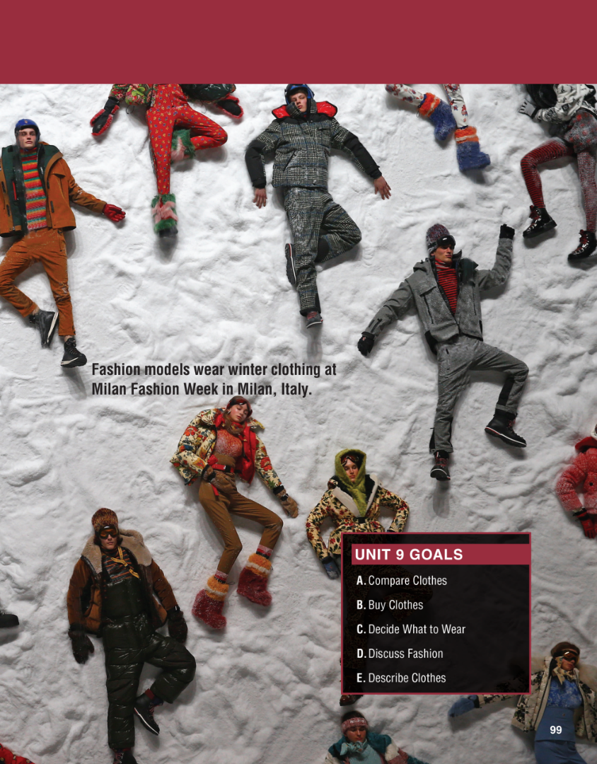

Slide 3
UNIT 9
TYPES OF CLOTHING
OVERVIEW
Do you know?
Clothing is a necessary and practical fact of life. Different types of clothing enable us to dress appropriately for specific occasions or to express our own individuality and style.
_______________________________________________________________________________________________________________________________________________________________________________________________________________________
National Geographic Learning, a Cengage Company. © 2022 Cengage Learning, Inc. ALL RIGHTS RESERVED. This presentation tool is for teaching purpose only. May not be scanned, copied or duplicated, or posted to a publicly accessible website, in whole or in part.

Slide 4
UNIT 9
TYPES OF CLOTHING
OVERVIEW
About the photo
Italian photographer Tony Gentile took this photo during fashion week in Milan, Italy. Milan has a very long history with
fashion, going back to the 16th century. It is a fashion capital of the world, one of the so-called “big four”: Milan, New York, Paris, and London.
_______________________________________________________________________________________________________________________________________________________________________________________________________________________
National Geographic Learning, a Cengage Company. © 2022 Cengage Learning, Inc. ALL RIGHTS RESERVED. This presentation tool is for teaching purpose only. May not be scanned, copied or duplicated, or posted to a publicly accessible website, in whole or in part.

Slide 5
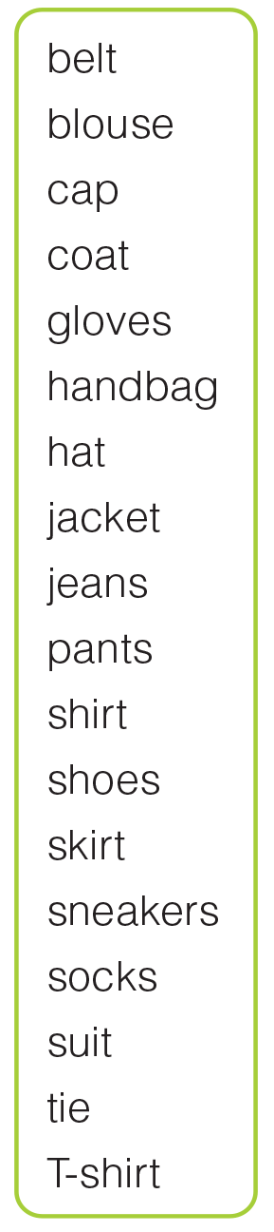
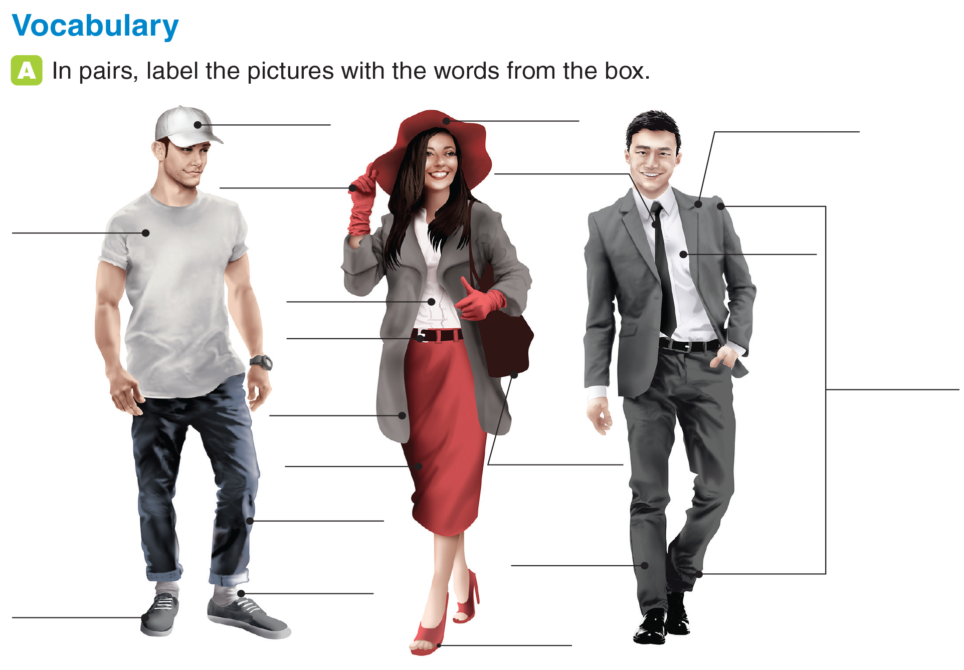
UNIT 9
TYPES OF CLOTHING
VOCABULARY
cap
hat
jacket
glove
tie
T-shirt
shirt
blouse
belt
suit
coat
skirt
handbag
jeans
pant
socks
sneakers
shoes
_______________________________________________________________________________________________________________________________________________________________________________________________________________________
National Geographic Learning, a Cengage Company. © 2022 Cengage Learning, Inc. ALL RIGHTS RESERVED. This presentation tool is for teaching purpose only. May not be scanned, copied or duplicated, or posted to a publicly accessible website, in whole or in part.

Slide 6
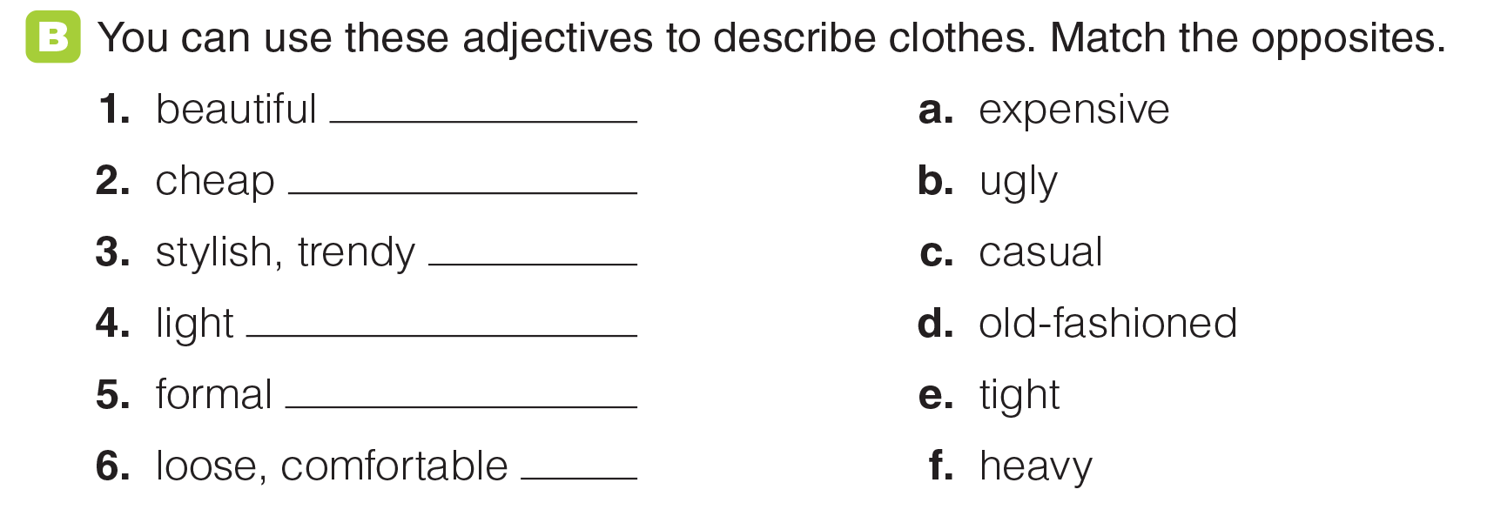
UNIT 9
TYPES OF CLOTHING
VOCABULARY
b
a
d
f
c
e
_______________________________________________________________________________________________________________________________________________________________________________________________________________________
National Geographic Learning, a Cengage Company. © 2022 Cengage Learning, Inc. ALL RIGHTS RESERVED. This presentation tool is for teaching purpose only. May not be scanned, copied or duplicated, or posted to a publicly accessible website, in whole or in part.

Slide 7
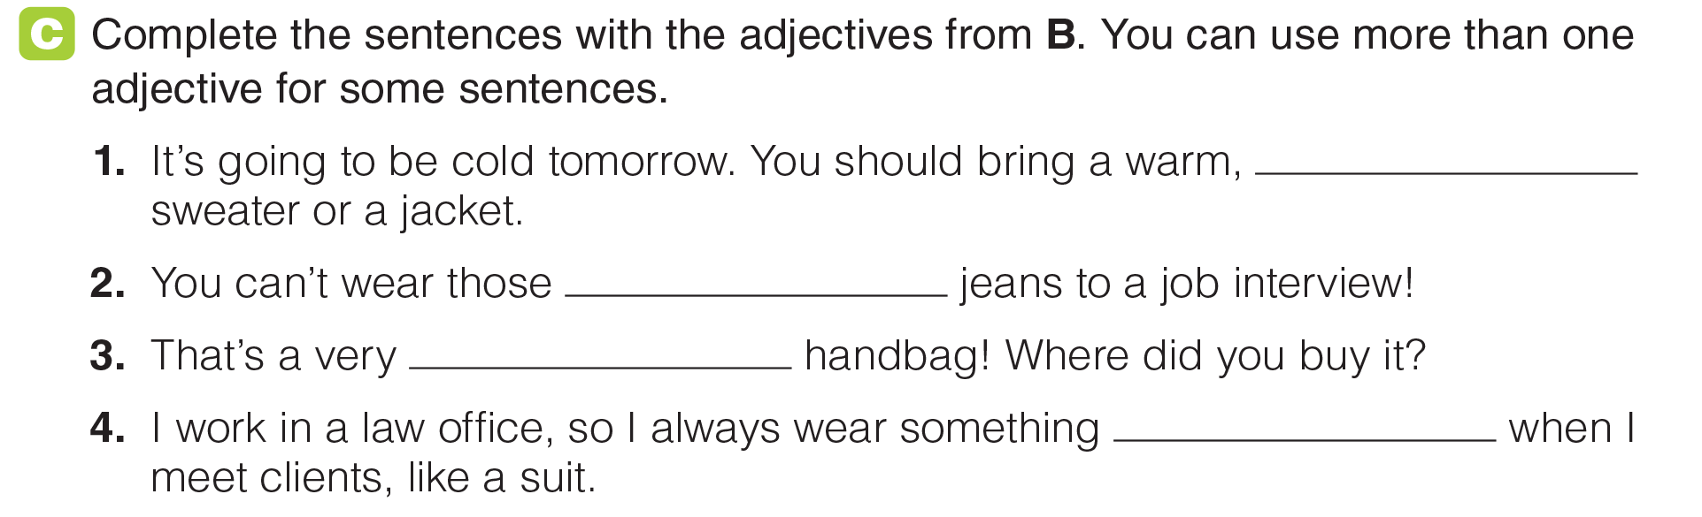
UNIT 9
TYPES OF CLOTHING
VOCABULARY
heavy
casual / ugly
stylish / beautiful
formal
_______________________________________________________________________________________________________________________________________________________________________________________________________________________
National Geographic Learning, a Cengage Company. © 2022 Cengage Learning, Inc. ALL RIGHTS RESERVED. This presentation tool is for teaching purpose only. May not be scanned, copied or duplicated, or posted to a publicly accessible website, in whole or in part.

Slide 8
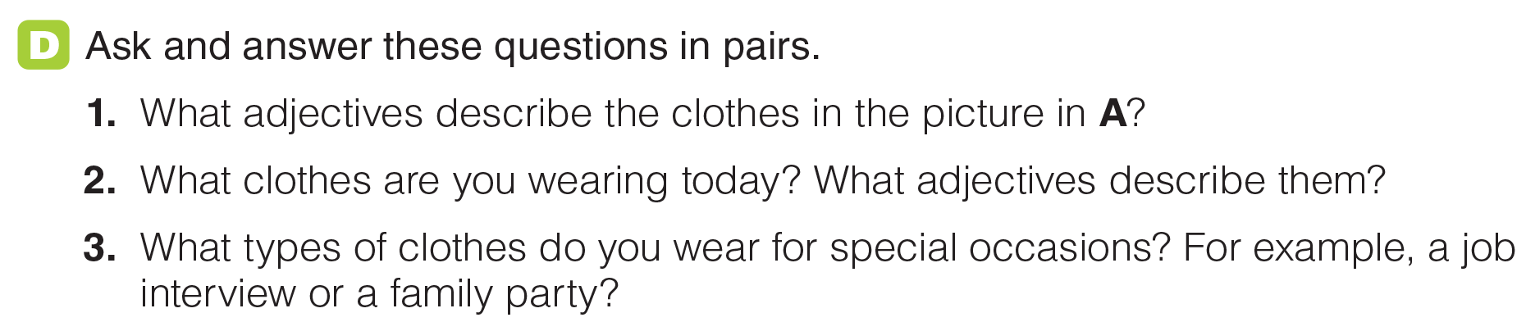
UNIT 9
TYPES OF CLOTHING
VOCABULARY
_______________________________________________________________________________________________________________________________________________________________________________________________________________________
National Geographic Learning, a Cengage Company. © 2022 Cengage Learning, Inc. ALL RIGHTS RESERVED. This presentation tool is for teaching purpose only. May not be scanned, copied or duplicated, or posted to a publicly accessible website, in whole or in part.

Slide 9
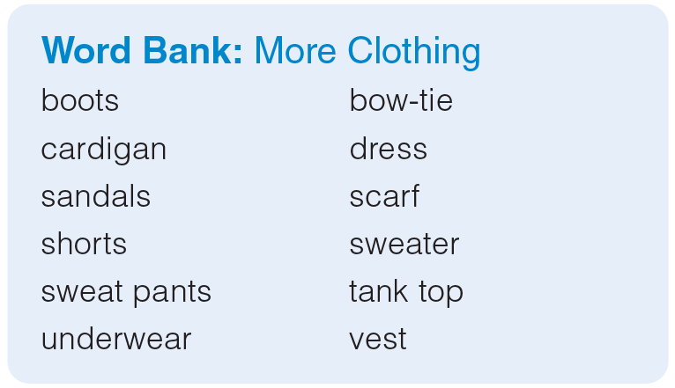
UNIT 9
TYPES OF CLOTHING
VOCABULARY
_______________________________________________________________________________________________________________________________________________________________________________________________________________________
National Geographic Learning, a Cengage Company. © 2022 Cengage Learning, Inc. ALL RIGHTS RESERVED. This presentation tool is for teaching purpose only. May not be scanned, copied or duplicated, or posted to a publicly accessible website, in whole or in part.

Slide 10
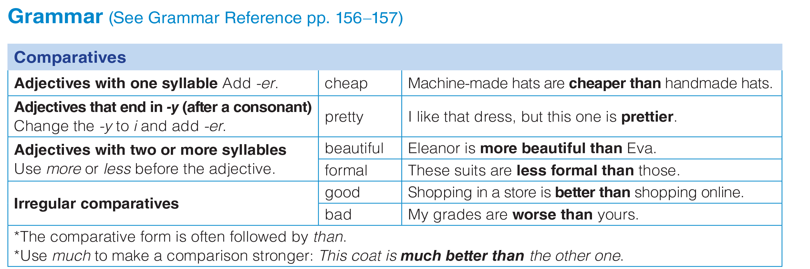
UNIT 9
TYPES OF CLOTHING
GRAMMAR
_______________________________________________________________________________________________________________________________________________________________________________________________________________________
National Geographic Learning, a Cengage Company. © 2022 Cengage Learning, Inc. ALL RIGHTS RESERVED. This presentation tool is for teaching purpose only. May not be scanned, copied or duplicated, or posted to a publicly accessible website, in whole or in part.

Slide 11
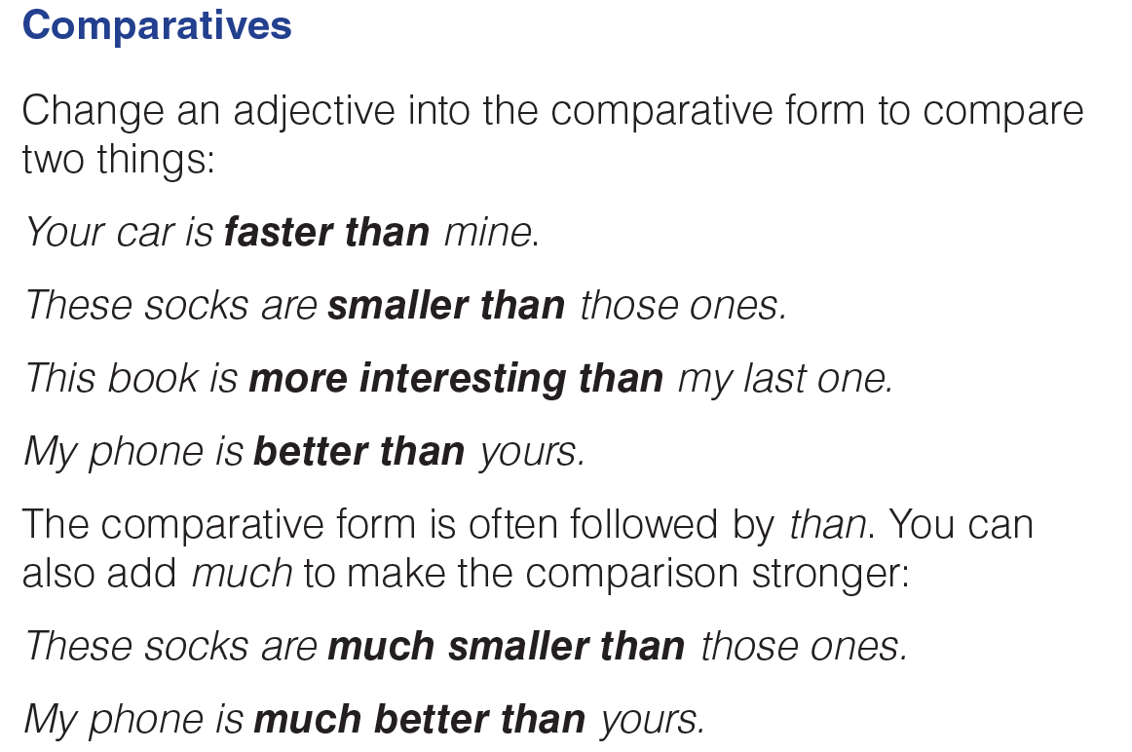
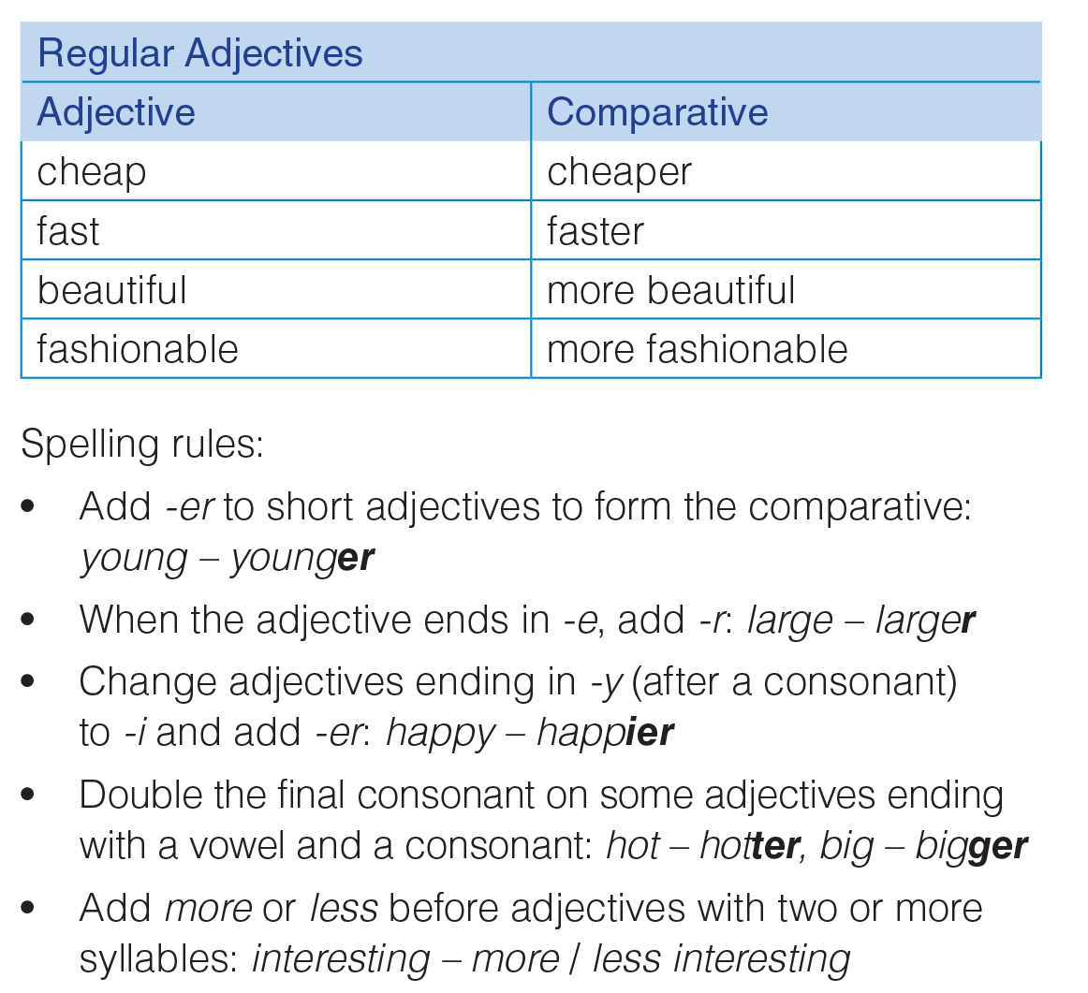
UNIT 9
TYPES OF CLOTHING
GRAMMAR
_______________________________________________________________________________________________________________________________________________________________________________________________________________________
National Geographic Learning, a Cengage Company. © 2022 Cengage Learning, Inc. ALL RIGHTS RESERVED. This presentation tool is for teaching purpose only. May not be scanned, copied or duplicated, or posted to a publicly accessible website, in whole or in part.

Slide 12
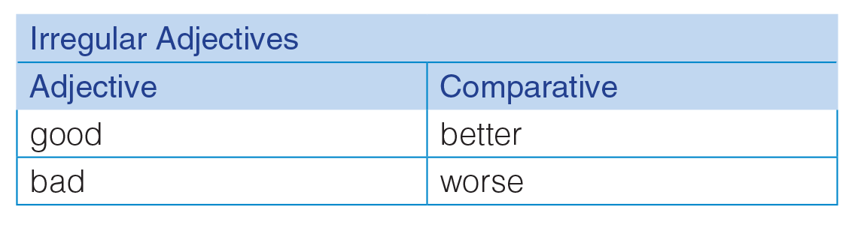
UNIT 9
TYPES OF CLOTHING
GRAMMAR
_______________________________________________________________________________________________________________________________________________________________________________________________________________________
National Geographic Learning, a Cengage Company. © 2022 Cengage Learning, Inc. ALL RIGHTS RESERVED. This presentation tool is for teaching purpose only. May not be scanned, copied or duplicated, or posted to a publicly accessible website, in whole or in part.

Slide 13
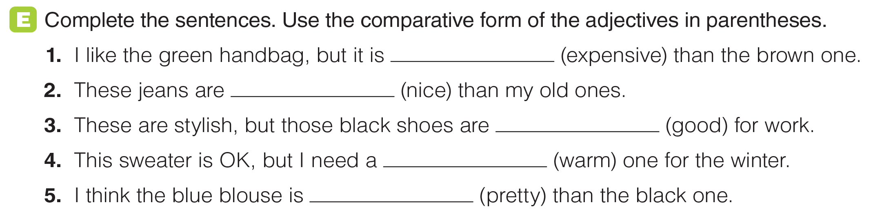
UNIT 9
TYPES OF CLOTHING
GRAMMAR
more expensive
nicer
better
warmer
prettier
_______________________________________________________________________________________________________________________________________________________________________________________________________________________
National Geographic Learning, a Cengage Company. © 2022 Cengage Learning, Inc. ALL RIGHTS RESERVED. This presentation tool is for teaching purpose only. May not be scanned, copied or duplicated, or posted to a publicly accessible website, in whole or in part.

Slide 14
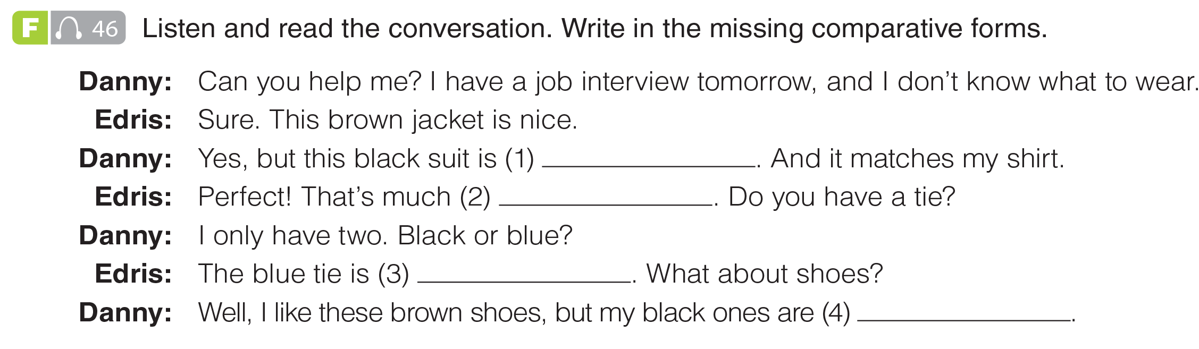

UNIT 9
TYPES OF CLOTHING
GRAMMAR
more formal
better
nicer
more comfortable
_______________________________________________________________________________________________________________________________________________________________________________________________________________________
National Geographic Learning, a Cengage Company. © 2022 Cengage Learning, Inc. ALL RIGHTS RESERVED. This presentation tool is for teaching purpose only. May not be scanned, copied or duplicated, or posted to a publicly accessible website, in whole or in part.

Slide 15
UNIT 9
TYPES OF CLOTHING
GRAMMAR
more formal
better
nicer
more comfortable
_______________________________________________________________________________________________________________________________________________________________________________________________________________________
National Geographic Learning, a Cengage Company. © 2022 Cengage Learning, Inc. ALL RIGHTS RESERVED. This presentation tool is for teaching purpose only. May not be scanned, copied or duplicated, or posted to a publicly accessible website, in whole or in part.

Slide 16
UNIT 9
TYPES OF CLOTHING
GRAMMAR
more formal
better
nicer
more comfortable
_______________________________________________________________________________________________________________________________________________________________________________________________________________________
National Geographic Learning, a Cengage Company. © 2022 Cengage Learning, Inc. ALL RIGHTS RESERVED. This presentation tool is for teaching purpose only. May not be scanned, copied or duplicated, or posted to a publicly accessible website, in whole or in part.

Slide 17
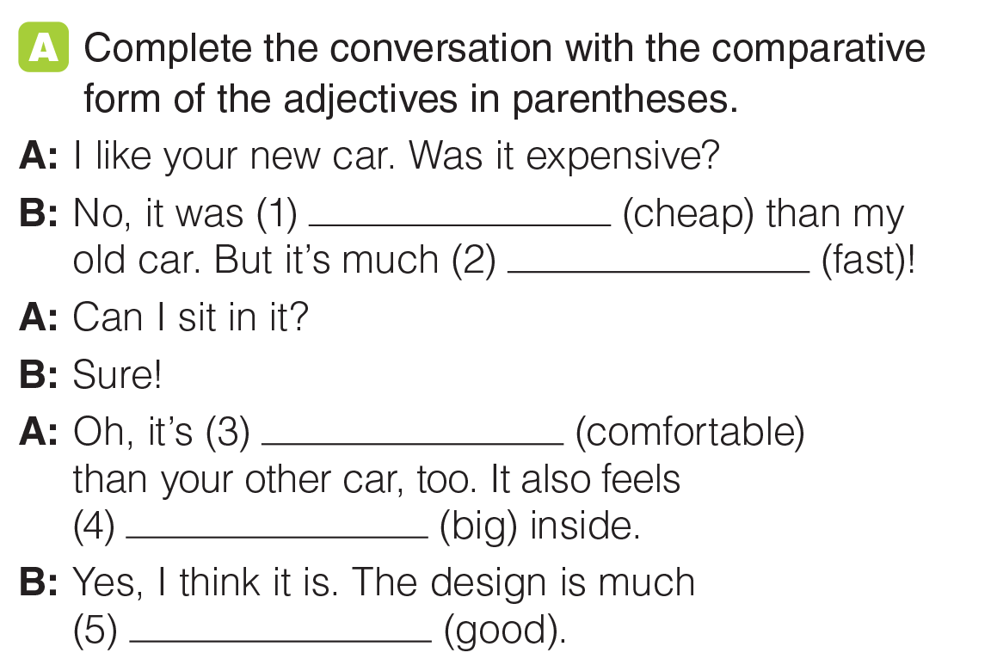
UNIT 9
TYPES OF CLOTHING
GRAMMAR
cheaper
faster
more comfortable
bigger
better
_______________________________________________________________________________________________________________________________________________________________________________________________________________________
National Geographic Learning, a Cengage Company. © 2022 Cengage Learning, Inc. ALL RIGHTS RESERVED. This presentation tool is for teaching purpose only. May not be scanned, copied or duplicated, or posted to a publicly accessible website, in whole or in part.

Slide 18
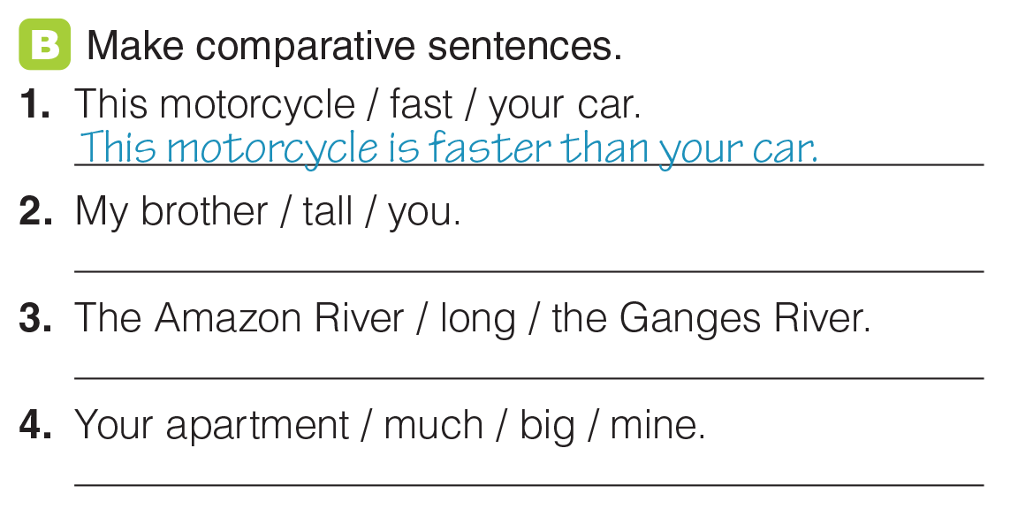
UNIT 9
TYPES OF CLOTHING
GRAMMAR
My brother is taller than you.
The Amazon River is longer than the Ganges River.
Your apartment is much bigger than mine.
_______________________________________________________________________________________________________________________________________________________________________________________________________________________
National Geographic Learning, a Cengage Company. © 2022 Cengage Learning, Inc. ALL RIGHTS RESERVED. This presentation tool is for teaching purpose only. May not be scanned, copied or duplicated, or posted to a publicly accessible website, in whole or in part.

Slide 19
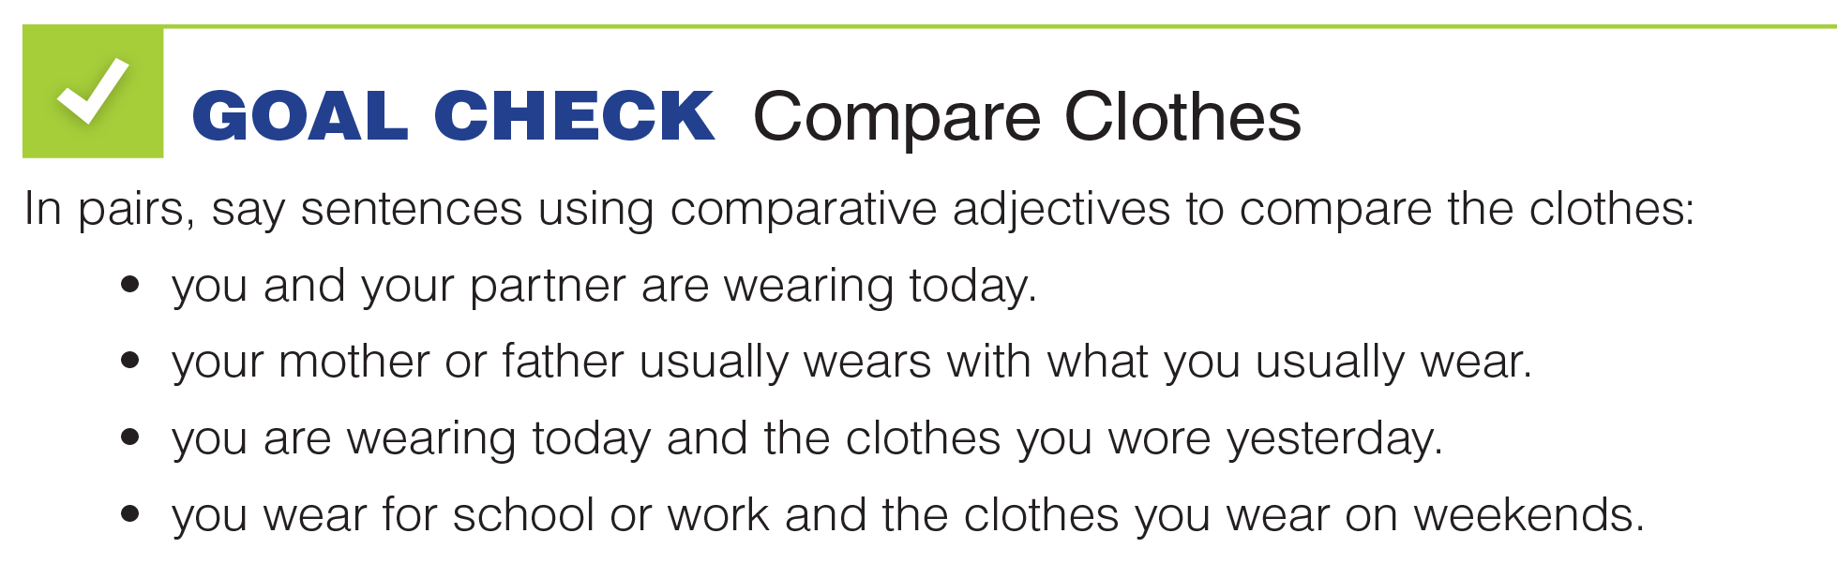

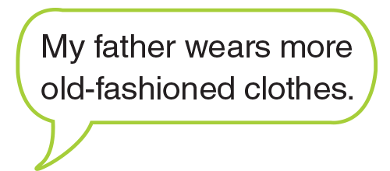
UNIT 9
TYPES OF CLOTHING
GOAL CHECK
_______________________________________________________________________________________________________________________________________________________________________________________________________________________
National Geographic Learning, a Cengage Company. © 2022 Cengage Learning, Inc. ALL RIGHTS RESERVED. This presentation tool is for teaching purpose only. May not be scanned, copied or duplicated, or posted to a publicly accessible website, in whole or in part.

Slide 20
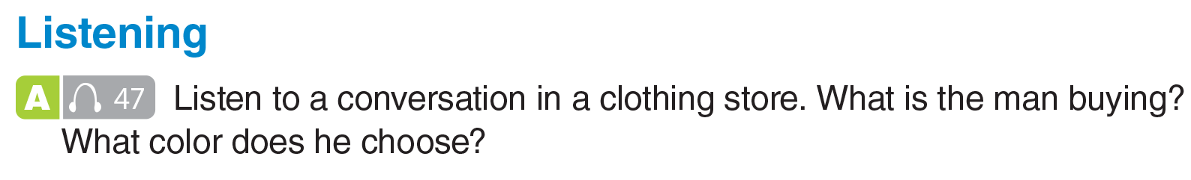

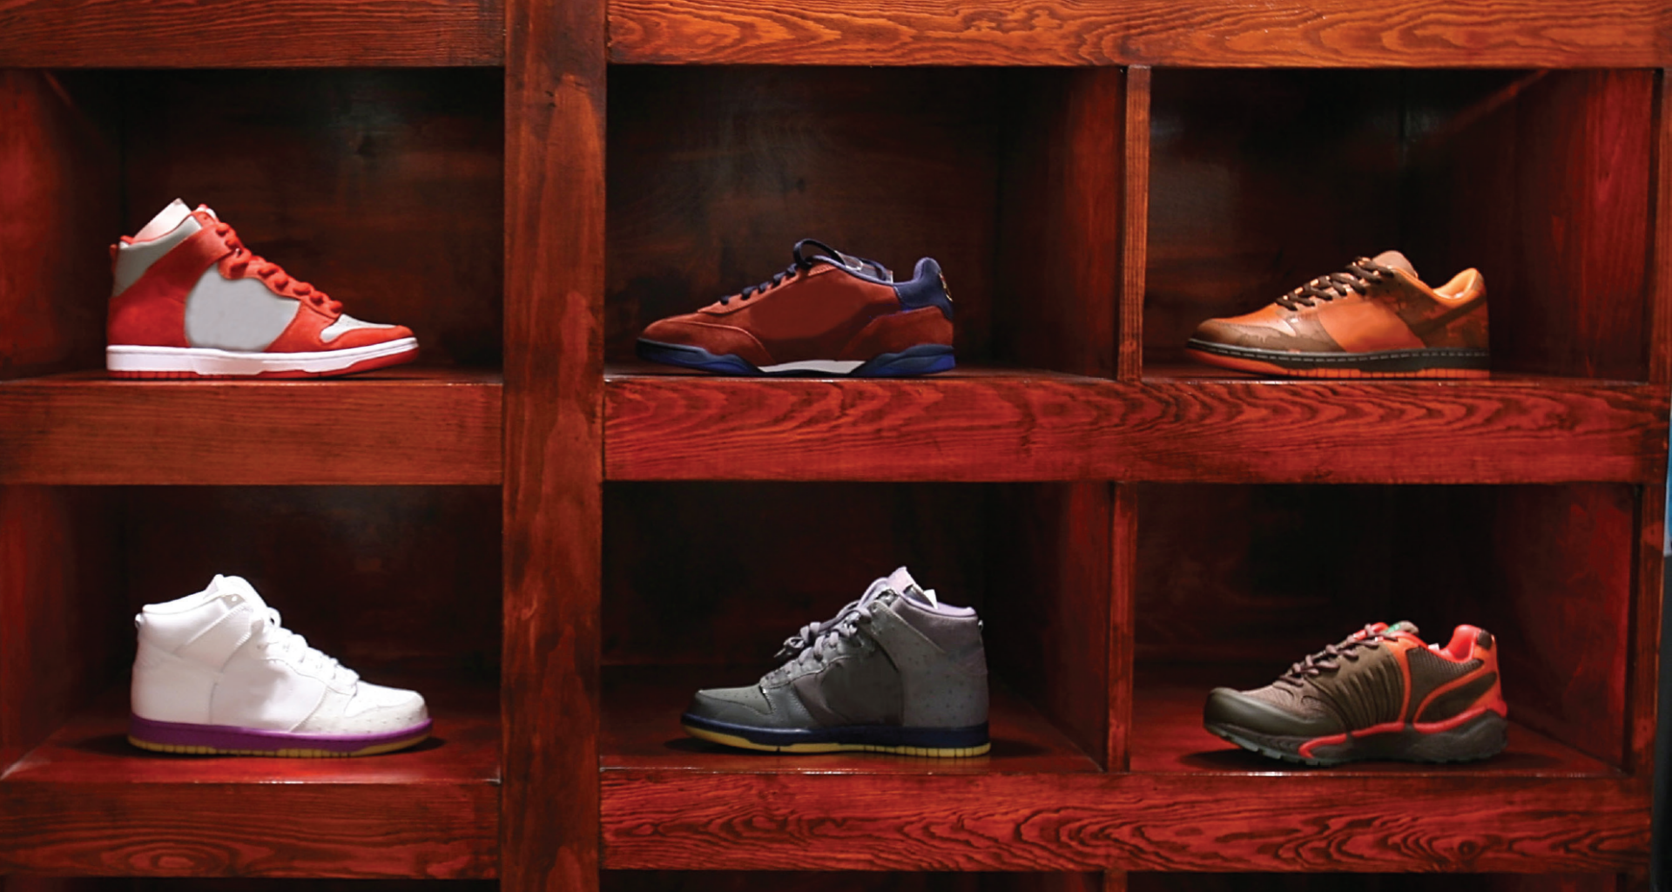
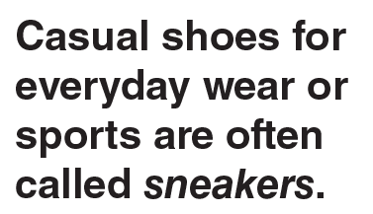
UNIT 9
TYPES OF CLOTHING
LISTENING
blue shoes
_______________________________________________________________________________________________________________________________________________________________________________________________________________________
National Geographic Learning, a Cengage Company. © 2022 Cengage Learning, Inc. ALL RIGHTS RESERVED. This presentation tool is for teaching purpose only. May not be scanned, copied or duplicated, or posted to a publicly accessible website, in whole or in part.

Slide 21
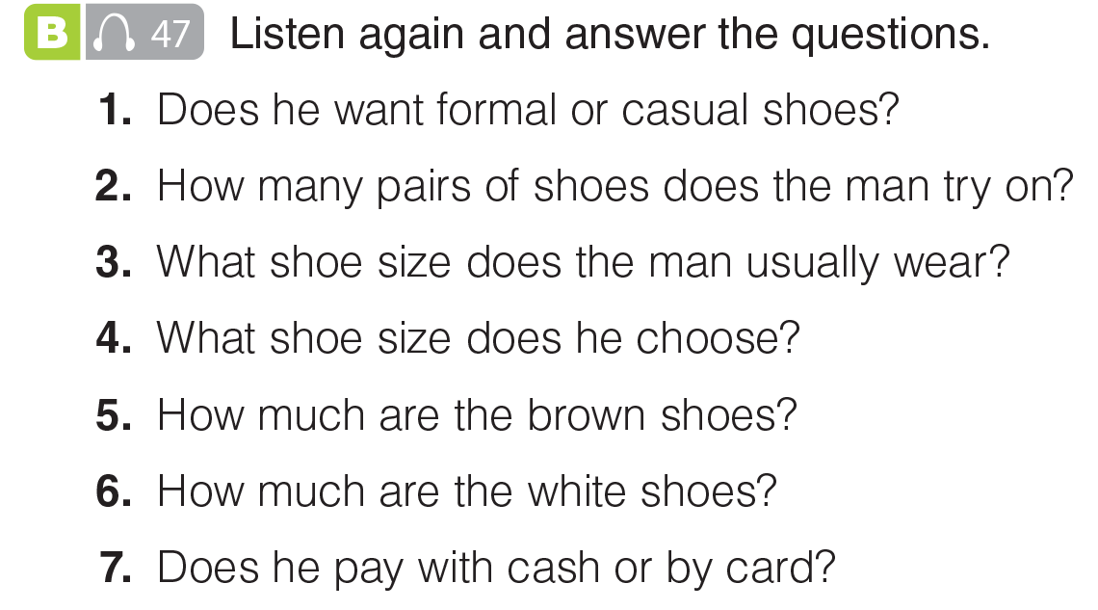
UNIT 9
TYPES OF CLOTHING
LISTENING
Casual
2 pairs
9.5 or 10
10
$45
$65
By card
_______________________________________________________________________________________________________________________________________________________________________________________________________________________
National Geographic Learning, a Cengage Company. © 2022 Cengage Learning, Inc. ALL RIGHTS RESERVED. This presentation tool is for teaching purpose only. May not be scanned, copied or duplicated, or posted to a publicly accessible website, in whole or in part.

Slide 22
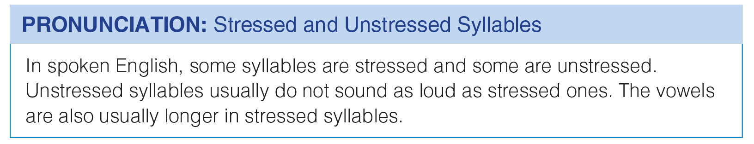
UNIT 9
TYPES OF CLOTHING
PRONUNCIATION
_______________________________________________________________________________________________________________________________________________________________________________________________________________________
National Geographic Learning, a Cengage Company. © 2022 Cengage Learning, Inc. ALL RIGHTS RESERVED. This presentation tool is for teaching purpose only. May not be scanned, copied or duplicated, or posted to a publicly accessible website, in whole or in part.

Slide 23
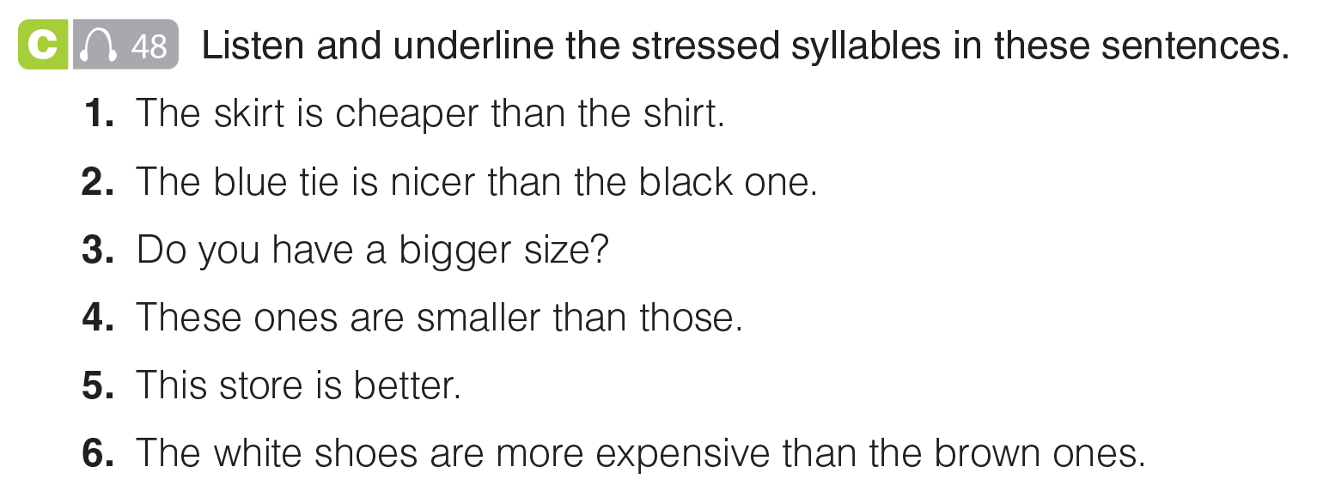
UNIT 9
TYPES OF CLOTHING
PRONUNCIATION
_______________________________________________________________________________________________________________________________________________________________________________________________________________________
National Geographic Learning, a Cengage Company. © 2022 Cengage Learning, Inc. ALL RIGHTS RESERVED. This presentation tool is for teaching purpose only. May not be scanned, copied or duplicated, or posted to a publicly accessible website, in whole or in part.

Slide 24
UNIT 9
TYPES OF CLOTHING
PRONUNCIATION
_______________________________________________________________________________________________________________________________________________________________________________________________________________________
National Geographic Learning, a Cengage Company. © 2022 Cengage Learning, Inc. ALL RIGHTS RESERVED. This presentation tool is for teaching purpose only. May not be scanned, copied or duplicated, or posted to a publicly accessible website, in whole or in part.

Slide 25
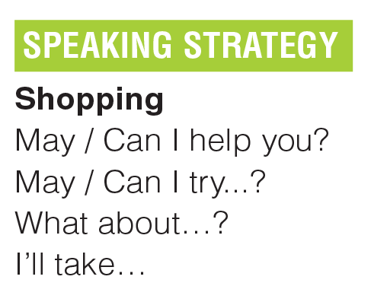
UNIT 9
TYPES OF CLOTHING
COMMUNICATION
_______________________________________________________________________________________________________________________________________________________________________________________________________________________
National Geographic Learning, a Cengage Company. © 2022 Cengage Learning, Inc. ALL RIGHTS RESERVED. This presentation tool is for teaching purpose only. May not be scanned, copied or duplicated, or posted to a publicly accessible website, in whole or in part.

Slide 26
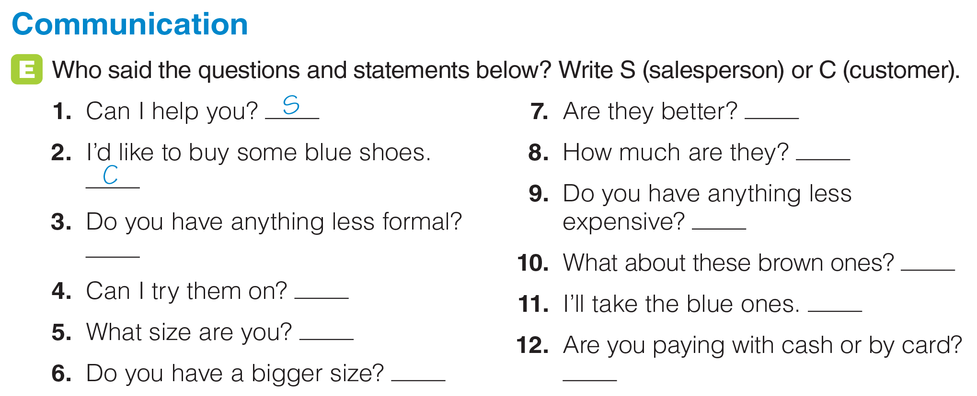
UNIT 9
TYPES OF CLOTHING
COMMUNICATION
S
C
C
C
S
C
C
S
C
S
_______________________________________________________________________________________________________________________________________________________________________________________________________________________
National Geographic Learning, a Cengage Company. © 2022 Cengage Learning, Inc. ALL RIGHTS RESERVED. This presentation tool is for teaching purpose only. May not be scanned, copied or duplicated, or posted to a publicly accessible website, in whole or in part.

Slide 27
UNIT 9
TYPES OF CLOTHING
COMMUNICATION
S
C
C
C
S
C
C
S
C
S
_______________________________________________________________________________________________________________________________________________________________________________________________________________________
National Geographic Learning, a Cengage Company. © 2022 Cengage Learning, Inc. ALL RIGHTS RESERVED. This presentation tool is for teaching purpose only. May not be scanned, copied or duplicated, or posted to a publicly accessible website, in whole or in part.

Slide 28
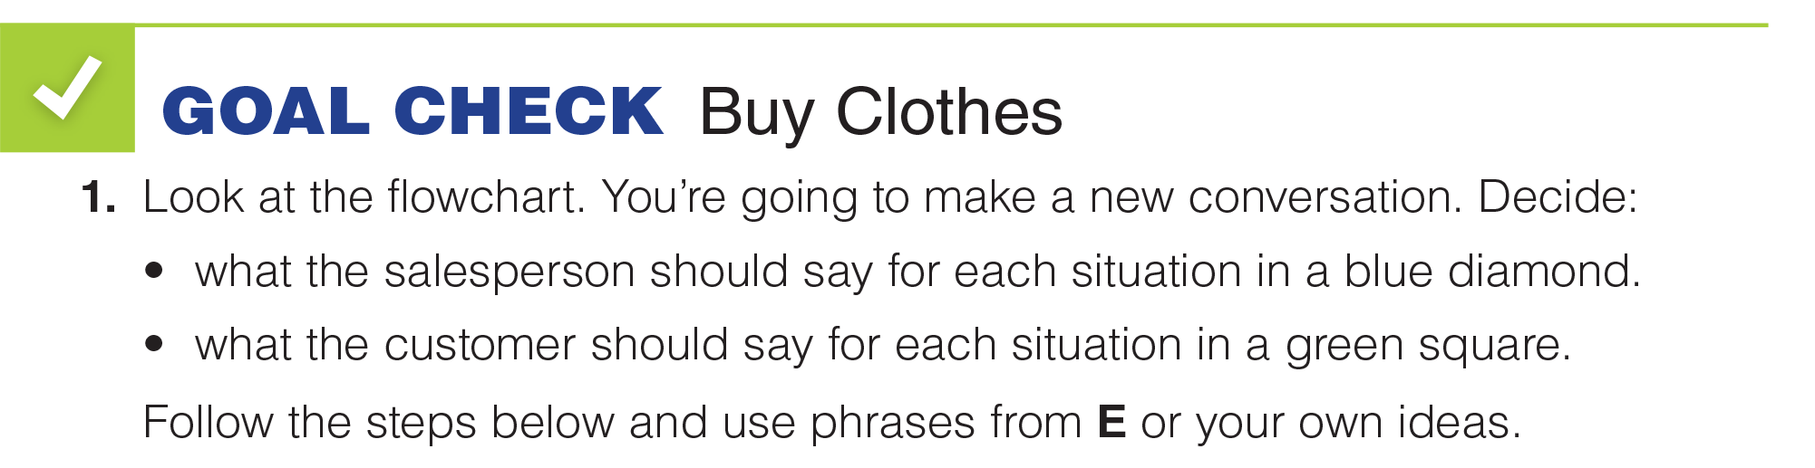
UNIT 9
TYPES OF CLOTHING
GOAL CHECK
_______________________________________________________________________________________________________________________________________________________________________________________________________________________
National Geographic Learning, a Cengage Company. © 2022 Cengage Learning, Inc. ALL RIGHTS RESERVED. This presentation tool is for teaching purpose only. May not be scanned, copied or duplicated, or posted to a publicly accessible website, in whole or in part.

Slide 29
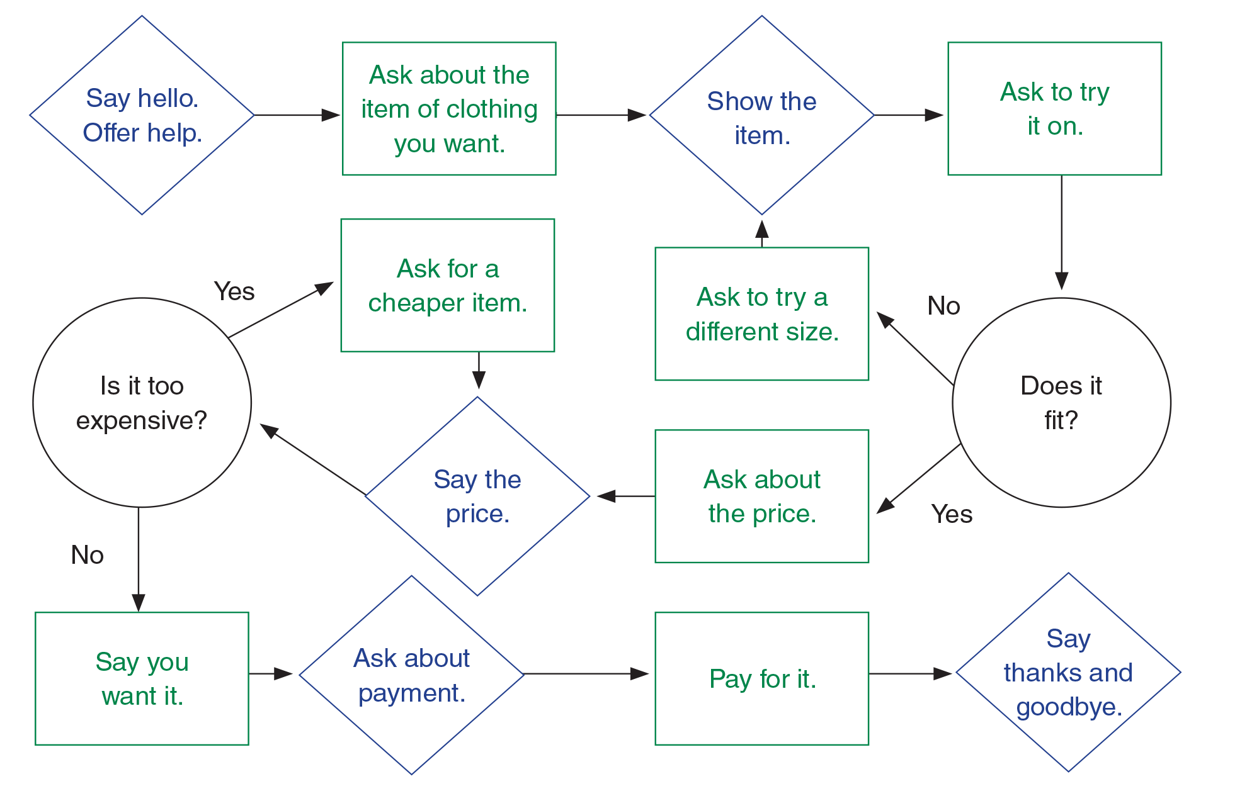
UNIT 9
TYPES OF CLOTHING
GOAL CHECK
_______________________________________________________________________________________________________________________________________________________________________________________________________________________
National Geographic Learning, a Cengage Company. © 2022 Cengage Learning, Inc. ALL RIGHTS RESERVED. This presentation tool is for teaching purpose only. May not be scanned, copied or duplicated, or posted to a publicly accessible website, in whole or in part.

Slide 30

UNIT 9
TYPES OF CLOTHING
GOAL CHECK
_______________________________________________________________________________________________________________________________________________________________________________________________________________________
National Geographic Learning, a Cengage Company. © 2022 Cengage Learning, Inc. ALL RIGHTS RESERVED. This presentation tool is for teaching purpose only. May not be scanned, copied or duplicated, or posted to a publicly accessible website, in whole or in part.

Slide 31
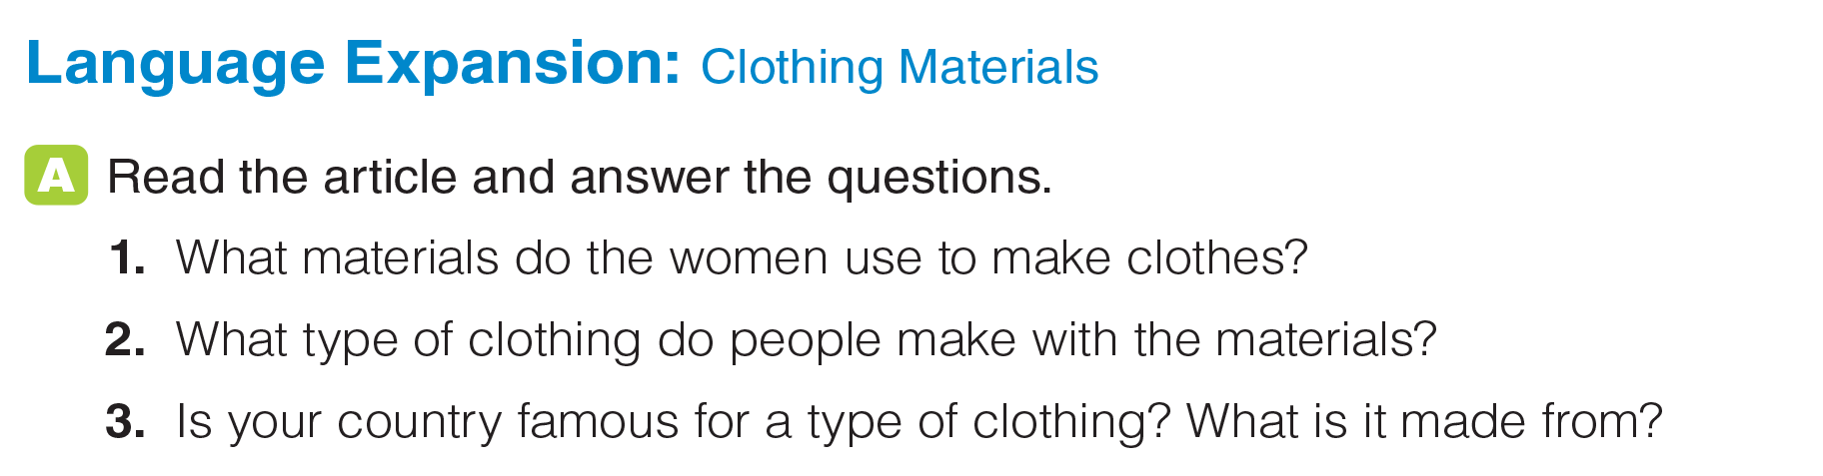
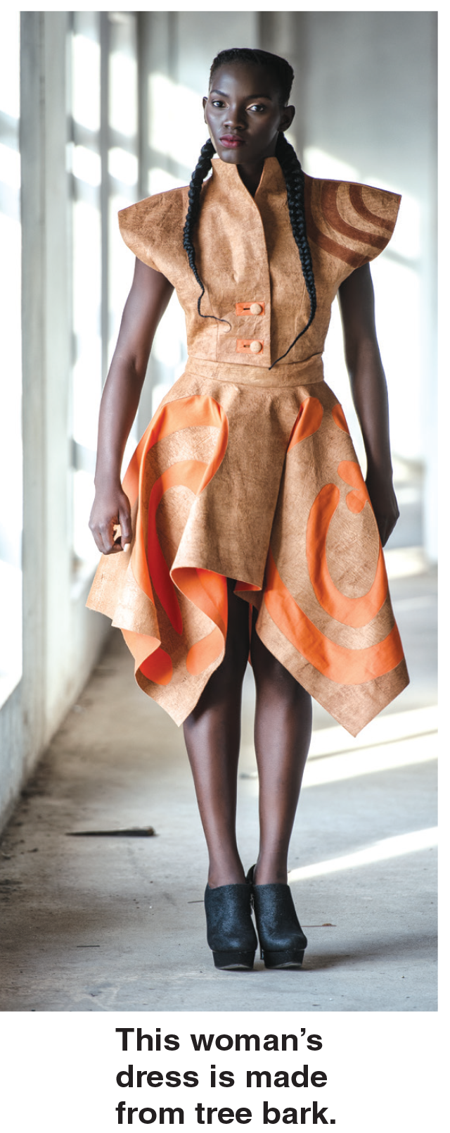
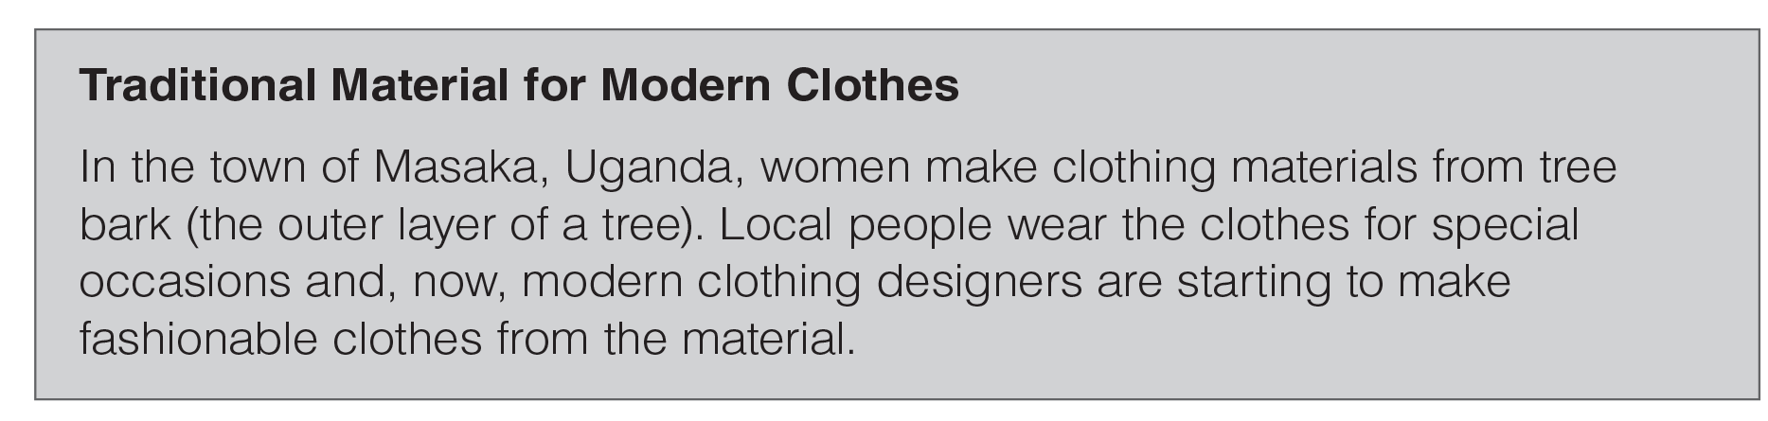
UNIT 9
TYPES OF CLOTHING
LANGUAGE EXPANSION
Tree bark
Clothes for special occasions and fashionable clothes
_______________________________________________________________________________________________________________________________________________________________________________________________________________________
National Geographic Learning, a Cengage Company. © 2022 Cengage Learning, Inc. ALL RIGHTS RESERVED. This presentation tool is for teaching purpose only. May not be scanned, copied or duplicated, or posted to a publicly accessible website, in whole or in part.

Slide 32
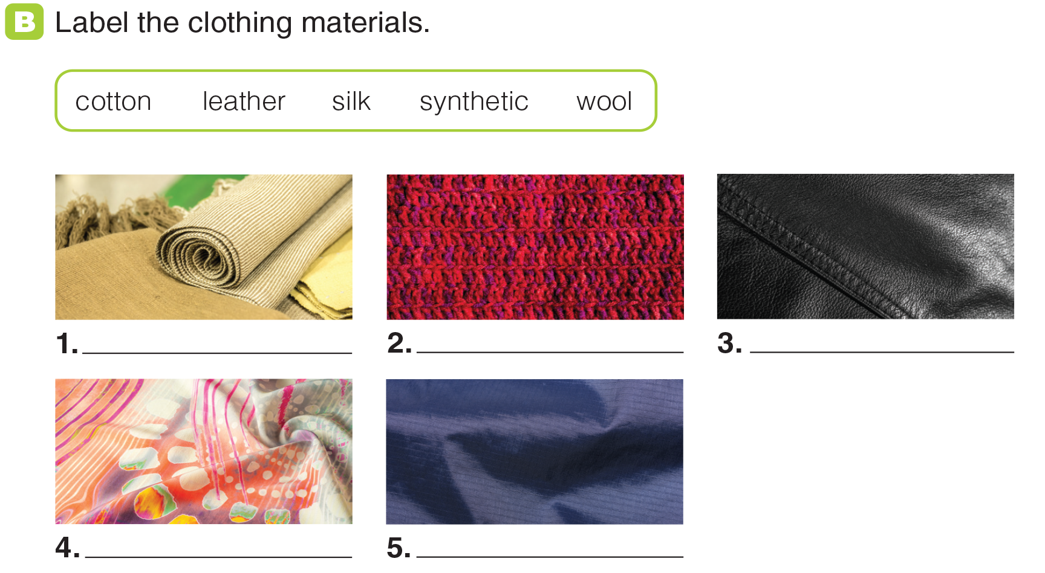
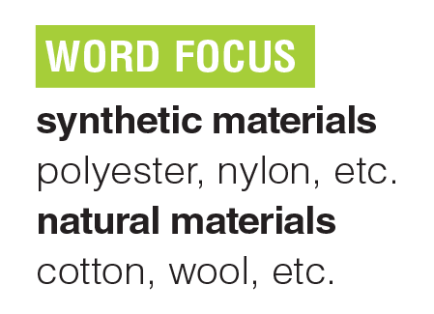
UNIT 9
TYPES OF CLOTHING
LANGUAGE EXPANSION
cotton
wool
leather
silk
synthetic
_______________________________________________________________________________________________________________________________________________________________________________________________________________________
National Geographic Learning, a Cengage Company. © 2022 Cengage Learning, Inc. ALL RIGHTS RESERVED. This presentation tool is for teaching purpose only. May not be scanned, copied or duplicated, or posted to a publicly accessible website, in whole or in part.

Slide 33
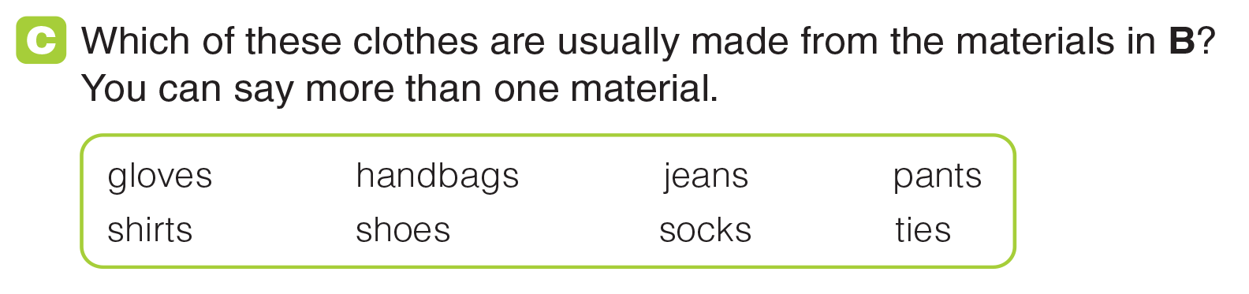
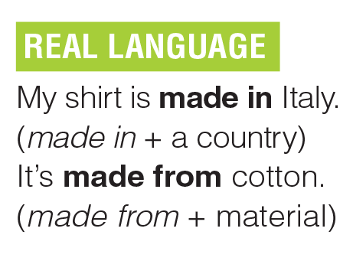

UNIT 9
TYPES OF CLOTHING
LANGUAGE EXPANSION
_______________________________________________________________________________________________________________________________________________________________________________________________________________________
National Geographic Learning, a Cengage Company. © 2022 Cengage Learning, Inc. ALL RIGHTS RESERVED. This presentation tool is for teaching purpose only. May not be scanned, copied or duplicated, or posted to a publicly accessible website, in whole or in part.

Slide 34
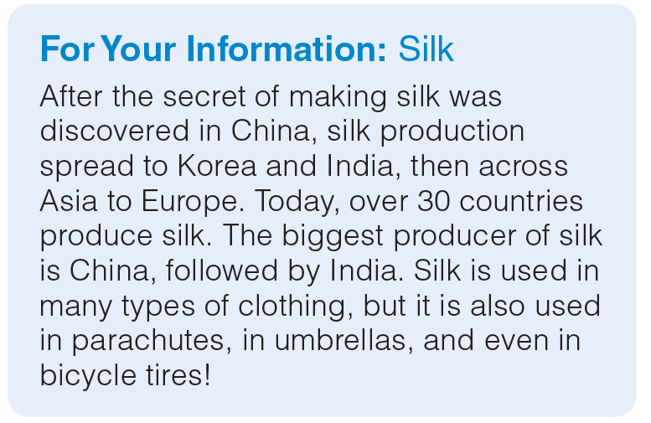
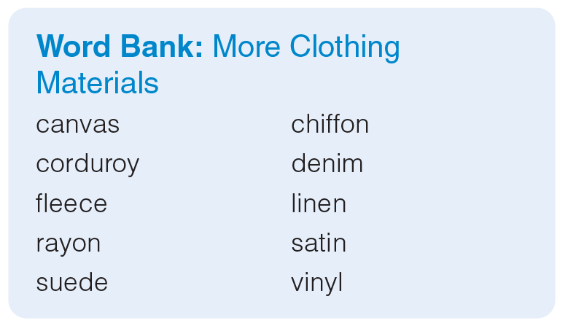
UNIT 9
TYPES OF CLOTHING
LANGUAGE EXPANSION
_______________________________________________________________________________________________________________________________________________________________________________________________________________________
National Geographic Learning, a Cengage Company. © 2022 Cengage Learning, Inc. ALL RIGHTS RESERVED. This presentation tool is for teaching purpose only. May not be scanned, copied or duplicated, or posted to a publicly accessible website, in whole or in part.

Slide 35
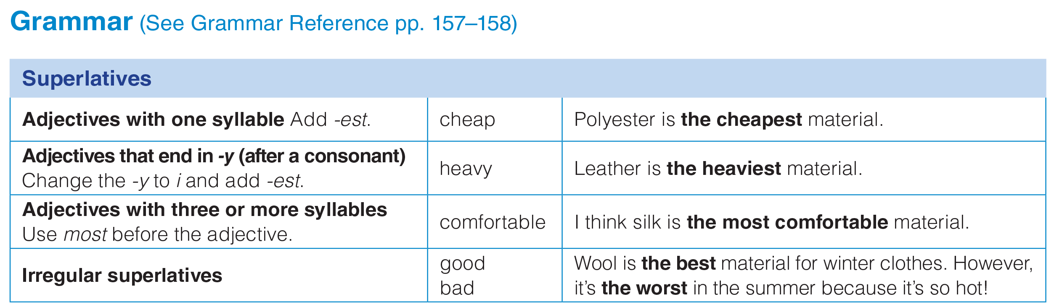
UNIT 9
TYPES OF CLOTHING
GRAMMAR
_______________________________________________________________________________________________________________________________________________________________________________________________________________________
National Geographic Learning, a Cengage Company. © 2022 Cengage Learning, Inc. ALL RIGHTS RESERVED. This presentation tool is for teaching purpose only. May not be scanned, copied or duplicated, or posted to a publicly accessible website, in whole or in part.

Slide 36
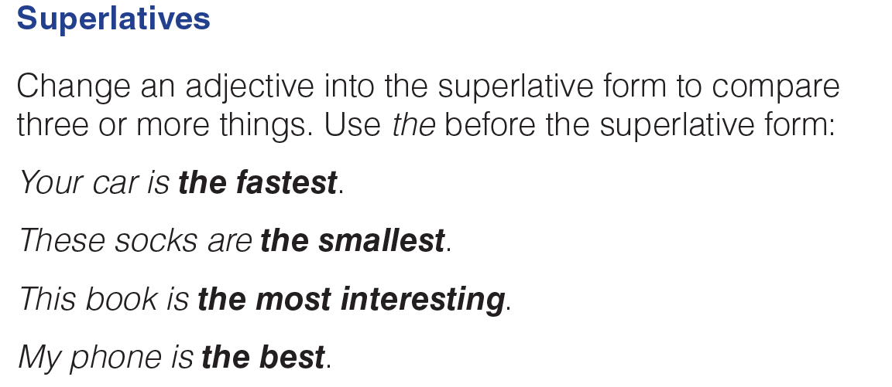
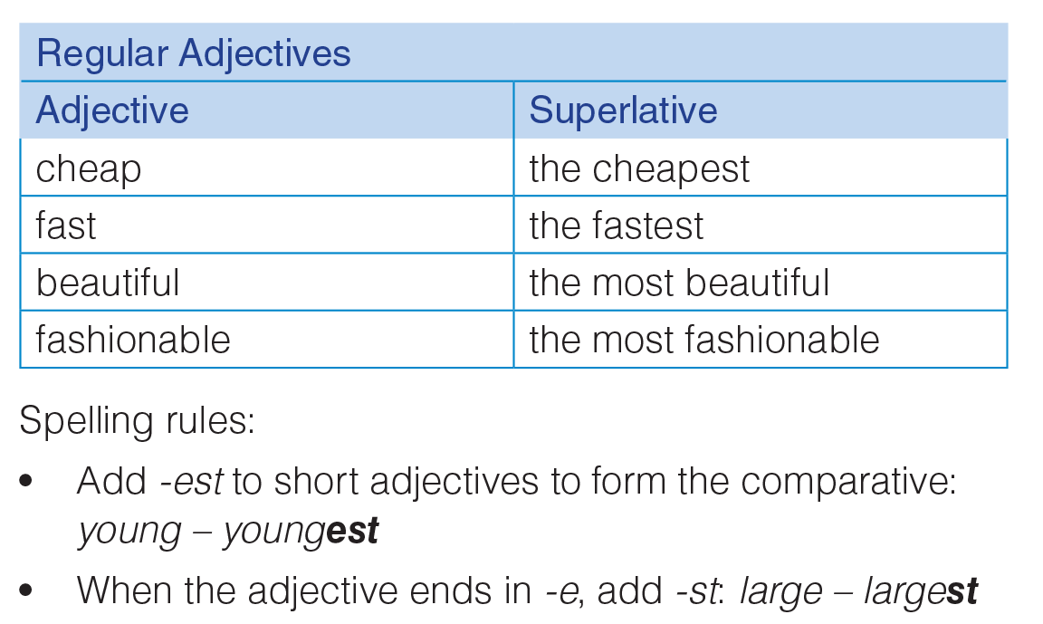
UNIT 9
TYPES OF CLOTHING
GRAMMAR
_______________________________________________________________________________________________________________________________________________________________________________________________________________________
National Geographic Learning, a Cengage Company. © 2022 Cengage Learning, Inc. ALL RIGHTS RESERVED. This presentation tool is for teaching purpose only. May not be scanned, copied or duplicated, or posted to a publicly accessible website, in whole or in part.

Slide 37
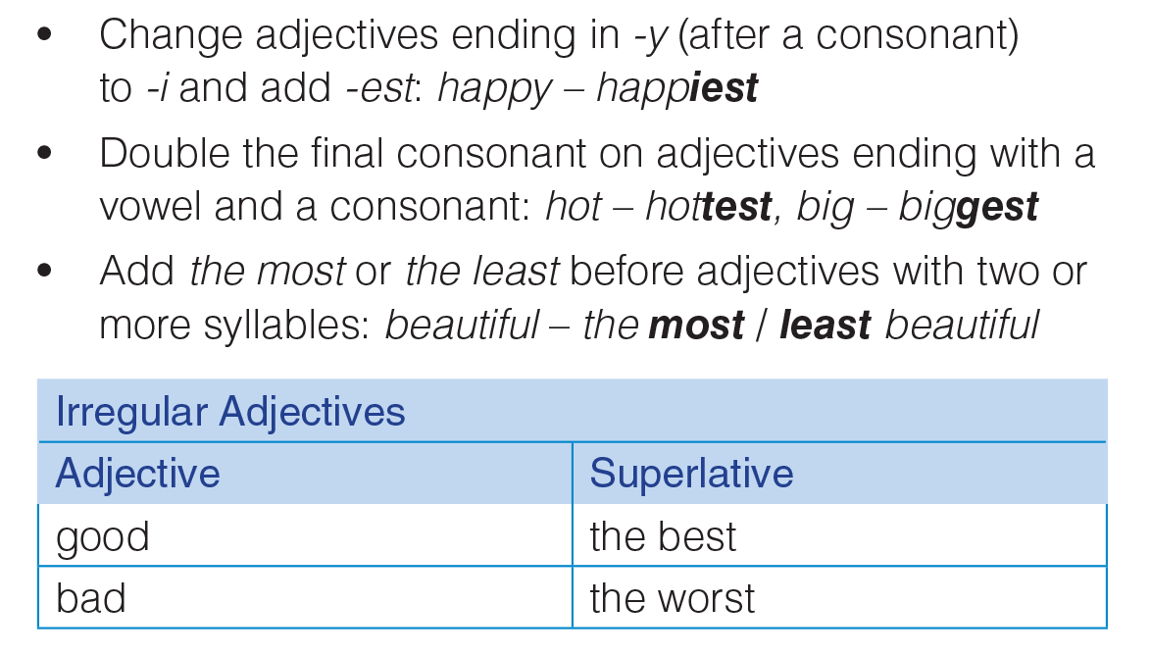
UNIT 9
TYPES OF CLOTHING
GRAMMAR
_______________________________________________________________________________________________________________________________________________________________________________________________________________________
National Geographic Learning, a Cengage Company. © 2022 Cengage Learning, Inc. ALL RIGHTS RESERVED. This presentation tool is for teaching purpose only. May not be scanned, copied or duplicated, or posted to a publicly accessible website, in whole or in part.

Slide 38
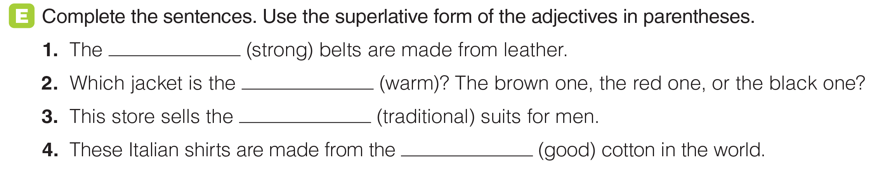
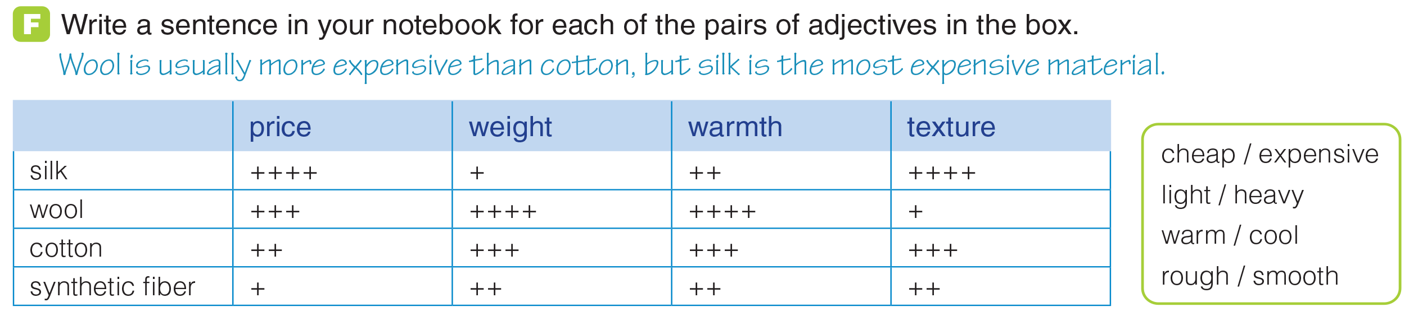
UNIT 9
TYPES OF CLOTHING
GRAMMAR
strongest
warmest
the most
traditional
best
_______________________________________________________________________________________________________________________________________________________________________________________________________________________
National Geographic Learning, a Cengage Company. © 2022 Cengage Learning, Inc. ALL RIGHTS RESERVED. This presentation tool is for teaching purpose only. May not be scanned, copied or duplicated, or posted to a publicly accessible website, in whole or in part.

Slide 39
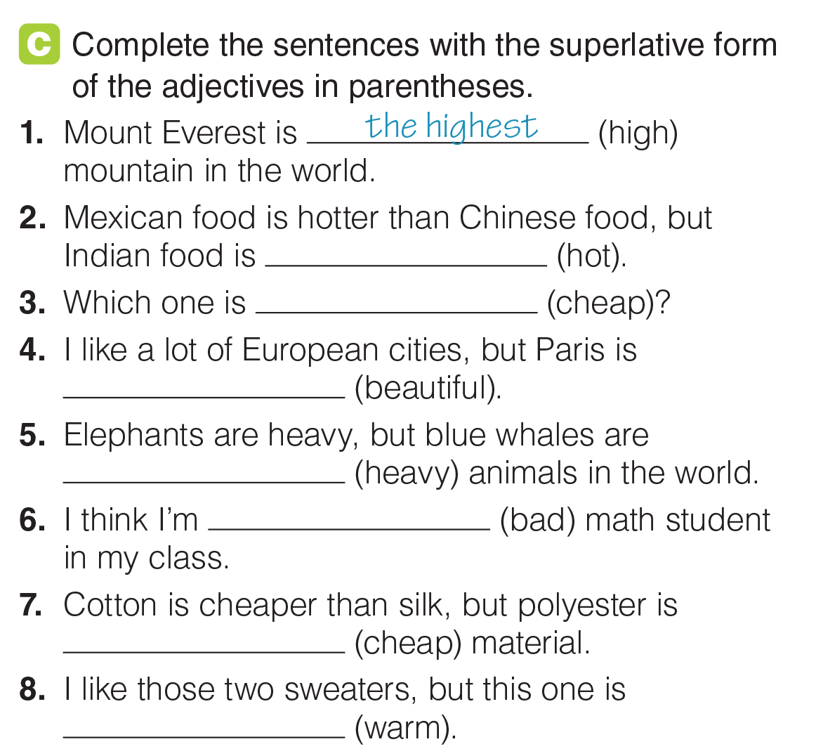
UNIT 9
TYPES OF CLOTHING
GRAMMAR
the hottest
the cheapest
the most beautiful
the heaviest
the worst
the cheapest
the warmest
_______________________________________________________________________________________________________________________________________________________________________________________________________________________
National Geographic Learning, a Cengage Company. © 2022 Cengage Learning, Inc. ALL RIGHTS RESERVED. This presentation tool is for teaching purpose only. May not be scanned, copied or duplicated, or posted to a publicly accessible website, in whole or in part.

Slide 40
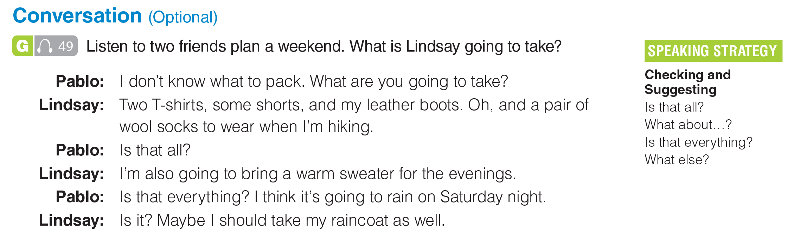
UNIT 9
TYPES OF CLOTHING
CONVERSATION
2 T-shirts, shorts, (leather) boots, (wool) socks, a (warm) sweater, maybe a raincoat
_______________________________________________________________________________________________________________________________________________________________________________________________________________________
National Geographic Learning, a Cengage Company. © 2022 Cengage Learning, Inc. ALL RIGHTS RESERVED. This presentation tool is for teaching purpose only. May not be scanned, copied or duplicated, or posted to a publicly accessible website, in whole or in part.

Slide 41
UNIT 9
TYPES OF CLOTHING
CONVERSATION
_______________________________________________________________________________________________________________________________________________________________________________________________________________________
National Geographic Learning, a Cengage Company. © 2022 Cengage Learning, Inc. ALL RIGHTS RESERVED. This presentation tool is for teaching purpose only. May not be scanned, copied or duplicated, or posted to a publicly accessible website, in whole or in part.

Slide 42
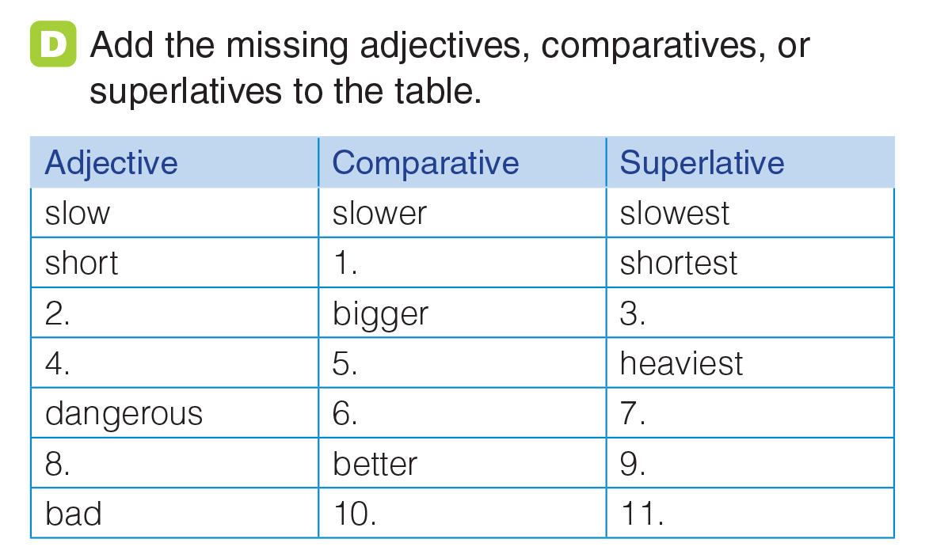
UNIT 9
TYPES OF CLOTHING
GRAMMAR
shorter
big
biggest
heavy
heavier
more dangerous
most dangerous
good
best
worse
worst
_______________________________________________________________________________________________________________________________________________________________________________________________________________________
National Geographic Learning, a Cengage Company. © 2022 Cengage Learning, Inc. ALL RIGHTS RESERVED. This presentation tool is for teaching purpose only. May not be scanned, copied or duplicated, or posted to a publicly accessible website, in whole or in part.

Slide 43
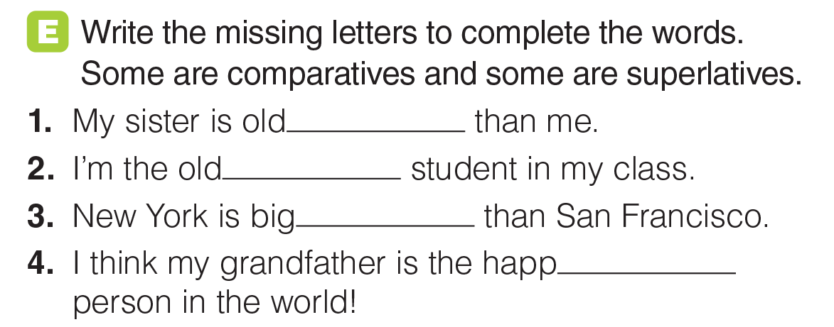
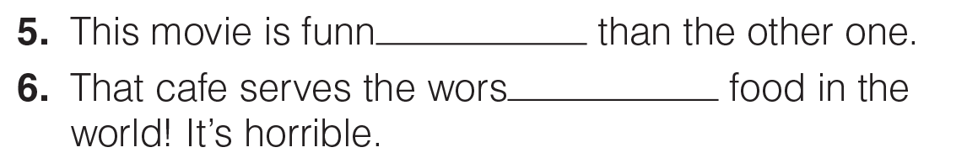
UNIT 9
TYPES OF CLOTHING
GRAMMAR
er
est
ger
iest
ier
t
_______________________________________________________________________________________________________________________________________________________________________________________________________________________
National Geographic Learning, a Cengage Company. © 2022 Cengage Learning, Inc. ALL RIGHTS RESERVED. This presentation tool is for teaching purpose only. May not be scanned, copied or duplicated, or posted to a publicly accessible website, in whole or in part.

Slide 44
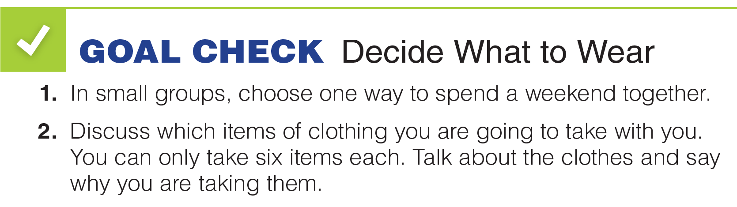

UNIT 9
TYPES OF CLOTHING
GOAL CHECK
_______________________________________________________________________________________________________________________________________________________________________________________________________________________
National Geographic Learning, a Cengage Company. © 2022 Cengage Learning, Inc. ALL RIGHTS RESERVED. This presentation tool is for teaching purpose only. May not be scanned, copied or duplicated, or posted to a publicly accessible website, in whole or in part.

Slide 45


UNIT 9
TYPES OF CLOTHING
READING
_______________________________________________________________________________________________________________________________________________________________________________________________________________________
National Geographic Learning, a Cengage Company. © 2022 Cengage Learning, Inc. ALL RIGHTS RESERVED. This presentation tool is for teaching purpose only. May not be scanned, copied or duplicated, or posted to a publicly accessible website, in whole or in part.

Slide 46


UNIT 9
TYPES OF CLOTHING
READING
2
1
3
_______________________________________________________________________________________________________________________________________________________________________________________________________________________
National Geographic Learning, a Cengage Company. © 2022 Cengage Learning, Inc. ALL RIGHTS RESERVED. This presentation tool is for teaching purpose only. May not be scanned, copied or duplicated, or posted to a publicly accessible website, in whole or in part.

Slide 47

UNIT 9
TYPES OF CLOTHING
READING
_______________________________________________________________________________________________________________________________________________________________________________________________________________________
National Geographic Learning, a Cengage Company. © 2022 Cengage Learning, Inc. ALL RIGHTS RESERVED. This presentation tool is for teaching purpose only. May not be scanned, copied or duplicated, or posted to a publicly accessible website, in whole or in part.

Slide 48

UNIT 9
TYPES OF CLOTHING
READING
c
a
d
b
_______________________________________________________________________________________________________________________________________________________________________________________________________________________
National Geographic Learning, a Cengage Company. © 2022 Cengage Learning, Inc. ALL RIGHTS RESERVED. This presentation tool is for teaching purpose only. May not be scanned, copied or duplicated, or posted to a publicly accessible website, in whole or in part.

Slide 49

UNIT 9
TYPES OF CLOTHING
GOAL CHECK
_______________________________________________________________________________________________________________________________________________________________________________________________________________________
National Geographic Learning, a Cengage Company. © 2022 Cengage Learning, Inc. ALL RIGHTS RESERVED. This presentation tool is for teaching purpose only. May not be scanned, copied or duplicated, or posted to a publicly accessible website, in whole or in part.

Slide 50

UNIT 9
TYPES OF CLOTHING
COMMUNICATION
_______________________________________________________________________________________________________________________________________________________________________________________________________________________
National Geographic Learning, a Cengage Company. © 2022 Cengage Learning, Inc. ALL RIGHTS RESERVED. This presentation tool is for teaching purpose only. May not be scanned, copied or duplicated, or posted to a publicly accessible website, in whole or in part.

Slide 51

UNIT 9
TYPES OF CLOTHING
COMMUNICATION
Shopping in a store is safer than shopping online.
Shopping online is quicker than shopping in a store.
Shopping online is often cheaper than shopping in a store.
Shopping online is easier because you can shop from home.

Slide 52

UNIT 9
TYPES OF CLOTHING
COMMUNICATION
_______________________________________________________________________________________________________________________________________________________________________________________________________________________
National Geographic Learning, a Cengage Company. © 2022 Cengage Learning, Inc. ALL RIGHTS RESERVED. This presentation tool is for teaching purpose only. May not be scanned, copied or duplicated, or posted to a publicly accessible website, in whole or in part.

Slide 53

UNIT 9
TYPES OF CLOTHING
WRITING
_______________________________________________________________________________________________________________________________________________________________________________________________________________________
National Geographic Learning, a Cengage Company. © 2022 Cengage Learning, Inc. ALL RIGHTS RESERVED. This presentation tool is for teaching purpose only. May not be scanned, copied or duplicated, or posted to a publicly accessible website, in whole or in part.

Slide 54

UNIT 9
TYPES OF CLOTHING
WRITING
✓
✓
✓
✓
✓
✓
✓
✓
✓
✓
_______________________________________________________________________________________________________________________________________________________________________________________________________________________
National Geographic Learning, a Cengage Company. © 2022 Cengage Learning, Inc. ALL RIGHTS RESERVED. This presentation tool is for teaching purpose only. May not be scanned, copied or duplicated, or posted to a publicly accessible website, in whole or in part.

Slide 55

UNIT 9
TYPES OF CLOTHING
WRITING
_______________________________________________________________________________________________________________________________________________________________________________________________________________________
National Geographic Learning, a Cengage Company. © 2022 Cengage Learning, Inc. ALL RIGHTS RESERVED. This presentation tool is for teaching purpose only. May not be scanned, copied or duplicated, or posted to a publicly accessible website, in whole or in part.

Slide 56

UNIT 9
TYPES OF CLOTHING
WRITING
_______________________________________________________________________________________________________________________________________________________________________________________________________________________
National Geographic Learning, a Cengage Company. © 2022 Cengage Learning, Inc. ALL RIGHTS RESERVED. This presentation tool is for teaching purpose only. May not be scanned, copied or duplicated, or posted to a publicly accessible website, in whole or in part.

Slide 57

UNIT 9
TYPES OF CLOTHING
WRITING
warm, black, wool
stylish, Italian
new, brown, leather
High-quality,
Indonesian, silk
red and green, cotton
_______________________________________________________________________________________________________________________________________________________________________________________________________________________
National Geographic Learning, a Cengage Company. © 2022 Cengage Learning, Inc. ALL RIGHTS RESERVED. This presentation tool is for teaching purpose only. May not be scanned, copied or duplicated, or posted to a publicly accessible website, in whole or in part.

Slide 58

UNIT 9
TYPES OF CLOTHING
GOAL CHECK
_______________________________________________________________________________________________________________________________________________________________________________________________________________________
National Geographic Learning, a Cengage Company. © 2022 Cengage Learning, Inc. ALL RIGHTS RESERVED. This presentation tool is for teaching purpose only. May not be scanned, copied or duplicated, or posted to a publicly accessible website, in whole or in part.

