Slide 1
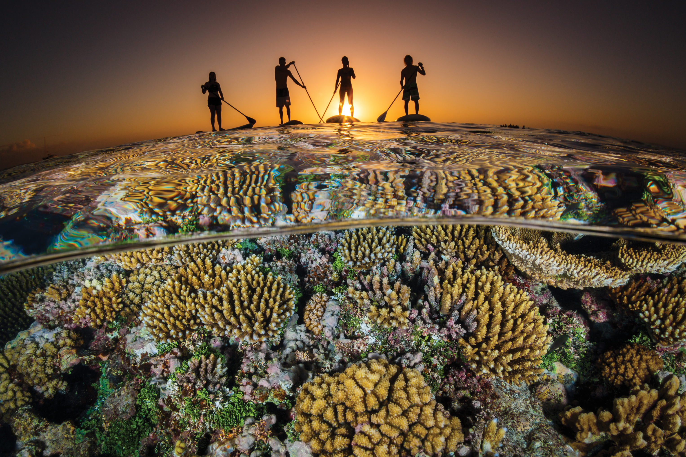


Unit 10:
LIFESTYLES
_______________________________________________________________________________________________________________________________________________________________________________________________________________________
National Geographic Learning, a Cengage Company. © 2022 Cengage Learning, Inc. ALL RIGHTS RESERVED. This presentation tool is for teaching purpose only. May not be scanned, copied or duplicated, or posted to a publicly accessible website, in whole or in part.

Slide 2
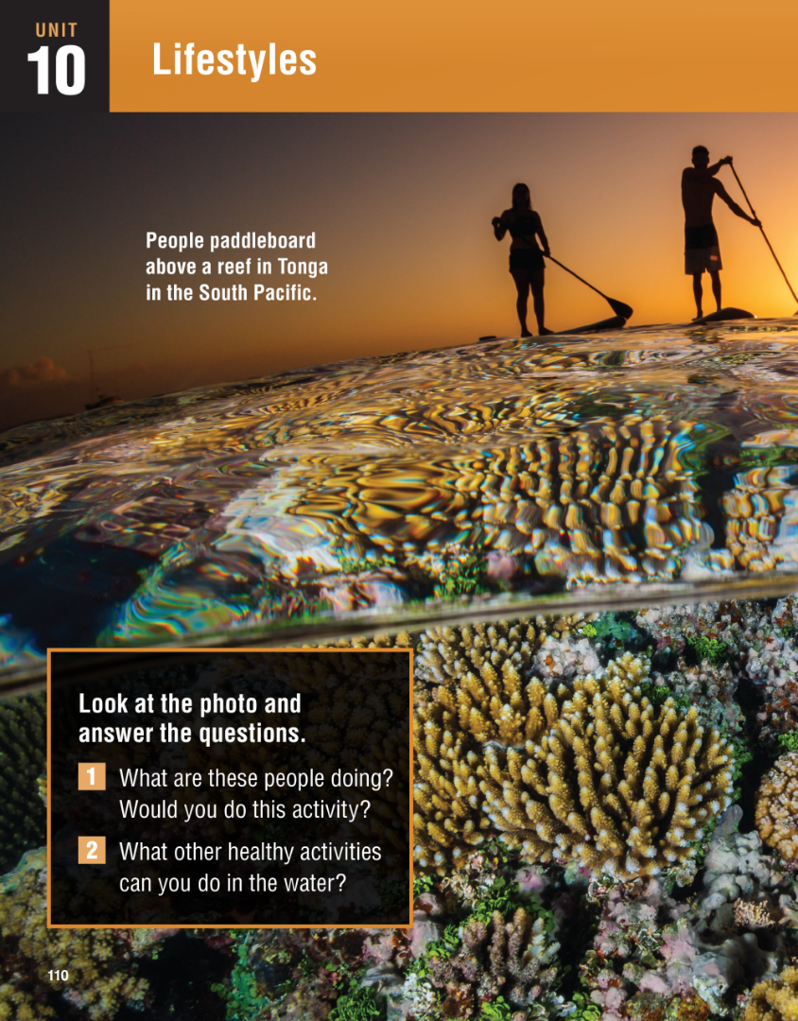
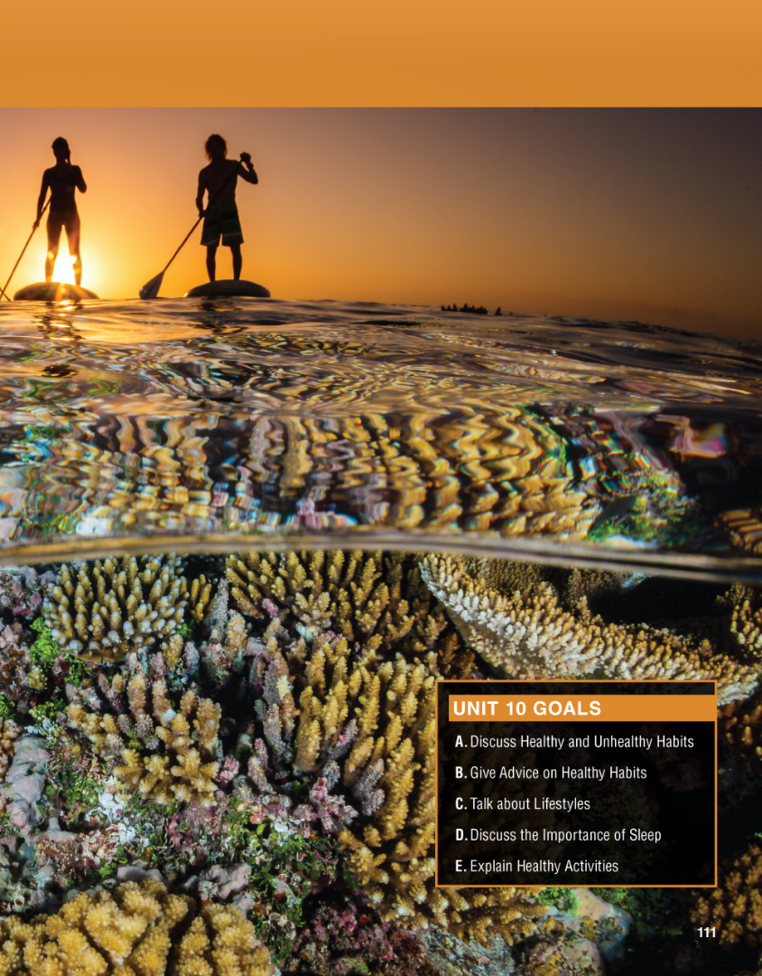

Slide 3
UNIT 10
LIFESTYLES
OVERVIEW
Do you know?
The concept of “lifestyle” was first developed in 1929 by the psychologist Alfred Adler, but it did not become widely used until the 1970s.
A person’s lifestyle is made up of a complex set of the choices they make, though it can also have deep roots in personal circumstances and / or societal mores.
_______________________________________________________________________________________________________________________________________________________________________________________________________________________
National Geographic Learning, a Cengage Company. © 2022 Cengage Learning, Inc. ALL RIGHTS RESERVED. This presentation tool is for teaching purpose only. May not be scanned, copied or duplicated, or posted to a publicly accessible website, in whole or in part.

Slide 4
UNIT 10
LIFESTYLES
OVERVIEW
About the photo
Although there is movement in the photo because the people are paddleboarding and the ocean always has a current, this picture conveys a great sense of stillness.
_______________________________________________________________________________________________________________________________________________________________________________________________________________________
National Geographic Learning, a Cengage Company. © 2022 Cengage Learning, Inc. ALL RIGHTS RESERVED. This presentation tool is for teaching purpose only. May not be scanned, copied or duplicated, or posted to a publicly accessible website, in whole or in part.

Slide 5
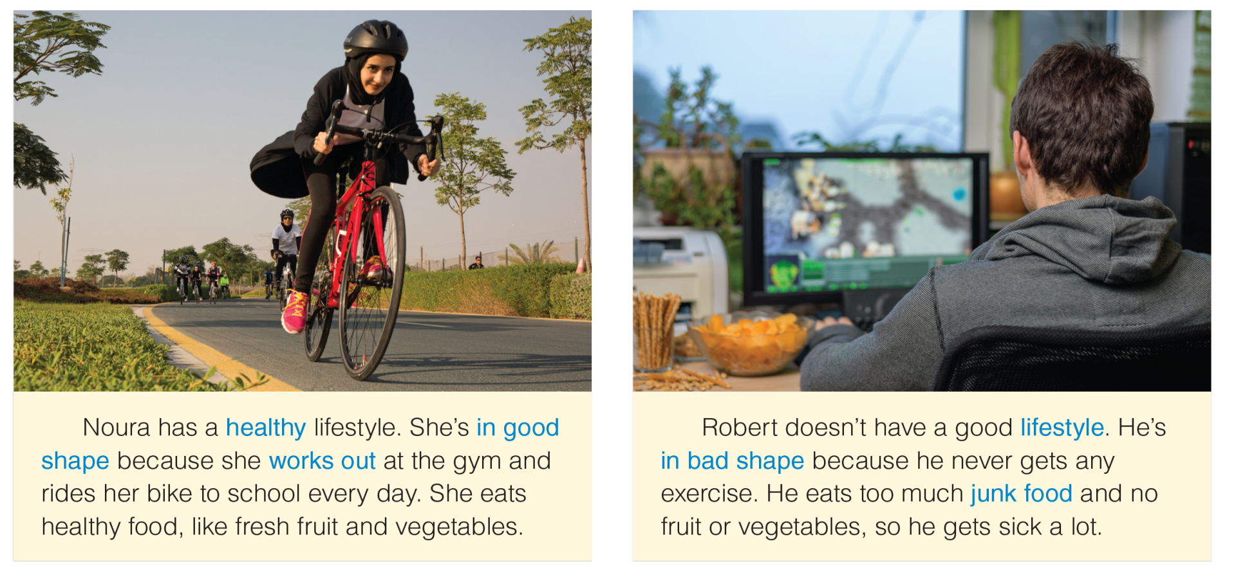
UNIT 10
LIFESTYLES
VOCABULARY
_______________________________________________________________________________________________________________________________________________________________________________________________________________________
National Geographic Learning, a Cengage Company. © 2022 Cengage Learning, Inc. ALL RIGHTS RESERVED. This presentation tool is for teaching purpose only. May not be scanned, copied or duplicated, or posted to a publicly accessible website, in whole or in part.

Slide 6
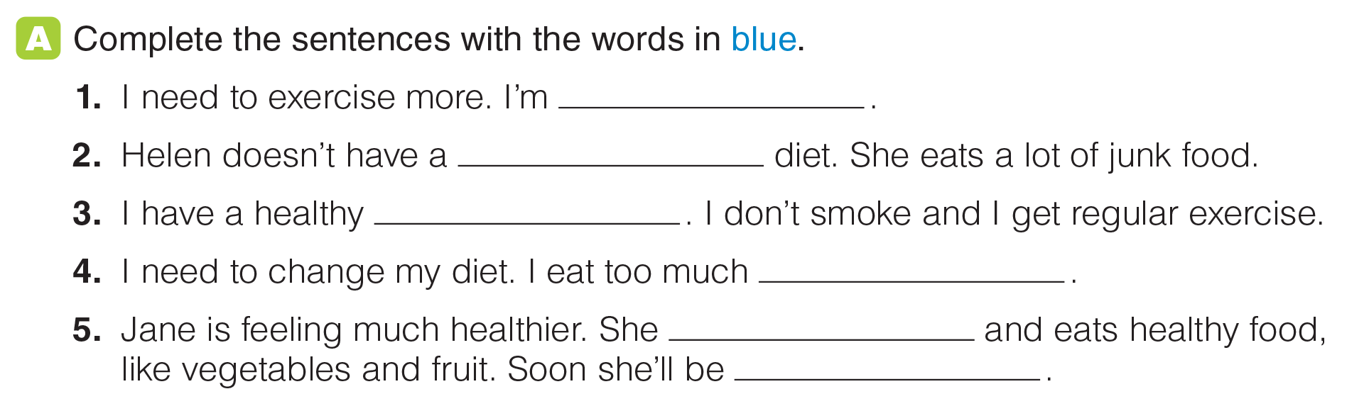
UNIT 10
LIFESTYLES
VOCABULARY
in bad shape
healthy
lifestyle
junk food
works out
in good shape
_______________________________________________________________________________________________________________________________________________________________________________________________________________________
National Geographic Learning, a Cengage Company. © 2022 Cengage Learning, Inc. ALL RIGHTS RESERVED. This presentation tool is for teaching purpose only. May not be scanned, copied or duplicated, or posted to a publicly accessible website, in whole or in part.

Slide 7
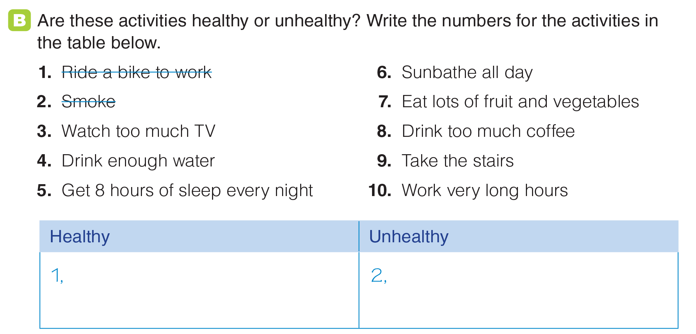
UNIT 10
LIFESTYLES
VOCABULARY
4, 5, 7, 9
3, 6, 8, 10
_______________________________________________________________________________________________________________________________________________________________________________________________________________________
National Geographic Learning, a Cengage Company. © 2022 Cengage Learning, Inc. ALL RIGHTS RESERVED. This presentation tool is for teaching purpose only. May not be scanned, copied or duplicated, or posted to a publicly accessible website, in whole or in part.

Slide 8
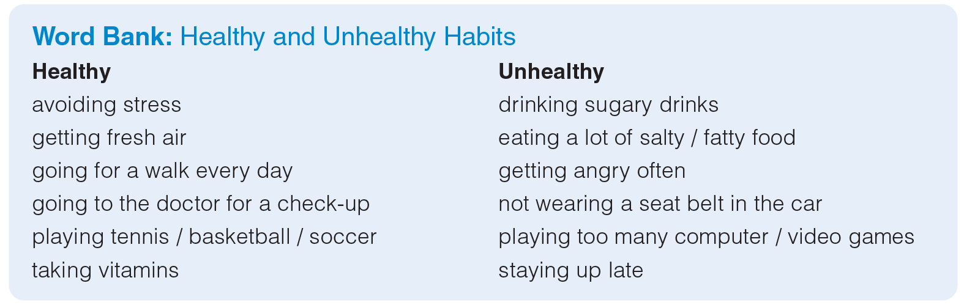
UNIT 10
LIFESTYLES
VOCABULARY
_______________________________________________________________________________________________________________________________________________________________________________________________________________________
National Geographic Learning, a Cengage Company. © 2022 Cengage Learning, Inc. ALL RIGHTS RESERVED. This presentation tool is for teaching purpose only. May not be scanned, copied or duplicated, or posted to a publicly accessible website, in whole or in part.

Slide 9
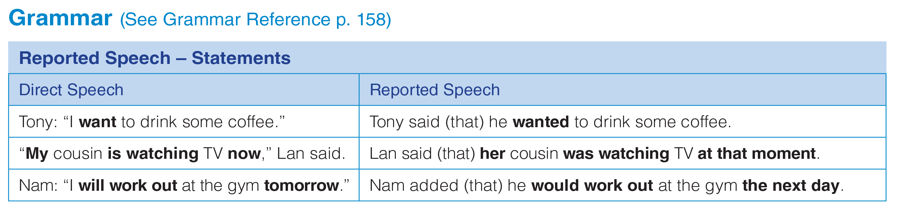
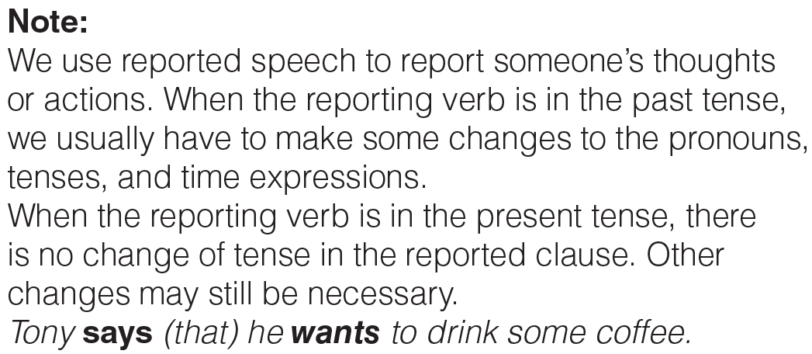
UNIT 10
LIFESTYLES
GRAMMAR
_______________________________________________________________________________________________________________________________________________________________________________________________________________________
National Geographic Learning, a Cengage Company. © 2022 Cengage Learning, Inc. ALL RIGHTS RESERVED. This presentation tool is for teaching purpose only. May not be scanned, copied or duplicated, or posted to a publicly accessible website, in whole or in part.

Slide 10
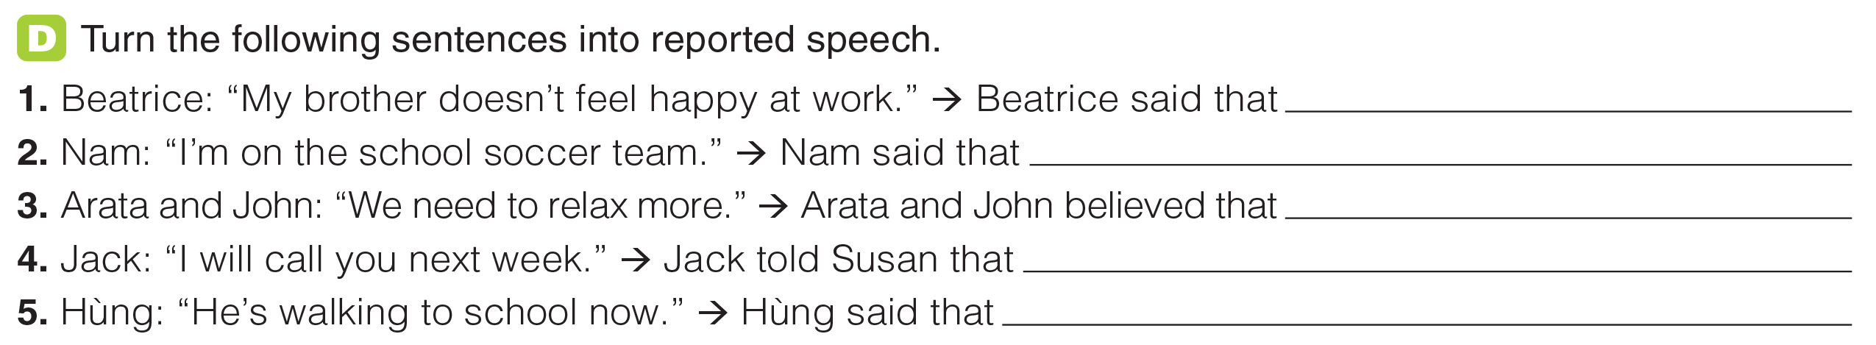
UNIT 10
LIFESTYLES
GRAMMAR
her brother didn’t feel happy at work.
he was on the school soccer team.
they needed to relax more.
he would call her the next / following week.
he was walking to school then / at the moment.
_______________________________________________________________________________________________________________________________________________________________________________________________________________________
National Geographic Learning, a Cengage Company. © 2022 Cengage Learning, Inc. ALL RIGHTS RESERVED. This presentation tool is for teaching purpose only. May not be scanned, copied or duplicated, or posted to a publicly accessible website, in whole or in part.

Slide 11
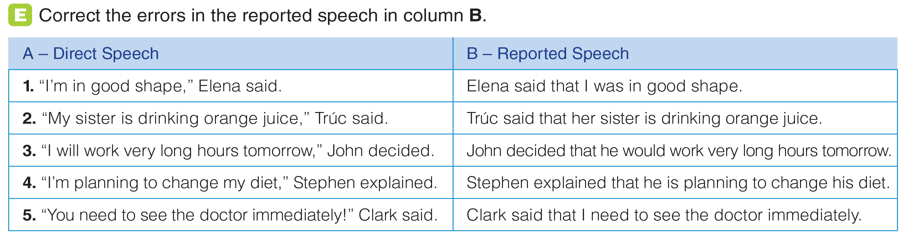
UNIT 10
LIFESTYLES
GRAMMAR
she
was
the next/following day
was
needed
_______________________________________________________________________________________________________________________________________________________________________________________________________________________
National Geographic Learning, a Cengage Company. © 2022 Cengage Learning, Inc. ALL RIGHTS RESERVED. This presentation tool is for teaching purpose only. May not be scanned, copied or duplicated, or posted to a publicly accessible website, in whole or in part.

Slide 12
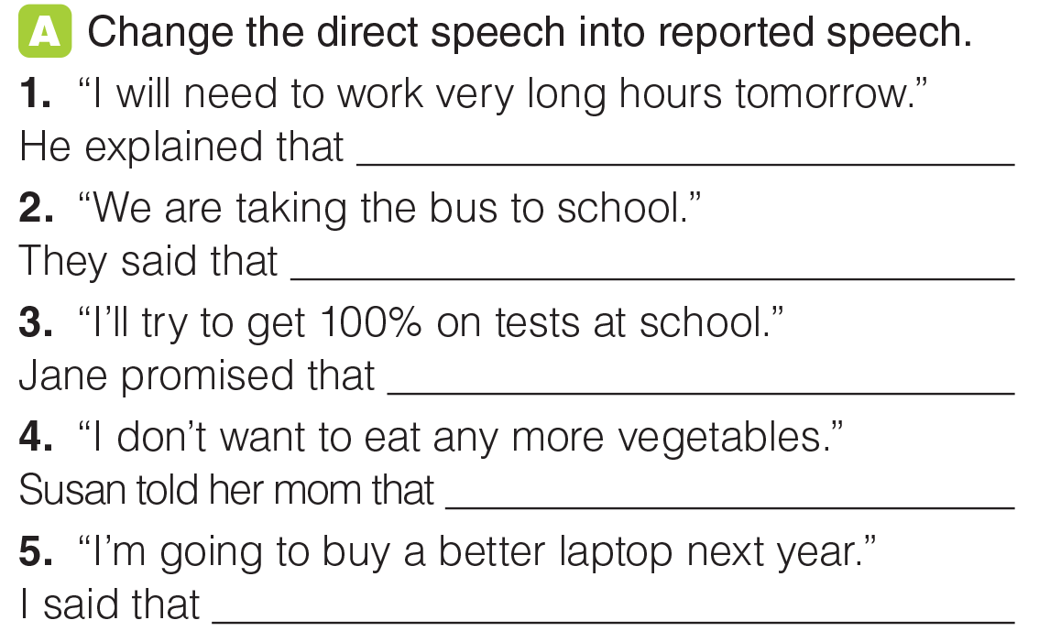
UNIT 10
LIFESTYLES
GRAMMAR
he would need to work very long hours the next day.
they were taking the bus to school.
she would try to get 100% on tests at school.
she didn’t want to eat any more vegetables.
I was going to buy a better laptop the following year.
_______________________________________________________________________________________________________________________________________________________________________________________________________________________
National Geographic Learning, a Cengage Company. © 2022 Cengage Learning, Inc. ALL RIGHTS RESERVED. This presentation tool is for teaching purpose only. May not be scanned, copied or duplicated, or posted to a publicly accessible website, in whole or in part.

Slide 13
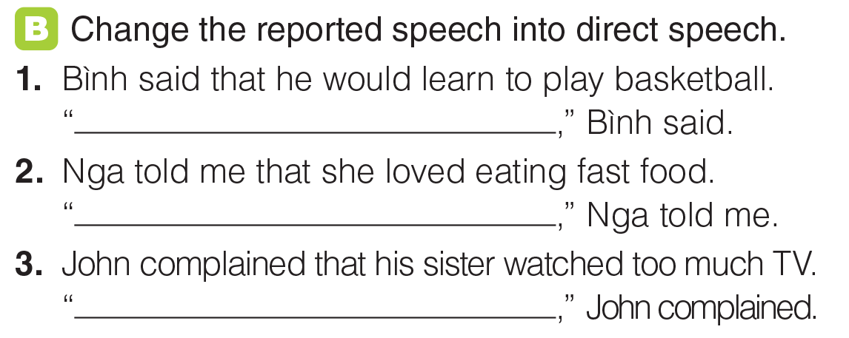
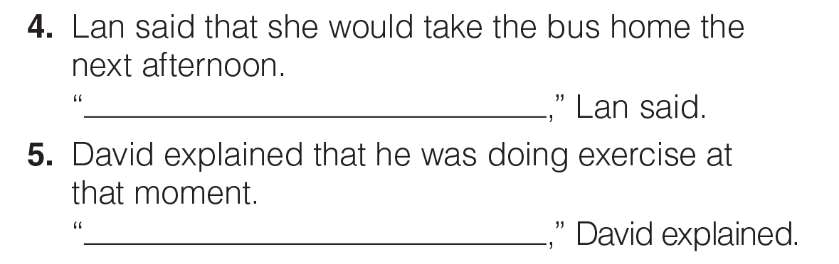
UNIT 10
LIFESTYLES
GRAMMAR
I will learn to play basketball
I love eating fast food
My sister watches too much TV
I’ll take the bus home tomorrow afternoon
I am doing exercise now / at the moment.
_______________________________________________________________________________________________________________________________________________________________________________________________________________________
National Geographic Learning, a Cengage Company. © 2022 Cengage Learning, Inc. ALL RIGHTS RESERVED. This presentation tool is for teaching purpose only. May not be scanned, copied or duplicated, or posted to a publicly accessible website, in whole or in part.

Slide 14
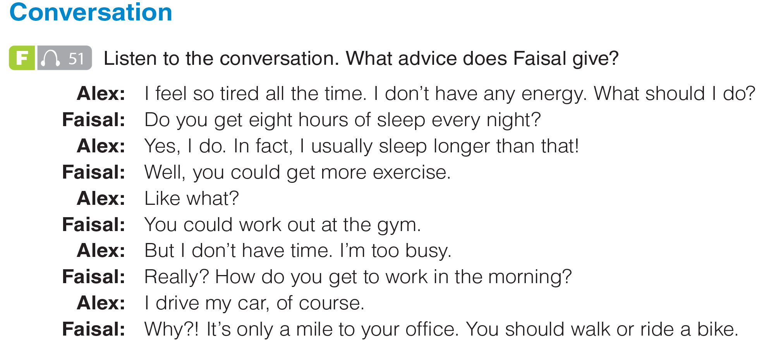

UNIT 10
LIFESTYLES
CONVERSATION
get more exercise; work out; bike or walk to work
_______________________________________________________________________________________________________________________________________________________________________________________________________________________
National Geographic Learning, a Cengage Company. © 2022 Cengage Learning, Inc. ALL RIGHTS RESERVED. This presentation tool is for teaching purpose only. May not be scanned, copied or duplicated, or posted to a publicly accessible website, in whole or in part.

Slide 15
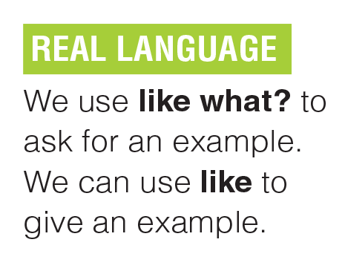
UNIT 10
LIFESTYLES
CONVERSATION
_______________________________________________________________________________________________________________________________________________________________________________________________________________________
National Geographic Learning, a Cengage Company. © 2022 Cengage Learning, Inc. ALL RIGHTS RESERVED. This presentation tool is for teaching purpose only. May not be scanned, copied or duplicated, or posted to a publicly accessible website, in whole or in part.

Slide 16
UNIT 10
LIFESTYLES
CONVERSATION
_______________________________________________________________________________________________________________________________________________________________________________________________________________________
National Geographic Learning, a Cengage Company. © 2022 Cengage Learning, Inc. ALL RIGHTS RESERVED. This presentation tool is for teaching purpose only. May not be scanned, copied or duplicated, or posted to a publicly accessible website, in whole or in part.

Slide 17
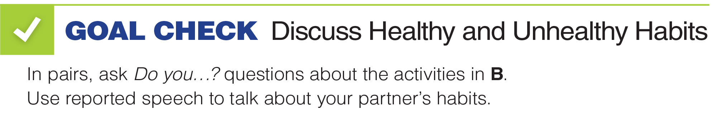
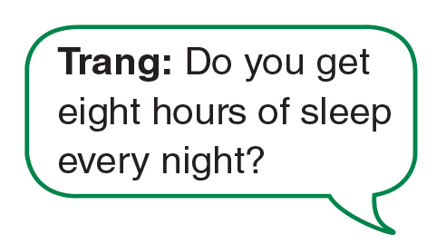
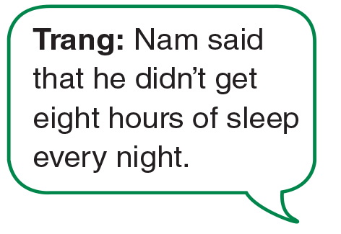

UNIT 10
LIFESTYLES
GOAL CHECK
_______________________________________________________________________________________________________________________________________________________________________________________________________________________
National Geographic Learning, a Cengage Company. © 2022 Cengage Learning, Inc. ALL RIGHTS RESERVED. This presentation tool is for teaching purpose only. May not be scanned, copied or duplicated, or posted to a publicly accessible website, in whole or in part.

Slide 18
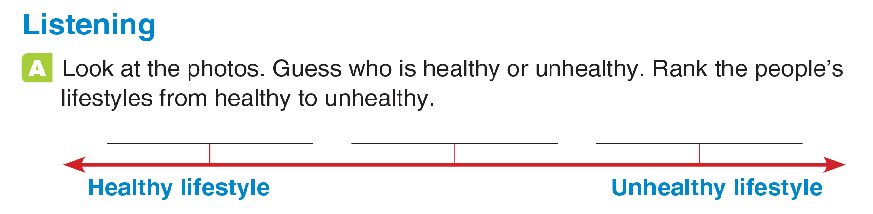

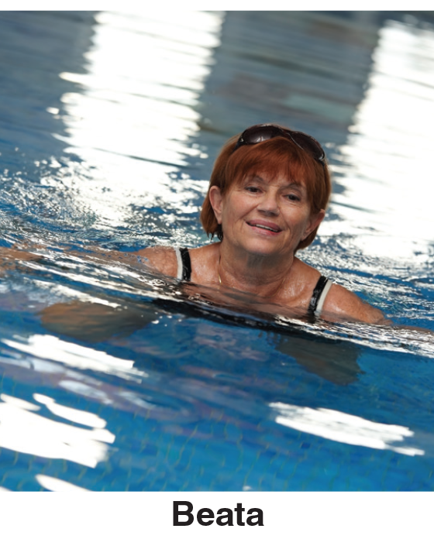
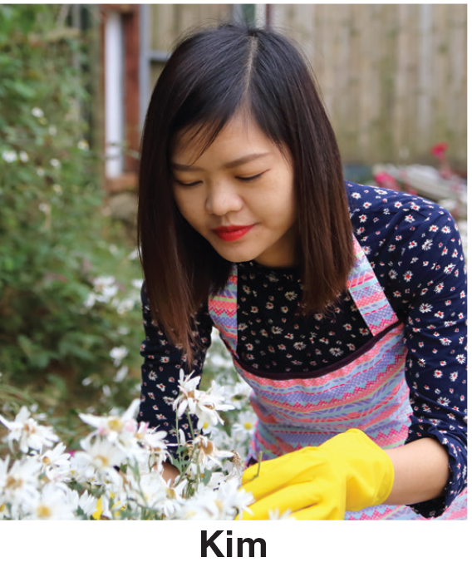
UNIT 10
LIFESTYLES
LISTENING
Kim
Beata
Ben
_______________________________________________________________________________________________________________________________________________________________________________________________________________________
National Geographic Learning, a Cengage Company. © 2022 Cengage Learning, Inc. ALL RIGHTS RESERVED. This presentation tool is for teaching purpose only. May not be scanned, copied or duplicated, or posted to a publicly accessible website, in whole or in part.

Slide 19
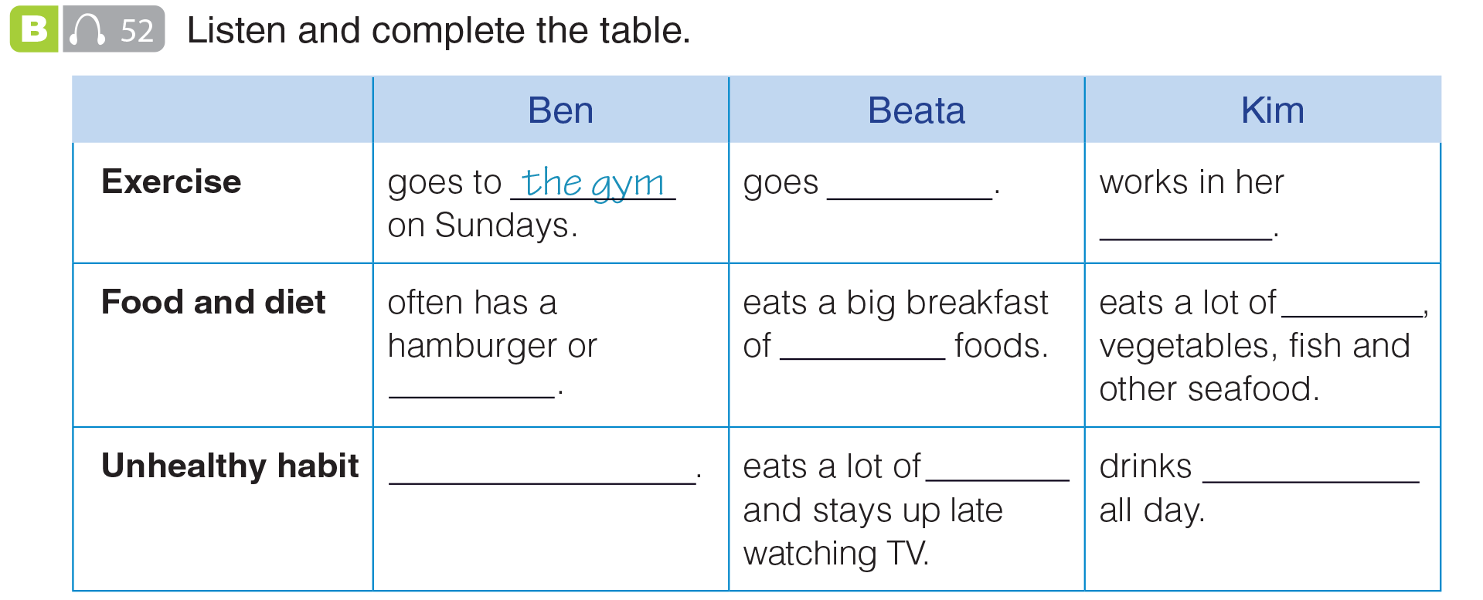
UNIT 10
LIFESTYLES
LISTENING
swimming
garden
fruit
healthy
hot dog
smoke
chocolate
coffee
_______________________________________________________________________________________________________________________________________________________________________________________________________________________
National Geographic Learning, a Cengage Company. © 2022 Cengage Learning, Inc. ALL RIGHTS RESERVED. This presentation tool is for teaching purpose only. May not be scanned, copied or duplicated, or posted to a publicly accessible website, in whole or in part.

Slide 20
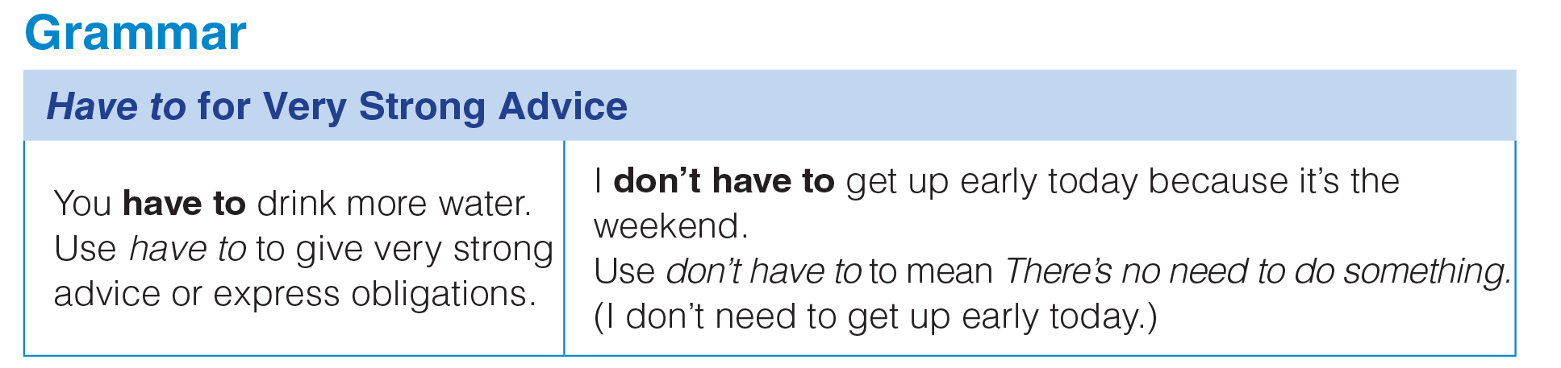
UNIT 10
LIFESTYLES
GRAMMAR
_______________________________________________________________________________________________________________________________________________________________________________________________________________________
National Geographic Learning, a Cengage Company. © 2022 Cengage Learning, Inc. ALL RIGHTS RESERVED. This presentation tool is for teaching purpose only. May not be scanned, copied or duplicated, or posted to a publicly accessible website, in whole or in part.

Slide 21
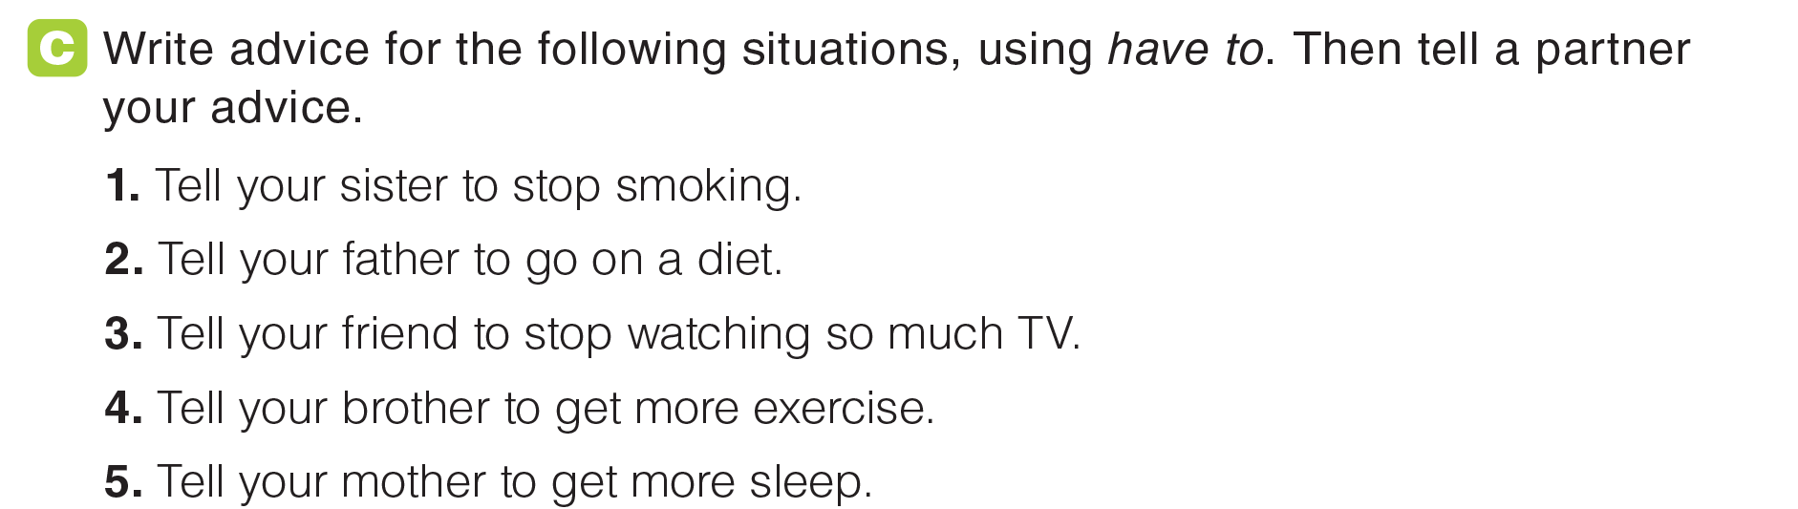
UNIT 10
LIFESTYLES
GRAMMAR
_______________________________________________________________________________________________________________________________________________________________________________________________________________________
National Geographic Learning, a Cengage Company. © 2022 Cengage Learning, Inc. ALL RIGHTS RESERVED. This presentation tool is for teaching purpose only. May not be scanned, copied or duplicated, or posted to a publicly accessible website, in whole or in part.

Slide 22
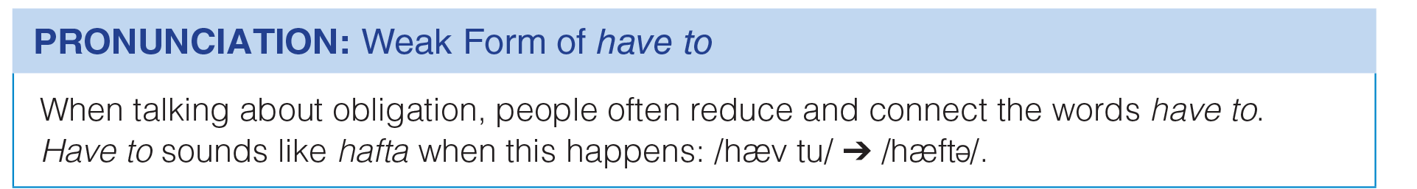
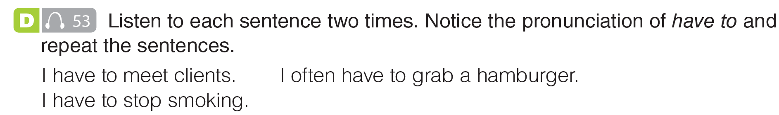
UNIT 10
LIFESTYLES
PRONUNCIATION
_______________________________________________________________________________________________________________________________________________________________________________________________________________________
National Geographic Learning, a Cengage Company. © 2022 Cengage Learning, Inc. ALL RIGHTS RESERVED. This presentation tool is for teaching purpose only. May not be scanned, copied or duplicated, or posted to a publicly accessible website, in whole or in part.

Slide 23
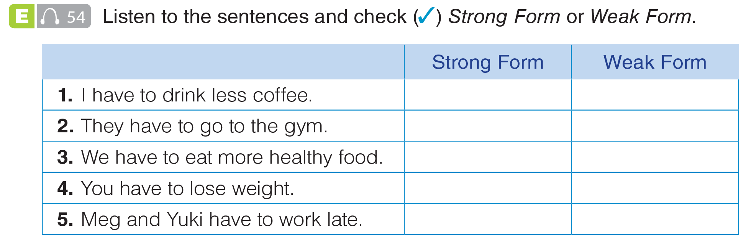
UNIT 10
LIFESTYLES
PRONUNCIATION
✓
✓
✓
✓
✓
_______________________________________________________________________________________________________________________________________________________________________________________________________________________
National Geographic Learning, a Cengage Company. © 2022 Cengage Learning, Inc. ALL RIGHTS RESERVED. This presentation tool is for teaching purpose only. May not be scanned, copied or duplicated, or posted to a publicly accessible website, in whole or in part.

Slide 24
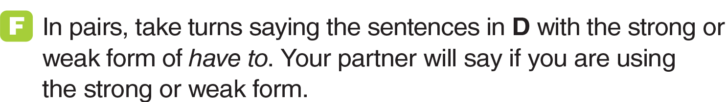
UNIT 10
LIFESTYLES
PRONUNCIATION
✓
✓
✓
✓
✓
_______________________________________________________________________________________________________________________________________________________________________________________________________________________
National Geographic Learning, a Cengage Company. © 2022 Cengage Learning, Inc. ALL RIGHTS RESERVED. This presentation tool is for teaching purpose only. May not be scanned, copied or duplicated, or posted to a publicly accessible website, in whole or in part.

Slide 25

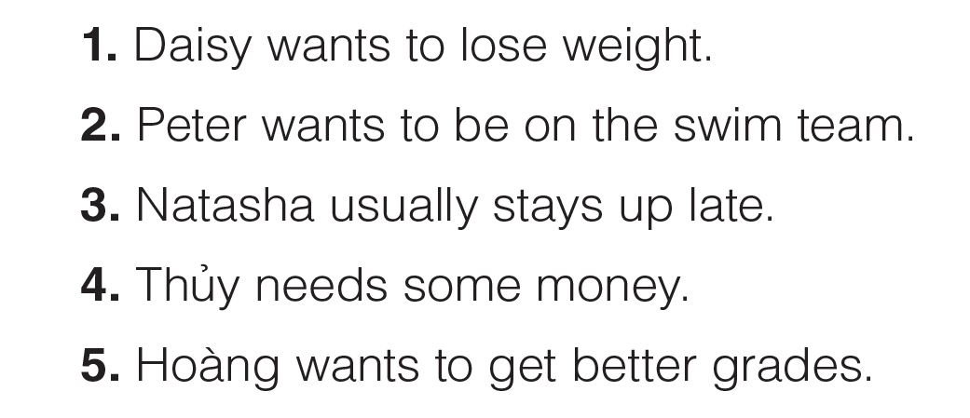
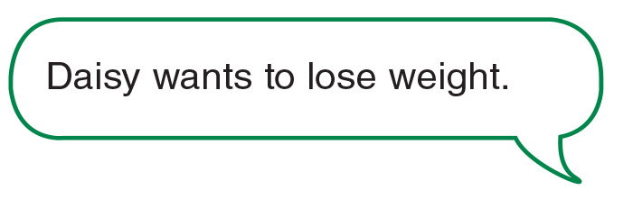
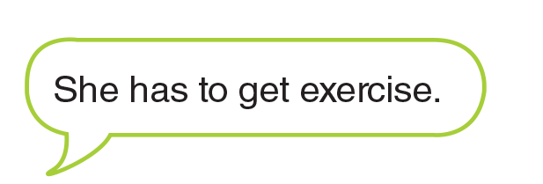

UNIT 10
LIFESTYLES
GOAL CHECK
_______________________________________________________________________________________________________________________________________________________________________________________________________________________
National Geographic Learning, a Cengage Company. © 2022 Cengage Learning, Inc. ALL RIGHTS RESERVED. This presentation tool is for teaching purpose only. May not be scanned, copied or duplicated, or posted to a publicly accessible website, in whole or in part.

Slide 26
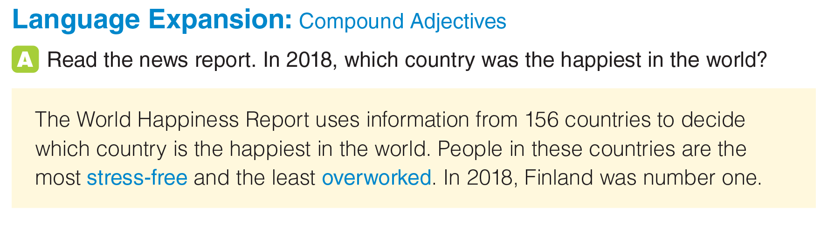
UNIT 10
LIFESTYLES
LANGUAGE EXPANSION
Finland
stress/free
over/worked
_______________________________________________________________________________________________________________________________________________________________________________________________________________________
National Geographic Learning, a Cengage Company. © 2022 Cengage Learning, Inc. ALL RIGHTS RESERVED. This presentation tool is for teaching purpose only. May not be scanned, copied or duplicated, or posted to a publicly accessible website, in whole or in part.

Slide 27
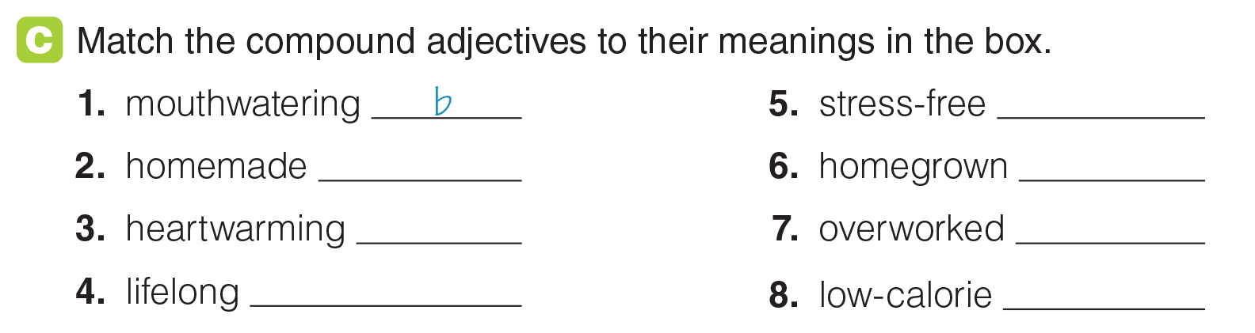
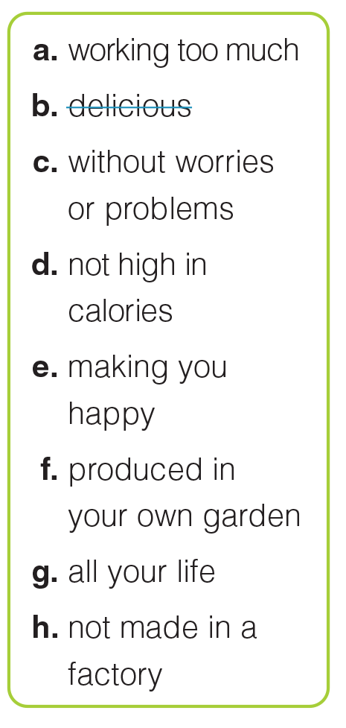
UNIT 10
LIFESTYLES
LANGUAGE EXPANSION
h
e
g
c
f
a
d
_______________________________________________________________________________________________________________________________________________________________________________________________________________________
National Geographic Learning, a Cengage Company. © 2022 Cengage Learning, Inc. ALL RIGHTS RESERVED. This presentation tool is for teaching purpose only. May not be scanned, copied or duplicated, or posted to a publicly accessible website, in whole or in part.

Slide 28
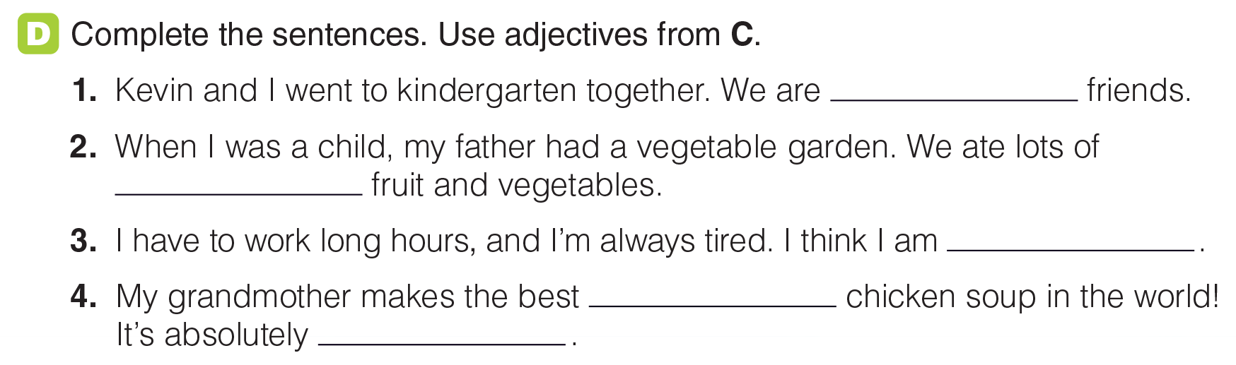
UNIT 10
LIFESTYLES
LANGUAGE EXPANSION
lifelong
homegrown
overworked
homemade
mouth-watering
_______________________________________________________________________________________________________________________________________________________________________________________________________________________
National Geographic Learning, a Cengage Company. © 2022 Cengage Learning, Inc. ALL RIGHTS RESERVED. This presentation tool is for teaching purpose only. May not be scanned, copied or duplicated, or posted to a publicly accessible website, in whole or in part.

Slide 29
UNIT 10
LIFESTYLES
LANGUAGE EXPANSION
_______________________________________________________________________________________________________________________________________________________________________________________________________________________
National Geographic Learning, a Cengage Company. © 2022 Cengage Learning, Inc. ALL RIGHTS RESERVED. This presentation tool is for teaching purpose only. May not be scanned, copied or duplicated, or posted to a publicly accessible website, in whole or in part.

Slide 30
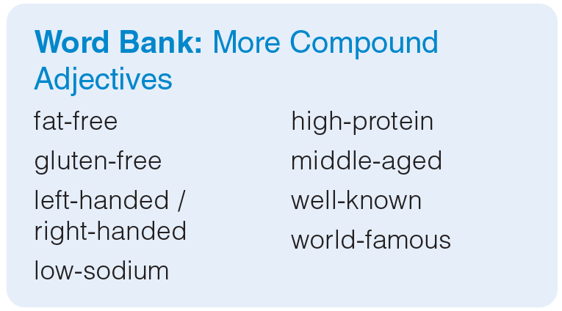
UNIT 10
LIFESTYLES
LANGUAGE EXPANSION
_______________________________________________________________________________________________________________________________________________________________________________________________________________________
National Geographic Learning, a Cengage Company. © 2022 Cengage Learning, Inc. ALL RIGHTS RESERVED. This presentation tool is for teaching purpose only. May not be scanned, copied or duplicated, or posted to a publicly accessible website, in whole or in part.

Slide 31
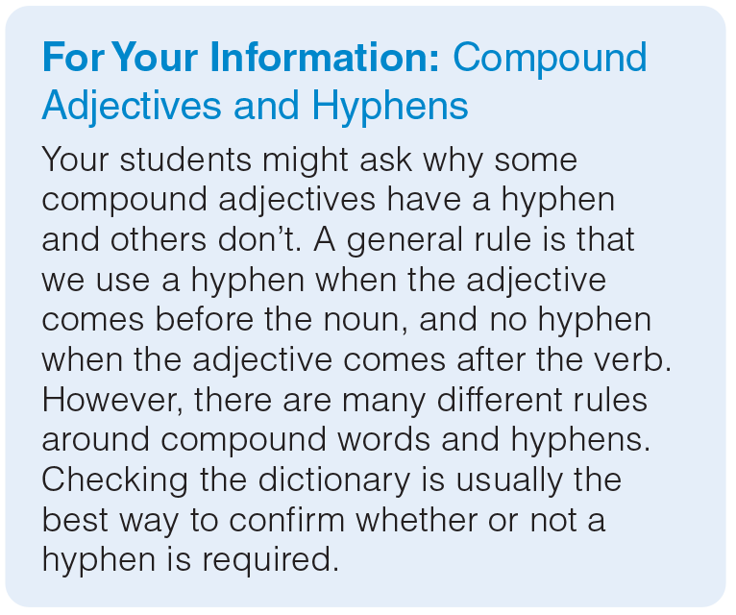
UNIT 10
LIFESTYLES
LANGUAGE EXPANSION
_______________________________________________________________________________________________________________________________________________________________________________________________________________________
National Geographic Learning, a Cengage Company. © 2022 Cengage Learning, Inc. ALL RIGHTS RESERVED. This presentation tool is for teaching purpose only. May not be scanned, copied or duplicated, or posted to a publicly accessible website, in whole or in part.

Slide 32
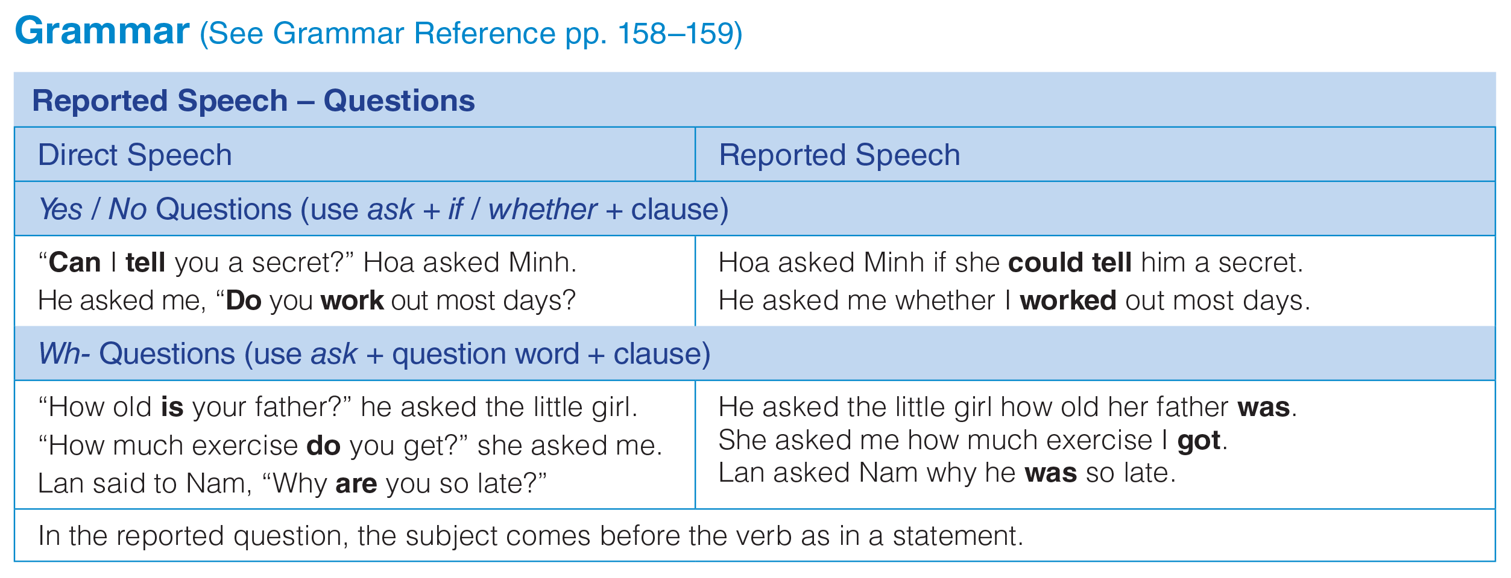
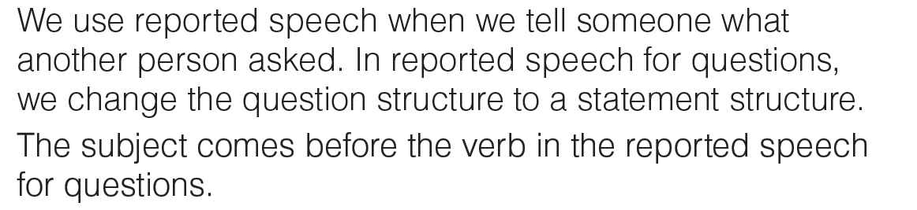
UNIT 10
LIFESTYLES
GRAMMAR
_______________________________________________________________________________________________________________________________________________________________________________________________________________________
National Geographic Learning, a Cengage Company. © 2022 Cengage Learning, Inc. ALL RIGHTS RESERVED. This presentation tool is for teaching purpose only. May not be scanned, copied or duplicated, or posted to a publicly accessible website, in whole or in part.

Slide 33
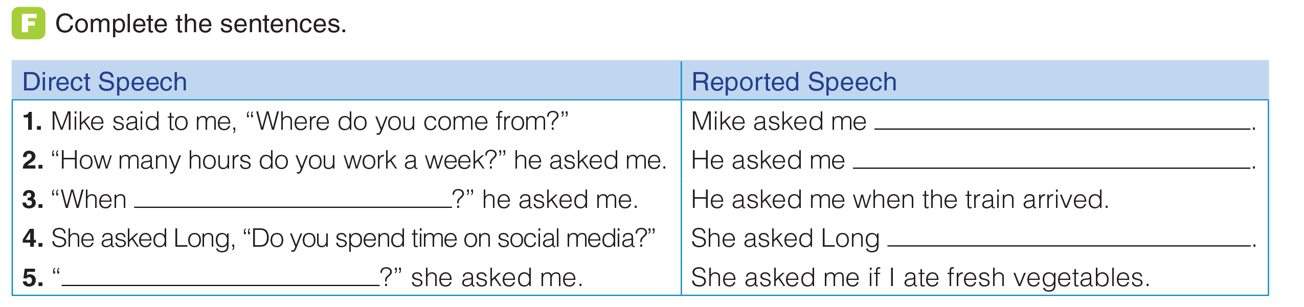
UNIT 10
LIFESTYLES
GRAMMAR
where I came from
how many hours I worked a week
does the train arrive
if / whether he spent time on social media
Do you eat fresh vegetables
_______________________________________________________________________________________________________________________________________________________________________________________________________________________
National Geographic Learning, a Cengage Company. © 2022 Cengage Learning, Inc. ALL RIGHTS RESERVED. This presentation tool is for teaching purpose only. May not be scanned, copied or duplicated, or posted to a publicly accessible website, in whole or in part.

Slide 34

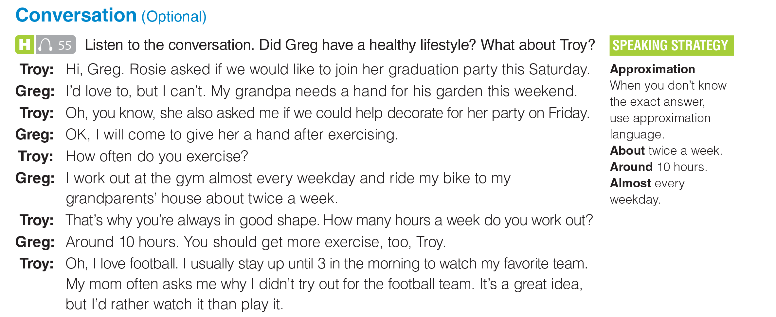
UNIT 10
LIFESTYLES
CONVERSATION
_______________________________________________________________________________________________________________________________________________________________________________________________________________________
National Geographic Learning, a Cengage Company. © 2022 Cengage Learning, Inc. ALL RIGHTS RESERVED. This presentation tool is for teaching purpose only. May not be scanned, copied or duplicated, or posted to a publicly accessible website, in whole or in part.

Slide 35
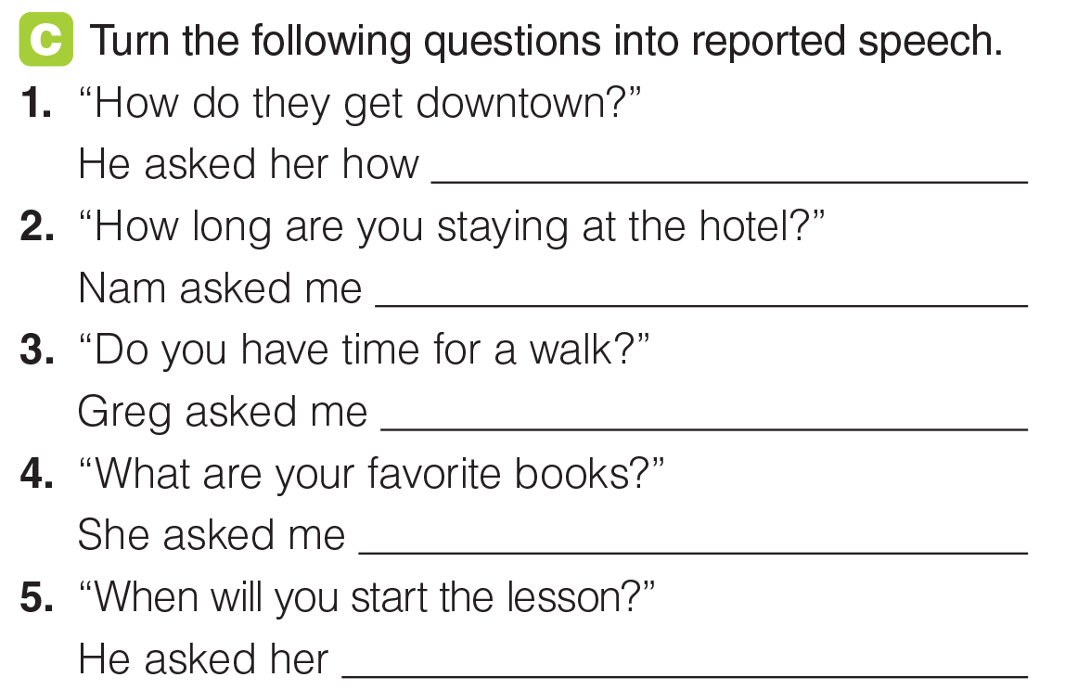
UNIT 10
LIFESTYLES
GRAMMAR
they got downtown.
how long I was staying at the hotel.
if / whether I had time for a walk.
what my favorite books were.
when she would start the lesson.
_______________________________________________________________________________________________________________________________________________________________________________________________________________________
National Geographic Learning, a Cengage Company. © 2022 Cengage Learning, Inc. ALL RIGHTS RESERVED. This presentation tool is for teaching purpose only. May not be scanned, copied or duplicated, or posted to a publicly accessible website, in whole or in part.

Slide 36
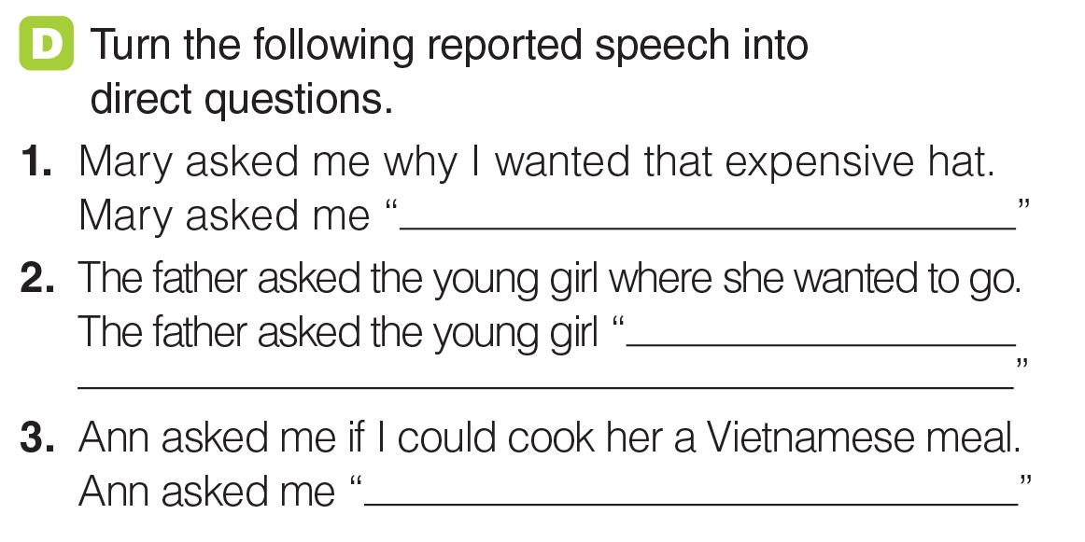
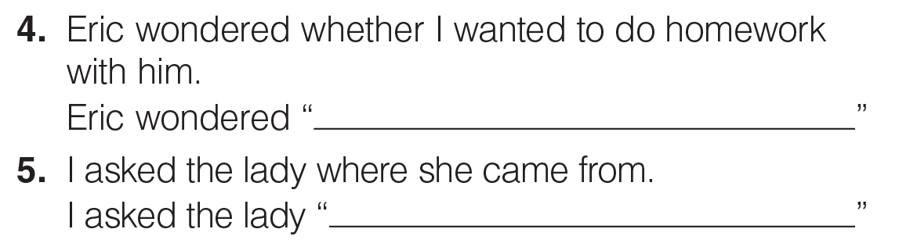
UNIT 10
LIFESTYLES
GRAMMAR
Why do you want this expensive hat?
Where do you want to go?
Can you cook me a Vietnamese meal?
Do you want to do homework with me?
Where do you come from?
_______________________________________________________________________________________________________________________________________________________________________________________________________________________
National Geographic Learning, a Cengage Company. © 2022 Cengage Learning, Inc. ALL RIGHTS RESERVED. This presentation tool is for teaching purpose only. May not be scanned, copied or duplicated, or posted to a publicly accessible website, in whole or in part.

Slide 37
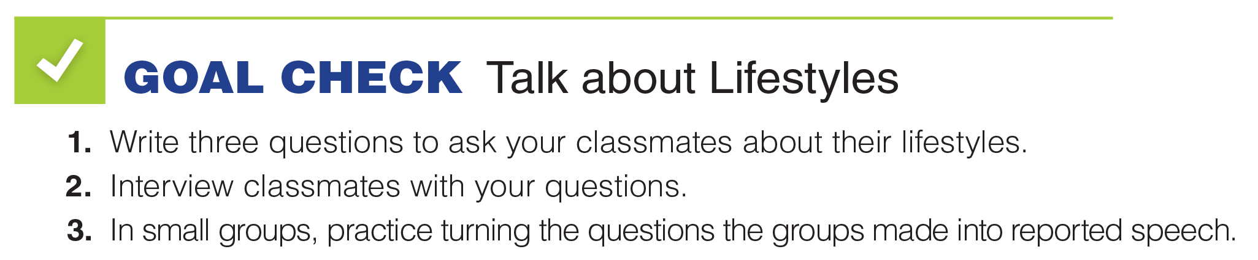
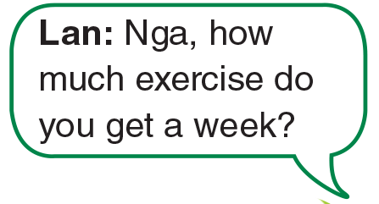
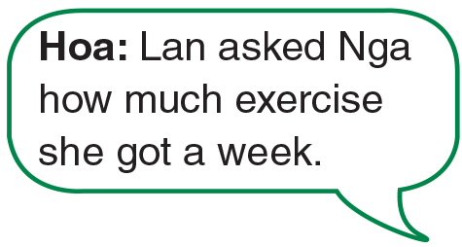
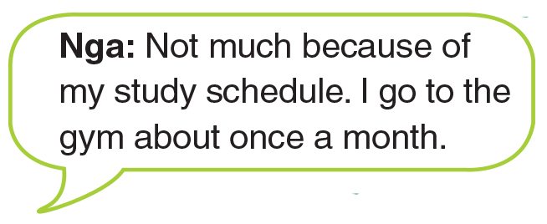
UNIT 10
LIFESTYLES
GOAL CHECK
_______________________________________________________________________________________________________________________________________________________________________________________________________________________
National Geographic Learning, a Cengage Company. © 2022 Cengage Learning, Inc. ALL RIGHTS RESERVED. This presentation tool is for teaching purpose only. May not be scanned, copied or duplicated, or posted to a publicly accessible website, in whole or in part.

Slide 38
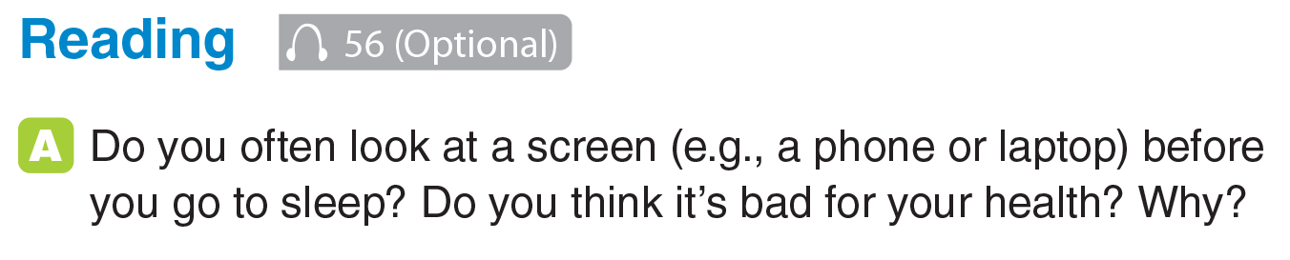

UNIT 10
LIFESTYLES
READING
2
3
1
_______________________________________________________________________________________________________________________________________________________________________________________________________________________
National Geographic Learning, a Cengage Company. © 2022 Cengage Learning, Inc. ALL RIGHTS RESERVED. This presentation tool is for teaching purpose only. May not be scanned, copied or duplicated, or posted to a publicly accessible website, in whole or in part.

Slide 39


UNIT 10
LIFESTYLES
READING
_______________________________________________________________________________________________________________________________________________________________________________________________________________________
National Geographic Learning, a Cengage Company. © 2022 Cengage Learning, Inc. ALL RIGHTS RESERVED. This presentation tool is for teaching purpose only. May not be scanned, copied or duplicated, or posted to a publicly accessible website, in whole or in part.

Slide 40

UNIT 10
LIFESTYLES
READING
_______________________________________________________________________________________________________________________________________________________________________________________________________________________
National Geographic Learning, a Cengage Company. © 2022 Cengage Learning, Inc. ALL RIGHTS RESERVED. This presentation tool is for teaching purpose only. May not be scanned, copied or duplicated, or posted to a publicly accessible website, in whole or in part.

Slide 41

UNIT 10
LIFESTYLES
READING
sickness
better
eight
late
work
blue
one
_______________________________________________________________________________________________________________________________________________________________________________________________________________________
National Geographic Learning, a Cengage Company. © 2022 Cengage Learning, Inc. ALL RIGHTS RESERVED. This presentation tool is for teaching purpose only. May not be scanned, copied or duplicated, or posted to a publicly accessible website, in whole or in part.

Slide 42

UNIT 10
LIFESTYLES
GOAL CHECK
_______________________________________________________________________________________________________________________________________________________________________________________________________________________
National Geographic Learning, a Cengage Company. © 2022 Cengage Learning, Inc. ALL RIGHTS RESERVED. This presentation tool is for teaching purpose only. May not be scanned, copied or duplicated, or posted to a publicly accessible website, in whole or in part.

Slide 43

UNIT 10
LIFESTYLES
COMMUNICATION
_______________________________________________________________________________________________________________________________________________________________________________________________________________________
National Geographic Learning, a Cengage Company. © 2022 Cengage Learning, Inc. ALL RIGHTS RESERVED. This presentation tool is for teaching purpose only. May not be scanned, copied or duplicated, or posted to a publicly accessible website, in whole or in part.

Slide 44

UNIT 10
LIFESTYLES
COMMUNICATION
1. Valorie felt unhappy, but a piece of classical music was on the radio. This made her feel better.
2. She thinks music can be good for our mental health.
_______________________________________________________________________________________________________________________________________________________________________________________________________________________
National Geographic Learning, a Cengage Company. © 2022 Cengage Learning, Inc. ALL RIGHTS RESERVED. This presentation tool is for teaching purpose only. May not be scanned, copied or duplicated, or posted to a publicly accessible website, in whole or in part.

Slide 45



UNIT 10
LIFESTYLES
COMMUNICATION
_______________________________________________________________________________________________________________________________________________________________________________________________________________________
National Geographic Learning, a Cengage Company. © 2022 Cengage Learning, Inc. ALL RIGHTS RESERVED. This presentation tool is for teaching purpose only. May not be scanned, copied or duplicated, or posted to a publicly accessible website, in whole or in part.

Slide 46


UNIT 10
LIFESTYLES
WRITING
Dancing
It keeps her in shape.
She has to memorize things and use her brain. She meets new people and has fun.
_______________________________________________________________________________________________________________________________________________________________________________________________________________________
National Geographic Learning, a Cengage Company. © 2022 Cengage Learning, Inc. ALL RIGHTS RESERVED. This presentation tool is for teaching purpose only. May not be scanned, copied or duplicated, or posted to a publicly accessible website, in whole or in part.

Slide 47
UNIT 10
LIFESTYLES
WRITING
_______________________________________________________________________________________________________________________________________________________________________________________________________________________
National Geographic Learning, a Cengage Company. © 2022 Cengage Learning, Inc. ALL RIGHTS RESERVED. This presentation tool is for teaching purpose only. May not be scanned, copied or duplicated, or posted to a publicly accessible website, in whole or in part.

Slide 48

UNIT 10
LIFESTYLES
WRITING
3
4
1
2
5
_______________________________________________________________________________________________________________________________________________________________________________________________________________________
National Geographic Learning, a Cengage Company. © 2022 Cengage Learning, Inc. ALL RIGHTS RESERVED. This presentation tool is for teaching purpose only. May not be scanned, copied or duplicated, or posted to a publicly accessible website, in whole or in part.

Slide 49

UNIT 10
LIFESTYLES
GOAL CHECK
_______________________________________________________________________________________________________________________________________________________________________________________________________________________
National Geographic Learning, a Cengage Company. © 2022 Cengage Learning, Inc. ALL RIGHTS RESERVED. This presentation tool is for teaching purpose only. May not be scanned, copied or duplicated, or posted to a publicly accessible website, in whole or in part.

