Slide 1



Unit 11:
ACHIEVEMENT
_______________________________________________________________________________________________________________________________________________________________________________________________________________________
National Geographic Learning, a Cengage Company. © 2022 Cengage Learning, Inc. ALL RIGHTS RESERVED. This presentation tool is for teaching purpose only. May not be scanned, copied or duplicated, or posted to a publicly accessible website, in whole or in part.

Slide 2



Slide 3
UNIT 11
ACHIEVEMENTS
OVERVIEW
Do you know?
One of the ways in which we grow and progress is through achieving goals that we set for ourselves. Every task that we successfully complete is an achievement, including small things such as doing our daily chores.
_______________________________________________________________________________________________________________________________________________________________________________________________________________________
National Geographic Learning, a Cengage Company. © 2022 Cengage Learning, Inc. ALL RIGHTS RESERVED. This presentation tool is for teaching purpose only. May not be scanned, copied or duplicated, or posted to a publicly accessible website, in whole or in part.

Slide 4
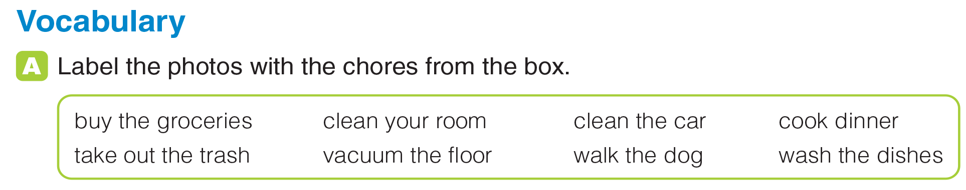
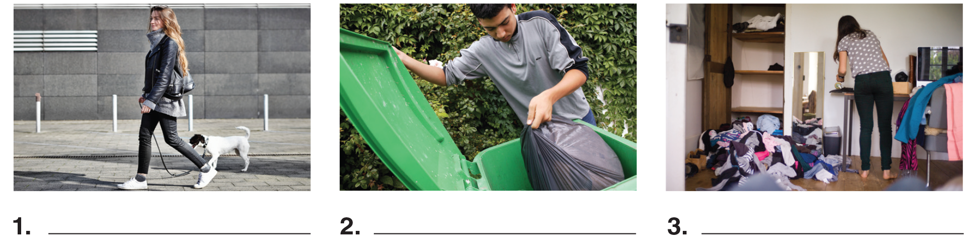
UNIT 11
ACHIEVEMENTS
VOCABULARY
walk the dog
take out the trash
clean your room
_______________________________________________________________________________________________________________________________________________________________________________________________________________________
National Geographic Learning, a Cengage Company. © 2022 Cengage Learning, Inc. ALL RIGHTS RESERVED. This presentation tool is for teaching purpose only. May not be scanned, copied or duplicated, or posted to a publicly accessible website, in whole or in part.

Slide 5
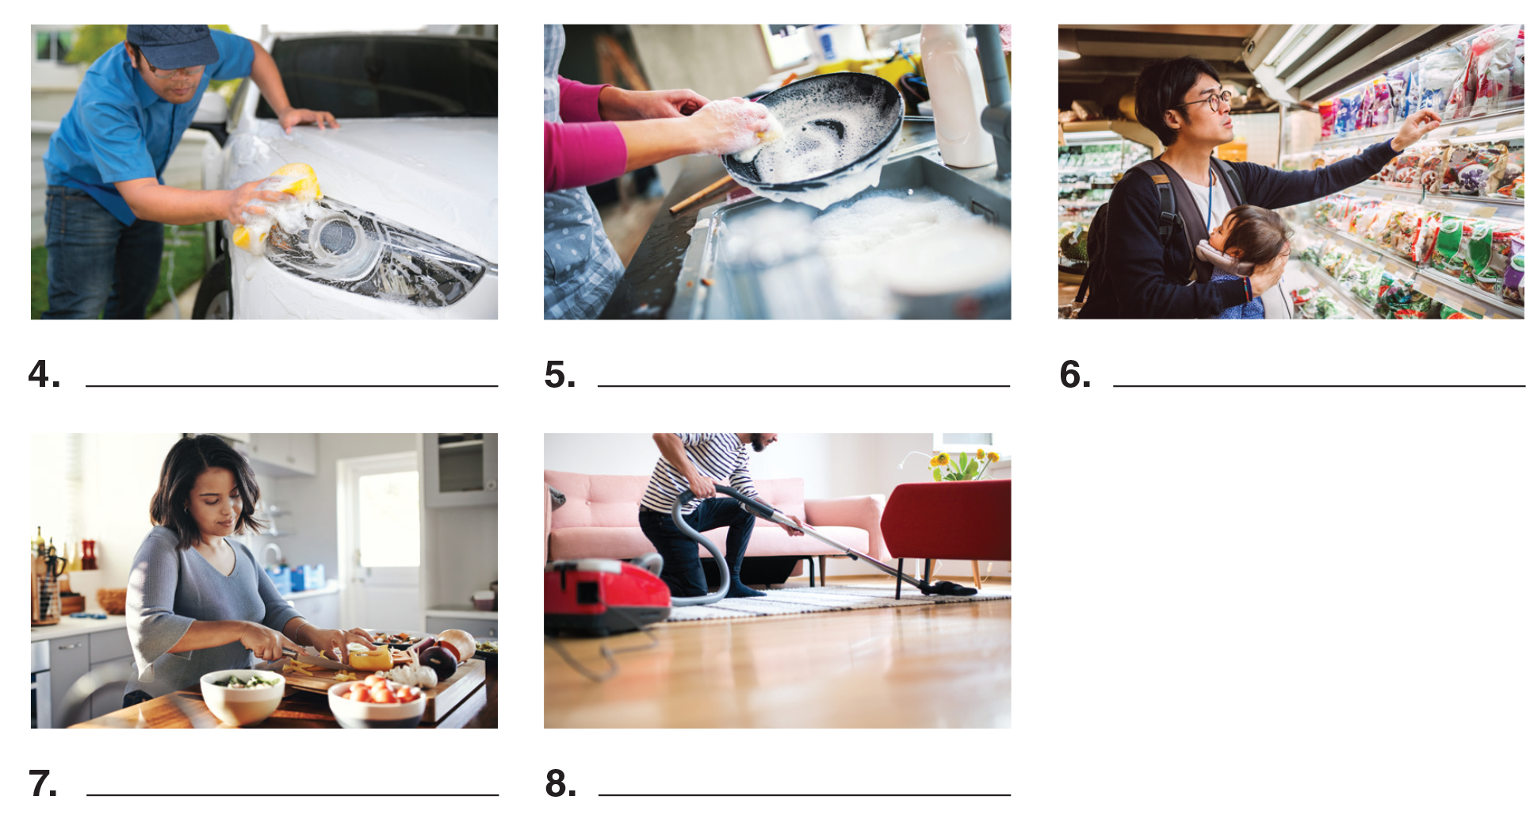
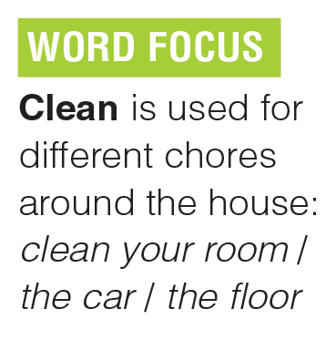
UNIT 11
ACHIEVEMENTS
VOCABULARY
clean the car
wash the dishes
buy the groceries
cook dinner
vacuum the floor
_______________________________________________________________________________________________________________________________________________________________________________________________________________________
National Geographic Learning, a Cengage Company. © 2022 Cengage Learning, Inc. ALL RIGHTS RESERVED. This presentation tool is for teaching purpose only. May not be scanned, copied or duplicated, or posted to a publicly accessible website, in whole or in part.

Slide 6
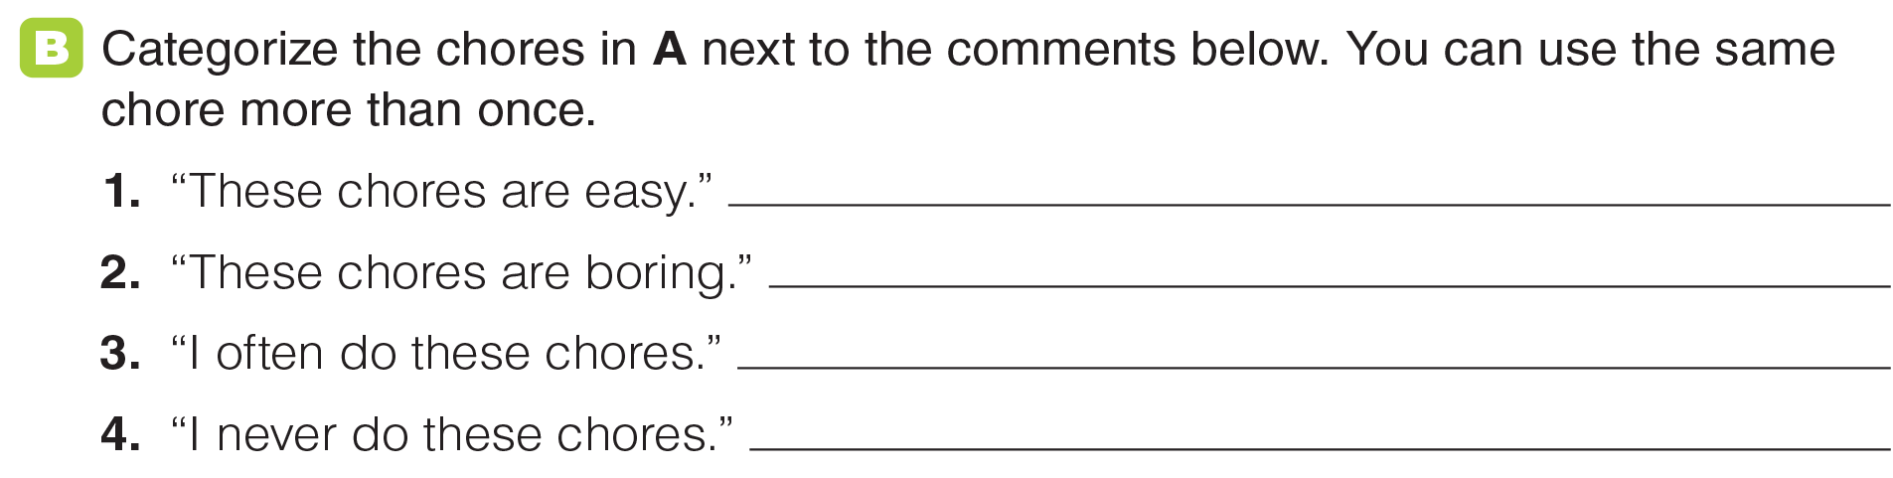
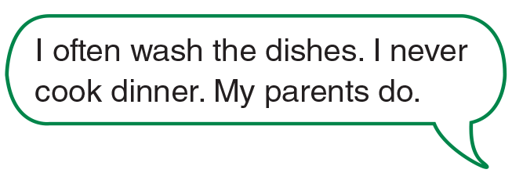
UNIT 11
ACHIEVEMENTS
VOCABULARY
_______________________________________________________________________________________________________________________________________________________________________________________________________________________
National Geographic Learning, a Cengage Company. © 2022 Cengage Learning, Inc. ALL RIGHTS RESERVED. This presentation tool is for teaching purpose only. May not be scanned, copied or duplicated, or posted to a publicly accessible website, in whole or in part.

Slide 7
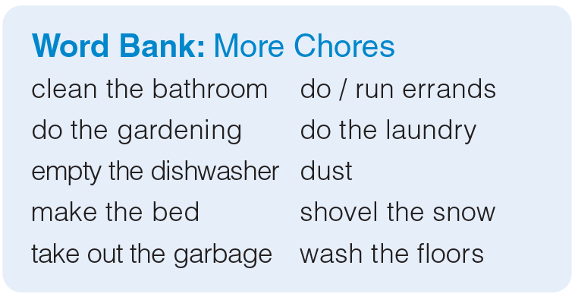
UNIT 11
ACHIEVEMENTS
VOCABULARY
_______________________________________________________________________________________________________________________________________________________________________________________________________________________
National Geographic Learning, a Cengage Company. © 2022 Cengage Learning, Inc. ALL RIGHTS RESERVED. This presentation tool is for teaching purpose only. May not be scanned, copied or duplicated, or posted to a publicly accessible website, in whole or in part.

Slide 8
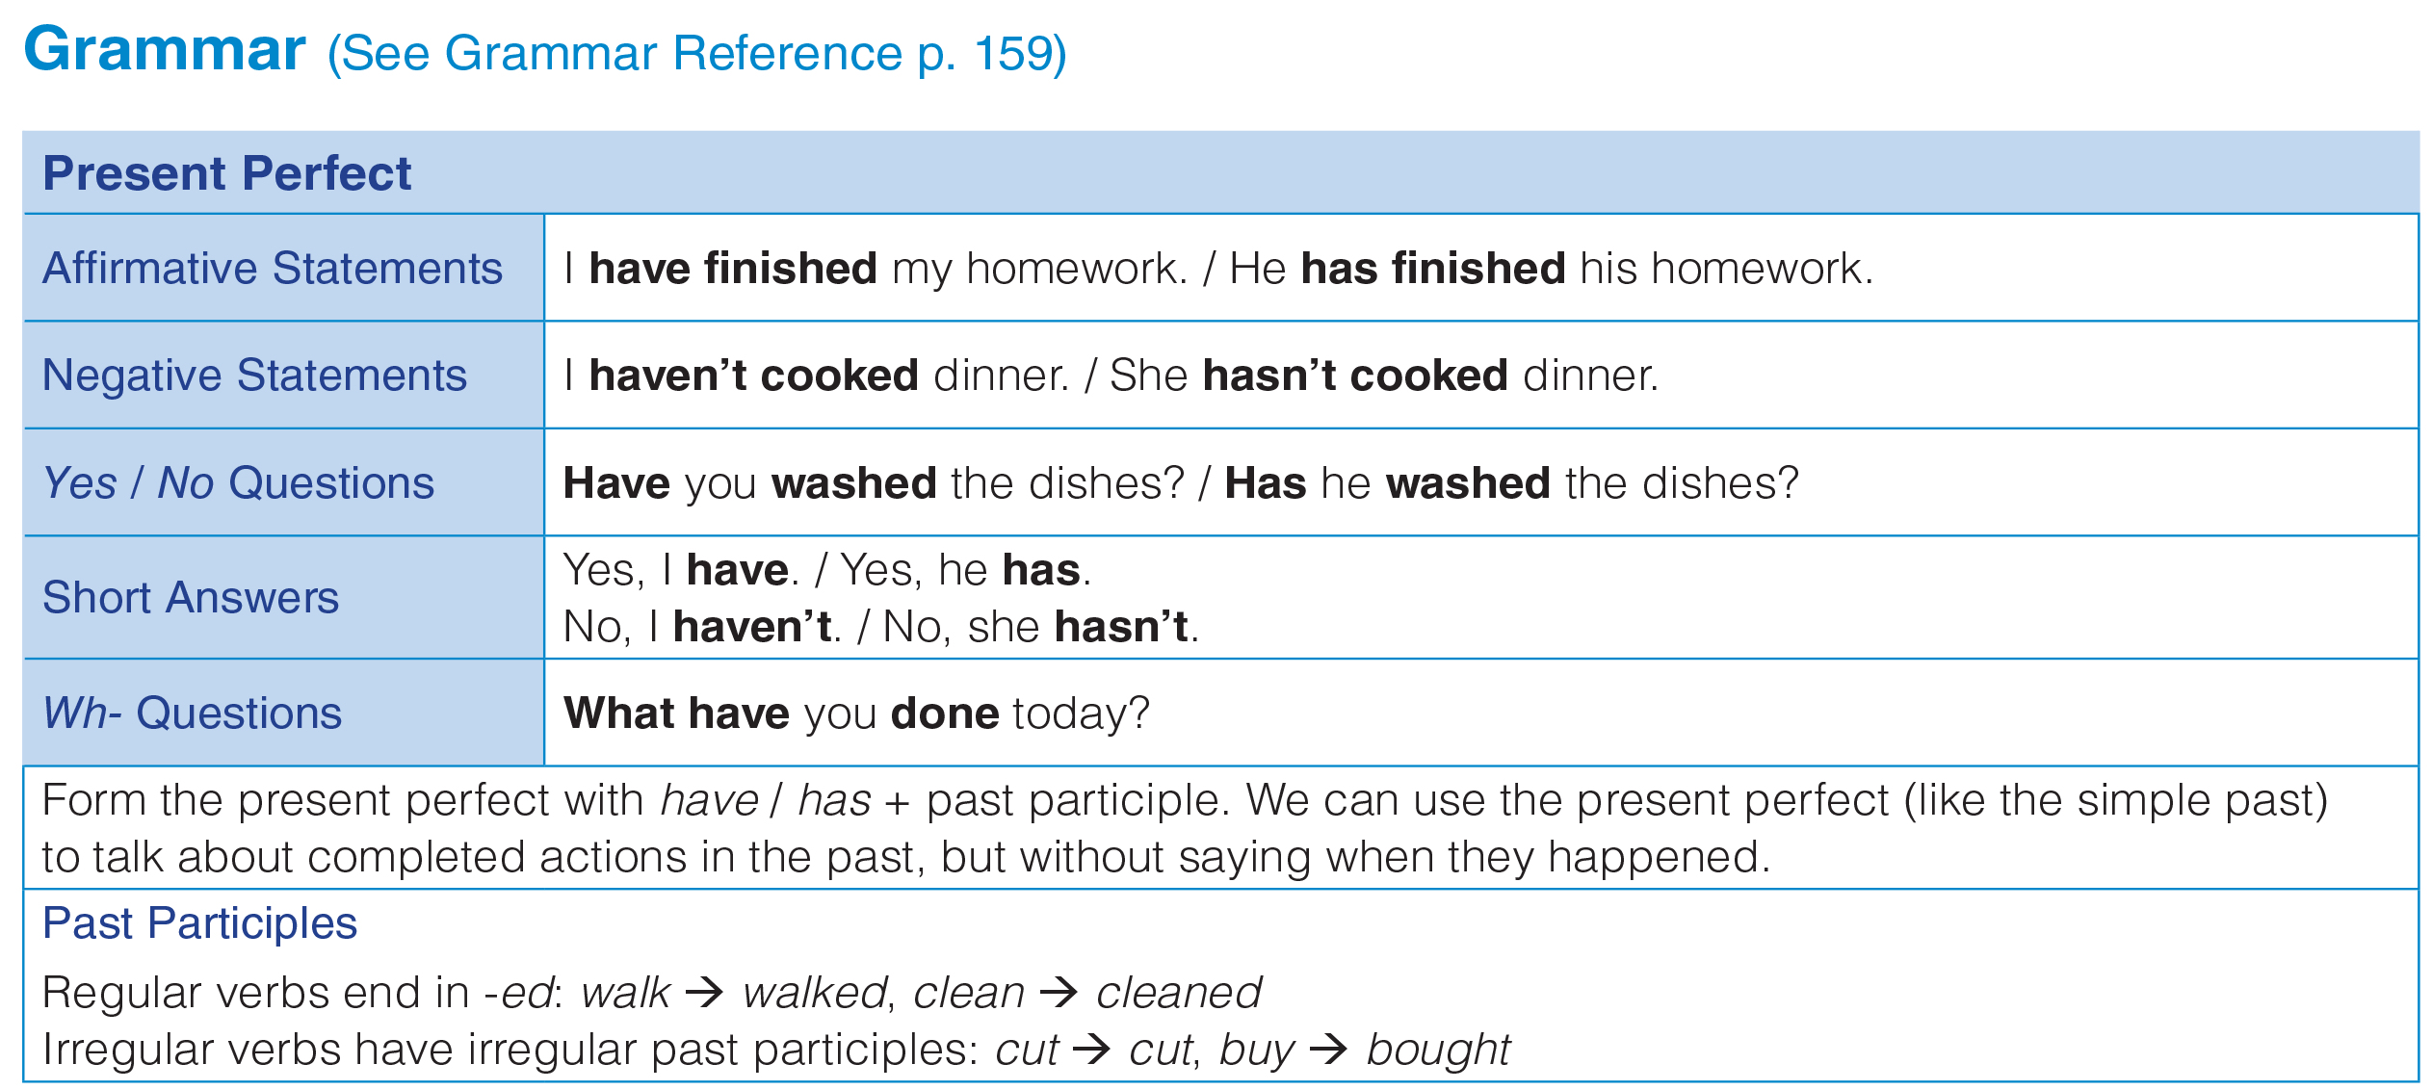
UNIT 11
ACHIEVEMENTS
GRAMMAR
_______________________________________________________________________________________________________________________________________________________________________________________________________________________
National Geographic Learning, a Cengage Company. © 2022 Cengage Learning, Inc. ALL RIGHTS RESERVED. This presentation tool is for teaching purpose only. May not be scanned, copied or duplicated, or posted to a publicly accessible website, in whole or in part.

Slide 9
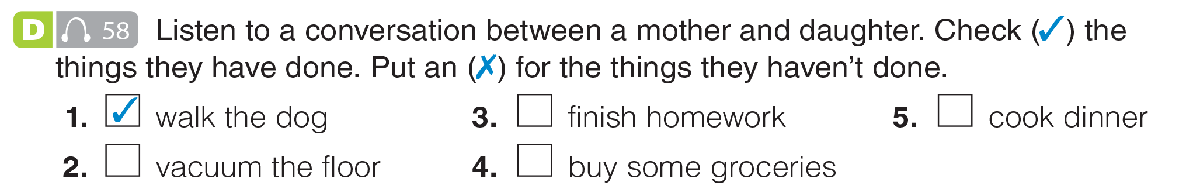

UNIT 11
ACHIEVEMENTS
GRAMMAR
✗
✗
✓
✓
_______________________________________________________________________________________________________________________________________________________________________________________________________________________
National Geographic Learning, a Cengage Company. © 2022 Cengage Learning, Inc. ALL RIGHTS RESERVED. This presentation tool is for teaching purpose only. May not be scanned, copied or duplicated, or posted to a publicly accessible website, in whole or in part.

Slide 10
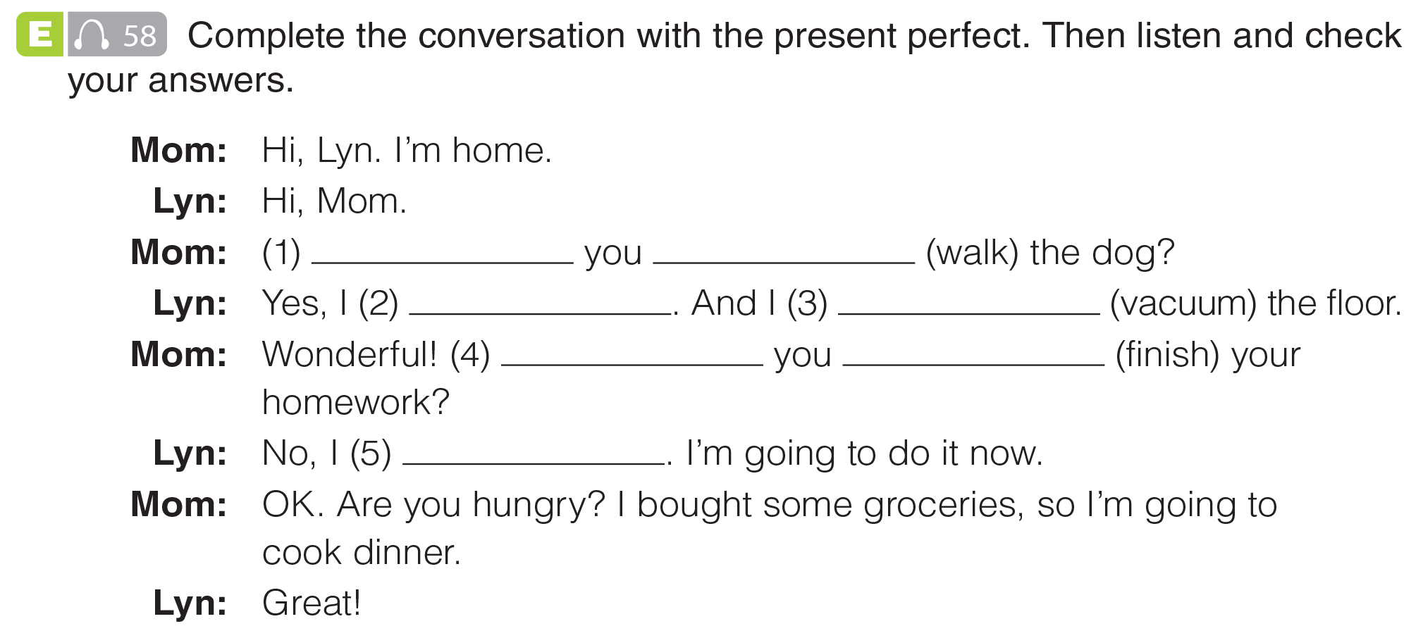
UNIT 11
ACHIEVEMENTS
GRAMMAR
Have
walked
have
vacuumed
Have
finished
haven’t
_______________________________________________________________________________________________________________________________________________________________________________________________________________________
National Geographic Learning, a Cengage Company. © 2022 Cengage Learning, Inc. ALL RIGHTS RESERVED. This presentation tool is for teaching purpose only. May not be scanned, copied or duplicated, or posted to a publicly accessible website, in whole or in part.

Slide 11
UNIT 11
ACHIEVEMENTS
GRAMMAR
Have
walked
have
vacuumed
Have
finished
haven’t
_______________________________________________________________________________________________________________________________________________________________________________________________________________________
National Geographic Learning, a Cengage Company. © 2022 Cengage Learning, Inc. ALL RIGHTS RESERVED. This presentation tool is for teaching purpose only. May not be scanned, copied or duplicated, or posted to a publicly accessible website, in whole or in part.

Slide 12


UNIT 11
ACHIEVEMENTS
GRAMMAR
_______________________________________________________________________________________________________________________________________________________________________________________________________________________
National Geographic Learning, a Cengage Company. © 2022 Cengage Learning, Inc. ALL RIGHTS RESERVED. This presentation tool is for teaching purpose only. May not be scanned, copied or duplicated, or posted to a publicly accessible website, in whole or in part.

Slide 13
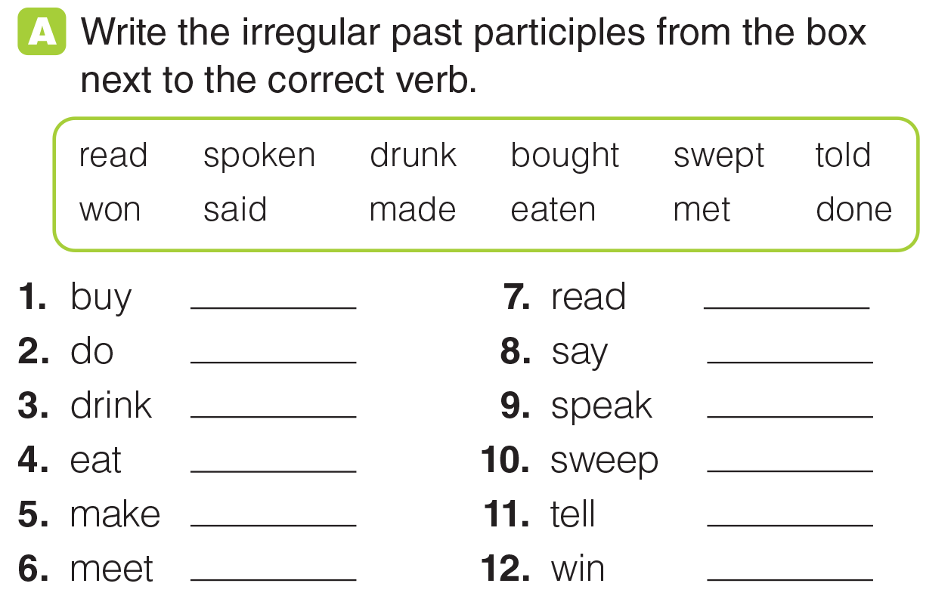
UNIT 11
ACHIEVEMENTS
GRAMMAR
bought
read
done
said
drunk
spoken
eaten
swept
made
told
met
won
_______________________________________________________________________________________________________________________________________________________________________________________________________________________
National Geographic Learning, a Cengage Company. © 2022 Cengage Learning, Inc. ALL RIGHTS RESERVED. This presentation tool is for teaching purpose only. May not be scanned, copied or duplicated, or posted to a publicly accessible website, in whole or in part.

Slide 14
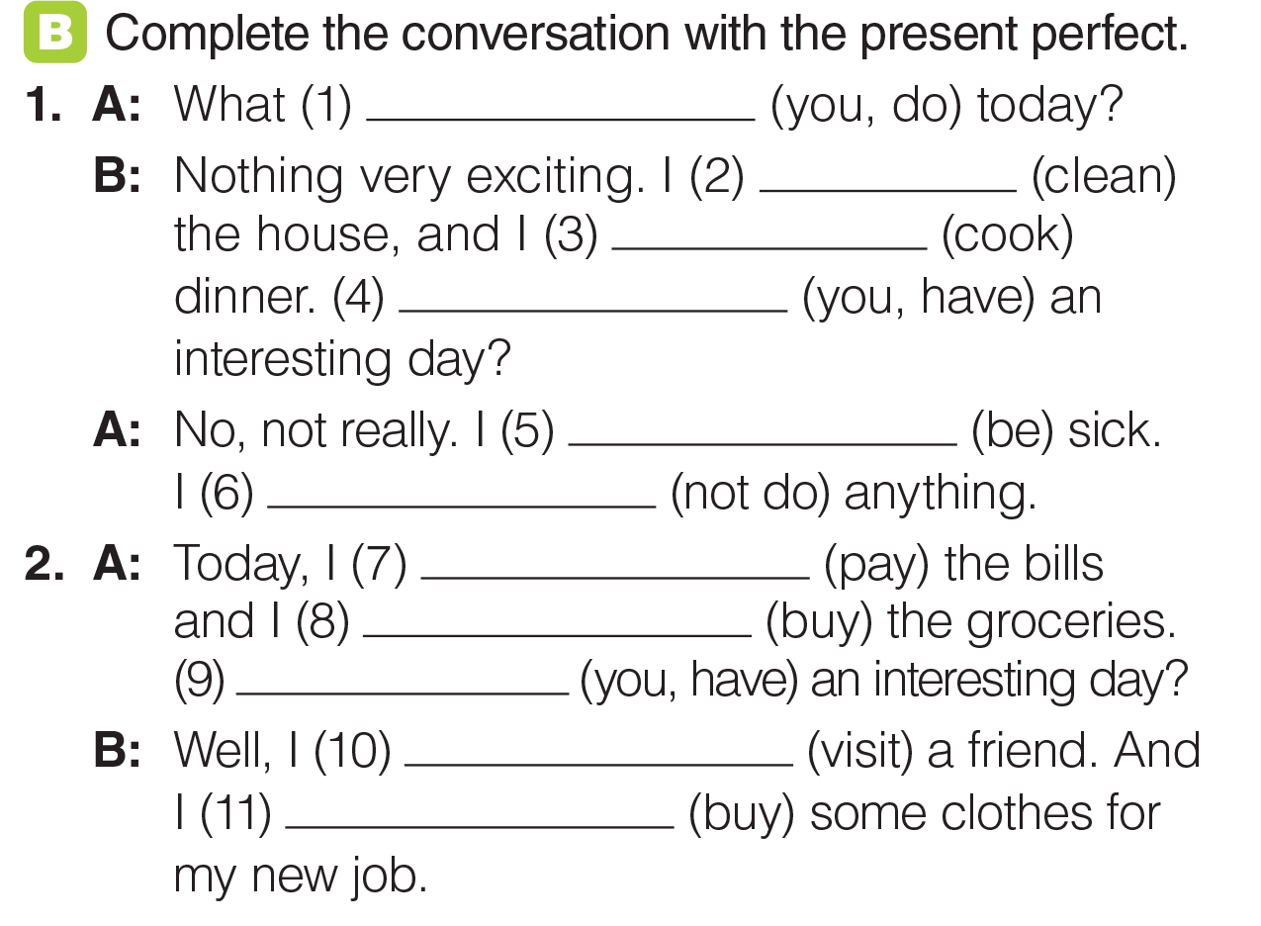
UNIT 11
ACHIEVEMENTS
GRAMMAR
have you done
‘ve cleaned
‘ve cooked
Have you had
I’ve been
haven’t done
have paid the bill
have bought the groceries
Have you had
‘ve visited
‘ve bought
_______________________________________________________________________________________________________________________________________________________________________________________________________________________
National Geographic Learning, a Cengage Company. © 2022 Cengage Learning, Inc. ALL RIGHTS RESERVED. This presentation tool is for teaching purpose only. May not be scanned, copied or duplicated, or posted to a publicly accessible website, in whole or in part.

Slide 15
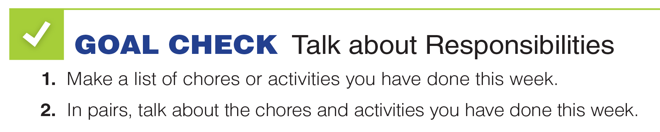


UNIT 11
ACHIEVEMENTS
GOAL CHECK
_______________________________________________________________________________________________________________________________________________________________________________________________________________________
National Geographic Learning, a Cengage Company. © 2022 Cengage Learning, Inc. ALL RIGHTS RESERVED. This presentation tool is for teaching purpose only. May not be scanned, copied or duplicated, or posted to a publicly accessible website, in whole or in part.

Slide 16



UNIT 11
ACHIEVEMENTS
LISTENING
Tour guide; English communication skills, ability to manage groups, driver’s license.
_______________________________________________________________________________________________________________________________________________________________________________________________________________________
National Geographic Learning, a Cengage Company. © 2022 Cengage Learning, Inc. ALL RIGHTS RESERVED. This presentation tool is for teaching purpose only. May not be scanned, copied or duplicated, or posted to a publicly accessible website, in whole or in part.

Slide 17

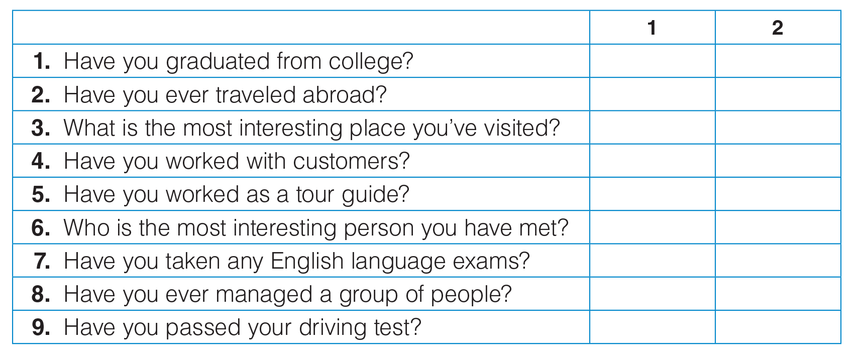
UNIT 11
ACHIEVEMENTS
LISTENING
✓
✓
✓
✓
✓
✓
✓
✓
✓
✓
_______________________________________________________________________________________________________________________________________________________________________________________________________________________
National Geographic Learning, a Cengage Company. © 2022 Cengage Learning, Inc. ALL RIGHTS RESERVED. This presentation tool is for teaching purpose only. May not be scanned, copied or duplicated, or posted to a publicly accessible website, in whole or in part.

Slide 18
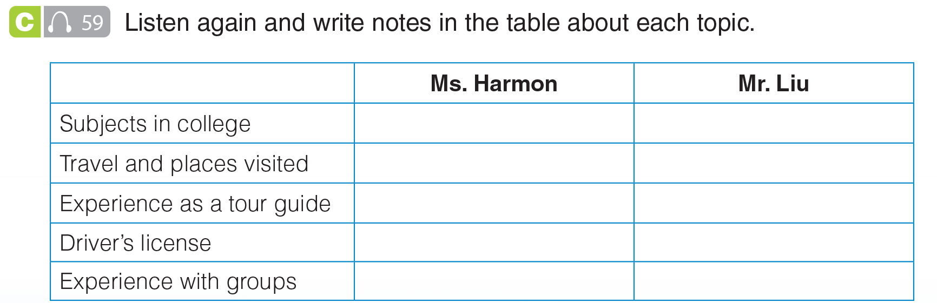
UNIT 11
ACHIEVEMENTS
LISTENING
English and History
English
Eight countries, Venice
Bali
None paid, but she has taken friends around museums.
In Bali last year
No. Going to take it next month.
Yes
-
Coached children’s soccer
_______________________________________________________________________________________________________________________________________________________________________________________________________________________
National Geographic Learning, a Cengage Company. © 2022 Cengage Learning, Inc. ALL RIGHTS RESERVED. This presentation tool is for teaching purpose only. May not be scanned, copied or duplicated, or posted to a publicly accessible website, in whole or in part.

Slide 19
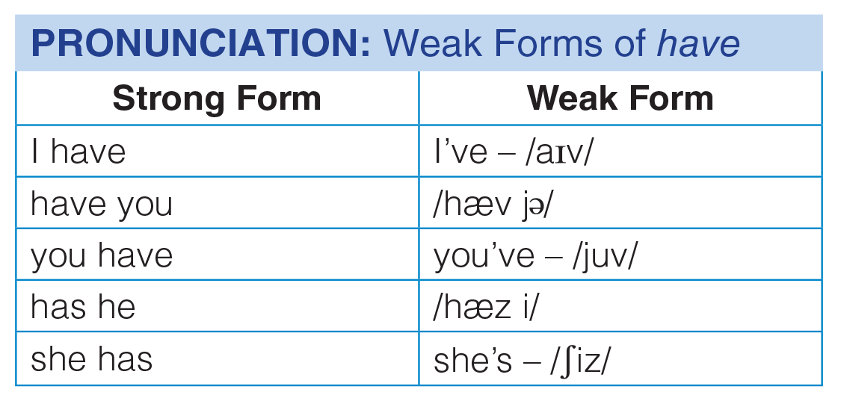
UNIT 11
ACHIEVEMENTS
PRONUNCIATION
_______________________________________________________________________________________________________________________________________________________________________________________________________________________
National Geographic Learning, a Cengage Company. © 2022 Cengage Learning, Inc. ALL RIGHTS RESERVED. This presentation tool is for teaching purpose only. May not be scanned, copied or duplicated, or posted to a publicly accessible website, in whole or in part.

Slide 20
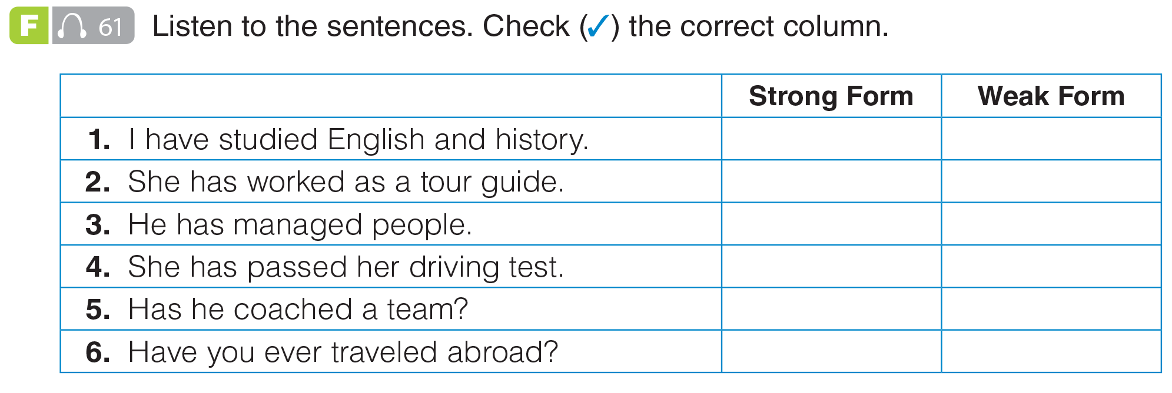
UNIT 11
ACHIEVEMENTS
PRONUNCIATION
✓
✓
✓
✓
✓
✓
_______________________________________________________________________________________________________________________________________________________________________________________________________________________
National Geographic Learning, a Cengage Company. © 2022 Cengage Learning, Inc. ALL RIGHTS RESERVED. This presentation tool is for teaching purpose only. May not be scanned, copied or duplicated, or posted to a publicly accessible website, in whole or in part.

Slide 21
UNIT 11
ACHIEVEMENTS
PRONUNCIATION
✓
✓
✓
✓
✓
✓
_______________________________________________________________________________________________________________________________________________________________________________________________________________________
National Geographic Learning, a Cengage Company. © 2022 Cengage Learning, Inc. ALL RIGHTS RESERVED. This presentation tool is for teaching purpose only. May not be scanned, copied or duplicated, or posted to a publicly accessible website, in whole or in part.

Slide 22
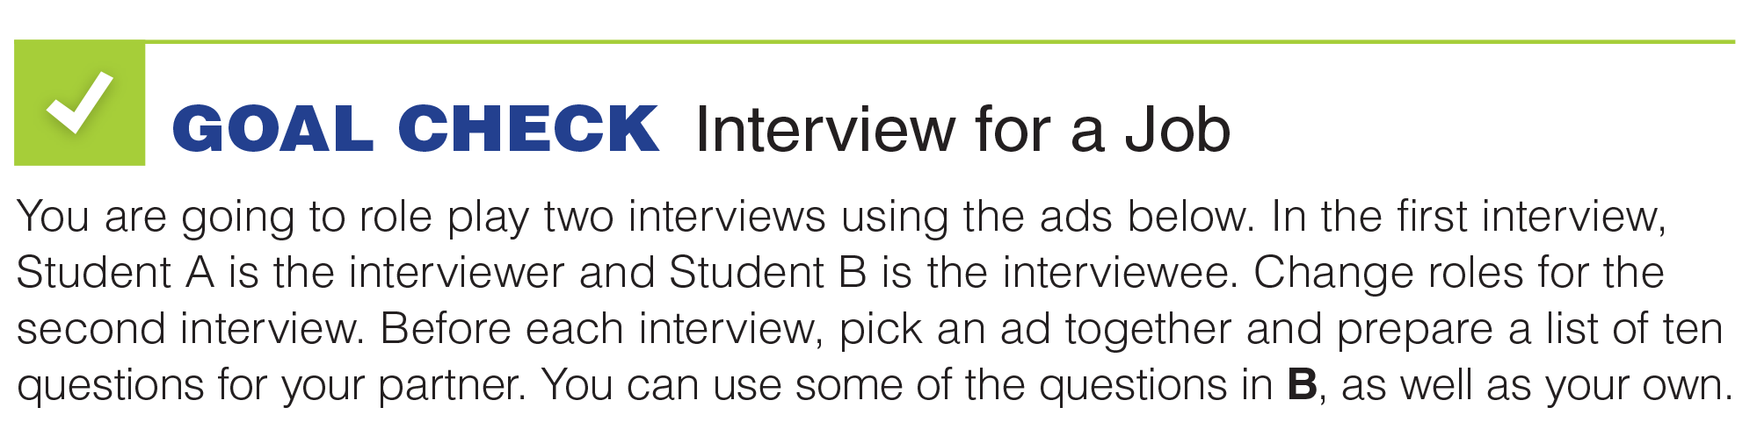
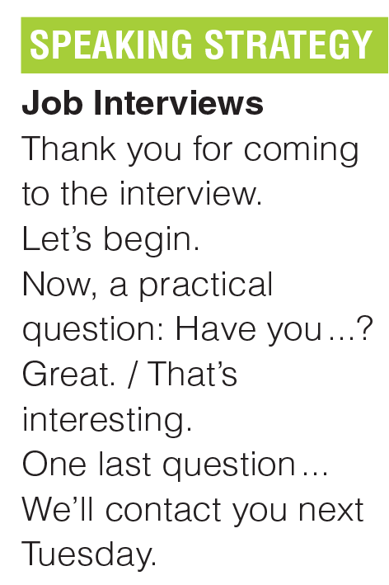
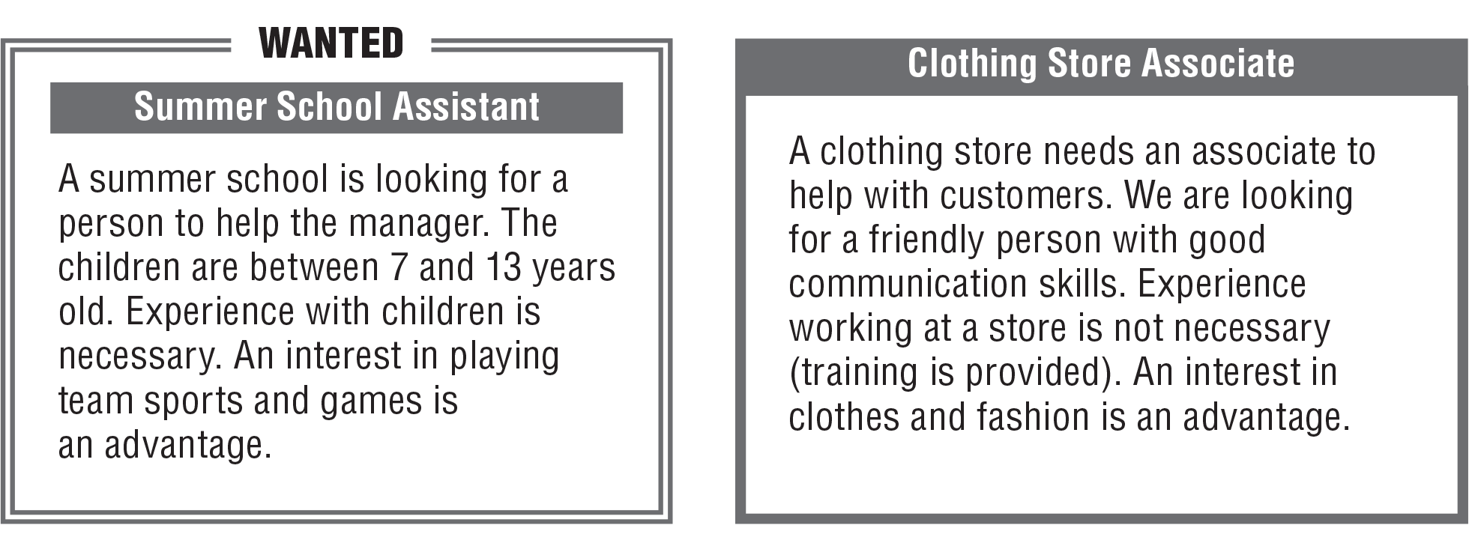


UNIT 11
ACHIEVEMENTS
GOAL CHECK
_______________________________________________________________________________________________________________________________________________________________________________________________________________________
National Geographic Learning, a Cengage Company. © 2022 Cengage Learning, Inc. ALL RIGHTS RESERVED. This presentation tool is for teaching purpose only. May not be scanned, copied or duplicated, or posted to a publicly accessible website, in whole or in part.

Slide 23
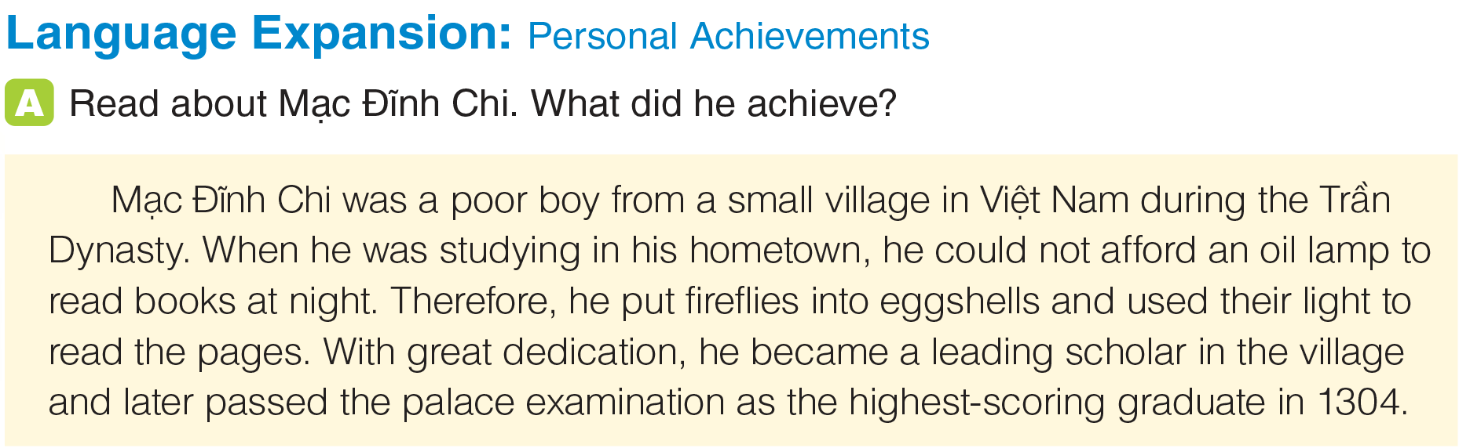

UNIT 11
ACHIEVEMENTS
LANGUAGE EXPANSION
_______________________________________________________________________________________________________________________________________________________________________________________________________________________
National Geographic Learning, a Cengage Company. © 2022 Cengage Learning, Inc. ALL RIGHTS RESERVED. This presentation tool is for teaching purpose only. May not be scanned, copied or duplicated, or posted to a publicly accessible website, in whole or in part.

Slide 24
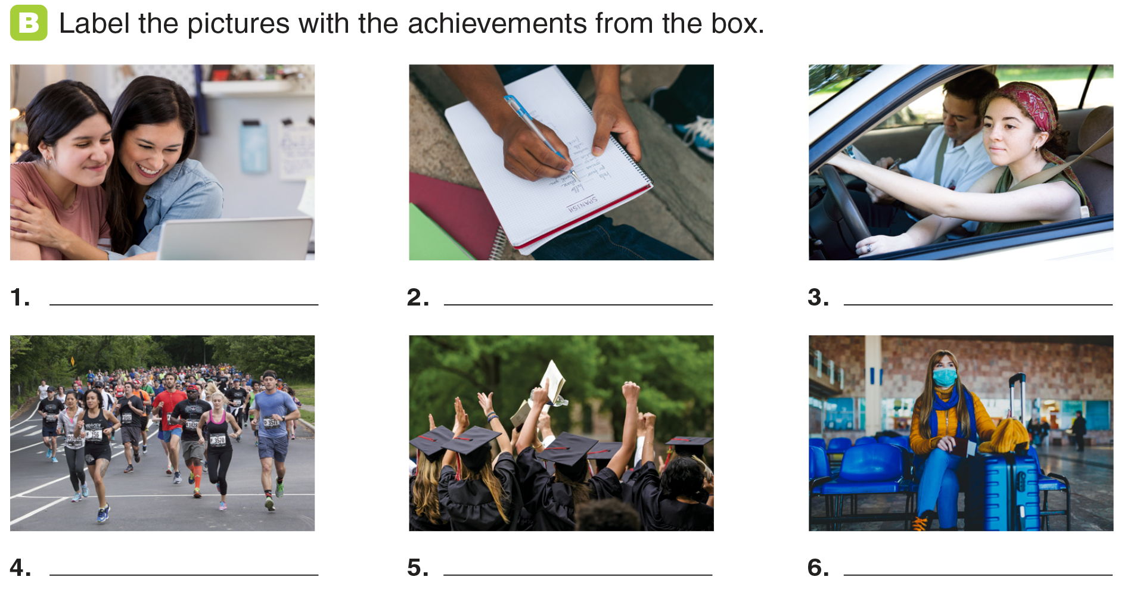
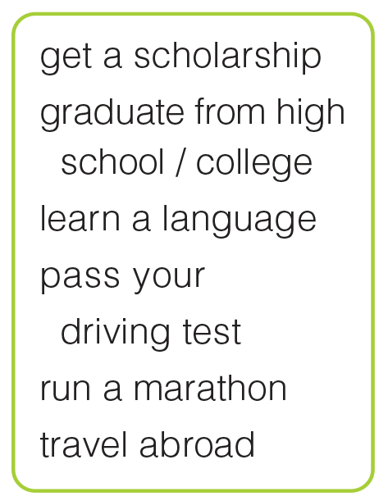
UNIT 11
ACHIEVEMENTS
LANGUAGE EXPANSION
get a scholarship
learn a language
pass your driving test
run a marathon
graduate from
high school / college
travel abroad
_______________________________________________________________________________________________________________________________________________________________________________________________________________________
National Geographic Learning, a Cengage Company. © 2022 Cengage Learning, Inc. ALL RIGHTS RESERVED. This presentation tool is for teaching purpose only. May not be scanned, copied or duplicated, or posted to a publicly accessible website, in whole or in part.

Slide 25
UNIT 11
ACHIEVEMENTS
LANGUAGE EXPANSION
get a scholarship
learn a language
pass your driving test
run a marathon
graduate from
high school / college
travel abroad
_______________________________________________________________________________________________________________________________________________________________________________________________________________________
National Geographic Learning, a Cengage Company. © 2022 Cengage Learning, Inc. ALL RIGHTS RESERVED. This presentation tool is for teaching purpose only. May not be scanned, copied or duplicated, or posted to a publicly accessible website, in whole or in part.

Slide 26
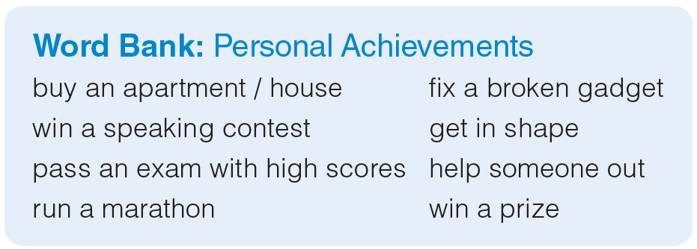
UNIT 11
ACHIEVEMENTS
LANGUAGE EXPANSION
_______________________________________________________________________________________________________________________________________________________________________________________________________________________
National Geographic Learning, a Cengage Company. © 2022 Cengage Learning, Inc. ALL RIGHTS RESERVED. This presentation tool is for teaching purpose only. May not be scanned, copied or duplicated, or posted to a publicly accessible website, in whole or in part.

Slide 27
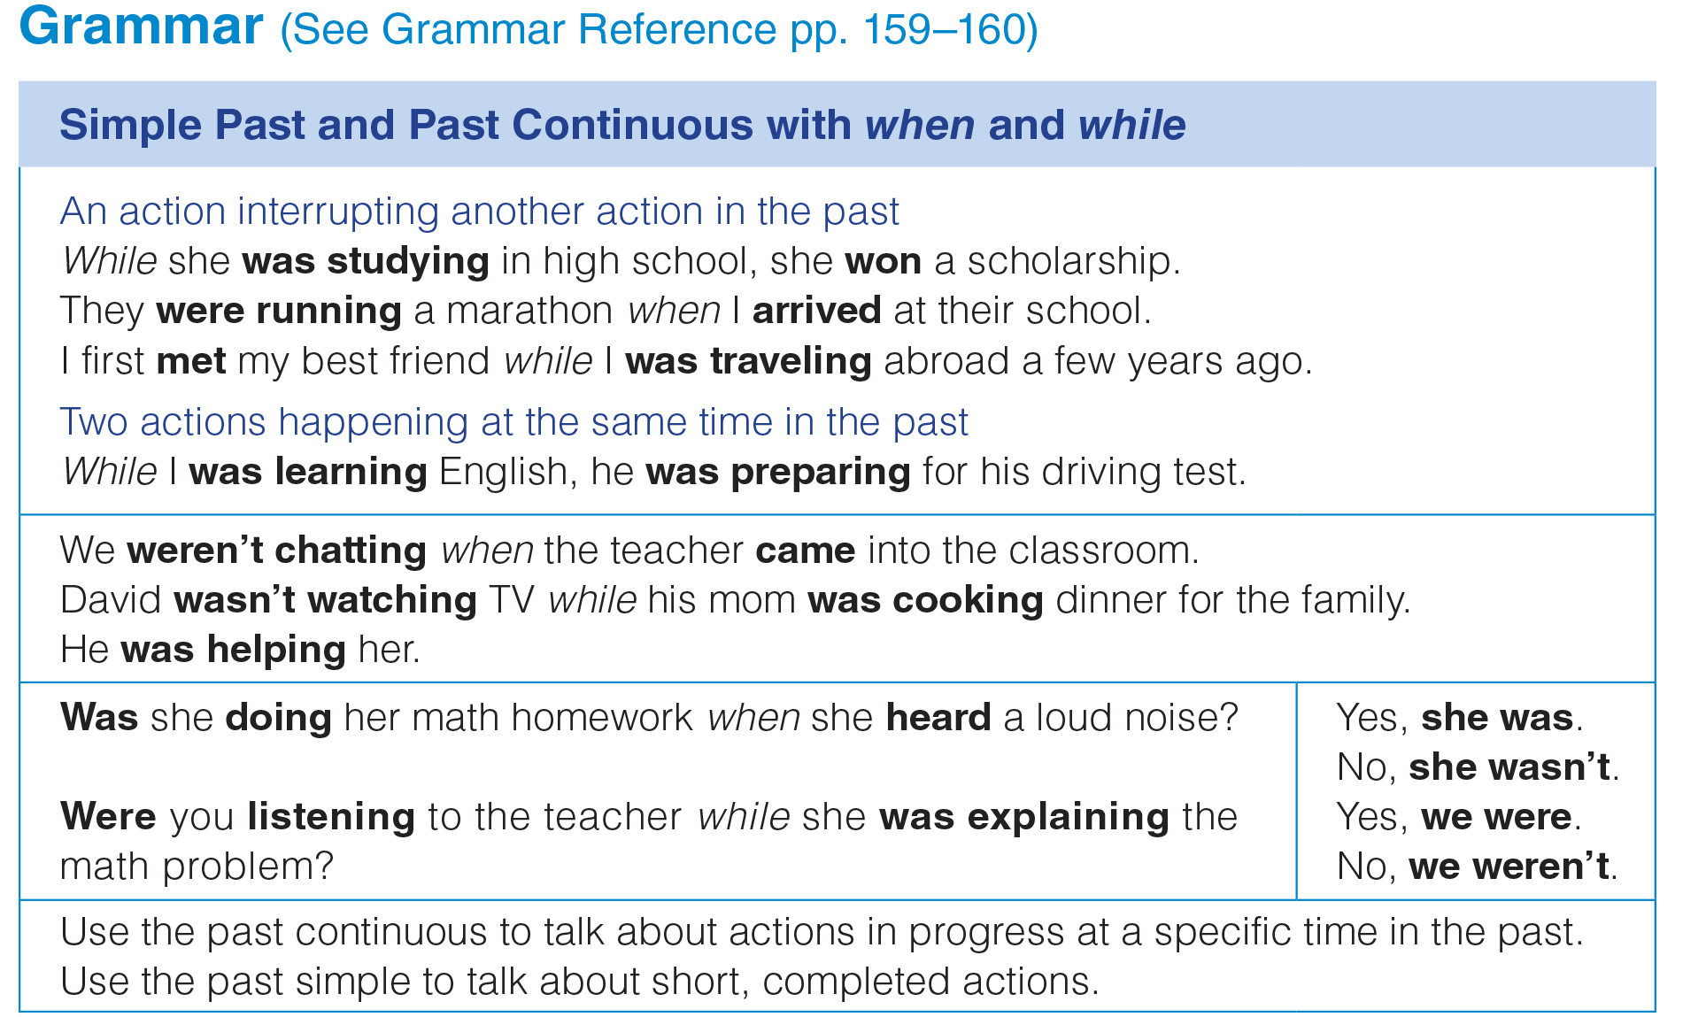
UNIT 11
ACHIEVEMENTS
GRAMMAR
_______________________________________________________________________________________________________________________________________________________________________________________________________________________
National Geographic Learning, a Cengage Company. © 2022 Cengage Learning, Inc. ALL RIGHTS RESERVED. This presentation tool is for teaching purpose only. May not be scanned, copied or duplicated, or posted to a publicly accessible website, in whole or in part.

Slide 28
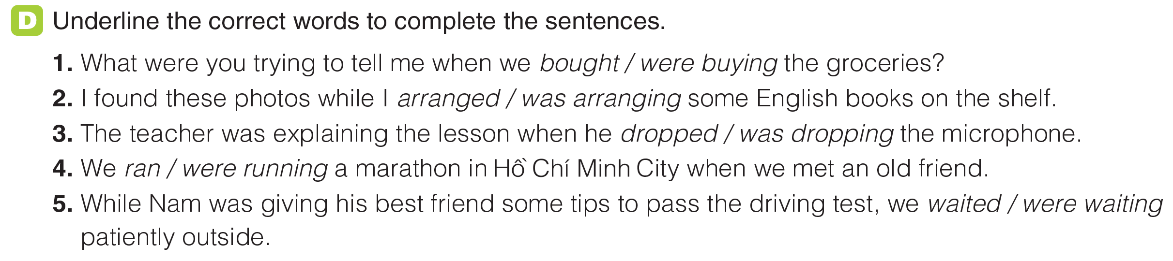
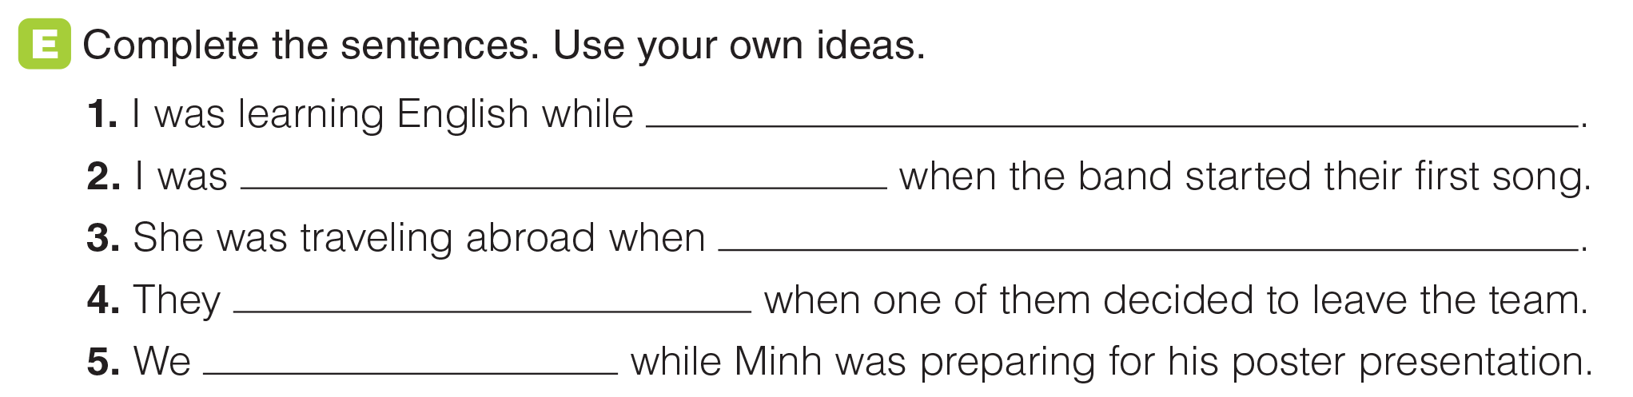
UNIT 11
ACHIEVEMENTS
GRAMMAR
_______________________________________________________________________________________________________________________________________________________________________________________________________________________
National Geographic Learning, a Cengage Company. © 2022 Cengage Learning, Inc. ALL RIGHTS RESERVED. This presentation tool is for teaching purpose only. May not be scanned, copied or duplicated, or posted to a publicly accessible website, in whole or in part.

Slide 29
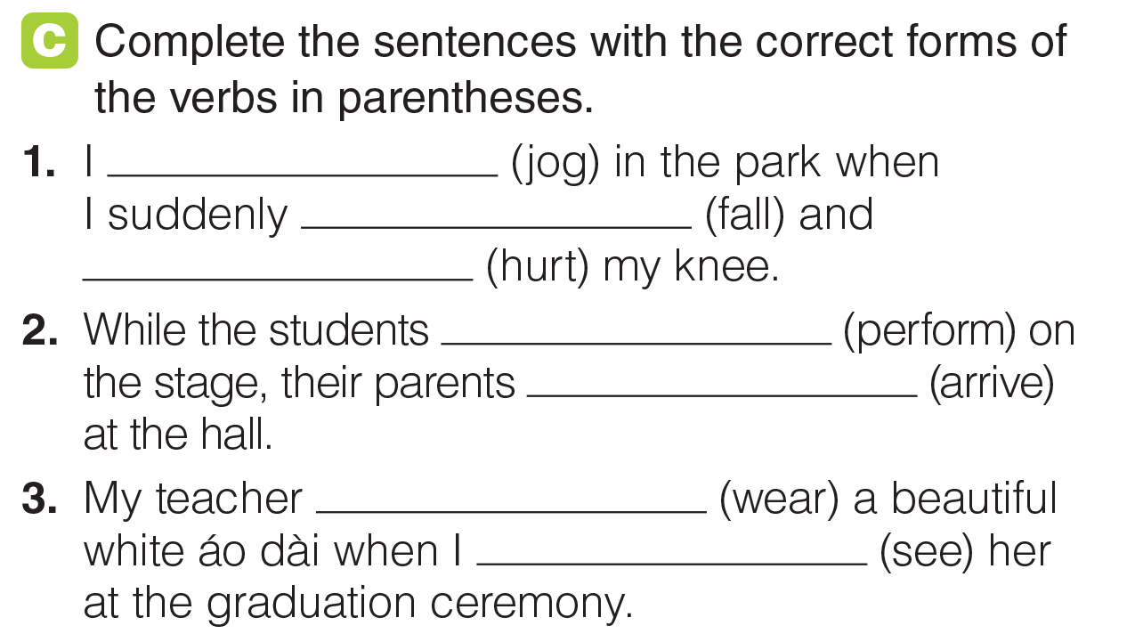
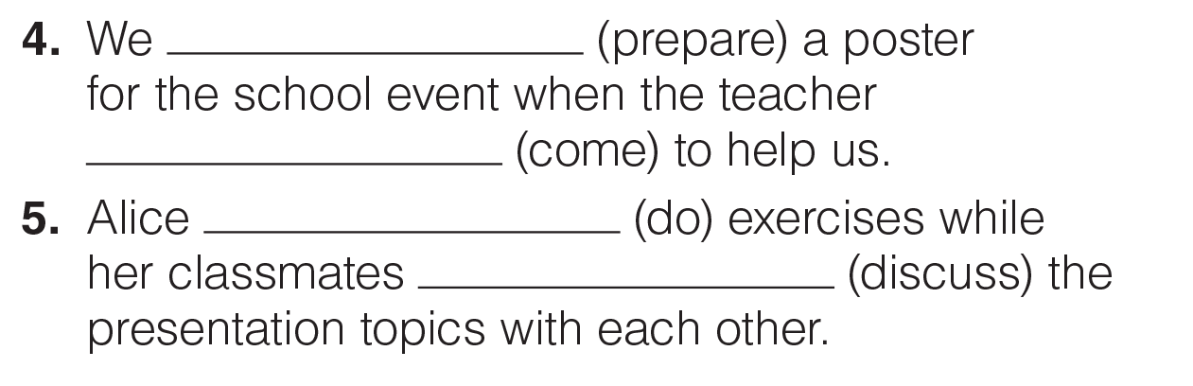
UNIT 11
ACHIEVEMENTS
GRAMMAR
was jogging
fell
hurt
were performing
arrived
was wearing
saw
was preparing
came
was doing
were discusing
_______________________________________________________________________________________________________________________________________________________________________________________________________________________
National Geographic Learning, a Cengage Company. © 2022 Cengage Learning, Inc. ALL RIGHTS RESERVED. This presentation tool is for teaching purpose only. May not be scanned, copied or duplicated, or posted to a publicly accessible website, in whole or in part.

Slide 30
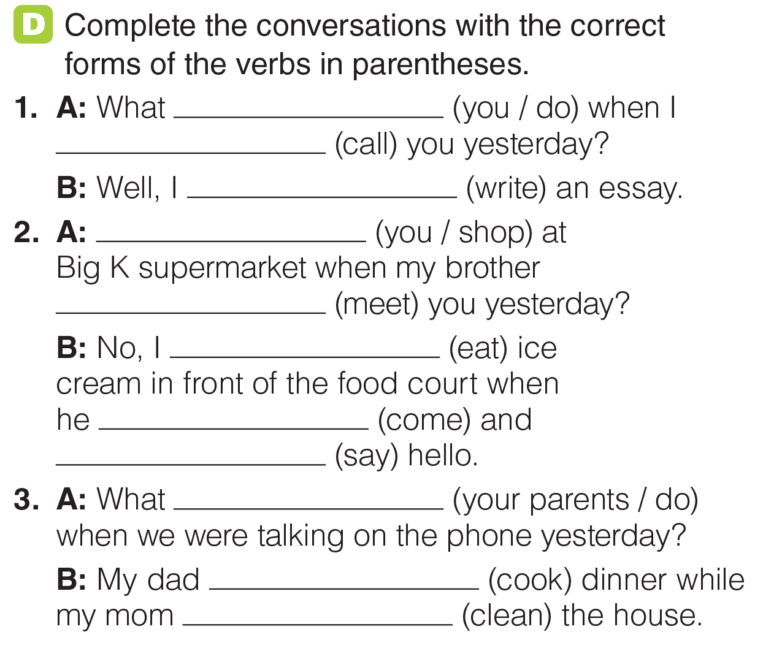
UNIT 11
ACHIEVEMENTS
GRAMMAR
were you doing
called
was writing
Were you shopping
met
was eating
came
said
were your
parents doing
was cooking
was cleaning
_______________________________________________________________________________________________________________________________________________________________________________________________________________________
National Geographic Learning, a Cengage Company. © 2022 Cengage Learning, Inc. ALL RIGHTS RESERVED. This presentation tool is for teaching purpose only. May not be scanned, copied or duplicated, or posted to a publicly accessible website, in whole or in part.

Slide 31
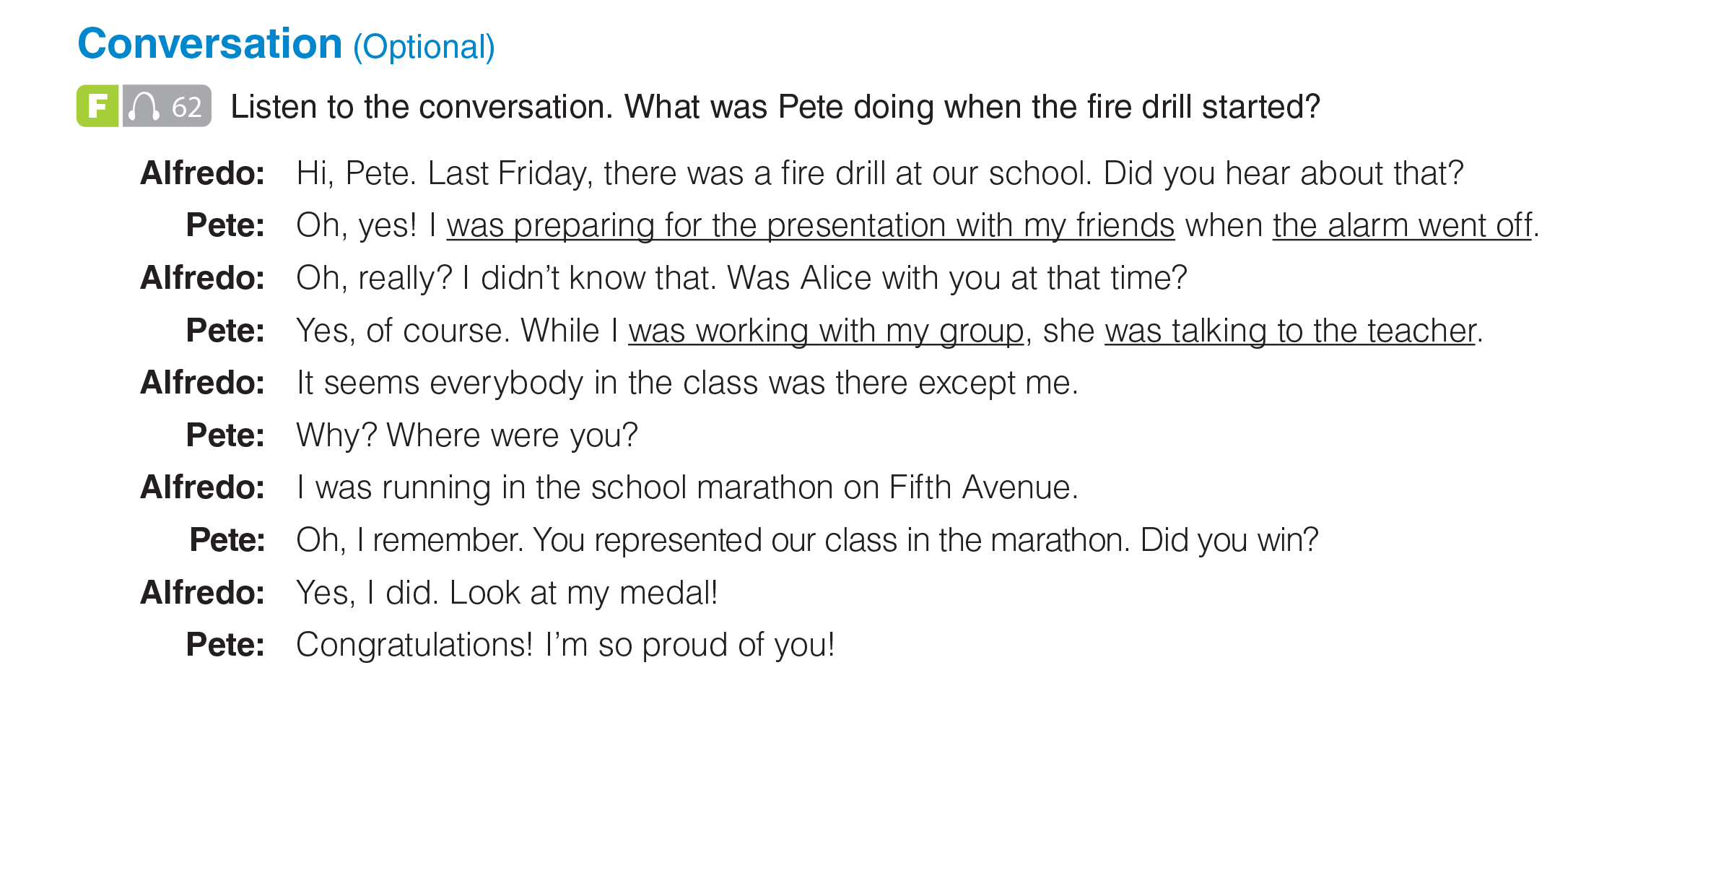

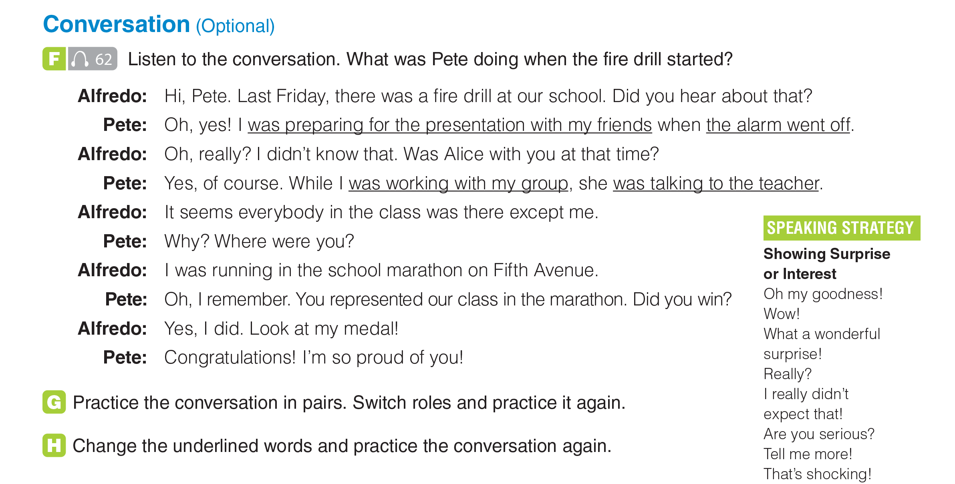
UNIT 11
ACHIEVEMENTS
CONVERSATION
_______________________________________________________________________________________________________________________________________________________________________________________________________________________
National Geographic Learning, a Cengage Company. © 2022 Cengage Learning, Inc. ALL RIGHTS RESERVED. This presentation tool is for teaching purpose only. May not be scanned, copied or duplicated, or posted to a publicly accessible website, in whole or in part.

Slide 32
UNIT 11
ACHIEVEMENTS
CONVERSATION
_______________________________________________________________________________________________________________________________________________________________________________________________________________________
National Geographic Learning, a Cengage Company. © 2022 Cengage Learning, Inc. ALL RIGHTS RESERVED. This presentation tool is for teaching purpose only. May not be scanned, copied or duplicated, or posted to a publicly accessible website, in whole or in part.

Slide 33
UNIT 11
ACHIEVEMENTS
CONVERSATION
_______________________________________________________________________________________________________________________________________________________________________________________________________________________
National Geographic Learning, a Cengage Company. © 2022 Cengage Learning, Inc. ALL RIGHTS RESERVED. This presentation tool is for teaching purpose only. May not be scanned, copied or duplicated, or posted to a publicly accessible website, in whole or in part.

Slide 34

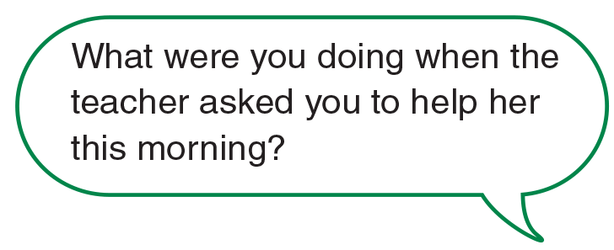
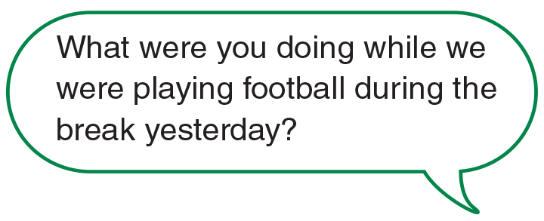
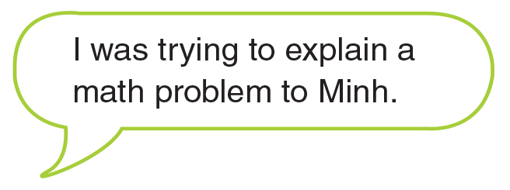

UNIT 11
ACHIEVEMENTS
GOAL CHECK
_______________________________________________________________________________________________________________________________________________________________________________________________________________________
National Geographic Learning, a Cengage Company. © 2022 Cengage Learning, Inc. ALL RIGHTS RESERVED. This presentation tool is for teaching purpose only. May not be scanned, copied or duplicated, or posted to a publicly accessible website, in whole or in part.

Slide 35
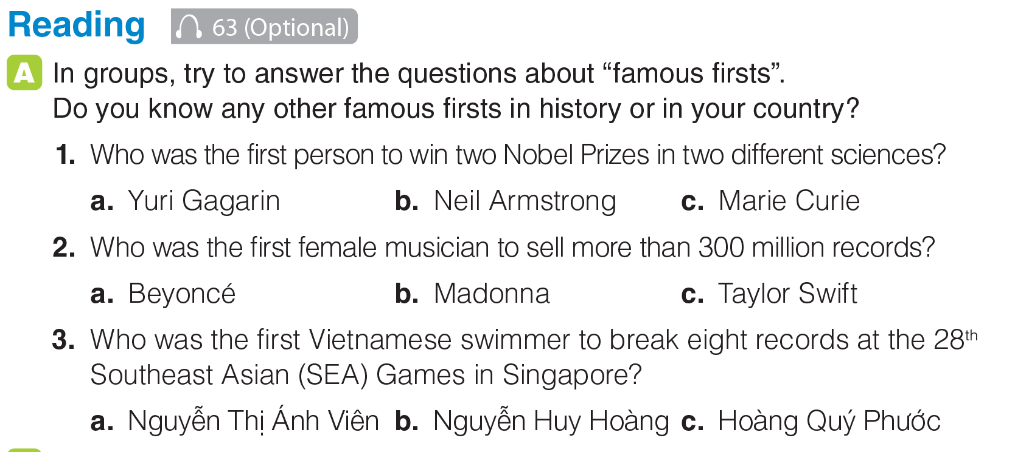
UNIT 11
ACHIEVEMENTS
READING
_______________________________________________________________________________________________________________________________________________________________________________________________________________________
National Geographic Learning, a Cengage Company. © 2022 Cengage Learning, Inc. ALL RIGHTS RESERVED. This presentation tool is for teaching purpose only. May not be scanned, copied or duplicated, or posted to a publicly accessible website, in whole or in part.

Slide 36

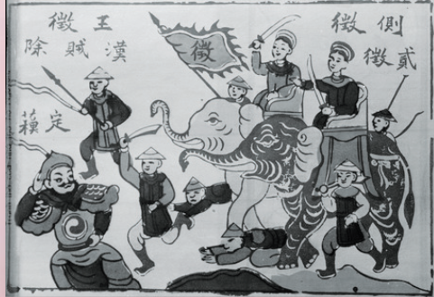

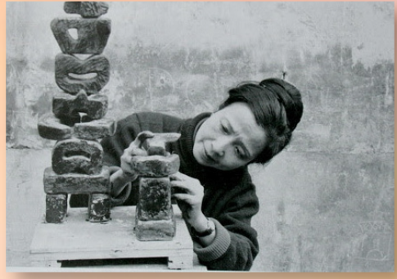
UNIT 11
ACHIEVEMENTS
READING
_______________________________________________________________________________________________________________________________________________________________________________________________________________________
National Geographic Learning, a Cengage Company. © 2022 Cengage Learning, Inc. ALL RIGHTS RESERVED. This presentation tool is for teaching purpose only. May not be scanned, copied or duplicated, or posted to a publicly accessible website, in whole or in part.

Slide 37
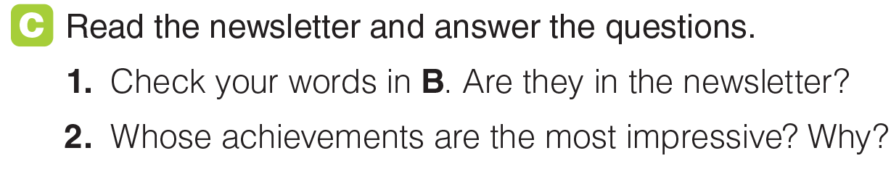
UNIT 11
ACHIEVEMENTS
READING
_______________________________________________________________________________________________________________________________________________________________________________________________________________________
National Geographic Learning, a Cengage Company. © 2022 Cengage Learning, Inc. ALL RIGHTS RESERVED. This presentation tool is for teaching purpose only. May not be scanned, copied or duplicated, or posted to a publicly accessible website, in whole or in part.

Slide 38
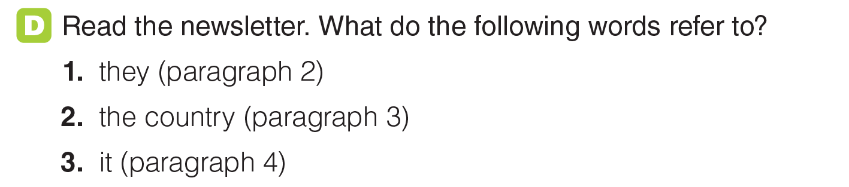
UNIT 11
ACHIEVEMENTS
READING
_______________________________________________________________________________________________________________________________________________________________________________________________________________________
National Geographic Learning, a Cengage Company. © 2022 Cengage Learning, Inc. ALL RIGHTS RESERVED. This presentation tool is for teaching purpose only. May not be scanned, copied or duplicated, or posted to a publicly accessible website, in whole or in part.

Slide 39

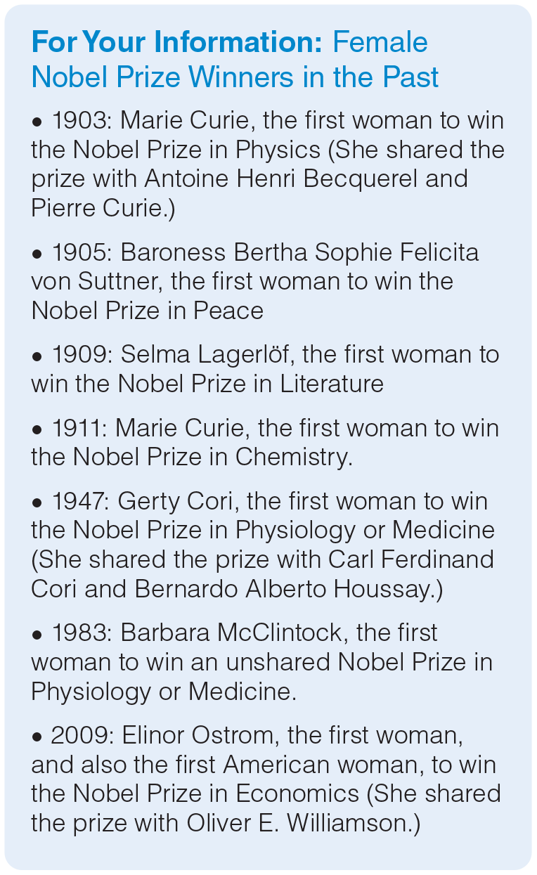
UNIT 11
ACHIEVEMENTS
READING
_______________________________________________________________________________________________________________________________________________________________________________________________________________________
National Geographic Learning, a Cengage Company. © 2022 Cengage Learning, Inc. ALL RIGHTS RESERVED. This presentation tool is for teaching purpose only. May not be scanned, copied or duplicated, or posted to a publicly accessible website, in whole or in part.

Slide 40
UNIT 11
ACHIEVEMENTS
READING
The Trưng Sisters / Trưng Trắc and Trưng Nhị
Việt Nam
Sculpture
_______________________________________________________________________________________________________________________________________________________________________________________________________________________
National Geographic Learning, a Cengage Company. © 2022 Cengage Learning, Inc. ALL RIGHTS RESERVED. This presentation tool is for teaching purpose only. May not be scanned, copied or duplicated, or posted to a publicly accessible website, in whole or in part.

Slide 41
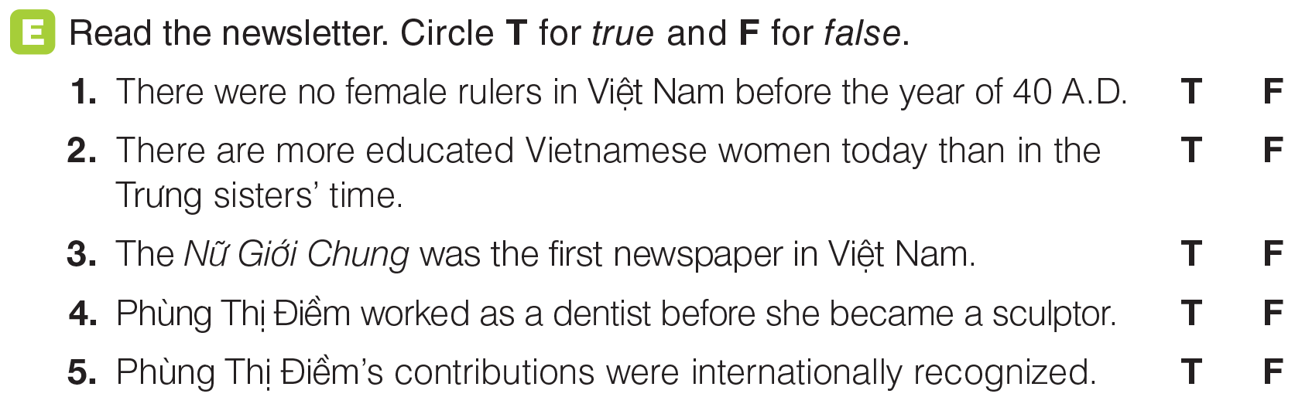
UNIT 11
ACHIEVEMENTS
READING
_______________________________________________________________________________________________________________________________________________________________________________________________________________________
National Geographic Learning, a Cengage Company. © 2022 Cengage Learning, Inc. ALL RIGHTS RESERVED. This presentation tool is for teaching purpose only. May not be scanned, copied or duplicated, or posted to a publicly accessible website, in whole or in part.

Slide 42
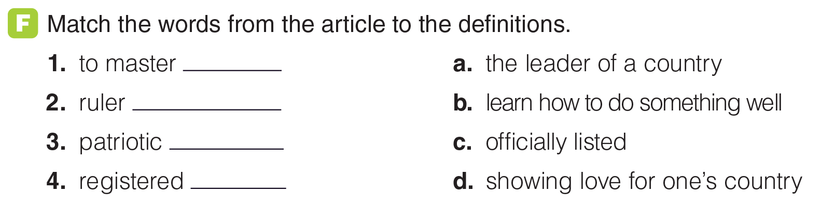
UNIT 11
ACHIEVEMENTS
READING
b
a
d
c
_______________________________________________________________________________________________________________________________________________________________________________________________________________________
National Geographic Learning, a Cengage Company. © 2022 Cengage Learning, Inc. ALL RIGHTS RESERVED. This presentation tool is for teaching purpose only. May not be scanned, copied or duplicated, or posted to a publicly accessible website, in whole or in part.

Slide 43
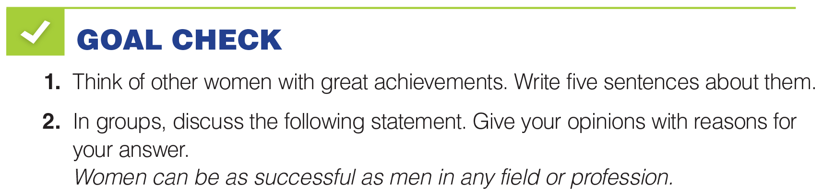
UNIT 11
ACHIEVEMENTS
GOAL CHECK
_______________________________________________________________________________________________________________________________________________________________________________________________________________________
National Geographic Learning, a Cengage Company. © 2022 Cengage Learning, Inc. ALL RIGHTS RESERVED. This presentation tool is for teaching purpose only. May not be scanned, copied or duplicated, or posted to a publicly accessible website, in whole or in part.

Slide 44

UNIT 11
ACHIEVEMENTS
COMMUNICATION
_______________________________________________________________________________________________________________________________________________________________________________________________________________________
National Geographic Learning, a Cengage Company. © 2022 Cengage Learning, Inc. ALL RIGHTS RESERVED. This presentation tool is for teaching purpose only. May not be scanned, copied or duplicated, or posted to a publicly accessible website, in whole or in part.

Slide 45
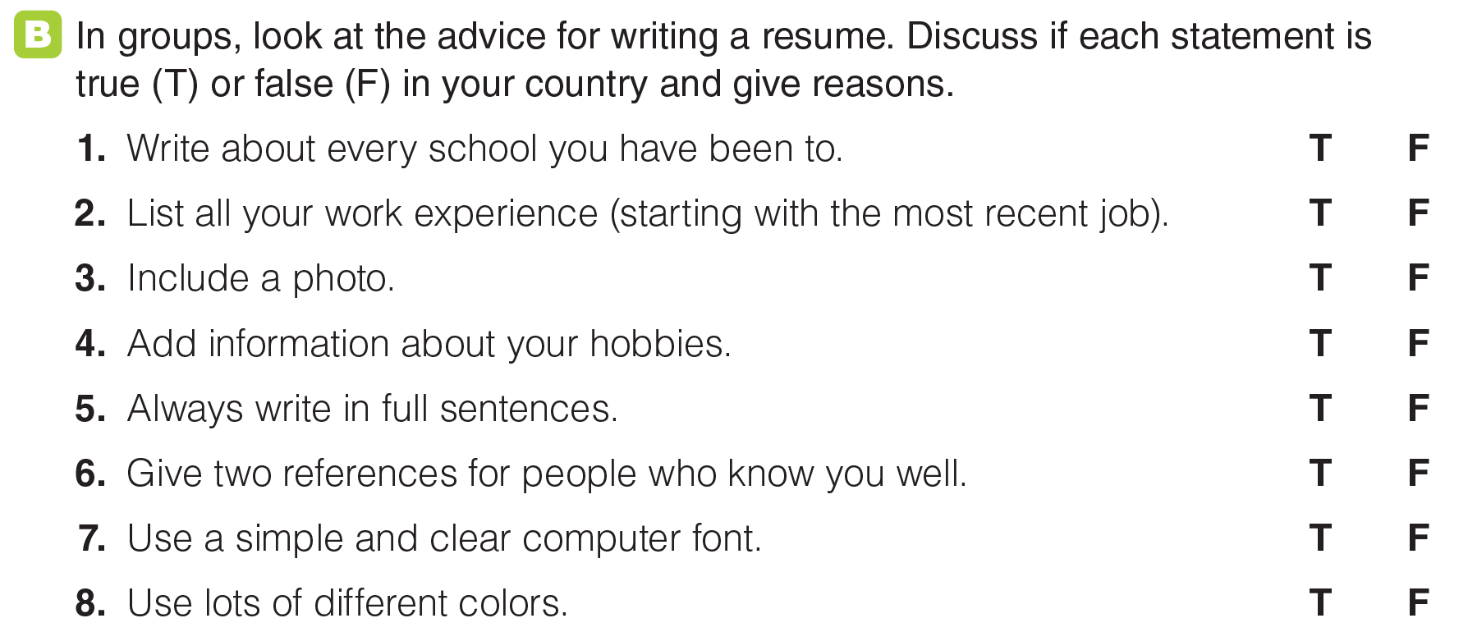
UNIT 11
ACHIEVEMENTS
COMMUNICATION
_______________________________________________________________________________________________________________________________________________________________________________________________________________________
National Geographic Learning, a Cengage Company. © 2022 Cengage Learning, Inc. ALL RIGHTS RESERVED. This presentation tool is for teaching purpose only. May not be scanned, copied or duplicated, or posted to a publicly accessible website, in whole or in part.

Slide 46
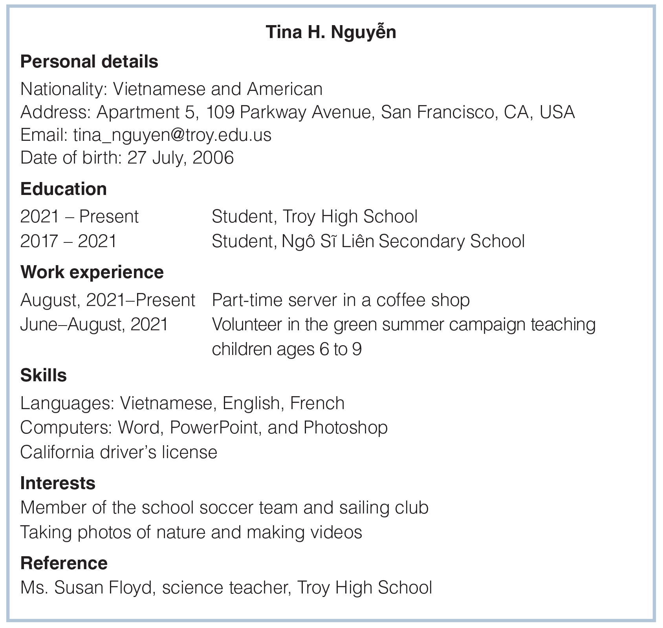
UNIT 11
ACHIEVEMENTS
COMMUNICATION
_______________________________________________________________________________________________________________________________________________________________________________________________________________________
National Geographic Learning, a Cengage Company. © 2022 Cengage Learning, Inc. ALL RIGHTS RESERVED. This presentation tool is for teaching purpose only. May not be scanned, copied or duplicated, or posted to a publicly accessible website, in whole or in part.

Slide 47
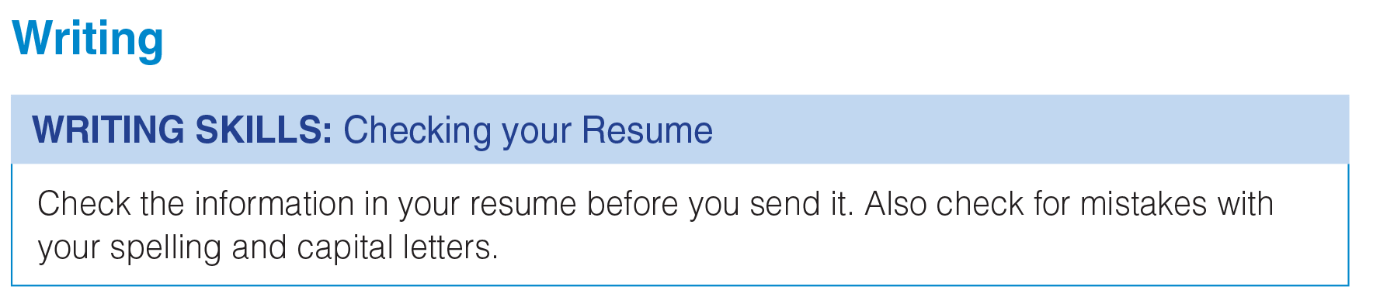
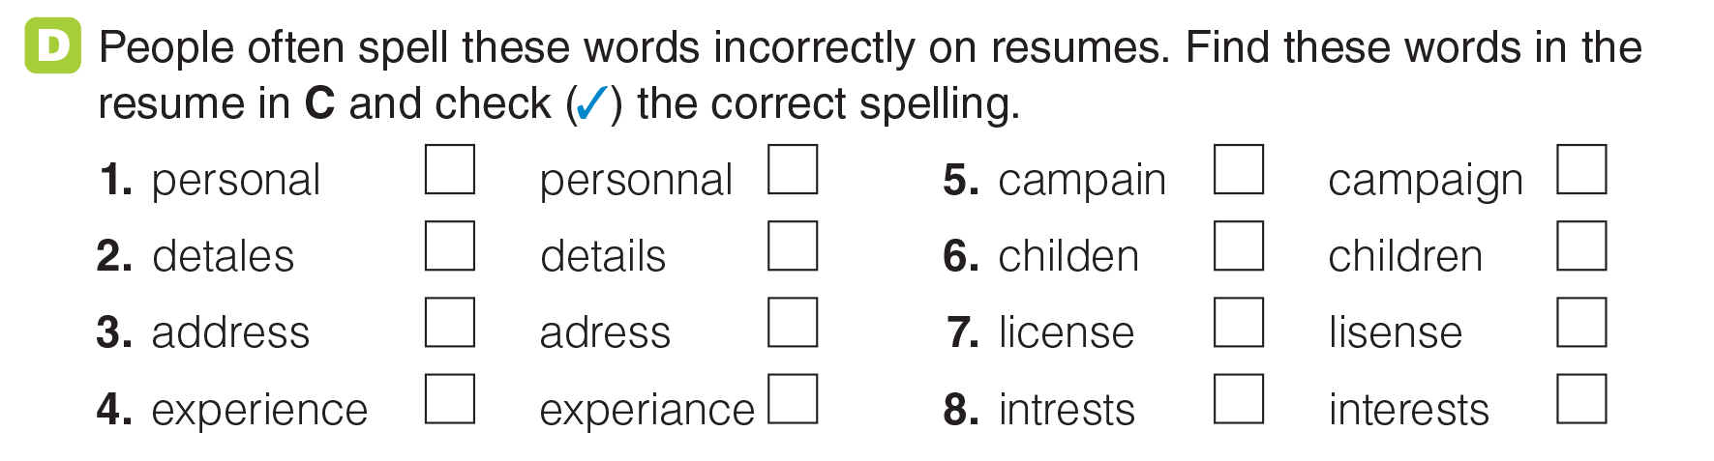
UNIT 11
ACHIEVEMENTS
WRITING
✓
✓
✓
✓
✓
✓
✓
✓
_______________________________________________________________________________________________________________________________________________________________________________________________________________________
National Geographic Learning, a Cengage Company. © 2022 Cengage Learning, Inc. ALL RIGHTS RESERVED. This presentation tool is for teaching purpose only. May not be scanned, copied or duplicated, or posted to a publicly accessible website, in whole or in part.

Slide 48
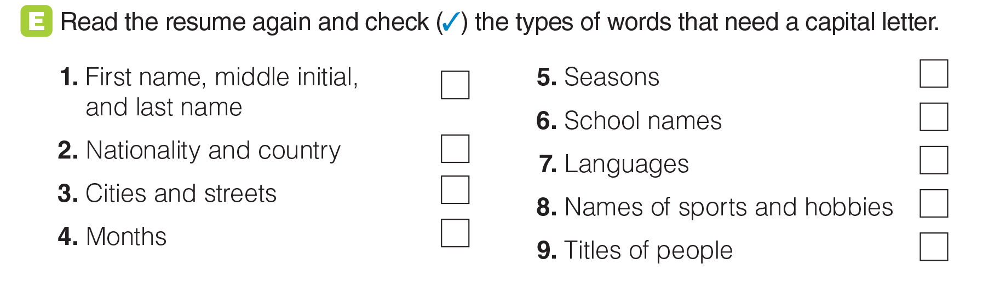
UNIT 11
ACHIEVEMENTS
WRITING
✓
✓
✓
✓
✓
✓
✓
_______________________________________________________________________________________________________________________________________________________________________________________________________________________
National Geographic Learning, a Cengage Company. © 2022 Cengage Learning, Inc. ALL RIGHTS RESERVED. This presentation tool is for teaching purpose only. May not be scanned, copied or duplicated, or posted to a publicly accessible website, in whole or in part.

Slide 49
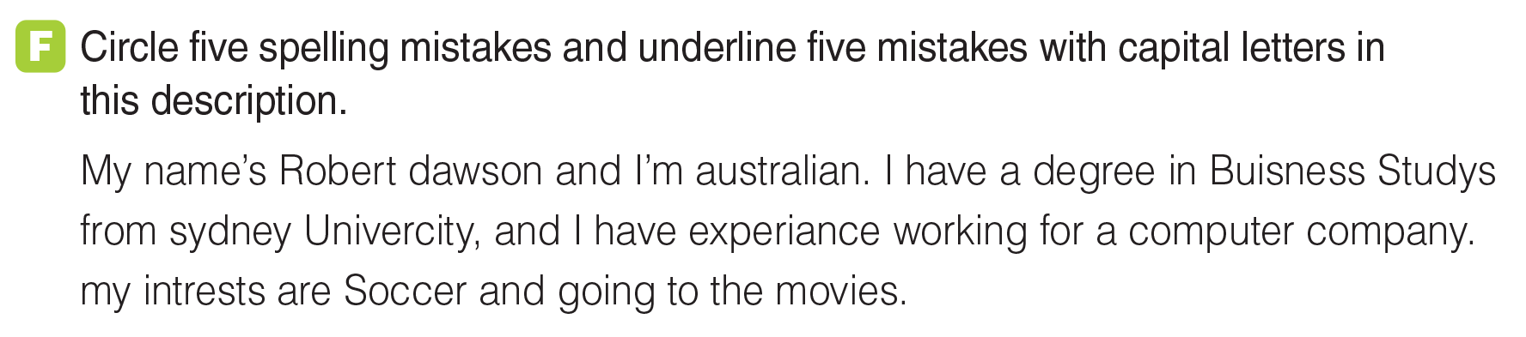
UNIT 11
ACHIEVEMENTS
WRITING
_______________________________________________________________________________________________________________________________________________________________________________________________________________________
National Geographic Learning, a Cengage Company. © 2022 Cengage Learning, Inc. ALL RIGHTS RESERVED. This presentation tool is for teaching purpose only. May not be scanned, copied or duplicated, or posted to a publicly accessible website, in whole or in part.

Slide 50

UNIT 11
ACHIEVEMENTS
GOAL CHECK
_______________________________________________________________________________________________________________________________________________________________________________________________________________________
National Geographic Learning, a Cengage Company. © 2022 Cengage Learning, Inc. ALL RIGHTS RESERVED. This presentation tool is for teaching purpose only. May not be scanned, copied or duplicated, or posted to a publicly accessible website, in whole or in part.

